Slide 1
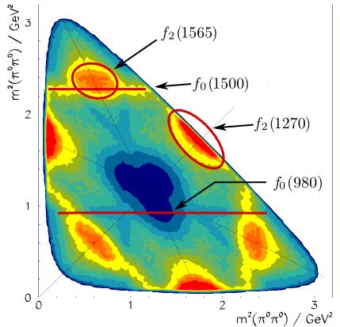
Physics Analysis Concepts with PandaRoot (2)
PANDA Lecture Week 2017
GSI, Dec 11 - 15, 2017
Klaus Götzen GSI Darmstadt

Slide 2
Topics
Particle Identification
Particle Selectors (PndPidCombiner, PndPidSelector)
MC Truth Match (PndAnalysis::McTruthMatch)
Fitting Basics
Fitting Tools (PndKinVtxFitter, PndKinFitter)
Uncertainties

Slide 3
PARTICLE IDENTIFICATION

Slide 4
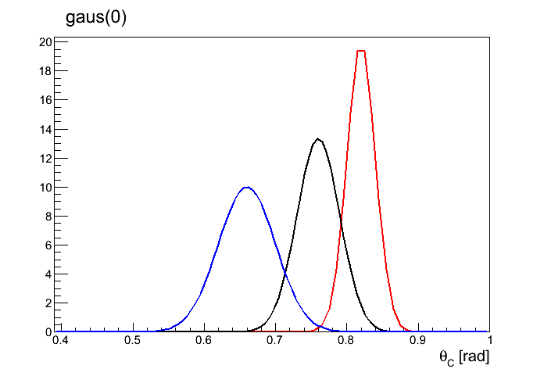
Particle Identification Basics
DIRC
How does PID work in principle?
Reconstruct track object
Match track with PID detector signal
Reconstruct PID information
Compute likelihood for various particle types (e.g. based on Likelihood functions)
TRK
expected θ_{c}
distributions
for a certain
momentum
PDF
current
measurement

Slide 5
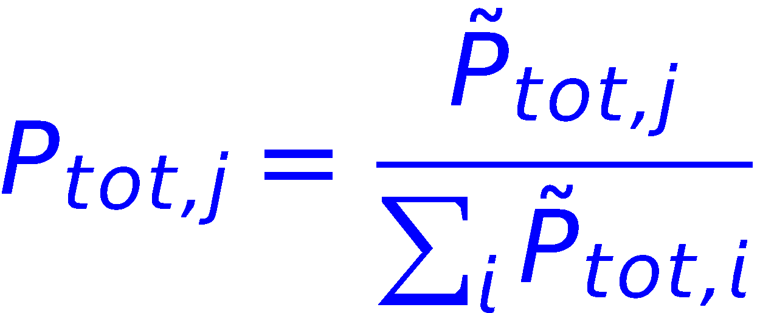
PID Concept in PandaROOT
Each PID subdetector delivers individual probability/likelihood information
PID Combiner, which combines the likelihood values from different detectors
Normalization via
PID Selector, which requires certain P_{tot} for positive identification

Slide 6
PID Concept in PandaROOT
PandaROOT objects: PndAnaPidCombiner, PndAnaPidSelector
PndAnaPidCombiner
combines on demand probabilities from various algorithms by computing product of all P_{k} (k=algorithms)
copies resulting probabilities to RhoCandidate/RhoCandList
PndAnaPidSelector
selects particles based on these probabilities
PndAnalysis::FillList is a short-cut to this funtionallity via pndana.FillList(list, “ElectronLoose“, "PidAlgoEmcBayes;PidAlgoDrc");
Predefined selection with keywords (probability based) Electron / Muon / Pion / Kaon / Proton + All / VeryLoose / Loose / Tight / VeryTight / Best + Plus / Minus (optional) Simple keywords Charged / Plus / Minus / Neutral / All

Slide 7
PID Concept in PandaROOT
PandaROOT objects: PndAnalysis, PndAnaPidCombiner, PndAnaPidSelector
PndAnalysis *pndana= new PndAnalysis();
pndana->FillList(eplus, "ElectronLoosePlus", "PidAlgoEmcBayes;PidAlgoMvd");
pndana->FillList(eminus, "ElectronLooseMinus", "PidAlgoEmcBayes;PidAlgoMvd");
Or 'by hand':
RhoCandList charged, kaonLoose;
PndAnaPidSelector kaonSel("KaonSelector");
kaonSel.SetSelection("KaonLoose"); // set selection criterion
PndAnaPidCombiner pidComb("PidCombiner");
pidComb.SetTcaNames("PidAlgoDrc;PidAlgoMvd"); // set algo‘s
while (evr->GetEvent())
{
pndana->FillList(charged, "Charged"); // start w/ charged candidates
pidComb.Apply(charged); // copy probab. to candidates
kaonLoose.Select(charged, kaonSel); // select kaons from charged
}

Slide 8
MONTE CARLO TRUTH

Slide 9
Monte Carlo Truth Match
In simulated reactions → possibility to map reco object to MC object
Tracking detector
MC track 1
MC track 2

Slide 10
Monte Carlo Truth Match
In simulated reactions → possibility to map reco object to MC object
Reco track based on MC track 1 (7 hits) & MC track 2 (2 hits) → Monte Carlo Truth(Reco track) = MC track 2 (max hits) [realized by FairLink class]
Tracking detector
MC track 1
MC track 2
Reco track

Slide 11
Monte Carlo Truth Access
Use cases:
For typical measurement the reco efficiency is needed
Sometimes the true signal distribution is of interest → Look in MC, whether you combine the correct candidates
Concerning MC truth, distinguish between
access MC truth object (or type) for certain reco object (see last slides)
MC truth match for a complete decay tree

Slide 12
MC Truth Access
For final state particles via RhoCandidate::GetMcTruth
The MC truth particles have the complete genealogy
Also complete MC truth list available
ana->FillList( eplus, "ElectronTightPlus", "PidAlgoEmcBayes" );
RhoCandidate *truth = eplus[0]->GetMcTruth();
if ( truth != 0x0 ) {
RhoCandidate *mother = truth->TheMother();
if ( truth->NDaughters() > 1 ) {
RhoCandidate *firstDaughter = truth->Daughter(0);
RhoCandidate *secondDaughter = truth->Daughter(1);
}
}
ana->FillList( mct, "McTruth" );
...
RhoCandidate *firstDaughter = mct[0]->Daughter(0);

Slide 13
Mc Truth Genealogy
Idea: Each Reco points to an McTruth object, from which the full true tree can be accessed
All Reco
McTruth
ψ(2S)
GetMcTruth()
trk⁺
TheMother()
Daughter(i)
trk⁻
π⁺
trk⁺
J/ψ
trk⁻
π⁻
neut
trk⁻
μ⁺
trk⁻
→ not matched
μ⁻
secondaries

Slide 14
PndAnalysis: MC Truth Match of Composites
Physics analysis might require a full mc truth match for composite particles for efficiency calculation, because
Functionality in PndAnalysis method PndAnalysis::McTruthMatch( RhoCandidate* );
p1
p1
p1
≠
Z
≠
X
p2
p2
X
p2
Y
X
p3
p3
p3

Slide 15
Example: ψ(2S) → J/ψ (μ⁺μ⁻) π⁺π⁻
We want to reconstruct the following decay
π⁺
π⁻
ψ(2S)
μ⁻
J/ψ
μ⁺
RhoCandList muplus, muminus, piplus, piminus, jpsi, psi2s;
ana->FillList( muplus, "MuonLoosePlus", myPidAlgos );
ana->FillList( muminus, "MuonLooseMinus", myPidAlgos );
ana->FillList( piplus, "PionLoosePlus", myPidAlgos );
ana->FillList( piminus, "PionLooseMinus", myPidAlgos );
jpsi.Combine( muplus, muminus );
psi2s.Combine( jpsi, piplus, piminus );

Slide 16
PndMcTruthMatch
Checklist for full tree match:
truth objects of final states have the correct PID types
π⁺
π⁻
ψ(2S)
μ⁻
J/ψ
μ⁺
≠
π⁺
μ⁻ (mis-id)
X
μ⁻
Y
unknow intermediate
states up to now
μ⁺

Slide 17
PndMcTruthMatch
Checklist for full tree match:
truth objects of final states have the same mother
π⁺
π⁻
ψ(2S)
μ⁻
J/ψ
μ⁺
≠
Z
π⁺
π⁻
X
μ⁻
Y
Z‘
μ⁺

Slide 18
PndMcTruthMatch
Checklist for full tree match:
mother has required type
π⁺
π⁻
ψ(2S)
μ⁻
J/ψ
μ⁺
≠
π⁺
π⁻
ψ(2S)
μ⁻
X
μ⁺

Slide 19
PndMcTruthMatch
Checklist for full tree match:
mother has correct number of daughters
π⁺
π⁻
ψ(2S)
μ⁻
J/ψ
μ⁺
≠
π⁺
π⁻
X
ψ(2S)
μ⁻
J/ψ
Y
μ⁺

Slide 20
Example: ψ(2S) → J/ψ (μ⁺μ⁻) π⁺π⁻
# | reco
1 | trk+
2 | trk+
3 | trk+
4 | trk-
5 | trk-
6 | trk-
7 | trk-
8 | neut
9 | neut
10 | neut
11 | neut
# | truth | TheMother()
1 | psi(2S)
2 | J/psi
3 | pi+
4 | pi-
5 | mu+
6 | mu-
7 | gamma
8 | gamma
9 | e+
10 | mu-
11 | gamma
12 | gamma
13 | pi-
GetMcTruth()

Slide 21
Example: ψ(2S) → J/ψ (μ⁺μ⁻) π⁺π⁻
# | reco
1 | trk+
2 | trk+
3 | trk+
4 | trk-
5 | trk-
6 | trk-
7 | trk-
8 | neut
9 | neut
10 | neut
11 | neut
 | J/psi
 | psi(2S)
# | truth | TheMother()
1 | psi(2S)
2 | J/psi
3 | pi+
4 | pi-
5 | mu+
6 | mu-
7 | gamma
8 | gamma
9 | e+
10 | mu-
11 | gamma
12 | gamma
13 | pi-
GetMcTruth()

Slide 22
Example: ψ(2S) → J/ψ (μ⁺μ⁻) π⁺π⁻
# | reco
1 | trk+
2 | trk+
3 | trk+
4 | trk-
5 | trk-
6 | trk-
7 | trk-
8 | neut
9 | neut
10 | neut
11 | neut
 | J/psi
 | psi(2S)
# | truth | TheMother()
1 | psi(2S)
2 | J/psi
3 | pi+
4 | pi-
5 | mu+
6 | mu-
7 | gamma
8 | gamma
9 | e+
10 | mu-
11 | gamma
12 | gamma
13 | pi-
GetMcTruth()

Slide 23
Usage of PndAnalysis::McTruthMatch
For matching, composite candidates have to have type set
PndAnalysis *ana = new PndAnalysis();
while ( ana->GetEvent() )
{
ana->FillList(muplus, "MuonPlus");
...
jpsi.Combine(muplus, muminus, "J/psi");
psi2s.Combine(jpsi, piplus, piminus, "pbarpSystem");
bool match = ana->McTruthMatch( psi2s[0] ); // match for RhoCandidate
int nmatch = ana->McTruthMatch( psi2s ); // match complete RhoCandList
for (int j=0; j<psi2s.GetLength(); ++j)
{
RhoCandidate *truth = psi2s[j].GetMcTruth(); // access truth of composites
...
although being at psi(2S)
energy, particle was
generated as pbarpSystem

Slide 24
Different levels of matching
Three different match levels are available via ana->McTruthMatch( psi[0], level );
Level = 0 only looks for correct PID
Level = 1 matches topology in addition
Level = 2 (default) is full match
π⁺
π⁻
μ⁻
μ⁺
π⁺
π⁻
X
μ⁻
Y
μ⁺
π⁺
π⁻
ψ‘
μ⁻
J/ψ
μ⁺

Slide 25
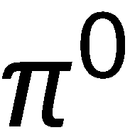
MC Truth Match Exercise
Fill in the
reco indices!
# | reco | mc
1 | trk+ | 7
2 | trk+ | 5
3 | trk- | 4
4 | trk- | 11
5 | trk- | 14
6 | trk- | 8
7 | neut | 10
8 | neut | 12
9 | neut | 9
# | truth | mum
1 | D0 | -1
2 | omega | 1
3 | phi | 1
4 | pi- | 2
5 | pi+ | 2
6 | pi0 | 2
7 | K+ | 3
8 | K- | 3
9 | gamma | 6
10 | gamma | 6
11 | e- | 9
12 | gamma | 11
13 | gamma | 11
14 | e- | 10
6
1
7
3
2
9

Slide 26
FITTING

Slide 27
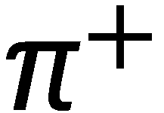
Kinematic Fitting
Let‘s e.g. consider a set of particle candidates
You believe what happend is this (hypothesis):
Kinematic fitting
gives a measure for the assumption, that hypothesis is true
improves the precision/resolution for kinematic quantities, when hypothesis actually is true
More about fitting under http://www.phys.ufl.edu/~avery/fitting.html

Slide 28
Kinematic Fitting: Constraints
In order to perform fit, you need to apply so-called constraints
Constraints correlate kinematics in the tree
Which constraints could be applied here?
Vertex constraint K_{S}: π⁺ & π⁻ from same origin
Mass constraint K_{S}: inv. π⁺ π⁻ mass = K_{S} rest mass
Mass constraint π⁰: inv. 2γ mass = π⁰ rest mass
Mass constraint D⁰: inv. K_{S} π⁰ mass = D⁰ rest mass

Slide 29
Kinematic Fitting: Constraints
Most common constraints are
Mass Constraint Composite particle has to have a certain invariant mass (only to be applied to quasi stable particles)
Vertex Constraint Set of 4-vectors originate from common spatial point (which is determined during the fit!). At least 2 charged tracks needed!
4-vector-Constraint 4-vector of composite particle has to match a certain 4-vector component-wise (used in exclusive reconstruction)
Pointing constraint 3-vector of composite particle is consistent with originating from a certaint point (e.g. the IP)

Slide 30
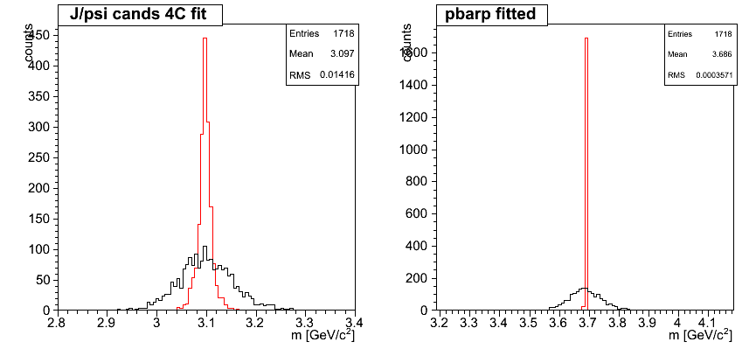
Fitting: 4 Constraint Fit
Can be applied in exclusive analysis, where the initial 4-vector is fully reconstructed
Fitted total system is not very meaningful (spiked mass), but intermediate resonances can be improved
Can do a cut on the fit probability to reject background
before
after
before
after

Slide 31
Vertex Fitting for Long-Living Particles
For long-living particles (e. g. K_{S}⁰, Λ⁰), vertex fitting is essential, since charged particles move on helices in magnet field
π⁺
π⁻
π⁻
π⁺
K_{S}
beam axis
beam axis
The 4-vector sum of daughters
is only consistent with resonance
4-vector when evaluated at true
points of origin!
Per default, the track reco computes
the 4-vectors at POCA to the IP (or
beam axis)
→ resulting 4-vector is bad!
⇒ Good vertex information necessary for proper resonance reco!

Slide 32
Fitting: Access to Results
After fit → full fitted tree is attached to the reco object
Reco'd Decay
Fit Results
GetFit()
ψ(2S)
ψ(2S)
TheMother()
Daughter(i)
TheMother()
Daughter(i)
π⁺
π⁺
π⁻
π⁻
J/ψ
J/ψ
μ⁺
μ⁺
μ⁻
μ⁻

Slide 33
Fitting in PandaROOT
Fitters basically all have a similar interface
Fit results are attached to RhoCandidates
Can be accessed as full tree, allows cascaded fitting!
E.g. vertex fitting + mass fitting might look like this:
RhoCandidate *lambda = pplus->Combine( piminus );
TVector3 IP( 0,0,0 );
...
PndKinVtxFitter fitvtx( lambda ); // setup vertex fitter
fitvtx.Fit(); // perform fit
RhoCandidate *lambda_vtx = lambda->GetFit(); // access fit results
PndKinFitter fitmass( lambda_vtx ); // setup mass fitter
fitmass.SetMassConstraint( 1.115 ); // set mass constraint
fitmass.Fit(); // perform fit
RhoCandidate *lambda_mass = lambda_vtx->GetFit(); // access cascaded fit results
RhoCandidate *fit_pplus = lambda_mass->Daughter( 0 );
RhoCandidate *fit_piminus = lambda_mass->Daughter( 1 );

Slide 34
Fitting Example: Vertex-Fit
PandaROOT object: PndKinVtxFitter
// ... in event loop ...
for (j=0; j<jpsi.GetLength(); ++j)
{
PndKinVtxFitter vtxfitter(jpsi[j]); // instantiate vertex fitter
vtxfitter.Fit(); // perform fit
RhoCandidate *jfit = jpsi[j]->GetFit(); // get fitted candidate
TVector3 jVtx = jfit->Pos(); // and the vertex position
double chi2_vtx = vtxfitter.GetChi2(); // and the chi^2 of the fit
if ( chi2_vtx<max_chi ) // if chi2 is good enough
{ // fill some histos
hjpsim_vf->Fill( jfit->M() );
hvpos->Fill( jVtx.X(),jVtx.Y() );
}
}

Slide 35
Fitting Example: 4C-Fit
PandaROOT object: PndKinFitter
// the lorentz vector of the initial system; important for the 4C-fit
TLorentzVector ini(0, 0, 6.232, 7.240);
// ... in event loop ...
for (j=0;j<psi2s.GetLength();++j)
{
PndKinFitter fitter(psi2s[j]); // instantiate the kinematic fitter
fitter.Add4MomConstraint(ini); // set 4 vector constraint
fitter.Fit(); // perform fit
RhoCandidate *jfit = psi2s[j]->Daughter(0)->GetFit(); // get fitted J/psi
Double_t chi2 = fitter.GetChi2(); // and the chi^2 of the fit
if ( 0 != jfit )
{
hjpsim_4cf->Fill( jfit->M() ); // fill histogram
}
}

Slide 36
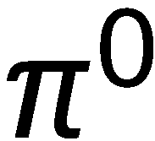
Which constraints do you see?
Particle | Γ [MeV]
J/ψ | 0.09
η_{c} | 28.6
D_{s} | 0
Φ | 4.26
ω | 8.49
η | 0.001
π⁰ | 0
1
2
3

Slide 37
UNCERTAINTIES

Slide 38
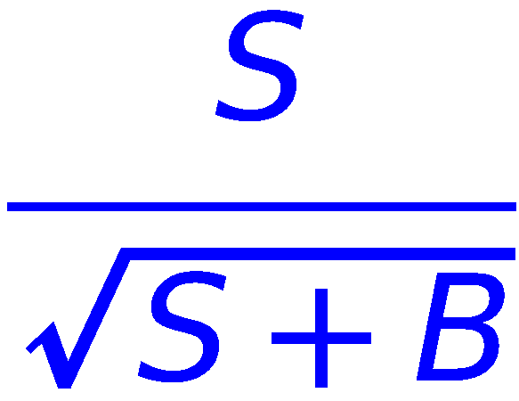
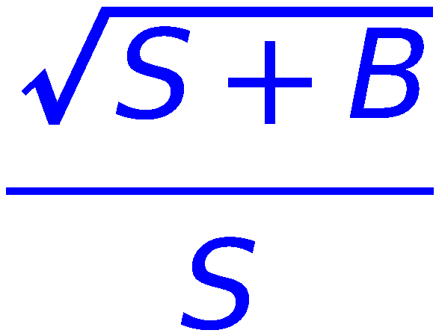
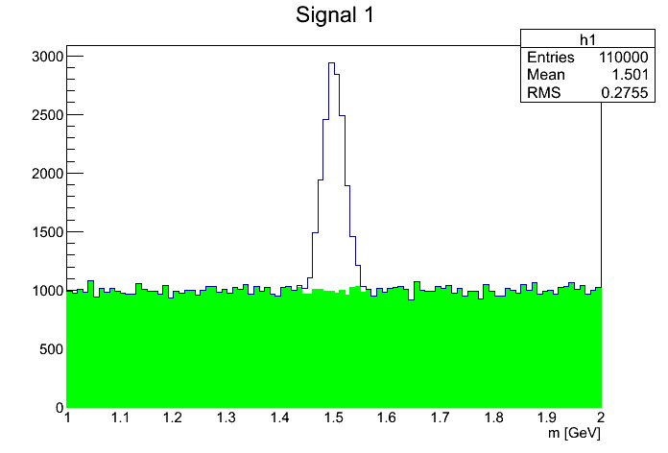
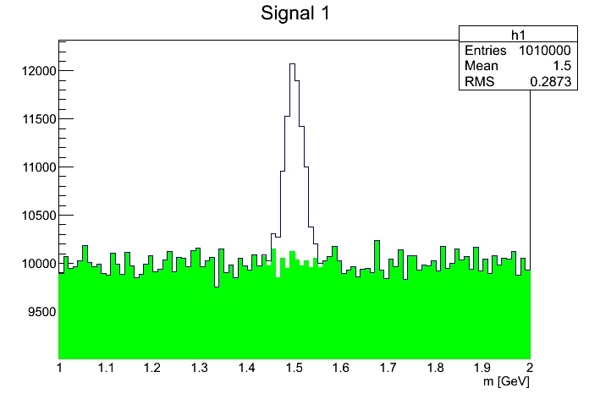
Uncertainties: Figure of merit
Figure of Merit for analysis: Minimization of the relative error! (not, as you might think, the measured value itself...)
In cut & count analyses, usually maximize significance
Explanation: Statistical fluctuation of S is (see below) → relative uncertainty = = 1/significance!
low background
high background
fluctuation
larger!
S
S
B
B
≈

Slide 39
Statistic and Systematic Uncertainties
The most common kinds are
Statistic uncertainties
Rule of thumb: Errors, which get smaller when taking more data are statistic errors. (sometimes also sys. errors get smaller with more statistics)
Systematic uncertainties
Usually do not decrease with more data (when systematics dominate, you can stop measuring longer)
Examples
Track reconstruction efficiency (BABAR: 1-2%/track)
PID selection efficiency (BABAR: 1-2%/particle)
Choice of fit model (e.g. 2nd vs. 3rd order bgk-polynomial)

Slide 40
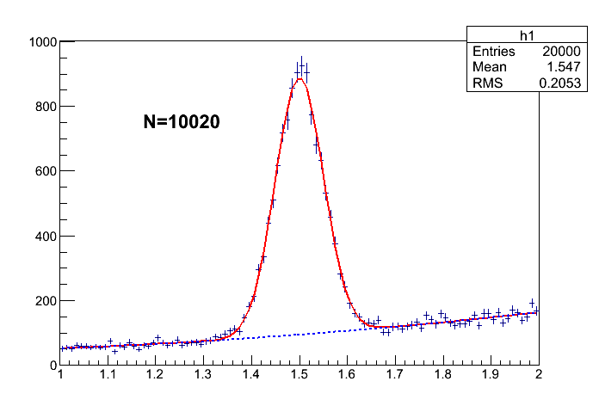
Systematics Example: Fit model uncertainty
Task: Determine number of signals ontop of background
Bgk-Model 1: Linear; integral N₁ = 9859
Bgk-Model 2: Parabolic; integral N₂ = 10020
Estimate for systematic error (fit model) could be
1
2

Slide 41
EXERCISES

Slide 42
Exercises Suggestions
Rho Tutorial website: http://panda-wiki.gsi.de/cgi-bin/view/Computing/PandaRootRhoTutorial
Take a look to tutorials/thailand2017/README Exercises: #2 - #6
Apply different PID selections and algorithms and compare
Apply MC truth match for your reconstructed channels
Try different fitters/constraints and compare resolution

Slide 43
Exercises Preparation
Preparation/hints in tutorials/thailand2017/README
FIRST setup environment: source ~/workshop/build/PandaRoot_trunk.../config.sh
To have some data for tutorial macros, do one of the following a) . ./tut_runall.sh 1000 # sim/reco 1000 events pbarp -> J/psi pi+ pi- b) cp data/signal_p*root . # preproduced default data
Macros named 'tut_ana...C' are stubs and should be completed by you.
At places marked with ' #### EXERCISE: ...' some code needs to be added; Run macros (default or different input data) with > root -l tut_ana...C # signal_pid.root, signal_par.root > root -l 'tut_ana...C(0,"mydata")' # mydata_pid.root, mydata_par.root
If getting stuck, sample solutions are in the subfolder 'solution' Run solution macros directly (default or different input data) with > root -l solution/tut_ana...C > root -l 'solution/tut_ana...C(0,"mydata")'

