Slide 1
Physics with the CBM Experiment
Volker Friese
GSI Darmstadt
on behalf of the CBM Collaboration
ICNFP 2017, Kolymbari, 25 August 2017

Slide 2
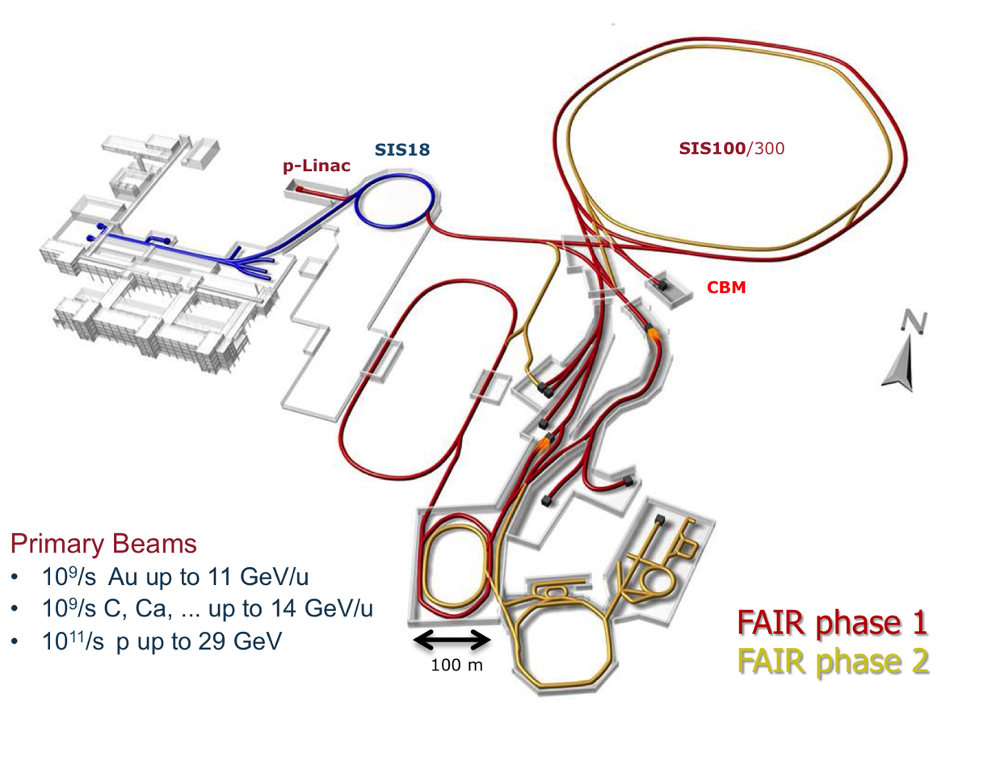
FAIR Accelerator Complex

Slide 3
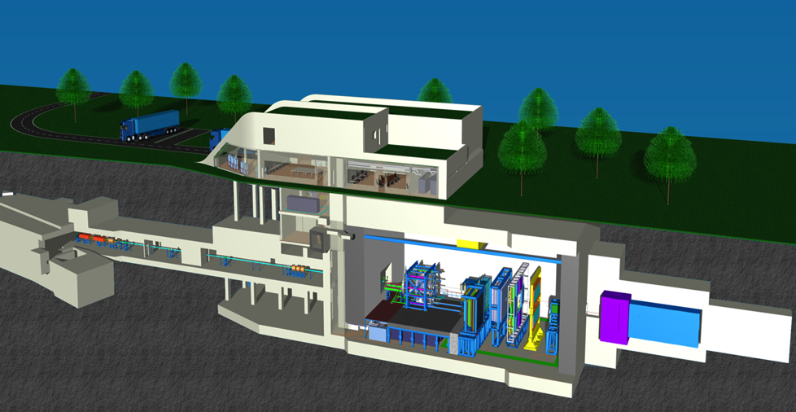
FAIR Accelerator Complex and CBM

Slide 4
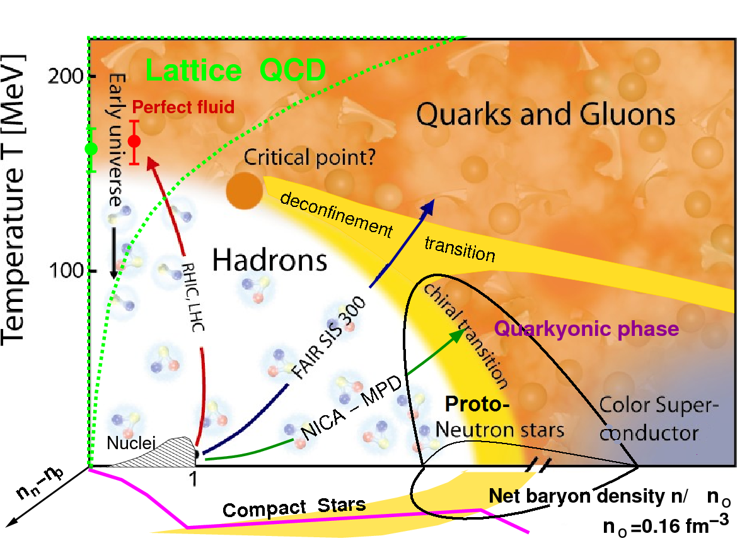
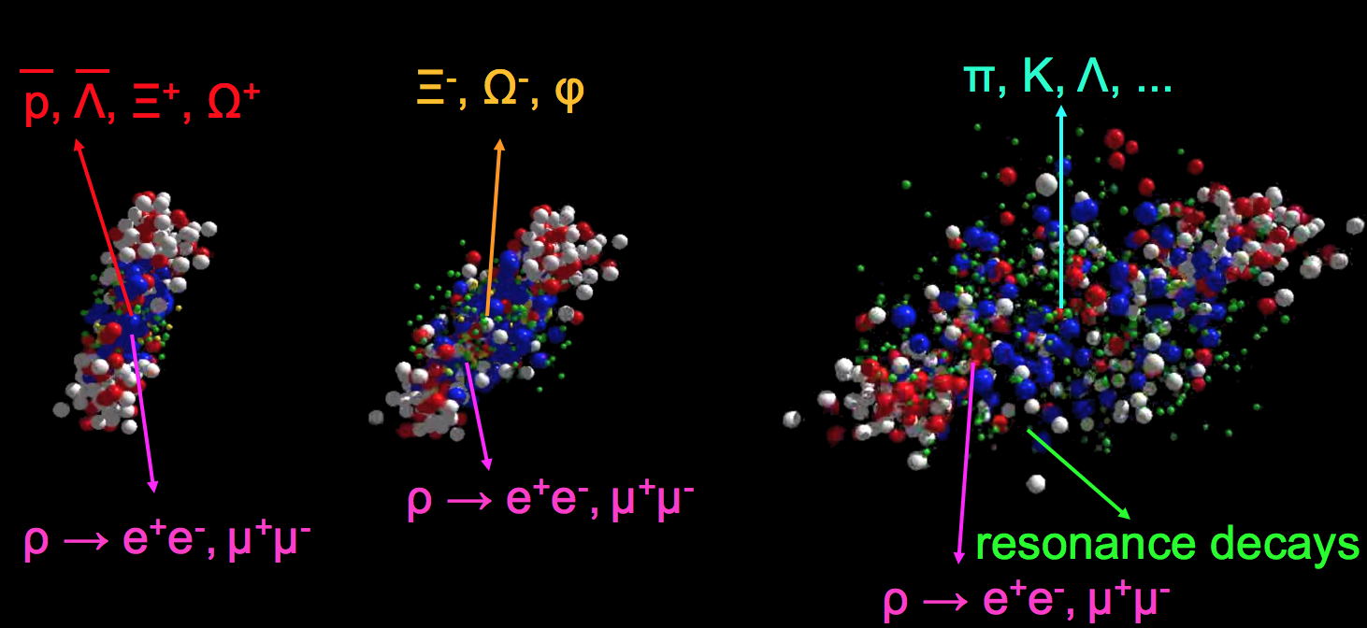
What We Are After
Theory, models
General experimental strategy: stay as open and flexible as possible; measure as many observables as you reasonably can.
The quest: study properties of QCD matter at high net-baryon densities
Equation-of-state
Onset of deconfinement / chiral restoration
Nature of transition (first-order?)
Critical end-point

Slide 5
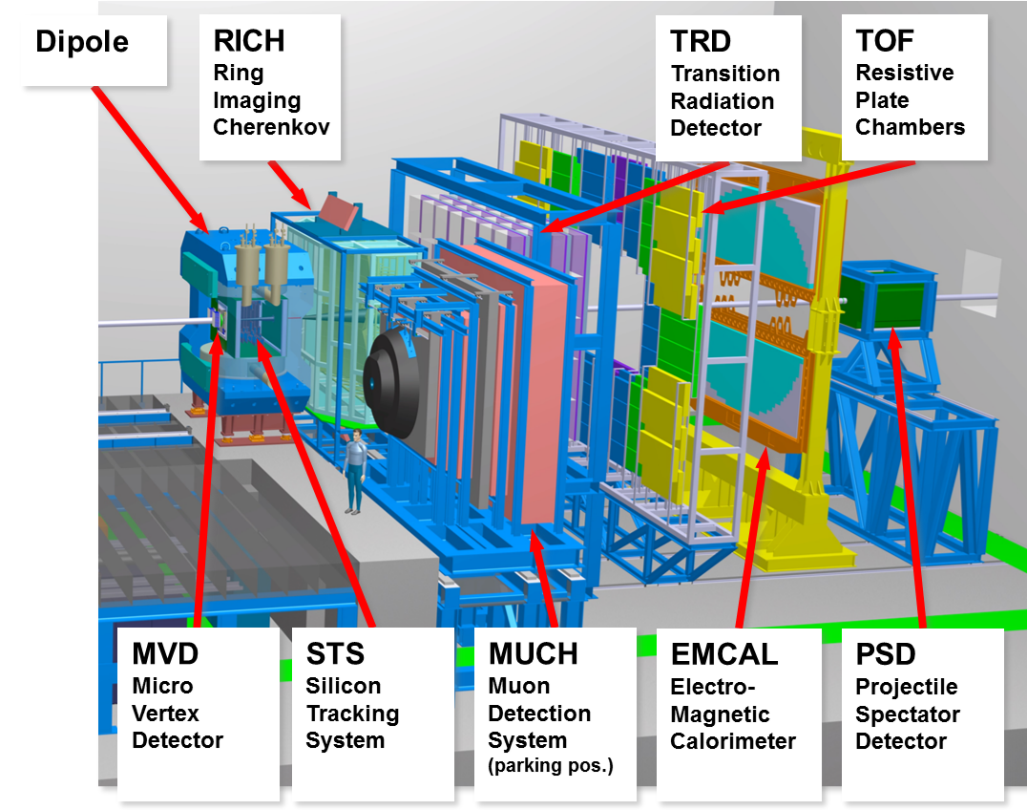
CBM: Experiment Systems
Large acceptance:
2.5° – 25°
Identify:
  Hadrons (TOF)
  Electrons (RICH, TRD)
  Muon (MUCH)
  Neutral probes (ECAL)
  Open charm (MVD)
High rates: up to 10⁷ events/s

Slide 6
SIS-100 and SIS-300
SIS-100 and CBM are part of the FAIR Modularised Start Version (MSV)
SIS-300 is agreed-on part of FAIR, but not of the start version; timeline is unclear
we concentrate here on CBM@SIS-100
  Au: 2A – 11A GeV
  Ni: 2A – 15A GeV
  p: up to 30 GeV
staying open for SIS-300 as later upgrade

Slide 7
CBM Physics: Strangeness
One of the ”classical” observables:
strangeness enhancement / canonical suppression
Strangeness yields from are well described by the statistical model: strong argument for phase transition (no hadronic mechanism to equilibrate e.g. Omega)
Model fits describe data at lower SPS and at AGS
  But with a limited amount of particle species
  Data on multi-strange baryons are scarce
Following this: measuring strange baryon abundances at lower energies.
  Down to which collision energies does the hadron gas model hold?

Slide 8
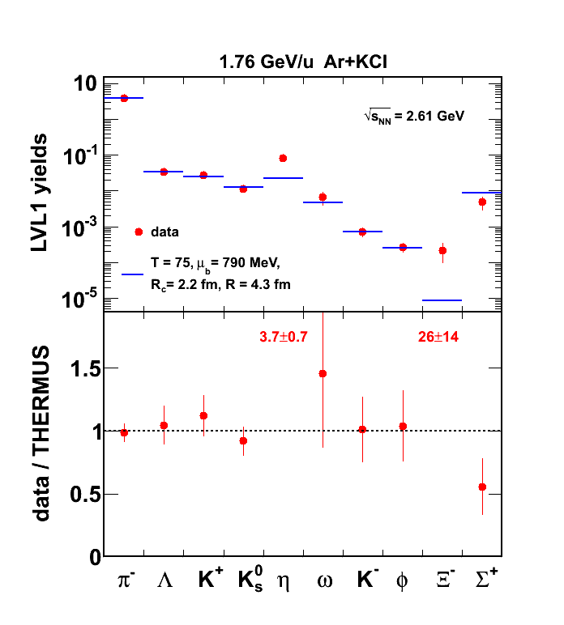

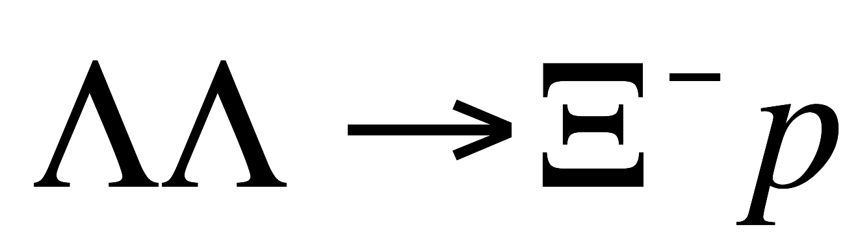

Breakdown of strangeness thermalisation?
HADES
HADES result for Xi⁻ at SIS-18 (1.76A GeV): Xi⁻ yield is off by an order of magnitude from the statistical model.
N.b.: This is deep sub-threshold. Production through multi-step processes
R. Holzmann, CBM Physics Workshop, April 2010

Slide 9
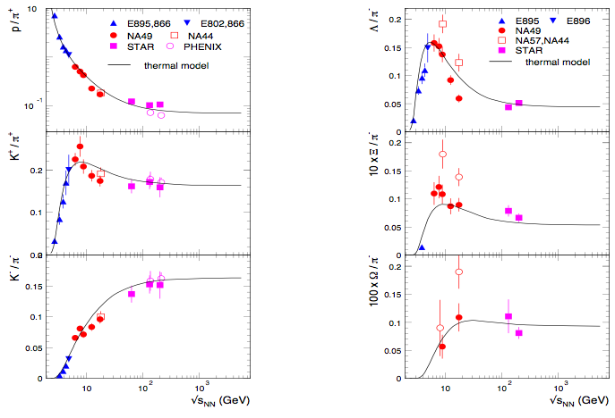
The need for data on multi-strange baryons
A long-lasting debate: pure hadronic description or signal of drastic change in matter properties?
Data on multi-strange baryons will be decisive!
“Onset” scenario: effect is due to increase in strangeness; sharp maximum at same location as K/pi; size of peak increases with strangeness content
Hadron Gas Model: effect is due to net-baryon density; broad maximum; size of maximum decreases with strangeness content; position of maximum shifts

Slide 10
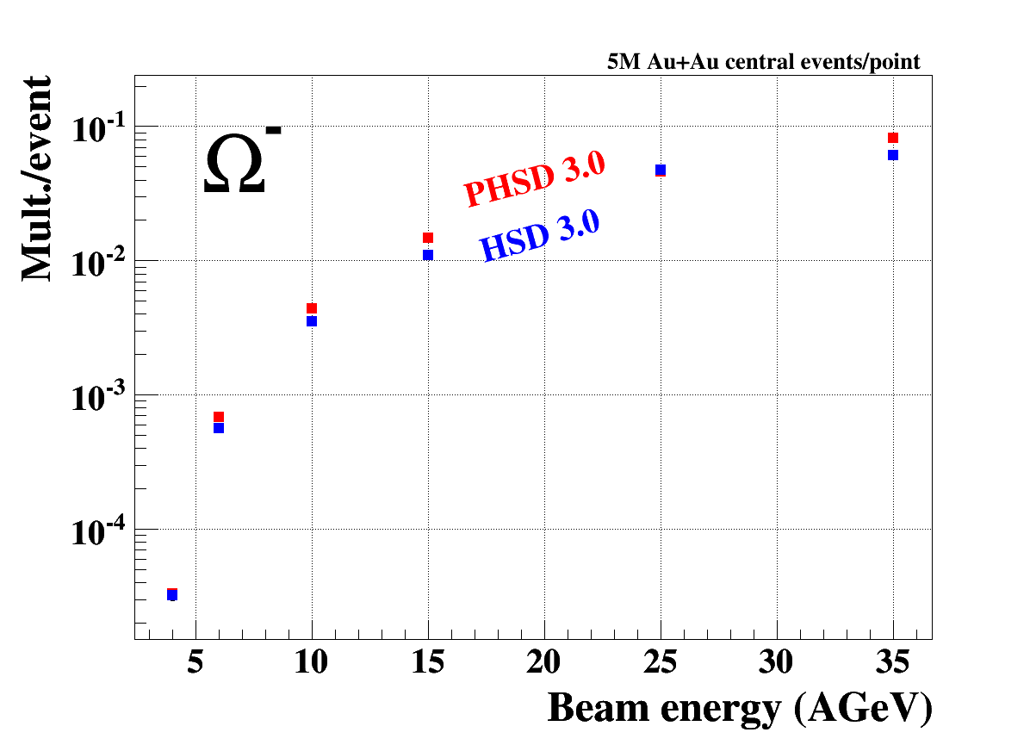
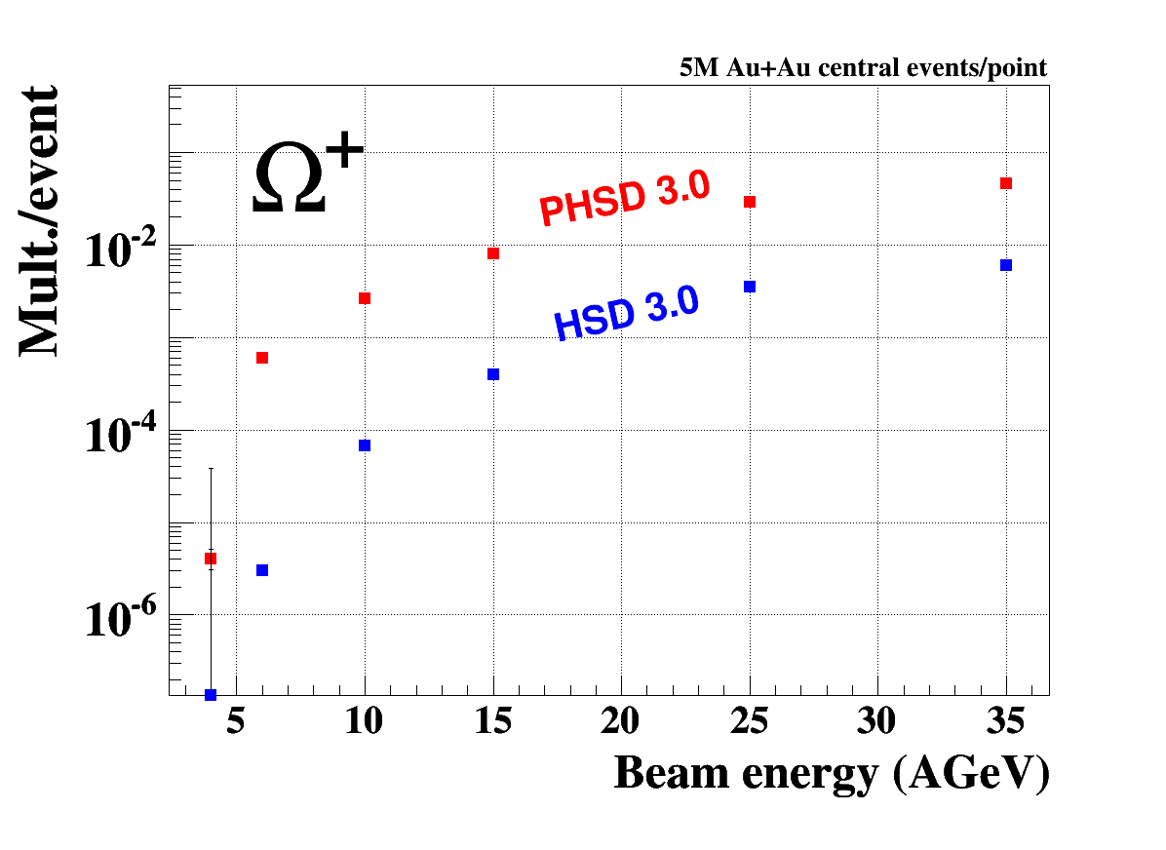
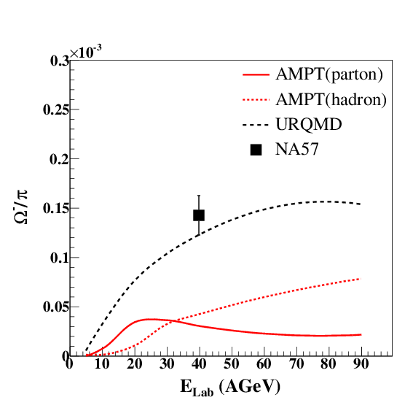
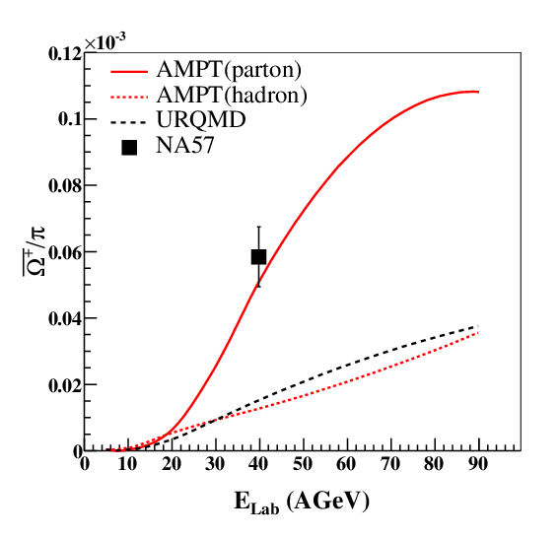
Strange anti-baryons at FAIR/NICA energies
HSD / pHSD
AMPT
Microscopic models (including partonic production) predict the anti-hyperons to be very sensitive to partonic production mechanisms (hyperons much less)

Slide 11
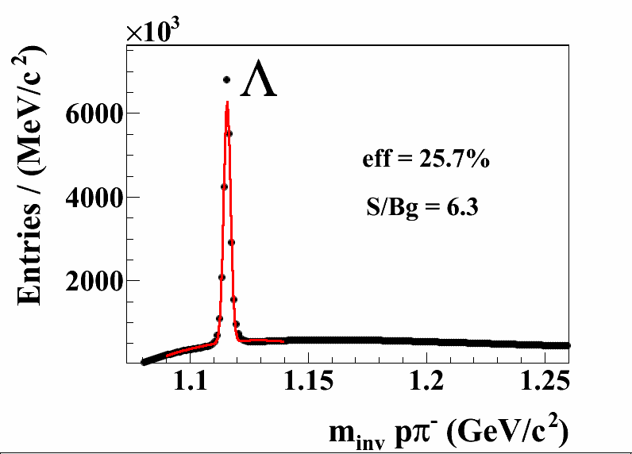
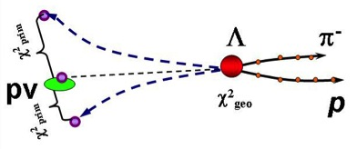
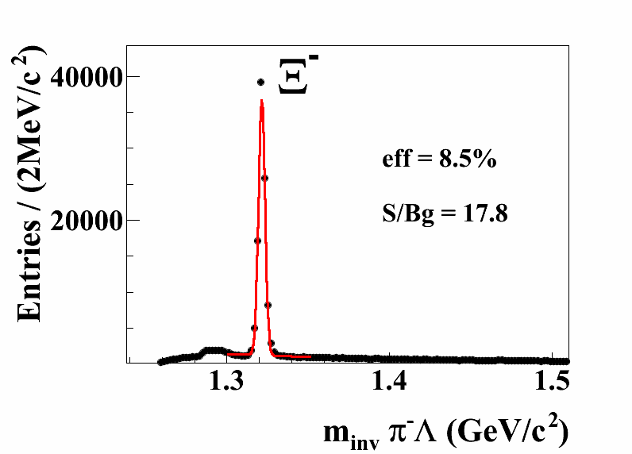
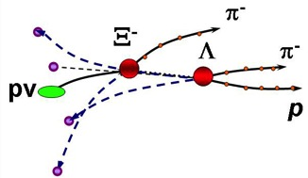
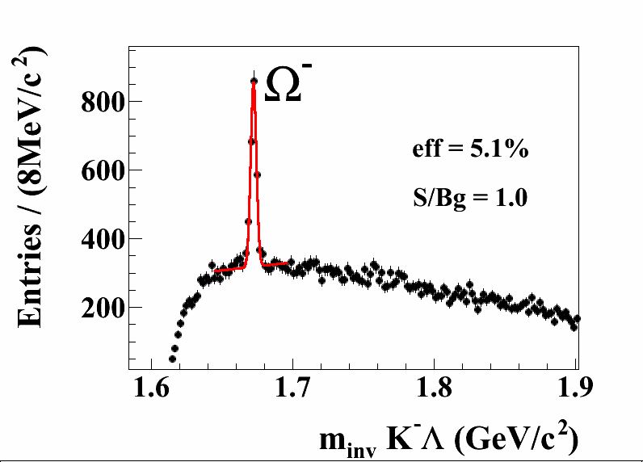
CBM Performance for Hyperons
Input: UrQMD, central Au+Au, 10A GeV
Reconstruction from fully simulated detector response

Slide 12
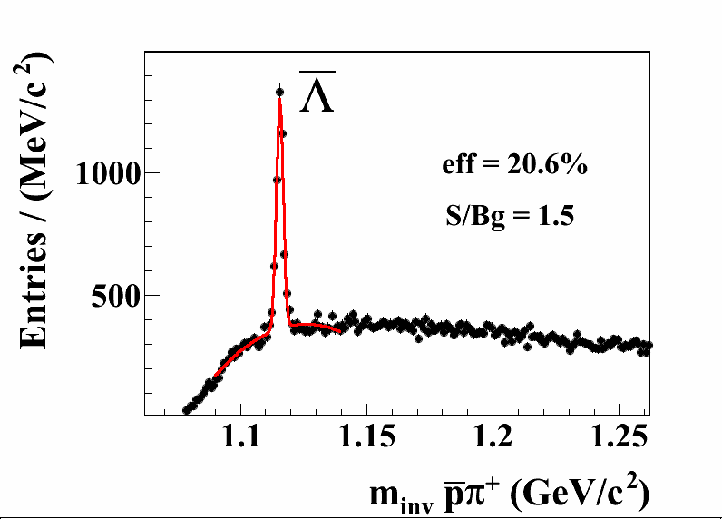
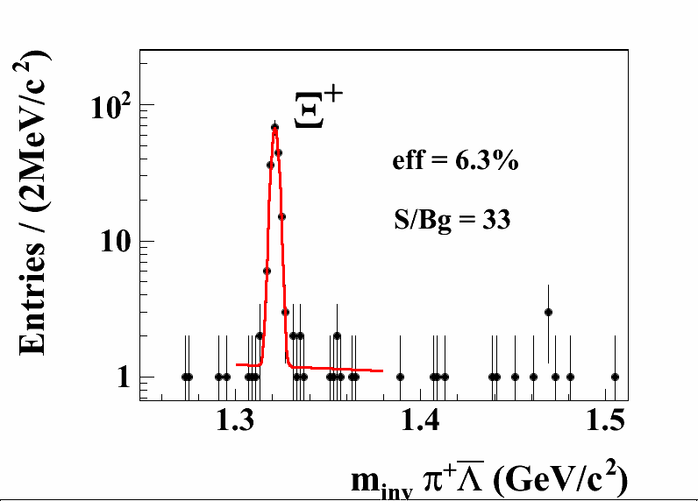
CBM Performance: Anti-Hyperons
Input: central Au+Au, 10A GeV
UrQMD (PHSD for Ω⁺)
Very rare probes; require high interaction rates and online selection!

Slide 13
Hyperons: Expected Statistics
Will allow systematic, differential studies also of rare particles!

Slide 14
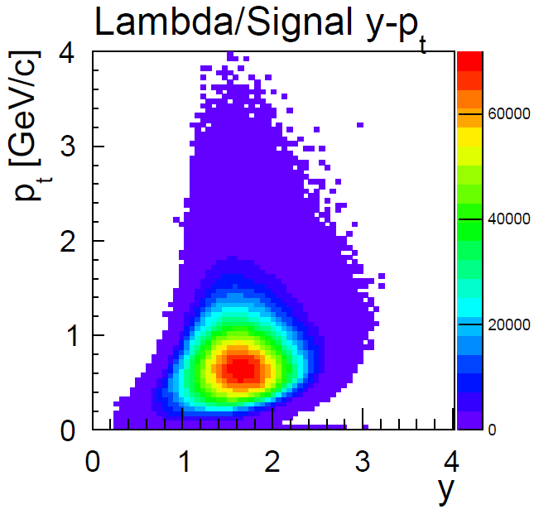
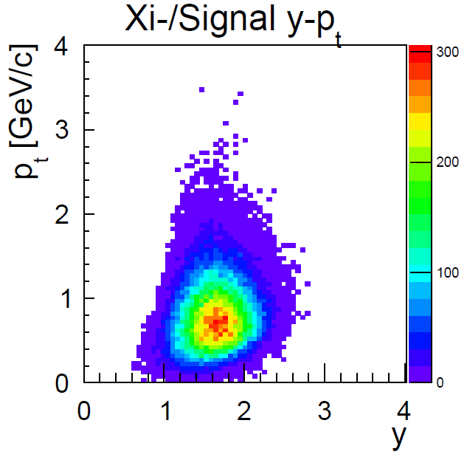
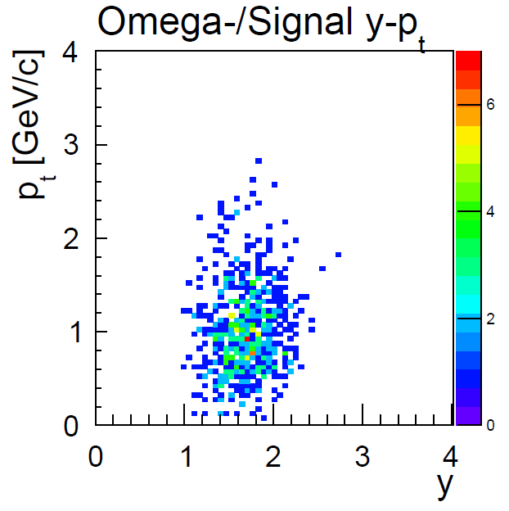
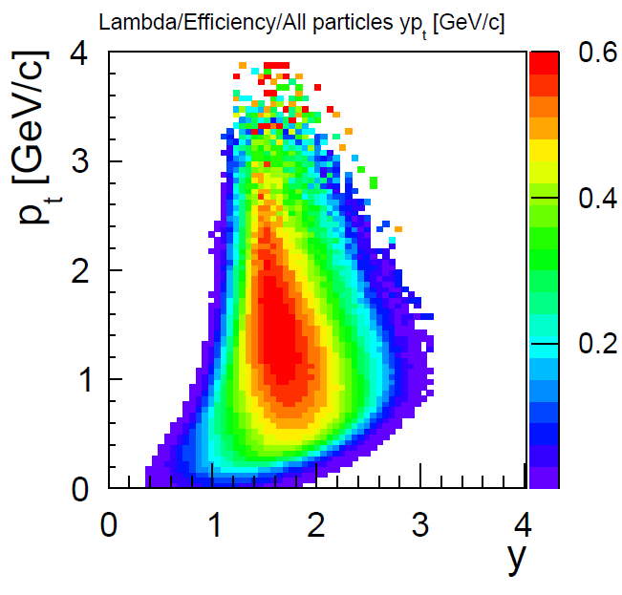
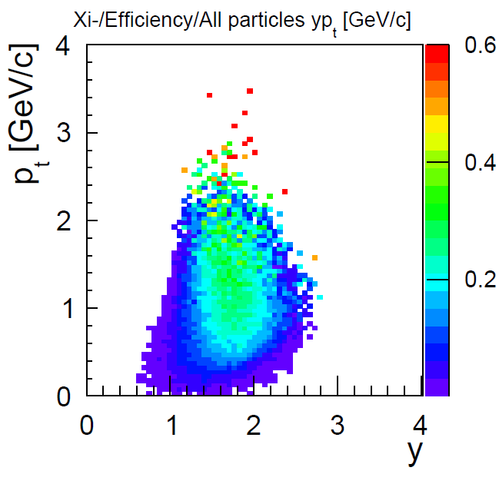
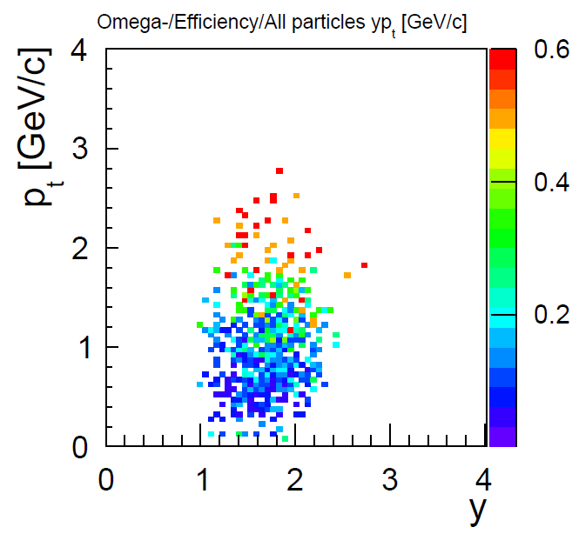
Hyperons: Acceptance and Efficiency

Slide 15
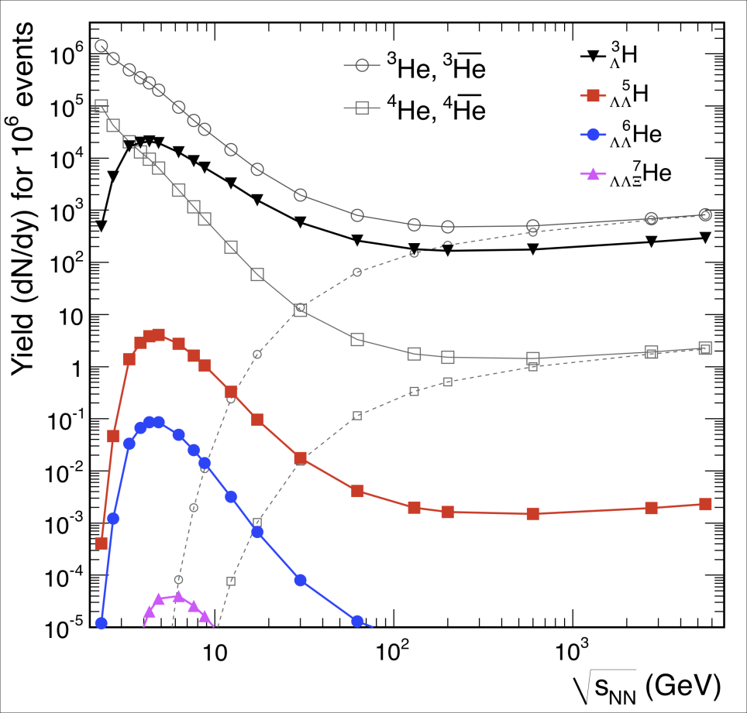
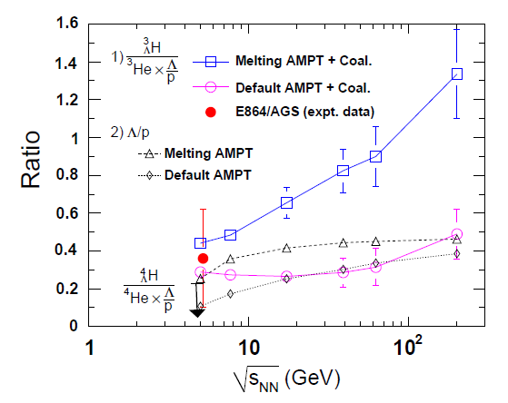
CBM Physics: Hyper-Matter
In heavy-ion collisions: produced through capture of Λ in light nuclei
A. Andronic et al., PLB 697 (2011) 203
S. Zhang et al., PLB 684 (2010) 224
Thermal model: maximum production at CBM energies
Transport: sensitive to medium properties (correlation of strangeness and baryon number)

Slide 16
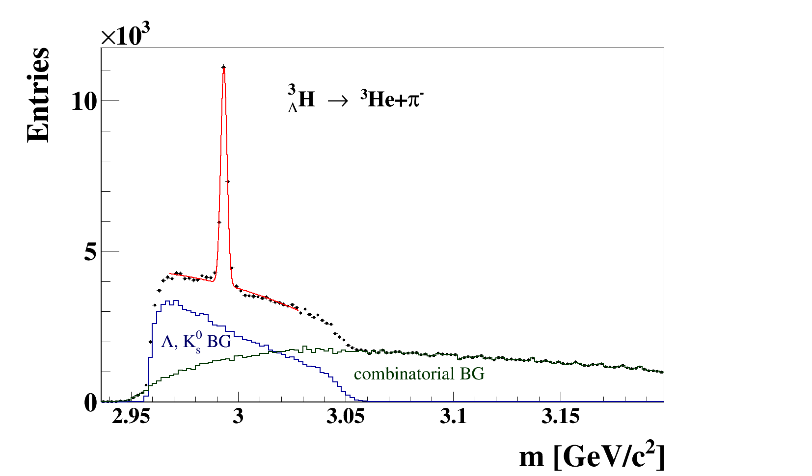
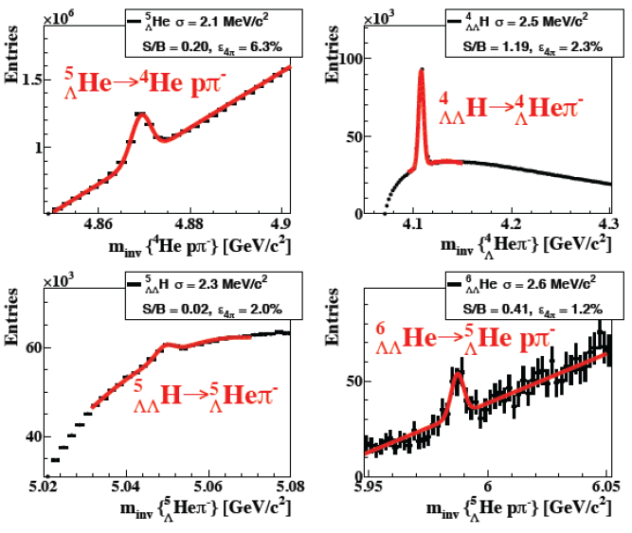
CBM Physics: Hyper-Matter
CBM Simulation
central Au+Au, 10A GeV
10¹² events (3 weeks beamtime)
Prospects are good;
double-strange hyper-nuclei require
maximal interaction rate

Slide 17
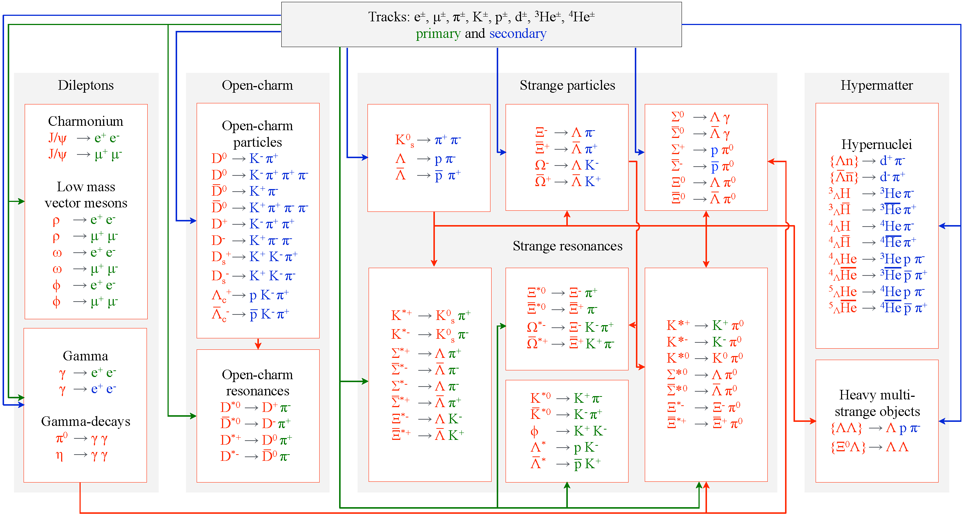
Particle reconstruction in real-time
A multitude of particles will become accessible.
Real-time reconstruction allows online selection of rare probes.
Software becomes the key to the physics output.

Slide 18
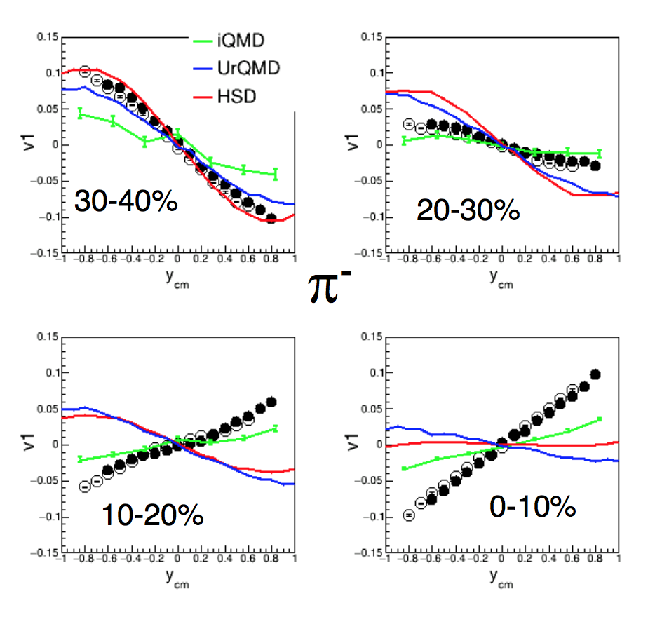
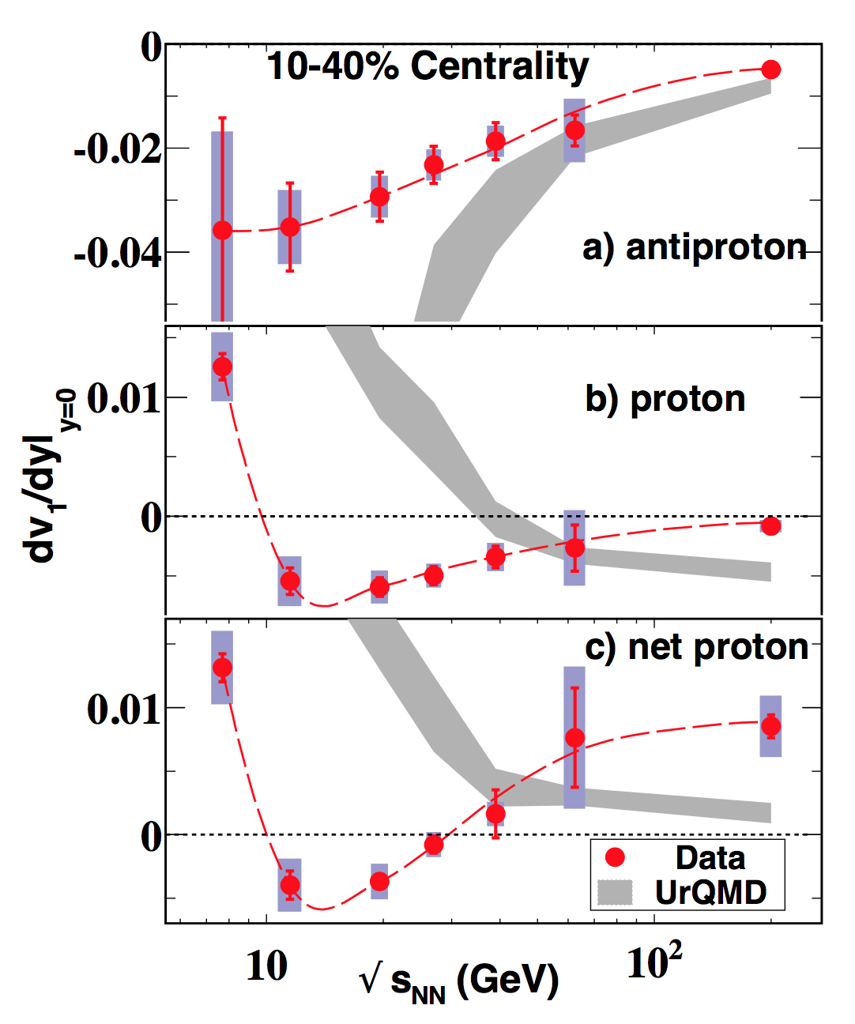
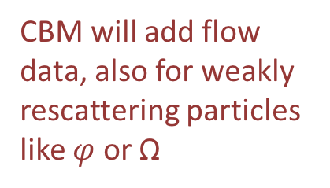
CBM Physics: Flow
The prime tool to study the equation-of-state
Results at lower energies not understood in terms of transport models
CBM will add flow data, also for weakly rescattering particles like $φ$ or Ω
A. Kugler, this conference
STAR, PRL 112 (2014) 162301

Slide 19
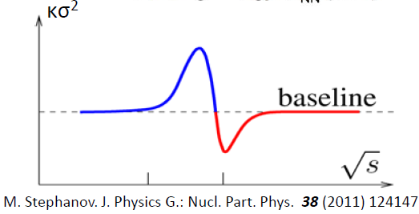
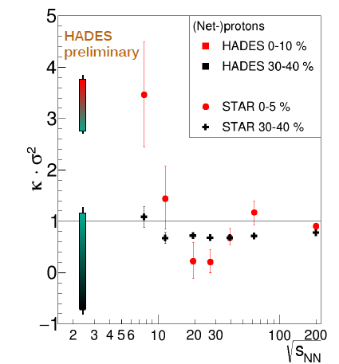
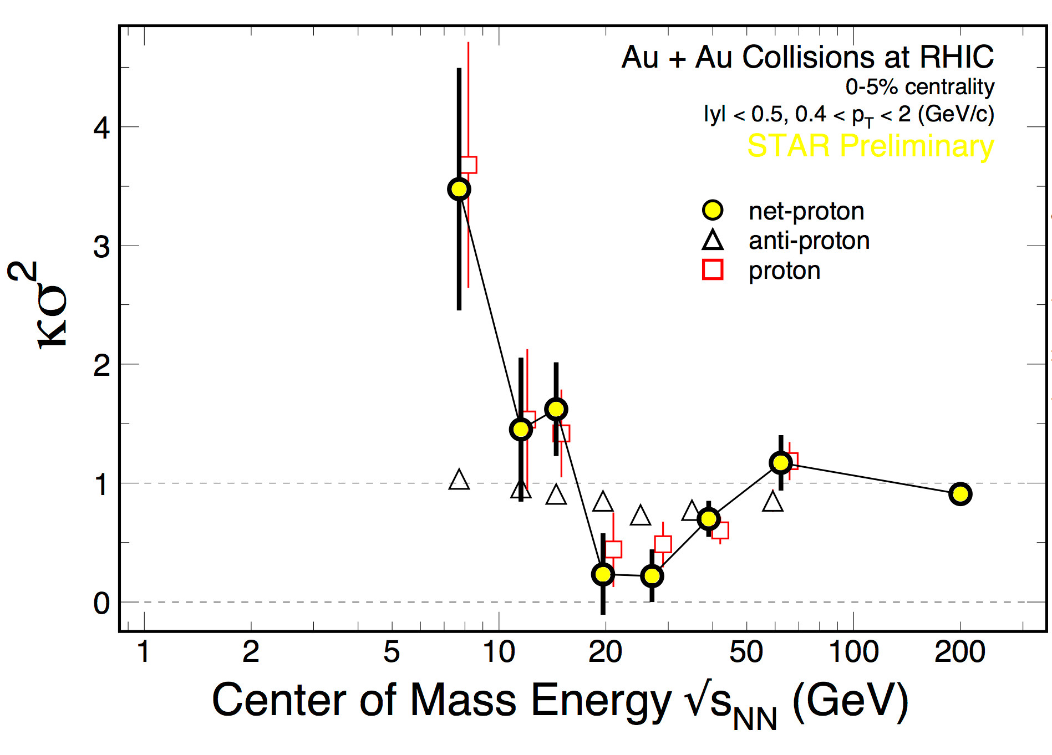
CBM Physics: Fluctuations
Should signal the critical point...
M. Lorentz, QM 2017
?
STAR, NPA 956 (2016) 320c
...or spinodial decomposition of a mixed phase?

Slide 20
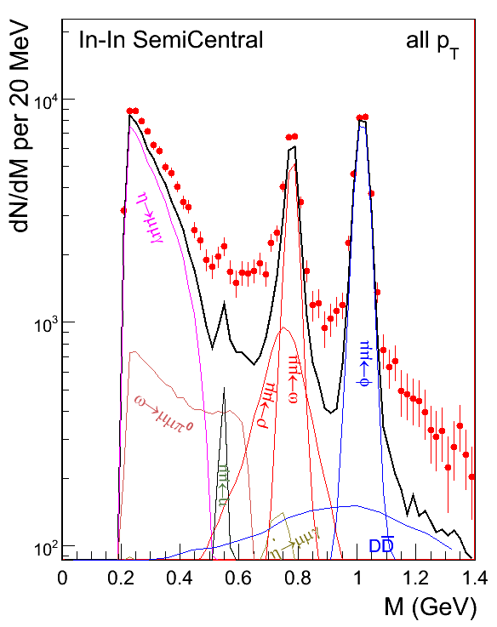
CBM Physics: Lepton Pairs
Emitted throughout the lifetime of the fireball: probe its space-time evolution
Low mass (< 1 GeV): in-medium properties of rho meson; excess yield (over vacuum hadronic cocktail) is sensitive to the lifetime of the system
Intermediate mass (1 – 2.5 GeV): no hadronic sources; measure directly the temperature of the fireball.
NA60, EPJC 59 (2009) 607

Slide 21
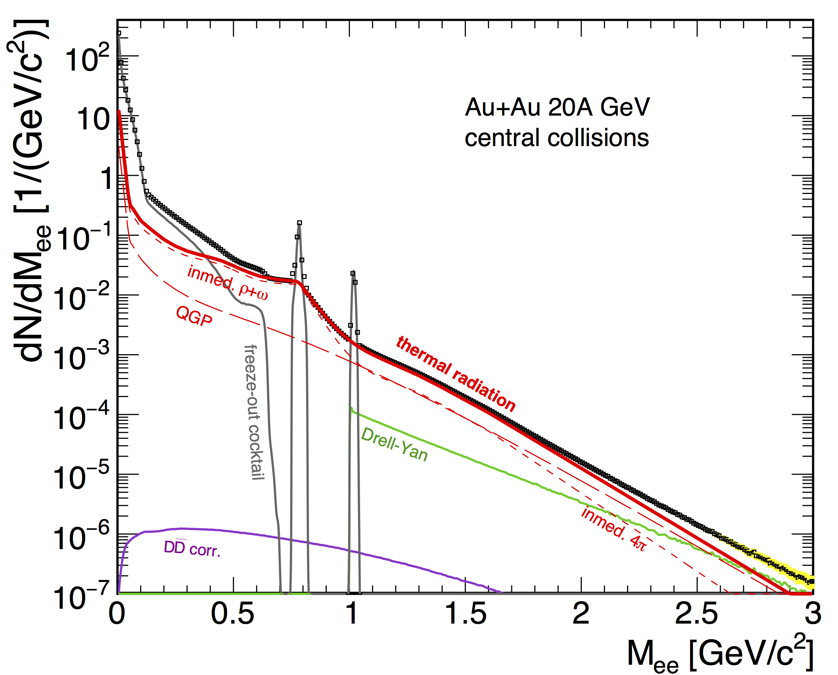
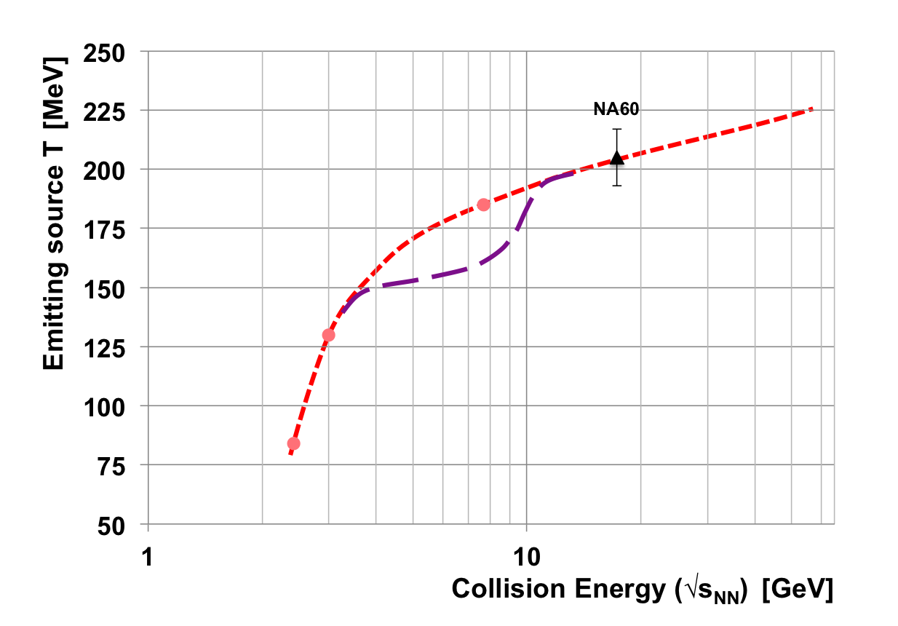
CBM Physics: Lepton Pairs
No di-lepton data exist between HADES and NA60!
CBM will provide di-lepton mass spectra and measure the caloric curve in the FAIR energy range. Interpretation almost model-independent!
Extracted temperature at intermediate masses; violet: speculated signature of a mixed phase
CBM Simulation

Slide 22
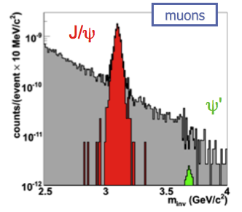
CBM Physics: Charm
Important (if not decisive) probe of the created medium
  that holds at all energies!
Fraction of charm hadronising in J/psi is sensitive to the medium properties (e.g. suppression in QGP)
Particular at lower energies (below top SPS):
  N_{ccbar} << 1 -> no regeneration, ”clean” probe
  Softer J/psi, longer-lived fireball: charm has a chance to see the medium
Proper interpretation of data requires the measurement of both open and hidden charm
  Important part of the CBM physics programme
CBM Simulation, Au+Au @ 25A GeV

Slide 23
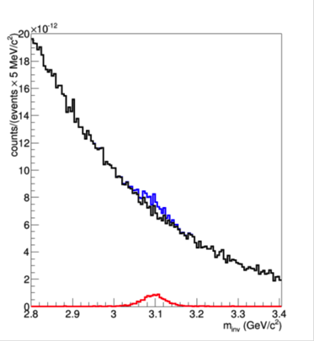
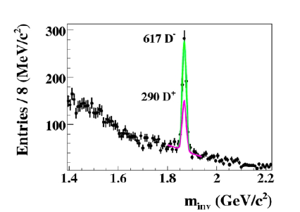
CBM Physics: Charm at SIS-100
The CBM charm programme is tailored for SIS-300 energies
At SIS-100:
  charmonium at top energy: Au+Au, 10A GeV (sub-threshold, extremely challenging)
  Z/A = 0.5 (e.g., Ni+Ni) @ 15A GeV (slightly above threshold)
  open and hidden charm in p+A up to 30 GeV (c-cbar cross section, cold matter effects)
central Au + Au, 10A GeV
p + C, 30 GeV
D± →Kππ
J/ψ → µ+µ-

Slide 24
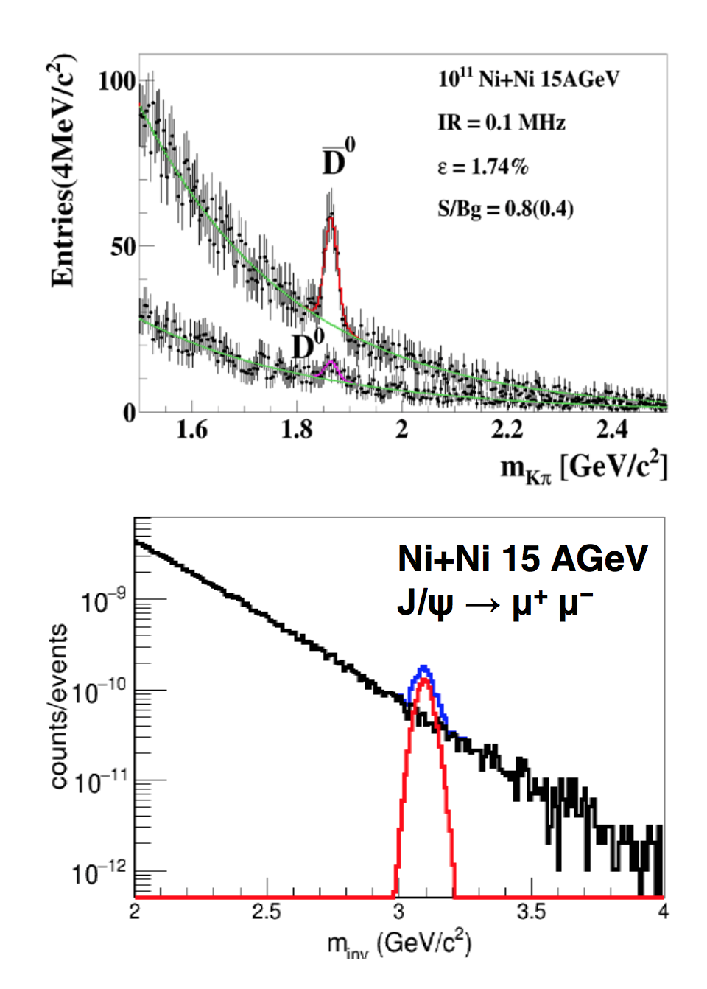
CBM Physics: Open Charm at SIS-100
D mesons:
Interaction rate 0.1 MHz
260 D⁰ and 45 D⁰ in 2 weeks
Acceptance down to zero p_{t}
Charmonium (muon channel):
Interaction 1 MHz
3300 J/Ψ in 2 weeks

Slide 25
Open Charm: Maybe There Is More Subthreshold
J. Steinheimer et al., PRC 95 (2017) 014911
Sub-threshold production through heavy baryonic resonances:
N* → Λ_{c} + D and N* → N +J/ψ

Slide 26
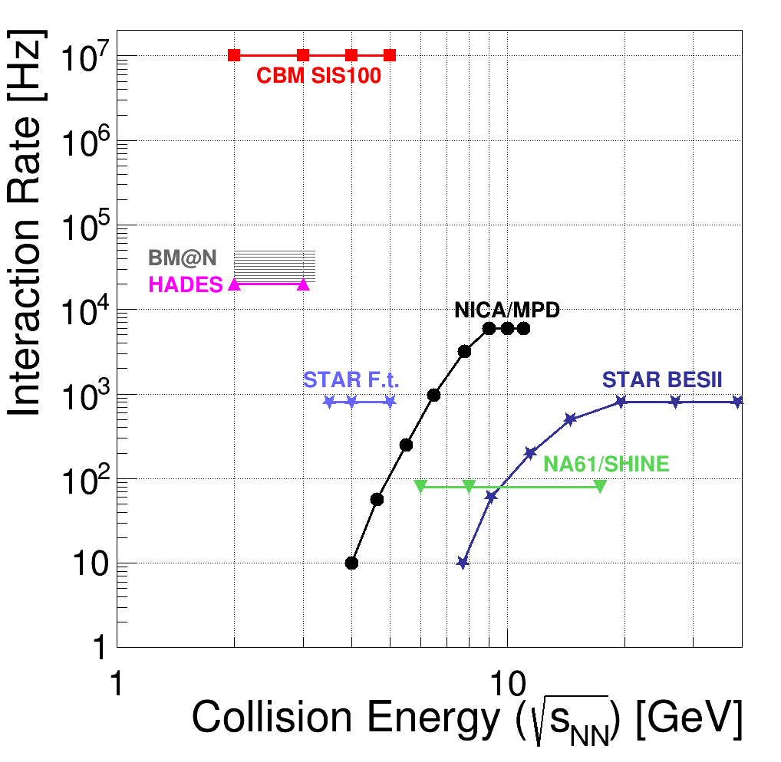
CBM and MPD
CBM: fixed-target
Extreme rates (large range of observables) but restructed energy range (in particular in the first years)
MPD: collider
Larger energy range
Limited in rate
A lot of complementarity;
Some competition where physics programmes overlap.
SIS300

Slide 27
Summary
The ambitious design of CBM, combining very high interaction rates with large acceptance and precision reconstruction, will allow the measurement of a multitude of particles originating from heavy-ion collision
  At SIS-100 (AGS energy range) up to 10A GeV from 2024 on
  After the installation of the second (booster) synchrotron up to 35A GeV (45 for symmetric nuclei)
Systematic measurements (collision energy, system size) will address the nature of QCD matter at high net-baryon density:
  Particle yields and spectra
  Flow
  Fluctuations
  Lepton pairs
  Charm

