Slide 1

Lecture on Particle
Detectors and
Electronic Readout
5th International FAIR School
Riva del Sole
Castiglione della Pescaia
Sept. 4 – 10, 2017
Christian J. Schmidt,
GSI Darmstadt

Slide 2
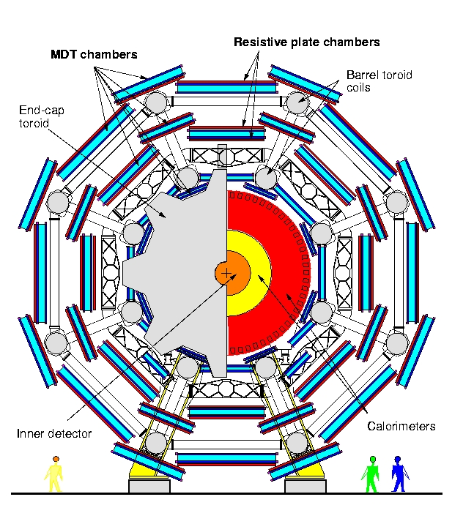
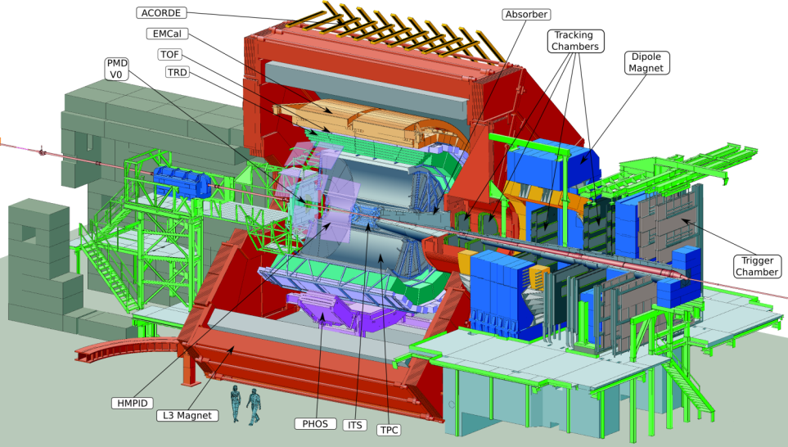
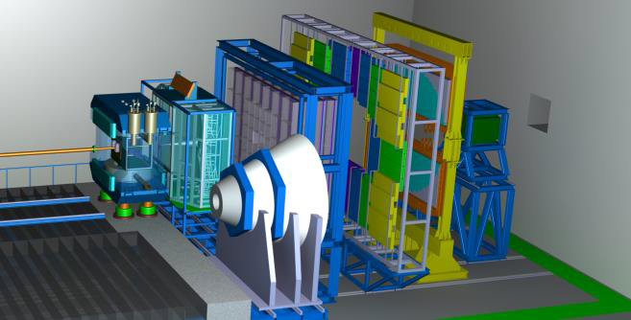
ATLAS
ALICE
Very Large Structures
Engineering
Electronics
Services, Cooling
Finally → Resolution limits are still defined by the fundamental detector physics processes …
CBM@FAIR

Slide 3
Plan
Ionization Detectors
Charged particle tracks, interaction and energy loss
Electronic detection and the detection process
Signal formation on electrodes
Fluctuations in energy loss

Slide 4
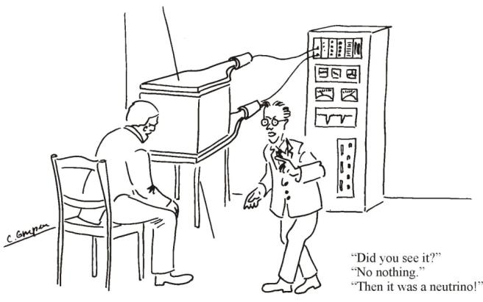
Detection of Radiation
Goal: Measurement of 4-momentum and position in space of particles
Methods:
Position-sensitive detectors  direction and position of momentum vector
Bending in magnetic field  magnitude of p
Absorption in calorimeter  energy
Cherenkov radiation, time of flight  velocity β
Transition radiation  γ
Energy loss  β, γ
Characteristic decay of a particle,
detection of secondaries  m
Detection by interaction with detector material:
electromagnetic interaction with ΔE<<E
interaction with ΔE~E (calorimtery)
[Claus Grupen, Particle Detectors, Cambridge, 1996]

Slide 5
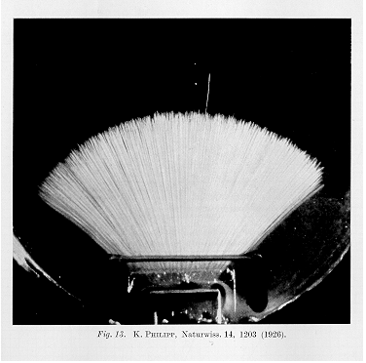
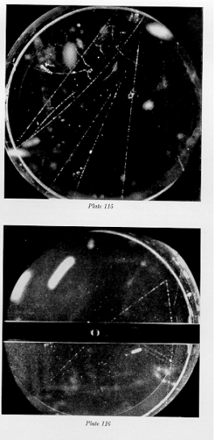
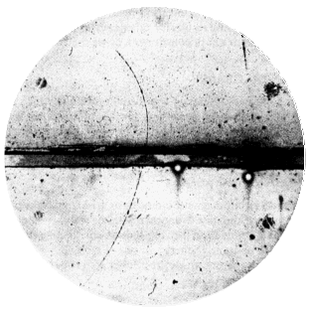
Cloud Chamber, C.T.R. Wilson 1910
Charges act as condensation nuclei in supersaturated water vapor
Alphas, Philipp 1926
Positron discovery, Carl Andersen 1933
V- particles, Rochester and Wilson, 1940ies

Slide 6
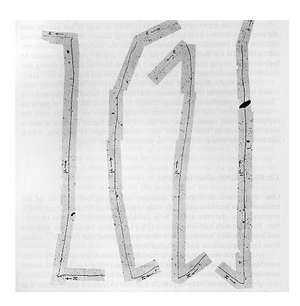
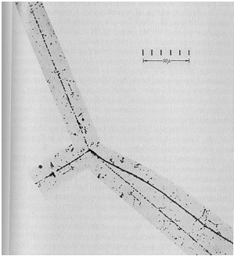
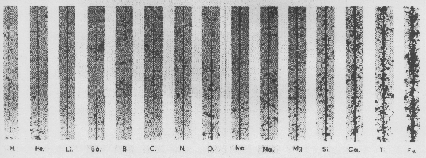
Nuclear Emulsion, M. Blau 1930`ies
Charges initiate a chemical reaction that blackens the emulsion (photographic film)
C. Powell, Discovery of muon and pion, 1947
Kaon Decay into 3 pions, 1949
Cosmic Ray Composition

Slide 7
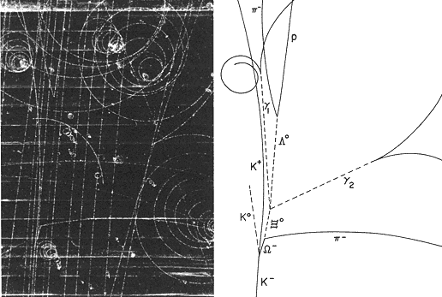
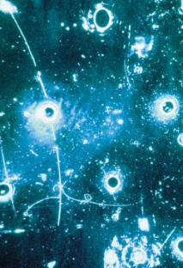
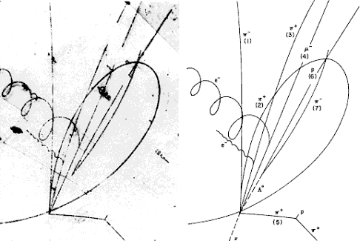
Bubble Chamber, D. Glaser 1952
Charges create bubbles in superheated liquid, e.g. propane or Hydrogen (Alvarez)
Discovery of the φ⁻ in 1964
Neutral Currents 1973
Charmed Baryon, 1975

Slide 8
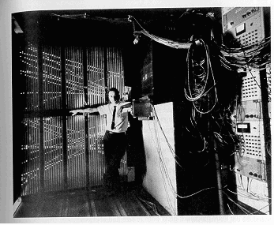
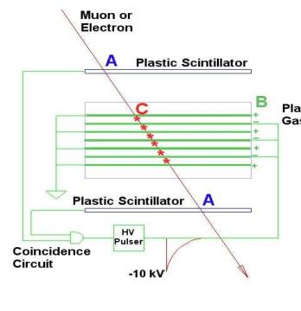
Spark Chamber, 1960ies
Charges create ‘conductive channel’ which initiates a spark in case HV is applied.
Discovery of the Muon Neutrino 1960ies

Slide 9
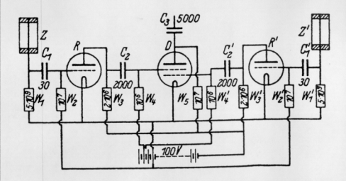
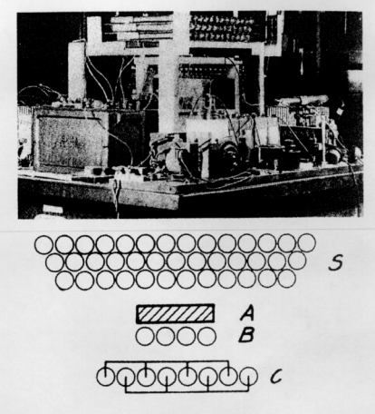
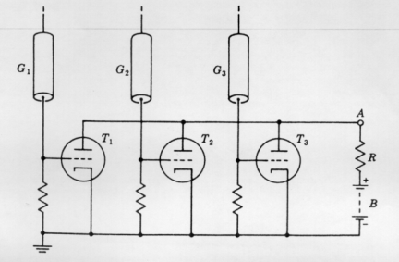
Electric Registration of Geiger Müller Tube Signals
Charges create a discharge in a cylinder with a thin wire set to HV. The charge is measured with a electronics circuit consisting of tubes → electronic signal.
W. Bothe, 1928
B. Rossi, 1932
Cosmic Ray Telescope 1930ies

Slide 10
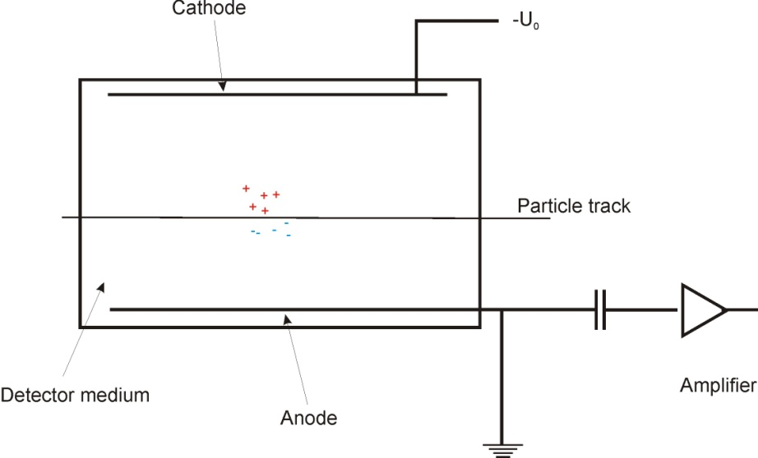
... more modern: collect signals as electronic charges
electronic signals can be read out electronically → computers
can go to higher...
  granularity (millions of very small pixels)
  faster and faster signal readout → higher intensities reveal rarest effects
What do we need to make a detector?
Gaseous detector, e.g. Ar/CO₂:
q ~ 100 e⁻/cm (MIP)
internal amplification necessary
quencher gas necessary
Solid state detector → Silicon, Diamond etc.:
q~10000 e⁻/100 μm (MIP)
detectable with low-noise amplifier

Slide 11
Electromagnetic Interaction of Particles with Matter
Z₂ electrons, q=-e₀
M, q=Z₁ e₀
Interaction with atomic electrons. The incoming particle loses energy and the atoms are excited or ionized.
Interaction with atomic nucleus. The particle is deflected (scattered) causing multiple scattering of the particle in the material. During this scattering a Bremsstrahlung photon can be emitted.
In case the particle’s velocity is larger than the velocity of light in the medium, the resulting EM shockwave manifests itself as Cherenkov Radiation. When the particle crosses the boundary between two media, there is a probability of the order of 1% to produced and X ray photon, called Transition radiation.

Slide 12
Particle Detection based on Ionization
Charged particles leave a trail of primary and secondary charges (and excited atoms) along their path:
Electron-Ion pairs in gases and liquids, electron hole pairs in solids.
The produced charges can be registered → Position measurement → Time measurement → Tracking Detectors ....
Cloud Chamber: Charges create drops → photography.
Bubble Chamber: Charges create bubbles → photography.
Emulsion: Charges ‘blacken’ film.
Spark Chamber: Charges produce a conductive channel that creates a discharge → photography

Slide 13
Electronic Detection of Ionization
Gaseous and Solid State Detectors:
Moving Charges (electric fields) induce electronic signals on
metallic electrodes that can be read by dedicated electronics.
In solid state detectors the charge created by the incoming particle is sufficient for detection.
In gaseous detectors (e.g. wire chamber, GEM-chamber) charges are internally multiplied in order to provide a measurable signal.
Detector material:
gas  fast collection of e- and ions, e.g. Ne, Ar
liquid  higher density, e.g. liquid Ar
solid  higher density, self-supporting, e.g. semiconductor

Slide 14
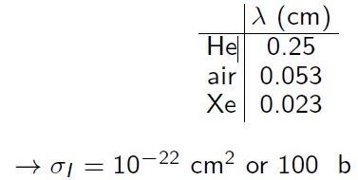
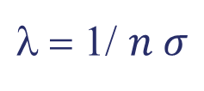
Statistics of Electron-Ion Pair Creation
Characteristic length: mean free path between ionizing collisions
efficiency of gaseous detector allows to find λ and thus σ_{i}
$\text{l}$ = 1/ $n σ$
σ = cross section for ionization
n = number density
Encounters with gas atoms are purely random, probability small
 Poisson distribution of number k of ionizing collisions over length L
L/λ = mean number of ionizing collisions in L
= mean number of primary e⁻-ion pairs n_{P}
Total number of e⁻-ion pairs: primary and secondary ionization
ξ = 1st term of Bethe-Bloch equation
Δ = mean energy loss in thickness L
W = effective average energy to produce one e⁻-ion pair,
usually W>I, since part of energy lost by excitation,
empirical determination
~
~
the total number is larger than the number of primary charges

Slide 15
Properties of Gases
W = mean energy for electron-hole pair
Gas | Z | A | δ | E_{ex} | E_{i} | I | W | dE/dx |  | n_{P} | n_{T}
 |  |  | (g/cm³) | (eV) | (eV) | (eV) | (eV) | (MeV/g cm⁻²) | (keV/cm) | (ip/cm) | (ip/cm)
He | 2 | 4 | 1.66E-4 | 19.8 | 24.5 | 24.6 | 41 | 1.94 | 0.32 | 5.9 | 7.8
N₂ | 14 | 28 | 1.17E-3 | 8.1 | 16.7 | 15.5 | 35 | 1.68 | 1.96 | (10) | 56
Ne | 10 | 20.2 | 8.39E-4 | 16.6 | 21.5 | 21.6 | 36 | 1.68 | 1.41 | 12 | 39
Ar | 18 | 39.9 | 1.66E-3 | 11.6 | 15.7 | 15.8 | 26 | 1.47 | 2.44 | 29.4 | 94
CO₂ | 22 | 44 | 1.86E-3 | 5.2 | 13.7 | 13.7 | 33 | 1.62 | 3.01 | (34) | 91
CH₄ | 10 | 16 | 6.70E-4 |  | 15.2 | 13.1 | 28 | 2.21 | 1.48 | 16 | 53
[F. Sauli, CERN 77-09 (1977)]
Properties of some Semiconductors and solid materials
Si 2,3 3,6
Ge 5,3 2,8
Diamond 3,5 5,8

Slide 16
Energy Loss of Charged Particles
Inelastic collisions
 statistical process (quantum mechanics!)
 mostly small energy losses (< 100 eV in 90% of all collisions)
 rare events with large single-collision energy loss e.g. delta electrons
 total energy loss fluctuates!
Number of collisions per macroscopic path length large
 fluctuations in total energy loss small
 characteristic parameter: average energy loss per unit pathlength
“stopping power”

Slide 17
towards dE/dx
Wish to know, how a charged ionizing particle interacts with detector.
Photo-Absorption Ionization model: PAI model
What is the energy loss dE in an infinitesimally thin disk of detector material dx? (dx is typically a mass density dx = ρdz)
[W.W.M Allison, J.H. Cobb, Ann. Rev. Nucl. Part. Sci. 30, 253 (1980)]

Slide 18
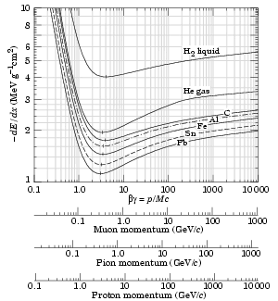
Bethe-Bloch Formula for Mean Energy Loss dE/dx
independent of mass of incident particle
depends only on velocity of inc. particle
and on I, the mean exitation energy
 main parameter
low energies 
minimum at βγ ≈ 3.5 : “MIP” dE/dx|_{min} ~ 1,5 MeV cm²/g
high energies  : relativistic rise
mass stopping power:
 almost independent of material
density effect: polarization of atoms along track
 partly compensates relativistic rise
[K. Nakamura et al. (PDG), J. Phys. G 37, 075021 (2010)]

Slide 19
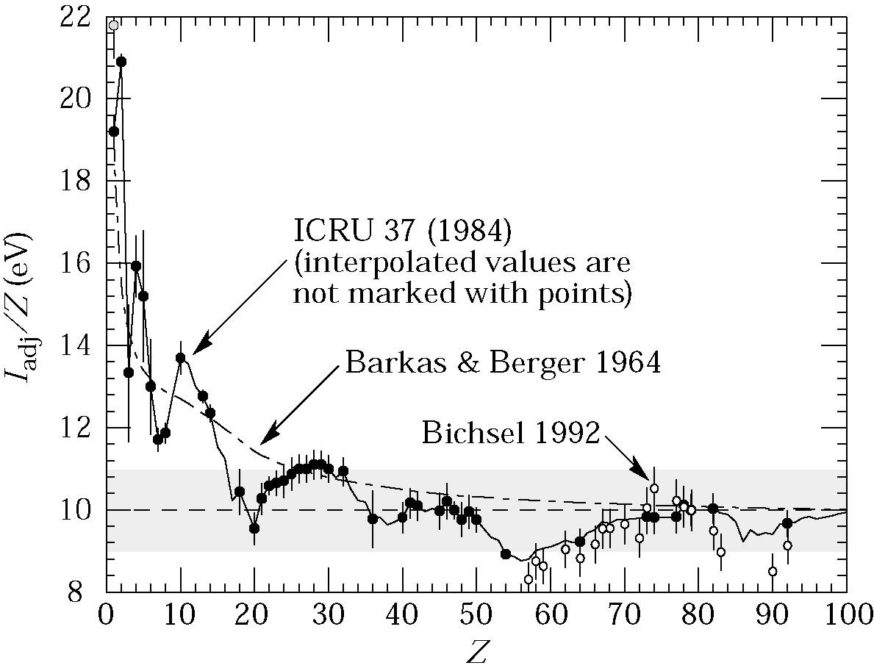
Mean Excitation Energy
[Review of Particle Physics, S. Eidelmann et al., Phys. Lett. B 592, 1 (2004)]
I = Z 10eV

Slide 20
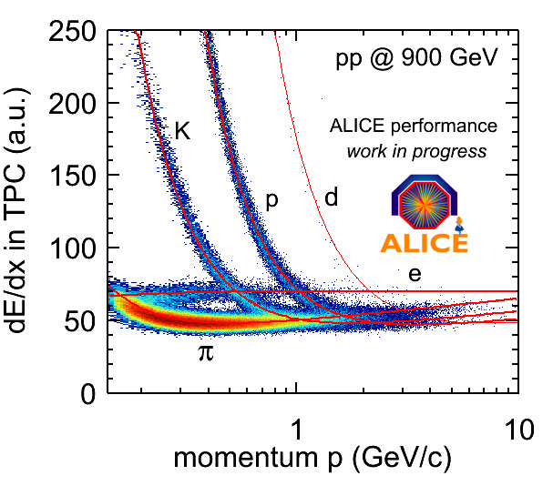
dE/dx can be used for particle ID if plotted vs E or p

Slide 21
Detection process
Primary interaction of ionizing particle with detector material
Second: charges drift in electric fields towards electrodes and create (very small) induced signals
  drift velocity for electrons in gas at decent drift fields ~ 1 to 6 cm/µs
  drift velocity for ions ~ 1 cm/ms, smaller by four orders of magn.
Drift time can be used for resolution enhancement
  Drift chamber: invented by A. Walenta, J. Heintze, 1970 at Phys. Inst. U. Heidelberg (NIM 92 (1971) 373)
Some charges trapped along drift path
  solid state detectors → impurities, lattice defects, radiation damage
  gaseous detectors → loss by electron attachment on electro-negative atoms → Oxygen, SF6 contamination
High field region may be employed for final gain boost (wire chamber, GEM chamber)

Slide 22
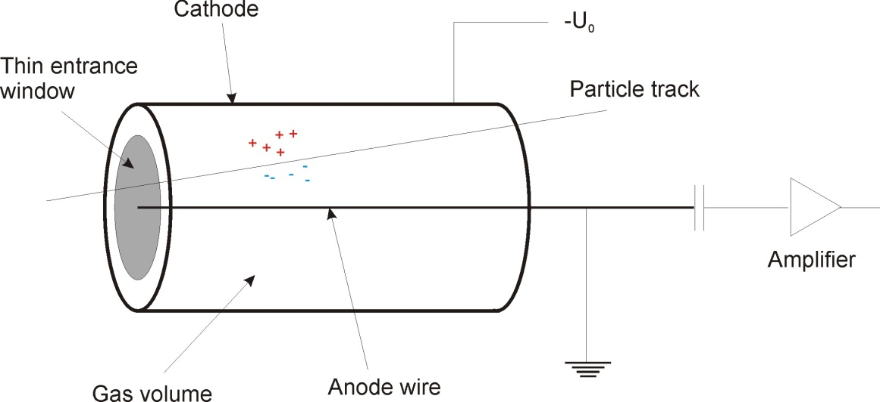
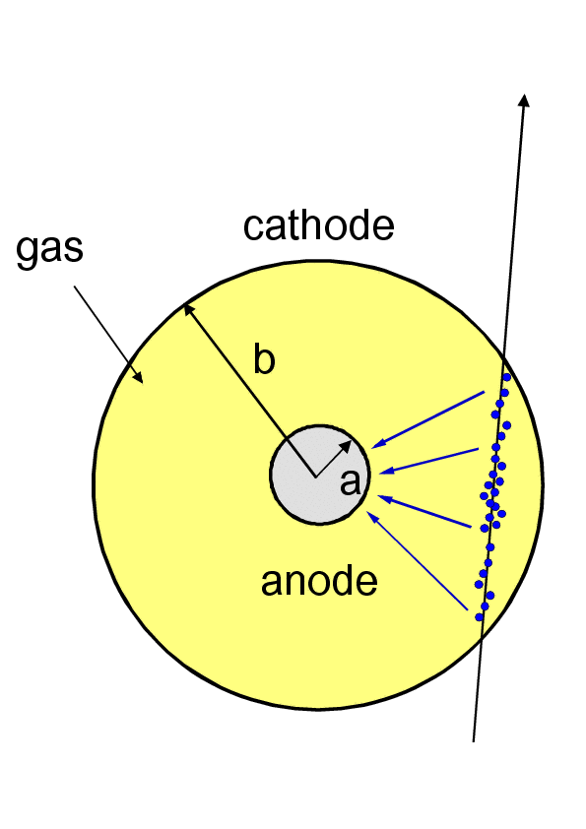
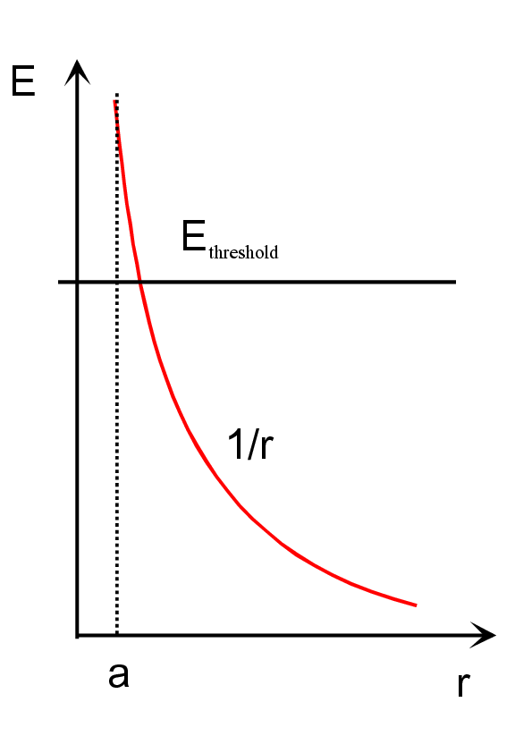
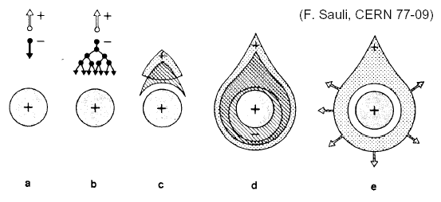
Need signal amplification: Proportional Wire Counter
Charge gain:
Typical values:
Proportional wire counter:
G~10⁴-10⁶
GEM: G~10³-10⁵
Amplification starts at r~5a
 negligible spatial dependence of pulse height
Notes:
Overcomes drawbacks of planar detector:
very high voltages required to obtain gas amplification
size of avalanche depends on location of charge creation => loss of proportionality!
high electric field in complete detector => risk of breakdown!

Slide 23
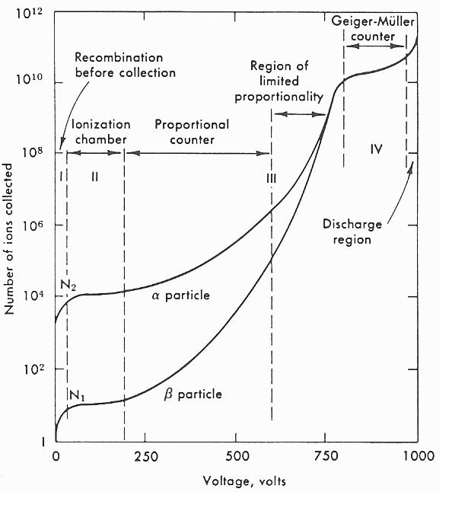
I-U Characteristics
Recombination during drift
Collection of all created e⁻-ion
pairs: ionization chamber
Avalanche creation:
proportional counter
Distortion of electric field around
anode
 screening of electric field
 loss of proportionality
Propagation of avalanche over full
length of anode (photon emission)
 electric discharge
 saturation of output current
Termination: quench gas or lower U
Continuous breakdown even
without radiation
IV
V
III
VI
Modes of operation of gas detectors
(after F. Sauli 1977, lecture notes )

Slide 24
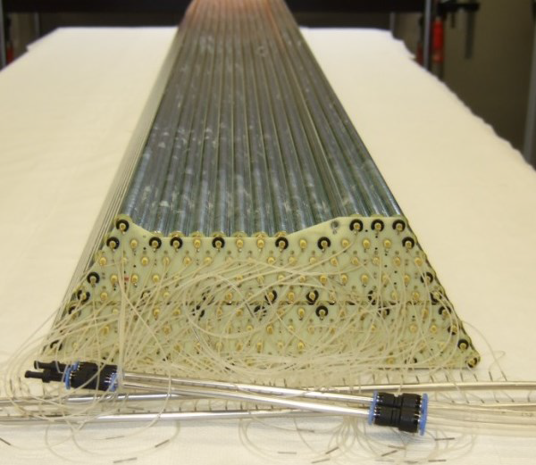
PANDA Straw Tracker, one submodule
Straws are of 20µm Coated Polyimide Foil, pressurized to 2bar.

Slide 25
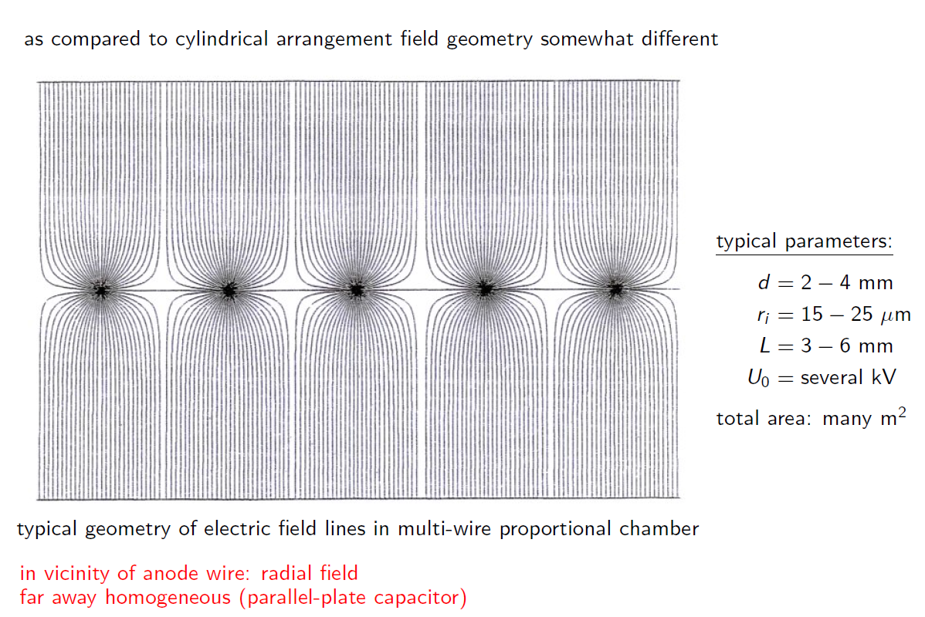
Charpak´s Multi-Wire Proportional Chamber MWPC
G. Charpak et al. NIM 62 (1968) 202
Nobel prize 1992, Rev. Mod. Phys. 65 (1993) 591

Slide 26
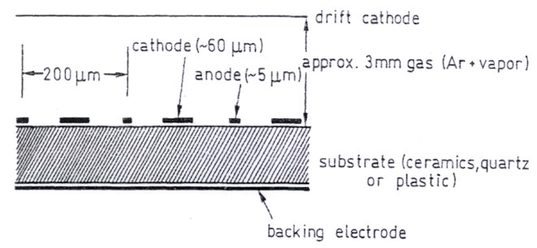
Anton Oed´s MSGC (Microstructured Gas Chamber)
On resistive glas substrate

Slide 27

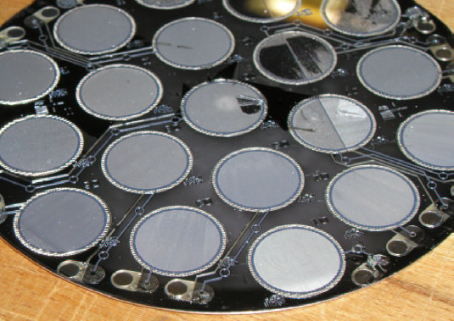
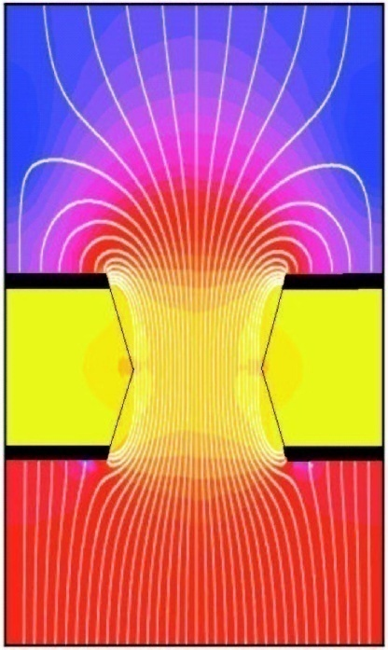
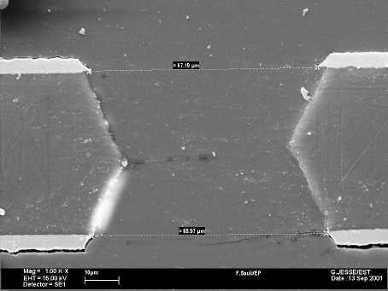
Microstructured Amplification Stages: GEM, InGrid
70 μm
GEM: Gas Electron Multiplier
[F. Sauli, NIM A386, 531 (1997)]
Photolithography: ~ 10.000 holes/cm²
amplified charge clouds rain onto readout pixels
Microstructures: Ions travel very short → rate capability
[J. Timmermans, VCI 2007]

Slide 28
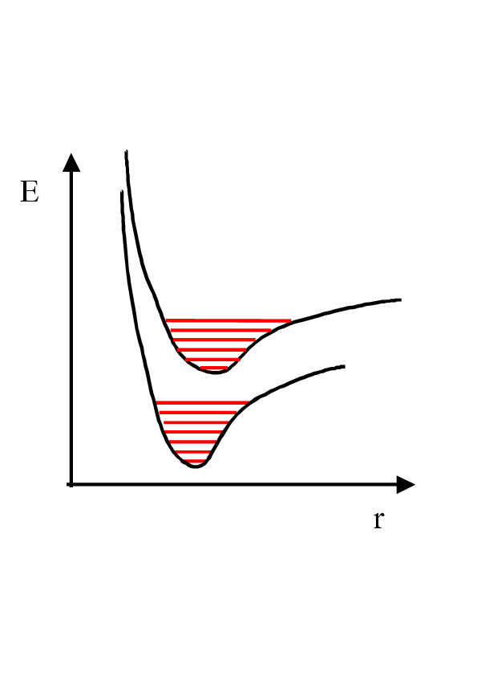
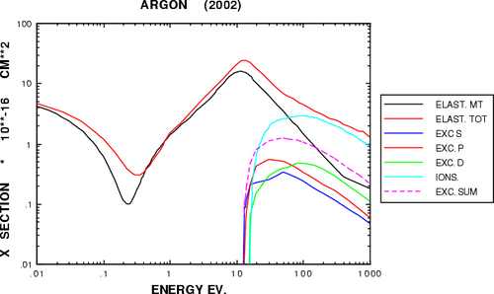
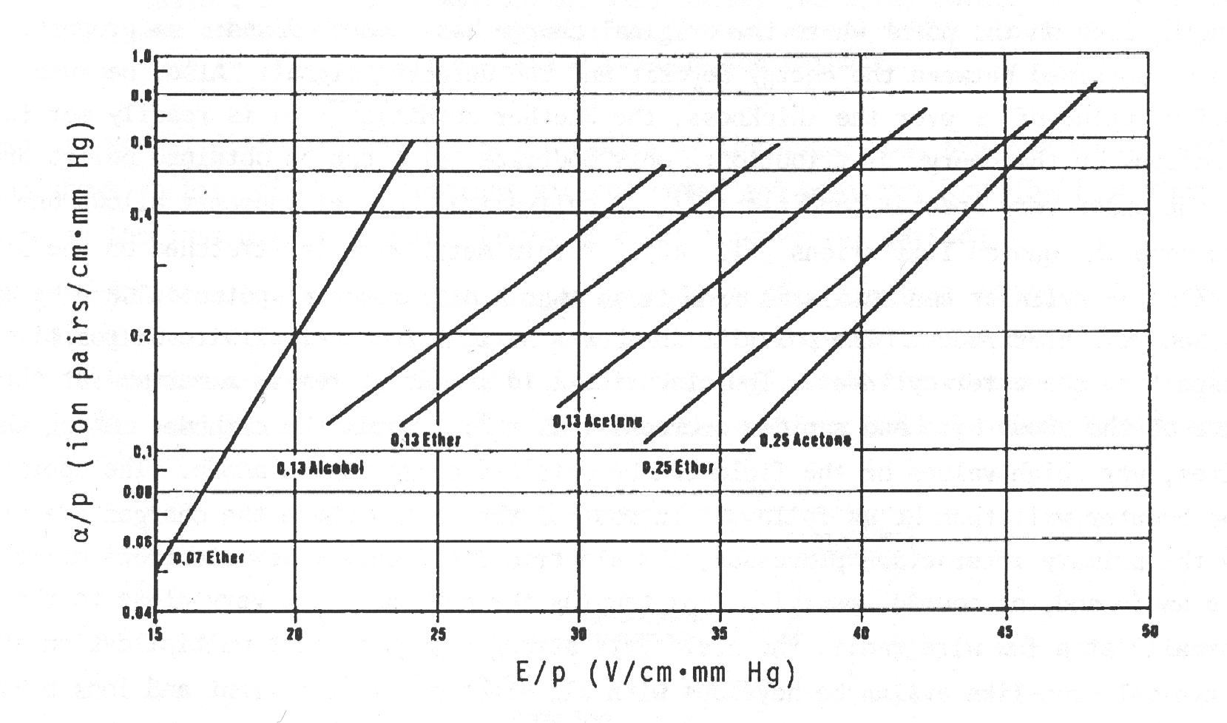
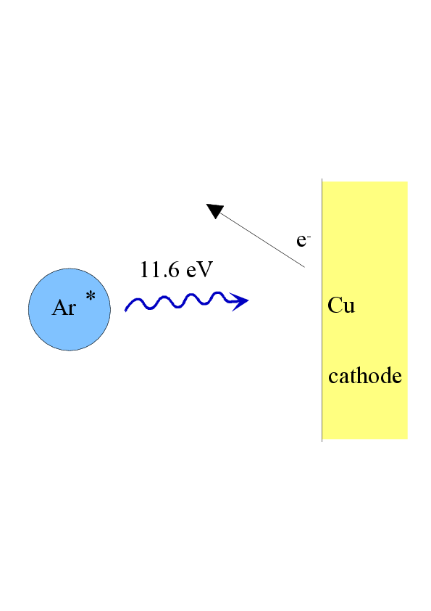
Choice of Detector gas
Noble gases: Energy dissipation
mainly through ionization
Polyatomic molecules:
Absorption of
photons in
broad energy
range
Ar + polyatomic gases
Deexcitation through photon emission
[O.K. Allkofer, Spark Chambers, Thiemig, München, 1969]
Polyatomic quencher gas essential for stable operation!

Slide 29
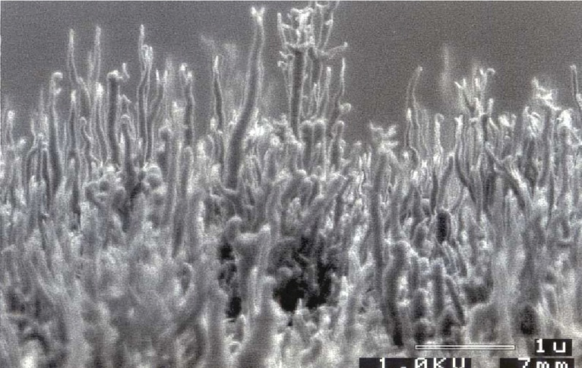
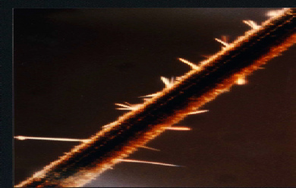
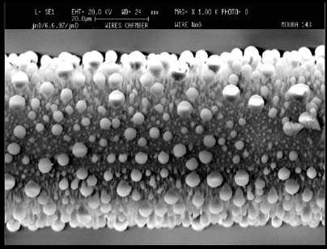
Aging
Let us take a three minute break!

Slide 30
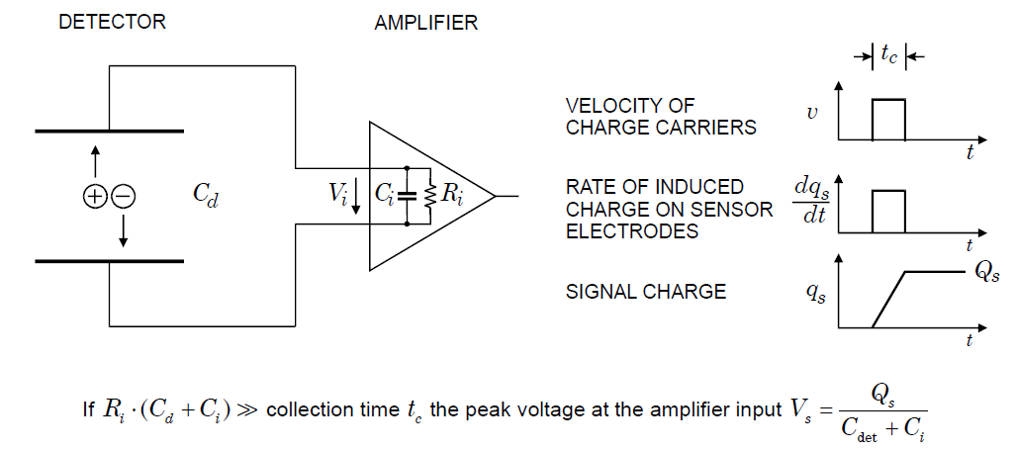
Electronic Signal Formation
Moving charges induce current in electrodes. Currents proportional to drift velocity.
Simple case: Ionization chamber, no gain

Slide 31
Varying Signal Formation
I
holes in semicond.
d
ions in gas
x_{o}
x_{o}/v_{el}
t
(d-x_{o})/v_{ion}
I
d
x_{o}/v_{el}
t
(d-x_{o})/v_{ion}

Slide 32
localized charge injection: one charge carrier only
I
Cathode
α
Anode
t
Cathode
I
α
Anode
d/v_{el}
t
→ realized to study mobility and drift velocity
More complicated detector geometries→ need Ramo´s Theorem

Slide 33
Mostly focus on fast, electron component
Charge sensitive amplifier integrates signal current to measure the full signal charge
→ (electronically low pass filter, integrate onto capacitor)
Ion drift in multi wire proportional chambers creates a long 1/(t + t_{o}) tail which leads to signal pile-up. A following shaper amplifier has high-pass filter characteristic that removes slow, ion-drift components
Ion tail nevertheless limits rate capability

Slide 34
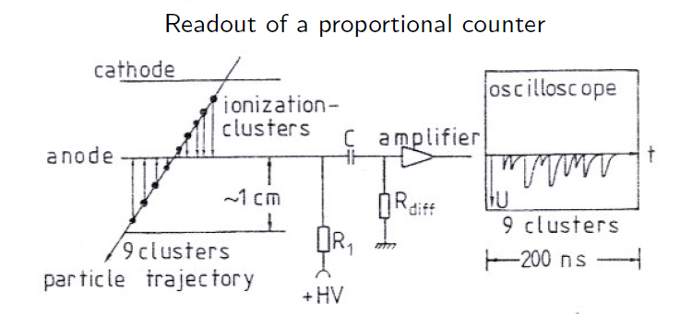
Since charge clusters need to drift to anode for amplification, time delay
proportional to drift distance → Drift chamber

Slide 35
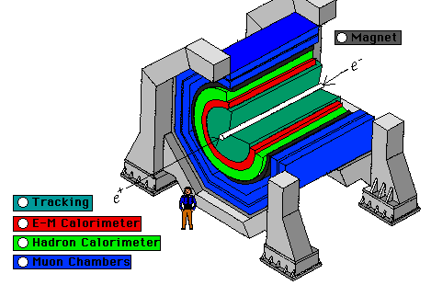
Modern Experiments Comprise a Detector System
Different components, measuring different aspects of reaction products:
track, charge, energy, momentum, particle type, ...
Tracking
chamber
Electromagn.
calorimeter
Hadron
calorimeter
Muon
chamber
γ
e±
Beam
μ
π±,p
Target
n
Magnet
The tracking detector is to see everything.....
.....but consist of nothing

Slide 36

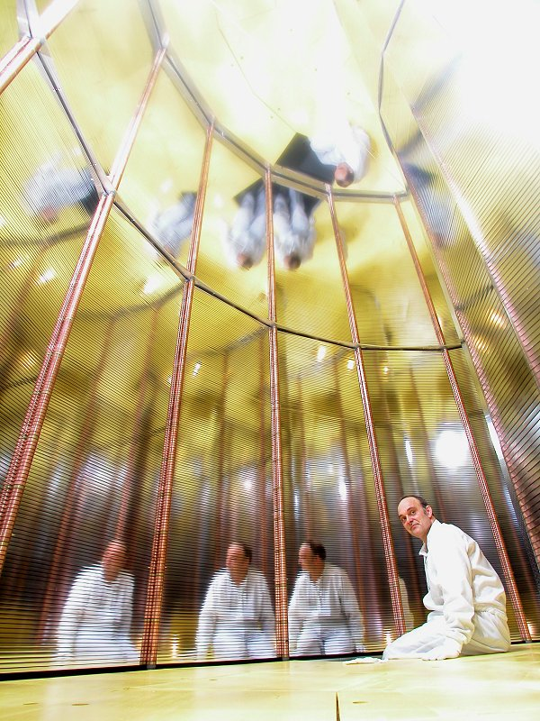
Time Projection Chamber, the Queen of Trackers
100 m³ gas

Slide 37
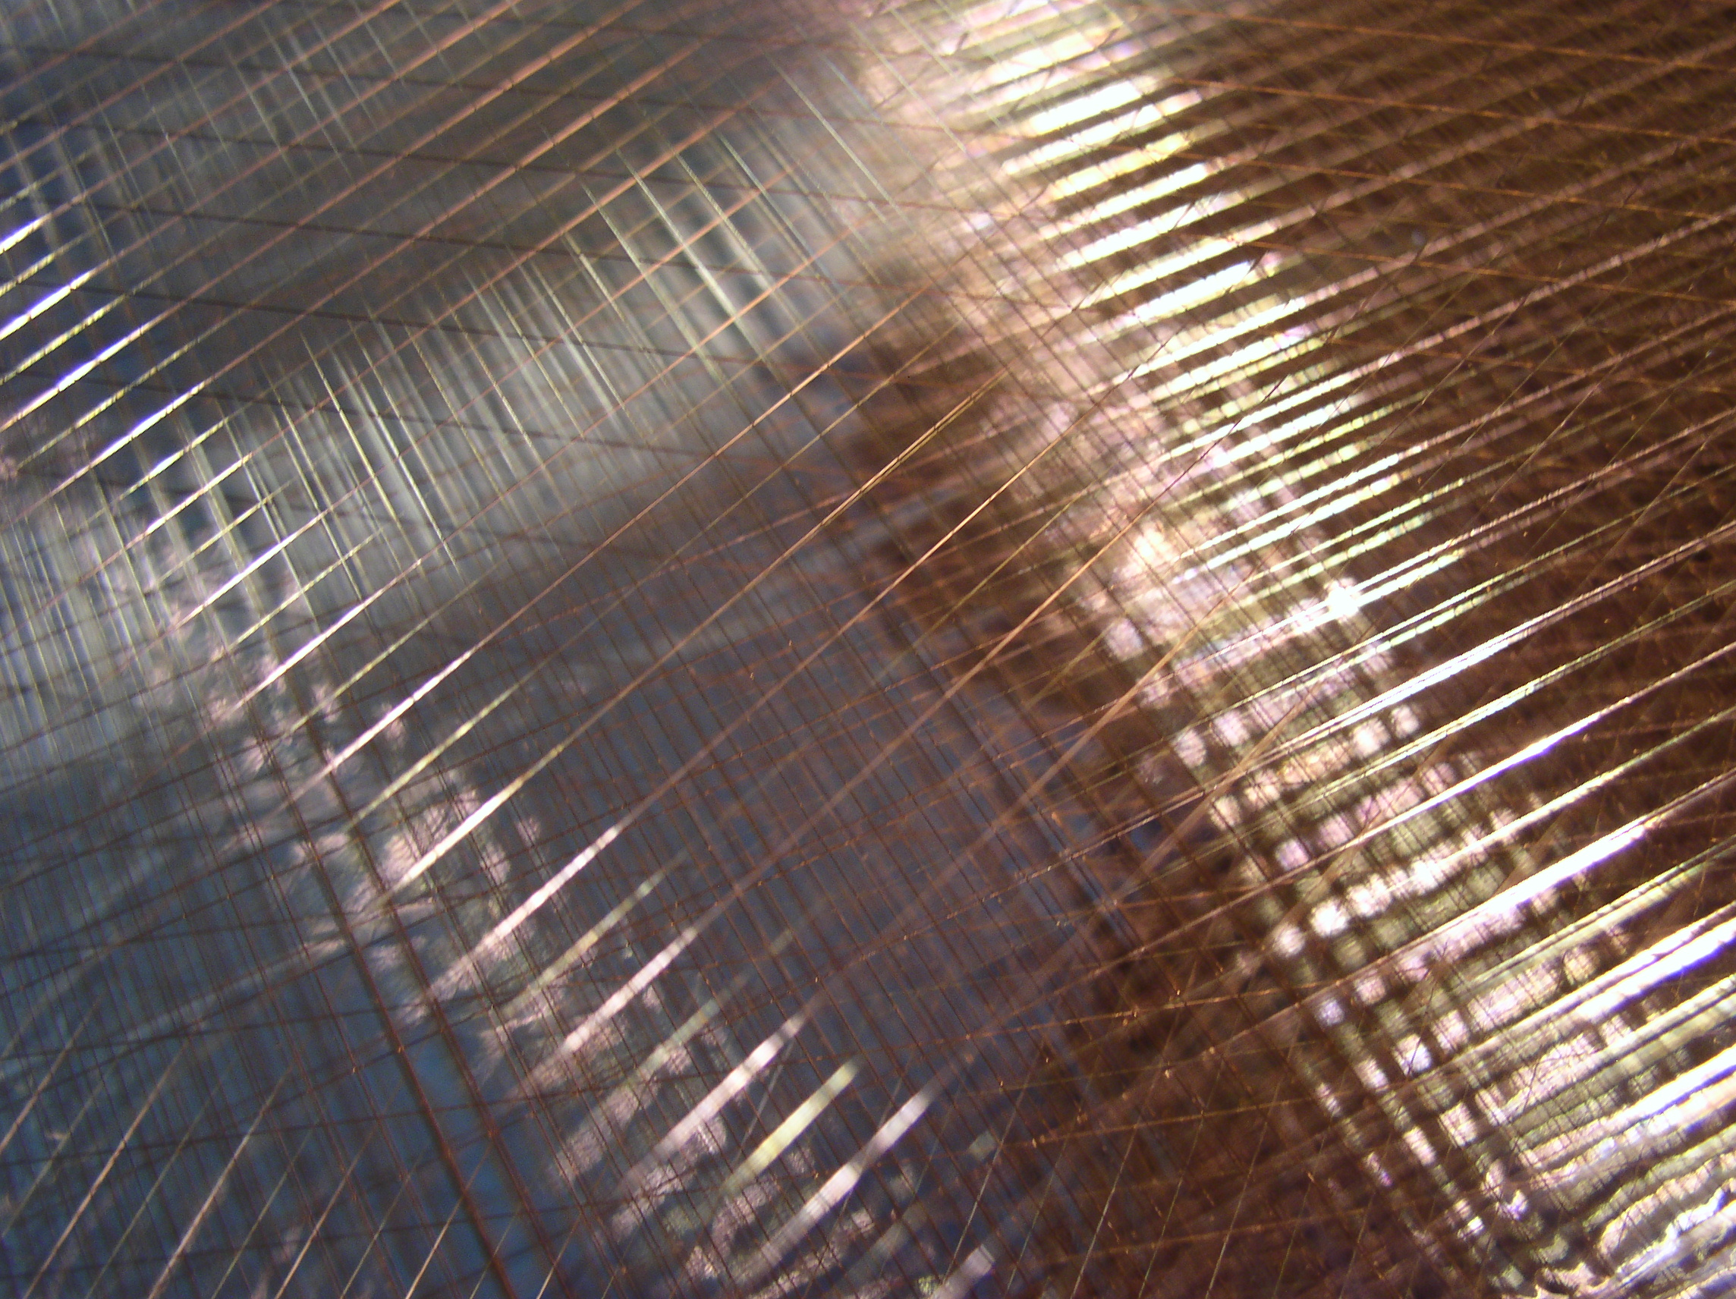
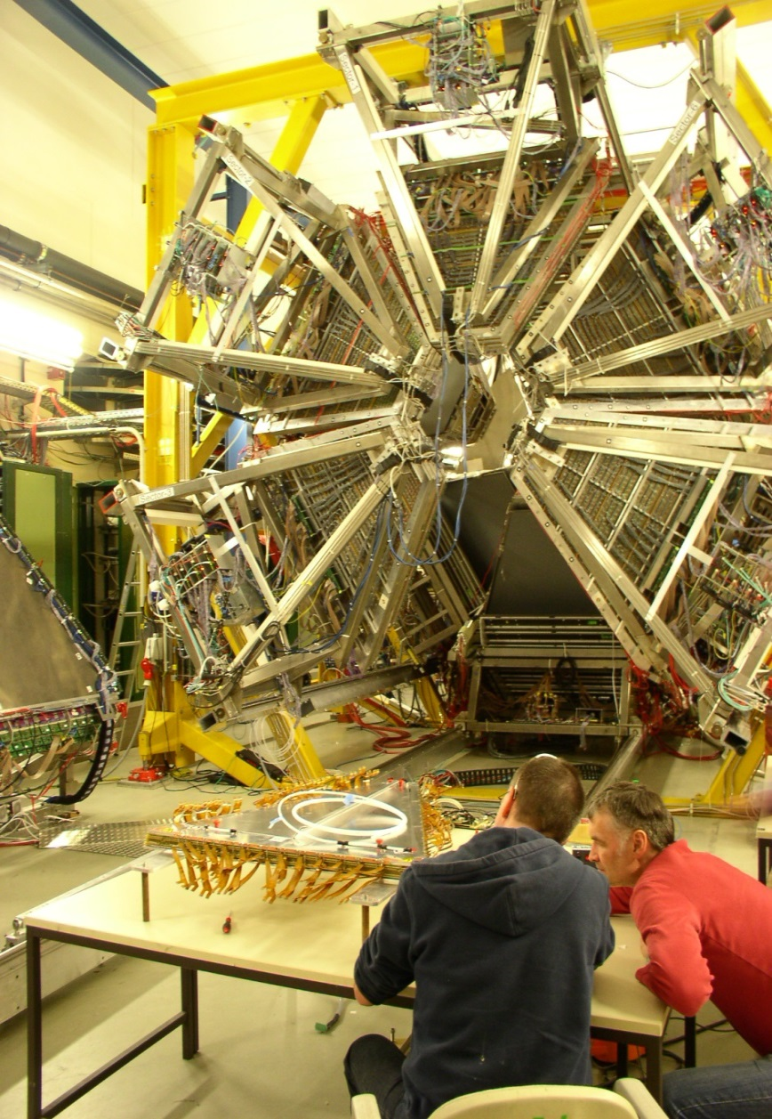
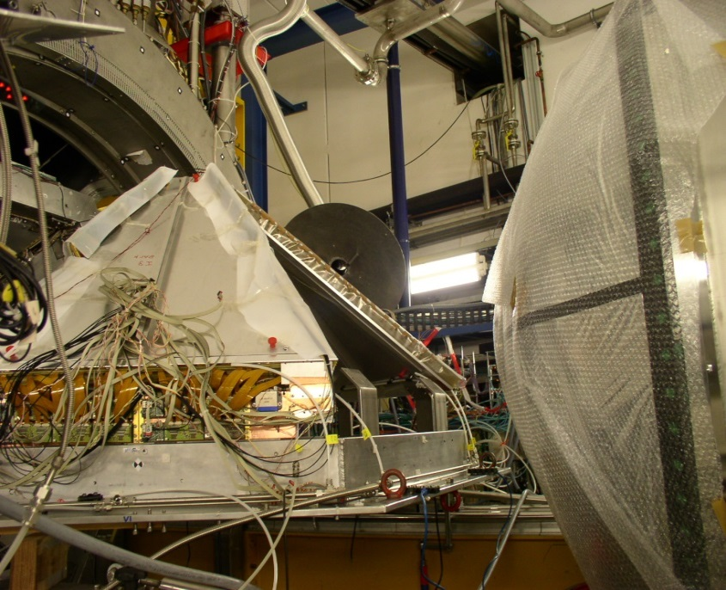
HADES- The GSI Dilepton Spectrometer

Slide 38
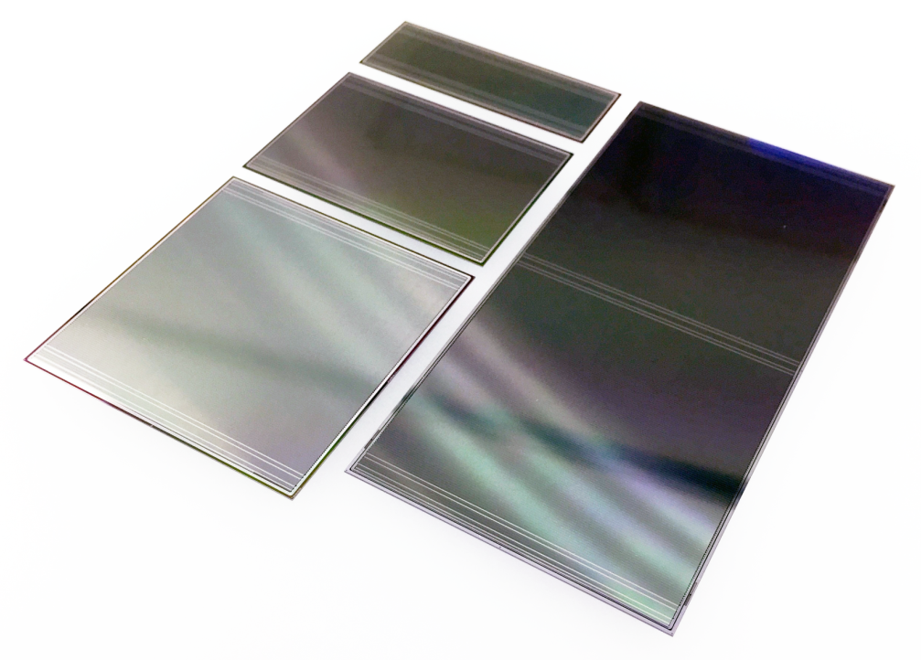


CBM Silicon Tracking System STS

Slide 39


Very Small: Single Crystal- CVD Diamond Detectors
Particle Identification by Time of Flight
time resolution better 50ps
identify particles by speed
exceptional radiation hardness properties
HADES @ GSI

Slide 40

Radiation hard material (scCVD diamond)
  3.04 x 10¹¹ Au ions / mm² → total absorbed dose: 87 MGy !!!!
suffered amplitude reduction but still good timing < 70ps
Jerzey Pietrasco et al. at GSI for HADES

Slide 41
Ionization Chambers, Wire Chambers, Solid State Detectors
!The movement of charges in electric fields induces signals on readout electrodes (No discharge, there is no charge flowing from cathode to Anode) !
Central Au+Au collision at 25 AGeV (UrQMD + GEANT4)
160 p 400 π⁻ 400 π⁺ 44 K⁺ 13 K⁻

Slide 42
Signals induced in Detectors by moving Charges
Signals induced on grounded electrodes:
S. Ramo, Currents induced by electron motion, Proc. IRE 27 (1939)
W. Shockley, 1938, Currents to Conductors Induced by a Moving Point Charge, Journal of Applied Physics, vol. 9 (1938) 635
Signals induced on electrodes connected by impedance elements:
E. Gatti, G. Padovini and V. Radeka, Signal evaluation in multielectrode radiation detectors by means of a time dependent weighting vector, Nucl. Instr. and Meth. 193 (1982) 651
Signals induced on electrodes embedded in materials with finite conductivity and connected with arbitrary impedance elements:
W. Riegler, Extended theorems for signal induction in particle detectors, Nucl. Instr. and Meth. A 535 (2004) 287.

Slide 43
The Principle of Signal Induction on Metal Electrodes by Moving Charges

Slide 44
Induced Charges
A point charge q at a distance z₀ above a grounded metal plate ‘induces’ a surface charge.
+
q
z₀
-
-
-
-
-
-
-
-
-

Slide 45



Electrostatics, things we know
Poisson Equation:
Gauss Law:
Metal Surface: Electric Field perpendicular to surface.
Charges are only on the surface, no electric field in the conductor.
Surface Charge Density σ and electric E field on the surface are related by
E
E
A
σ
A
σ
E=0
Perfect Conductor

Slide 46
Induced Charges
In order to find the charge induced on an electrode we therefore have to
Solve the Poisson equation with boundary condition that ϕ = 0 on the conductor surface.
Calculate the electric field E on the surface of the conductor
Integrate ε₀E over the electrode surface.
+
q
z₀
-
-
-
-
-
-
-
-
-

Slide 47

Induced Charges
The solution for the field of a point charge in front of a metal plate is equal to the solution of the charge together with a (negative) mirror charge at z=-z₀.
q
q
+
+
E
z₀
E
=
z₀
-
-
-
-
-
-
-
-
-
z₀
The field on the electrode surface (z=0) is therefore
-

Slide 48


Induced Charges
We therefore find a surface charge density of
And therefore a total induced charge of
+
q
z₀
-
-
-
-
-
-
-
-
-

Slide 49
Induced Charges
The total charge induced by a point charge q on an infinitely large grounded metal plate is equal to –q, independent of the distance of the charge from the plate.
The surface charge distribution does however depend on the distance z₀ of the charge q.
+
q
z₀
-q
-
-
-
-
-
-
-
-
-

Slide 50

Induced Charges
Moving the point charge closer to the metal plate, the surface charge distribution becomes more peaked, the total induced charge is however always equal to –q.
q
q
-q
-q
I=0

Slide 51


Signal Induction by Moving Charges
If we segment the grounded metal plate and if we ground the individual strips, the surface charge density doesn’t change with respect to the continuous metal plate.
q
The charge induced on the individual strips does now depend upon the position z₀ of the charge.
If the charge is moving there are currents flowing between the strips and ground.
→ The movement of the charge induces a current.
V
-q
-q
I₁(t) I₂(t) I₃(t) I₄(t)

Slide 52

a little more general, more practical
In a real particle detector, the electrodes (wires, cathode strips, silicon strips, plate electrodes …) are not grounded but they are connected to readout electronics and interconnected by other discrete elements and kept at different potentials.
We want to answer the question:
What are the voltages induced on metal electrodes by a charge q moving along a trajectory x(t), in case these metal electrodes are connected by arbitrary linear impedance components ?

Slide 53


solution in two steps
We first calculate the currents induced on grounded electrodes.
We then insert the currents as ideal current sources,
shrink the electrodes to nodes and add all the inter-node impedances.
+
=
The second step is typically performed by using an analog circuit simulation program. We will focus on the induced currents.

Slide 54

Signal Polarity Definition
-q
-q
+q
-
+
+
+q
-
+
+
-
+
+
-
+
+
-
-
+
-
-
+
-
-
Positive Signal
I(t)
Negative Signal
I(t)
The definition of I = -dQ/dt states that the positive current is pointing away from the electrode.
The signal is positive if:
Positive charge is moving from electrode to ground or
Negative charge is moving from ground to the electrode
The signal is negative if:
Negative charge is moving from electrode to ground or
Positive charge is moving from ground to the electrode

Slide 55
Signal Polarity Definition
-q
-q
+q
-
+
+
+q
-
+
+
-
+
+
-
+
+
-
-
+
-
-
+
-
-
Positive Signal
I(t)
Negative Signal
I(t)
By this we can guess the signal polarities:
In a wire chamber, the electrons are moving towards the wire, which means that they attract positive charges that are moving from ground to the electrode. The signal of a wire that collects electrons is therefore negative.

Slide 56



Induced Current, Ramo Shockley Theorem
the general, arbitrary electrode case
0
The current induced on a grounded electrode n by a moving point charge q is given by
Where the weighting field E_{n} is defined by removing the point charge, setting the electrode in question to potential V_{w} and keeping the other electrodes grounded.
Removing the charge means that we just have to solve the Laplace equation and not the Poisson equation !

Slide 57




Parallel Plate Chamber
I₂(t)
Plate 2
q₂
v
q
D
z₀
q₁
Plate 1
I₁(t)
Weighting field E₁ of plate 1: Remove charge, set plate1 to V_{w} and keep plate2 grounded
Weighting field E₂ of plate 2: Remove charge, set plate2 to V_{w} and keep plate1 grounded
So we have the induced currents

Slide 58




Signal Calclulation in 3 Steps
What are the signals induced by a moving charge on electrodes that are connected with arbitrary linear impedance elements ?
1) Calculate the particle trajectory in the ‘real’ electric field.
2) Remove all the impedance elements, connect the electrodes to ground and calculate the currents induced by the moving charge on the grounded electrodes.
The current induced on a grounded electrode by a charge q moving along a trajectory x(t) is calculated the following way (Ramo Theorem):
Weighting Field E_{n}:
Remove q from the setup, set the electrode to voltage V₀ while keeping all other electrodes grounded. This results in an electric field E_{n}(x), the Weighting Field
3) These currents are then placed as ideal current sources on a circuit where the electrodes are ‘shrunk’ to simple nodes and the mutual electrode capacitances are added between the nodes. These capacitances are calculated from the weighting fields by

Slide 59




Careful design of multi-electrode, highly segmented Germanium Crystal Detectors
and full understanding of the signals along Ramo, Shockley and the Weighting field
were the basis for AGATA Gamma Tracking → Lecture by Andreas Heinz

Slide 60


General Signal Theorems
The following relations hold for the induced currents:
1) The charge induced on an electrode through a charge moving from a point x₀ to a point x₁ is
and is independent of the actual path.
2) Once ALL charges have arrived at the electrodes, the total induced charge in the electrodes is equal to the charge that has ARRIVED at the particular electrode.
3) If there is one electrode enclosing all the others, the sum of all induced currents is zero at any time.
take a 3 min break

Slide 61

Wire Chamber Signals
People sometimes picture detector signals as ‘the charge entering the electrode and flowing through the amplifier’.
This is very misleading and gives incorrect results – once the moving charges have arrived at the electrodes the signal is over.
The shape of the signal is determined by the movements of the charges in between the electrodes.
Werner Riegler, CERN
b
b
a
Wire

Slide 62


Consequences on wire chamber readout
Primary charges become visible through avalanche amplification at the anode wire
negative signals at anode
induced positive signals at cathodes
→ localized avalanche

Slide 63


Cathode Pad Response Function P_{o}(λ) in MWPC
Electrons in avalanche do not travel far
→ surface charge distribution does not change for the fast, electron induced signals
Signal factorizes into I_{cathode}(t) x Pad Response Function
q
z₀
-q
I₁(t) I₂(t) I₃(t) I₄(t)

Slide 64


Further Example: Double Sided Silicon Strip Detector
n-side
p-side
CBM-STS
silicon strip detector
58µm pitch, 300µm thick
7.5° stereo angle

Slide 65

Further Example: Double Sided Silicon Strip Detector
Weighting Potential
strip positions

Slide 66

Weighting Potential gives Total Charge Detected

Slide 67
Conclusion on Signals
The principle of signal generation is identical for Solid State Detectors, Gaseous Detectors and Liquid Detectors.
The signals are due to charges (currents) induced on metal electrodes by moving charges.
The easiest way to calculate signals induced by moving charges on metal electrodes is the use of Weighting fields (Ramo – Shockley theorem) for calculation of currents induced on grounded electrodes.
These currents can then be placed as ideal current sources on an equivalent circuit diagram representing the detector.
An extended version of the theorem applies to detectors containing any resistive materials.

Slide 68
Conclusion on Ramo Shockley Theorem
With the Ramo Shockley prescription we can fully understand signal formation
... even in an arbitrary detector volume with arbitrarily shaped electrodes
Cannot be inverted i.e. from knowledge of all signals in all electrodes, the charge distribution cannot necessarily be reconstructed, but a hypothesis may be tested
Prerequisit is the measurement of the actual signal shapes

Slide 69
Fluctuations in Energy Loss
Bethe-Bloch formula  mean energy loss,
i.e. statistical average over many collisions
Important quantity to understand the response of a detector:
probability distribution of energy loss Δ in material of thickness x,
determined by
cross section dσ/dT
n_{e}x
Calculation of energy loss distribution: two approaches
Convolution method
Laplace transform method
[Allison, Cobb, Ann. Rev. Nucl. Part. Sc., 253 (1980)]

Slide 70


Landau Distribution
Universal Landau distribution:
ξ is the scaling factor for the energy loss
Landau distribution in ROOT:
Properties of φ(λ):
asymmetric: tail up to T_{max}
Maximum at λ= - 0.223
FWHM = 4.02
numerical evaluation

Slide 71



Analytical approximation: Moyal distribution [Moyal 1955]:
The Moyal tends to zero exponentially while the (correct, physical) Landau distribution decays as 1/E².
Since the long tail of the Landau distribution has significant impact on detector resolution it is a very bad idea to use it – it is simply incorrect and gives wrong predictions ….
People worry a lot about the details of the energy deposit spectrum around the most probable value, but forget the long tail by cutting at low values – which will give very wrong predictions.
Moyal:
Fit to Landau
coarse shape correct
tail too low!

Slide 72

Landau Distribution does not follow Central Limit Theorem
[H. Bichsel, Rev. Mod. Phys. 60, 663 (1988)]
The tail does not vanish with increasing detector depth!
Mean and Variance of Landau distribution are infinite even though it is normalized!

Slide 73


Small signal extend, read-out by single electrode: Position Resolution
$$σ= \sqrt{\frac{1}{w}\int_{−w/2}^{w/2}{x^{2}}dx } = \frac{w}{\sqrt{12}}$$
Resolution = Sqrt(Variance signal distribution)
Gausian of width σ has the same variance
scan
$$FWHM=2.35 σ= \frac{2.35 w}{\sqrt{12}}=68\% w$$
readout
signal
Statistics of the cylinder hat distribution...
w
same as digitization error
x
x_{m}

Slide 74
Enhancement of Resolution
spatial extension of induced cathode signals allow for high precision → the center of pad response function can be determined
typical gaseous detector resolution ~ 150µm << pad size (~cm)
Similarly: lateral diffusion enhances resolution on TPC with finite granularity
→ Detector granularity does not limit resolution as long as cluster sizes are larger than pad size.

Slide 75
Detector Simulation Tools available from CERN
Garfield (Rob Veenhof)
  electric fields, particle drift, induced signals, electronics ….
Magboltz (Steve Biagi)
  transport properties of gas mixtures, driftvelocity, diffusion
Heed (Igor Smirnov)
  charge deposit of fast particles in gas mixtures with PAI model
Very reliable simulation of all the chamber and signal processes

Slide 76

Short introduction to CBM tracking

Slide 77
CBM technological challenges
Central Au+Au collision at 25 AGeV (UrQMD + GEANT4):
160 p 400 π⁻ 400 π⁺ 44 K⁺ 13 K⁻
➢ 10 million Au+Au reactions/sec
➢ determination of (displaced) vertices (σ ≈ 50 μm)
➢ identification of leptons and hadrons
➢ fast and radiation hard detectors
➢ free-streaming readout electronics
high speed data acquisition and high performance
computer farm for online event selection
➢ 4-D event reconstruction

Slide 78




ASICs - Pre-Amplifier Microchips made for FAIR
Self triggered, free streaming data generated with detector front-end chips
analogue signal sequence
Testpulse Release
128 amplifiers and signal
digitizers on
one chip
Slow Shaper: Energy
Fast Shaper: Timestamp
Discriminator Output
n-XYTER 2006 built for neutrons
FAIR-CBM
STS-XYTER 2013
AGH Krakow, Poland

Slide 79



Game industry supplies computing power for physics!
...Computer graphics relies on ray-tracing
particle tracking is not
much different!
For the experiments:
At 1000 Gbyte/s, there is
no time to store the data!
At FAIR, on-line event reconstruction will be realized by means of many thousands of Graphics-Chips operating in parallel!

Slide 80




Work at the GSI Detectorlab

