Slide 1
The Compressed Baryonic Matter Experiment at FAIR
Joachim Stroth
Goethe University Frankfurt am Main / GSI
PANIC 2017, Beijing, September 2017

Slide 2

The QCD challenge
From particles (quarks) to hadrons to nuclei and to matter (NS merger as site for r-process)
Governed by non-perturbative QCD, ab-initio approach complicated
Experimental approach to QCD matter: heavy-ion collisions, gravitational waves
Density profile across a merging NS binary system.
Taken $t=1.4 \text{ms}$ ($t=0$ see below).
supra-normal
nuclear densities
A. Bauswein et al. [1302.6530]
M. Hanauske, L. Rezzolla et al. J.Phys.Conf.Ser. 878 (2017) no.1, 012031

Slide 3
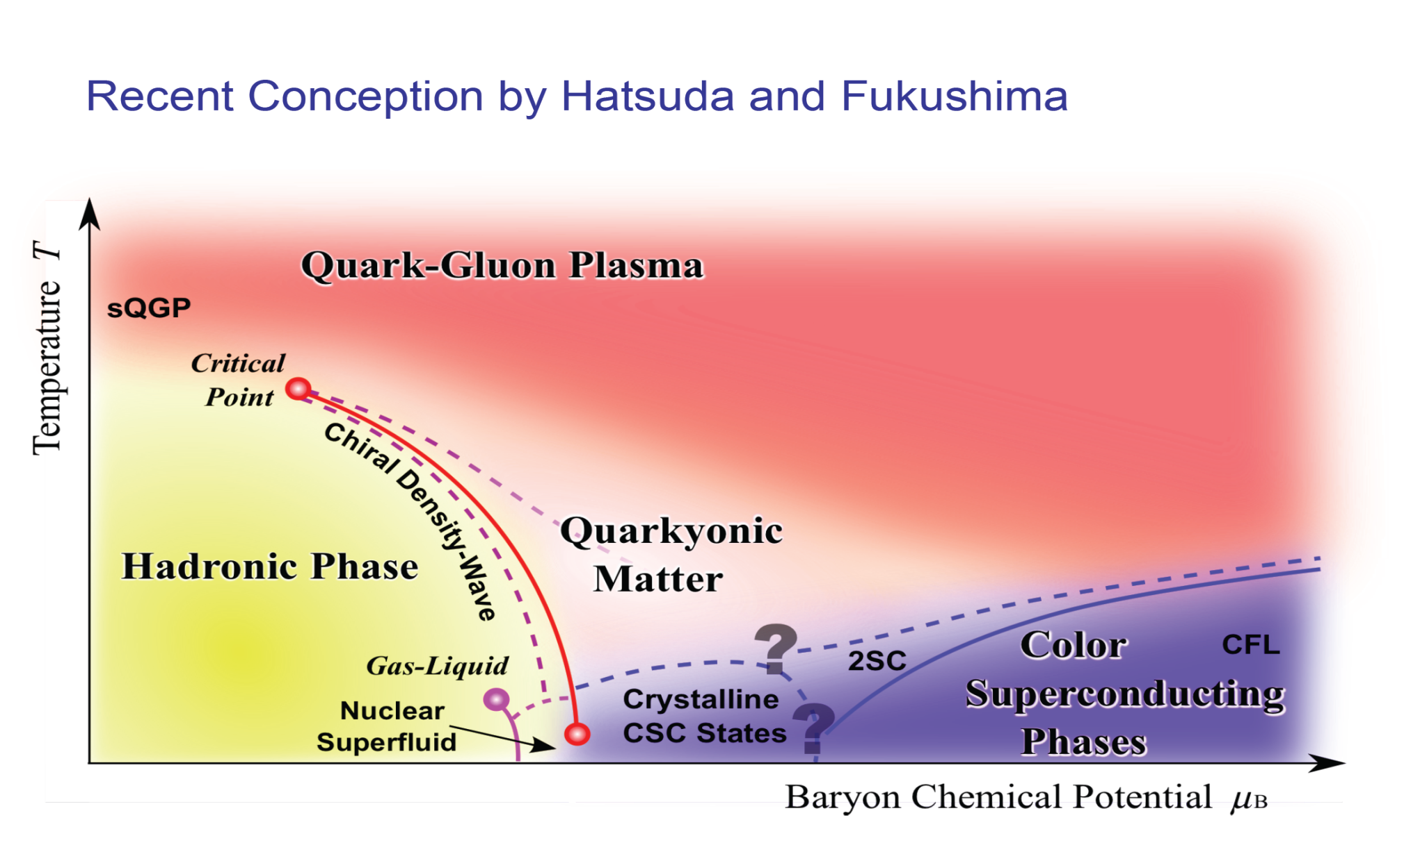
The QCD phase diagram
Open questions:
Origin of mass?
Nature of confinement?
Role of condensates?
EOS of dense/hot matter
Courtesy of K. Fukushima & T. Hatsuda

Slide 4
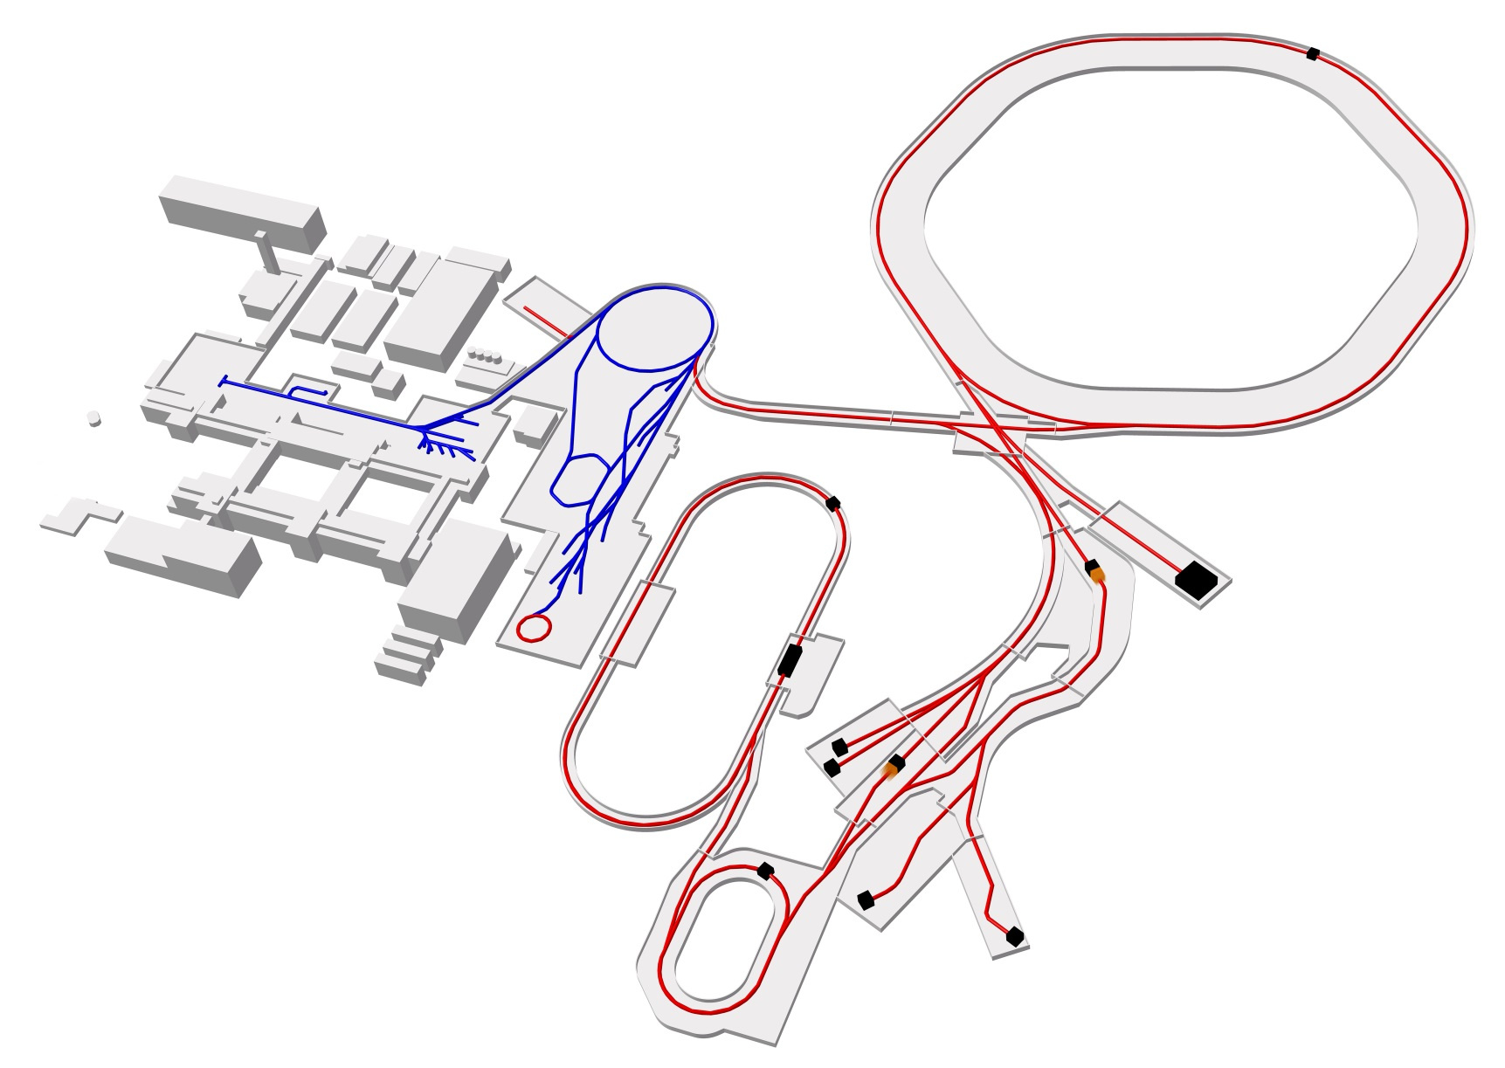
The FAIR Facility
Ring
accelerator
SIS18
Ring accelerator SIS100
Linear
accelerator
Production of new exotic nuclei
Antiproton
ring
HESR
CBM HADES
Production of antiprotons
100 meters
Existing facility
Planned facility
Experiments
PANDA
Collector
ring CR

Slide 5
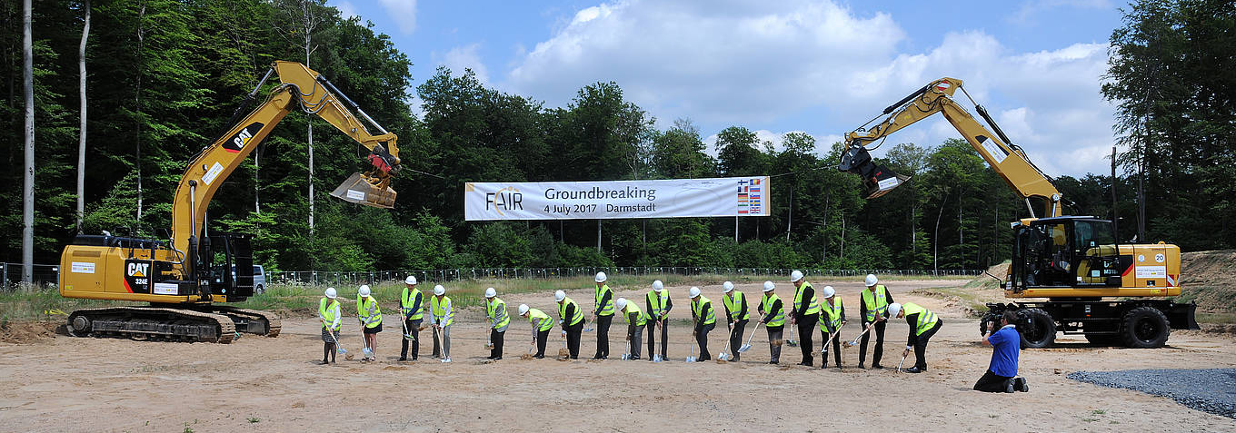
FAIR Groundbreaking Ceremony June 2017
2021 finish concrete pouring – 2023 start installation CBM/HADES –2025 full operation.

Slide 6
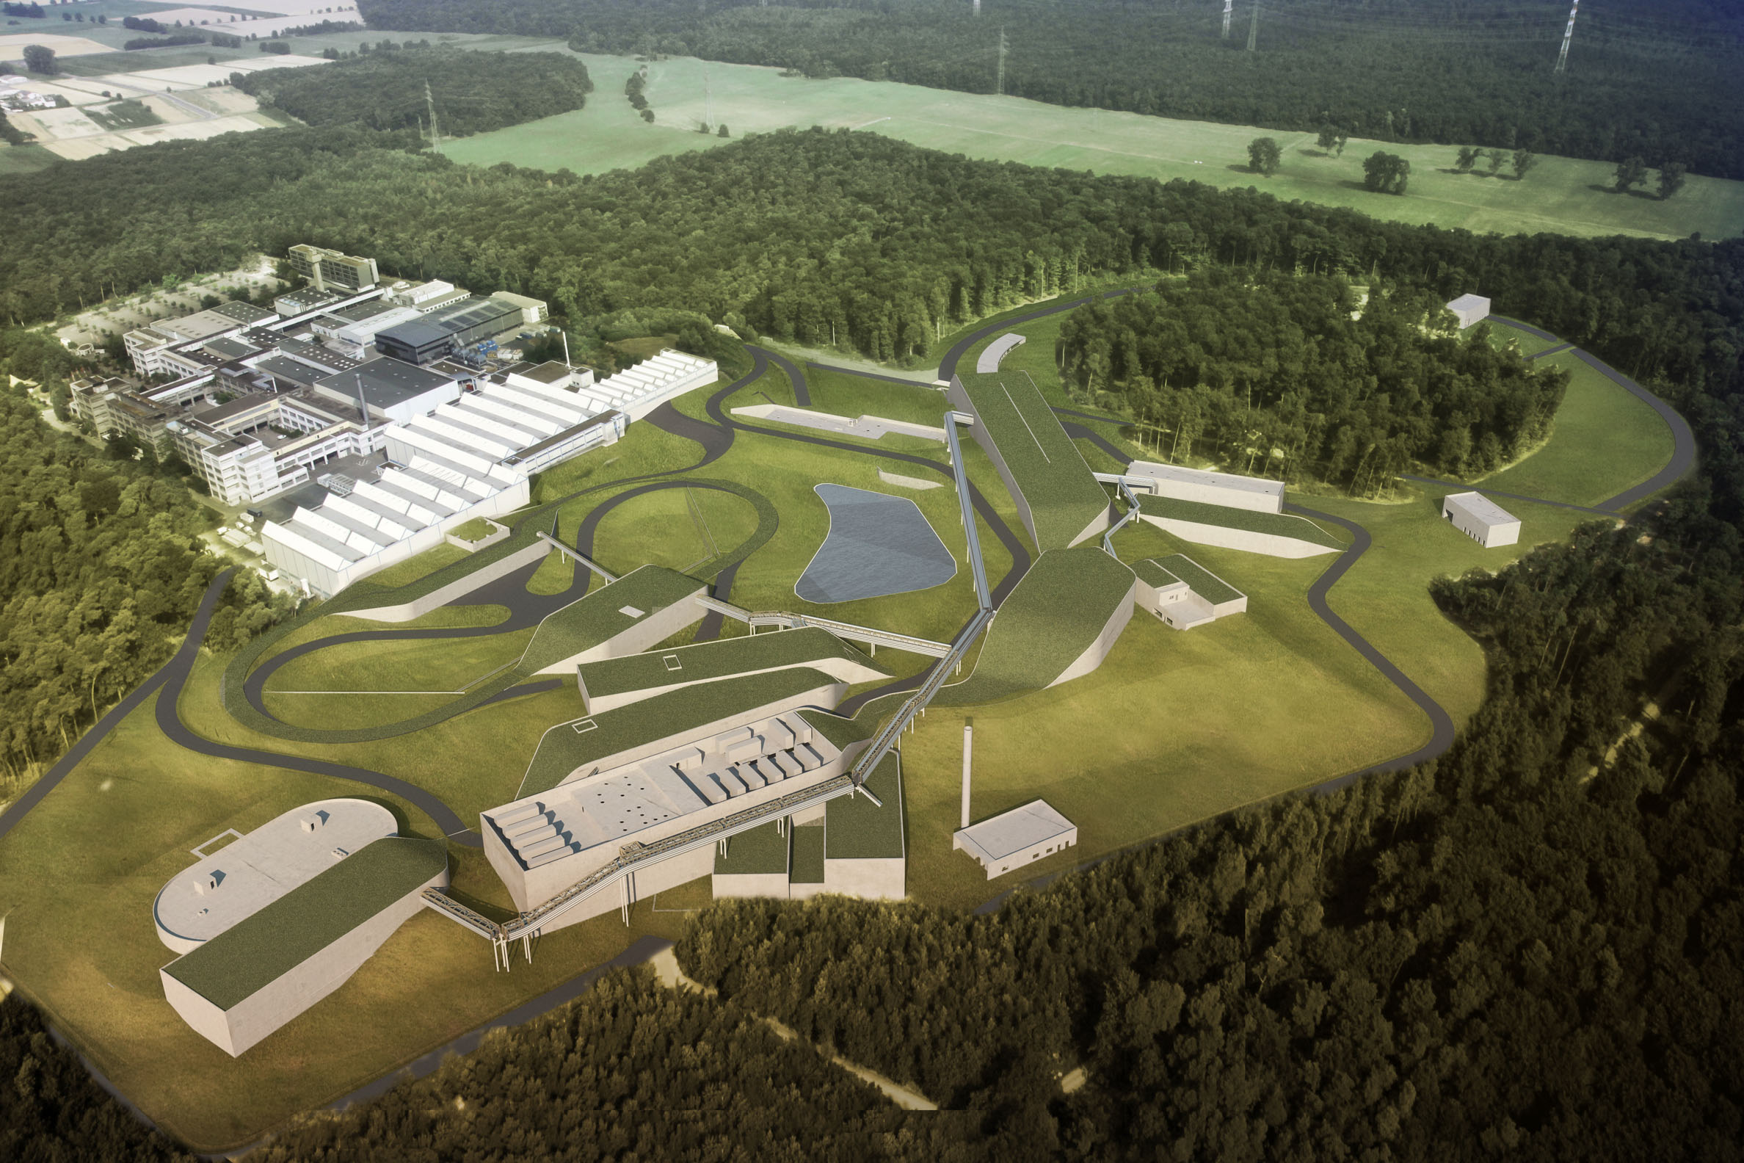

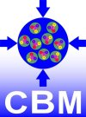

QCD physics at FAIR
Hadron- and Quark Matter Physics (CBM/HADES)
Hadron Spectroscopy and Structure (PANDA)
Properties and Reactions of Rare Isotope (NUSTAR)
Past and present heavy-ion programs
$$\sqrt{s_{NN} } \\ \left[\text{GeV}\right]$$
CERN
ALICE, ATLAS,
CMD,
LHCb
2000
BNL
GSI
LBL
STAR PHENIX
STAR-BES
200
NA48, NA49, WA98, NA50-60, CERES
E***
(AGS)
NA61
FOPI, KAOS
HADES
20
Plastic Ball, Streamer Chamber
2
1980
2000
2020
year
progress in technology

Slide 7
Motivation

Slide 8
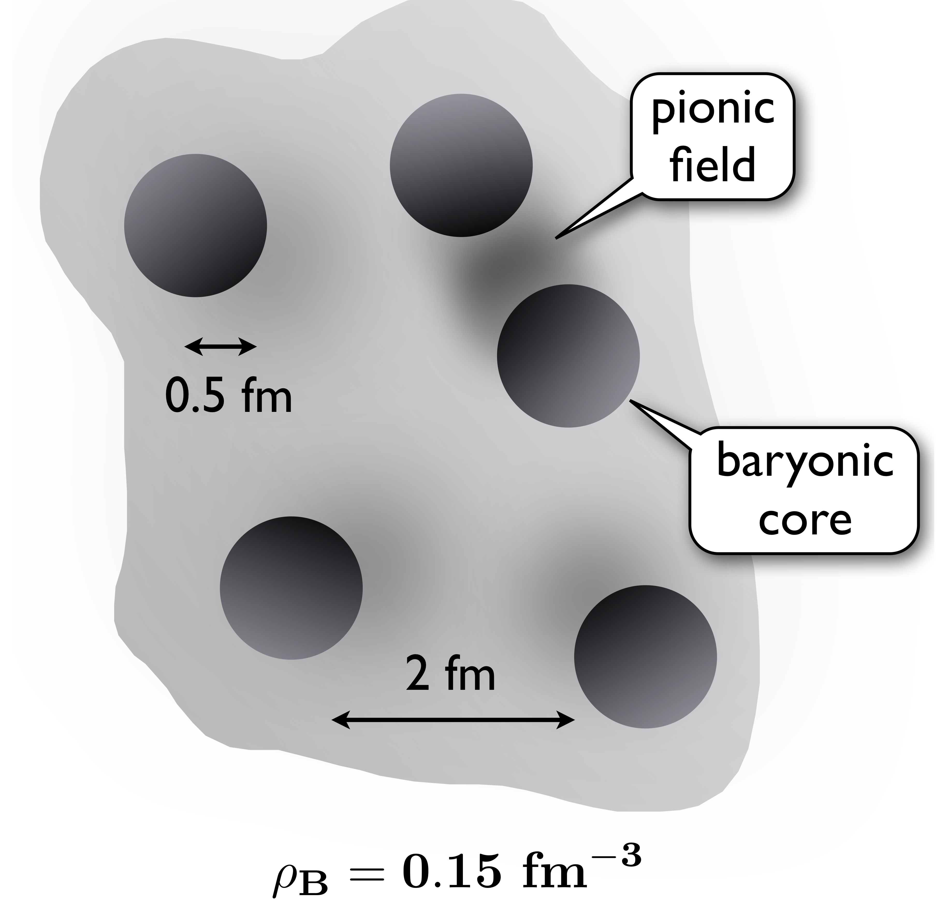
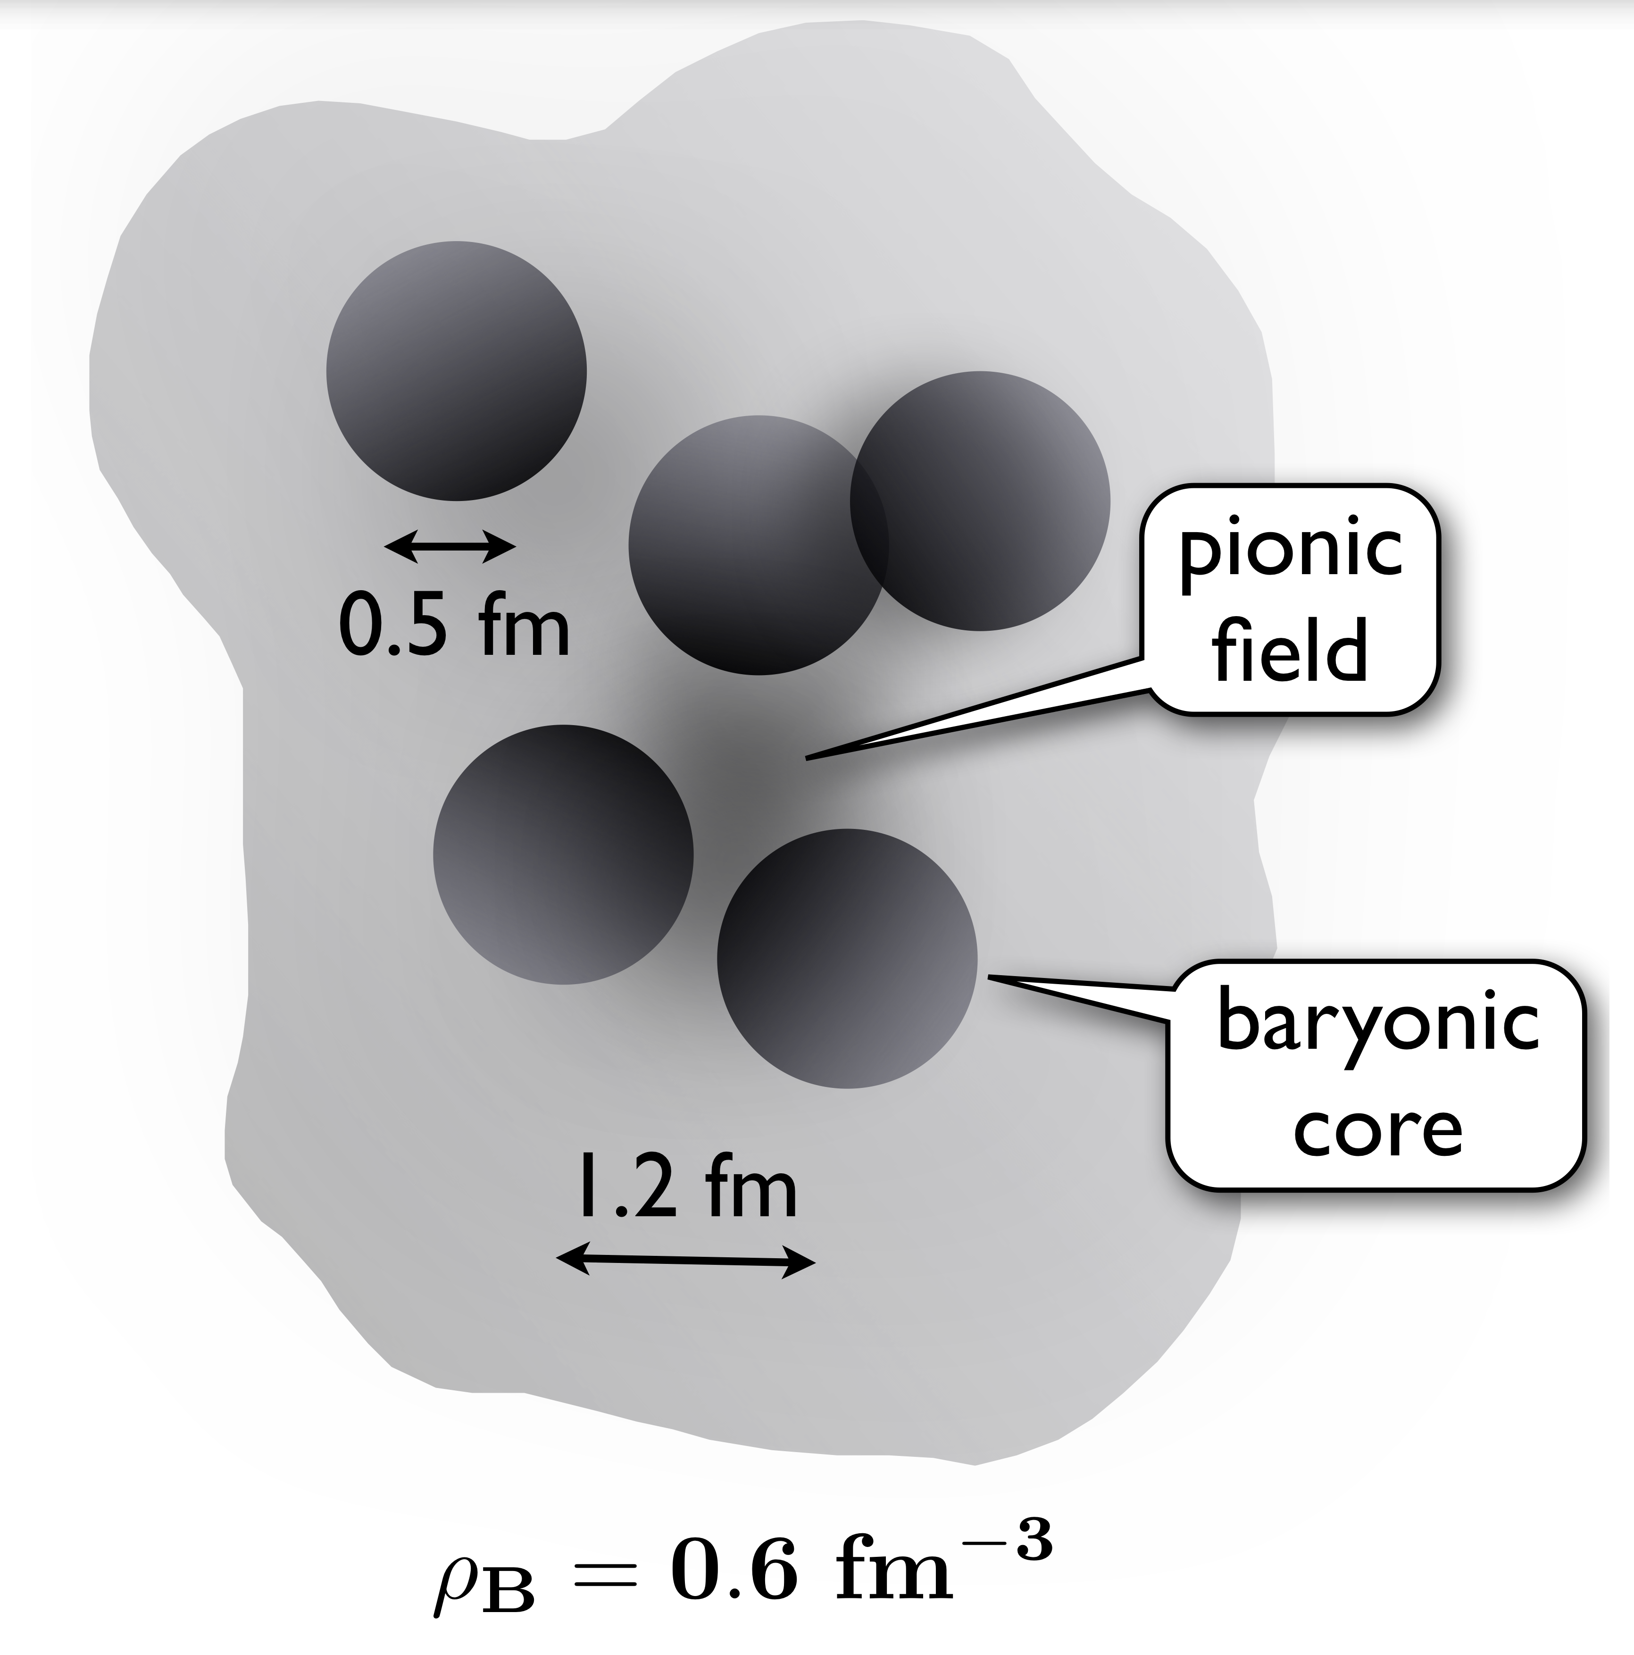
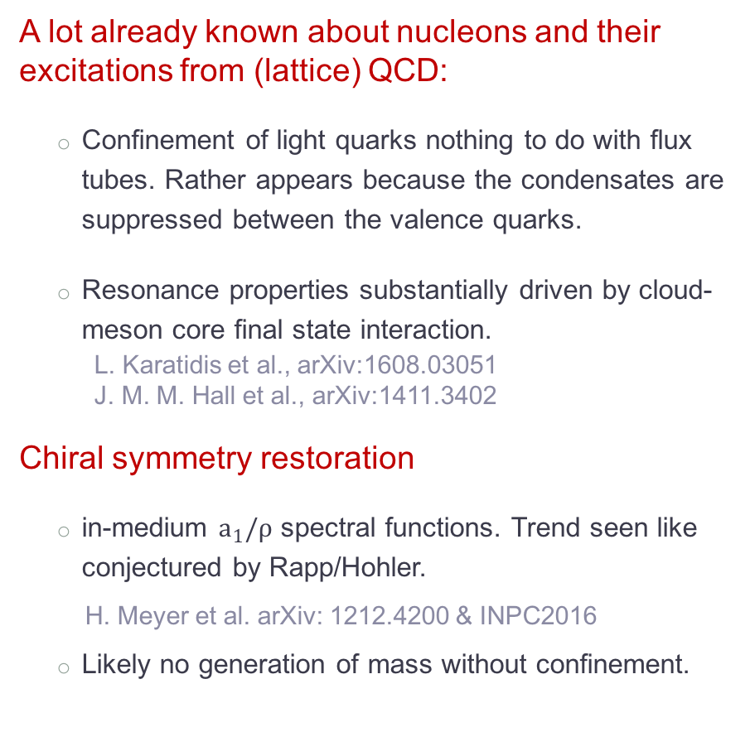
CBM - “nomen est omen” - Cloudy Bag Model ;)
A lot already known about nucleons and their excitations from (lattice) QCD:
  Confinement of light quarks nothing to do with flux tubes. Rather appears because the condensates are suppressed between the valence quarks.
  Resonance properties substantially driven by cloud-meson core final state interaction.
    L. Karatidis et al., arXiv:1608.03051
    J. M. M. Hall et al., arXiv:1411.3402
Chiral symmetry restoration
  in-medium $a_{1}/ρ$ spectral functions. Trend seen like conjectured by Rapp/Hohler.
  H. Meyer et al. arXiv: 1212.4200 & INPC2016
  Likely no generation of mass without confinement.
What does it take, to force the quarks forming a giant bubble?
Chiral Perturbation Theory:
  Provides prediction for chiral order parameter a.f.o. baryon
  Sees strong repulsion (at low to moderate temperatures.
    J.W. Holt, M. Rho, W. Weise arXiv1411.6681

Slide 9
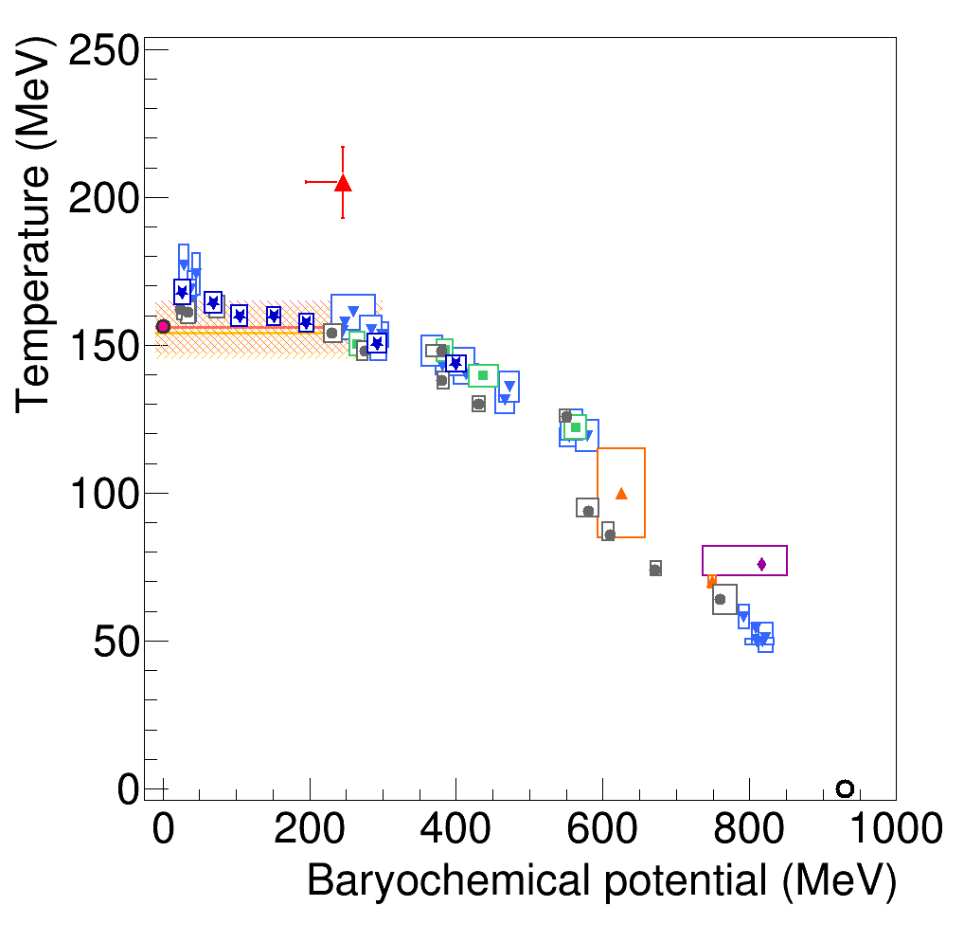
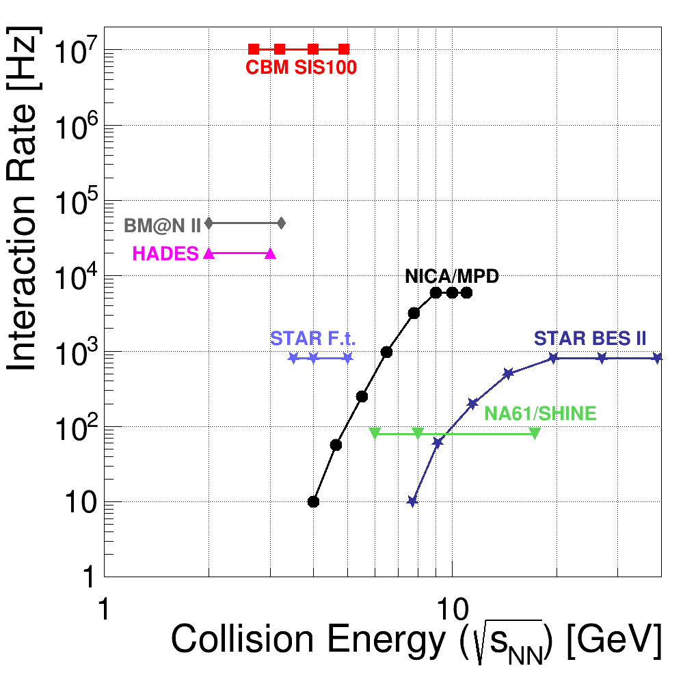

Exploration of the High-$μ_{B}$ Region
Reach:
Temperature and chemical potential extracted from
particle multiplicities and assuming thermalization
Speed:
Mean event rates before event selection.
Note the luminosity drop for colliders at low beam energy.
Quark-gluon plasma
STAR BES
LHC
SPS
STAR FXT
SIS100
AGS
Hadrons
SIS18
Nuclei

Slide 10

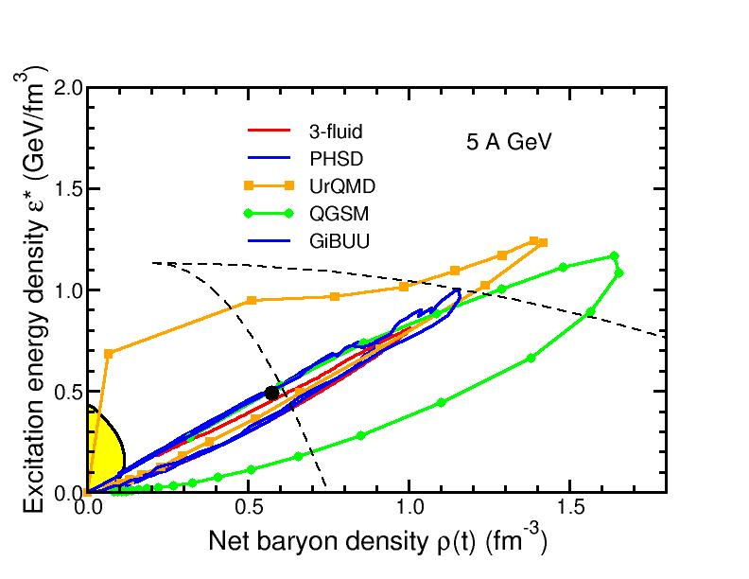

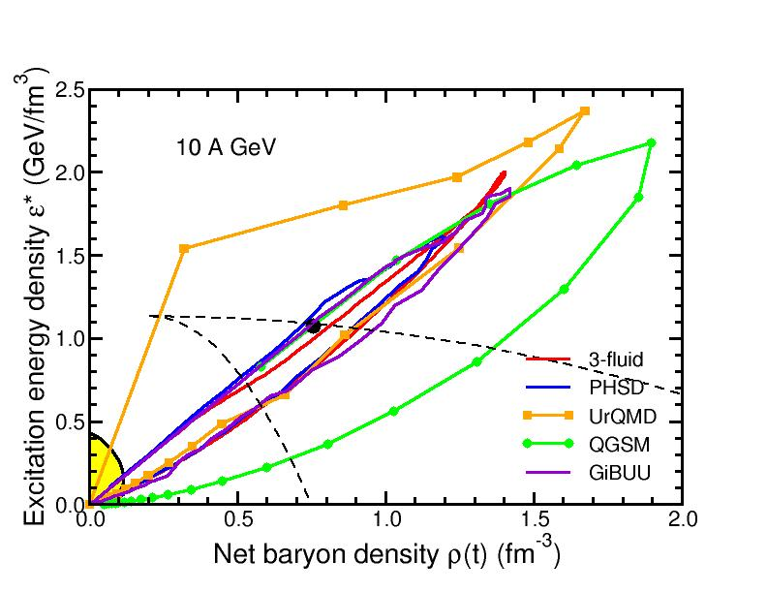
Heavy-ion collisions at SIS100 energies
Nearly complete stopping leads to baryon-rich matter in the overlap zone.
Generally shorter lifetime and larger densities as beam energy goes from 1 to 10 A GeV.
5 A GeV
10 A GeV
I.C. Arsene et al., Phys. Rev. C 75, 24902 (2007)

Slide 11
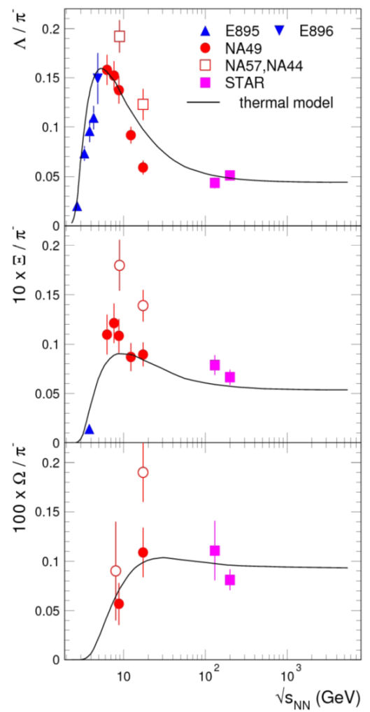
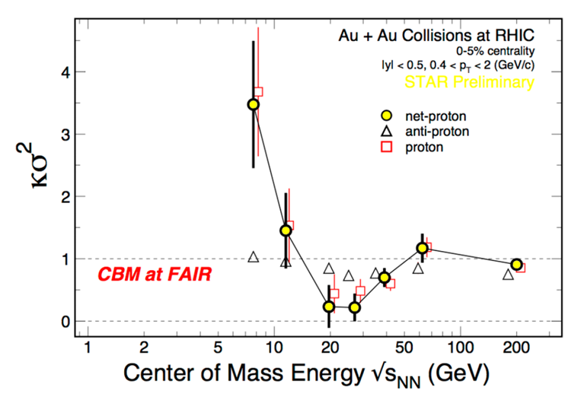
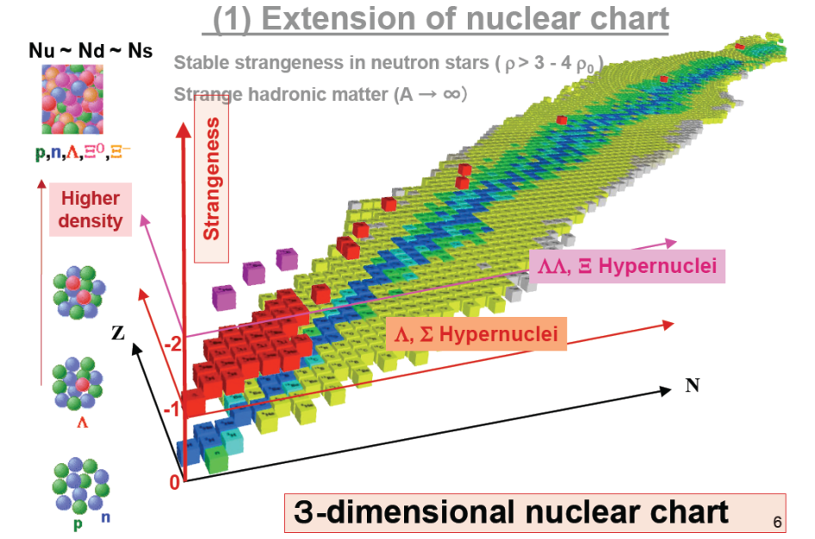
Physics addressed by CBM
The QCD Equation-of-State
  Collective behavior (flow)
  Multi-strange baryons
Search for novel phases and 1st order phase transition
  e-b-e observables (higher-moments)
  Excitation function of hadron multiplicities and virtual photons
Path to restoration of chiral symmetry
  High-precision invariant mass distributions low- and intermediate mass range
Strange matter
    (Double-) lambda hypernuclei
    Meta-stable objects (e.g. strange dibaryons)
Charm production (and propagation) at threshold
  Open-charm in pp, pA
  Backward production in pA (R_{pA})

Slide 12
The Detector system

Slide 13
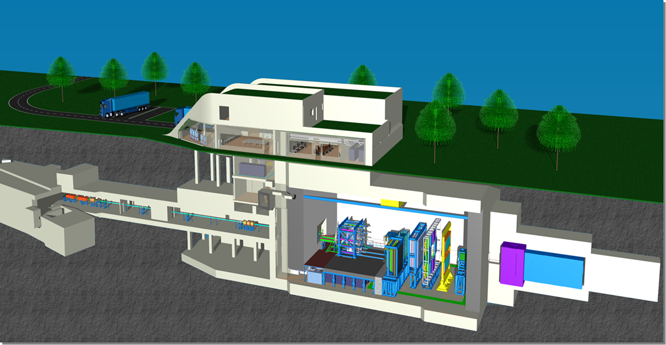
The CBM cave

Slide 14
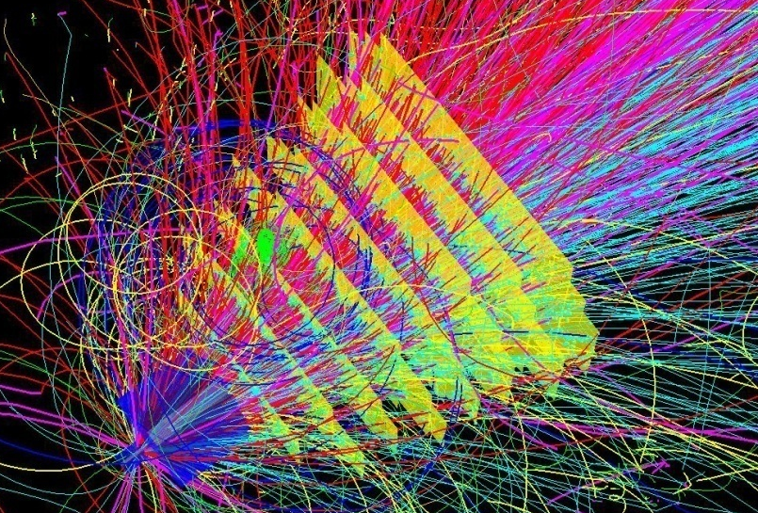
The CBM strategy
10⁵ - 10⁷ Au+Au reactions/sec
determination of displaced
vertices (σ ≈ 50 μm)
identification of leptons
and hadrons
fast and radiation hard
detectors and FEE
free-streaming
readout electronics
high speed
data acquisition
and
online event selection
4-D event
reconstruction
Notes:
14
14
14

Slide 15
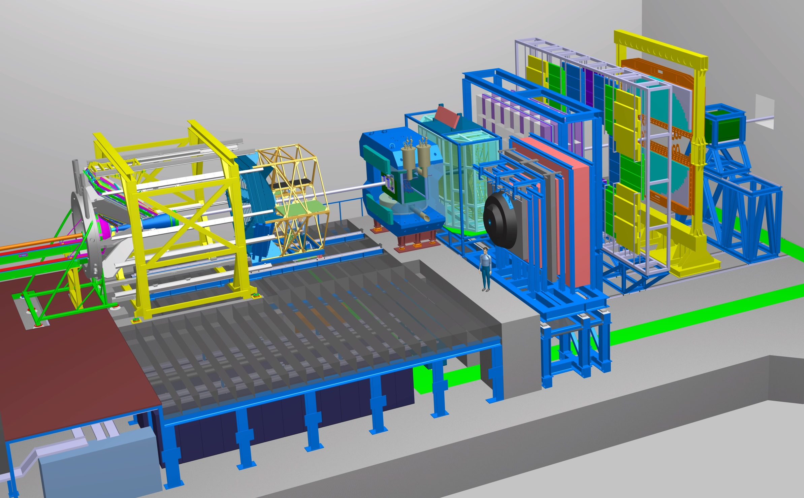
Ring
Imaging
Cherenkov
Transition
Radiation
Detector
Silicon
Tracking
System
Time of Flight
Detector
HADES
p+p, p+A
A+A (low mult.)
Dipol
Magnet
Micro
Vertex
Detector
Experimental requirements
Muon
Detector
Projectile
Spectator
Detector
DAQ/FLES HPC cluster

Slide 16
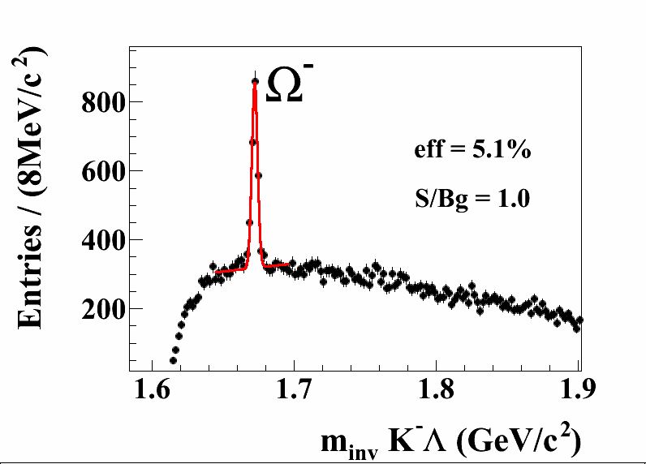
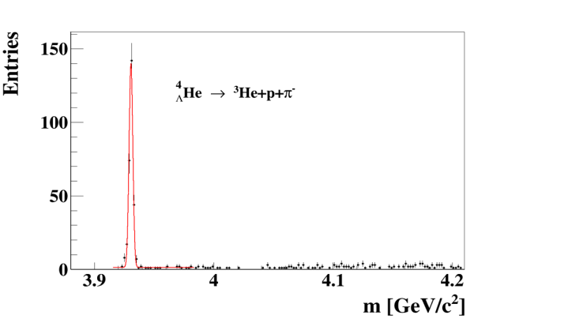

Time of Flight
Detector
Silicon
Tracking
System
Dipol
Magnet
Hadron measurements
DAQ/FLES HPC cluster
Projectile
Spectator
Detector
Hyperons and
hypernuclei
in central
Au+Au collisions at 10A GeV
→ΛK⁻

Slide 17
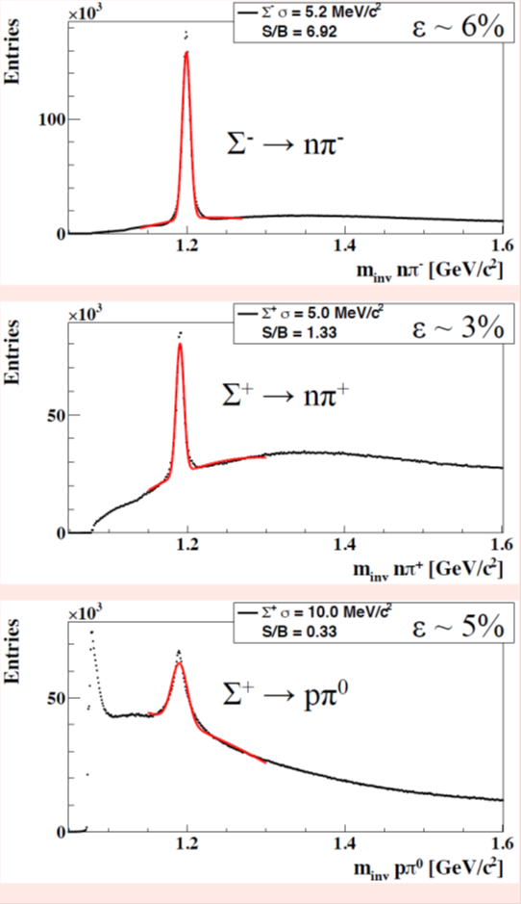
Time of Flight
Detector
Silicon
Tracking
System
Dipol
Magnet
Micro
Vertex
Detector
Hadron measurements
DAQ/FLES HPC cluster
Projectile
Spectator
Detector
Hyperons with neutral daughter in central
Au+Au collisions at 10A GeV

Slide 18
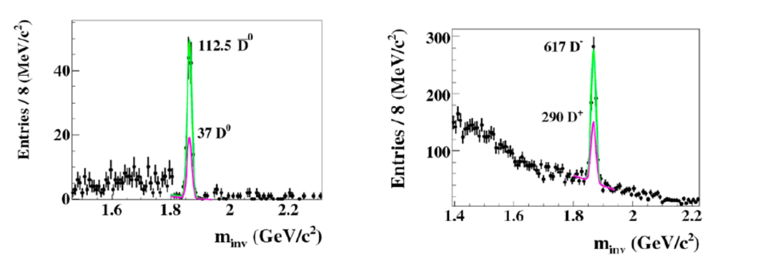
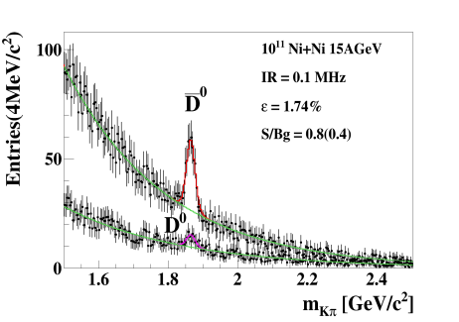
Time of Flight
Detector
Silicon
Tracking
System
Dipol
Magnet
Micro
Vertex
Detector
Open charm measurements
DAQ/FLES HPC cluster
Projectile
Spectator
Detector
Open Charm in p+A
30 GeV and Ni+Ni
15A GeV

Slide 19
Transition
Radiation
Detector
Time of Flight
Detector
Silicon
Tracking
System
Ring
Imaging
Cherenkov
Dipol
Magnet
Micro
Vertex
Detector
Di-electron measurements
Projectile
Spectator
Detector
e⁺e⁻
DAQ/FLES HPC cluster
Dileptons in central
Au+Au collisions at 8A GeV

Slide 20
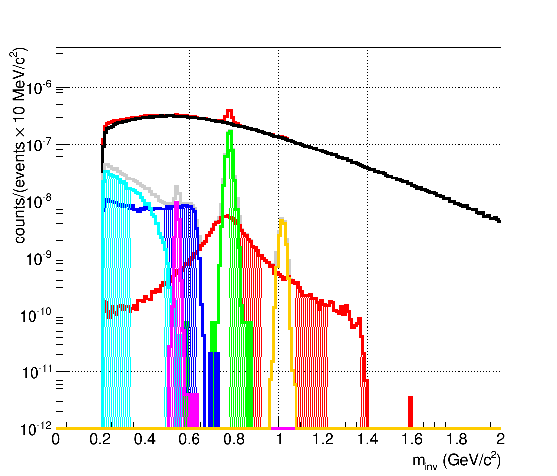
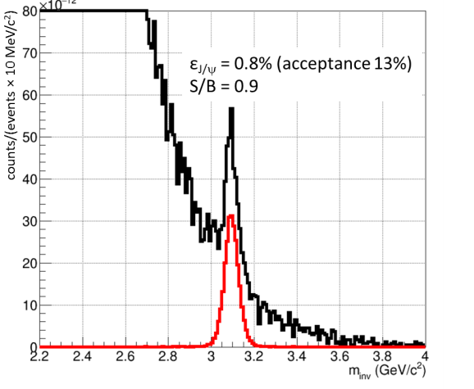
Transition
Radiation
Detector
Time of Flight
Detector
Silicon
Tracking
System
Dipol
Magnet
Di-muon measurements
Muon
Detector
DAQ/FLES HPC cluster
Projectile
Spectator
Detector
Di-muons in central
Au+Au collisions at
8A GeV and
10A GeV (J/ψ)
µ⁺µ⁻
η
ω
φ
J/ψ→µ⁺µ⁻
ρ

Slide 21
R&D

Slide 22
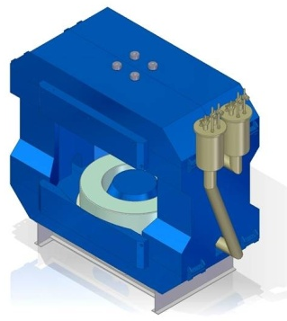
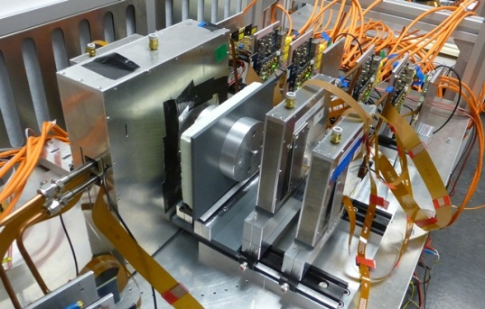
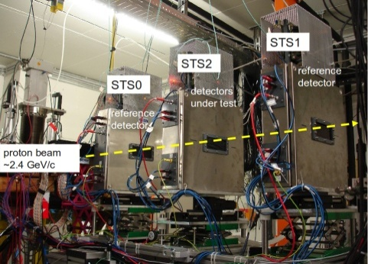
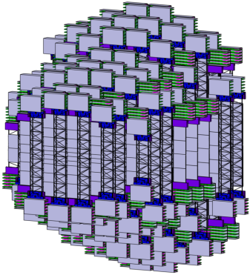
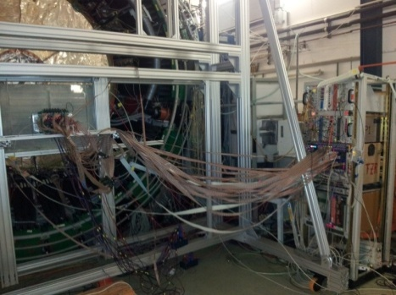
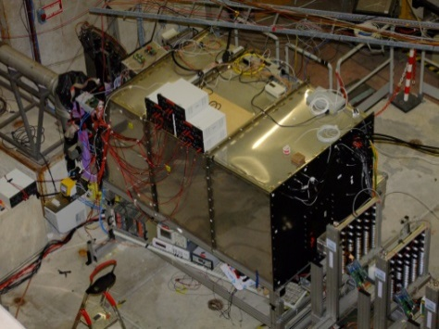
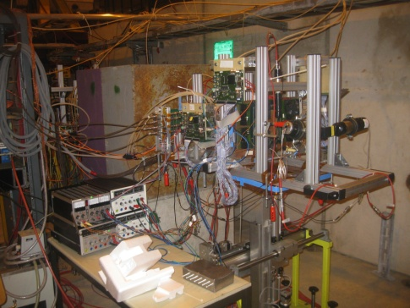
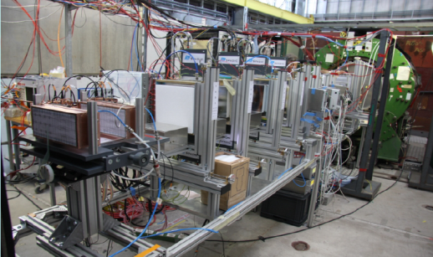
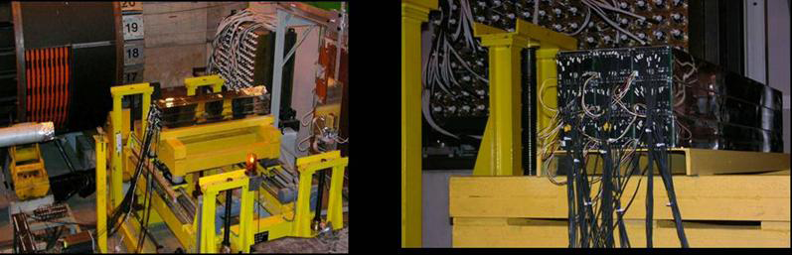
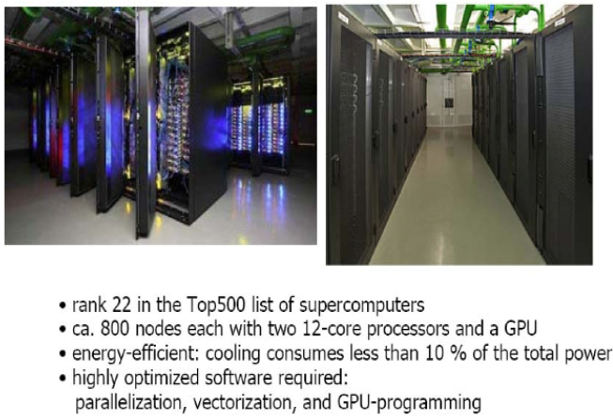
CBM Technical Developments
SC Magnet: JINR Dubna
Micro-Vertex Detector:
Frankfurt, Strasbourg
Silicon Tracking System: Darmstadt, Dubna, Krakow, Kiev, Kharkov, Moscow, St. Petersburg, Tübingen
MRPC ToF Wall: Beijing, Bucharest, Darmstadt, Frankfurt, Hefei, Heidelberg, Moscow, Rossendorf, Wuhan, Zagreb
RICH Detector:
Darmstadt, Giessen,
St. Petersburg, Wuppertal
Muon detector:
Kolkata + 13 Indian Inst., Gatchina, Dubna
Transition Radiation Detector:
Bucharest, Frankfurt, Heidelberg, Münster
Forward calorimeter:
Moscow, Prague, Rez
DAQ and online event selection:
Darmstadt, Frankfurt, Kharagpur, Warsaw

Slide 23
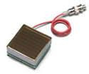
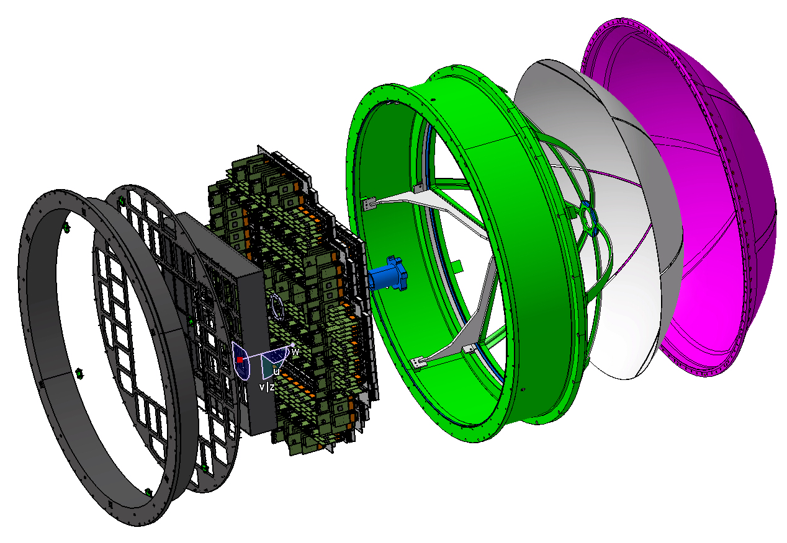
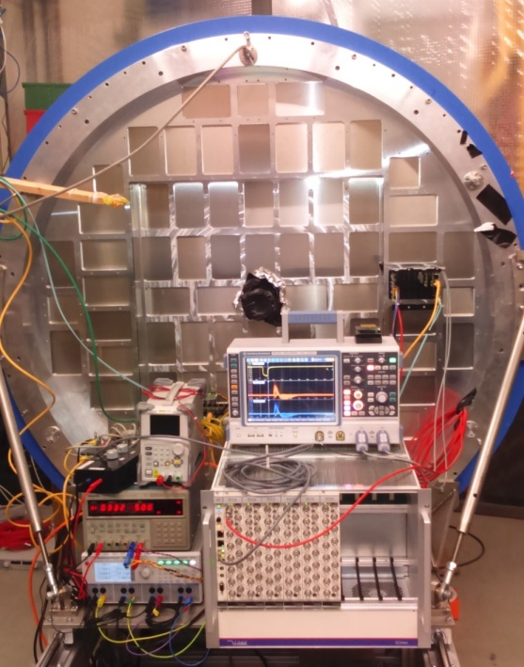
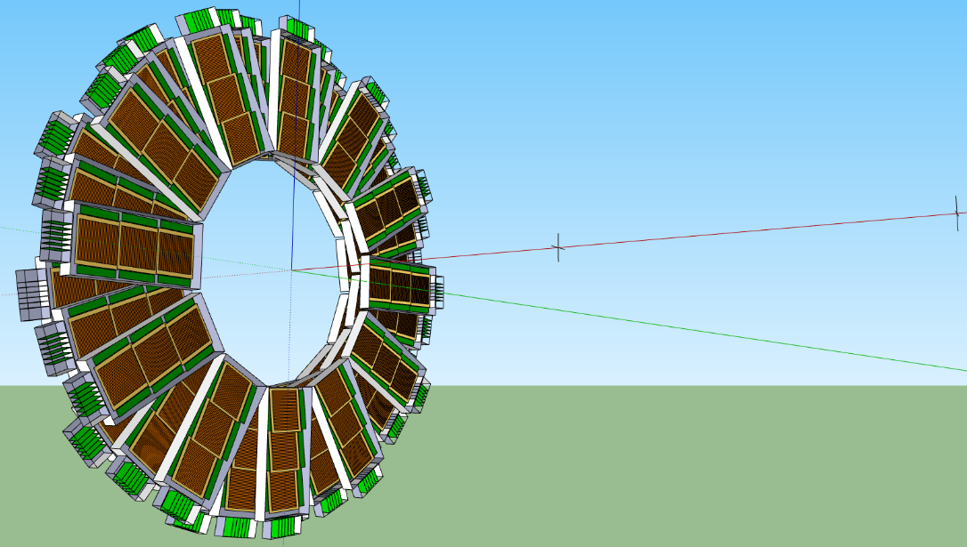
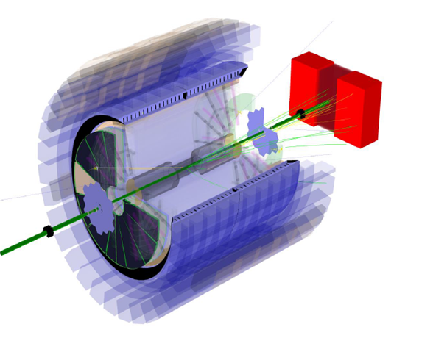
CBM FAIR Phase 0 experiments
430 MAPMTs
Install, commission and use 430 out of 1100
  CBM RICH multi-anode photo-multipliers (MAPMT) in HADES RICH photon detector
Install, commission and use
  10% of the CBM TOF modules including read-out chain at STAR/RHIC (BES II 2019/2020)
Read
out
Exist. RICH
100 cm
collider vertex
(~250 cm)
fixed target pos.
(~500 cm)
CBM MRPC active area
CBM electronics

Slide 24
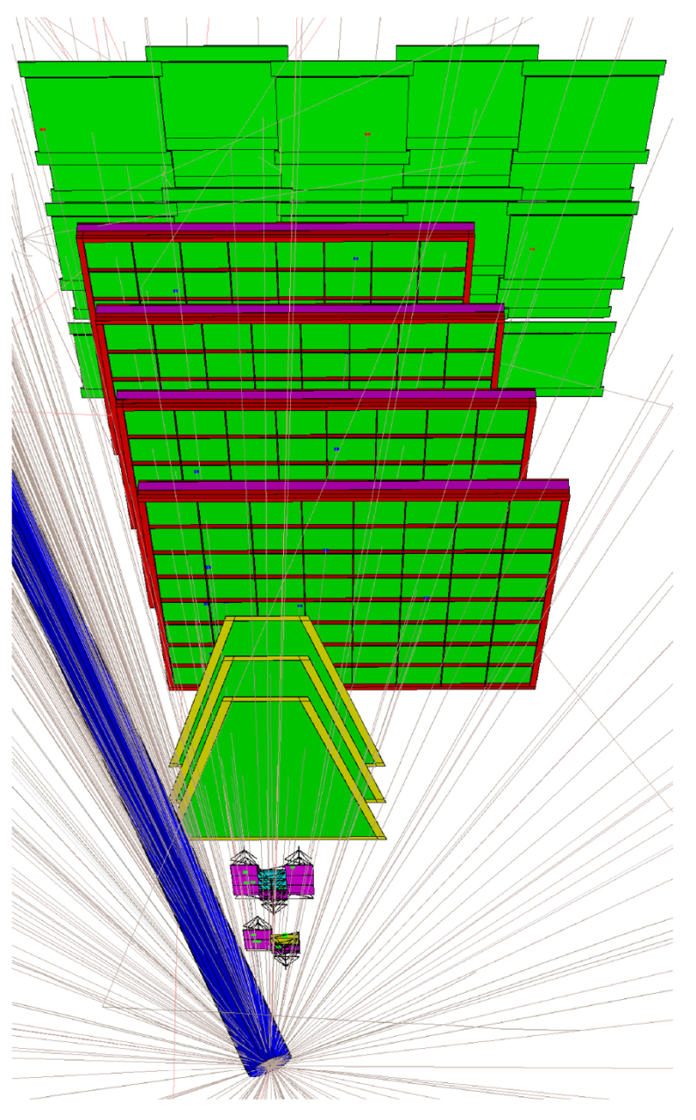
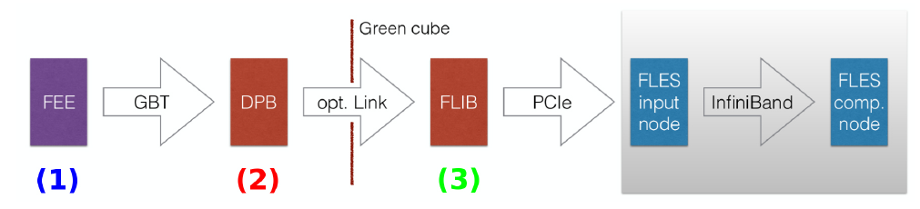
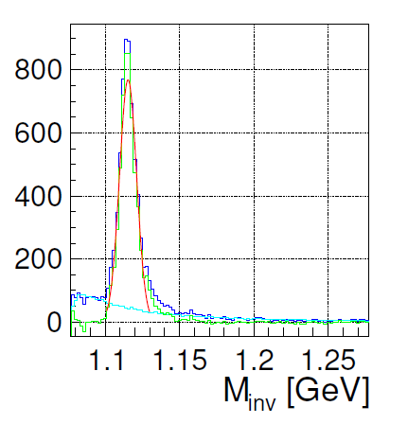
mCBM
Pre-series detector modules will be arranged to track charged particles w/o magnetic field.
Test full read-out chain with free streaming front-ends
Operate starting from 2019 on at SIS18
On-line select Lambda decays by track topology only
Reconstruction performance based on 10⁸ simulated UrQMD collisions of Ni-Ni at
1,93 AGeV
Technical goal: reach respective statistics in less than a minute data taking

Slide 25
performance examples

Slide 26
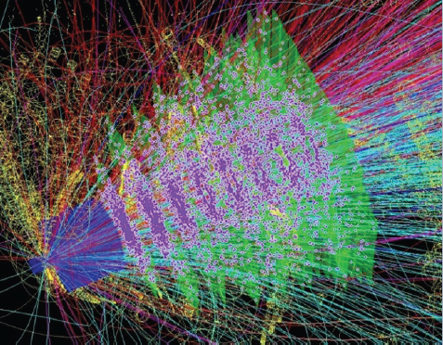
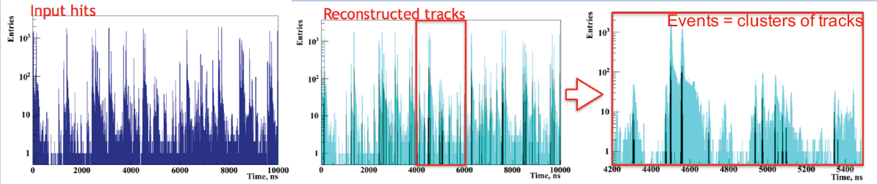
CBM readout and online systems
Novel readout system
no hardware trigger on events, free streaming triggerless data
detector hits with time stamps,
full online 4-D track and event reconstruction
analysis of 10 MHz event rate implemented, only very moderate losses in efficiency

Slide 27
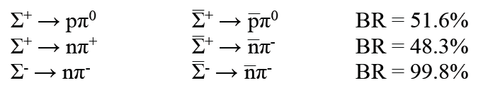
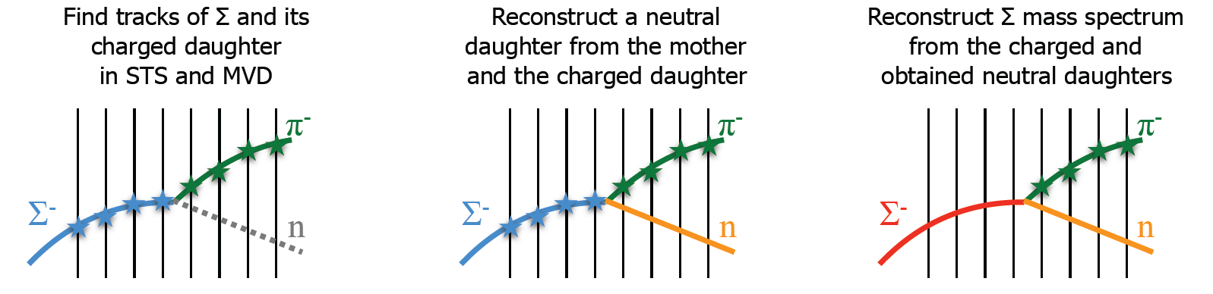
Strange particle production: Σ⁺ & Σ⁻
NEW: Identification of Σ⁺ and Σ⁻ via their decay topology
Method:
  Find all primary and secondary tracks, use TOF PID for secondary track
  Search whether two would fit together with a kink
  From momentum conservation get momentum of neutral particle
  Assume e.g. Σ⁻ decay, calculate (missing) mass of neutral particle
  Select neutron candidates, recalculate Σ mass

Slide 28
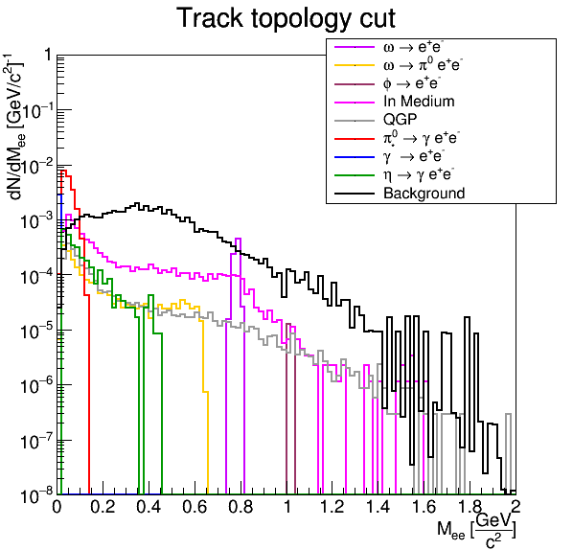
Di-electron measurements with CBM
Au-Au collisions at 8 A GeV, full Monte-Carlo.
Input cocktail Reconstructed in acceptance

Slide 29
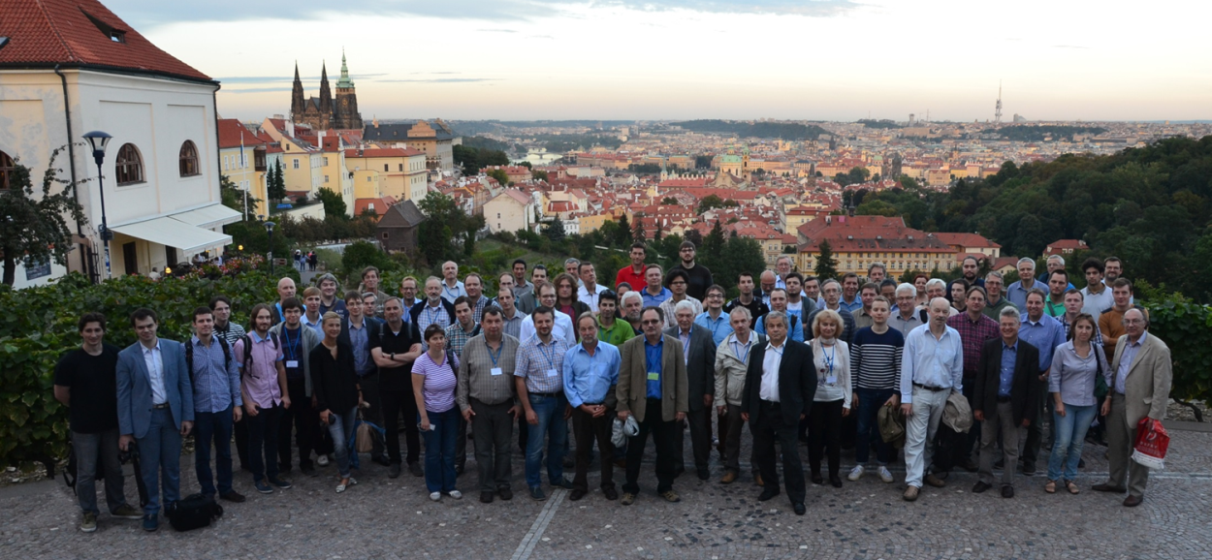
Croatia:
Split Univ.
China:
CCNU Wuhan
Tsinghua Univ.
USTC Hefei
CTGU Yichang
Czech Republic:
CAS, Rez
Techn. Univ.Prague
France:
IPHC Strasbourg
Hungary:
KFKI Budapest
Budapest Univ.
Germany:
Darmstadt TU
FAIR
Frankfurt Univ. IKF
Frankfurt Univ. FIAS Frankfurt Univ. ICS
GSI Darmstadt
Giessen Univ.
Heidelberg Univ. P.I.
Heidelberg Univ. ZITI
HZ Dresden-Rossendorf
KIT Karlsruhe
Münster Univ.
Tübingen Univ.
Wuppertal Univ.
ZIB Berlin
Ukraine:
T. Shevchenko Univ. Kiev
Kiev Inst. Nucl. Research
India:
Aligarh Muslim Univ.
Bose Inst. Kolkata
Panjab Univ.
Rajasthan Univ.
Univ. of Jammu
Univ. of Kashmir
Univ. of Calcutta
B.H. Univ. Varanasi
VECC Kolkata
IOP Bhubaneswar
IIT Kharagpur
IIT Indore
Gauhati Univ.
Korea:
Pusan Nat. Univ.
Poland:
AGH Krakow
Jag. Univ. Krakow
Silesia Univ. Katowice
Warsaw Univ.
Warsaw TU
Romania:
NIPNE Bucharest
Univ. Bucharest
Russia:
IHEP Protvino
INR Troitzk
ITEP Moscow
Kurchatov Inst., Moscow
LHEP, JINR Dubna
LIT, JINR Dubna
MEPHI Moscow
Obninsk Univ.
PNPI Gatchina
SINP MSU, Moscow
St. Petersburg P. Univ.
Ioffe Phys.-Tech. Inst. St. Pb.
26th CBM Collaboration meeting in Prague, CZ
14 -18 Sept. 2015
The Collaboration
60 institutions, 530 members

Slide 30
Summary
CBM scientific program at SIS100:
  Exploration of the QCD phase diagram in the region of neutron star core densities
  → large discovery potential.
First measurements with CBM:
  High-precision multi-differential measurements of hadrons incl. multistrange hyperons, hypernuclei and dileptons for different beam energies and collision systems
  → terra incognita.
Status of experiment preparation:
  Prototype detector performances fulfill CBM requirements.
  7 TDRs approved, 4 TDRs in preparation.
FAIR Phase 0:
  HADES with CBM RICH photon detector, use CBM detectors at STAR/BNL, BM@N/JINR, NA61/SPS.
  mCBM@SIS18 including DAQ and FLES for full system test

