Slide 1
Cryring Operator School
September 13-15, 2017

Slide 2
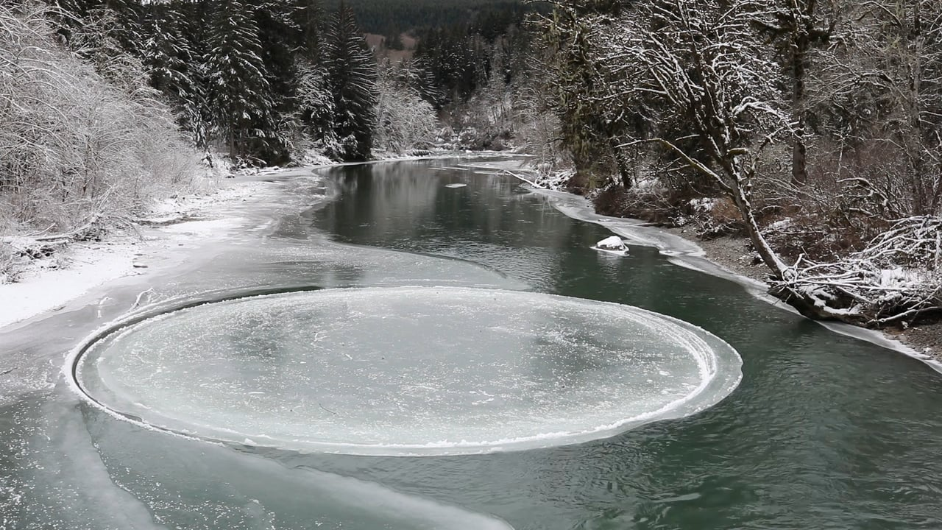
When you google Cry(o) Ring…

Slide 3
When you google Cry(o) Ring…
sichtlich ist das ein Kreis, kein Ring

Slide 4
Cryring operation&trainings 2017
3 week operation
from Stephan‘s presentation 27 April
3 week operation
3 week operation

Slide 5
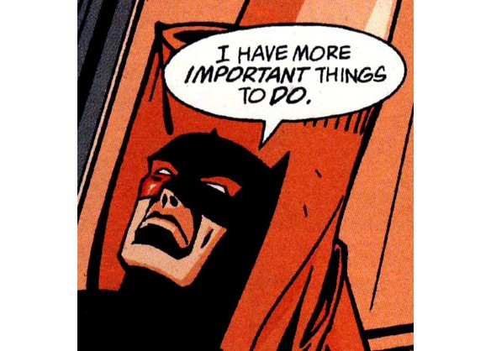
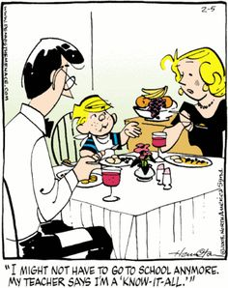
Warum anderes Training???

Slide 6
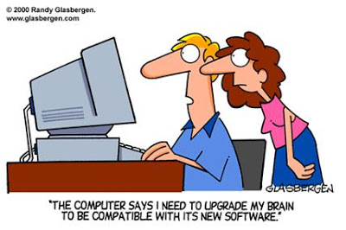
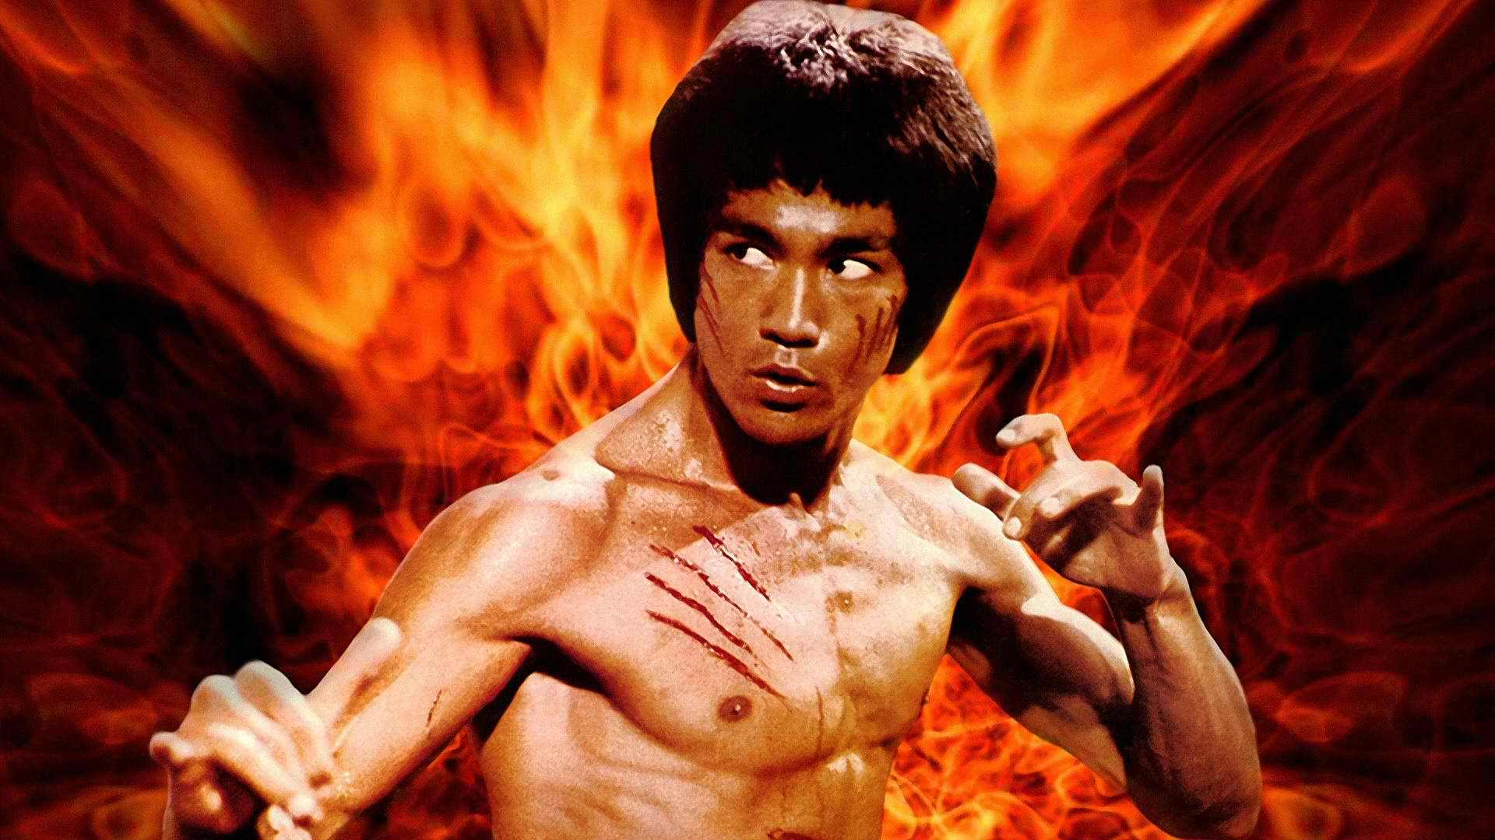
Warum anderes Training???
Completely new control system (focus on that)
New colleagues
repetitio mater studiorum est… specially that we have no other operation for long time
Übung macht den Meister.

Slide 7
Ablauf
next week: training Schichts
slides: http://indico.gsi.de/event/6410/
slides from April training: https://indico.gsi.de/event/5933/

Slide 8
Have a good Operateur Schulung!

