Slide 1
CRYRING@ESR INTRODUCTION AND OVERVIEW. Operators training.
Svetlana Fedotova

Slide 2
Agenda
Origin and location of CRYRING@ESR.
Purposes of CRYRING@ESR facility
Injection into CRYRING@ESR
CRYRING ring assembly
CRYRING@ESR commissioning status and future plans

Slide 3
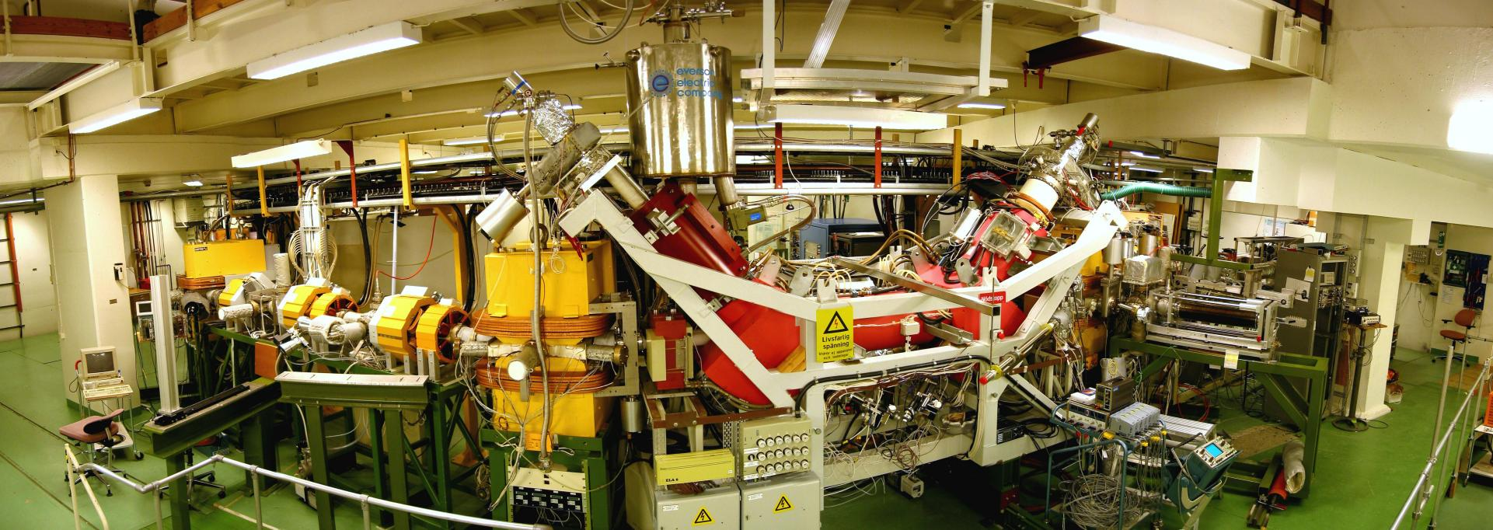
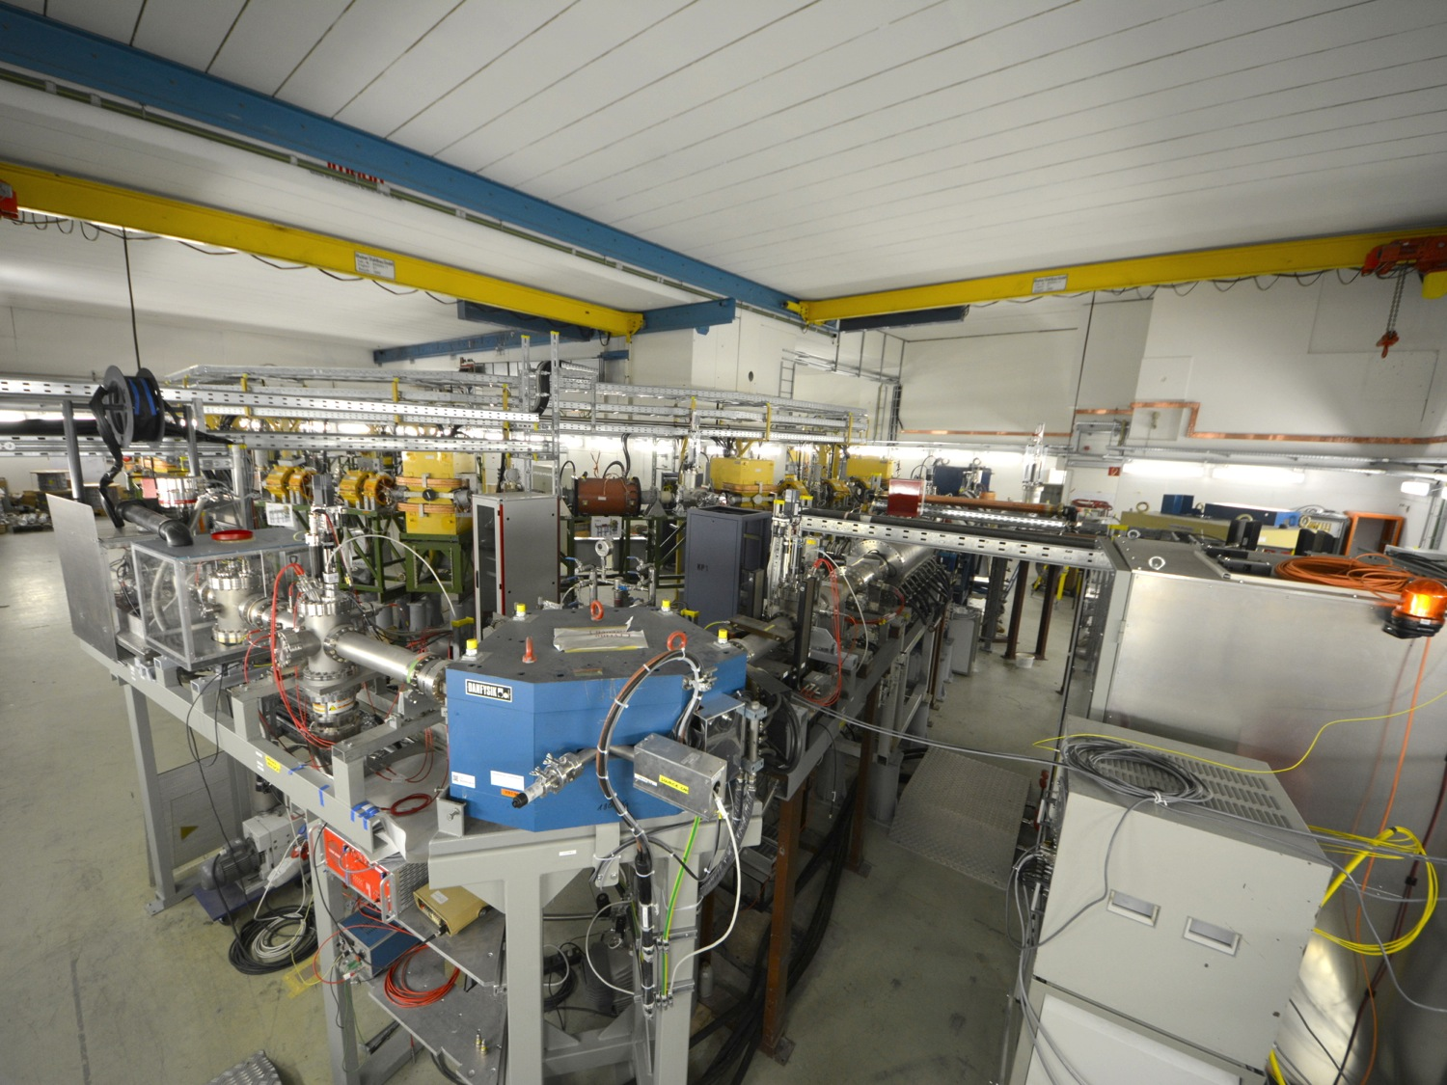
Origin and location of CRYRING@ESR.
Heavy ion storage ring:
Stores, cooles, accelerates and decelerates heavy HCI.
Manne-Siegbahn Laboratory (MSL), Stockholm
1992-2010
GSI, Darmstadt
2013- present

Slide 4
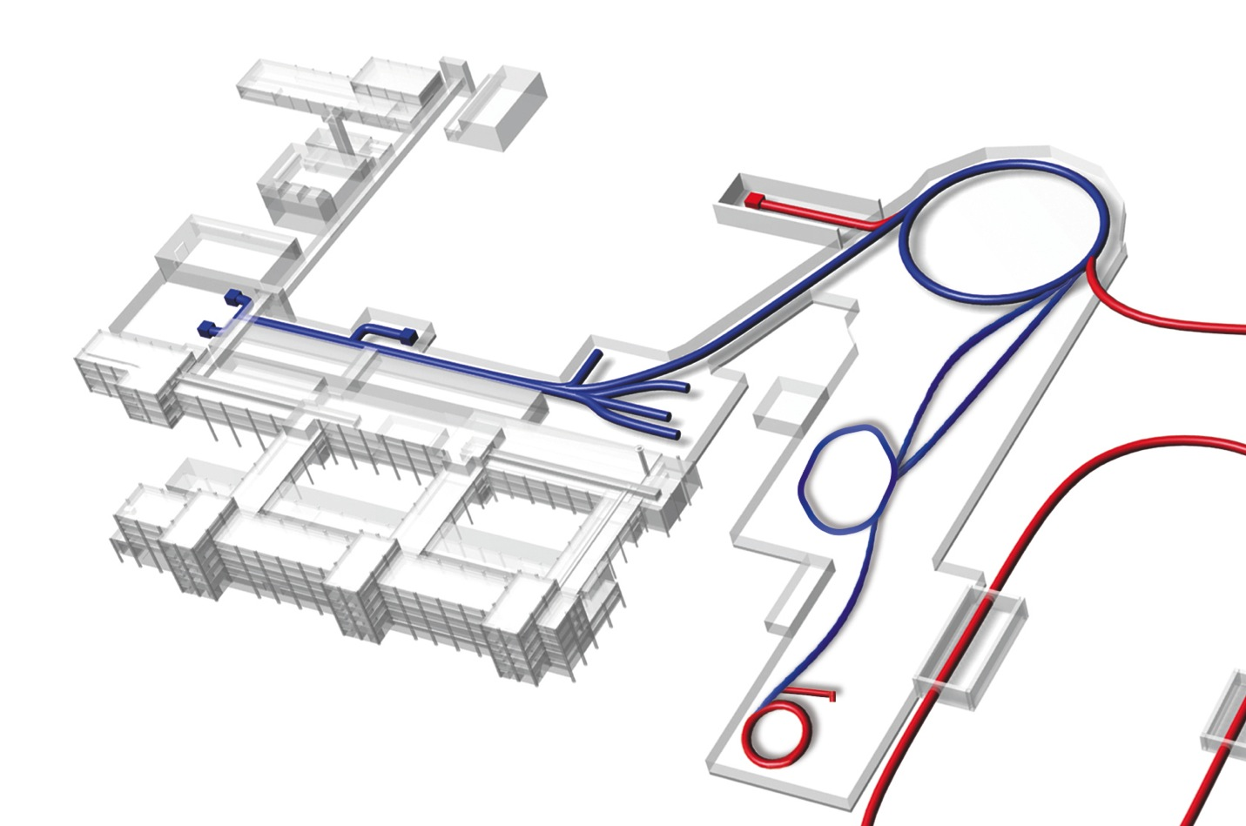
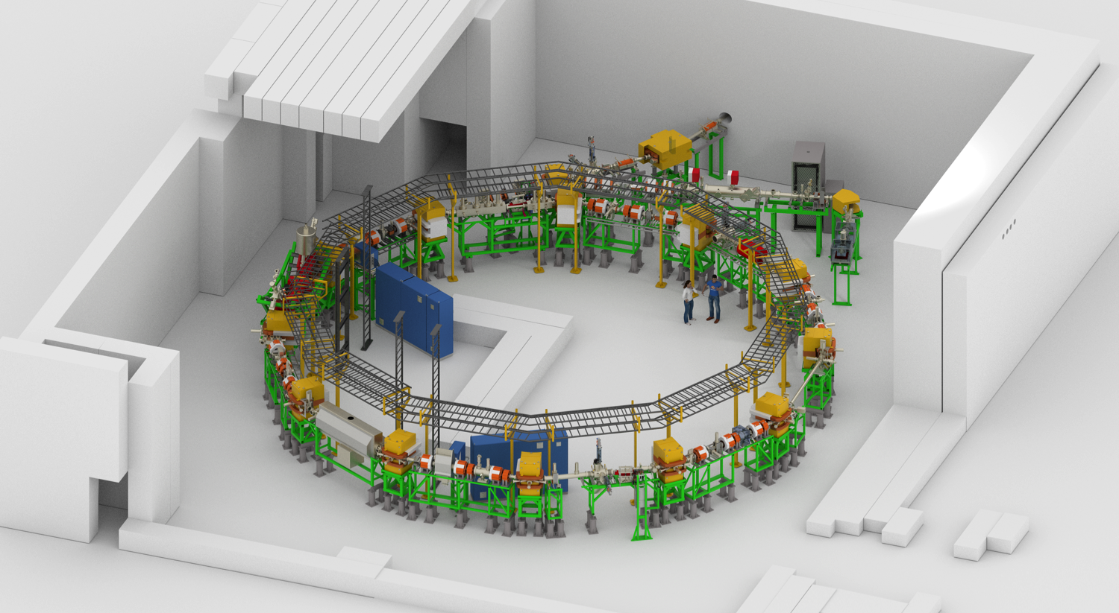
Origin and location of CRYRING@ESR.
Main CRYRING@ESR characteristics
Circumference | 54.17 m (ESR/2)
Vacuum pressure | 10⁻¹¹-10⁻¹² mbar
Ion energy | < 300 keV/u - 14 MeV/u
Rigidity for ions | 0.054 - 1.44 Tm
Magnet ramping | 1 T/s (4 T/s, 7 T/s)
Stand-alone operation | local ion beam (300 keV/u, q/A > 0.25)
Beam injection | multiturn and fast
Beam extraction | slow and fast
SIS
UNILAC
11 MeV/u
FRS
400 MeV/u
ESR
ESR
Local
ion source
4 MeV/u
E-cooler
CRYRING@ESR
17 m
Target
section
RF cavity
Extraction

Slide 5
Purposes of CRYRING@ESR facility
CRYRING@ESR is a prototype for FAIR
Tests of novel detectors and beam diagnostics systems
Tests of FAIR accelerator control system
Tests of FAIR safety and radiation protection access systems
Standalone operation during commissioning
Training of personnel on new control system
Scientific Opportunities
Heavy HCI (up to U⁹²⁺ ) at low energy 100 keV/u -10 MeV/u: covers the energy gap between the ESR (> 4 MeV/u) and HITRAP (<10 keV/u)
Exotic short-lived ions: Fast ramping (~1s)
Atomic, nuclear, biophysics, materials research
Photonic, electronic and atomic collisions, extraction towards downstream experiments
Research may continue even during major shutdowns (at limited ion ranges).

Slide 6
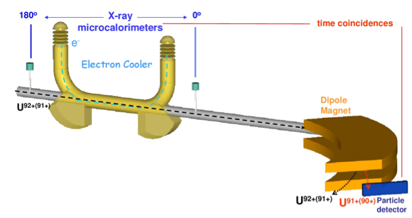
Strong Field QED in Helium-like Ions
Measurement of X-rays emitted during
K-shell radiative recombination employing
X-ray microcalorimeters
Accurate measurements of binding energies of K-electron in
H- and He-like ions (<1 eV) highest sensitivity to high-order QED corrections
6

Slide 7
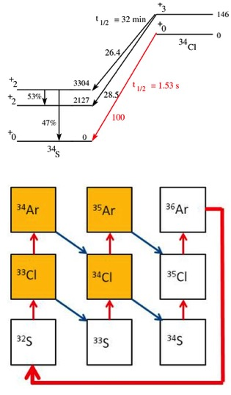
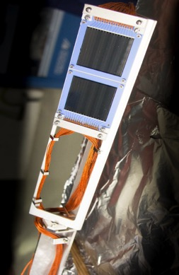
DSSD to be used in CRYRING
Nuclear Reaction Rates
(p,γ) reactions in novae for γ-ray astronomy
M. Lestinsky et al. “Physics Book: CRYRING@ESR”
Proof of principle:
⁹⁶Ru(p,γ)⁹⁷Rh
Mei et al. PRC92 (2015)35803
Critical rate for abundance of γ-rays
Notes:
With dwarfs of One type develop into novae, want to measure 33Cl p, gamma 34 Argon
Referenz zum Test im ESR Rh cross sections

Slide 8
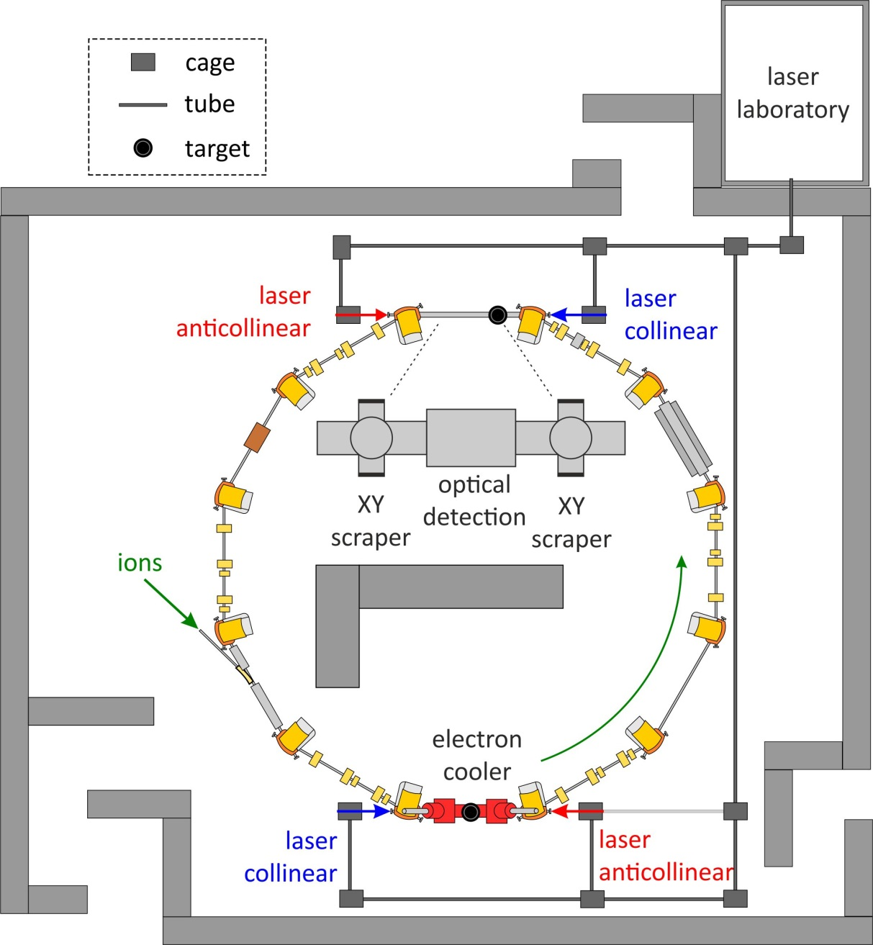
Laser Experiments - CRYRING@ESR
Dielectronic recombination assisted laser spectroscopy
Preparation of polarized ion beams in a storage ring
…
Start with
^{24,25}Mg⁺
⁹Be⁺
…
H and Li like Pr, Pb, and Bi
x-ray cell?
Laser lab infrastructure ready
Design of laser beam line ongoing
Detection chamber in production
Development of ion source ongoing
x-ray cell?

Slide 9
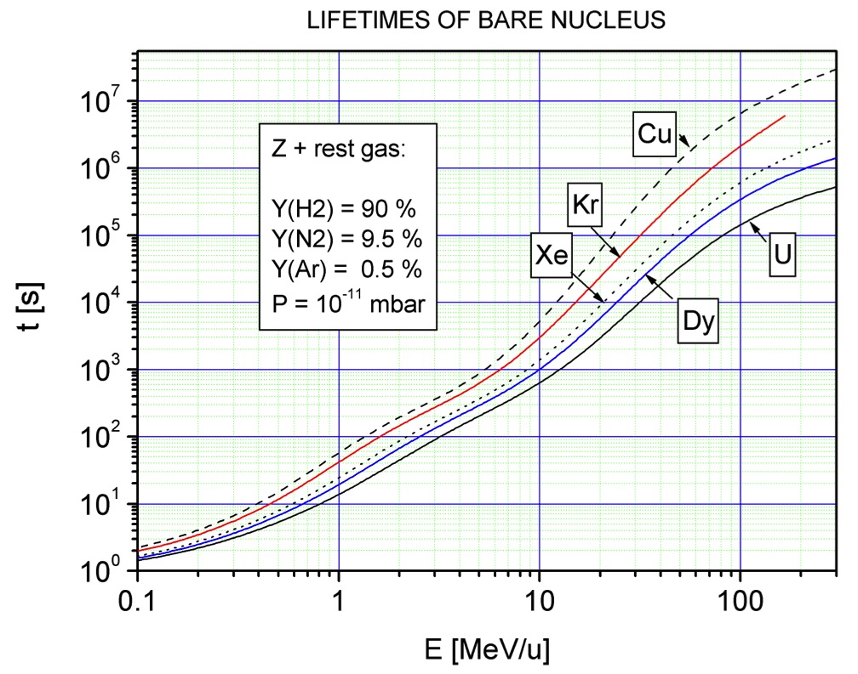
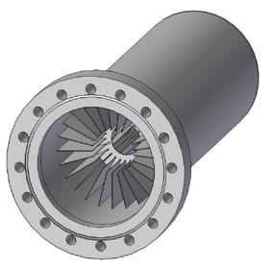
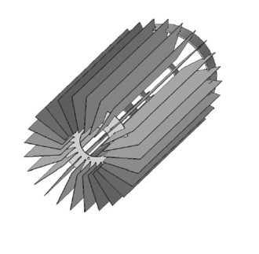
Ultra High Vacuum & Beam Life Time
Ion pumps
~ 10
Cryopumps
NEG pumps
~ 100
15 min
2 min
First bake out cycle finished
Mean pressure along the ring 8 x 10⁻¹¹ mbar
V. Shevelko, priv. comm.
3 s
0.4 s
0.3
15

Slide 10
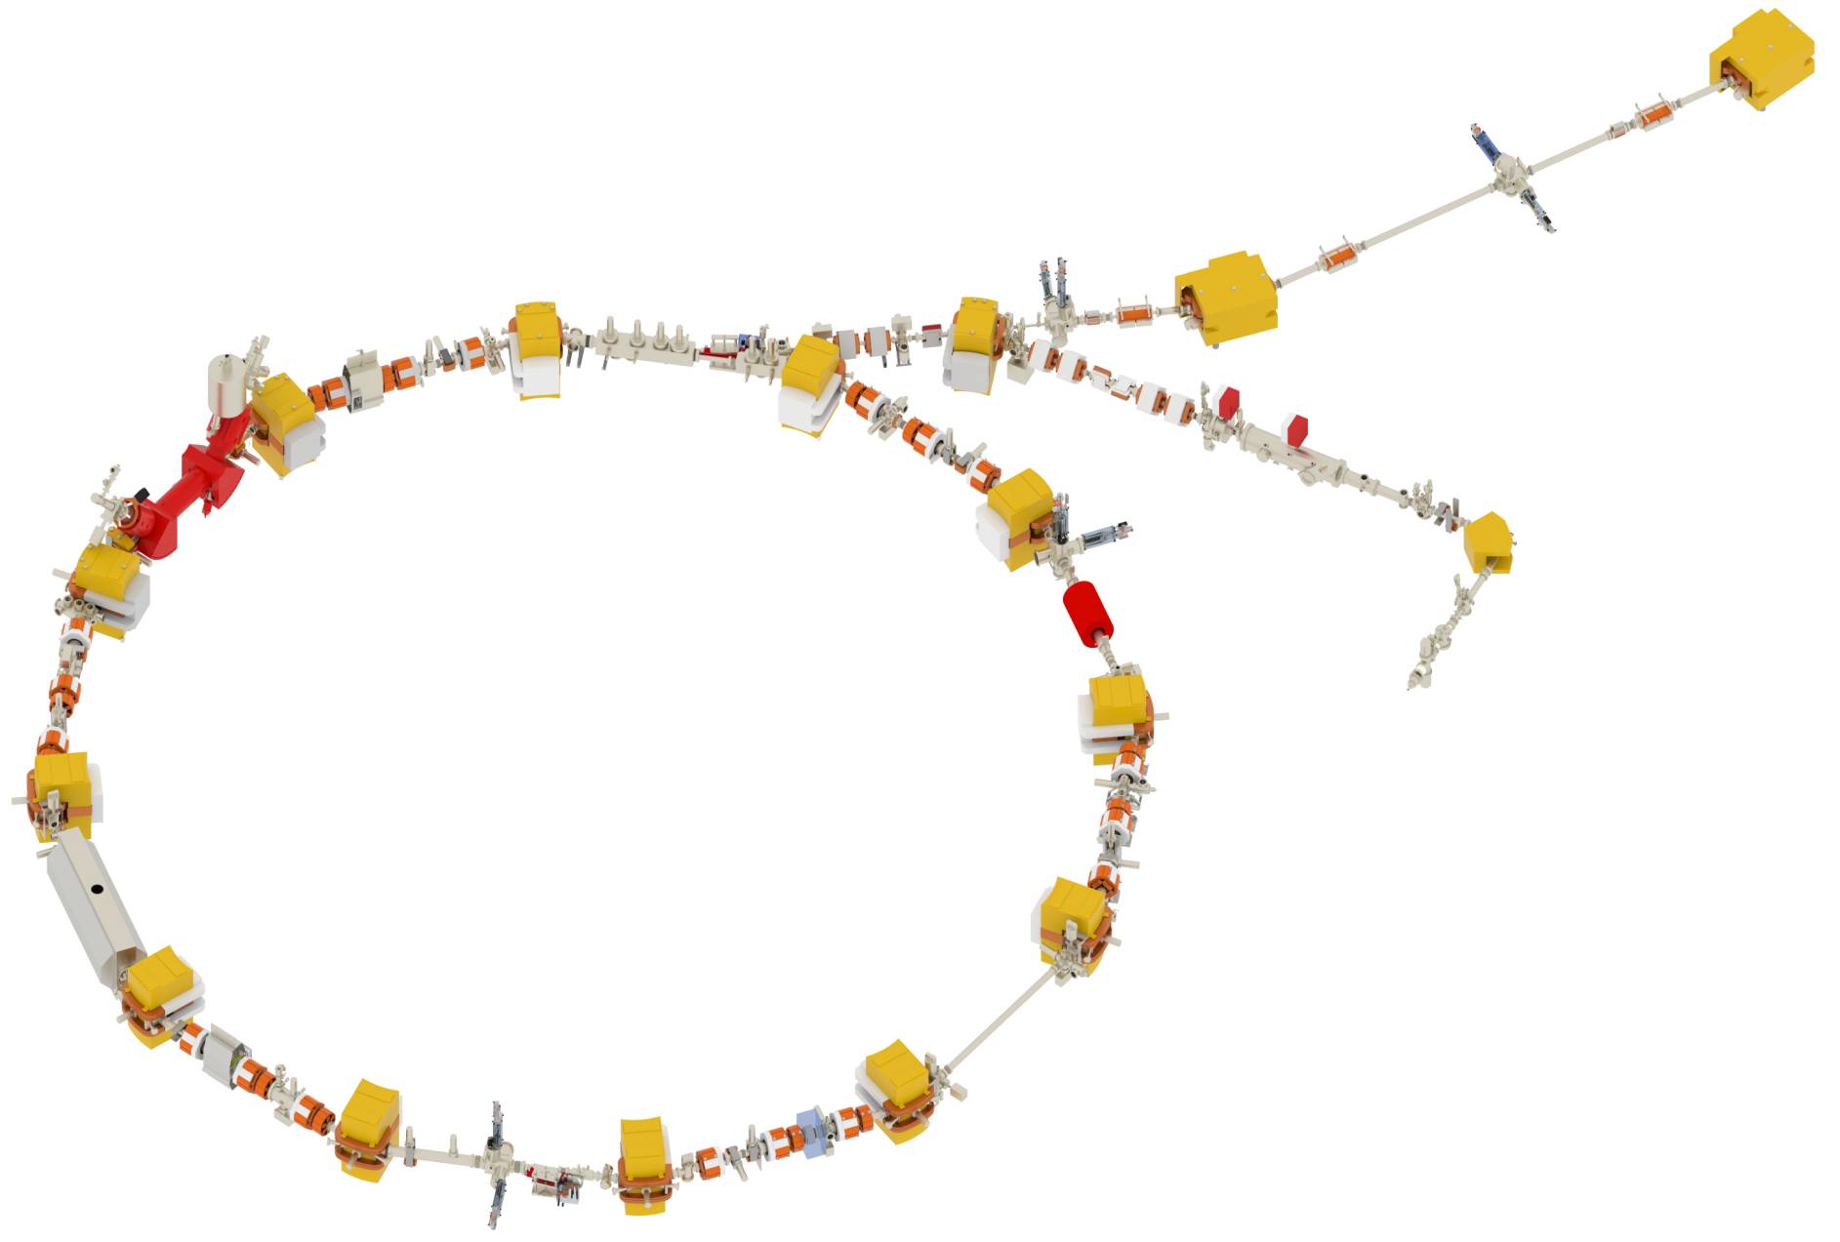
Injection into CRYRING@ESR
Injection
ESR
E-cooler
Ion source
RF-cavity
Extraction

Slide 11
Injection into CRYRING@ESR
Transfer line from ESR towards CRYRING: GTT1VV1T – GHTBMU1
Injection line up to CRYRING ring: GHTBMU1 – YR01MP1I
ESR ion beams: from He (Z=1) to U (Z=92)
Injection energy at CRYRING: from 4 MeV/u to 14 MeV/u
Repetition rate: 1 per 60 s
Pulse length: 4 μs
Beam intensity: 10⁷ -10⁸ particle per pulse

Slide 12
Injection into CRYRING@ESR
Injection from ESR
Fast injection mode: pulsed injection septum magnet + pulsed kicker magnet
ESR
Injection kicker magnet
PULSED
Injection septum magnet
PULSED

Slide 13
Injection into CRYRING@ESR
Local injection line from the ion source up to the ring:
YRT1IN – YR01MP1
Local ion beams after RFQ: q/A > 0.25: ²H₂¹⁺, D¹⁺,¹⁸Ar¹⁺
Injection energy: 300 keV/u
Repetition rate: 1 Hz
Pulse length: 1 μs – 1 ms
Beam intensity: max 10 μA (6*10⁷ part per 1μs pulse)

Slide 14
Injection into CRYRING@ESR
Injection from the local ion source
Multiturn injection mode: pulsed electrostatic bumper
Injection septum magnet
DC
Injection bumper
PULSED
Ion source

Slide 15
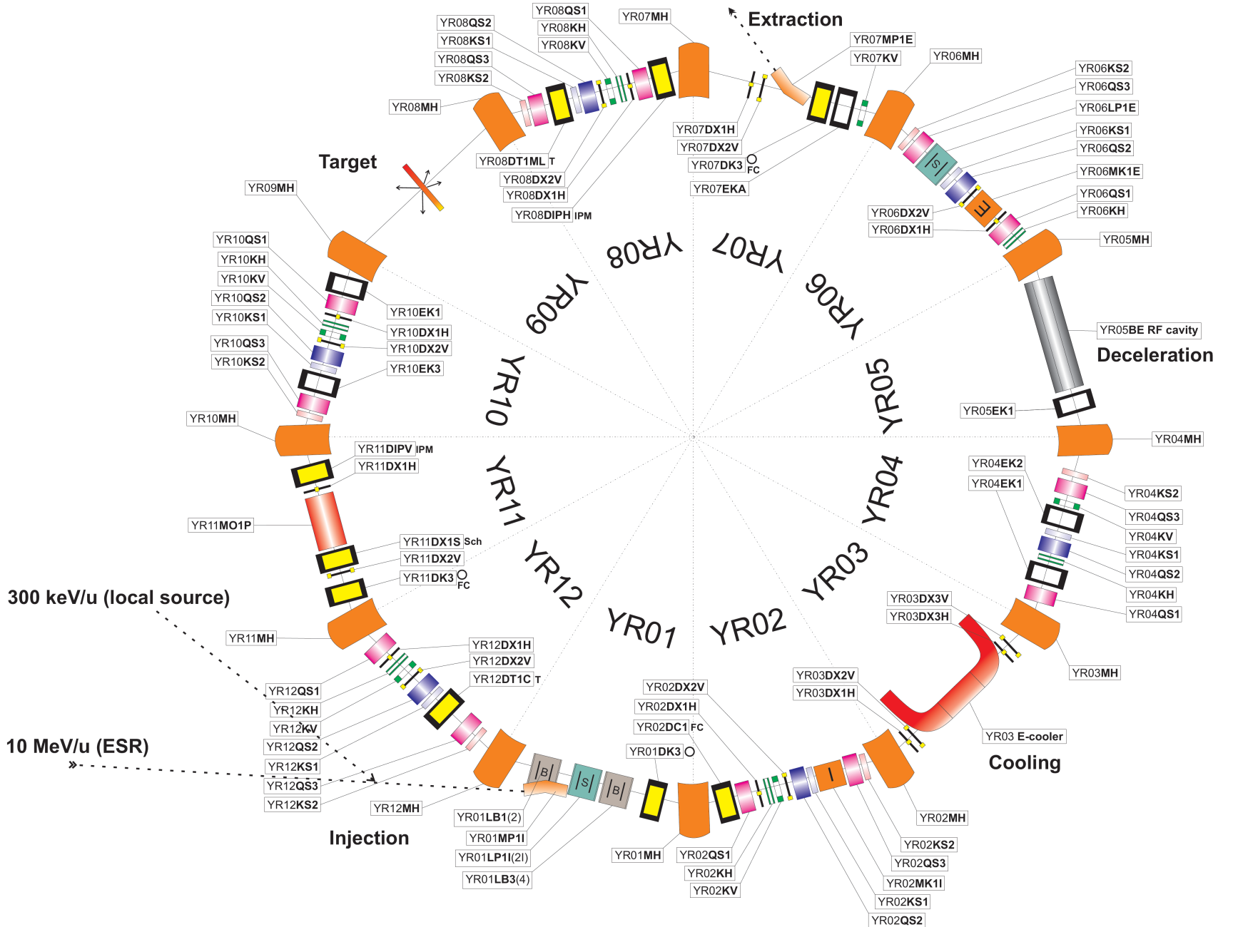
CRYRING ring assembly

Slide 16
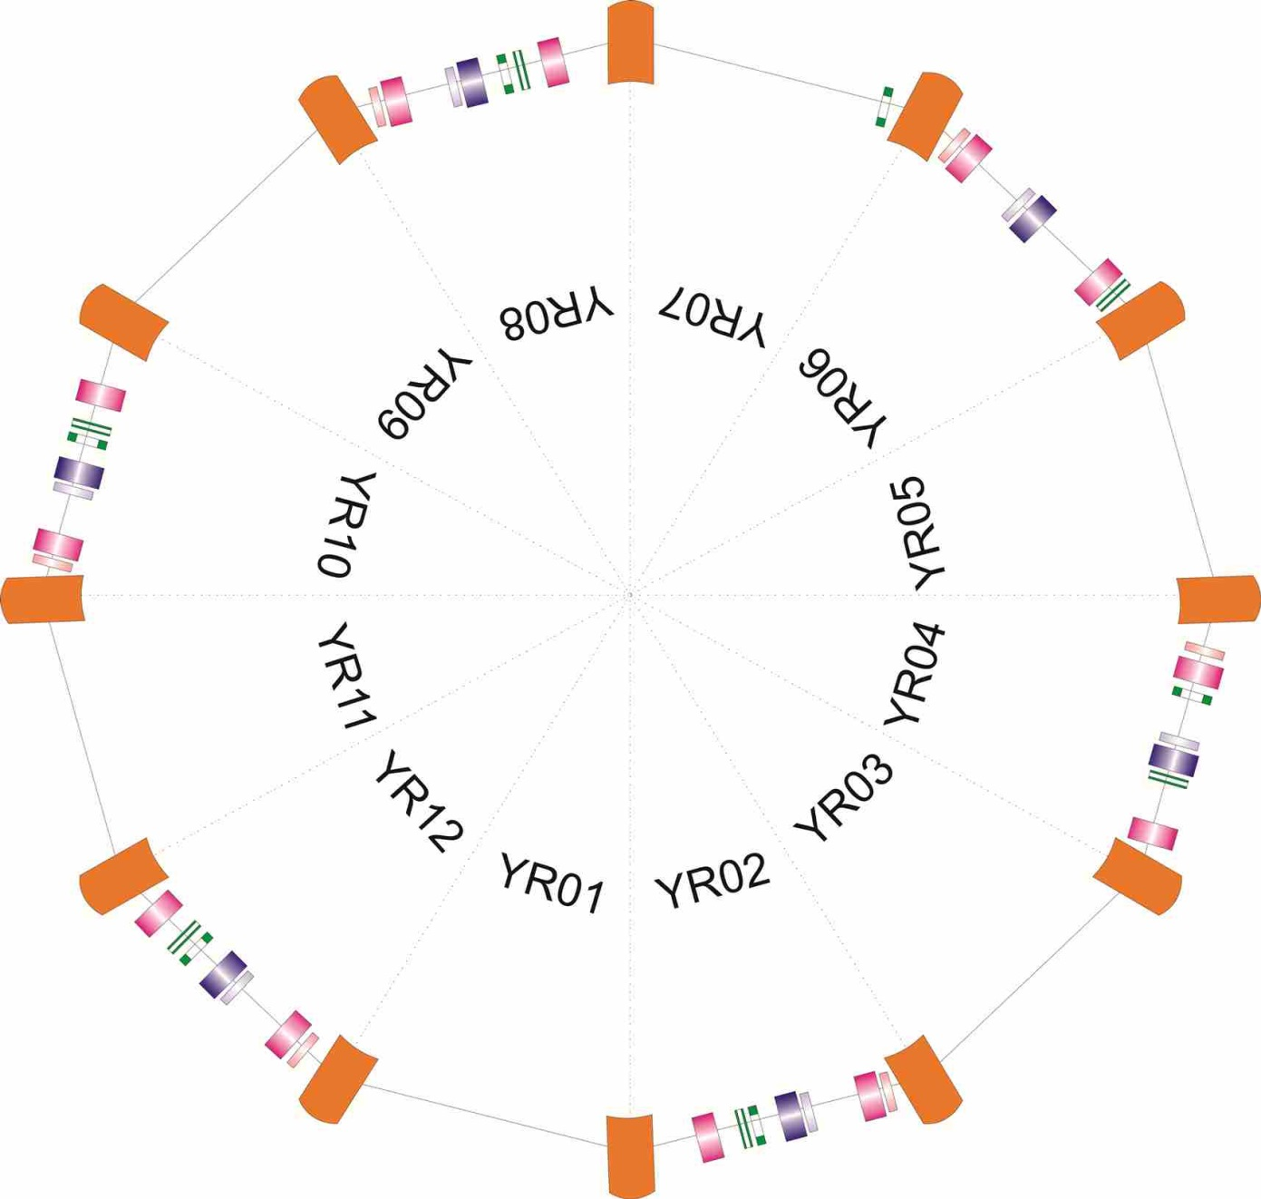
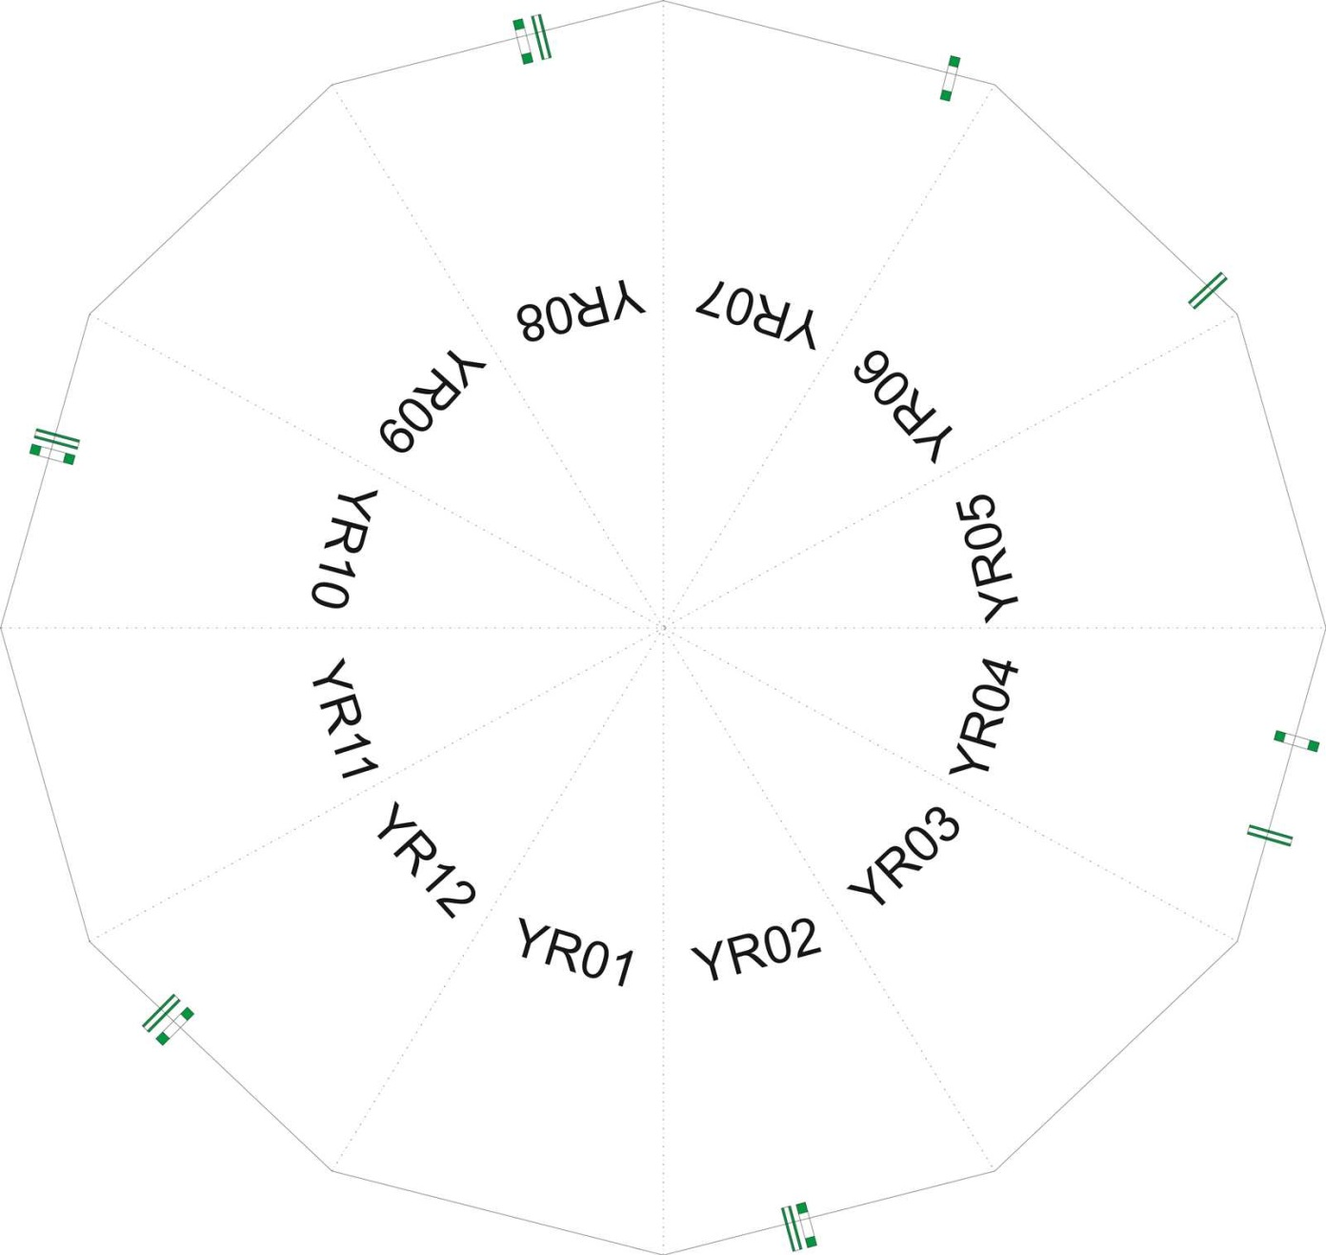
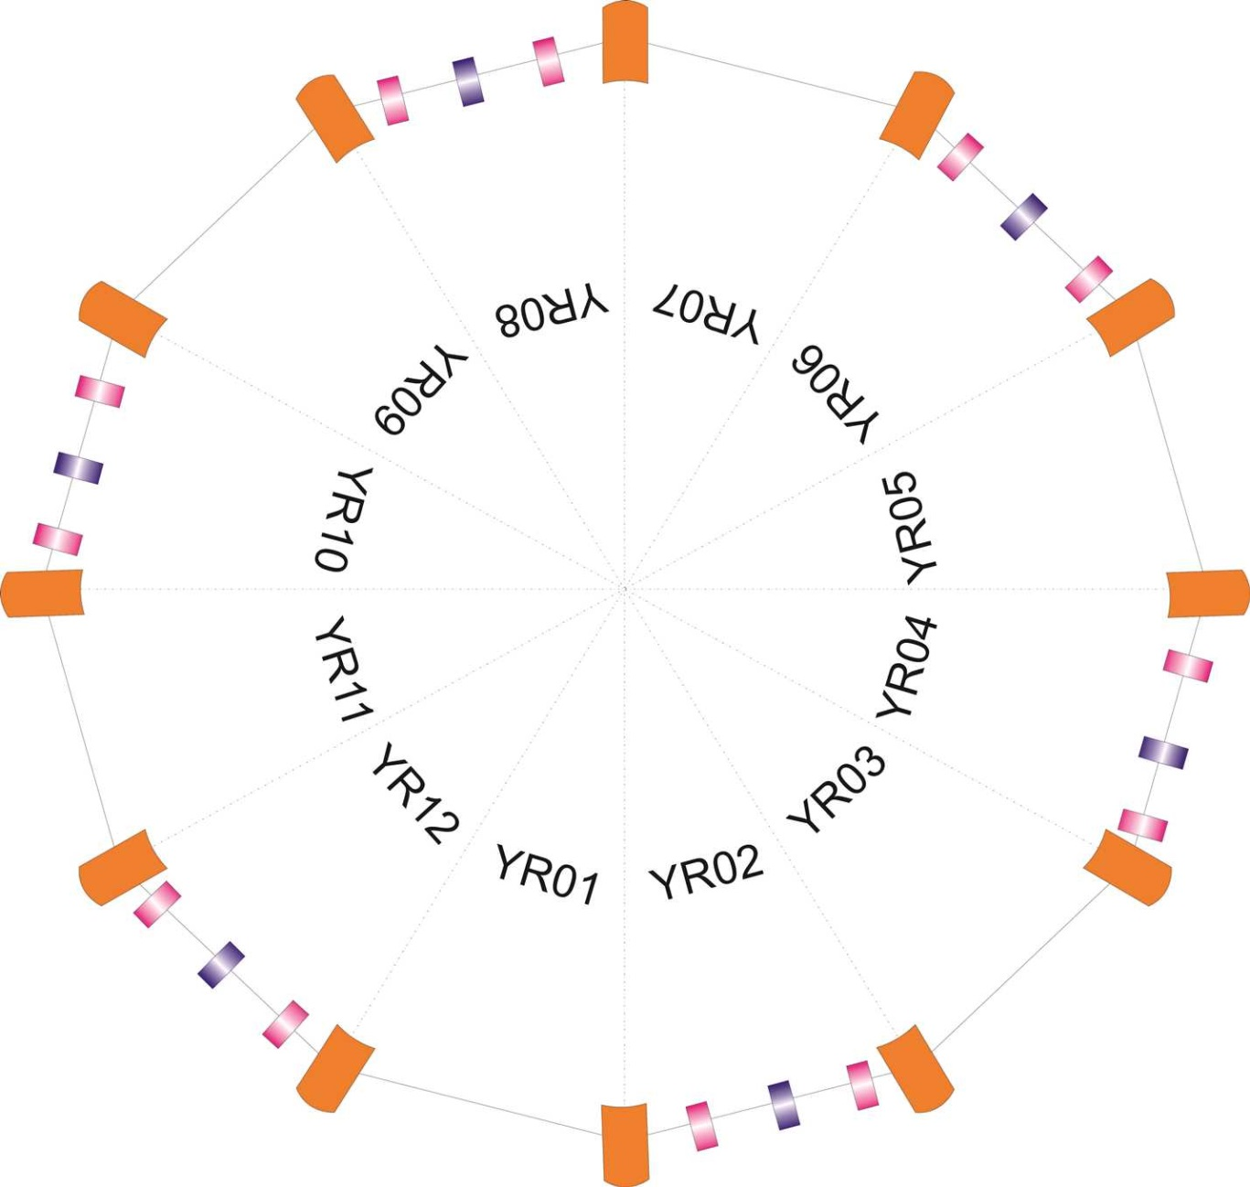
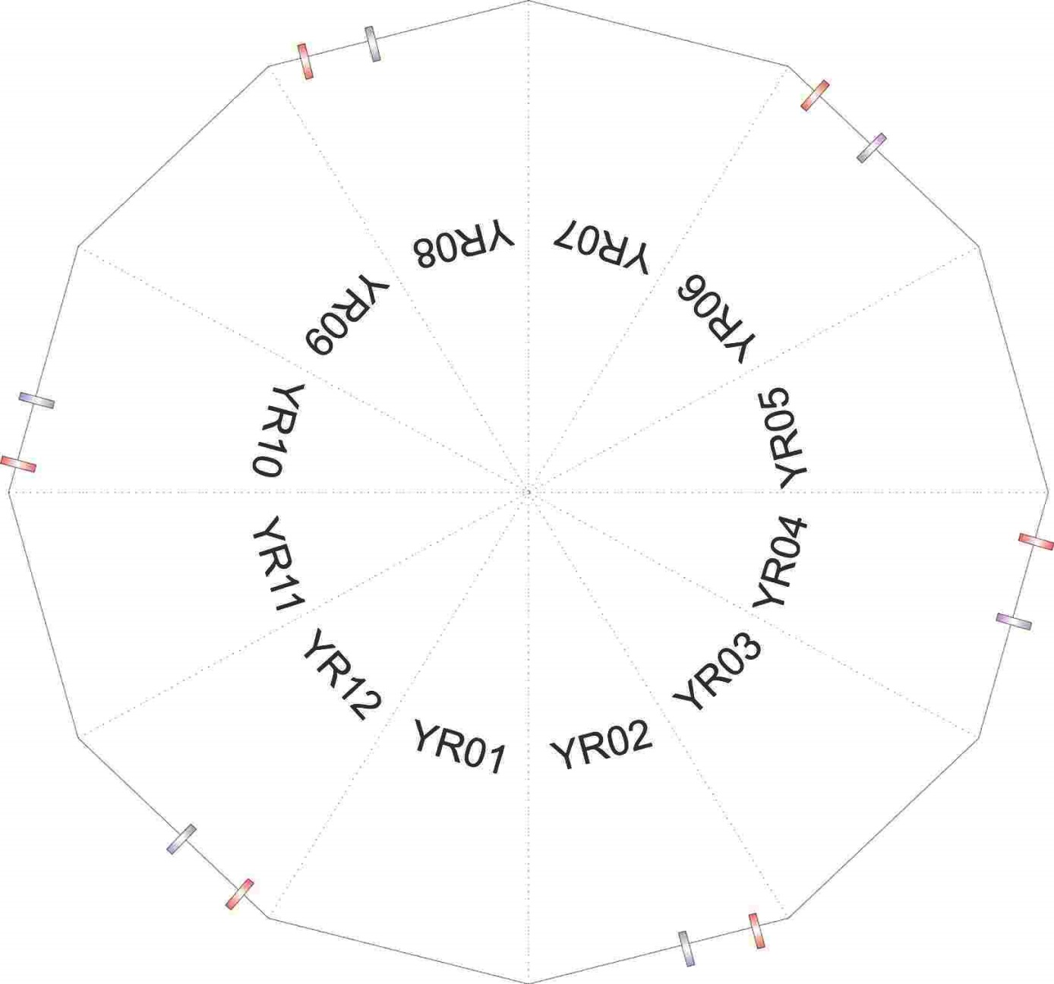
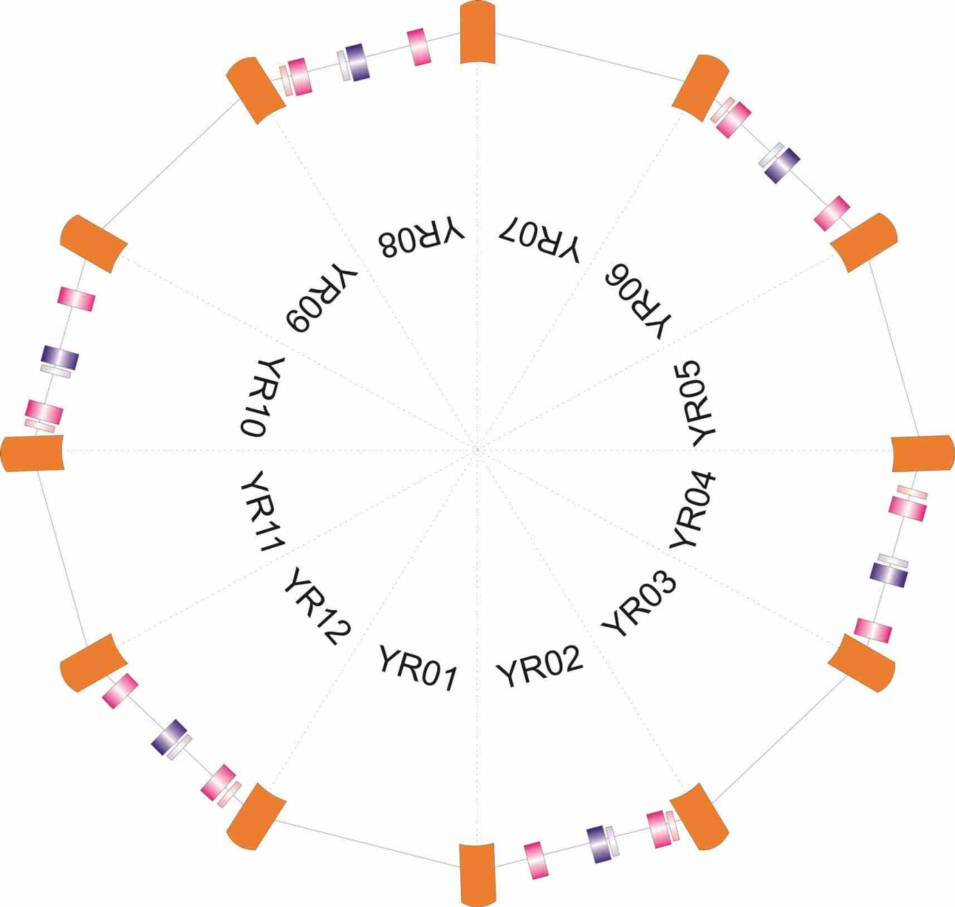
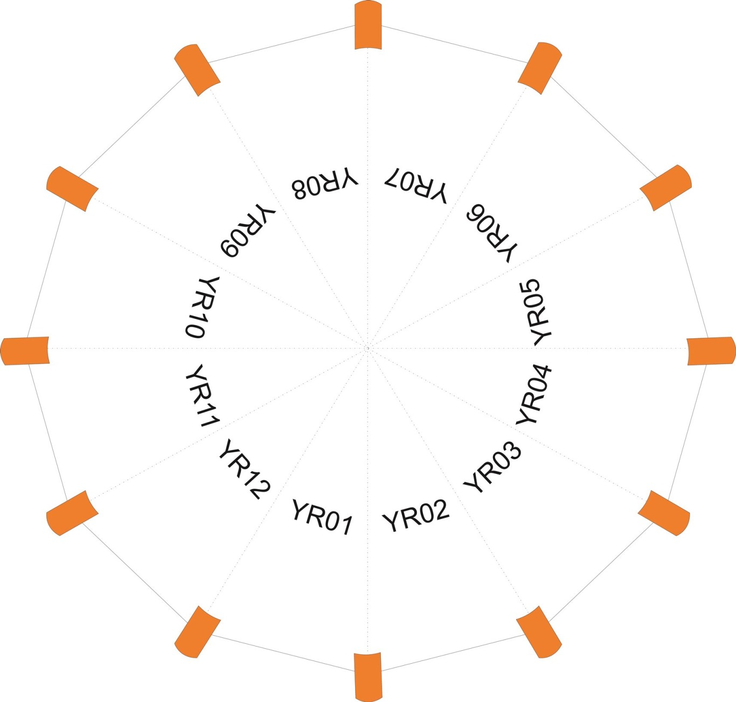
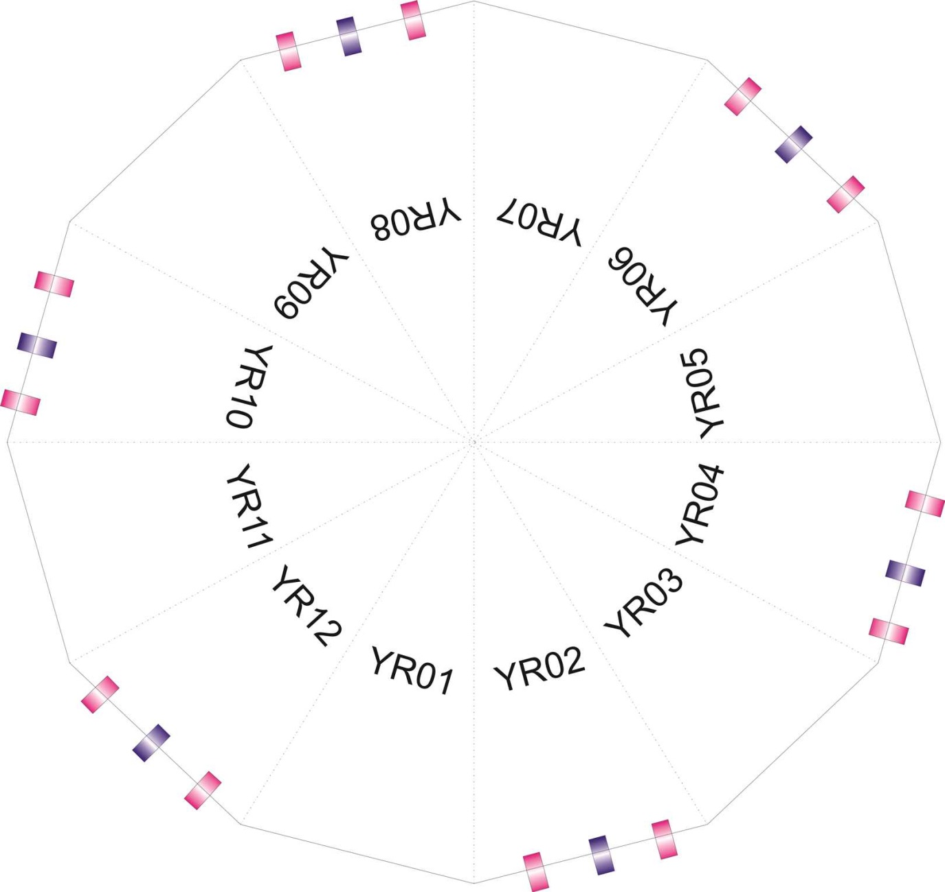
CRYRING ring assembly: magnet straight sections
12 Dipoles: ramped
Bending angle 30°
Max field 1.2T
Nom current 1097A
18 Quadrupoles: ramped
12 Focusing
6 Defocusing
Max field 5 T/m
Nom current 336 A
12 Sextupoles:
6 Focusing
6 Defocusing
Max field 27 T/m²
Nom current 10 A
12 Correction dipoles:
6 Vertical
6 Horizontal
Max field 0.03 T
Nom current 10 A

Slide 17
CRYRING ring assembly
E-cooler:
~20 voltage and current supplies:
7 Guiding magnets for e- beam
Superconducting gun solenoid
Compensation solenoid
2 Correctors + 2 dipols backleg windings
10 Steering coils
RF driven drift tube:
Slow ramping mode (1 T/s)
RF frequency 40 kHz- 2.4 MHz
RF voltage 0-1000V_{p-p}

Slide 18
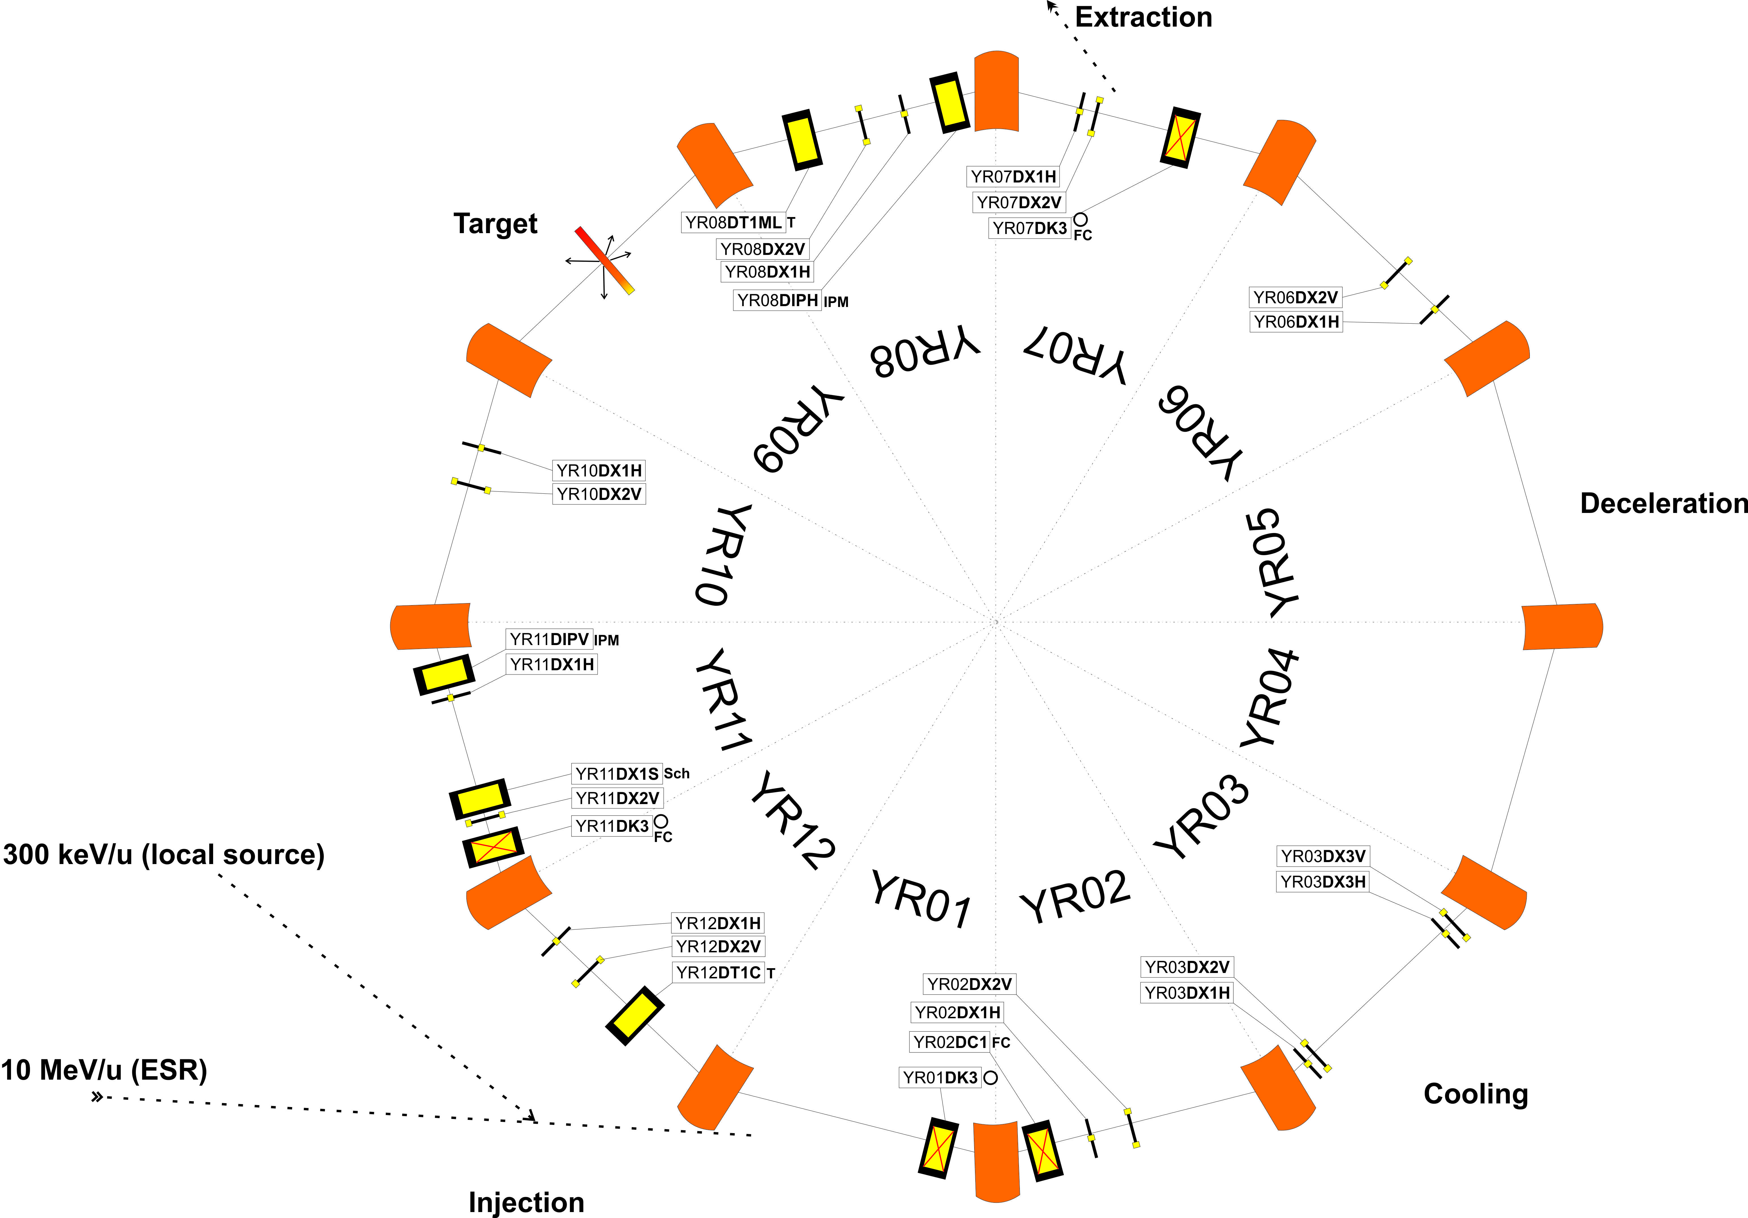
CRYRING ring assembly: Diagnostics
Faraday cups
Screens (MCP, Cromox)
Beam position monitors (BPM)
Schottky pickup
Ionization profile monitors (IPM)
Current transformers (AC, DC)
➢➢ For details about the diagnostics see presentation of H. Bräuning

Slide 19
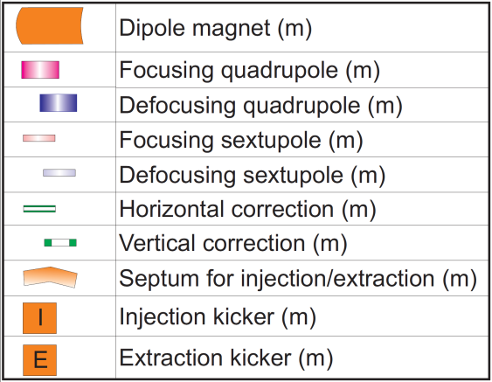
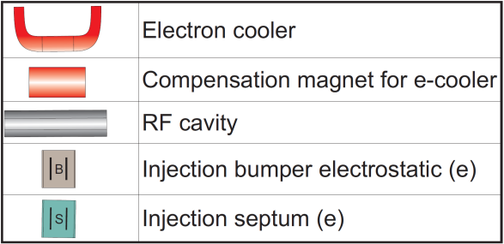
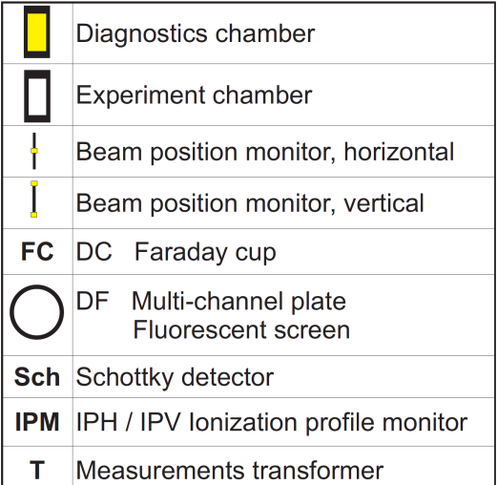
CRYRING ring assembly

Slide 20
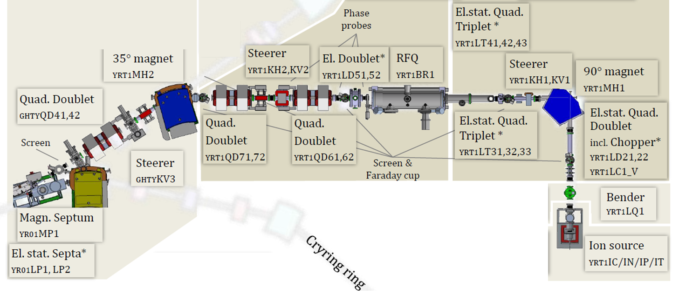
Local Ion Source
Typical gases so far – H₂, D₂, Ar
Typical intensities of beam for injection – 40 μA, has been improved starting at 1 μA
Uninterrupted operation time –improved from a few days to weeks
Second version built for fast change over
Other source types (e.g. EBIT) and upgrade of RF Power discussed or already scheduled

Slide 21
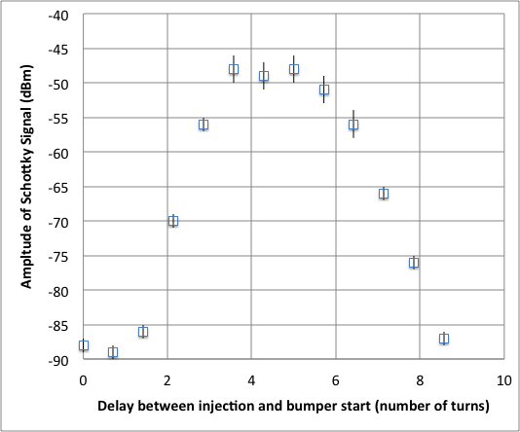
Status of Commissioning
Many turns and RF bunching
Multi turn injection (improving)
Stored Beam Lifetime Measurement in Schottky
0.5 s

Slide 22
CRYRING@ESR Control room
Cave B
Entrance
TH.1.023
way to CRYRING control room

Slide 23
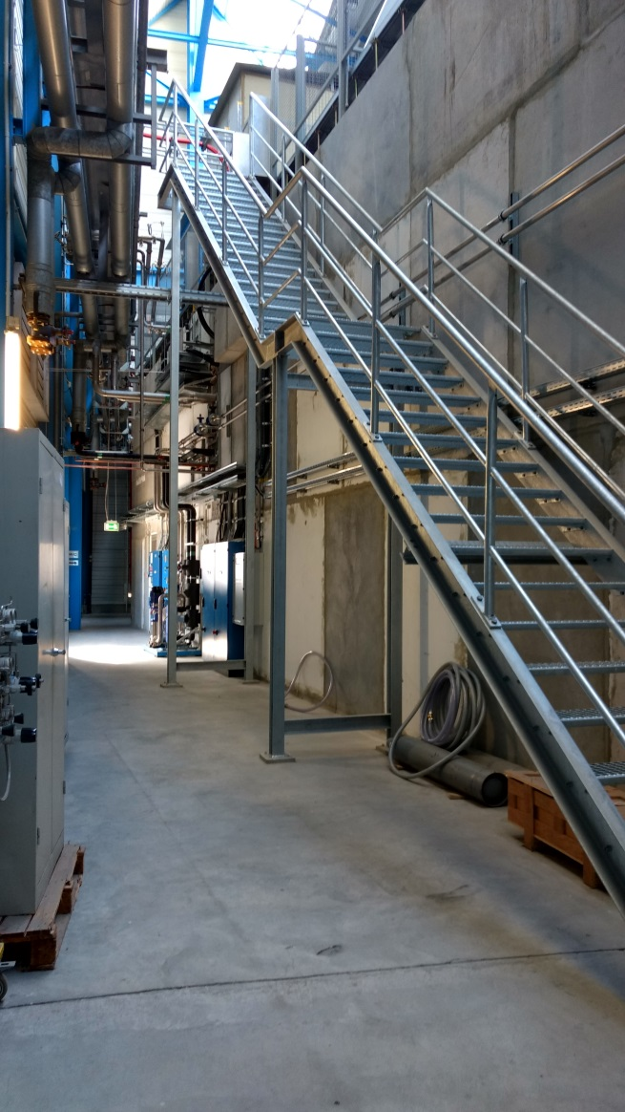
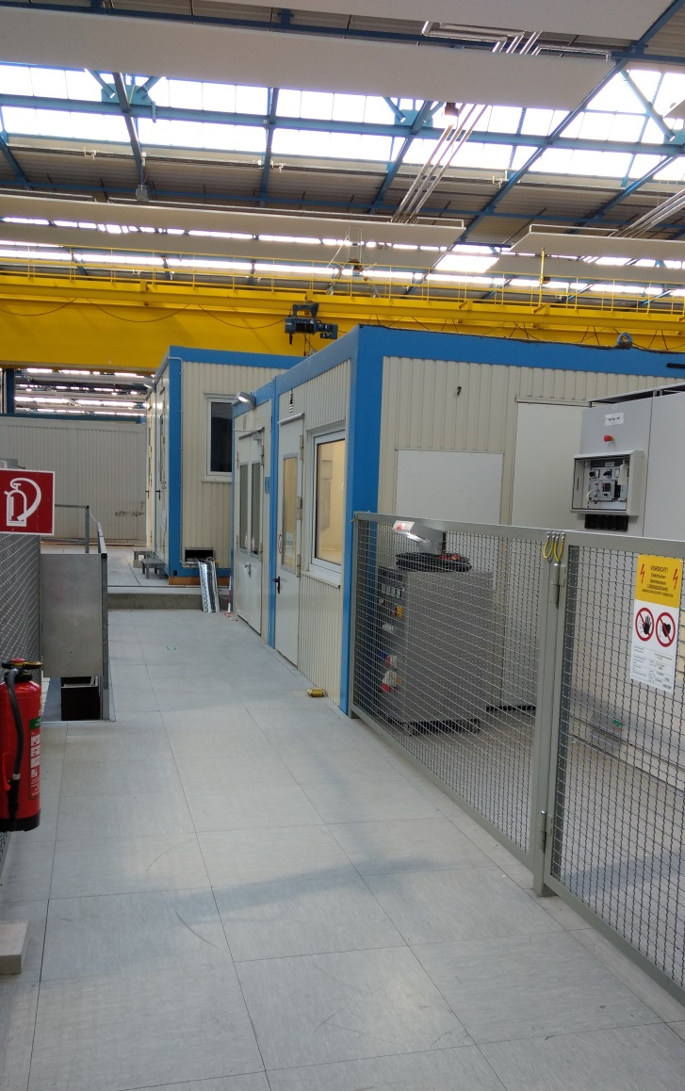
CRYRING@ESR Control room
TH.2.034

Slide 24
CRYRING operations in 2017-2019
AUGUST-SEPTEMBER, 2017
Commissioning with UHV
Operators training
NOVEMBER-DECEMBER, 2017
Commissioning with UHV
First experiment
Operators training
2018-2019
Ready to accept ESR beam
Scheduled dry runs and beam time
For dates, look into plan of accelerator operations and a beam time schedule by S. Reimann

