Slide 1


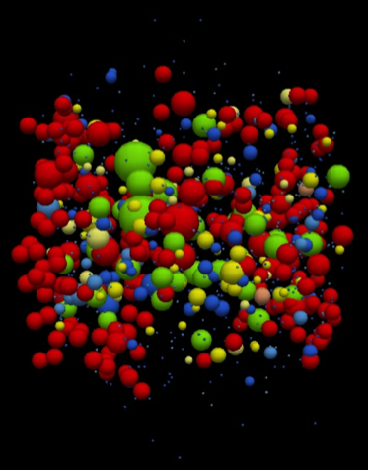




Slide 2

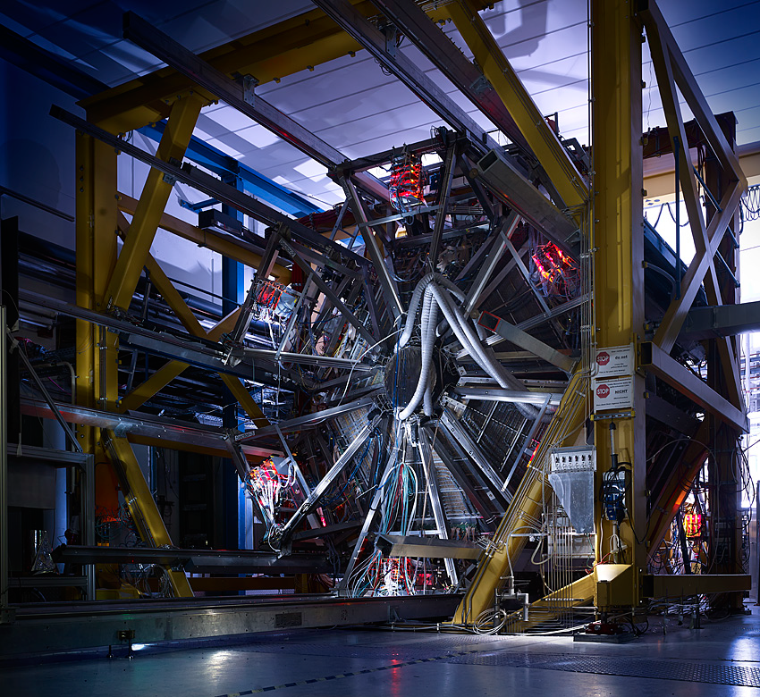

Hades gate
High Acceptance DiElectron Spectrometer

Slide 3


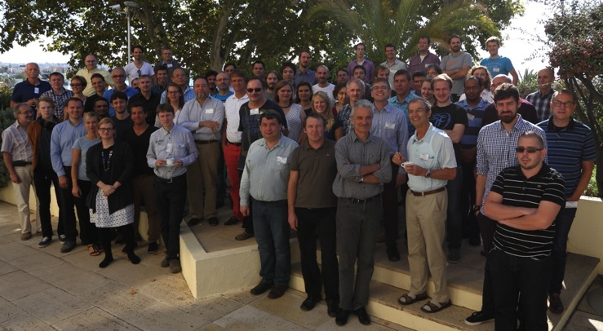
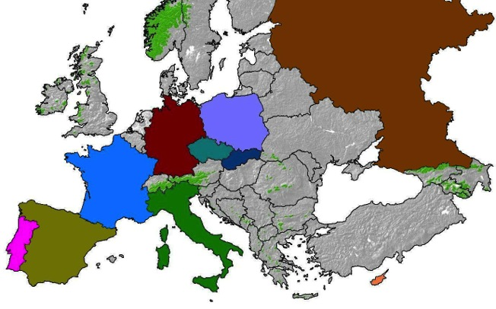


Slide 4


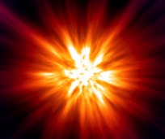
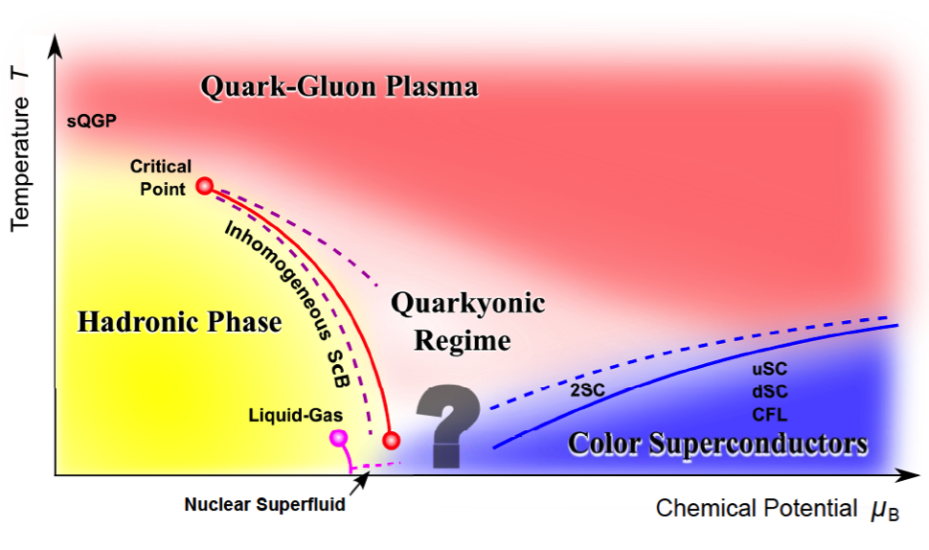
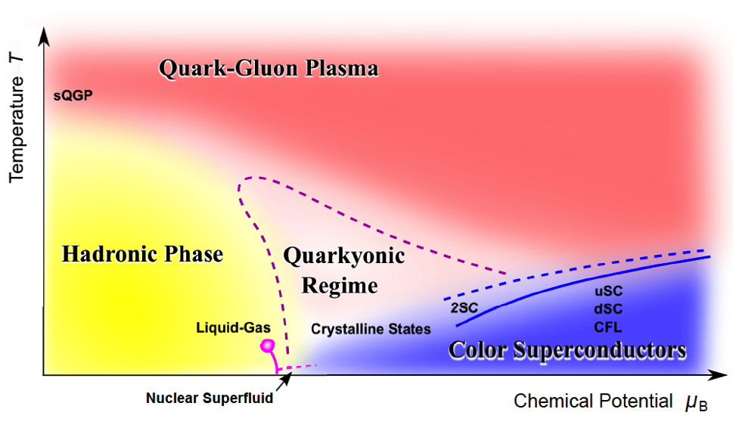
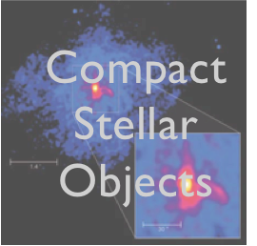
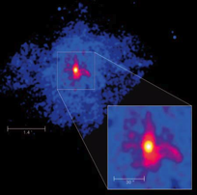

“Even without any sharp structure, the QCD phase diagram contains rich physics at high density”
Early
Universe
Compact
Stellar
Objects

Slide 5



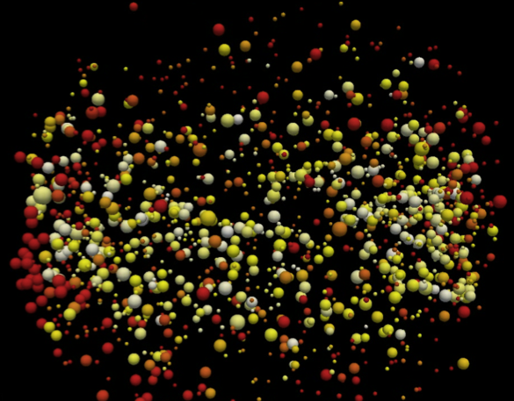
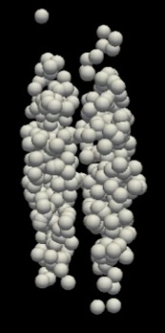
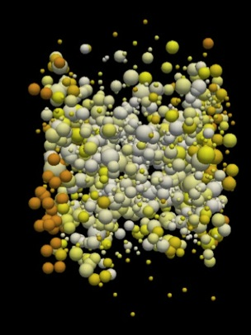
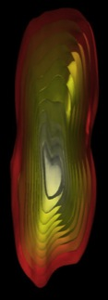






Slide 6


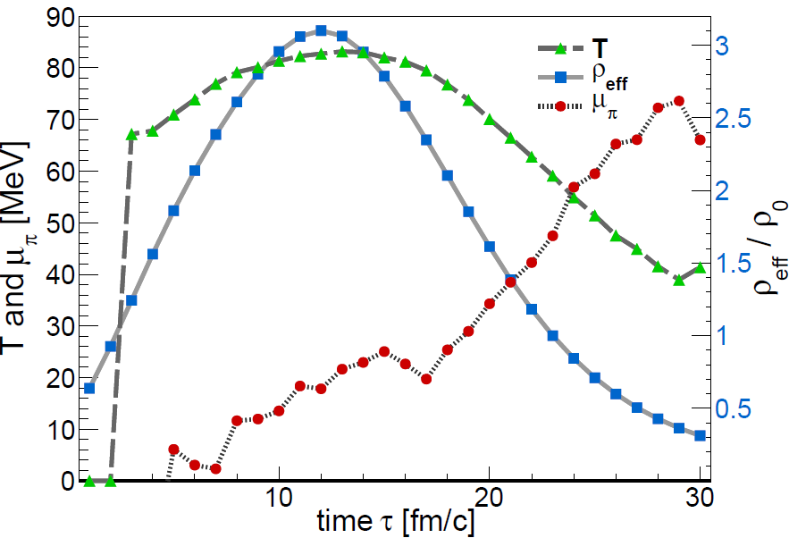
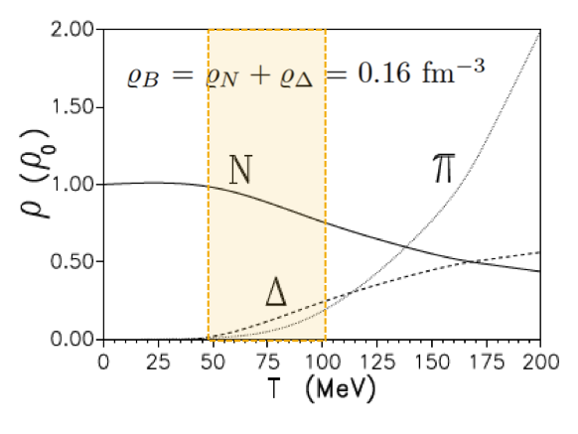





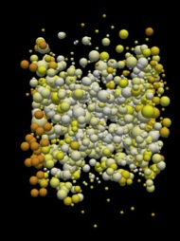

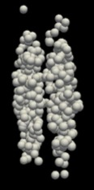

γ*
e⁺
e⁻
Κ, Λ, φ, Ξ,…
Rare and penetrating probes
γ*
e⁺
e⁻
γ*
e⁺
e

Slide 7

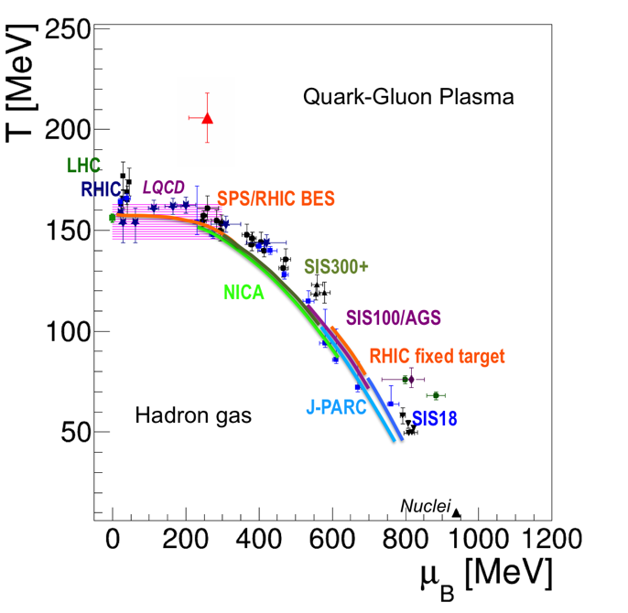


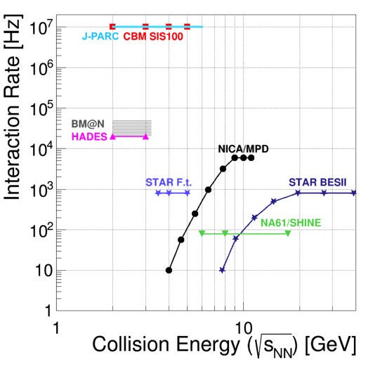
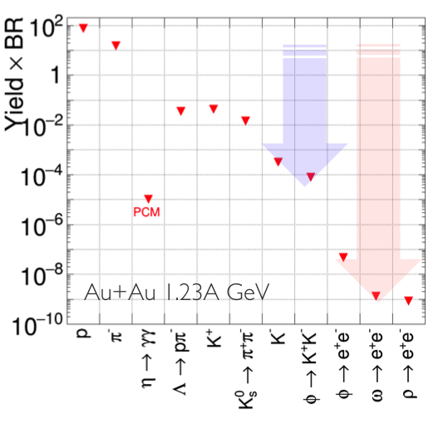
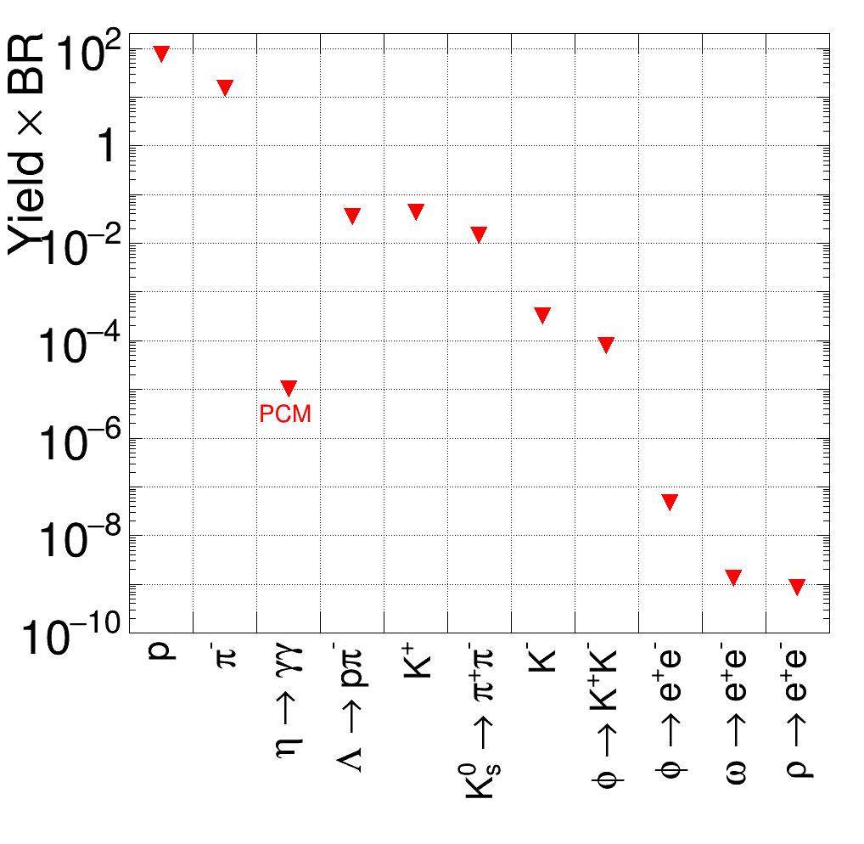


HADES currently explores the high-μ_{B} region
Very competitive w.r.t. interaction rate capability
Au+Au 1.23A GeV
HADES is part of the beam energy scan
→ marks lowest point of the excitation function
CBM collab., arXiv:1607.01487 [nucl-ex]
Notes:
Progress in understanding is driven by experiments at LHC, SPS,
RHIC Beam Energy Scan
Series of future facilities planned:
FAIR, NICA, J-PARC
Strangeness and vector mesons production far below free NN threshold
Di-lepton production governed by the factor α², branching ratio to e⁺e⁻ <10⁻⁴

Slide 8
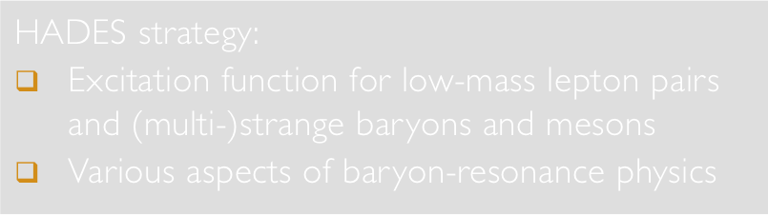
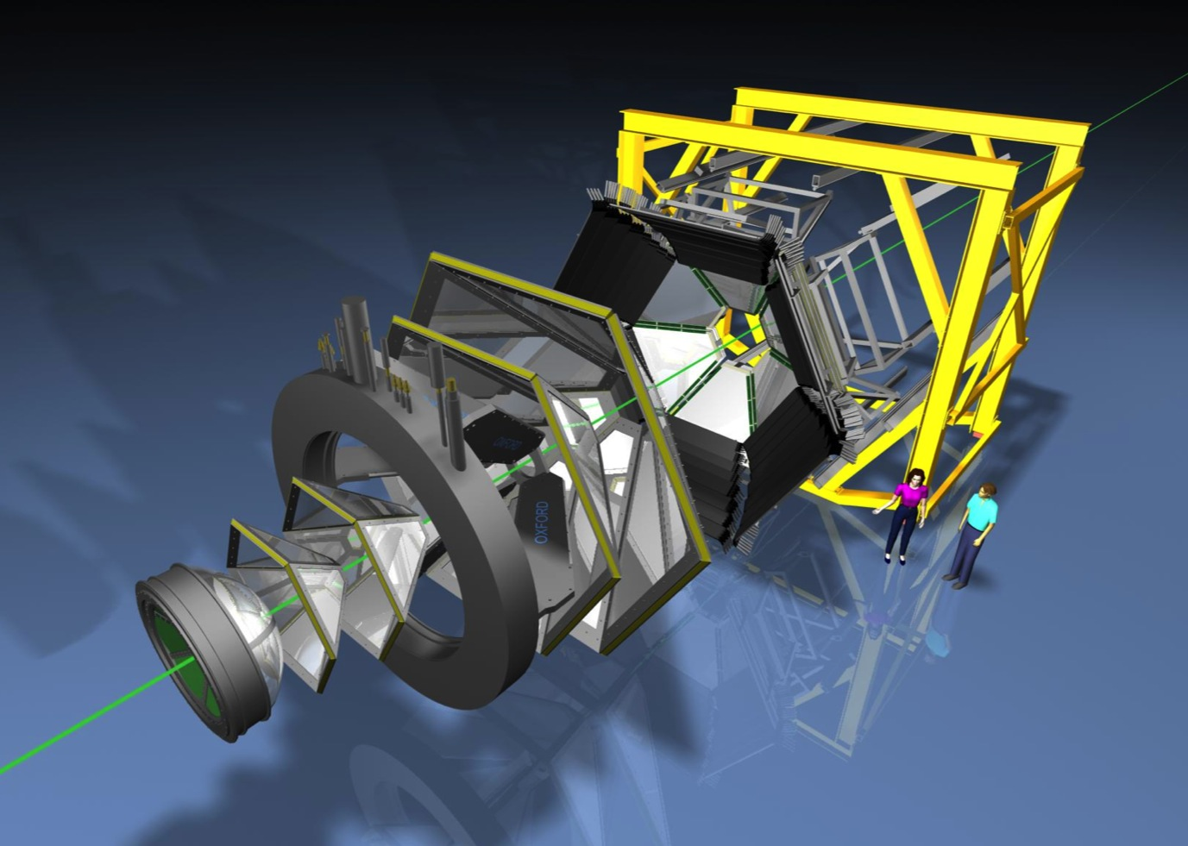

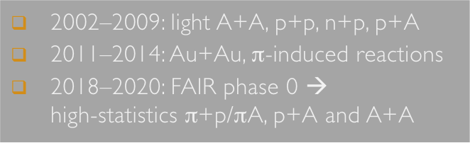

Slide 9
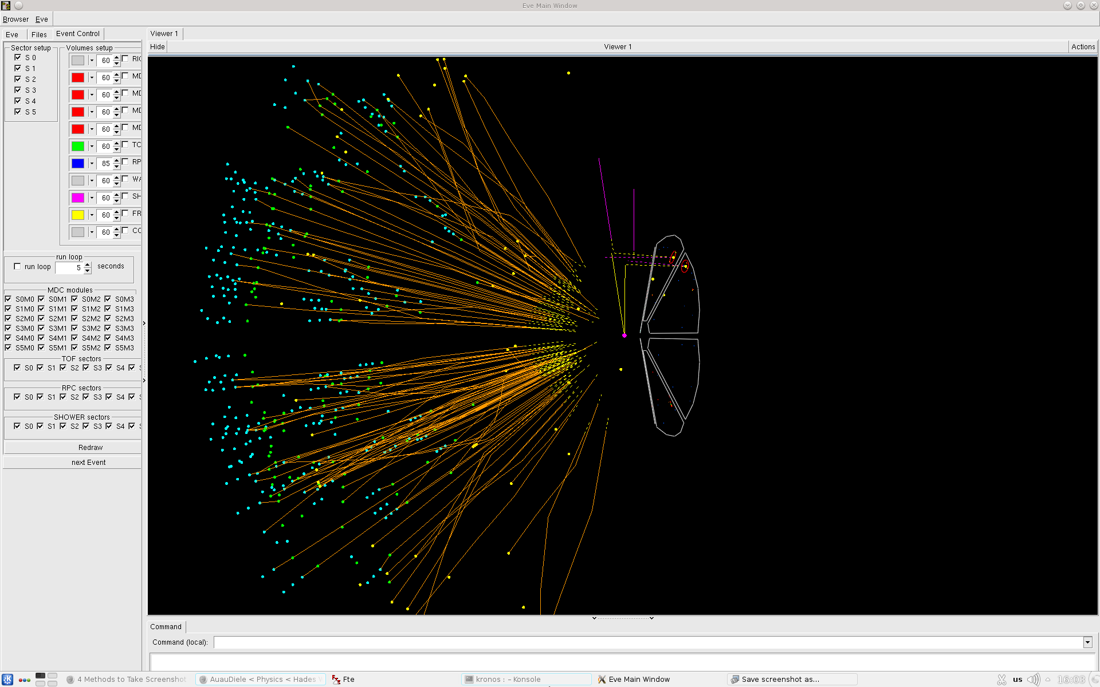
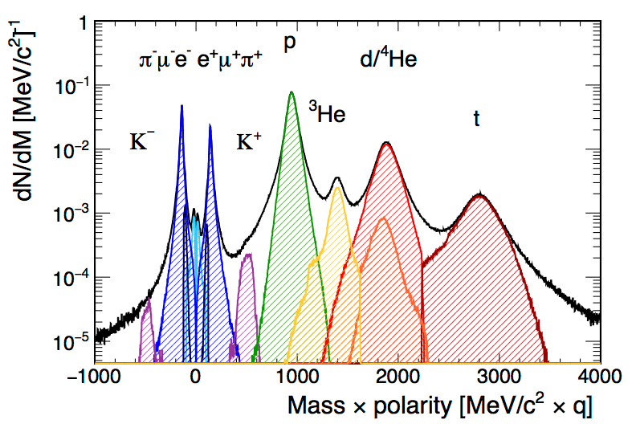



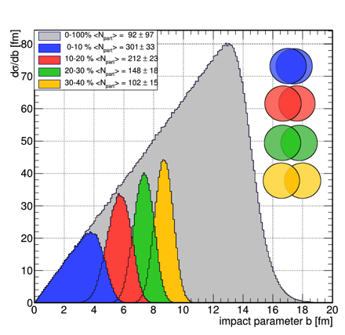
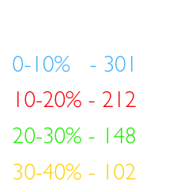
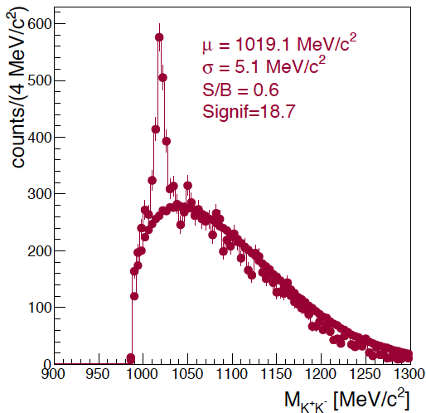
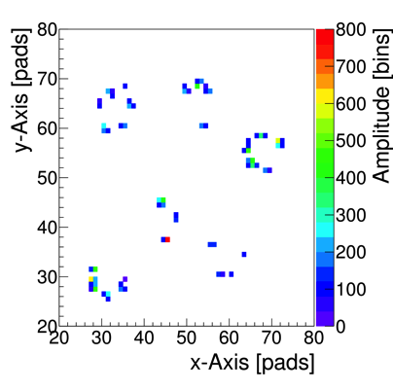

Slide 10


Slide 11

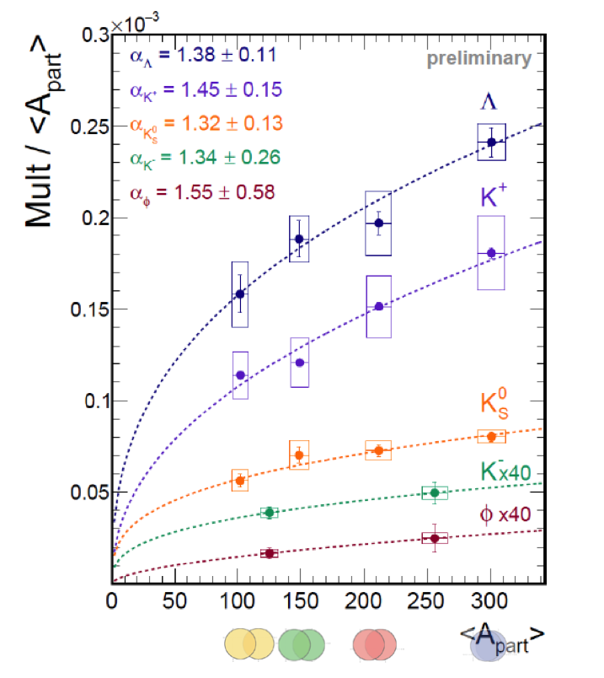
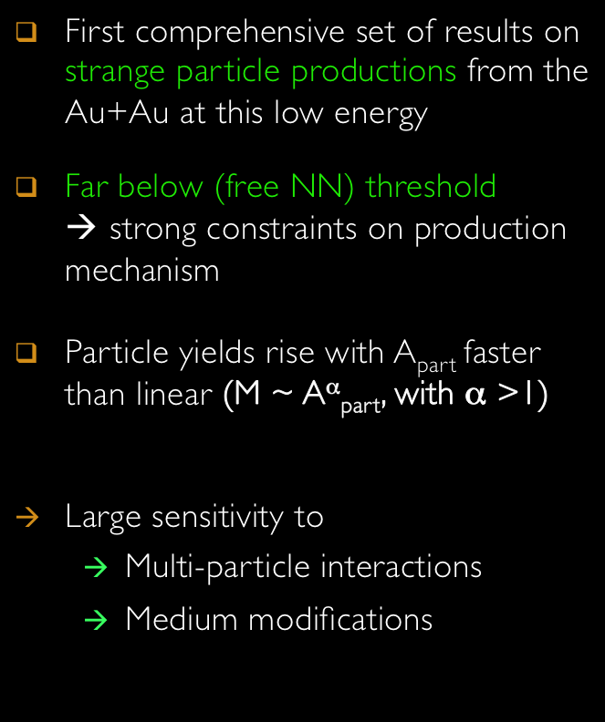


Slide 12



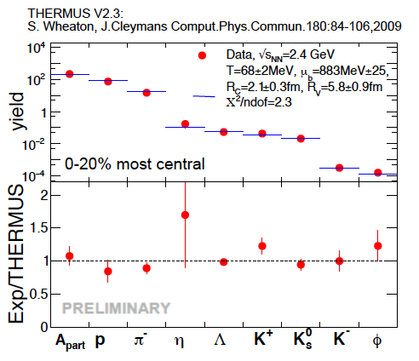
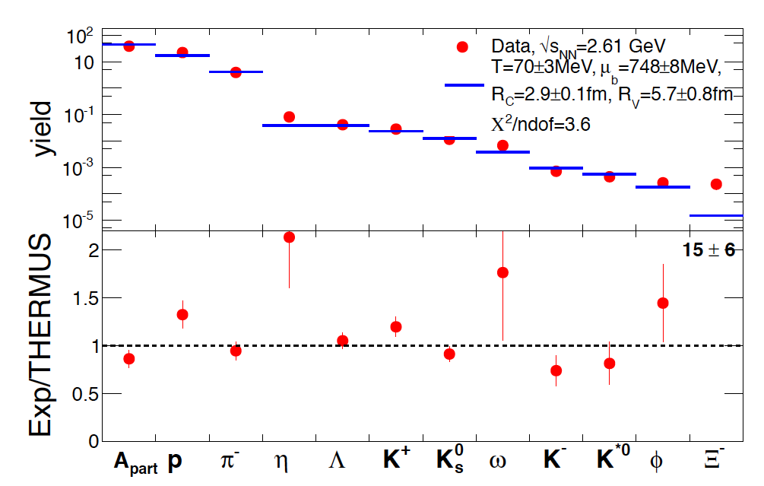
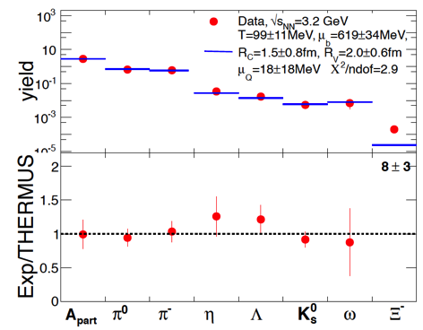





Thermal equilibrium also at low energies (high μ_{B})?
What is the mechanism responsible for system thermalization?
Grand canonical ensemble
(T, μ_{B}, V and sometimes γ_{s})
Strangeness canonically suppressed at low temperatures → needs additional parameter: R_{c} < R_{V}
Hadron abundances described by T, μ_{B,}R_{V},R_{c}
Surprises:
  φ meson (hidden strangeness) not suppressed
  Ξ⁻(s = -2) yield “enhanced”

Slide 13

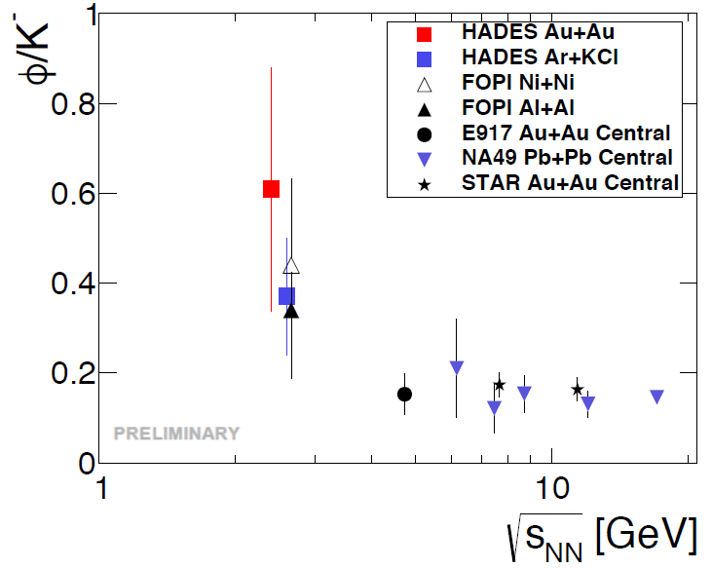
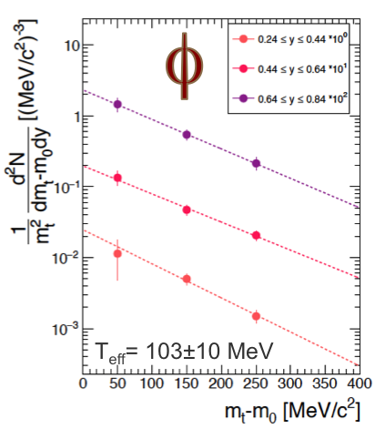
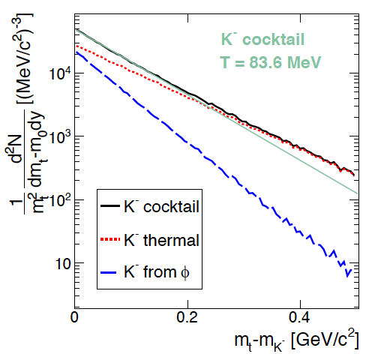
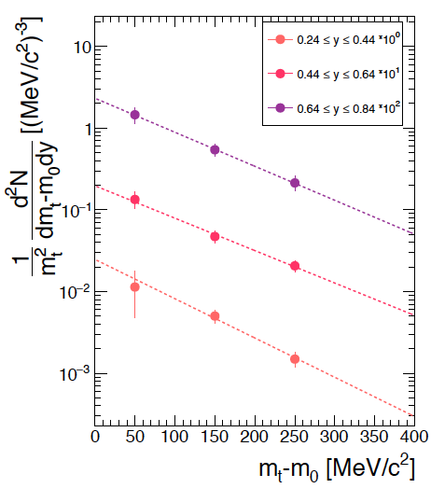
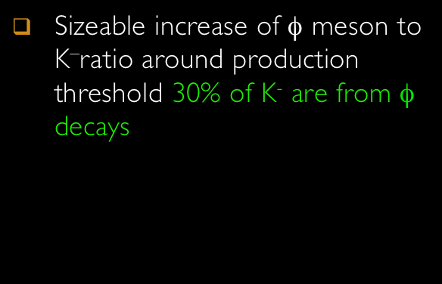



φ
  T_{eff}= 103±10 MeV
Sizeable increase of φ meson to K–ratio around production threshold 30% of K⁻ are from φ decays
Sufficient statistics to perform multi-differential analysis for K⁺, K⁻ and φ
  T_{eff}(K⁺) = 105±4 MeV
  T_{eff}(K⁻) = 82±9 MeV
Unique freeze-out criteria when φ decay kinematics is taken into account → no evidence for sequential freeze-out of K⁺, K⁻ → support for statistical model

Slide 14
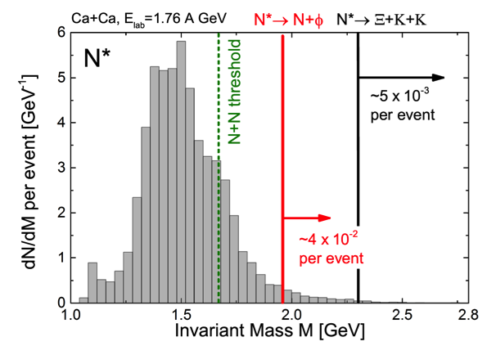









J. Steinheimer et al., J.Phys. G43 (2016) no.1, 015104
Multi-strange baryons (Ξ, Ω) are expected to be a sensitive probe for compressed baryonic matter
HADES observes unexpectedly large production cross sections inAr+KCl and p+Nb collisions
UrQMD microscopic transport models →
dominant role of high mass baryonic resonances?
  N* → N+φ is fixed by ANKE data
  Y. Maeda et al. [ANKE collab.], PRC 77, 015204 (2008)
  Spectroscopy of N* → Ξ+K+K is badly needed

Slide 15
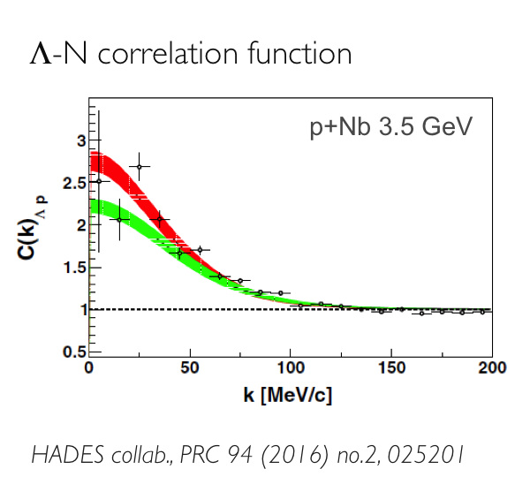

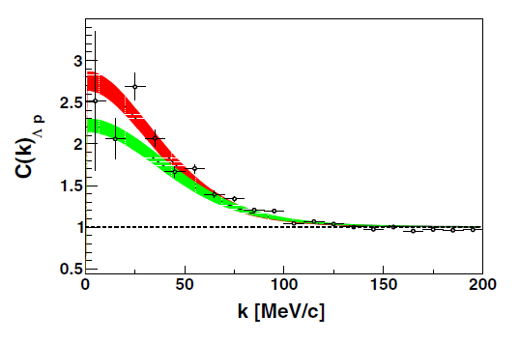
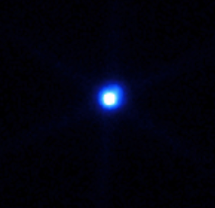
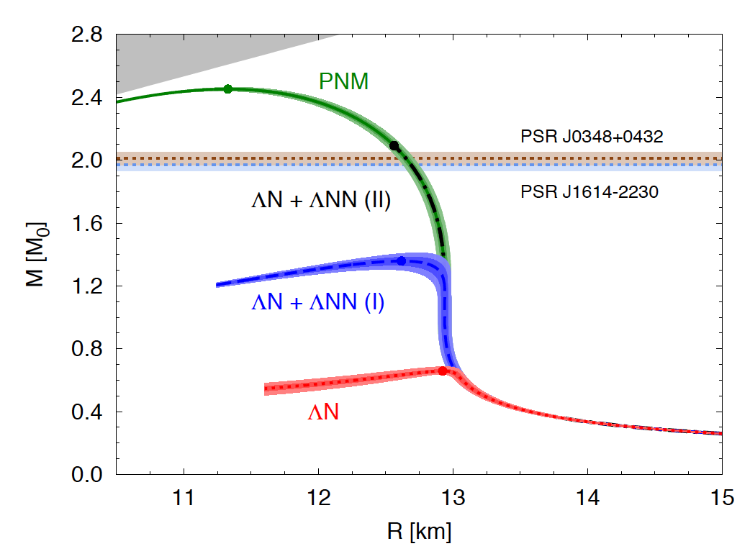
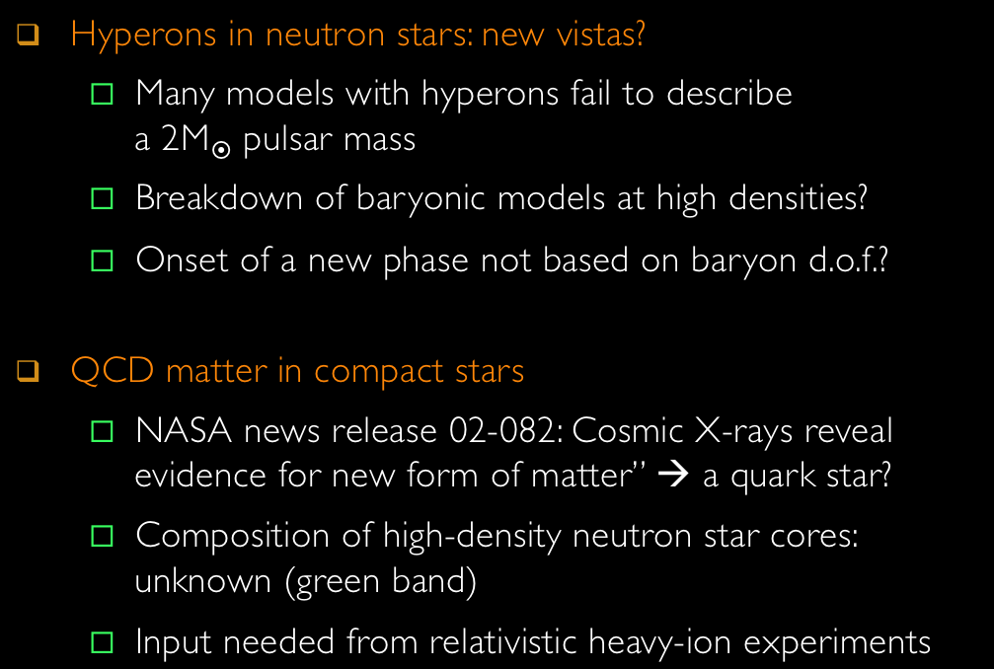
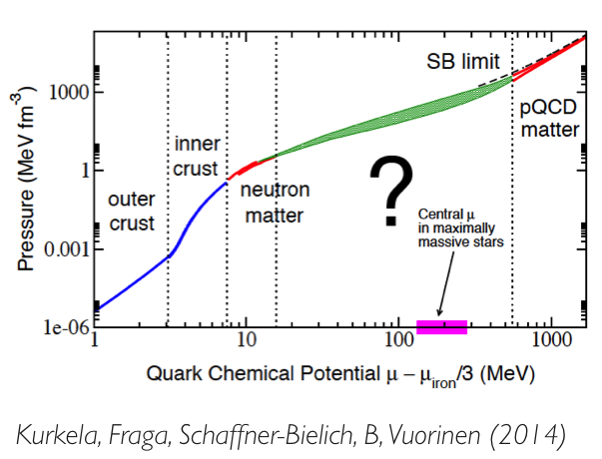
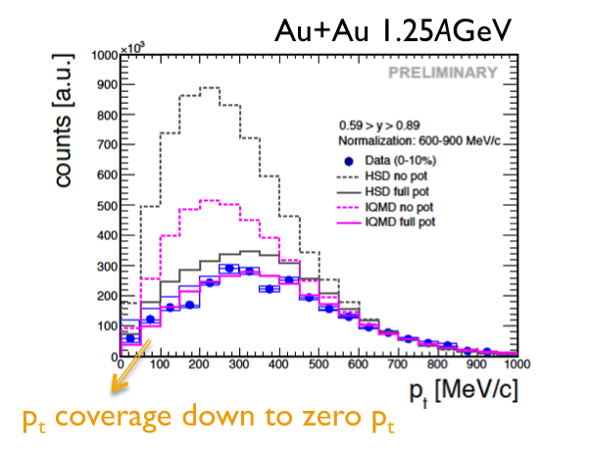
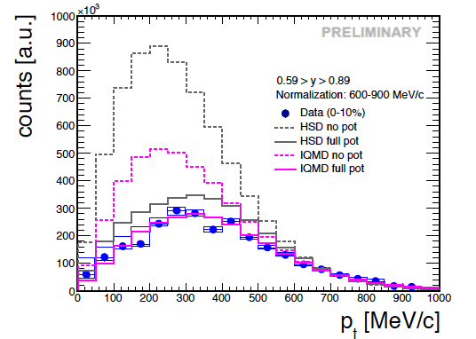

Λ-N correlation function
Hyperons in neutron stars: new vistas?
  Many models with hyperons fail to describe
  a 2M pulsar mass
  Breakdown of baryonic models at high densities?
  Onset of a new phase not based on baryon d.o.f.?
QCD matter in compact stars
  NASA news release 02-082: Cosmic X-rays reveal evidence for new form of matter” → a quark star?
  Composition of high-density neutron star cores: unknown (green band)
  Input needed from relativistic heavy-ion experiments
p+Nb 3.5 GeV
HADES collab., PRC 94 (2016) no.2, 025201
Au+Au 1.25AGeV
HADES
  ΛN, ΞN further studies in high statistic p+Ag in 2018
  Data support in-medium repulsive vector K⁰ potential ~40 MeV [PRC 82 (2009) 044907; PRC 90 (2014) 054906 ]
p_{t} coverage down to zero p_{t}
Notes:
Hypernuclear programs: JLab, J-PARC, PANDA, ALICE HYPHI, CBM, …

Slide 16


Slide 17
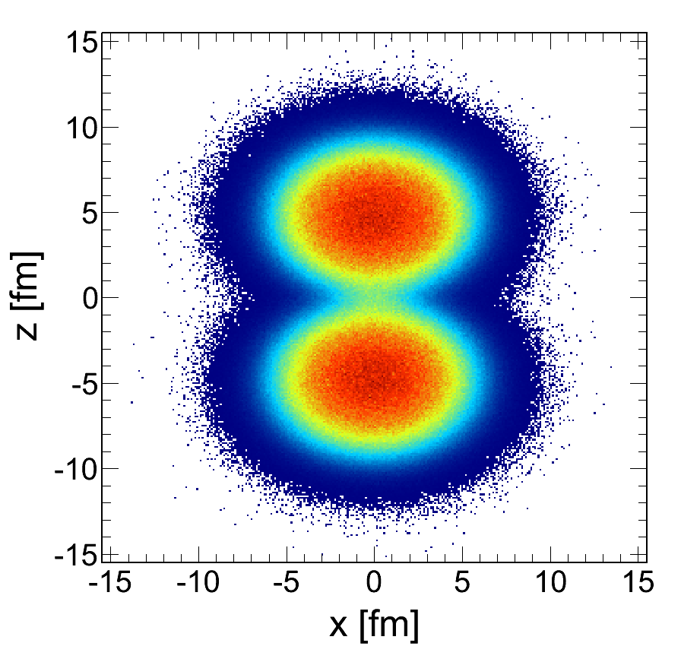







































Slide 18



Notes:
To access the in-medium SF one has to know the reference

Slide 19











Notes:
KEK-E325 has published data for ρ− and ω−meson production:
Contradicting to CLAS and HADES
HADES: sees rather a melting than a shift
CLAS: high relative momentum to the medium

Slide 20










Slide 21





Notes:
double Δ excitation plus "final state" interaction
G. E. Brown, M. Rho, and W. Weise, Nucl. Phys. A454, 669 (1986) - FF2 is derived from the assumption
that photon couples about 50% directly to the intrinsic quark structure of the pion and
remaining 50% indirectly through the rh0 meson.

Slide 22




Comparison to e⁺e⁻ cocktail accounting for decays of mesons (π⁰, η, ω, φ) at freeze-out
Strong enhancement above π⁰
(in-medium radiation, baryons..)
Comparison to e⁺e⁻ measured in NN collisions scaled to same A_{part}
Excess yield 0.2<M<0.5 GeV/c²
→ true in-medium effect
Almost exponential spectrum up to vector meson region!

Slide 23











Slide 24






Bulk evolution from microscopic transport
  Coarse graining in space-time cells →
  extract T, μ_{B}, μ_{π}, collective velocity...
Apply in-medium ρ&ω spectral functions to compute EM emission rates
Coarse-graining method works at low energies
Supports baryon-driven medium effects at UrHIC (SPS and RHIC)!

Slide 25










Chemical freeze-out from measured particle yields analyzed with SHM
  Trajectories extracted from inner cube of cells with coarse-grained UrQMD
Time-window of dilepton emission
  Radiation stops shortly after chemical freeze-out
  Access to hot and dense stage of the heavy-ion collision
Excitation of the vacuum (melting of condensate) matches spectral medium effects!

Slide 26







π⁻

Slide 27








Preliminary
Vector Meson Dominance: the basis of emissivity calculations for QCD matter.
Crucial to support the validity of the model by elementary reactions
Virtual excitation of ρ-meson states in the baryons' meson cloud?
Strong deviation from unity show the time-like contribution to the resonance decay and along strict VMD!

Slide 28



Slide 31











