Slide 1
Muon System Digital Electronics
(prototype design)
N.Zhuravlev, JINR/Dubna
Novosibirsk, September, 2017

Slide 2
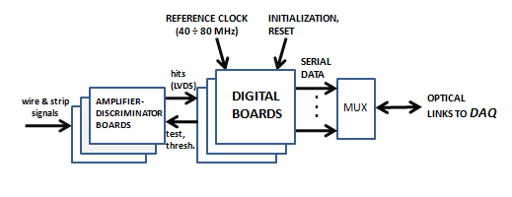
Electronics for PANDA Muon System
Simplified Block diagram of the data stream
- The total number of readout channels in Muon System is about 100000
- The time resolution of the mini-drift tubes - 100÷200ns
- The average hit rate from Muon System is about 30 hits/interaction
- The expected data rate for Muon System is about 19 Gbps
- Digital unit operates as an input register (so called “Latch mode”).
- The most-effective solution for Digital Electronics is the use of FPGA architecture
- The design Digital unit on the basis of Xilinx FPGA XC7A200 (Artix 7 Family) is in progress
The purpose is to test efficiency of this chip
- The unit will be functionally analogous to COMPASS digital R/O unit on the basis of TDC F1

Slide 3
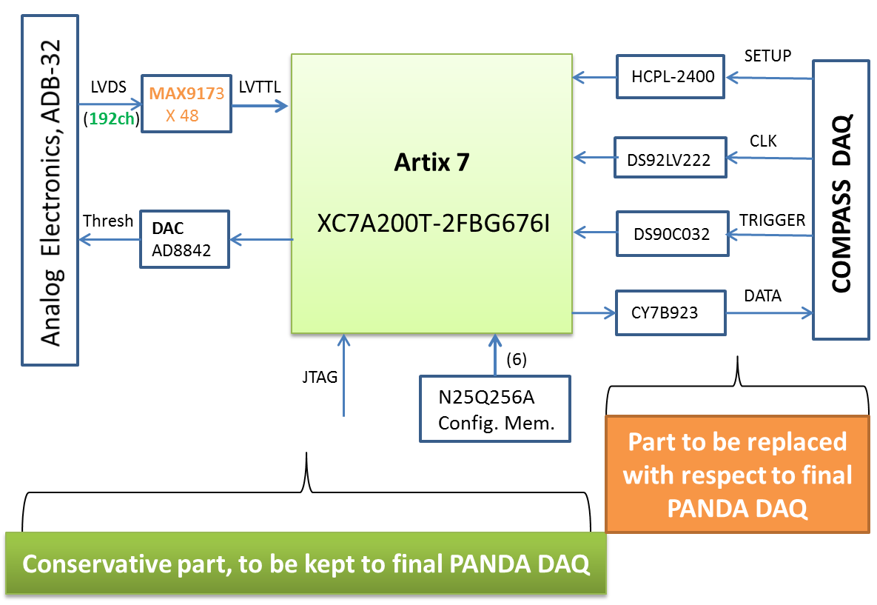
Simplified Block-diagram of Xilinx FPGA Prototype R/O Module (192ch) (to be tested with Range System Prototype at CERN; if the results will be positive, the Artix 7 chip may be regarded as the basis for the final PANDA/DAQ)

Slide 4
DIGITAL 6U VME R/O UNIT STRUCTURE
(192 channel, VME 6U, double width)
Consists of 3 boards:
LVDS
96 ch
Mezzanine board
Threshold
3
Programming Module
for Xilinx FPGA (DIGILENT)
LVTTL
Analog Electronics
3
96
LVDS
USB -> JTAG
JTAG
SMT1
S
(stand Config)
96 ch
CONFIG.
Motherboard
(FPGA/Artix 7)
Interface board
Remote Config
RS-485
Threshold
DATA
DAQ
3
Interface

Slide 5
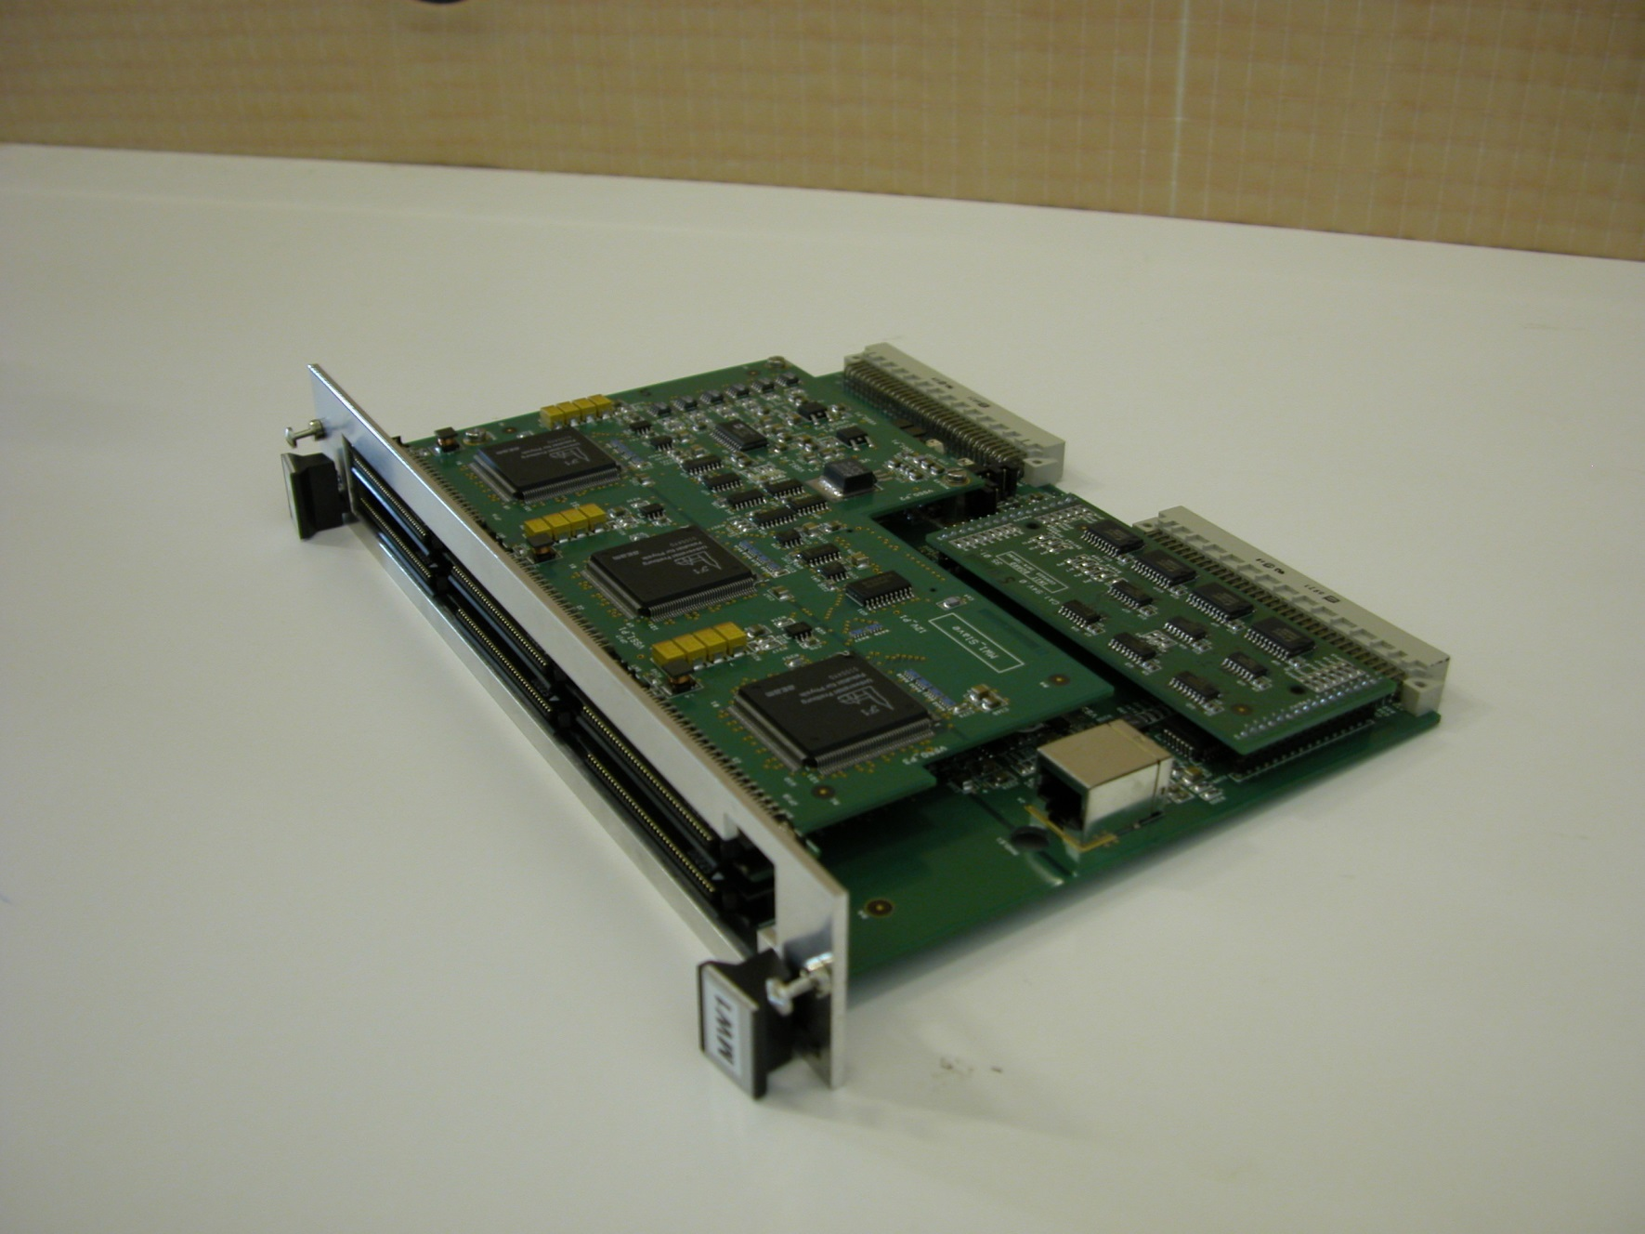
Approximate view of Prototype Digital Module (to be tested with prototype at CERN)
will be removed: 6 F1(192 ch.), Initialization card, RJ-45
Will be installed: FPGA, Interface card (connected via P2 VME connector)
COMPASS digital unit (MWDB) is taken as basis
(crossed elements will be removed)
P1
RS-485 Out
Interface board
RS-485 In
RJ-45
USB-JTAG
RJ-45
RJ-45
DAQ Interface
USB
Micro USB
RJ-45
RJ-45
P2
FPGA
Artix 7
FPGA based digital module

Slide 6
INTERFACE CARD BLOCK DIAGRAM (under discussion)
Secure Digital
memory Card
(SD)
96 Mb/s
0.45/1.4/24 Mb/s
µController
JTAG
MOXA/Home-made/SD
(STM32F4xx)
Interface
RS-485
FPGA
Firmware
MUX
Switch (ID)
900Kb/s –MOXA
2.8Mb/s – Home-made
(CPLD)
Host PC
JTAG
USB to stand PC
JTAG-SMT1
30Mb/s
Hit data
DAQ Interface
FPGA
DAQ Interface
3 variants for Firmware loading: - Stand (local) PC -> JTAG-SMT programming module -> FPGA
- Host PC -> RS-485 Interface -> µController -> FPGA
- SD -> µController -> FPGA

Slide 7
FPGA reloding System Structure ( view from back side of VME crate)
V.1
Rackmount serial device server (industrial )
MOXA NPORT 5630-8/16
Home-made device server (2.8 Mbps)
FPGA
FPGA
(900 Kbps)
JTAG
VME crate #1
V.2
M1
M10
Port 1
Interface board
Ethernet
Host PC
Up to 100Mbps
Port8/16
Rt
- The loading of crates – in parallel
- The loading inside crate – sequentially
- The loading from SD – all modules in
parallel by a broadcast command
Estimated loading time
for the whole PANDA Muon System:
10 sec ÷ 60 min depending on
the loading source (SD/Home-made
server/ MOXA device server)
RS-485
Twisted pair cable
VME crate #xx
M1
M10
Interface board
Port 1
Rt

Slide 8
Status of Muon System Digital Electronics
(prototype design)
The development of the double width VME 6U module on the basis of
Artix 7 Family FPGA is in progress
- Motherboard card circuit diagram is ready for 75%
Mezzanine card circuit diagram is ready for 80%
Interface card circuit diagram is under discussion (block diagram is developed)
The structure of firmware loading system was selected
Plans:
To finish design of the circuit diagrams of the Motherboard and Mezzanine cards,
at the end of the 2017, and to start PCB design
To produce the prototype of Interface card in the first half of 2018
To start tests of the digital VME module with Range System prototype at CERN in 2018
Manpower:
1 student, 1 PhD expert, 1 technician, 1 colleaque from the Moscow State University
(according to the agreement with the University)
- Increasing of manpower is possible depending on available budget

