Slide 1
PANDA Collaboration Meeting 04-08.09.2017, BINP Sergey Pivovarov.

Slide 2
PANDA Yoke of the Magnet
Status of work
PANDA Collaboration Meeting 04-08.09.2017, BINP, Sergey Pivovarov.

Slide 3
3D model of the Magnet, Yoke, Platform and Frame.
The main parts of the detector PANDA for production at BINP

Slide 4
Dimensions of the Assembling Magnet, Yoke and Frame.
The total weight of the Magnet, Yoke and Frame is ~335 t.

Slide 5
Configuration 12th layers of Yoke
For a successful insertion of the muon chambers it was removed one sheet of barrel part of the yoke and increased the gap between the layers up to 35 mm.
It was increased the gap to 35 mm in the door too.

Slide 6
New Barrel part of the Yoke of the PANDA Detector
After contact with the plant it was proposed to change the design of the octants of the yoke.

Slide 7
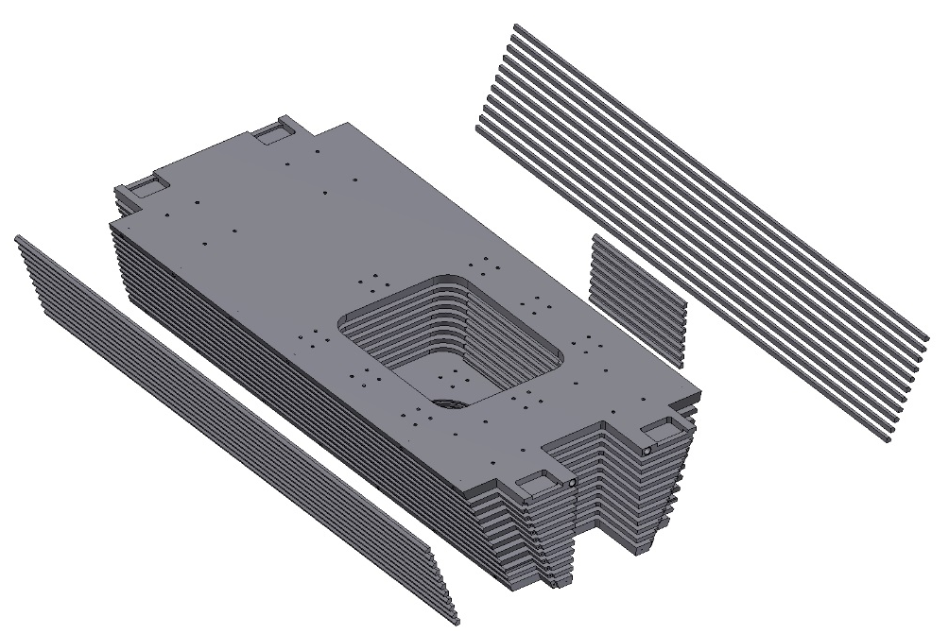
The old design of the octant of the Yoke
The Octant consists of the plates and bars. The bars connect the plates of the octant by welding. Disadvantage of such design:
1. A lot of welds.
2. Final machining on the surface of welded joints. It's very bad for a tools.
3. Octant construction is not so rigid.

Slide 8
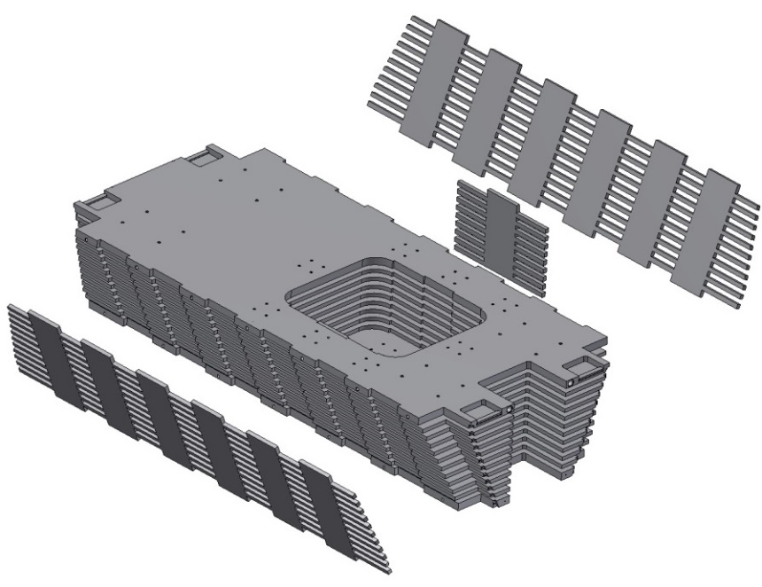
The modified octant of the Yoke
The bars was replaced by a side plates. The side plates are manufactured using water cutting machine. Advantage of such design:
The number of welds is reduced.
Final machining on the surface of the side plates (not welded joints).
3. Octant construction is more rigid.

Slide 9
The Octant of the Yoke of the PANDA Detector
For moving, rotation, assembling to be used the ears which will be removed after final assembly

Slide 10
Drawing of the Octant.

Slide 11
Drawing of the Octant.

Slide 12
Drawing of the Octant.

Slide 13
Drawing of the Octant.

Slide 14
Drawing of the Octant.

Slide 15
3D-Model of the Front Door of Yoke.
For moving, rotation and assembling the doors to be used the ears which will be removed after final Assembly (if necessary).

Slide 16
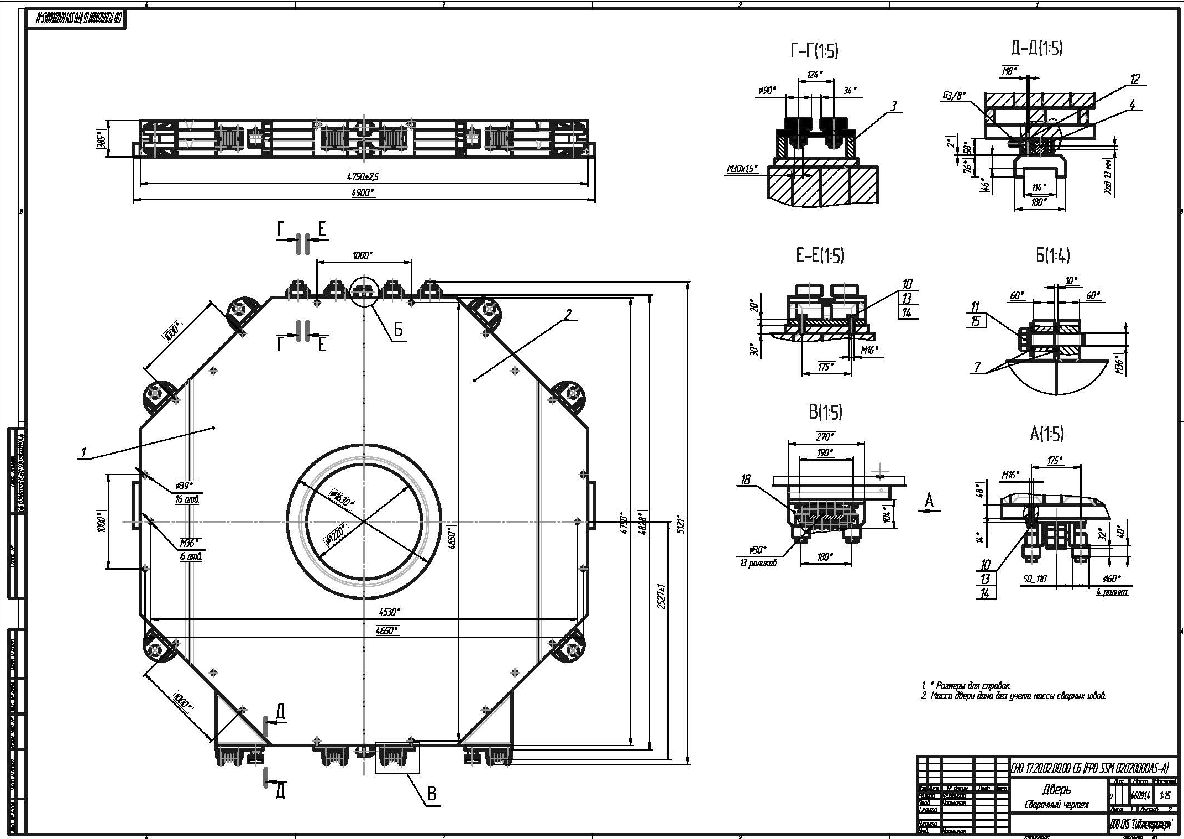
Drawing of the Front Door.

Slide 17
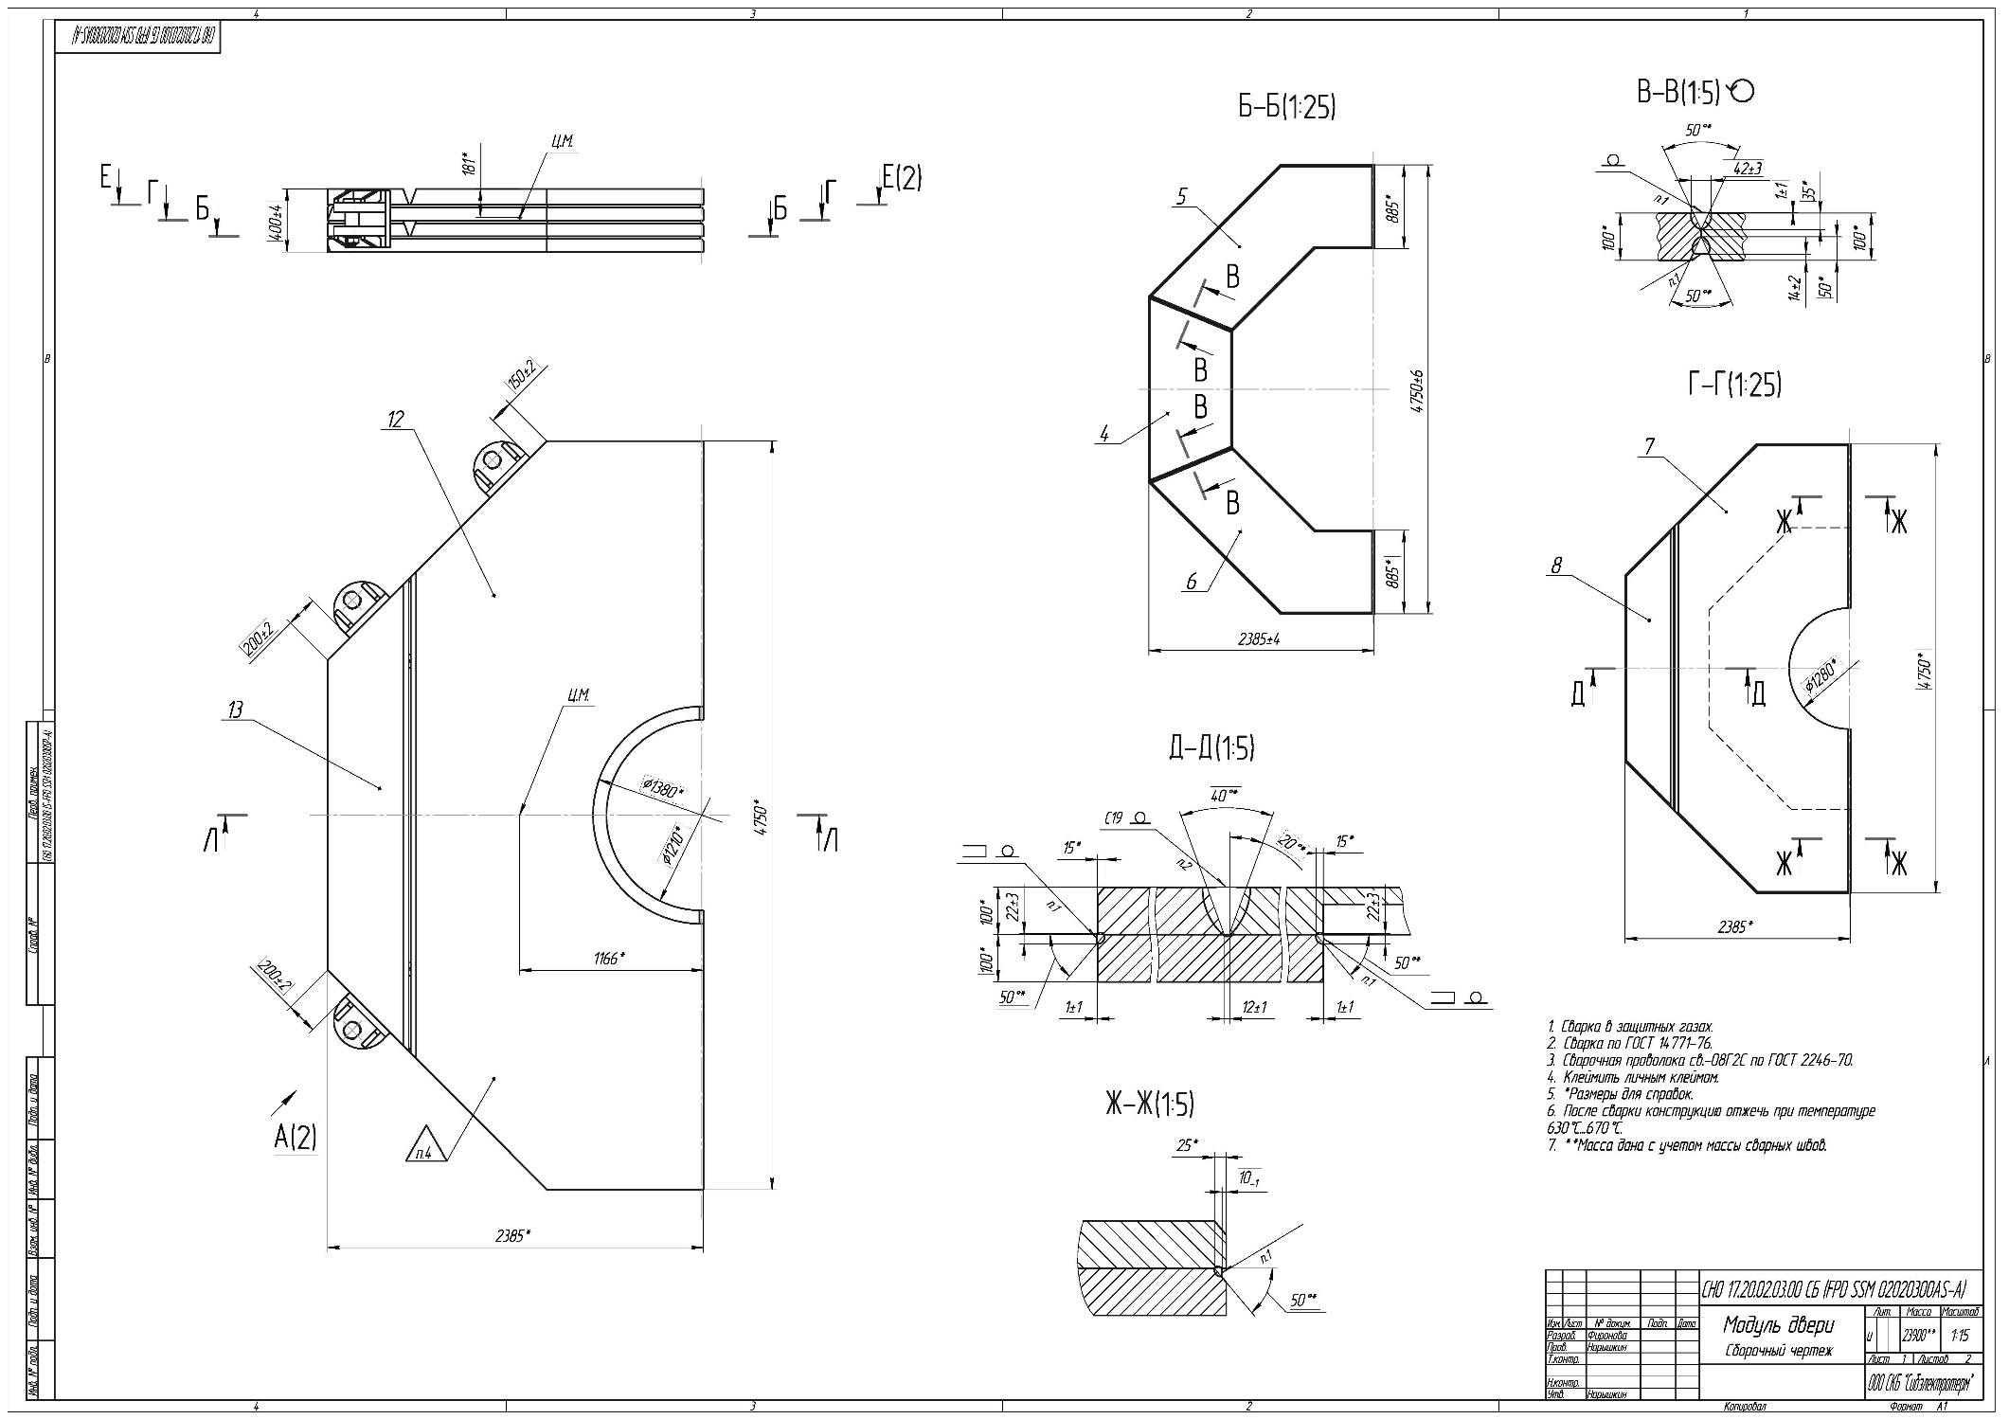
Drawing of the Front Door.

Slide 18
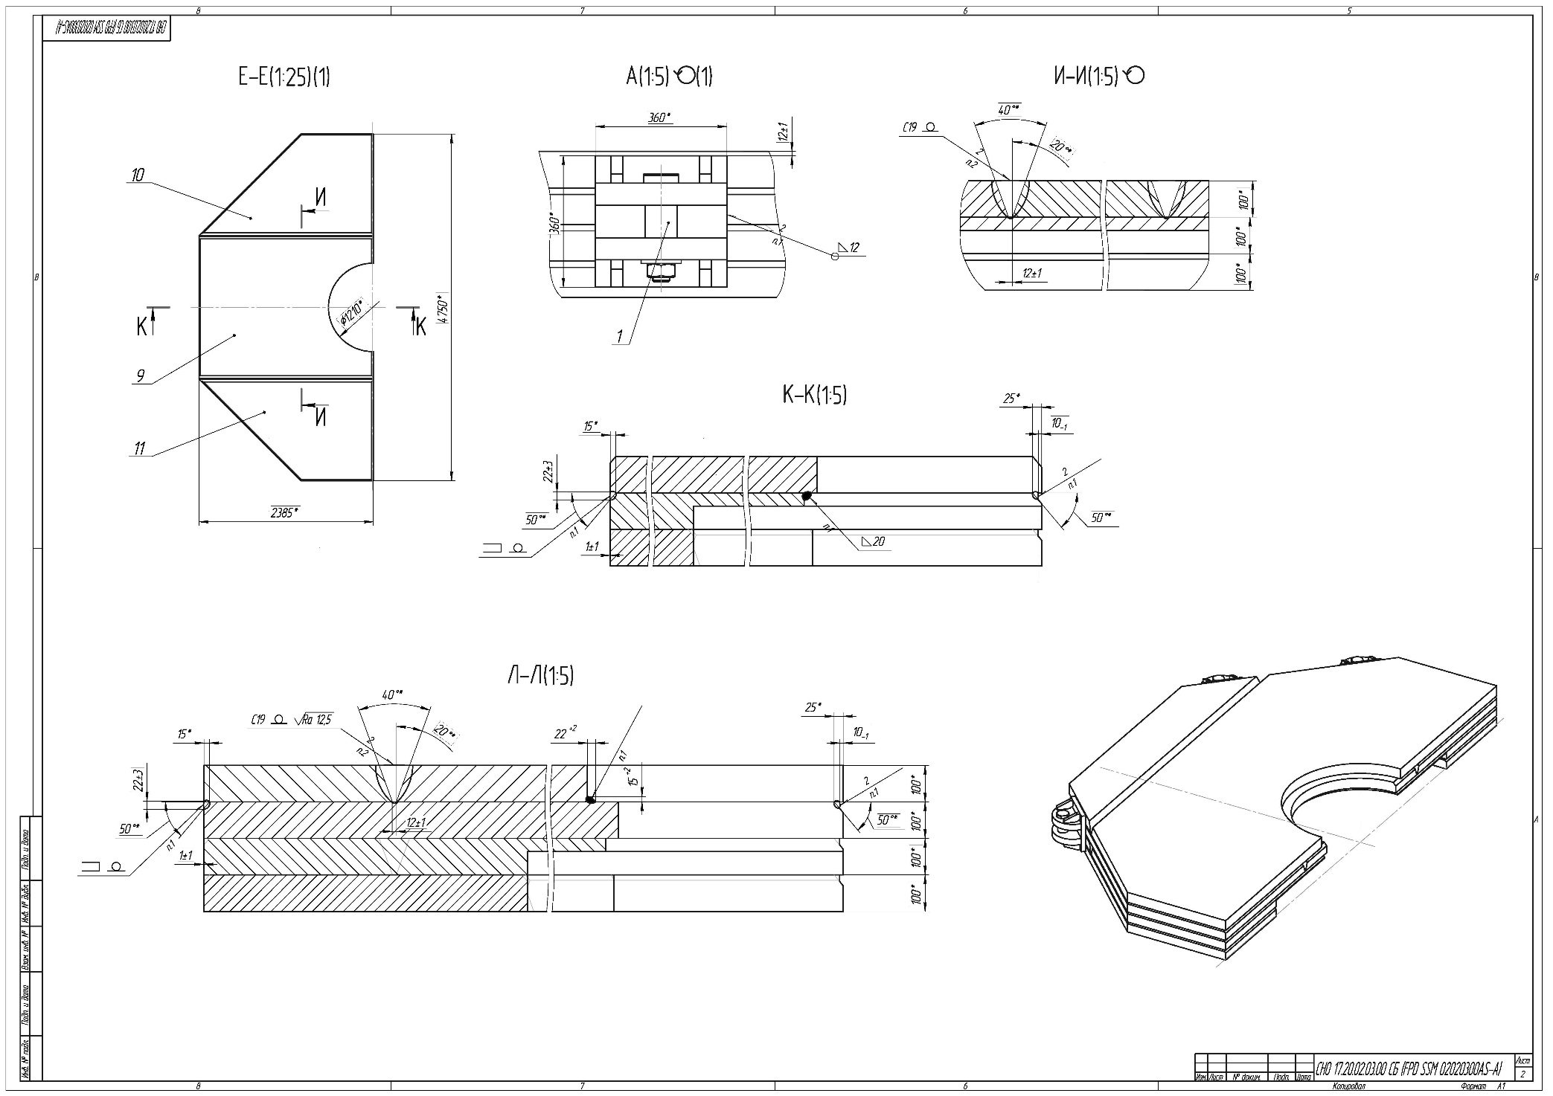
Drawing of the Front Door.

Slide 19
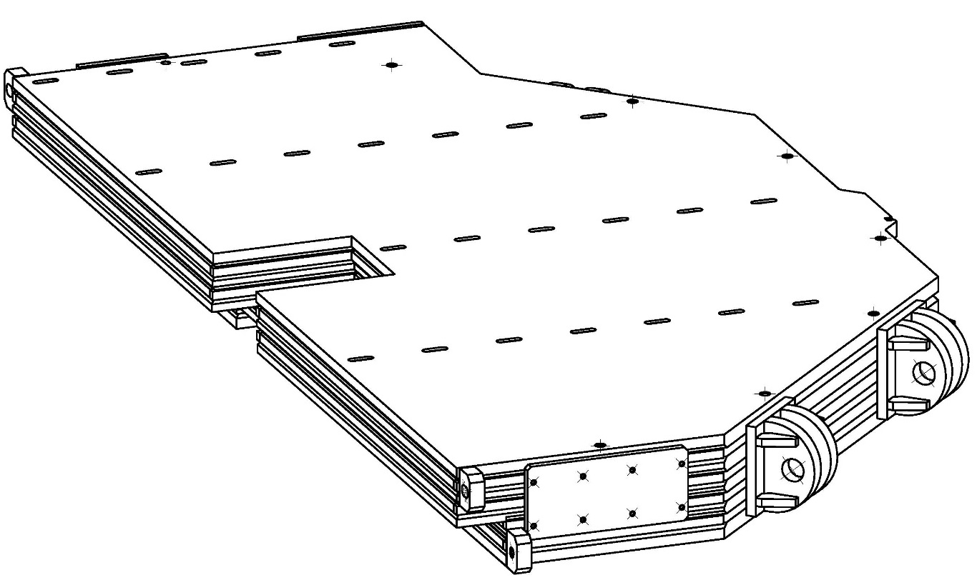
3D-Model of the Back Door of Yoke.

Slide 20
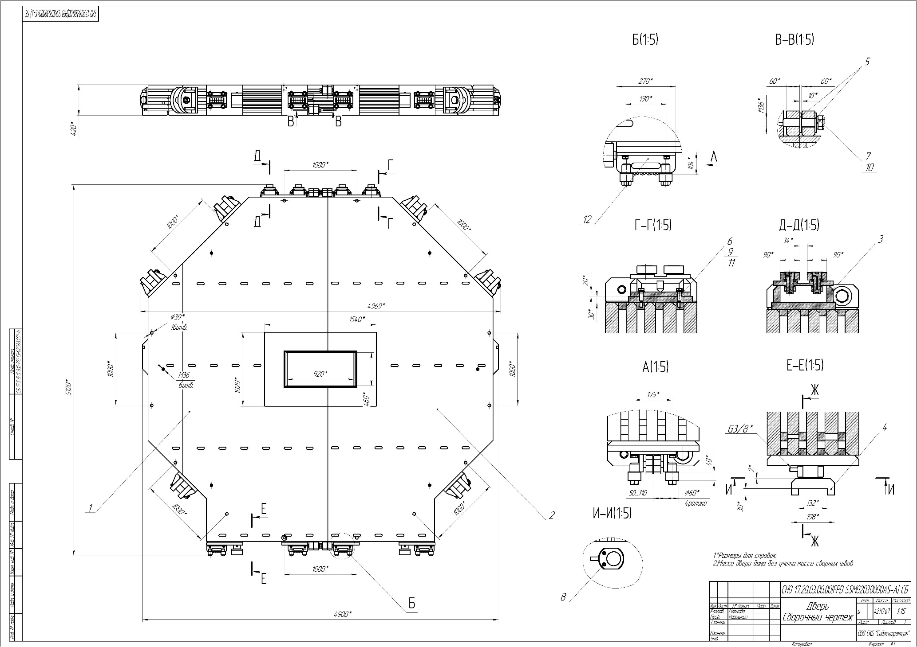
Drawing of the Back Door.

Slide 21
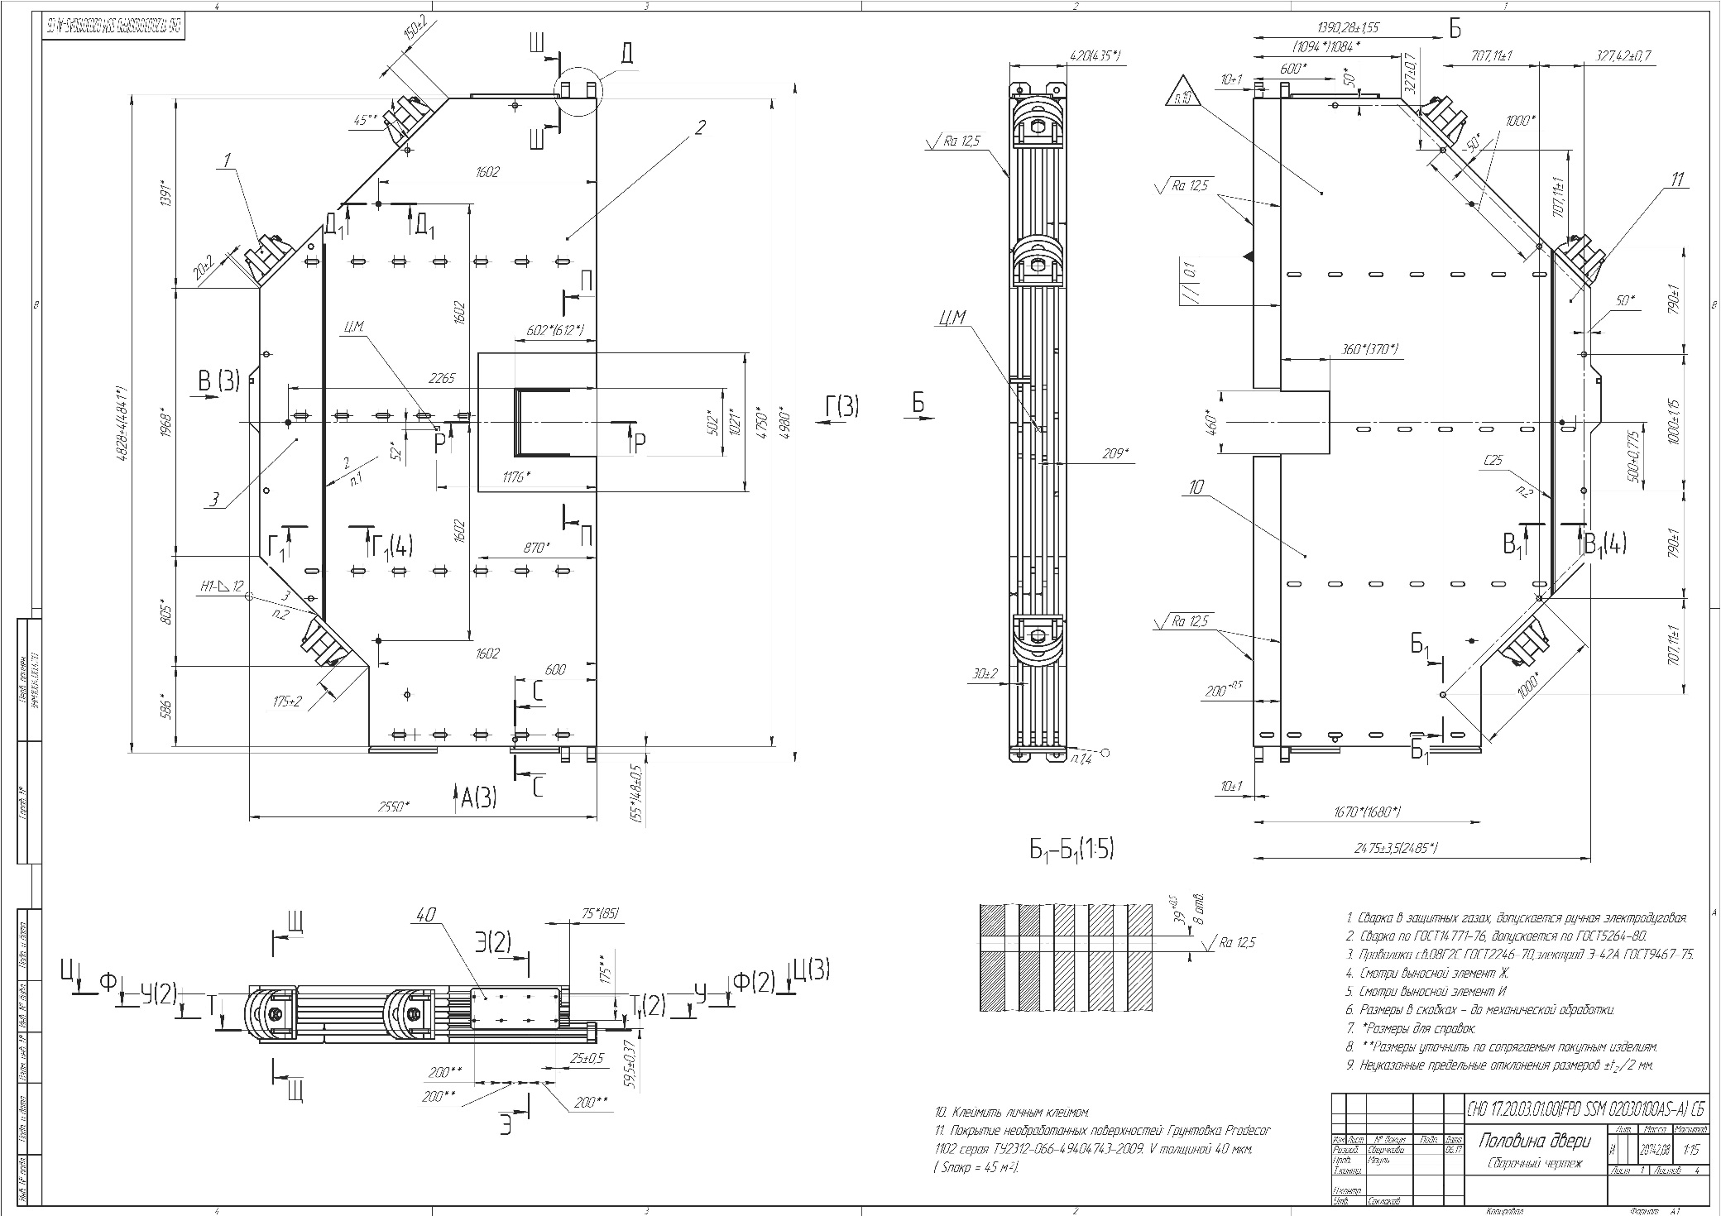
Drawing of the Back Door.

Slide 22
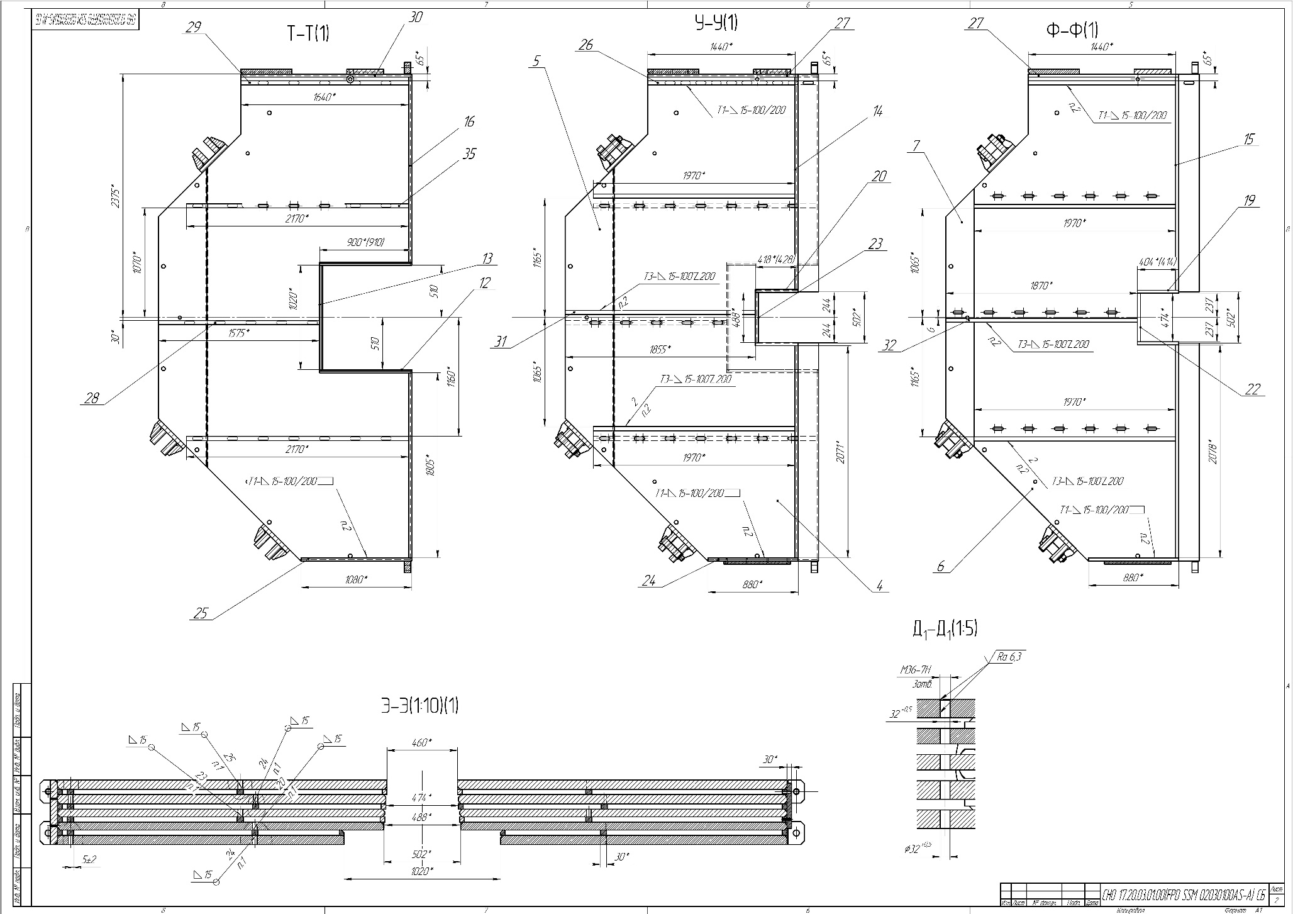
Drawing of the Back Door.

Slide 23
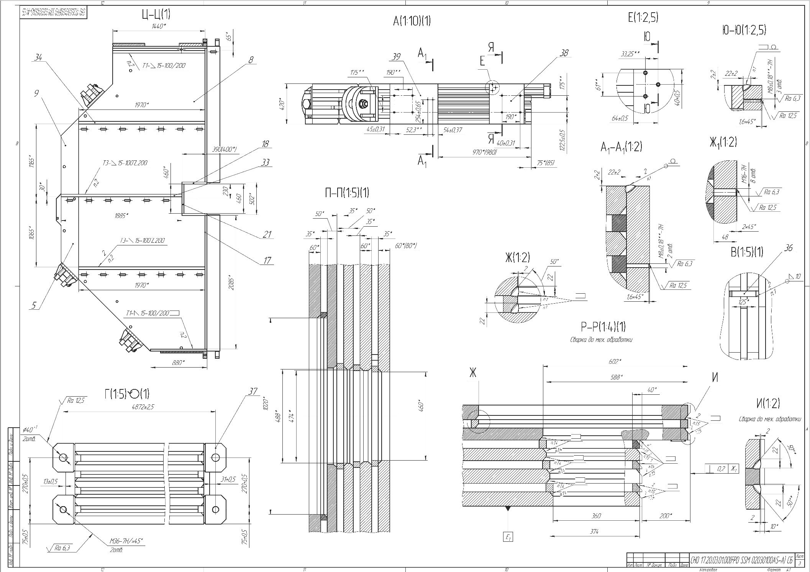
Drawing of the Back Door.

Slide 24
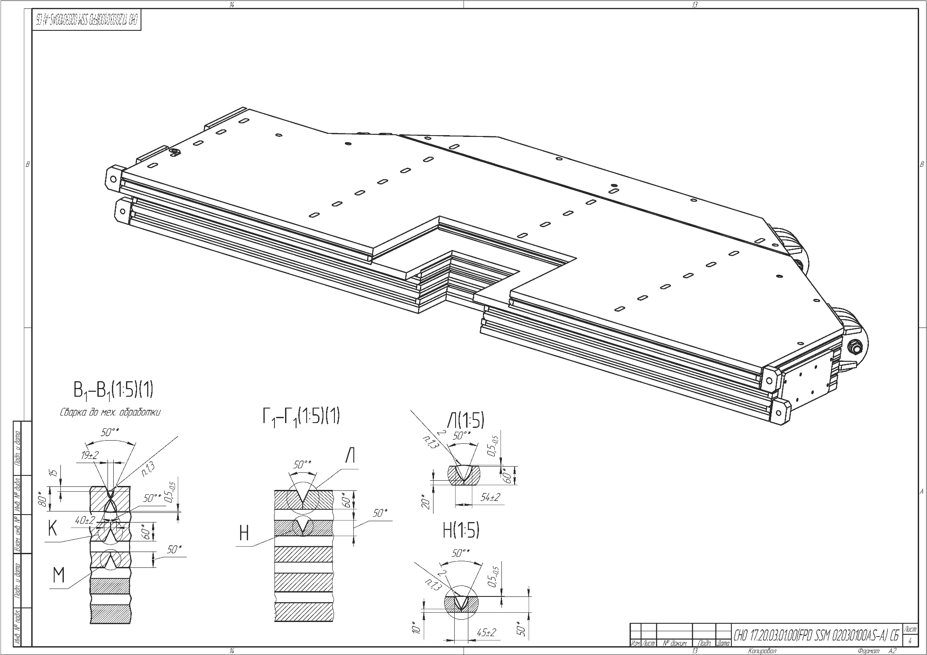
Drawing of the Back Door.

Slide 25
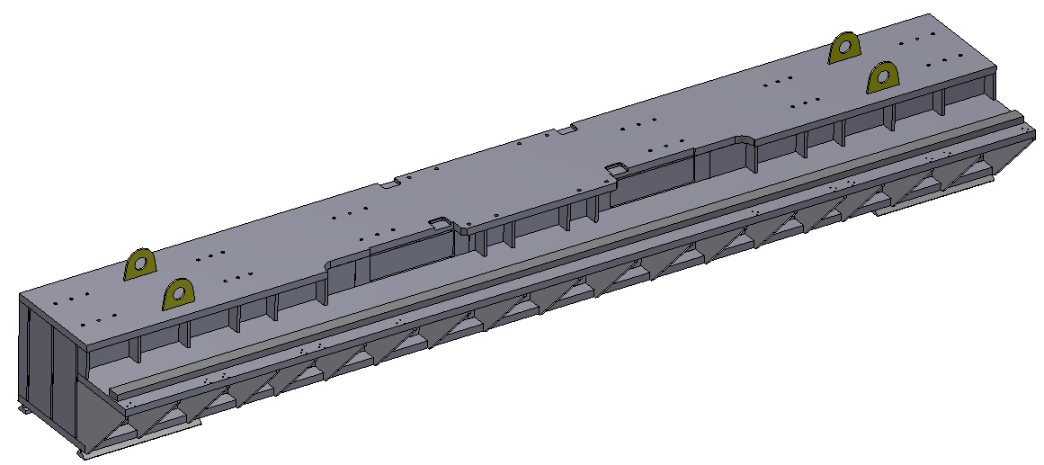
Beam of the support of Yoke.

Slide 26
Drawing of the Beam.

Slide 27
Drawing of the Beam.

Slide 28
Drawing of the Beam.

Slide 29
Drawing of the Beam.

Slide 30
3D model of the Magnet, Yoke, Platform and Frame.

Slide 31
Conclusion
The drawings of the main assemblies will be ready on September 15.
PDR – end of September.
All drawings will be ready on the end of October.
FDR – beginning of November.
Start of production – December.

Slide 32
Thank you for your attention!

