Slide 1
Problems in π⁰ Reconstruction
September 5, 2017 | Albrecht Gillitzer, IKP Forschungszentrum Jülich
PANDA Collaboration Meeting 17/3, Novosibirsk, Russia

Slide 2
Neutral Pion Modes in Ξ* Decays
studied channel: 4.6 GeV/c $\overline{p}p→{\overline{Ξ}}^{+}Ξ^{−}π^{0}$
PandaRoot release feb17p1 → trunk 30122, all Geant4
simulated 2.4 M events (feb17p1), 2.7 M events (trunk 30122)
this talk: analyzed 0.2 M events (trunk 30122)
analysis task based on Xinying‘s code
focus in analysis on π⁰ reconstruction
found very low MC truth matching in rel. feb17p1 → trunk
high combinatorial background also induced by secondary particles other than photons

Slide 3
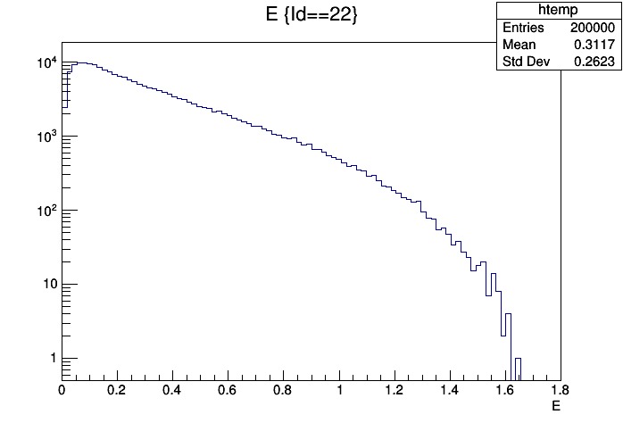
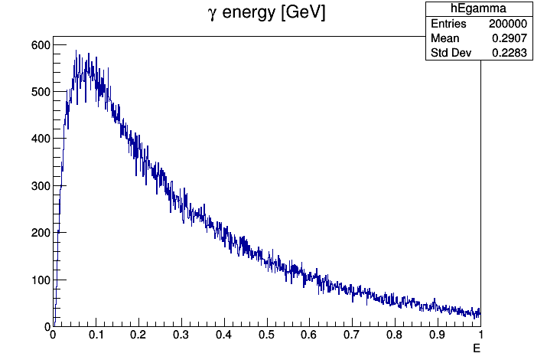
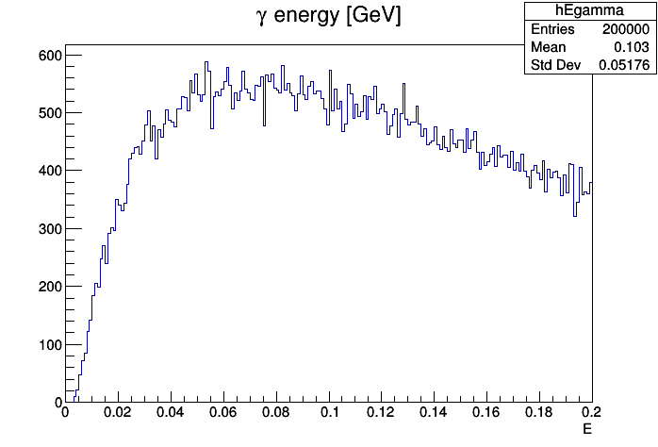
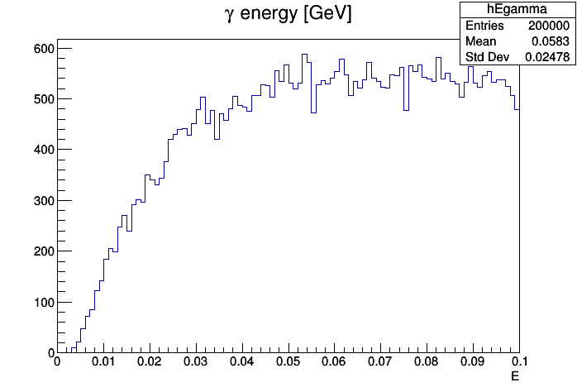
MC Truth Photon Energy Spectrum
100000 events
log
lin
low energy
threshold required
15 MeV
0 – 200 MeV
0 – 100 MeV

Slide 4
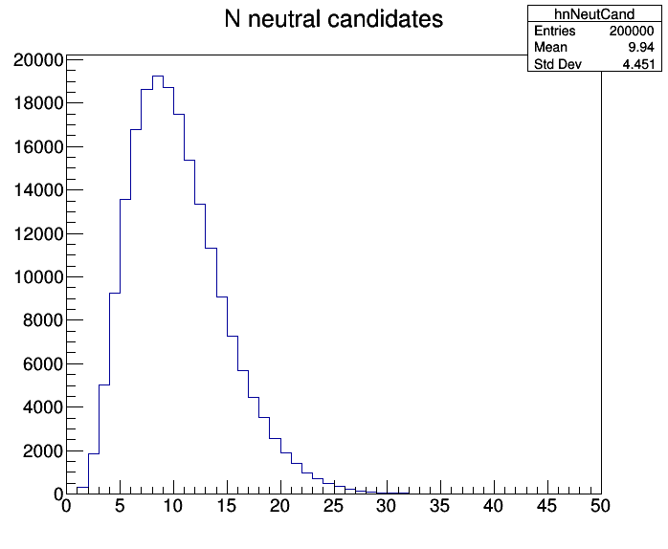
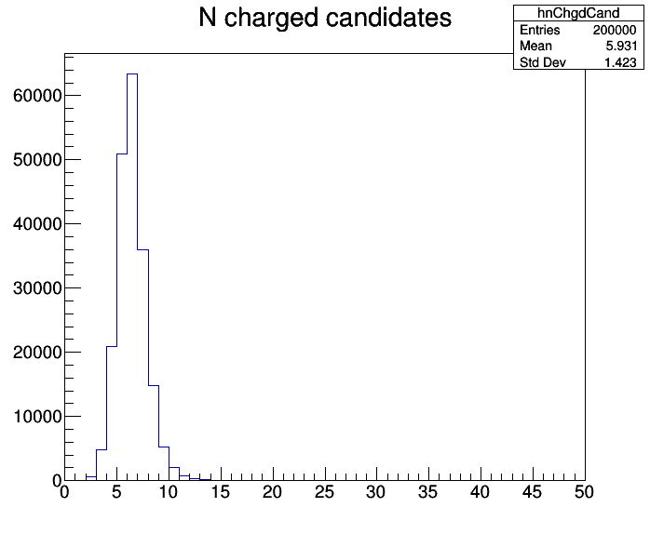
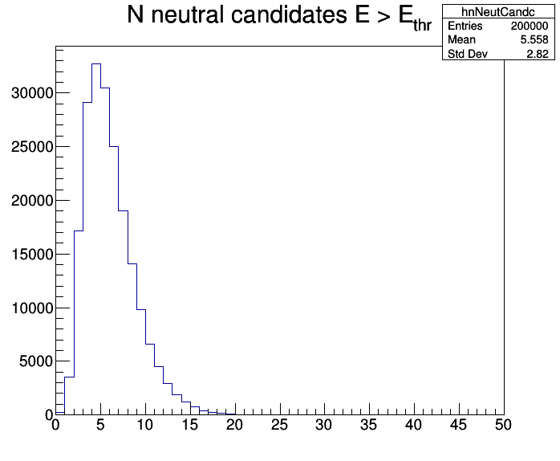
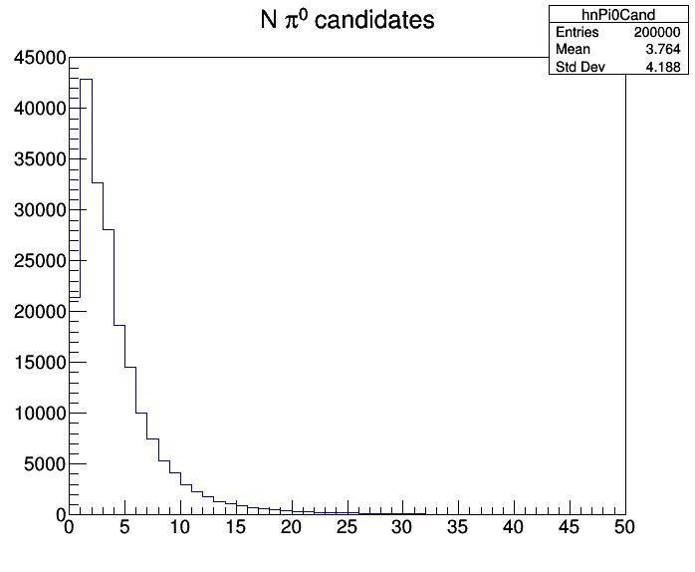
Multiplicity of Candidates
200000 events
neutral cand‘s
charged cand‘s
neutral cand‘s E > 15 MeV
80 MeV < M < 180 MeV
π⁰ cand‘s
mostly more than
one π⁰ candidate

Slide 5
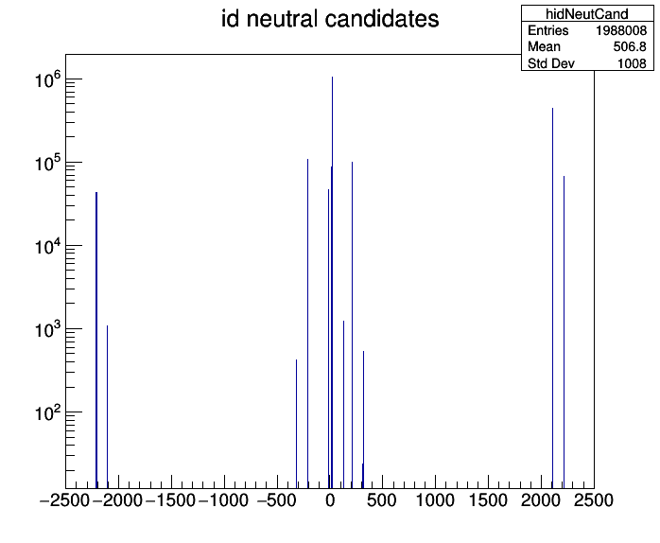
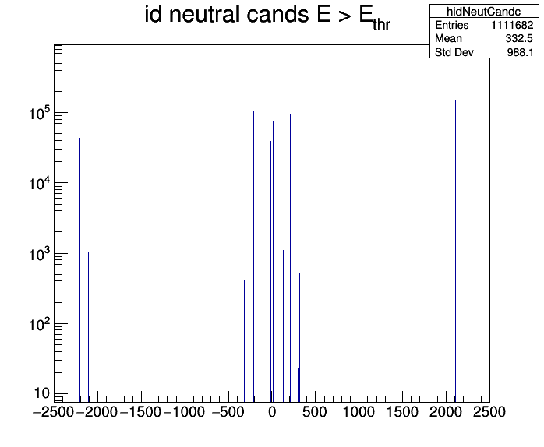
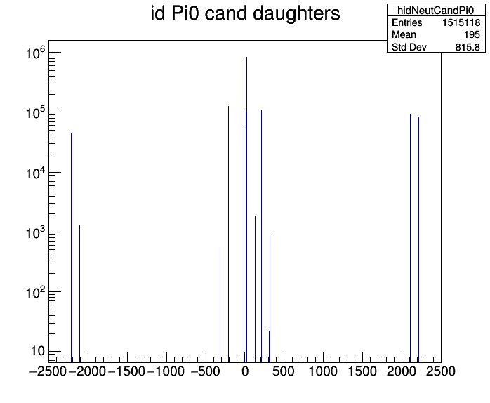
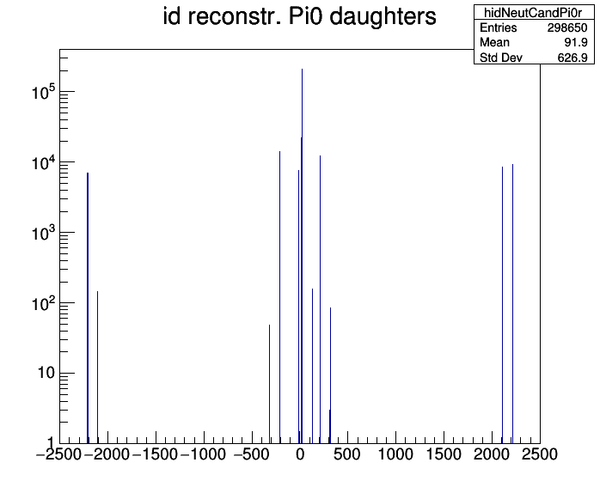
Id of Neutral Candidates: all types of particles (incl. $ν !)$
$γ$: 52.4%
all
$γ$: 44.3%
E > 15 MeV
π⁰ daugh‘s
rec. π⁰ daugh‘s
$γ$: 55.7%
$γ$: 70.9%

Slide 6
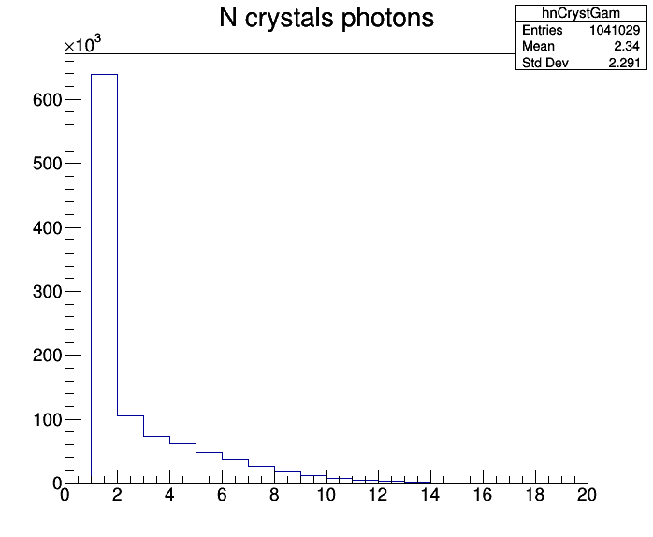
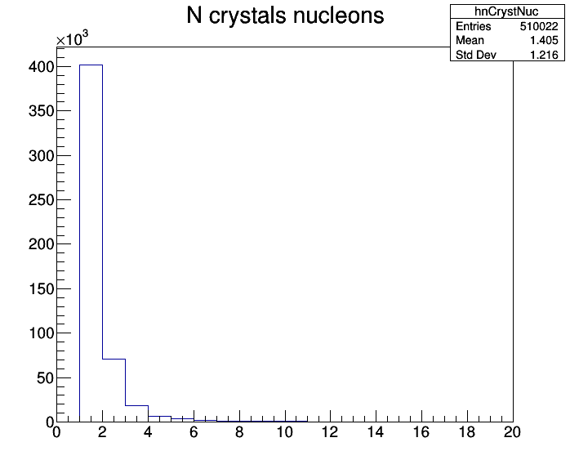
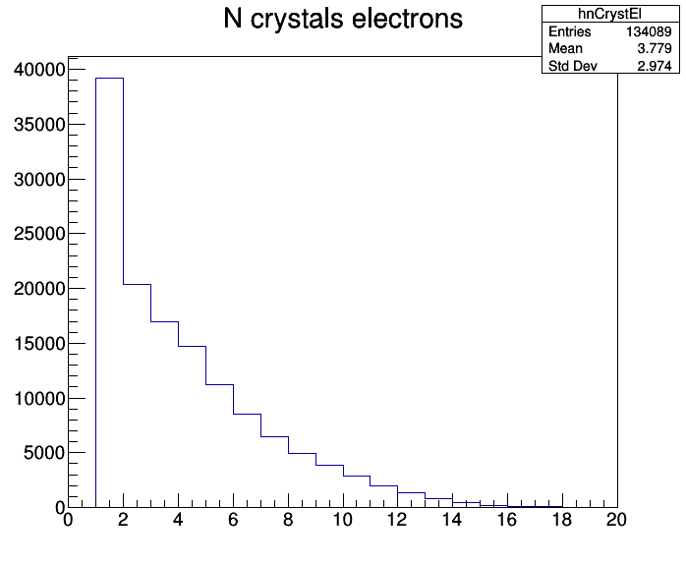
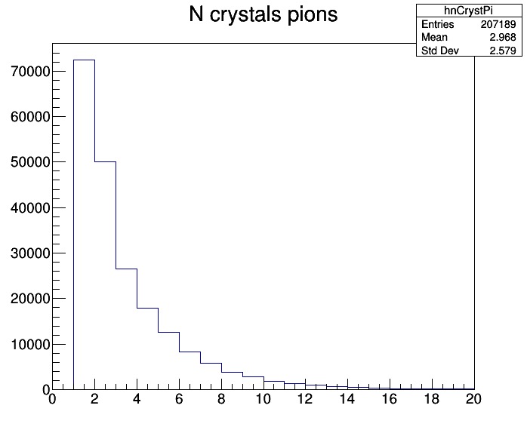
# Hit EMC Crystals of Neutral Candidates
$$γ$$
N
$$e^{±}$$
$$π^{±}$$

Slide 7
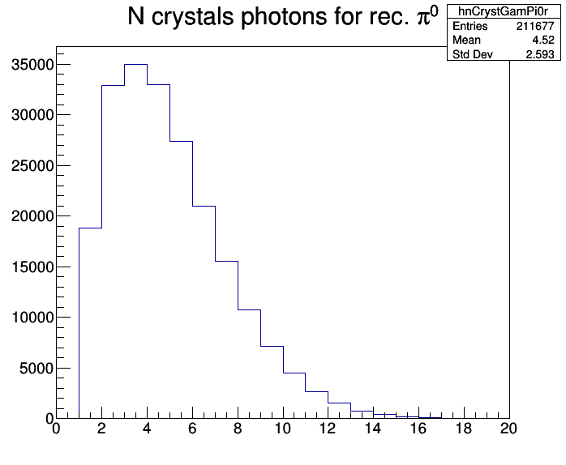
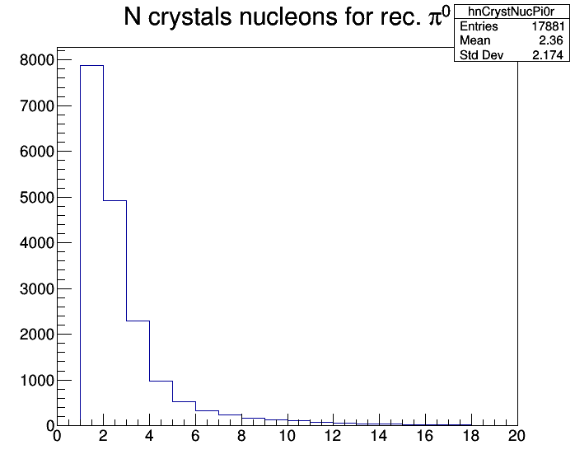
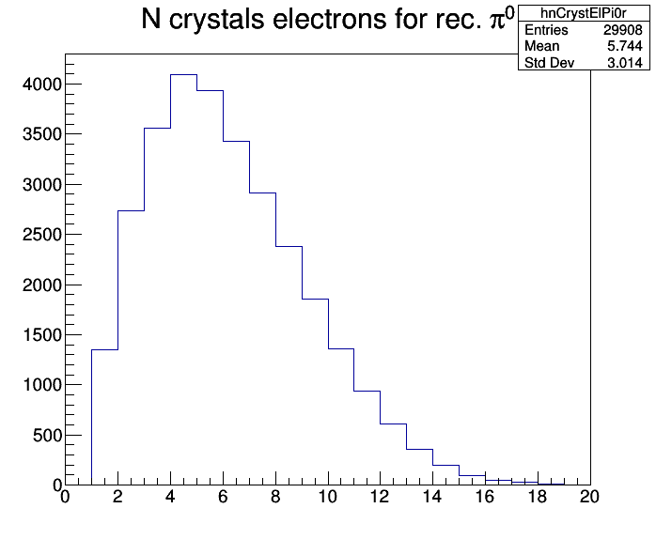
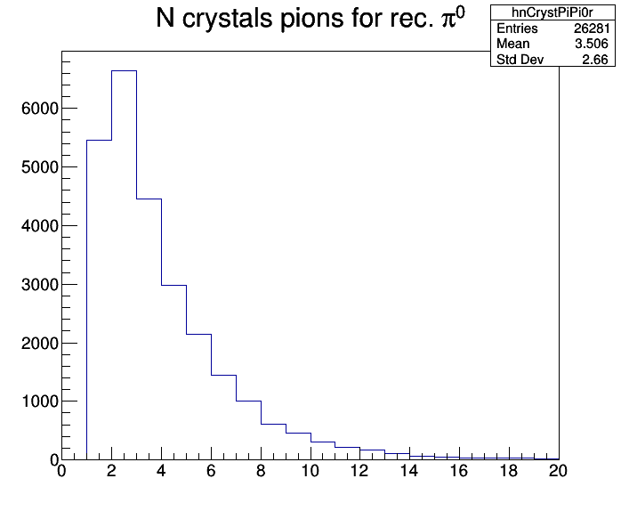
# Hit EMC Crystals of Neutral Candidates (Rec. π⁰)
$γ$ in rec. π⁰
N in rec. π⁰
$e^{±}$ in rec. π⁰
$π^{±}$ in rec. π⁰
no parameter
to cut on

Slide 8
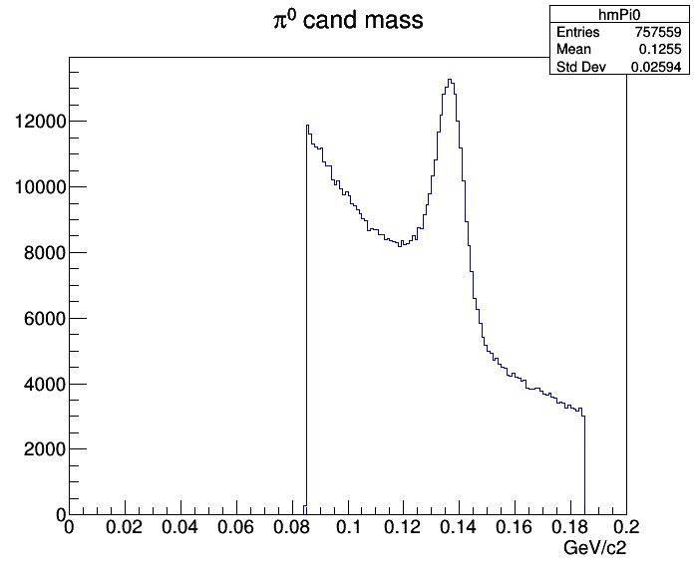
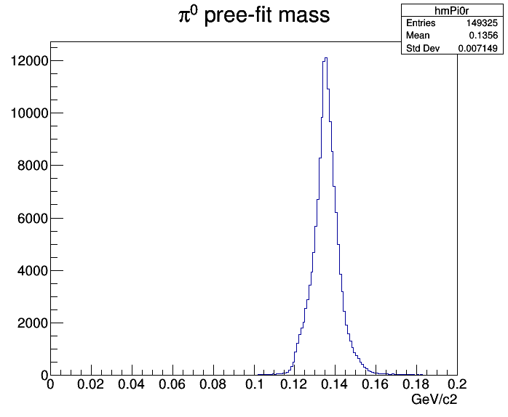
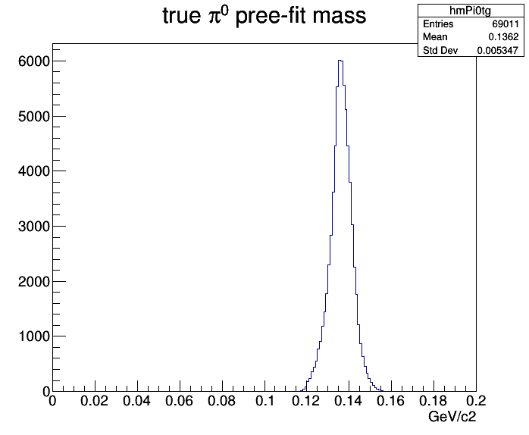
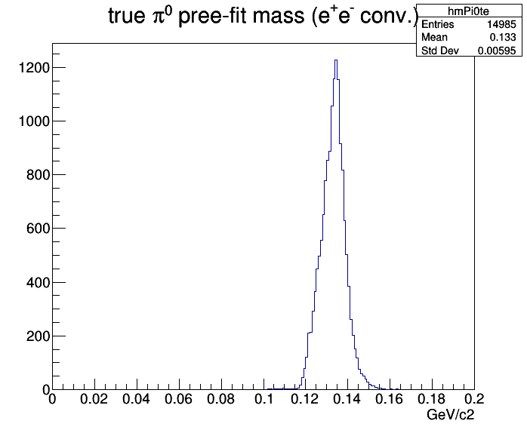
Masses of π⁰ Candidates
raw π⁰
pre-fit π⁰
true p.-f. π⁰
true p.-f. π⁰
$≥$1 $e^{±}$

Slide 9
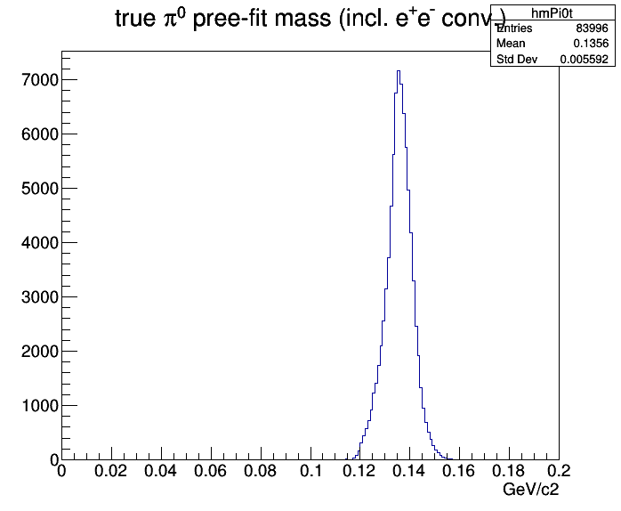
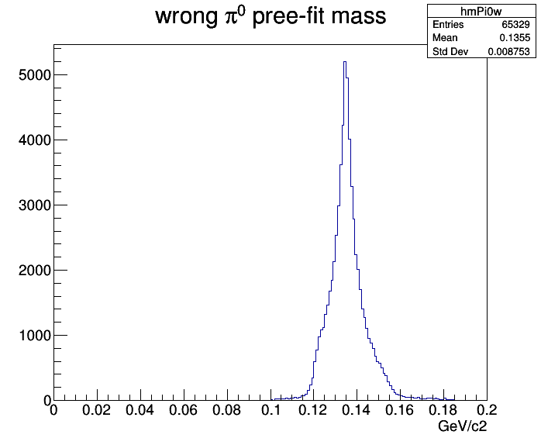
Masses of π⁰ Candidates
true p.-f. π⁰
true p.-f. π⁰
$≥$1 $e^{±}$
true p.-f. π⁰
$γγ \&≥$1 $e^{±}$
fake p.-f. π⁰

Slide 10
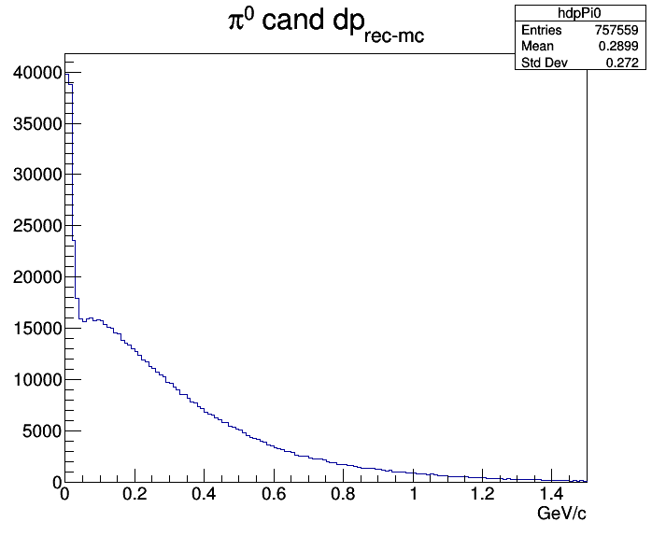
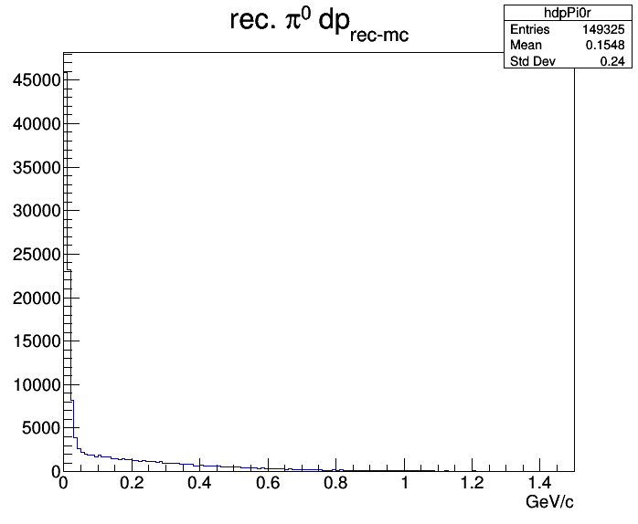
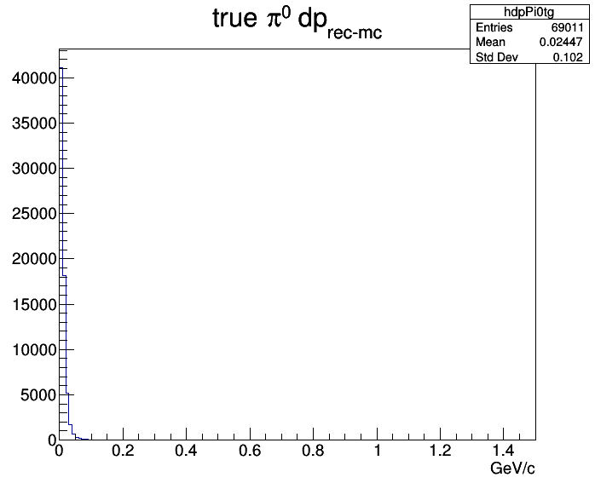
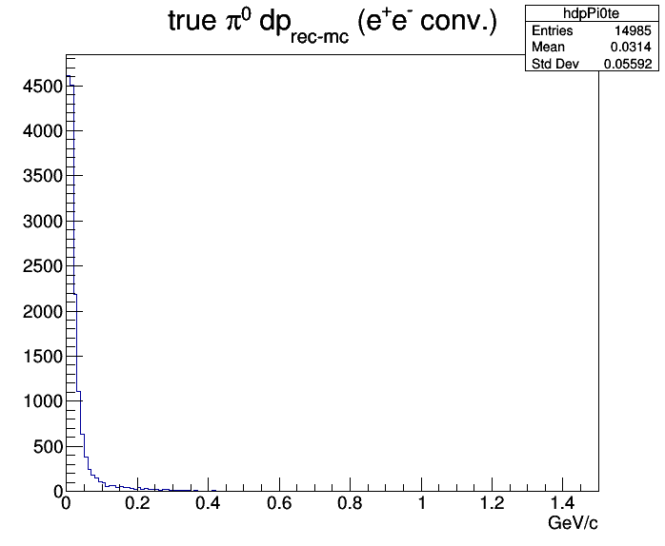
$\left|{\vec{P}}_{rec}−{\vec{P}}_{MC}\right|$ of π⁰ Candidates
raw π⁰
reco π⁰
true reco π⁰
true reco π⁰
$≥$1 $e^{±}$

Slide 11
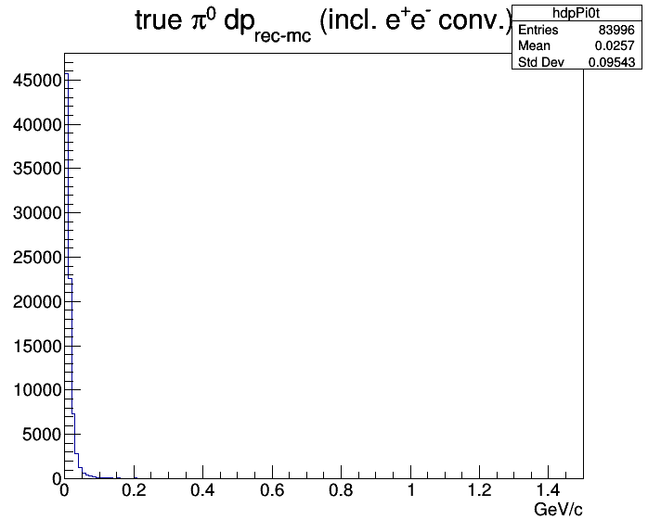
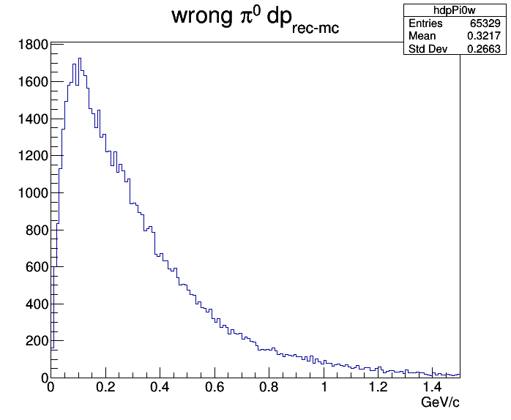
$\left|{\vec{P}}_{rec}−{\vec{P}}_{MC}\right|$ of π⁰ Candidates
true reco π⁰
true reco π⁰
$≥$1 $e^{±}$
true reco π⁰
$γγ \&≥$1 $e^{±}$
fake reco π⁰

Slide 12
Origin of Neutral Candidates
Where do the neutral candidates come from?
Why are there so many charged particles in the list?
The following slides show the start points of neutral candidate tracks:
all neutral candidates
photons
neutrons
all charged
electrons ($e^{±}$)
pions ($π^{±}$)
protons ($p,\overline{p}$)

Slide 13
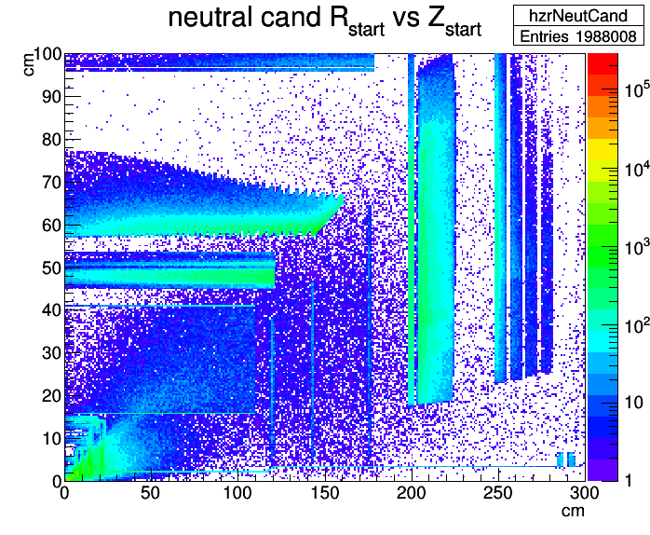
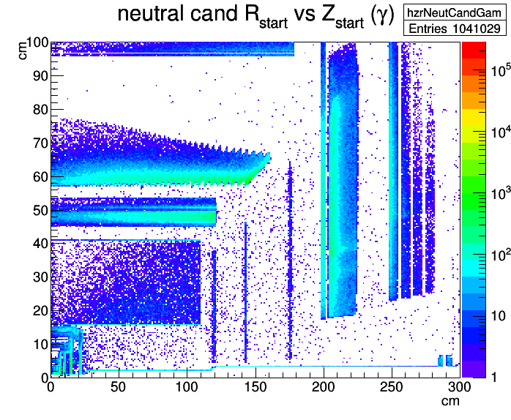
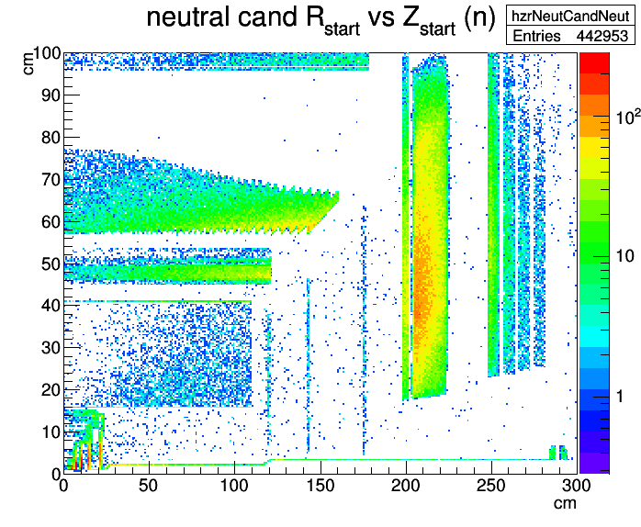
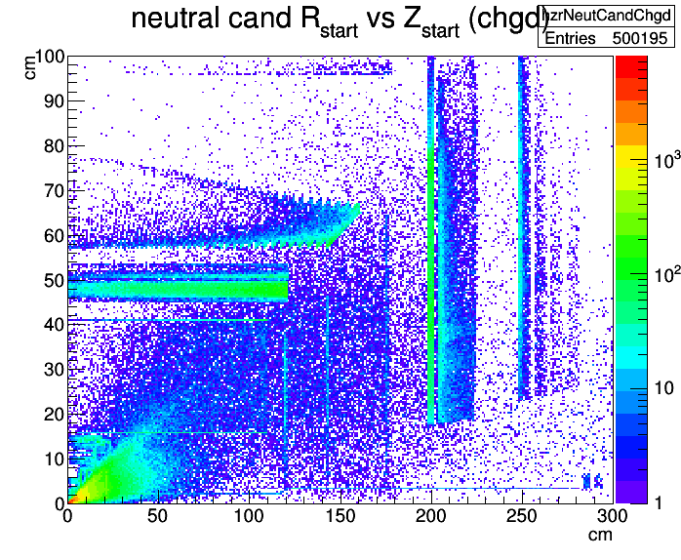

Slide 14
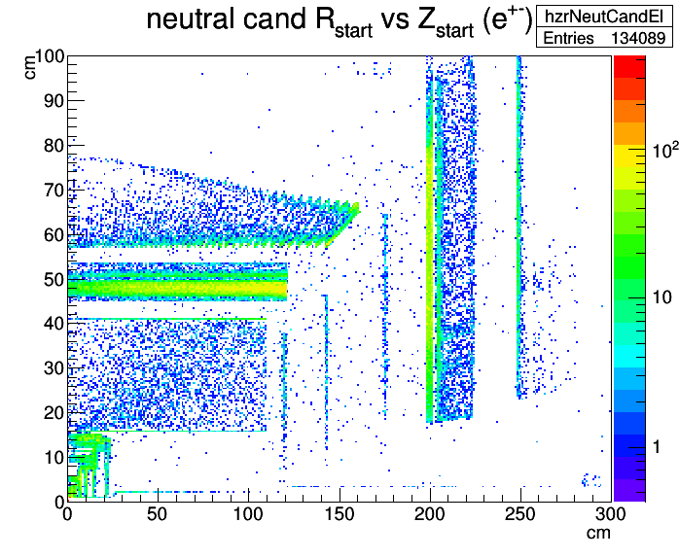
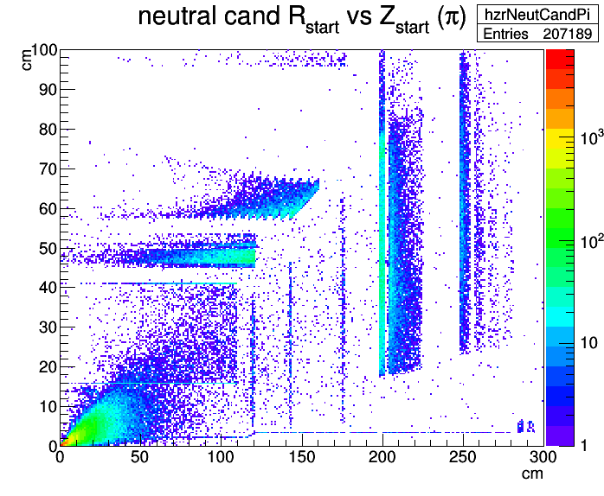
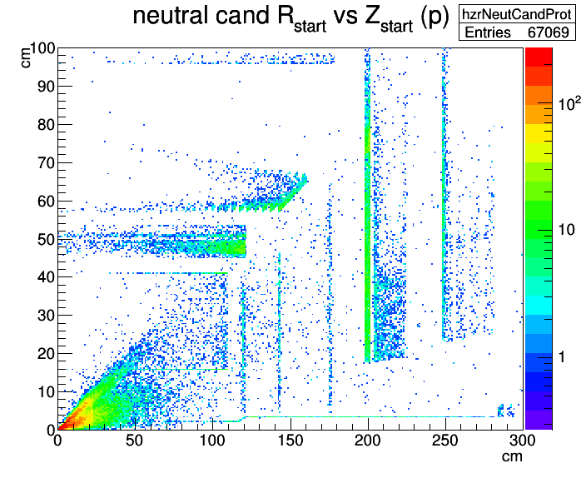

Slide 15
Status Summary
π⁰ reco efficiency too low: ~42% true π⁰ found (rel. to generated)
Ratio of signal to combinatorial background too low: S/B ~ 1.3
MC truth match fraction improved in trunk 30122 compared to release feb17p1 (~30%)
options to separate photons from other particles currently insuficient
4C fit removes part of the background but result is unsatisfactory (not discussed here)
→ need further effort to improve neutral particle reconstruction e.g. time information to suppress slow particles

Slide 16
Thank You
for Your Attention !
spare

Slide 17
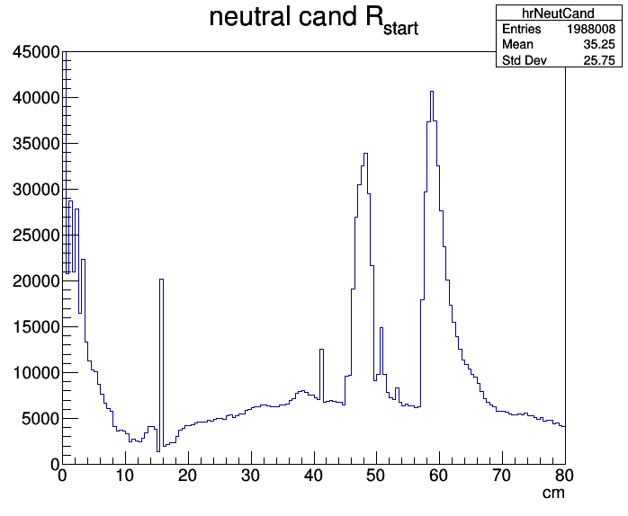
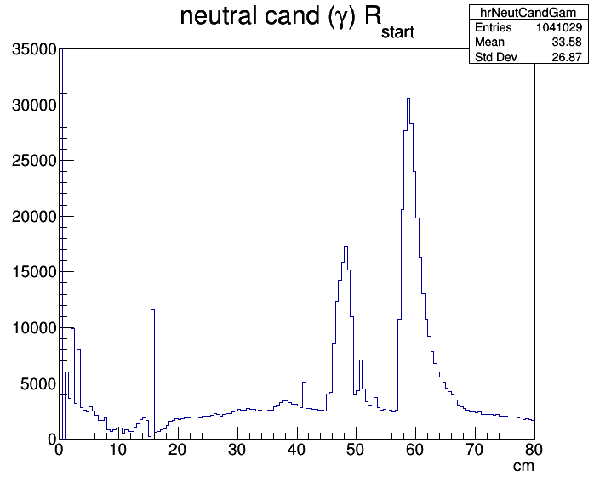
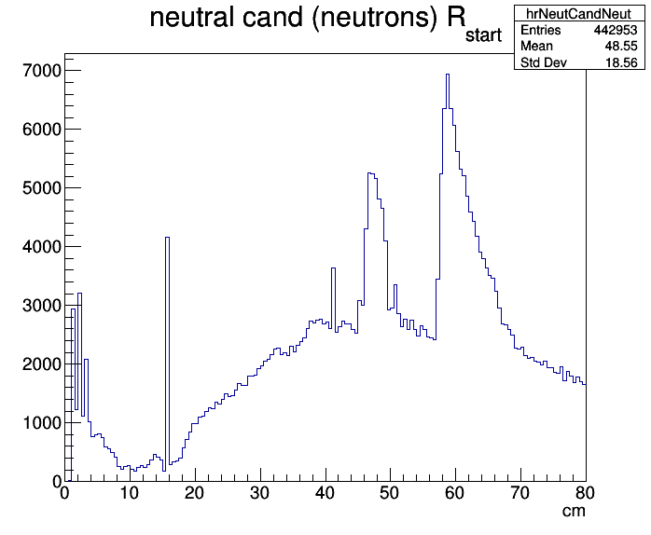
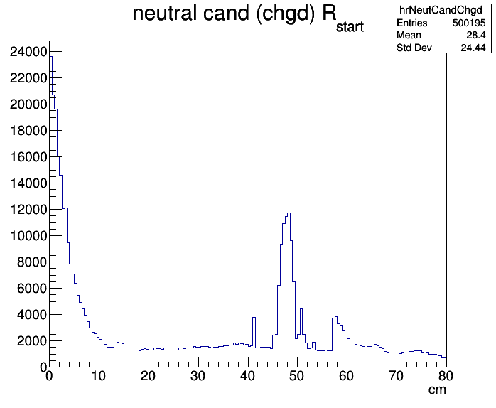
300000
280000
=
=
all cand’s
$$γ$$
n
charged

Slide 18
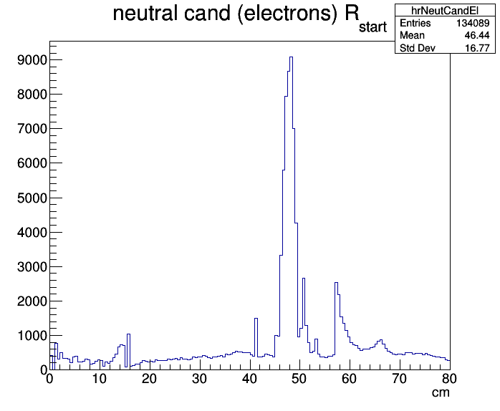
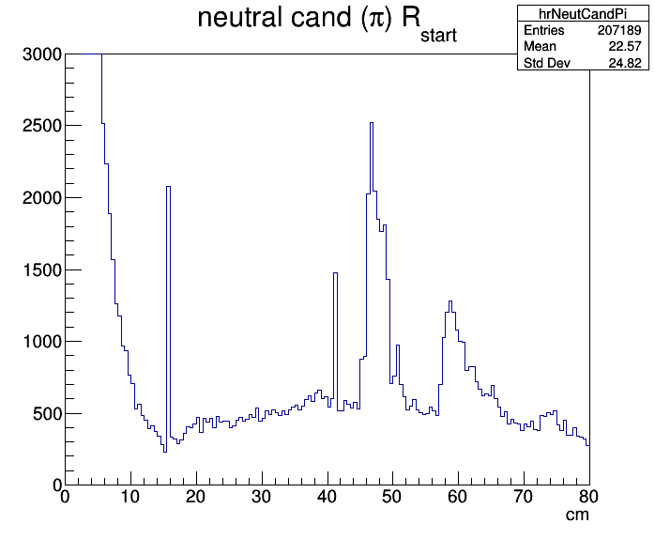
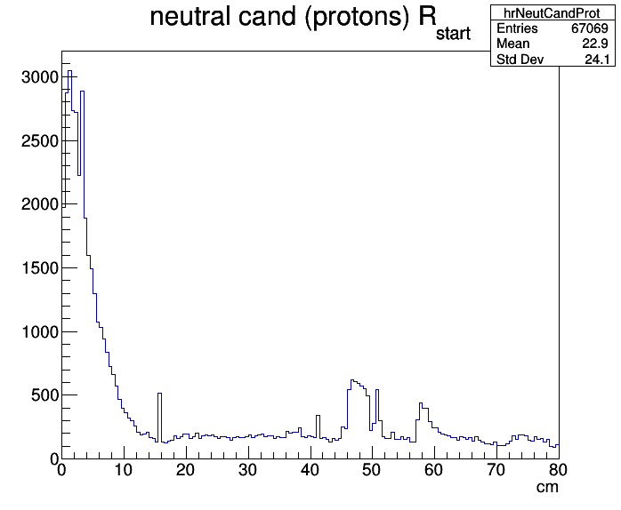
charged
$$e^{±}$$
18500
=
$$π^{±}$$
$$p,\overline{p}$$

Slide 19
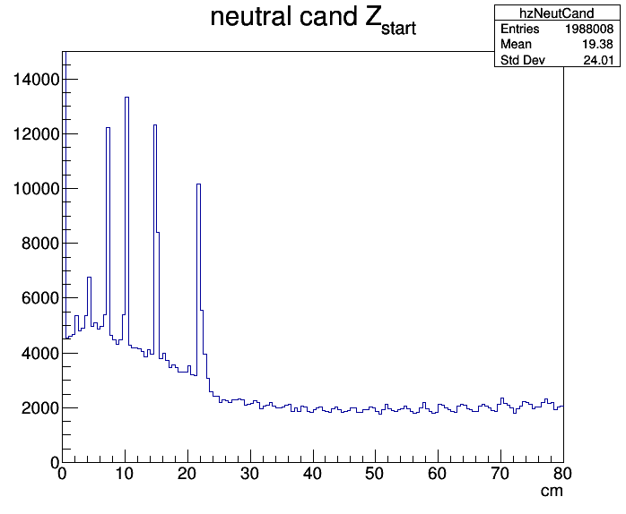
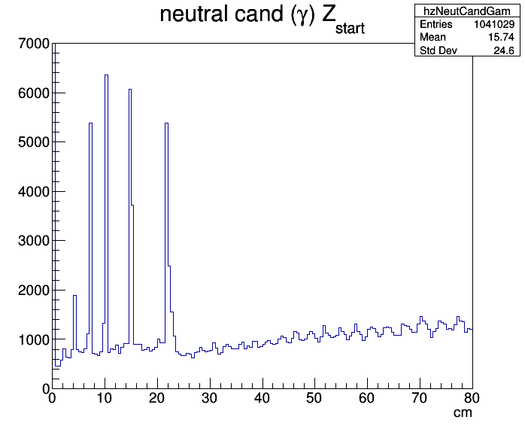
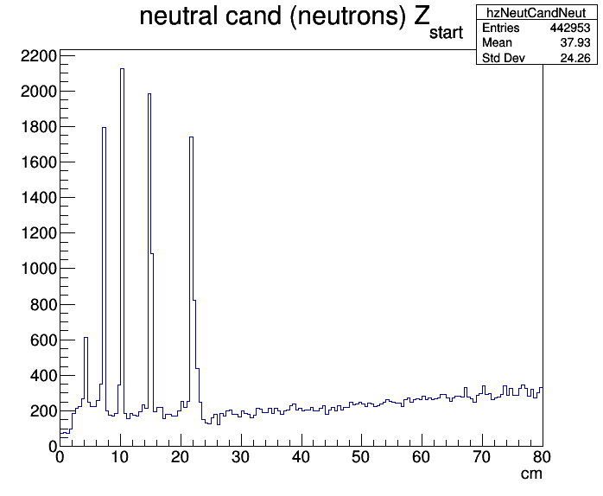
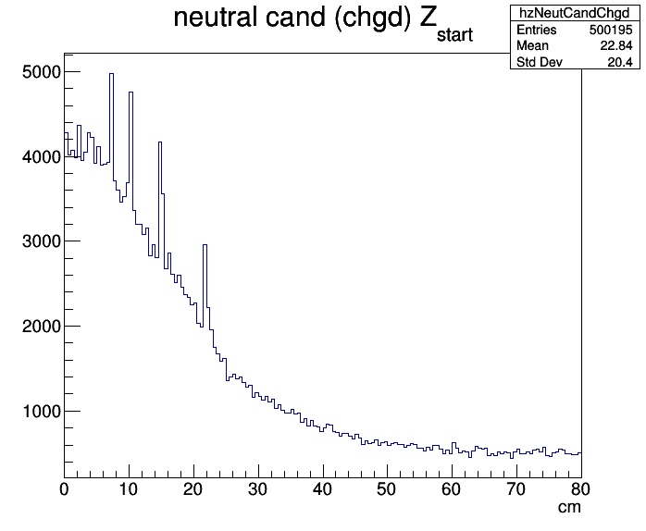
280000
280000
=
=
all cand’s
$$γ$$
n
charged

Slide 20
charged
$$e^{±}$$
3700
=
$$π^{±}$$
$$p,\overline{p}$$

