Slide 1
Benchmark Channels for the DAQ TDR
Computing Session CM 17/3
Sep. 5, 2017
K. Götzen, R. Kliemt, F. Nerling, K. Peters
GSI Darmstadt

Slide 2
Benchmark Channels for TDR
Proof-of-principle benchmark channels for TDR
Should cover various aspects of day-1 physics
PhysCom decided on:
Small cross section case / charmonium: p → J/ψX (= π⁺π⁻ / π⁺ π⁻ π⁰ / γ / π⁰ / π⁰ π⁰) @ 3.872 GeV
Very small cross-section, exclusive / form factor physics: p → e⁺e⁻ @ 2.254 GeV
High cross section / hyperon physics: p → Λ @ 2.304 GeV
Single trigger lines (although should be simultaneous for J/ψ)
Use mainly simple quantities, probably easy to determine online

Slide 3
Simulation
Setup options for simulation
"day1 + gem + fts1256"
Data:
Channel | signal | background
p → J/ψ(e⁺e⁻ )X | 250k | 1M (DPM inel.)
p → J/ψ(μ⁺μ⁻ )X | 250k | 1M (DPM inel.)
p → e⁺e⁻ | 50k | 2M (DPM inel.) + 500k (DPM el.)
p → Λ | 100k | 1M (filtered out Lambda)

Slide 4
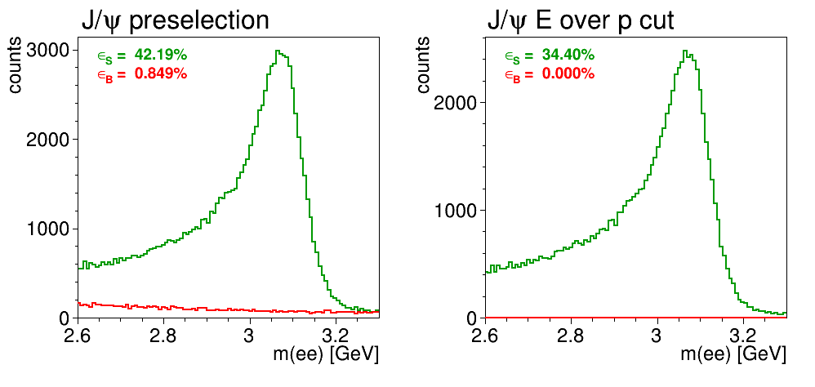
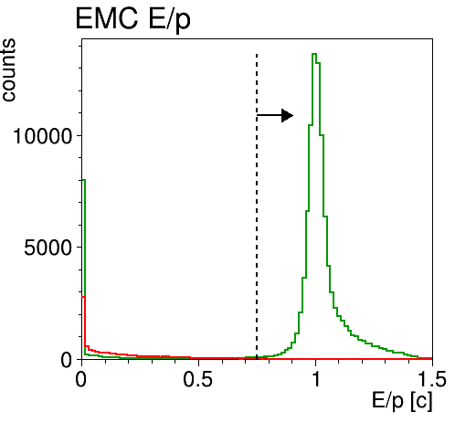
p → J/ψ(e⁺e⁻)X (using EMC E/p)
ε_{B} = 0.0002%
f_{sup} = 500000
signal
background
E/p [1/c]

Slide 5
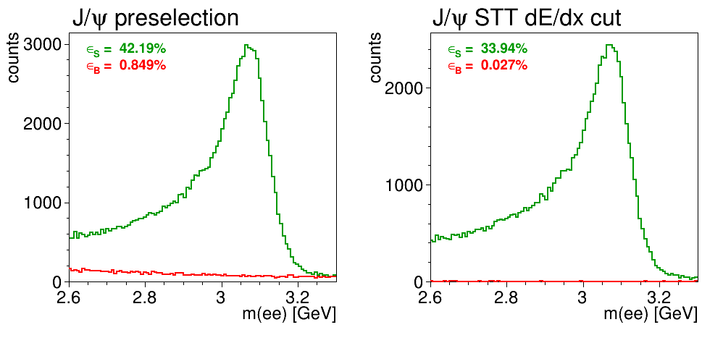
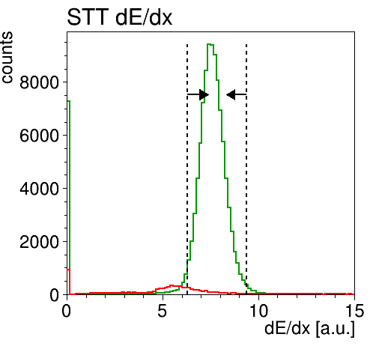
p → J/ψ(e⁺e⁻)X (using STT dE/dx)
ε_{B} = 0.027%
f_{sup} = 3660
signal
background

Slide 6
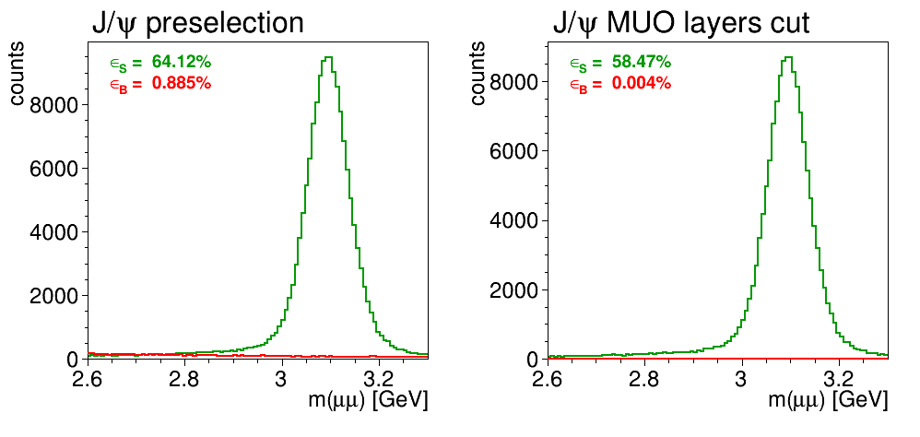
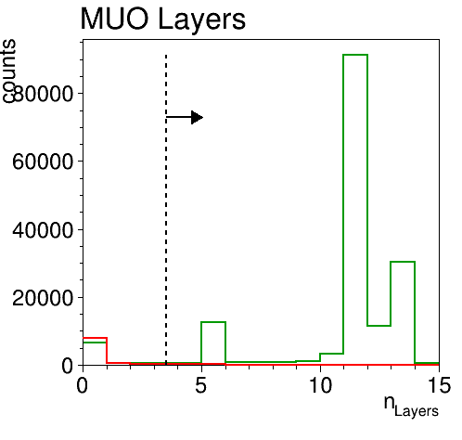
p → J/ψ(μ⁺μ ⁻)X (using MUO #layers)
ε_{B} = 0.004%
f_{sup} = 23300
signal
background

Slide 7
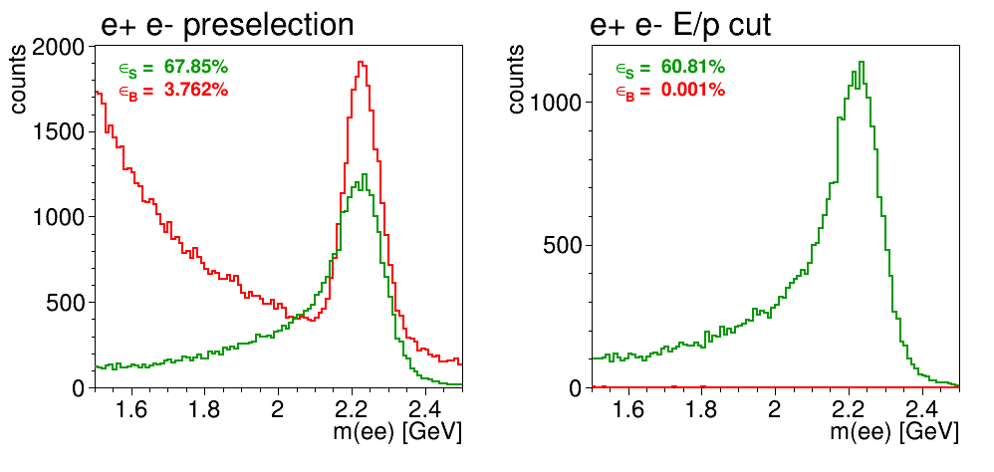
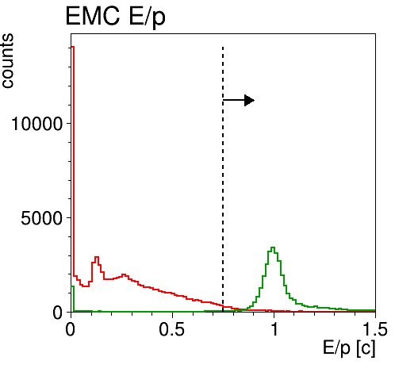
p → e⁺e⁻ (using EMC E/p)
ε_{B} = 0.001%
f_{sup} = 95200
signal
background
E/p [1/c]

Slide 8
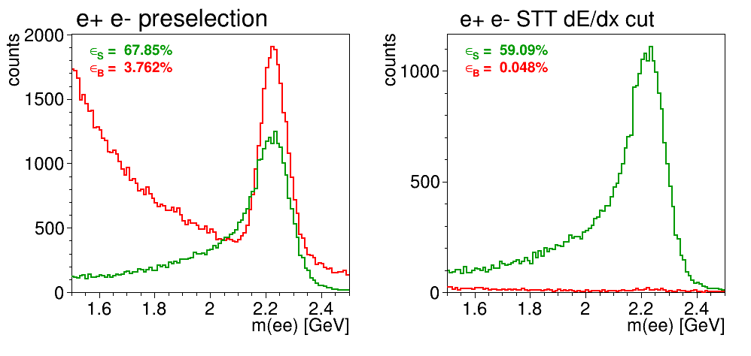
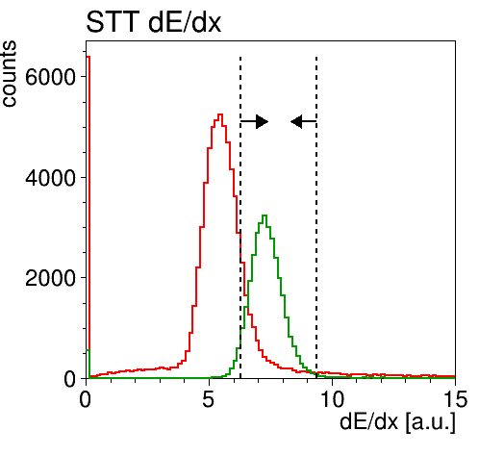
p → e⁺e⁻ (using STT dE/dx)
ε_{B} = 0.048%
f_{sup} = 2070
signal
background

Slide 9
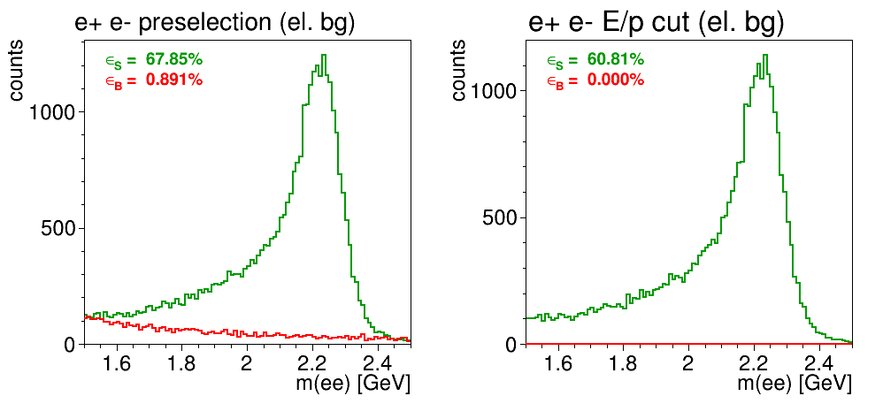
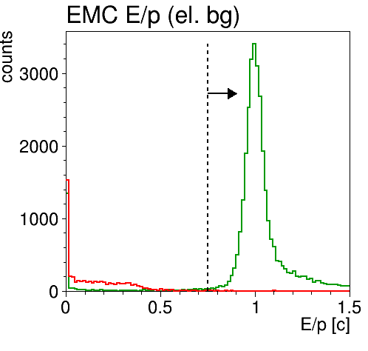
p → e⁺e⁻ (using EMC E/p, DPM el.)
ε_{B} = 0.0002%
f_{sup} = 500000
signal
background
E/p [1/c]

Slide 10
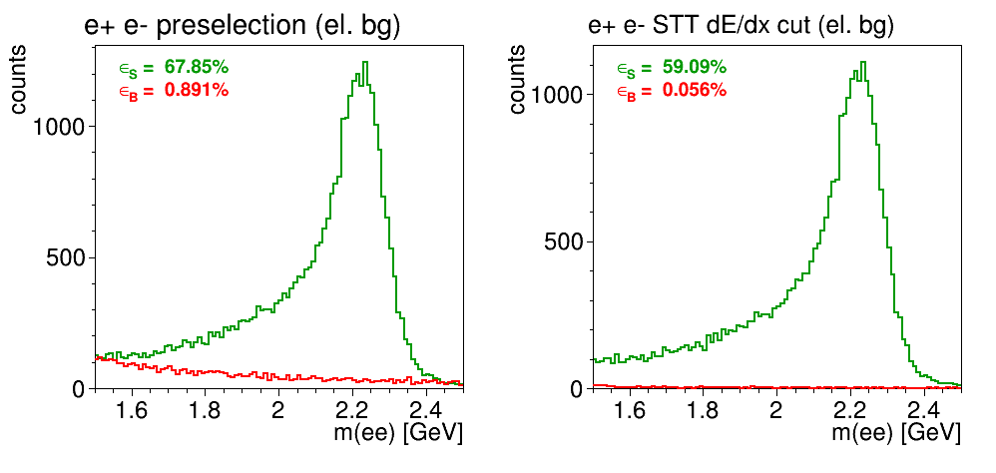
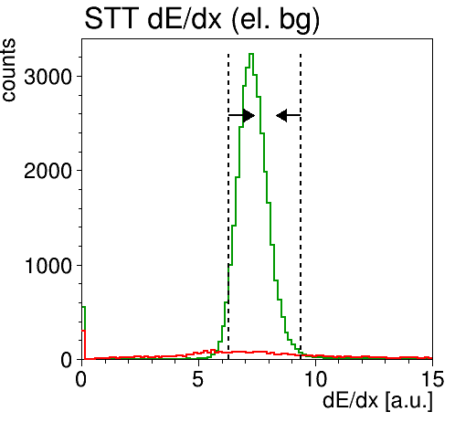
p → e⁺e⁻ (using STT dE/dx, DPM el.)
ε_{B} = 0.056%
f_{sup} = 1770
signal
background

Slide 11
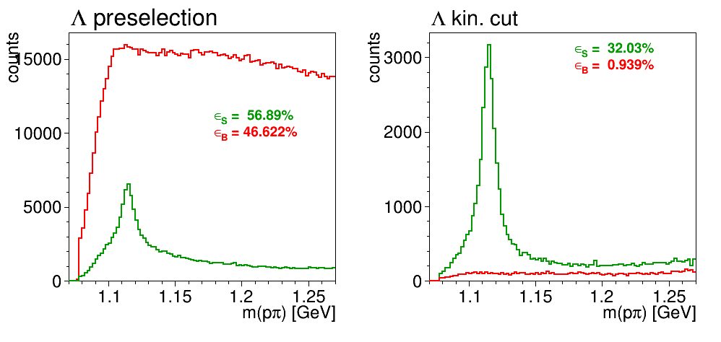
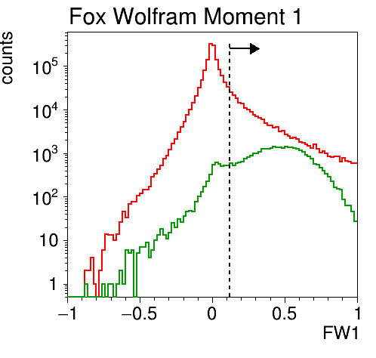
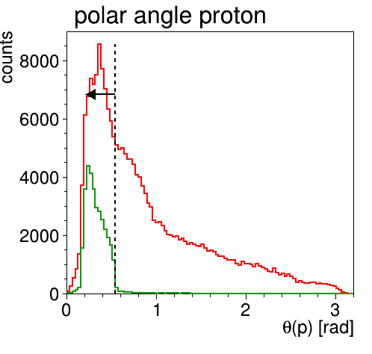
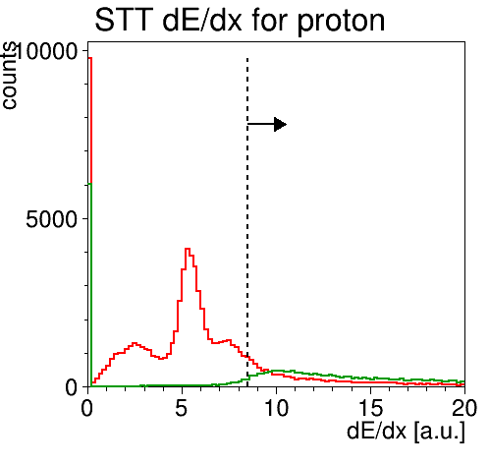
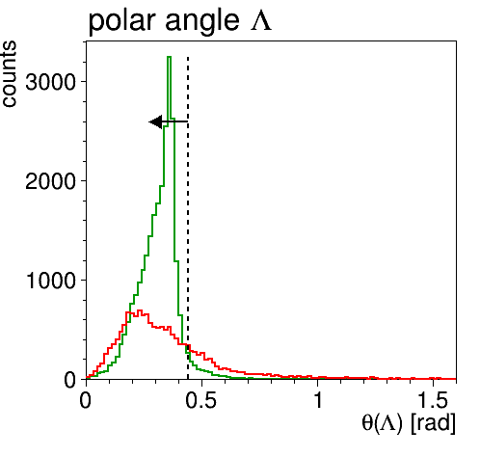
p → Λ (using kinematics + STT dE/dx)
ε_{B} = 0.939%
f_{sup} = 106
signal
background

Slide 12
Summary Table
Channel | ε_{S} [%] | ε_{B} [%] | BG suppr.
p → J/ψ(e⁺e⁻ )X (EMC) | 34.4 | 0.0002 | 500,000
p → J/ψ(e⁺e⁻ )X (STT) | 33.9 | 0.027 | 3,660
p → J/ψ(μ⁺μ⁻ )X (MUO) | 58.5 | 0.004 | 23,300
p → e⁺e⁻ (EMC) | 60.8 | 0.001 | 95,200
p → e⁺e⁻ (STT) | 59.1 | 0.048 | 2,070
p → e⁺e⁻ (EMC) DPM el | 60.8 | 0.0002 | 500,000
p → e⁺e⁻ (STT) DPM el | 59.1 | 0.056 | 1,770
p → Λ (kin. + STT) | 32.0 | 0.939 | 106

Slide 13
Conclusions
First results look promising
Leptonic benchmark channels are easy to trigger
J/ψ → e⁺e⁻: BG reduction of 500k (EMC), 3k (STT)
J/ψ → μ⁺μ⁻: BG reduction of 23k (MUO)
p → e⁺e⁻: BG reduction of 500k (EMC), 2k (STT)
Lambda channel more challenging
reduction factor merely about 100
More reliable results require more realistic (online) simulation

