Slide 1
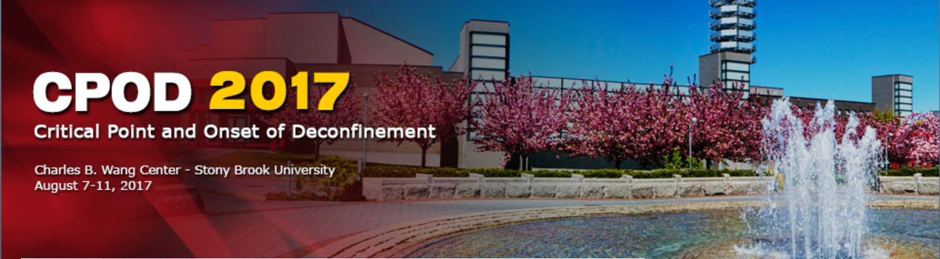
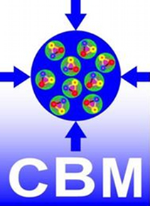

The physics program of the CBM experiment
Event display of a Au + Au reaction at E_{beam} = 25 AGeV
Ingo Deppner for the CBM Collaboration
Physikalisches Institut,
Heidelberg Univ.
Outline
Motivation - the QCD phase diagram
Theoretically predicted observables probing the dense medium
The FAIR facility and the CBM experiment
Summary

Slide 2
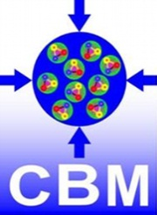
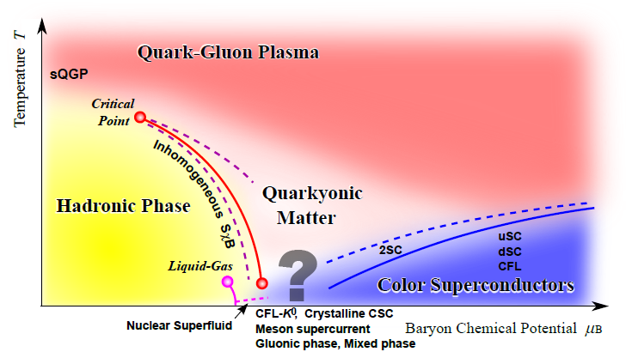
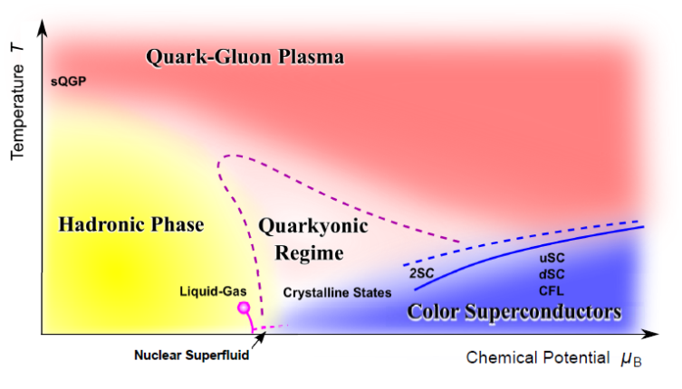


Motivation
At large µ_{b} most of the phase structure is speculation
Is there a first order phase transition?
Is there a critical point?
Does the deconfinement phase transition coincide with the chiral symmetry restoration phase transition at high μ_{B}?
Quarkyonic phase?
(K. Fukushima, T. Hatsuda, Rept.Prog.Phys.74:014001,2011)
?

Slide 3
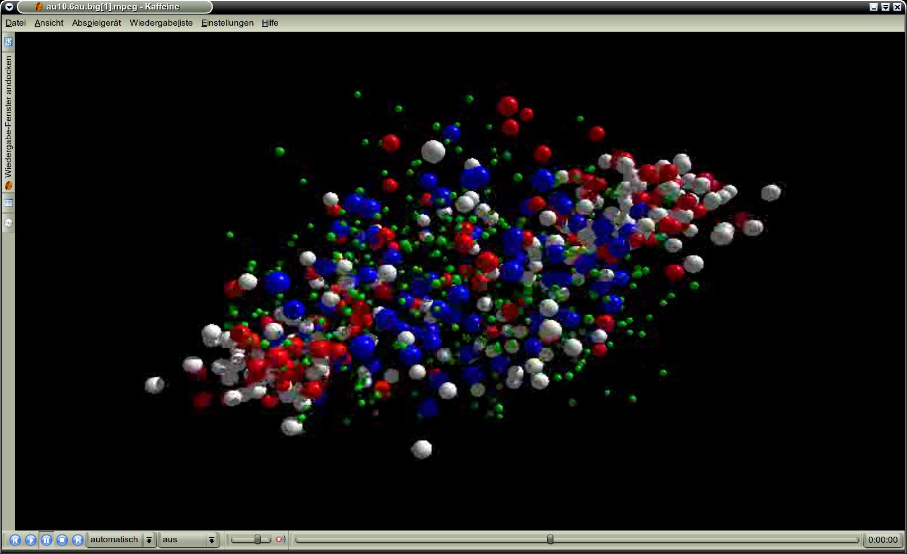
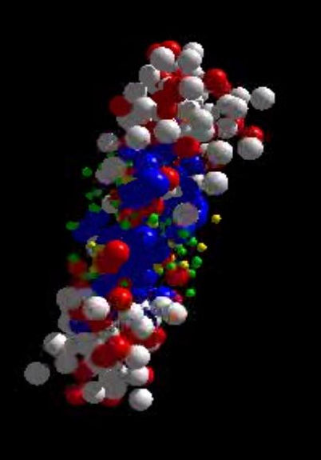
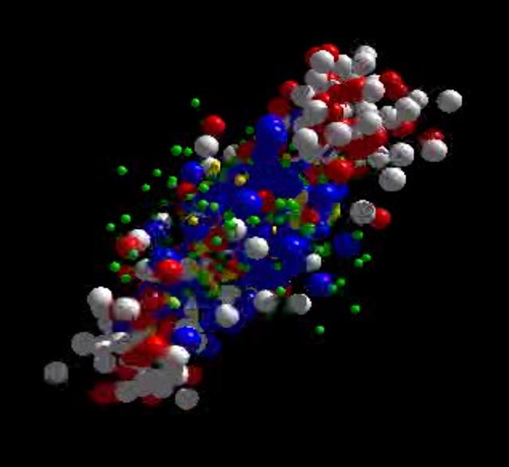
Motivation
UrQMD transport calculation Au+Au 10.7 A GeV
Ξ⁻, Ω⁻, φ
π, K, Λ, ...
p, Λ, Ξ⁺, Ω⁺
ρ → e⁺e⁻, μ⁺μ⁻
ρ → e⁺e⁻, μ⁺μ⁻
resonance decays
Penetrating probes
(integrate over collision history)
Relicts
(produced in dense phase)
ρ → e⁺e⁻, μ⁺μ⁻
Hard probes
(initial state)
Freeze-out
(final state particles)
Thermalized (?) hadrons

Slide 4


Motivation
Central Au + Au collision at beam energy of
5 A GeV
10 A GeV
8 ρ₀
5 ρ₀
I.C. Arsene et al., Phys. Rev. C 75, 24902 (2007)

Slide 5
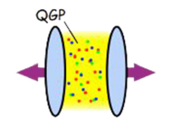
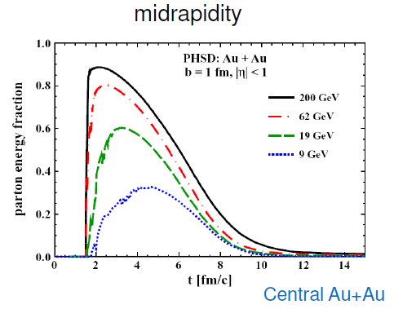

Observables
Chiral symmetry restoration
- di-leptons
- strange mesons and baryons
- sub threshold charm production
Onset of deconfinement
- multi-strange (anti)-baryons
- Hypernuclei
Critical point
- Fluctuations
net proton cumulants
Cassing, CBM collaboration meeting, GSI 2016
“At AGS, only a small part of the initial energy is converted into the QGP phase”

Slide 6
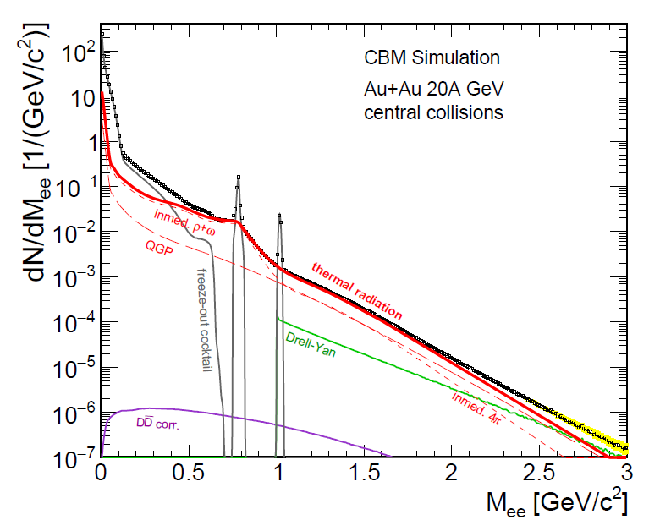
Di-leptons as a probe of dense matter
Background sources strongly
reduced with respect to SPS
- (Drell-Yan, open charm)
Di-lepton measurement can provide
- Temperature of fireball
- Lifetime of fireball
- Chiral symmetry restoration
Large statistics needed
to achieve sufficiently small errors !
LMR
IMR
Mass resolution: 13.6 MeV (ω)
LMVM: about 10⁶ ω per week
IMR: S/B > 1/100
Statistical accuracy of 10% requires
~1 week of CBM beamtime at 100 kHz IR

Slide 7
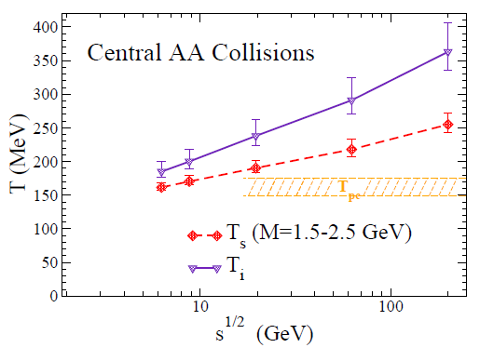
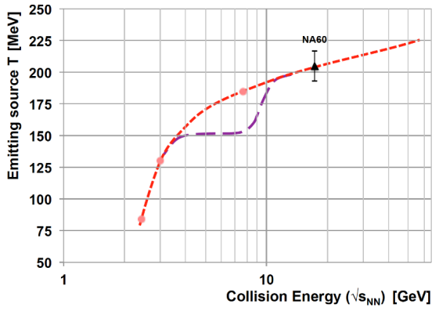
Di-leptons as a probe of dense matter
R. Rapp, H. v.Hees, PLB 753 (2016) 586
SIS100
LMR
?
IMR
LMR: ρ – chiral symmetry restoration
fireball space – time extension
IMR: access to fireball temperature
ρ-a₁ chiral mixing
Kink in the caloric curve would be an indication of a 1st order phase transition
T. Galatyuk et al., Eur. Phys. J. A 52 (2016) 131
Caloric curve?
Notes:
Measurement program: e.g. excitation function of IMR - slope

Slide 8
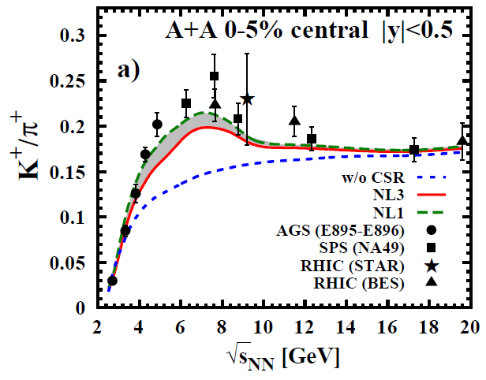
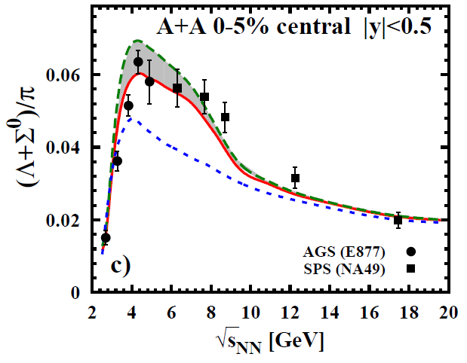

Light strange hadrons as a probe of dense matter
W. Cassing et al. Phys.Rev. C93 (2016) 014902
A. Palmese et al. Phys.Rev. C94 (2016) no.4, 044912
SIS100
SIS100
“The microscopic PHSD studies support the idea that CSR occurs in hadronic systems with high temperatures and densities before the deconfinement phase transition takes over.”

Slide 9
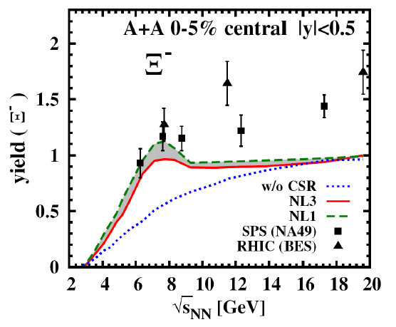
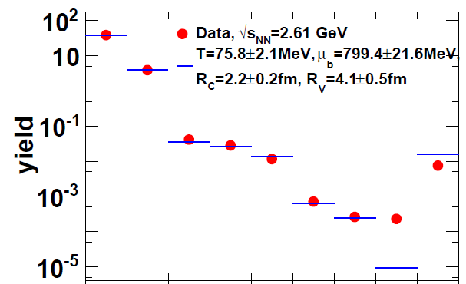


Multi-strange baryons as a probe of dense matter
Ar+KCl reactions at 1.76A GeV
Ξ⁻ yield by appr. factor 25 higher than thermal yield
A. Palmese et al. Phys.Rev. C94 (2016) no.4, 044912
SIS100
?
A possible explanation for the deep sub-threshold Ξ⁻ production yield - via resonance excitation and decay N∗ → Ξ + K + K
No data available
J. Steinheimer and M. Bleicher J.Phys. G43 (2016) no.1, 015104

Slide 10
Charm as a probe of dense matter
UrQMD prediction of subthreshold charm production via
N* → Λ_{c} + D and N* → N +J/ψ
“It opens the possibility to study
charm production and propagation
in very dense hadronic environment
possible effects of chiral symmetry
restoration could become visible”
production mechanism?
Extreamly rare probe (10⁻⁵ – 10⁻⁷)
J. Steinheimer, A. Botvina, M. Bleicher, Phys. Rev. C 95, 014911 (2017)

Slide 11
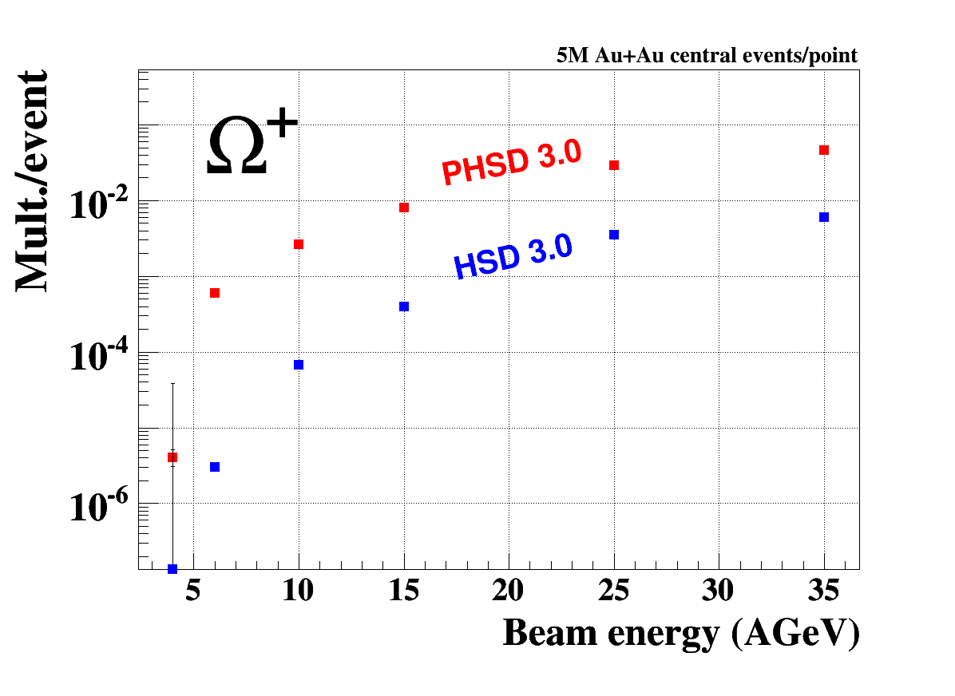
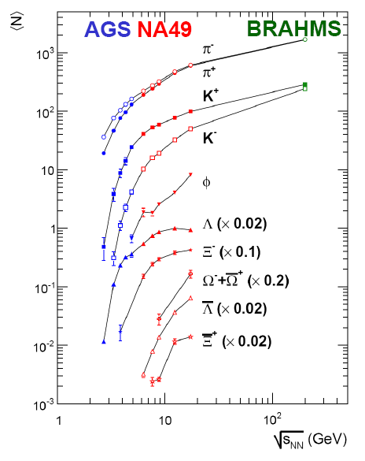
Anti multi-strange hyperons as a probe of deconfinement
I. Vassiliev, CBM, private communication
[C. Blume, JP 31 (2005) S57]
SIS100
SIS100
?
An sudden increase in Ω⁺ yield could indicate an onset of deconfinement
Ω⁺ is a rare probe
No data available

Slide 12
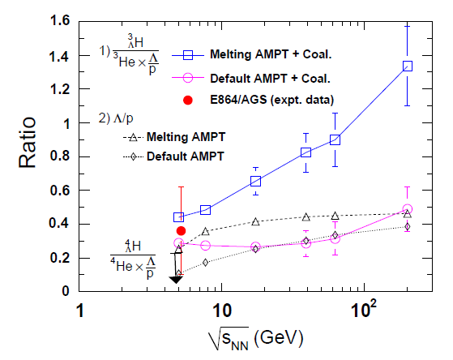
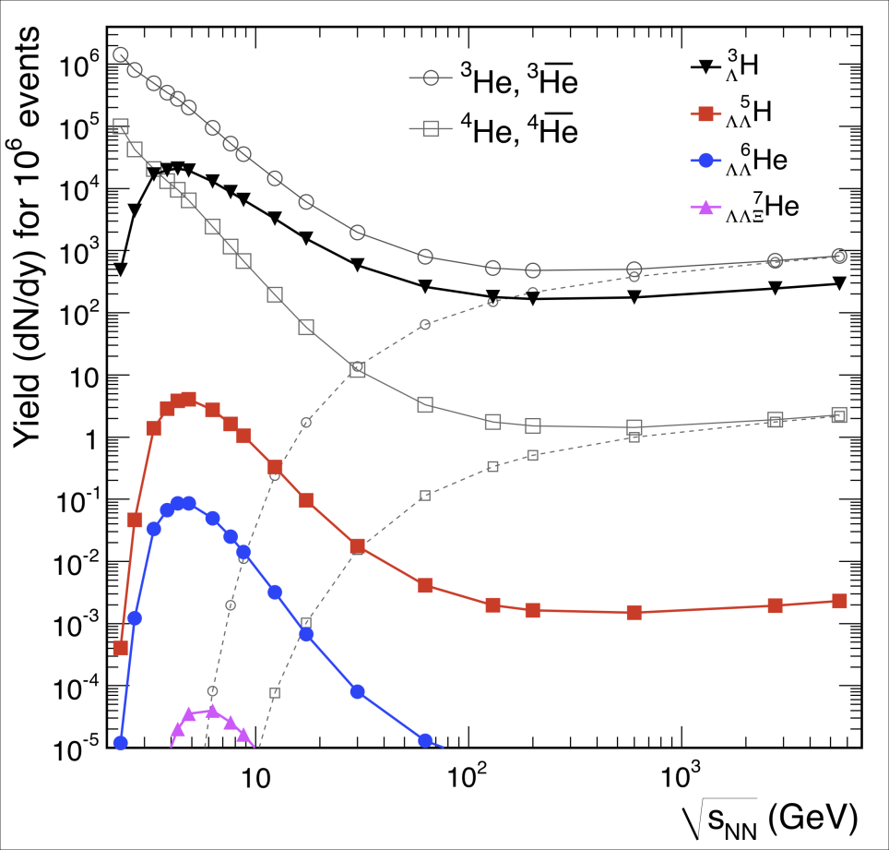

Hypernuclei as a probe of deconfinement
A. Andronic, P. Braun-Munzinger, J. Stachel, and H. Stocker, Phys. Lett. B697, 203 (2011), arXiv:1010.2995 [nucl-th]
S. Zhang et al., Phys.Lett. B684, 224 (2010)
SIS100
SIS100
Local correlation between baryon number and strangeness => sensitivity to deconfinement!
Strangeness Population Factor
Thermal model predicts a maximal yield at top SIS100 energies
Notes:
We expect a prominent enhancement of the Strangeness Population Factor in a system that passes through a deconfined partonic state
The local correlation strength between baryon number and strangeness is sensitive to the effective number of degrees of freedom of the system created
It should be noted that if the onset of deconfinement takes place at a specific beam energy, this may result in a sharper increase of S3 than the AMPT prediction with string melting scenario

Slide 13
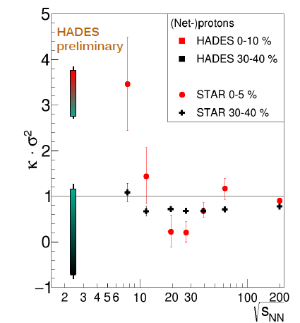
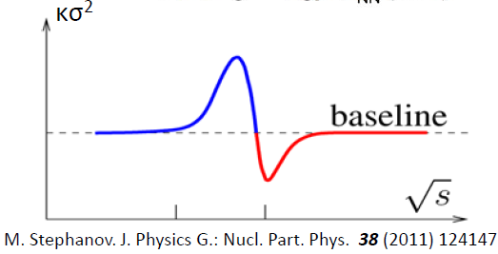





Fluctuations as a probe of the critical point
HADES: M. Lorenz, QM 2017
STAR: X. Luo et al, CPOD 2014
in the vicinity of the critical point
y₀ ± 0.2
?
SIS100
Notes:
correlation length ξ of the fluctuations diverges at the critical point

Slide 14

Facility for Antiproton & Ion Research
SIS18
SIS100/300
CBM
Beam | p_{lab, max} | √s_{NN, max}
heavy ions (Au) | 11A GeV | 4.7 GeV
light ions (Z/A = 0.5) | 14A GeV | 5.3 GeV
protons | 29 GeV | 7.5 GeV
FAIR phase 1
FAIR phase 2

Slide 15
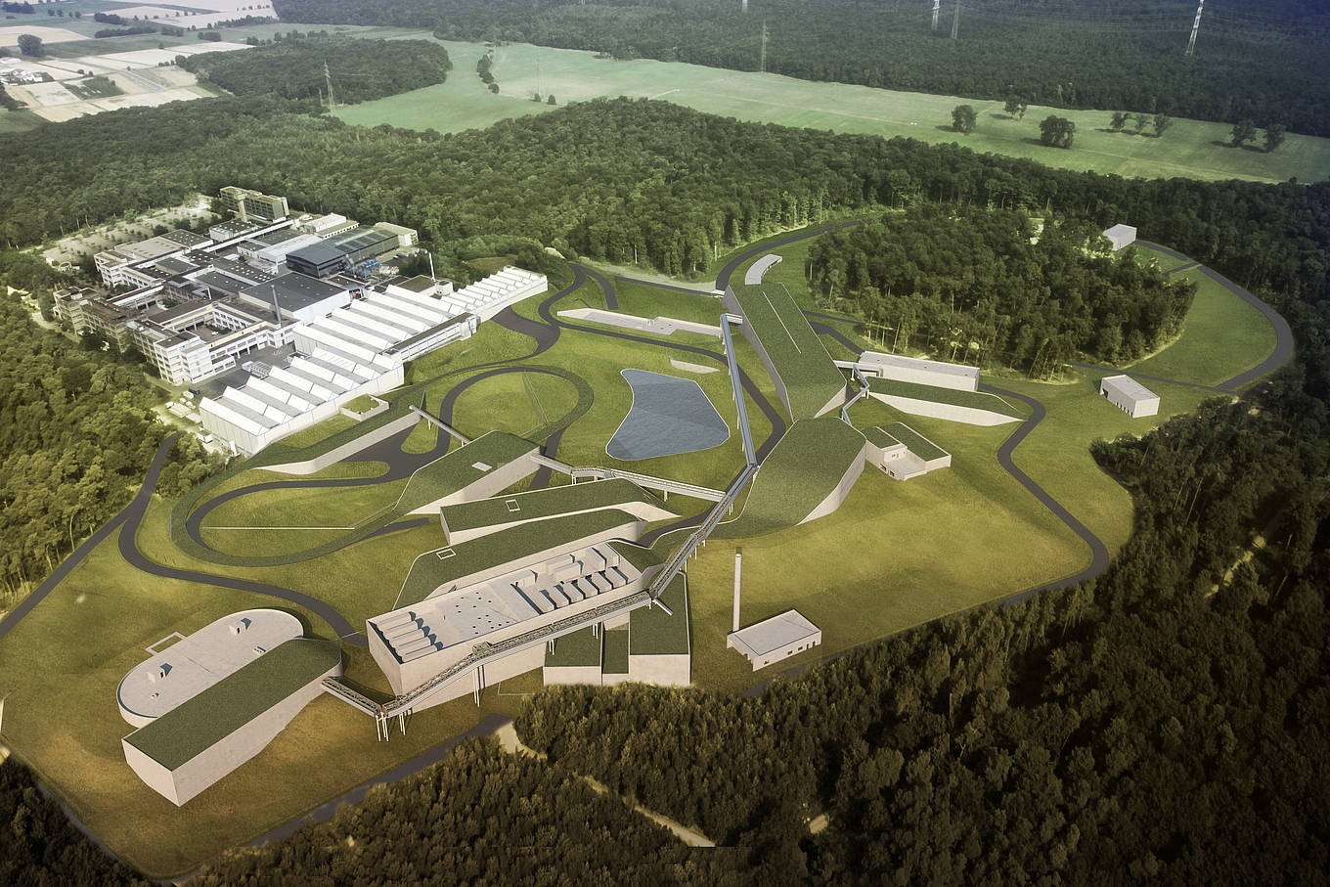
Facility for Antiproton & Ion Research
CBM

Slide 16
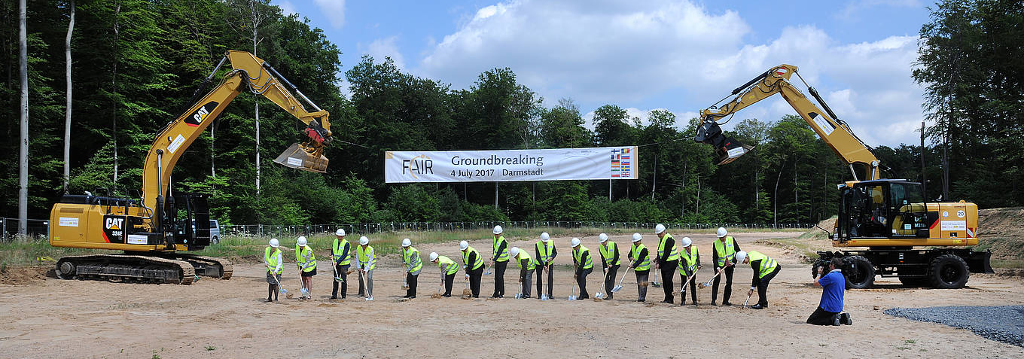
Facility for Antiproton & Ion Research
FAIR Groundbreaking ceremony July 4th, 2017
Civil construction of SIS 100 tunnel and CBM cave started
Detector installation/ commissioning 2021 – 2024
FAIR delivers 1st beam 2024 (FAIR phase 0 from 2018 on)

Slide 17
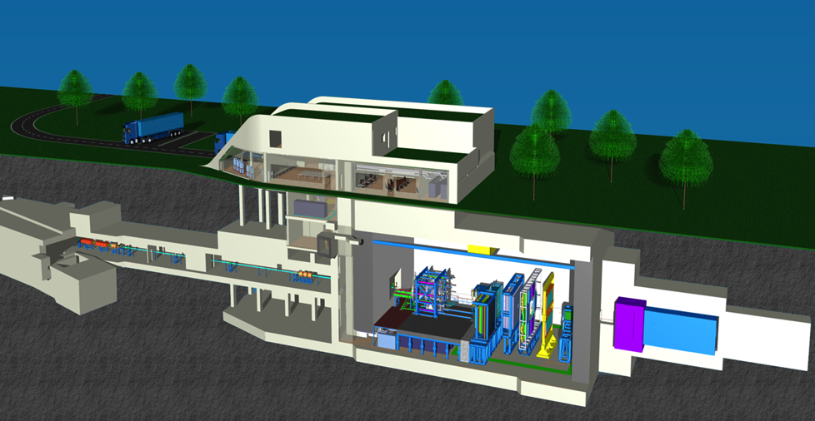
The HADES and CBM cave
HADES
CBM
HADES: mainly p+p, p+A, low material budget, 20°-85° polar angle, 20 kHz
CBM: p+A, A+A, larger material budget, 2.5°-25° polar angle, max. 10 MHz

Slide 18
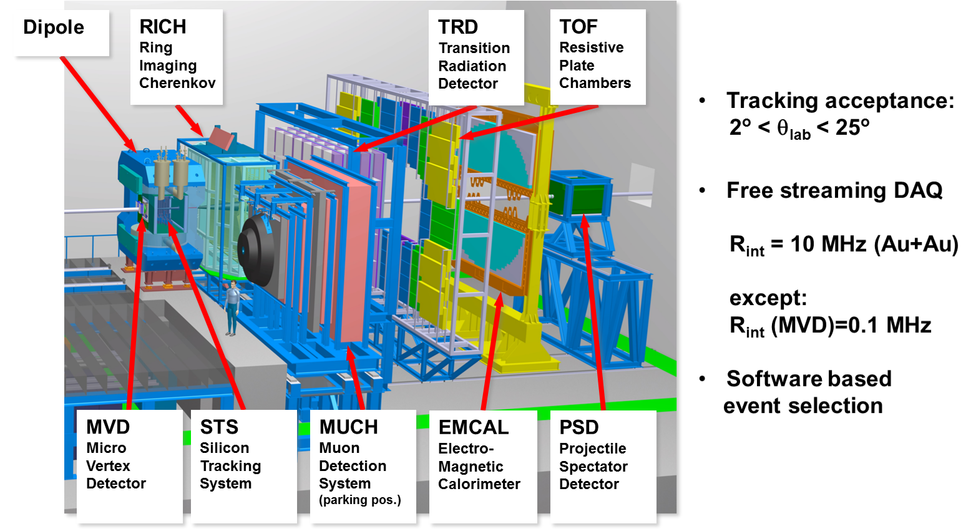
CBM apparatus
TOF
PSD
Muon System

Slide 19
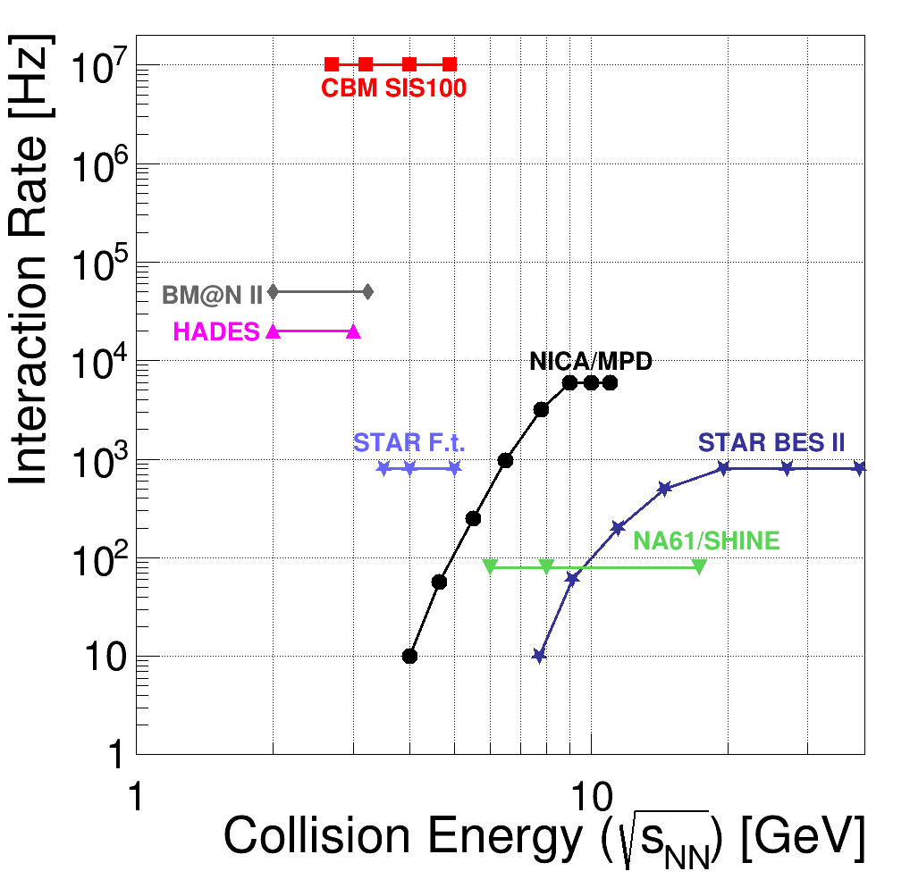
CBM experiment
CBM:
is a high rate experiment!
Opens up new possibilities!
Electromagnetic observables, charm production
High statistics and good systematics on hadronic observables:
multi-strange baryons, flow,
fluctuations
New (exotic) observables:
kaonic clusters, hypernuclei

Slide 20
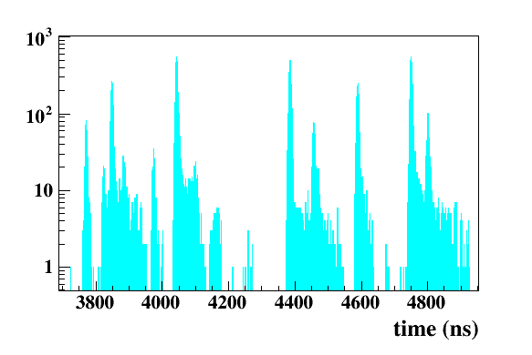
CBM readout and online system
Novel readout system
no hardware trigger on events, free streaming trigger-less data
detector hits with time stamps,
High rate scenario: STS hits vs time
10 MHz

Slide 21
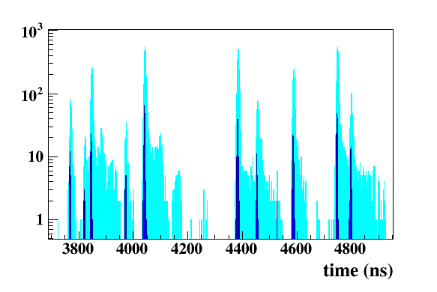
CBM readout and online system
Novel readout system
no hardware trigger on events, free streaming trigger-less data
detector hits with time stamps,
full online 4-D track and event reconstruction
- Requirement: online calibration
Full analysis of 10 MHz event rate implemented, only very moderate losses in efficiency
High rate scenario: STS hits vs time
10 MHz
Track reconstruction

Slide 22
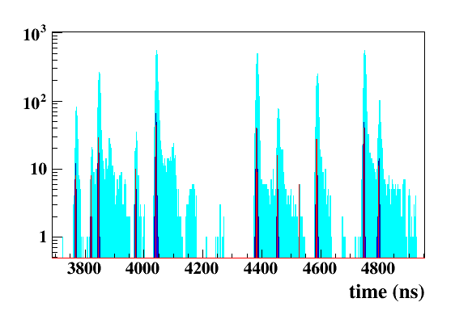
CBM readout and online system
Novel readout system
no hardware trigger on events, free streaming trigger-less data
detector hits with time stamps,
full online 4-D track and event reconstruction
- Requirement: online calibration
Full analysis of 10 MHz event rate implemented, only very moderate losses in efficiency
High rate scenario: STS hits vs time
10 MHz
Track reconstruction
Event reconstruction – clustering tracks

Slide 23
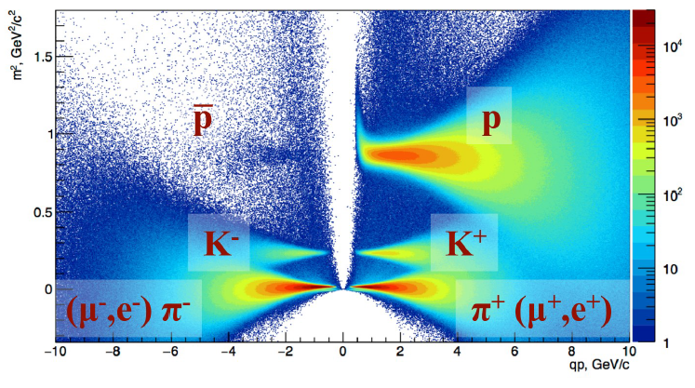
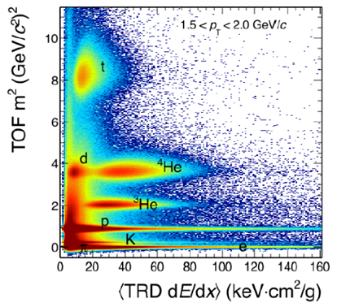
PID
Hadron id: TOF (+TRD)
Lepton id: RICH+TRD or MUCH
γ, π⁰: EMC (or RICH)
TOF
TOF + TRD

Slide 24
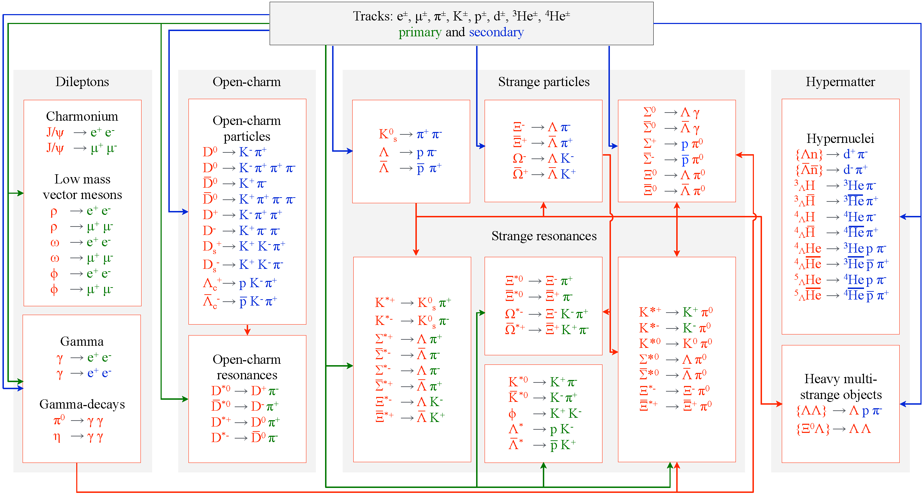
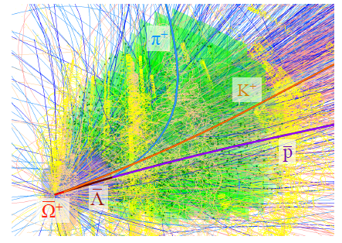
Online particle identification
The KF Particle Finder
I.Vassiliev, V.Akishina, I.Kisel, P.Kisel and M.Zyzak

Slide 25
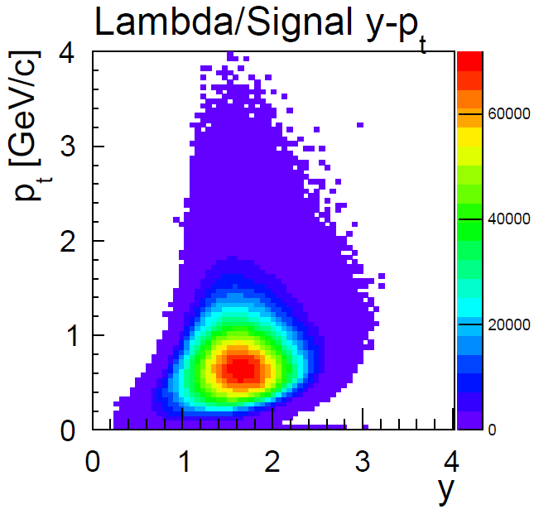
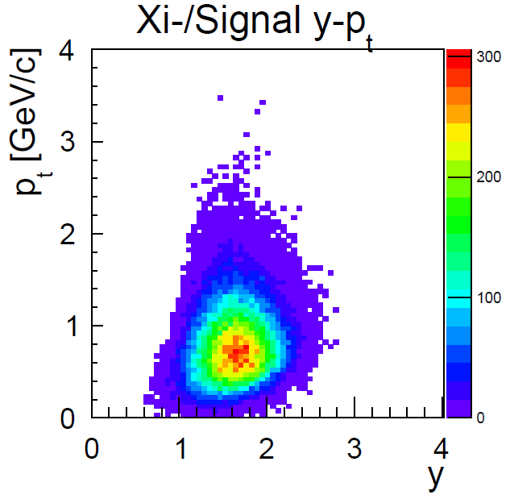
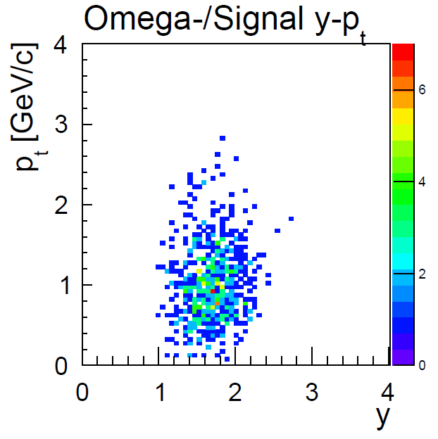
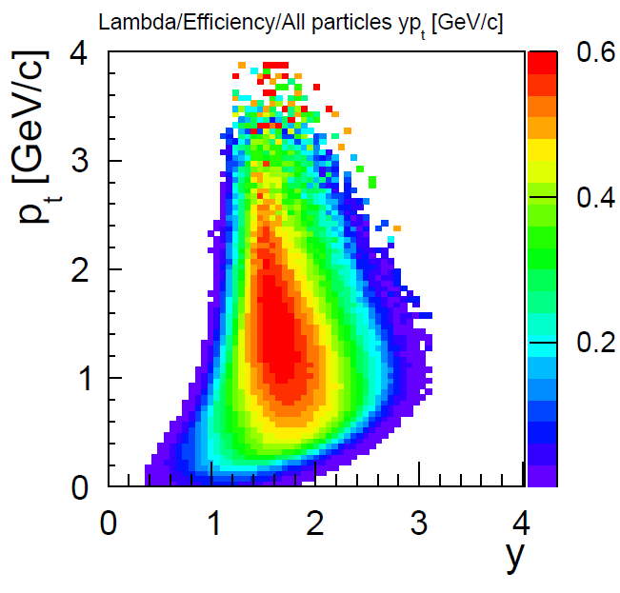
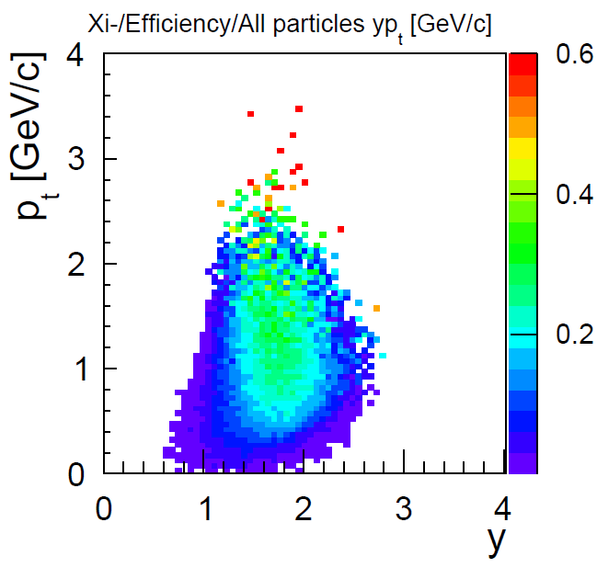
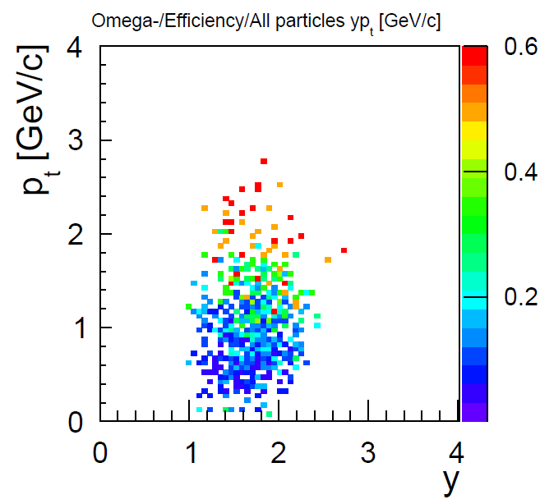
Acceptance and Efficiency
Efficiency

Slide 26
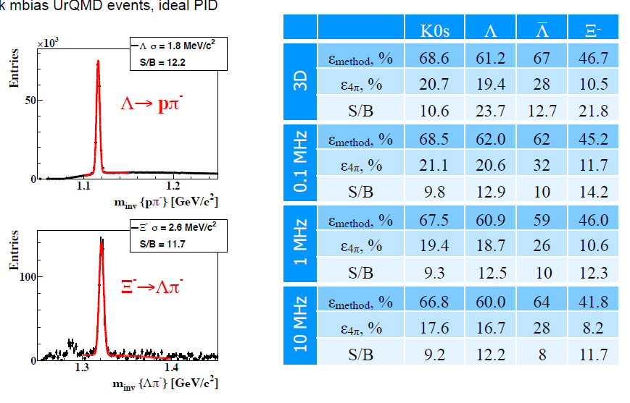
Acceptance and Efficiency

Slide 27
Reconstruction of hyperons and hypernuclei
Expected particle yields Au+Au @ 6, 10 AGeV
Particle (mass MeV/c²) | Multi- plicity 6 AGeV | Multi- plicity 10 AGeV | decay mode | BR | ε (%) | yield (s⁻¹) 6AGeV | yield (s⁻¹) 10AGeV | yield in 10 weeks 6AGeV | yield in 10 weeks 10 AGeV | IR MHz
Λ (1115) | 4.6·10⁻⁴ | 0.034 | pπ⁺ | 0.64 | 11 | 1.1 | 81.3 | 6.6·10⁶ | 2.2·10⁸ | 10
Ξ⁻ (1321) | 0.054 | 0.222 | Λπ⁻ | 1 | 6 | 3.2·10³ | 1.3·10⁴ | 1.9·10¹⁰ | 7.8·10¹⁰ | 10
Ξ⁺ (1321) | 3.0·10⁻⁵ | 5.4·10⁻⁴ | Λπ⁺ | 1 | 3.3 | 9.9·10⁻¹ | 17.8 | 5.9·10⁶ | 1.1·10⁸ | 10
Ω⁻ (1672) | 5.8·10⁻⁴ | 5.6·10⁻³ | ΛK⁻ | 0.68 | 5 | 17 | 164 | 1.0·10⁸ | 9.6·10⁸ | 10
Ω⁺ (1672) | - | 7·10⁻⁵ | ΛK⁺ | 0.68 | 3 | - | 0.86 | 0 | 5.2·10⁶ | 10
³ _{Λ}H (2993) | 4.2·10⁻² | 3.8·10⁻² | ³Heπ⁻ | 0.25 | 19.2 | 2·10³ | 1.8·10³ | 1.2·10¹⁰ | 1.1·10¹⁰ | 10
⁴_{Λ}He (3930) | 2.4·10⁻³ | 1.9·10⁻³ | ³Hepπ⁻ | 0.32 | 14.7 | 110 | 87 | 6.6·10⁸ | 5.2·10⁸ | 10
systematic measurement of multi-dimensional observables of rare probes become possible

Slide 28
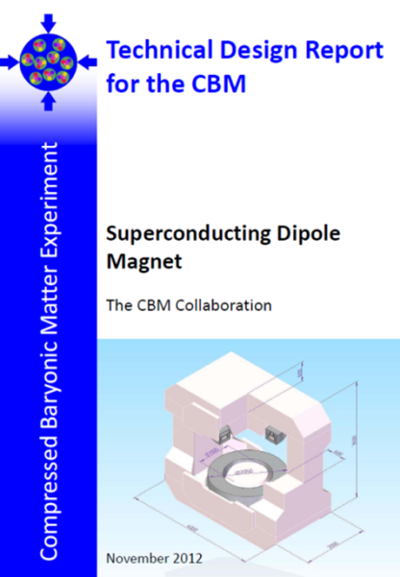
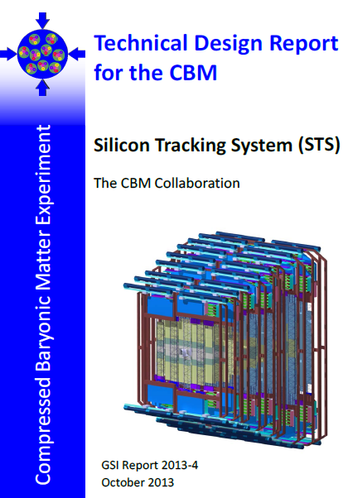
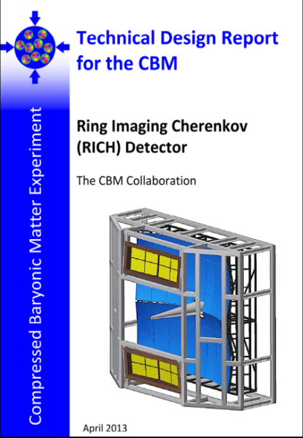
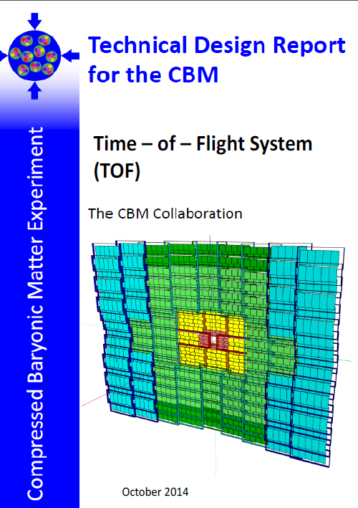

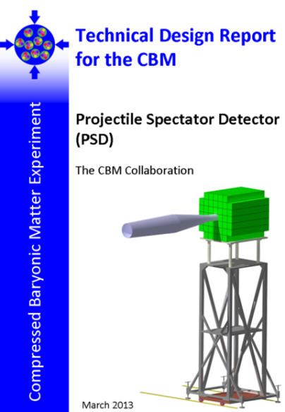
CBM technical design report status
http://www.fair-center.eu/en/for-users/experiments/cbm/documents.html
# | Project | TDR Status
1 | Magnet | approved
2 | STS | approved
3 | RICH | approved
4 | TOF | approved
5 | MuCh | approved
6 | HADES ECAL | approved
7 | PSD | approved
8 | MVD | submission 2018
9 | DAQ/FLES* | submission 2018
10 | TRD | submission 2017
11 | ECAL | submission 2017
12 | Computing* | submission ~2020

Slide 29
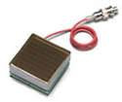
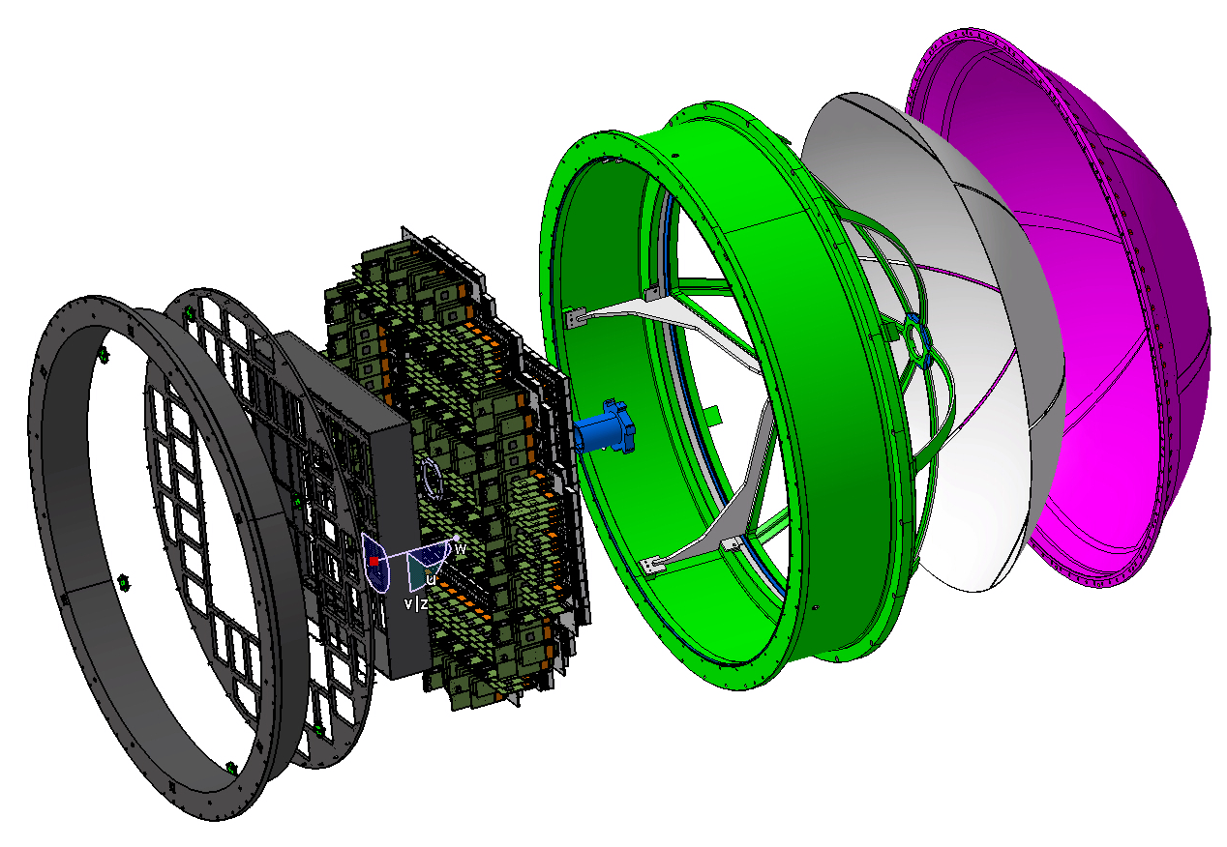
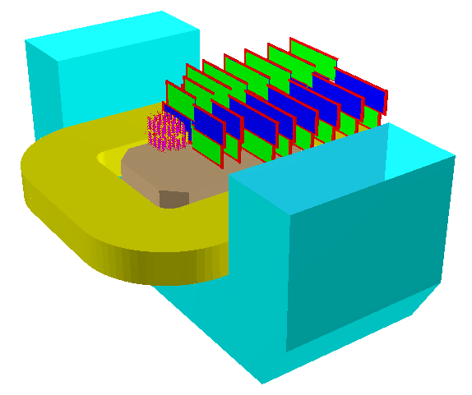

FAIR phase 0 program
1. Install, commission and use 430 out of 1100
CBM RICH multi-anode photomultipliers
(MAPMT) in HADES RICH photon detector
430 MAPMTs
Read
out
Supp. frames
Exist. RICH
2. Install, commission and use 4 STS layers and the
PSD at the BM@N experiment at the
Nuclotron in JINR/Dubna
(Au-beams up to 4.5 A GeV in 2018/19)

Slide 30



FAIR phase 0 - program
3. Install, commission and use 10% of the CBM TOF modules including CBM
read-out chain at STAR/RHIC (BES II 2019/2020)
02/2018 2nd system integration test with one
sector by participating in the Run18
beam time in STAR
09/2018 Installation and commissioning
2019/2020 Start of the BES II campaign
2021 Decommissioning and shipping of all
modules including infrastructure to FAIR
eTOF

Slide 31






FAIR phase 0 - miniCBM
4. A CBM full system test-setup for high-rate nucleus-nucleus collisions at GSI/FAIR
the mCBM test-setup (“mini-CBM”) will focus on the
test of final detector prototypes
free streaming data transport to a computer farm
online reconstruction and event selection
offline data analysis
02/2018 mFLES cluster in Green IT Cube operational
03/2018 ready for installation of detector subsystems
09/2018 start commissioning with beam
2020 1st benchmark run
(Sub)threshold Λ – baryon reconstruction.
Event based MC simulation of 10⁸ events
Ni+Ni
1.93 AGeV
TOF
TRD
MuCH
STS
FLIB
green IT cube

Slide 32


The CBM collaboration
60 institutions, ~530 members
Croatia:
Split Univ.
China:
CCNU Wuhan
Tsinghua Univ.
USTC Hefei
CTGU Yichang
Czech Republic:
CAS, Rez
Techn. Univ.Prague
France:
IPHC Strasbourg
Hungary:
KFKI Budapest
Budapest Univ.
Germany:
Darmstadt TU
FAIR
Frankfurt Univ. IKF
Frankfurt Univ. FIAS Frankfurt Univ. ICS
GSI Darmstadt
Giessen Univ.
Heidelberg Univ. P.I.
Heidelberg Univ. ZITI
HZ Dresden-Rossendorf
KIT Karlsruhe
Münster Univ.
Tübingen Univ.
Wuppertal Univ.
ZIB Berlin
India:
Aligarh Muslim Univ.
Bose Inst. Kolkata
Panjab Univ.
Rajasthan Univ.
Univ. of Jammu
Univ. of Kashmir
Univ. of Calcutta
B.H. Univ. Varanasi
VECC Kolkata
IOP Bhubaneswar
IIT Kharagpur
IIT Indore
Gauhati Univ.
Korea:
Pusan Nat. Univ.
Poland:
AGH Krakow
Jag. Univ. Krakow
Silesia Univ. Katowice
Warsaw Univ.
Warsaw TU
Romania:
NIPNE Bucharest
Univ. Bucharest
Russia:
IHEP Protvino
INR Troitzk
ITEP Moscow
Kurchatov Inst., Moscow
LHEP, JINR Dubna
LIT, JINR Dubna
MEPHI Moscow
PNPI Gatchina
SINP MSU, Moscow
St. Petersburg P. Univ.
Ioffe Phys.-Tech. Inst. St. Pb.
Ukraine:
T. Shevchenko Univ. Kiev
Kiev Inst. Nucl. Research

Slide 33

Summary
Phase structure of QCD will not be revealed by a single measurement.
QCD matter physics needs a facility for systematic studies and
a 3rd generation experiment -> CBM
rate capability: 10 MHz interaction rate
CBM physics program
many open physics questions
substantial discovery potential at SIS100
CBM strategy
systematic measurement of multi-dimensional observables
of (rare) probes
use detector components as tool kit.
CBM status
well advanced with respect to overall FAIR timeline
CBM, Eur. Phys. J. A (2017) 53: 60.
80 Ω
1 ns

Slide 34
Thank you for your attention
80 Ω
1 ns

Slide 35
Backup
Backup Slides
80 Ω
1 ns

Slide 36


Particle production threshold
C. Blume, J. Phys. G31, S57 (2005)
Strange and charmed particle production thresholds in pp - collisions
SIS 100
reaction | $\sqrt{s}$ (GeV) | T_{lab}(GeV)
$$pp→K^{+}Λp$$ | 2.548 | 1.6
$$pp→K^{+}K^{−}pp$$ | 2.864 | 2.5
$$pp→K^{+}K^{+}Ξ^{−}p$$ | 3.247 | 3.7
$$pp→K^{+}K^{+}K^{+}Ω^{−}n$$ | 4.092 | 7.0
$$pp→Λ\overline{Λ}pp$$ | 4.108 | 7.1
$$pp→Ξ^{−}{\overline{Ξ}}^{+}pp$$ | 4.520 | 9.0
$$pp→Ω^{−}{\overline{Ω}}^{+}pp$$ | 5.222 | 12.7
$$pp→J/Ψpp$$ | 4.973 | 12.2
Yield of sub-threshold produced hyperons is sensitive to the medium density (multi step processes)
In the SIS100 energy regime very few data available

Slide 37


Kaon production at SIS 18
C.Sturm et al. (KaoS), PRL 86 (2001) 39
  C. Fuchs et al., PRL 86 (2001) 1974
NN production threshold
Strong sensitivity to Equation Of State due to multistep production (formation of nucleon resonances)
=> soft EOS (K=200 MeV)

Slide 38

Backup
Particle acceptance
central Au+Au collisions at 10 A GeV
80 Ω
1 ns

