Slide 1
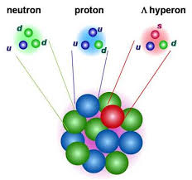



Multi-strange hypernuclei
with F. Gulminelli
and J. Margueron
Elias Khan
2d EMMI workshop: Anti-matter, hyper-matter and exotica production at LHC
6-10 November 2017, Turin

Slide 2
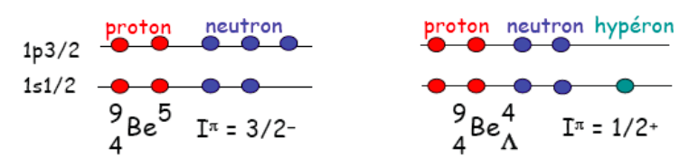
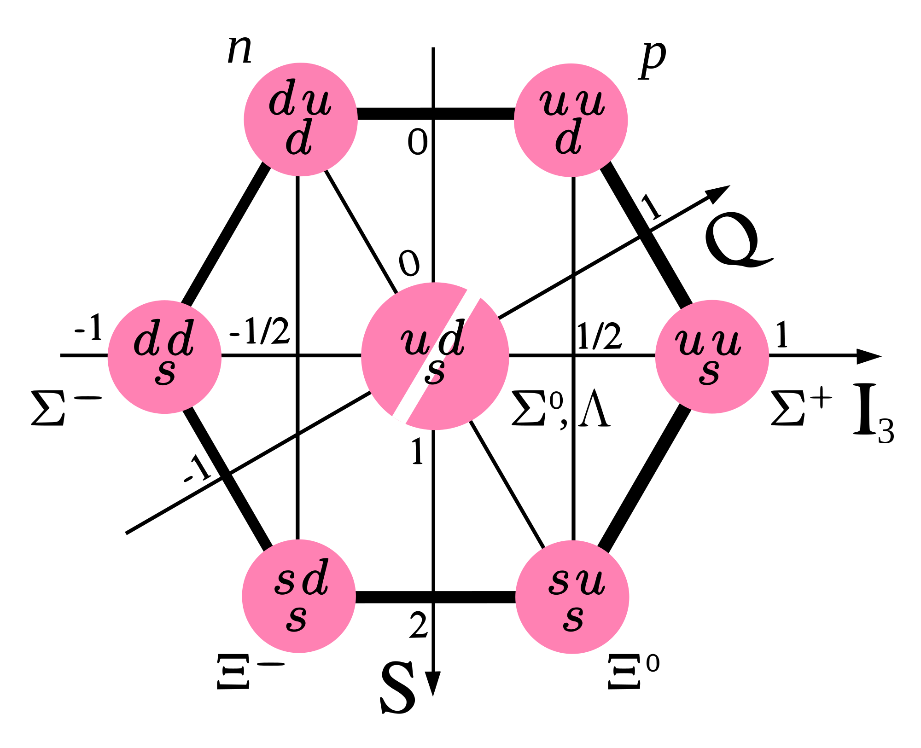
Hypernuclei
Bound by strong interaction
Desexcitation by electromagnetic interaction
Decay by weak interaction ( τ(Λ) = 263 ps )
S(Λ)= -1 ; S(Ξ)= -2

Slide 3
Scope: a microscopic hypernuclear chart
Increase of dedicated experimental activities on hypernuclei (J-Parc, GSI, LHC, …)
Conjectures (strangelets, strangeness in stars)
Puzzles (hyperons in neutron star, lifetime of Λ+n+p compared to free Λ, ...)
Open questions (strange interaction, Ξ-Nuclei, impact on the drip lines, the structure of the nucleus, strange clusters states
=> Explore and predict the N,Z,S chart from a global microscopic approach

Slide 4
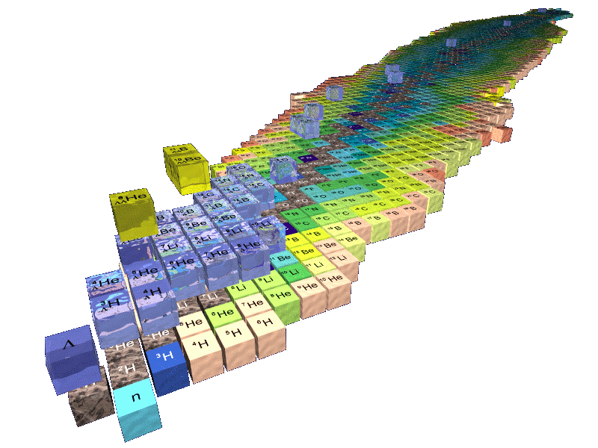
From the experimental hypernuclear chart

Slide 5
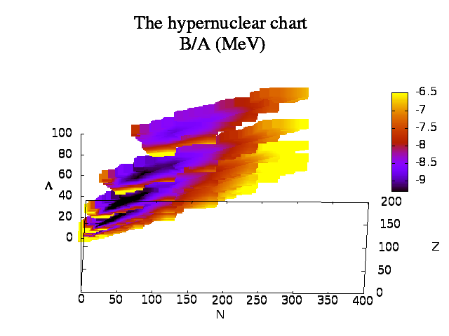
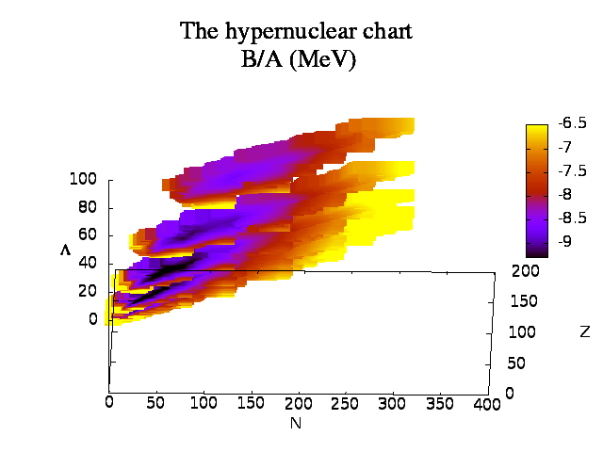
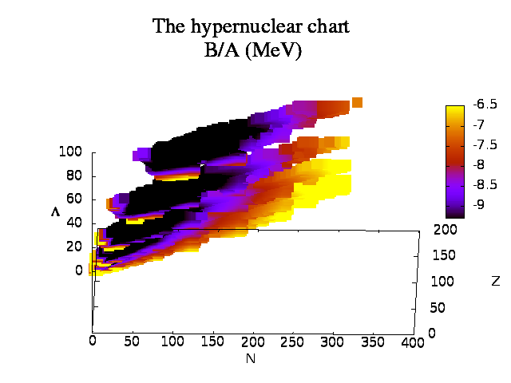
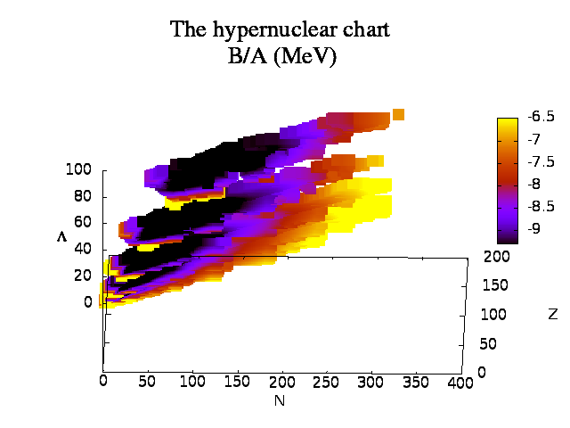
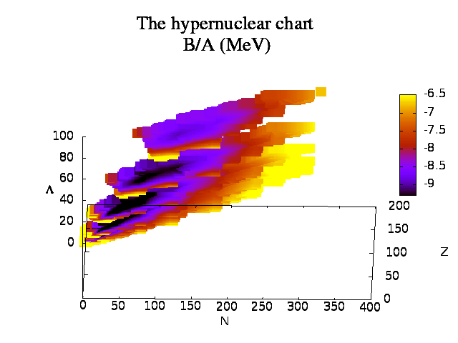
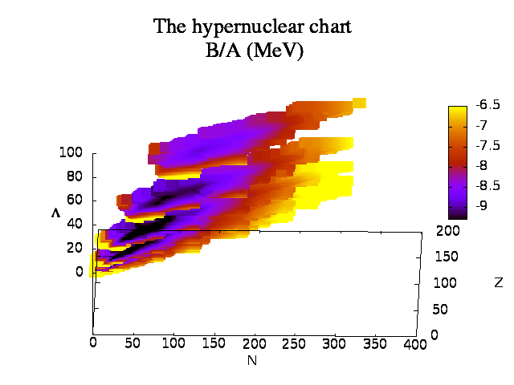
x=1/2
to theoretical ones
x=4
DF-NSC89
DF-NSC97a
DF-NSC97f

Slide 6
Theoretical approach: status
Microscopic EDF approaches
Relativisitic and non-relativistic
Spherical and deformed
Beyond mean-field: collective excitations (RPA)
low-lying spectrum (GCM)
Schaffner, Greiner, Stöcker (1992)
Schaffner, Dover, Gal (1994)
Zhou, Schulze, Sagawa et al. (2007)
Minato and Hagino (2012, 2013)
…

Slide 7
Present theoretical approach
Non relativistic, spherical microscopic EDF:
universal approach for nuclear structure
Three goals:
Evaluate the limit of the hyper nuclear chart
(with uncertainties due to the hyper-interaction)
2) Analyse exotic effects for specific hypernuclei
3) Strong decay of Λ in hypernuclei
E. Khan, J. Margueron, F. Gulminelli, and Ad. R. Raduta Phys. Rev. C 92, 044313 (2015)
J. Margueron, E. Khan, F. Gulminelli, to be published in Phys. Rev. C (2017)

Slide 8
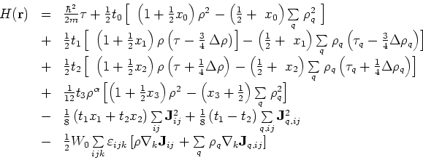


Interactions used and open questions
Nucleon-Nucleon: Skyrme (SLy4) functional
Nucleon-Lambda: fit on BHF calculations to decribe s.p. data
(Pot of -30 MeV at saturation density) (NSC89-97)
Lambda-Lambda interaction:
Exp Bond energy in _{ΛΛ}⁶He ~ 1 MeV (EmpB1, EmpB2)
No constraint at large density ( ρ > 1.5ρ₀ )

Slide 9
Interactions used and open questions
Ξ interactions:
N-Ξ : Ξ removal energy from the Kiso event (¹²_{Ξ}Be, ¹⁵_{Ξ}C)
Ξ-Λ and Ξ-Ξ: less important, unknown: off or on (like N-Λ or N-Ξ, respectively) (VY0,VY1,VY2)
No Sigma nor Omega: Λ decays pref. into Ξ
3-Body YNN neglected, although effectively taken into account
by α₂ term in the NΛ interaction : NNΛ
2M neutron star: repulsive Λ potential at large density but not a strong constraint
(uncertainties on the various species in the core of neutron stars)

Slide 10
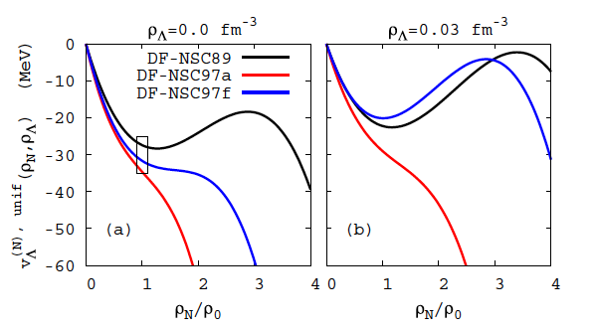
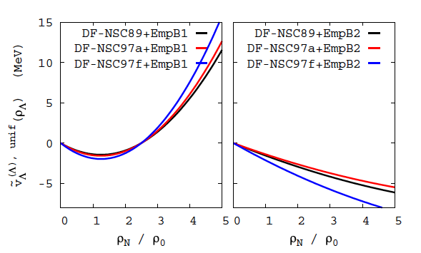
Interactions used and open questions
NΛ
potential
ΛΛ
potential
20% of Λ
x=1/2
20% of Λ
x=4

Slide 11
First microscopic prediction
of the hypernuclear chart
x=1/2
x=4
DF-NSC89
DF-NSC97a
DF-NSC97f

Slide 12
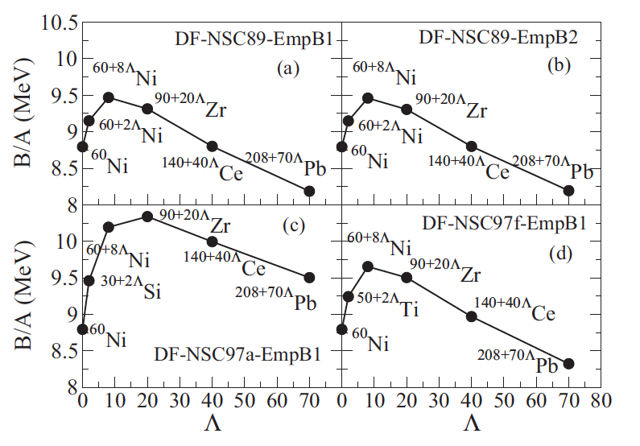
Fusion and fission of hypernuclei

Slide 13
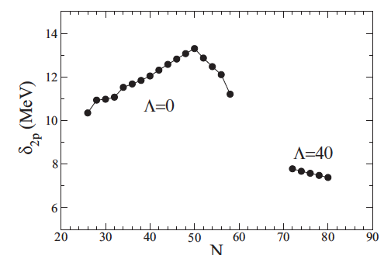
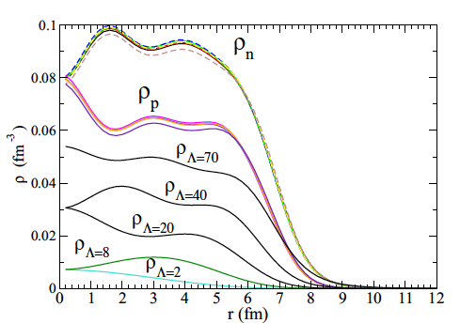
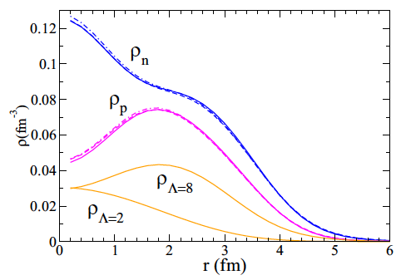
Multi-Lambda hypernuclei structure
^{208+Λ}Pb
N
^{34+Λ}Si
A. Mutschler et al. Nat. Phys. 13(2017)152

Slide 14






Decay of multi Lambda hypernuclei
Consider the strong interaction decays to shape the multi-strange hypernuclear chart
;
Q=-26 MeV
;
;
Q=-80 MeV
Q=-180 MeV

Slide 15
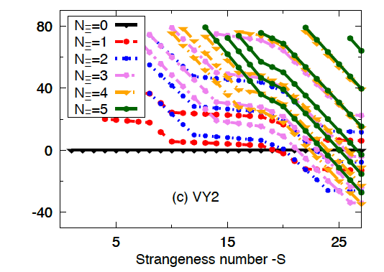


Decay of multi Lambda into Ξ
Q=50
A=132
Coulomb allows Ξ– to be favored instead of Ξ⁰, whereas mass(Ξ–)=mass(Ξ⁰) +7MeV

Slide 16
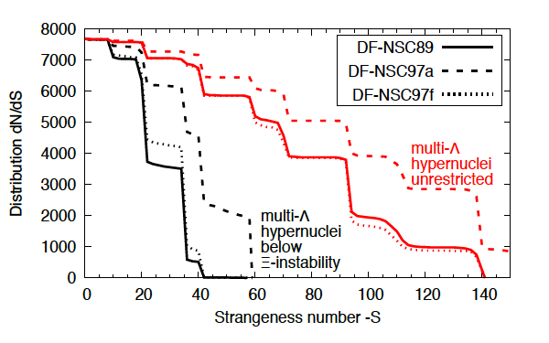
Hyperdriplines

Slide 17
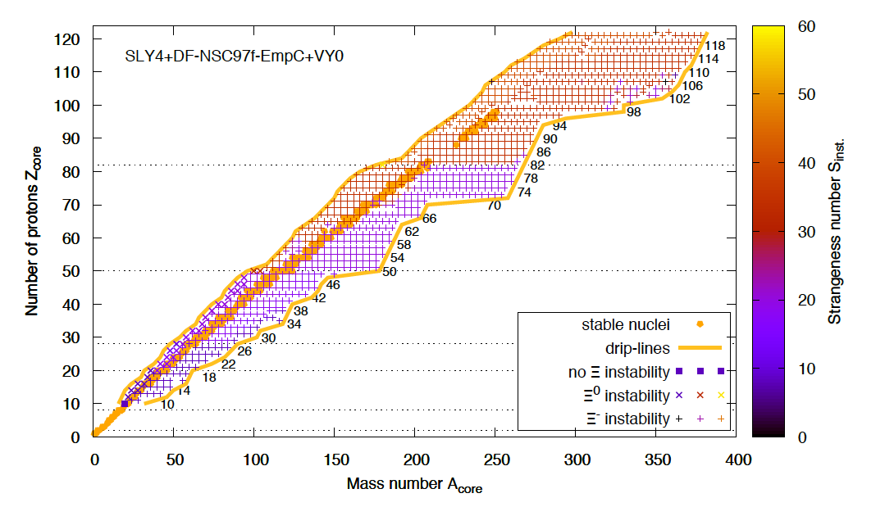
Hypernuclear chart

Slide 18
Hypernuclear landscape (Z<120)
Nuclei: 6 900 ± 500 nuclei J. Erler et al. Nature 486(2012)509
Λ-hypernuclei: 654 752 (+113 200 –62 560: NΛ interaction uncertainty)
Λ-hypernuclei (Ξ-instability effect): 237 877 (+65 563 -39 429: NΛ inter. uncertainty)
Λ-hypernuclei (Ξ-instability effect): 196 278 (+107 161 -65 502: NΛ+YY inter. uncertainties)

Slide 19
Conclusion
Microscopic view of universal hypernuclei chart, including strong decay of Λ into Ξ
Investigation of hypernuclei structure
Decoupling between hypernuclei physics and the ρ > 1.5 ρ₀ regime
Large uncertainties due to the NΛ and YY interactions: more data on bond energy ?
Future: excitations, pairing, deformation, temperature in hypernuclei
Charmed nuclei ?

