Slide 1
Five-body structure of heavy pentaquark system
Emiko Hiyama (Kyushu Univ./RIKEN)
J-M. Richard(Lyon)
Hosaka (RCNP/JAEA)
M. Oka (TIT/JAEA)
First, I would like to talk about my recent
Work on penta-quark system.
If there are some plan to produce
Pentaquark system at Alice,
my work might be helpful.

Slide 2
For this purpose, search for multi exotic quarks systems such as tetra quark systems, penta quark
systems, and di-baryon systems have a long history.
X(3872):3871.2±0.5 MeV
1⁺⁺
Γ<2.3MeV
Tetra quark systems:
Phys. Rev. Lett. 91, 262001 (2003)
Belle Group
u
u
C
C
After observation of X(3872),
there are many observed exotic
state candidates shown in red color.
Z(4430) ± have been observed , recently.
Black: Observed conventional cc states
Blue: Predicted conventional cc states
Red: Exotic state candidates with cc inside

Slide 3
q
q
c
q
c
4380±8±29

Slide 4
To describe the data of Pc(4380)⁺ and Pc(4459)⁺ state, there are theoretical
effort.
・Cusp?
Phys. Rev. D92 071502 (2015), Phys. Lett. B751 59 (2015)
・Meson-Baryon state?
Phys. Rev. Lett. 115 172001(2015), Phys. Rev. D92 094003 (2015)
Phys. Rev. Lett. 132002 (2015), Phys. Rev. D92 114002 (2015)
Phys. Lett. B753 547 (2016)
・Baryoncharmonnia
Phys. Rev. D92 031502 (2015)
・Tightly bound pentaquark states
Eur. Phys. J. A48 61 (2012), Phys. Lett. B 749 454 (2015),
Phys. Lett. B749 289 (2015) , Phys. Lett. B764 254 (2017) etc.

Slide 5
Motivated by the experimental data of pentaquark system at LHCb,
We calculate this system within the framework of non-relativistic
constituent quark model.
Σc*+D*
q
q
c
Σc+D*
q
Pc(4450)
c
Σ*+D
This is 5-body problem and it requested to calculate
resonant state. Then, we should develop our method
ror resonant state.
J/Ψ+Δ
Σc+D
Λc+D*
Δ+ηc
To describe the experimental data,
It is necessary to reproduce the observed
threshold.
The Hamiltonian is important
to reproduce the low-lying energy
spectra of meson and baryon system.
Pc(4380)
Λc+D
J/Ψ+p

Slide 6
Hamiltonian
ーΛ/r
Λ=0.1653GeV²
K=0.5069
ξ_{α}=(2π/3)kp β=A((2m_{i}m_{j})/(m_{i}+m_{j}))^{(-B)}
Kp=1.8609 A=1.6553 B=0.2204
B. Silvestre-Brac and C. Semay,
Z. Phys. C 61 (1994) 271
m_{q}=315 MeV, m_{c}=1836 MeV

Slide 7
Cal. Exp.
Baryon
N: 953 MeV 939 MeV
Δ: 1265 MeV 1232
Λc: 2276 MeV 2286
Σc:2451 MeV 2465
Σc*:2531 MeV 2545
Meson
D: 1862 MeV 1870
D*:2016 MeV 2010
J/Ψ:3102 MeV 3094
ηc :3007 MeV 2984
χ_{c} l=1,s=0: 3462.4 MeV hc:3525 MeV
L=1,S=1 :3486.5 MeV 3530 MeV
Calculated energy spectra for meson and baryon systems are in good agreement with the observed data.

Slide 8
In order to solve few-body problem accurately,
Gaussian Expansion Method (GEM) , since 1987
,
・A variational method using Gaussian basis functions
・Take all the sets of Jacobi coordinates
Developed by Kyushu Univ. Group,
Kamimura and his collaborators.
Review article :
E. Hiyama, M. Kamimura and Y. Kino,
Prog. Part. Nucl. Phys. 51 (2003), 223.
High-precision calculations of various 3- and 4-body systems:
Exotic atoms / molecules ,
3- and 4-nucleon systems,
multi-cluster structure of light nuclei,
Light hypernuclei,
3-quark systems,
⁴He-atom tetramer

Slide 9
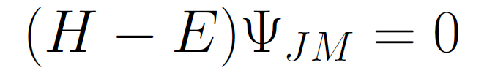


3
r
r
R
R
1
2
R
3
1
2
1
2
r
3
C=1
C=2
C=3
Notes:
9

Slide 10


3
r
r
R
R
1
2
R
3
1
2
1
2
r
3
C=1
C=2
C=3
Basis functions of each Jacobi coordinate
Determined by diagonalizing H
Notes:
10

Slide 11





Where the energy and overlap matrix elements are given by
H_{in}= <Φ_{i} | H | Φ_{n} > (i, n =1,…,N)
N_{in} = <Φ_{i} | 1 | Φ_{ｎ} > --- non-orthogonal basis
Next, we get eigenenergy E and coefficients C_{n}
by solving generalized matrix eigenvalue problem,
.
( H_{i n}) - E ( N_{i n} )
C_{n}
=0
solution
Notes:
Now, let me explain how to solve three-body problem for simplicity.

Slide 12
q
C
C
q
q
4
3
q
q
q
q
C
C=1(J/Ψ+p,ηc+p)
C=2(Λc+D,Σc+D)
C=3
C=4
Ψ_{JM}(qqqcc)= Φ_{JM}^{(C=1)} +Φ_{JM} ^{(C=2)} +φ_{JM}^{(c=3)} +Φ_{JM} ^{(C=4)}
Φ_{αJM}(qqqcc)=A_{qqqq}{[(color)^{(c)}_{α} (isospin)^{(c)}_{α}
(spin)^{(C)}_{α} (spatial)^{(c)}_{α}]_{JM}}

Slide 13
Wavefunction of
Color part
q
q
C
Similar for C=2
C
q
4
C
3
q
q
q
q
C=2(Λc+D,Σc+D)
1
X
1
=1

Slide 14
Confining channels
3
X
3
=3
3
X
3
=3
3
X
3=8 + 1
X
3=8 + 1
3
I take color singlet.
I take color singlet.

Slide 15
q
C
C
q
q
4
3
q
q
q
q
C
C=1(J/Ψ+p,ηc+p)
C=2(Λc+D,Σc+D)
C=3
C=4
Ψ_{JM}(qqqcc)= Φ_{JM}^{(C=1)} +Φ_{JM} ^{(C=2)} +φ_{JM}^{(c=3)} +Φ_{JM} ^{(C=4)}
Φ_{αJM}(qqqcc)=A_{qqqq}{[(color)^{(c)}_{α} (isospin)^{(c)}_{α}
(spin)^{(C)}_{α} (spatial)^{(c)}_{α}]_{JM}}
(spatial)^{(c)}_{α}=φ_{nl}^{(c)}(r_{c})ψ_{νλ}^{(c)}(ρ_{c})φ^{(c)}_{kj}(s_{c})Φ_{n LM}^{(c)}(R_{c})
Same procedure
is taken for
r,ρ, and s.
R

Slide 16
For the Pc(4380) and (4450), we consider the following 9 candidates states,
Total orbital angular momentum: L=0, 1, 2
Total Spin : S=1/2, 3/2, 5/2
For example, in the case of total orbital angular momentum L=0, S=1/2, 3/2, 5/2, J^{π}=1/2⁻,3/2⁻,5/2⁻
We take s-waves for all coordinates.
q
C
C
q
q
4
0
0
0
0
3
q
q
q
q
C
C=1(J/Ψ+p,ηc+p)
C=2(Λc+D,Σc+D)
C=3
C=4

Slide 17
(H-E)Ψ=0
By the diagonalization of Hamiltonian, we obtain N eigenstates for each J^{π}.
Here, we use about 40,000 basis functions.
Then, we obtained 40,000 eigenfunction for each J^{π}.
First, we investigate J=1/2-, namely, L(total angular momentum)=0, S(total spin)=1/2.
・・・・
・・・・
L=0,S=1/2 for example

Slide 18
q
C
C
q
q
4
3
q
q
q
q
C
C=1(J/Ψ+p,ηc+p)
C=2(Λc+D,Σc+D)
C=3
C=4
First, we take two channels.

Slide 19
Confining channels
3
X
3
=3
3
X
3
=3
3
X
3=8 + 1
X
3=8 + 1
3
I take color singlet.
I take color singlet.

Slide 20
Σc*+D*(4587)
N+J/Ψ*(4584)
N+ ηc* (4544)
Σc+D*(4505)
Pc(4450)
Σc+D(4353)
Λc+D*(4323)
Λc+D(4171)
J/Ψ+N(4040)
L=0,S=1/2

Slide 21
q
C
C
q
q
4
3
q
q
q
q
C
C=1(J/Ψ+p,ηc+p)
C=2(Λc+D,Σc+D)
C=3
C=4
Next, we take two scattering channels.

Slide 22
Results before doing the scattering calculation
Bound-state approximation
q
q
c
Σc*+D*
q
c
Σc+D*
Pc(4450)
Σ*+D
Do these states correspond
to resonance states or
discrete non-resonance
continuum states?
J/Ψ+Δ
Σc+D
Λc+D*
Δ+ηc
Pc(4380)
Λc+D
L=0,S=1/2
L=0, S=3/2
J/Ψ+p

Slide 23
useful method: real scaling method
often used in atomic physics
In this method, we artificially scale the range parameters
of our Gaussian basis functions by multiplying a factor α:
r_{n}→αr_{n} in r^{l}exp^{(-r/r )} for exmple 0.8 <α<1.5
2
n
and repeat the diagonalization of Hamiltonian for many
value of α.
← resonance state
Non-resonance continuum state
α: range parameter of Gaussian basis function
[schematic illustration of the real scaling]
What is the result in our pentaquark calculation?

Slide 24
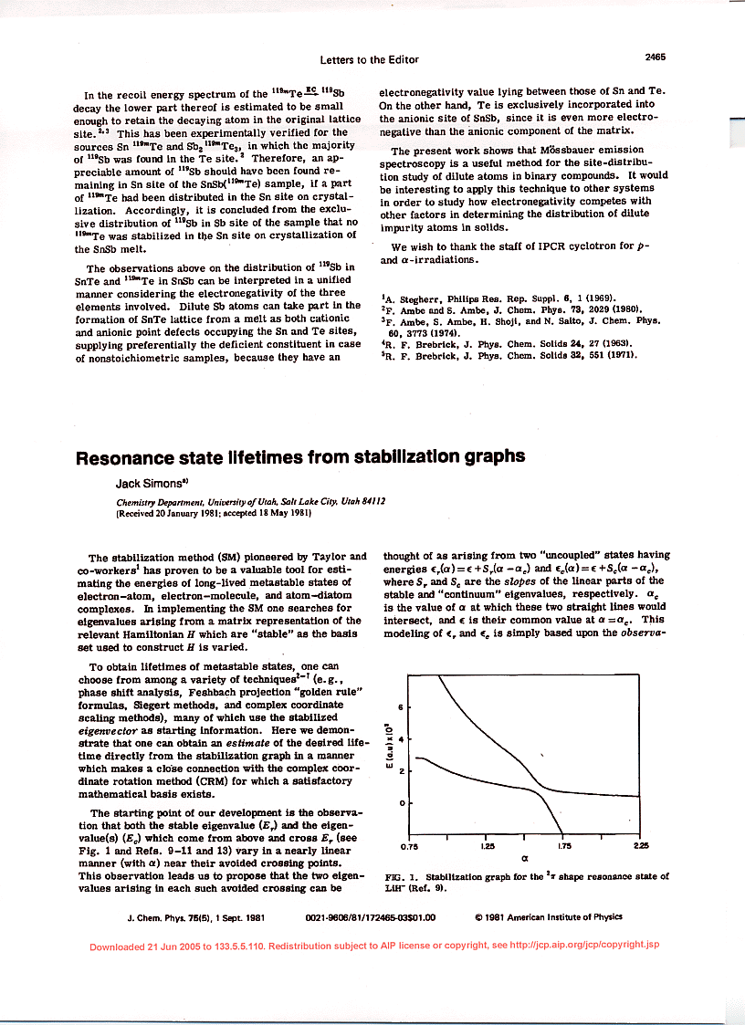

Slide 25
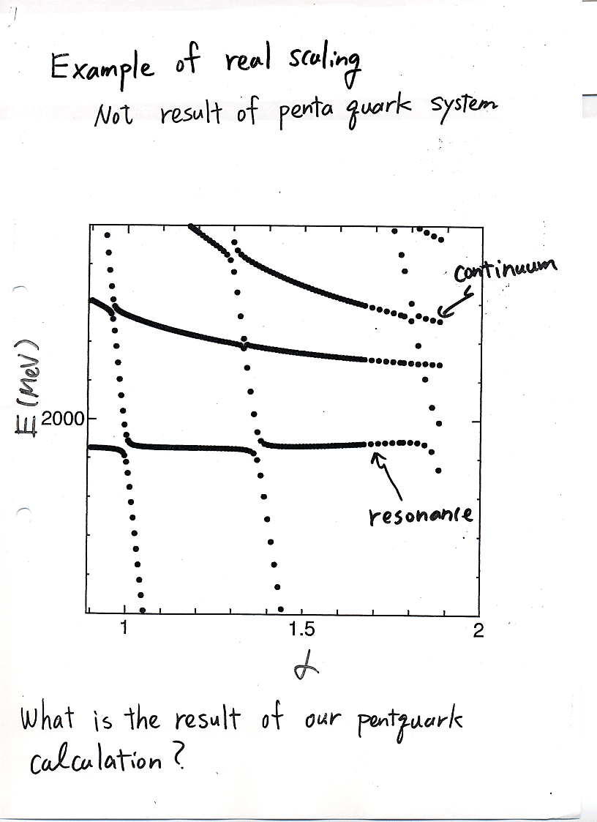

Slide 26
q
C
C
q
q
4
3
q
q
q
q
C
C=1(J/Ψ+p,ηc+p)
C=2(Λc+D,Σc+D)
C=3
C=4
R_{nR} => αR_{nR}

Slide 27
Results before doing the scattering calculation
Bound-state approximation
All states are melted into each meson-
baryon continuum decaying state.
Then, there is no resonant state
between 4000 MeV to 4600 MeV.
Σc*+D*
Σc+D*
Σc*+D* threshold
Pc(4450)
Σ*+D
J/Ψ+Δ
Σc+D
Λc+D*
Δ+ηc
MeV
Pc(4380)
J/Ψ+p threshold
Λc+D
α
ηc+N
J/Ψ+p
L=0, S=1/2

Slide 28
One resonance
at ４６９０ MeV
Much higher than the
observed data
Why we have a resonance
state at such higher energy?

Slide 29
This corresponds to resonant state, like a feshbach resonant state.
It is considered that other states are melted into various threshold.
Σc*+D*(4587)
N+J/Ψ*(4584)
N+ ηc* (4544)
Σc+D*(4505)
q
q
c
Pc(4450)
q
Σc+D(4353)
c
Λc+D*(4323)
Λc+D(4171)
For example, let us consider this state.
J/Ψ+N(4040)
Confining channels
L=0,S=1/2

Slide 30
L=0,S=1/2
Σc*+D*(4587)
N+J/Ψ*(4584)
+
N+ ηc* (4544)
Σc+D*(4505)
Pc(4450)
Σc+D(4353)
Λc+D*(4323)
ηc+N channel
Λc+D(4171)
Conjecture: 4119 MeV can be describe as ηc+N like.
However, due the restriction of the configurations, namely,
by only C=4 and 5 channels, the mass energy is up than the
ηc+N by about 200 MeV. In order to investigate this conjecture,
we solve scattering states including ηc+N channel only with
real scaling method. If 4119 MeV is ηc+N like structure, this
State should be melted into ηc+N threshold.
J/Ψ+N(4040)
ηc+N(3900)

Slide 31
L=0,S=1/2
Σc*+D*(4587)
N+J/Ψ*(4584)
N+ ηc* (4544)
Σc+D*(4505)
Pc(4450)
Σc+D(4353)
Λc+D*(4323)
J/Ψ+N like?
100 MeV
Λc+D(4171)
Melted into η_{c}+N threshold
J/Ψ+N(4040)
η_{c}+N
100 MeV difference
4119 MeV is η_{c}+N like structure!
ηc+N(3900)

Slide 32
L=0,S=1/2
Σc*+D*(4587)
N+J/Ψ*(4584)
+
N+ ηc* (4544)
Σc+D*(4505)
Pc(4450)
Σc+D(4353)
Λc+D*(4323)
J/Ψ+N channel
Λc+D(4171)
J/Ψ+N(4040)
ηc+N(3900)

Slide 33
L=0,S=1/2
Σc*+D*(4587)
N+J/Ψ*(4584)
N+ ηc* (4544)
Σc+D*(4505)
Pc(4450)
Σc+D(4353)
Λc+D*(4323)
J/Ψ+N like structure
Melted into J/psi+N
Λc+D(4171)
J/Ψ+N
J/Ψ+N(4040)
ηc+N(3900)

Slide 34
L=0,S=1/2
No coupled with any threshold
then, exist as a resonant state
J/Ψ*+N like
Σc*+D*(4587)
N+J/Ψ*(4584)
N+ ηc* (4544)
Σc+D*(4505)
Λc+D,Λc+D*
Pc(4450)
Mixture of ηc+N,Λc+D*,Σc+D
Σc+D(4353)
Λc+D*(4323)
J/Ψ+N like structure
Λc+D(4171)
ηc+N like structure
J/Ψ+N(4040)
ηc+N(3900)

Slide 35
Resonant state=> it is highly energy region than the observed data.
Λc+D*,J/ψ+N,Σc+D*
J/ψ+N structure

Slide 36
Summary
・Motivated by the observed Pc(4380) and Pc(4450) systems at LHCb,
we calculated energy spectra of qqqcc system using non-relativistic constituent quark
model. To obtain resonant states, we also use real scaling method.
・Currently, we find no sharp resonant states (penta-quark like)
with L=0,S=1/2 (J^{π}=1/2⁻) and L=0, S=3/2(J^{π}=3/2⁻) at observed energy region.
However, we have one resonant state at 4690 MeV for J^{π}=1/2⁻
and at 4890 MeV for J^{π}=3/2⁻ . This can be penta-quark state.
From our calculation, we would suggest that the resonant states observed
at LHCb are meson-baryon resonant states which we cannot calculate in our model.
If it is possible to produce the penta-quark system at Alice, I would like to ask you
what kinds of pentaquark system they can produce.

Slide 37
Thank you!

