Slide 1
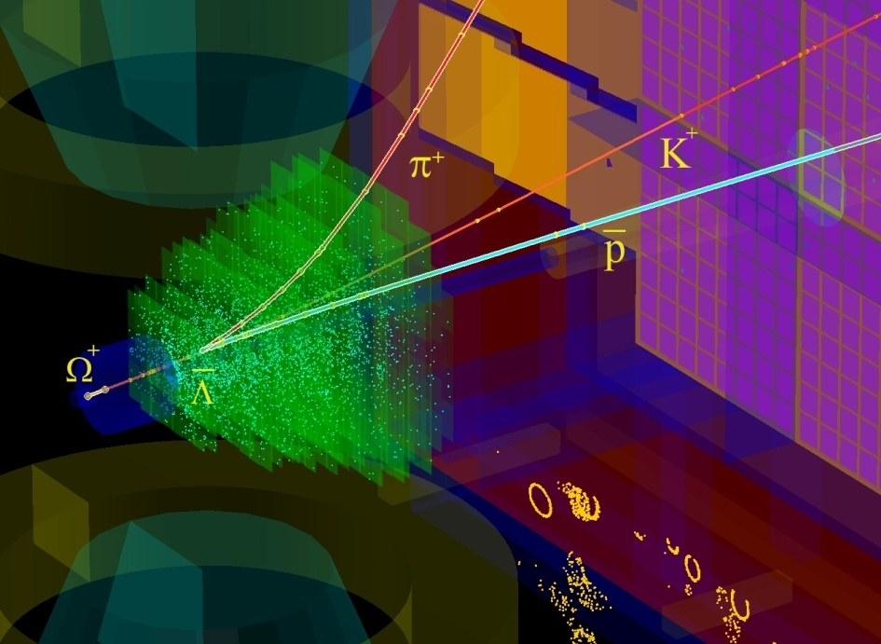
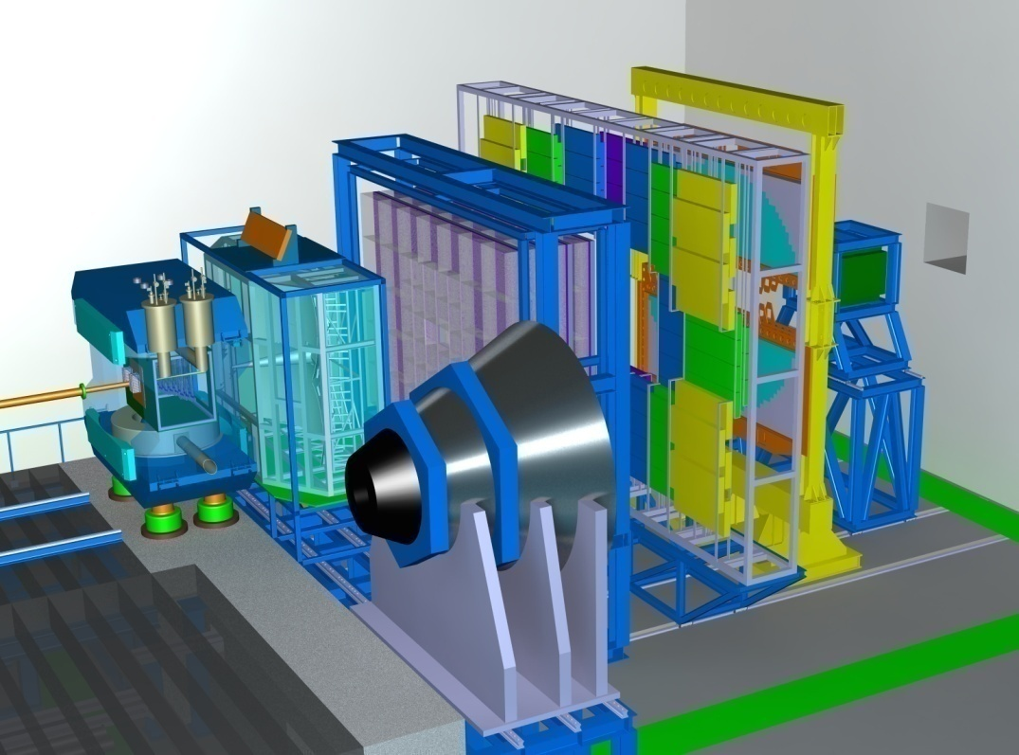
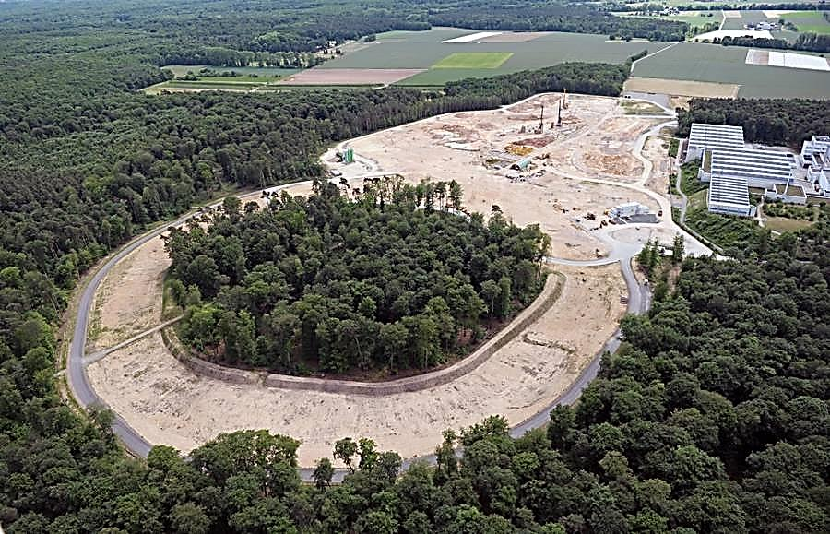
Perspectives on strangeness physics with CBM
I.Vassiliev for the CBM Collaboration
TOF
ECAL
TRD
RICH
STS
PSD
MVD
MUCH
Physics case
Developed methods & tasks
High rate scenario
Conclusions
November 2017 Turin
Notes:
1
1
1
1

Slide 2
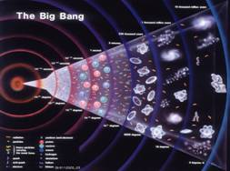
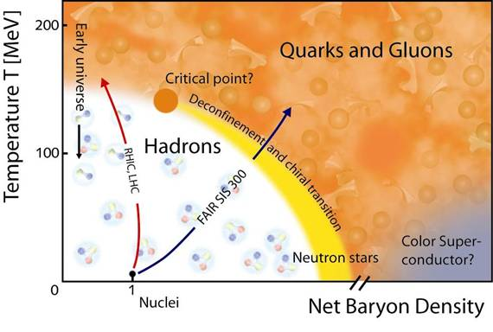
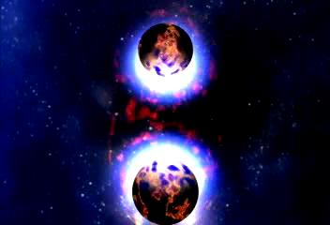
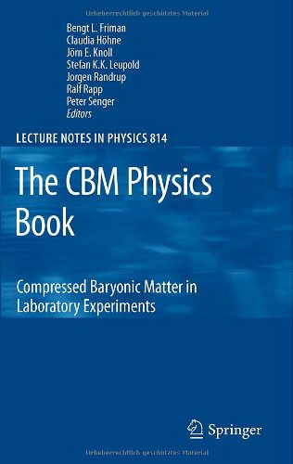
Physics case: Exploring the QCD phase diagram
The equation-of-state at high ρ_{B}
collective flow of hadrons
particle production at threshold energies: open charm, multi-strange hyperons, HN
Deconfinement phase transition at high ρ_{B}
excitation function and flow of strangeness (K, Λ, Σ, Ξ, Ω) and
charm (J/ψ, ψ', D⁰, D_{s}, D±, Λ_{c})
QCD critical endpoint
excitation function of event-by-event fluctuations (K/π, ... Ξ/ π, Ω/ π)
Onset of chiral symmetry restoration at high ρ_{B}
in-medium modifications of hadrons (ρ,ω,φ)
excitation function of multi-strange (anti)hyperons (PHSD 4.0)
LHC
RHIC
SPS-CERN
CBM
Projects to explore the QCD phase diagram at large μ_{B}:
RHIC energy-scan, NA61@SPS, MPD@NICA: bulk observables
CBM: bulk and rare observables, high statistic!
2
Notes:
2
2
2

Slide 3
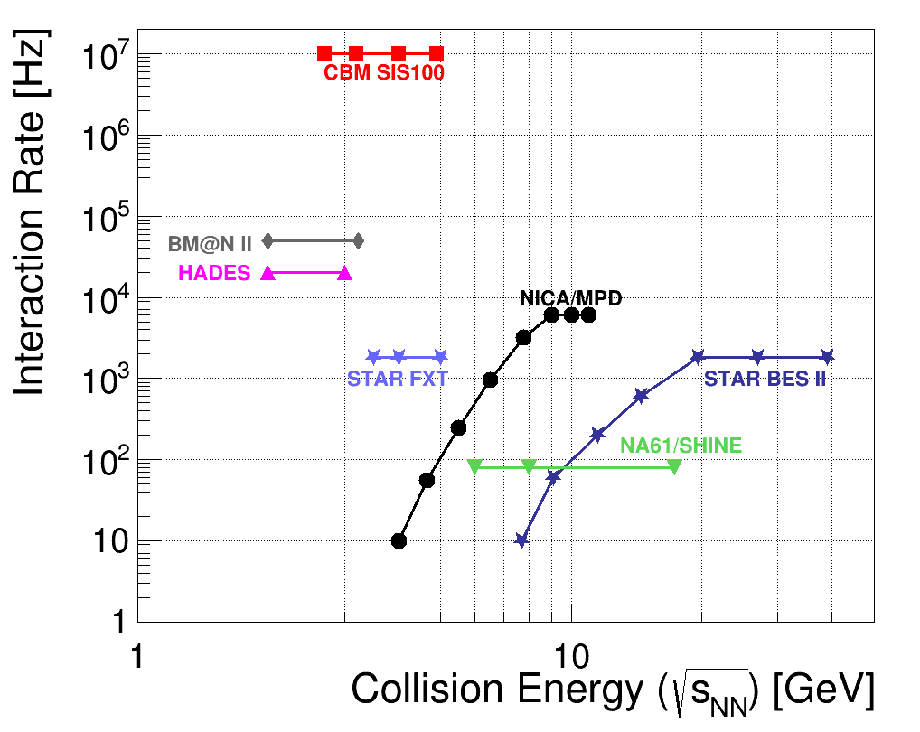
Experiments exploring dense QCD matter
high
net-baryon densities
CBM:
world record
rate capability
determination of (displaced) vertices with high resolution
(≈ 50 μm)
identification of leptons and hadrons
fast and radiation hard detectors
self-triggered readout electronics
high speed data acquisition and
online event selection
powerful computing farm and 4D tracking
software triggers

Slide 4
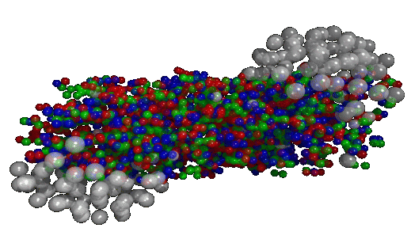
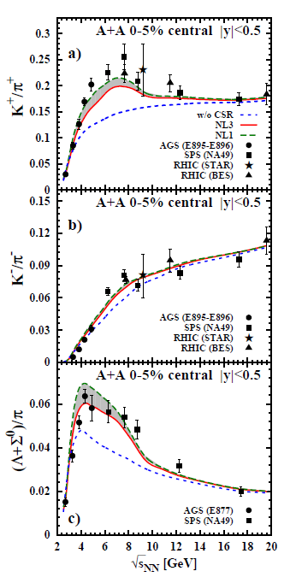
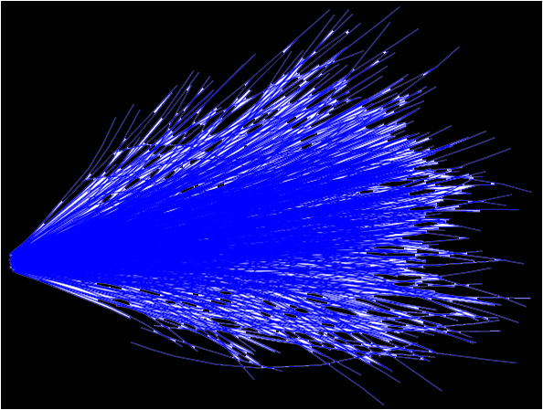
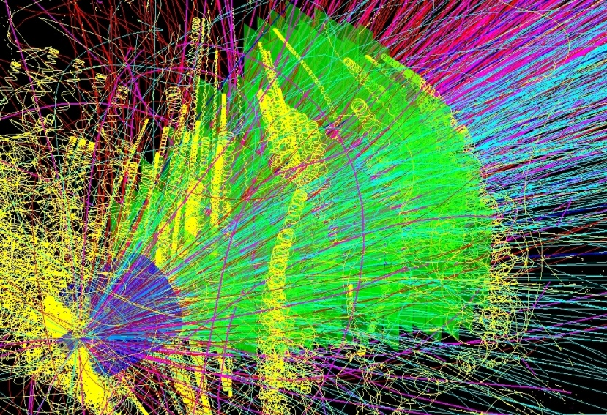
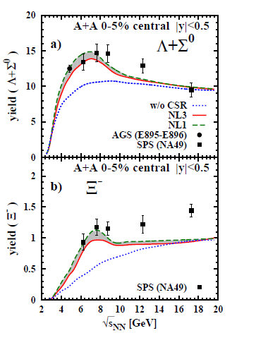

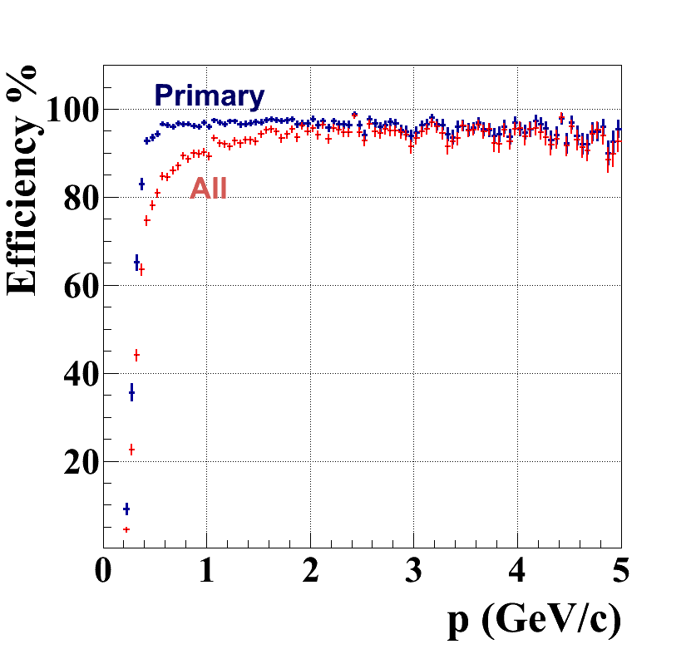
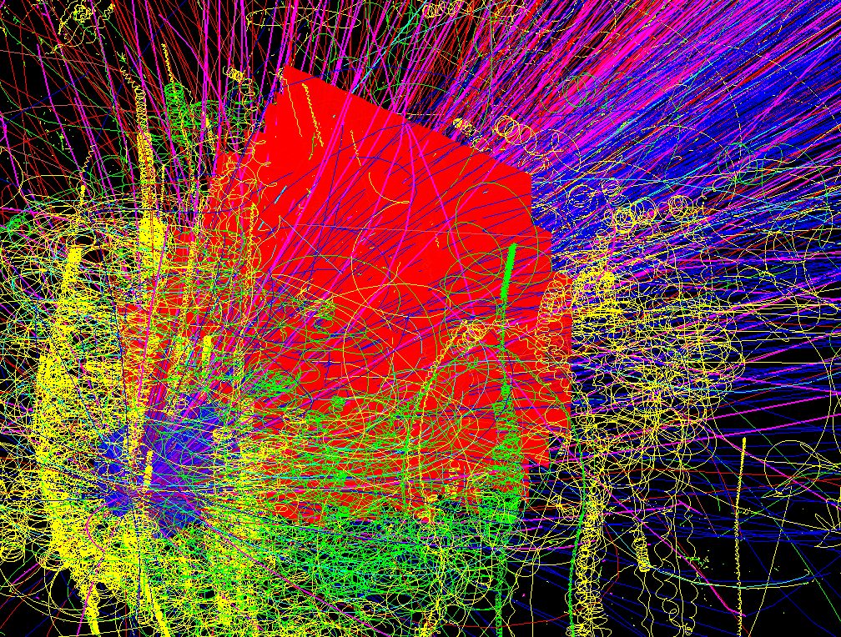
SIS-300: central Au + Au (UrQMD or PHSD) events
Simulation and reconstruction
UrQMD
simulation
~700 π
160 p
53 K
32 Λ
27 K_{S}⁰
0.44 Ξ⁻
0.018 Ω⁻
reconstruction
simulation
~700 π
174 p
42 K
30 Λ
24 K_{S}⁰
2.4 Ξ⁻
0.005 Ω⁻
CA track finder
low p tracks !
648 recstructed tracks
Ref. prim. eff = 96%
All set eff = 87%
dp/p = 1.2%
central: 82 (TF) + 16 (PF) ms/core
mbias : 10 (TF) + 2 (PF) ms/core
up to 80 cores/CPU
Notes:
4
4

Slide 5
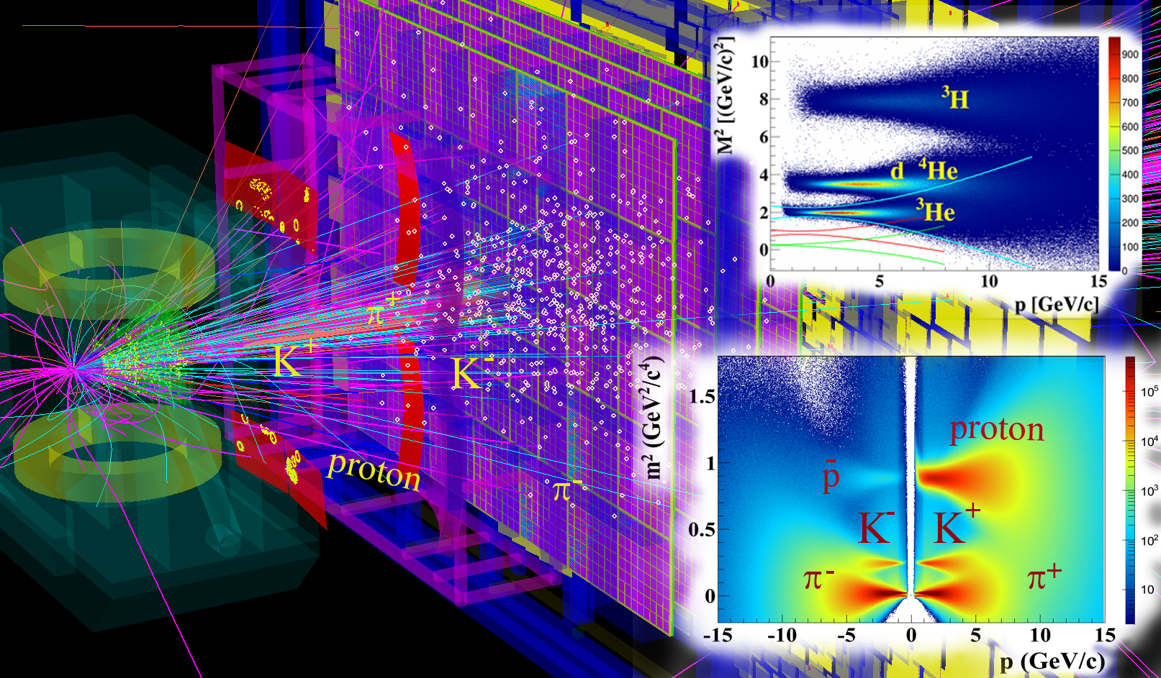
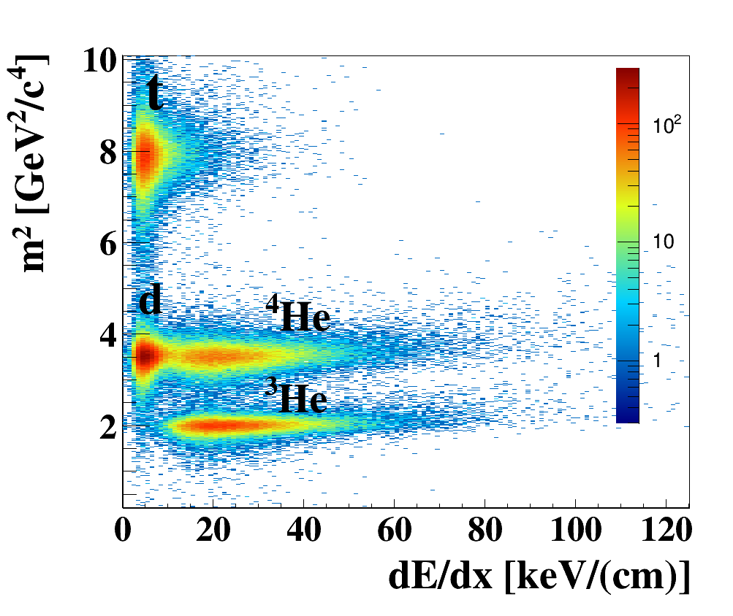
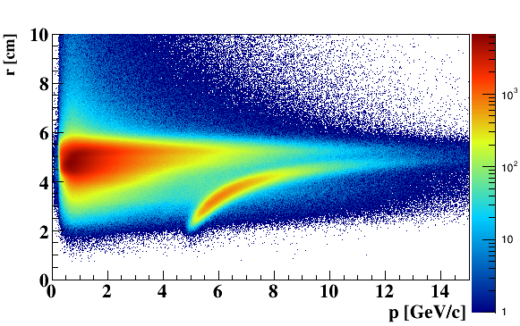
Particle identification with PID detectors :
Ni+Ni 15 AGeV
123 π
53 p
6 K⁺
1.6 K⁻
4 Λ
7.5 K_{S}⁰
0.4 Ξ⁻
e
π
Central event: 40 (TF) + 7 (PF) ms/core with MVD!
(~ 2 faster w/o MVD)

Slide 6
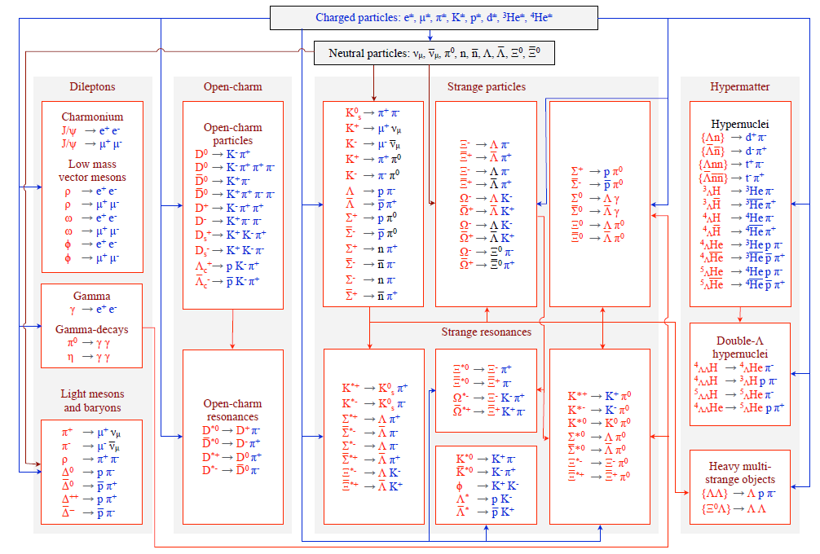
KF Particle Finder for the CBM Experiment
+ STAR, ALICE, PANDA, HADES, NA61

Slide 7
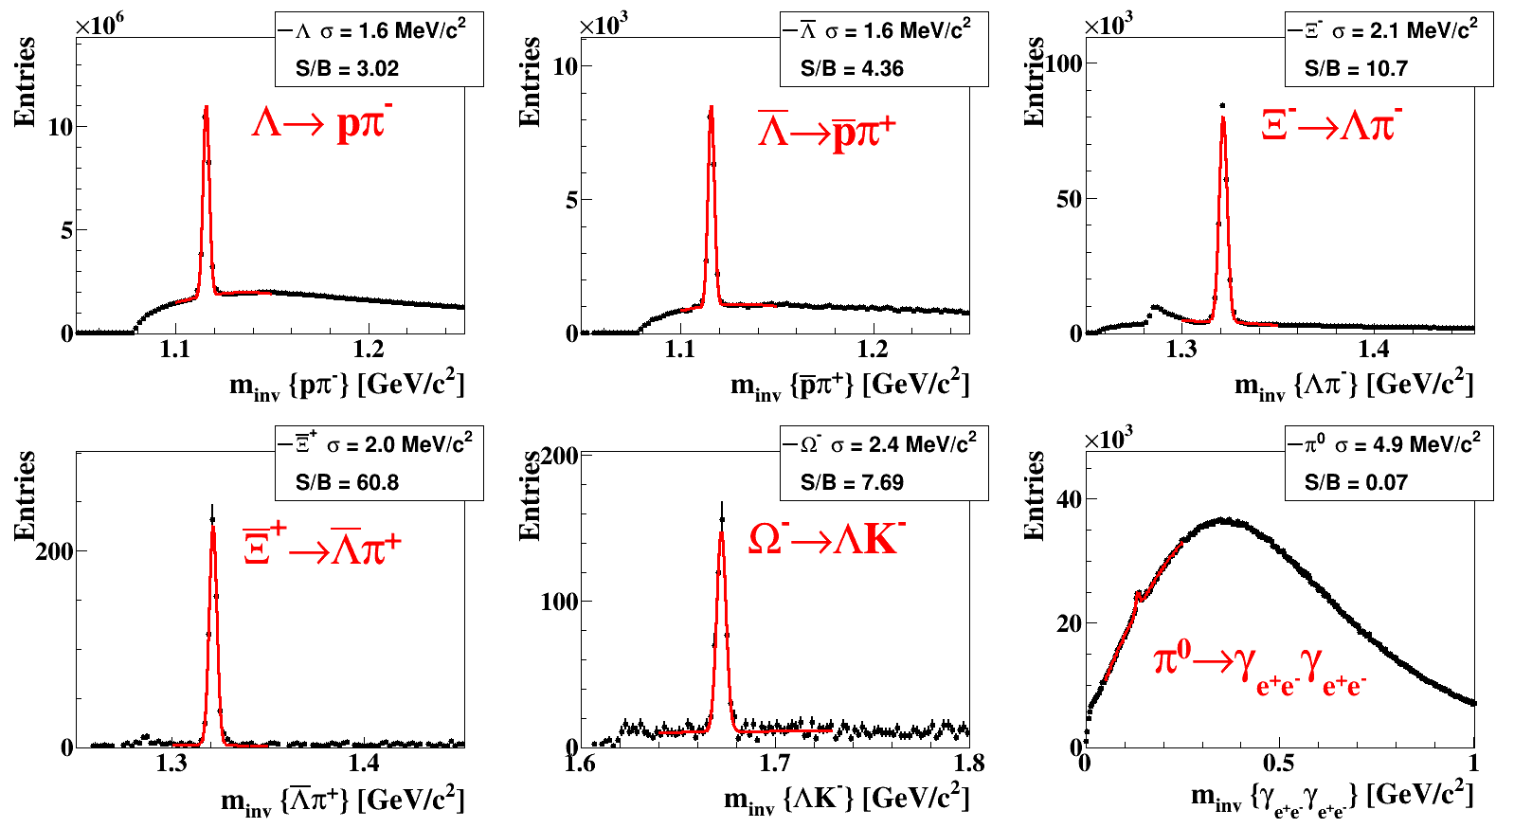
5M central AuAu collisions, 10AGeV

Slide 8
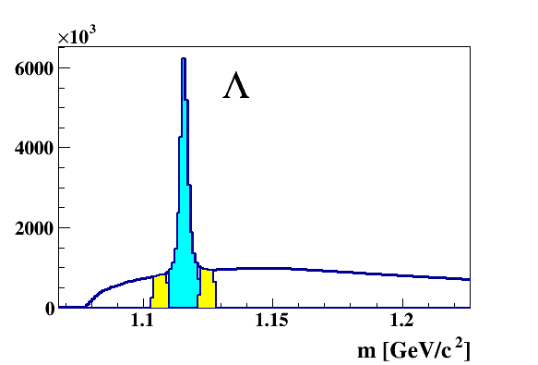
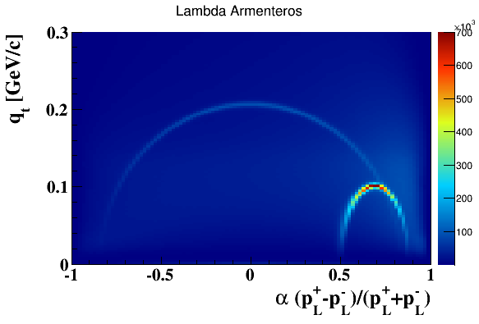
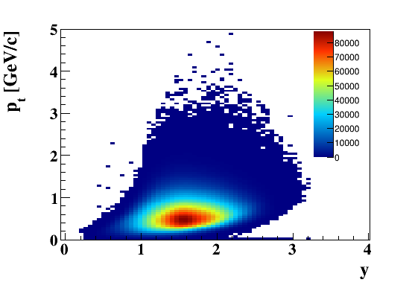
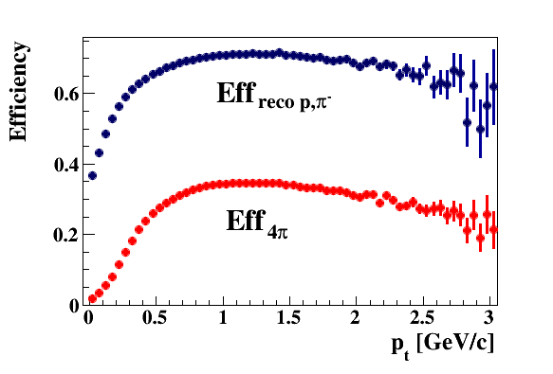
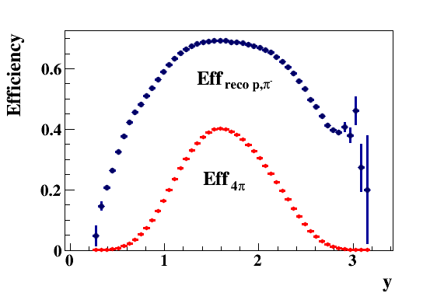
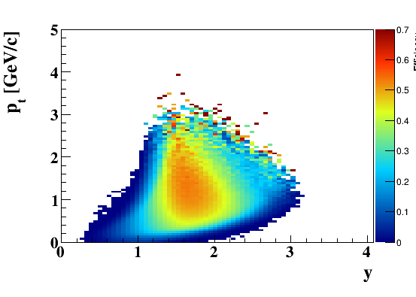
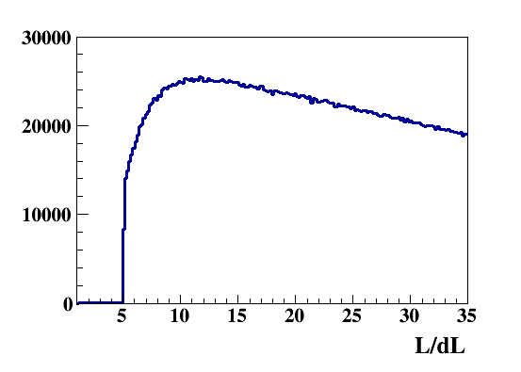
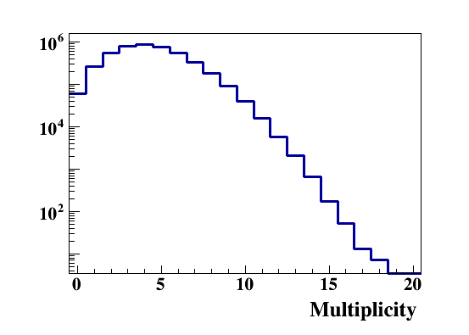
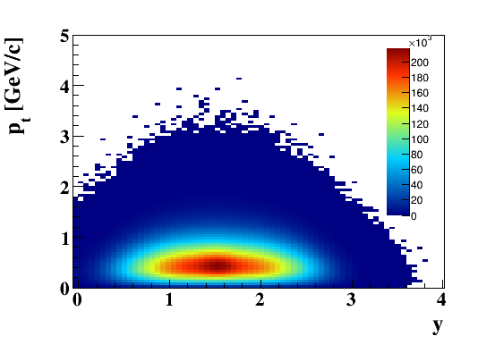
5M central Au Au collisions, 10AGeV (Λ)
Reco
Efficiency_{4π}
MC

Slide 9
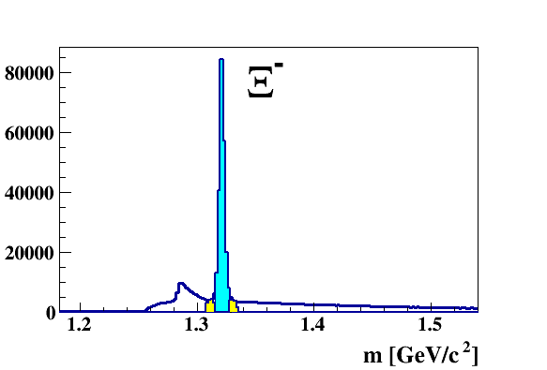
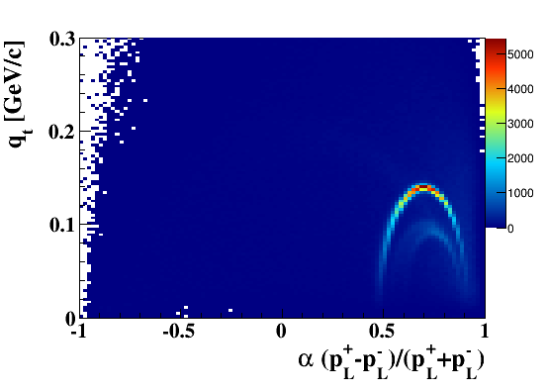
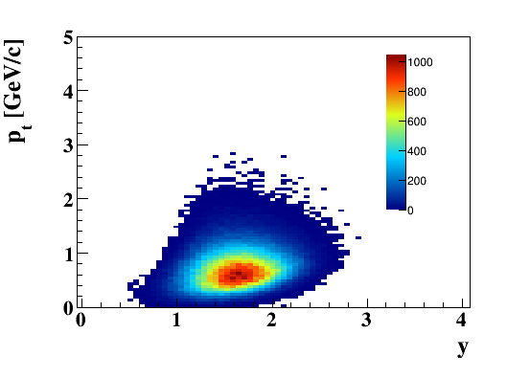
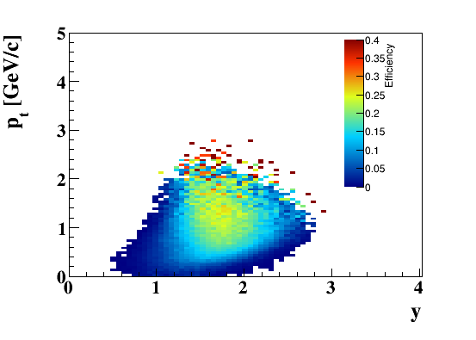
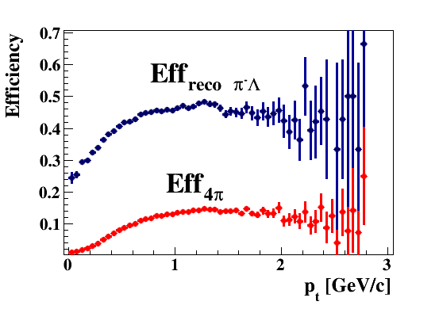
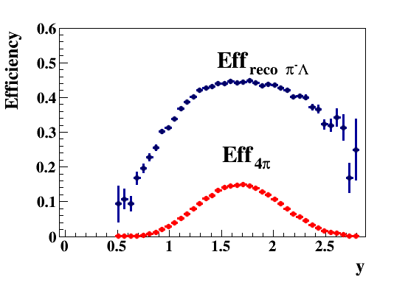
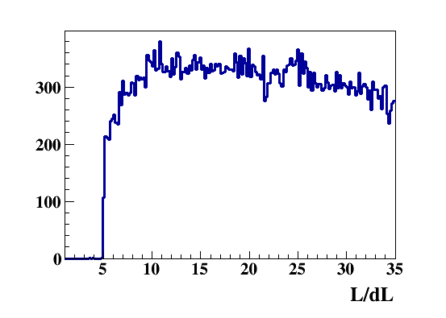
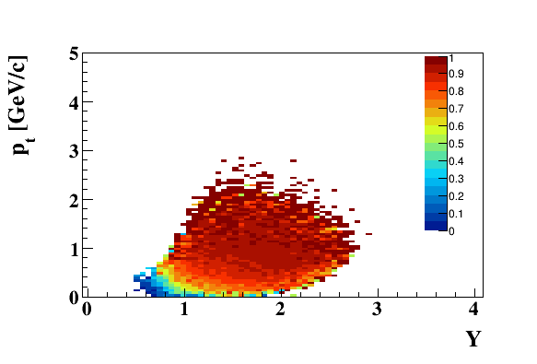
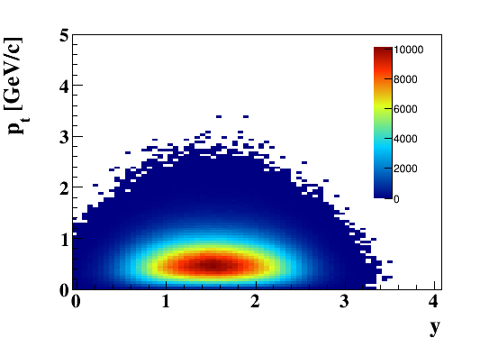
5M central Au Au collisions, 10AGeV (Ξ⁻)
Reco
Efficiency_{4π}
Purity
MC

Slide 10

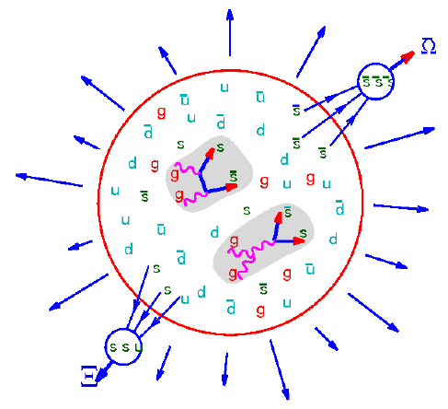
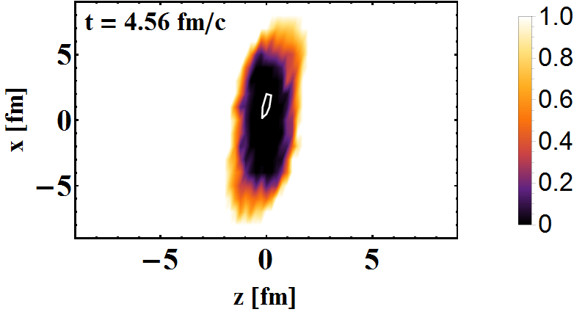
KF Particle Finder with ToF track ID: Au+Au @ 10AGeV
165 π
170 p
26 K
15 Λ
20 K_{S}⁰
0.3 Ξ⁻
QGP !?
pv

Slide 11
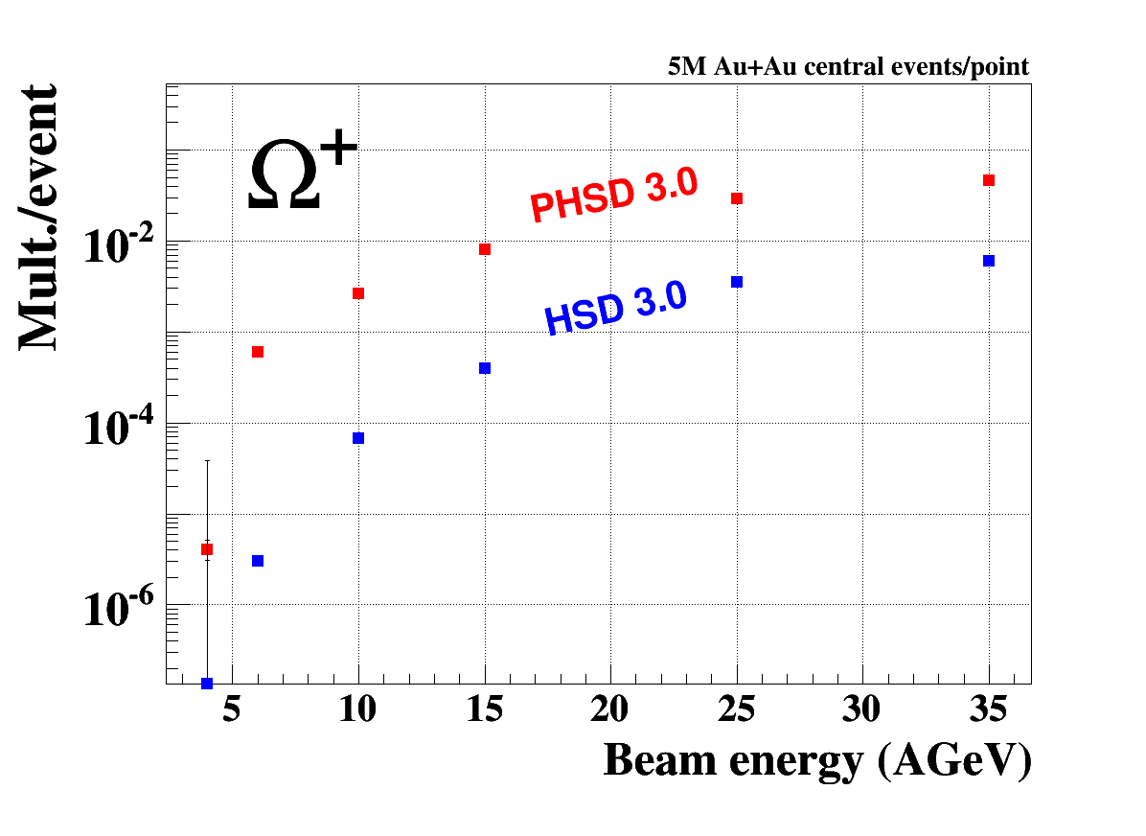
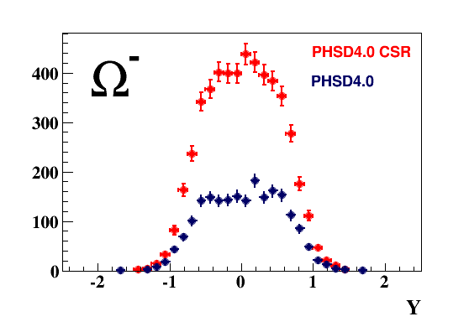
QGP and CSR signatures at FAIR energies:
Multi-strange baryons and antibaryons
PHSD 4.0 Au + Au @ 10 AGeV
QGP
5M events/point
Most of the Ω+ produced by QGP @ FAIR energy
CSR increase yield of MS Baryons & Antibaryons

Slide 12
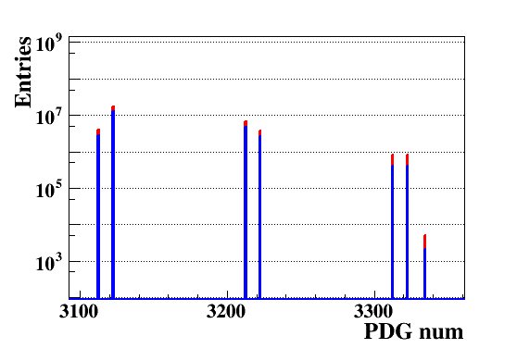
central AuAu collisions, 10AGeV
with CSR
wo CSR
Λ
Σ⁰
Σ⁺
Σ⁻
Ξ⁻
Ξ⁰
MVD+M³
Ω⁻
(M)-S Baryons

Slide 13
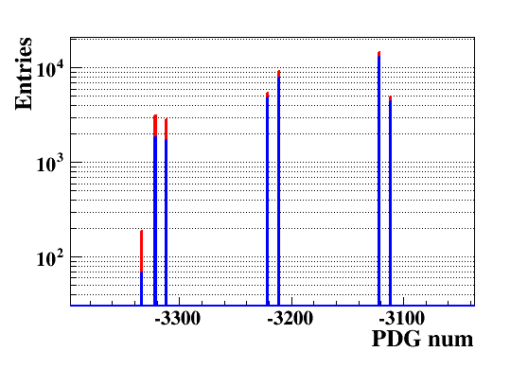
central AuAu collisions, 10AGeV
with CSR
wo CSR
Σ⁺
Λ
Σ⁰
Ξ⁰
Σ⁻
Ξ⁺
MVD+M³
Ω⁺
(M)-S Anti-Baryons

Slide 14
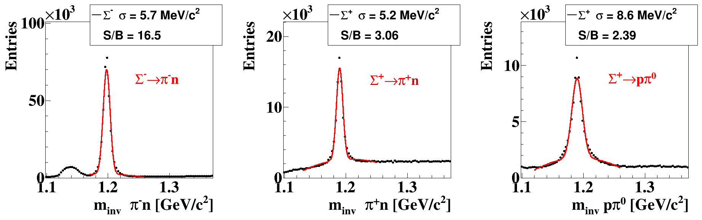
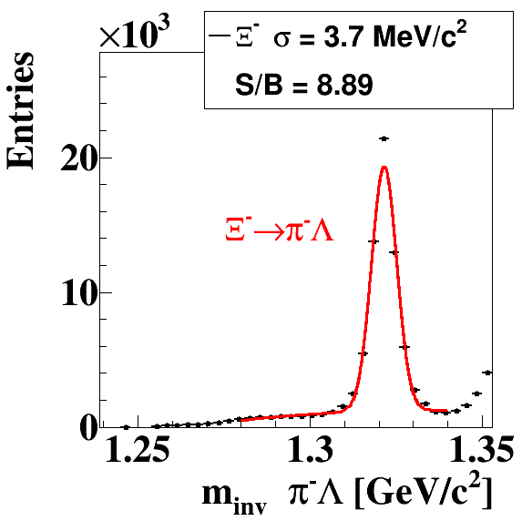
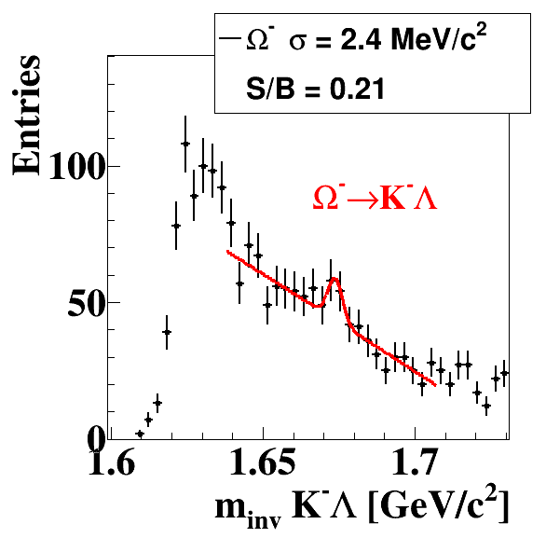
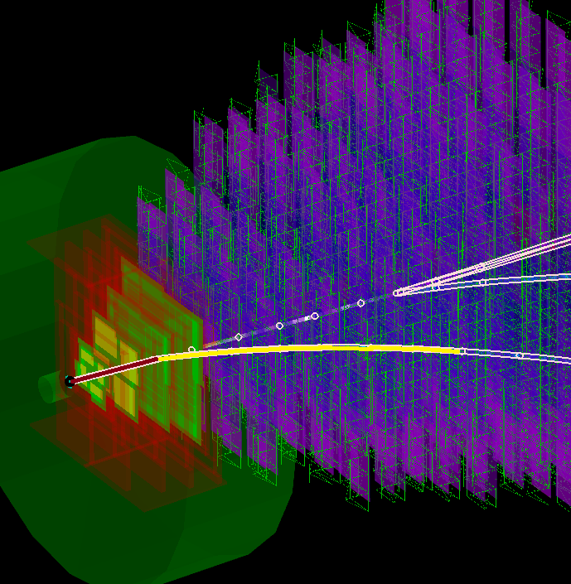
PHSD 4.0 (CSR) 5M central Au +Au collisions , M³ (P. Kisel)
Λ
Ξ⁻
π⁻
14

Slide 15
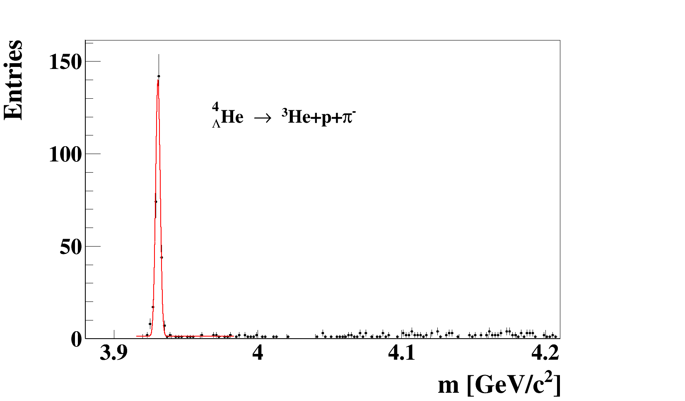
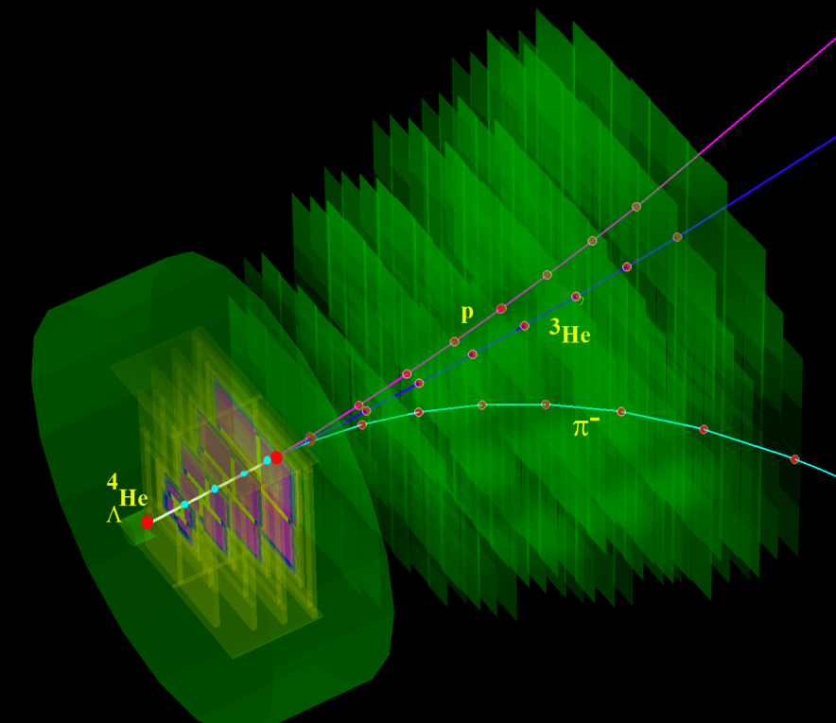
UrQMD
Au+Au 10 AGeV 5M central events
Extended KFParticle Finder ⁴_{Λ}He
~ 1 min. of data taking!
STS
MVD
eff = 14.7%
= 1.6 MeV
S/B ~ 50
BR ~ 0.2
3 prong detached vertex is good signature of ⁴_{Λ}He decay
M from J. Steinheimer et al., Phys. Lett. B714, 85, (2012)
15

Slide 16





5M mbias AuAu collisions, 10AGeV
Extended KFParticle Finder ³_{Λ}H
p
p
K
K
π
π
5 seconds of data taking!
ToF + TRD
ToF + STS
ToF

Slide 17



DCM with CBM detector 5M mbias C + C collisions
A.S.Botvina, K.K.Gudima, J.Pochodzalla. Production of hypernuclei in peripheral relativistic ion collisions. Phys. Rev. C , v. 88, p. 054605, 2013.
10 AGeV
d
³He
d
p
³He
p
³_{Λ}H→³He + π⁻

Slide 18

DCM with CBM detector 5M mbias C + C collisions
About 10 sec of data taking assuming 5*10⁵ IR
eff_{4π} = 13%
Λ N, ΛNN, ⁴_{Λ}H and ⁴ _{Λ}He

Slide 19


⁴_{ΛΛ}H decay topology
⁴_{ΛΛ}H decay reconstructed with CBM detector

Slide 20


⁶_{ΛΛ}He decay topology
p
p
π
⁶_{ΛΛ}He
e
⁵_{Λ}He
t
-
-
⁶_{ΛΛ}He decay reconstructed with CBM detector

Slide 21


Slide 22
Expected particle yields Au+Au @ 6, 10 AGeV
Particle (mass MeV/c²) | Multi- plicity 6 AGeV | Multi- plicity 10 AGeV | decay mode | BR | ε (%) | yield (s⁻¹) 6AGeV | yield (s⁻¹) 10AGeV | yield in 10 weeks 6AGeV | yield in 10 weeks 10 AGeV | IR MHz
Λ (1115) | 4.6·10⁻⁴ | 0.034 | pπ⁺ | 0.64 | 11 | 1.1 | 81.3 | 6.6·10⁶ | 2.2·10⁸ | 10
Ξ⁻ (1321) | 0.054 | 0.222 | Λπ⁻ | 1 | 6 | 3.2·10³ | 1.3·10⁴ | 1.9·10¹⁰ | 7.8·10¹⁰ | 10
Ξ⁺ (1321) | 3.0·10⁻⁵ | 5.4·10⁻⁴ | Λπ⁺ | 1 | 3.3 | 9.9·10⁻¹ | 17.8 | 5.9·10⁶ | 1.1·10⁸ | 10
Ω⁻ (1672) | 5.8·10⁻⁴ | 5.6·10⁻³ | ΛK⁻ | 0.68 | 5 | 17 | 164 | 1.0·10⁸ | 9.6·10⁸ | 10
Ω⁺ (1672) | - | 7·10⁻⁵ | ΛK⁺ | 0.68 | 3 | - | 0.86 | 0 | 5.2·10⁶ | 10
³ _{Λ}H (2993) | 4.2·10⁻² | 3.8·10⁻² | ³Heπ⁻ | 0.25 | 19.2 | 2·10³ | 1.8·10³ | 1.2·10¹⁰ | 1.1·10¹⁰ | 10
⁴_{Λ}He (3930) | 2.4·10⁻³ | 1.9·10⁻³ | ³Hepπ⁻ | 0.32 | 14.7 | 110 | 87 | 6.6·10⁸ | 5.2·10⁸ | 10
⁵_{ΛΛ}He(5047) |  | 5.0·10⁻⁶ | ³He2p2π | 0.01 | 1 |  | 5·10⁻³ |  | 3·10⁴ | 10
⁶_{ΛΛ}He(5986) |  | 1.0·10⁻⁷ | ⁴He2p2π | 0.01 | 1 |  | 1·10⁻⁴ |  | 600 | 10

Slide 23



High rate scenario: MSH reconstruction with 4D tracking
100 kHz
1 MHz
10 mks window
10 MHz
K. KASINSKI

Slide 24

V. Akishina

Slide 25

High rate scenario: MSH reconstruction
with 4D tracking

Slide 26

High rate scenario: MSH reconstruction
with 4D tracking

Slide 27


High rate scenario: MSH reconstruction
with 4D tracking

Slide 28

60 Institutes, 600 members
Summary:
CBM detector is an excellent device to measure
not only bulk observables, but strangeness, hypernuclei and other rare probes with
high statistic
28
Notes:
28

