Slide 1
Morning : results on BB interactions from different models
  Chiral EFT + SU(3) breaking (Johann Haidenbauer)
  HALQCD (
  meson exchange and more (Th.A. Rijken)
Afternoon : contribution on theoretical predictions and measurements on exotic states including heavy quark sector

Slide 2
Baryon-baryon interaction from chiral effective field theory, Johann Haidenbauer
BB within interaction Chiral EFT + SU(3) breaking
YN results at NLO compatible with data
Λ and Σ in nuclear matter
  Λ single-particle potential at nuclear matter saturation density is in line with “empirical” results.
  a repulsive Σ single-particle potential, weak Λ-nuclear spin-orbit potential is achieved
  repulsive Λ potential at high density->hints for hyperon puzzle in NS
S = −2: ΛΛ, ΞN results are in agreement with empirical constraints -> need SU(3) symmetry breaking when going from NN to YN to YY !

Slide 3
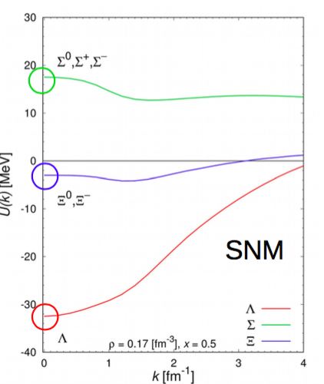
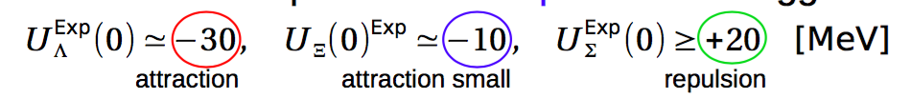
Hyperons in infinite nuclear matter based on the hyperon-baryon interactions from the HALQCD method, Prof. Takashi INOE
HALQCD approach : two step approach lattice + potentials to determine hyperon interactions
Hyperon in nuclear matter : start from YN , YY as predicted from QCD, then use the single particle potential
  nice agreement of single particle potential with data starting from QCD only
    -> remarkable success
Future plans : improve theoretical approach (SU(3)F , BBB, etc. ) thanks to improved computing power in order make predictions on high density matter like NS and provide explanations on hypernuclei from QCD and solve hyperon puzzle of NS

Slide 4
Dibaryon candidates from Lattice QCD, Kenji Sasaki
Within the HALQCD approach the BB interacions were studied in 4 cases : H-dibaryon, NΩ, ΔΔ and ΩΩ
H-dybarion : difficult to conclude the fate, strong attraction in NΞ J=0 with I=0
NΩ state with J^{p}=2⁺ : interaction is strongly attractive, no short range repulsion. It forms a bound state with about 20MeV B.E. Physical point result will be open for ΩN channel.
ΔΔ(I=0) have strongly attractive potential, ΔΔ(I=3) and ΩΩ potential have repulsive core and attractive pocket. Physical ΩΩ system in J=0 strangest dibaryon

Slide 5
Baryon-baryon interactions from Meson-exchange, Th. A. Rijken
BB-interactions ⇒ Quark-interactions :
Via Quark Pair Creation model (QPC), quark momenta meson exchange and Strong Coupling Lattice QCD
Possibility to extract parameters at the quark level from the parameters extracted at the baryon level.

Slide 6
Afternoon sessions

Slide 7
Recent results on light (hyper-)nuclei structure from NPLQCD, Assumpta PARREÑO
Nuclear Physics with Lattice Quantum Chromo Dynamics (NPLQCD)
no e.m. interactions, SU(3) (J=0, J=1)
Description of the Lattice (->compromise with computational cost)
Analysis on YN and YY states
predictions on energy levels and shifts from two body interactions and bound states
calculations of magnetic moments of baryonic systems
continue production at lighter pion mass (~300 MeV)

Slide 8
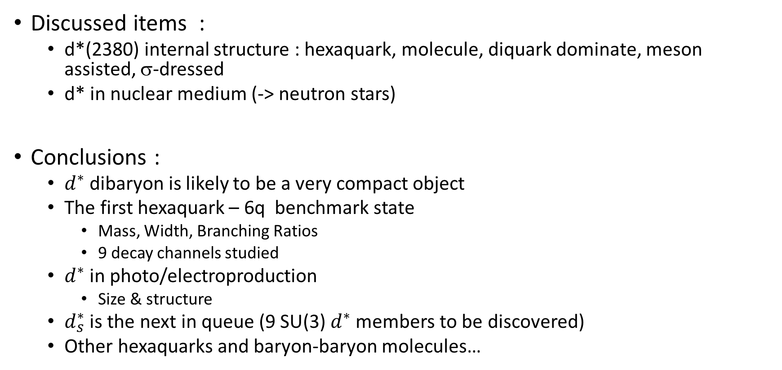
Dibaryon production and structure, Mikhail Bashkanov
Discussed items :
  d*(2380) internal structure : hexaquark, molecule, diquark dominate, meson assisted, σ-dressed
  d* in nuclear medium (-> neutron stars)
Conclusions :
  $d^{∗}$ dibaryon is likely to be a very compact object
  The first hexaquark – 6q benchmark state
    Mass, Width, Branching Ratios
    9 decay channels studied
  $d^{∗}$ in photo/electroproduction
    Size & structure
  $d_{s}^{∗}$ is the next in queue (9 SU(3) $d^{∗}$ members to be discovered)
  Other hexaquarks and baryon-baryon molecules…

Slide 9
Structure of exotic compounds, Melahat Bayar
Fixed Center Approximation approach to the Faddeev equations computation for multi hadron interaction
Promising tool to describe composite objects made of hadrons:
  ρ(1700) appears as resonance of ρK Kbar
  Multi ρ states could be identified with meson states of increasing spin : f2(1270ρ), ρ3(1690), f4(2050), ρ5(2350) and f6(2510)
  K ∗ -multi r states can also be identified with K ∗ states of increasing spin : K2∗(1430), K3∗(1780), K4∗(2045), K5∗(2380) and K6∗
  In the charm sector the method is repeated and new charmed resonances, D3∗, D4∗, D5∗ and D6∗ are predicted
  The method is expanded to the beauty sector ...

Slide 10
Overview on exotica production with CMS, Nazar BARTOSIK
CMS is perfectly suitable for heavy-flavor physics
Important contributions to studies of exotic states made by CMS:
  observation of Y(4140)
  measurement of X(3872) differential cross section
  search for Xb partner of X(3872)
  search for X(5568)
Not all searches resulted in observed particles, but Run-II data is bringing a lot of opportunities

Slide 11
Exotica structure from Bethe-Salpeter approach, Gernot EICHMANN
Exotic particles : composite objects
Bethe –Sapleter approach initially described for mesons and baryons
compute mesons, baryons, tetraquarks, . . . from same dynamics
  Meson masses
  Baryon masses (including strange baryons)
  Tetraquark : Four-quark bound-state equation can be considered as two-body interactions and permutations -> meson molecule
  Interestung system : rare π⁰ -> e⁺e⁻
  Towards 6 q objects….

Slide 12
Exotica production in heavy-ion experiments, Suhoung LEE
Compact multiquark states can be understood from color spin flavor wave function
A strong attractive short range interaction is needed in the SU(3) broken limit
- Heavy quarks are needed to reduce extra kinetic energy
  Tcc could be strongly bound
Measurements from Heavy Ion can discriminate the structures

