Slide 1


Dibaryon production and structure
Mikhail Bashkanov

Slide 2
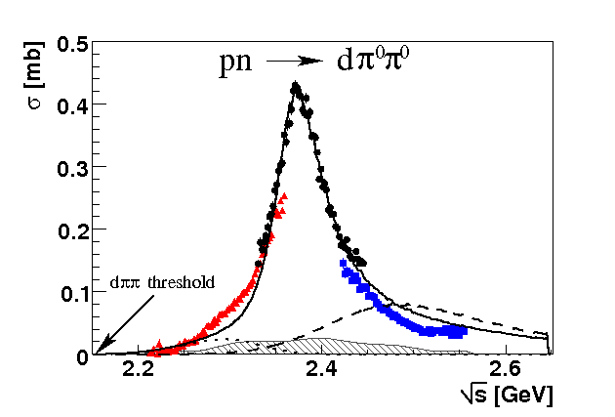
Total cross section pn → dπ⁰π⁰
“d* resonance”
Γ∼70 MeV
ΔΔ
NN*(1440)
P. Adlarson et. al Phys. Rev. Lett. 106:242302, 2011

Slide 3
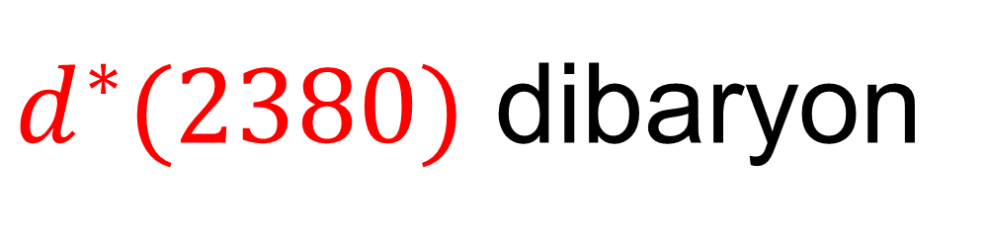
$d^{∗}(2380)$ dibaryon
$$Γ_{d^{∗}}=70 MeV≪Γ_{ΔΔ}=240 MeV$$
u
u
u
d
d
d
Threshold
I(J^{p}) = 0(3⁺)
80 MeV
d*
Δ
Δ
$$M_{d^{∗}}=2.38 GeV≈2M_{Δ}−80 MeV$$

Slide 4
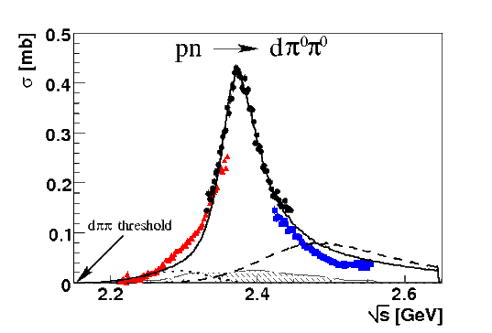

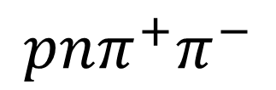

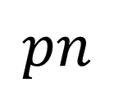
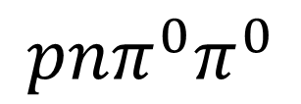
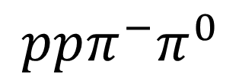
Dibaryon hadronic decays
PRL 106 (2011) 242302
PLB 721 (2013) 229
WASA data
$$dπ^{0}π^{0}$$
$$dπ^{+}π^{−}$$
pn → d*(2380)
$$pn$$
$$ppπ^{−}π^{0}$$
$$pnπ^{0}π^{0}$$
$$pnπ^{+}π^{−}$$
PRL 112 (2014) 202301
PRC 90, (2014) 035204
d*
d*
PRC 88 (2013) 055208
PLB 743 (2015) 325
d*

Slide 5
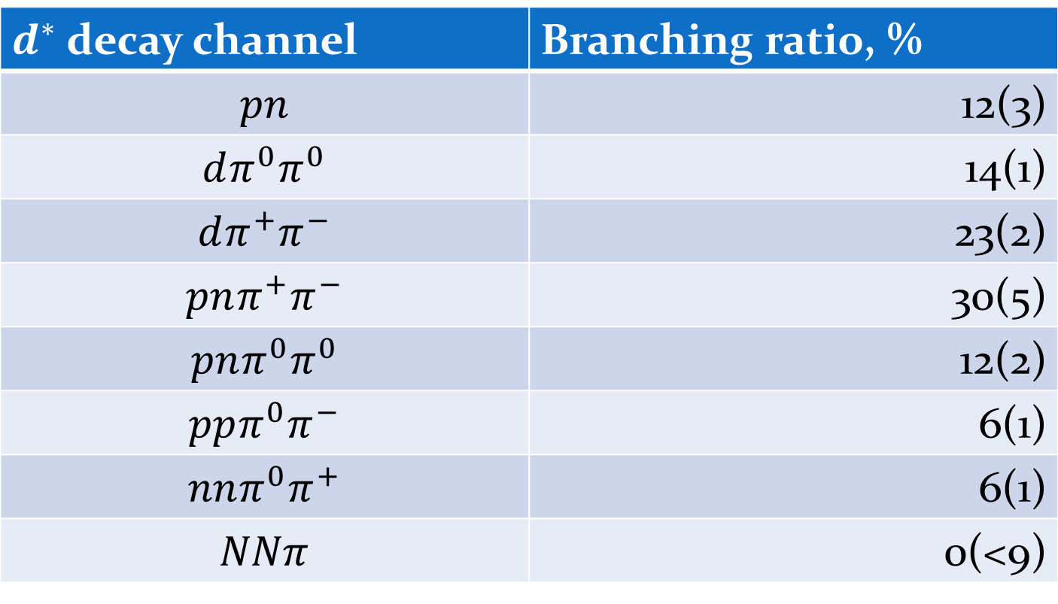
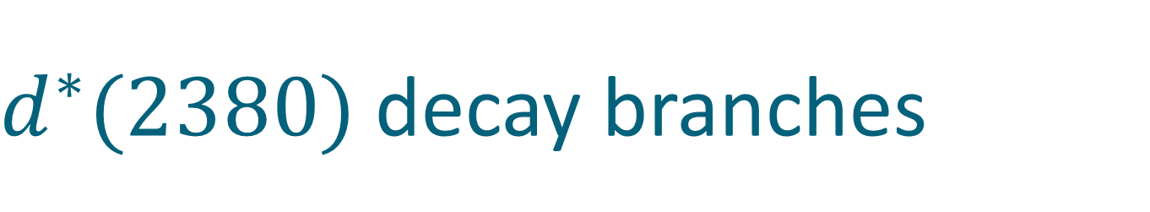
$d^{∗}(2380)$ decay branches
$d^{∗}$ decay channel | Branching ratio, %
$$pn$$ | 12(3)
$$dπ^{0}π^{0}$$ | 14(1)
$$dπ^{+}π^{−}$$ | 23(2)
$$pnπ^{+}π^{−}$$ | 30(5)
$$pnπ^{0}π^{0}$$ | 12(2)
$$ppπ^{0}π^{−}$$ | 6(1)
$$nnπ^{0}π^{+}$$ | 6(1)
$$NNπ$$ | 0(<9)
Eur.Phys.J. A51 (2015) 7, 87

Slide 6
d* Internal Structure

Slide 7
d* internal structure
Hexaquark
Molecule
Diquark dominated
Meson assisted
σ-dressed
σ

Slide 8
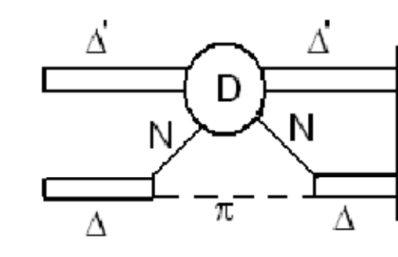


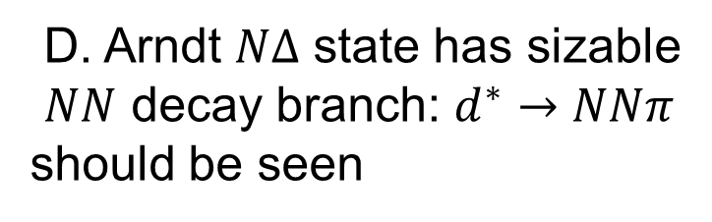
$d^{∗}→NNπ$ decay and $NΔπ$ component of the d*
Molecular Picture, A. Gal,
Phys.Lett. B769 (2017)
$$π^{−}$$
P-wave
p
d*
D-wave
p
Hidden color picture/hexaquark
Yubing Dong, Fei Huang, Pengnian Shen, Zongye Zhang
Phys.Lett. B769 (2017) 223
D. Arndt $NΔ$ state has sizable
$NN$ decay branch: $d^{∗}→NNπ$
should be seen
T. Skorodko et al. arXiv:1702.07212

Slide 9
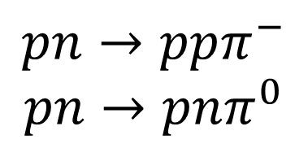
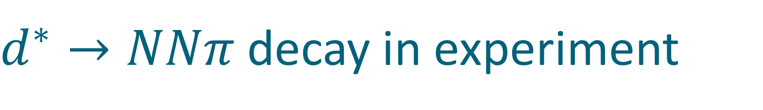
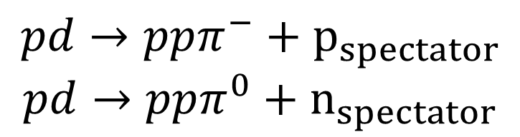
$d^{∗}→NNπ$ decay in experiment
$$pp→pnπ^{+}$$
$$pp→ppπ^{0}$$
Pure isovector (I=1)
$$pn→ppπ^{−}$$
$$pn→pnπ^{0}$$
Mixed (I=1& I=0)
Predominantly isovector
Interested in isoscalar part only
$σ_{NN→NNπ}\left(I=0\right)=3(2σ_{pn→ppπ^{−}}−σ_{pp→ppπ^{0}})$
Proton beam
Deuteron target
$$pd→ppπ^{−}+p_{spectator}$$
$$pd→ppπ^{0}+n_{spectator}$$

Slide 10
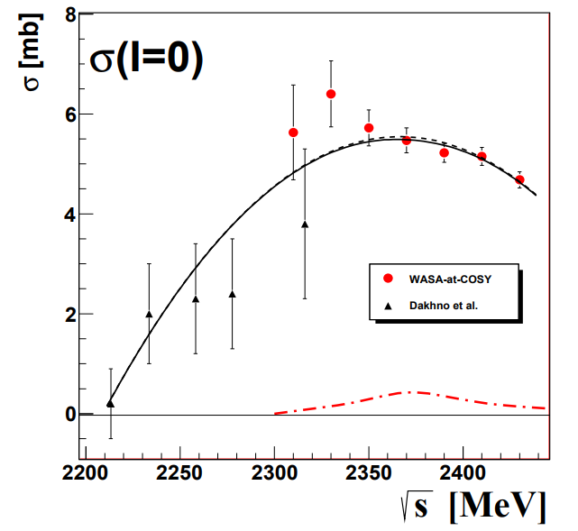
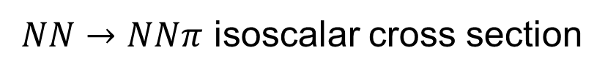
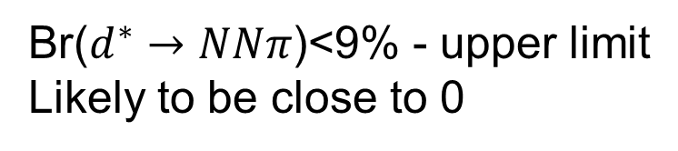
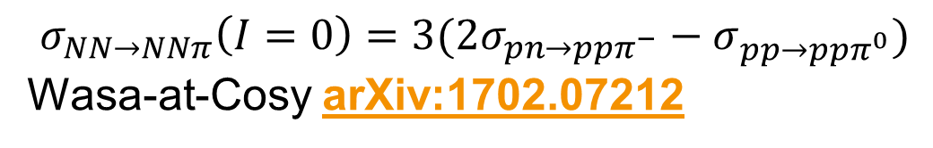
$d^{∗}→NNπ$ decay in experiment
$NN→NNπ$ isoscalar cross section
$σ_{NN→NNπ}\left(I=0\right)=3(2σ_{pn→ppπ^{−}}−σ_{pp→ppπ^{0}})$
Wasa-at-Cosy arXiv:1702.07212
Systematical errors!!!!
Same beam
Same detector
Same deuteron target
Two protons in final state measured in the same kinematics
Br($d^{∗}→NNπ$)<9% - upper limit
Likely to be close to 0

Slide 11

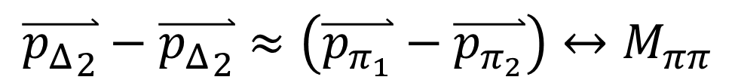


$d^{∗}→dππ$ decay and D-wave$ΔΔ$ component
pn → d* → ΔΔ → dππ
π
p
Δ
$$N_{1}$$
d
n
$$N_{2}$$
Δ
π
$$\overset{⃑}{{p_{Δ}}_{2}}−\overset{⃑}{{p_{Δ}}_{2}}=\left(\overset{⃑}{p_{N_{1}}}+\overset{⃑}{p_{π_{1}}}\right)−\left(\overset{⃑}{p_{N_{2}}}+\overset{⃑}{p_{π_{2}}}\right)=\left(\overset{⃑}{p_{N_{1}}}−\overset{⃑}{p_{N_{2}}}\right)+\left(\overset{⃑}{p_{π_{1}}}−\overset{⃑}{p_{π_{2}}}\right)≈\left(\overset{⃑}{p_{π_{1}}}−\overset{⃑}{p_{π_{2}}}\right)$$
$$\overset{⃑}{p_{N_{1}}}≈\overset{⃑}{p_{N_{1}}}$$
$$\overset{⃑}{{p_{Δ}}_{2}}−\overset{⃑}{{p_{Δ}}_{2}}≈\left(\overset{⃑}{p_{π_{1}}}−\overset{⃑}{p_{π_{2}}}\right)↔M_{ππ}$$

Slide 12
d*(2380) internal structure and the ABC effect
L=0
Δ
Δ
Δ
Δ
L=2
M. Bashkanov et al, Nucl.Phys. A958 (2017) 129

Slide 13
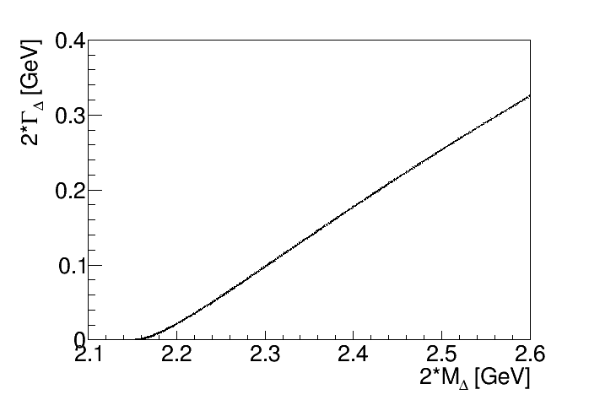
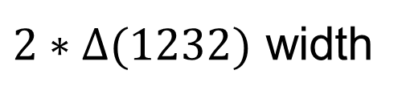
Deltaron: the with quest
$2∗Δ(1232)$ width

Slide 14
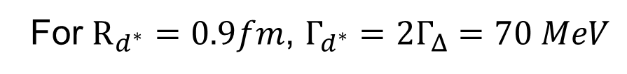
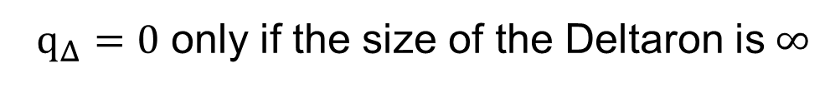
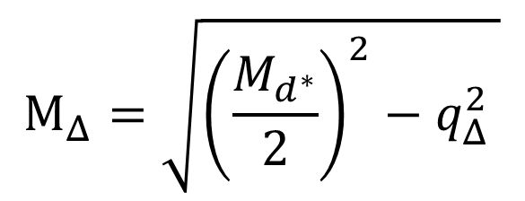
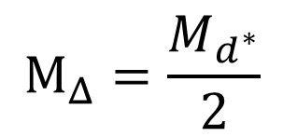
Deltaron: the with quest
$$M_{Δ}=\sqrt{{\left(\frac{M_{d^{∗}}}{2}\right)}^{2}−q_{Δ}^{2} }$$
The mass of the bound $Δ$
in the Deltaron
$Δ$ momentum in the Deltaron
$$M_{Δ}=\frac{M_{d^{∗}}}{2}$$
only if $q_{Δ}=0$
$q_{Δ}=0$ only if the size of the Deltaron is$∞$
For $R_{d^{∗}}=0.9fm$, $Γ_{d^{∗}}=2Γ_{Δ}=70 MeV$
see A. Gal, Phys.Lett. B769 (2017) 436 for details

Slide 15






Deltaron vs Hexaquark
0.7 fm
$$≈66\%$$
$$≈33\%$$
$$?$$
Narrow width
L=0
Branching ratios
Dalitz plots
Δ
Δ
Δ
Δ
L=2
$$≈90\%$$
$$≈10\%$$
$M_{ππ}$, see Nucl.Phys. A958 (2017) 129-146
F. Huang et al, Chin.Phys. C39 (2015) 7, 071001

Slide 16
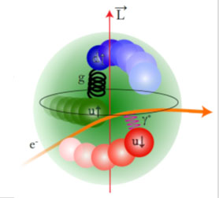

$d^{∗}$size
e⁻
e⁻
γ*
d*(2380)
d
Transition form factor
Charge distribution
Internal structure

Slide 17
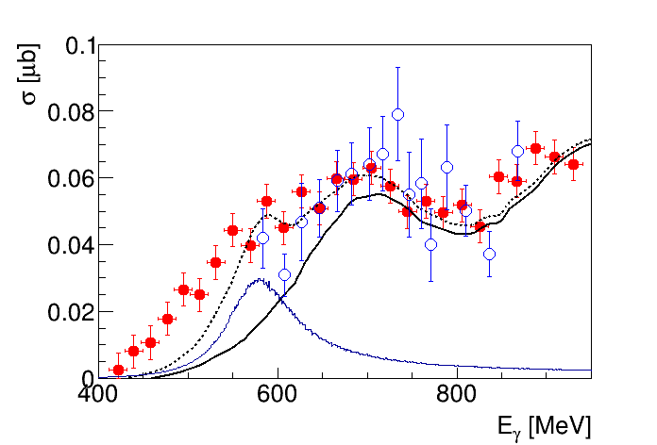




d*(2380) in photoproduction?
$$π^{0}$$
γ
p
$$π^{0}$$
d*
γ
d*
d
d
d
n
$γd→dπ^{0}π^{0}$
$γd→dπ^{0}π^{0}$
Conventional Background
M. Egorov, A. Fix,
Nucl.Phys. A933 (2015) 104-113
$$d^{∗}$$
M. Guenther, Hadron 2017
T. Ishikawa et al. Phys.Lett. B772 (2017) 398

Slide 18
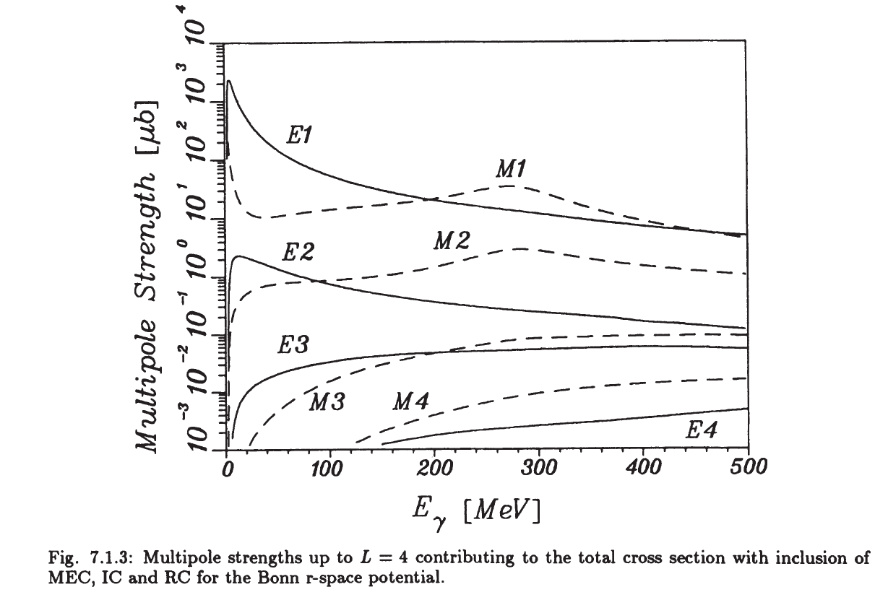


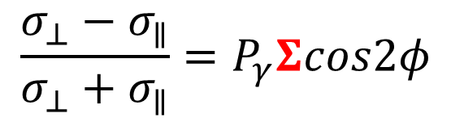
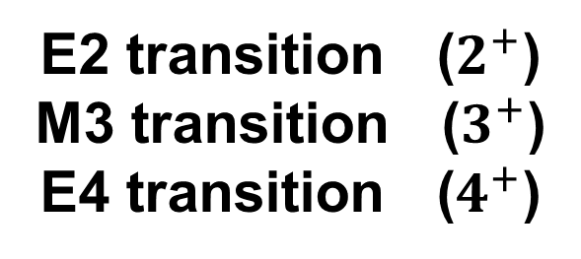
$d^{∗}$ and beam asymmetry $Σ$
E2 transition ($2^{+}$)
M3 transition ($3^{+}$)
E4 transition ($4^{+}$)
γ
$$d^{∗}$$
p
d
n
$$\frac{σ_{⊥}−σ_{∥}}{σ_{⊥}+σ_{∥}}=P_{γ}Σcos2φ$$
H. Arenhoevel, M. Sanzone “Photodisintegration of the deuteron”

Slide 19

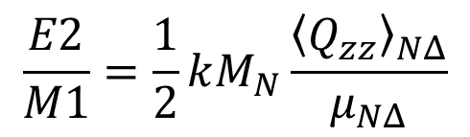
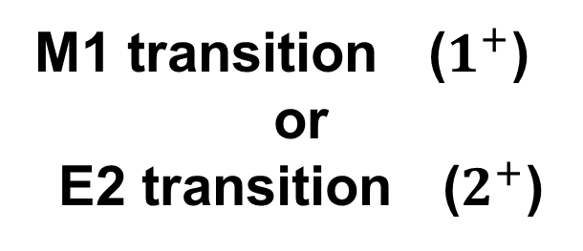

Beam asymmetry $Σ$
M1 transition ($1^{+}$)
or
E2 transition ($2^{+}$)
γ
$$Δ$$
$$π$$
p
N
$$\frac{σ_{⊥}−σ_{∥}}{σ_{⊥}+σ_{∥}}=P_{γ}Σcos2φ$$
E2/M1 ratio for the $γN→Δ$
$$\frac{E2}{M1}=\frac{1}{2}kM_{N}\frac{{\left\langle Q_{zz}\right\rangle }_{NΔ}}{μ_{NΔ}}$$
T. Watabe et al.
hep-ph 9502244
R. Beck et al. (MAMI-A2)
Phys.Rev. C61 (2000) 035204
Analysis of beam asymmetry
$$\frac{E2}{M1}=2.5\%$$

Slide 20
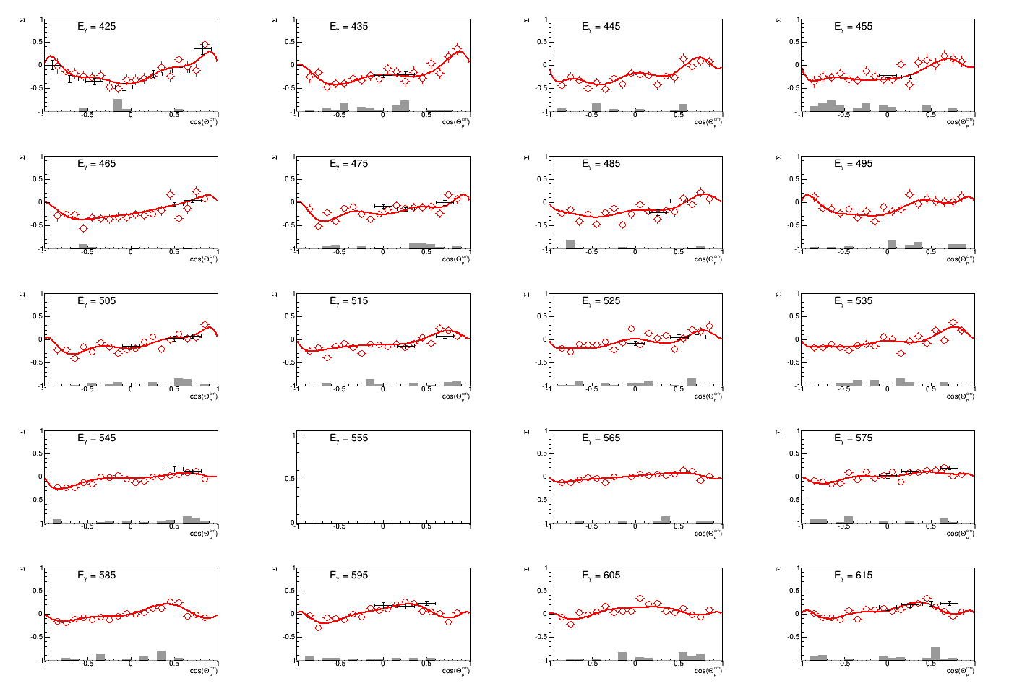
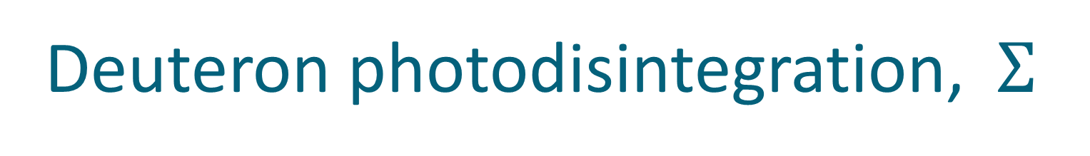



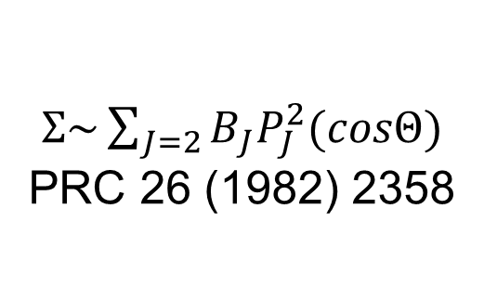
Deuteron photodisintegration, $Σ$
γ
p
$Σ\sim \sum_{J=2}{B_{J}P_{J}^{2}(cosΘ)}$
PRC 26 (1982) 2358
d
n
$E_{γ}\sim 420−620MeV$
$$Σ$$
$$cosΘ_{n}^{∗}$$

Slide 21
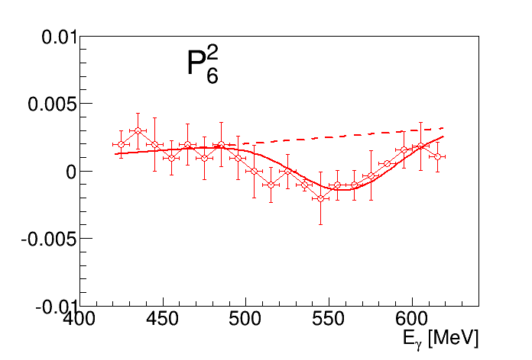
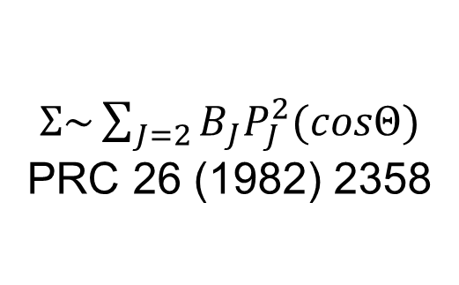
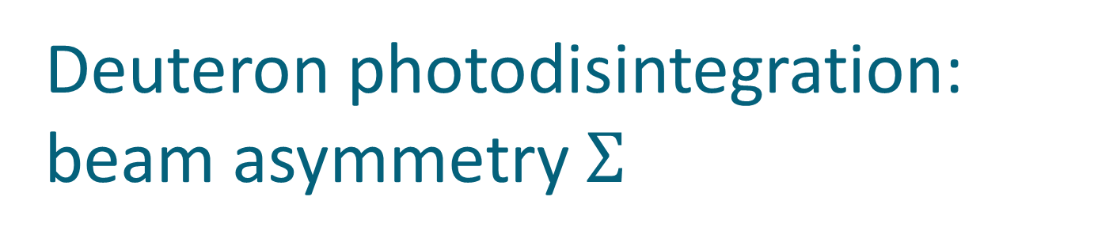
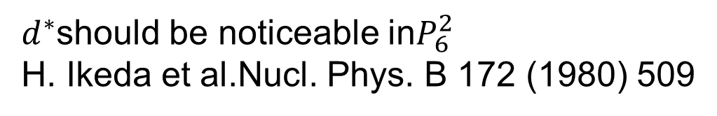
Deuteron photodisintegration: beam asymmetry $Σ$
γ
p
$Σ\sim \sum_{J=2}{B_{J}P_{J}^{2}(cosΘ)}$
PRC 26 (1982) 2358
d
n
$d^{∗}$should be noticeable in$P_{6}^{2}$
H. Ikeda et al.Nucl. Phys. B 172 (1980) 509

Slide 22
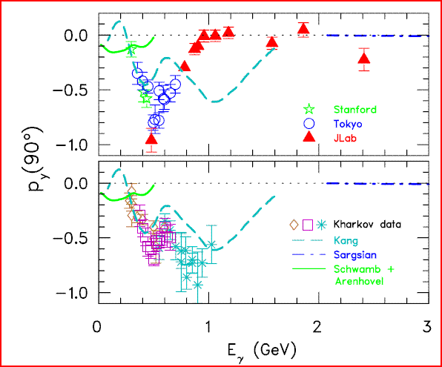

d*(2380) in photoproduction?
R. Gilman and F. Gross nucl-th/0111015 (2001)
d*
γ
p
T. Kamae, T. Fujita Phys. Rev. Lett. 38, Feb 1977, 471
d
n
H. Ikeda et al., Phys. Rev. Lett. 42, May 1979, 1321
I(J^{p}) = 0(3⁺)
$$M=2.38 GeV$$

Slide 23
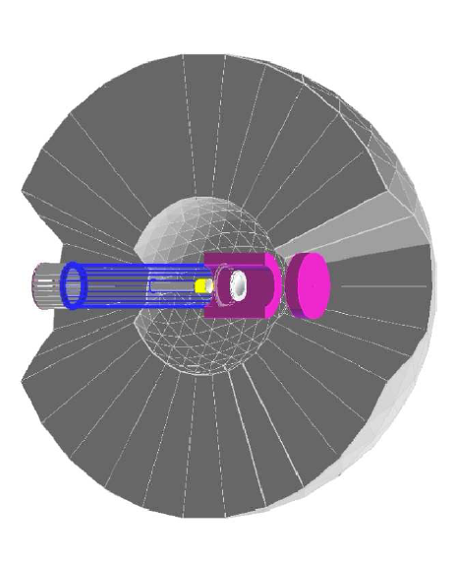

The benchmark measurement
Edinburgh polarimeter
$$\vec{γ}$$
d*
p
d
n
Measure polarization of both
proton and neutron !

Slide 24


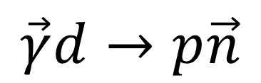


Experiment
$$γ$$
p
$$n$$
$$Θ,φ,E$$
p
Target
$$Θ^{′},φ′$$
$$\vec{γ}d→p\vec{n}$$
Polarimeter

Slide 25
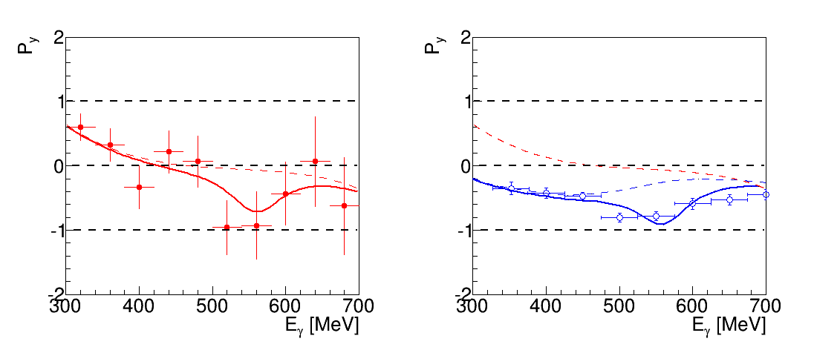
Recoil polarization at 90 degree
proton
Conventional background, Kang et al
background+ d*
H. Ikeda et al., Phys. Rev. Lett. 42, May 1979, 1321

Slide 26
Recoil polarization at 90 degree
neutron
proton
Conventional background, Kang et al
Very preliminary
background+ d*
background+ d*
H. Ikeda et al., Phys. Rev. Lett. 42, May 1979, 1321

Slide 27
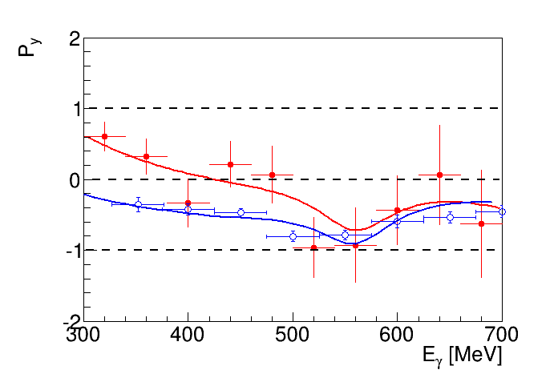
Recoil polarization at 90 degree
neutron
proton
Very preliminary

Slide 28

$$d^{∗}in nuclear medium$$

Slide 29

Nuclear matter at high density
d*
n
p

Slide 30
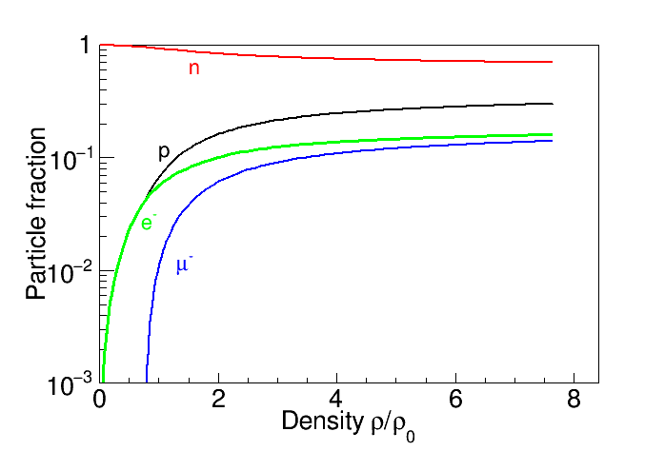
Neutron stars EoS
I. Vidaña, M. Bashkanov, D.P. Watts, A. Pastore
arXiv:1706.09701v1

Slide 31
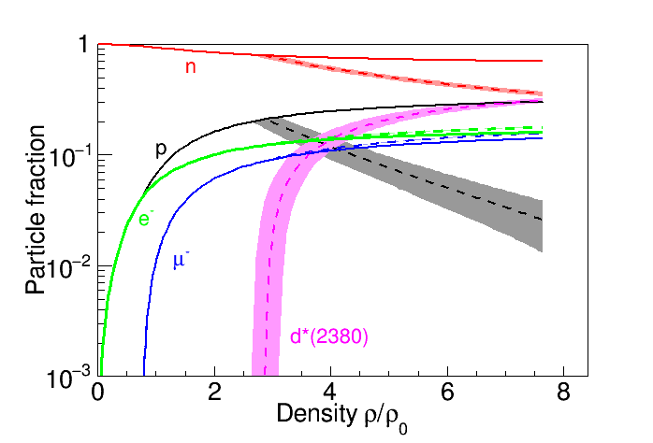
The d ∗ (2380) in neutron stars - a new degree of freedom?
I. Vidaña, M. Bashkanov, D.P. Watts, A. Pastore
arXiv:1706.09701v1

Slide 32
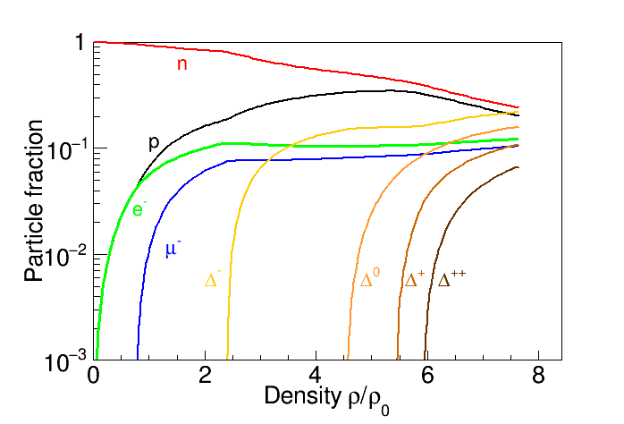
The d ∗ (2380) in neutron stars - a new degree of freedom?
I. Vidaña, M. Bashkanov, D.P. Watts, A. Pastore
arXiv:1706.09701v1

Slide 33
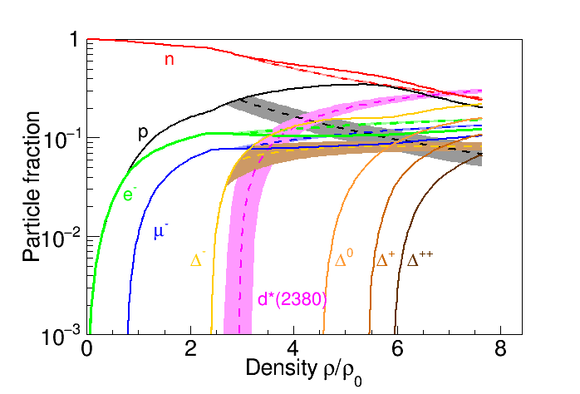
The d ∗ (2380) in neutron stars - a new degree of freedom?
I. Vidaña, M. Bashkanov, D.P. Watts, A. Pastore
arXiv:1706.09701v1

Slide 34
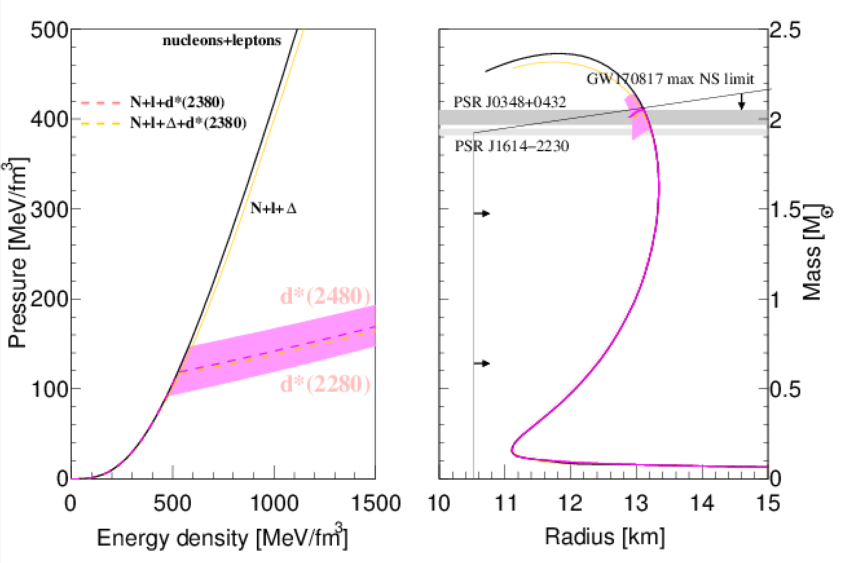
The d ∗ (2380) in neutron stars
I. Vidaña, M. Bashkanov, D.P. Watts, A. Pastore
arXiv:1706.09701v1
GW170817 from arXiv:1710.05938v1

Slide 35

$d^{∗}(2380)$ medium modifications?
Trivial modifications:
Fermi smearing
Collision damping
N
N
N
Δ
N
$$d^{∗}$$
Δ
Δ
BUT!
Pauly blocked in
infinite nuclear matter
$d^{∗}$ is stable!
N

Slide 36

$d^{∗}(2380)$ medium modifications?
$d^{∗}$ interaction with nuclear matter
Attractive/Repulsive?
Mass change?
Changes in size?

Slide 37








$d^{∗}$ in neutron stars
Urca cooling
$$d^{∗}→nn+e^{+}+ν_{e}$$
$$ρ\sim 2.8ρ_{0}$$
$$ρ>2.8ρ_{0}$$
Neutron stars mergers
$$d^{∗}→pn$$
$$nn→d^{∗}+e^{−}+\overline{ν_{e}}$$
Ejecta
HMNS->black hole
nucleosynthesis

Slide 38



Cold Baryonic Matter
DLS puzzle
Dibaryons as a probes of
“cold hadronic soup”
M. Bashkanov, H. Clement, Eur. Phys. J. A50, 107, (2014)

Slide 39

Hades results on $pn→pne^{+}e^{−}$
Exclusive measurements, Eur.Phys.J. A53 (2017) no.7, 149
$d^{∗}$model
Giessen model

Slide 40


$d^{∗}$ on nuclear targets
Deuterium
Carbon
Calcium
Tin
Lead
$d^{∗}$ mass and width as a function of A
  $d^{∗}$ medium modifications

Slide 41




d*(2380) SU(3) multiplet
J^{p} = 3⁺
ΔΔ
$$d^{∗}(2380)$$
$$M_{d^{∗}}−M_{Δ}+M_{Σ^{∗}}<M_{d_{s}^{∗}}≤M_{Δ}+M_{Σ^{∗}}$$
ΔΣ*
$$d_{s}^{∗}(2.53−2.60)$$
ΔΞ*
$$d_{ss}^{∗}(2.68−2.76)$$
ΔΩ
$$d_{sss}^{∗}(2.82−2.90)$$

Slide 42

Conclusion
$d^{∗}$ dibaryon is likely to be a very compact object
The first hexaquark – 6q benchmark state
  Mass, Width, Branching Ratios
  9 decay channels studied
$d^{∗}$ photo/electroproduction
  Size & structure
$d_{s}^{∗}$ is the next in queue (9 SU3 $d^{∗}$ members to be discovered)
Other hexaquarks and baryon-baryon molecules…

Slide 43

ΔΔ
$$d^{∗}(2380)$$
Thank you
ΔΣ*
ΔΞ*
ΔΩ

Slide 44
The benchmark measurement
Newly installed
Edinburgh polarimeter
γ
p
d*
d
n
Measure polarization of both
proton and neutron !

Slide 45


$Λ−Δ$ competition in neutron star
Phys.Rev. C90 (2014) no.6, 065809

Slide 46
$$d^{∗}→NNπ$$

Slide 47



$NN→NNπ$ isoscalar cross section
$σ_{NN→NNπ}\left(I=0\right)=3(2σ_{pn→ppπ^{−}}−σ_{pp→ppπ^{0}})$
$pp→ppπ^{0}$
$np→ppπ^{−}$
Complete cancellation of $Δ$ resonance in isoscalar case

Slide 48




$NN→NNπ$ isoscalar cross section
$pp→ppπ^{0}$
$np→ppπ^{−}$

Slide 49
$d^{∗}→NNπ$ decay in experiment
Br($d^{∗}→NNπ$)<9%
An upper limit
Likely to be close to 0
Can be further reduced by careful PWA
$d^{∗}→NNπ$ should have very distinctive angular distributions
$$π^{−}$$
P-wave
p
d*
D-wave
p

Slide 50


$A_{y}$ energy dependence at $83°$
p
p
n
n
SAID
New SAID
solutions
P. Adlarson et al. Phys. Rev. Lett. 112, 202301, (2014)

Slide 51


Dimensionless partial wave amplitudes
Pole at $(2380±10)−i(40±5) MeV$
Dimensionless partial wave amplitudes
Im
SP14
SP07
Re
$${}_{}^{3}{D_{3}}$$
$$ε_{3}$$
$${}_{}^{3}{G_{3}}$$
Resonance in the pn system
P. Adlarson et al. Phys. Rev. Lett. 112, 202301, (2014)

Slide 52
Argand plot
P. Adlarson et al. Phys. Rev. Lett. 112, 202301, (2014)
P. Adlarson et al. Phys. Rev. C 90, 035204 , (2014)

Slide 53
Total pn cross-section
Devlin et al, PRD8, 136 (73)
LisowskI et al, PRL49, 255(82)
SAID SP07
SAID new solution
P. Adlarson et al. Phys. Rev. Lett. 112, 202301, (2014)
P. Adlarson et al. Phys. Rev. C 90, 035204 , (2014)

Slide 54

NN vs ΔΔ
I = 1, J =0
$${}_{}^{1}{S_{0}}$$
I = 3, J =0
Z=+4
p
n
Δ
Δ
66 keV
Threshold
?
2.2 MeV
p
n
80 MeV
deuteron
d*
Δ
Δ
I = 0, J =1
I = 0, J =3

Slide 55






Z=+4 dibaryon isospin coefficients
$$π$$
$$π$$
p
p
p
p
$$π$$
I
$$π$$
$${pp→π^{−}π^{−}d}^{4+}→π^{−}π^{−}Δ^{++}Δ^{++}→ppπ^{+}π^{+}π^{−}π^{−}$$
$$1$$
$$2∙{\left(\frac{1}{15}\right)}^{2}$$
$${pp→π^{+}π^{−}d}^{2+}→π^{+}π^{−}Δ^{++}Δ^{0}→ppπ^{+}π^{+}π^{−}π^{−}$$
$${\left(\frac{1}{15}\right)}^{2}$$
$${pp→π^{+}π^{+}d}^{0} →π^{+}π^{+}Δ^{+}Δ^{−} →ppπ^{+}π^{+}π^{−}π^{−}$$

Slide 56




$pp→ppπ^{+}π^{+}π^{−}π^{−}$data
$$T_{p}=2.063 GeV$$
$$T_{p}=2.541 GeV$$
$$M_{ppπ^{+}π^{+}}$$
Double-Roper
$$M_{ppπ^{−}π^{−}}$$
$$d^{4+}$$

Slide 57



Charge Z=+4 dibaryon upper limit
$$T_{p}=2.063 GeV$$
$$T_{p}=2.541 GeV$$
$$Γ=150 MeV$$
$$Γ=100 MeV$$
$$Γ=50 MeV$$
20 nb of possible $Z=+4$dibaryon vs 1.500.000 nb of $d^{∗}(2380)$

Slide 58

$pp→pp{2π}^{+}2π^{−}$ total X-section

