Slide 1

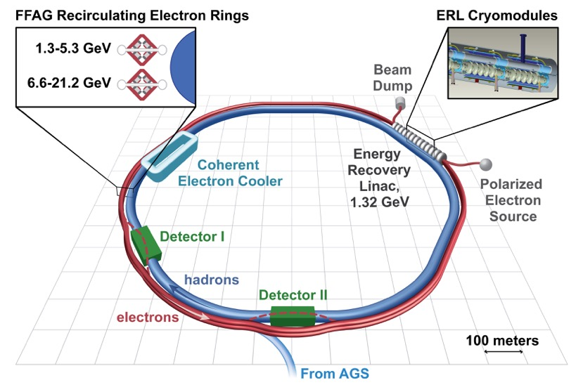
Hadron Structure with the EIC
Cold Ion Collider Ring
(8 to 100 GeV)
Warm Electron
Collider Ring
(3 to 12 GeV)
IP
IP
Booster
Linac
Ion Source
Electron Injector
12 GeV CEBAF
Andrea Bressan (University of Trieste and INFN-Trieste)

Slide 2
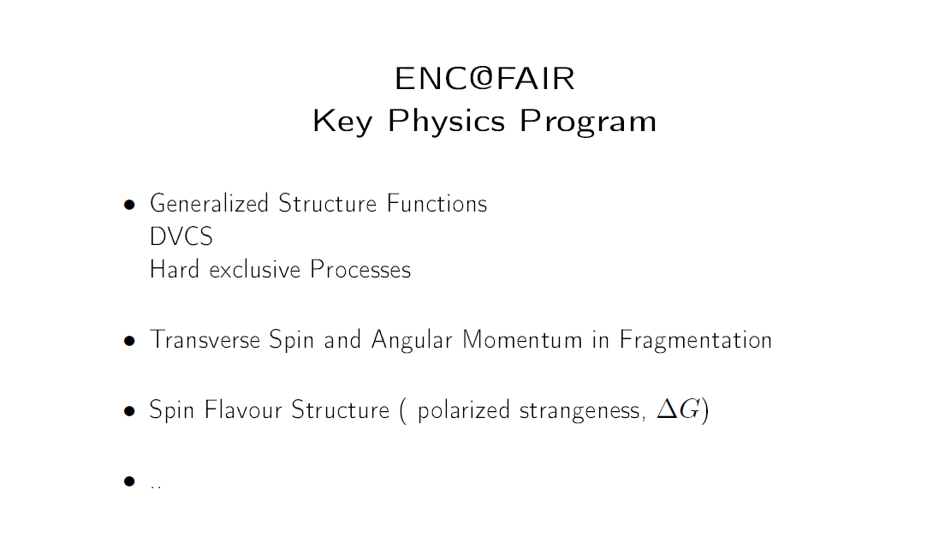
Not a brand new discussion here
DvH. 12.12.2008

Slide 3
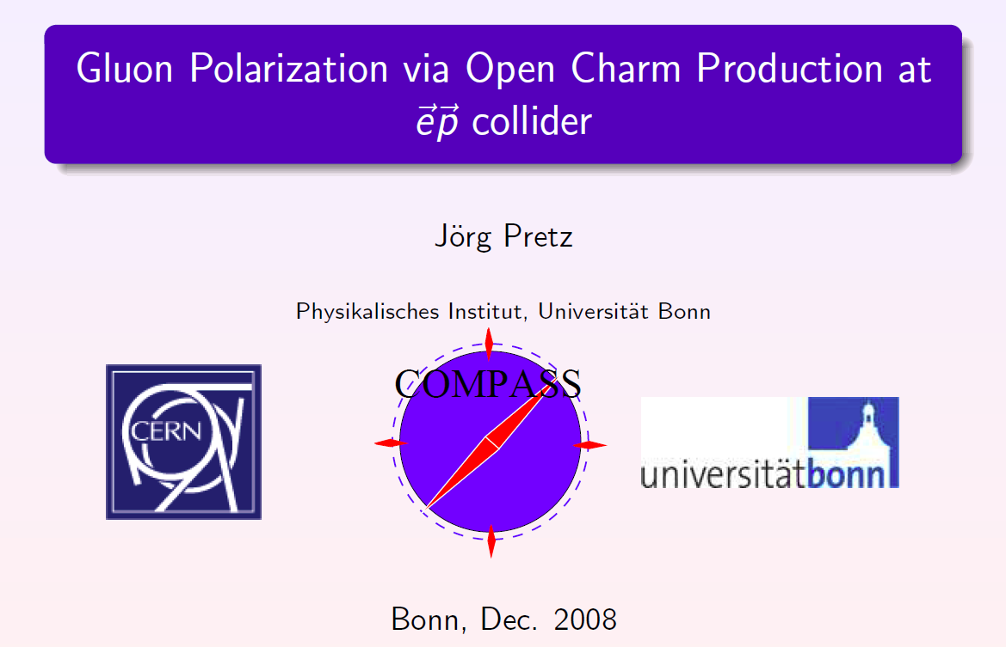
Not a brand new discussion here

Slide 4
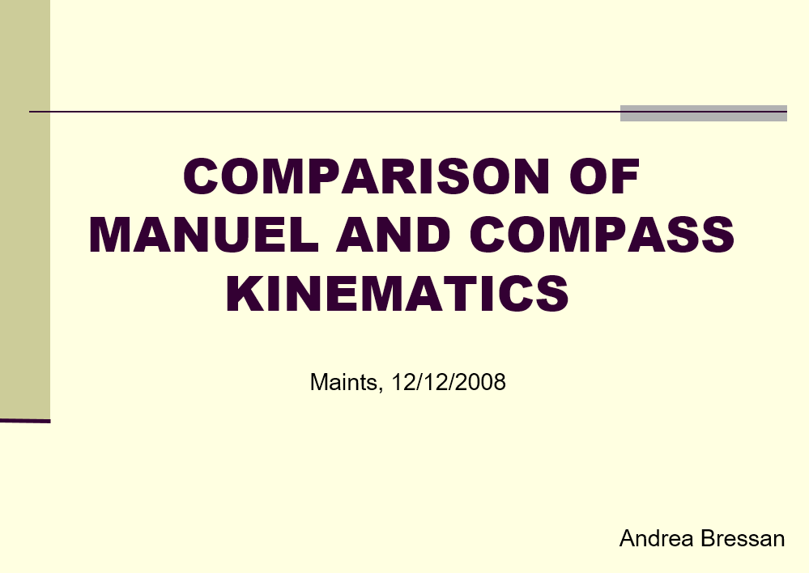
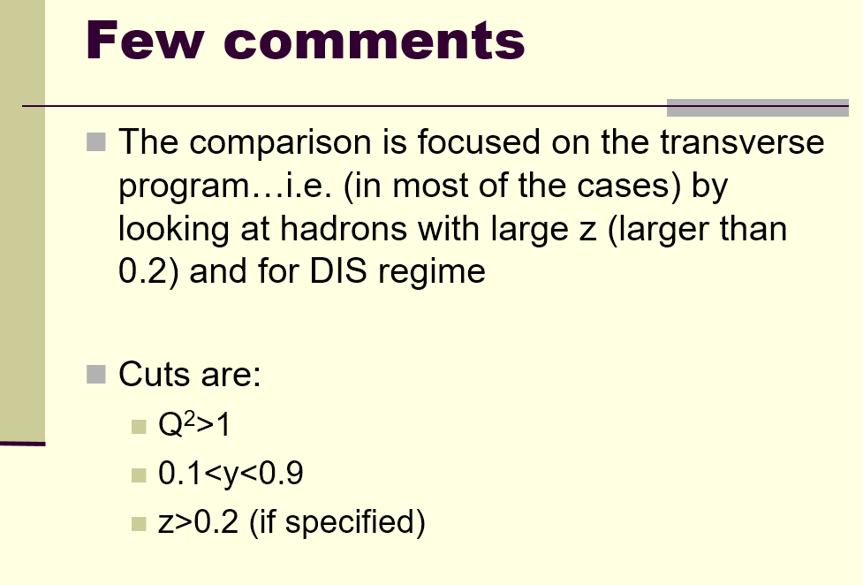
Not a brand new discussion here

Slide 5

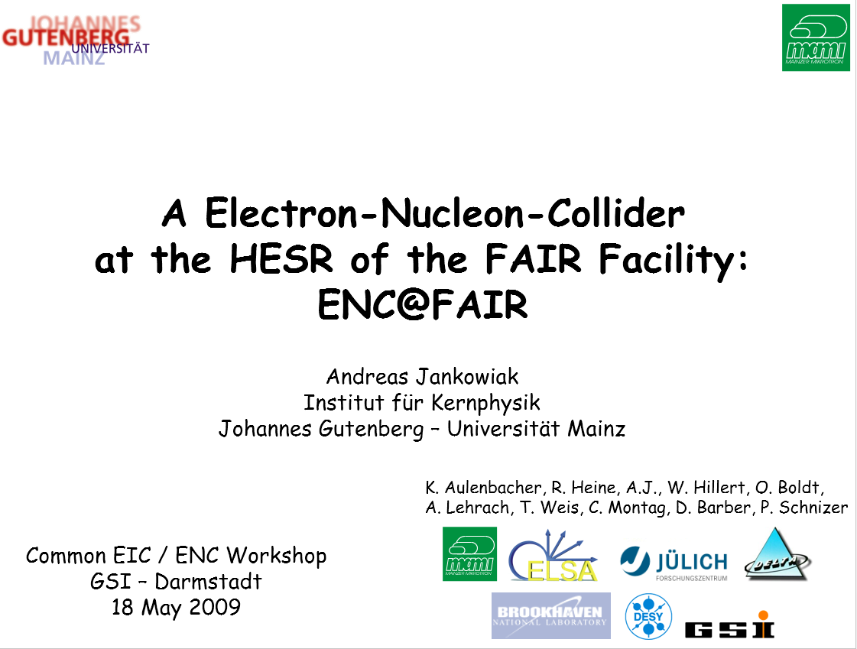
Not a brand new discussion here

Slide 6
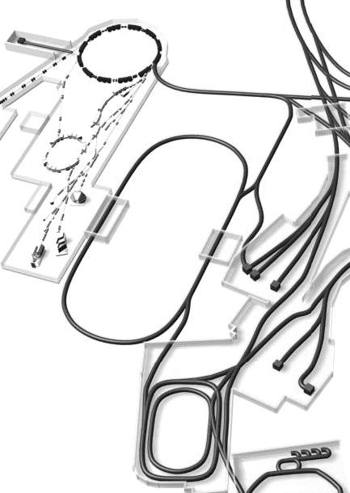
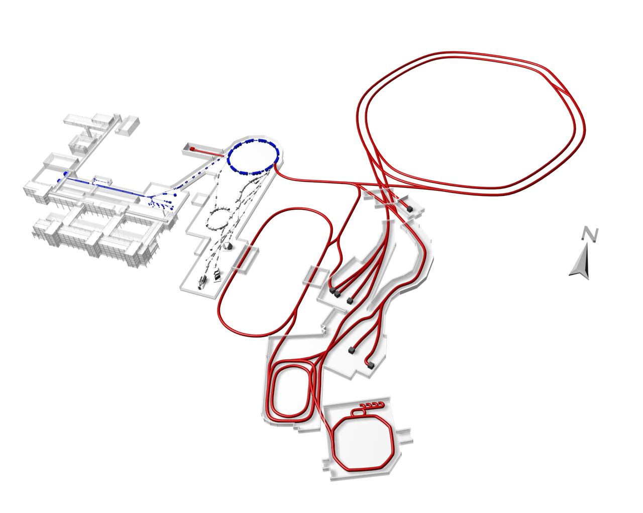
Just a remaind
A “simple” idea: ENC@FAIR (i)
P
HESR
pRing
eRing
8MV eCool
pol. e⁻ -inj.
PANDA
e⁻
HESR:
anti proton storage ring
1.5 – 15 GeV/c (max. 50Tm)
L=576m, e-Cooling, stoch. cooling
PANDA fixed target experiment

Slide 7
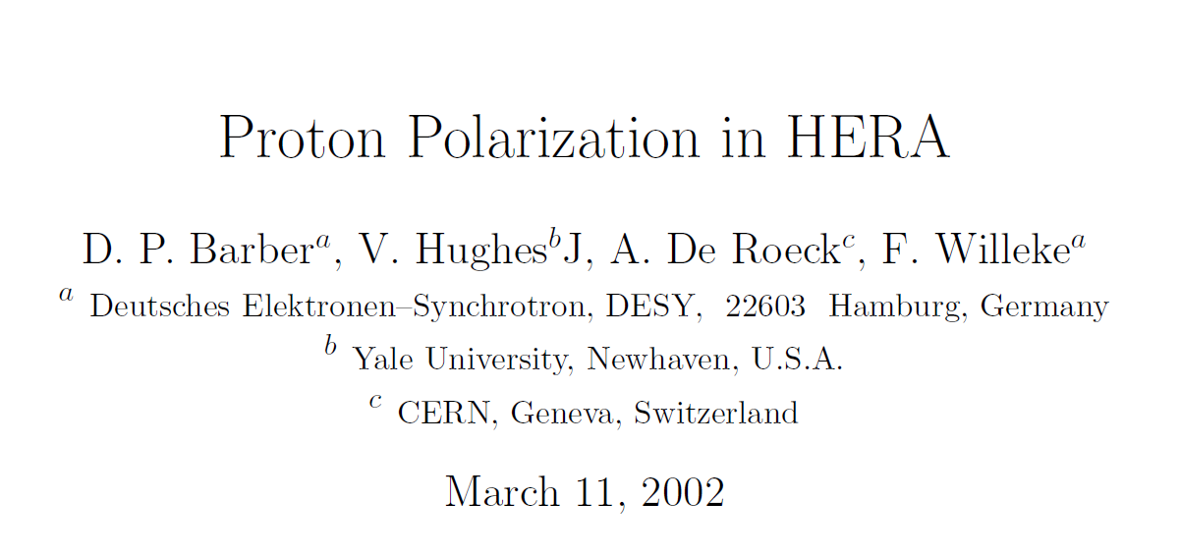
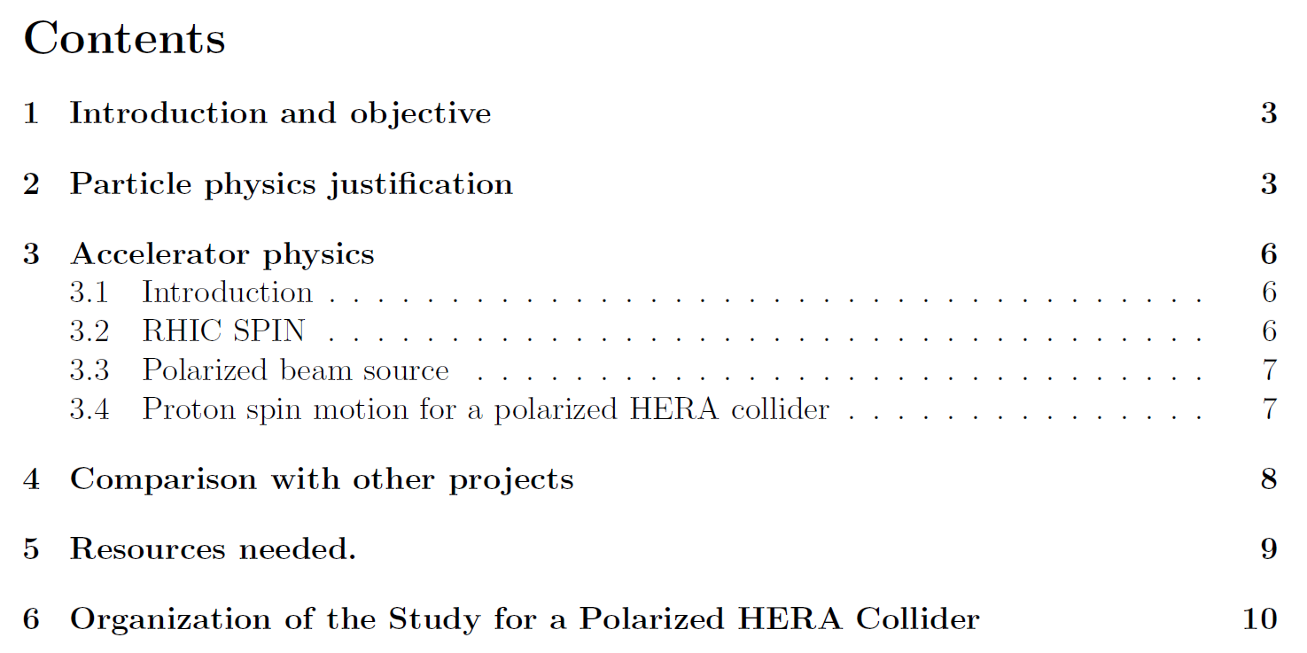
But even before that @ HERA

Slide 8
Why we need EIC?
Understanding how hadrons & nuclei emerge from quarks and gluons is one of the key issues in modern particle physics
Past and present experiment at CERN, SLAC, DESY, Jefferson Lab, … have provided critical information but many open questions still remains:
How are the macroscopic properties of the proton (mass, spin, …) connected to its constituents, i.e. quark and gluons ?
How are sea-quark and gluons distributed in space and momentum in nucleons and nuclei?
What is the quark-gluon origin of the nucleon-nucleon forces?
…
EIC, with a versatile range of kinematics, beam polarizations, high luminosity and beam species, aims at precisely imaging the sea quarks and gluons in nucleons and nuclei to address these outstanding issues and explore new frontiers in QCD
<< 0.1 fm
> 1 fm
π
p
Quarks and Gluons
Mesons & Baryons

Slide 9
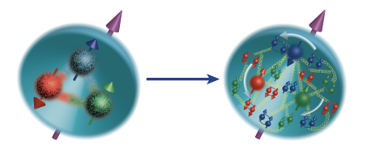
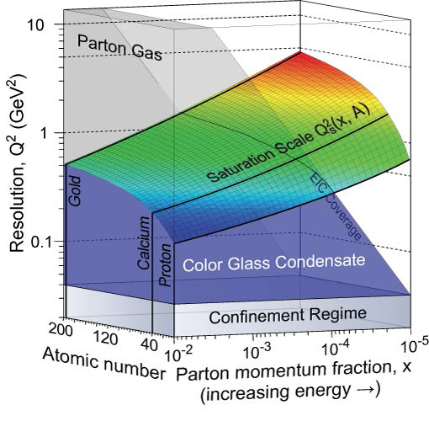
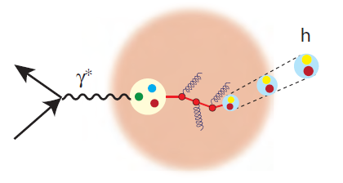
EIC Science Program
Explore and image the spin and 3D structure of the nucleon
(show the nucleon structure picture of the day…)
Discover the role of gluons in structure and dynamics (without gluons there are no protons, no neutrons, no atomic nuclei)
Understand the emergence of hadrons from color charge
(how does M = E/c² work to create pions and nucleons?)
Search for physics beyond the Standard Model
Needs high (polarized) luminosity and range of energies: s ~ 500-5000+
Needs range of ions up to A ~ 200 and energies: s ~ 1000-10000
Needs access to ion fragments and energy: s ~ few 100-few 1000
Needs energy & ultra-high polarized luminosity

Slide 10
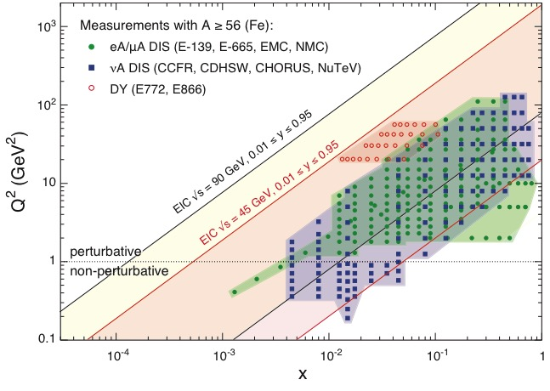
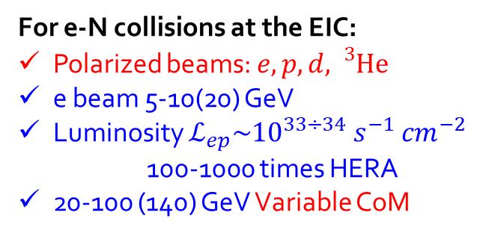
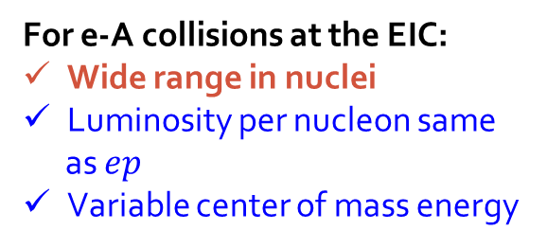
The Electron Ion Collider
1212.1701.v3
A. Accardi et al
For e-N collisions at the EIC:
Polarized beams: $e, p, d, {}_{}^{3}{He}$
e beam 5-10(20) GeV
Luminosity $ℒ_{ep}\sim {10}^{33÷34} s^{−1} {cm}^{−2}$
100-1000 times HERA
20-100 (140) GeV Variable CoM
For e-A collisions at the EIC:
Wide range in nuclei
Luminosity per nucleon same
as $ep$
Variable center of mass energy
World’s first
Polarized electron-proton/light ion
and electron-Nucleus collider
Notes:
Contrast with HERA could be made more explicit. Table/column presentation.
RY: Uniqueness of EIC compared to HERA and other DIS facilities is more effectively made on p.7. Keep as backup.

Slide 11
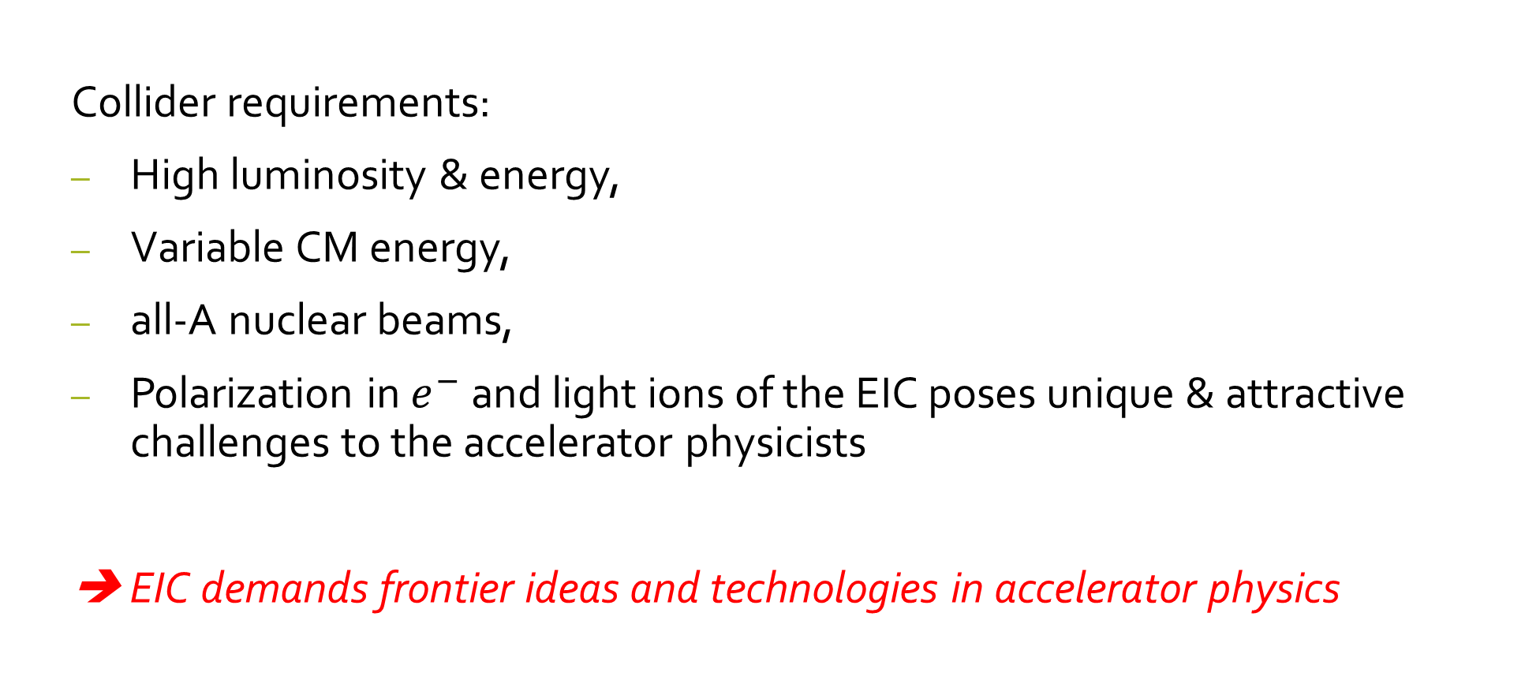
Accelerator Challanges and Physics Opportunities
Collider requirements:
High luminosity & energy,
Variable CM energy,
all-A nuclear beams,
Polarization in $e^{−}$ and light ions of the EIC poses unique & attractive challenges to the accelerator physicists
➔ EIC demands frontier ideas and technologies in accelerator physics

Slide 12
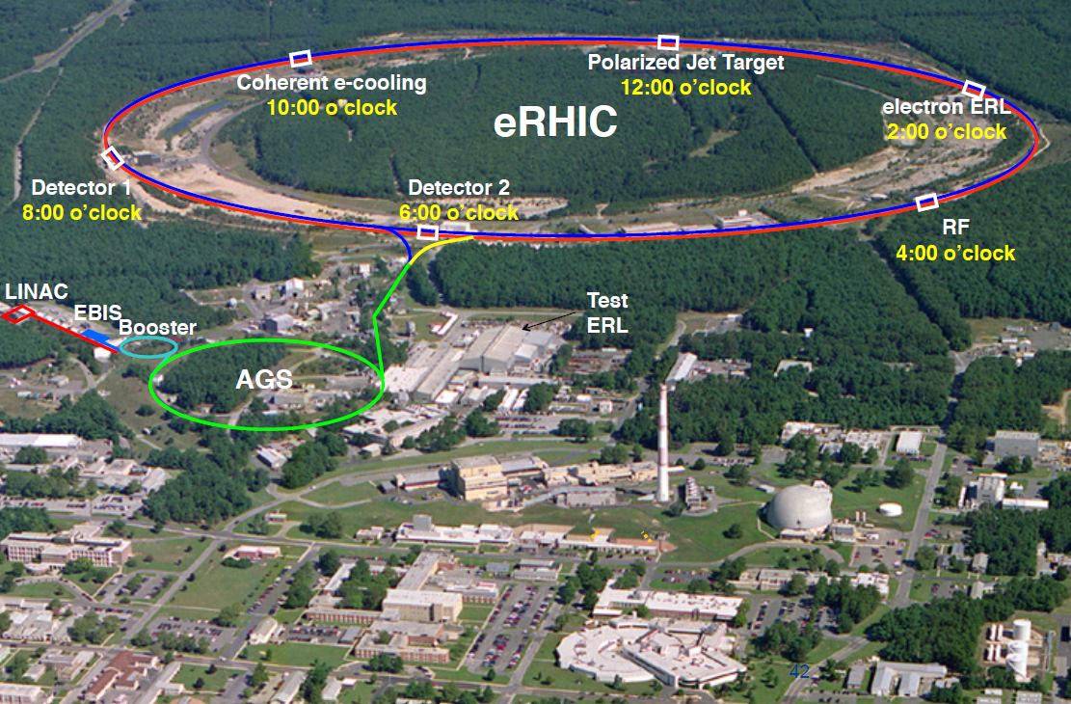
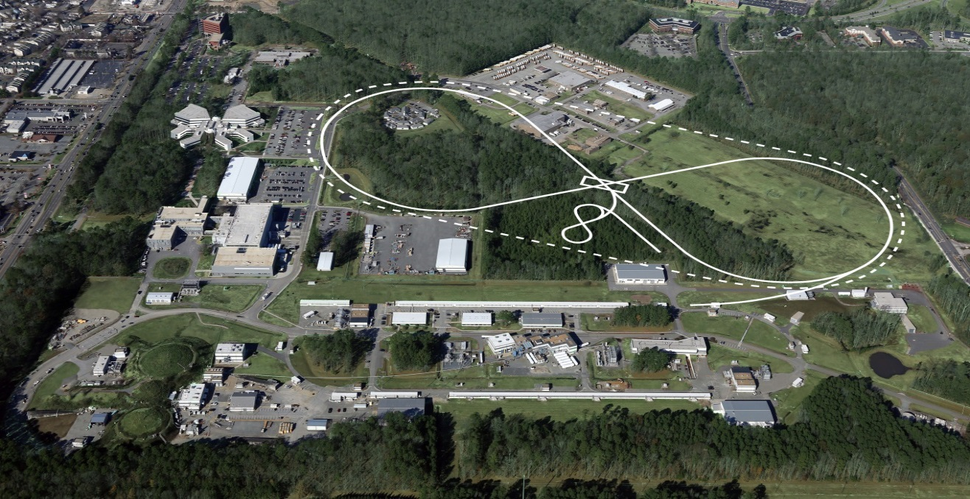
US-Based EICs
JLEIC
Notes:
12

Slide 13
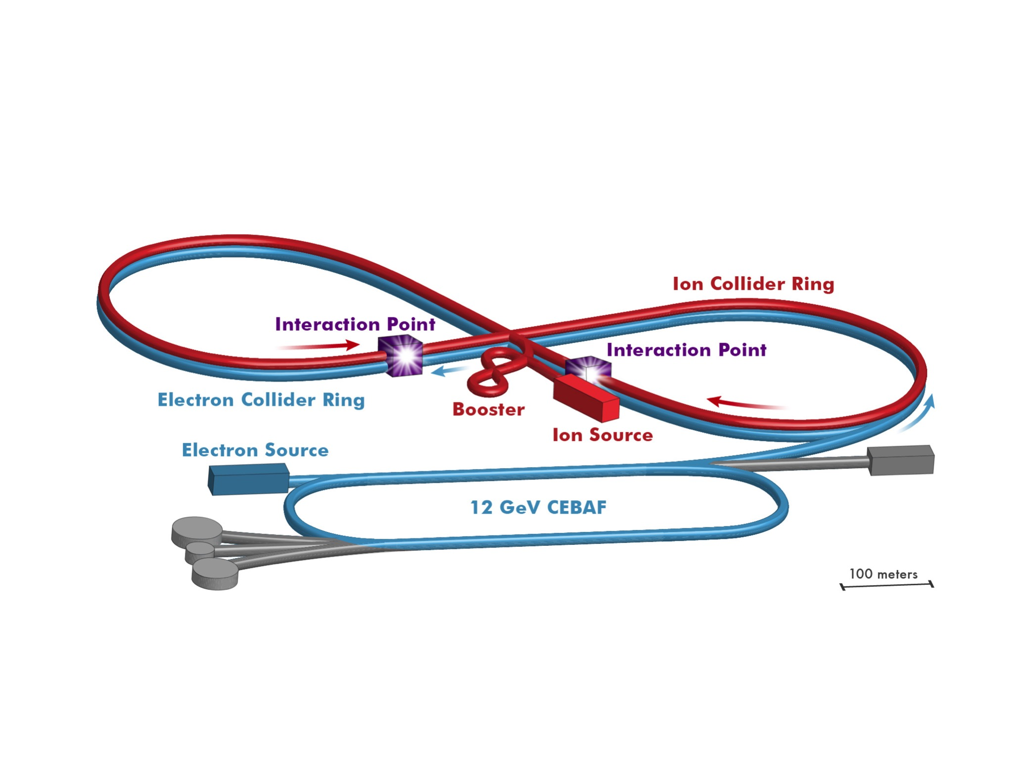
JLEIC Realization
Use existing CEBAF for polarized electron injector
Figure 8 Layout: Optimized for high ion beam polarization  polarized deuterons
Energy Range: √s : 20 to 65 - 140 GeV (magnet technology choice)
Fully integrated detector/IR
JLEIC achieves initial high luminosity, with technology choice determining initial and upgraded energy reach

Slide 14
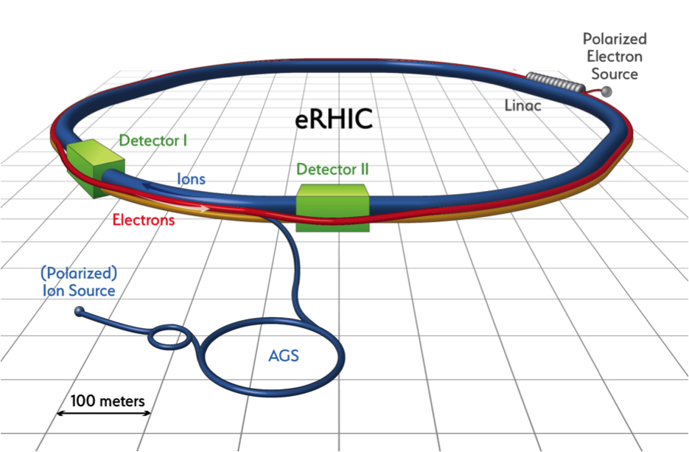
eRHIC Realization
Use existing RHIC
Up to 275 GeV protons
Existing: tunnel, detector halls & hadron injector complex
Add 18 GeV electron accelerator in the same tunnel
Use either high intensity Electron Storage Ring or Energy Recovery Linac
Achieve high luminosity, high energy e-p/A collisions with full acceptance detector
Luminosity and/or energy staging possible

Slide 15
eRHIC Design
EIC User Workshop 2017
Trieste, July 18-22, 2017
Ferdinand Willeke
BNL

Slide 16
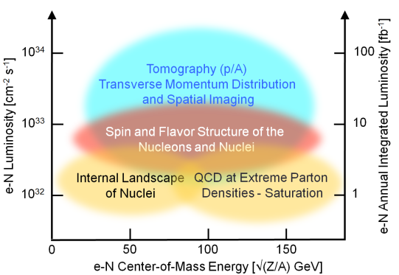
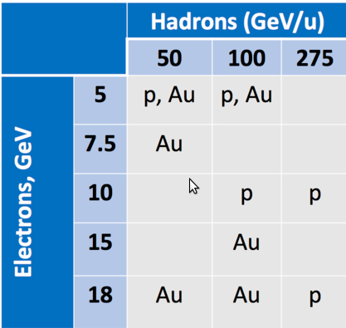
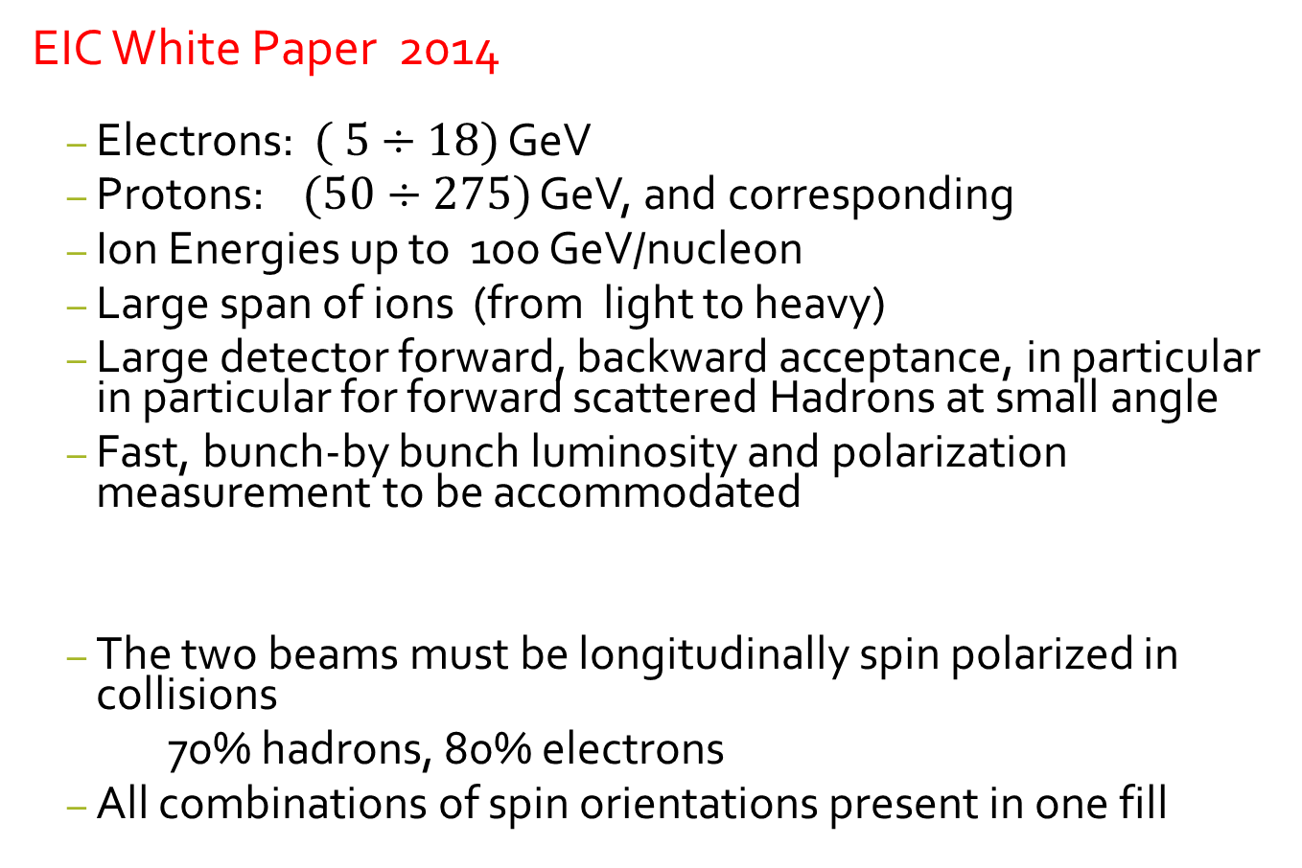
EIC Requirements
EIC White Paper 2014
Electrons: $( 5÷18)$ GeV
Protons: $(50÷275)$ GeV, and corresponding
Ion Energies up to 100 GeV/nucleon
Large span of ions (from light to heavy)
Large detector forward, backward acceptance, in particular in particular for forward scattered Hadrons at small angle
Fast, bunch-by bunch luminosity and polarization measurement to be accommodated
The two beams must be longitudinally spin polarized in collisions
70% hadrons, 80% electrons
All combinations of spin orientations present in one fill

Slide 17
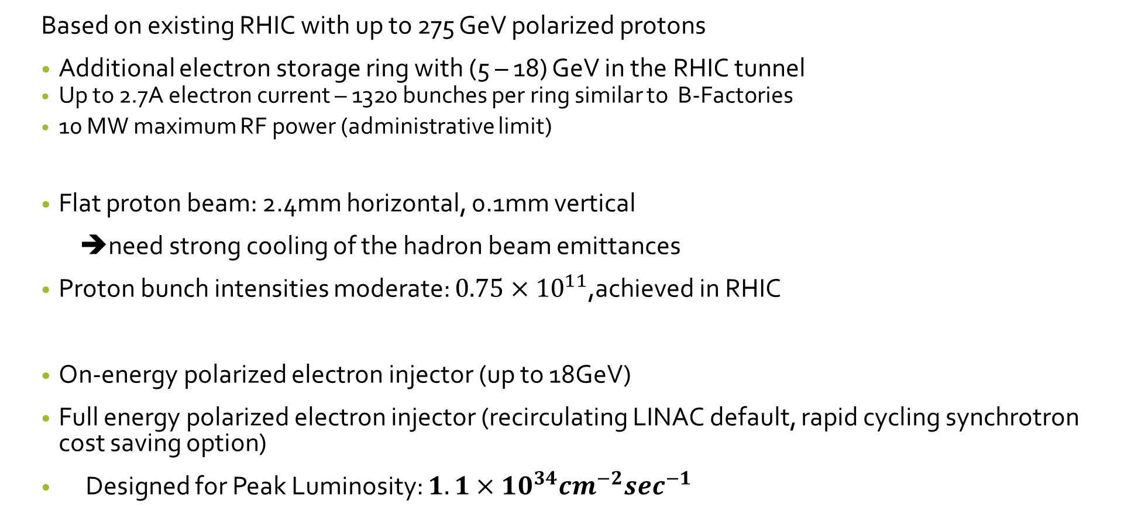
eRHIC Design Concept
Based on existing RHIC with up to 275 GeV polarized protons
Additional electron storage ring with (5 – 18) GeV in the RHIC tunnel
Up to 2.7A electron current – 1320 bunches per ring similar to B-Factories
10 MW maximum RF power (administrative limit)
Flat proton beam: 2.4mm horizontal, 0.1mm vertical
➔need strong cooling of the hadron beam emittances
Proton bunch intensities moderate: $0.75×{10}^{11}$,achieved in RHIC
On-energy polarized electron injector (up to 18GeV)
Full energy polarized electron injector (recirculating LINAC default, rapid cycling synchrotron cost saving option)
Designed for Peak Luminosity: $1.1×{10}^{34}{cm}^{−2}\sec^{−1}$

Slide 18
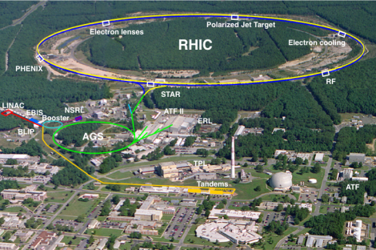
eRHIC uses the Relativistic Heavy Ion Collider RHIC
The major part of a future eRHIC facility already exists
eRHIC uses the Yellow Ring and parts of the Blue Ring
Most of RHIC will remain untouched
RHIC beam parameters will satisfy eRHIC requirements
Some changes in the straight sections are required to maintain a constant revolution time independent of energy

Slide 19
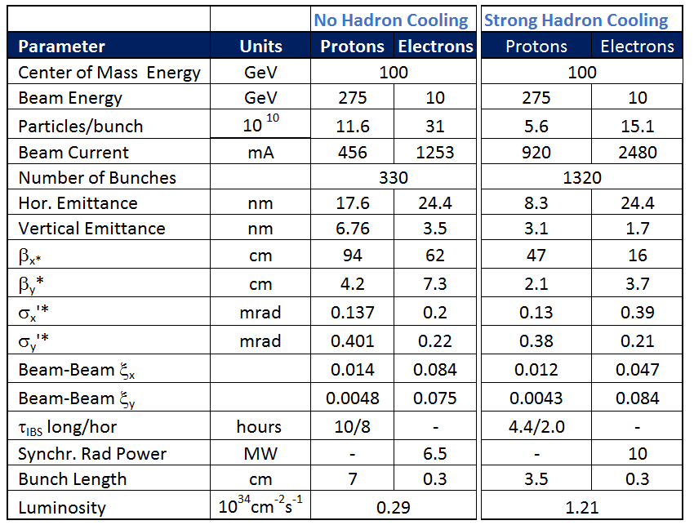
Main Parameters for Maximum Luminosity
E_{p} = 275 GeV, E_{e}= 10 GeV
19

Slide 20
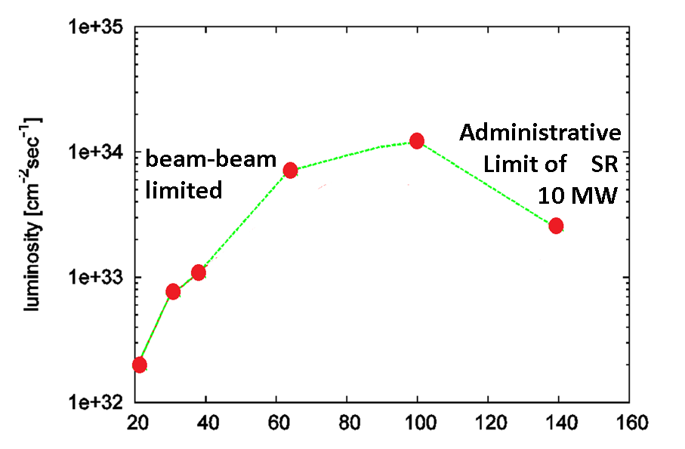
Luminosity vs. Center of Mass Energy
E_{cm} ➔

Slide 21
Coherent Electron Cooling
Principle
E < E_{h}
V.N.Litvinenko, Y.S Derbenev, Physical Review Letters 102, 114801 (2009).
E_{h}
E < E_{h}
Dispersion section
( for hadrons)
E > E_{h}
E_{h}
λ
Hadrons
Modulator
Kicker
E > E_{h}
High gain FEL (for electrons)
Electrons
➔ cooling of high energy Hadron beams with high band-width; BW: 1THz
cooling times of sec-min to balance strong IBS
21

Slide 22
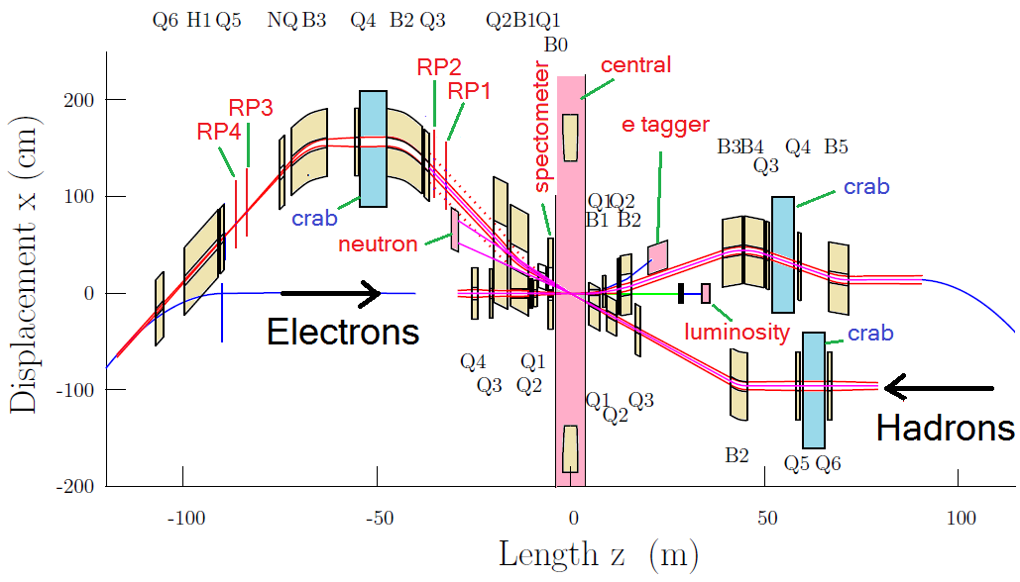
Interaction Region Layout
Interleaved arrangement of electron and hadron quadrupoles
22mrad total crossing angle, using crab cavities
Beam size in crab cavity region independent of energy – crab cavity apertures can be rather small, thus allowing for higher frequency
Forward spectrometer (B0) and Roman Pots (R1-R4) for full acceptance

Slide 23
Beam Polarization
Requirements
70% hadron polarization, 80% electron polarization
All combinations of spin orientations present in one fill
Hadron Polarization
Polarized protons with P > 60% are already provided by RHIC and its injector chain ➔ no design concern at this point
H3 Polarization: source available soon, requires additional Siberian Snakes taken from the Blue Ring
Electron Polarization
Sokolov-Ternov either too slow (at 5-18 GeV) or detrimental for spin || B-dipole ➔
Storage ring requires full energy injection of polarized bunches, no top off
Drives the requirements of the injector chain from source to high energy accelerator
50nC polarized source: SLAC gun: 16 nC 120 Hz, eRHIC 50nC 1 Hz, may need accumulator
superconducting recirculating linac $$ or rapid cycling synchrotron
Storage Ring Polarization
Spin || B-dipole: depolarization by Sokolov-Ternov effect, need exchange bunches every 6 minutes (kick-in / kick out)
Spin Polarization preservation will be based on HERA experience: Spin matching, harmonic orbit control, choice of tunes near integer resonance, ….

Slide 24

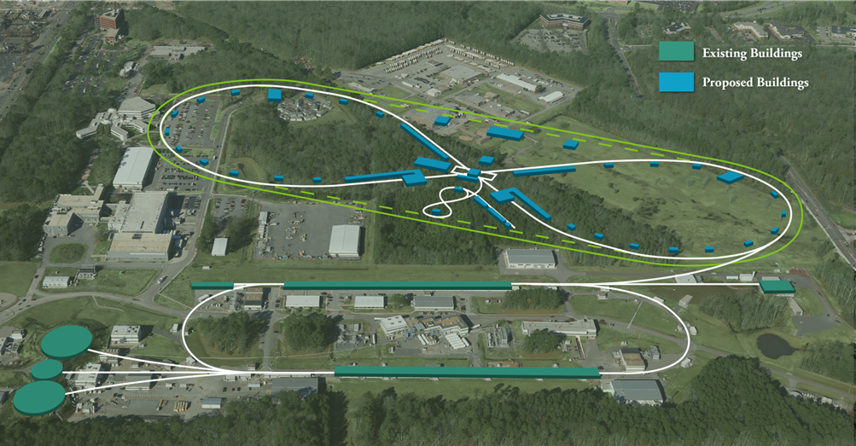
JLEIC Design and R&D
Fulvia Pilat
Fulvia Pilat

Slide 25
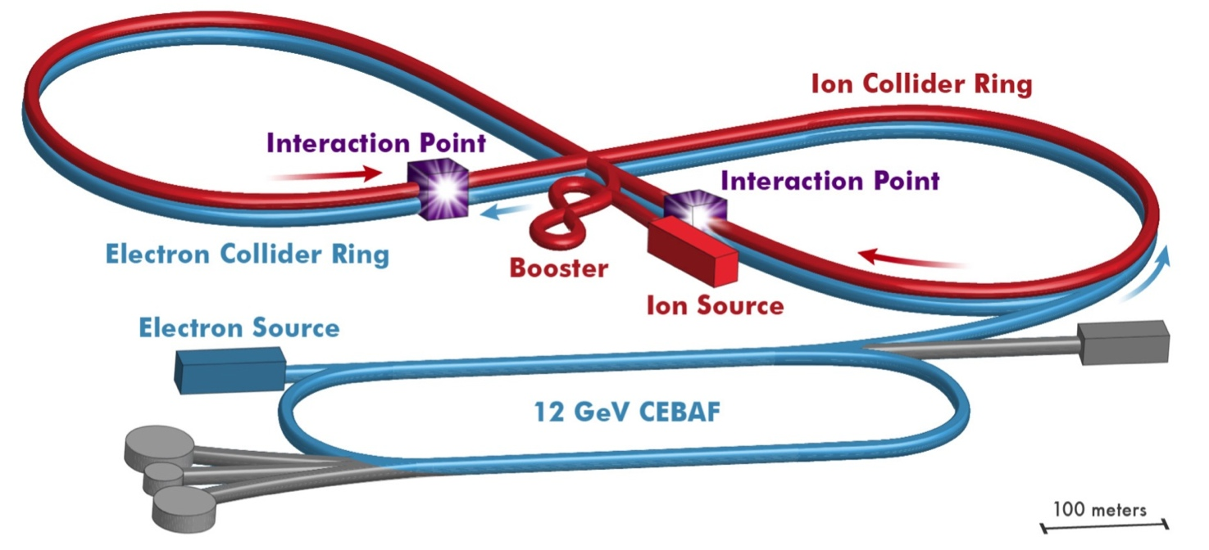
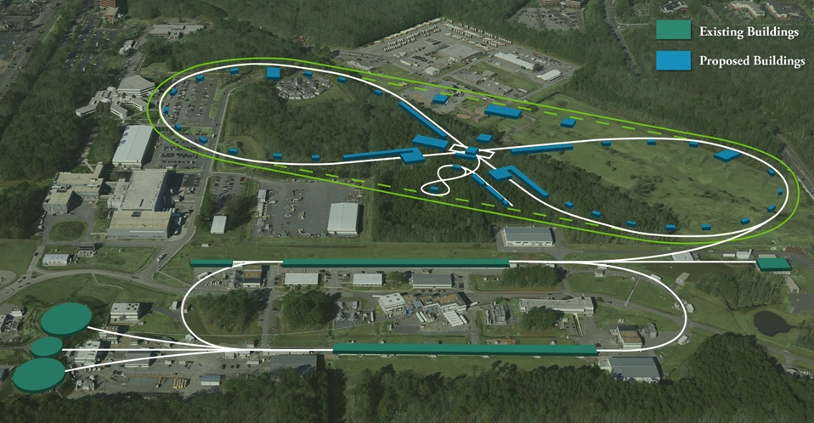
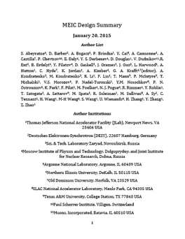
JLEIC Design
energy range:
e-: 3-10 GeV
p : 20-100 GeV
√s: up to ~70 GeV
Range to √s=100 GeV and √s=140 GeV p
Is a feasible option
Electron complex
CEBAF
Electron collider ring
Ion complex
Ion source
SRF linac
Booster
Ion collider ring
Fully integrated IR and detector
DC and bunched beam coolers
2015
arXiv:1504.07961

Slide 26

Design Fundamentals
High Luminosity
Based on high bunch repetition rate small bunch charge colliding beams
$$ℒ=f\frac{n_{1}n_{2}}{4πσ_{x}^{∗}σ_{y}^{∗}}\sim f\frac{n_{1}n_{2}}{εβ_{y}^{∗}}$$
KEK-B reached > $2×{10}^{34} s^{−1}{cm}^{−2}$
CEBAF beam already up to 1.5 GHz
New ion complex can be designed to deliver high bunch repetition rate
High Polarization w/ Figure-8
All rings are in a figure-8 shape
➔ critical advantages for both beams
Spin precessions in the left & right parts of the ring are exactly cancelled
Net spin precession (spin tune) is zero, thus energy independent
Spin can be controlled & stabilized by small solenoids or other compact spin rotators
Beam Design
High repetition rate
Low bunch intensity
Short bunch length
Small emittance
IR Design
Very small β*
Crab crossing
Damping
Synch. radiation
Electron cooling
Detection Capability
Interaction region is design to support
Full acceptance detection (including forward tagging)
Low background

Slide 27
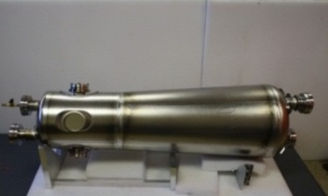
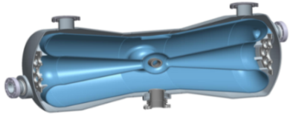
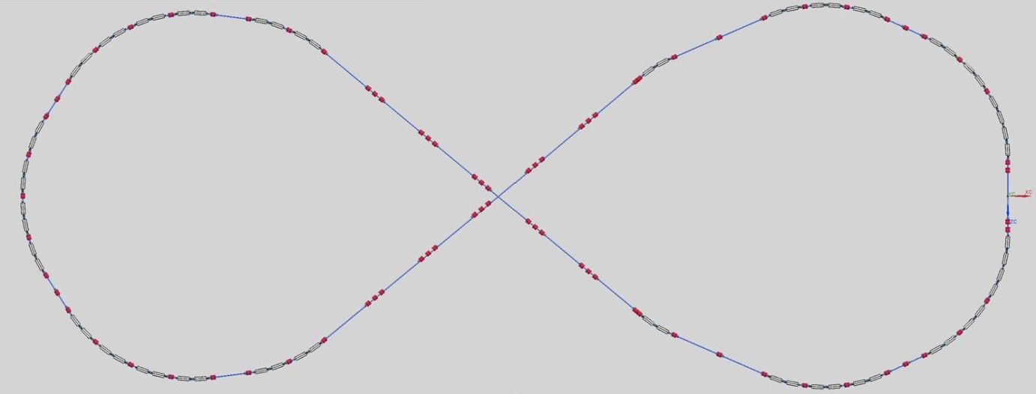
Ion Injector Complex
cooling
Generate, accumulate & accelerate ion beams
Covering all required varieties of ion species
Delivering required time and phase space structure for matching with electron beam
ion sources
SRF linac
cooling
collider ring
booster
Ion linac
QWR
HWR
booster
Quarter Wave Resonator
Half-Wave Resonator
RF cavity
kicker
 | Length (m) | Max. energy (GeV/c)
SRF linac |  | 0.2
booster | ~300 | 8
collider ring | ~2100 | 100
Crossing:79.8 deg.
extraction
injection

Slide 28
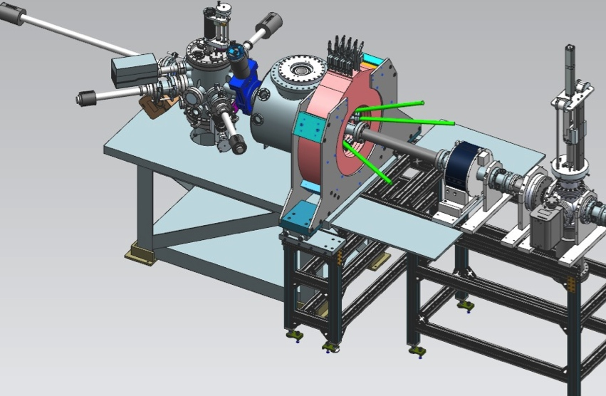
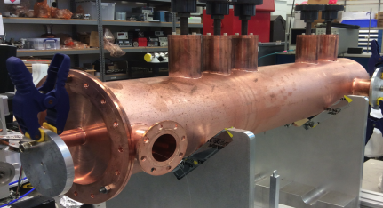
Strong Cooling: Circulator Ring
ion beam
Magnetization flip
ion beam
cooling solenoid (B<0)
cooling solenoid (B>0)
circulator ring
ERL ring
linac
fast extraction kicker
beam dump
injector
fast injection kicker
circulating bunches
injected bunches
exchange
septum
extracted bunches
dechirper
vertical
bend to CCR
vertical
bend to ERL
rechirper
Enabling technologies :
Fast kickers, rise time<1 ns
Magnetized source ~140mA
Electron energy | MeV | 20-55
Bunch charge | nC | Up to 3.2
Turns in circulator ring | turn | ~11
Current in CCR/ERL | A | 1.5/0.14
Bunch repetition | MHz | 476
Cooling section length | m | 2x30
Cooling solenoid field | T | 1
Magnetized source
Fast kicker

Slide 29
JLEIC Parameters (3T magnets)
CM energy | GeV | 21.9 (low) |  | 44.7 (medium) |  | 63.3 (high)
 |  | p | e | p | e | p | e
Beam energy | GeV | 40 | 3 | 100 | 5 | 100 | 10
Collision frequency | MHz | 476 |  | 476 |  | 476/4=119
Particles per bunch | 10¹⁰ | 0.98 | 3.7 | 0.98 | 3.7 | 3.9 | 3.7
Beam current | A | 0.75 | 2.8 | 0.75 | 2.8 | 0.75 | 0.71
Polarization | % | 80 | 80 | 80 | 80 | 80 | 75
Bunch length, RMS | cm | 3 | 1 | 1 | 1 | 2.2 | 1
Norm. emitt., hor./vert. | μm | 0.3/0.3 | 24/24 | 0.5/0.1 | 54/10.8 | 0.9/0.18 | 432/86.4
Horizontal & vertical β* | cm | 8/8 | 13.5/13.5 | 6/1.2 | 5.1/1 | 10.5/2.1 | 4/0.8
Vert. beam-beam param. |  | 0.015 | 0.092 | 0.015 | 0.068 | 0.008 | 0.034
Laslett tune-shift |  | 0.06 | 7x10⁻⁴ | 0.055 | 6x10⁻⁴ | 0.056 | 7x10⁻⁵
Detector space, up/down | m | 3.6/7 | 3.2/3 | 3.6/7 | 3.2/3 | 3.6/7 | 3.2/3
Hourglass(HG) reduction |  | 1 |  | 0.87 |  | 0.75
Luminosity/IP, w/HG, 10³³ | cm⁻²s⁻¹ | 2.5 |  | 21.4 |  | 5.9

Slide 30
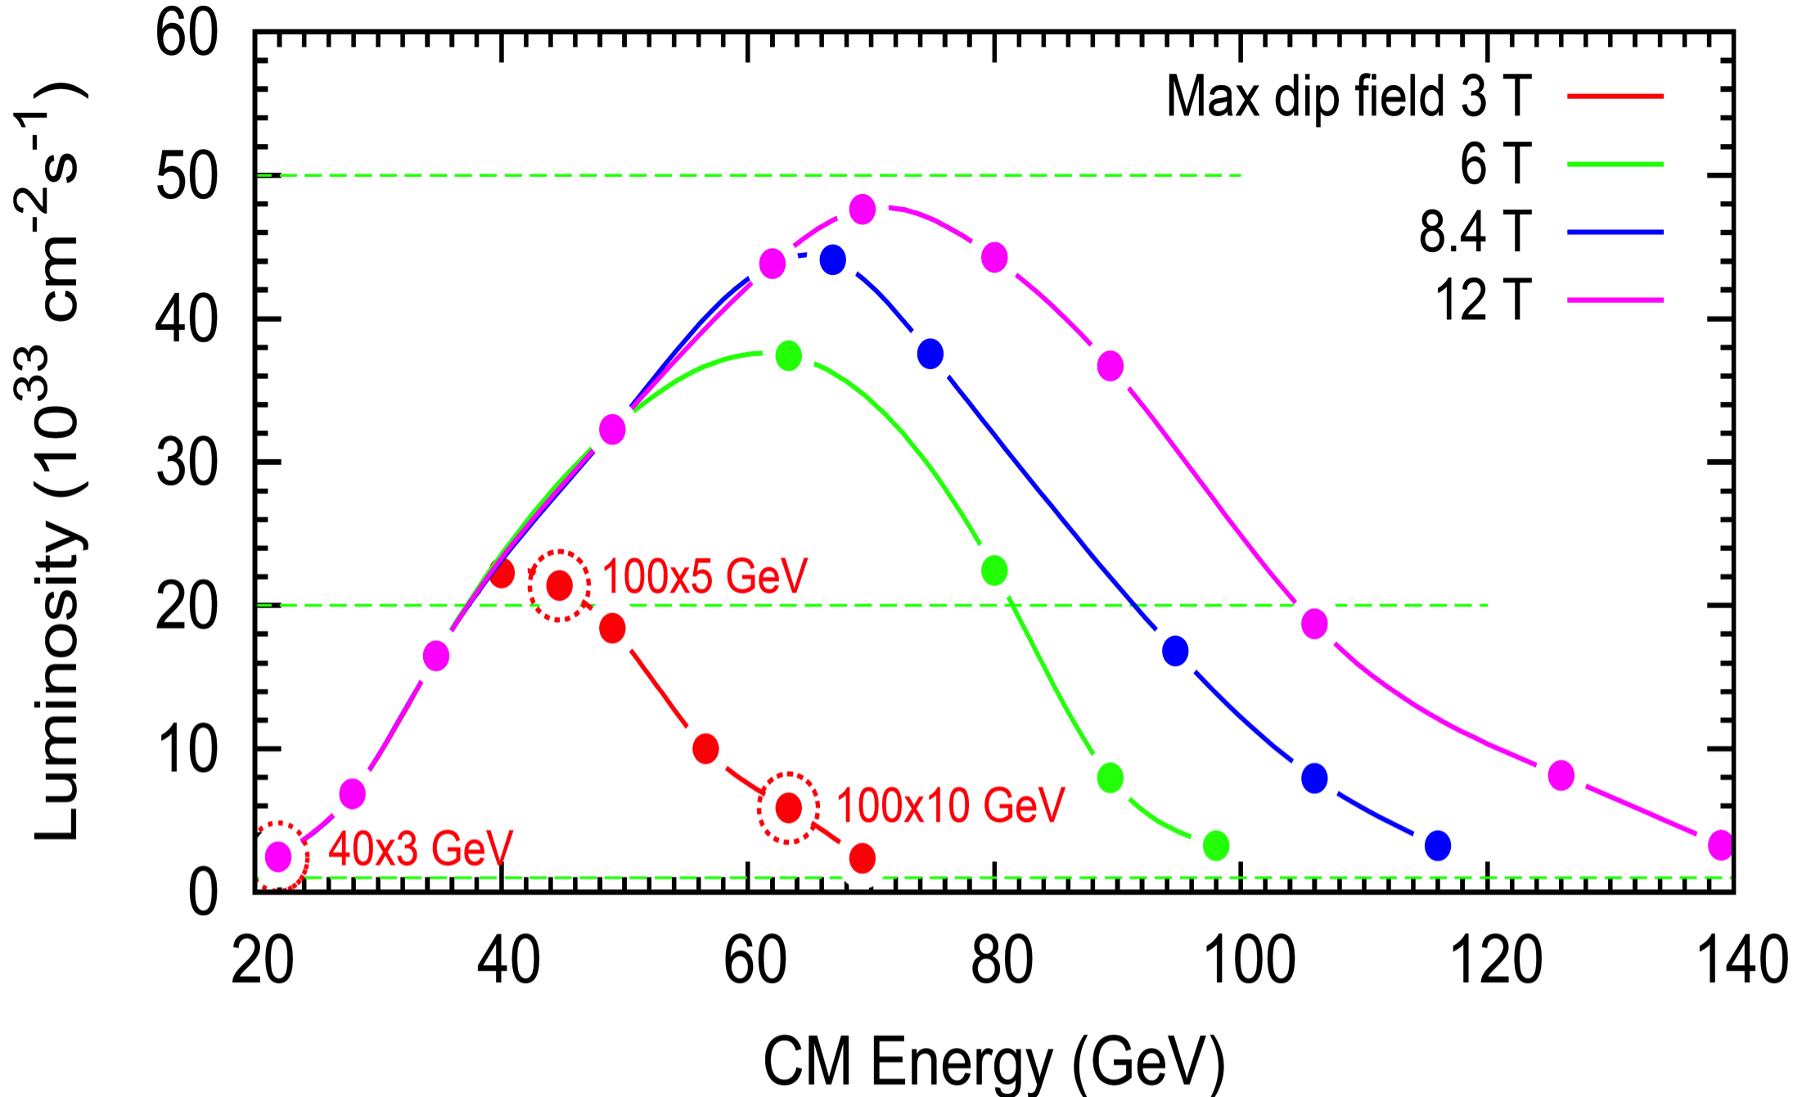
JLEIC Lumi and Energy Technical Choice
LHC technology
LHC Upgrade technology

Slide 31
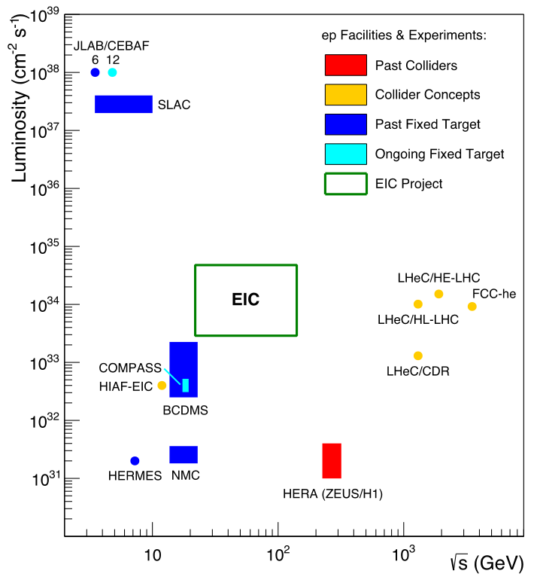
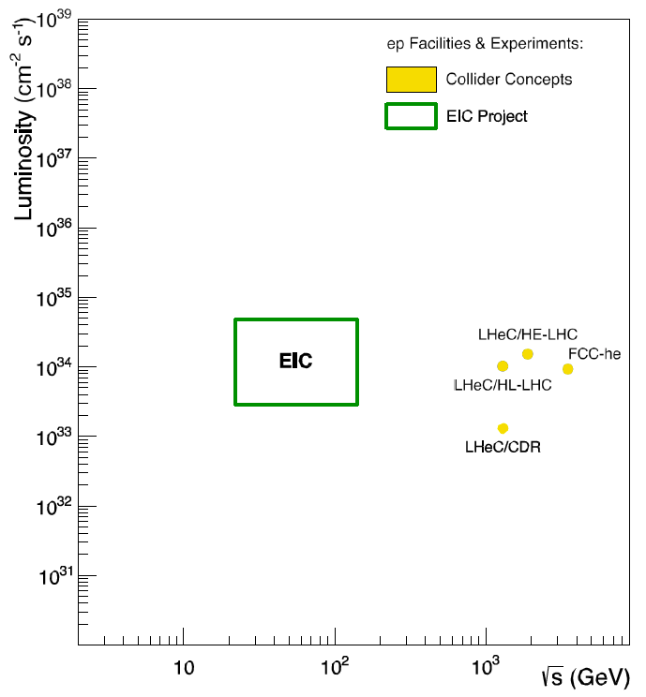
Uniqueness of EIC among all DIS Facilities
All DIS facilities in the world.
However,
if we ask for:
high luminosity &
wide reach in √s

Slide 32
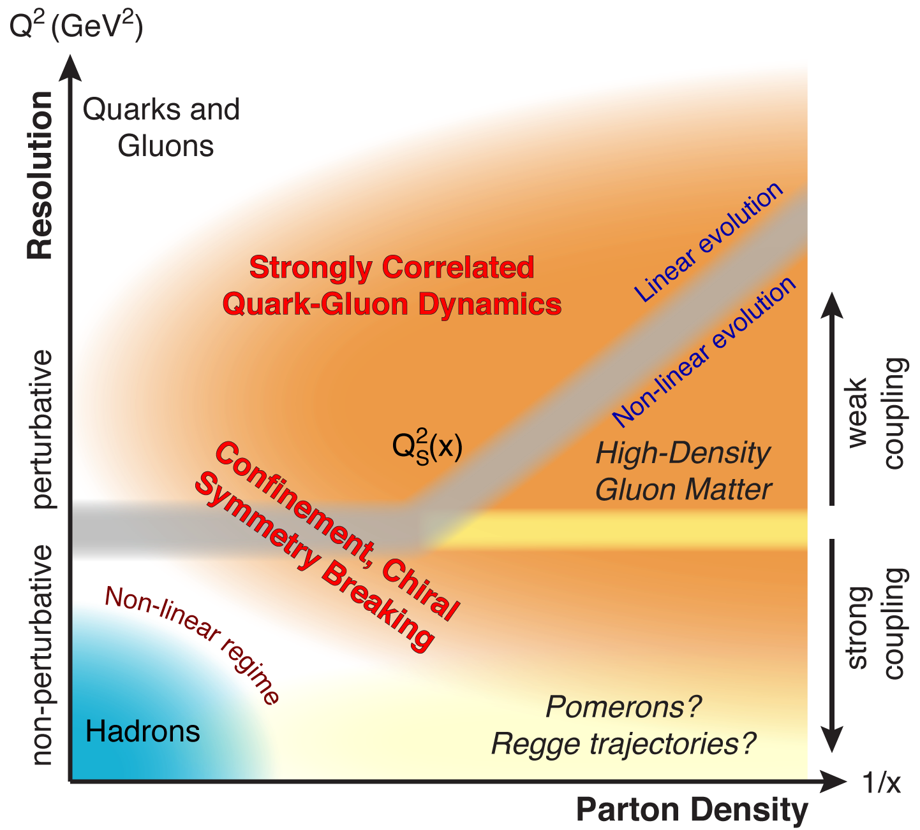
QCD Landscape explored by EIC
QCD at high resolution (Q²) —weakly correlated quarks and gluons are well-described
Strong QCD dynamics creates
many-body correlations between
quarks and gluons
→ hadron structure emerges
EIC systematically explores
correlations in this region.
An exciting opportunity: Observation by EIC of a new regime in QCD of weakly coupled high density matter

Slide 33
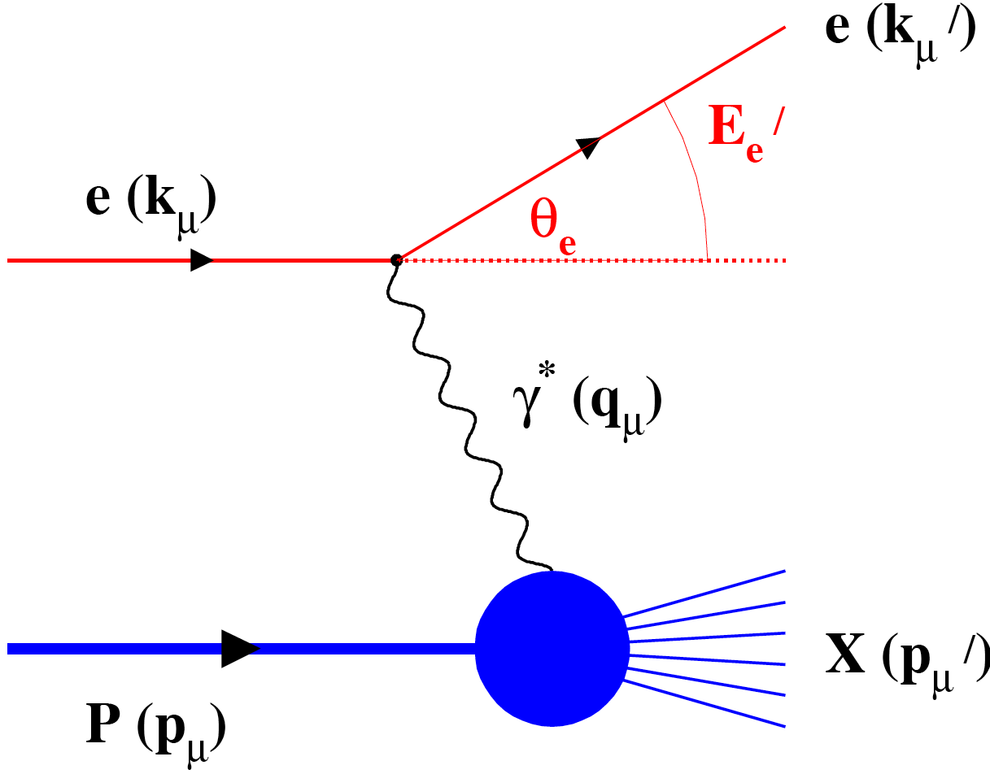
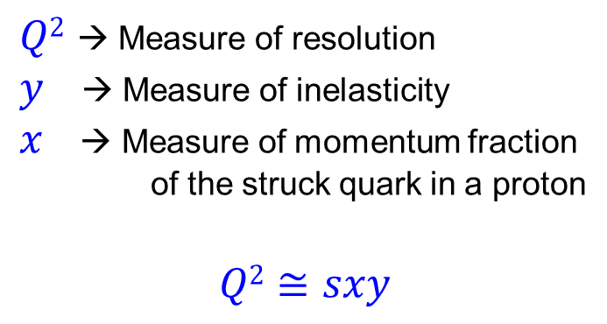
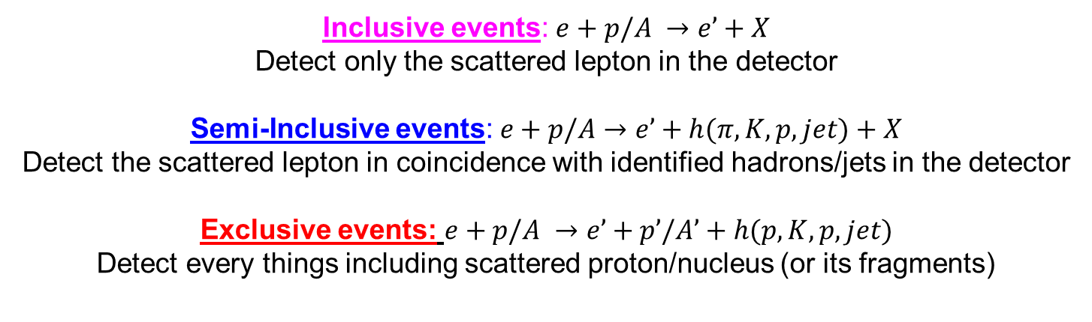
Deep Inelastic Scattering
➔ Precision microscope with superfine control
$Q2$ → Measure of resolution
$y$ → Measure of inelasticity
$x$ → Measure of momentum fraction
of the struck quark in a proton
$$Q2≅sxy$$
Inclusive events: $e+p/A →e’+X$
Detect only the scattered lepton in the detector
Semi-Inclusive events: $e+p/A→e’+h(π,K,p,jet)+X$
Detect the scattered lepton in coincidence with identified hadrons/jets in the detector
Exclusive events: $e+p/A →e’+p’/A’+h(p,K,p,jet)$
Detect every things including scattered proton/nucleus (or its fragments)
Notes:
33

Slide 34
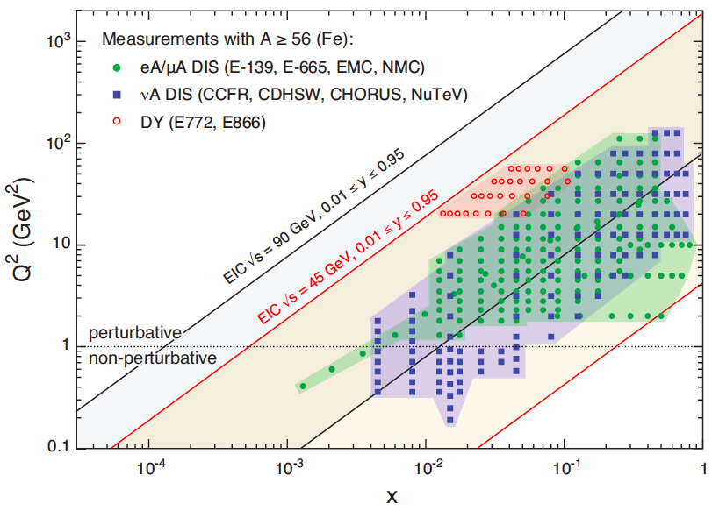
US EIC: Kinematic reach & properties
For e-N collisions at the EIC:
Polarized beams: e, p, d/³He
Variable center of mass energy
Wide Q² range → evolution
Wide x range → spanning valence to low-x physics
For e-A collisions at the EIC:
Wide range in nuclei
Lum. per nucleon same as e-p
Variable center of mass energy
Wide Q² range (evolution)
Wide x region (reach high gluon densities)
Notes:
34

Slide 35
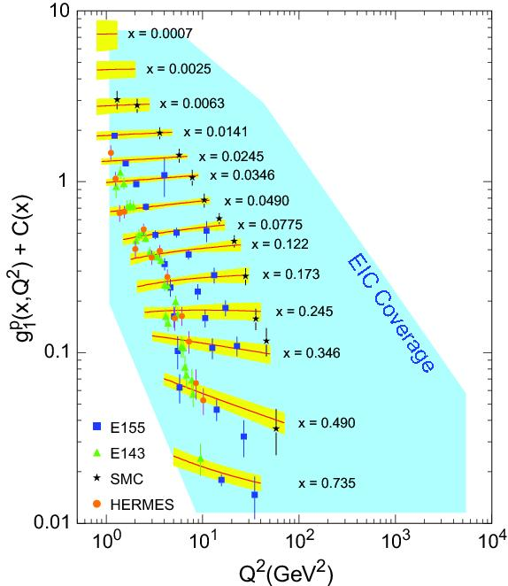
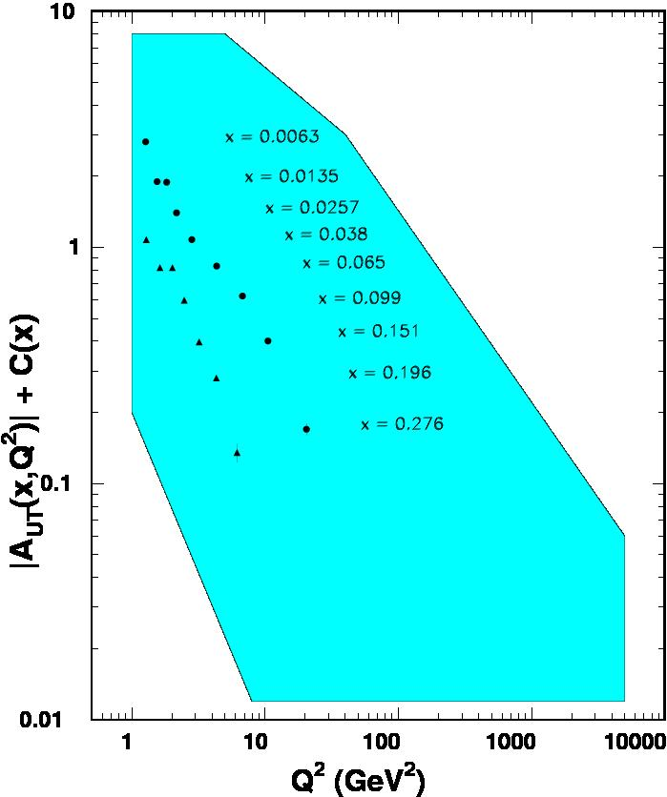

World Data on F₂^{p}
World Data on g₁^{p}
World Data on h₁^{p}
F_{UT}^{sin(φh+φs)}(x,Q²) + C(x) $∝h1$
An EIC makes it possible!
EIC coverage
COMPASS
HERMES
transverse spin ~ angular momentum
momentum
spin

Slide 36
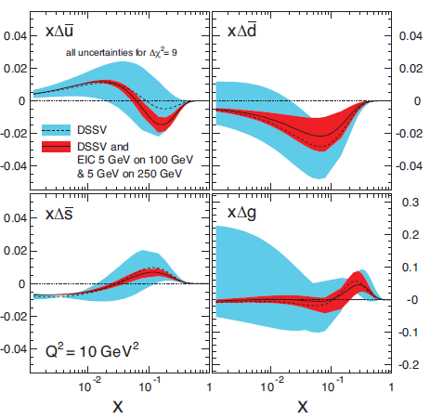



Helicity PDFs at an EIC
A Polarized EIC:
Tremendous improvement on $x∆g(x)$
Good improvement in $∆Σ$Spin Flavor decomposition of the Light Quark Sea
Many models predict
$$Δ\overline{u}>0, Δ\overline{d}<0$$
Needs range of √s, here from ~ 45 to ~ 70
Needs range of √s ~ 30-70 (and good luminosity)
Notes:
36

Slide 37






Our Understanding of Nucleon Spin
$$\frac{1}{2}=\left[\frac{1}{2}ΔΣ+L_{q}\right]+\left[Δg+L_{g}\right]$$
${ΔΣ}/2=$ Quark contribution to Proton Spin
$L_{q} =$ Quark Orbital Ang. Momentum
$∆g =$Gluon contribution to Proton Spin
$L_{g} =$ Gluon Orbital Ang. Momentum
Precision in $ΔΣ$ and $∆g$ ➔ A clear idea of the magnitude of $L_{q}+L_{g}$
Notes:
37

Slide 38



Confined parton motion in a hadron
Scattering with a large momentum transfer
Momentum scale of the hard probe $Q≫1/R\sim Λ_{QCD}\sim 1 fm$
Combined motion $\sim 1/R$ is too week to be sensitive to the hard probe
Collinear factorization – integrated into PDFs
Scattering with multiple momentum scales observed
Two-scale observables (such as SIDIS, low $p_{T}$ Drell-Yan)
$$Q≫q_{T}\sim 1/R\sim Λ_{QCD}\sim 1 fm$$
“Hard” scale $Q$ localizes the probe to see the quark or gluon d.o.f.
“Soft” scale $q_{T}$ could be sensitive to the confined motion
TMD factorization: the confined motion is encoded into TMDs
$${\vec{k}}_{⊥}$$
$${\vec{b}}_{T}$$

Slide 39








Structure of proton
Transverse Momentum Dependent parton distribution (TMDs)
Sivers function: an asymmetric parton distribution in a transversely polarized nucleon ($k_{⊥}$ correlated with the spin of the nucleon)
Boer-Mulders function: an asymmetric parton distribution in an unpolarised nucleon ($k_{⊥}$ correlated with the spin of the quark)
$$k_{⊥}$$
$$p_{q}≈xP$$
$$f\left(x\right)$$
$$f\left(x,k_{⊥}\right)$$
Longitudinal motion only
Longitudinal + transverse motion
$$f_{q/{h↑}}\left(x,k_{⊥}, \vec{S}\right)=f_{q/h}\left(x,k_{⊥}\right)−\frac{1}{M}f_{1T}^{⊥q}\left(x,k_{⊥}\right)\vec{S}∙\left(\hat{p}×{\vec{k}}_{⊥}\right)$$
$$f_{q/{h↑}}\left(x,k_{⊥}, \vec{s}\right)=f_{q/h}\left(x,k_{⊥}\right)−\frac{1}{M}h_{1T}^{⊥q}\left(x,k_{⊥}\right)\vec{s}∙\left(\hat{p}×{\vec{k}}_{⊥}\right)$$

Slide 40


Factorization in QCD – SIDIS
Perturbative definition – in terms of TMD factorization:
Low $P_{hT}$ – TMD factorization:
$$σ\left(Q, P_{hT}, x, z\right)=\hat{H}\left(Q\right)⨂φ_{f}\left(x,k_{⊥}\right)⨂D_{f→h}\left(z,p_{⊥}\right)⨂S\left(k_{s⊥}\right)+ℴ\left[\frac{P_{hT}}{Q}\right]$$
High $P_{hT}$ – Collinear factorization:
$$σ\left(Q, P_{hT}, x, z\right)=\hat{H}\left(Q,P_{hT},α_{s}\right)⨂φ_{f}\left(x\right)⨂D_{f→h}\left(z\right)+ℴ\left[\frac{1}{P_{hT}},\frac{1}{Q}\right]$$
$P_{hT}$ Integrated – Collinear factorization:
$$σ\left(Q, x, z\right)=\hat{H}\left(Q,α_{s}\right)⨂φ_{f}\left(x\right)⨂D_{f→h}\left(z\right)+ℴ\left[\frac{1}{Q}\right]$$
TMD Fragmentation
Soft Factor
TMD Distribution

Slide 41

TMD evolution:
QCD evolution of TMDs in Fourier space (solution of equation)
Polarized scattering data comes as ratio: e.g. $A_{UT}^{\sin\left(φ_{h}−φ_{s}\right)}=F_{UT}^{\sin\left(φ_{h}−φ_{s}\right)}/F_{UU}$
Unpolarized data is very important to constrain/extract the key ingredient for the non-perturbative part
$$F\left(x, b;Q\right)≈C⨂F\left(x, c/b^{∗}\right)\exp\left\{−\int_{c/b^{∗}}^{Q_{f}}{\frac{dμ}{d}}\left(A\ln{\frac{Q_{f}^{2}}{μ^{2}}}+B\right)\right\}×\exp\left[−S_{non−pert}\left(b,Q\right)\right]$$
Non-perturbative part has to be fitted to experimental data
The key ingredient is spin-independent
Evolution of longitudinal/ collinear part
Evolution of transverse part (Sudakov form factor)

Slide 42

Effect of QCD evolution
What evolution does
Spread out the distribution to much larger $k_{⊥}$. At low $k_{⊥}$, the distribution decreases due to this spread
Echevarria, Idilbi, Kang, Vitev. Kang, Prokudin, Sun, Yuan

Slide 43




Accessing TMD PDFs and FFs
TMD factorization works in the domain where there are two observed momenta in the process, such as SIDIS, DY, $e^{+}e^{−}$. $Q≫q_{T}$: $Q$ is large to ensure the use of pQCD, $q_{T}$ is much smaller such that it is sensitive to parton’s transverse momentum
SIDIS off polarized p, d, n targets
polarised Drell-Yan
$e^{+}e^{−}→h_{1}h_{2}$
HERMES
COMPASS
JLab
future: eN colliders?
$$σ^{ℓp→ℓ^{′}hX}\sim q\left(x\right)⊗{\hat{σ}}^{γq→q}⊗D_{q}^{h}\left(z\right)$$
COMPASS
RHIC
FNAL
future: FAIR, JPark, NICA
$$σ^{hp→μμ}\sim {\overline{q}}_{h}\left(x_{1}\right)⊗q_{p}\left(x_{2}\right)⊗{\hat{σ}}^{\overline{q}q→μμ}\left(\hat{s}\right)$$
BaBar
Belle
Bes III
$$σ^{e^{+}e^{−}→h_{1}h_{2}}\sim {\hat{σ}}^{ℓℓ→\overline{q}q}\left(\hat{s}\right)⊗D_{q}^{h_{1}}\left(z_{1}\right)⊗D_{q}^{h_{2}}\left(z_{2}\right)$$

Slide 44


Importance of unpolarized SIDIS
The cross-section dependence from $p_{T}^{h}$ results from:
intrinsic $k_{⊥}$ of the quarks
$p_{⊥}$ generated in the quark fragmentation
A Gaussian ansatz for $k_{⊥}$ and $p_{⊥}$ leads to
$\left\langle P_{hT}^{2}\right\rangle =z^{2}\left\langle k_{⊥}^{2}\right\rangle +\left\langle p_{⊥}^{2}\right\rangle$
The azimuthal modulations in the unpolarized cross sections comes from:
Intrinsic $k_{⊥}$ of the quarks
The Boer-Mulders PDF
Difficult measurements were one has to correct for the apparatus acceptance
COMPASS and HERMES have
results on ${}_{}^{6}{LiD} \left(\sim d\right)$ and $d$ and on p (Hermes only)
No COMPASS measurements on $p$ since on $NH_{3} \left(\sim p\right)$ nuclear effects may be important
$⇒$COMPASS-II, measurements on LH₂ in parallel with DVCS

Slide 45




Importance of unpolarized SIDIS
$$F_{UU}^{h}\left(x, z, P_{hT}^{2}; Q^{2}\right)=x\sum_{q}{e_{q}^{2}\int{d^{2}{\vec{k}}_{⊥}d^{2}{\vec{p}}_{⊥}δ\left({\vec{p}}_{⊥}−z{\vec{k}}_{⊥}−{\vec{P}}_{hT}\right) f_{1}^{q}\left(x, k_{⊥}^{2};Q^{2}\right)D_{1}^{q→h}\left(z,p_{⊥}^{2};Q^{2}\right)}}$$
$$M^{h}\left(x,z, P_{hT}^{2};Q^{2}\right)=\frac{d^{5}σ^{h}/dxdQ^{2}dzd^{2}{\vec{p}}_{T}}{d^{2}σ^{DIS}/dxdQ^{2}}\sim \frac{F_{UU}^{h}\left(x, z, P_{hT}^{2}; Q^{2}\right)}{F_{UU,T}+εF_{UU,L}}$$

Slide 46



Sivers asymmetry on proton. Multidimensional
π-
Notes:
46

Slide 47

Sivers in DY by COMPASS

Slide 48


TMD Landscape at an EIC: Sivers as example
√s ~ 15 GeV
√s ~ 45 GeV
√s ~ 140 GeV
( ) upgraded EIC

Slide 49


Access to the Gluon TMDs
Access to gluon TMDs may be possible by:
Di-jet/di-hadron production
Heavy quark production
Quarkonium production
Integrated luminosity of 100 fb⁻¹
Example:
where both D and D are in the current fragmentation region, with momentum k₁ and k₂, respectively, and N is a transversely polarized nucleon.
Gluon Sivers will introduce an azimuthal asymmetry correlating
k’ = k₁ + k₂ of the DD pair
with the transvers polarization S

Slide 50
The US Nuclear Science Long-Range Planning Process
Notes:
50

Slide 51



Gluons and the EIC – US Coverage
Scientific American
May 2015
Notes:
51

Slide 52

Gluons and the EIC – Italy Coverage
Le Scienze
July 2015
The secrets of the particles that hold matter together
Notes:
52

Slide 53




Slide 54

Keen Interest in Asia
(China, India, Japan, Korea)
Sent in the context of the US Long-Range Plan process

Slide 55

Nuclear Science Long-Range Planning
As for us (running now) every 5-7 years the Nuclear Science community produces a Long-Range Planning (LRP) Document
Previous versions: 1979, 1983, 1989, 1996, 2002, 2007
The final document includes a small set of recommendations for the field of Nuclear Science for the next decade
For instance, 12 GeV construction was the highest recommendation of the 2007 plan.
Town Meeting on Computational Nuclear Physics
SURA, Washington DC, 14-15 July, 2014
https://www.jlab.org/conferences/cnp2014/
Town Meeting on Education and Innovation
Michigan State University, East Lansing, 7-8 August 2014
http://meetings.nscl.msu.edu/Education-Innovation-2014/program.htm
Town Meeting on Nuclear Structure and Nuclear Astrophysics
Texas A&M University, College Station, 21-23 August 2014
http://www.lecmeeting.org/program.htm
Town Meeting on QCD and Hadronic Physics
Town Meeting on Phases of QCD Matter
(One Day Joint)
Temple University, Philadelphia, 13-15 September 2014 https://indico.bnl.gov/conferenceTimeTable.py/pdf?view=standard&confId=857
Town Meeting on Fundamental Symmetries and Neutrinos
Chicago, 28-29 September 2014
https://fsnutown.phy.ornl.gov/fsnuweb/

Slide 56
Recommendations
The progress achieved under the guidance of the 2007 Long Range Plan has reinforced U.S. world leadership in nuclear science. The highest priority in this 2015 Plan is to capitalize on the investments made.
12 GeV – unfold quark & gluon structure of hadrons and nuclei
FRIB – understanding of nuclei and their role in the cosmos
Fundamental Symmetries Initiative – physics beyond the SM
RHIC – properties and phases of quark and gluon matter
The ordering of these four bullets follows the priority ordering of the 2007 plan
We recommend the timely development and deployment of a U.S.-led ton-scale neutrinoless double beta decay experiment.
We recommend a high-energy high-luminosity polarized Electron Ion Collider as the highest priority for new facility construction following the completion of FRIB.
We recommend increasing investment in small and mid-scale projects and initiatives that enable forefront research at universities and laboratories.
Iniziatives
We recommend vigorous detector and accelerator R&D in support of the neutrinoless double beta decay program and the Electron Ion Collider.

Slide 57
Ongoing and next steps
Notes:
57

Slide 58
EIC Timeline
EIC accelerator R&D questions will not be completely answered until ~2017
EIC construction has to start after FRIB completion, with FRIB construction
anticipated to start ramping down near or in FY20
Most optimistic scenario would have EIC construction start (CD3) in FY20, perhaps more realistic FY22-23 timeframe
Best guess for EIC completion assuming formal NSAC/LRP recommendation would be 2025-2030 timeframe
Activity Name | 2010 | 2011 | 2012 | 2013 | 2014 | 2015 | 2016 | 2017 | 2018 | 2019 | 2020 | 2021 | 2022 | 2023 | 2024 | 2025
12 GeV Upgrade
12 GeV Operations
FRIB
EIC Physics Case
NSAC LRP
CD0
EIC Machine Design and R&D
CD1(Down-select)
CD2/CD3
EIC Construction
CD0 = DOE “Mission Need” statement
CD1 = technology and site selection (VA/NY)
CD2/CD3 = establish project baseline cost and schedule

Slide 59

DOE budget in FY 2015 $: “Modest Growth”

Slide 60


The EIC Users Group: EICUG.ORG
697 collaborators, 29 countries, 160 institutions... (April, 2017)
(no students included as of yet)
Map of institution’s locations
The EIC Users Meeting at Stony Brook, June 2014:
http://skipper.physics.sunysb.edu/~eicug/meeting1/SBU.html
The EIC UG Meeting at University of Berkeley, January 6-9, 2016
http://skipper.physics.sunysb.edu/~eicug/meeting2/UCB2016.html
Recent EICUG Argonne National Laboratory July 7-10, 2016
http://eic2016.phy.anl.gov
Remote/Internet: meeting: March 16th : For NAS Review preparation
Last meeting:
July 18-22, 2017 Trieste, Italy

Slide 61

EICUG 2017
Electron-Ion Collider User Group meeting in Trieste, July 2017
eicug2017.ts.infn.it/

Slide 62

Meeting structure and key figures
Registered participants: 112 (USA: 46 ; IT: 32 ; F: 14 ; others: 20 )
Algeria, Australia, Belgium, Cyprus, Czech Rep., Finland, Germany, Japan, Netherlands, Spain, Switzerland, UK
Planary talks: 25
Accelerator workshop, talks: 13 •
Parallel sessions, talks: 50
+ EICUG institutional meetings and reports

Slide 63

Highlights, Opening Session

Slide 64


Slide 65


Slide 66


Slide 67
Conclusion
The EIC will profoundly impact our understanding of the structure of nucleons and nuclei in terms of sea quarks & gluons. → Can we provide a bridge between sea quarks/gluons and nuclei?
EIC will enable IMAGES of yet unexplored regions of phase spaces in QCD with its high luminosity/energy, nuclei & beam polarization → There is high potential for discovery
Outstanding questions raised both by the science at RHIC/LHC and at HERMES/COMPASS/Jefferson Lab, have naturally led to the science and design parameters of the EIC
There exists world wide interest in collaborating on the EIC
Accelerator scientists at RHIC and Jlab, in collaboration with many outside interested accelerator groups, can provide the intellectual and technical leadership to realize the EIC, a frontier accelerator facility.
The future of QCD-based nuclear science demands an Electron Ion Collider
Notes:
67

Slide 68
Backups

Slide 69
Physics vs. Luminosity & Energy
Electroweak
Fundamental Symmetry Tests
10³⁴
Tomography (p/A) Transverse Momentum Distribution and Spatial Imaging
Luminosity (cm⁻² sec⁻¹)
Spin and Flavor Structure of the Nucleon and Nuclei
10³³
QCD at Extreme Parton Densities - Saturation
Parton Distributions in Nuclei
10³²
40
80
120
√S (GeV)
Notes:
69

Slide 70
Gluons and the EIC – Brasil Coverage
Scientific American Brasil
June 2015
FÍSICA DE PARTÍCULAS – p.48 A cola que nos une Os físicos sabem que glúons mantêm a integridade de prótons, nêutrons e do Universo. Mas ainda é um mistério como essas partículas funcionam. Rolf Ent, Thomas Ullrich e Raju Venugopalan
FISICA
Novas pesquisas sobre as particulas que mantem o Universo unido
New inquiries on the particles that hold the universe together
Notes:
70
Note BSM not included in project

Slide 71

Gluons and the EIC – France Coverage
Pour La Science - September 2015
Notes:
71

Slide 72

Gluons and the EIC – Germany Coverage
Spektrum der Wissenschaft - December 2015
Notes:
72
Note BSM not included in project

Slide 73



Evolution of a Proton – Deep into the Sea
=
>
Saturation

Slide 74



QCD and Confinement
Asymptotic Freedom
Confinement
Small Distance
High Energy
Large Distance
Low Energy
Perturbative QCD
Strong QCD
High Energy Scattering
Hadron Spectrum - no signature of gluons?
Gluon Jets
Observed

Slide 75
Emergence of hadrons from partons
Nucleus as a Femtometer sized filter
Unprecedented ν, the virtual photon energy range @ EIC : precision & control
Energy loss by light vs. heavy quarks:
Control of ν by selecting kinematics;
Control the medium by selecting ions
Colored quark emerges as color neutral hadron ➔ What is nature telling us about confinement?
Identify π vs. D^{0 (charm)} mesons in e-A collisions: Understand energy loss of light vs. heavy quarks traversing nuclear matter
Need the collider energy of EIC and its control on parton kinematics
Notes:
75

Slide 76


Color neutralization – it’s a correlated 3D problem
Can we learn more on how hadrons emerge from color charge by correlating one hadron with the residual system, and track where it’s momentum and spin originate?
Final transverse momentum of the detected pion P_{t} arises from convolution of the struck quark transverse momentum k_{t} with the transverse momentum generated during the fragmentation p_{t}.
D_{u}^{π+}(z,p_{t})
Mass of hadrons = E/c²

Slide 77
Proton at Low and High Energy
Low energy
High x
Regime of JLab
High energy
Low- x
Regime of a Collider
At high energy:
Wee partons fluctuations time dilated in strong interaction time scales
Long lived gluons can radiate further smaller x gluons ➔ runaway growth?
Notes:
77
Note BSM not included in project

Slide 78
Full Acceptance for Forward Physics!
Example: acceptance for p’ in e + p → e’ + p’ + X
Huge gain in acceptance for forward tagging to measure F₂^{n} and diffractive physics!!!

