Slide 1
DDS
Dynamic Deployment System
Andrey Lebedev
Anar Manafov
GSI, Darmstadt, Germany
2017-07-06

Slide 2
Motivation
Create a system, which is able to spawn and control
hundreds of thousands of different user tasks
which are tied together by a topology,
can be run on different resource management systems
and can be controlled by external tools.

Slide 3
The Dynamic Deployment System
is a tool-set that automates and significantly simplifies a deployment of user defined processes and their dependencies on any resource management system using a given topology

Slide 4
Basic concepts
DDS:
implements a single-responsibility-principle command line tool-set and APIs,
treats users’ tasks as black boxes,
doesn’t depend on RMS (provides deployment via SSH, when no RMS is present),
supports workers behind FireWalls (outgoing connection from WNs required),
doesn’t require pre-installation on WNs,
deploys private facilities on demand with isolated sandboxes,
provides a key-value properties propagation service for tasks,
provides a rules based execution of tasks.

Slide 5
The system takes so called “topology file” as the input.
Users describe desired tasks and their dependencies using this file.
Users are also provided with a Web GUI to create topologies.
The contract
<topology id="myTopology">
<decltask id="task1">
<exe reachable="false">/Users/andrey/Test1.sh –l</exe>
</decltask>
<decltask id="task2">
<exe>/Users/andrey/DDS/Test2.sh</exe>
</decltask>
<main id="main">
<task>task1</task>
<task>task2</task>
</main>
</topology>
Declaration of user tasks. Commands with command line argument are supported.
Main block defines which tasks has to be deployed to RMS.
More info: http://dds.gsi.de/doc/nightly/topology.html

Slide 6
DDS Workflow
Server
WN
Task1
dds-scout
dds-agent
dds-commander
WN
Task2
dds-scout
dds-agent
dds-server start
DDS SSH plugin cfg file
dds-submit -r ssh -c ssh_hosts.cfg
ssh_hosts.cfg
@bash_begin@
@bash_end@
flp, lxi0234.gsi.de, , /tmp/dds_wrk, 8
epn, lxi235.gsi.de, , /tmp/dds_wrk, 10
dds-topology –activate topology.xml
dds-topology –update new_topology.xml

Slide 7
Highlights of the DDS features
key-value propagation,
custom commands for user tasks and ext. utils,
RMS plug-ins,
Watchdogging
… many more other features
more details here: https://github.com/FairRootGroup/DDS/blob/master/ReleaseNotes.md

Slide 8
key-value propagation
2 tasks → static configuration with shell script
100k tasks → dynamic configuration with DDS
Allows user tasks to exchange and synchronize the information dynamically at runtime.
Use case:
In order to fire up the FairMQ devices they have to exchange their connection strings.
DDS protocol is highly optimized for massive key-value transport. Internally small key-value messages are accumulated and transported as a single message.
DDS agents use shared memory message queue to deliver key-value to a user task.

Slide 9
key-value in the topology file
Property declaration with a key.
<topology id="myTopology">
<property id="property_1" />
<property id="property_2" />
<decltask id="task1">
<exe reachable="false">/Users/andrey/Test1.sh –l</exe>
<properties>
<id access=”read">property_1</id>
<id access="write">property_2</id>
</properties>
</decltask>
<decltask id="task2">
<exe>/Users/andrey/DDS/Test2.sh</exe>
<properties>
<id access=”write">property_1</id>
<id access=”readwrite">property_2</id>
</properties>
</decltask>
…
</topology>
Task defines a list of dependent properties with access modifier: “read”, “write” or “readwrite”.
When property is received user task will be notified about key-value update.

Slide 10
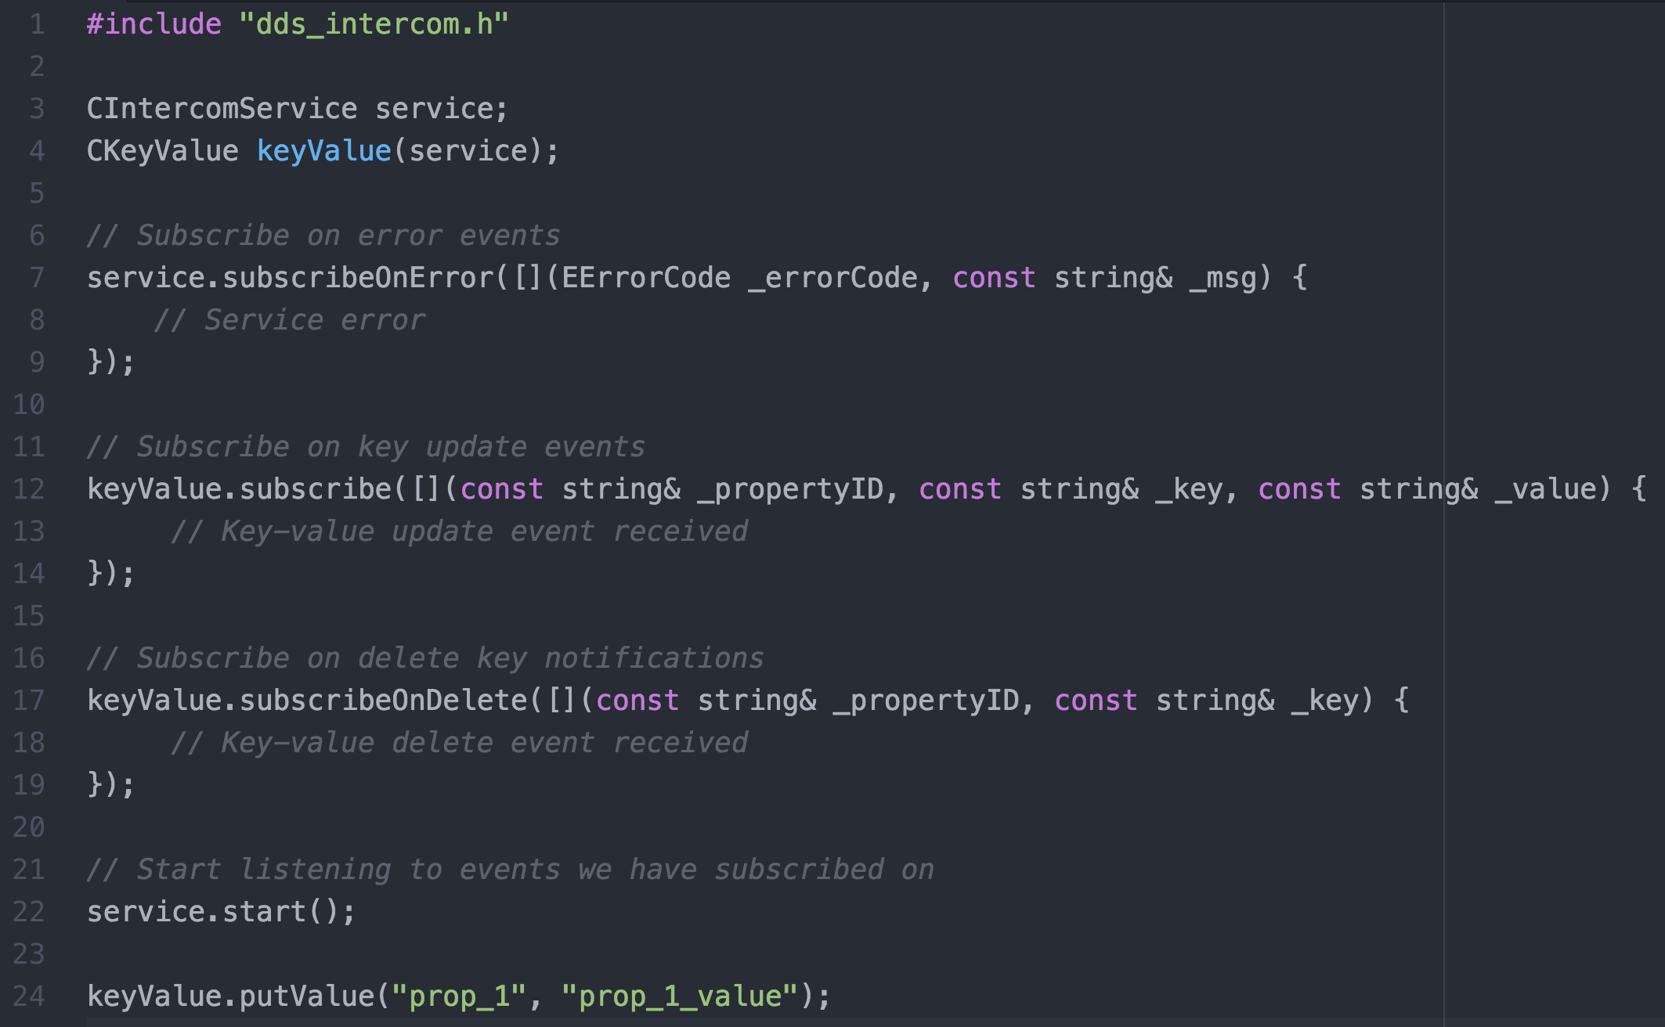
Key-value API
dds-intercom-lib and header “dds_intercom.h”
For more information refer to Tutorial1 of DDS.
10

Slide 11
Custom commands (1)
A possible use case: Control System for Experiment which is able to communicate with user tasks
Shared memory message queue
Custom command requesting information from tasks
Server
DDSCustomCmd
Task1
dds-agent
CS-UI
DDSCustomCmd
dds-commander
Task2
External process which communicates with user tasks
dds-agent
DDSCustomCmd
// Subscribe on custom commands
ddsCustomCmd.subscribeCmd(...);
// Send custom command
ddsCustomCmd.sendCmd(...);
Reply with requested information

Slide 12
Custom commands (2)
Sending of custom commands from user tasks and ext. utilities.
Two use cases:
User task communicates with DDS agent via shared memory
Ext. utility which connects to DDS commander via network
A custom command is a standard part of the DDS protocol.
From the user perspective a command can be any text, for example, JSON or XML.
A custom command recipient is defined by a condition.
Broadcast custom command to all tasks with this path.
Condition types:
Internal channel ID which is the same as sender ID.
Path in the topology: main/RecoGroup/TrackingTask.
Hash path in the topology: main/RecoGroup/TrackingTask_23.
Task index.

Slide 13
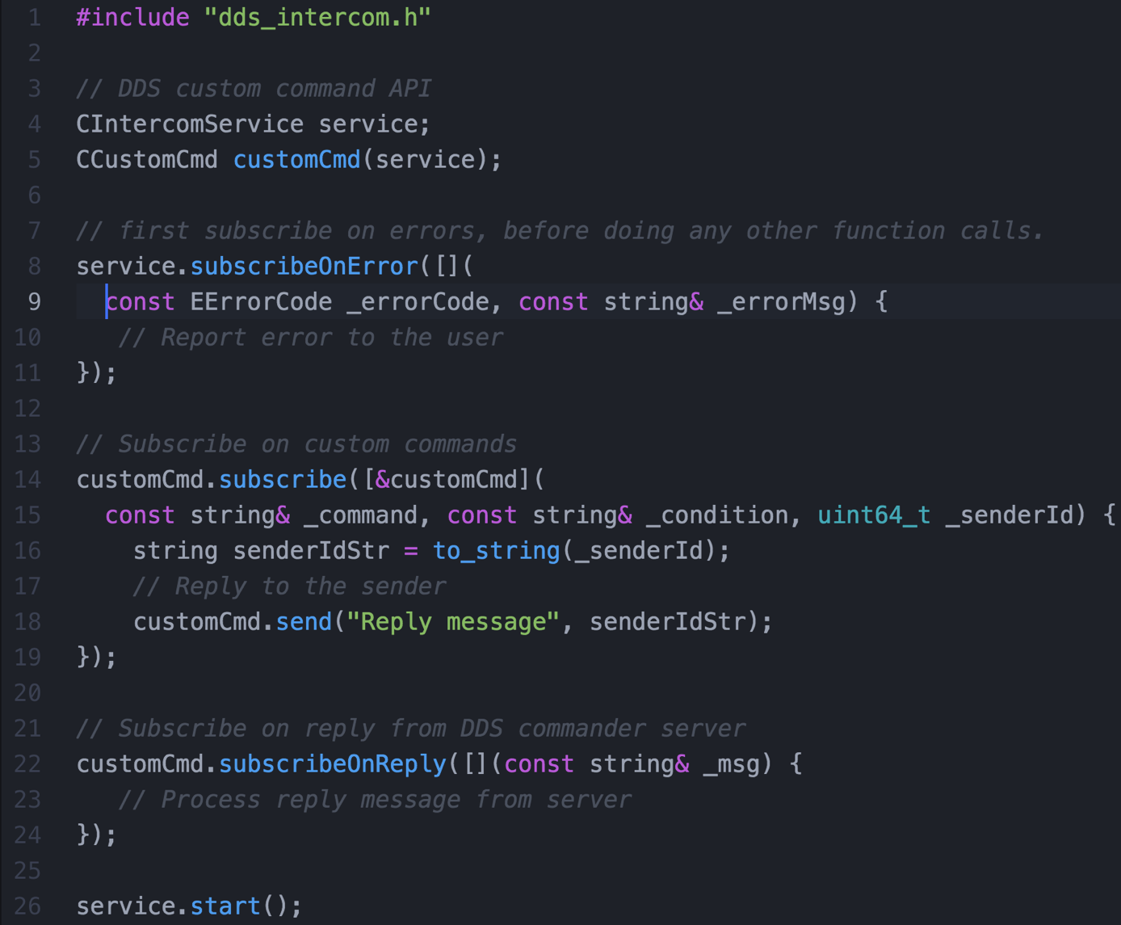
Custom commands API
dds-intercom-lib and header “dds_intercom.h”
For more information refer to Tutorial2 of DDS.

Slide 14
RMS plug-in architecture
Motivation
Give external devs. a possibility to create DDS plug-ins - to cover different RMS.
Isolated and safe execution. A plug-in must be a standalone processes - if segfaults, won’t effect DDS.
Use DDS protocol for communication between plug-in and commander server - speak the same language as DDS.

Slide 15
RMS plug-in architecture
Server
dds-submit
Cluster
dds-commander
-r ssh
-r slurm
-r mesos
-r localhost
-r pbs
-r lsf
DDSScout
Slurm
DDSScout
SSH plugin
dds-submit-ssh
DDSScout
Mesos
DDS protocol
Slurm plugin
dds-submit-slurm
DDSScout
Mesos plugin
dds-submit-mesos
dds-commander starts a plug-in based on the dds-submit parameter,
plug-in contact DDS commander server asking for submissions details,
plug-in deploy DDSScout fat script on target machines,
plug-in execute DDSScout on target machines.

Slide 16
List of available RMS plug-ins
#1: SSH
#2: localhost
#3: Slurm
#4: MESOS (CERN)
#5: PBS
#6: LSF

Slide 17
Documentation and tutorials
• User manual
• API documentation
• Tutorial1: key-value propagation
• Tutorial2: custom commands
For more information refer to DDS documentation:
http://dds.gsi.de/documentation.html

Slide 18
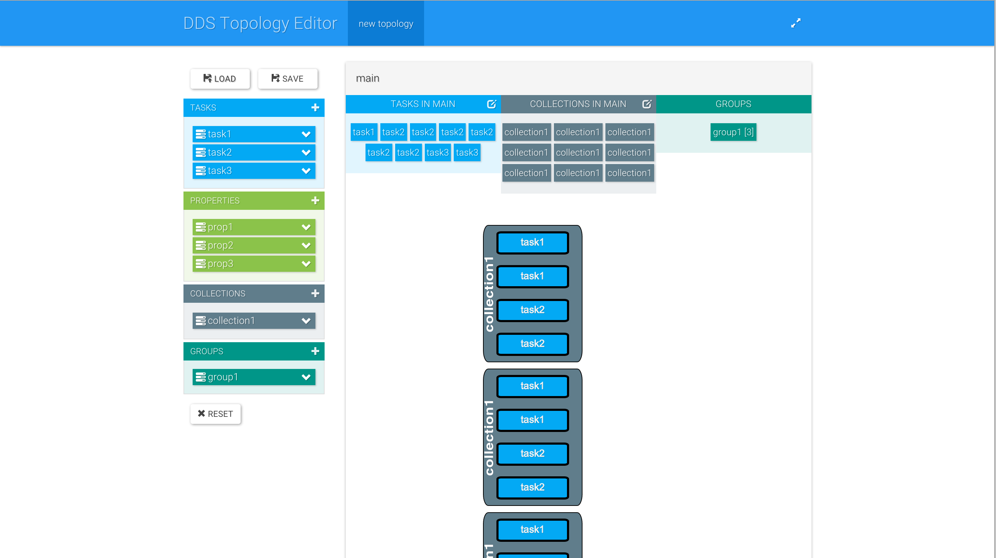
Topology editor
http://rbx.github.io/DDS-topology-editor/
By Alexey Rybalchenko (GSI, Darmstadt)

Slide 19
Releases - DDS v1.6
(http://dds.gsi.de/download.html),
DDS Home site: http://dds.gsi.de
User’s Manual: http://dds.gsi.de/documentation.html
Continues integration: http://demac012.gsi.de:22001/waterfall
Source Code:
https://github.com/FairRootGroup/DDS
https://github.com/FairRootGroup/DDS-user-manual
https://github.com/FairRootGroup/DDS-web-site
https://github.com/FairRootGroup/DDS-topology-editor

Slide 20
BACKUP

Slide 21
Elements of the topology
#### Task
A task is a single entity of the system.
A task can be an executable or a script.
A task is defined by a user with a set of props and rules.
Each task will have a dedicated DDS watchdog process.
####Collection
A set of tasks that have to be executed on the same physical computing node.
####Group
A container for tasks and collections.
Only main group can contain other groups.
Only group define multiplication factor for all its daughter elements.

Slide 22
key-value performance stats
Tested on kronos @ GSI
10081 devices (5040 FLP + 5040 EPN + 1 Sampler);
Startup time 207 sec (3:27);
DDS propagated ~77 Millions key-value properties.
Device – in this context is a user executable. FLP, EPN and Sampler are concrete device types for the Alice O2 framework.

Slide 23
CRMSPluginProtocol prot("plugin-id");
(1)
prot.onSubmit([](const SSubmit& _submit) {
// Implement submit related functionality here.
// After submit has completed call stop() function.
prot.stop();
});
(2)
// Let DDS commander know that we are online and start listen for messages.
prot.start(bool _block = true);
(3)
// Report error to DDS commander
proto.sendMessage(dds::EMsgSeverity::error, “error message here”);
// or send an info message
proto.sendMessage(dds::EMsgSeverity::info, “info message here”);

Slide 24
RMS plug-in architecture
$ dds-submit -r localhost -n 10
dds-submit: Contacting DDS commander on pb-d-128-141-130-162.cern.ch:20001 ...
dds-submit: Connection established.
dds-submit: Requesting server to process job submission...
dds-submit: Server reports: Creating new worker package...
dds-submit: Server reports: RMS plug-in: /Users/anar/DDS/1.1.52.gfb2d346/plugins/dds-submit-localhost/dds-submit-localhost
dds-submit: Server reports: Initializing RMS plug-in...
dds-submit: Server reports: RMS plug-in is online. Startup time: 17ms.
dds-submit: Server reports: Plug-in: Will use the local host to deploy 10 agents
dds-submit: Server reports: Plug-in: Using '/var/folders/ng/vl4ktqmx3y93fq9kmtwktpb40000gn/T/dds_2016-03-31-15-33-32-090' to spawn agents
dds-submit: Server reports: Plug-in: Starting DDSScout in '/var/folders/ng/vl4ktqmx3y93fq9kmtwktpb40000gn/T/dds_2016-03-31-15-33-32-090/wn'
dds-submit: Server reports: Plug-in: DDS agents have been submitted
dds-submit: Server reports: Plug-in: Checking status of agents...
dds-submit: Server reports: Plug-in: All agents have been started successfully

Slide 25
Two ways to activate a topology
dds-submit -r RMS -n 100
dds-topology –activate <topology_file #1>
dds-topology –stop
dds-topology –activate <topology_file #2>
(1)
Reserve resources first, then deploy different topologies on it.
dds-submit -r RMS --topo <topology_file>
(2)
Reserve resources according to requirements of a given topology.
We aim to delegate the complex work of requirements analysis and corresponding resource allocation to RMS.

Slide 26
Lobby based deployment
agents
tasks
commander server
DDS Commander will have one connection per host (lobby),
lobby host agents (master agents) will act as dummy proxy services, no special logic will be put on them except key-value propagation inside collections,
key-value will be either global or local for a collection

Slide 27
Shared memory communication
Shared memory channel:
Similar API as DDS network channel;
Two way communication;
Asynchronous read and write operations;
dds-protocol.
Implementation:
boost::message_queue: message transport via shared memory;
dds-protocol: message encoding and decoding;
boost::asio: proactor design pattern, thread pool.
27

Slide 28
key-value and custom commands
NEW
Shared memory communication
between dds-agent and user task
Server
WN
Task
dds-agent
dds-commander
dds-intercom
library
shared
memory
queue
network
No need to cache messages in the dds-intercom-lib – we guarantee that the message will be delivered. Messages are stored directly in the shared memory and managed by the message queue.
2x better performance for our test case:
40 tasks intensively exchanging key-values on a single node with 40 logical cores.
28

Slide 29
Versioning in key-value propagation [1]
Single property in the topology – multiple keys at runtime.
A certain key can be changed only by one task instance.
Why do we need versioning?
Starts, sends key-value and dies
Property
defined in the topology
Task1
Value_one
dds-commander
Keys
Restarts, sends key-value again
Task1
Value_two
Property.3783782
Property.6847347
Property.8843434
Property.8398223
If Value_two arrives first, than it will be overwritten by Value_one and all tasks will be notified with the wrong value.
Property name
Task instance ID
29

Slide 30
Versioning in key-value propagation [2]
Versioning is completely hidden from the user.
WN
Task
dds-commander
manages runtime key-value storage
dds-agent
dds-intercom-lib
caches key-value versions
Task sets key-value using dds-intercom-lib.
dds-agent sets version for key-value and sends it to dds-commander.
dds-commander checks version:
                a) if version is correct than it updates version in storage and broadcasts the update to all related dds-agents;
  b) in case of version mismatch it sends back an error containing current key-value version in the storage. dds-agent receives error, updates version cache and forces the key update with the latest value set by the user.
30

Slide 31
Runtime topology update [1]
Update of the currently running topology without stopping the whole system.
Steps:
Get the difference between current and new topology. The algorithm calculates hashes for each task and collection in the topology based on the full path and compares them. As a result a list of removed tasks and collections and a list of added tasks and collections are obtained.
Stop removed tasks and collections.
Schedule and activate added tasks and collections.
Limitation:
Declaration of tasks and collections can’t be changed.
<decltask id="task1">
<exe>/Users/andrey/DDS/task1.sh</exe>
<properties>
<id access=”write">property1</id>
</properties>
</decltask>
31

Slide 32
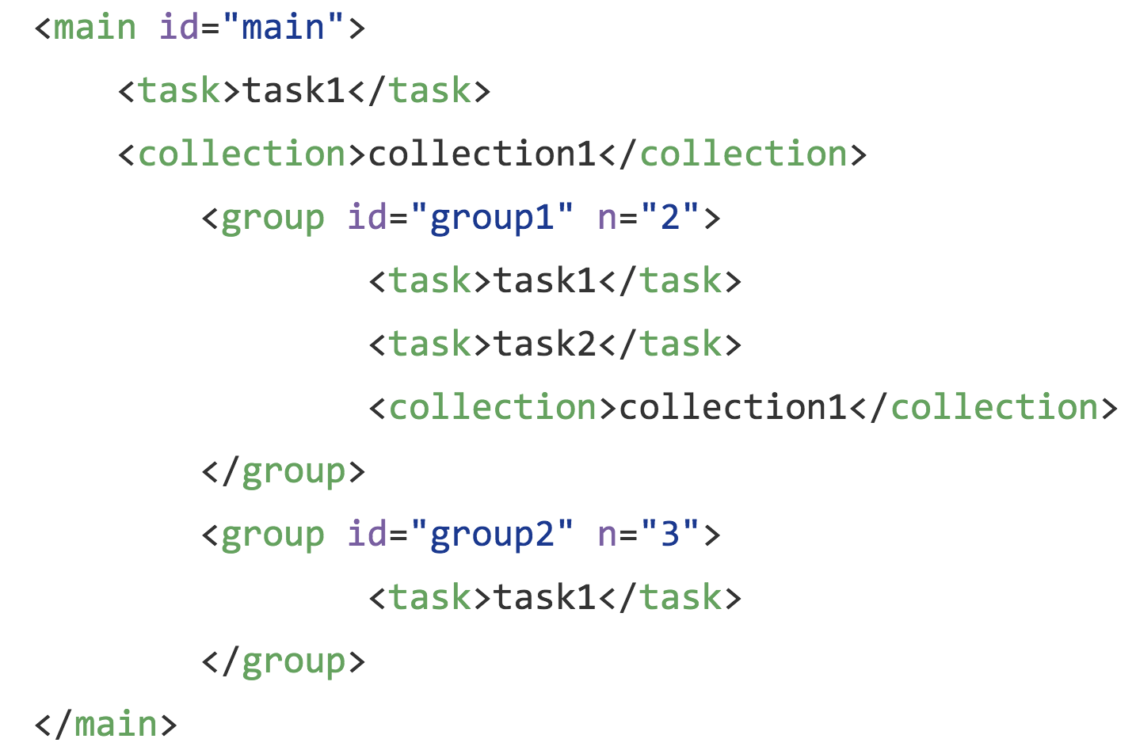
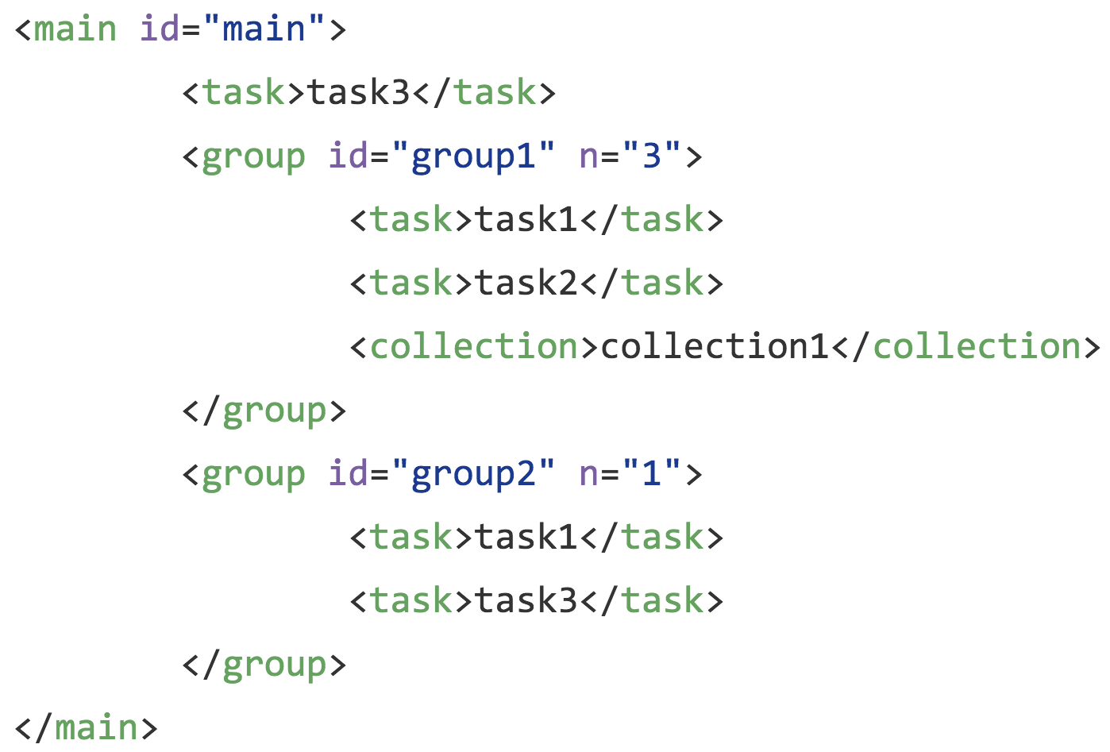
Runtime topology update [2]
32

Slide 33
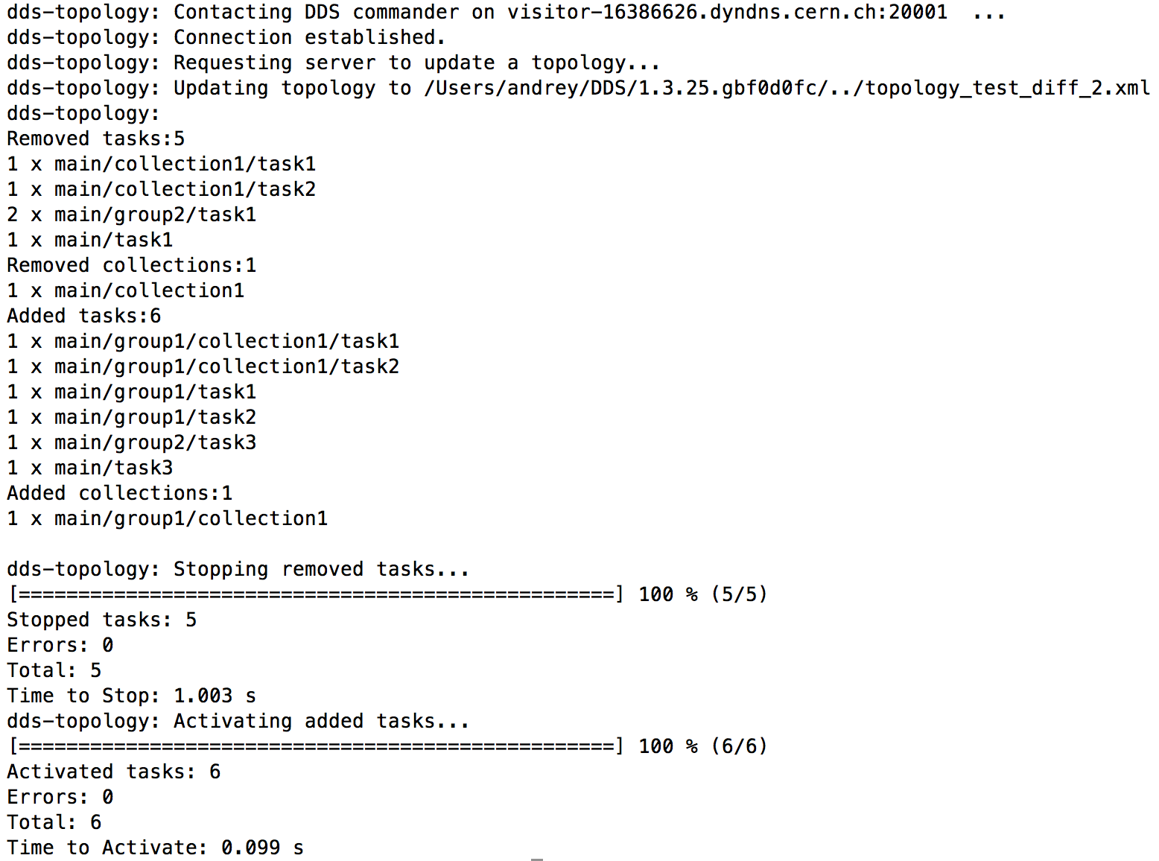
Runtime topology update [3]
dds-topology --update new_topology.xml
33

Slide 34
dds-octopus
Motivation: Growing complexity of DDS requires powerful functional tests. Unit tests can’t cover all cases. Most of issues can be only detected during run-time when multiple agents are in use.
dds-octopus: A full blown functional test machinery for DDS.
Test DDS using DDS.
dds-octopus: core components
dds-octopus-start - a steering script. Starts DDS, deploys agents and activates predefined topologies. It validates return values of all used DDS commands and timeouts on each of them.
dds-octopus-task - an executable. Acts as a regular “user” task. This the same task is part of all test topologies.
dds-octopus - an executable. Acts as external test manager. It is not a part of topology.
34

