Slide 1



CBM @ FAIR
Claudia Höhne for the CBM collaboration

Slide 2
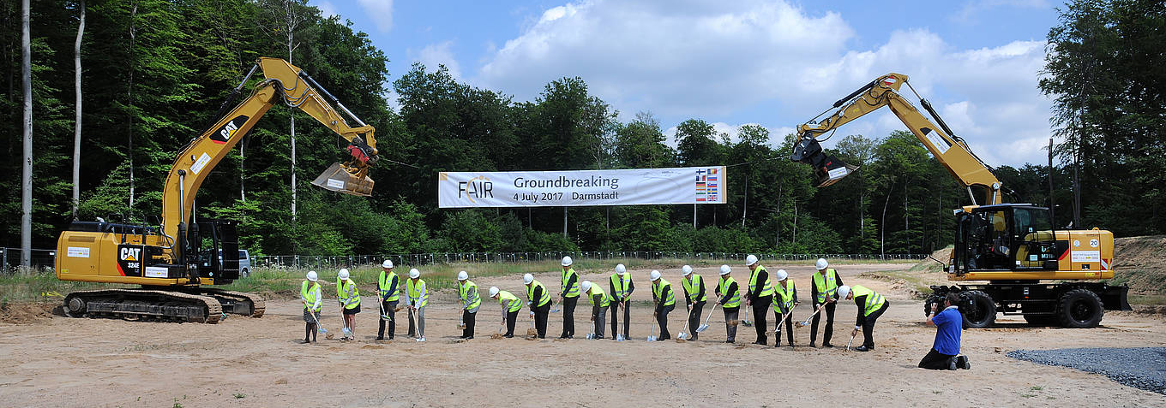
FAIR Groundbreaking ceremony July 4th, 2017
Civil construction of SIS 100 tunnel and CBM cave started
CBM will get first SIS100 beams
Detector installation/ commissioning 2021 – 2024
FAIR MSV fully operational 2025 (FAIR phase 0 from 2018 on)

Slide 3
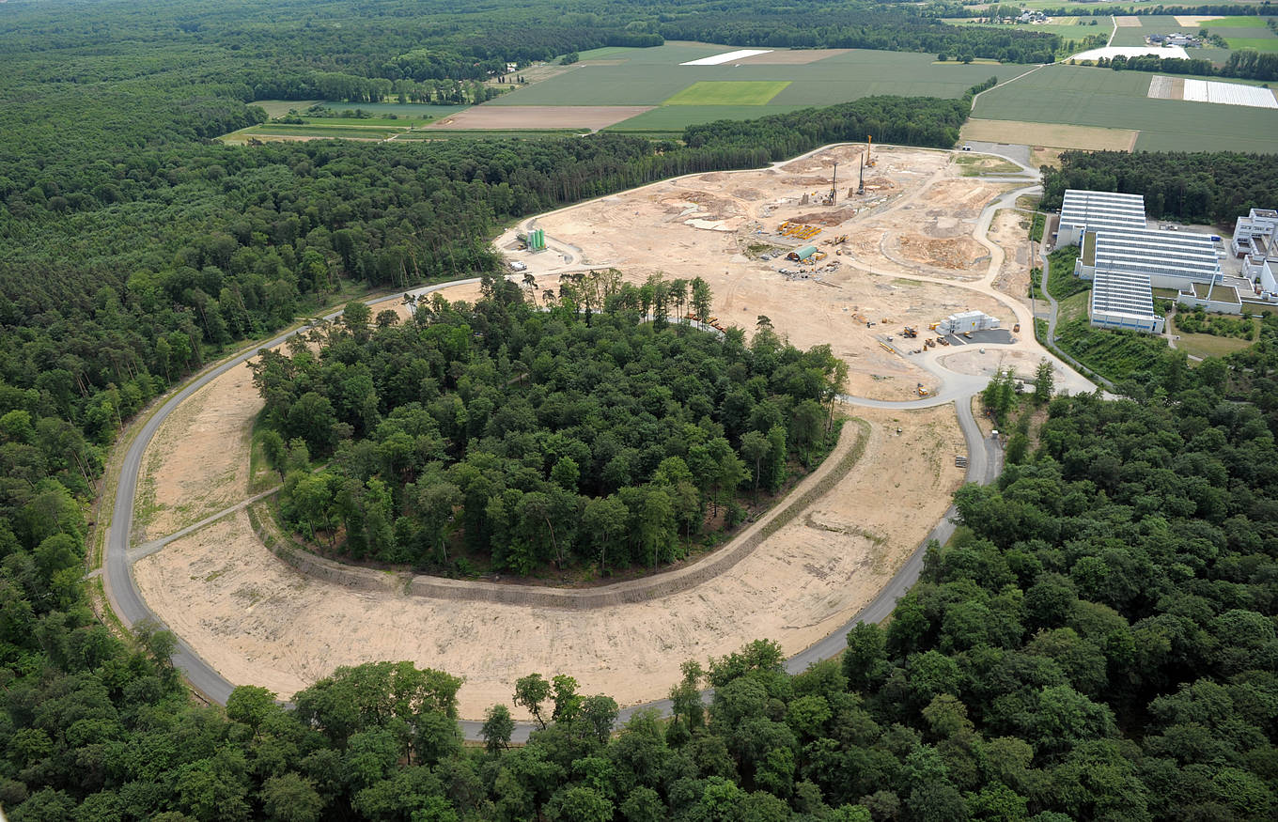
2017

Slide 4
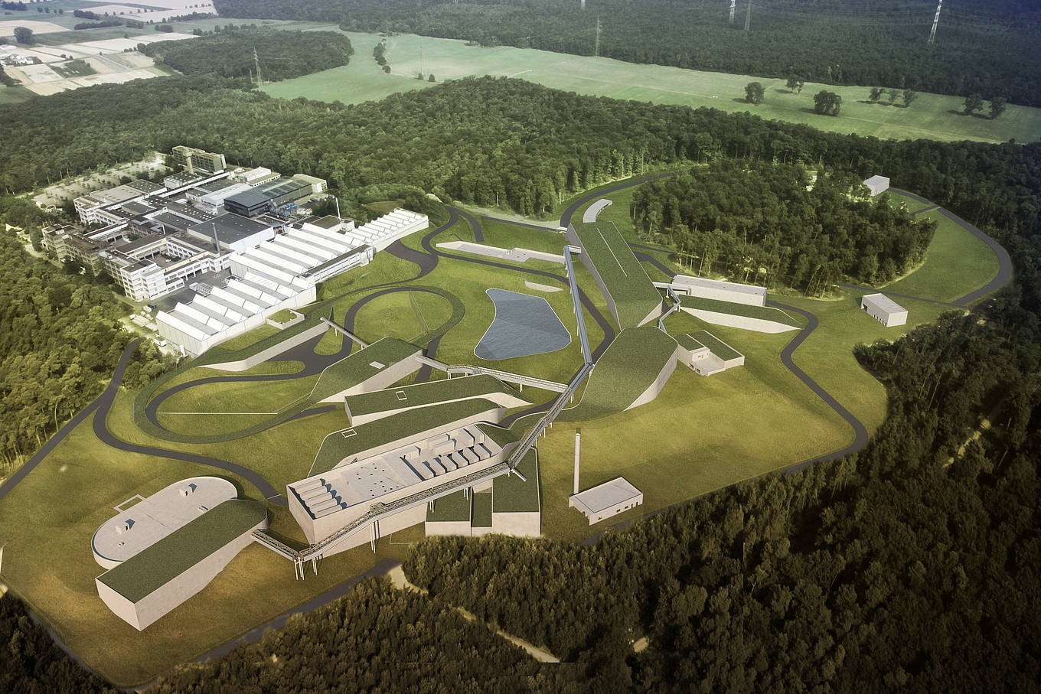
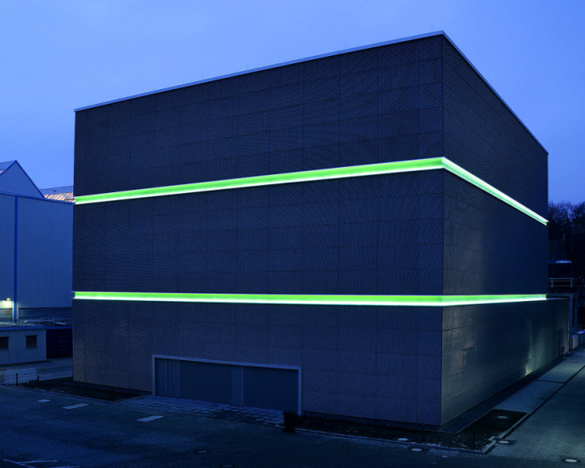
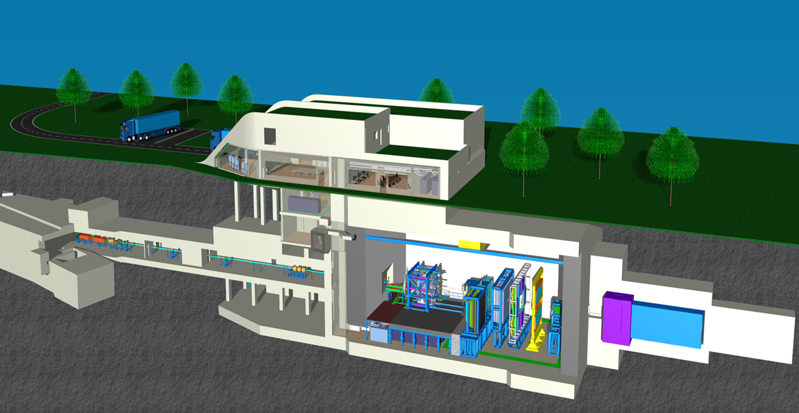
≤ 2025 !
CBM & HADES at SIS 100:
Systematic exploration of baryon dominated, high density matter in A+A collisions from 2-11 AGeV (Au+Au) beam energy with next generation experiments
HADES: mainly p+p, p+A, low material budget, 20°-85° polar angle, 20 kHz
CBM: p+A, A+A, larger material budget, 2.5°-25° polar angle, max. 10 MHz

Slide 5
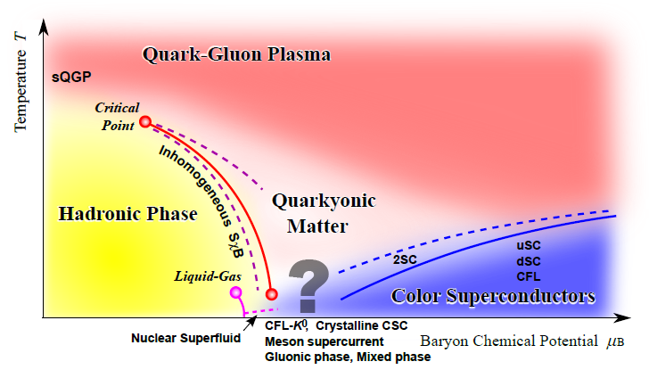
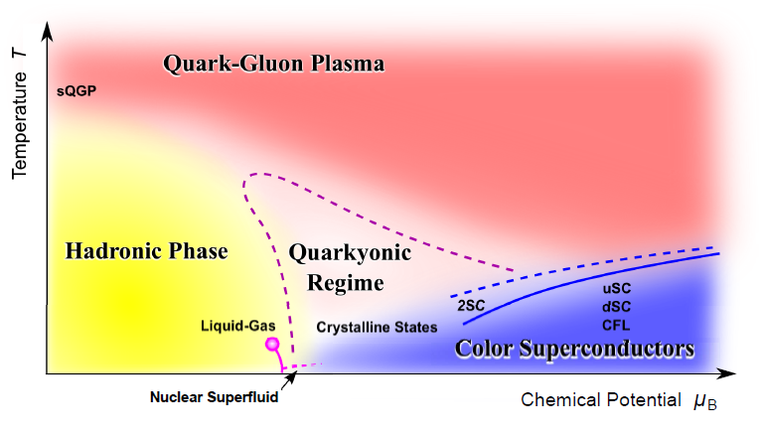
High density range of QCD phase diagram
At large µ_{b} phase structure is uncharted territory
first order phase transition at large μ_{b} ?
→ e.g. latent heat phase coexistence region ?
critical point ?
Deconfinement, chiral symmetry restoration
different forms of matter? Quarkyonic phase?
Field driven by experimental data!
Need: ~ 2-40 AGeV beam energies
(K. Fukushima, T. Hatsuda, Rept.Prog.Phys.74:014001,2011)
?
Notes:
Source: SINAP colloq, Dec.2015
Nicht mal klar, obs Phasenübergang gibt, offen sein

Slide 6
Outline
Introduction/ Motivation
Energy and baryon density reach of CBM
Physics questions & observables in CBM energy range
The CBM detector
Novel readout and data taking concept
Simulation results
FAIR phase 0 activities
Experimental preparations

Slide 7
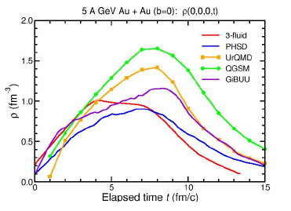
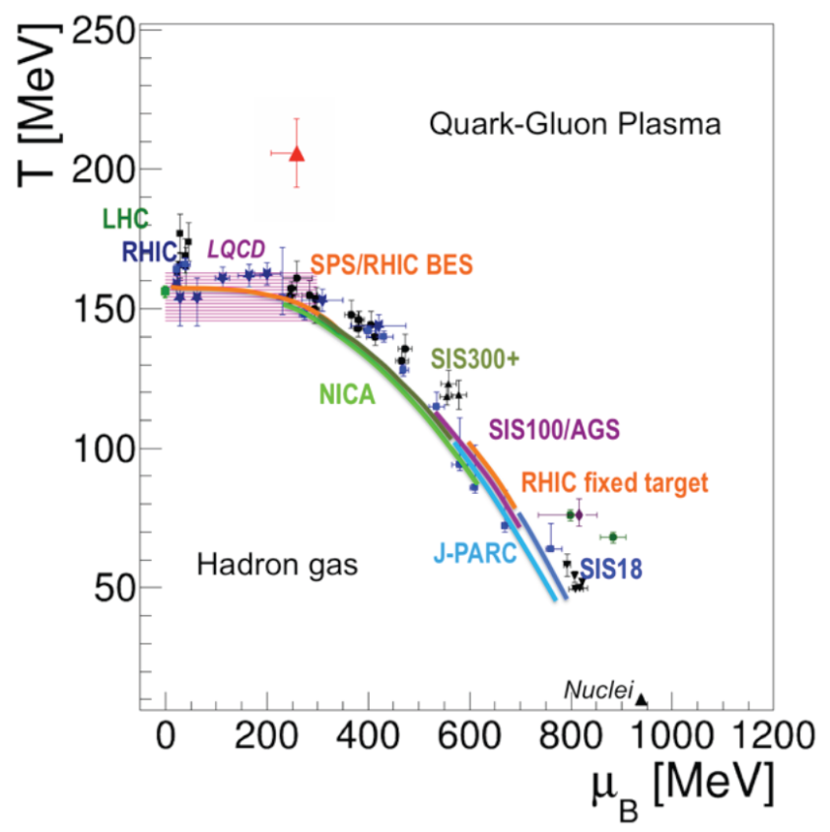
Baryon density
SIS 100 beam energy range
High net-baryon densities to be probed
Expected to persist for a few fm/c
Characteristics of matter created?
Beam | p_{lab, max} | √s_{NN, max}
heavy ions (Au) | 11A GeV | 4.7 GeV
light ions (Z/A = 0.5) | 14A GeV | 5.3 GeV
protons | 29 GeV | 7.5 GeV
5ρ₀
[CBM Physics Book]
Notes:
Interessant weil hohe Dichten!!
Inneres Neutronenstern?

Slide 8
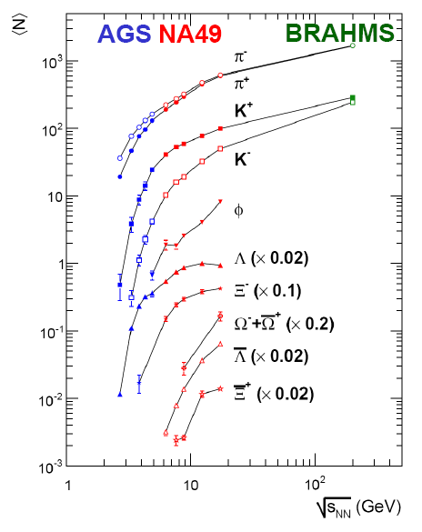
Energy dependence of strangeness production
[C. Blume, JP 31 (2005) S57]
Physics Questions
→ thermal equilibrium also for multi-s hadrons?
→ equilibrium as signature for phase transition?
→ EOS?
→ production mechanism, in particular for
multi-s hadrons??
CBM
→ yields and phase space distributions of strange
particles including Ω, Ξ, φ and antiparticles
→ flow, fluctuations
→ systematic scan of energies and system size
→ (sub)threshold production of multi-s hadrons:
sensitivity to EOS, µ_{B}?

Slide 9
Charm production
Physics Questions
→ subthreshold production of charm?
→ production mechanism?
CBM
→ excitation function of open-charm
and charmonium
UrQMD prediction of subthreshold charm production via
N* → Λ_{c} + D and N* → N +J/ψ
J. Steinheimer, A. Botvina, M. Bleicher, Phys. Rev. C 95, 014911 (2017)
9

Slide 10
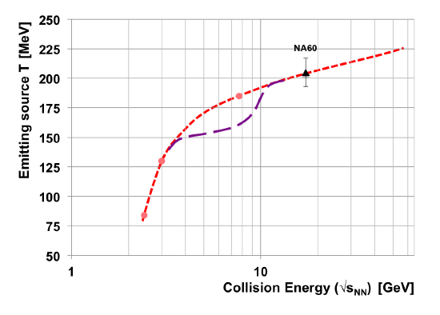
Dileptons at CBM
Physics Questions
→ phase transition
→ quarkyonic matter?
→ lifetime of dense hadonic fireball
→ in-medium properties of vector mesons
[T. Galatyuk et al., EPJA 52 (2016) 131]
?
CBM
→ yields and phase space
distributions of dileptons
→ mass range > 1 GeV to extract
thermal fireball radiation

Slide 11
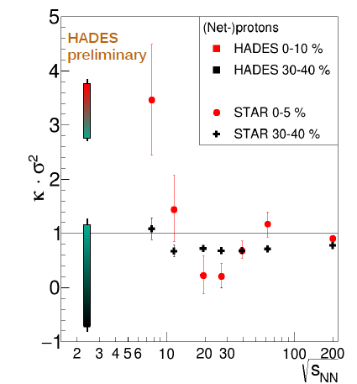
(Net-) proton number fluctuations
Physics Questions
→ phase transition?
→ order of phase transition?
→ mixed phase?
?
CBM
→ net-proton number fluctuations
→ fluctuations of conserved quantities
including strangeness
HADES: M. Lorenz, QM 2017
STAR: X. Luo et al, CPOD 2014

Slide 12
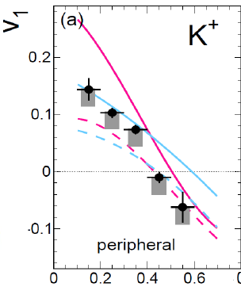
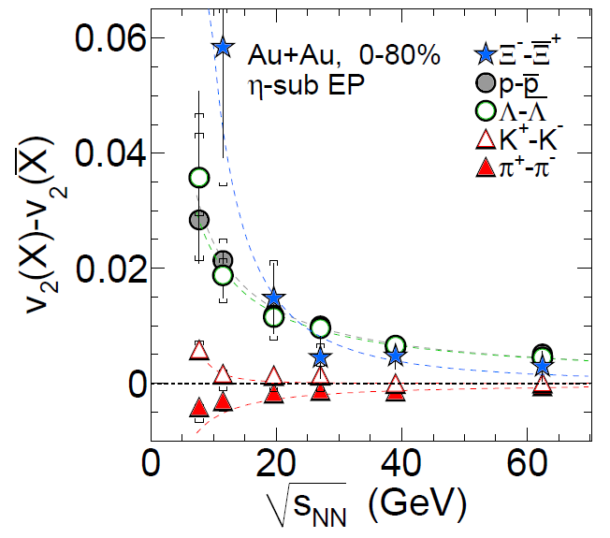
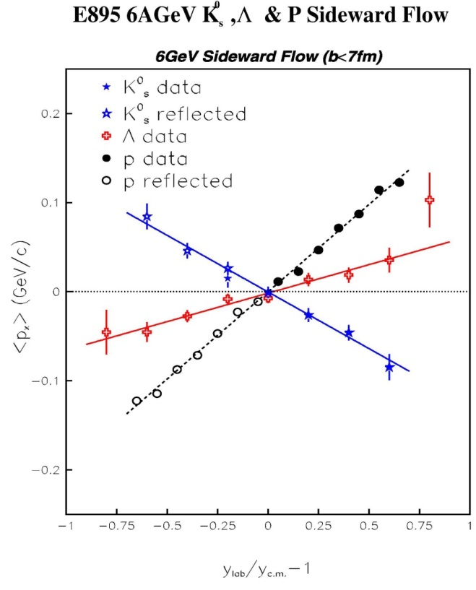

Directed and elliptic flow
Physics Questions
→ equation of state of dense matter?
→ production mechanism?
→ in-medium properties?
CBM
→ directed and elliptic flow of all
particles
→ (kaon) flow as barometer?
V.Zinyuk et al. (FOPI)
PRC 90 (2014) 025210
[STAR, PRL 110 (2013) 142301]
P. Chung et al. (E895), PRL85, 940 (2000)

Slide 13
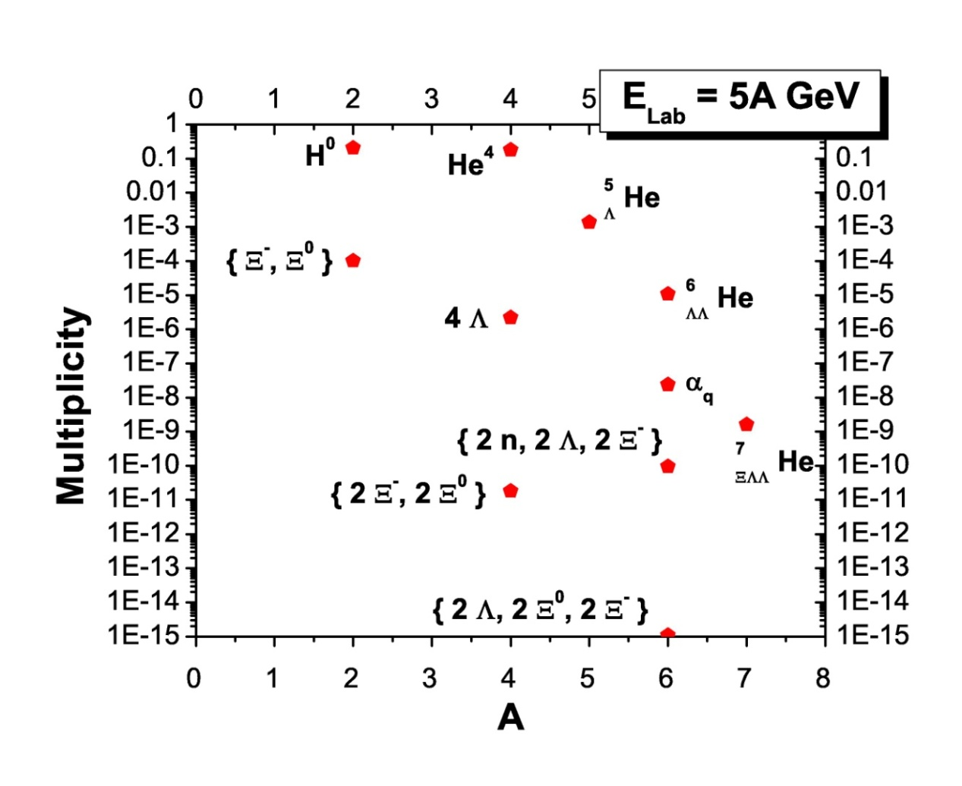

Strange baryonic bound states
Physics Questions
→ existence and yield of (exotic)
strange objects?
→ ΛΛ, NΛ interactions?
→ remnants of dense (chirally
restored? strange?) matter?
CBM
→ search for and measure strange hypernuclei and (all) other kinds of exotic strange baryons
A. Andronic, P. Braun-Munzinger, J. Stachel, H. Stöcker, Phys. Lett. B697 (2011) 203
H. Stöcker et al., Nucl. Phys. A 827 (2009) 624c
Notes:
Geht alles toll in CBM
4.8 sqrt SNN in SIS 100 – einzeichnen
ansonsten_: Vorhersagen (Stöcker) – aber keiner weiss….

Slide 14
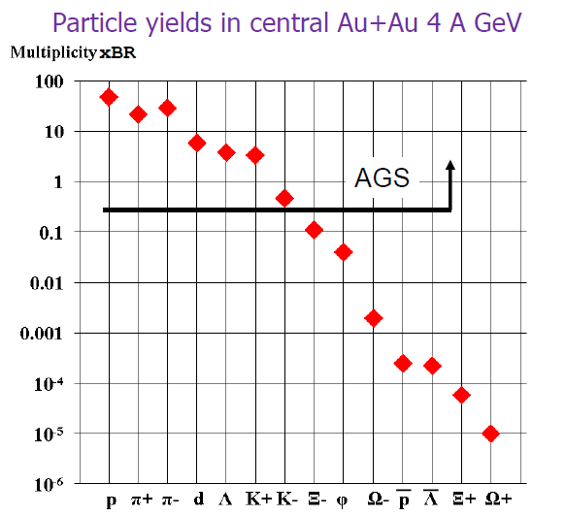
Experimental challenge
All multistrange particles are rare, not to speak of dileptons or charm ….
Yields: A. Andronic private communication, statistical model

Slide 15
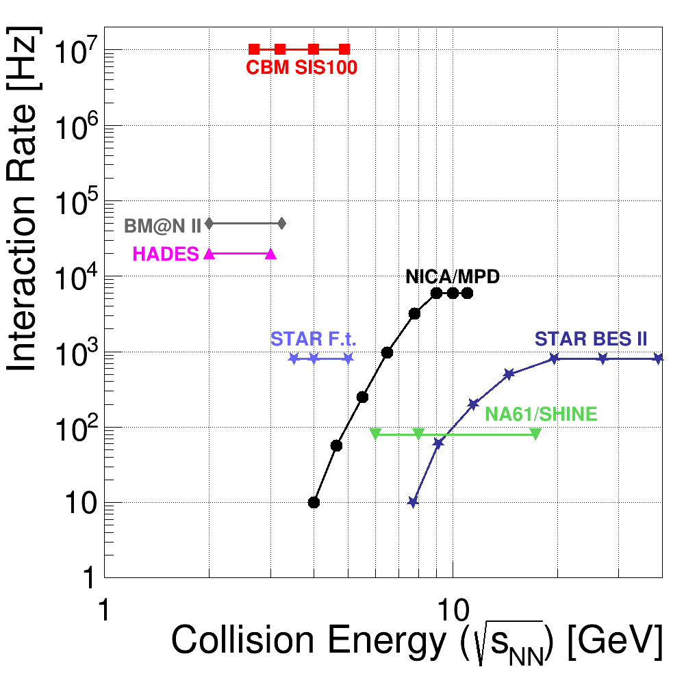
CBM – interaction rates
CBM, Eur. Phys. J. A (2017) 53: 60.
CBM:
high rate experiment!
Opens up new possibilities!
High statistics and good systematics on hadronic observables shown before:
multi-s baryons, flow,
fluctuations
Electromagnetic observables, charm production
New (exotic) observables:
kaonic clusters,
hypernuclei
!*
* Important part of CBM program, but not covered in this talk

Slide 16
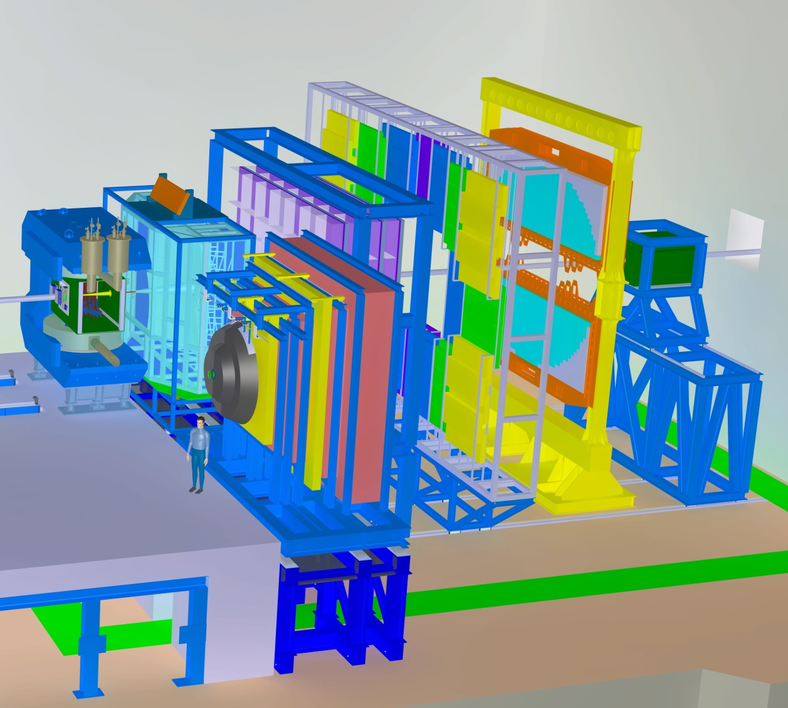

The CBM experiment at SIS 100
Tracking, momentum, V⁰: MVD+STS+dipole magnet
Event characterization: PSD
Hadron id: TOF (+TRD)
Lepton id: RICH+TRD or MUCH
γ, π⁰: EMC (or RICH)
High speed DAQ
Online event selection
STS+MVD
TOF
ECAL
TRD
RICH
magnet
PSD
350 m
Linear distance
MuCH

Slide 17
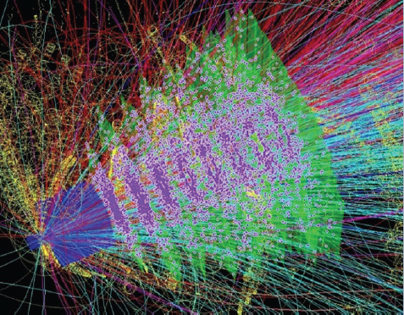
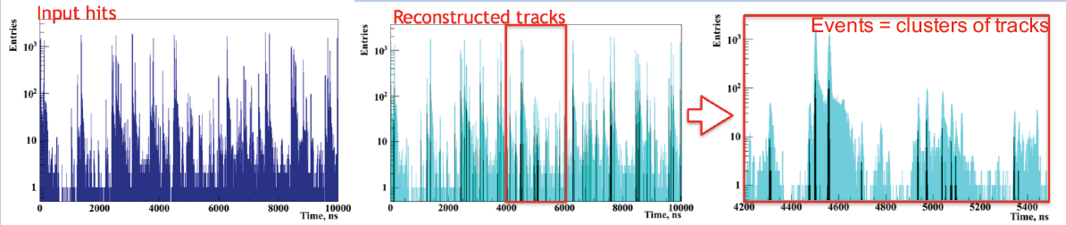
CBM readout and online systems
Novel readout system
no hardware trigger on events, free streaming triggerless data
detector hits with time stamps,
full online 4-D track and event reconstruction
Full analysis of 10 MHz event rate implemented, only very moderate losses in efficiency
Notes:
1-2 % efficiency losses in tracking, a bit more for milti-s particles
8 ms/ev
Event length ~ 7ns → 142 MHz
At 10 MHz: 80% resolved events, 14% double events, 5% triple events
1 MHz 100% resolved events

Slide 18
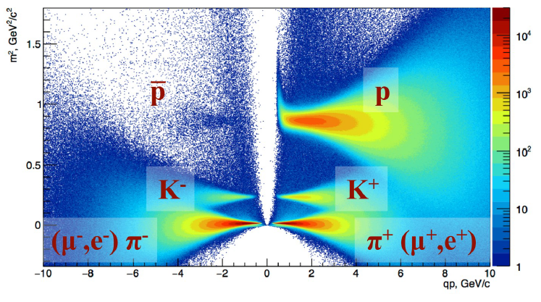
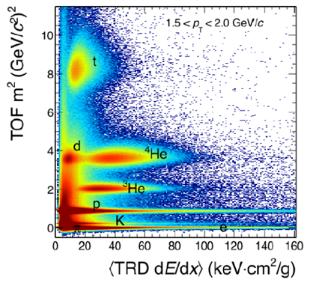
Hadron identification
Hadron identification in TOF & TRD
Add energy loss information from TRD to identify heavier fragments!
TOF
TOF + TRD

Slide 19
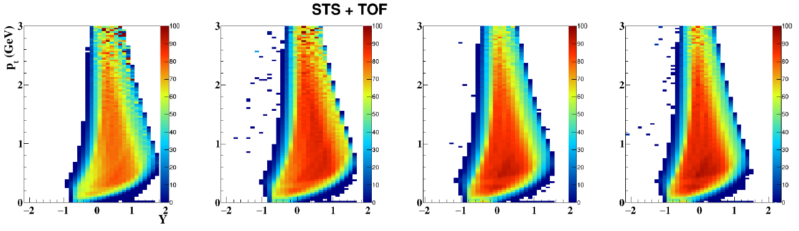
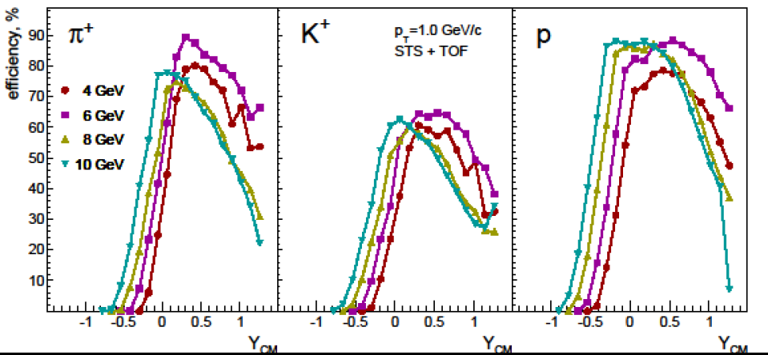
Hadron acceptance (STS + TOF)
4 AGeV
6 AGeV
8 AGeV
10 AGeV
Acceptance (STS + TOF)
for
protons in (y,pt)
π, K, p projected onto y
→ yields; also of resonances
(φ-meson!)
→ flow
→ fluctuations

Slide 20
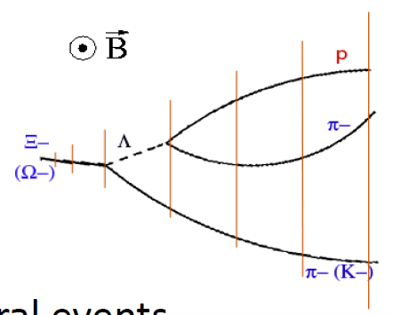
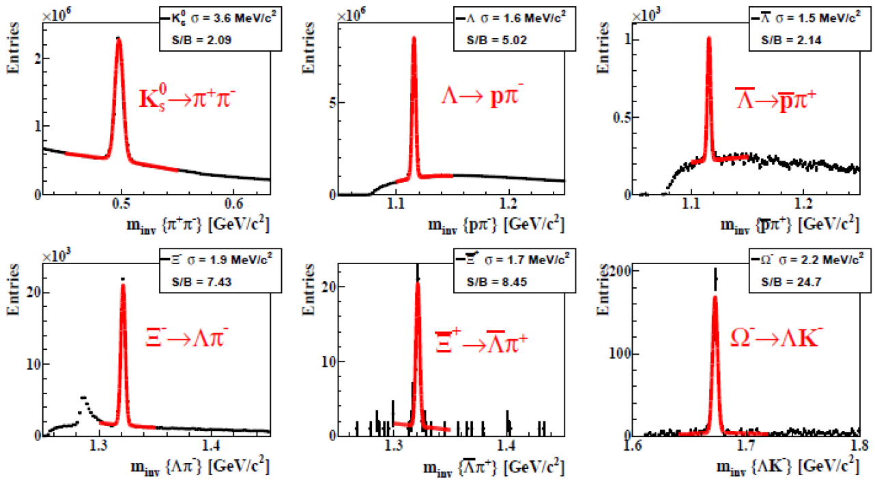
Strange baryons
Simulation: central (b=0fm) Au+Au collisions at 10 AGeV, 3.5M events
Massively parallel data reconstruction and selection in real-time
1MHz interaction rate, 10% central Au+Au collisions,
10 weeks beamtime
→ 10⁷ Ω at 6 AGeV
→ 10⁸ Ω at 10 AGeV
18% eff.
11% eff.
6% eff.
3% eff.
5% eff.

Slide 21
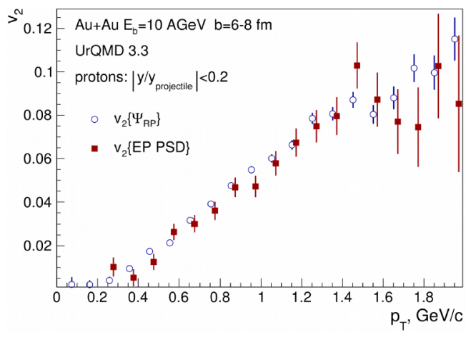
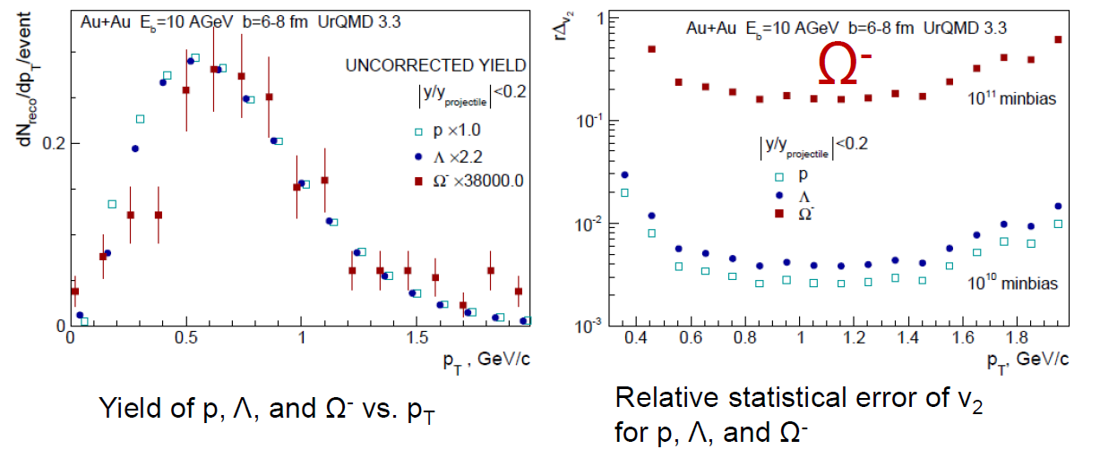
Elliptic flow v₂
Reaction plane resolution (PSD) ~30-40 degrees for mid-central Au+Au coll.
UrQMD simulation: 1M mid-central
(b=6-8 fm) Au+Au collisions:
succesfully reconstruct input proton flow
Use this and yields/ event for estimate of
relative statistical errors for p, Λ, Ω flow
in 10¹⁰ (10¹¹) minbias Au+Au events
250 kHz minbias Au+Au → 2·10¹⁰ ev/day
Notes:
Event plane resolution with PSD: 30-40 degrees

Slide 22
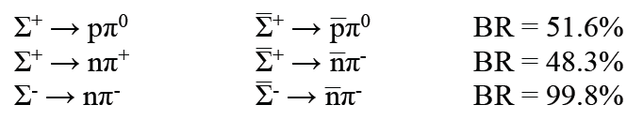
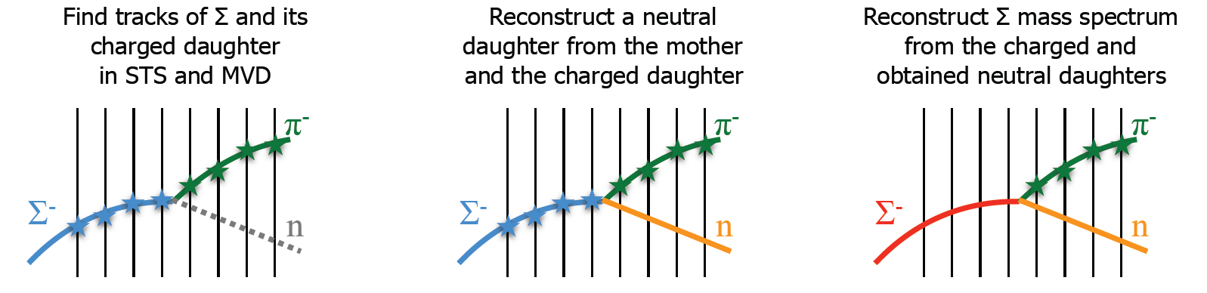
Strange particle production: Σ⁺ & Σ⁻
NEW: Identification of Σ⁺ and Σ⁻ via their decay topology
Method:
  Find all primary and secondary tracks, use TOF PID for secondary track
  Search whether two would fit together with a kink
  From momentum conservation get momentum of neutral particle
  Assume e.g. Σ⁻ decay, calculate (missing) mass of neutral particle
  Select neutron candidates, recalculate Σ mass

Slide 23
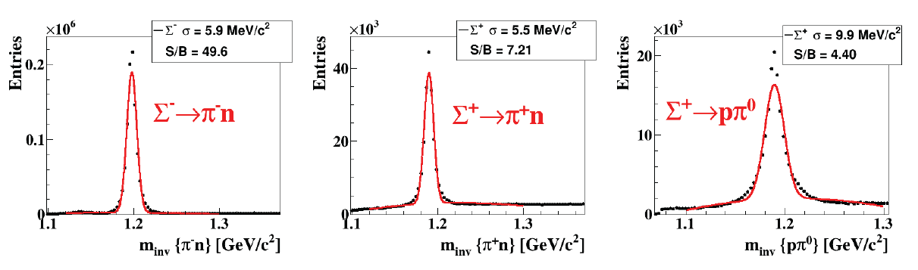
Strange particle production: Σ⁺ & Σ⁻
Simulations: UrQMD, 5M central collisions Au+Au, 10 AGeV beam energy
Method also applicable for
  Anti-Σ
  K± → π⁰ + π±
Total (4π) efficiency ~(1-3)%
Remark:
Che-Ming Ko (Tuesday):
Symmetry energy effect on Σ⁻/Σ⁺ ratio

Slide 24
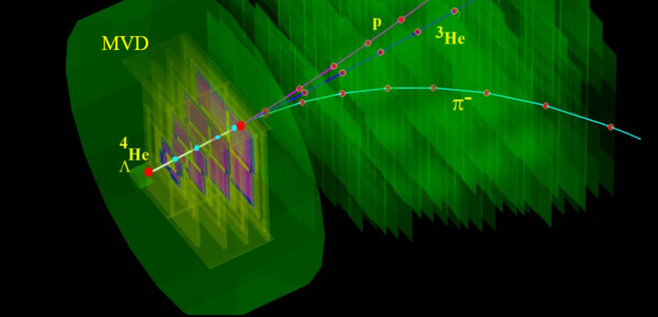
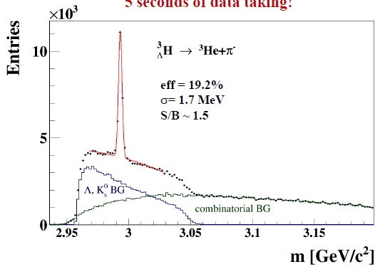
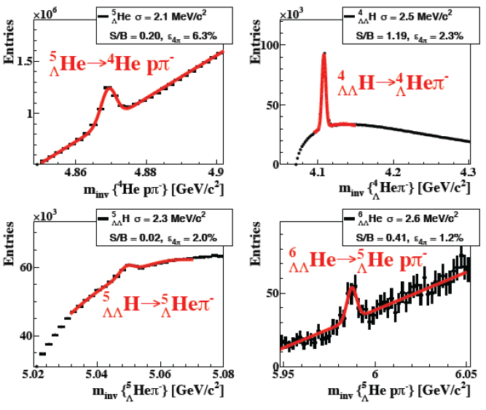
Hypernuclei
Simulations: UrQMD, 5M central collisions Au+Au, 10 AGeV beam energy
Simulations: UrQMD, 10¹² events, central collisions Au+Au, 10 AGeV beam energy

Slide 25
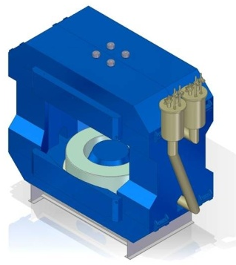
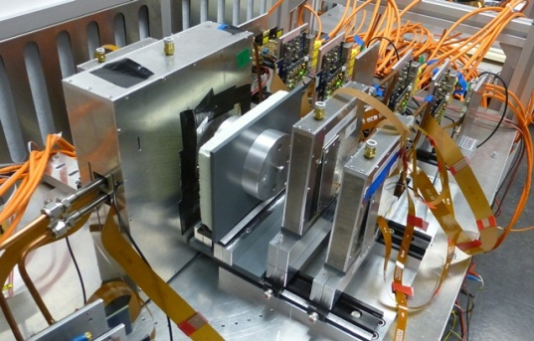
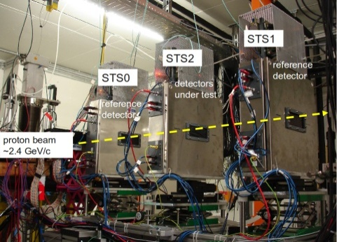
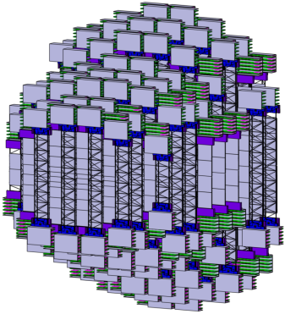
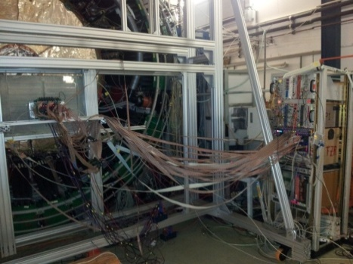
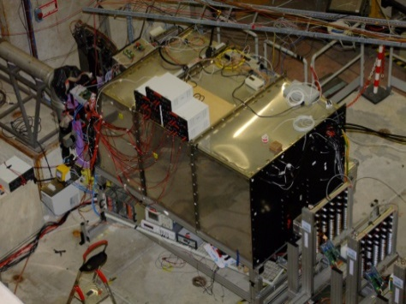
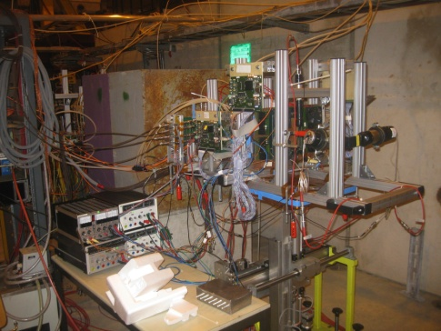
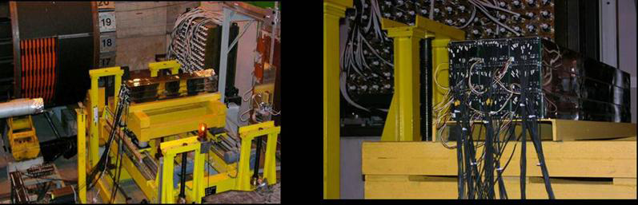
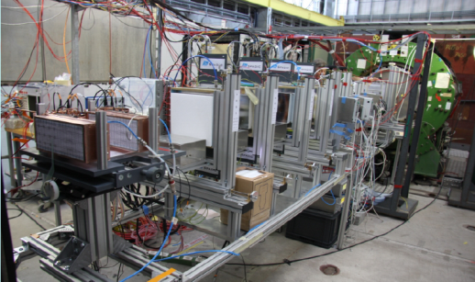
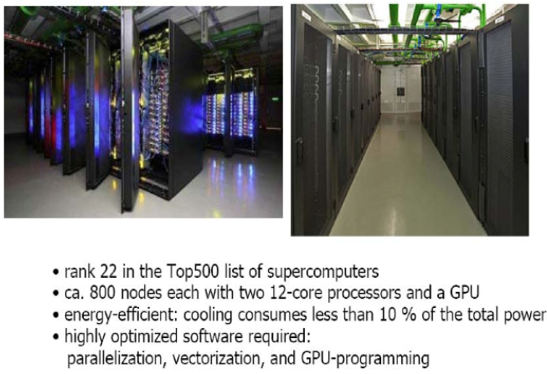
CBM Technical Developments
SC Magnet: JINR Dubna
Micro-Vertex Detector:
Frankfurt, Strasbourg
Silicon Tracking System: Darmstadt, Dubna, Krakow, Kiev, Kharkov, Moscow, St. Petersburg, Tübingen
MRPC ToF Wall: Beijing, Bucharest, Darmstadt, Frankfurt, Hefei, Heidelberg, Moscow, Rossendorf, Wuhan, Zagreb
RICH Detector:
Darmstadt, Giessen,
St. Petersburg, Wuppertal
Muon detector:
Kolkata + 13 Indian Inst., Gatchina, Dubna
Transition Radiation Detector:
Bucharest, Frankfurt, Heidelberg, Münster
Forward calorimeter:
Moscow, Prague, Rez
DAQ and online event selection:
Darmstadt, Frankfurt, Kharagpur, Warsaw

Slide 26
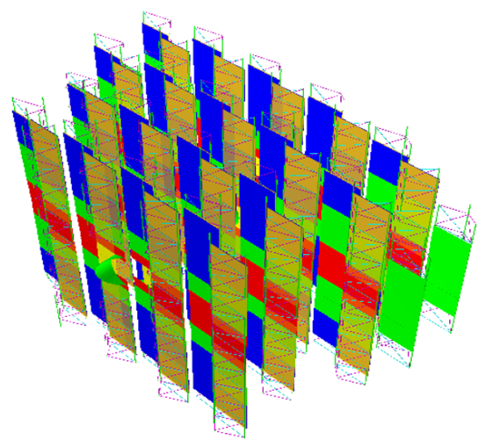
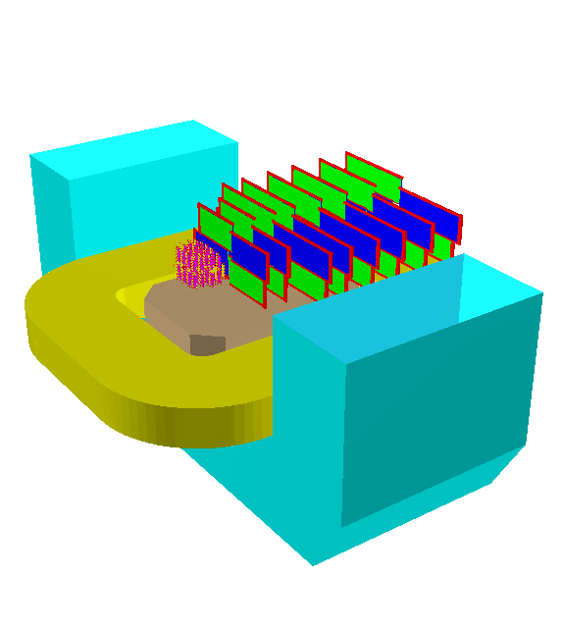
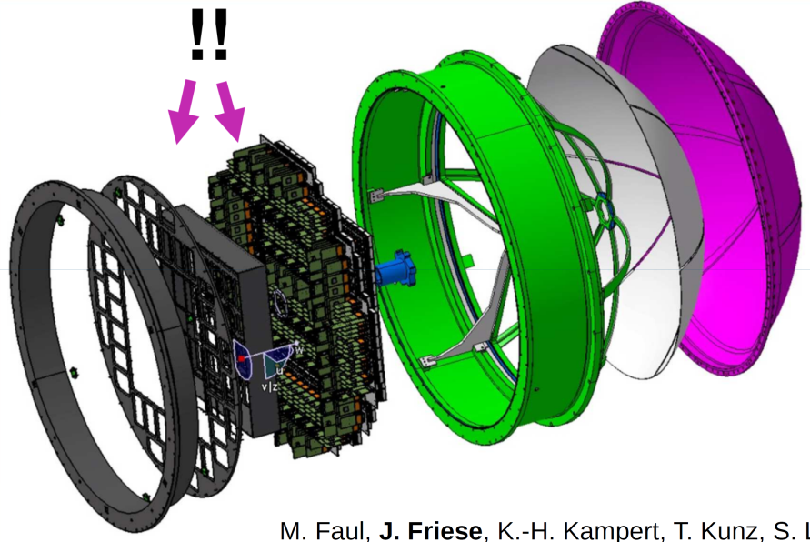
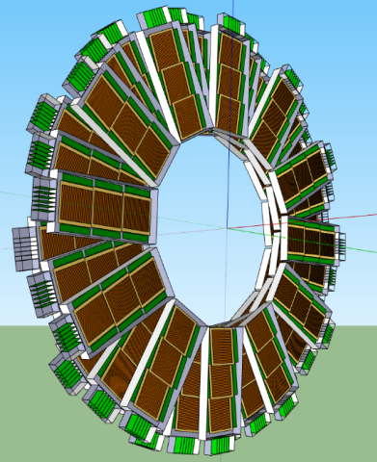
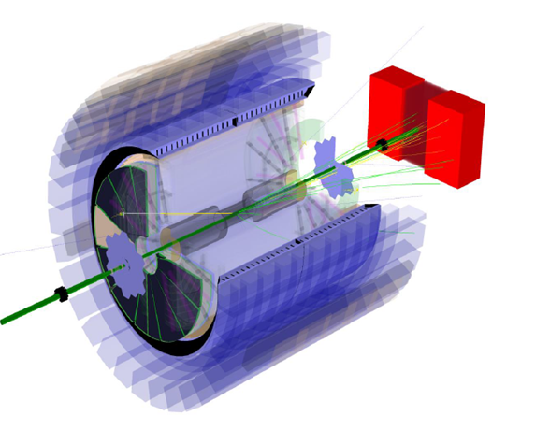
FAIR phase 0 experiments
Install, commission and use CBM detector components in ongoing (starting) physics campaigns
4 STS stations in BM@N experiment at Dubna
40% of the RICH MAPMTs and electronics in HADES RICH for SIS 18
10% of the TOF detector moduls including readout in STAR at RHIC for BESII

Slide 27



mCBM
Beamtime proposal for „miniCBM“ at GSI handed in:
using prototype detectors of CBM in order
to test/ establish self-triggered read-out,
data transfer to FLES, event building,
online analysis
CBM readout chain, start-up phase
10⁸ minbias UrQMD collisions, 1,93 AGeV Ni+Ni
Technical goal: 10 s data taking

Slide 28



HADES RICH upgrade
HADES RICH detector in operation since more than 10 years
Reduced performance over years
→ replace by CBM-RICH MAPMTs and gain a huge factor in e-PID
HADES beamtime proposal:
CB subtracted e⁺e⁻ mass spectrum
for 5·10⁹ events (4 weeks beamtime)
Simulation and reconstruction of single/ double rings
Preparation of new photondetector plane

Slide 29


Conclusion/ Summary
Daniel Cebra, Tuesday morning:
✓
✓
✓
✓
CBM, Eur. Phys. J. A (2017) 53: 60.
CBM
→ phase structure will not be revealed by a single measurement – need
systematic studies!
→ systematic studies with sufficient statistics: strangeness, em probes, charm
→ CBM well advanced with respect to FAIR timeline, 7 out of 11 TDRs accepted,
start version 90% financed
→ exciting FAIR phase-0 activities!

Slide 30


The CBM collaboration
Croatia:
Split Univ.
China:
CCNU Wuhan
Tsinghua Univ.
USTC Hefei
CTGU Yichang
Czech Republic:
CAS, Rez
Techn. Univ.Prague
France:
IPHC Strasbourg
Hungary:
KFKI Budapest
Budapest Univ.
Germany:
Darmstadt TU
FAIR
Frankfurt Univ. IKF
Frankfurt Univ. FIAS Frankfurt Univ. ICS
GSI Darmstadt
Giessen Univ.
Heidelberg Univ. P.I.
Heidelberg Univ. ZITI
HZ Dresden-Rossendorf
KIT Karlsruhe
Münster Univ.
Tübingen Univ.
Wuppertal Univ.
ZIB Berlin
India:
Aligarh Muslim Univ.
Bose Inst. Kolkata
Panjab Univ.
Rajasthan Univ.
Univ. of Jammu
Univ. of Kashmir
Univ. of Calcutta
B.H. Univ. Varanasi
VECC Kolkata
IOP Bhubaneswar
IIT Kharagpur
IIT Indore
Gauhati Univ.
Korea:
Pusan Nat. Univ.
Poland:
AGH Krakow
Jag. Univ. Krakow
Silesia Univ. Katowice
Warsaw Univ.
Warsaw TU
Romania:
NIPNE Bucharest
Univ. Bucharest
Russia:
IHEP Protvino
INR Troitzk
ITEP Moscow
Kurchatov Inst., Moscow
LHEP, JINR Dubna
LIT, JINR Dubna
MEPHI Moscow
PNPI Gatchina
SINP MSU, Moscow
St. Petersburg P. Univ.
Ioffe Phys.-Tech. Inst. St. Pb.
Ukraine:
T. Shevchenko Univ. Kiev
Kiev Inst. Nucl. Research
26th CBM Collaboration meeting in Prague, CZ
14 -18 Sept. 2015
60 institutions, > 500 members

Slide 32
Particle yields based on HSD calculations
10% most central Au+Au collisions at 6 and 10 A GeV
Particle (mass MeV/c²) | Multi- plicity 6 A GeV | Multi- plicity 10 A GeV | decay mode | BR | ε (%) | yield (s⁻¹) 6 A GeV | yield (s⁻¹) 10 A GeV | yield in 10 weeks 6 A GeV | yield in 10 weeks 10 A GeV | IR MHz
K⁺ (494) | 12.5 | 20 | - | - | 31 | 3.9·10⁵ | 6.2·10⁵ | 2.4·10¹² | 3.7·10¹² | 1
K⁻ (494) | 1.4 | 3 | - | - | 27 | 3.8·10⁴ | 8.1·10⁴ | 2.3·10¹¹ | 4.8·10¹¹ | 1
ρ (770) | 5 | 9 | L⁺L⁻ | 4.7·10⁻⁵ | 4.6 | 1.1 | 2.0 | 6.5·10⁶ | 1.2·10⁷ | 1
ω (782) | 3.3 | 6 | L⁺L⁻ | 7.1·10⁻⁵ | 5.2 | 1.2 | 2.2 | 7.4·10⁶ | 1.3·10⁷ | 1
φ (1020) | 0.07 | 0.12 | L⁺L⁻ | 3·10⁻⁴ | 6.0 | 1.3·10⁻¹ | 2.2·10⁻¹ | 7.6·10⁵ | 1.3·10⁶ | 1
Λ (1115) | 10.4 | 17.4 | pπ⁻ | 0.64 | 18 | 1.2·10⁵ | 2.0·10⁵ | 7.2·10¹¹ | 1.2·10¹² | 1
͞Λ (1115) | 4.6·10⁻⁴ | 0.034 | ͞pπ⁺ | 0.64 | 11 | 1.1 | 81.3 | 6.6·10⁶ | 2.2·10⁸ | 10
Ξ⁻ (1321) | 0.054 | 0.222 | Λπ⁻ | 1 | 6 | 3.2·10³ | 1.3·10⁴ | 1.9·10¹⁰ | 7.8·10¹⁰ | 10
Ξ⁺ (1321) | 3.0·10⁻⁵ | 5.4·10⁻⁴ | Λπ⁺ | 1 | 3.3 | 9.9·10⁻¹ | 17.8 | 5.9·10⁶ | 1.1·10⁸ | 10
Ω⁻ (1672) | 5.8·10⁻⁴ | 5.6·10⁻³ | ΛK⁻ | 0.68 | 5 | 17 | 164 | 1.0·10⁸ | 9.6·10⁸ | 10
Ω⁺ (1672) | - | 7·10⁻⁵ | ΛK⁺ | 0.68 | 3 | - | 0.86 | - | 5.2·10⁶ | 10
J/ψ (3097) | ⁻ | 1.74·10⁻⁷ | L⁺L⁻ | 0.06 | 5 | - | 5.2·10⁻⁴ | - | 3100 | 10
³ _{Λ}H (2993) | 4.2·10⁻² | 3.8·10⁻² | ³Heπ⁻ | 0.25 | 19.2 | 2·10³ | 1.8·10³ | 1.2·10¹⁰ | 1.1·10¹⁰ | 10
⁴_{Λ}He (3930) | 2.4·10⁻³ | 1.9·10⁻³ | ³Hepπ⁻ | 0.32 | 14.7 | 110 | 87 | 6.6·10⁸ | 5.2·10⁸ | 10
p + A collisions at 20 and 30 GeV
Particle (mass MeV/c²) | Multi- plicity 20 GeV | Multi- plicity 30 GeV | decay mode | BR | ε (%) | yield (s⁻¹) 20 GeV | yield (s⁻¹) 30 GeV | yield in 10 weeks 20 GeV | yield in 10 weeks 30 GeV | IR MHz
D± (1869) | 3.4·10⁻⁷ | 1.3·10⁻⁶ | K⁺π⁻π⁻ | 0.09 | 13 | 4.0·10⁻² | 1.5·10⁻¹ | 2.4·10⁵ | 9.2·10⁵ | 10
D⁰ (1865) | 5.1·10⁻⁷ | 2.0·10⁻⁶ | K⁺π⁻π⁻π⁺ | 0.08 | 2 | 8.2·10⁻³ | 3.2·10⁻² | 4.9·10⁴ | 1.9·10⁵ | 10
J/ψ (3097) | 7.5·10⁻⁸ | 2.9·10⁻⁶ | L⁺L⁻ | 0.06 | 5 | 2.3·10⁻³ | 8.7·10⁻² | 1.4·10⁴ | 5.2·10⁵ | 10

Slide 33

Online particle identification
Fast (online) reconstruction of all resonances available
use excellent tracking of STS + MVD: secondary vertex finding

Slide 34
Heavy – Ion Collisions
Hadrons:
In final state: thermalized?
From „before“:
relicts from high density phase still carrying information on this phase?
Penetrating probes: … not this talk …
Hard probes
(initial state)
Penetrating probes
(integrate over collision history)
“Relicts”
(produced in dense phase)
Freeze-out
(final state particles)
Thermalized (?) hadrons
Notes:
Signale?
Hadronen – Endzustand: thermalisiert? Was sind Argumente dafür
Manche Hadronen auch sensitiv auf frühe Phase: „relicts“: multi-s: die auch sensitiv auf mu_B; aber: rescattering?
Penetrating! --- 2te Schiene auch in CBM, aber hier nicht Thema

Slide 35

Baryon – Strangeness – Correlation
CBM
→ Compare _{Λ}t/³He production to Λ/p:
Local correlation between baryon number and strangeness
→ sensitivity to deconfinement!
S. Zhang et al., Phys.Lett. B684, 224 (2010)
Notes:
Was könnte man mit 3H machen?
Sensitivität auf deconfinemtn?
FOPI wäre bei s. letzte Zeile

Slide 36

Dileptons at CBM
Photons: access to early temperatures
→ excitation function?
Low-mass vector mesons: in-medium properties of ρ
→ strength due to coupling to baryons (see HADES)
→ go to real dense matter!
Intermediate range: access to thermal fireball radiation:
QGP, 4π- or ρ-a₁ chiral mixing
→ quarkyonic phase?
J/ψ: charm as a probe for dense baryonic / partonic matter
→ propagation of charm?
→ distribution amongst hadrons?
!
Central Au+Au collisions, 25 AGeV

Slide 37

Dileptons at CBM
Photons: access to early temperatures
→ excitation function?
Low-mass vector mesons: in-medium properties of ρ
→ strength due to coupling to baryons (see HADES)
→ go to real dense matter!
Intermediate range: acces to fireball radiation (see NA60): QGP, 4π- or ρ-a₁ chiral mixing
→ quarkyonic phase?
J/ψ: charm as a probe for dense baryonic / partonic matter
→ propagation of charm?
→ distribution amongst hadrons?
[Rapp, Hees, PLB 753 (2016) 586]
?
Caloric curve?

