Slide 1
High rate time of flight system
for FAIR-CBM
Wang Yi for CBM-TOF group
Department of Engineering Physics, Tsinghua University
International conference on technology and instrumentation in particle physics, May 22-26,
Beijing

Slide 2
Outline
Introduction on FAIR and CBM-TOF
Structure of CBM-TOF
Development of low resistive glass
Design of strip-MRPC and pad-MRPC
Beam test @GSI and SPS
Conclusions

Slide 3
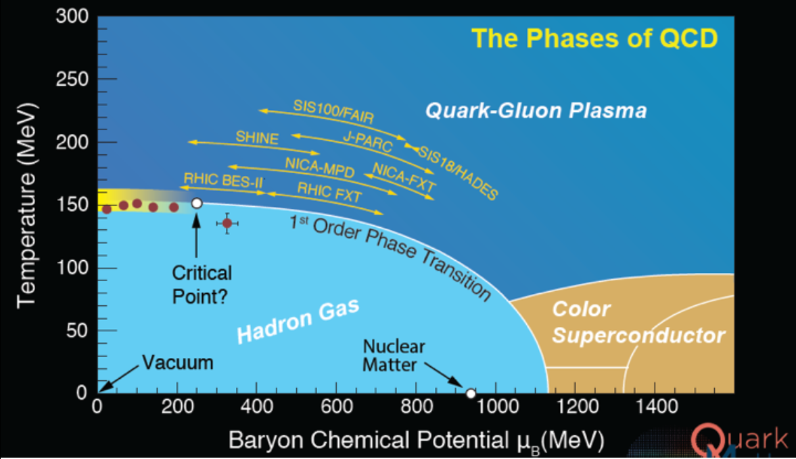
The phase diagram of strongly interacting matter

Slide 4
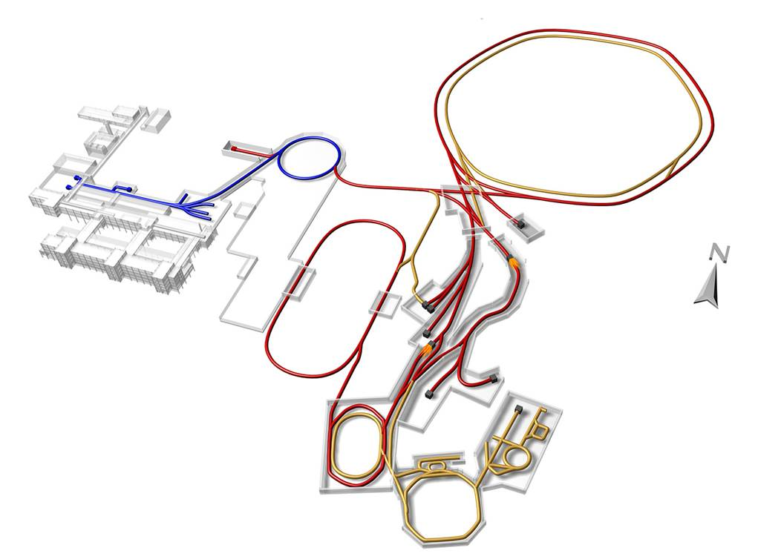
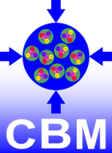
Facility for Antiproton and Ion Research
SIS18
SIS100/300
p-Linac
Atomic, Plasma, Applied Physics
Compressed Baryonic Matter
HESR
Primary Beams
Anti-Proton Physics
Super Fragment-Separator:
Nuclear Structure and Astrophysics
10¹²/s; 1.5 GeV/u; ²³⁸U²⁸⁺
10¹⁰/s ²³⁸U⁷³⁺ up to 35 GeV/u
3x10¹³/s 30 GeV protons
Secondary Beams
CR
range of radioactive beams up to 1.5 - 2 GeV/u; up to factor 10 000 higher in intensity than presently
antiprotons 3 - 30 GeV
FAIR phase 1
FAIR phase 2
100 m

Slide 5
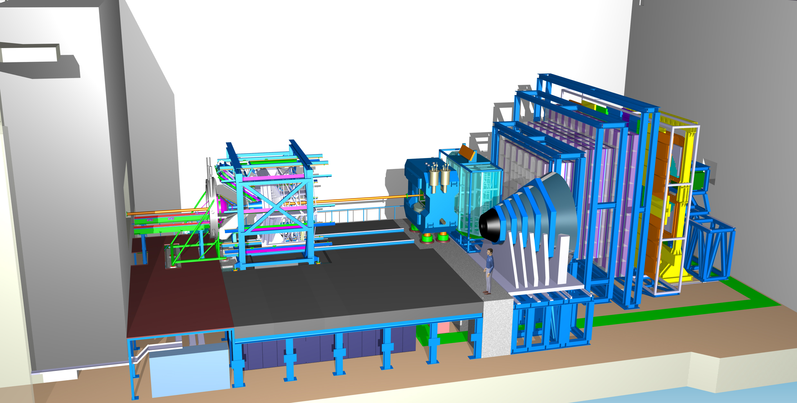
Layout of CBM detector
Ring
Imaging
Cherenkov
Time of Flight
Silicon
Tracking
System
Dipol
Magnet
Transition
Radiation
Detector
(SIS100)
Micro
Vertex
Detector
DAQ/FLES HPC cluster
(SIS100)
Projectile
Spectator
Detector
Muon
Detector
(SIS100)

Slide 6
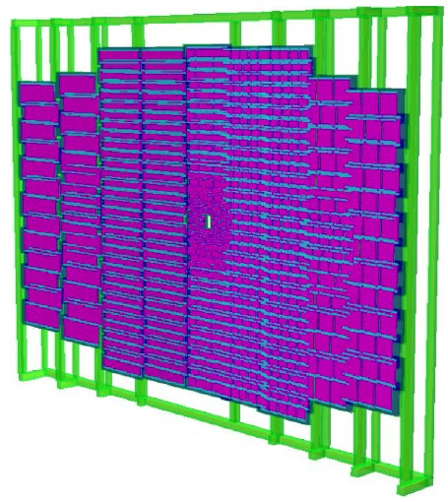
The structure of CBM-TOF wall
CBM-ToF Requirements
Full system time resolution σ_{T} ~ 80 ps
Efficiency > 95 %
Rate capability ≤ 30 kHz/cm²
Polar angular range 2.5°– 25°
Occupancy < 5 %
Low power electronics
(~100.000 channels)
Free streaming data acquisition
Au+Au, Center, 10AGeV
Simulated with CBM ROOT

Slide 7
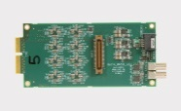
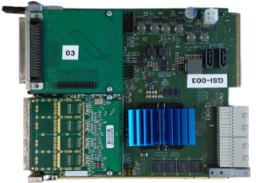
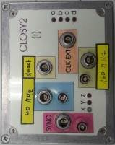
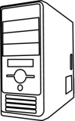
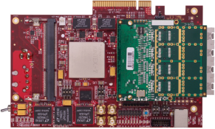
Electronics & Readout chain
MRPC
2
3
MRPC
MRPC
MRPC
CAVE
CBM CLK (40MHz)
Example for 192 Channel
ToF CLK (160MHz)
Counting-Room
ToF SYNC Signal
Optic (~50m)

Slide 8
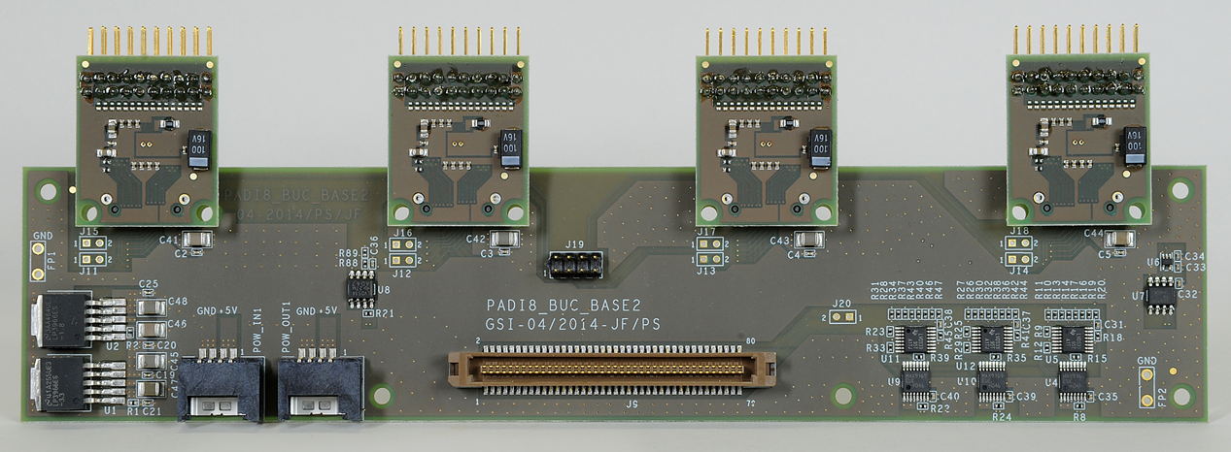
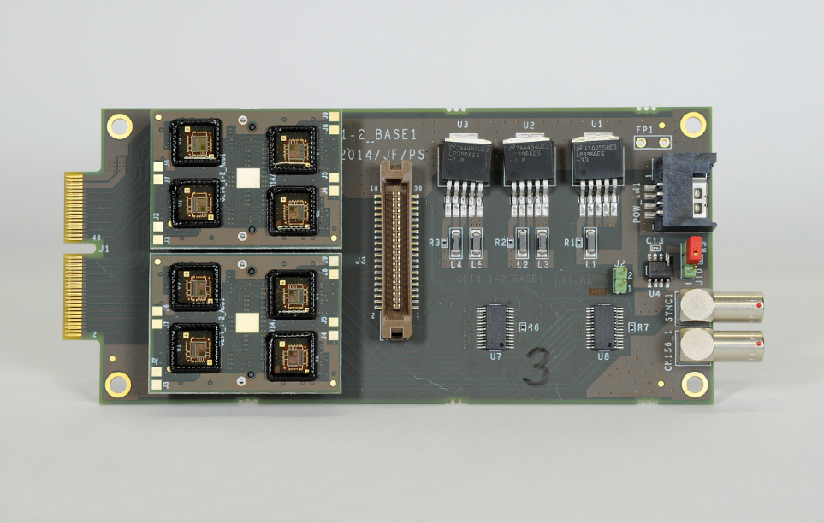
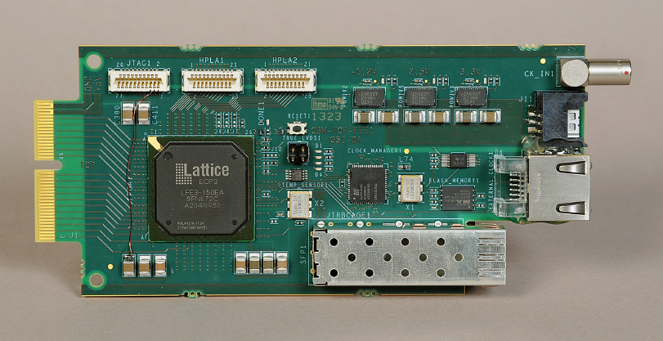
TOF electronics
Padi8
GET4
FPGA - TDC

Slide 9
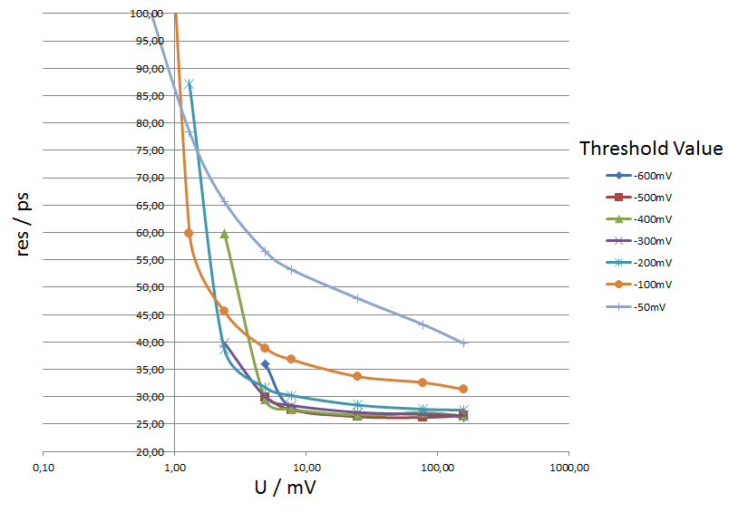
Pulser test of PADIX & GET4
Precision between two channels
PADI X & GET4 V1.23
below 30ps
below 30ps
below 30ps

Slide 10
How to increase rate of MRPC
The voltage drop in the gas gap:
The smaller the voltage drop, the higher efficiency and higher rate capability!
Two main ways to improve rate capability:
Reducing bulky resistivity of electrode glass (CBM)
Reducing the avalanche charge (ATLAS)
Other methods:
Reducing the thickness of glass
Warming the detector

Slide 11
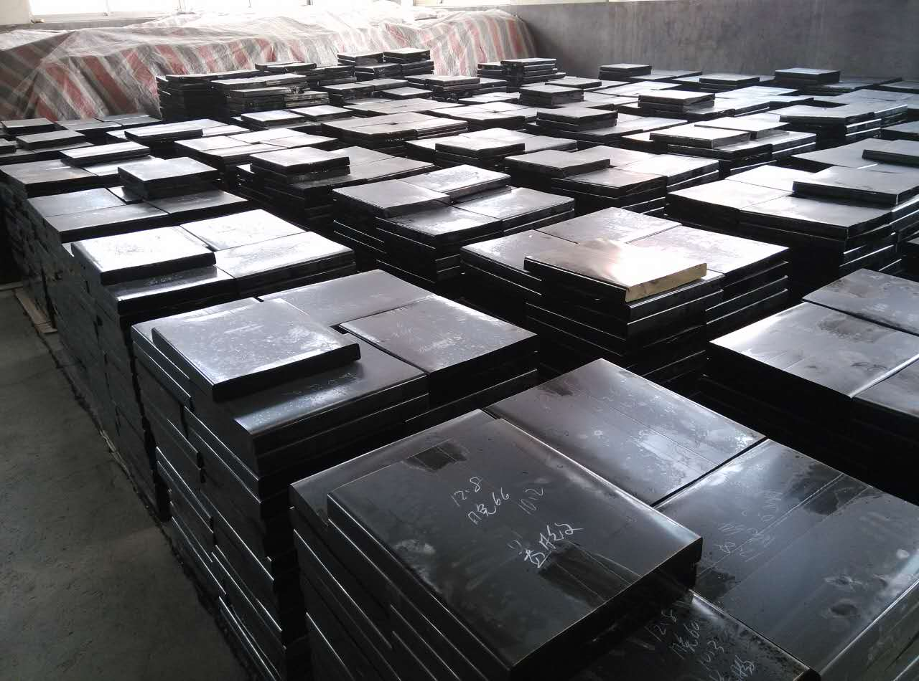
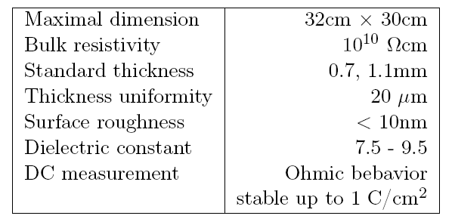
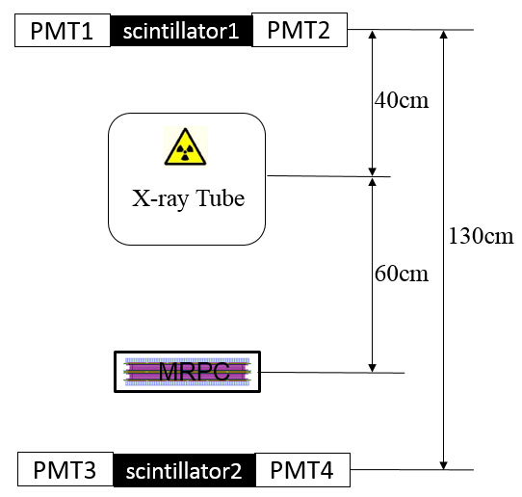
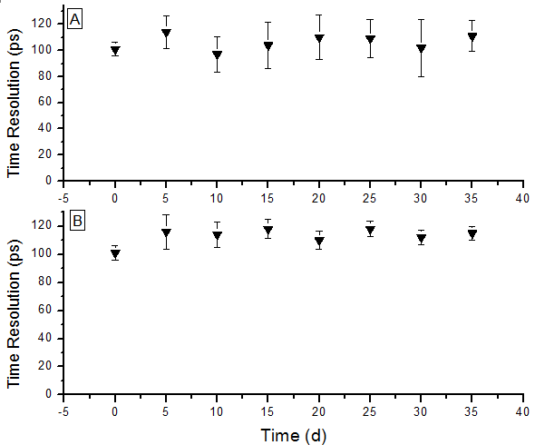
Development of low resistive glass
Performance of the glass
Glass mass production
Yield >100m²/month
Online test system. The efficiency and time resolution can be obtained by cosmic ray while irradiated by X-rays. 0.1C/cm² charge is accumulated in 35 days.
Aging test with X-ray source

Slide 12
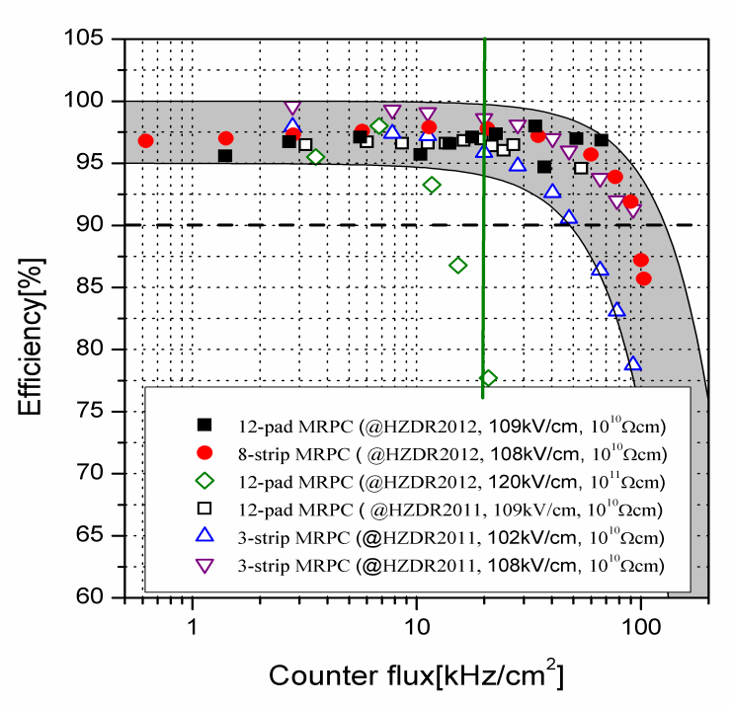
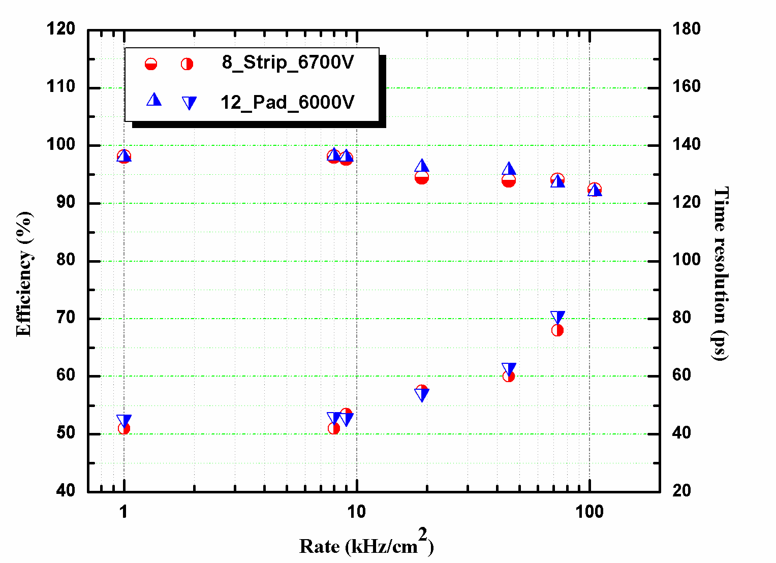
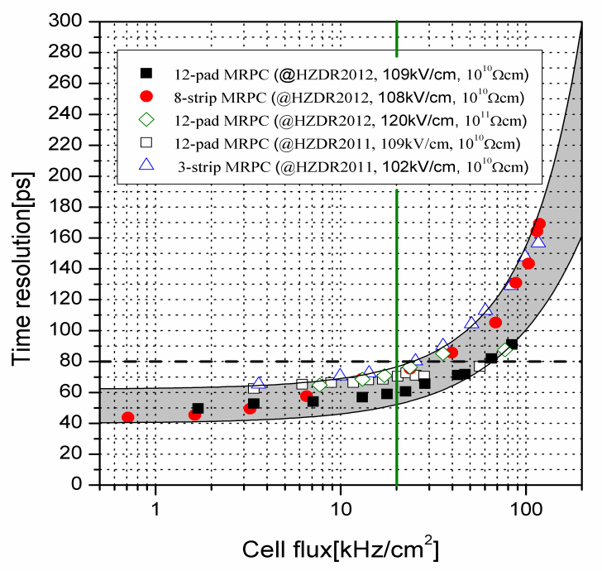
Rate capability of high rate MRPC
Test results at Nuclotron, Dubna
Rate: 70kHz/cm²
Time resolution: 40 ps
Even though the rate is 70kHz/cm², the efficiency is still higher than 90% and the time resolution is about 80ps.

Slide 13
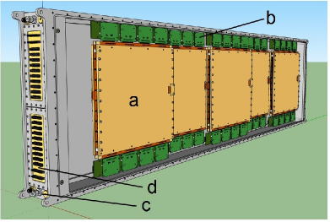
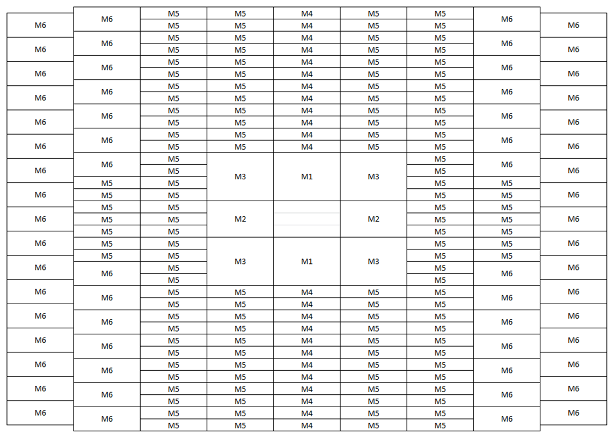
Prototype design for CBM-TOF
Strip-MRPC
Inner zone-MRPC

Slide 14
Design of strip-MRPC for high rate region
Glass: low resistive glass
0.7mm thick, 27cm x 25cm
Strip: 27cm x 0.7cm, 0.3cm interval, 24 strips
Gas gap: 8 x 0.25mm, two stacks
Gas box: 600mm x 500mm x 72mm
w
t
h
ground
Differential strip: 7mm wide+3mm interval
Feed trough: Micro-strip, 50Ω
14
14

Slide 15
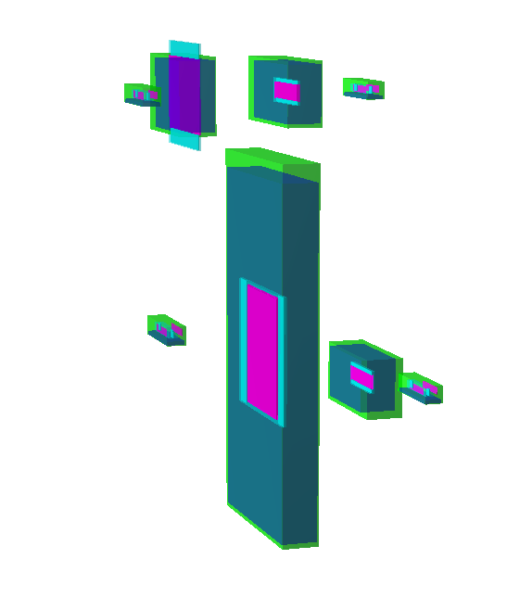
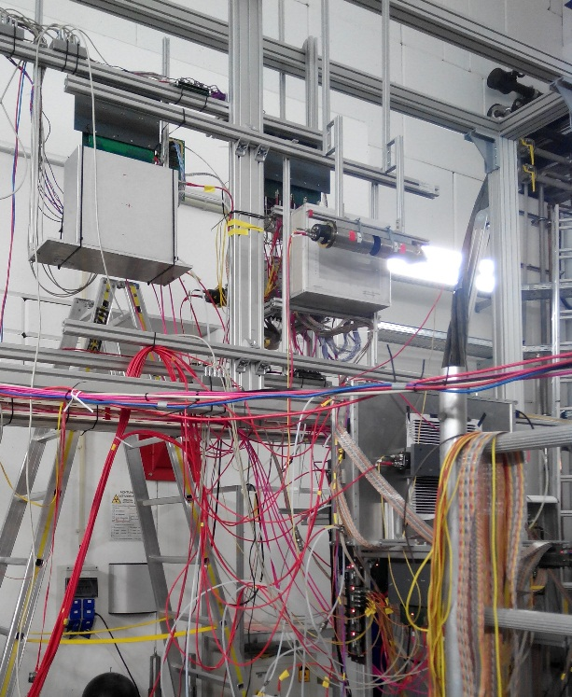
Beam test @GSI, Oct.2014
Experimental Setup:
Buc-2013
THU-Pad
Particle trajectory
BEAM
Buc-Ref
PMT
THU-Strip
HD-P2
HD-Ref
Beam time in October 2014 at GSI
1.1 GeV ¹⁵²Sm beam On 0.3mm/4mm/5mm Pb target
Flux rate several hundreds Hz/cm²
Particle trajectory
15
15

Slide 16
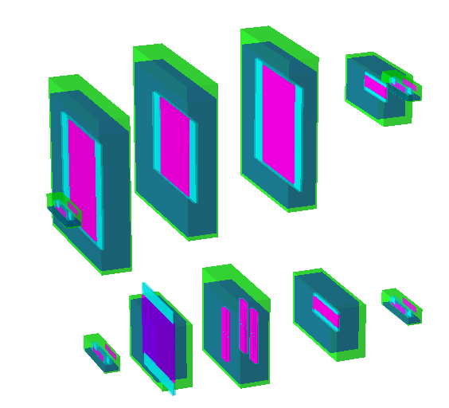
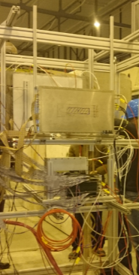
Beam test @ SPS Feb 2015
Experimental Setup:
USTC
THU-Strip
HD-Ref
HD-P2
Up setting
PMT
Down setting
High rate test in February 2015 at SPS CERN
13 GeV Ar beam
Flux rate around 1kHz/cm²
Buc-Ref
Buc-2013
THU-Pad
16

Slide 17
Data analysis method
The data analysis is based on CBM ROOT, macro developed by TOF Group.
Analysis Procedure: 3 Main Steps.
1
Unpacking
2
Cluster Building
3
Analysis
Converting LMD files into unpacked ROOT file, containing timing, TOT, super module type, super module, RPC, strip, side information of each hit.
Initial calibration: Align center of each strip in Detector Under Test and Reference Detector.
Build calibrated hits into clusters.
Iterative calibration: Calibrate data in time-walk, gain and velocity correction.
Calculating observables from fully calibrated hits include cluster size, time resolution and efficiency.

Slide 18
Calibration method
Time-walk correction
Large signals arrive at discriminator threshold faster, leading to a dependence of measured time and amplitude of the analogue signal.
Gain correction
Amplification gain of PADI varies between each channel, which should be corrected out to get initial amplitude for time-walk correction.
Strip alignment correction
Different cable length and electronic delay lead to the shifting of calculated center of different strip, influencing the position of hits.
Velocity correction
Slower particles need a longer time to cross the distance between Dut and Mref, widen the time difference distribution.

Slide 19
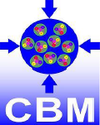
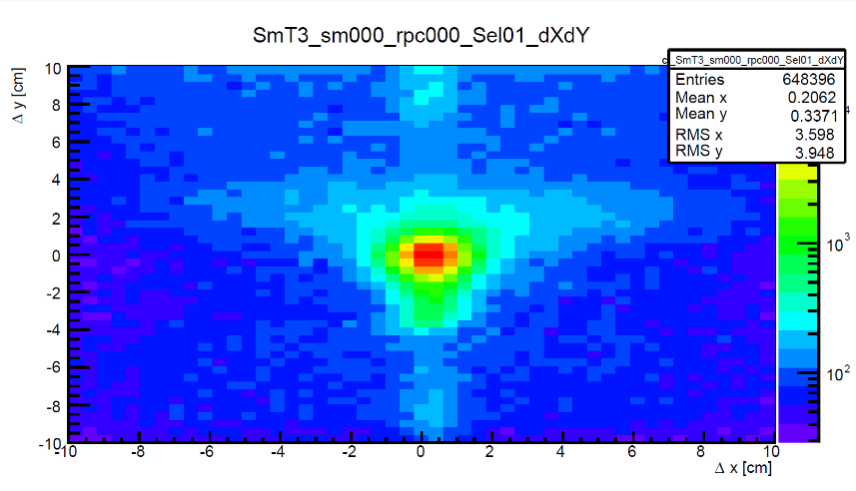
Analysis results: GSI Oct 2014
Analysis Setting:
Analysis Procedure:
Init_calib.sh (Initial calibration)
Iter_calib.sh (Iterative calibration)
iteration procedure: 1-6-8-2-10-2-10
Iter_hits.sh (Analysis)
analysis correction procedure: 1-2-3-4-1
Lower part of setup:
Diamond
THU-Strip
HD-Ref
Cut Selection: Cut 1
tofAnaTestbeam->SetMul4Max(1.);
tofAnaTestbeam->SetCh4Sel(8.);
tofAnaTestbeam->SetDCh4Sel(7.); tofAnaTestbeam->SetPosY4Sel(0.5);
tofAnaTestbeam->SetMulDMax(1.); tofAnaTestbeam->SetDTDia(0.);
Particle
BRef:
Starting counter for events.
Dut:
Counter under test.
MRef:
Reference measure for Dut.
19

Slide 20
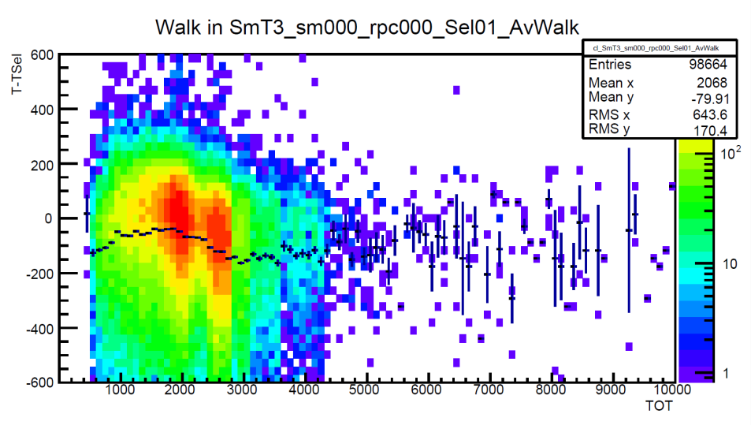
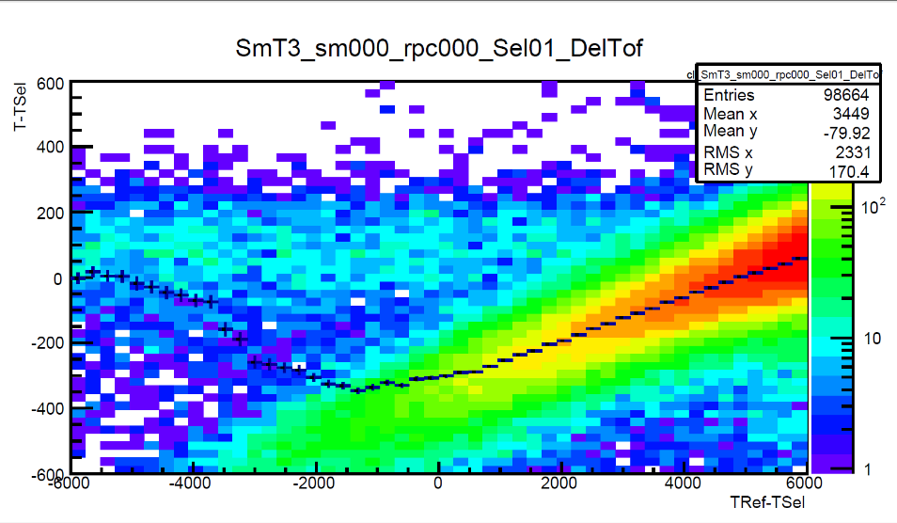
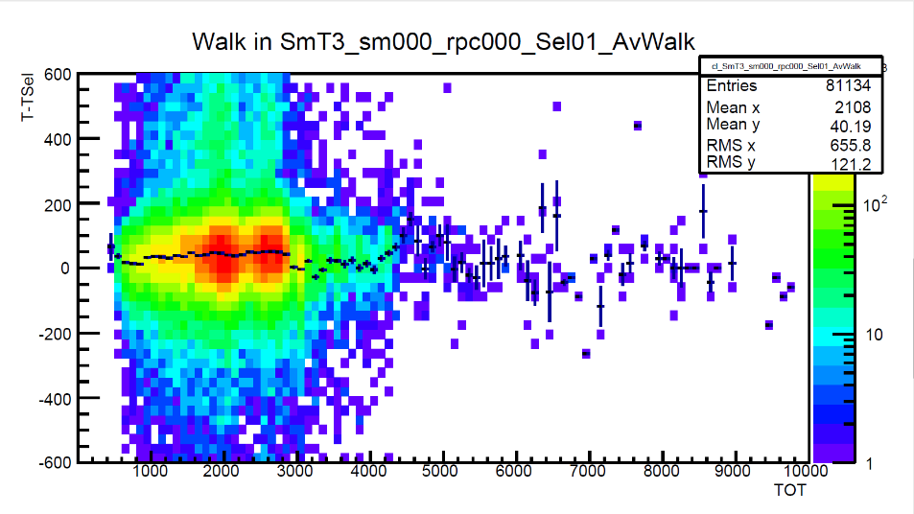
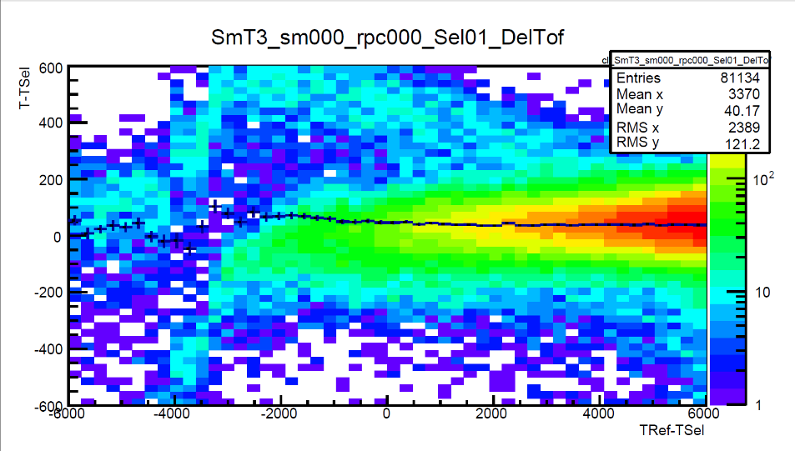
Run: Sun1205 – 5500V: Analysis Process
Time-walk correction
Velocity correction
Before Calibration
After Calibration

Slide 21
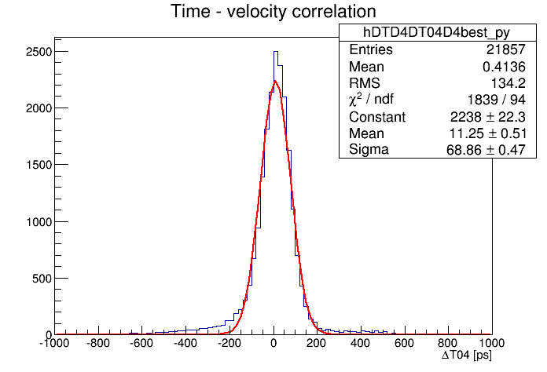
Results of strip-MRPC
Run: Sun1205 – 5500V Time Resolution
Efficiency:
Around 97%
Analysis Result under Different Threshold
Threshold | Efficiency | Time Resolution | Cluster Size
170mV | 97.0% | 71.6ps | 1.7
180mV | 97.0% | 68.9ps | 1.7
190mV | 97.0% | 71.0ps | 1.6
200mV | 96.7% | 68.9ps | 1.6
Time resolution:
Around 70ps

Slide 22
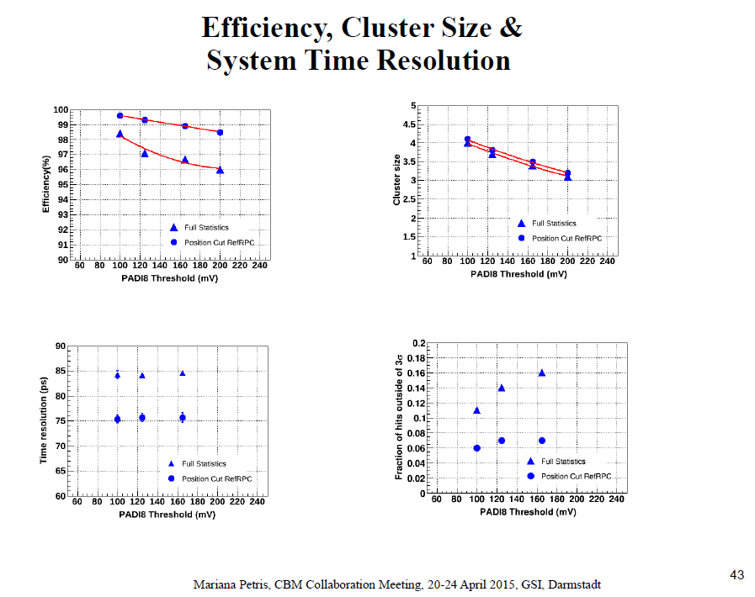
Performance of Inner zone-MRPC

Slide 23
CBM mile stones
CBM components | TDR approved | Start production | Ready for installation | Ready for beam
Micro Vertex Detector (MVD) | 01.04.17 | 30.04.18 | 31.12.19 | 30.06.20
Silicon Tracking System (STS) | 05.07.13 | 31.03.17 | 31.03.20 | 31.12.20
Ring Imaging Cherenkov Detector (RICH) | 07.01.14 | 31.12.16 | 31.12.19 | 31.12.20
Muon Detector (MUCH) | 28.02.15 | 31.12.16 | 31.12.19 | 31.12.20
Transition Radiation Detector (TRD) | 01.04.17 | 31.12.17 | 31.12.20 | 31.12.21
Time of Flight System (TOF) | 30.04.15 | 01.01.17 | 31.12.19 | 31.12.20
Electromagnetic Calorimeter (ECAL) | 31.12.16 | 30.06.18 | 31.12.19 | 31.12.20
Projectile Spectator Detector (PSD) | 28.02.15 | 31.12.15 | 31.12.18 | 31.12.19
Dipol Magnet | 01.10.13 | 30.06.17 | 31.12.19 | 30.06.20
Online Systems (DAQ and FLES) | 31.12.17 | 30.06.18 | 30.06.19 | 31.12.19

Slide 25
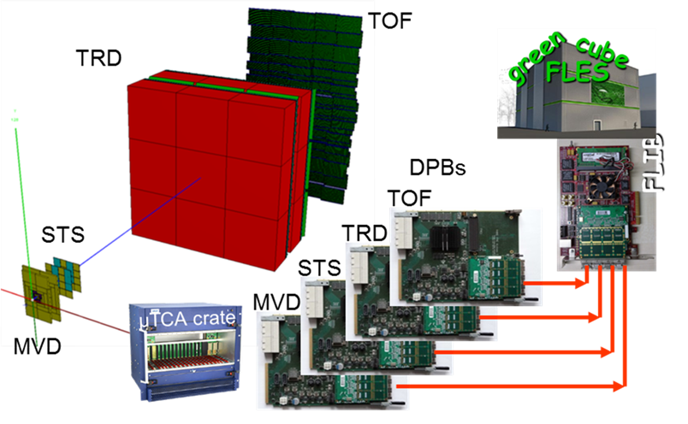
Summary
The rate of CBM-TOF reach 25kHz/cm2
Time resolution ~60ps
Free running mode
120 square meters
It will first used in STAR-eTOF
Mini CBM will be set up soon!
Participate FAIR Phase 0
experiments…
Structure of Mini CBM

Slide 26
Thanks for your attention !

