Slide 1






Finalizing the CBM-MVD Geometry:
CAD and Simulation
81. Jahrestagung der DPG und DPG-Frühjahrstagung, Münster
30. März 2017, HK 53.7, 18:30
Philipp Klaus
on behalf of the CBM-MVD Collaboration
klaus@physik.uni-frankfurt.de
This work has been supported by BMBF (05P15RFFC1), GSI and HIC for FAIR

Slide 2
Outline
  Updated sensor dimensions
  Geometries of the MVD: Mechanics & Simulation
  Comparison Cad2Root ⇿ Scripting in Root
  New MVD Geometry via Scripting
  Summary

Slide 3
Need for Geometry Change due to
Update of Sensor Dimensions
Preliminary
Previous (assumed) sensor:
“3x FSBB”
New (assumed) sensor:
“MIMOSIS-1”
10mm
13mm
Pixel Matrix (sensitive)
1024x504 pixel
16mm
13mm
Readout Part (insensitive)
30mm
31mm

Slide 4
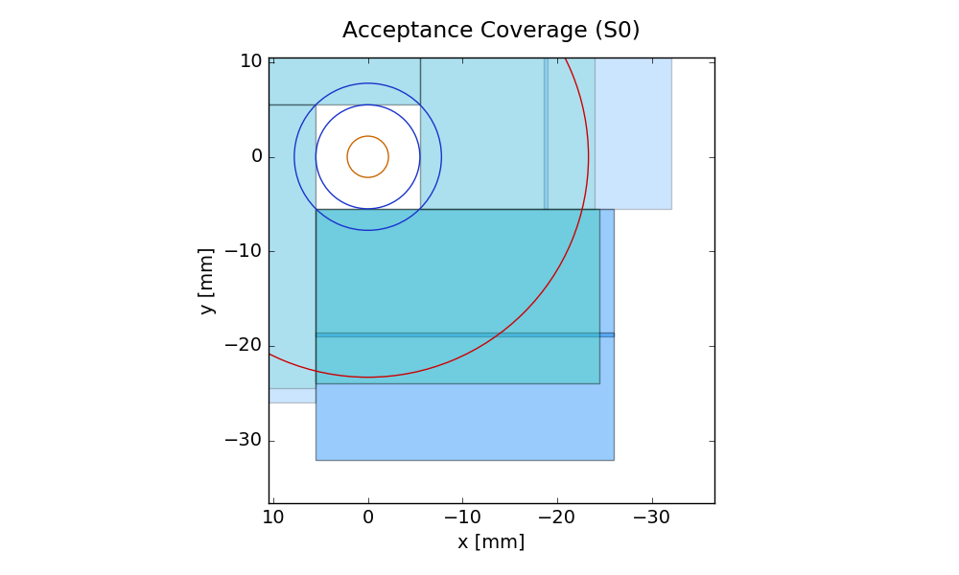
Plot Legend
Quadrant acceptance of previously
assumed 3xFSBB quadrant composition
(PhD Thesis of Tobias Tischler)
Quadrant acceptance with new
(assumed) MIMOSIS-1
sensor dimensions, if same sensor
arrangement to be used as in
PhD Thesis of Tobias Tischler
Overlap area of sensors on
front and back side of the carrier
with new sensor dimensions

Slide 5
Plot Legend
Actual inner CBM-MVD
acceptance limit:
Resulting beam hole
Begin of acceptance
Nominal CBM
acceptance limits:
Fully established acceptance
2.5 degrees
25 degrees

Slide 6
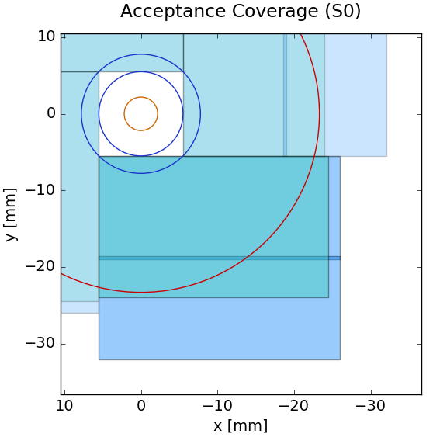
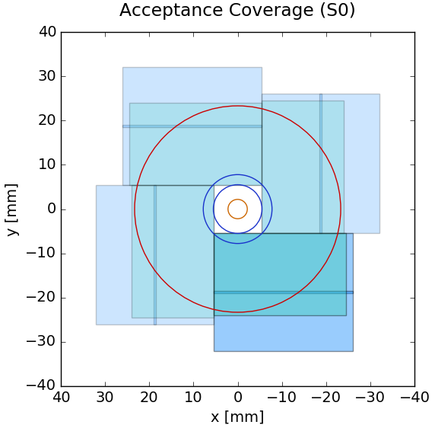
Acceptance Coverage: Station 0

Slide 7
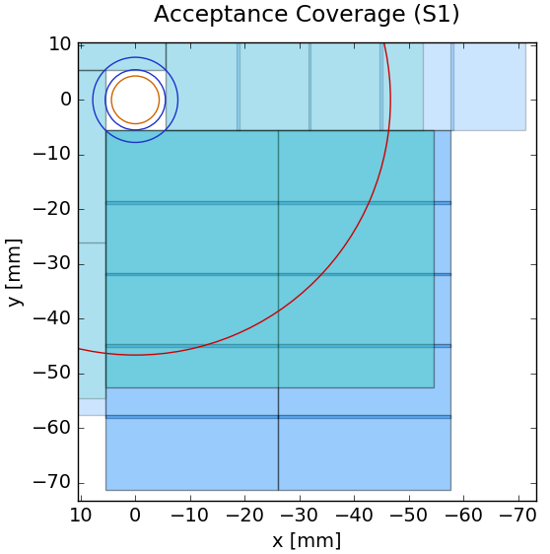
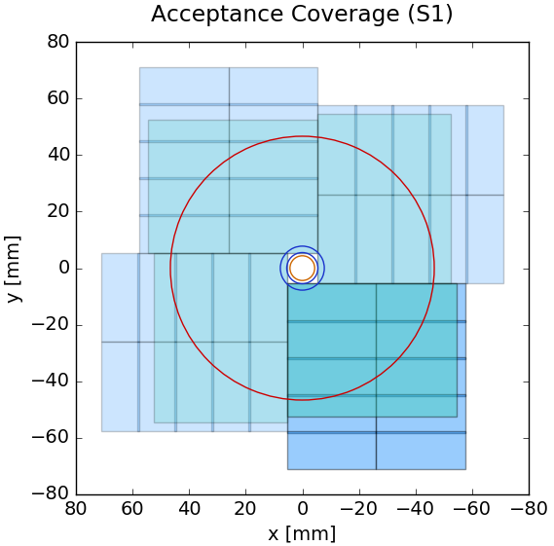
Acceptance Coverage: Station 1

Slide 8
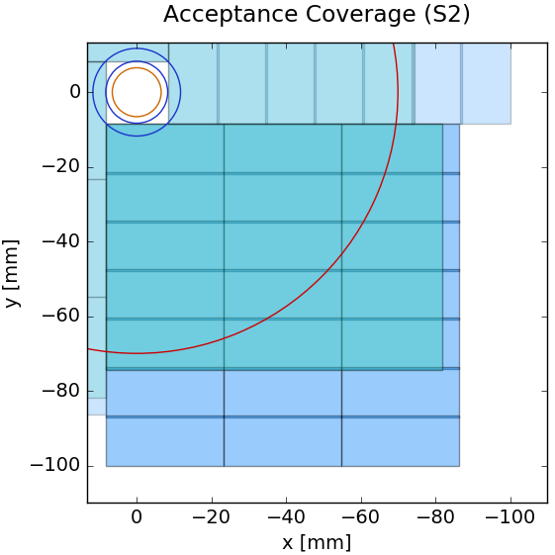
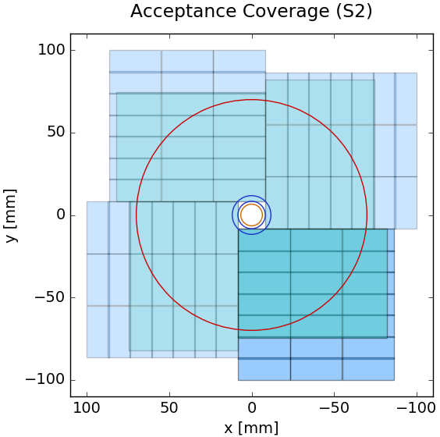
Acceptance Coverage: Station 2

Slide 9
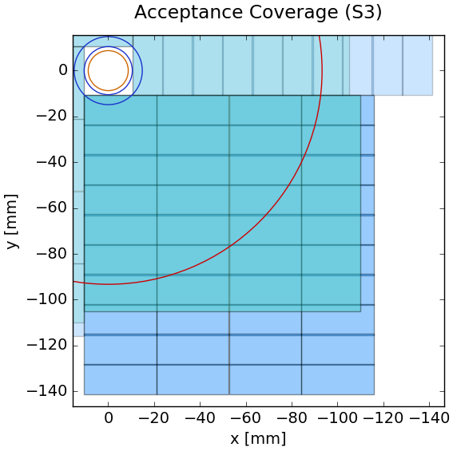
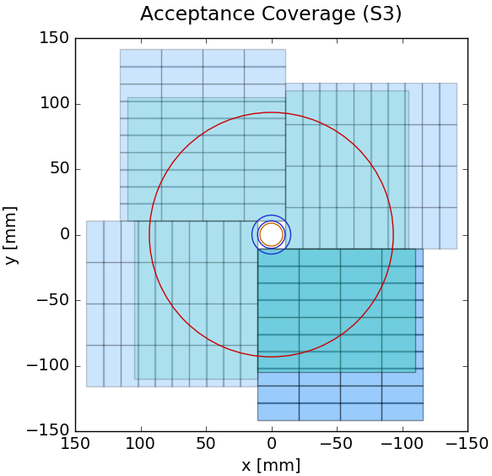
Acceptance Coverage: Station 3

Slide 10
Result of Updated Sensor Dimensions
  For some stations, the new sensor dimensions
  allow to reduce the integration complexity by
  removing some rows of sensors.
  The MVD geometries for engineering and
  simulation need to be updated.
      This is where the problems started…

Slide 11
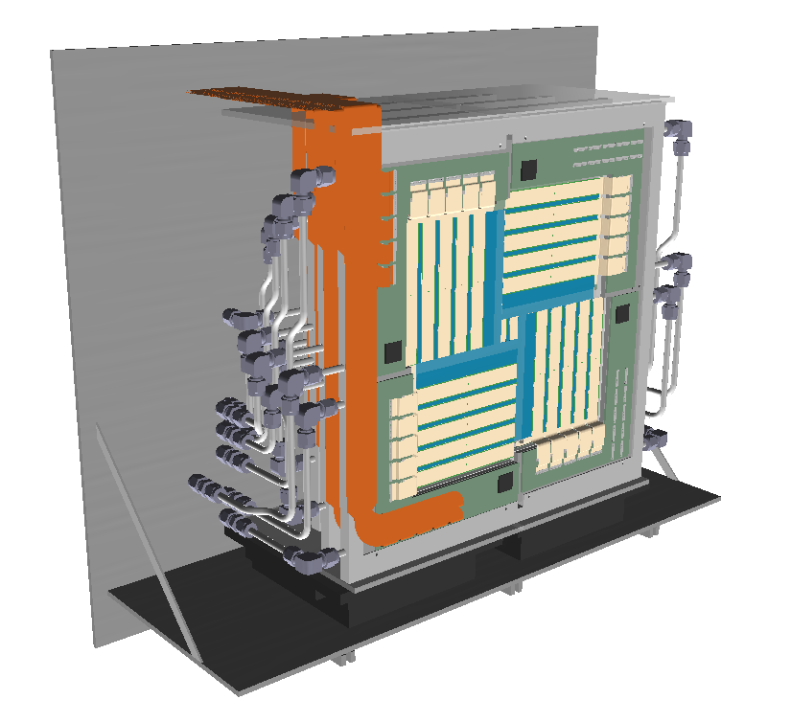
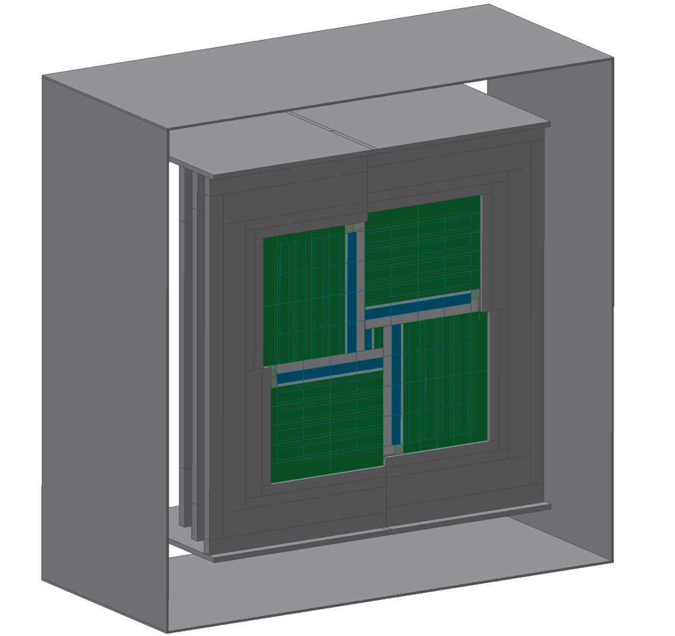
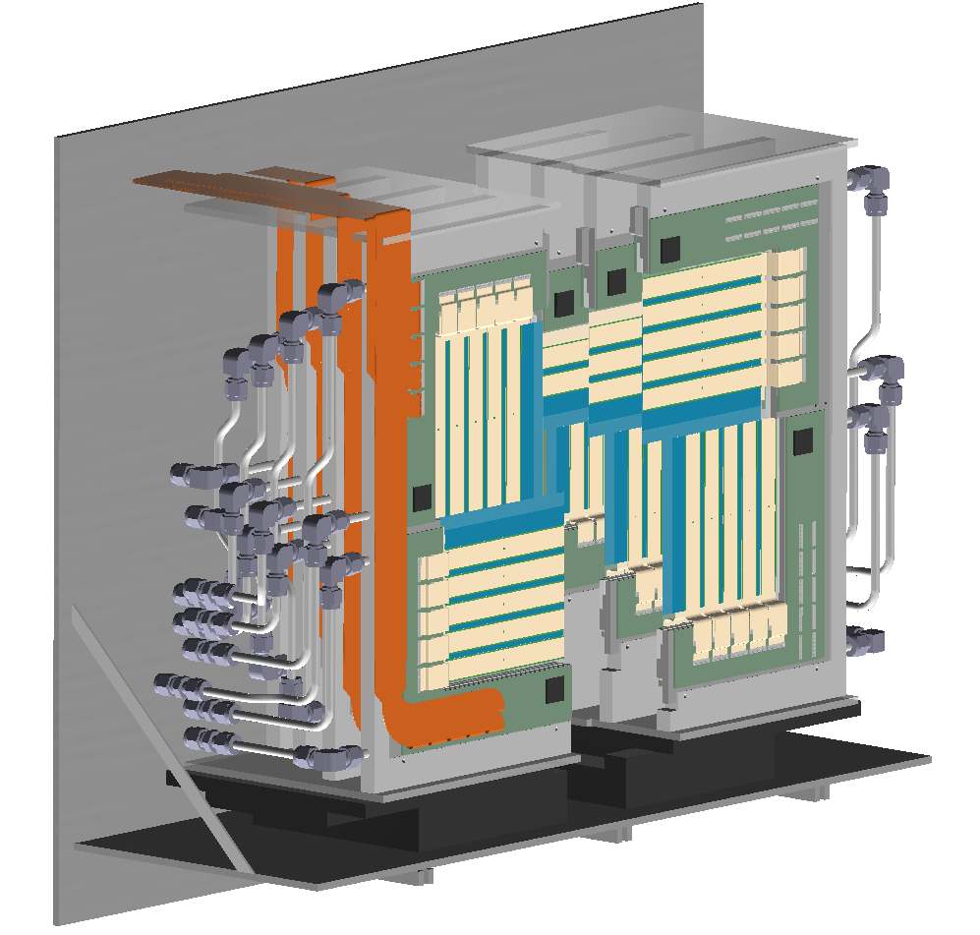
Geometry Status of the MVD up to now
→ Geometry for Engineering / Mechanics
→ Geometry for CbmRoot Simulations
Parametric feature based modelling (“CAD”) with Autodesk Inventor
←software: same→
← look: similar →
← still: quite different →
← required: consistency →
Where they differ, there should be a justified
reason such as:
Simulation Speed
Simplicity
Particle distributions

Slide 12
Workflow of the “Cad2Root ” Conversion Approach For CbmRoot Geometries
Material Map
Dependencies
(OpenCascade)
↓
↓
Cad2Root
Simulation w/ CbmRoot
ROOT File with Geometry
Export to STEP →
→
→
https://panda-wiki.gsi.de/foswiki/bin/view/Computing/CadConverter
[Autor: Dr. Tobias Stockmanns, FZ Jülich]

Slide 13
Cad2Root Conversion Aspects
Using Parametric feature based modelling (“CAD”) with Autodesk Inventor
Why good / Pros:
Creating the geometry can be done very quickly if experienced with CAD software
Work can be offloaded if you have an engineering department
Component interferences can be checked and visually inspected nicely
Interferences with other detectors can be checked well, if also created with CAD software.
Better UI than ROOT.
Why bad / Cons:
Many dependencies for the conversion:
  Cad2Root, FairROOT, OpenCascade
More difficult to track changes to the geometry (no text file in version control)
Bigger workflow for changes
Small userbase of Cad2Root / maintenance needed to keep up to date
New geometry will be scripted in a ROOT macro
instead of being created with Cad2Root.

Slide 14
Previous Approaches to
CAD ↔ ROOT Conversion (for completeness)
STEP-to-ROOT – from CAD to Monte Carlo Simulation
Tobias Stockmanns 2012 J. Phys.: Conf. Ser. 396 022050
DOI: https://doi.org/10.1088/1742-6596/396/2/022050
“Cad2Root”
STEP → ROOT
Development and application of CATIA-GDML geometry builder
S Belogurov et al 2014 J. Phys.: Conf. Ser. 513 022003
DOI: http://iopscience.iop.org/article/10.1088/1742-6596/513/2/022003
CATIA ↔ ROOT
TGeoCad: an Interface between ROOT and CAD Systems
C Luzzi and F Carminati 2014 J. Phys.: Conf. Ser. 523 012017
DOI: https://doi.org/10.1088/1742-6596/523/1/012017
ROOT → STEP

Slide 15
Scripting a new Geometry in Root
Documentation
Root User Guide (v5.34) chapter ”The Geometry Package”:
https://root.cern.ch → Documentation → User’s Guides → User’s Guides (all formats and series) → HTML – Geometry
FairRoot HowTo “Detector Geometry and Media”:
https://fairroot.gsi.de → HowTo → Detector Geometry and Media
In short:
Define Materials, Media, Shapes,
Volumes, Volume Assemblies,
and instances of the Volumes
positioned in a mother volume
using a transformation Matrix.
Relevant classes in Root:
TGeoMaterial
TGeoShape
TGeoVolume
TGeoBBox
TGeoMedium
TGeoNode
TGeoVolumeAssembly
TGeoMatrix

Slide 16
Structure of the New, Scripted
CBM-MVD Geometry
Preliminary
Legend (Root Classes):

Slide 17
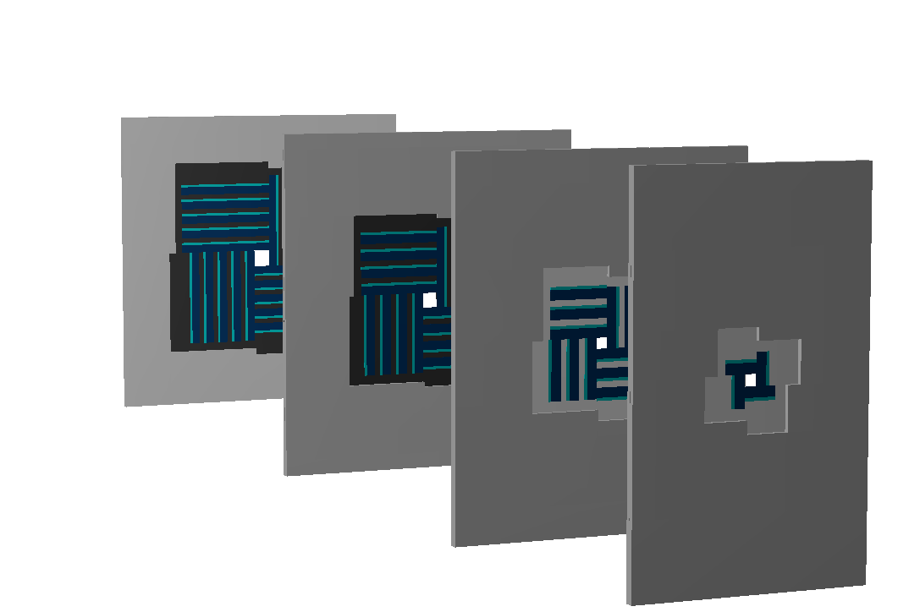
Current Status - Scripted Geometry
Preliminary
  A success so far.
  Up next: MVD Digitizer to be adapted to work with the new geometry.
An impression in 3D
(station position in
z-direction streched)

Slide 18
Current Status - Scripted Geometry
Stations 0 and 1
Preliminary
S0
S1
Height: identical
for all 4 stations
y
x
z
23.1 cm
31.1 cm

Slide 19
Current Status - Scripted Geometry
Stations 2 and 3
Preliminary
Last station:
Heatsink fully quadratic
S2
S3
Height: identical
for all 4 stations
y
x
z
34.34 cm
37.7 cm

Slide 20
Summary
  Changed sensor dimensions require an update of the MVD geometry
  Move away from Cad2Root → geometry scripted in Root
  Goals for the scripted geometry:
    First step: reproduce current v15a MVD geometry
    Next step: update for the changed sensor dimensions
    Next next step: evaluate additional station configurations of the MVD to cover more physics cases
    Thank you for your attention!
    If you are interested in the slides, write to:
    klaus@physik.uni-frankfurt.de
sensor
design
feedback
→ simulation →

