Slide 1
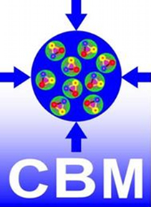
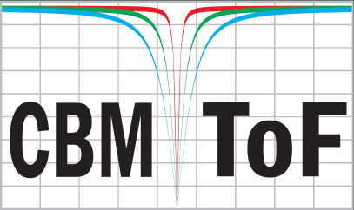
DPG – Frühjahrstagung 2017
The CBM Time-of-Flight wall
Ingo Deppner for the CBM-TOF Group
Physikalisches Institut der Uni. Heidelberg
Outline:
Introduction
CBM TOF requirements
Tof wall arrangements
Ceramics RPC and the central region of the ToF wall
Beam-time @ SPS Nov. 2015
Beam-time @ SPS Nov. 2016
TOF Project timeline
TOF FAIR Phase 0 project
Summary and Outlook

Slide 2
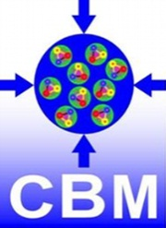
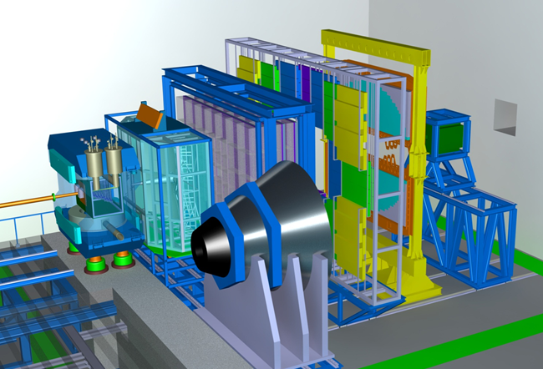
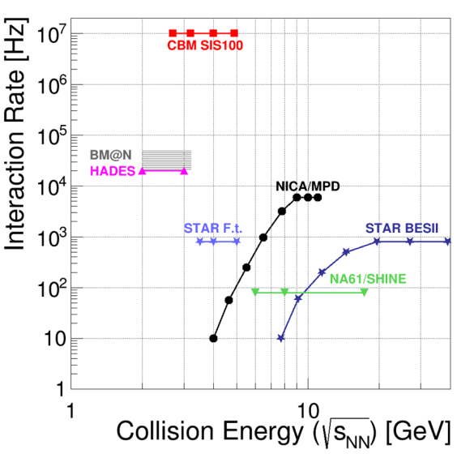


Introduction
The Compressed Baryonic Matter Experiment
Tracking acceptance: 2° < θ_{Lab} < 25°
Free streaming DAQ
Software based event selection
R_{int} = 10 MHz (Au + Au)
Dipole magnet
TOF
ECAL
PSD
TRD
RICH
High net-baryon densities
CBM overview talk: HK30.1
Group reports: 6
Short reports: 41
Poster: 8
MVD & STS
MUCH
1 ns

Slide 3

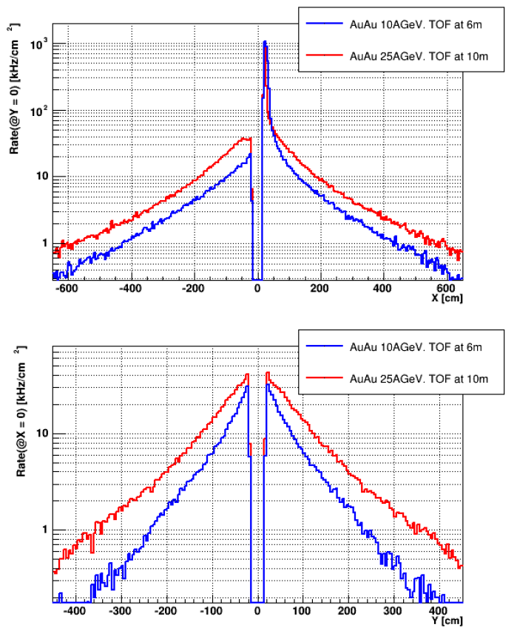
Incident particle flux
URQMD simulated charged particle flux from Au + Au events for an
interaction rate of 10 MHz
kHz/cm²
Flux ranging from 0.1 to 100 kHz/cm²
At different regions Time-of-Flight detectors with different rate capabilities are needed
kHz/cm²

Slide 4
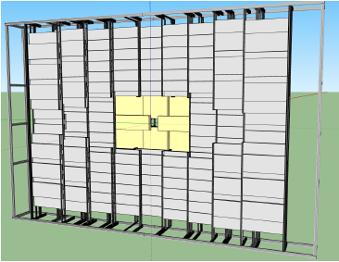
Requirements
Charged hadron identification is provided by Time-of-Flight (ToF) measurement
CBM-ToF Requirements
Full system time resolution σ_{T} ~ 80 ps
Efficiency > 95 %
Rate capability ≤ 30 kHz/cm²
Polar angular range 2.5° – 25°
Active area of 120 m²
Occupancy < 5 %
Low power electronics
(~120.000 channels)
Free streaming data acquisition
twisted pair cabe
RPC
twisted pair cabe
feed through
gas box
Multi-gap Resistive Plate Chambers (MRPC) are the most suitable ToF detectors fulfilling our requirements
120 Ω
80 Ω
1 ns

Slide 5
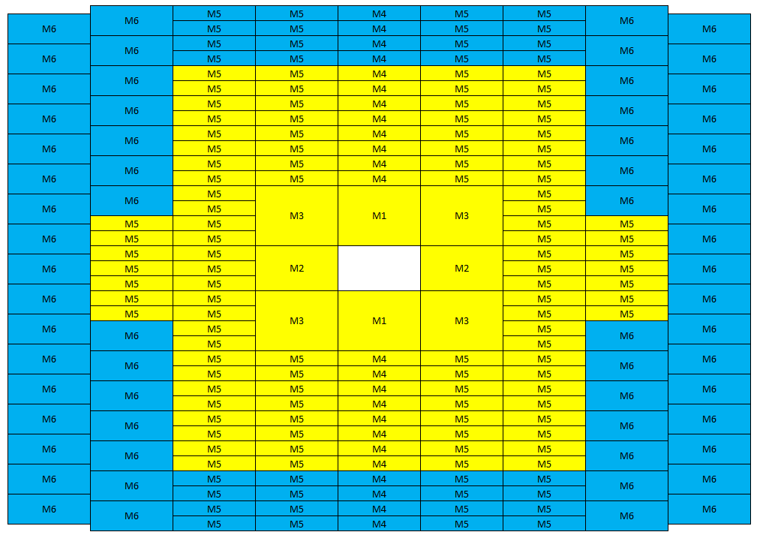
TDR ToF wall layout
6 types of modules (M1 – M6) only
A module contains several MRPC counters
Region containing counters equipped with float glass
Region containing counters equipped with low resistive glass
Region containing counters equipped with ceramic material

Slide 6
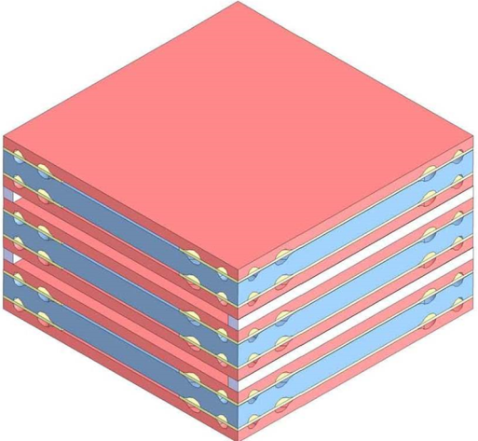
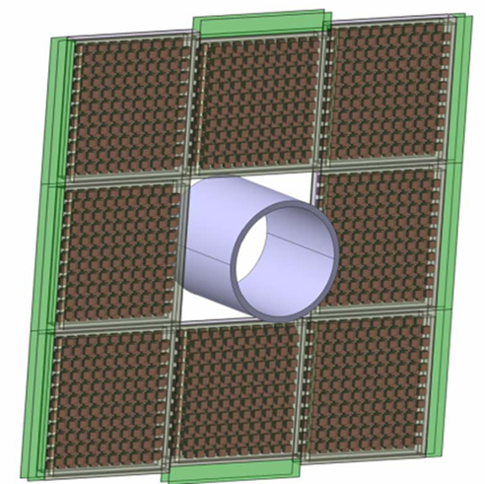
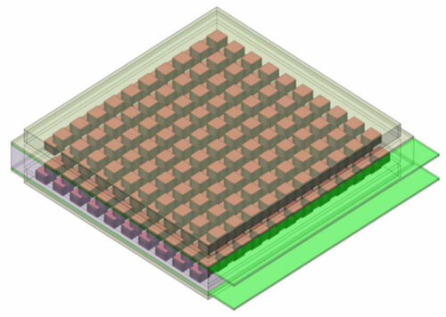
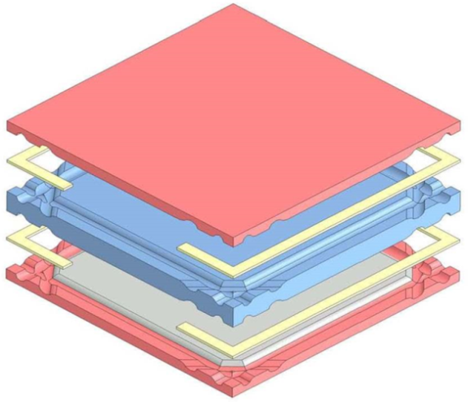
Ceramic RPCs for BFTC
Important scopes of High Energy Heavy Ion experiments are the start-time and the reaction-plane determination. For CBM the use of RPC for the Beam Fragmentation T₀ Counter (BFT₀C) with low resistive radiation hard ceramics electrodes and small chess-board like single
cells is under consideration.
24 mm
1200 mm
1 RPC
3 cells
400 mm
1 cell
2 gaps
1 module
400 RPCs
BFT₀C = 8 modules

Slide 7
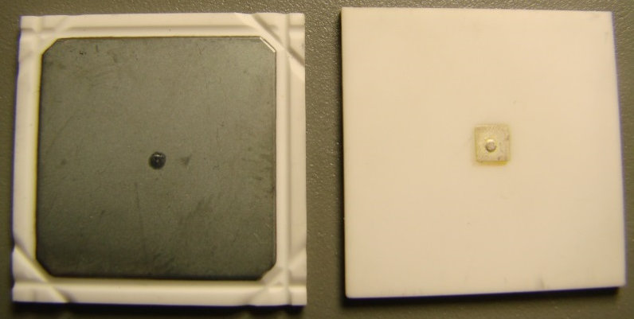
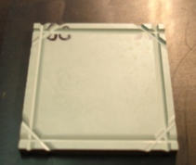
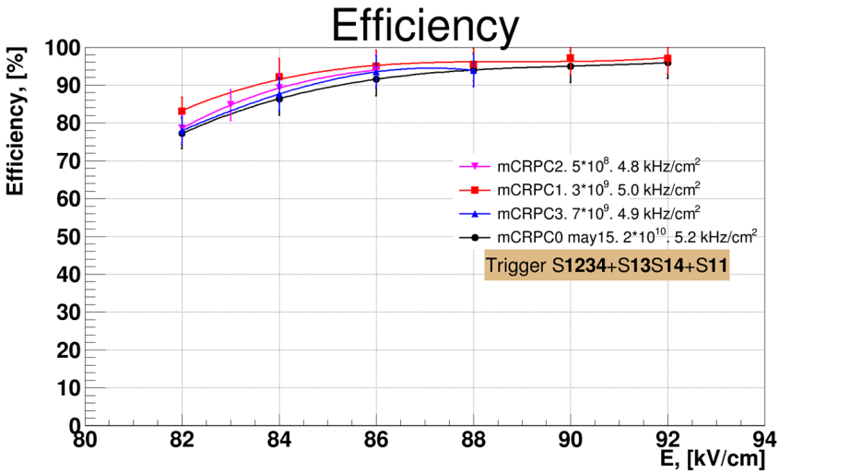
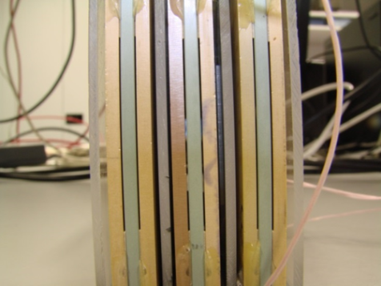
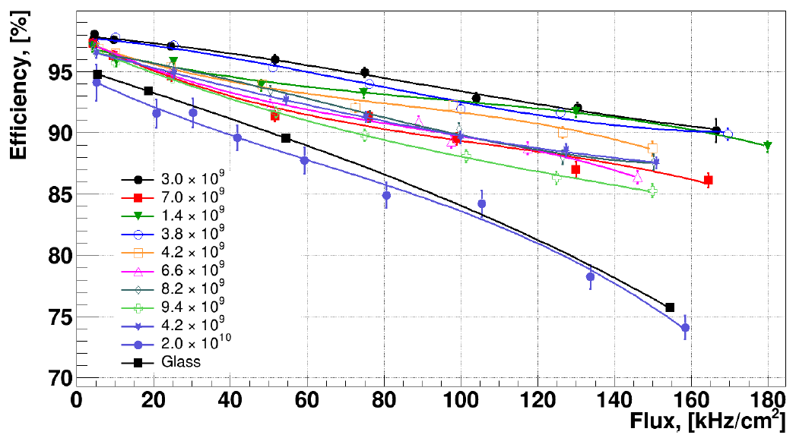
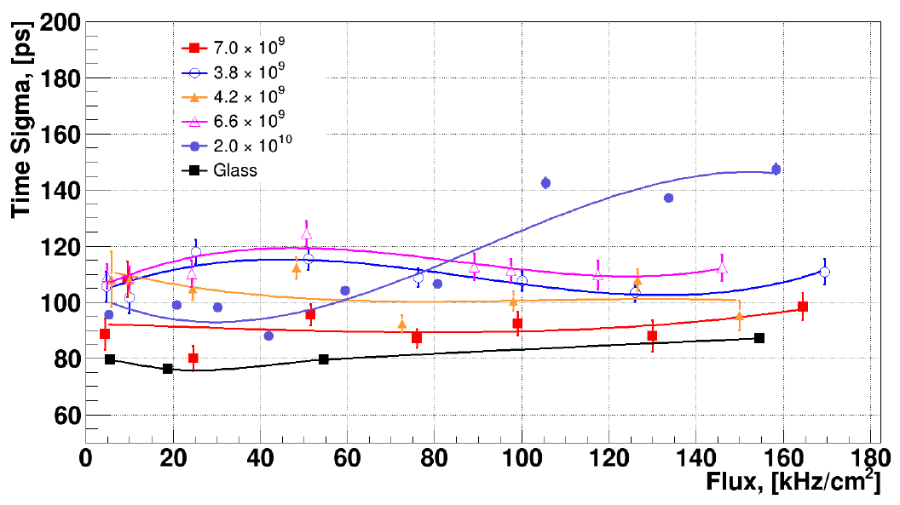
Ceramic RPCs for BFTC
RPC
electrodes
4 × 10⁹ Ωcm: most suitable resistivity order for our aims

Slide 8
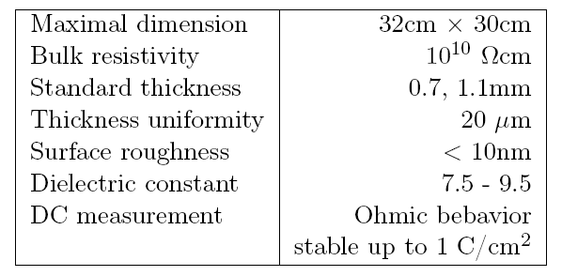
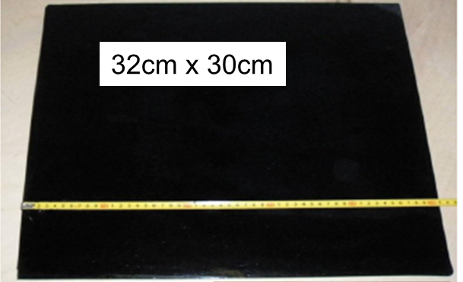
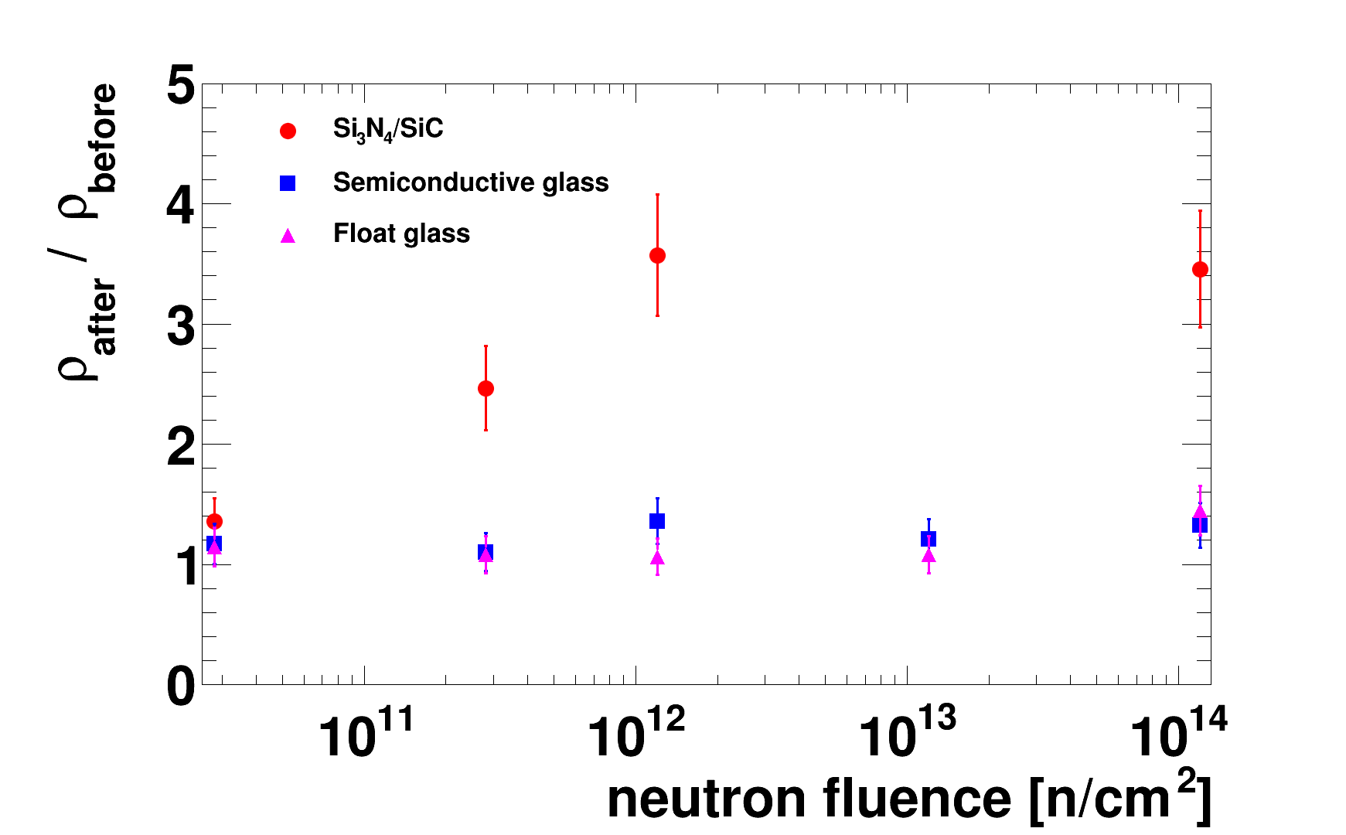
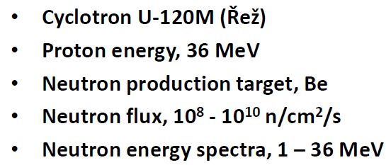
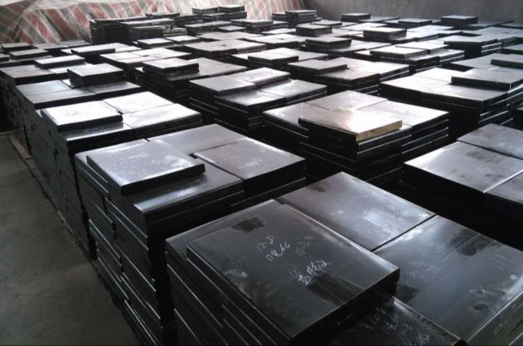
Resistive Glass Development
Resistive glass for high-rate MRPCs is developed in Beijing, China
Aging tests
Raw resistive glass material for 400 m²

Slide 9
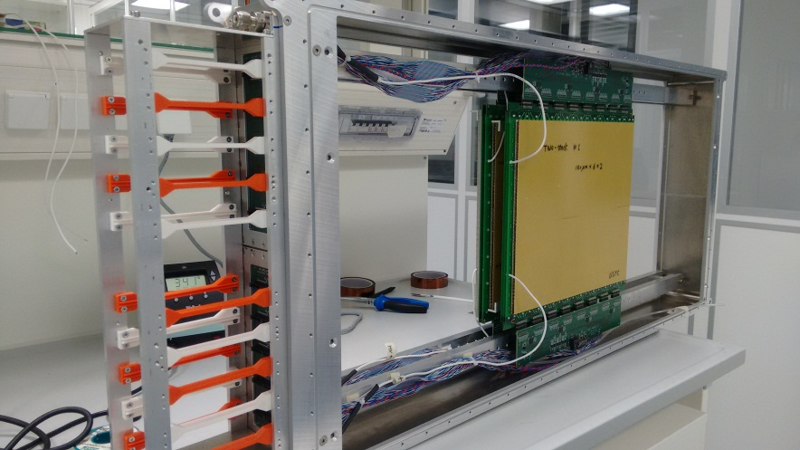
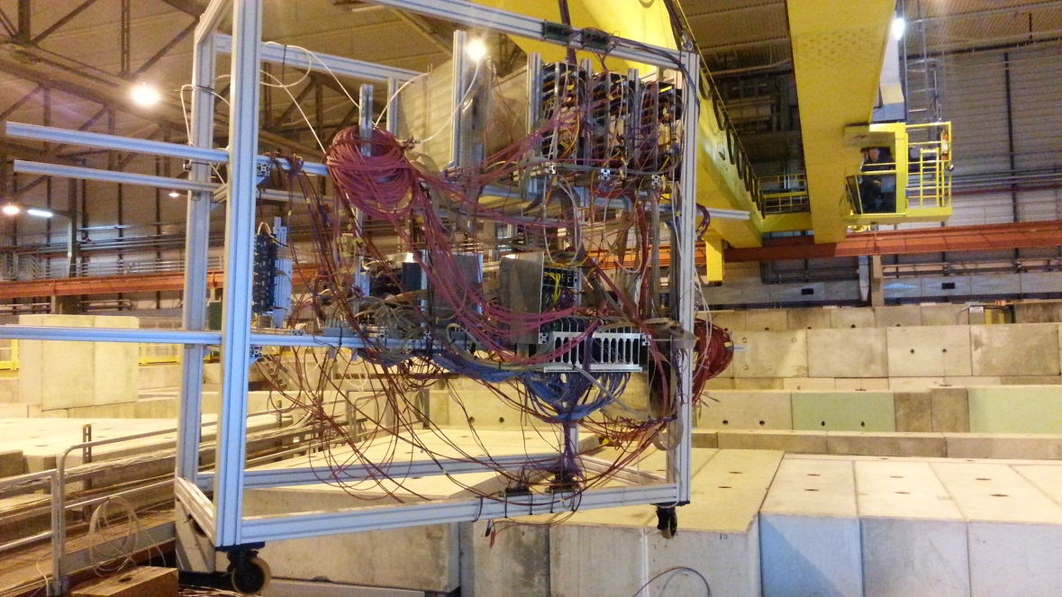
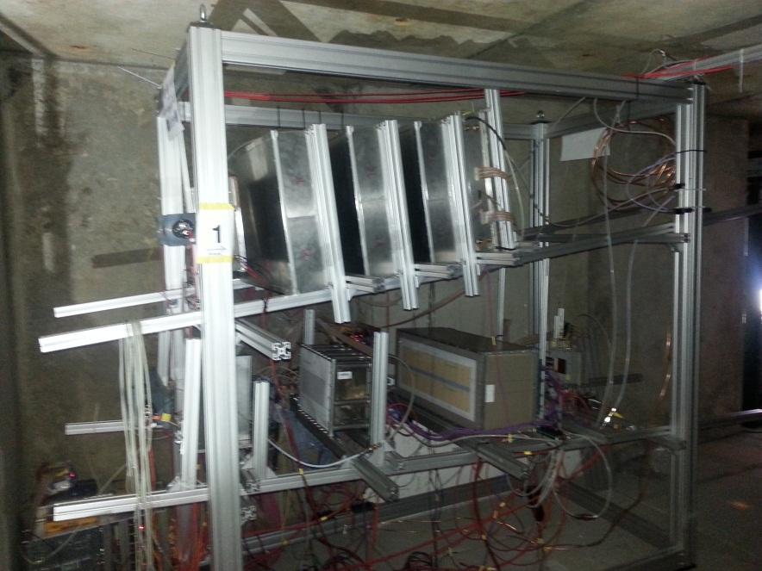
Beam-time @ SPS in
Nov. 2015
Beam-time @ SPS North Area in Nov. 2015
Beam: Lead @ 30A GeV
Target: Lead 1 mm
Intensity: 10⁷ / spill
Spill length: 8 s
Rates: few 100 Hz/cm² - 1 kHz/cm²
Energy close to SIS300 conditions
CBM TOF module
Upper setup
∠ = 6°
Beam
∠ = 3.5°
Lower setup
20 MRPC
About 1100 channels

Slide 10
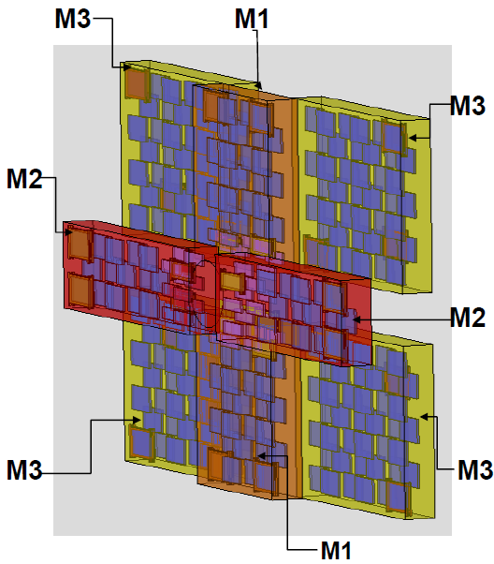
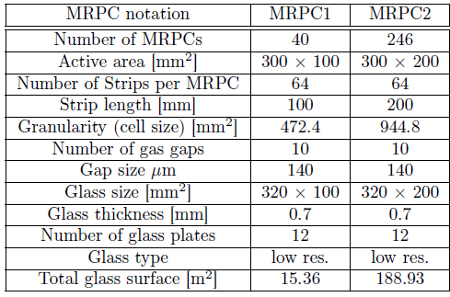
Beam-time @ SPS in
Nov. 2015
Alternative solution with Pad-MRPCs is available

Slide 11
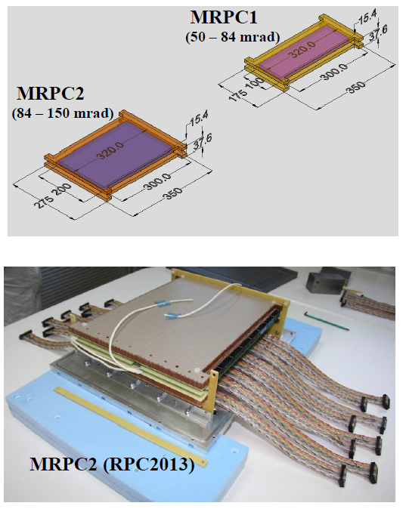
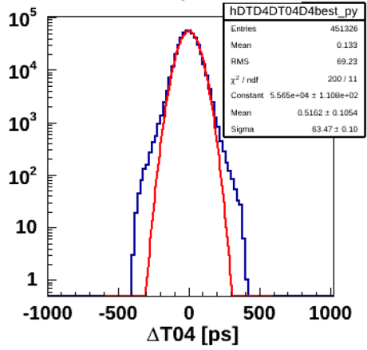
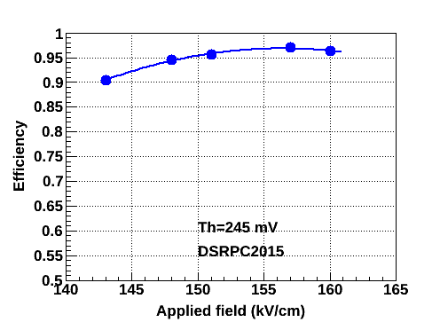
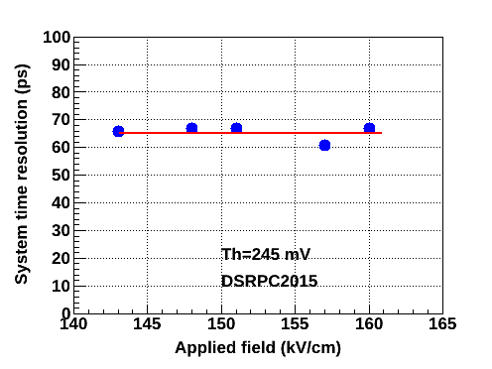
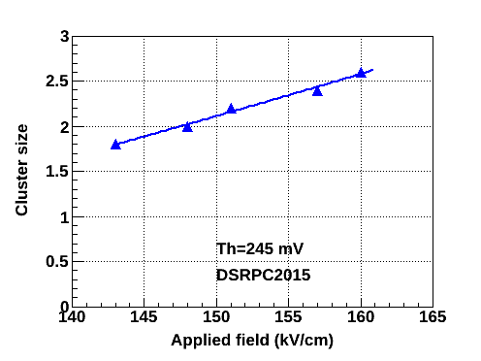
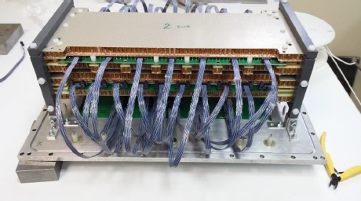
Beam-time @ SPS in
Nov. 2015
Counter time resolution about 46 ps
Efficiency about 97 %
Cluster size > 2
Particle flux only a few hundred Hz/cm²

Slide 12
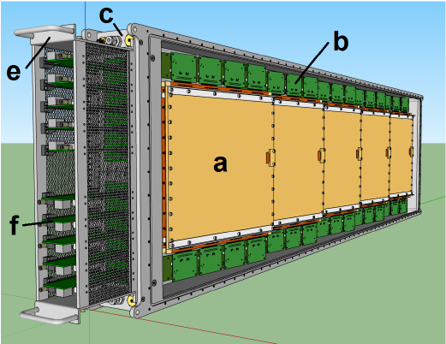
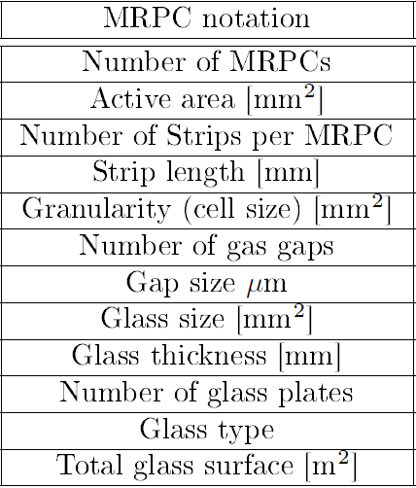
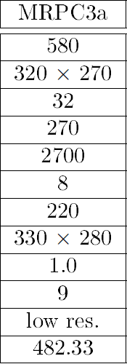
Beam-time @ SPS in
Nov. 2015
Module M5

Slide 13
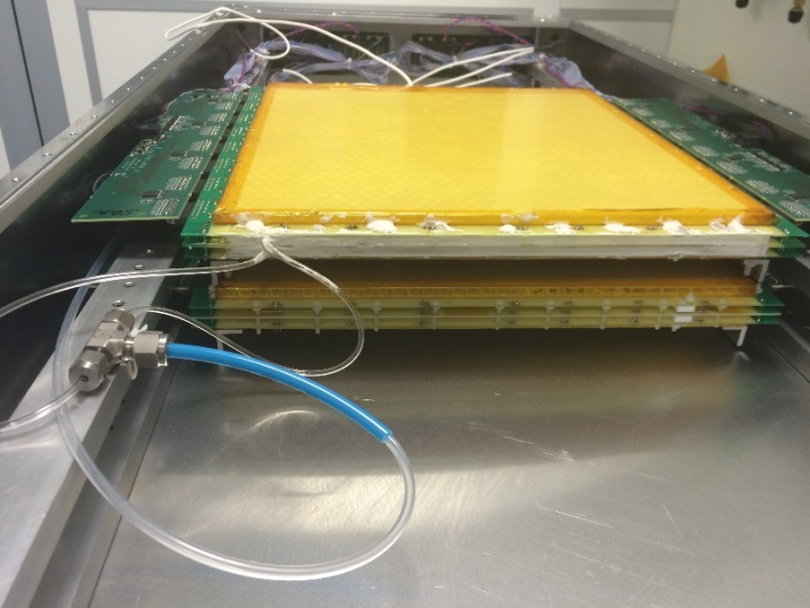
Beam-time @ SPS in
Nov. 2015
MRPC3a prototypes
Counter time resolution about 60 ps
Efficiency about 97 %
Cluster size about 1.5

Slide 14
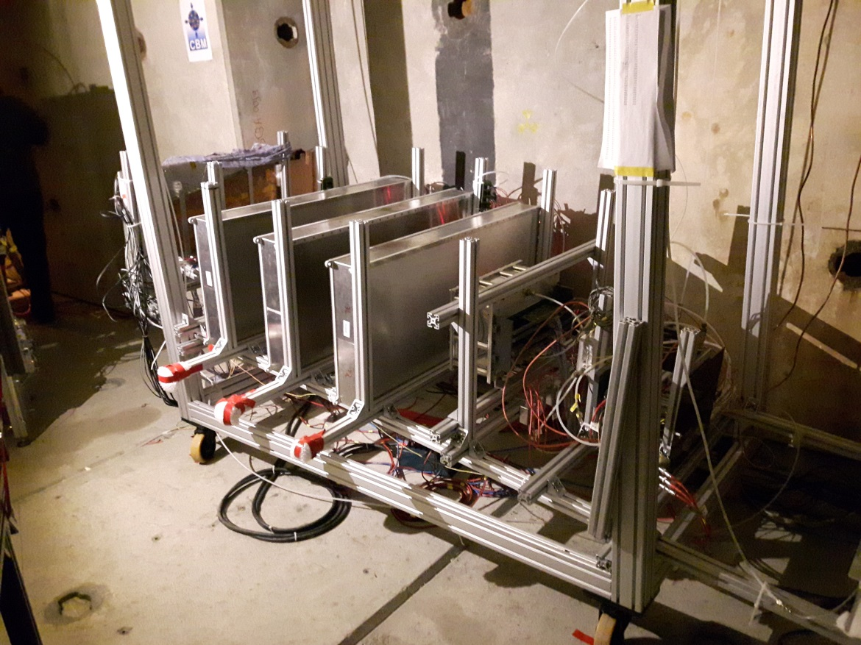
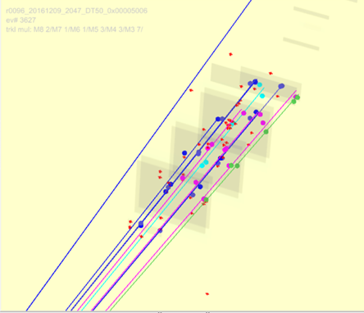
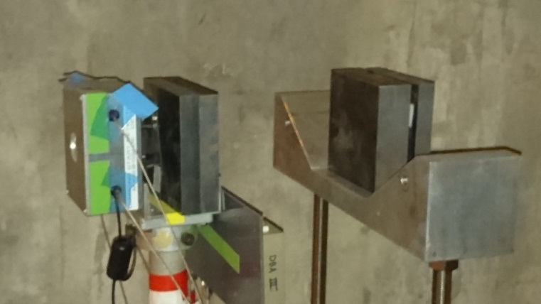
Beam-time @ SPS in
Nov. 2016
Event Display
Beam
Target
two multiplicity 8 tracks found
Target
Pb
Fe
Fe
Beam-time @ SPS North Area in Nov. 2016
Beam: Lead @ 158A GeV
Target: 4 mm Pb (+ 10 cm Fe)
Rates: few 200 Hz/cm² - 1 kHz/cm²
Diamond
80 Ω
1 ns

Slide 15
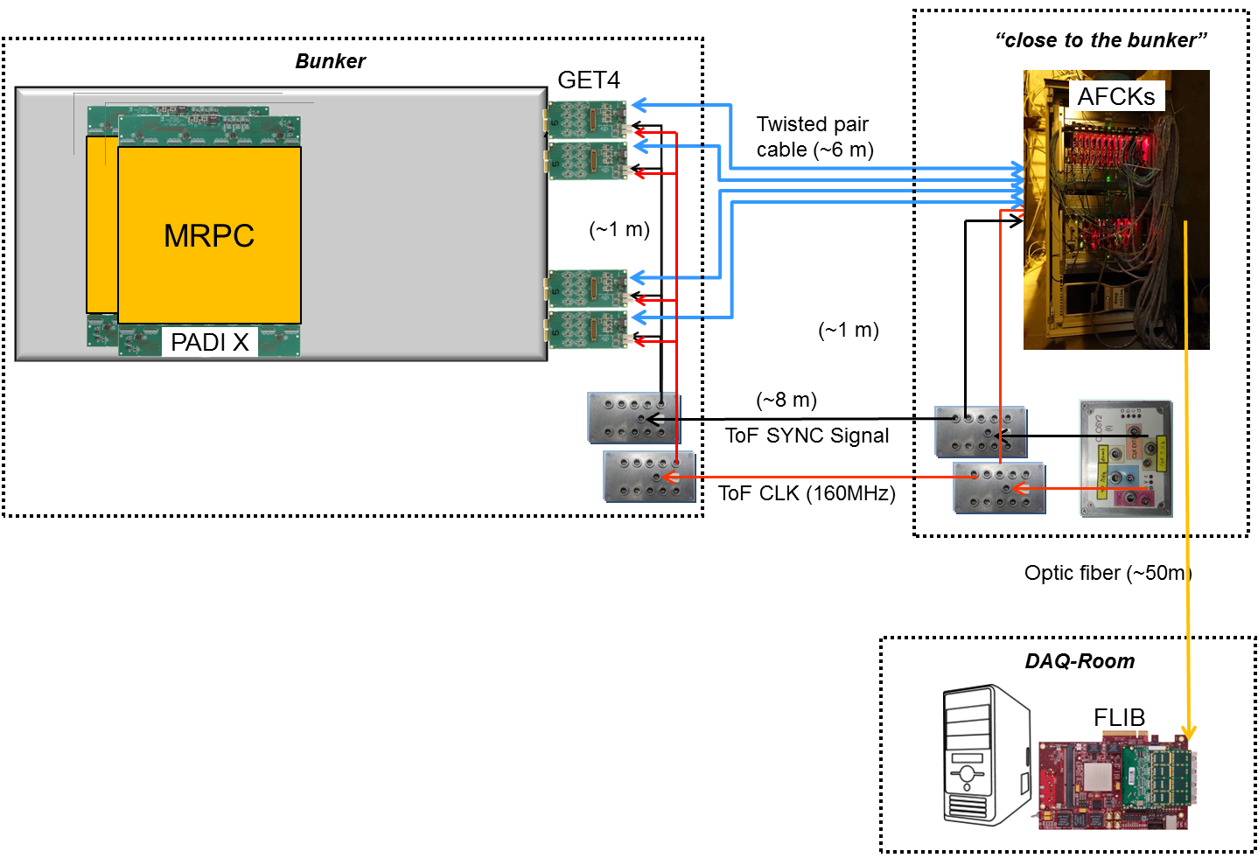
Beam-time @ SPS in
Nov. 2016
~ 500 Channels with the new “CLOSE TO FINAL” Free-streaming Readout-Chain:
PADI / GET4 / AFCK / FLIB
=> DAQ was running stable
80 Ω
1 ns

Slide 16
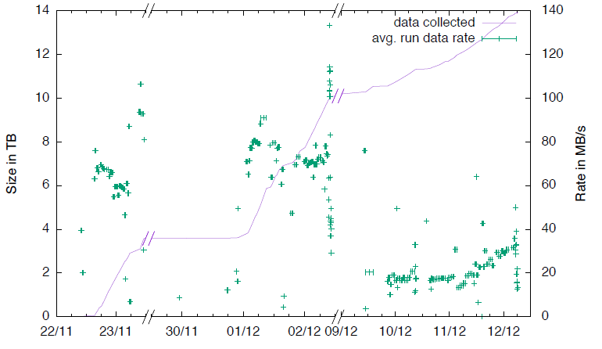
Beam-time @ SPS in
Nov. 2016
80 Ω
1 ns
Mostly epoch markers!

Slide 17
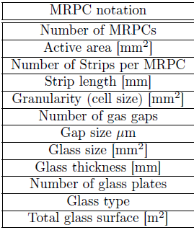
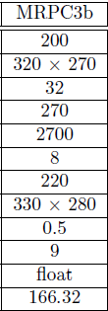
Beam-time @ SPS in
Nov. 2016
Module M5
12
140
0.28
13

Slide 18
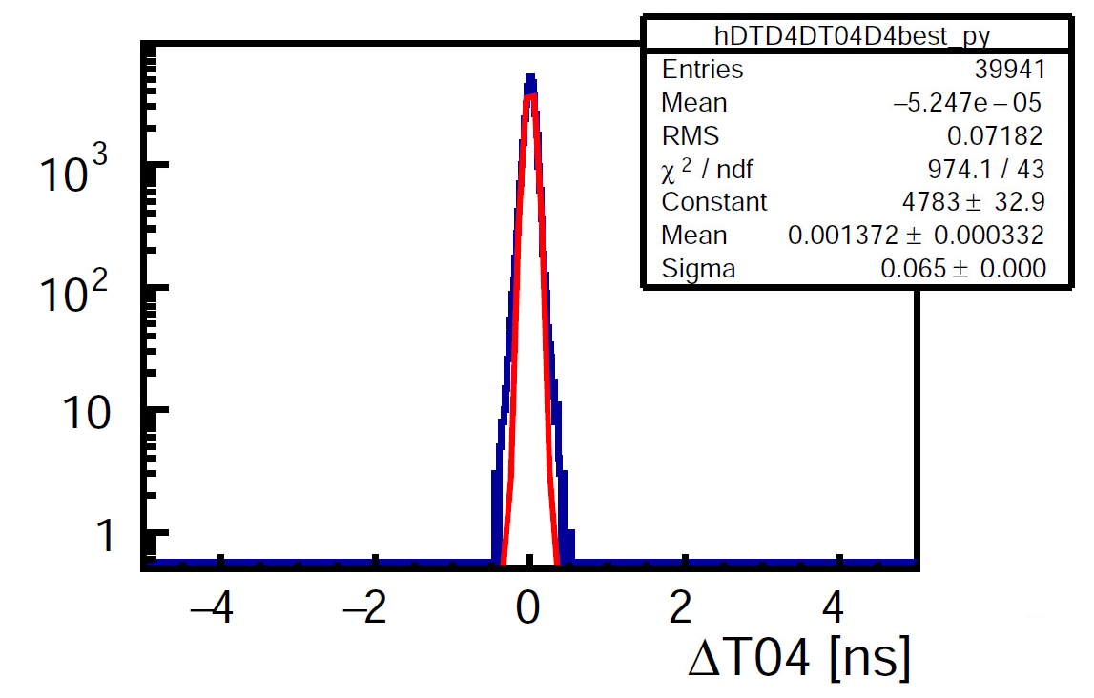
Beam-time @ SPS in
Nov. 2016
MRPC3b
Dut: 911
Mref: 910
Bref: 500
Sel2: 921
System time resolution
Backup Slides
Cuts:
χ²(Dut-Mref) = 10
χ²(Mref-Sel2) = 3
Selected Mref area 0.5
Efficiency about 93%
80 Ω
Analysis ongoing
1 ns

Slide 19

ToF – Project Timeline
RPC type | res. material | efficiency | time resolution | rate capability
Ceramic MRPC | Ceramic | ≈ 90 % | ≈ 100 ps | ≈ 150 kHz/cm²
MRPC1/2 | sem. glass | > 95 % | ≈ 50 ps | > 30 kHz/cm²
MRPC3a | sem. glass | > 95 % | ≈ 60 ps | > 30 kHz/cm²
MRPC3b | float glass | > 95 % | ≈ 50 ps | ≈ 1.5 kHz/cm²
The prototype MRPC counters fulfill the CBM TOF requirements
Time line
Full-size demonstrator end 2012
TDR approved mid. 2015
Full-size modules mid. 2015
Full-size modules with ‘final’ electronics mid. 2016
Construction of the modules 2017- 2020
Integration in STAR@RHIC@BNL 2017- 2018
eTOF ready for beam 01.01.2019
Integration in CBM@SIS100@FAIR 2019- 2021
ToF ready for beam 01.06.2023

Slide 20
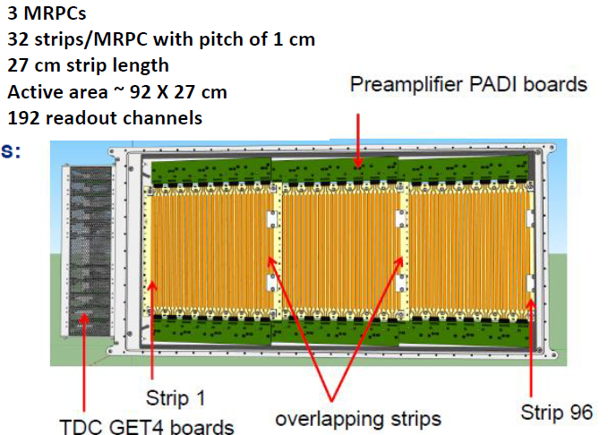
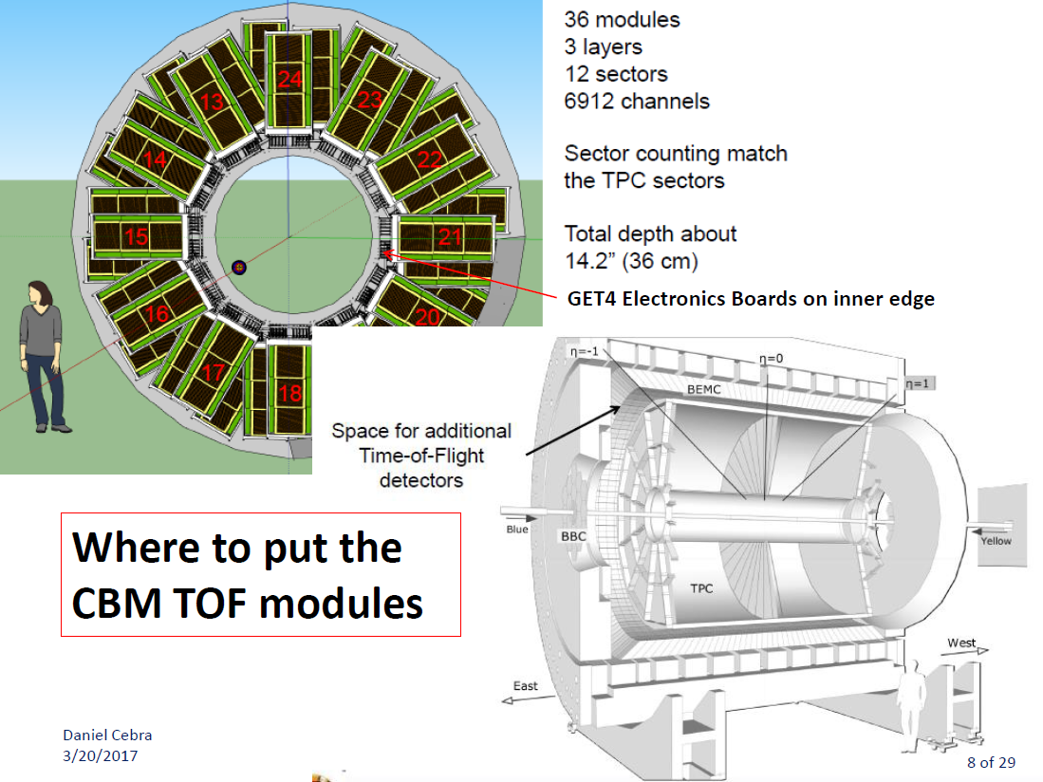
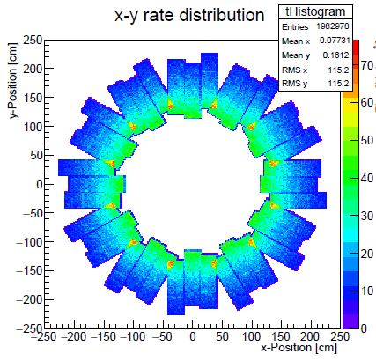
The TOF FAIR Phase 0 program
Location of CBM eTOF modules
Particle flux < 45 Hz/cm², Multi-hit probability < 7.4%

Slide 21
The TOF FAIR Phase 0 program
Benefit for STAR:
providing critical TOF coverage for BES II
- PID extension to y = 1.2 in collider mode
- access to energies from 4.5 to 7.7 GeV in the fixed target program
Benefit for CBM:
providing a large-scale integration test of the CBM TOF system, including PID and calibration of the detectors (hardware and software)
preparation for day one experiment at SIS 100
Benefit for CBM-TOF group members:
participation in the analysis of the physics data provided by the CBM TOF detectors, including authorship of any publications from this data.

Slide 22
The TOF FAIR Phase 0 program
Milestones
Summer 2016 shipping a real size module to BNL and installing it on the east side pole of STAR
Feb. 2017 1st system integration test with one module by participating in the Run17 beam time in STAR
Fall 2017 shipping and installation of one sector
Feb. 2018 2nd system integration test with one sector by participating in the Run18 beam time in STAR
Summer 2018 shipping all 36 modules including infrastructure (gas system, LV-, HV-power supply) to BNL
Fall 2018 Installation and commissioning
Feb 2019 Start of the BES II campaign
Summer 2021 Decommissioning and shipping of all modules including infrastructure to FAIR

Slide 23
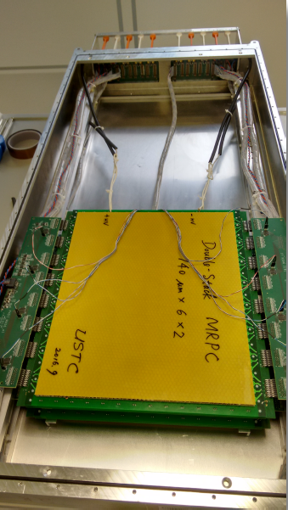


The TOF FAIR Phase 0 program
Module installation in Oct. 2016
Open module
Module fixed at the pole-tip
Running
(Mar. 2017)
about
100 Hz/cm²

Slide 24
Summary and outlook
CBM TOF started system performance tests under realistic load conditions
Counters maintain their performance so far
Preproduction about to start (QC, QA procedures initiated)
R&D for BFTC ongoing
FAIR phase 0 started - looking forward to physics
80 Ω
1 ns

Slide 25



Thank you for your attention
Contributing institutions:
Tsinghua Beijing,
NIPNE Bucharest,
GSI Darmstadt,
IRI Frankfurt
USTC Hefei,
PI Heidelberg,
ITEP Moscow,
HZDR Rossendorf,
CCNU Wuhan,
Special thanks go to:
Norbert Herrmann

Slide 26
Backup
Backup Slides
80 Ω
1 ns

Slide 27

Backup Slides
CBM Physics topics
Deconfinement / phase transition
at high ρ_{B}
QCD critical endpoint
The equation-of-state at high ρ_{B}
chiral symmetry restoration at
high ρ_{B}
Observables
excitation function and flow of strangeness
and charm
collective flow of hadrons
particle production at threshold energies
excitation function of event-by-event
fluctuations
excitation function of low-mass lepton
pairs
in-medium modifications of hadrons
(ρ,ω,φ → e+e-(µ+µ-), D)
D. Kresan Au + Au @ 25GeV
π
p
K
non twisted part
connector
Kaon acceptance depends critically on TOF resolution

Slide 28

PID capability
80 Ω
1 ns

Slide 29




Working principle of an RPC
First Multi-gap RPC 1996
E. Cerron Zeballos et al., Nucl.Instrum.Meth. A374 (1996) 132-13
E. Cerron Zeballos et al., Nucl.Instrum.Meth. A374 (1996) 132-136
Time resolution:
Efficiency:
φ: incident ch. particle flux, ρ: electrode bulk resistivity, d: electrode thickness
How to increase the rate capability?
ρ ≈ 3x10¹² Ωcm
ρ ≈ 10¹⁰ Ωcm
E₀ = 120 kV/cm

Slide 30

Backup Slides
Engineering design of the CBM experiment
TRD
TOF
Nominal ToF position is between 6 m and 10 m from the target
RICH
Magnet
Movable design allows for optimization of the detection efficiency of weakly decaying particles (Kaons)

Slide 31

Backup Slides

Slide 32



Backup Slides

Slide 33

Backup Slides

Slide 34

Production Readiness Review
Freeze the design by March. Start counter assembly from April.
Produce 10 MRPC3a/b as “Pre-mass production”.
Check the performance and use for summer installation @ STAR.
Finish production by November.
Send to Heidelberg in three batches.
80 Ω
1 ns

Slide 35

Beam-time @ SPS in
Nov. 2015
Event display after position calibration
1 Track (blue) with hit multiplicity 8
2 Tracks (green) with hit multiplicity 7
1 Track (light blue) hit with multiplicity 6
1 Track (pink) with hit multiplicity 5
Tracks
RPC layers
The opportunity to reconstruct tracks offers new possibilities to analyze and study the counters in much greater detail:
multi hit response,
2d position dependencies
RPC Hits

