Slide 1
Progress with System Integration of the CBM Silicon Tracking Detector
Johann M. Heuser, GSI Helmholtz Center for Heavy Ion Research, Darmstadt, Germany
for the CBM Collaboration
DPG Frühjahrstagung, Münster, Germany, 27 March 2017

Slide 2
STS - Task & integration challenges
pile-up free track point determination in high-rate collision environment:
10⁵ − 10⁷/s (A+A), up to 10⁹/s (p+A), track multiplicities up to 700/collision
momentum resolution Δp/p ≈ 1-2%
physics aperture : 2.5° ≤ Θ ≤ 25°
8 tracking stations: 0.3 m ≤ z ≤ 1.0 m
material : ≈ 0.3 % – 1% X₀ per station
896 detector modules , 106 ladders
double-sided silicon microstrip sensors
hit spatial resolution ≈ 25 µm
operation at T = -5 °C (radiation field)
1.8 million r/o channels, 14 000 r/o ASICs
time-stamp resolution ≈ 5 ns
power dissipation: ≈ 40 kW
STS ladder arrangement

Slide 3
STS - Task & integration challenges
pile-up free track point determination in high-rate collision environment:
10⁵ − 10⁷/s (A+A), up to 10⁹/s (p+A), track multiplicities up to 700/collision
momentum resolution Δp/p ≈ 1-2%
physics aperture : 2.5° ≤ Θ ≤ 25°
8 tracking stations: 0.3 m ≤ z ≤ 1.0 m
material : ≈ 0.3 % – 1% X₀ per station
896 detector modules , 106 ladders
double-sided silicon microstrip sensors
hit spatial resolution ≈ 25 µm
operation at T = -5 °C (radiation field)
1.8 million r/o channels, 14 000 r/o ASICs
time-stamp resolution ≈ 5 ns
power dissipation: ≈ 40 kW
Challenges:
precision assembly of modules, ladders, stations
cooling of front-end electronics
cold sensors – thermal enclosure
routing of cables/cooling tubes
installation into dipole magnet
STS ladder arrangement

Slide 4
Integration – from modules to stations
front-end board in cooling block
896 modules
ultra-thin r/o cables
sensor
C-frame
read-out + power boards
8-10 modules
8 tracking stations
18 mechanical half-units
106 ladders

Slide 5
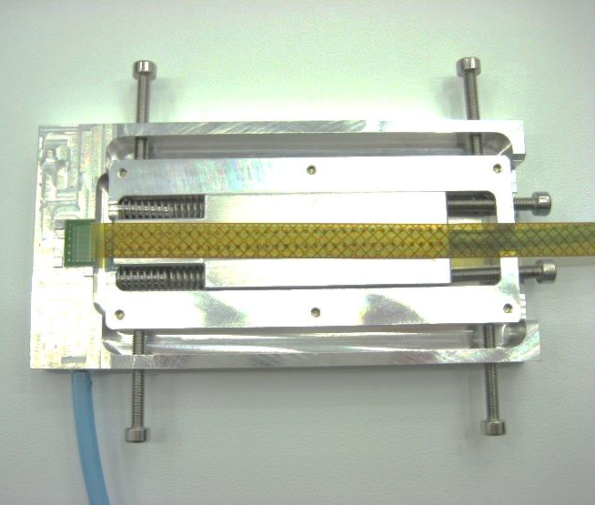
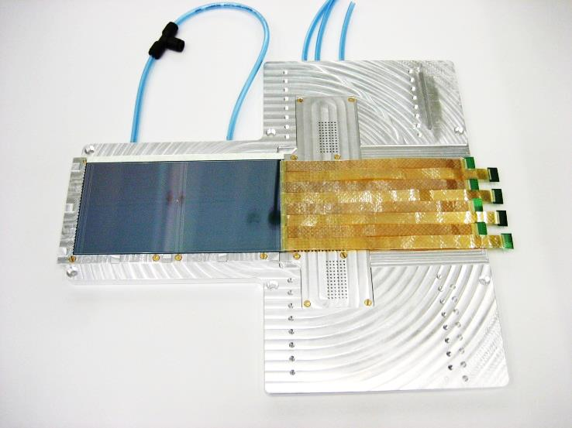
Progress with module assembly
GSI-Detector Lab
Work flow, per side:
TAB bonding of microcables to ASICs
TAB bonding of microcables to silicon sensor
die- and wire-bonding of ASICs to FEB
gluing of shielding layers and spacers

Slide 6
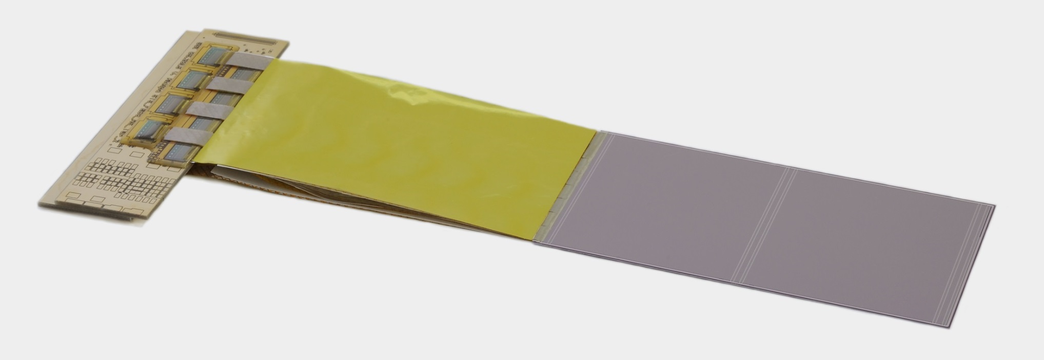
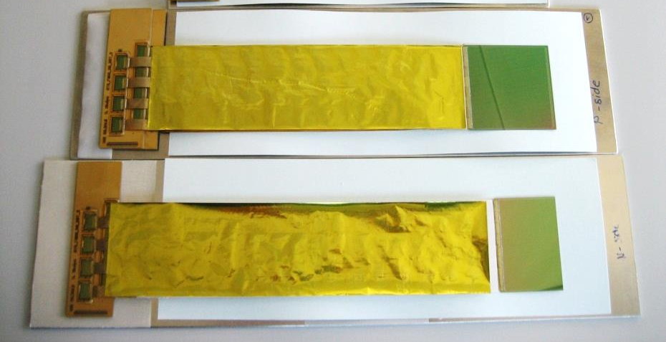
Progress with module assembly
dummy modules produced during set-up of assembly line

Slide 7
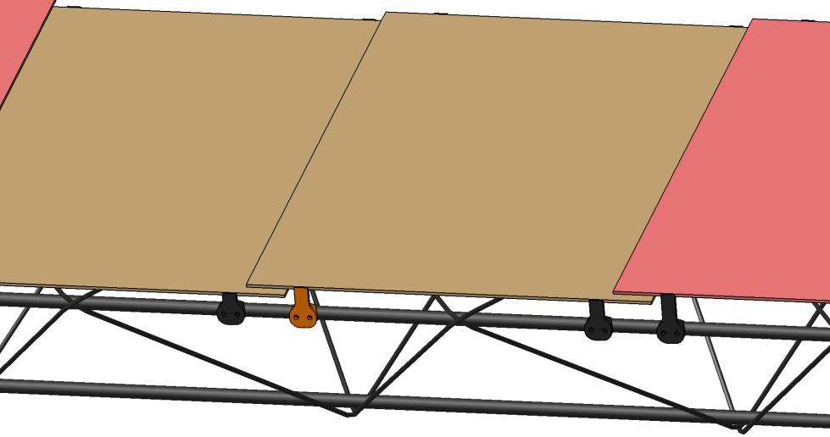
Detector ladders
fixed bearing side
silicon sensors
floating bearing side
ladder holder
carbon ladder
sensor mounting with “L-legs”
Beampipe cut-out for central ladders

Slide 8
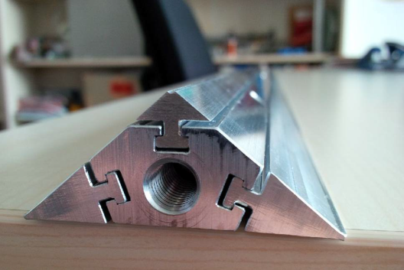
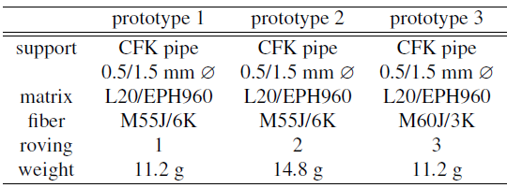
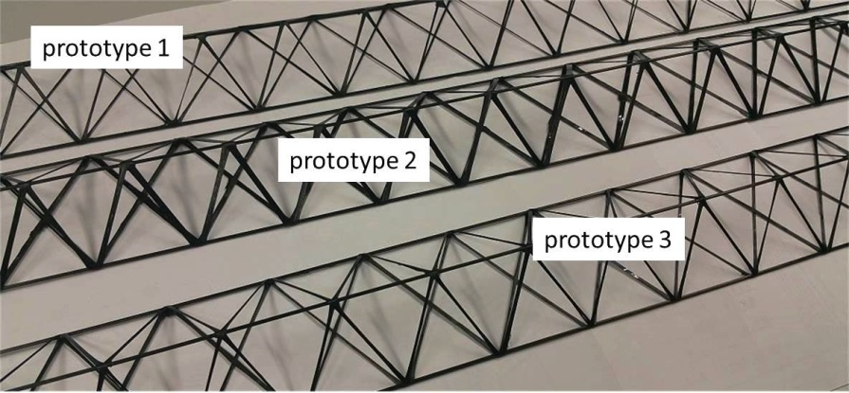
Carbon fiber ladders
prototypes made in aerospace industry, Germany
hub
hub from Al, 130 cm long
carbon fiber structure dimensions:
base: 6.1 cm
height: 2.0 cm
length: 120 cm
tube supports: 1.5/0.5 mm ∅

Slide 9
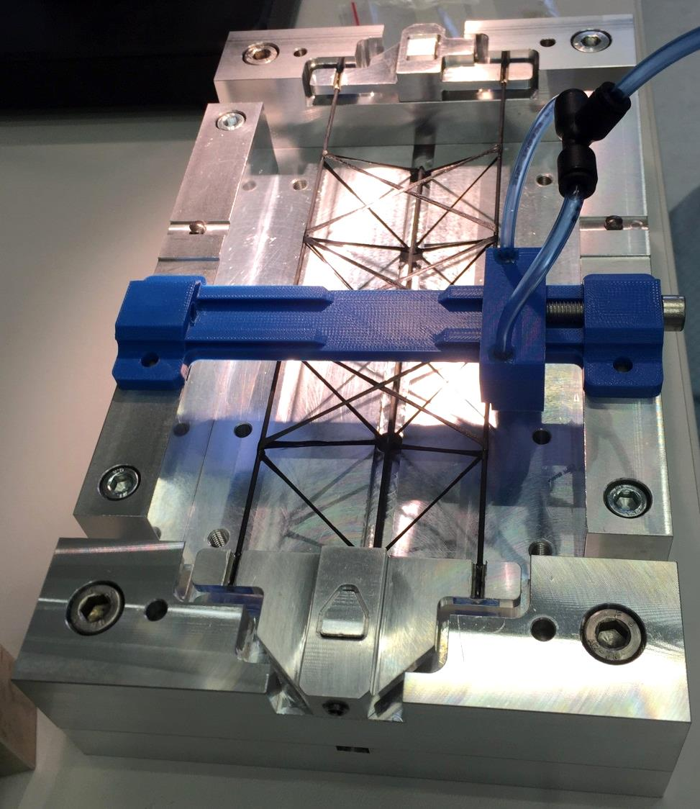
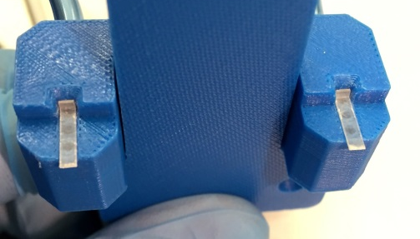
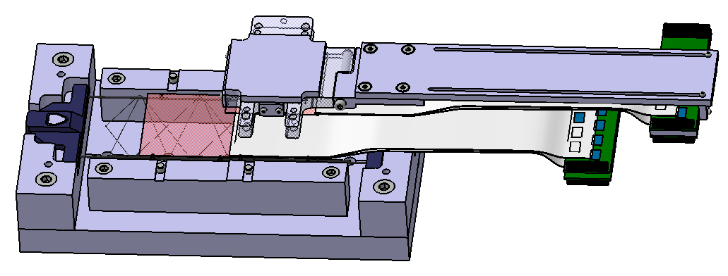
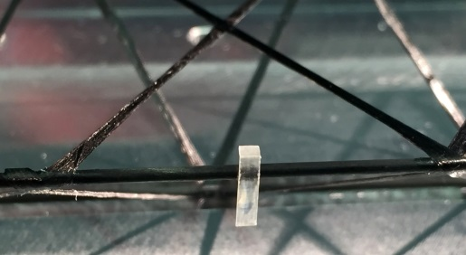
Progress with ladder assembly
concept tool
sensor 1
sensor 2

Slide 10
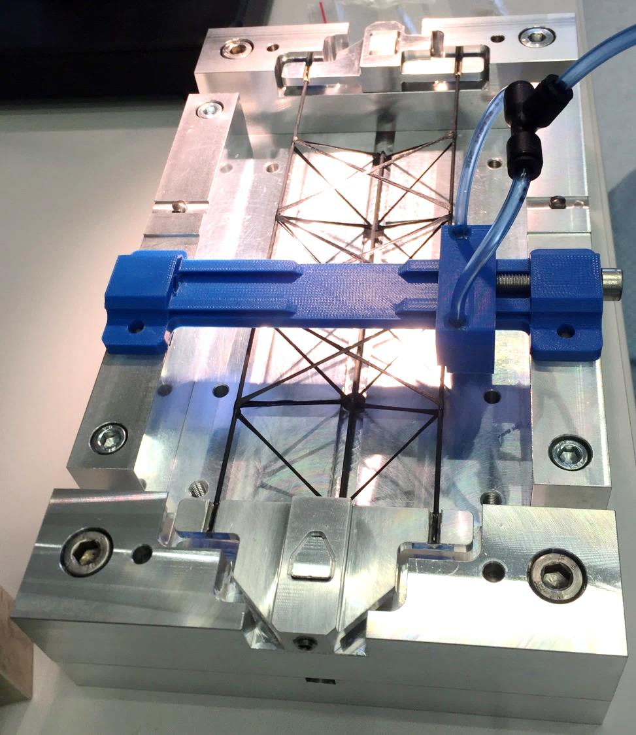
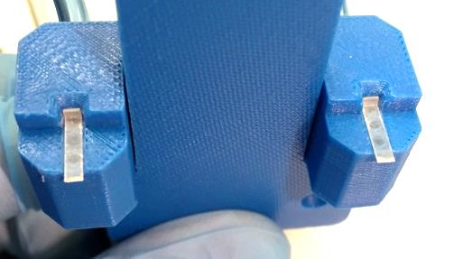
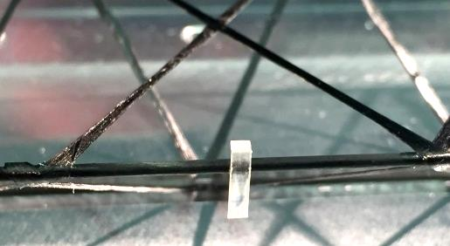
Progress with ladder assembly
concept tool
sensor 1
sensor 2

Slide 11
Progress with ladder assembly
concept tool
sensor 1
sensor 2
placement accuracy < 100 μm
optical survey
position refinement with tracks < 10 μm

Slide 12
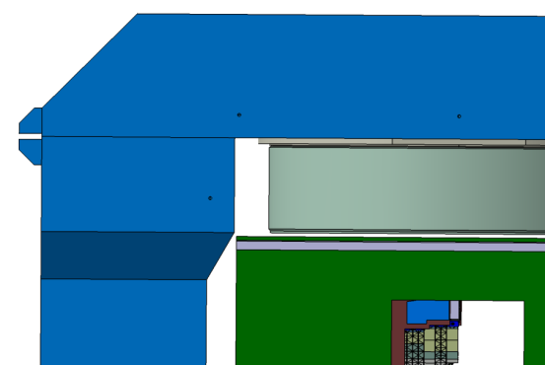
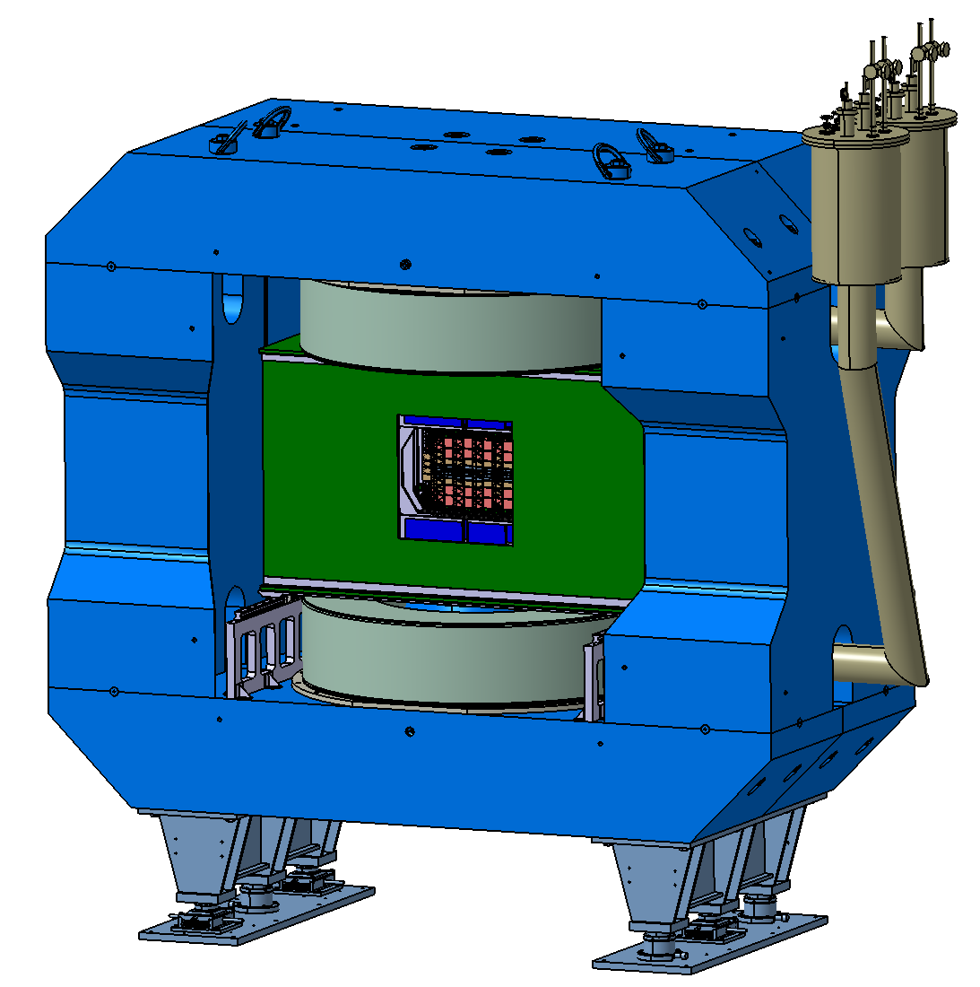
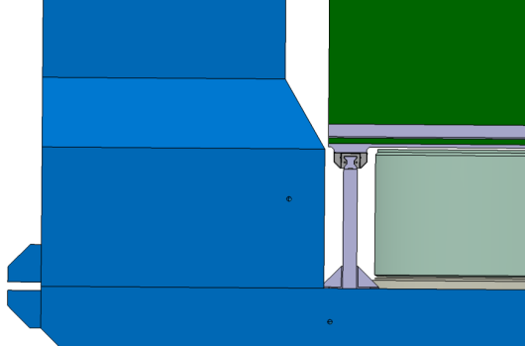
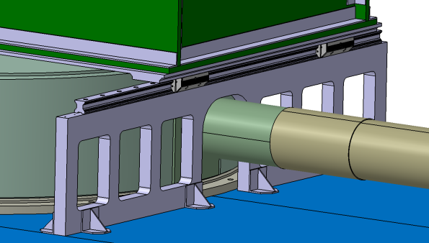
STS in Dipole Magnet
top magnet coil
300 cm
20mm
144 cm
bottom magnet coil
Rail
Baseplate
Runner block
8mm
Thermal
insulation box
Rail support
Cryogenic pipe

Slide 13
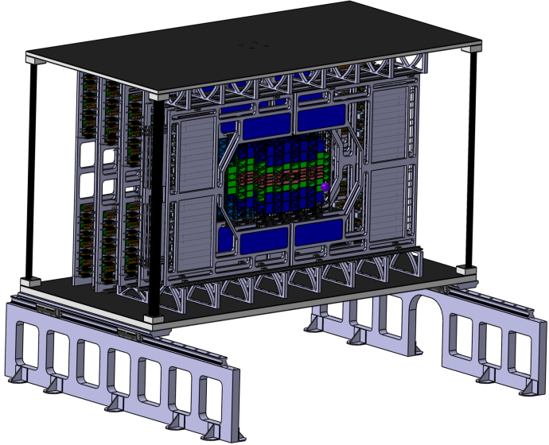
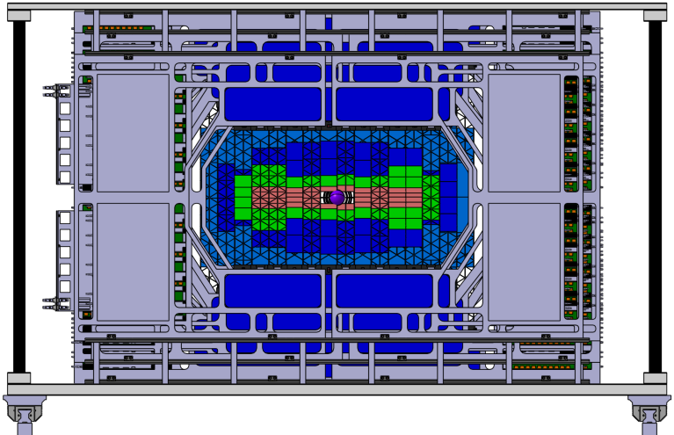
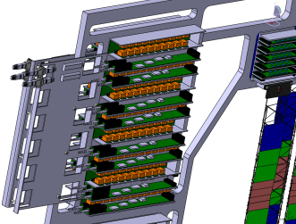
Progress with STS CAD model
Cable Stacks
Design concept:
Cable routing
Unit disassembly
Integrated design
Thickness: 40mm
CF composite
Filler material/structure
Peripheral cabling design
Sandwich concept:
Lightweight and stiff
Parameters depend on filler material
Versatile configuration
Further development requires:
Thermal testing
Requirement summary
Coordination with industrial manufacturers
Further CAD development:
Finalize cabling concept
Schematic cable routing
Integrated design

Slide 14
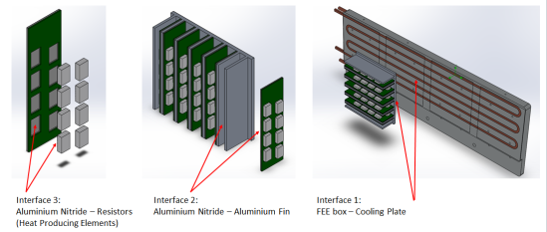
Construction of a mock-up STS
¼ Unit 07 – detailed CAD:
Status:
CAD finished
Assembly ongoing
Final parts manufacturing
FEB dummies
ROB/POB dummies
Demo coolers
Cooling pipes
C-Frame integration
Testing of different types of ladder bearings:
Set-up to study thermal management of FEE
water cooling → CO2 cooling
CNC pin Al bearing
CNC pin Ceramic bearing
Dowel pin Al bearing
Ruby ball Fiberglas bearing

Slide 15
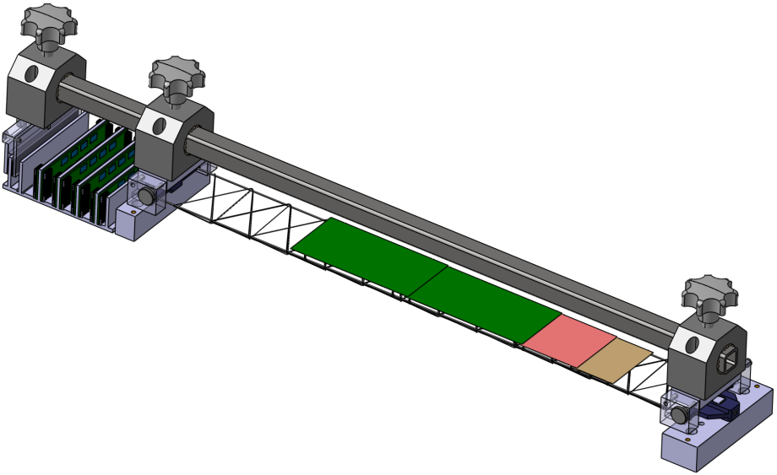
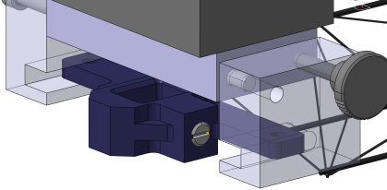
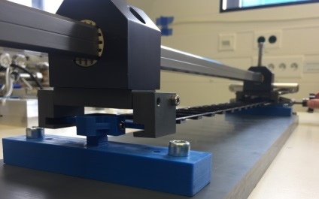
Development of ladder handling tool
[Square rail and brackets from IGUS]
Holding area
Longitudinal bearing fixture
FEB Box fixture
Lateral bearing fixture
Design issues:
Stress free ladder handling
Variable length for multiple ladder types
Mounting and dismounting from Master jig to C-Frame
Sufficient precision
Easy handling
Status
First prototype assembled
Tests ongoing
Mounting of Mock-up ladders planned

Slide 16
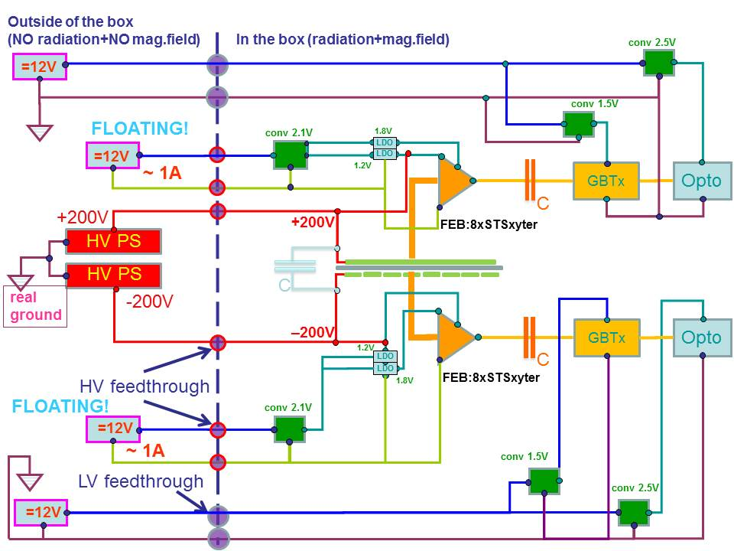
LV/HV powering scheme
Sensor bias: ± 200 V, common ground
FEE floating
ASIC powering: ~ 2.2 V, ca. 4 A (per FEB) by a FEAST DC/DC converter
Two LDOs convert to 1.8 V (digital) and 1.2 V (analog)
12 V, ca. 1 A, and HV are delivered from outside STS

Slide 17
Summary
Challenges of CBM-STS system integration:
precision assembly and mounting of its components, to yield the final spatial resolution
fast front-end electronics requires efficient cooling (CO2)
cold operation of sensors requires thermal enclosure
routing of services
installation in dipole magnet
Module assembly: fully developed, dummy modules produced.
FEB under development for functional modules
Ladder assembly: procedure and tooling under development
System integration:
CAD well advanced, in concept and detail
¼ unit demonstrator and cooling demonstrators under construction
electronics & powering components being produced
open topic: beam pipe section in STS
Aim to advance system integration towards production readiness in 2018.

Slide 18
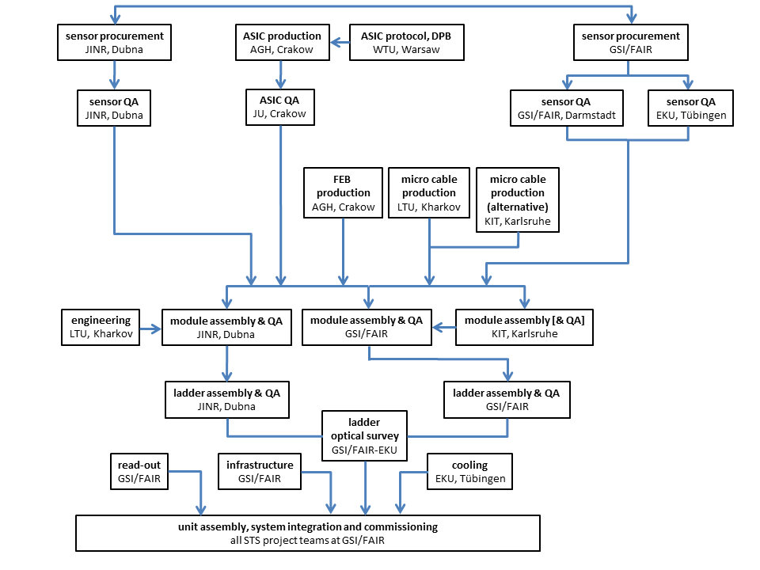
STS assembly and integration flow

Slide 19
Key project institutes:
GSI-FAIR, Darmstadt, Germany
JINR, Dubna, Russia
Univ. Tübingen, Germany
KIT, Karlsruhe, Germany
AGH, Cracow, Poland; JU, Cracow, Poland; WUT, Warsaw, Poland
Assembly Centers: GSI-FAIR, JINR -VBLHEP

