Slide 1
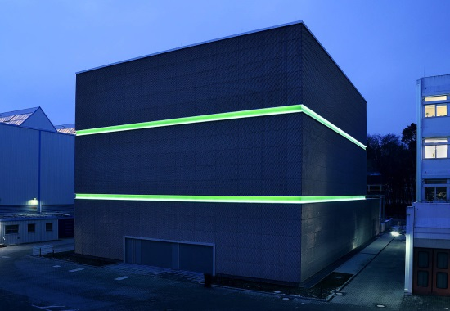
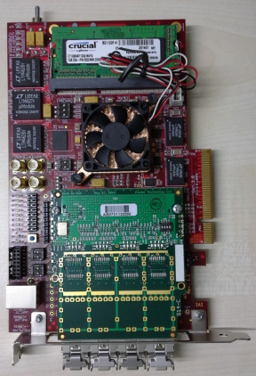
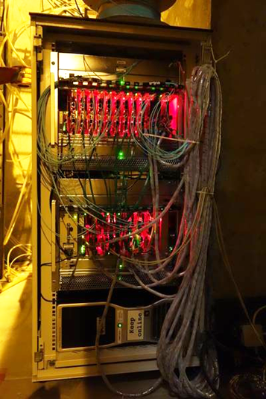
mCBM@SIS18 – a CBM full system test-setup at GSI
Christian Sturm et al. , GSI Helmholtz Center
for the CBM Collaboration
green cube
mCBM@SIS18 - a test facility for the
CBM FLES
(HK 15.1,J. de Cuveland
HK 63.6, D.Hutter)
CBM free-streaming DAQ System
(HK15.4,D. Emschermann)
FLIB
Introduction and status of the project:
Motivation and Concept
Present Design
Preparations

Slide 2
CBM experimental challenges
Perform measurements at unprecedented reaction rates
10⁵ - 10⁷ Au+Au reactions/sec
→ fast and radiation hard detectors
→ free-streaming read-out electronics
→ high speed data acquisition and
high performance computer farm for online event selection
→ 4-D event reconstruction
Identification
of leptons and hadrons
Determination of
(displaced) vertices (σ ≈ 50 μm)
Central Au+Au at 25 A GeV / UrQMD+GEANT4:
160 p, 400 π⁺, 400 π⁺, 44 K⁺, 13 K⁻

Slide 3
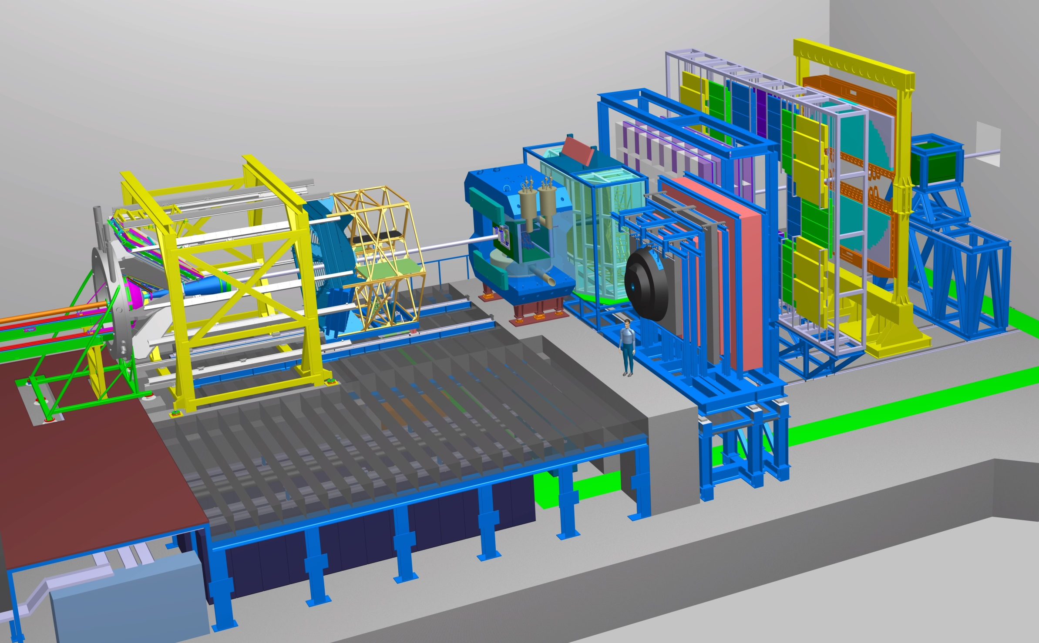
The CBM experiment
Time of Flight
Detector
ECAL
Transition
Radiation
Detector
Ring
Imaging
Cherenkov
Dipol
Magnet
Projectile
Spectator
Detector
Micro
Vertex
Detector
Silicon
Tracking
System
HK 30.1, J. Lehnert
Muon
Detector
DAQ/FLES HPC cluster

Slide 4
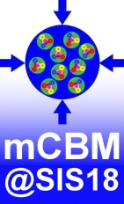
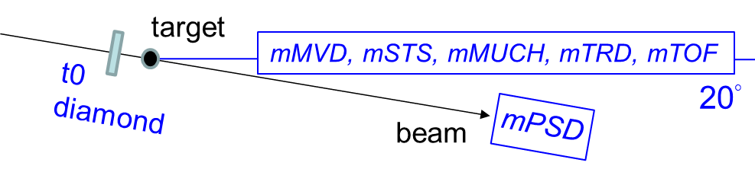
Motivation and Concept
mCBM@SIS18 - a CBM full system test-setup in high-rate
nucleus-nucleus collisions at GSI/FAIR, 2017 – 2021
with focus on the
free streaming data transport to a mFLES or FLES
online reconstruction
offline data analysis
controls
permanent test-setup at the host lab
test of final detector prototypes
detector prototypes at θ_{lab} ≈ 15° - 20°
straight tracks, no B-field
high resolution TOF (t₀ – TOF stop wall)
event characterization with PSD prototype

Slide 5
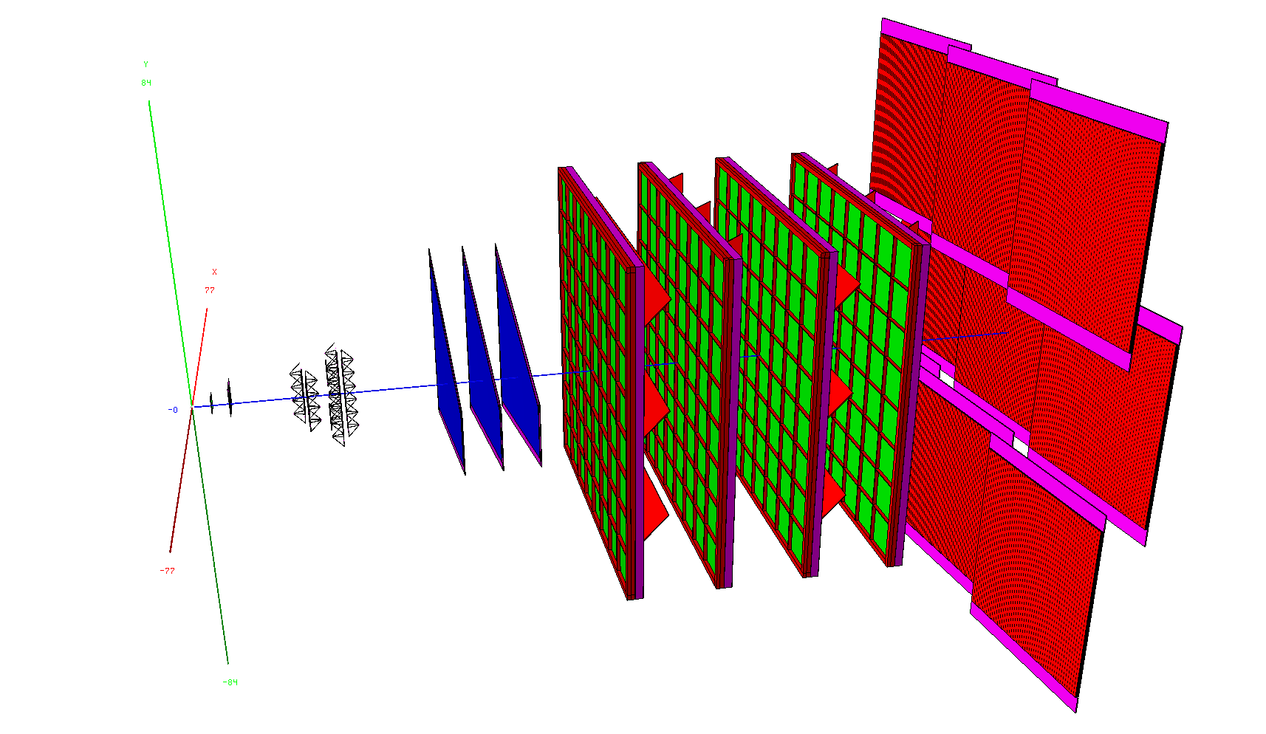
Present design of mCBM@SIS18
side view
mTOF
mTRD
mMUCH
mSTS
mMVD
2.5m

Slide 6
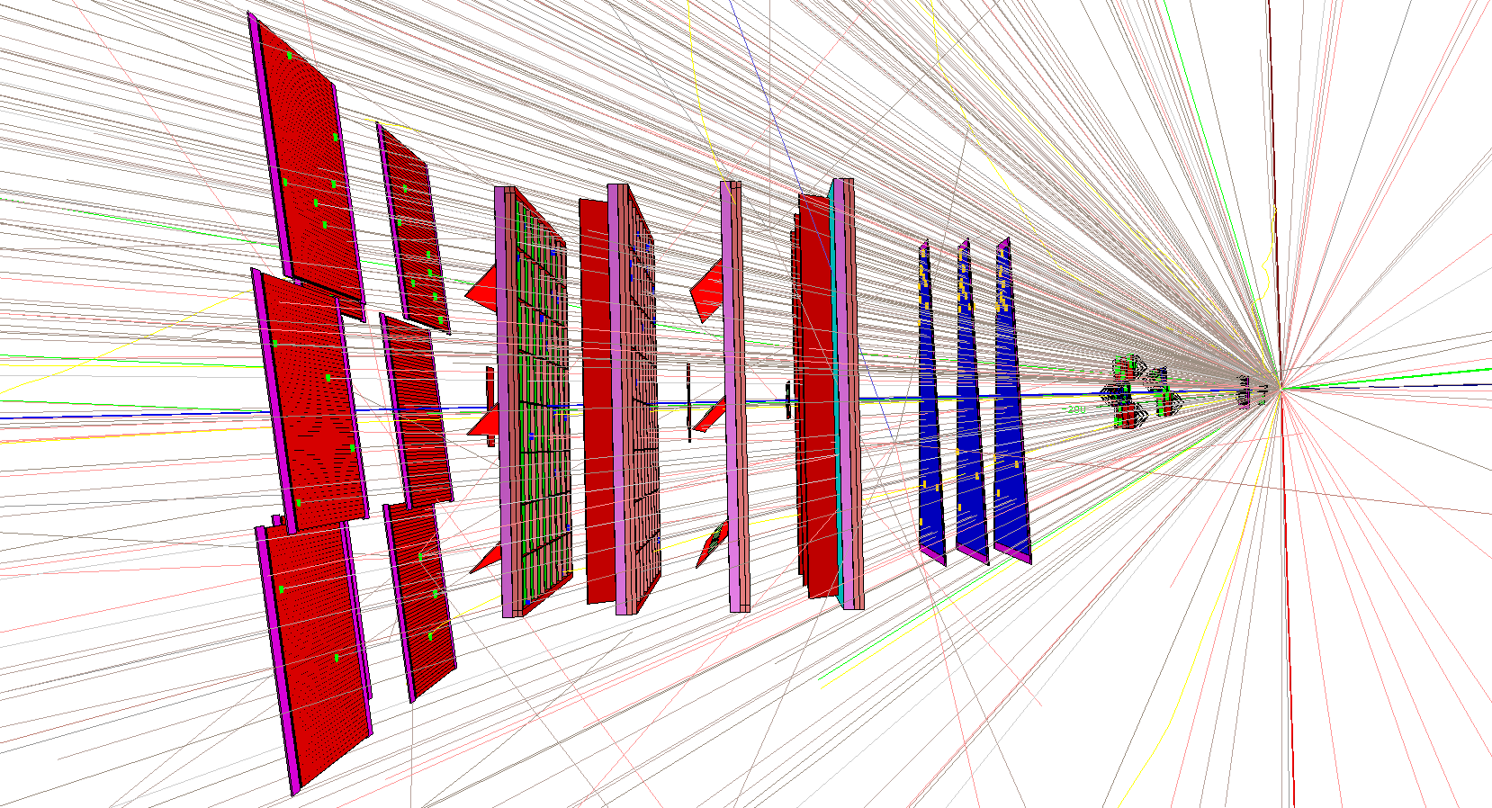
Present design of mCBM@SIS18
top view
mTOF
mTRD
mMUCH
mSTS
mMVD
UrQMD event:
Ag+Ag 1.65 AGeV
central collision
First results from
simulation: < M_{track} > ≈ 7

Slide 7
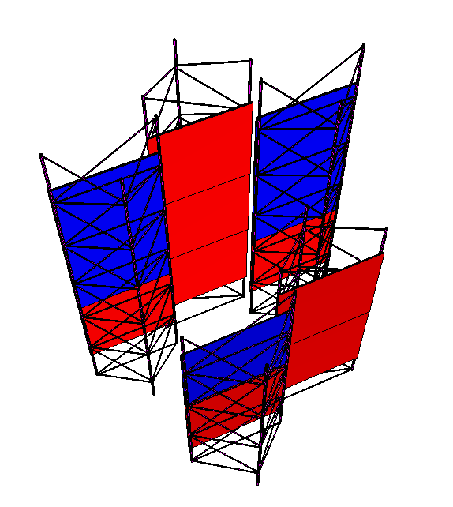
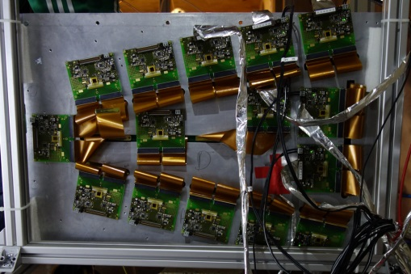
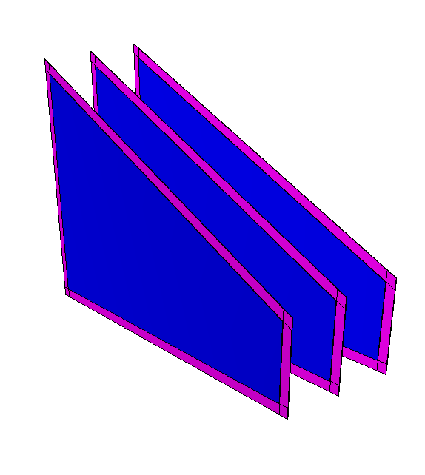
mCBM - contributions by subsystems: STS and MUCH
mSTS
mMUCH
SPS2016
mSTS: 2x stations
1st: 2x2 modules
2nd: 3x3 modules
= 5 half-ladders
= 13x 6x6 cm² sensors
all components available
... except FEB-8
mMUCH: 3x layers
3x M2 GEM modules
18x FEBs per module (STS-XYTER)
used during CERN beamtest 2016

Slide 8
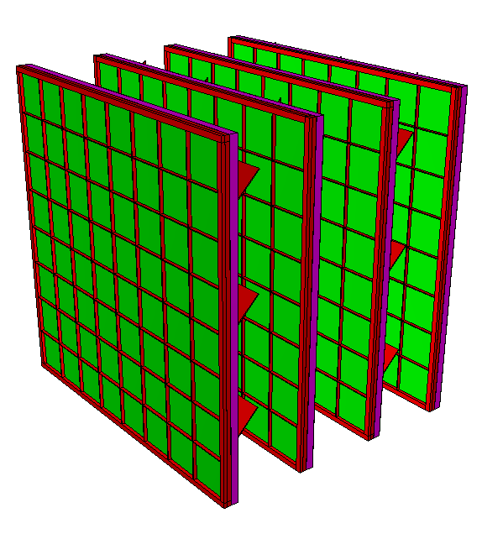
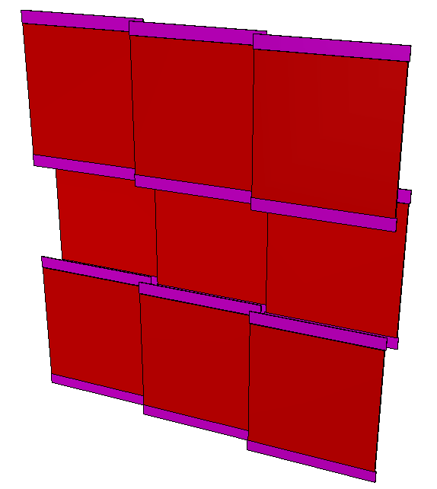
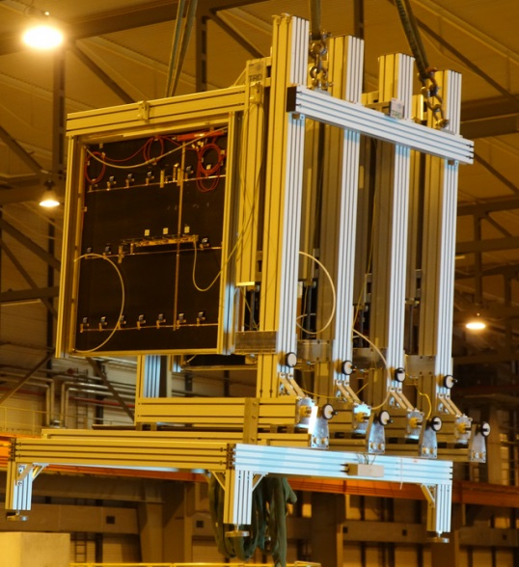
mCBM - contributions by subsystems: TRD and TOF
mTRD
mTOF
SPS 2016
mTOF:
3x STAR modules
3x MRPC counter / module
read-out scheme is identical
to the STAR setup
mTRD: 4 layers
TRD modules (Frankfurt/Münster)
incl. read-out from CERN test beam
Nov./Dec. 2016

Slide 9
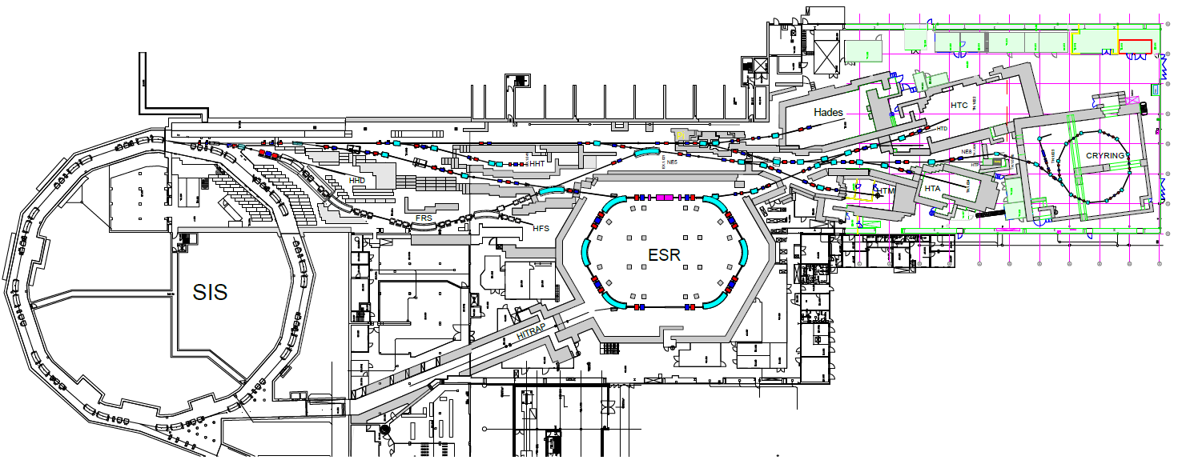
Present GSI SIS18 Facilities

Slide 10
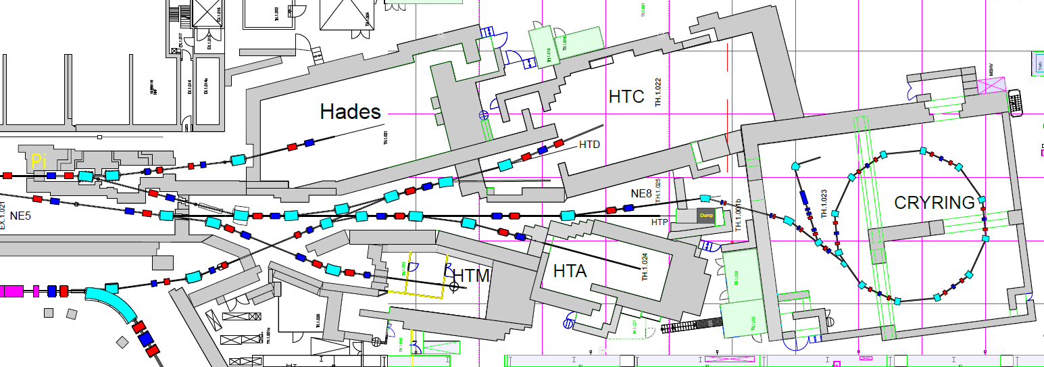
Zoom-in: Present SIS18 Target Hall
HADES
R3B
BioMat

Slide 11
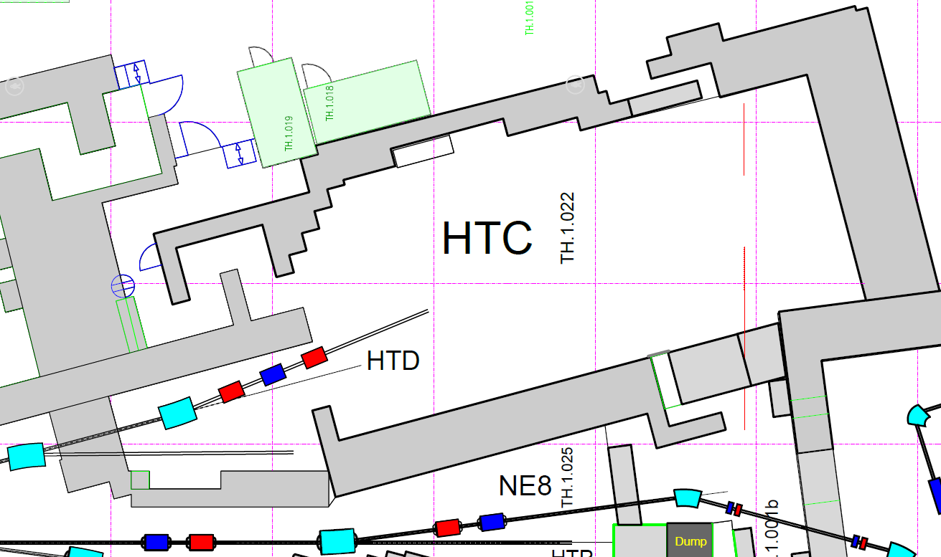
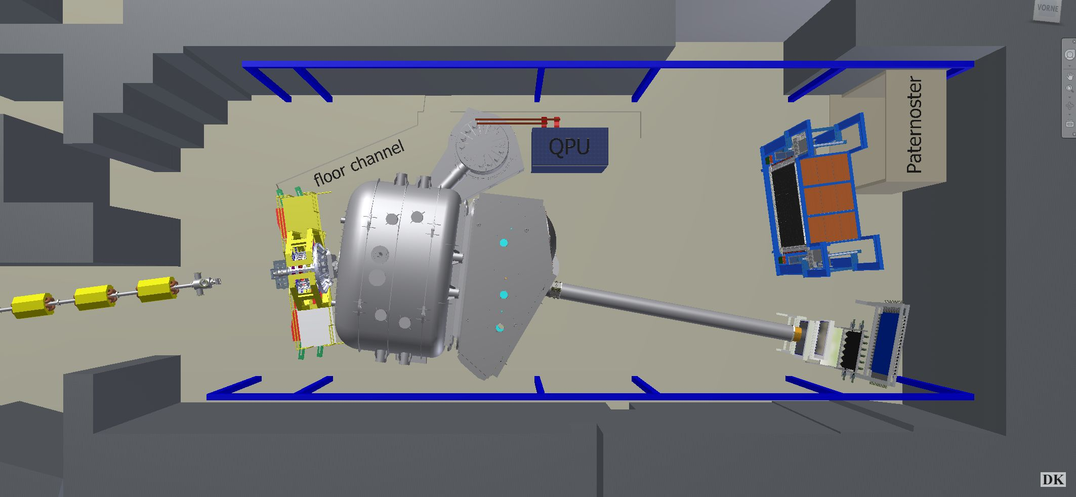
Cave C and HTD Test Stand
Cave C
R³B
HTD

Slide 12
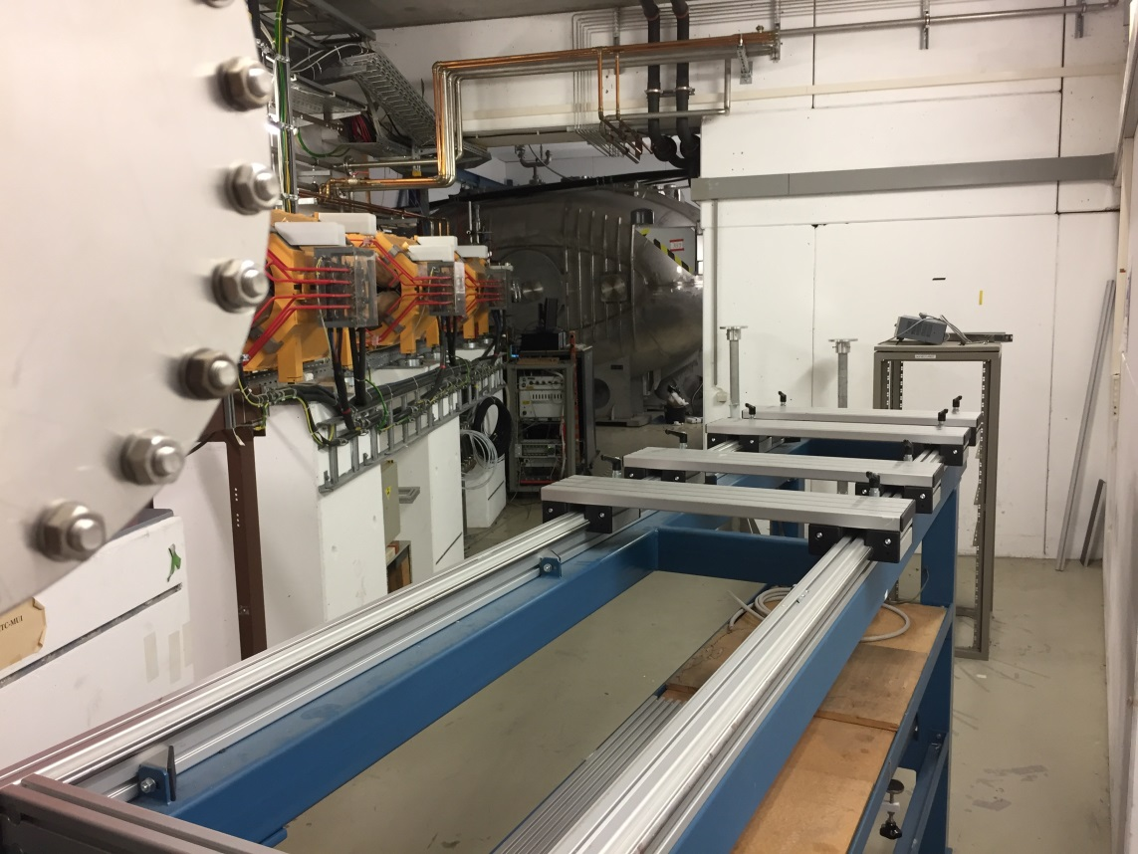
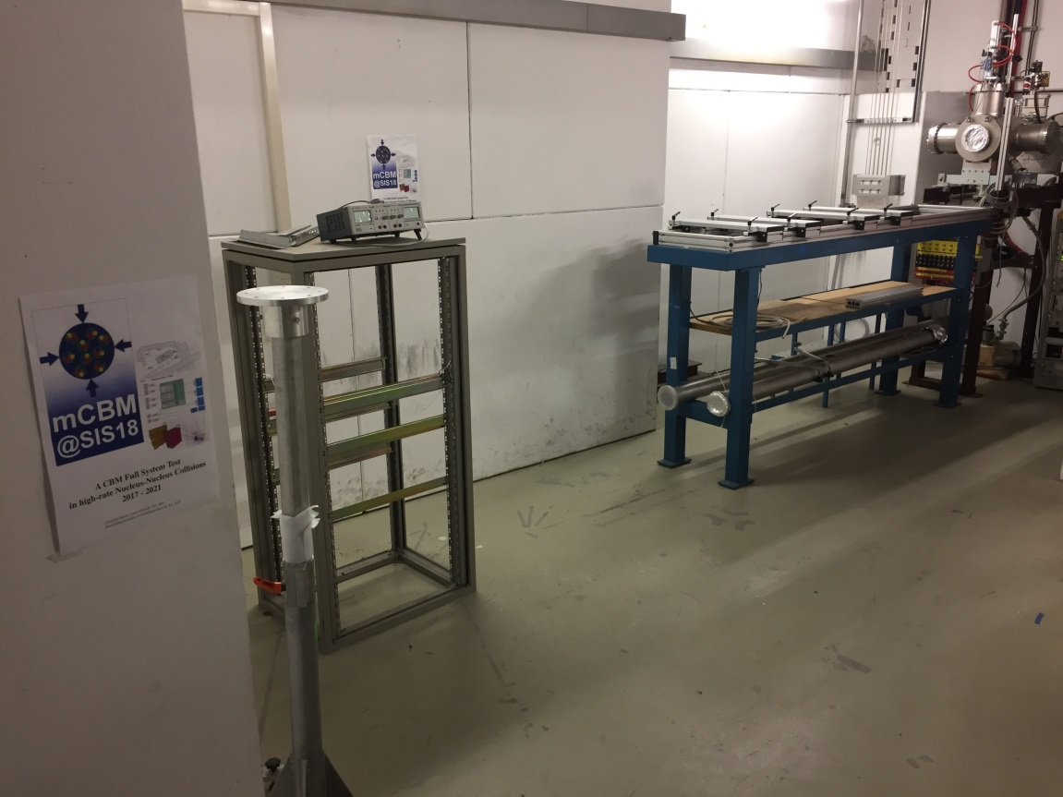
mCBM Cave - HTD at present
March 24th, 2017

Slide 13
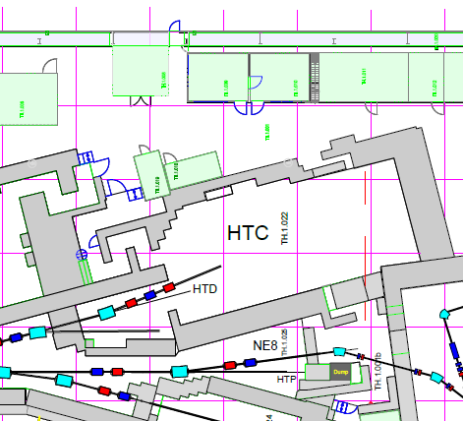
mCBM – support infrastructure
gas area
counting house
DAQ container
mCBM
cave
Green Cube

Slide 14
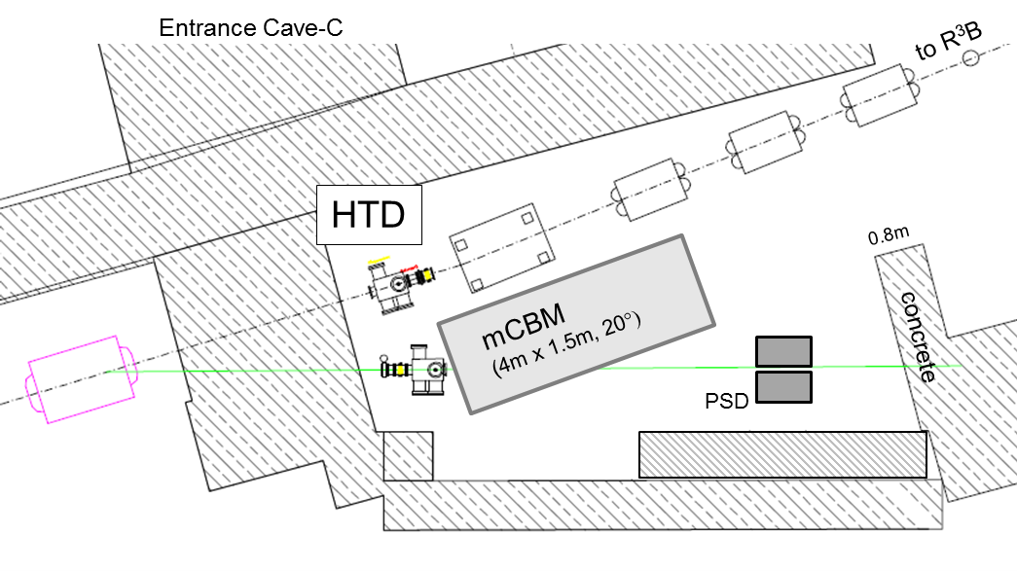
Sketch of the mCBM Cave – Test Stand HTD

Slide 15
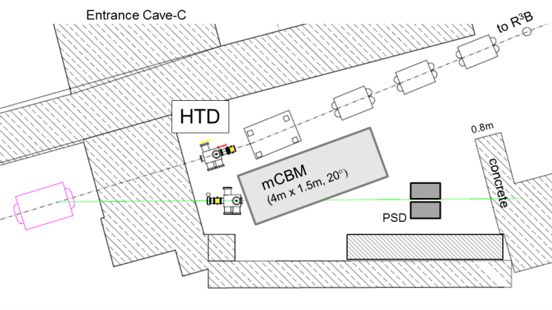
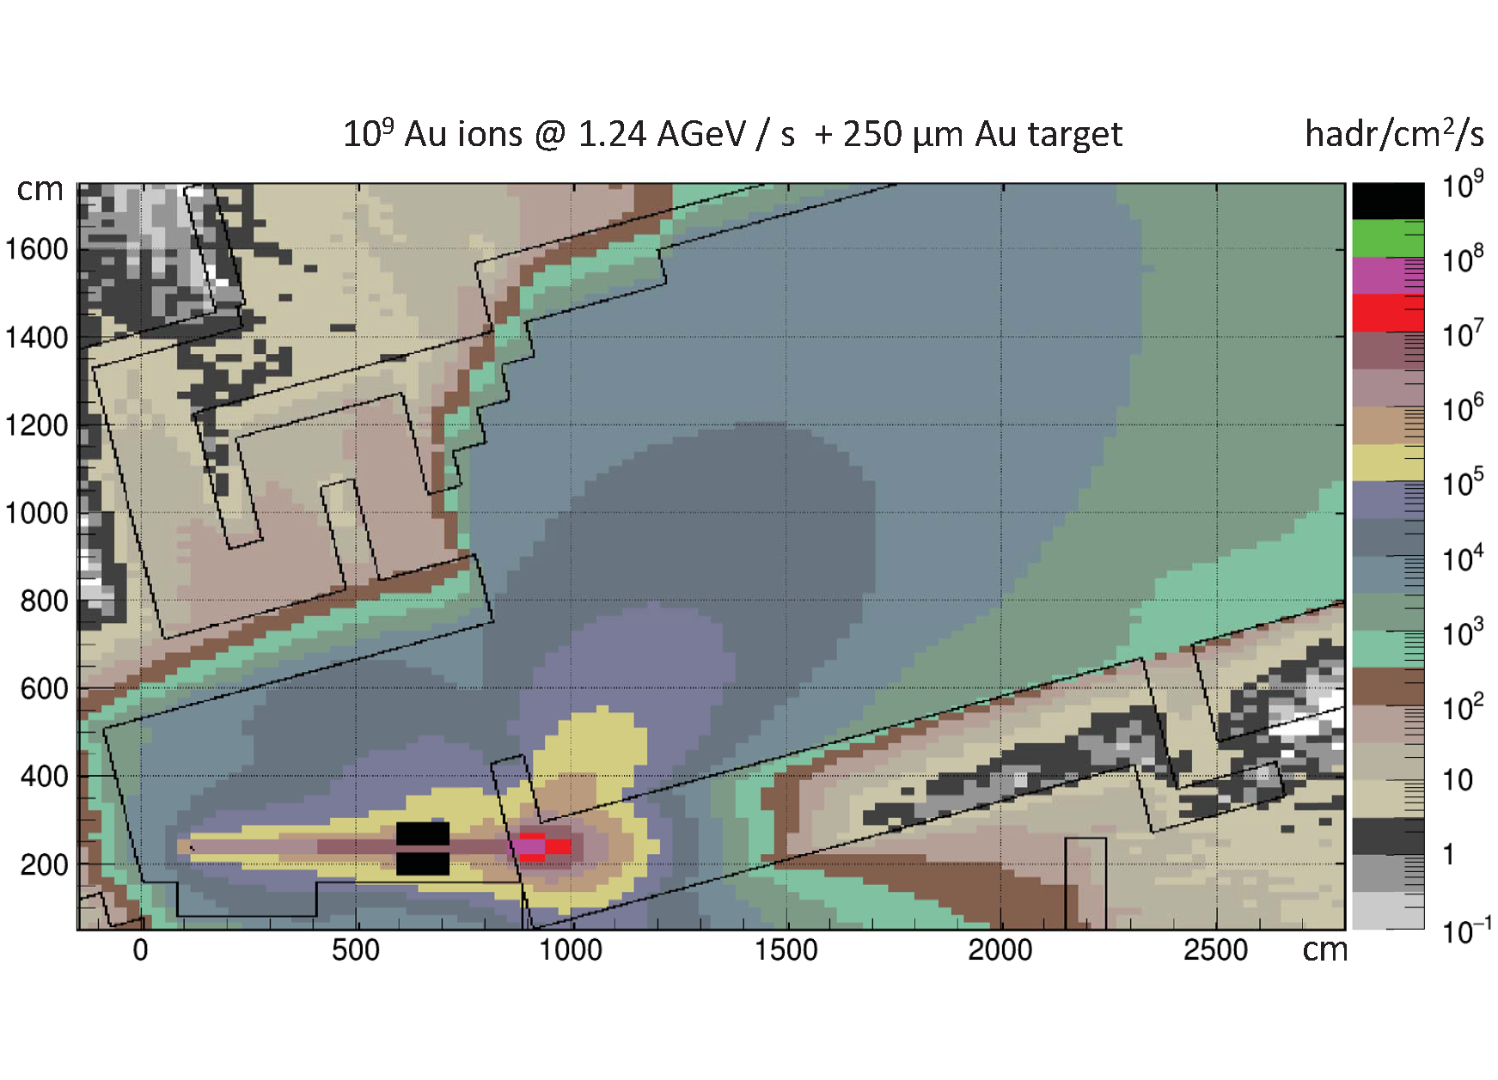
Radiation level simulation at top SIS18 energies and CBM collision rates
FLUKA simulation

Slide 16
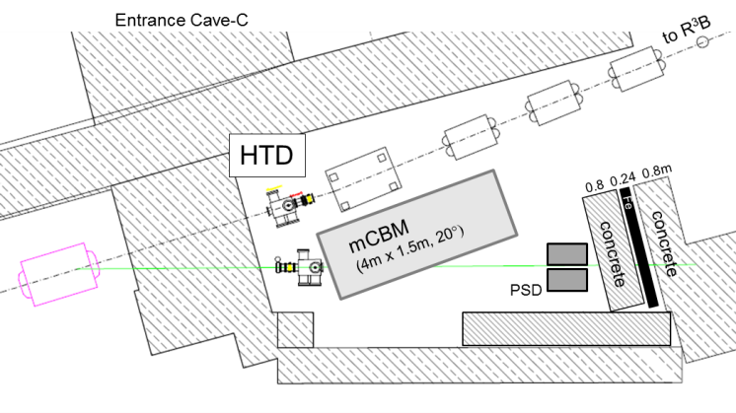
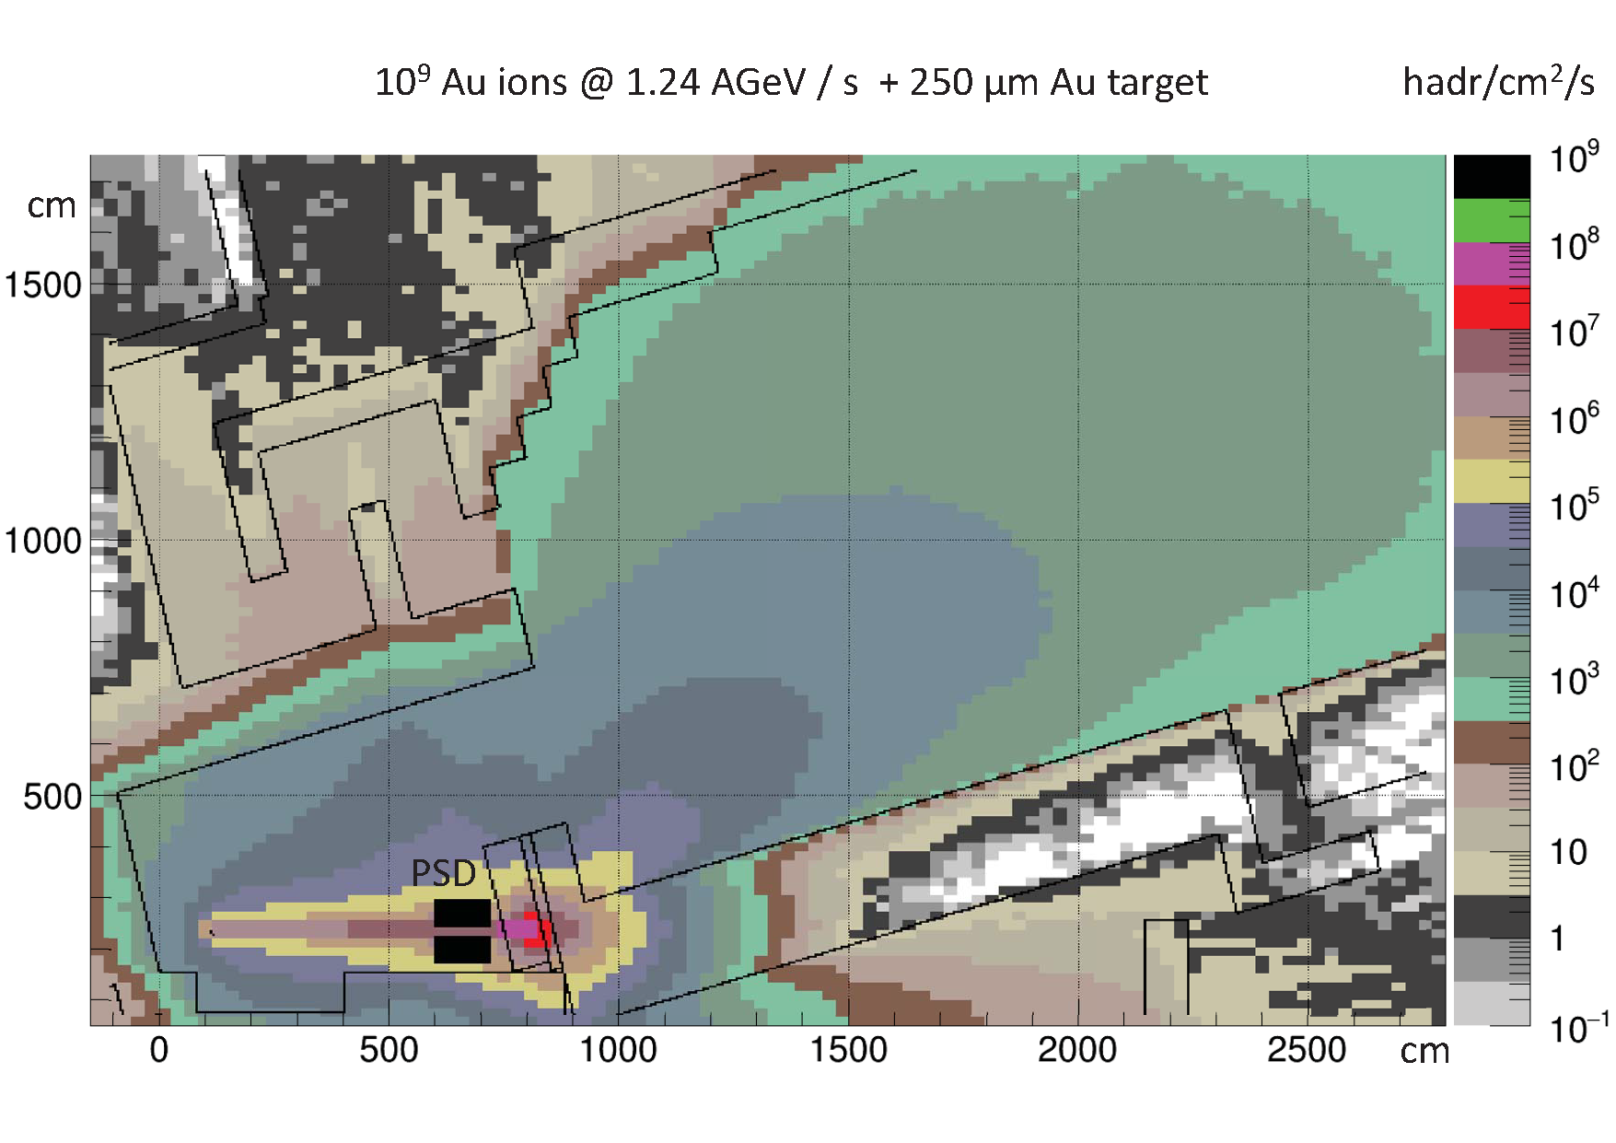
Radiation level simulation at top SIS18 energies and CBM collision rates
FLUKA simulation

Slide 17
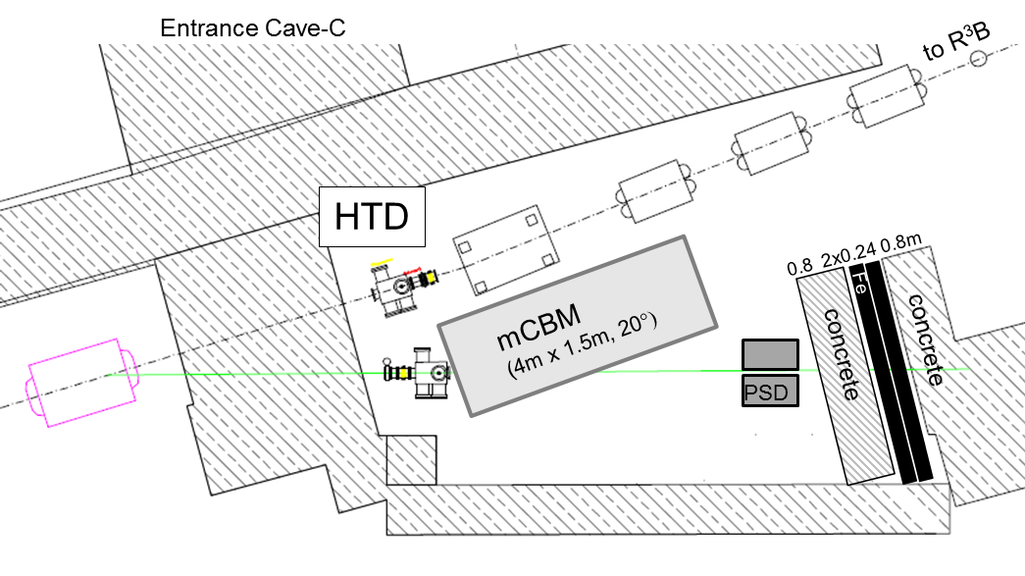
Additional shielding required
Additional iron and concrete layer
radiation level simulation
optimization ongoing

Slide 18
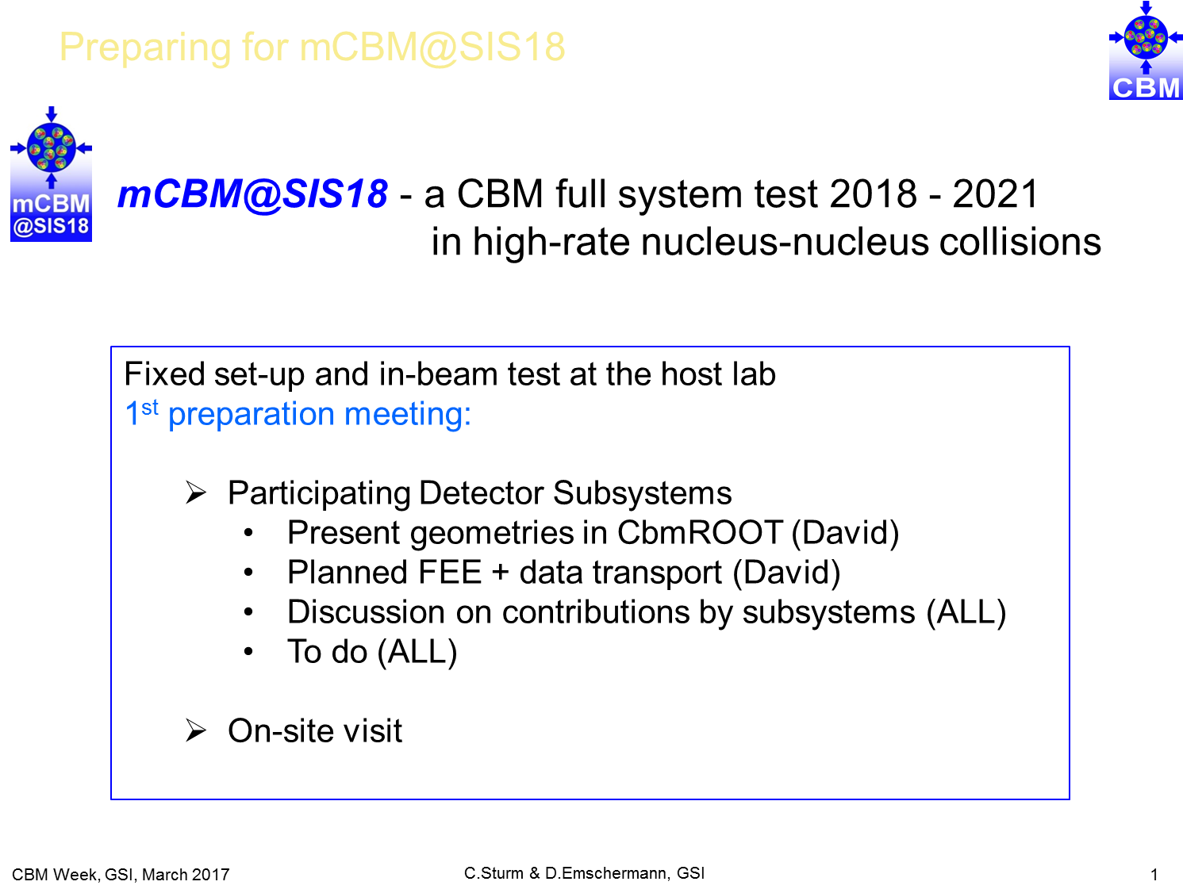
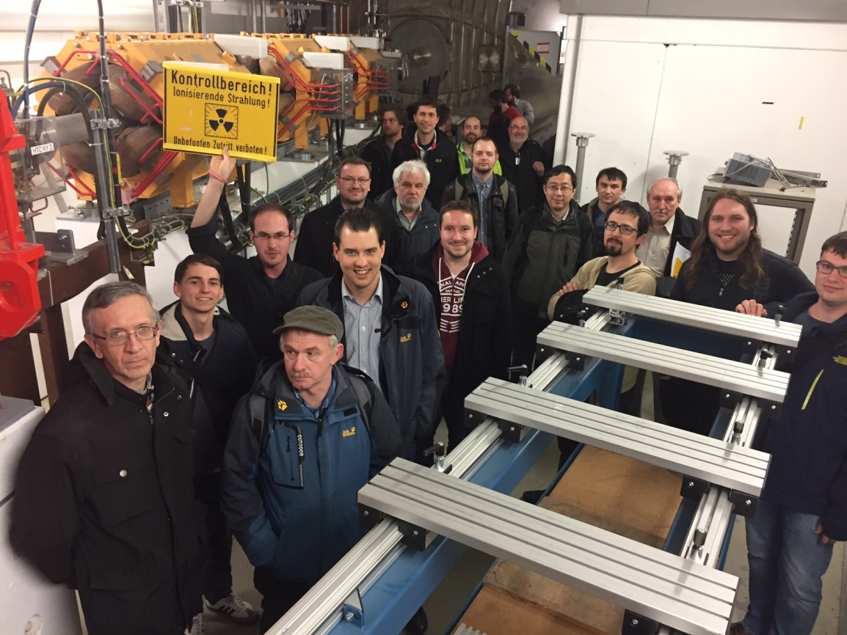
1st Preparation Meeting
Tuesday, March 20, 2017

Slide 19
Summary and Outlook
mCBM@SIS18 – a CBM full system test at GSI
A test facility for the
High-performance free-streaming DAQ system
FLES
Final detector prototypes
2016 – 2018 design and construction phase
2018 – 2021 permanent test-setup incl. beam tests with high-rate A+A collisions
Next steps
Design freeze of the
Contributions by subsystems
HTD cave
Preparation of the installation site

Slide 20
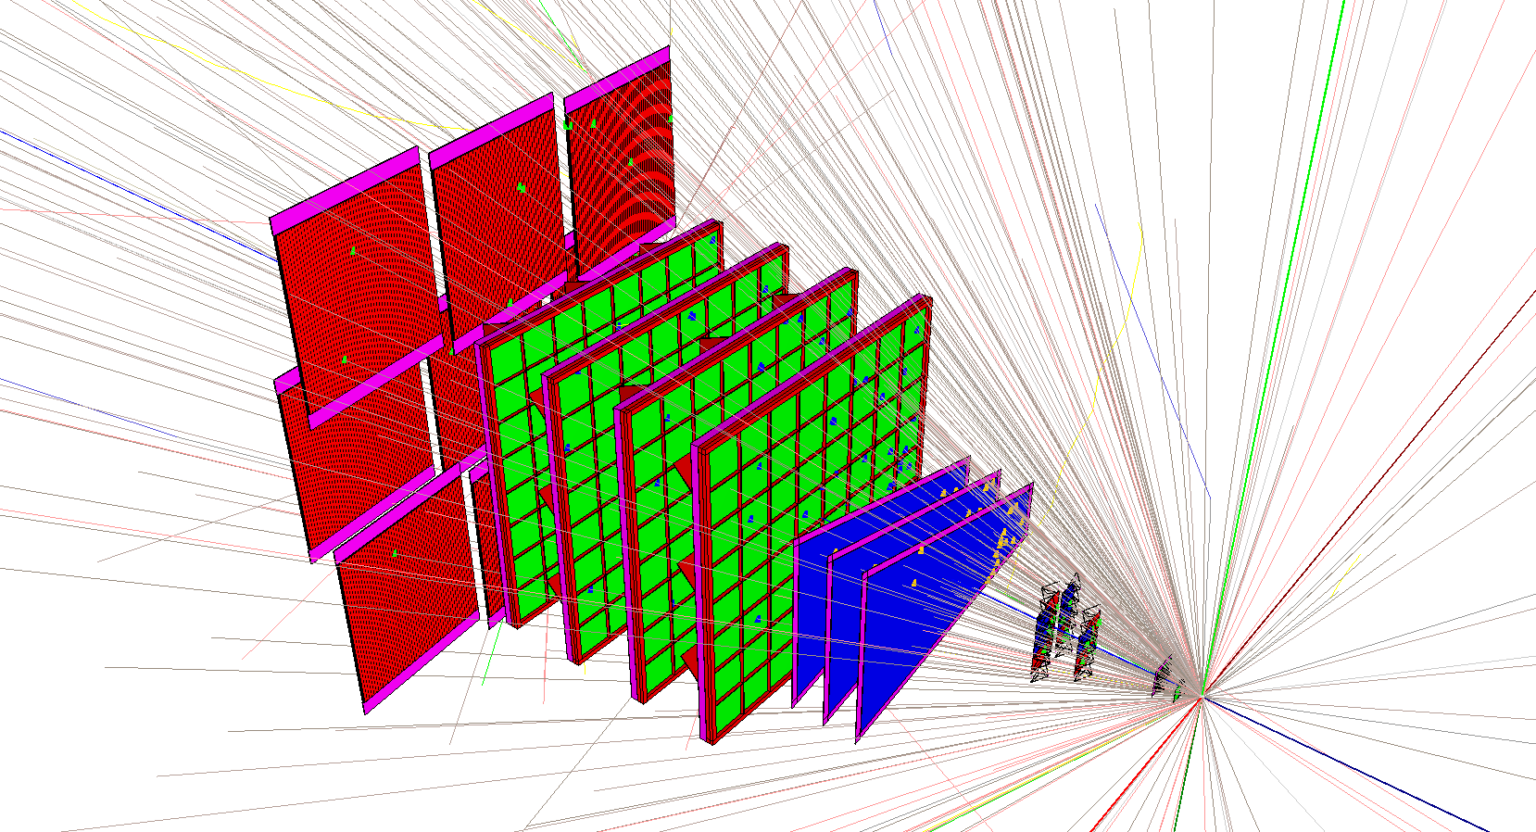
GSI core team
D. Emschermann
J. Frühauf
W. Niebur
P-A. Loizeau
A. Senger
F. Uhlig
C. Sturm

