Slide 1



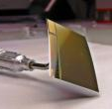



AD^{vanced}
MO^{nolithic}
S^{ensors for}
Radiation hardness of fully depleted
CMOS Monolithic Active Pixel Sensors
Tobias Bus, Benjamin Linnik, Michael Deveaux
Notes:
Hey gays,

Slide 2
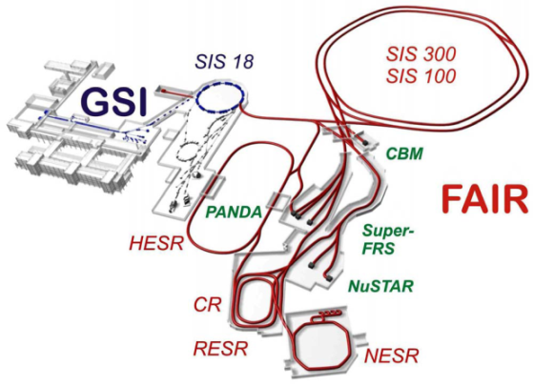
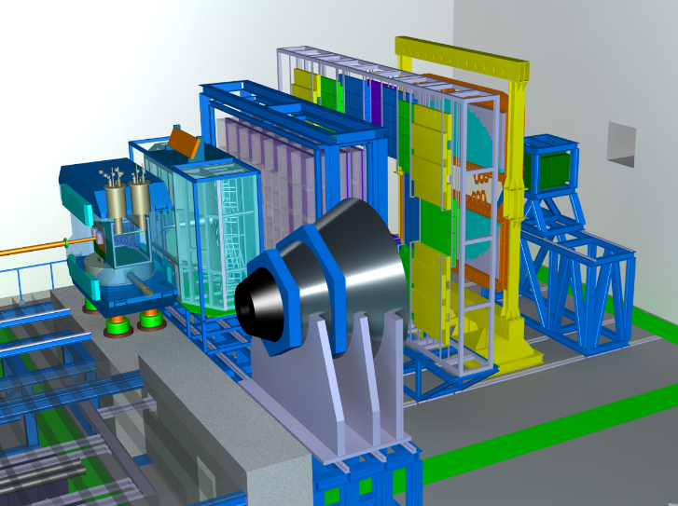

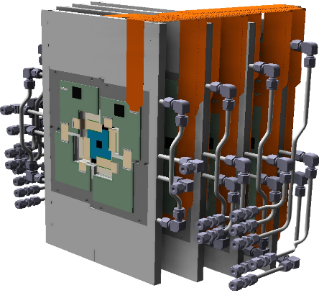
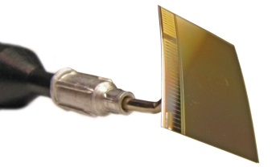
MAPS – Monolithic Active Pixel Sensors
MimoSIS design goals:
The CBM-MVD
 | MIMOSIS – Expected performance
CMOS Process | Tower/Jazz 0.18 µm Quad-Well
Pixel dimensions | 30.1 x 26.9 µm²
Spatial resolution | ~ 5µm
Material budget | 50 µm Si (0.05 % X₀)
Radiation tolerance | > 3Mrad (@-20°C). > 3x10¹³n_{eq}/cm²

Slide 3
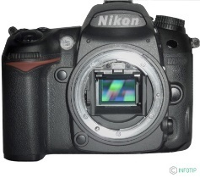
MAPS – Monolithic Active Pixel Sensors
+3.3V
Reset
+3.3V
Output
SiO₂
SiO₂
SiO₂
N++
N++
N+
P+
50µm
15µm
P-
P+
Notes:
Übergang verbessern zu dieser Folie. Um Ergebnisse zu verstehen Funktionsweise. E-Feld einführen.-

Slide 4

Effects of non-ionizing radiation
Readout
Readout
Trapping & recombination
of signal electrons
Diode
Leakage current → higher noise
Cooling decreases this effect
e-
e-
e-
Detecting layer
Particle
Defects due
to radiation
Depleting the sensor allows to accelerate the charge collection.
=> More radiation tolerance.
Non-ionizing radiation
Energy deposition into the crystal
Notes:
Defect states in the crystal structure Absorption nicht, recombination and generation centers. Singalladung verlieren, Thermische rauschen als effektals
One major weak point of CMOS sensors regarding non-ionizing radiation is the slow diffusion of charge as non-ionizing radiation creates defects in the epitaxial layer, which become recombination centres for the signal electrons. After recombination, signal electrons become unavailable for the charge collection. If the charge is collected trough diffusion, it has a longer path until it is collected in the diode and therefore a higher chance of being absorbed before detected.

Slide 5
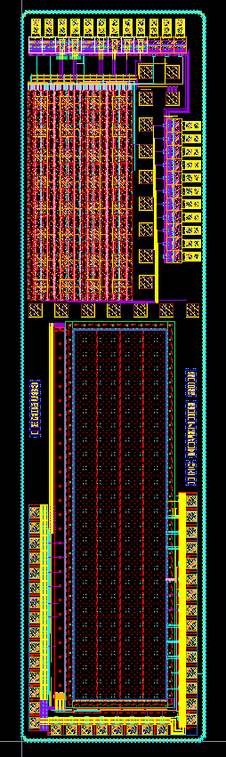
Pipper – 2: A fully depleted HR-MAPS
Issue:
Standard CMOS restricted to few volts
=> Too few for full depletion.
Analysis:
Restriction due to transistor gates.
Diodes and metal lines tolerate higher
voltages.
Approach:
Use AC-couping to separate vulnerable
transistors from HV on diode.
Depletion voltage up to 40V possible.
Apply to 22x22 µm² pixels.
Standard pixel
Pipper - 2

Slide 6
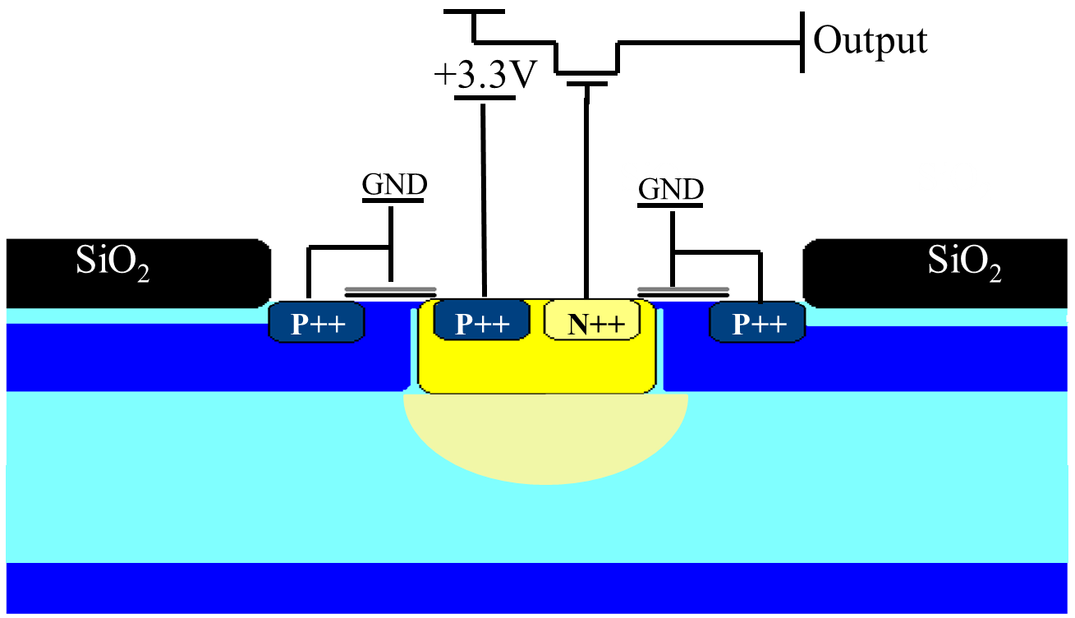
Standard sensor – Test results
Fe-55
Depleted volume
Epi-layer
Epi-layer
Depleted volume
Standard sensor – Only few hits from depleted volume.
Other hits: Reduced amplitude (charge sharing).

Slide 7
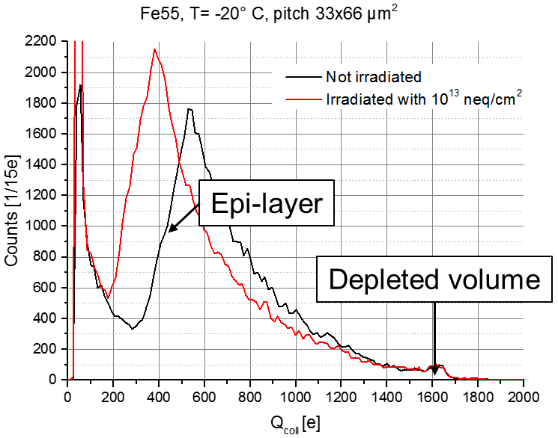
Pipper – 2 – Test results
Hits mostly in depleted volume peak.
No modification for >20V => indicator for full depletion

Slide 8
Vllt keine zeit dafür?
Standard sensor
Epi-layer
Depleted volume
20V
Pipper - 2
Depleted volume

Slide 9
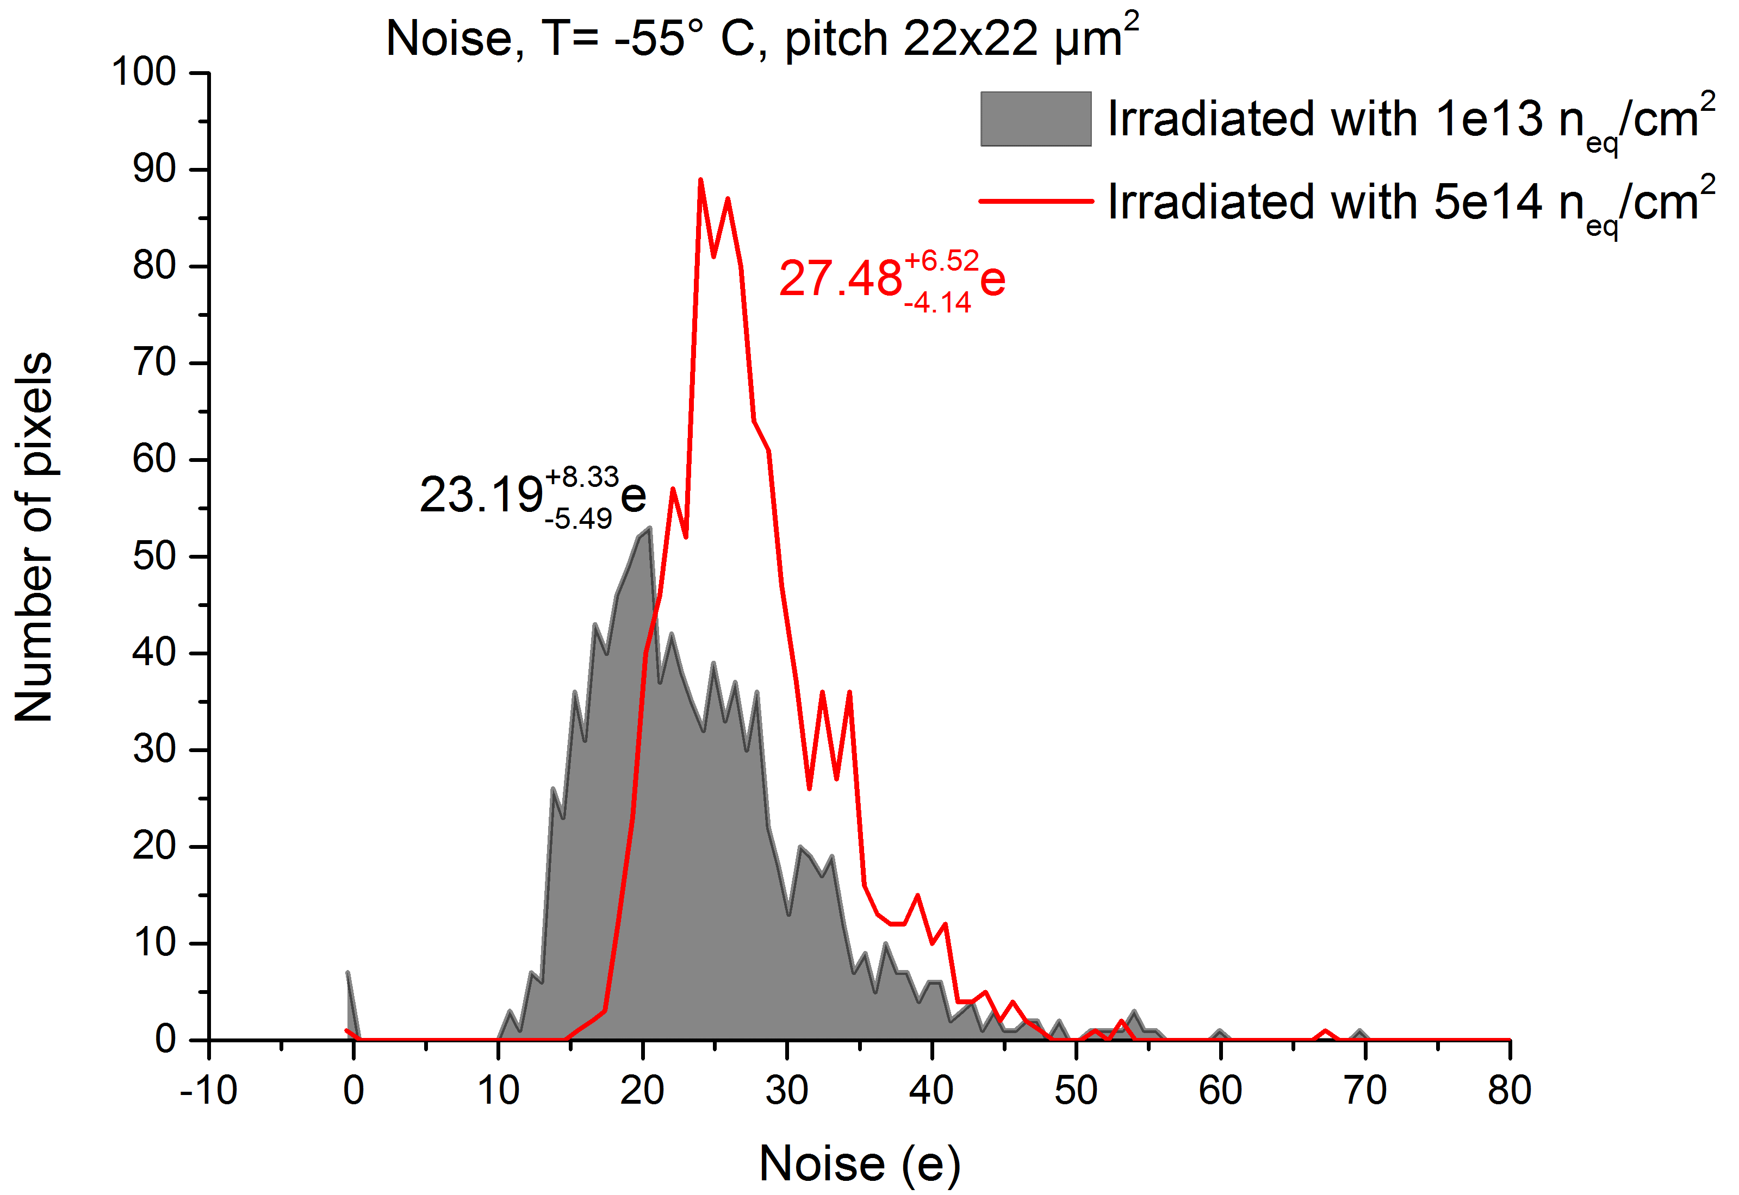


Test with ⁹⁰Sr beta rays
860e
1290e
S/N (Sr-90) >15 ⬄ typically > 99% MIP - efficiency
T = -55° C | Signal MPV (e) | Avg. noise (e) | S/N
10¹³n_{eq}/cm² | 1290 | 23.19 | 55.6
5·10¹⁴n_{eq}/cm² | 860 | 27.48 | 31.3
Notes:
Zeit lassen beim erkären.
Plots erklären, Charge Spektrum erklären. MPV,.

Slide 10
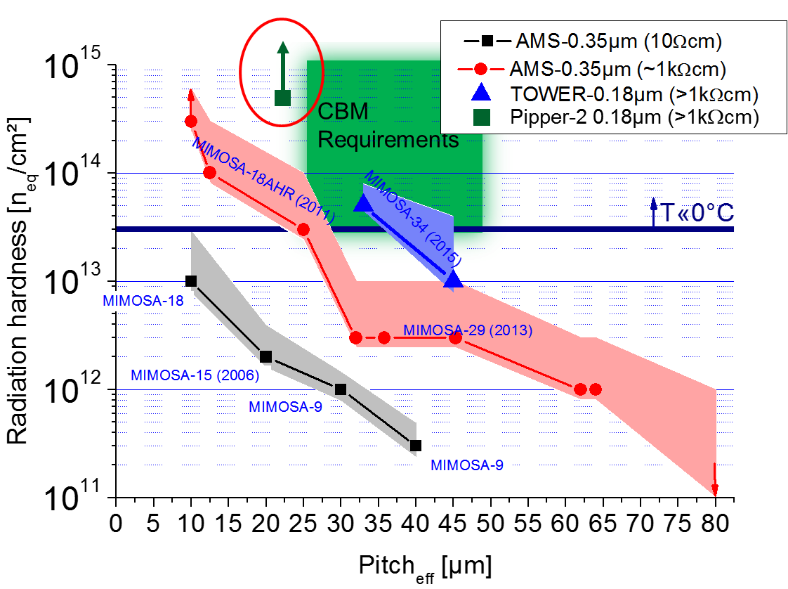
Summary and conclusion
Radiation tolerance (MIMOSA-series)
This work
A CMOS sensor allowing for
40V depletion voltage in Tower/Jazz 0.18µm has been built and tested.
Results suggest full depletion.
Laboratory tests suggest tolerance to >5 x 10¹⁴ n_{eq}/cm².
(Remaining S/N>30 if cooled).

