Slide 1
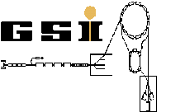
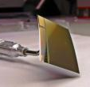
Radiation damage caused by neutron capture in boron doped silicon pixel sensors
AD^{vanced}
MO^{nolithic}
S^{ensors for}
Benjamin Linnik, Tobias Bus,
Michael Deveaux, Dennis Doering, Ali Yazgili for the CBM-MVD collaboration
27.3.2017
Institut für Kernphysik, Goethe University, Frankfurt am Main

Slide 2
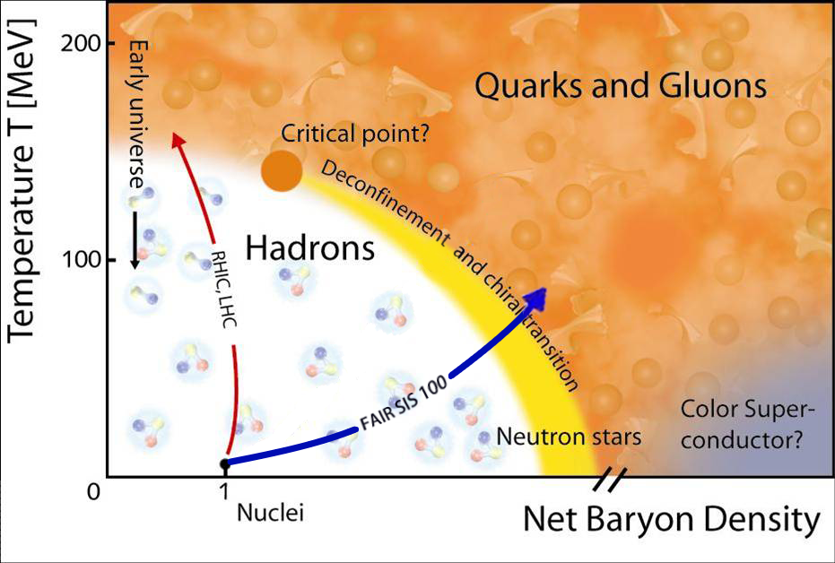
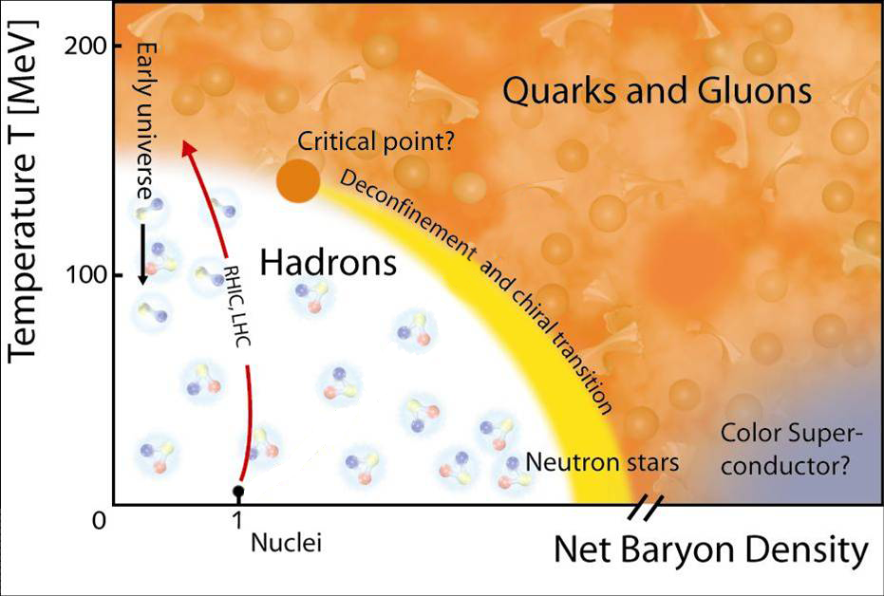
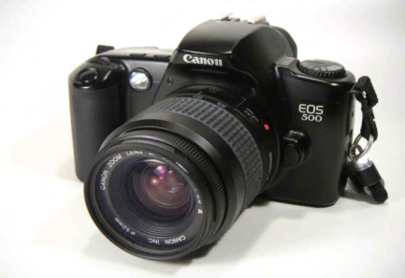
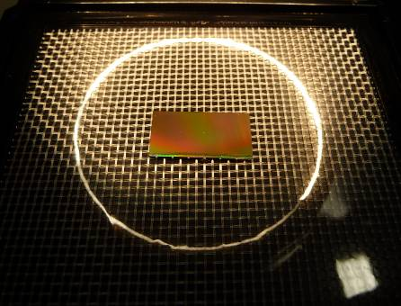
What is the task and why MAPS can do it?
Study matter at extreme conditions by reconstructing secondary vertices of dileptons and open charm particle
Need:
Good spatial resolution
High granularity
Vacuum compatible design
Radiation tolerant
Low material budget
MAPS:
CMOS sensors have low material budget
Excellent spatial resolution
Good time resolution
Radiation tolerant

Slide 3
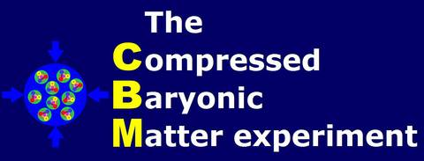
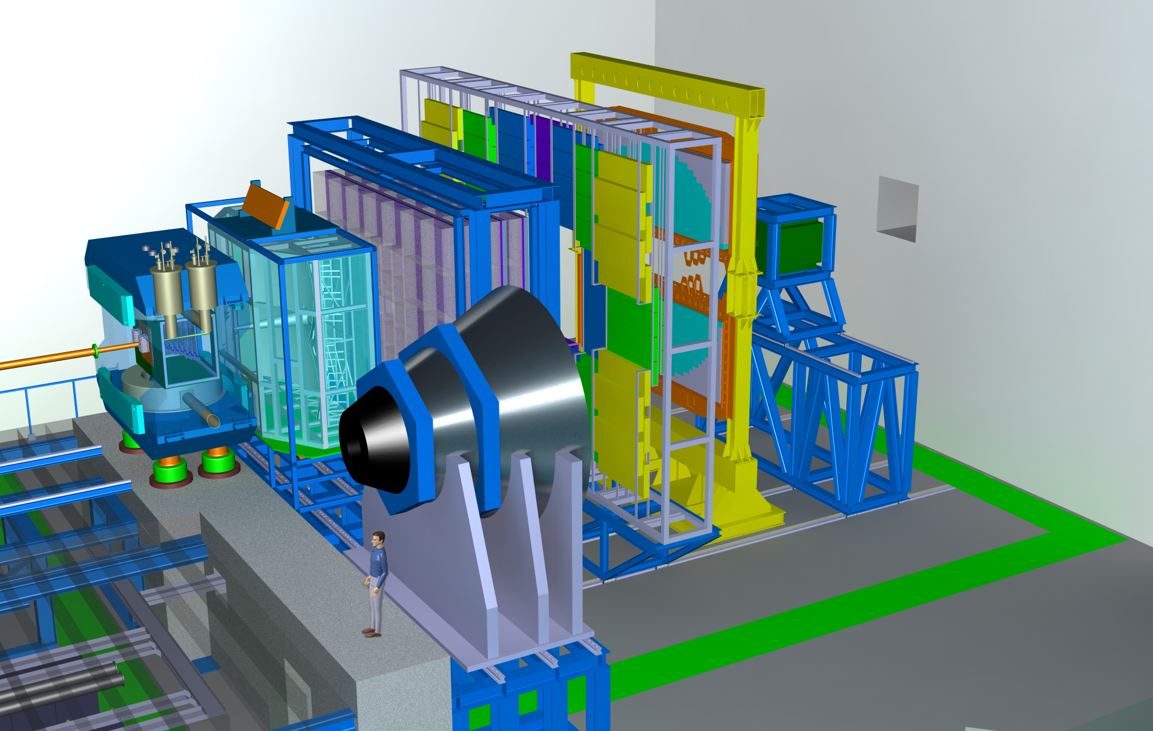
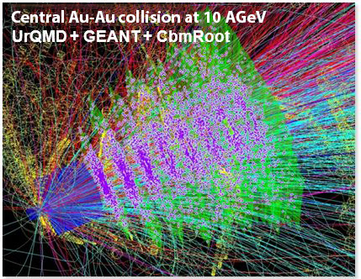
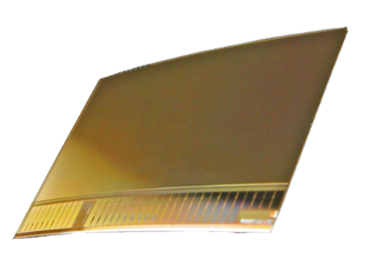
MVD
(Micro Vertex Detector)

Slide 4
How do we test for radiation hardness?
Damage in pure silicon can be rescaled with the NIEL model
By definition a 1 MeV neutron has a hardness factor of 1
NIEL is correct for pure silicon
Neutron energys below 20 keV are often considered neglectable
Sensors are often irradiated for test purposes with higher energetic neutrons only
…BUT

Slide 5
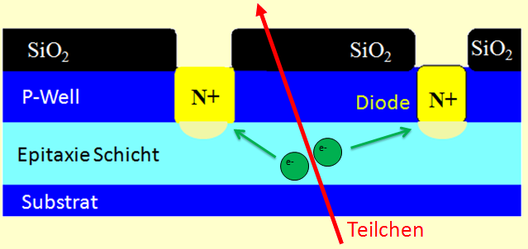
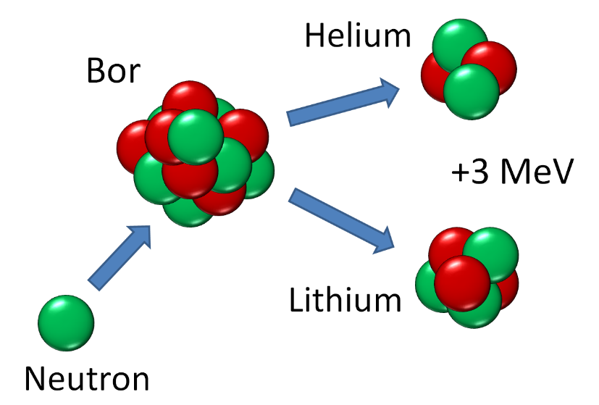
Is the NIEL hypothesis valid for P-doped sensors?
10-40µm
CMOS Monolithic Active Pixel Sensors
Are being optimized to tolerate extremely high radiation doses (ionizing and non-ionizing).
Based typically on P-doped silicon
=> Contains Boron
50µm
15µm
particle
Boron (¹⁰B) is known to:
Capture thermal neutrons with huge cross section (~1000 b)
Decay n+¹⁰B => ⁷Li + ⁴He + 3 MeV
Fast ions are created in Si
Additional bulk damage is created
Boron
Does ¹⁰B cause sizable additional radiation damage w.r.t standard NIEL model?

Slide 6
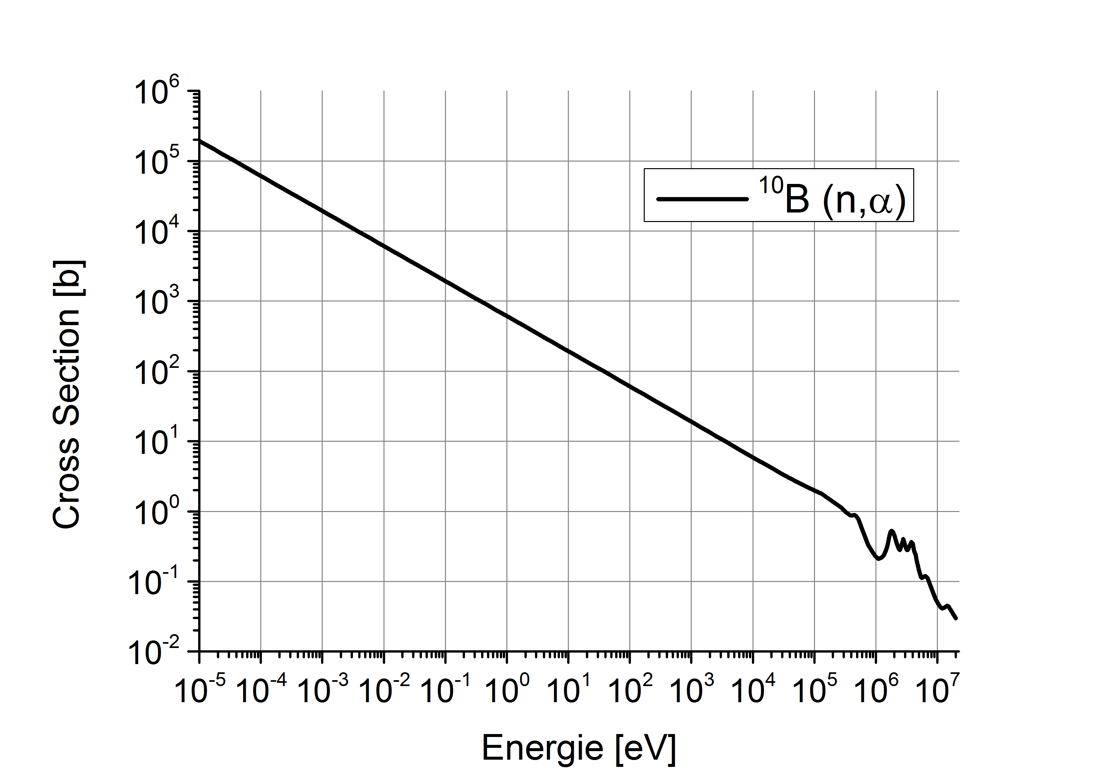
Theoretical estimate
(Natural) Boron doping [1/cm³]
Neutron flux [n/cm²]
+
Boron decays [1/cm³]
Energy dependent
cross section
Decay energy
+
Energy deposit [J/cm³]
http://www.nndc.bnl.gov/sigma/getPlot.jsp?evalid=14969&mf=3&mt=107&nsub=10
Most energy deposit ionizing.
How to get NIEL?
Notes:
Doping, boron decay cross section high at low energay

Slide 7
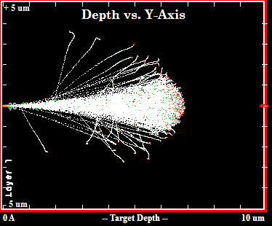
From ion energy to NIEL
Idea: Compare number of vacancies:
caused by fission ions (unknown hardness factor)
caused by protons (known hardness factor)
Tool: SRIM (software and references: www.srim.org)
Simulates flight of ions in matter (~MeV energies)
Simulate vacancies cause by p, ⁴He and ⁷Li
Results:
 | Vacancies
p (30 MeV) | 0.7 / 40µm
⁴He | 277 / ion
⁷Li | 613 / ion
40µm Si target: Avoid energy loss
=> const. hardness factor
Notes:
Read alout whats written there

Slide 8
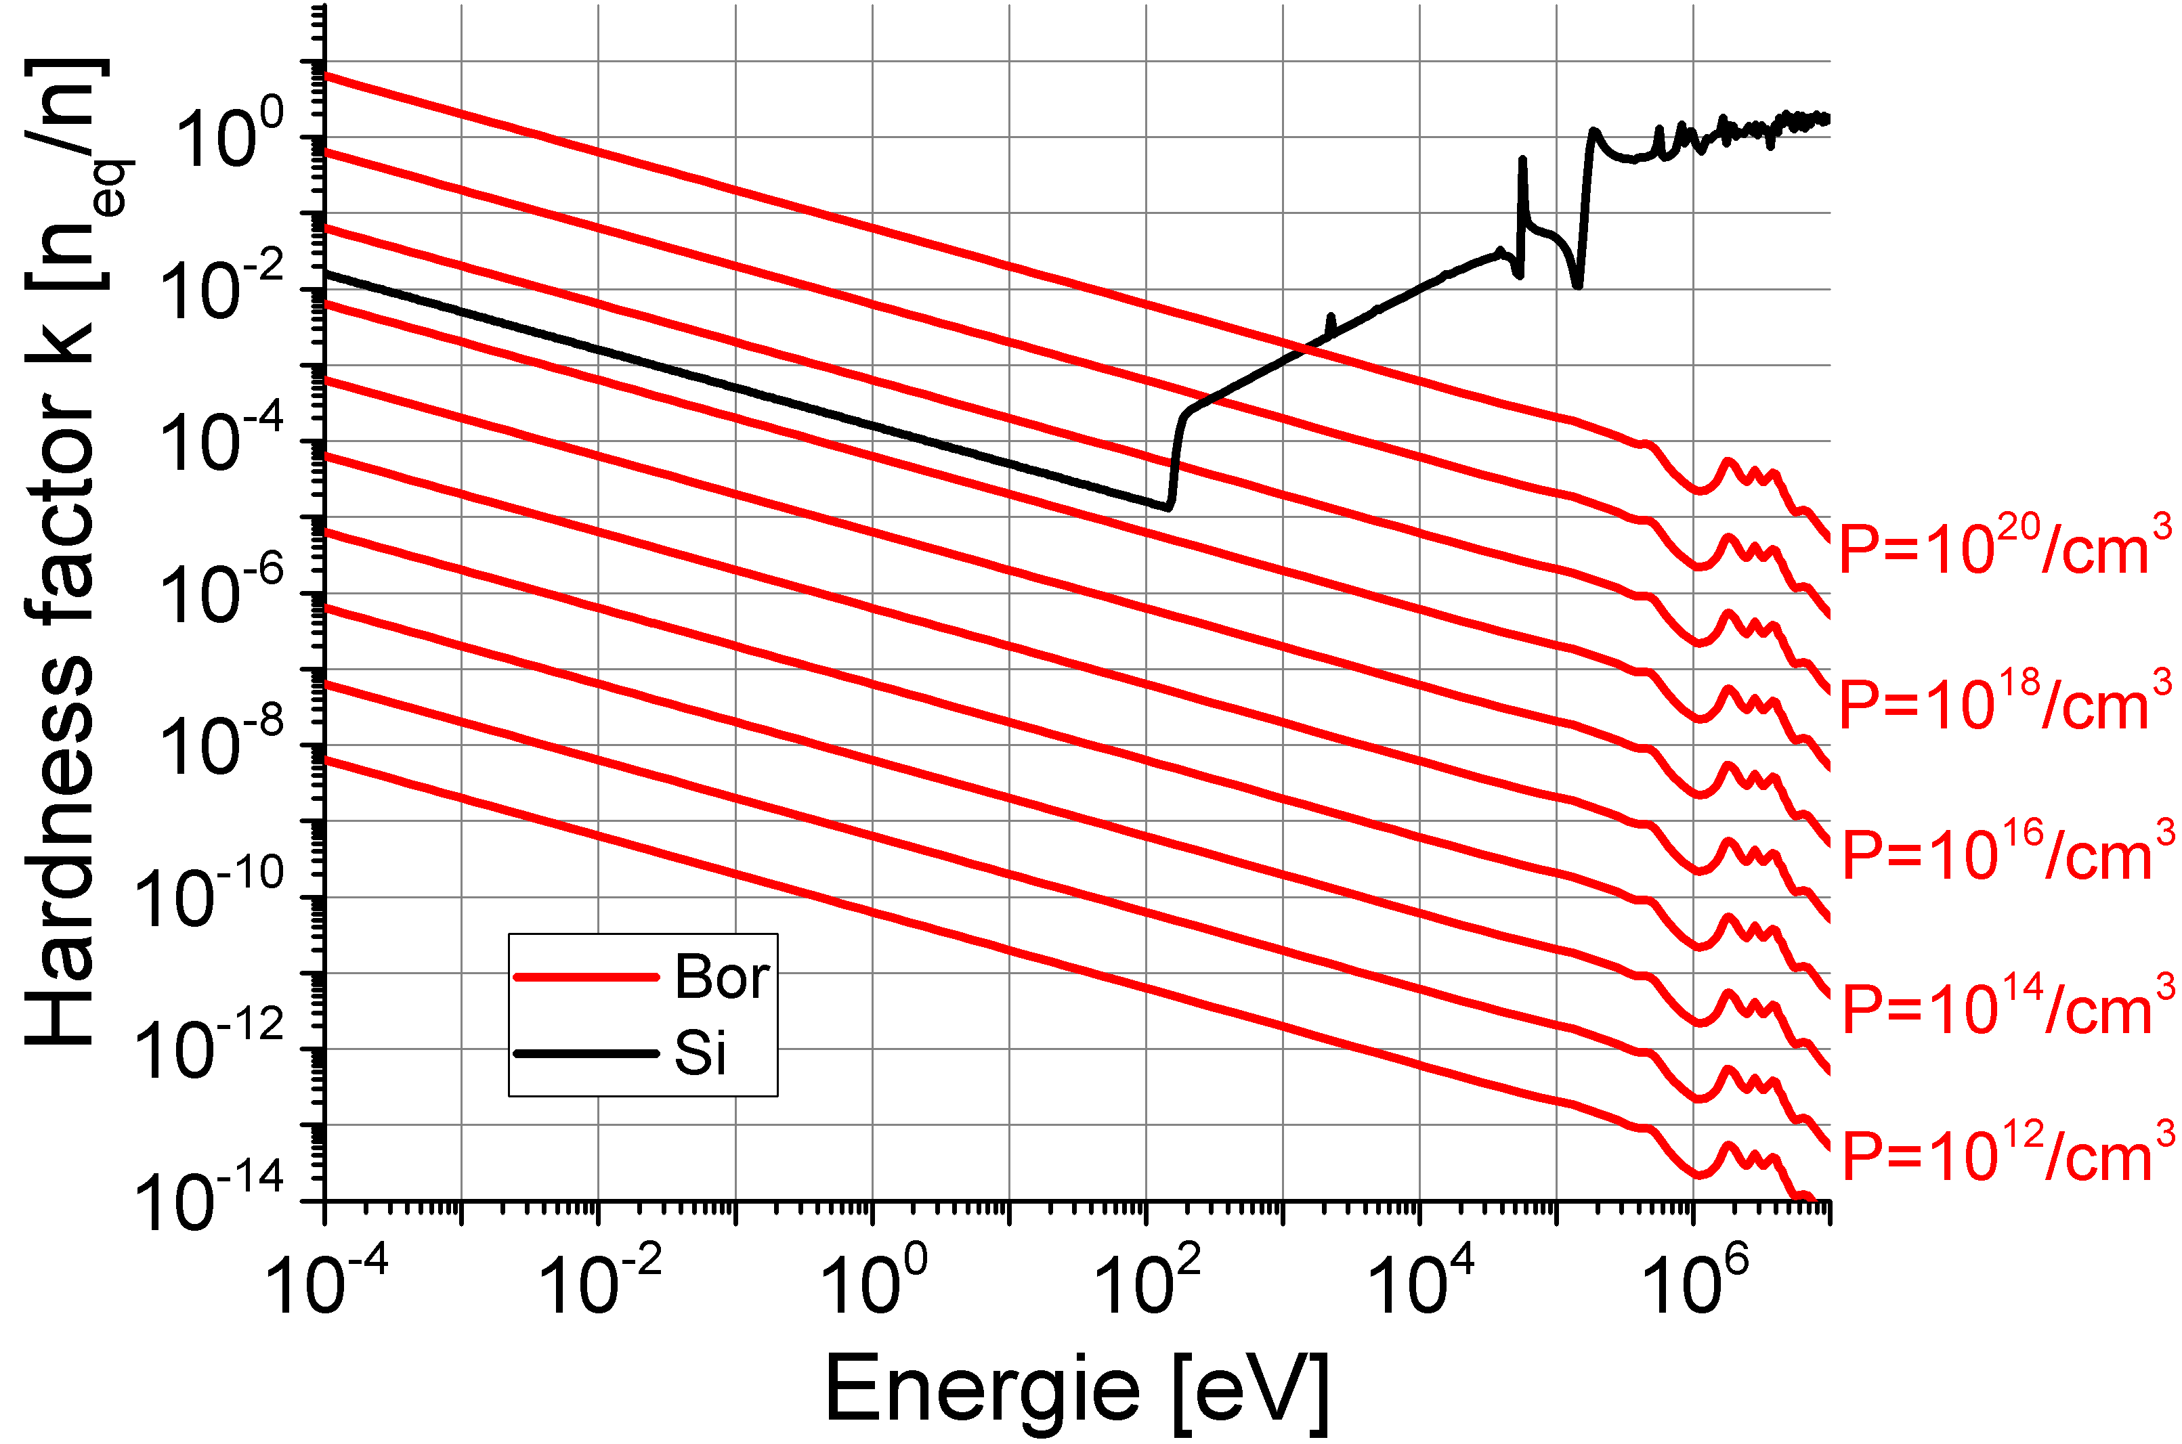
Result after normalization:
1 n_{eq}
P++, substrate
¹⁰B dominated
CPS Sensitive layer
10¹⁷/cm³
Si dominated
¹⁰B – fission => additional radiation damage in highly doped structures

Slide 9
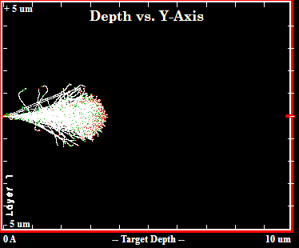
Does boron decay additionally damage the sensor?
In first order:
Lowly doped sensitive volume not affected
Ions are created in highly doped volumes.
SiO2
P-Well
P++
N-Well
P-Epi (sensitive)
He
Li
~3 µm
~ 7 µm
~ 3 µm
P++ Substrate
Penetration depth of ions (SRIM)
Possible damage mechanism:
Ions are created in P++
Ions enter sensitive volume, create sizable (?) damage here
Likely:
Only part of sensitive volume affected
„Effective“ hardness factor depending on sensor geometry, etc...
~ 7 µm

Slide 10
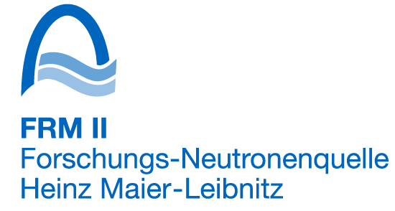
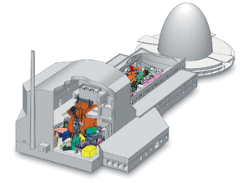
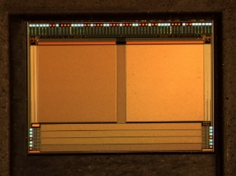
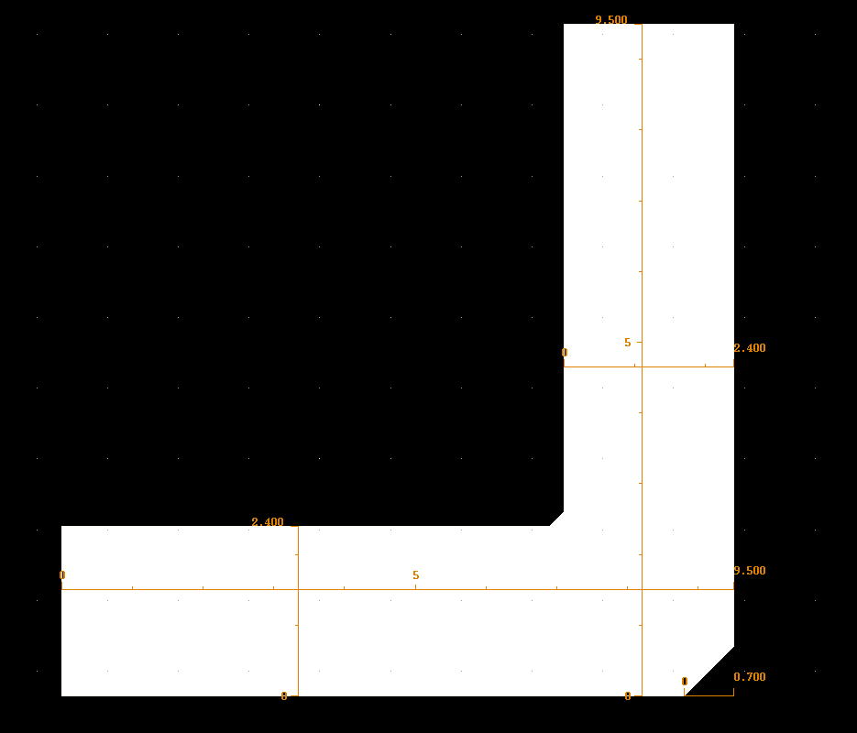
How do we test for additional damage?
Idea: Compare radiation damage caused by fast and cold neutrons
MEDAPP
Direct ²³⁵U fission neutrons
99% of all neutrons >100 keV
PGAA
Cold neutrons 1.8 x 10⁻³ eV
FRM II, Garching
Sensor: MIMOSA-19, IPHC, Strasbourg
Design: AMS 0.35 LR, Year 2006
Pixel: 12 µm pitch
Doping assumption: $∼{10}^{15} \left(epi\right), \sim {10}^{19}(substrate)$
=> Not depleted, charge collection by diffusion
9.5µm
Observables: Charge collection efficiency

Slide 11
What are our results on the additional damage?
Sensor illuminated with ¹⁰⁹Cd (22.1 keV X-ray), detect clusters
Not expected: CCE increases with
irradiation (Cold neutrons)
Summed charge of 4 pixels
Expected: CCE shrinks with irradiation (1 MeV neutrons)
Response differs fundamentally between cold ⬄ 1MeV Neutrons
Effective hardness factor cannot be extracted

Slide 12
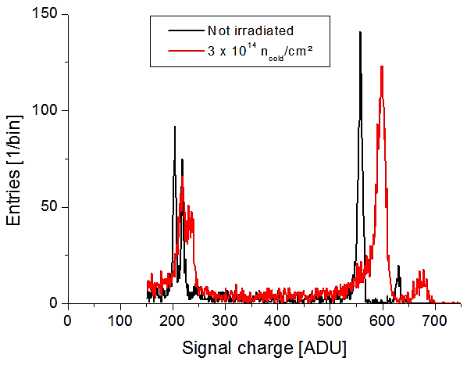
Experimental results: CCE
Preliminary!
$${}^{109}Cd K_{α}$$
Gain increases after irradiation
Decrease of diode capacity?
More depletion?
Only hits in depleted volume
Number of entries increases after irradiation by factor x2.
Scales with depleted volume
More depletion!
Less doping
Abrupt flat junction (?):
Doping decreases by factor x4
-------- Ignore this region ---------
(noise, X-ray fluorescence etc.)
$${}^{109}Cd K_{β}$$
Potential explaination:
Intense acceptor removal (factor x4 from P=10¹⁵/cm³)
Additional depletion improves CCE, dominates trapping
! No significant acceptor removal observed with 1 MeV neutrons for <2x10¹³n_{eq}/cm²

Slide 13
Summary and cautious conclusion
Does ¹⁰B fission cause sizable rad. damage in P-doped Si?
Theoretical estimate:
P>10¹⁷/cm³ => Expect additional damage w.r.t standard NIEL curve
Fission ions may damage lowly doped silicon indirectly due to 7µm range
Experimental study (MIMOSA-19, ~10¹⁵/cm³ epi layer, ~10¹⁹/cm³ substrate ):
Observation:
CCE:
Cold neutrons cause strong acceptor removal, CCE increases
Acceptor removal exceeds finding for 2x10¹³n_{eq}/cm² (1MeV)
Preliminary conclusion:
¹⁰B fission seems to cause rad. damage beyond standard NIEL
Risk of unexpected effects in case of high thermal neutron doses.

