Slide 1

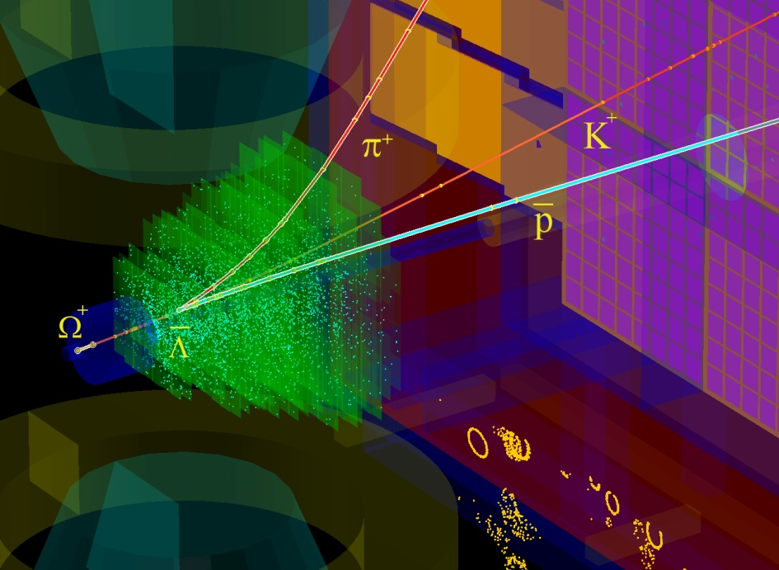
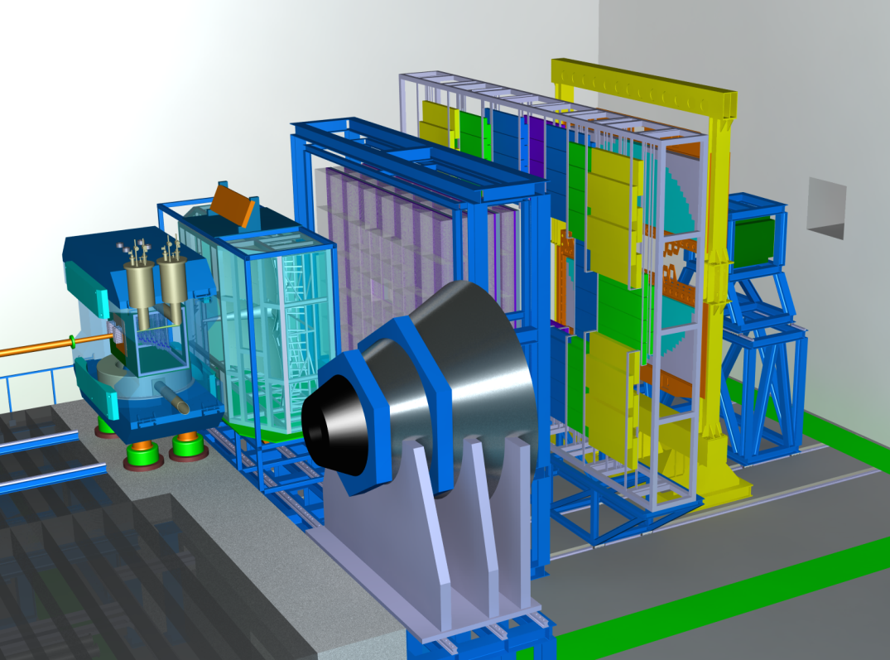
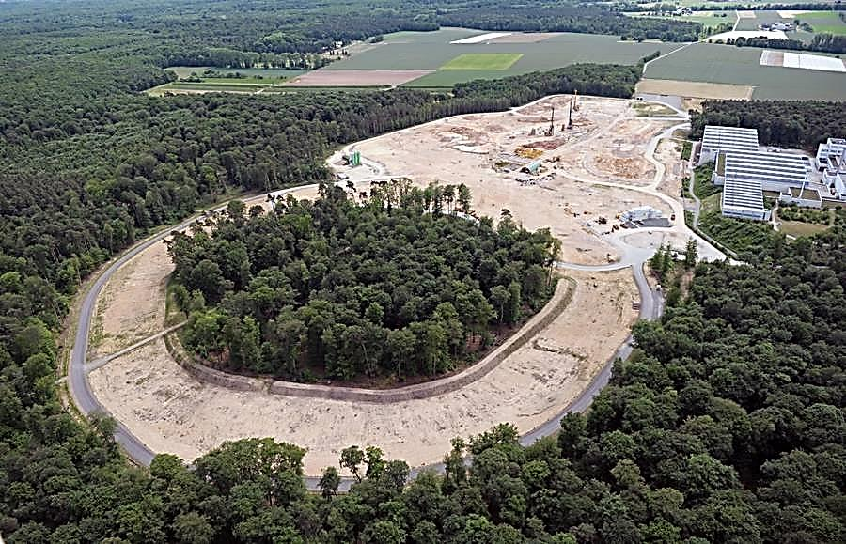
Multi-strange Hyperons and Hypernuclei reconstruction at the CBM experiment
I. Vassiliev, V. Akishina, I.Kisel and
M. Zyzak for the CBM Collaboration
TOF
ECAL
TRD
RICH
STS
MVD
PSD
MUCH
Physics case
Developed methods & tasks
High rate scenario
Conclusions & plans
1
DPG Munster March 2017
Notes:
1
1
1
1

Slide 2
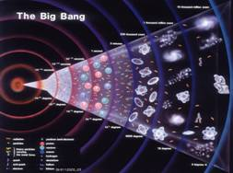
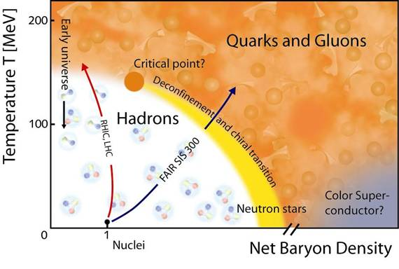
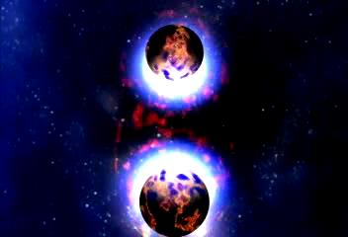
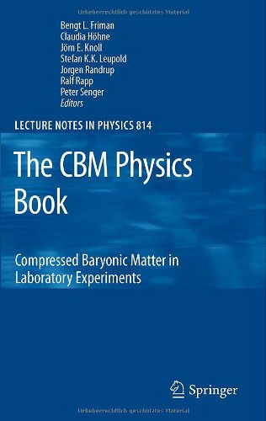
Physics case:
Exploring the QCD phase diagram
The equation-of-state at high ρ_{B}
collective flow of hadrons
particle production at threshold energies: open charm, multi-strange hyperons
Deconfinement phase transition at high ρ_{B}
excitation function and flow of strangeness (K, Λ, Σ, Ξ, Ω) and
charm (J/ψ, ψ', D⁰, D_{s}, D±, Λ_{c})
Charmonium suppression, for J/ψ and ψ
QCD critical endpoint
excitation function of event-by-event fluctuations (K/π, ... Ξ/ π, Ω/ π)
Onset of chiral symmetry restoration at high ρ_{B}
in-medium modifications of hadrons (ρ,ω,φ)
excitation function of multi-strange (anti)hyperons (PHSD 4.0)
LHC
RHIC
SPS-CERN
CBM
Projects to explore the QCD phase diagram at large μ_{B}:
RHIC energy-scan, NA61@SPS, MPD@NICA: bulk observables
CBM: bulk and rare observables, high statistic!
2
Notes:
2
2
2

Slide 3
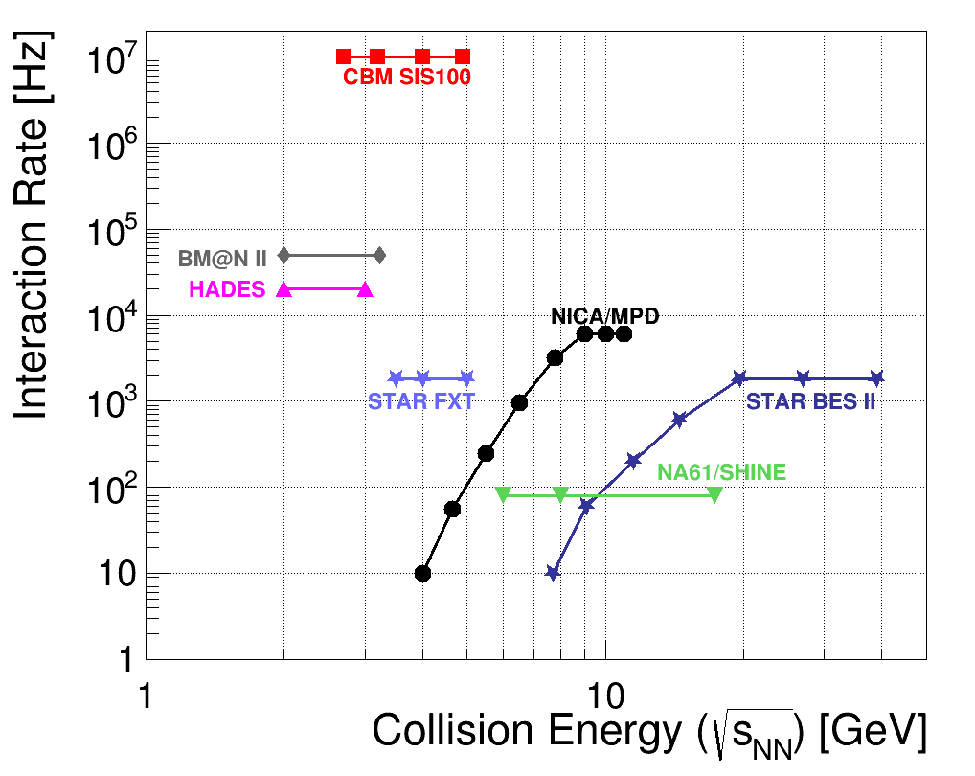
Experiments exploring dense QCD matter
high
net-baryon densities
CBM:
world record
rate capability
determination of (displaced) vertices with high resolution
(≈ 50 μm)
identification of leptons and hadrons
fast and radiation hard detectors
self-triggered readout electronics
high speed data acquisition and
online event selection
powerful computing farm 4-d tracking
software triggers

Slide 4
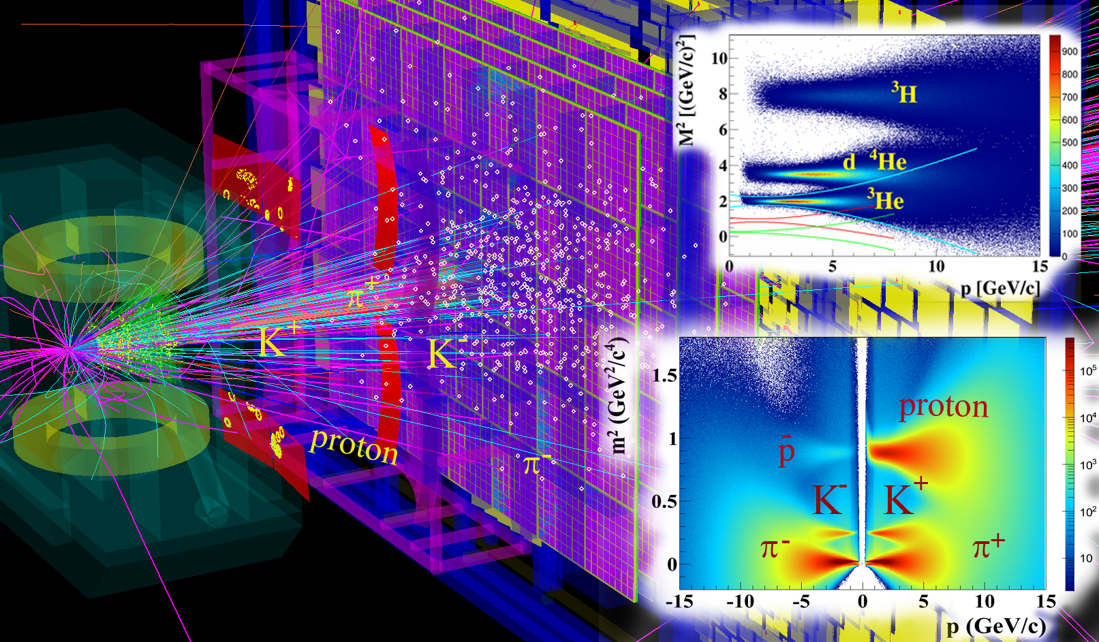
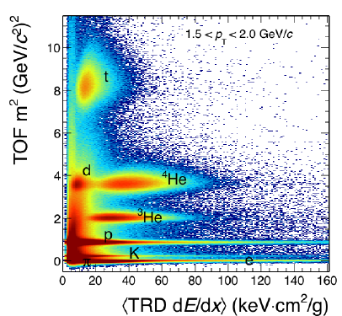
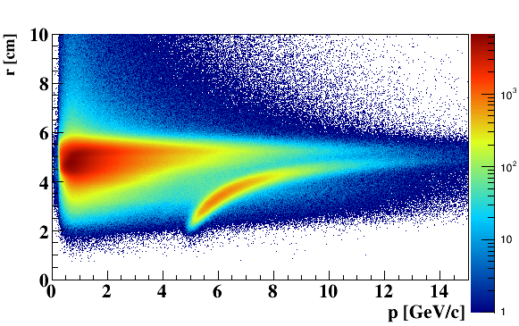
Particle identification with PID detectors :
Ni+Ni 15 AGeV
123 π
53 p
6 K⁺
1.6 K⁻
4 Λ
7.5 K_{S}⁰
0.4 Ξ⁻
e
π
Central event: 40 (TF) + 7 (PF) ms/core with MVD!
(~ 2 faster w/o MVD)

Slide 5
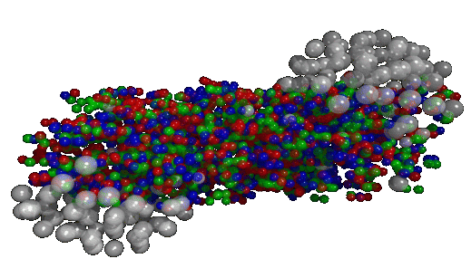
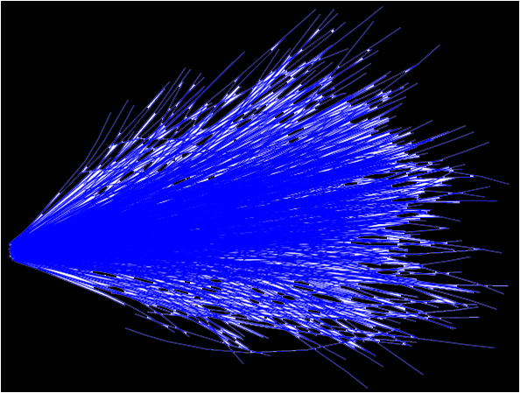
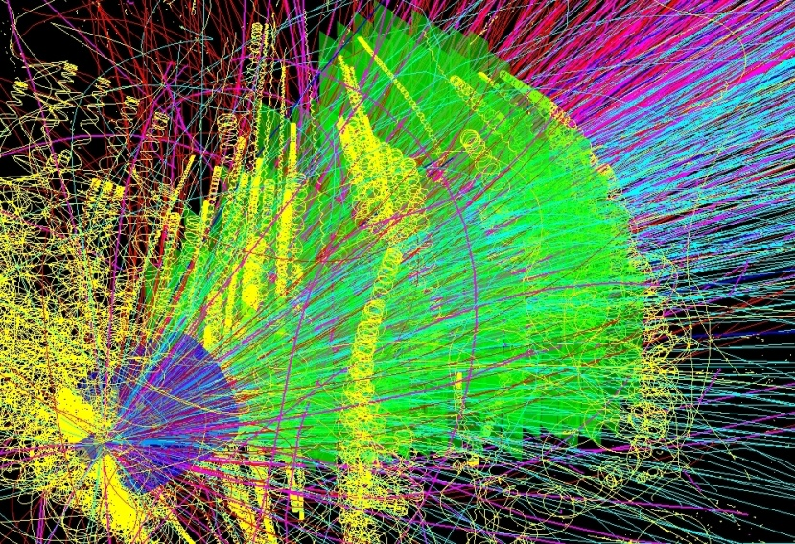

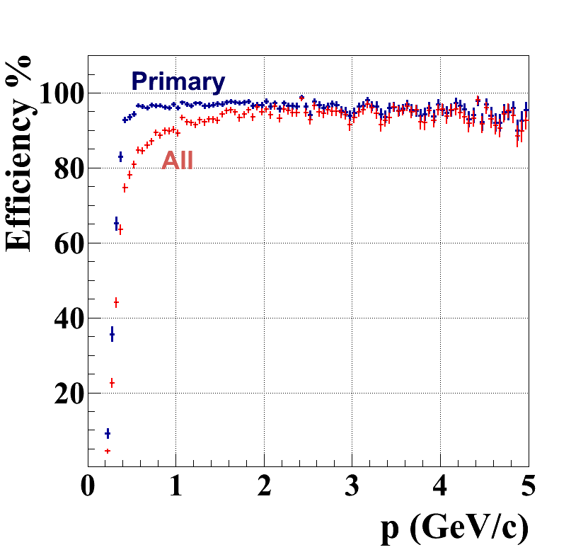
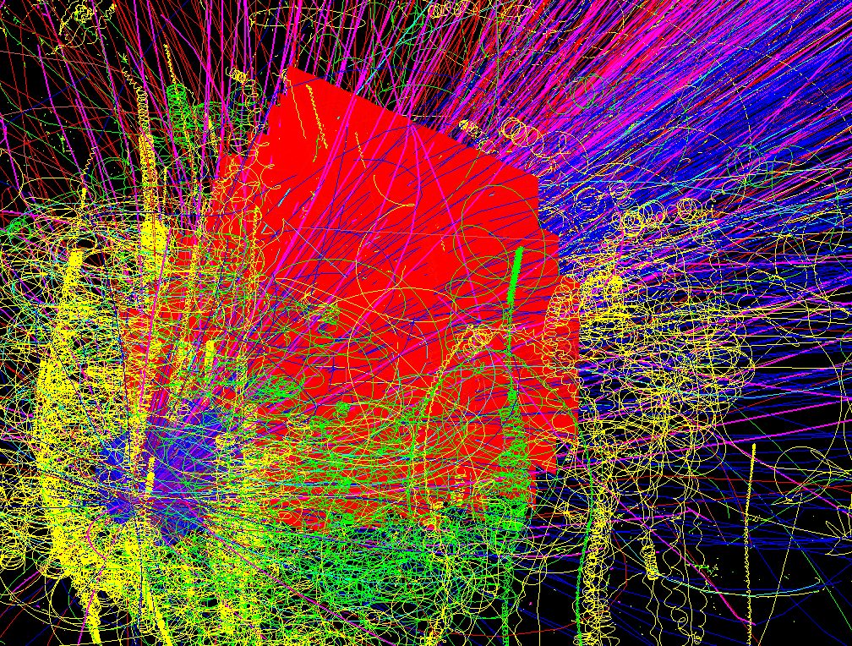
SIS-300: central Au + Au (UrQMD or PHSD) events
Simulation and reconstruction
UrQMD
simulation
~700 π
160 p
53 K
32 Λ
27 K_{S}⁰
0.44 Ξ⁻
0.018 Ω⁻
reconstruction
simulation
~700 π
174 p
42 K
30 Λ
24 K_{S}⁰
2.4 Ξ⁻
0.005 Ω⁻
CA track finder
low p tracks !
648 recstructed tracks
Ref. prim. eff = 96%
All set eff = 87%
dp/p = 1.2%
central: 82 (TF) + 16 (PF) ms/core
mbias : 10 (TF) + 2 (PF) ms/core
up to 80 cores/CPU
Notes:
5
5

Slide 6
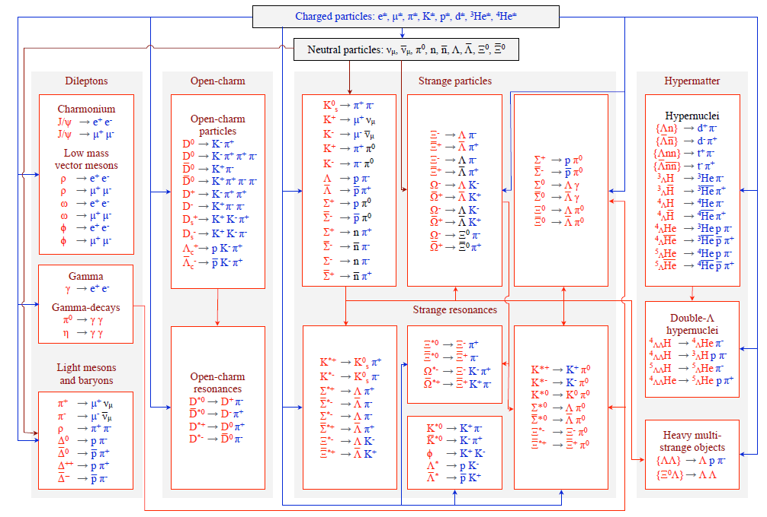
KF Particle Finder for the CBM Experiment
+ STAR, ALICE, PANDA, HADES, NA61

Slide 7
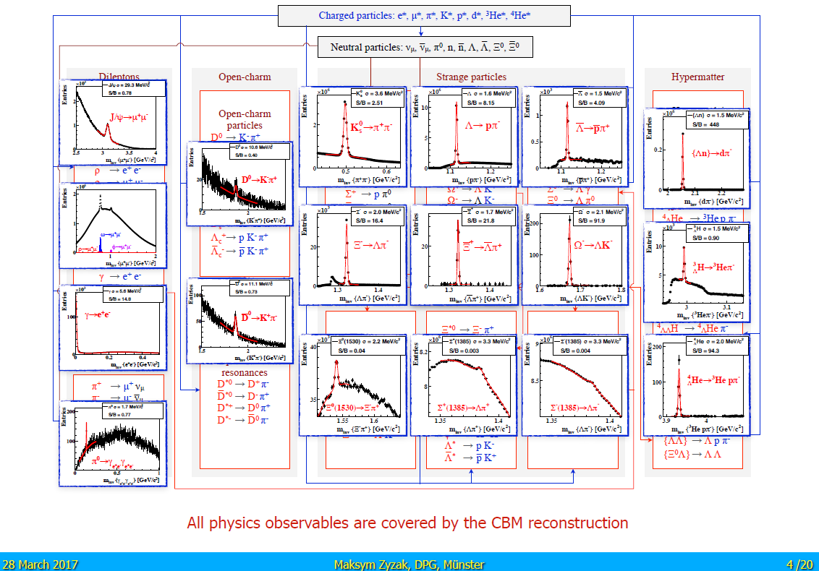

Slide 8
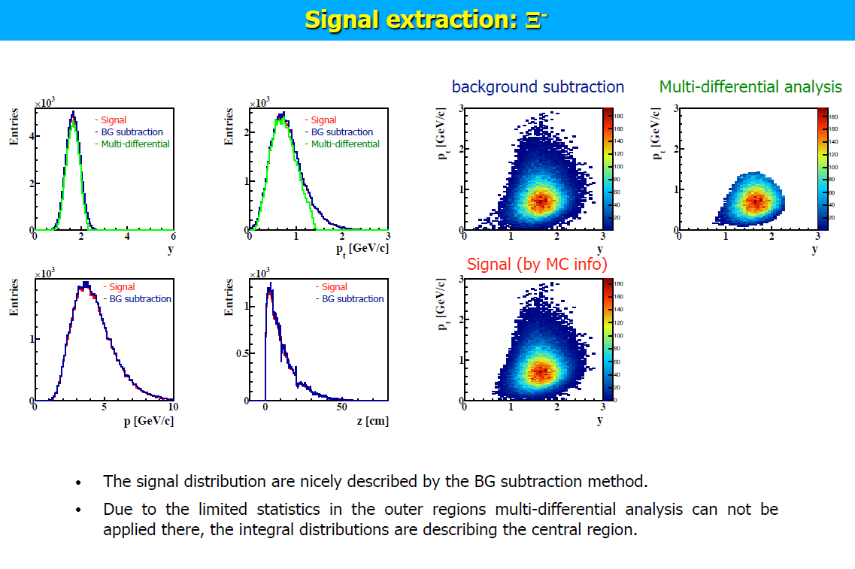
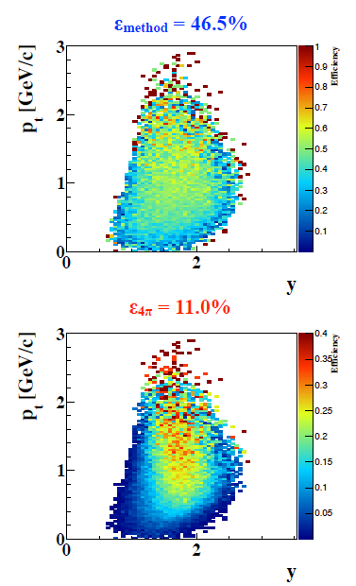

Slide 9

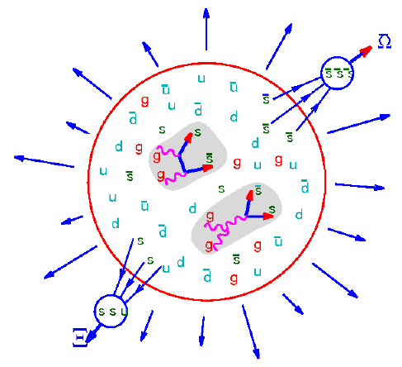
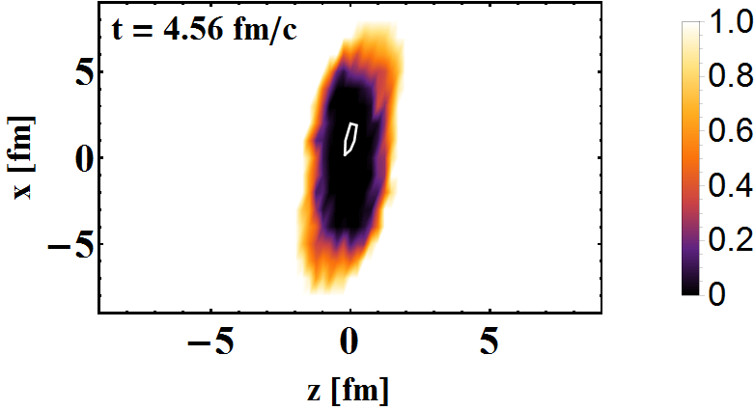
KF Particle Finder with ToF track ID: Au+Au @ 10AGeV SIS100
165 π
170 p
26 K
15 Λ
20 K_{S}⁰
0.3 Ξ⁻
QGP
pv

Slide 10
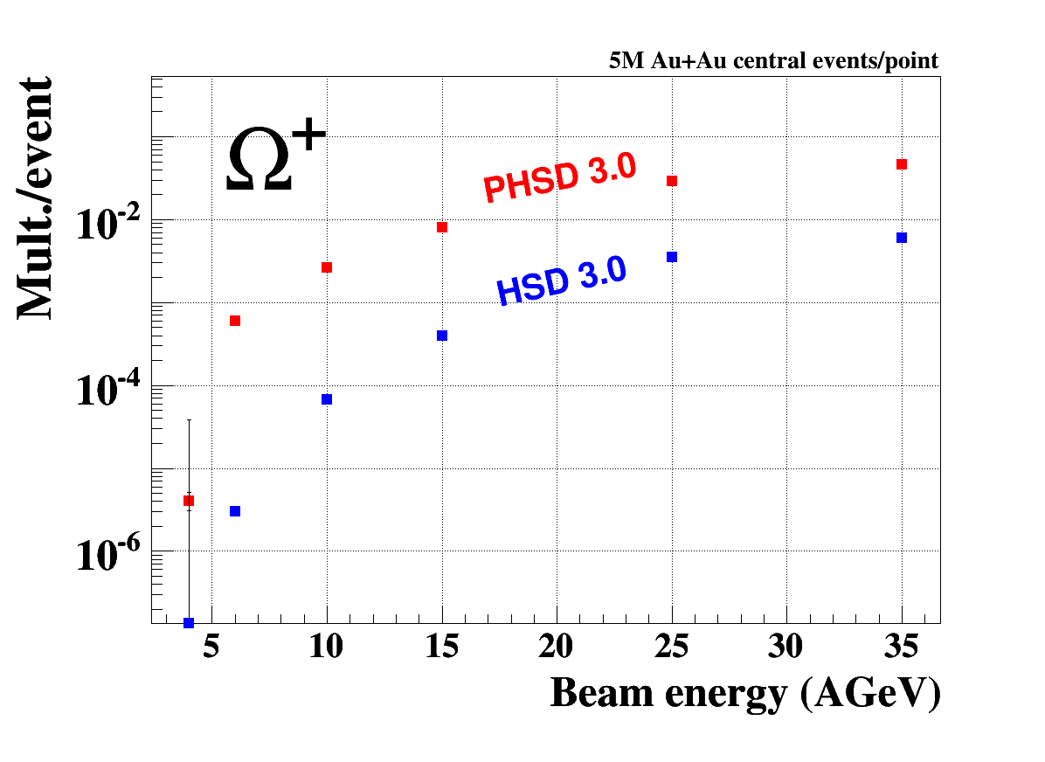
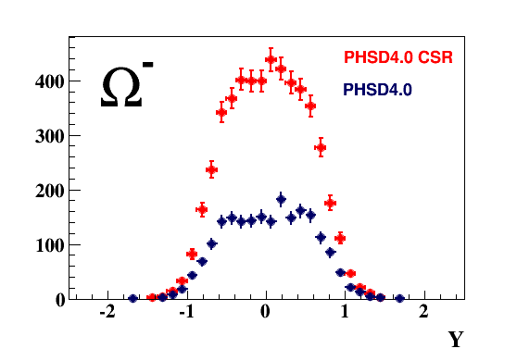
QGP and CSR signatures at FAIR energies:
Multi-strange baryons and antibaryons
PHSD 4.0 Au + Au @ 10 AGeV
QGP
preliminary
5M events/point
Most of the Ω+ produced by QGP @ FAIR energy
CSR increase yield of MS Baryons & Antibaryons !?

Slide 11
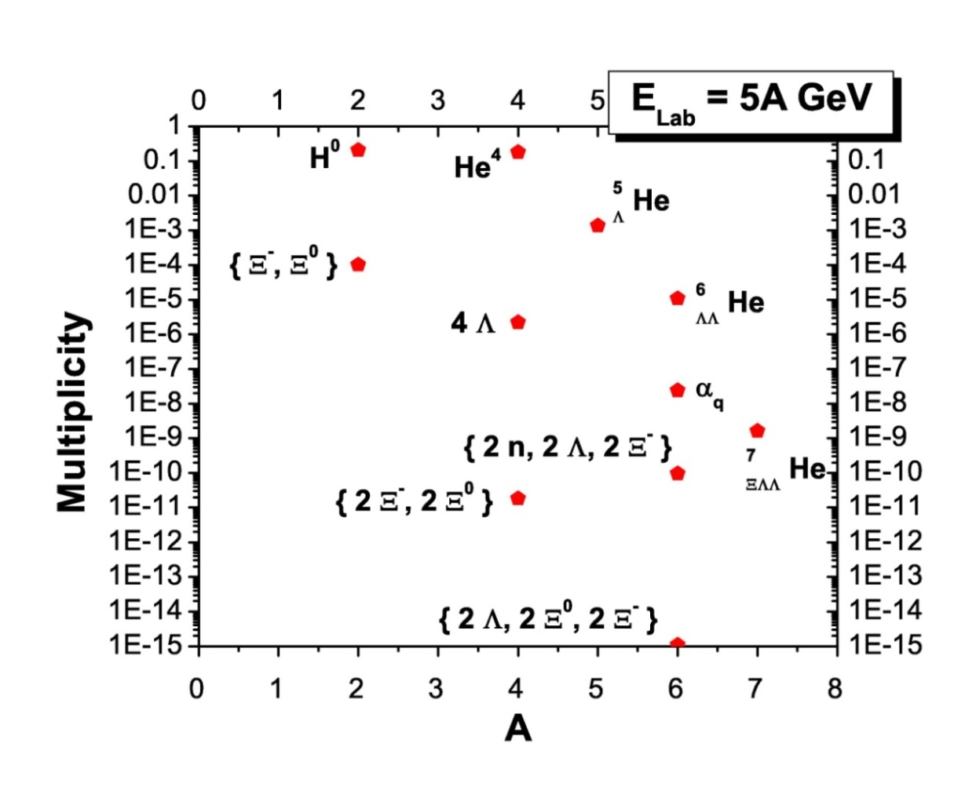

CBM physics program (P.Senger)
Motivation:
No data at FAIR energies
Strange matter
Hypernuclei, strange dibaryons and massive strange objects
Production of hypernuclei via coalescence
of hyperons and light nuclei
CBM
A. Andronic et al., Phys. Lett. B697 (2011) 203
H. Stöcker et al., Nucl. Phys. A 827 (2009) 624c

Slide 12
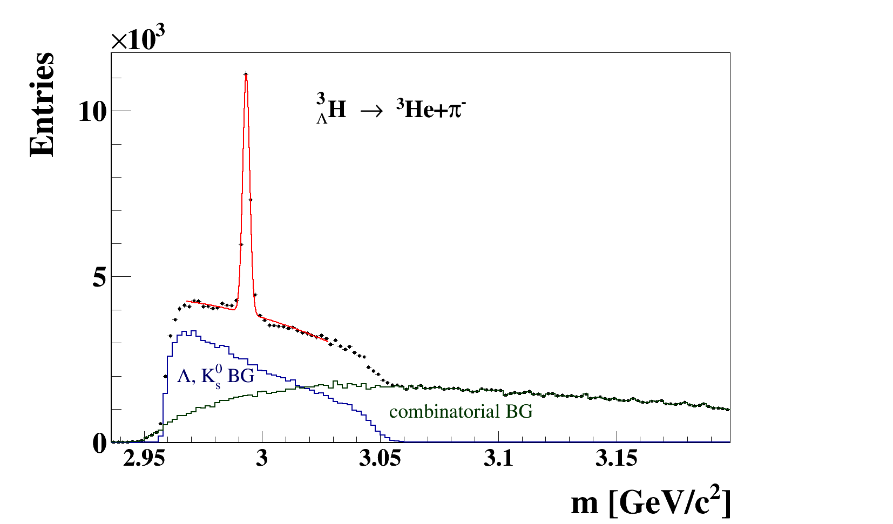
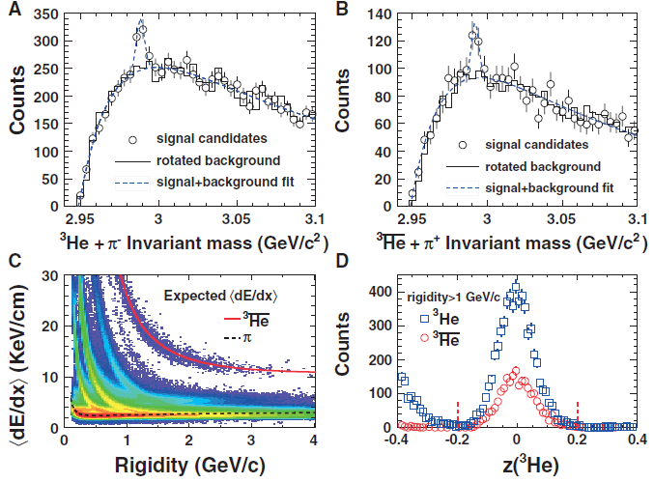
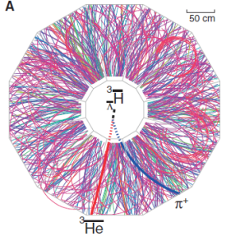
UrQMD
Au+Au 10 AGeV 5M central events
Extended KFParticle Finder ³_{Λ}H
5 seconds of data taking!
STAR 2010
eff = 19.2%
= 1.7 MeV
S/B ~ 1.5
BR from H. Kamada et al., Phys. Rev., Ser. C 57, 1595 (1998)
12

Slide 13
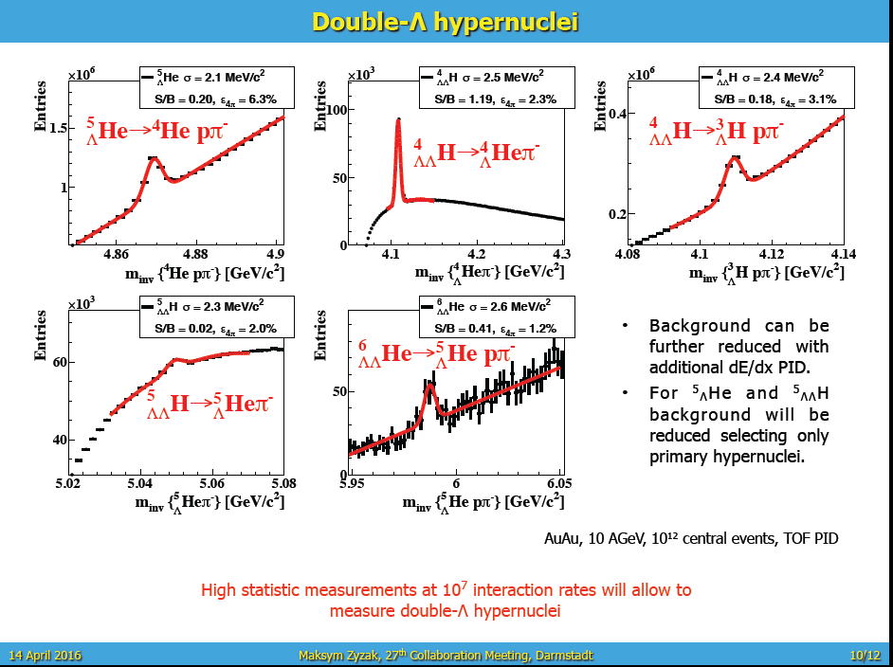

Slide 14
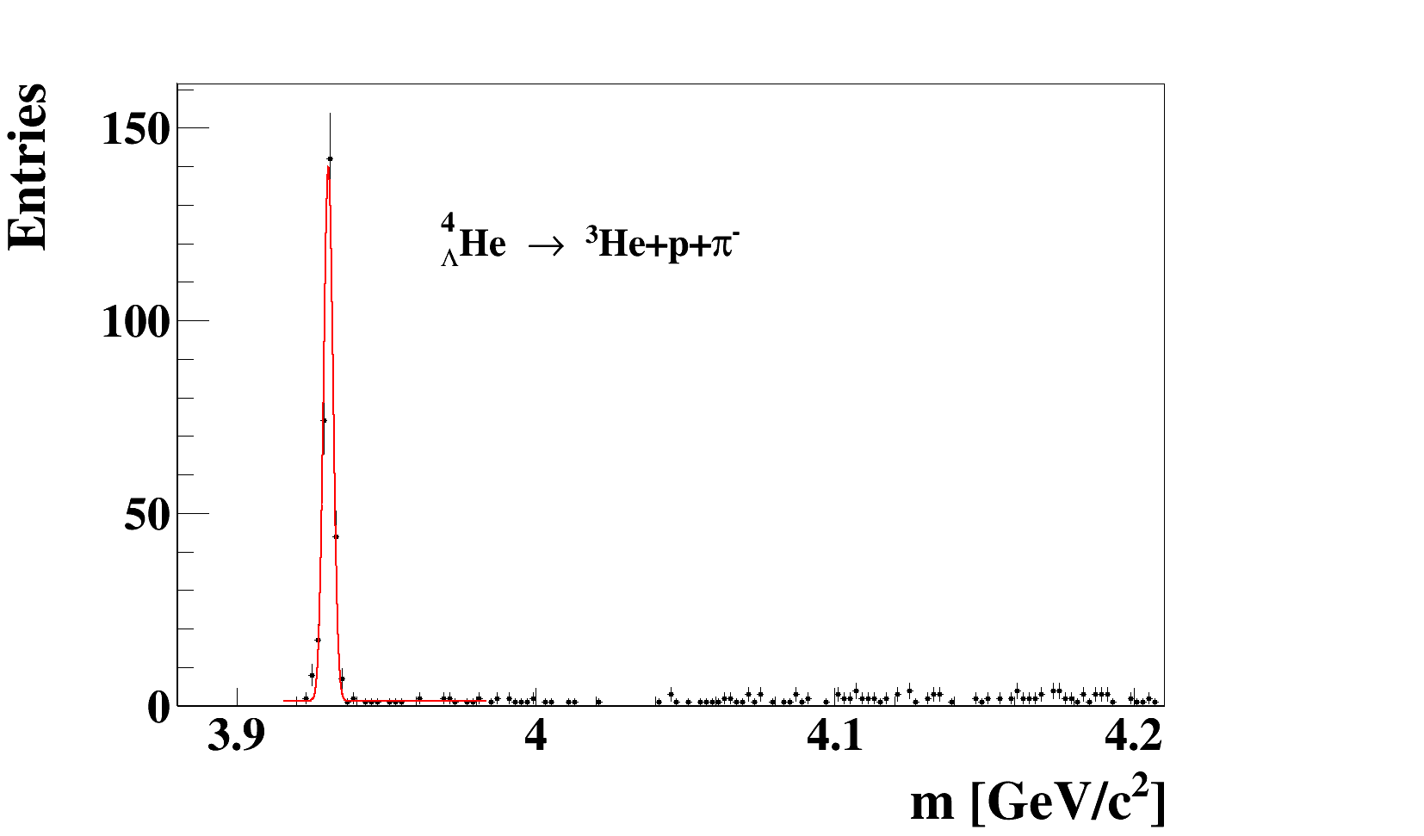
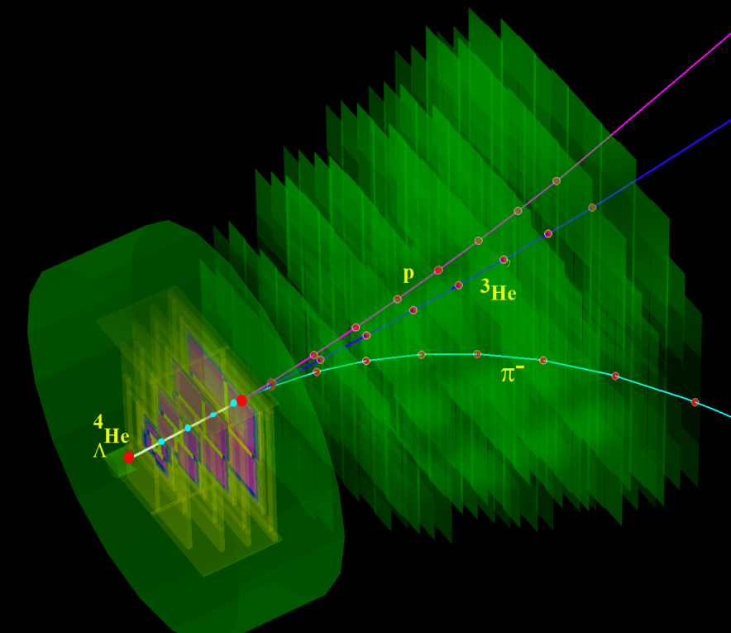
UrQMD
Au+Au 10 AGeV 5M central events
Extended KFParticle Finder ⁴_{Λ}He
~ 1 min. of data taking!
STS
MVD
eff = 14.7%
= 1.6 MeV
S/B ~ 50
BR ~ 0.2
3 prong detached vertex is good signature of ⁴_{Λ}He decay
M from J. Steinheimer et al., Phys. Lett. B714, 85, (2012)
14

Slide 15
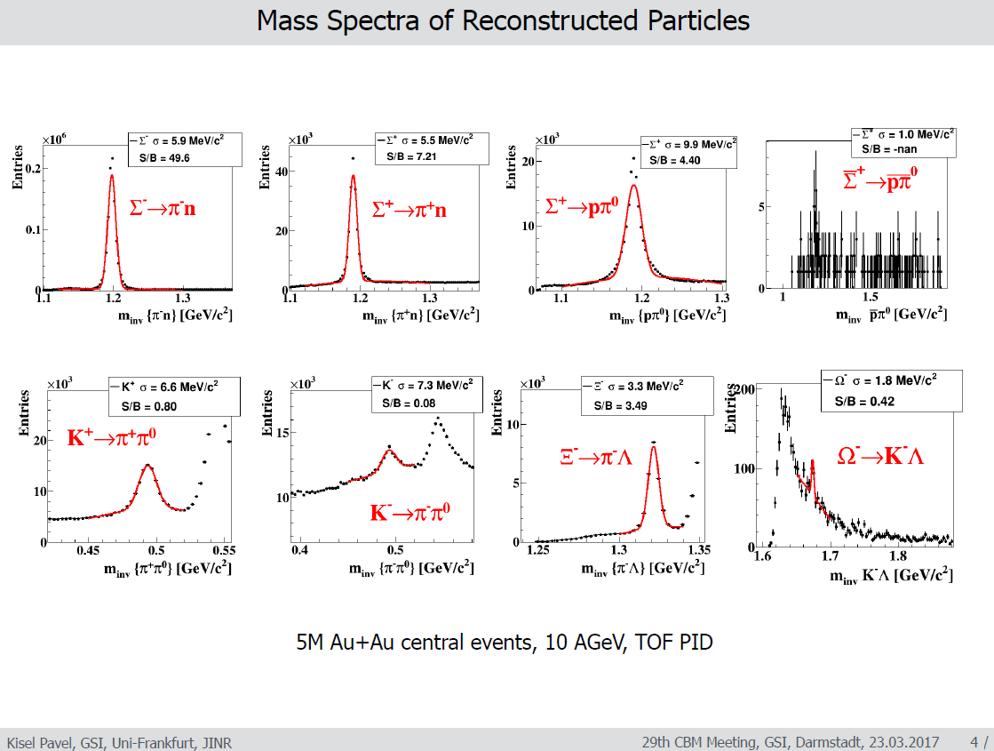
New visit card of CBM

Slide 16
Expected particle yields Au+Au @ 6, 10 AGeV
Particle (mass MeV/c²) | Multi- plicity 6 AGeV | Multi- plicity 10 AGeV | decay mode | BR | ε (%) | yield (s⁻¹) 6AGeV | yield (s⁻¹) 10AGeV | yield in 10 weeks 6AGeV | yield in 10 weeks 10 AGeV | IR MHz
Λ (1115) | 4.6·10⁻⁴ | 0.034 | pπ⁺ | 0.64 | 11 | 1.1 | 81.3 | 6.6·10⁶ | 2.2·10⁸ | 10
Ξ⁻ (1321) | 0.054 | 0.222 | Λπ⁻ | 1 | 6 | 3.2·10³ | 1.3·10⁴ | 1.9·10¹⁰ | 7.8·10¹⁰ | 10
Ξ⁺ (1321) | 3.0·10⁻⁵ | 5.4·10⁻⁴ | Λπ⁺ | 1 | 3.3 | 9.9·10⁻¹ | 17.8 | 5.9·10⁶ | 1.1·10⁸ | 10
Ω⁻ (1672) | 5.8·10⁻⁴ | 5.6·10⁻³ | ΛK⁻ | 0.68 | 5 | 17 | 164 | 1.0·10⁸ | 9.6·10⁸ | 10
Ω⁺ (1672) | - | 7·10⁻⁵ | ΛK⁺ | 0.68 | 3 | - | 0.86 | - | 5.2·10⁶ | 10
³ _{Λ}H (2993) | 4.2·10⁻² | 3.8·10⁻² | ³Heπ⁻ | 0.25 | 19.2 | 2·10³ | 1.8·10³ | 1.2·10¹⁰ | 1.1·10¹⁰ | 10
⁴_{Λ}He (3930) | 2.4·10⁻³ | 1.9·10⁻³ | ³Hepπ⁻ | 0.32 | 14.7 | 110 | 87 | 6.6·10⁸ | 5.2·10⁸ | 10
⁴ _{Λ} _{Λ}H (4108) | - | 3.7·10⁻⁵ | ⁴_{Λ}Heπ⁻ | 0.2 | 2.6 | - | 0.6 | - | 3.8·10⁶ | 10
⁶_{ΛΛ}He (5986) | - | 2.5·10⁻⁸ | ⁵_{Λ} Hepπ⁻ | 0.2 | 1.3 | - | 2.6·10⁻⁴ | - | 1.6·10³ | 10
4D time based analysis !
New tools;
A lot to learn;

Slide 17
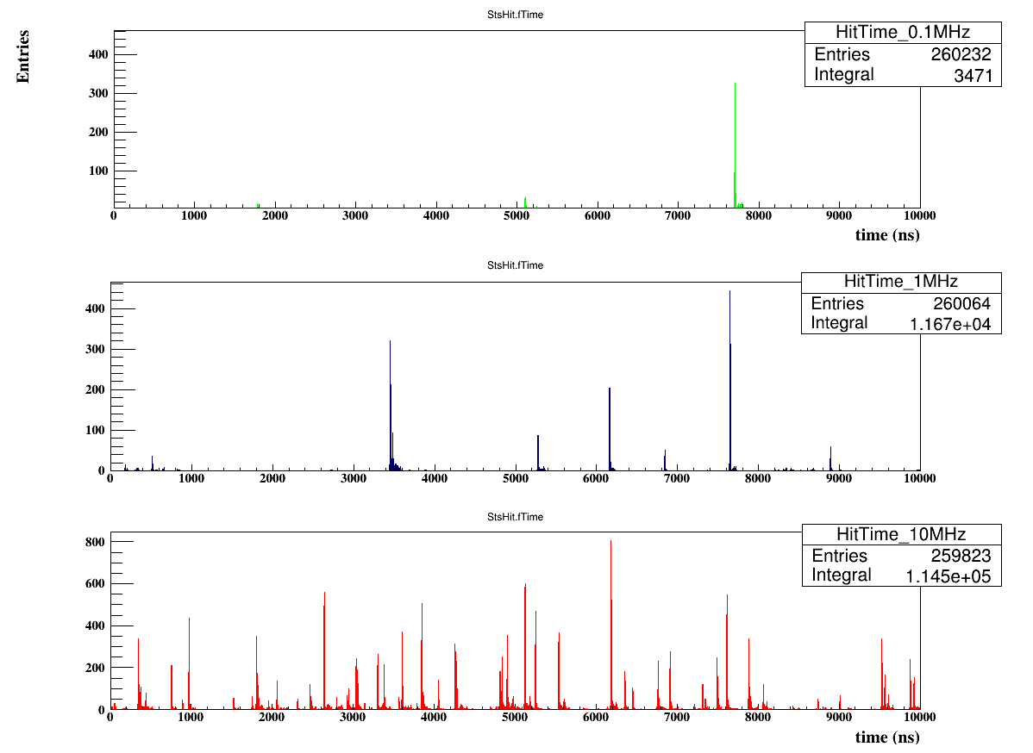
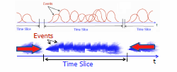
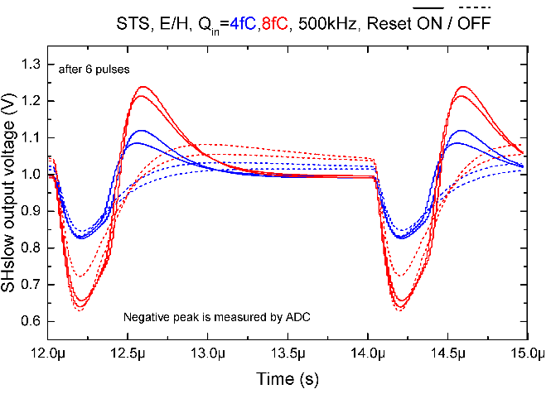
10 mks window
100 kHz
1 MHz
10 MHz
K. KASINSKI

Slide 18
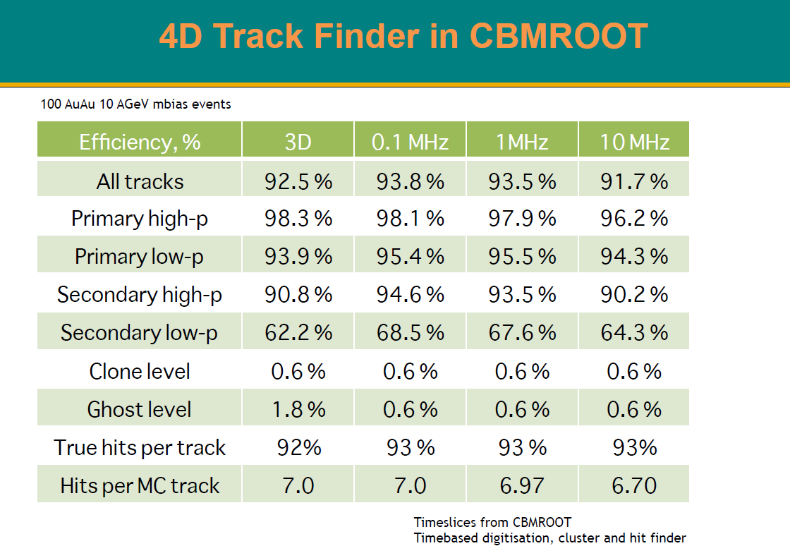
V. Akishina

Slide 19
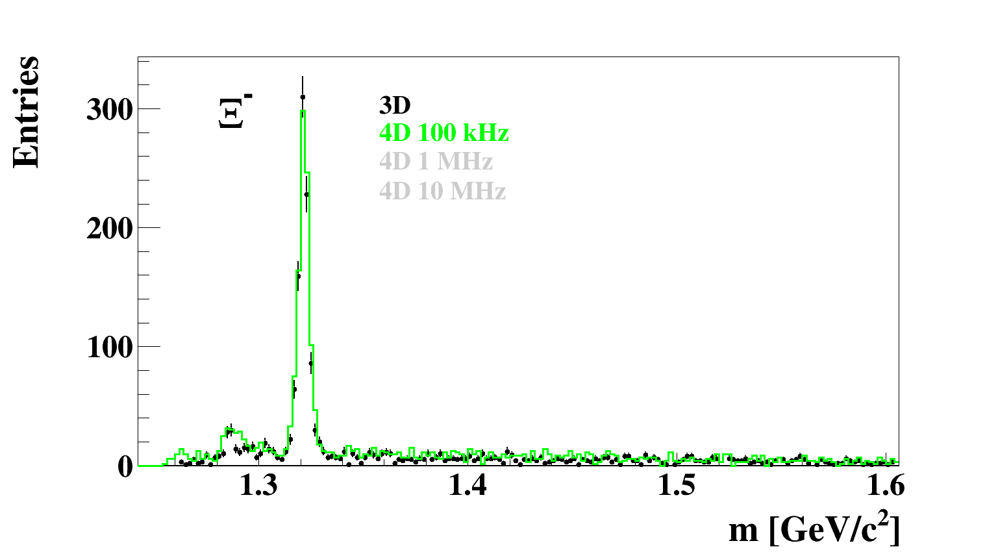
High rate scenario: MSH reconstruction with 4D tracking

Slide 20
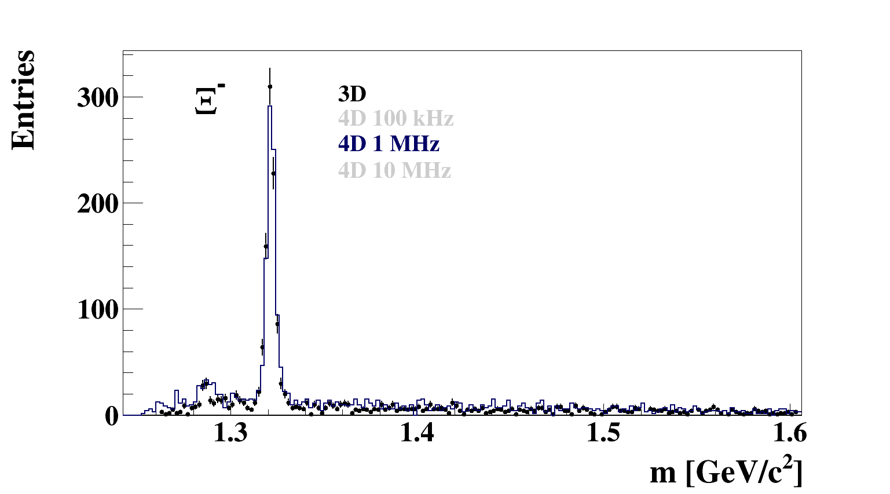
High rate scenario: MSH reconstruction with 4D tracking

Slide 21
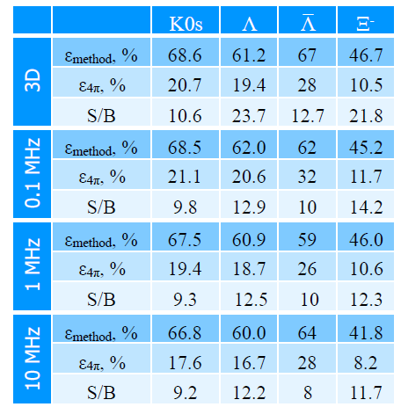
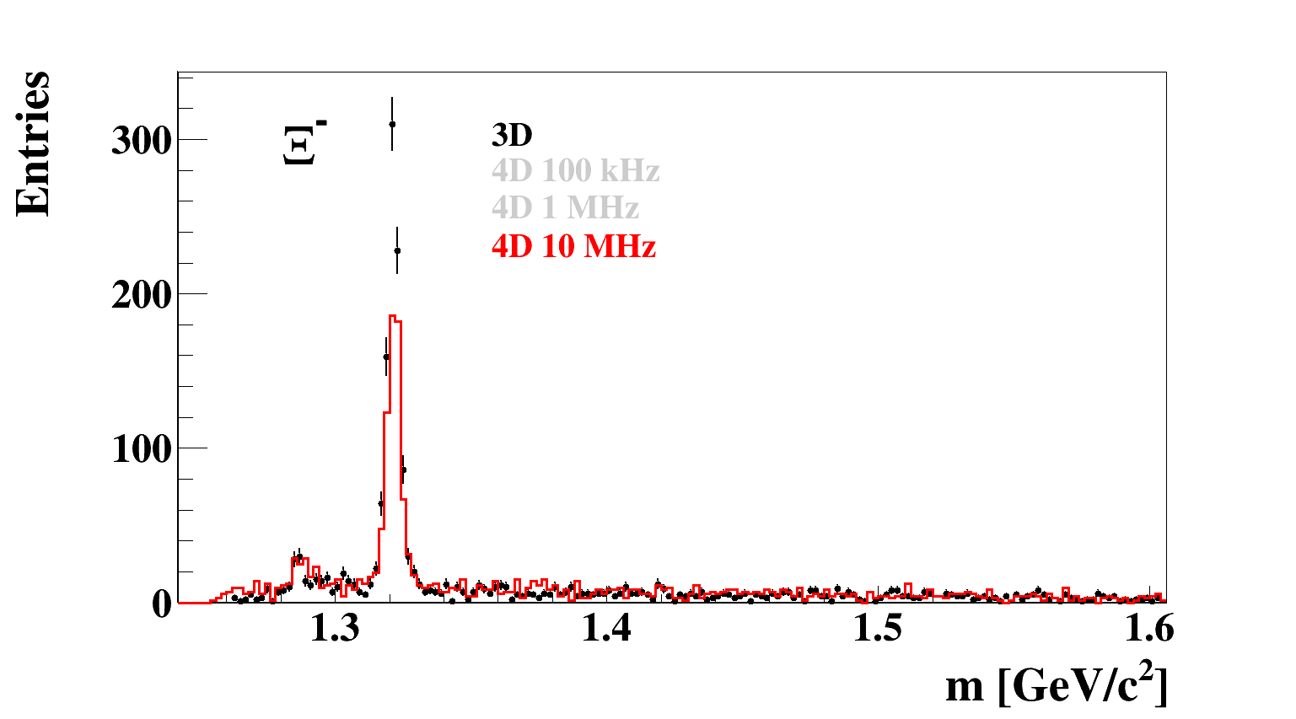
High rate scenario: MSH reconstruction with 4D tracking

Slide 22
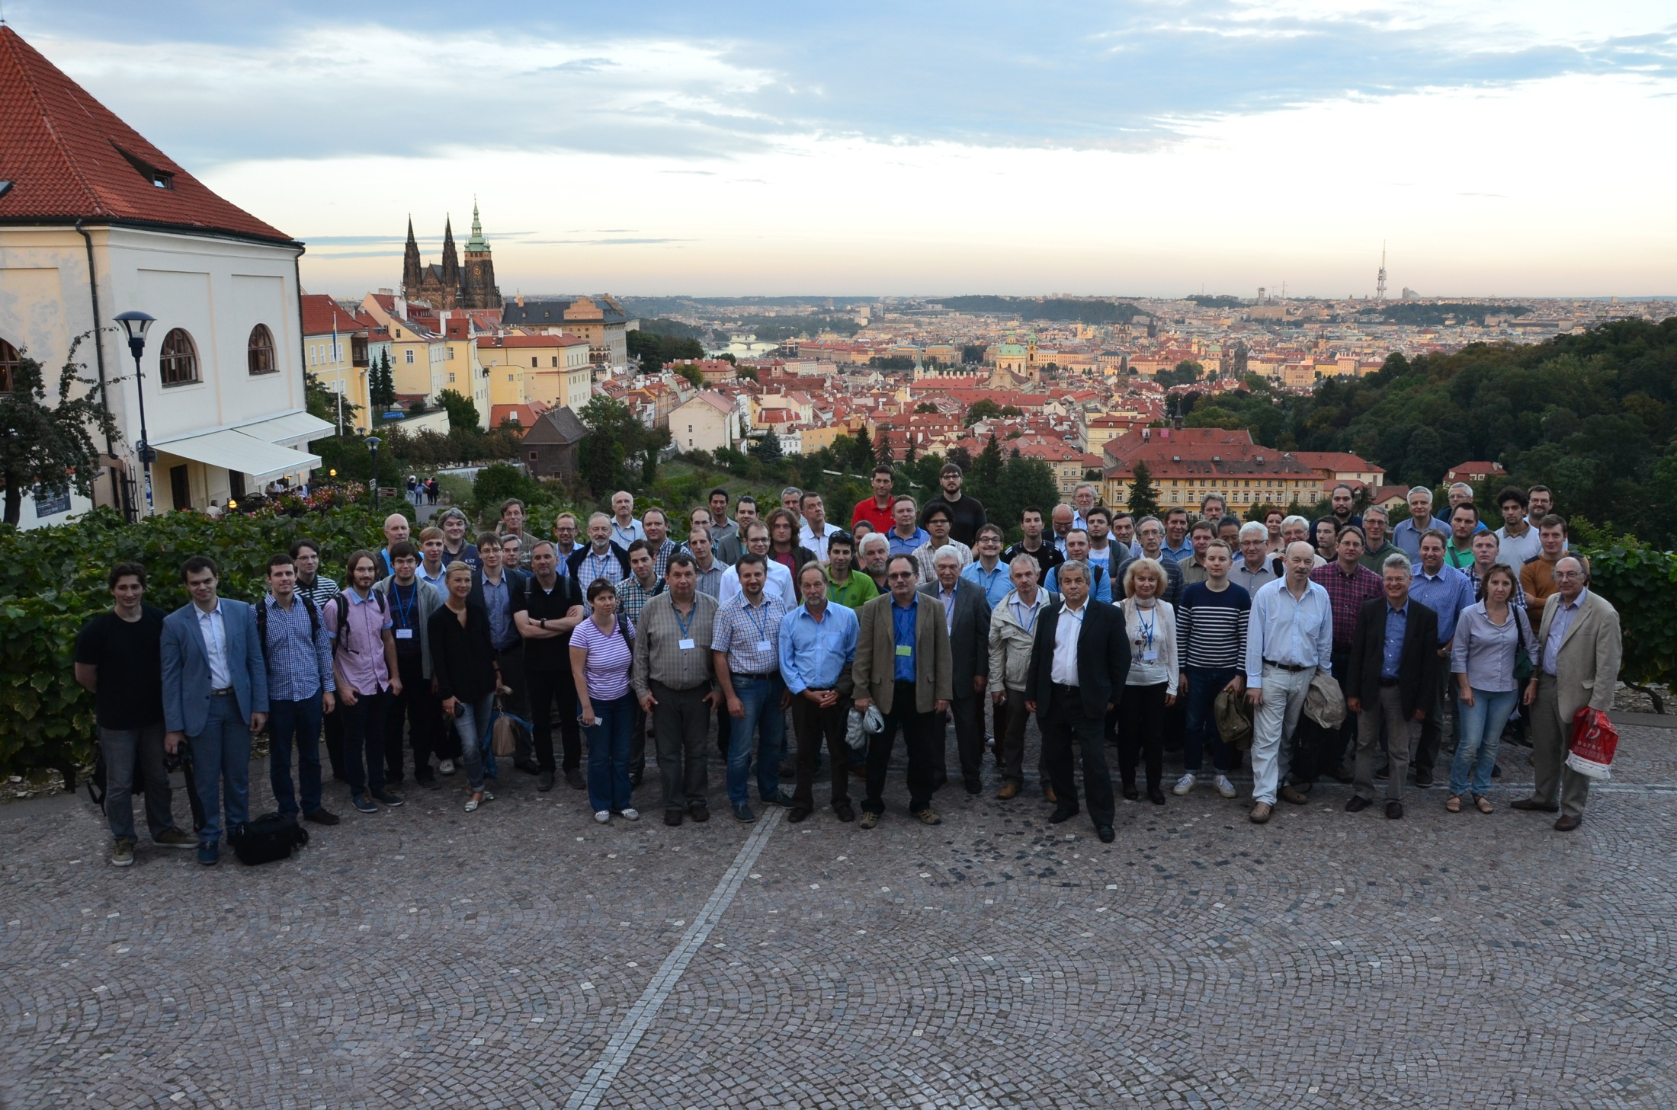
60 Institutes, 600 members
Summary:
CBM detector is an excellent device to measure
not only bulk observables, but strangeness, hypernuclei and other rare probes with
high statistic
22
Notes:
22

Slide 23
23

Slide 24


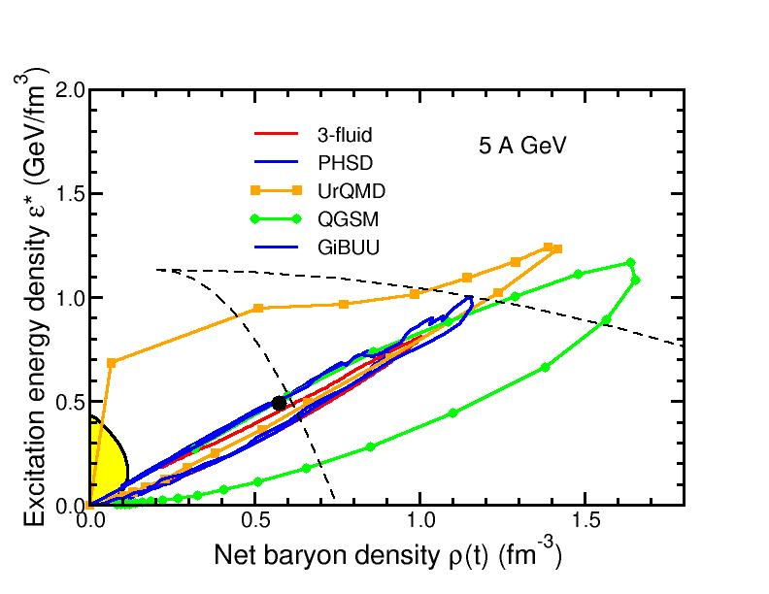
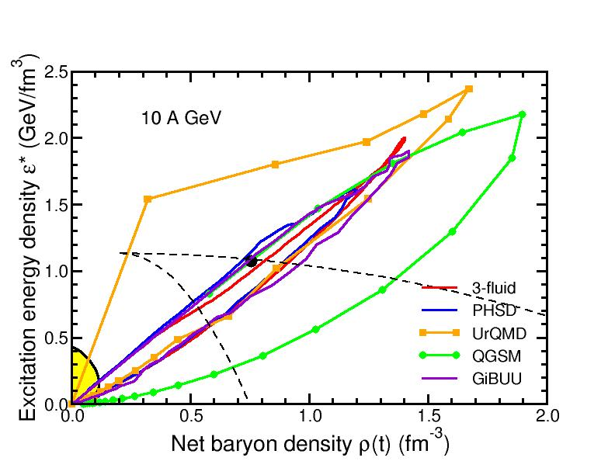
Baryon densities in central Au+Au collisions
I.C. Arsene et al., Phys. Rev. C 75, 24902 (2007)
5 A GeV
10 A GeV
8 ρ₀
5 ρ₀
phase
coexistence

Slide 25
CBM First Level Event Selection (FLES)
The FLES package is
vectorized, parallelized, portable and scalable up to 3 200 cores
Example:
Full track reconstruction including KF particle analysis of multi-strange
(anti) hyperons for min. bias Au+Au collisions at 25 A GeV.
Single node with up to 80 cores
100 nodes with 32 cores each
220 k events/s !
HPC cluster at
ITEP Moscow
25

Slide 26
