Slide 1

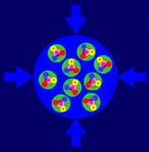

The CBM Silicon Tracking Station and CBM-related ASIC developments
Christian J. Schmidt
3rd Annual MT Meeting
Jan. 31st to Feb. 2nd, 2017, GSI, Darmstadt, Germany
CBM

Slide 2
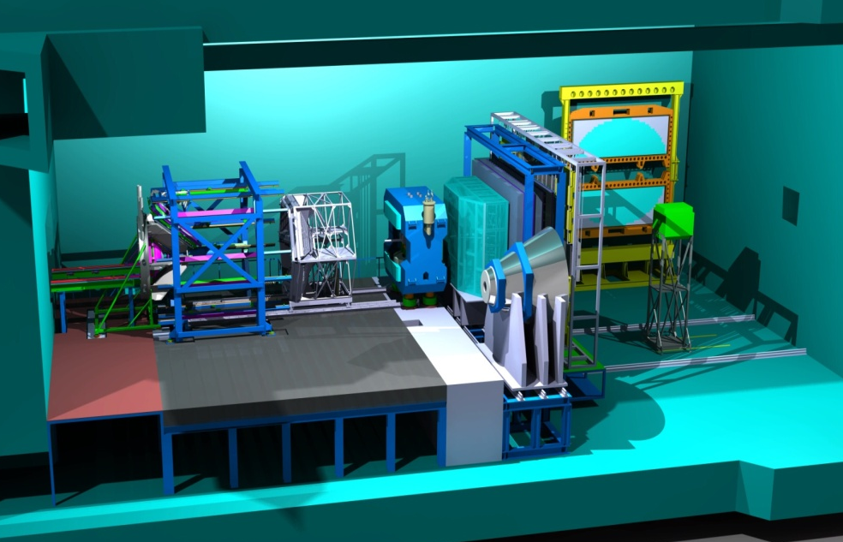
The Compressed Baryonic Matter Experiment
Transition
Radiation
Detector
Resistive Plate
Chambers
(TOF)
Ring Imaging
Cherenkov
Detector
Electro-
magnetic
Calorimeter
(parking
position)
Projectile
Spectator
Detector
Vertex
Detector
Silicon
Tracking
Stations
Dipole
magnet
HADES
Muon Detection System
(parking position)

Slide 3
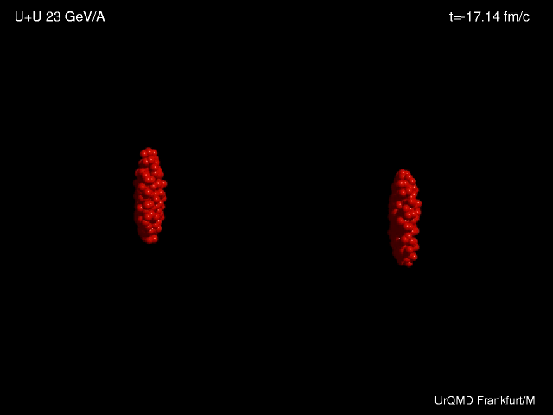
Heavy-ion collisions

Slide 4
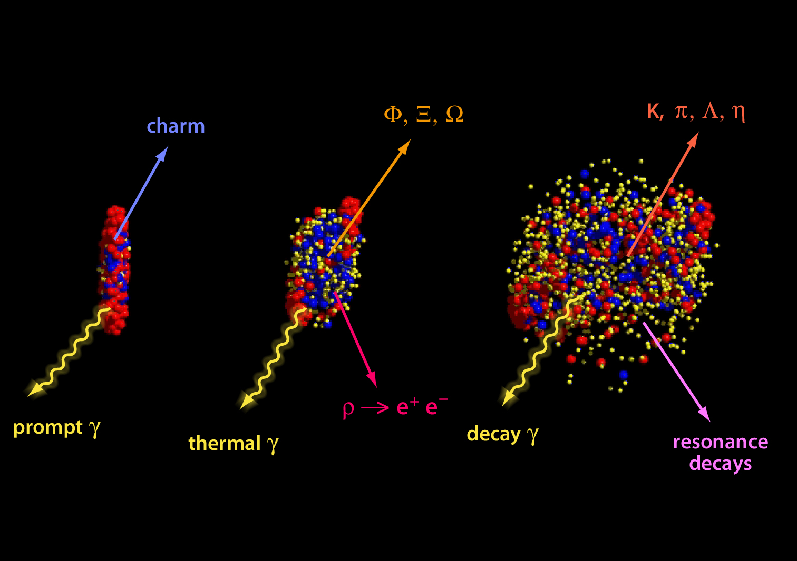
Diagnostic probes

Slide 5
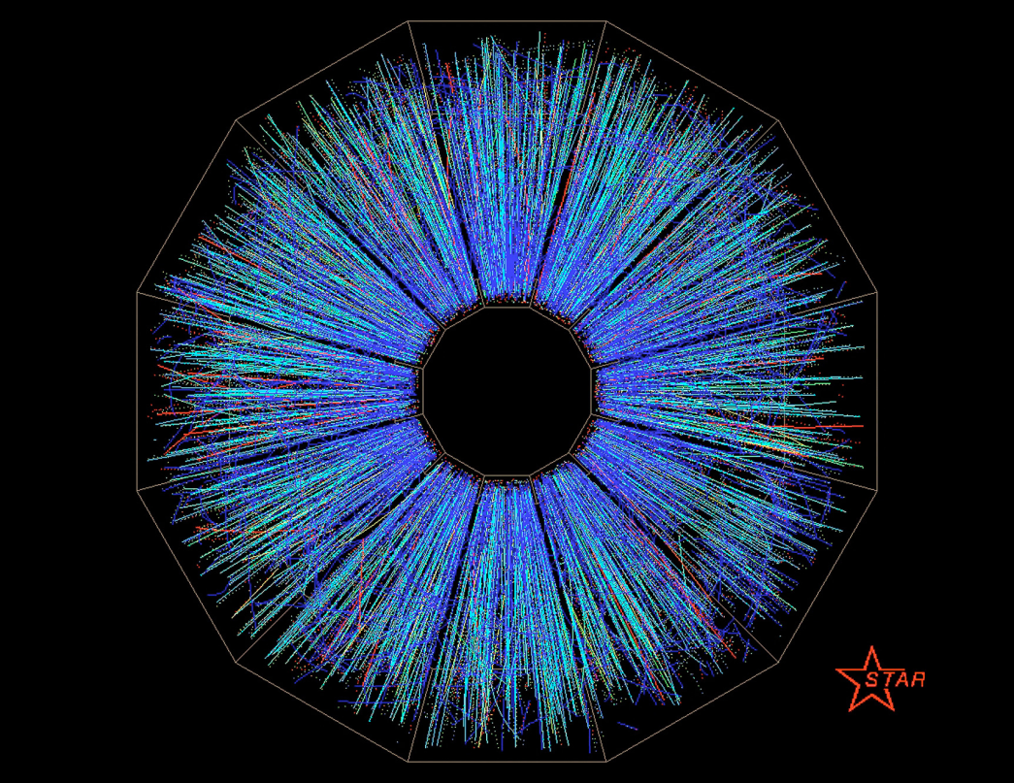
Charged-particle tracks, collider experiment
TPC detector

Slide 6
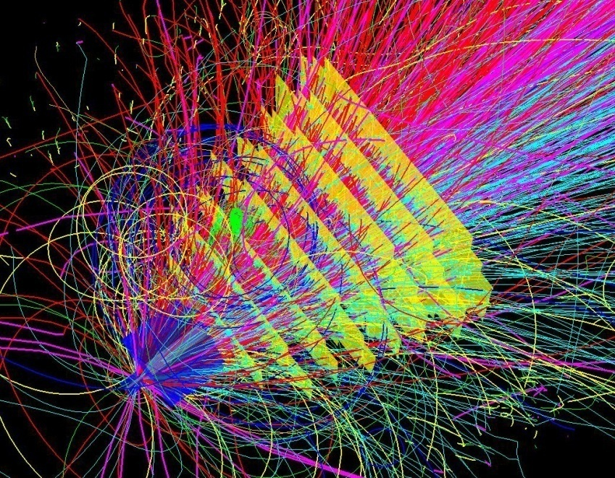
CBM technological challenges
fixed target configuration makes 10MHz Au+Au interaction rate feasible at FAIR
➢ determination of (displaced) vertices (σ ≈ 50 μm)
➢ identification of leptons and hadrons
➢ fast and radiation hard detectors
➢ free-streaming readout electronics
high speed data acquisition and high performance
computer farm for online event selection
➢ 4-D event reconstruction
Notes:
6
6
6

Slide 7
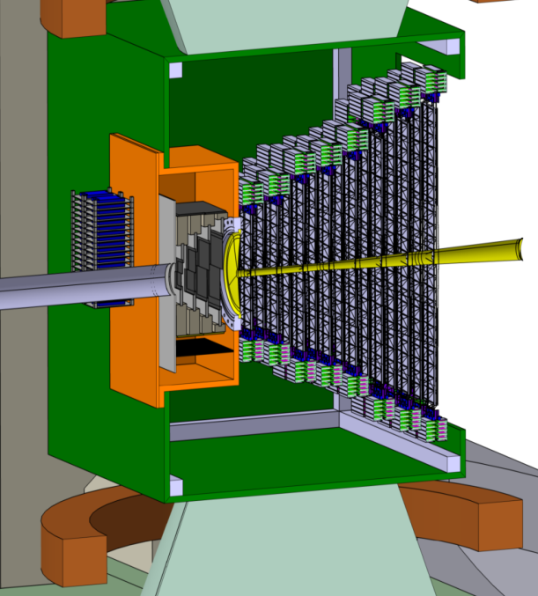
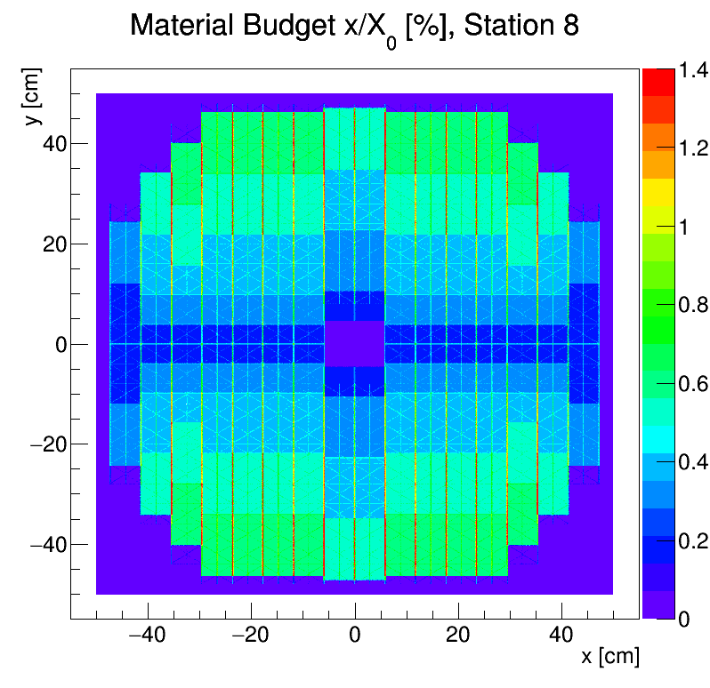
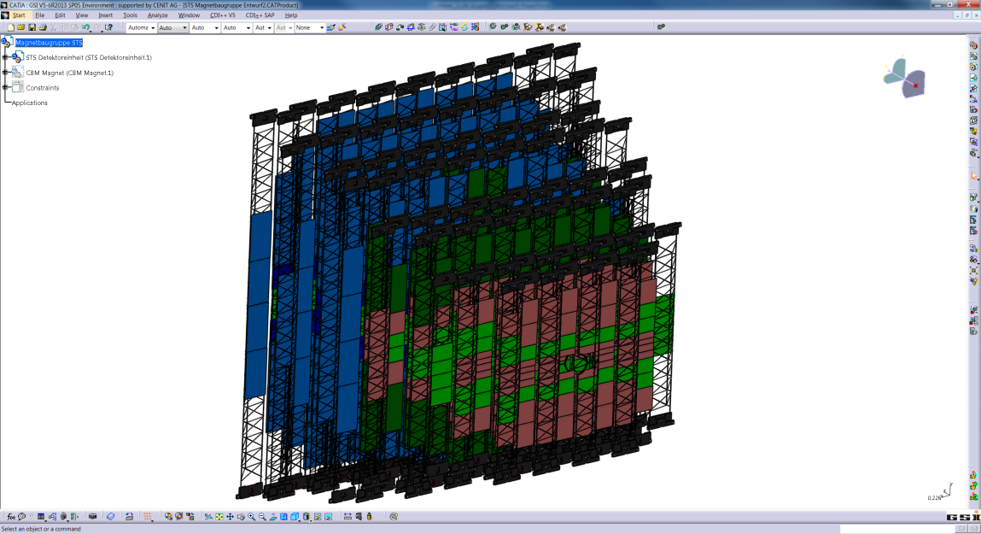
The Silicon-Tracking-System
Low-mass micro cables from sensor to FEE
selftriggering ASIC readout
1.8 Mio channels, cooling power ~ 40 kW
STS
beam
2.5°
25°
x/X₀ [%]
target
~ 3 sqm active sensor area
double sided strips 7.5°, 58µm pitch
8 Stations,
106 ultra-light carbon ladders
896 Sensor modules
material budget per station

Slide 8
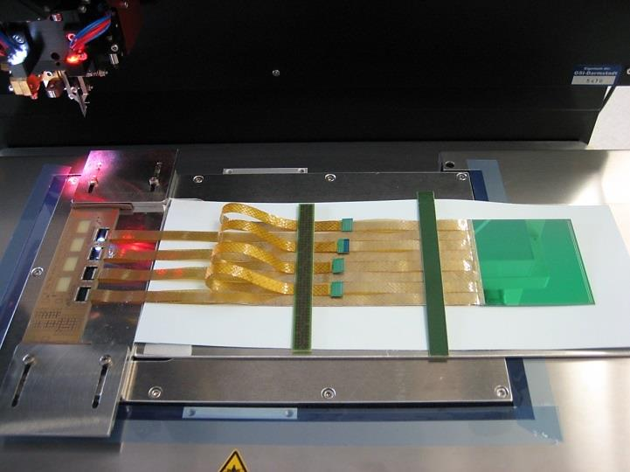



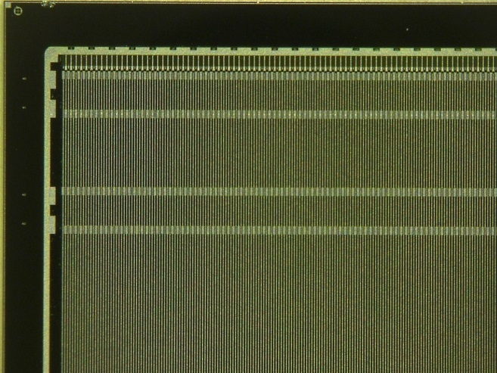
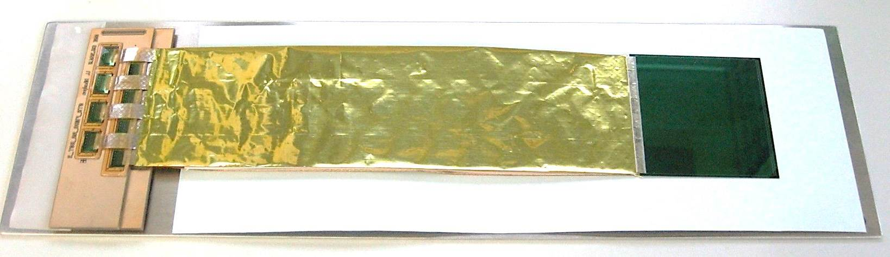
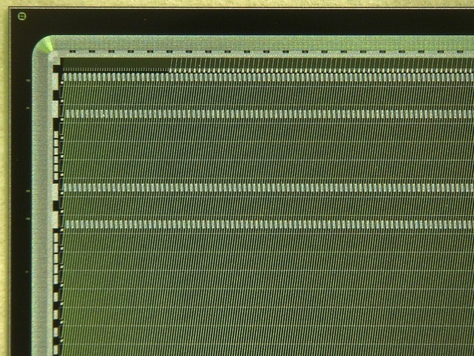
Assembly of double sided strip detector modules, a collaborative effort → talk by Carmen Simons
prototyping ongoing
Topical workshop on radiation induced surface effects in silicon detectors, Oct. 2016 at KIT

Slide 9
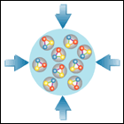
CBM-related Chip Developments and Options
PADI for Diamond
M. Ciobanu, ISS
CBM MuCH XYTER
E. Atkin et al, MEPhI
PADI for TOF
M. Ciobanu, ISS
Bucharest
CBM STS-XYTER/MuCH-XYTER
AGH Krakow, R. Szczygiel et al
GET-4 TDC (TOF)
H. Flemming, H. Deppe, GSI
SPADIC for TRD
ZiTi Heidelberg, P. Fischer et al
SPADIC 2.0 with e-link interface
CBM-GBTx
Chipset ordered from CERN
GBTx
FPGA emulation for
VECC and JINR
Rad tolerant LDOs
SCL Chandigarh, India

Slide 10
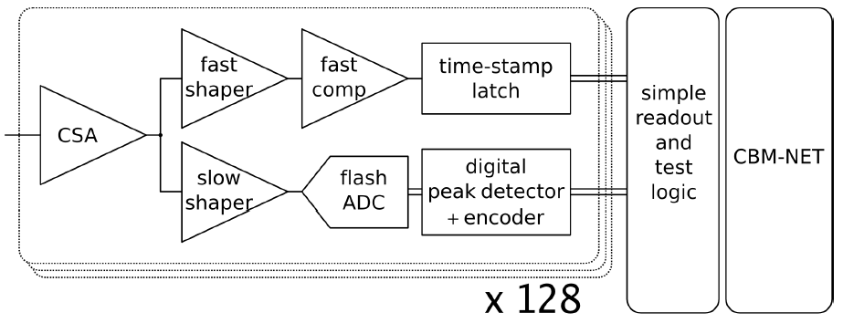
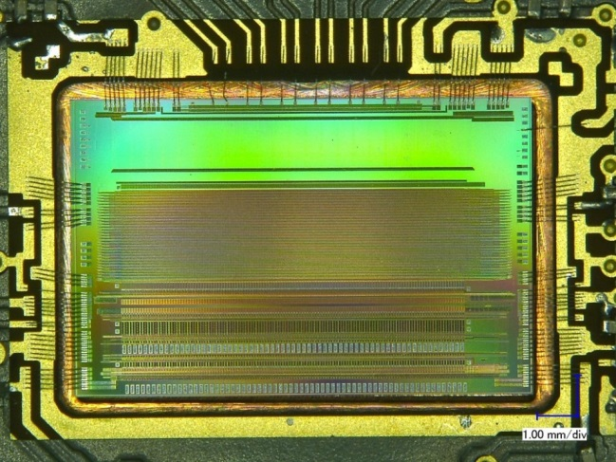

Fully digital Read-out ASIC “STS-XYTER”
purely data driven read-out
time-stamped data elements
250kHz per channel
for every channel:
fast branch: time-stamp
slow branch: signal height digitization (energy)
STS-XYTER ASIC
t_{s} = 30 ns
r/o
logic
CBM-NET
(v1.0 )
GBT
(V2.0)
UMC 180 nm CMOS
LSB veto
t_{s} = 80 ns
noise minimization in self-triggering system:
effective two-level discrimination
trigger to the timestamp latch vetoed if ADC-LSB generated no signal
channels | 128, polarity +/-
noise | < 1000 e⁻ under load
ADC range | 16 fC, 5 bit
clock | 160 MHz
power | < 10 mW/channel
timestamp | < 5 ns resolution
out interface | 5 × 320 Mbit/s LVDS
Design Team:
R. Szczygiel et al. at AGH Krakow/Poland

Slide 11
STS-XYTER R. Szczygiel et al. AGH Krakow
STS-XYTER turns into MuCH-XYTER via Gain Switch (x 0,2)
Submission Review in Feb. 2015: Noise is an issue →
system issue, optimization with complete system perspective, extensive architectural studies → goal < 1000 ENC
Submission Review in Oct. 2015 → full go for submission
STS-XYTER 2.0: adaptation to GBTx-eLink-readout, STS-r/o protocol
→ intensive collaboration AGH-WUT (W. Zabolotny (DPB)) on design and verification
  STS-XYTER defines critical path for STS!
  → This submission has all architectural elements included!

Slide 12
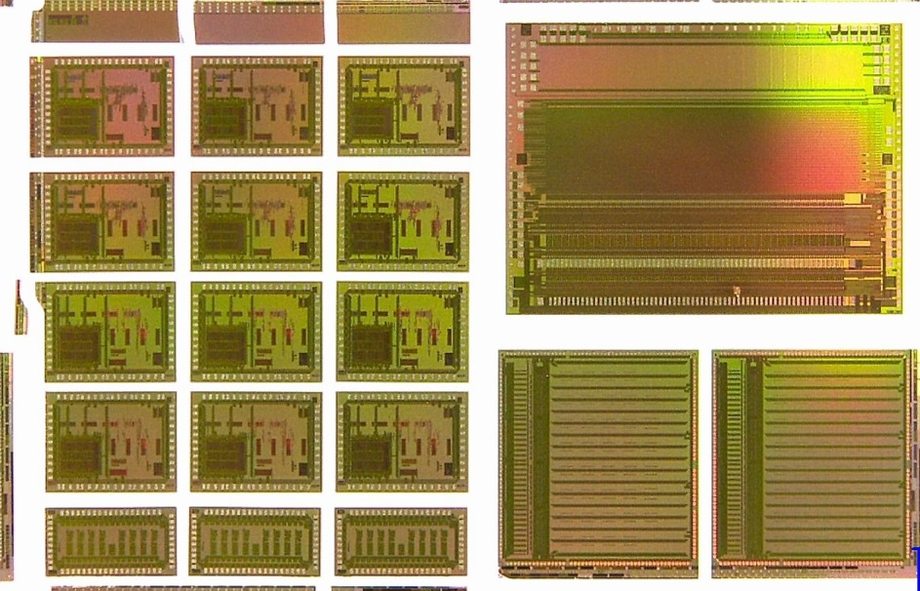
Long awaited STS-XYTER 2.0 Submission Mai 2016
...evolved to a grand CBM-Joined 6-Chip Submission
STS-XYTER 2.0 → yield 930 chips for STS- and MUCH-prototyping
TOF readout ASICs, Volume production for operation at STAR
  Get4-TDC in two versions:
    Bug-fix version
    Version for robust operation at 40MHz
  PADI – fast 8-channel TOF pre-amp
SPADIC V2 → prototype run with CBM compatible e-link interface

Slide 13
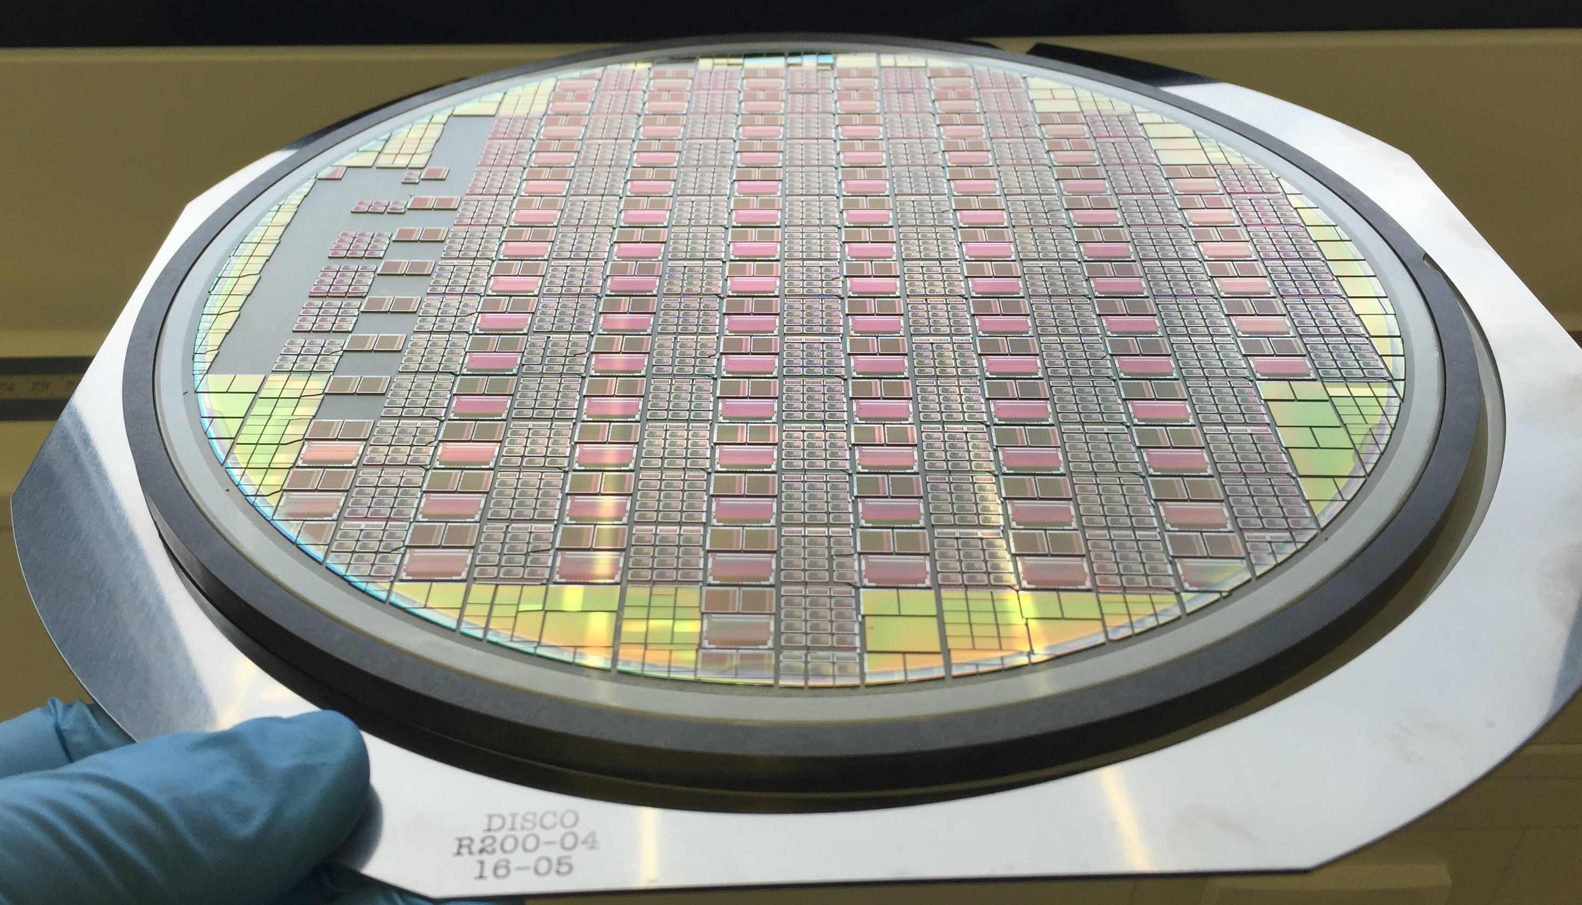
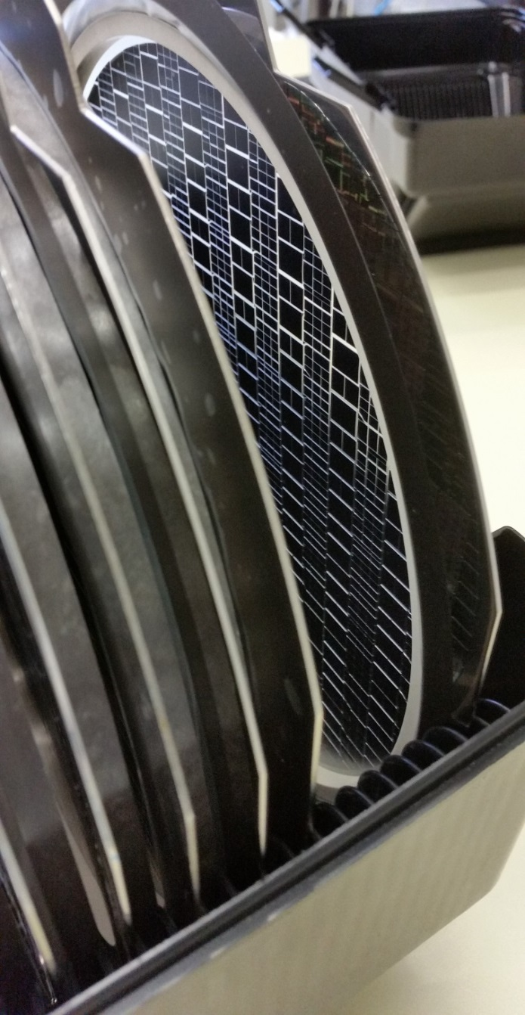
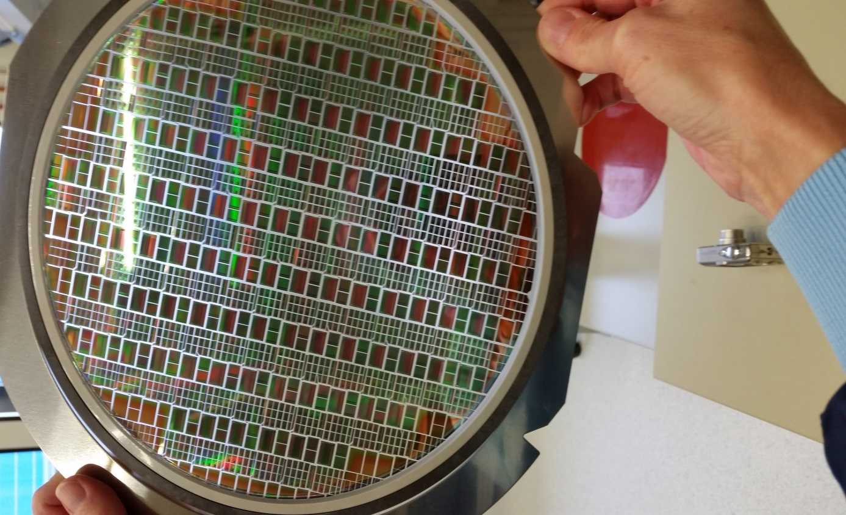
Unpacking was solemn like X-mas

Slide 14
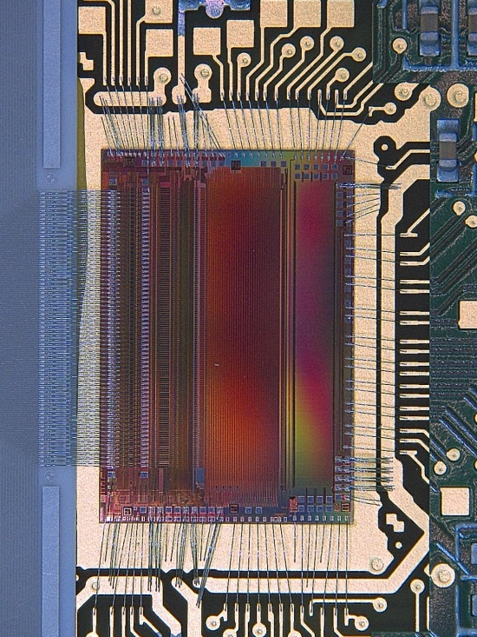
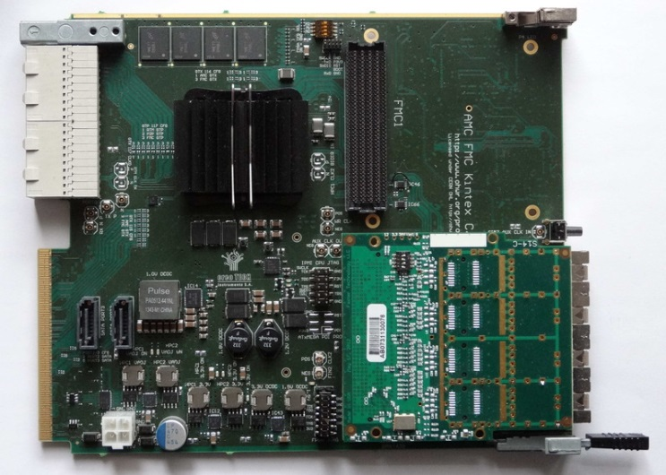
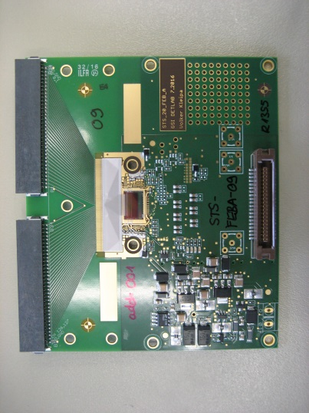
The Readout-ASIC STS-XYTER
Switchable gain
(5x smaller for MUCH)
+ trimming 2 bit
The moment of truth: Testing is a joined AGH, WUT, VECC and GSI effort → workshop on STS-XYTER testing Feb. 2017 in India
Beam-time Feb. 2017 at Helmholtz FZ-J COSY: Rad. tests
Switchable
(90ns – 280ns)
in 4 steps

Slide 15
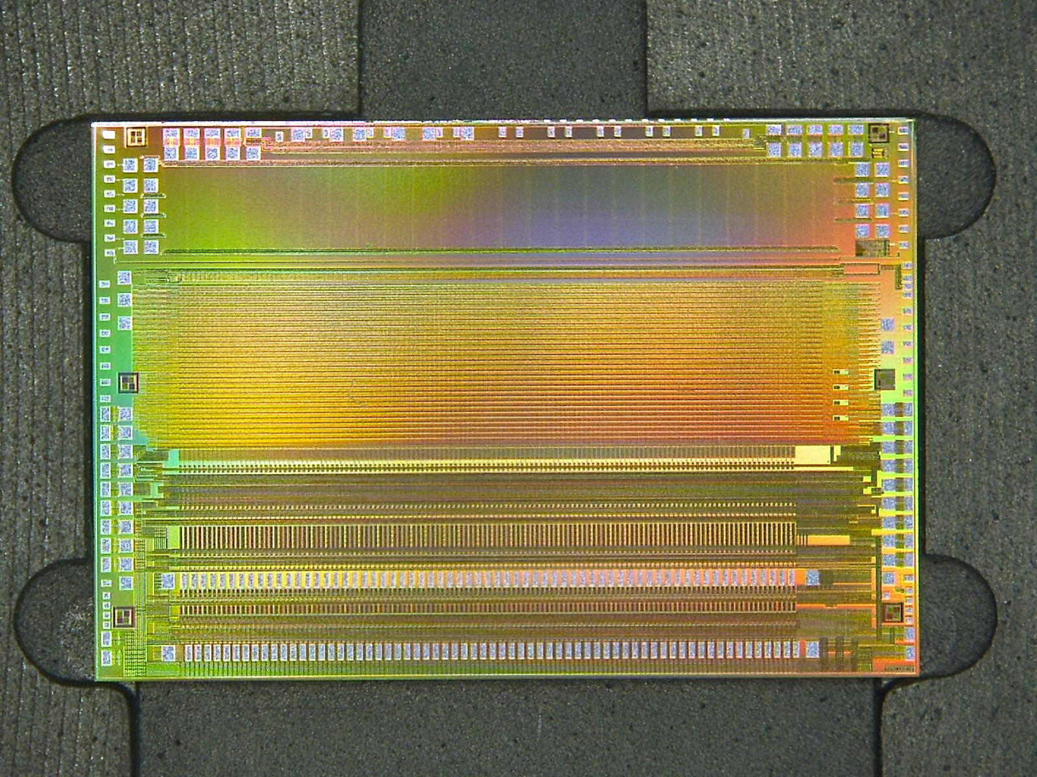

Slide 16
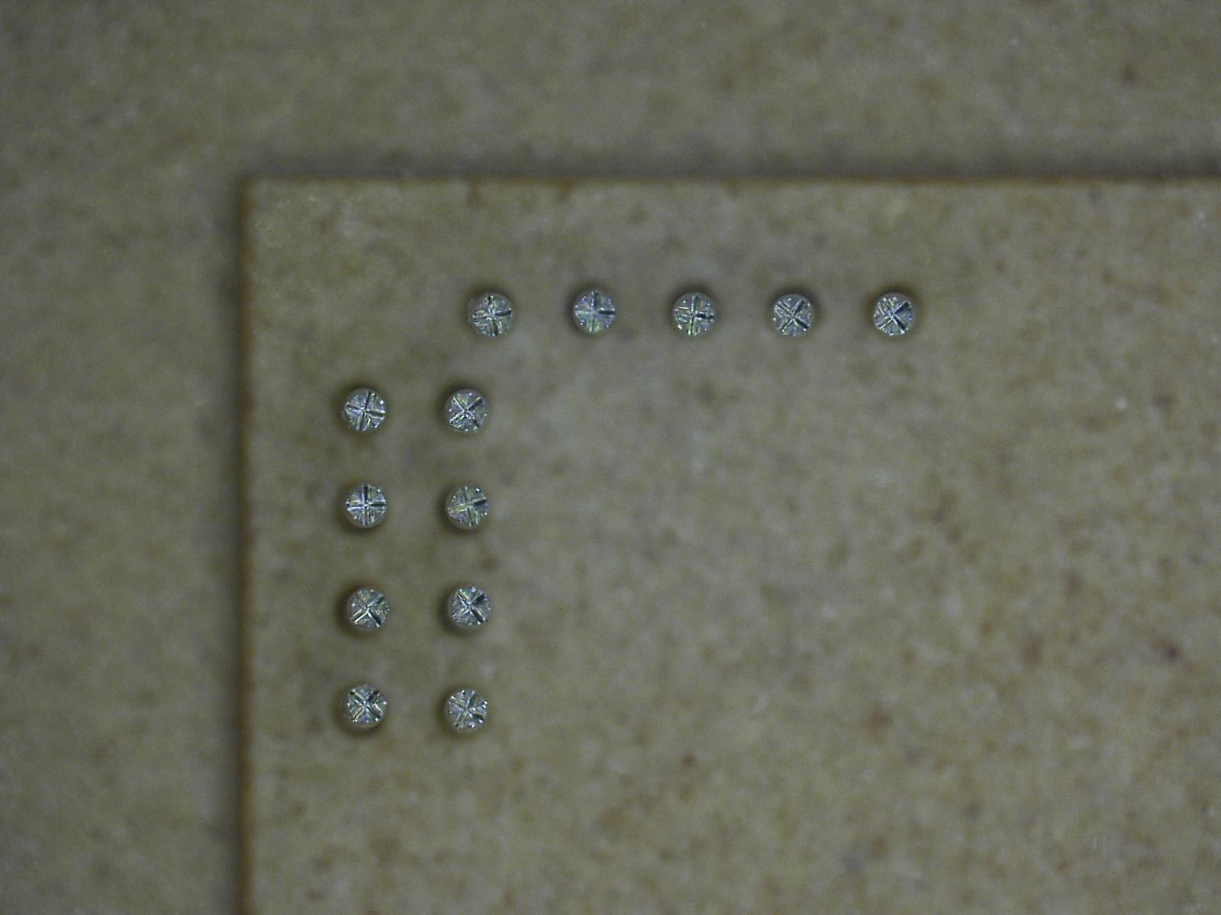
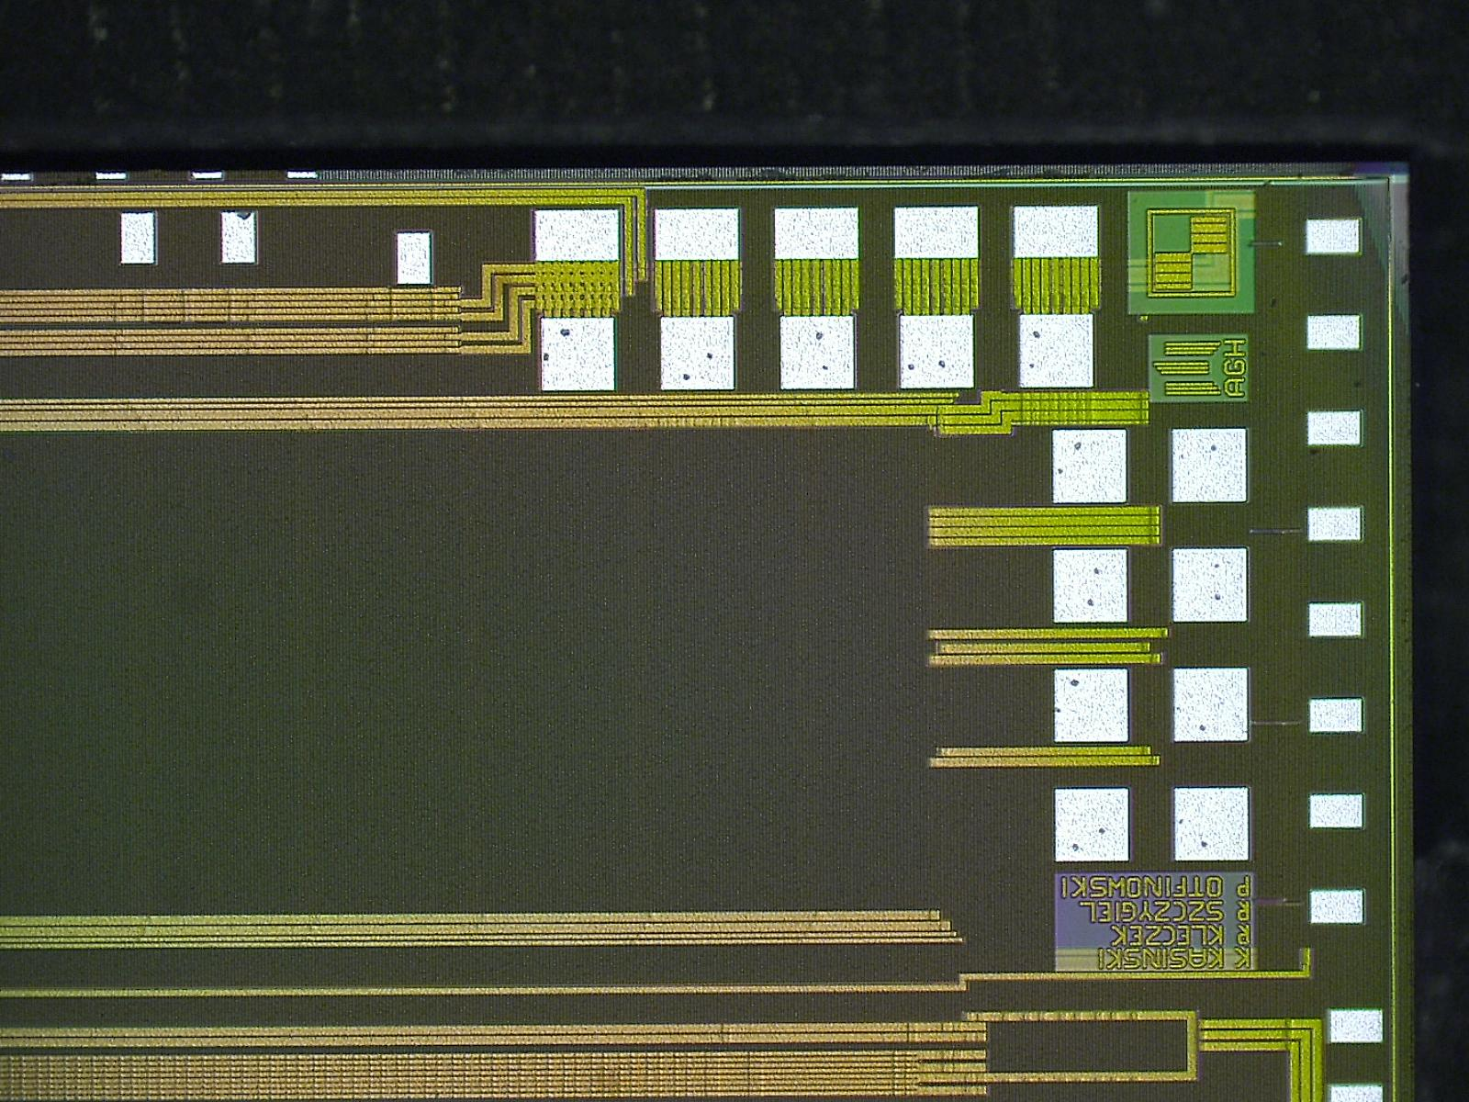
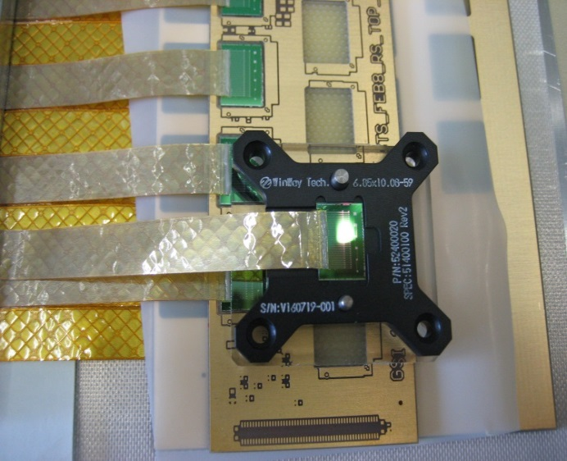
Dicing precision successful: 100µm Pogo-Pins match!

Slide 17
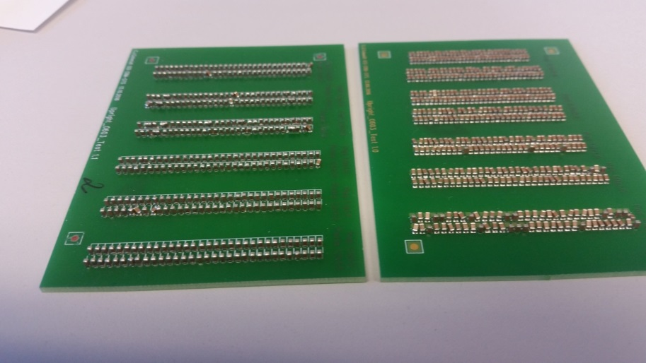
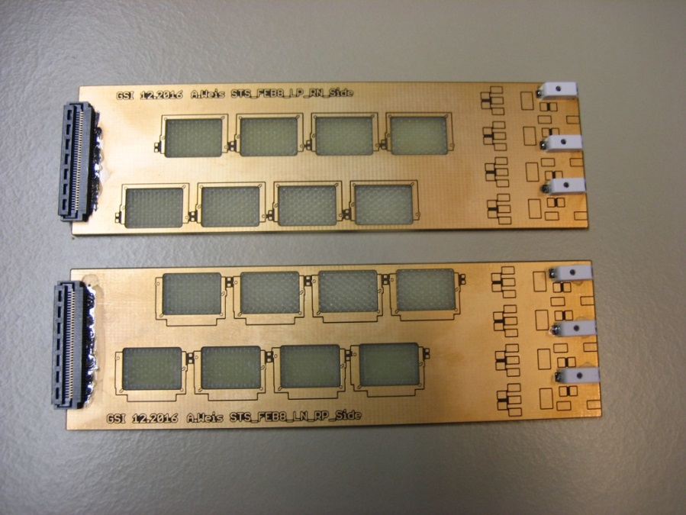
STS-Module Front-End Board
very dense (101 x 31mm²)
cooling challenges (~ 10W)
floating at biasing potential
upto 40 x 320Mbps data transfer
in-board chip LDOs
point of load skimming regulation
powered by CERN Feast-based DC/DC converters

Slide 18
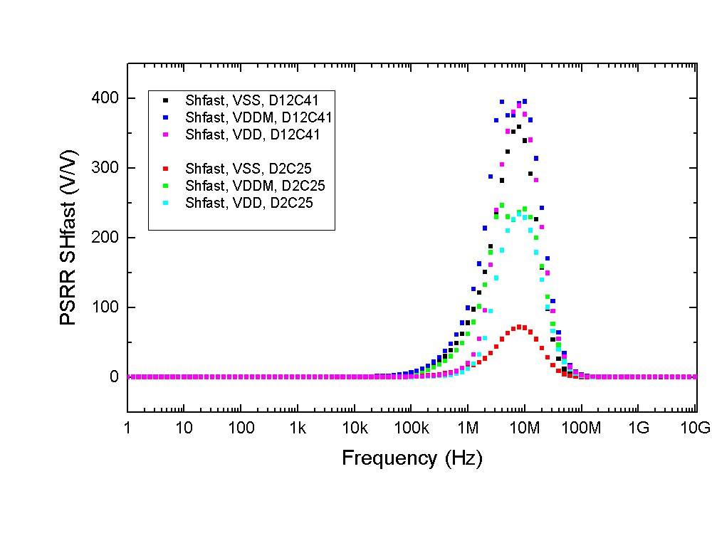
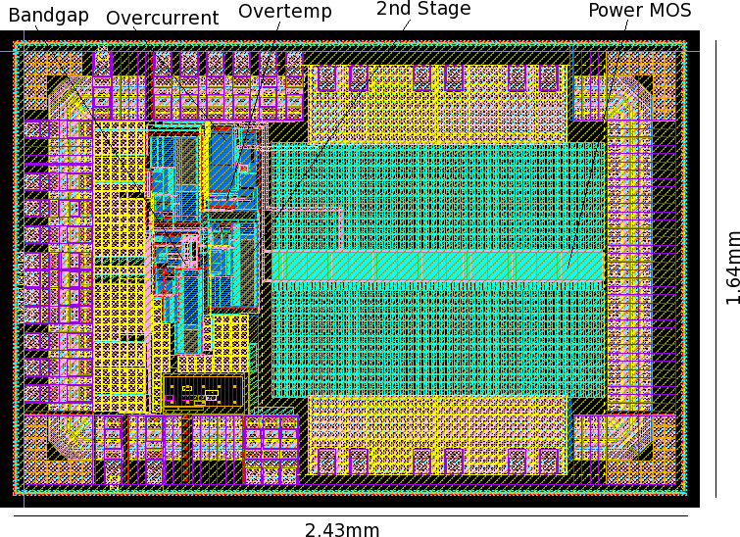

SCL realizes radiation tolerant LDOs for CBM
Linear regulators for skimming at point of load
Sensitivity to Total Ionizing Dose evaluated by VECC Kolkata → OK for CBM
Sensitivity to Single Event Upset evaluated by GSI at COSY, FZJ → OK for CBM
STS-XYTER single ended cascode
very sensitive to supply noise
180nm Tower Jazz Process
Semi–Conductor Laboratory
Department of Space, Government of India

Slide 19
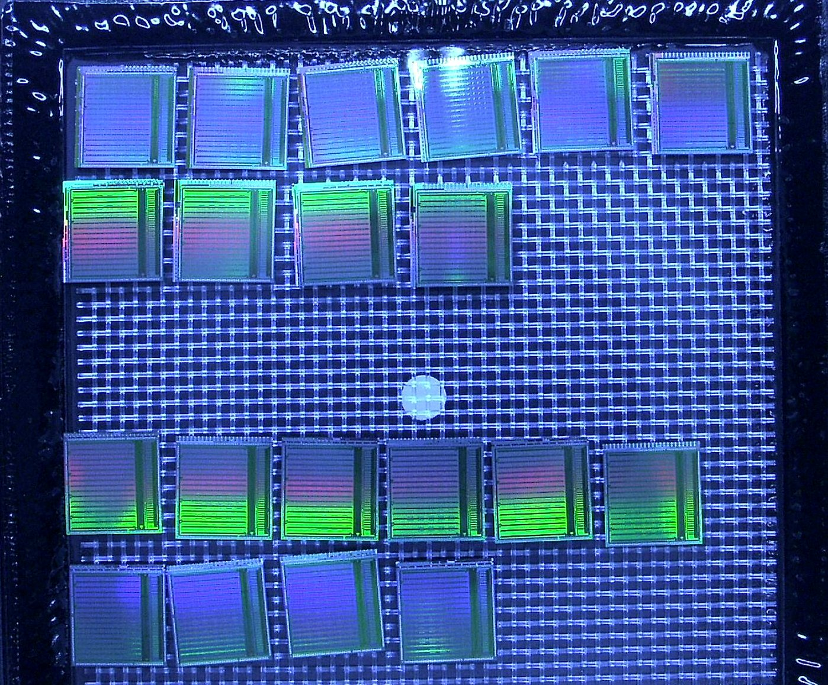
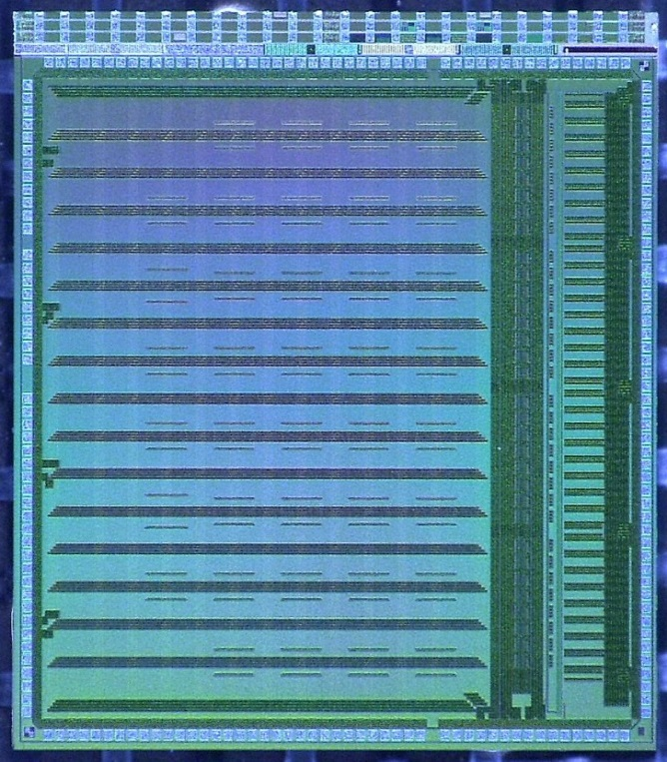
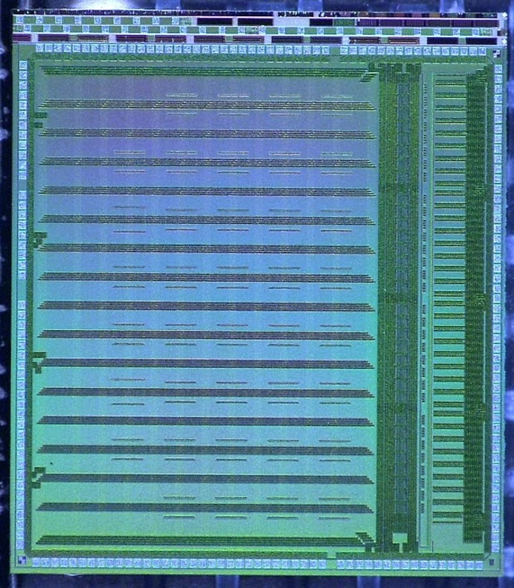
CBM-TRD: Spadic 2.0 in two versions being tested
32-channel signal digitizer 8bit at 16 MHz
self triggered
forced next neighbor trigger
e-link interface
Readout chip for CBM Transition Radiation Detector (allows to tell electrons from pions)

Slide 20
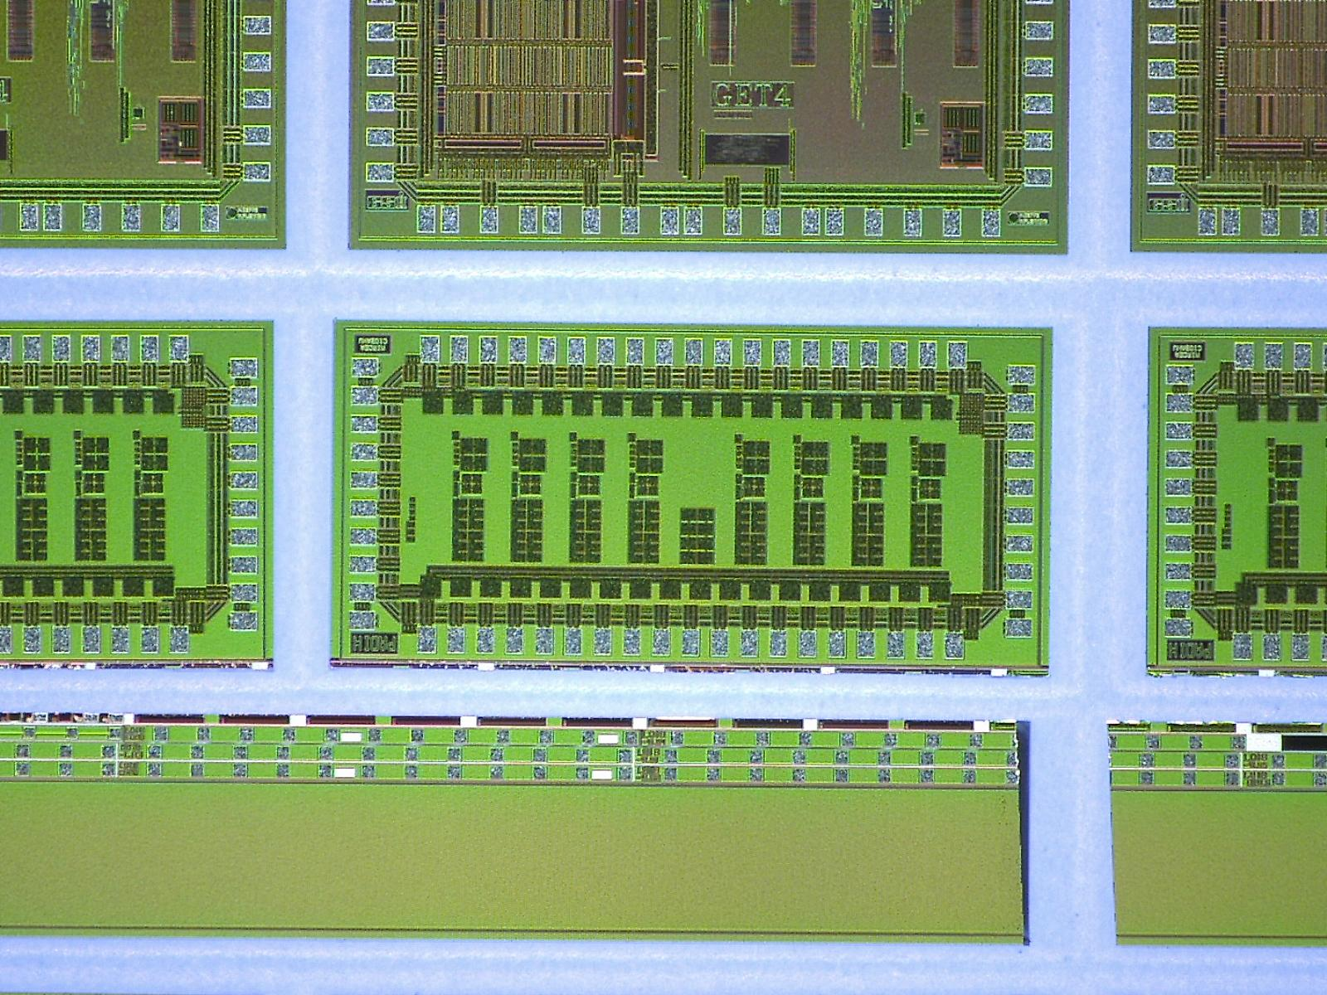
PADI, the one proven design, is available in large numbers now
Designer: Mircea Ciobanu

Slide 21
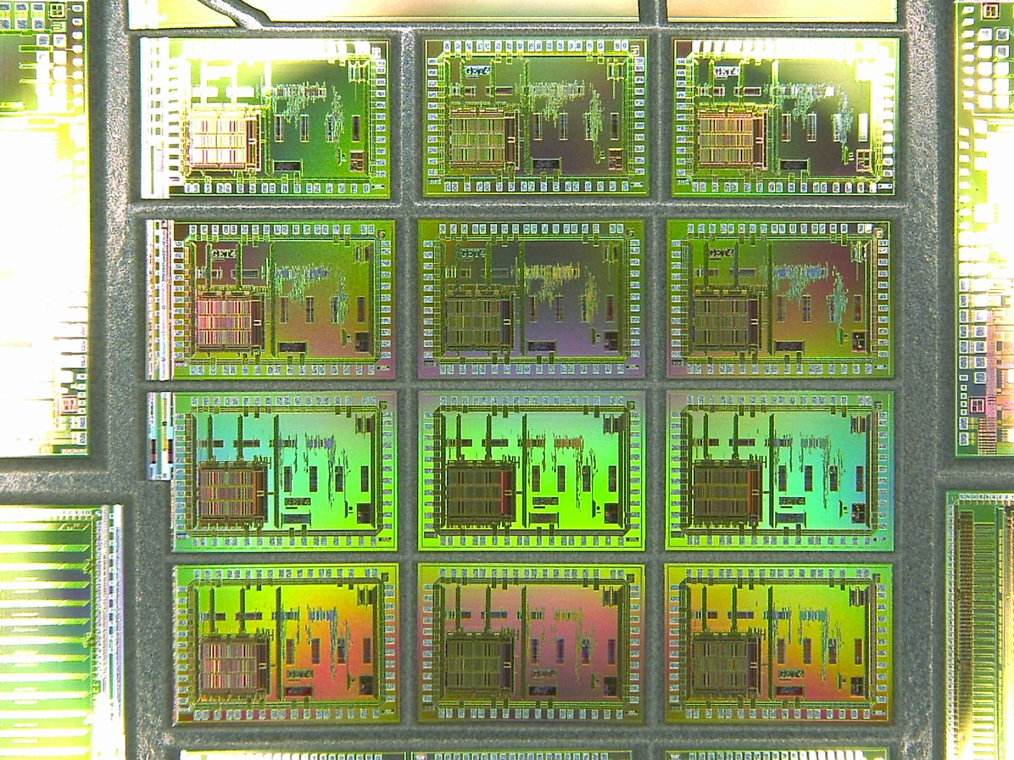
GET4
TDC σ~20ps
Designer: H. Flemming, H. Deppe GSI/EE

Slide 22
