Slide 1
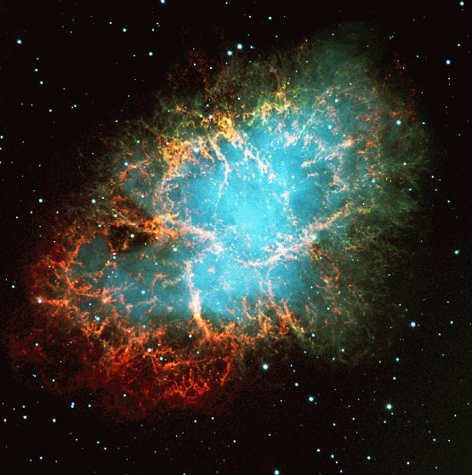
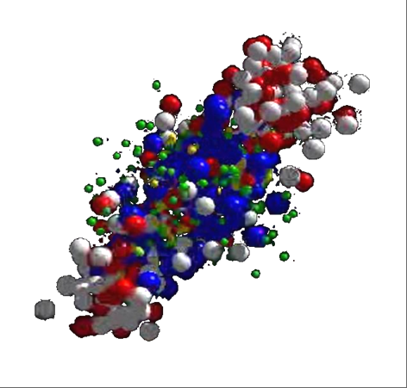
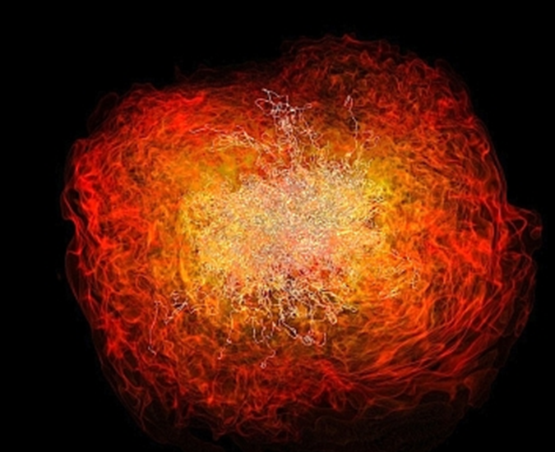
The heavy-ion program at FAIR
Peter Senger GSI and Univ. Frankfurt
Outline:
The status of FAIR
The CBM physics case
The CBM experiment
ICPPA 2016, Moscow, October 10 – 14, 2016

Slide 2










Facility for Antiproton & Ion Research
Germany
Russia
Finland
France
India
Poland
Romania
Slovenia
Sweden
UK (associated)
FAIR is the largest upcoming fundamental science project worldwide this decade.
Forefront research in nuclear, hadron, atomic, plasma and applied physics.
Construction until 2022
10 member states up to date
2500 - 3000 users
Total cost ~1.6 Billion €
(German funds 70%, rest
from International partners)
FAIR Signatory Countries

Slide 3

Facility for Antiproton & Ion Research
Primary Beams
10¹²/s; 1.5 GeV/u; ²³⁸U²⁸⁺
10¹⁰/s ²³⁸U⁹²⁺ up to 11 (35) GeV/u
3x10¹³/s 30 (90) GeV protons
SIS18
SIS100/300
p-Linac
Technical Challenges
cooled beams
rapid cycling superconducting magnets
dynamical vacuum
Compressed Baryonic Matter
HESR
Secondary Beams
Anti-Proton Physics
radioactive beams up to
1.5 - 2 GeV/u; up to factor 10000
higher in intensity than presently
antiprotons 3 - 30 GeV
Super Fragment-Separator:
Nuclear Structure and Astrophysics
Storage and Cooler Rings
CR
radioactive beams
10¹¹ antiprotons 1.5 - 15 GeV/c,
stored and cooled
FAIR phase 1
FAIR phase 2
100 m

Slide 4
FAIR Experiments
Super-FRS
NuSTAR
Rare Isotope beams
➢ Nuclear structure far off stability
➢ Nucleosynthesis in stars and supernovae

Slide 5
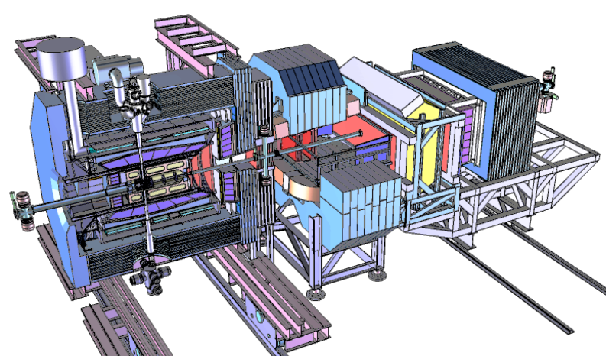
FAIR Experiments
Antiproton-proton collisions:
➢ Charmed hadrons (XYZ)
➢ Gluonic matter and hybrids
➢ Hadron structure
➢ Double Lambda hypernuclei
PANDA

Slide 6
FAIR Experiments
APPA
Atomic & Plasma Physics & Applications
➢ Highly charged atoms
➢ Plasma physics
➢ Radiobiology
➢ Material science

Slide 7
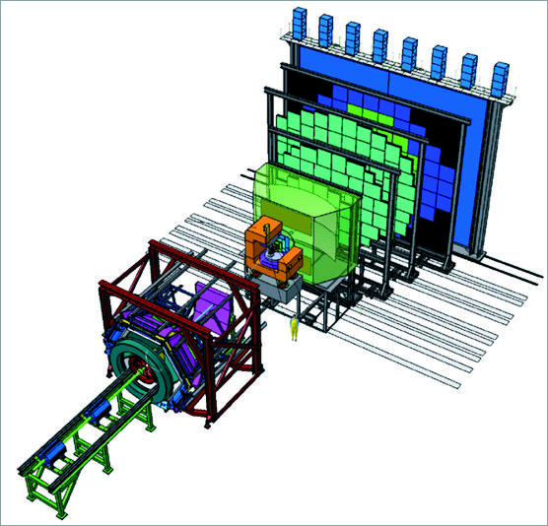
FAIR Experiments
CBM
Nucleus-nucleus collisions:
➢ Nuclear matter at neutron
star core densities
➢ Phase transitions from
hadrons to quarks

Slide 8
Status of FAIR
On Sept. 13, 2016 BMBF gave green light and 203 M€ to start civil construction.
1st call for tender on Sept. 22: water management and excavation
2nd call for tender in Nov.:
shell construction ‘north area’, includes SIS100 and CBM cave
Start of construction mid of 2017

Slide 9
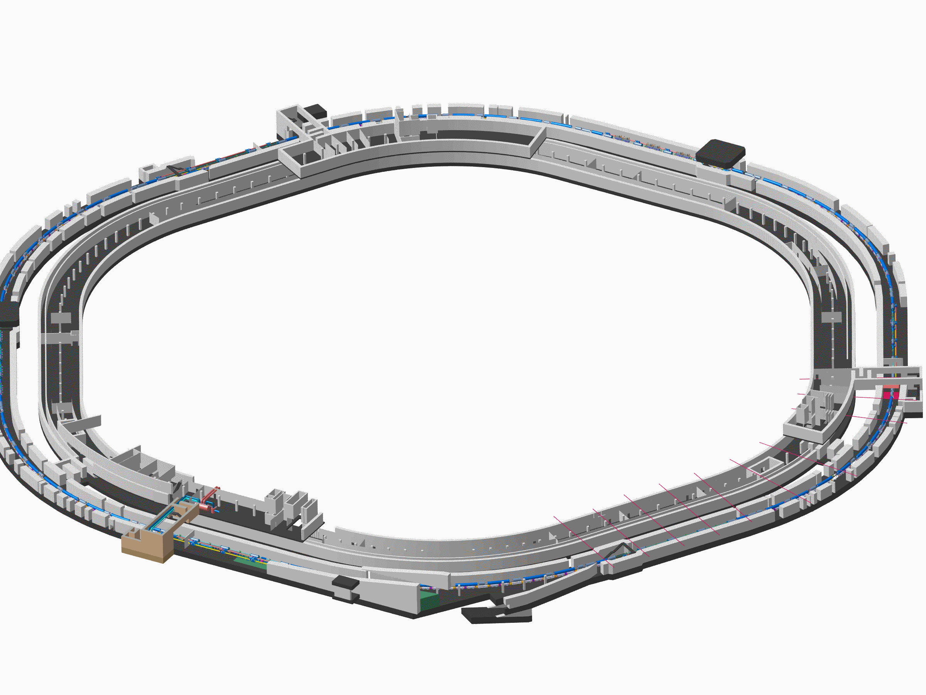
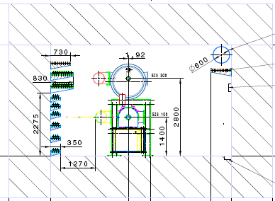
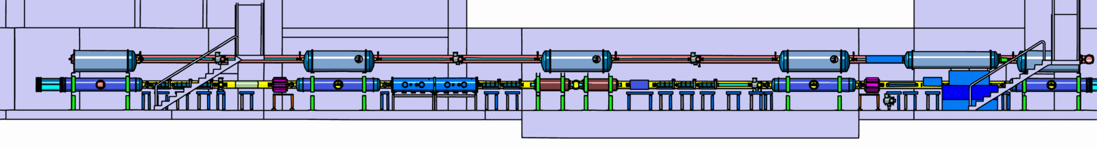
Tunnel for SIS100/300

Slide 10
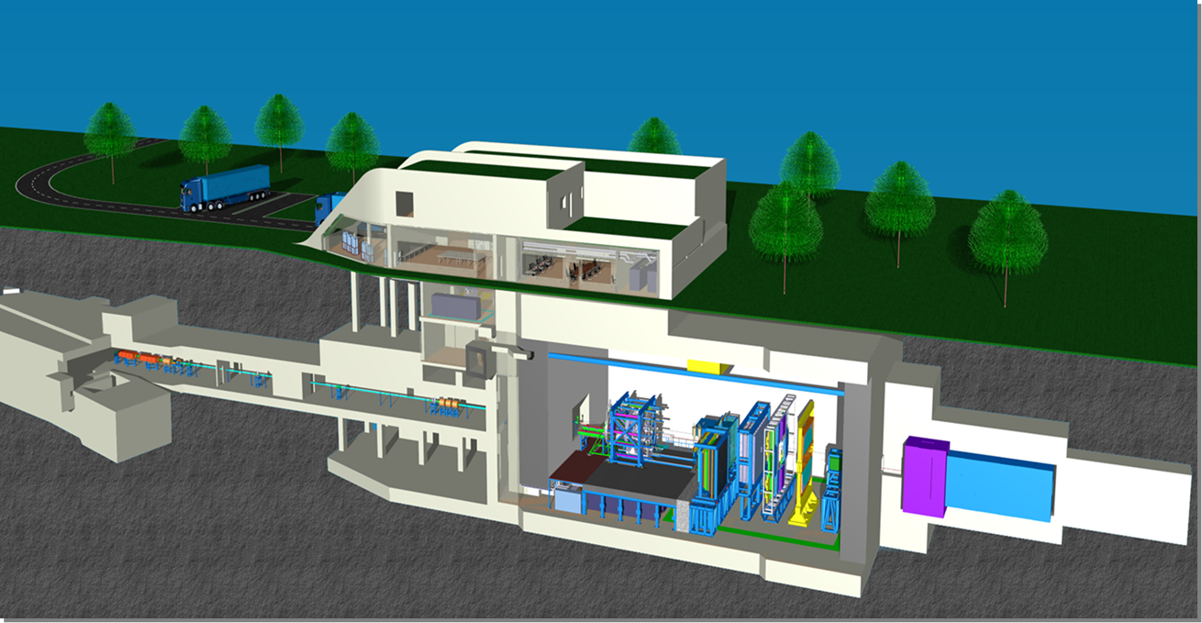
The Compressed Baryonic Matter (CBM)
experiment

Slide 11
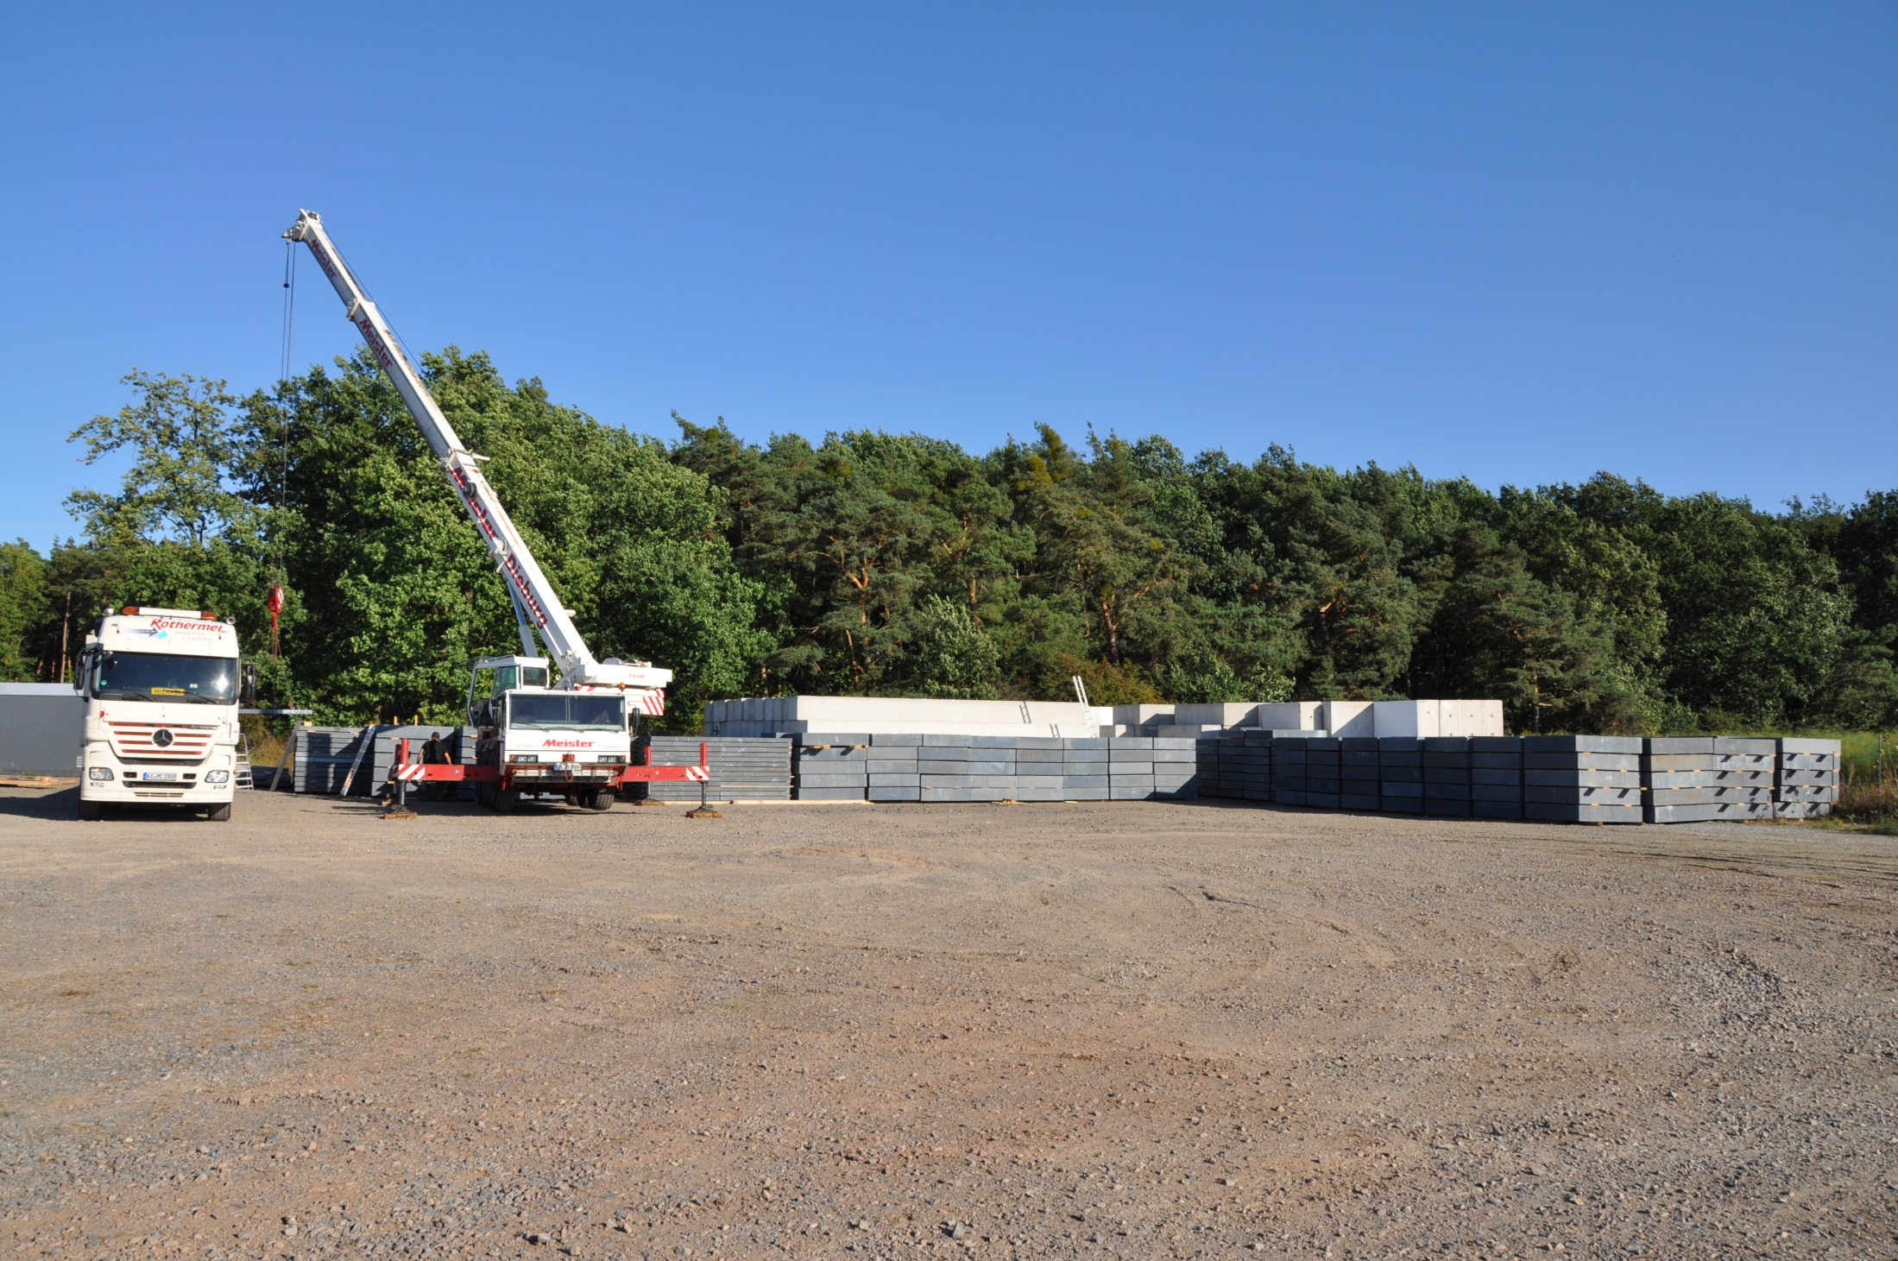
4000 tons of steel plates
transported from KIT to FAIR
for the CBM beam dump

Slide 12
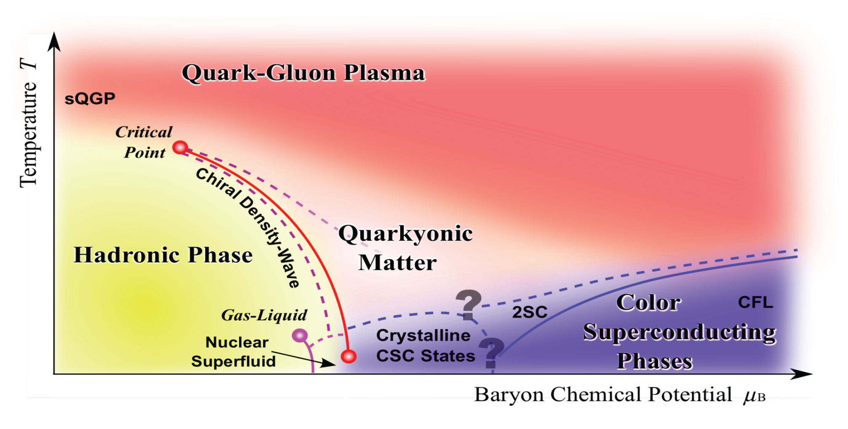
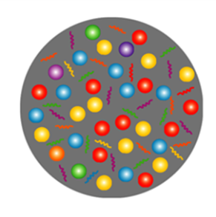
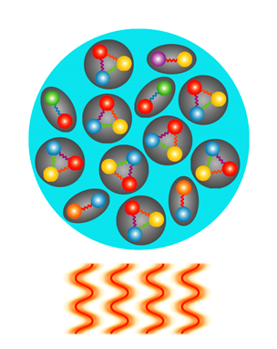
Exploring the QCD phase diagram
Courtesy of K. Fukushima & T. Hatsuda
At very high temperature:
➢ N of baryons ≈ N of antibaryons
Situation similar to early universe
➢ L-QCD finds crossover transition between
hadronic matter and Quark-Gluon Plasma
➢ Experiments: ALICE, ATLAS, CMS at LHC
STAR, PHENIX at RHIC

Slide 13
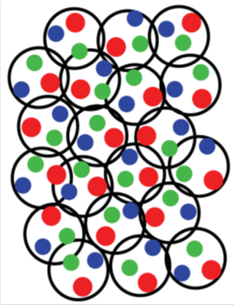
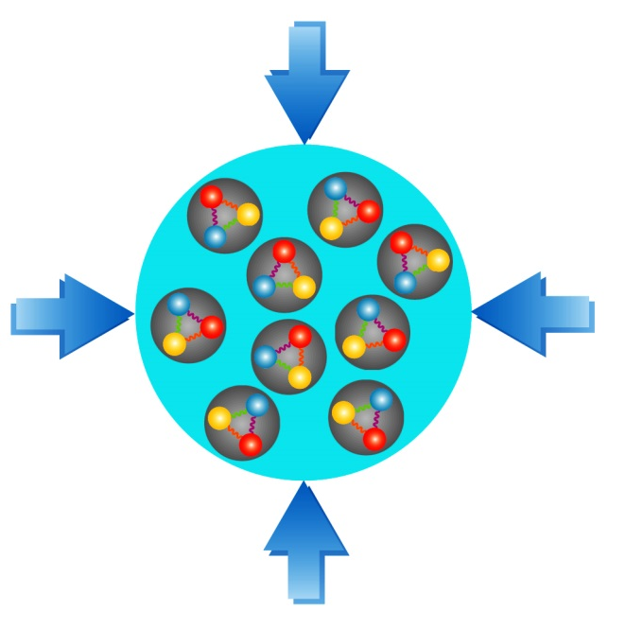
Exploring the QCD phase diagram
Courtesy of K. Fukushima & T. Hatsuda
At high baryon density:
➢ N of baryons >> N of antibaryons
Densities like in neutron star cores
➢ L-QCD not (yet) applicable
Models predict first order phase transition
with mixed or exotic phases
Experiments: BES at RHIC, NA61 at CERN SPS,
CBM at FAIR, NICA at JINR, J-PARC

Slide 14
Exploring the QCD phase diagram
Courtesy of K. Fukushima & T. Hatsuda
∼ 2 ρ₀
∼ 5 ρ₀
courtesy Toru Kojo (CCNU)

Slide 15
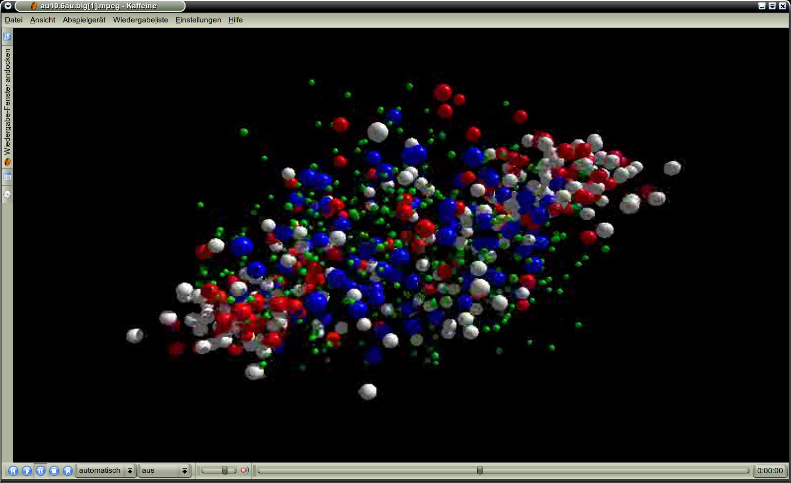
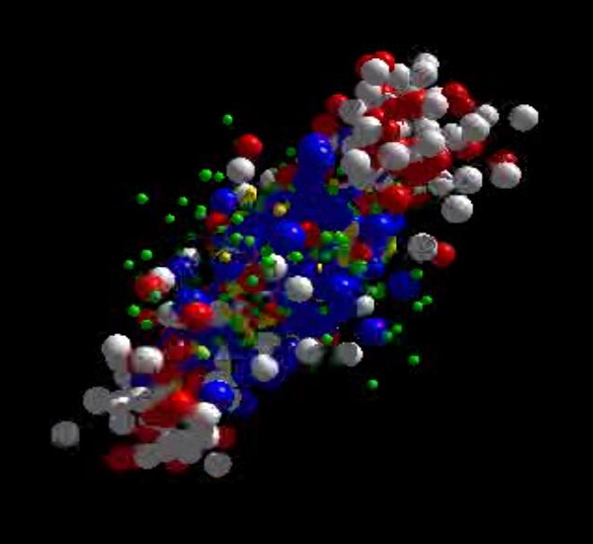
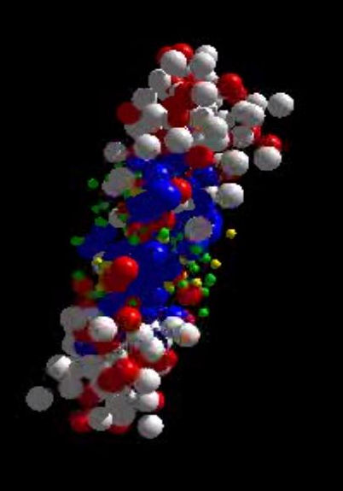
Messengers from the dense fireball:
CBM at FAIR
UrQMD transport calculation Au+Au 10.7 A GeV
Ξ⁻, Ω⁻, φ
π, K, Λ, ...
p, Λ, Ξ⁺, Ω⁺, J/ψ
ρ → e⁺e⁻, μ⁺μ⁻
resonance decays
ρ → e⁺e⁻, μ⁺μ⁻
ρ → e⁺e⁻, μ⁺μ⁻

Slide 16
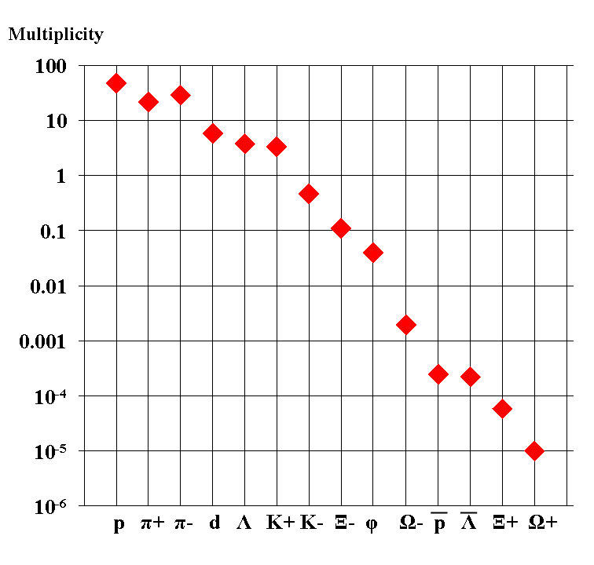
Experimental challenges
Particle yields in central Au+Au 4 A GeV
Statistical model, A. Andronic, priv. com.
AGS
extremely high
interaction rates
required !
e⁺e⁻
μ⁺μ⁻

Slide 17
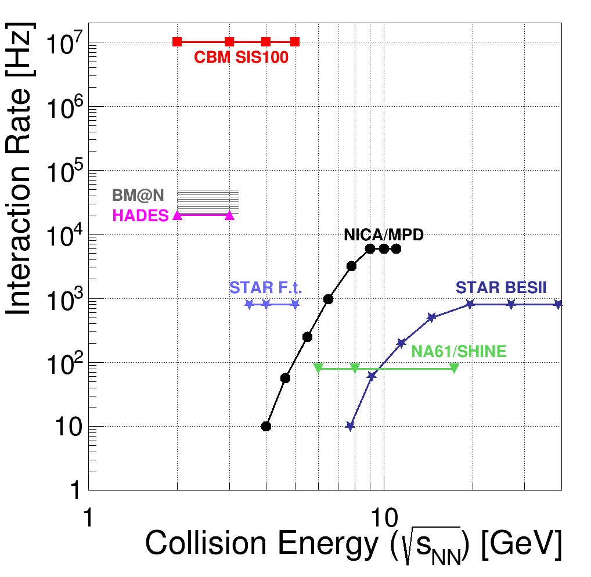
Experiments exploring dense QCD matter
high
net-baryon densities

Slide 18


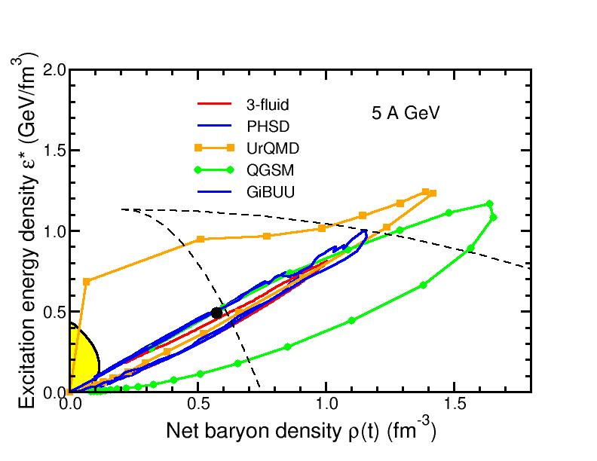
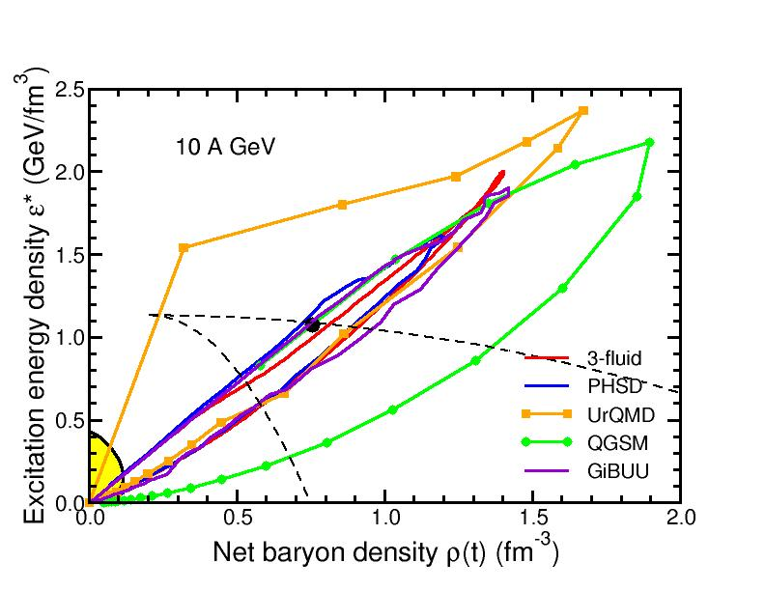
Baryon densities in central Au+Au collisions
I.C. Arsene et al., Phys. Rev. C 75, 24902 (2007)
5 A GeV
10 A GeV
8 ρ₀
5 ρ₀
phase
coexistence
phase
coexistence

Slide 19
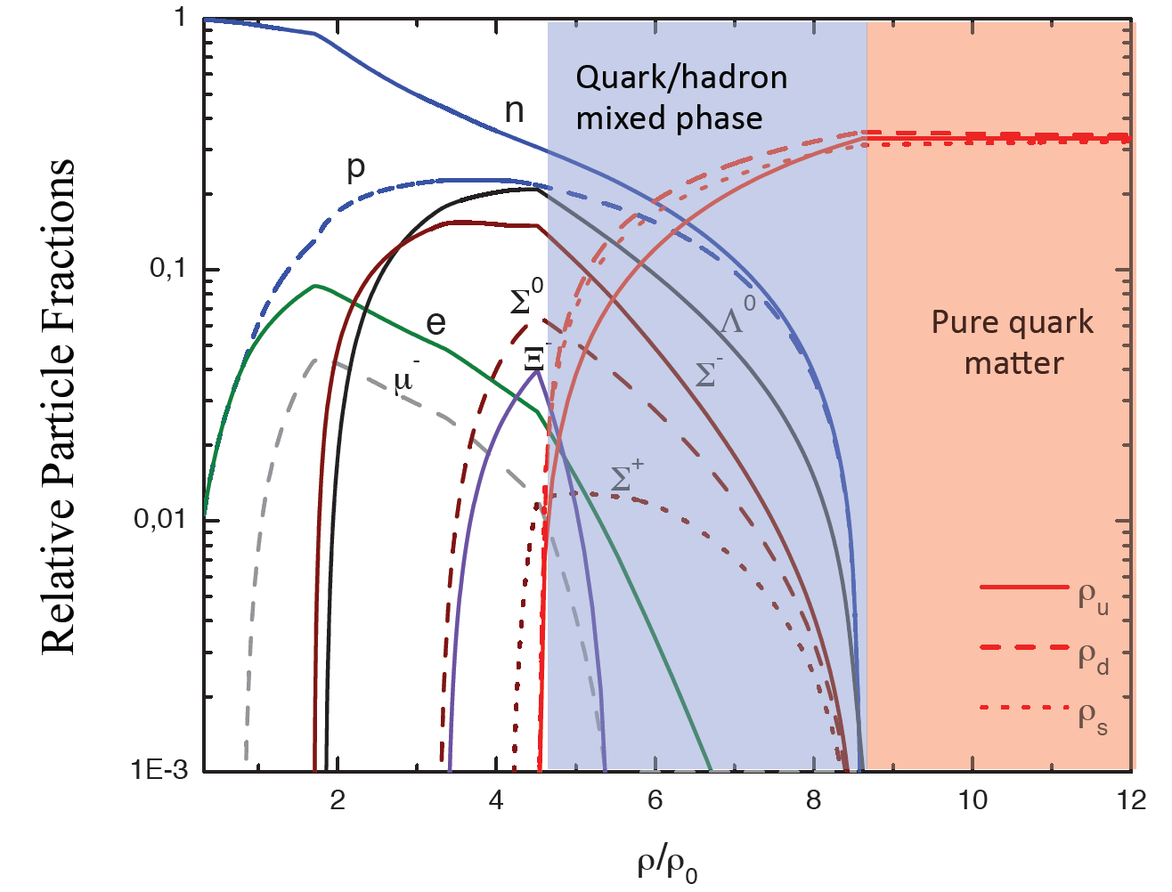
Quark matter in massive neutron stars?
M. Orsaria, H. Rodrigues, F. Weber, G.A. Contrera, arXiv:1308.1657
Phys. Rev. C 89, 015806, 2014

Slide 20
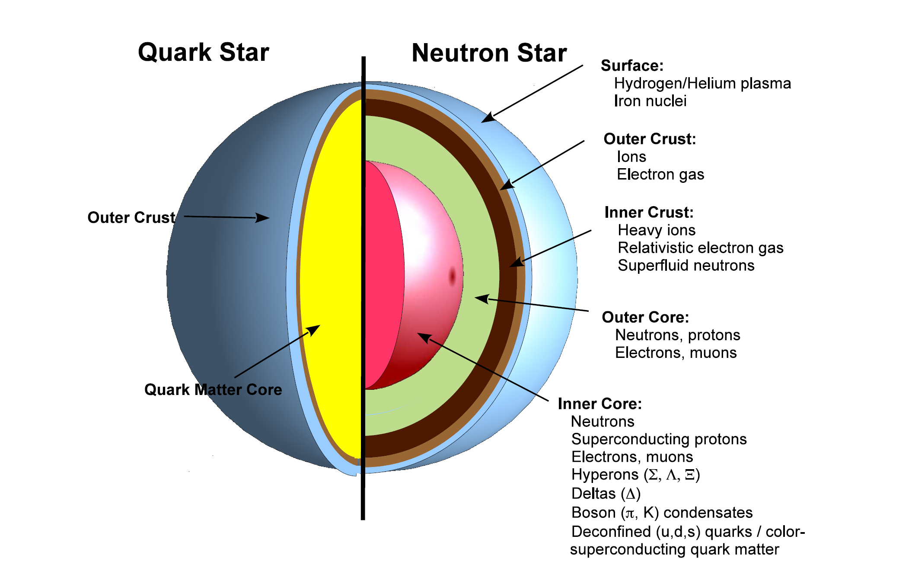
CBM physics case and observables
The equation-of-state at neutron star core densities
➢ collective flow of hadrons (driven by pressure)
➢ particle production at threshold energies (multi-strange hyperons)

Slide 21
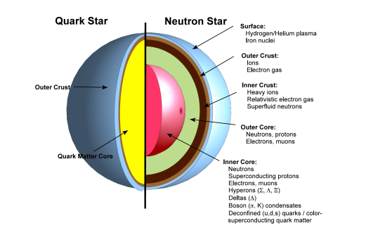
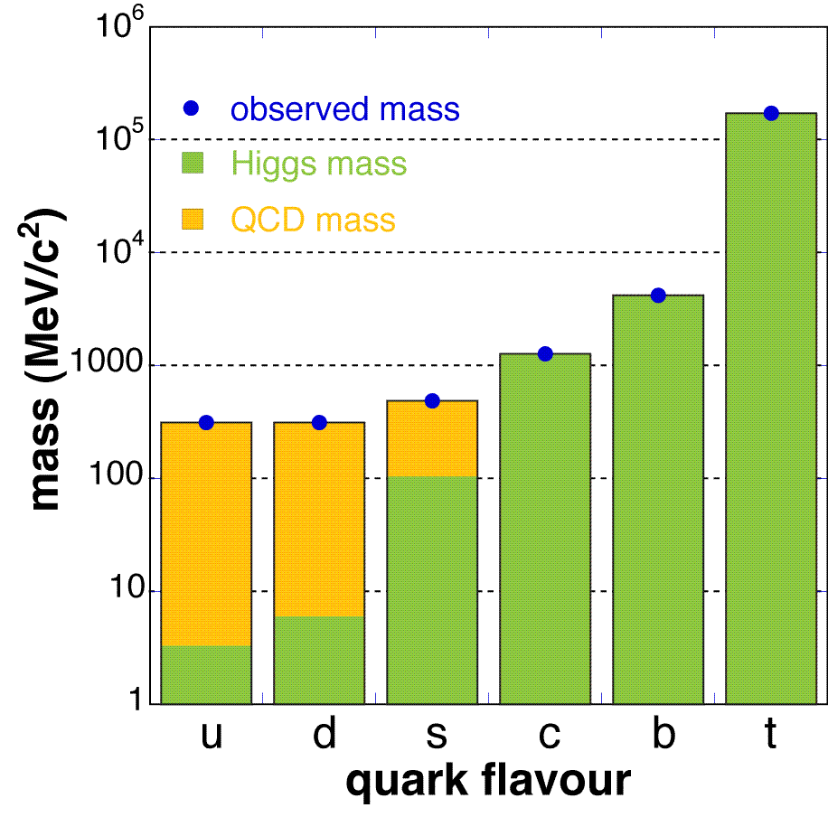
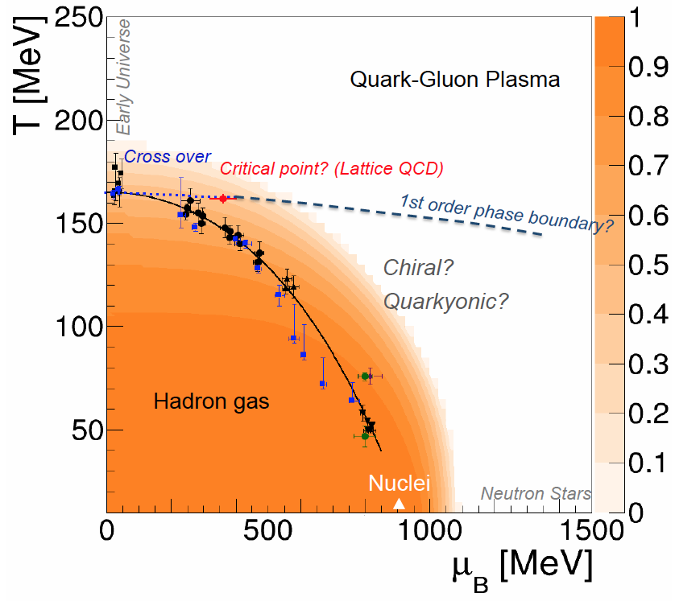
CBM physics case and observables
The equation-of-state at neutron star core densities
➢ collective flow of hadrons
➢ particle production at threshold energies (multi-strange hyperons)
Onset of chiral symmetry restoration at high ρ_{B}
➢ in-medium modifications of hadrons (ρ,ω,φ →e⁺e⁻(μ⁺μ⁻))
➢ dileptons at intermediate invariant masses: ρ-a₁ chiral mixing
Origin of quark masses
Orange region: Chiral condensate

Slide 22
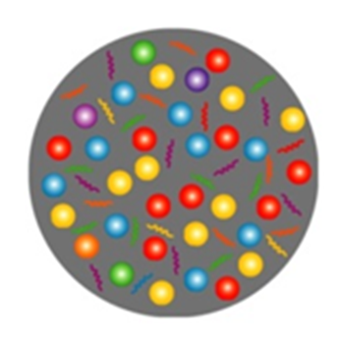
CBM physics case and observables
The equation-of-state at neutron star core densities
➢ collective flow of hadrons
➢ particle production at threshold energies (multi-strange hyperons)
Onset of chiral symmetry restoration at high ρ_{B}
➢ in-medium modifications of hadrons (ρ,ω,φ →e⁺e⁻(μ⁺μ⁻))
➢ dileptons at intermediate invariant masses: ρ-a₁ chiral mixing
Phase transitions from partonic to hadronic matter
➢ excitation function of strangeness: Ξ⁻(dss),Ξ⁺(dss),Ω⁻(sss),Ω⁺(sss)
→ chemical equilibration at the phase boundary
➢ excitation function and flow of charm (J/ψ, ψ', D⁰, D±, Λ_{c})

Slide 23
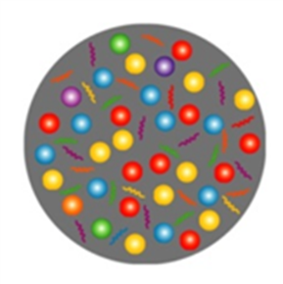
CBM physics case and observables
The equation-of-state at neutron star core densities
➢ collective flow of hadrons
➢ particle production at threshold energies (multi-strange hyperons)
Onset of chiral symmetry restoration at high ρ_{B}
➢ in-medium modifications of hadrons (ρ,ω,φ →e⁺e⁻(μ⁺μ⁻))
➢ dileptons at intermediate invariant masses: ρ-a₁ chiral mixing
Phase transitions from partonic to hadronic matter
➢ excitation function of strangeness: Ξ⁻(dss),Ξ⁺(dss),Ω⁻(sss),Ω⁺(sss)
→ chemical equilibration at the phase boundary
➢ excitation function and flow of charm (J/ψ, ψ', D⁰, D±, Λ_{c})
Phase coexistence, critical point, new states of matter
➢ excitation function (invariant mass) of lepton pairs:
thermal radiation from fireball: “caloric curve”
➢ anisotropic azimuthal angle distributions: “spinodal decomposition”
➢ event-by-event fluctuations of B, C, S: “critical opalescence”

Slide 24
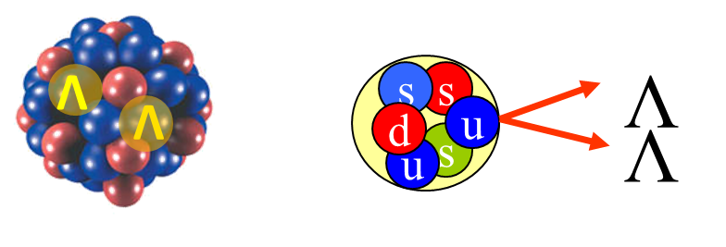
CBM physics case and observables
The equation-of-state at neutron star core densities
➢ collective flow of hadrons
➢ particle production at threshold energies (multi-strange hyperons)
Onset of chiral symmetry restoration at high ρ_{B}
➢ in-medium modifications of hadrons (ρ,ω,φ →e⁺e⁻(μ⁺μ⁻))
➢ dileptons at intermediate invariant masses: ρ-a₁ chiral mixing
Phase transitions from partonic to hadronic matter
➢ excitation function of strangeness: Ξ⁻(dss),Ξ⁺(dss),Ω⁻(sss),Ω⁺(sss)
→ chemical equilibration at the phase boundary
➢ excitation function and flow of charm (J/ψ, ψ', D⁰, D±, Λ_{c})
Phase coexistence, critical point, new states of matter
➢ excitation function (invariant mass) of lepton pairs:
thermal radiation from fireball: ”caloric curve”
➢ anisotropic azimuthal angle distributions: “spinodal decomposition”
➢ event-by-event fluctuations of B, C, S: “critical opalescence”
Strange matter
➢ (double-) lambda hypernuclei
➢ strange meta-stable objects
(e.g. strange dibaryons)

Slide 25
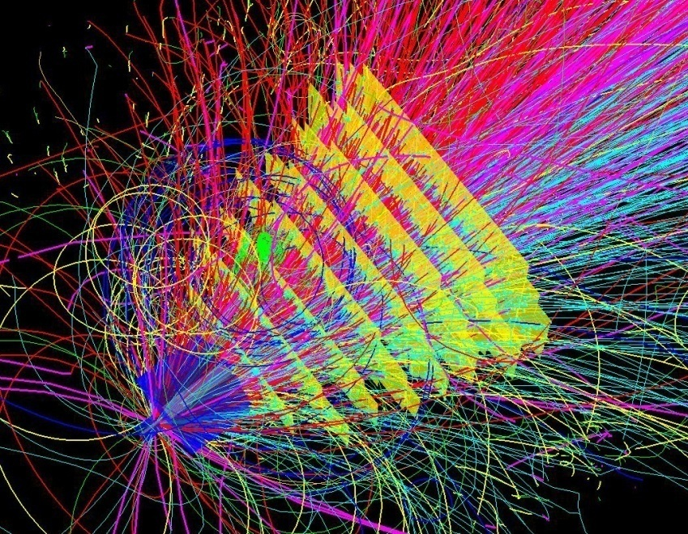
Experimental requirements
10⁵ - 10⁷ Au+Au reactions/sec
determination of displaced vertices (σ ≈ 50 μm)
identification of leptons and hadrons
fast and radiation hard detectors and FEE
free-streaming readout electronics
high speed data acquisition and high performance
computer farm for online event selection
4-D event reconstruction
Notes:
25
25
25

Slide 26
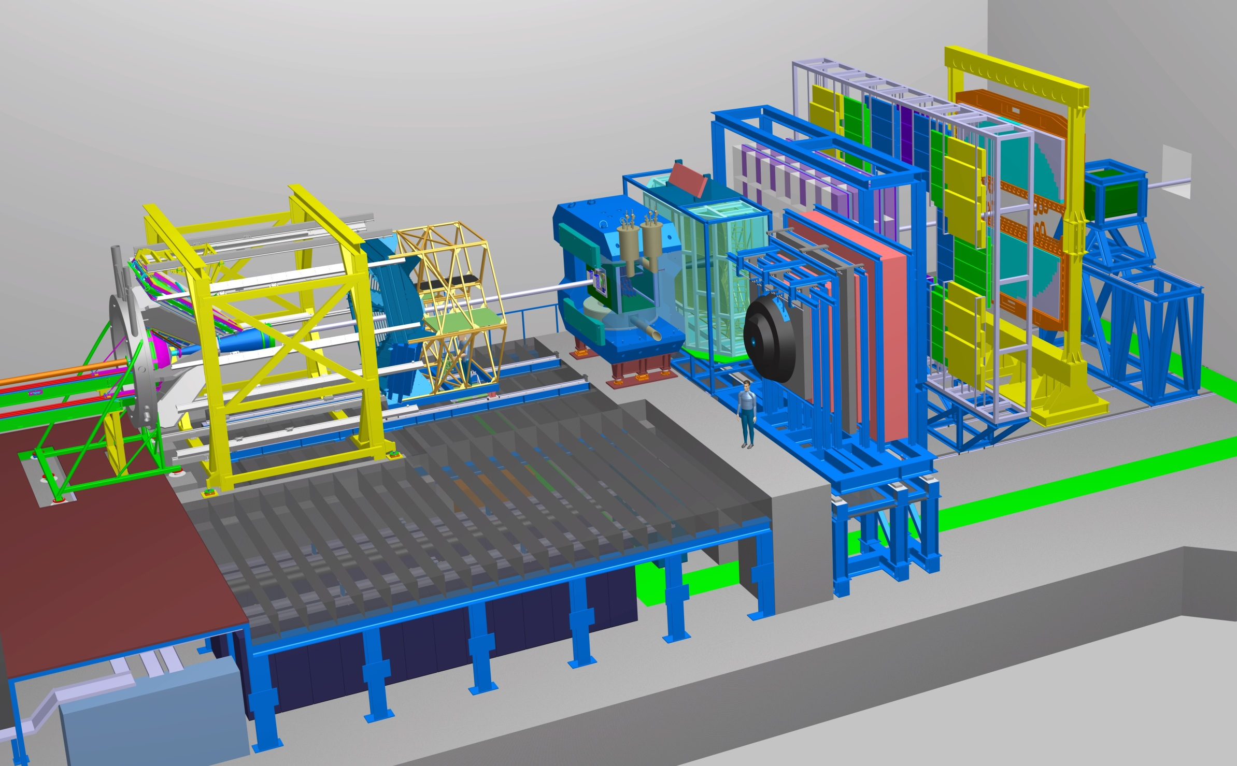
Experimental requirements
Transition
Radiation
Detector
Time of Flight
Detector
Ring
Imaging
Cherenkov
Dipol
Magnet
Silicon
Tracking
System
HADES
p+p, p+A
A+A (low mult.)
Micro
Vertex
Detector
Muon
Detector
Projectile
Spectator
Detector
DAQ/FLES HPC cluster

Slide 27
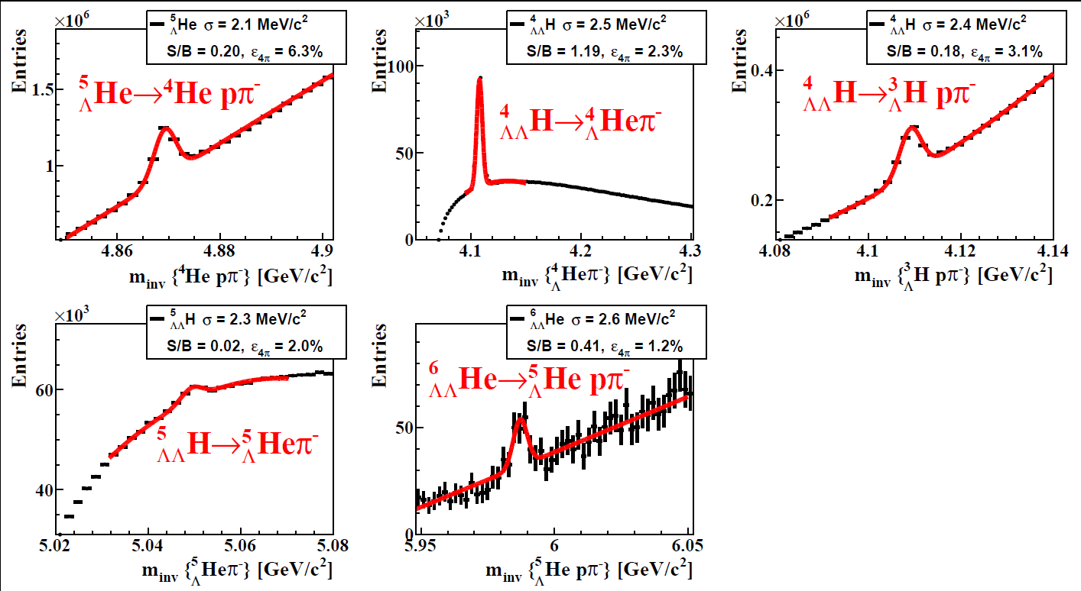
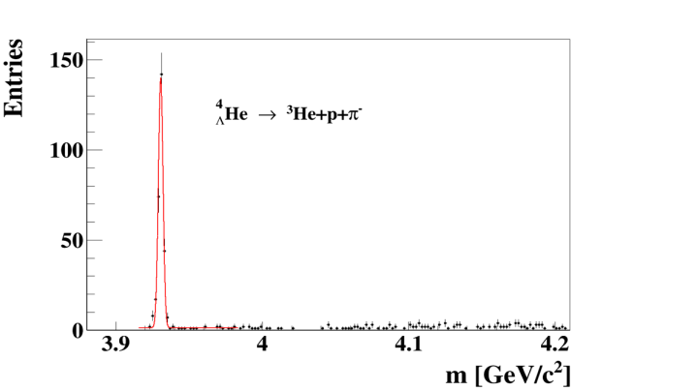

Hadron measurements
Time of Flight
Detector
Dipol
Magnet
Silicon
Tracking
System
Projectile
Spectator
Detector
DAQ/FLES HPC cluster
Hyperons
and
hypernuclei
in central
Au+Au
collisions
at 10A GeV

Slide 28
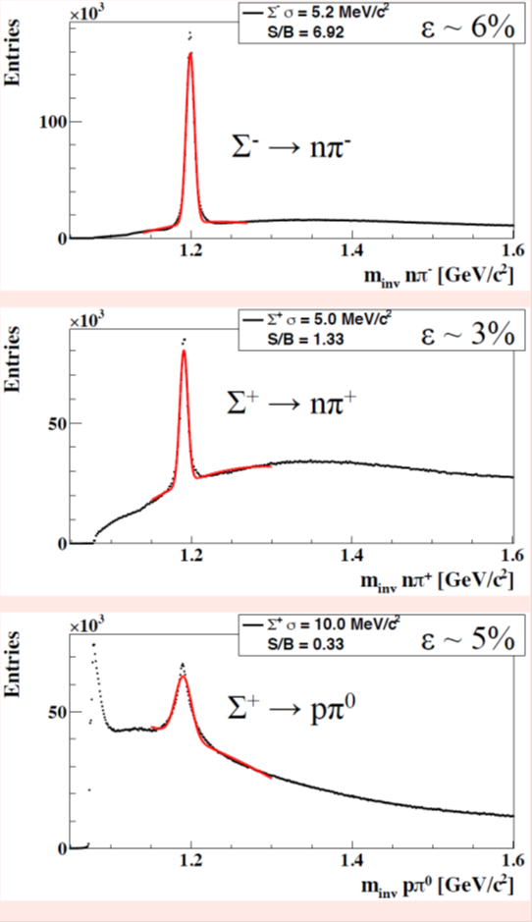
Hadron measurements
Time of Flight
Detector
Dipol
Magnet
Silicon
Tracking
System
Micro
Vertex
Detector
DAQ/FLES HPC cluster
Projectile
Spectator
Detector
Hyperons with neutral daughter in central
Au+Au collisions at 10A GeV

Slide 29
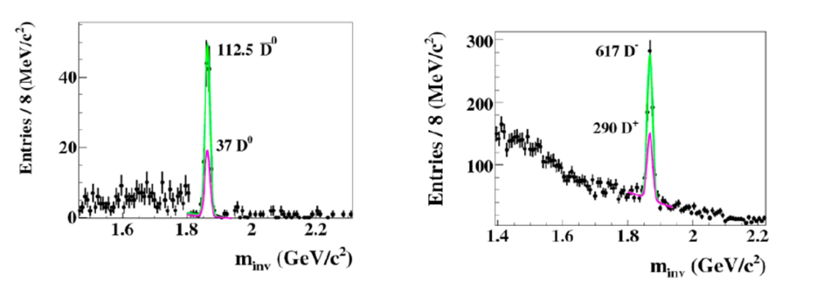
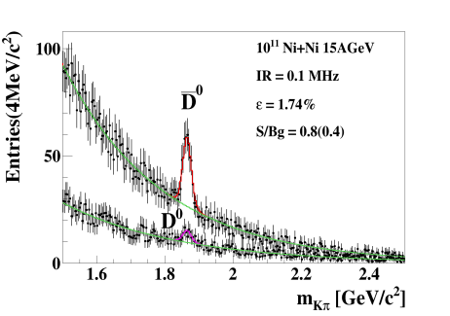
Open charm measurements
Time of Flight
Detector
Dipol
Magnet
Silicon
Tracking
System
Micro
Vertex
Detector
DAQ/FLES HPC cluster
Projectile
Spectator
Detector
Open Charm in p+A
30 GeV and Ni+Ni
15A GeV

Slide 30
Di-electron measurements
Transition
Radiation
Detector
Time of Flight
Detector
Ring
Imaging
Cherenkov
Dipol
Magnet
Silicon
Tracking
System
Micro
Vertex
Detector
e⁺e⁻
Projectile
Spectator
Detector
DAQ/FLES HPC cluster
Dileptons in central
Au+Au collisions at 8A GeV

Slide 31
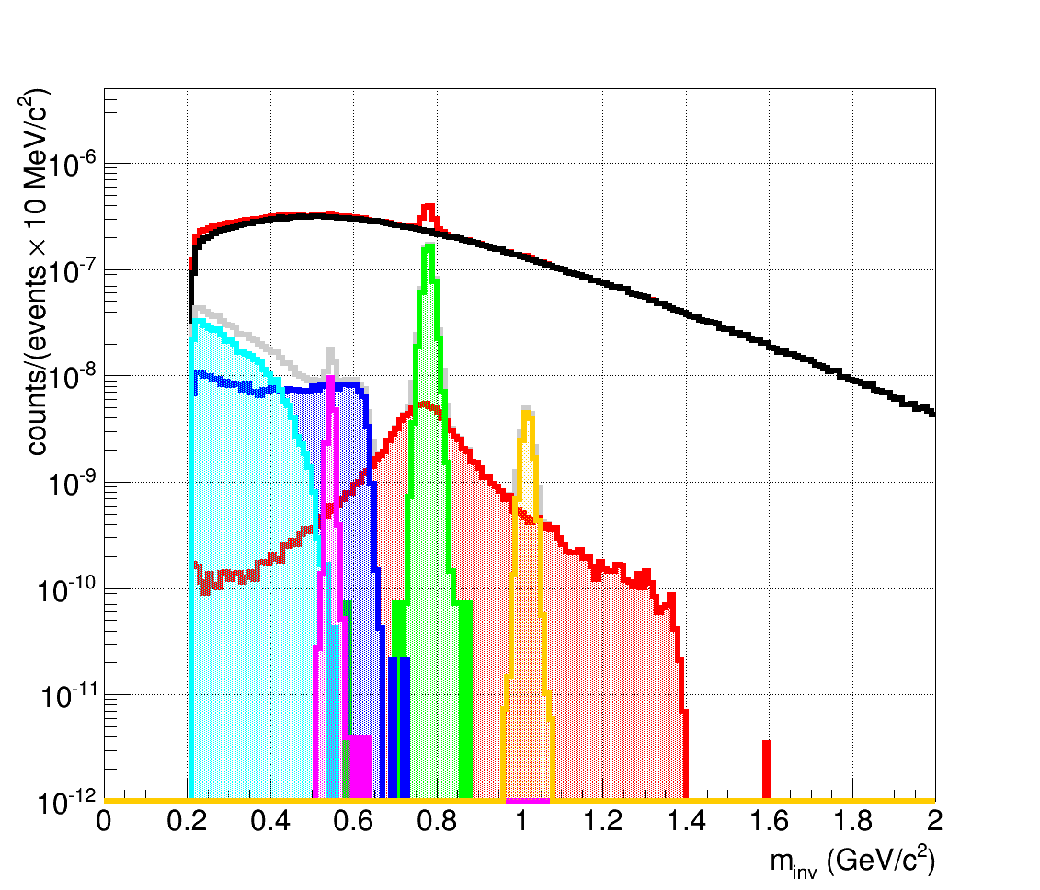
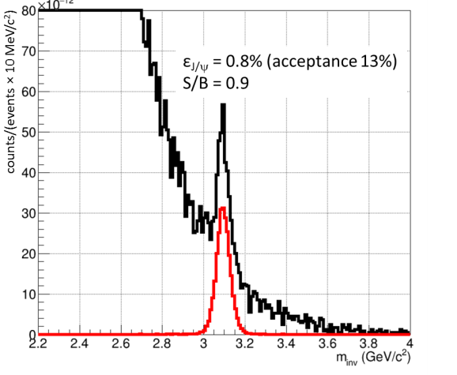
Di-muon measurements
Transition
Radiation
Detector
Time of Flight
Detector
Dipol
Magnet
Silicon
Tracking
System
Muon
Detector
DAQ/FLES HPC cluster
Projectile
Spectator
Detector
Di-muons in central
Au+Au collisions at
8A GeV and
10A GeV (J/ψ)
µ⁺µ⁻
η
ω
φ
J/ψ→µ⁺µ⁻
ρ

Slide 32
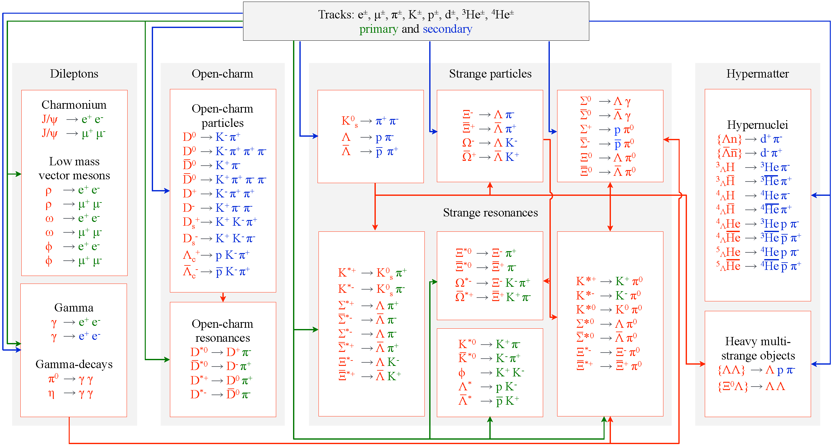
Online particle identification in CBM:
The KF Particle Finder
successfully used online in the STAR experiment

Slide 33
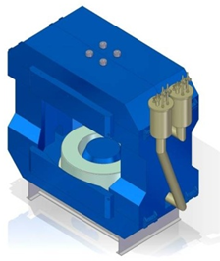
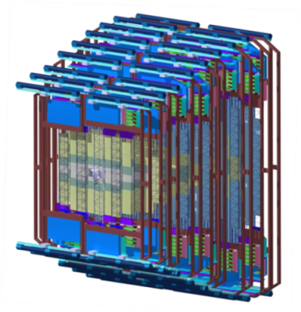
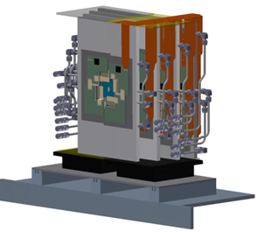
Status experiment preparation
Superconducting Dipole Magnet
➢ TDR approved
Funding: Russia
JINR Dubna, BINP Novosibirsk, GSI
Silicon Tracking System
➢ TDR approved
Funding: Germany, Russia, Poland
GSI, JINR Dubna, KIT, INR Kiev, AGH and UJ Krakow,
Univ. Tübingen, Warsaw UT
High-rate MRPC TOF wall
➢ TDR approved
Funding: Germany, Romania, China, Russia
THU Beijing, NIPNE Bucharest, GSI Darmstadt, TU Darmstadt,
IfI Frankfurt, USTC Hefei, Univ. Heidelberg, ITEP Moscow,
HZDR Rossendorf, CCNU Wuhan
Micro-Vertex Detector
Funding: Germany, France
Univ. Frankfurt, IPHC Strasbourg

Slide 34
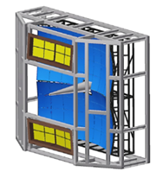
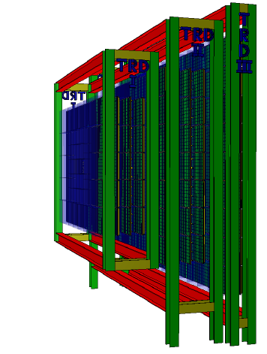
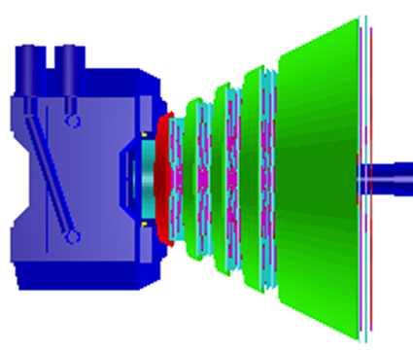
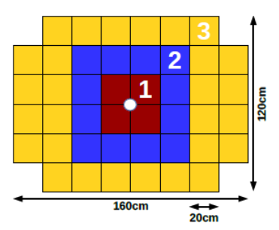
Status experiment preparation
Ring Imaging Cherenkov Detector
➢ TDR approved
Funding: Germany, Russia
Univ. Gießen, Univ. Wuppertal, PNPI Gatchina
Transition Radiation Detector
Funding: Germany, Romania
NIPNE Bucharest, JINR Dubna, Univ. Frankfurt,
Univ. Heidelberg, Univ. Münster, WI Budapest
Muon Chambers
➢ TDR approved
Funding: India, Russia
➢ VECC Kolkata + 12 Indian Inst., PNPI Gatchina, JINR Dubna
Projectile-Spectator Detector
➢ TDR approved
Funding: Russia, Czechia, Germany
INR Moscow, Prague, Rez, TU Darmstadt

Slide 35
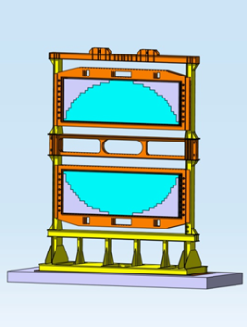
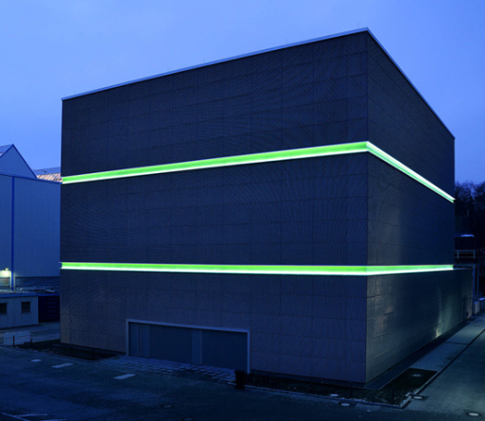
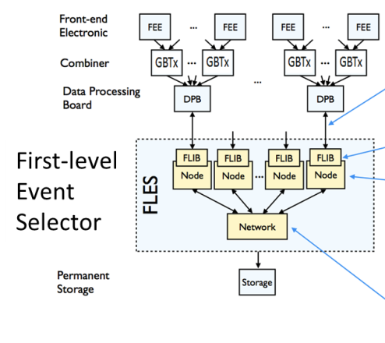
Status experiment preparation
Electromagnetic Calorimeter
Funding: Russia (EOI)
ITEP Moscow
DAQ, First Level Event Selection
Funding: Germany, Poland
Univ. Frankfurt, FIAS, GSI, KIT Karlsruhe,
IIT Kharagpur, Warsaw UT, ZIB Berlin
GSI GreenIT Cube

Slide 36


FAIR Phase 0 experiments
1. Install, commission and use 430 out of 1100
CBM RICH multi-anode photo-
multipliers (MAPMT) in
HADES RICH photon detector
430 MAPMTs
Read
out
Supp. frames
Exist. RICH

Slide 37


FAIR Phase 0 experiments
1. Install, commission and use 430 out of 1100
CBM RICH multi-anode photo-
multipliers (MAPMT) in
HADES RICH photon detector
430 MAPMTs
Read
out
2. Install, commission and use
10% of the CBM TOF modules
including read-out chain
at STAR/RHIC (BES II 2019/2020)
Supp. frames
Exist. RICH
100 cm
collider vertex
(~250 cm)
fixed target pos.
(~500 cm)
CBM MRPC active area
CBM electronics

Slide 38


FAIR Phase 0 experiments
3. Install, commission and use 4 Silicon tracking layers and the
Project Spectator Detector at the BM@N experiment at the
Nuclotron in JINR/Dubna (Au-beams up to 4.5 A GeV in 2018/19)

Slide 39

FAIR Phase 0 experiments
3. Install, commission and use 4 Silicon tracking layers and the
Project Spectator Detector at the BM@N experiment at the
Nuclotron in JINR/Dubna (Au-beams up to 4.5 A GeV in 2018/19)
4. Build mCBM at GSI/SIS18
for a full system test with
high-rate nucleus-nucleus
collisions from 2018 - 2020

Slide 40


The CBM Collaboration: 59 institutions, 530 members
Croatia:
Split Univ.
China:
CCNU Wuhan
Tsinghua Univ.
USTC Hefei
CTGU Yichang
Czech Republic:
CAS, Rez
Techn. Univ.Prague
France:
IPHC Strasbourg
Hungary:
KFKI Budapest
Budapest Univ.
Germany:
Darmstadt TU
FAIR
Frankfurt Univ. IKF
Frankfurt Univ. FIAS Frankfurt Univ. ICS
GSI Darmstadt
Giessen Univ.
Heidelberg Univ. P.I.
Heidelberg Univ. ZITI
HZ Dresden-Rossendorf
KIT Karlsruhe
Münster Univ.
Tübingen Univ.
Wuppertal Univ.
ZIB Berlin
Russia:
IHEP Protvino
INR Troitzk
ITEP Moscow
Kurchatov Inst., Moscow
LHEP, JINR Dubna
LIT, JINR Dubna
MEPHI Moscow
PNPI Gatchina
SINP MSU, Moscow
St. Petersburg P. Univ.
Ioffe Phys.-Tech. Inst. St. Pb.
Ukraine:
T. Shevchenko Univ. Kiev
Kiev Inst. Nucl. Research
India:
Aligarh Muslim Univ.
Bose Inst. Kolkata
Panjab Univ.
Rajasthan Univ.
Univ. of Jammu
Univ. of Kashmir
Univ. of Calcutta
B.H. Univ. Varanasi
VECC Kolkata
IOP Bhubaneswar
IIT Kharagpur
IIT Indore
Gauhati Univ.
Korea:
Pusan Nat. Univ.
Poland:
AGH Krakow
Jag. Univ. Krakow
Silesia Univ. Katowice
Warsaw Univ.
Warsaw TU
Romania:
NIPNE Bucharest
Univ. Bucharest
26th CBM Collaboration meeting in Prague, CZ
14 -18 Sept. 2015

Slide 41

Summary
CBM scientific program at SIS100:
Exploration of the QCD phase diagram in the region of neutron
star core densities → large discovery potential.
First measurements with CBM:
High-precision multi-differential measurements of hadrons incl.
multistrange hyperons, hypernuclei and dileptons for different
beam energies and collision systems → terra incognita.
Status of experiment preparation:
Prototype detector performances fulfill CBM requirements.
7 TDRs approved, 4 TDRs in preparation.
Funding:
CBM start version is financed by about 2/3 (+ EoI).
FAIR Phase 0:
HADES with CBM RICH photon detector,
use CBM detectors at STAR/BNL and BM@N/JINR

Slide 43
Backup

Slide 44


CBM physics case and observables
The QCD matter equation-of-state at neutron star core densities
➢ collective flow of identified particles (π,K,p,Λ,Ξ,Ω,...)
driven by the pressure gradient in the early fireball
AGS: proton flow in Au+Au collisions
Azimuthal angle distribution:
dN/dφ = C (1 + v₁ cos(φ) + v₂ cos(2φ) + ...)
P. Danielewicz, R. Lacey, W.G. Lynch, Science 298 (2002) 1592

Slide 45

CBM physics case and observables
The QCD matter equation-of-state at neutron star core densities
➢ collective flow of identified particles (π,K,p,Λ,Ξ,Ω,...)
driven by the pressure gradient in the early fireball
➢ particle production at (sub)threshold energies via
multi-step processes (multi-strange hyperons, charm)
Direct multi-strange hyperon production:
pp → Ξ⁻ K⁺K⁺p (E_{thr} = 3.7 GeV)
pp → Ω⁻ K⁺K⁺K⁰p (E_{thr} = 7.0 GeV)
pp → Λ⁰Λ⁰ pp (E_{thr} = 7.1 GeV)
pp → Ξ⁺ Ξ⁻ pp (E_{thr} = 9.0 GeV)
pp → Ω⁺ Ω⁻ pp (E_{thr} = 12.7 GeV
Ω⁻ production in 4 A GeV Au+Au
Hyperon production via multiple collisions
pp → K⁺Λ⁰p, pp → K⁺K⁻pp,
pΛ⁰→ K⁺ Ξ⁻ p, πΛ⁰→ K⁺ Ξ⁻ π,
Λ⁰Λ⁰→ Ξ⁻ p, Λ⁰K⁻ → Ξ⁻ π⁰
3 . Λ⁰ Ξ⁻ → Ω⁻ n, Ξ⁻K⁻ → Ω⁻ π⁻
Antihyperons
1. Λ⁰ K⁺ → Ξ⁺π⁰ ,
2. Ξ⁺ K⁺ → Ω⁺ π⁺.
HYPQGSM calculations , K. Gudima et al.

Slide 46

CBM physics case and observables
The QCD matter equation-of-state at neutron star core densities
➢ collective flow of identified particles (π,K,p,Λ,Ξ,Ω,...)
driven by the pressure gradient in the early fireball
➢ particle production at (sub)threshold energies via
multi-step processes (multi-strange hyperons, charm)
Direct multi-strange hyperon production:
pp → Ξ⁻ K⁺K⁺p (E_{thr} = 3.7 GeV)
pp → Ω⁻ K⁺K⁺K⁰p (E_{thr} = 7.0 GeV)
pp → Λ⁰Λ⁰ pp (E_{thr} = 7.1 GeV)
pp → Ξ⁺ Ξ⁻ pp (E_{thr} = 9.0 GeV)
pp → Ω⁺ Ω⁻ pp (E_{thr} = 12.7 GeV
Hyperon production via multiple collisions
pp → K⁺Λ⁰p, pp → K⁺K⁻pp,
pΛ⁰→ K⁺ Ξ⁻ p, πΛ⁰→ K⁺ Ξ⁻ π,
Λ⁰Λ⁰→ Ξ⁻ p, Λ⁰K⁻ → Ξ⁻ π⁰
3 . Λ⁰ Ξ⁻ → Ω⁻ n, Ξ⁻K⁻ → Ω⁻ π⁻
Antihyperons
1. Λ⁰ K⁺ → Ξ⁺π⁰ ,
2. Ξ⁺ K⁺ → Ω⁺ π⁺.
Very few data
at FAIR energies

Slide 47
CBM physics case and observables
Phase transitions from partonic to hadronic matter
excitation function of strangeness: Ξ⁻(dss),Ξ⁺(dss),Ω⁻(sss),Ω⁺(sss)
→ chemical equilibration at the phase boundary
A. Andronic, P. Braun-Munzinger, K. Redlich, J. Stachel, Jour. Phys. G38 (2011)

Slide 48


CBM physics case and observables
Phase transitions from partonic to hadronic matter
excitation function of strangeness: Ξ⁻(dss),Ξ⁺(dss),Ω⁻(sss),Ω⁺(sss)
→ chemical equilibration at the phase boundary
Particle yields and thermal model fits
HADES: Ar + KCl 1.76 A GeV
G. Agakishiev et al., arXiv:1512.07070
Very few data
at FAIR energies

Slide 49


CBM physics case and observables
Phase transitions from partonic to hadronic matter
➢ excitation function of strangeness: Ξ⁻(dss),Ξ⁺(dss),Ω⁻(sss),Ω⁺(sss)
→ chemical equilibration at the phase boundary
Phase coexistence
excitation function (invariant mass) of lepton pairs:
thermal radiation from QGP, caloric curve
Invariant mass distribution of lepton pairs
Slope of dilepton invariant mass spectrum
1 GeV/c² < M_{inv} < 2.5 GeV/c²
No data
at FAIR energies

Slide 50
CBM physics case and observables
Phase transitions from partonic to hadronic matter
➢ excitation function of strangeness: Ξ⁻(dss),Ξ⁺(dss),Ω⁻(sss),Ω⁺(sss)
→ chemical equilibration at the phase boundary
Phase coexistence
excitation function (invariant mass) of lepton pairs:
thermal radiation from QGP, caloric curve
➢ anisotropic azimuthal angle distributions: “spinodal decomposition”
Spinodal decomposition
of the mixed phase
Slope of dilepton invariant mass spectrum
1 GeV/c² < M_{inv} < 2.5 GeV/c²

Slide 51

CBM physics case and observables
Phase transitions from partonic to hadronic matter
➢ excitation function of strangeness: Ξ⁻(dss),Ξ⁺(dss),Ω⁻(sss),Ω⁺(sss)
→ chemical equilibration at the phase boundary
Phase coexistence
excitation function (invariant mass) of lepton pairs:
thermal radiation from QGP, caloric curve
anisotropic azimuthal angle distributions: “spinodal decomposition”
Critical point
event-by-event fluctuations of conserved quantities (B,S,Q)
“critical opalescence”
4th moment of net-proton
multiplicity distribution:
critical fluctuations
No data
at FAIR energies

Slide 52
CBM physics case and observables
Onset of chiral symmetry restoration at high ρ_{B}
Origin of quark masses
Chiral condensate: orange region

Slide 53

CBM physics case and observables
Onset of chiral symmetry restoration at high ρ_{B}
➢ in-medium modifications of hadrons: ρ,ω,φ →e⁺e⁻(μ⁺μ⁻)
➢ dileptons at intermediate invariant masses: 4 π → ρ-a₁ chiral mixing

Slide 54


CBM physics case and observables
N-Λ, Λ-Λ interaction, strange matter?
➢ (double-) lambda hypernuclei
➢ meta-stable objects (e.g. strange dibaryons)
SIS100
A. Andronic et al., Phys. Lett. B697 (2011) 203

Slide 55
CBM physics case and observables
N-Λ, Λ-Λ interaction, strange matter?
➢ (double-) lambda hypernuclei
➢ meta-stable objects (e.g. strange dibaryons)
Double lambda hypernuclei production
in central Au+Au collisions at 10 A GeV:
 | Multiplicity | Yield in 1 week
⁵_{ΛΛ}H | 5 ⋅ 10⁻⁶ | 3000
⁶_{ΛΛ}He | 1 ⋅ 10⁻⁷ | 60
Assumption for yield calculation:
Reaction Rate 1 MHz
BR 10% (2 sequential weak decays)
Efficiency 1%
SIS100
A. Andronic et al., Phys. Lett. B697 (2011) 203

Slide 56

CBM physics case and observables
Charm production at threshold energies in cold and dense matter
➢ excitation function of charm production in p+A and A+A (J/ψ, D⁰, D±)
No data
at FAIR energies
HSD calculation
Central coll. Au+Au 10 A GeV :
M_{J/ψ} = 1.7⋅10⁻⁷
UrQMD calculation including
subthreshold charm production via
N* → Λ_{c} + D and N* → N +J/ψ
Central Au+Au collisions 10 A GeV:
M_{J/ψ} = 5⋅10⁻⁶
W. Cassing, E. Bratkovskaya, A. Sibirtsev,
Nucl. Phys. A 691 (2001) 753
J. Steinheimer, A. Botvina, M. Bleicher, arXiv:1605.03439v1

