Slide 1
The CBM Experiment at FAIR and its Silicon Tracking System:
Physics case, Experimental approach, Status of development
Johann M. Heuser
GSI Helmholtz Center for Heavy Ion Research, Darmstadt, Germany
for the CBM Collaboration
JAEA Advanced Scientific Research Center, Tokai, Japan, 4 August 2016

Slide 2
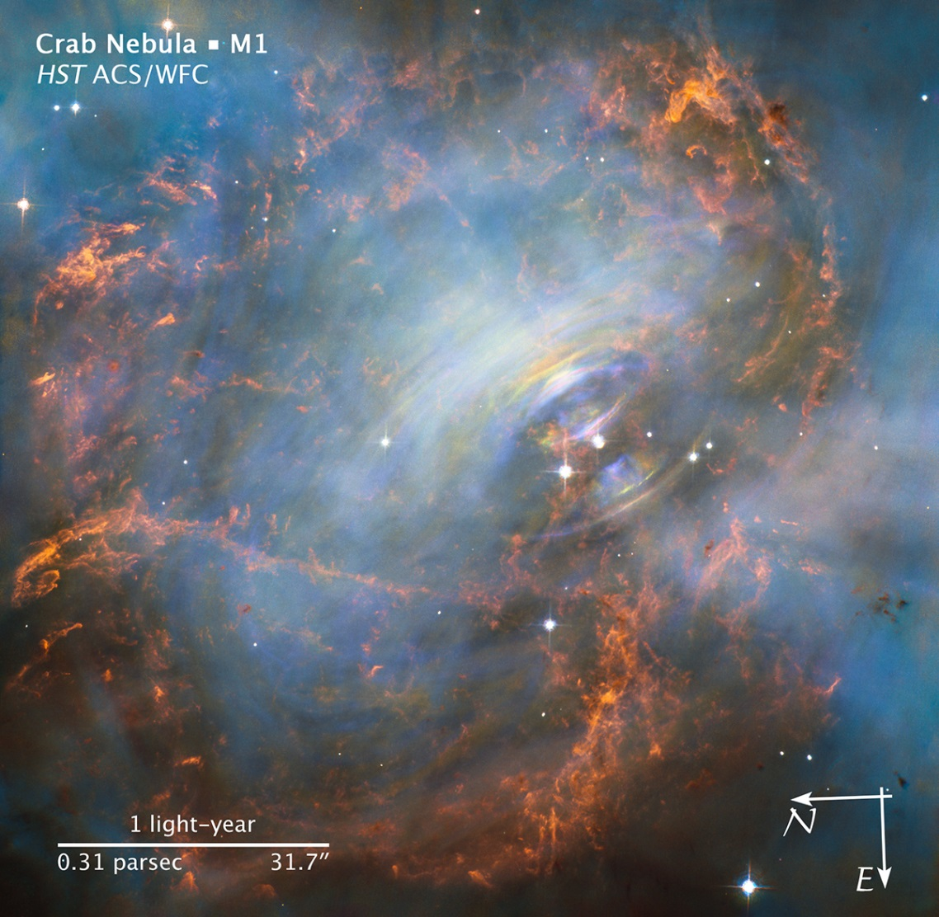
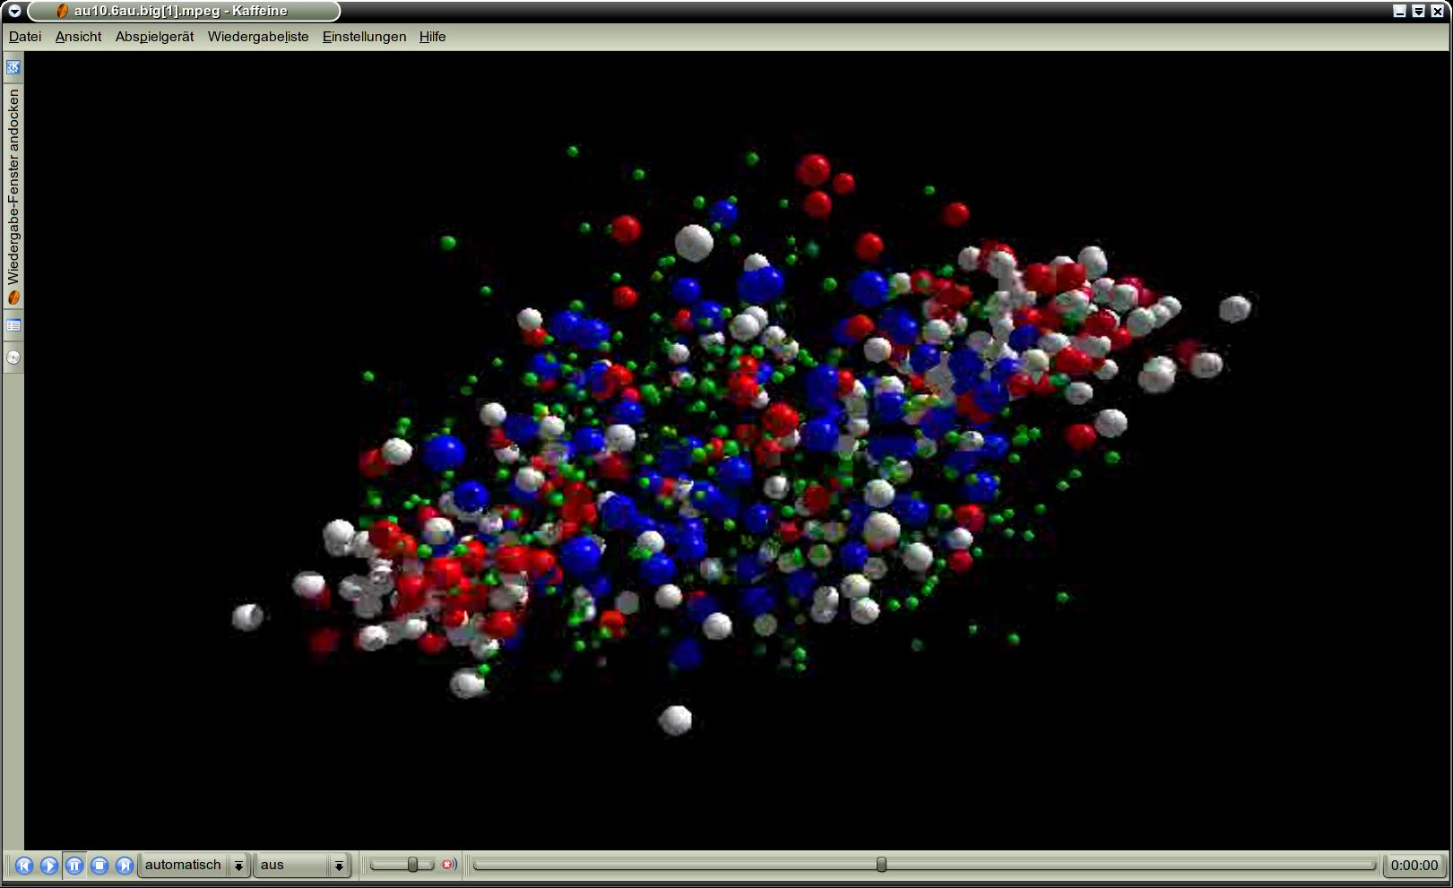
Compressed Baryonic Matter

Slide 3
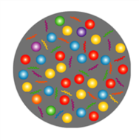
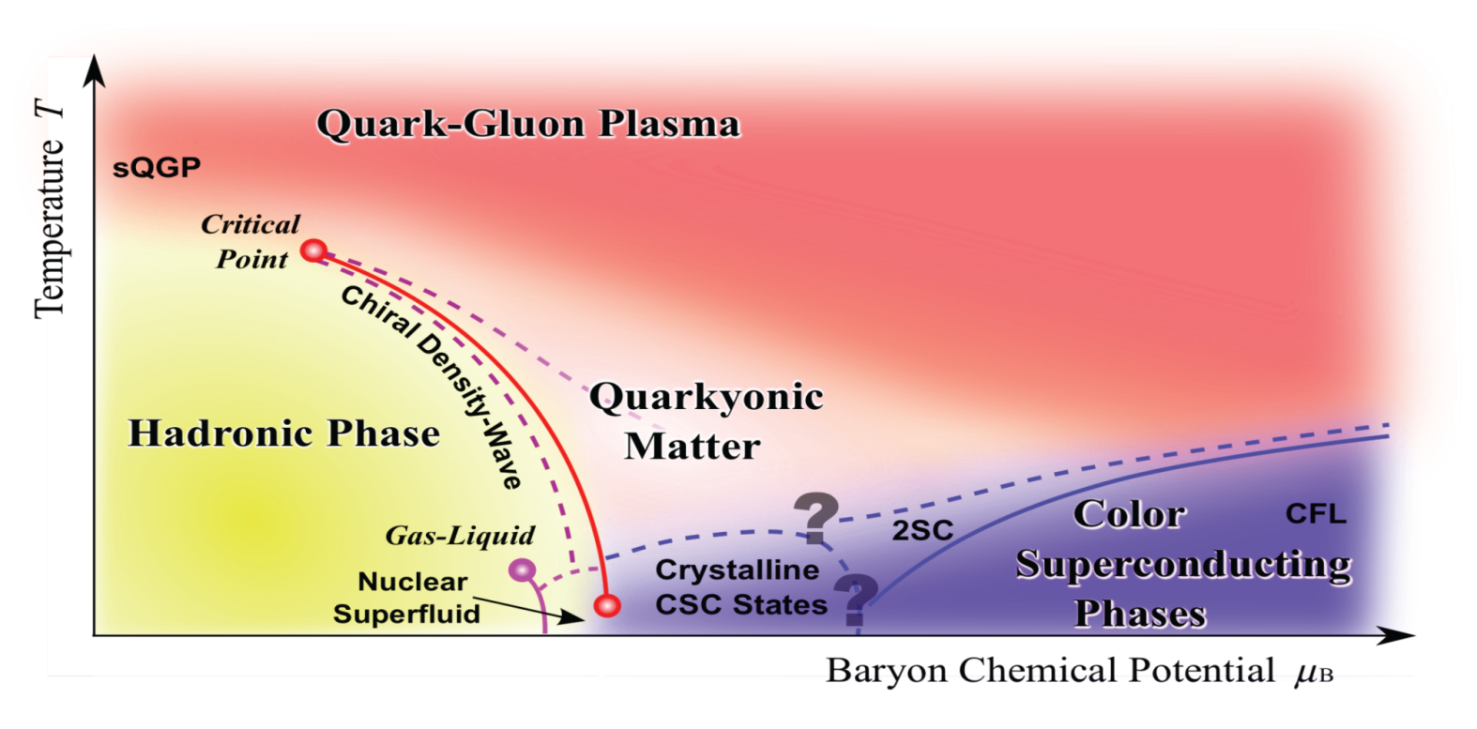
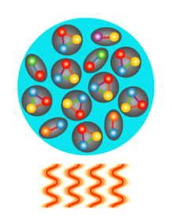
Exploring the QCD phase diagram
Courtesy of K. Fukushima & T. Hatsuda
At very high temperature:
N of baryons ≈ N of antibaryons
Situation similar to early universe
L-QCD finds crossover transition between
hadronic matter and Quark-Gluon Plasma
Experiments: ALICE, ATLAS, CMS at LHC
STAR, PHENIX at RHIC

Slide 4
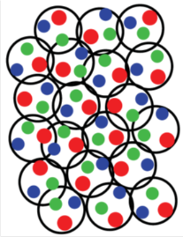
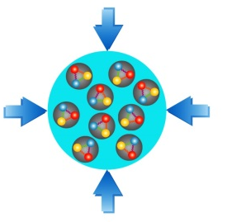
Exploring the QCD phase diagram
Courtesy of K. Fukushima & T. Hatsuda
At high baryon density:
N of baryons >> N of antibaryons; Densities like in neutron star cores
L-QCD not (yet) applicable
Models predict 1st order phase transition with mixed or exotic phases
Experiments: BES at RHIC, NA61 at CERN SPS,
CBM at FAIR, NICA at JINR

Slide 5
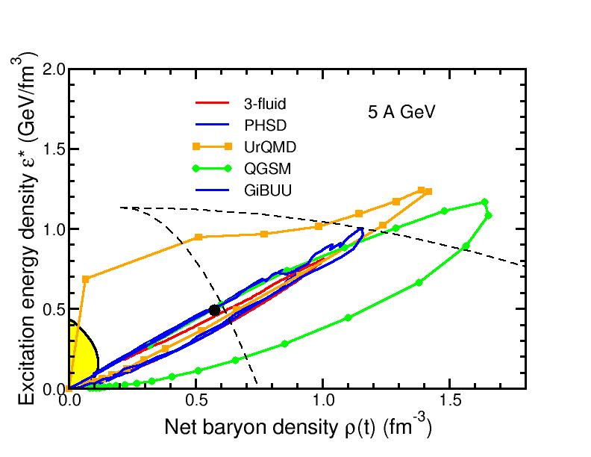
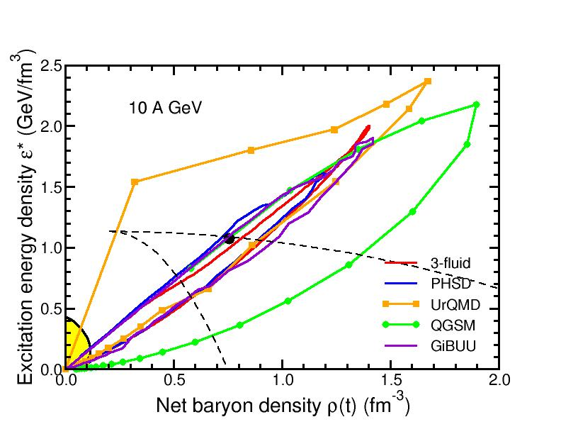


Baryon densities in central Au+Au collisions
I.C. Arsene et al., Phys. Rev. C 75, 24902 (2007)
5 A GeV
10 A GeV
phase
coexistence
8 ρ₀
5 ρ₀

Slide 6
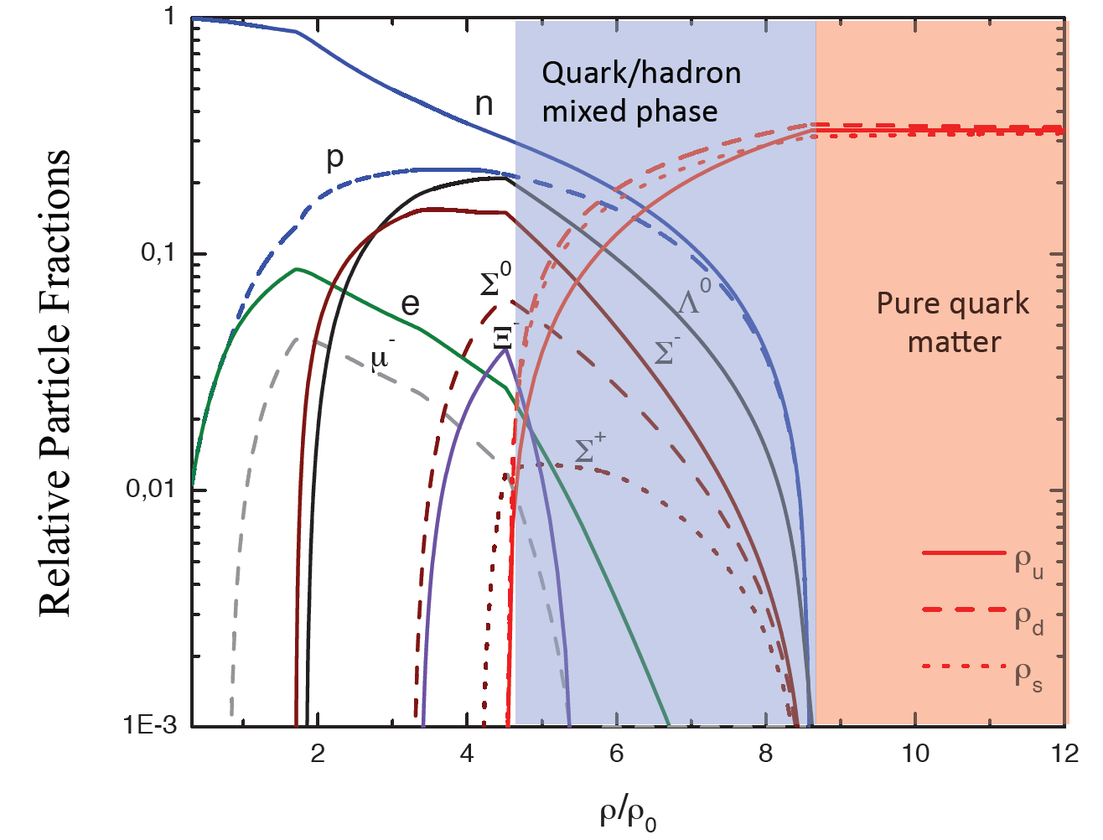
Quark matter in massive neutron stars?
Equation-of-state: Non-local SU(3) NJL with vector coupling
M. Orsaria, H. Rodrigues, F. Weber, G.A. Contrera, arXiv:1308.1657

Slide 7
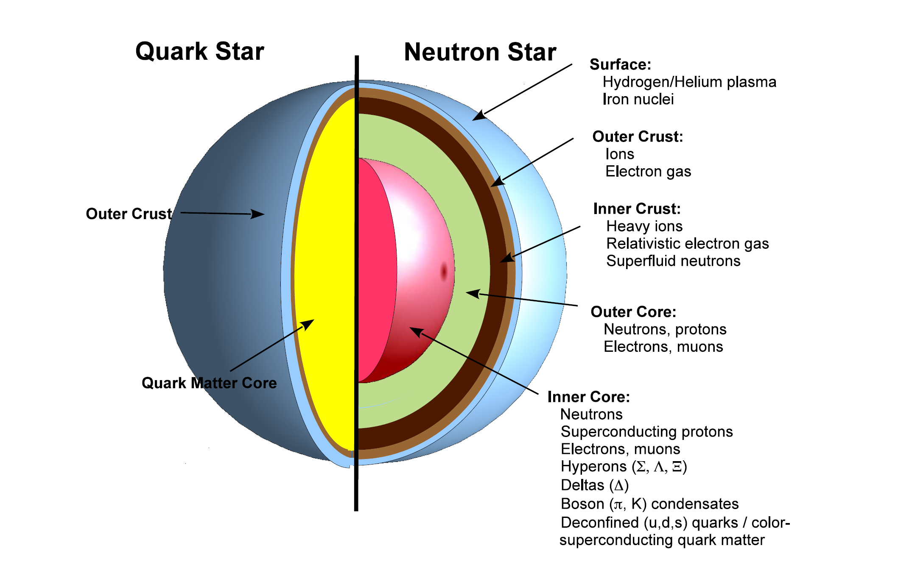
CBM physics case and observables
The equation-of-state at neutron star core densities
collective flow of hadrons (driven by pressure)
particle production at threshold energies (multi-strange hyperons)

Slide 8

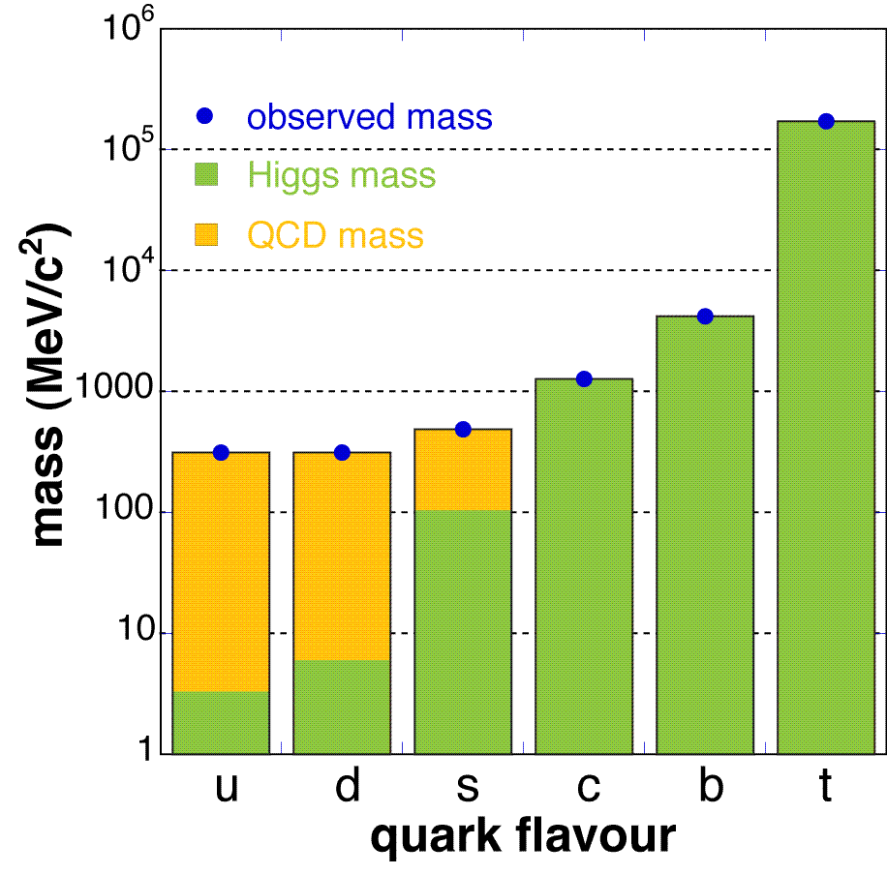
CBM physics case and observables
The equation-of-state at neutron star core densities
collective flow of hadrons (driven by pressure)
particle production at threshold energies (multi-strange hyperons)
Onset of chiral symmetry restoration at high ρ_{B}
in-medium modifications of hadrons (ρ,ω,φ →e⁺e⁻(μ⁺μ⁻))
dileptons at intermediate invariant masses: ρ-a₁ chiral mixing

Slide 9
CBM physics case and observables
The equation-of-state at neutron star core densities
collective flow of hadrons (driven by pressure)
particle production at threshold energies (multi-strange hyperons)
Onset of chiral symmetry restoration at high ρ_{B}
in-medium modifications of hadrons (ρ,ω,φ →e⁺e⁻(μ⁺μ⁻))
dileptons at intermediate invariant masses: ρ-a₁ chiral mixing
New phases of strongly-interacting matter
excitation function and flow of lepton pairs
excitation function and flow of strangeness (K, Λ, Σ, Ξ, Ω)

Slide 10
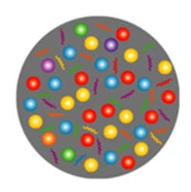
CBM physics case and observables
The equation-of-state at neutron star core densities
collective flow of hadrons (driven by pressure)
particle production at threshold energies (multi-strange hyperons)
Onset of chiral symmetry restoration at high ρ_{B}
in-medium modifications of hadrons (ρ,ω,φ →e⁺e⁻(μ⁺μ⁻))
dileptons at intermediate invariant masses: ρ-a₁ chiral mixing
New phases of strongly-interacting matter
excitation function and flow of lepton pairs
excitation function and flow of strangeness (K, Λ, Σ, Ξ, Ω)
Deconfinement phase transition at high ρ_{B}
excitation function and flow of charm (J/ψ, ψ', D⁰, D±, Λ_{c})
anomalouus charmonium suppression

Slide 11
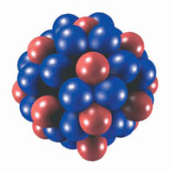
CBM physics case and observables
The equation-of-state at neutron star core densities
collective flow of hadrons (driven by pressure)
particle production at threshold energies (multi-strange hyperons)
Onset of chiral symmetry restoration at high ρ_{B}
in-medium modifications of hadrons (ρ,ω,φ →e⁺e⁻(μ⁺μ⁻))
dileptons at intermediate invariant masses: ρ-a₁ chiral mixing
New phases of strongly-interacting matter
excitation function and flow of lepton pairs
excitation function and flow of strangeness (K, Λ, Σ, Ξ, Ω)
Deconfinement phase transition at high ρ_{B}
excitation function and flow of charm (J/ψ, ψ', D⁰, D±, Λ_{c})
anomalouus charmonium suppression
Strange matter
(double-) lambda hypernuclei
strange meta-stable objects (e.g. strange dibaryons)
s
s
Λ
Λ
Λ
d
u
Λ
u
s

Slide 12
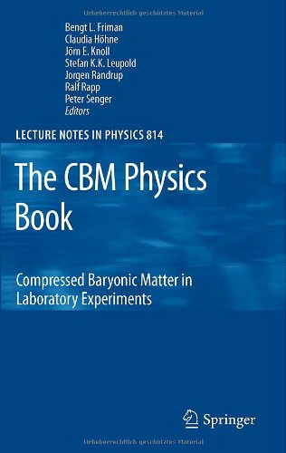
The CBM Physics Book
Foreword by Frank Wilczek
Springer Series:
Lecture Notes in Physics, Vol. 814
1st Edition., 2011, 960 p., Hardcover
ISBN: 978-3-642-13292-6
Electronic Authors version:
http://www.fair-center.eu/fileadmin/fair/experiments/CBM/documents/PhysBook_A4.rar

Slide 13
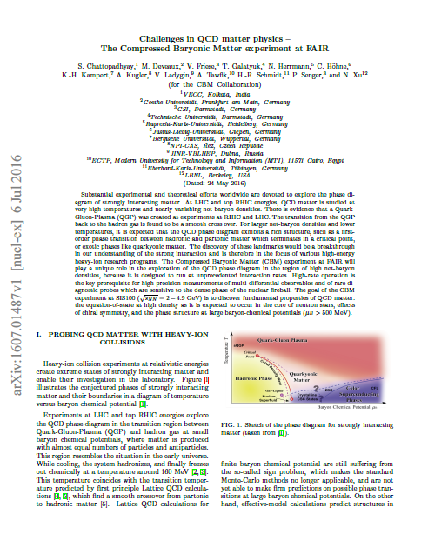
Challenges in QCD matter physics –
The Compressed Baryonic Matter
experiment at FAIR
CBM Collaboration
arXiv:1607.01487 [nucl-ex]
6 July 2016
to be published in a refereed journal

Slide 14
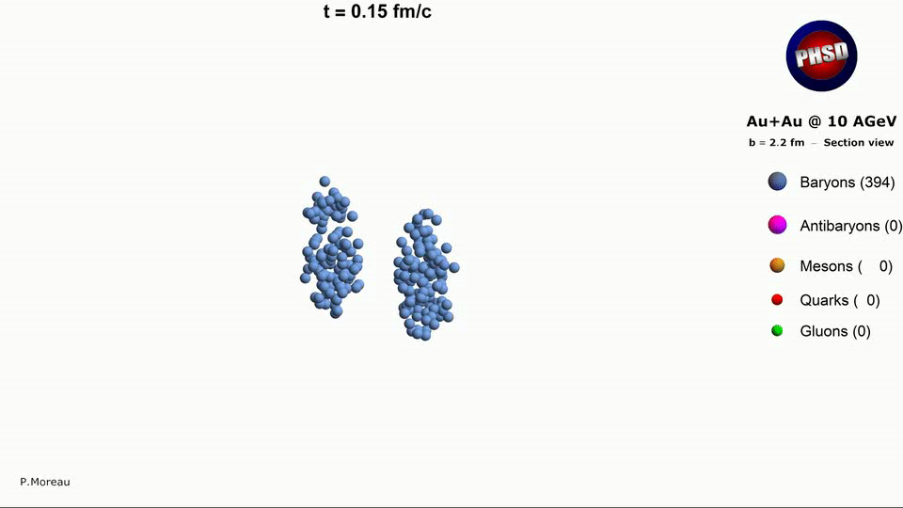
Heavy-ion collisions

Slide 15
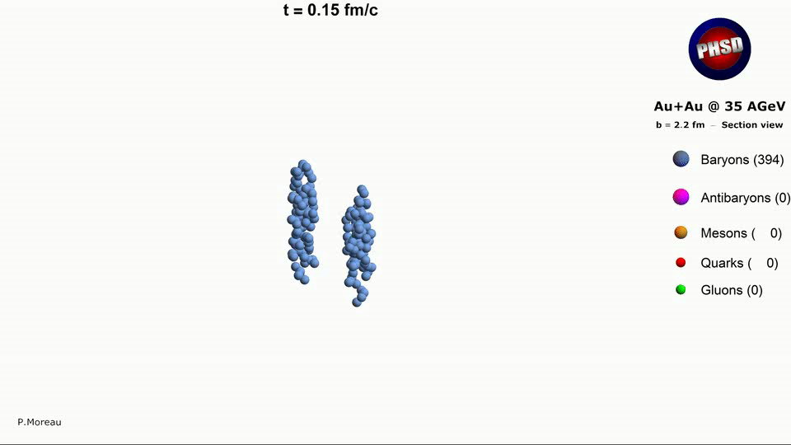
Heavy-ion collisions

Slide 16
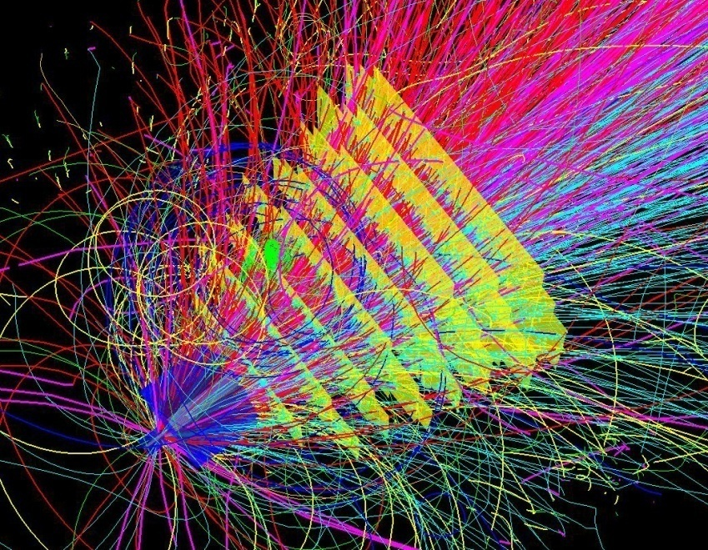
Heavy-ion collisions

Slide 17
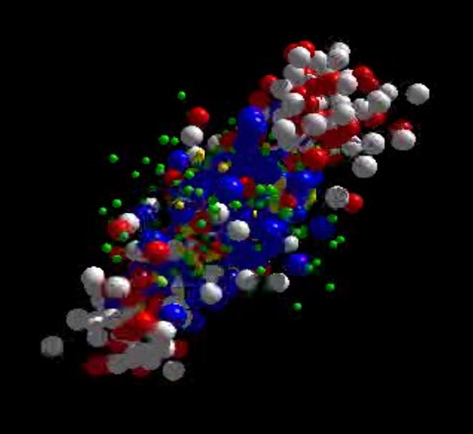
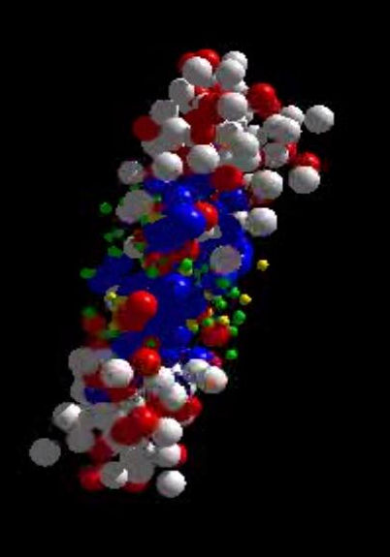
Messengers from the dense fireball:
CBM at SIS100
UrQMD transport calculation Au+Au 10.7 A GeV
Ξ⁻, Ω⁻, φ
π, K, Λ, ...
p, Λ, Ξ⁺, Ω⁺, J/ψ
ρ → e⁺e⁻, μ⁺μ⁻
resonance decays
ρ → e⁺e⁻, μ⁺μ⁻
ρ → e⁺e⁻, μ⁺μ⁻

Slide 18
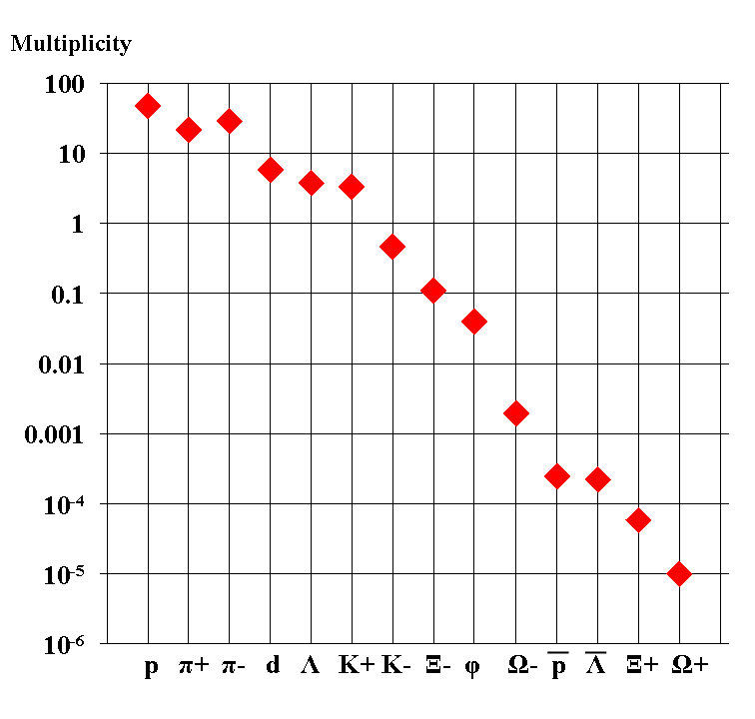
Experimental challenges
Particle yields in central Au+Au 4 A GeV
× BR
AGS

Slide 19
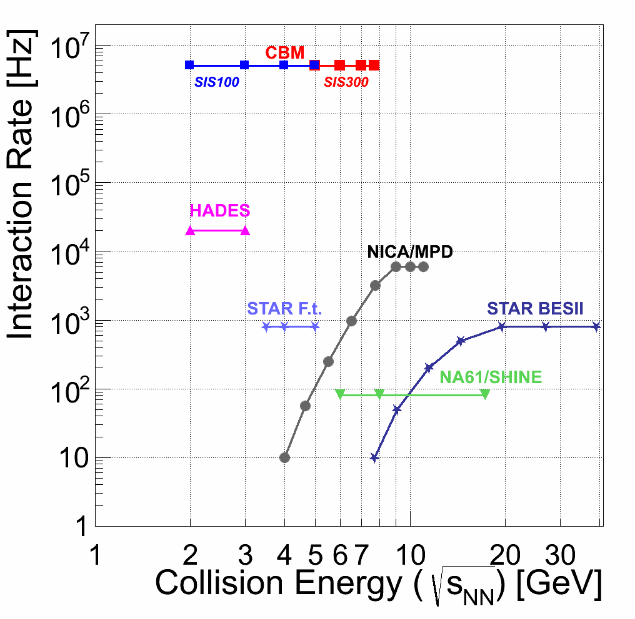
Experiments exploring dense QCD matter
high
net-baryon densities

Slide 20
Experimental requirements
10⁵ - 10⁷ Au+Au reactions/sec
fast and radiation tolerant detectors
identification of leptons and hadrons
determination of displaced vertices (σ ≈ 50 μm)
free-streaming readout electronics
high speed data acquisition and high performance
computer farm for online event selection
“4-D” event reconstruction
Notes:
20
20
20

Slide 21
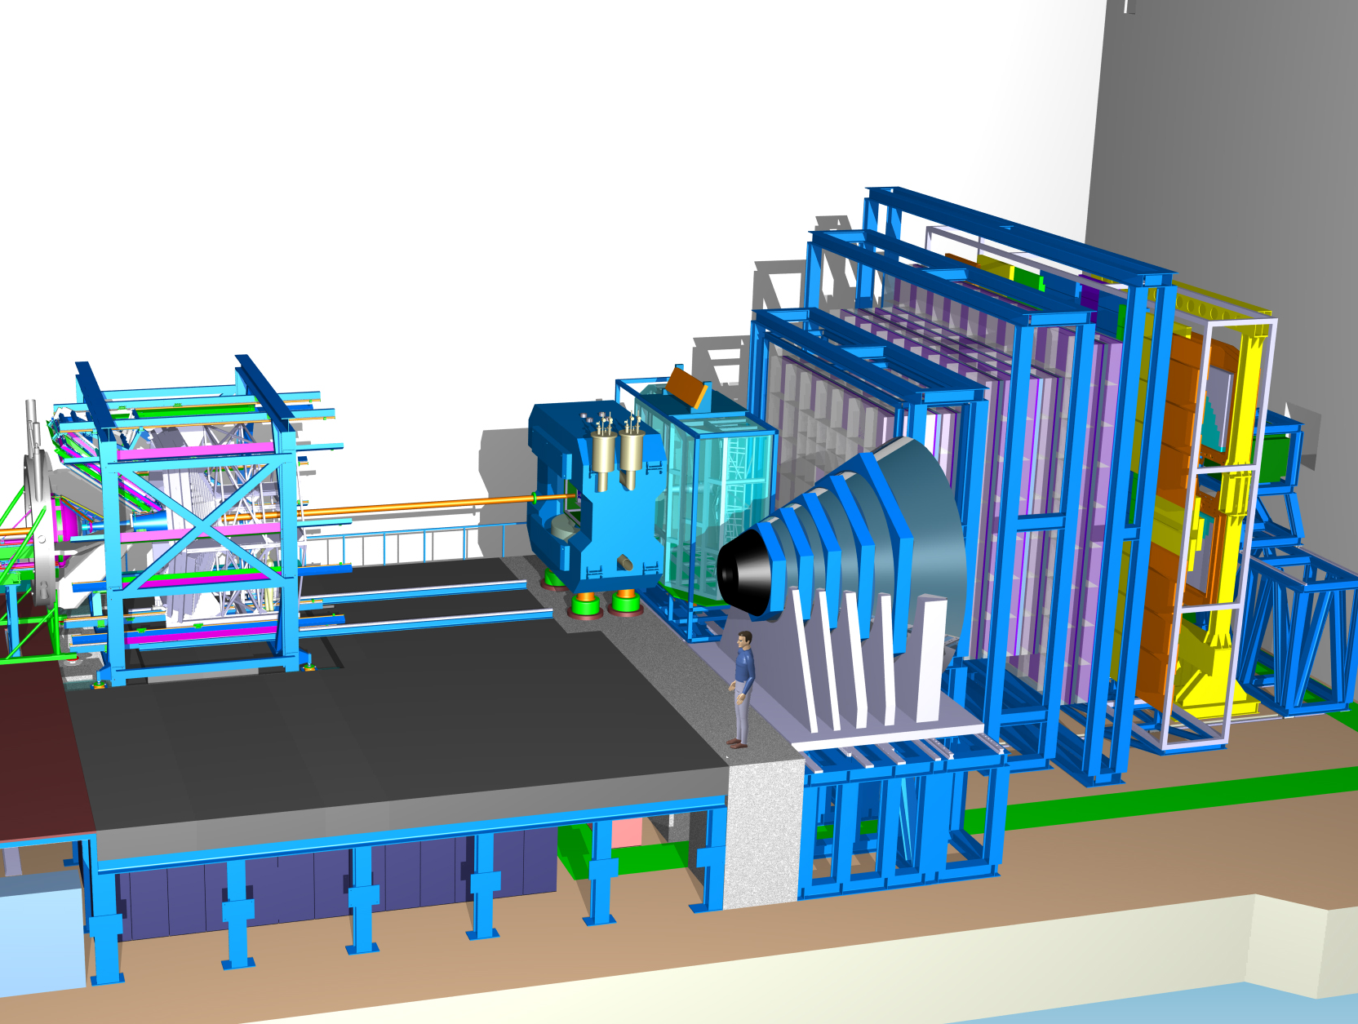
Experimental requirements
(Hadrons incl. hyperons, hypernuclei)
Time of Flight
Dipole
Magnet
Silicon
Tracking
System
HADES
p+p, p+A
A+A (low mult.)
Micro
Vertex
Detector
DAQ/FLES HPC cluster
Projectile
Spectator
Detector

Slide 22
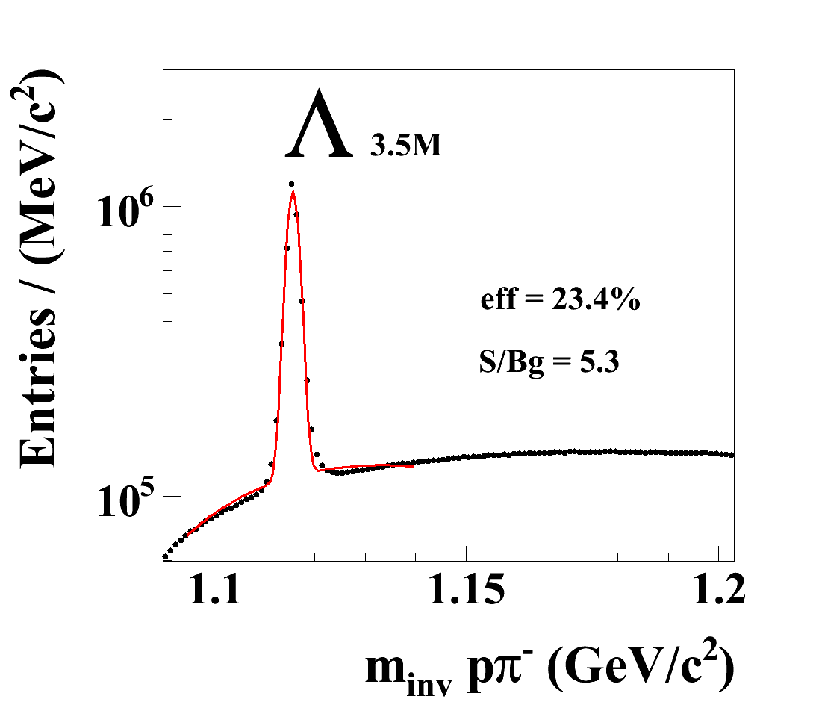
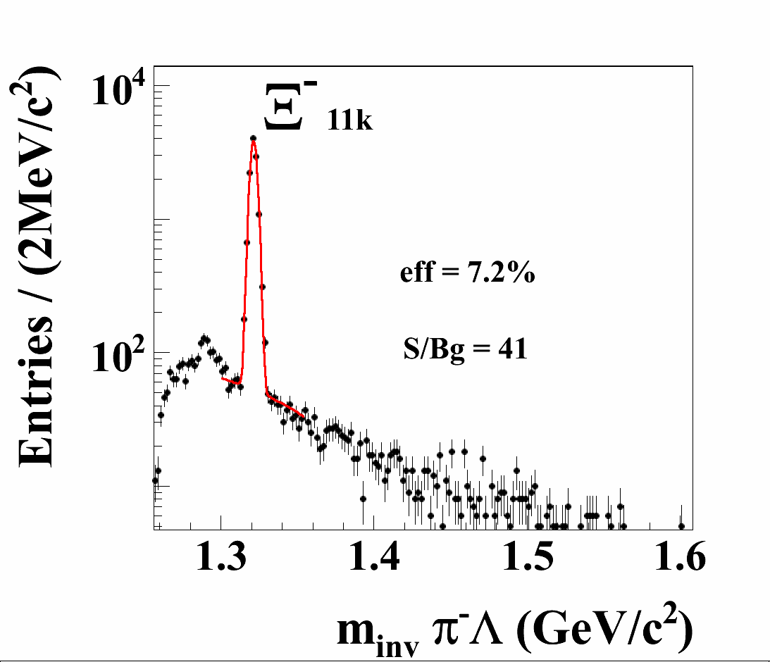
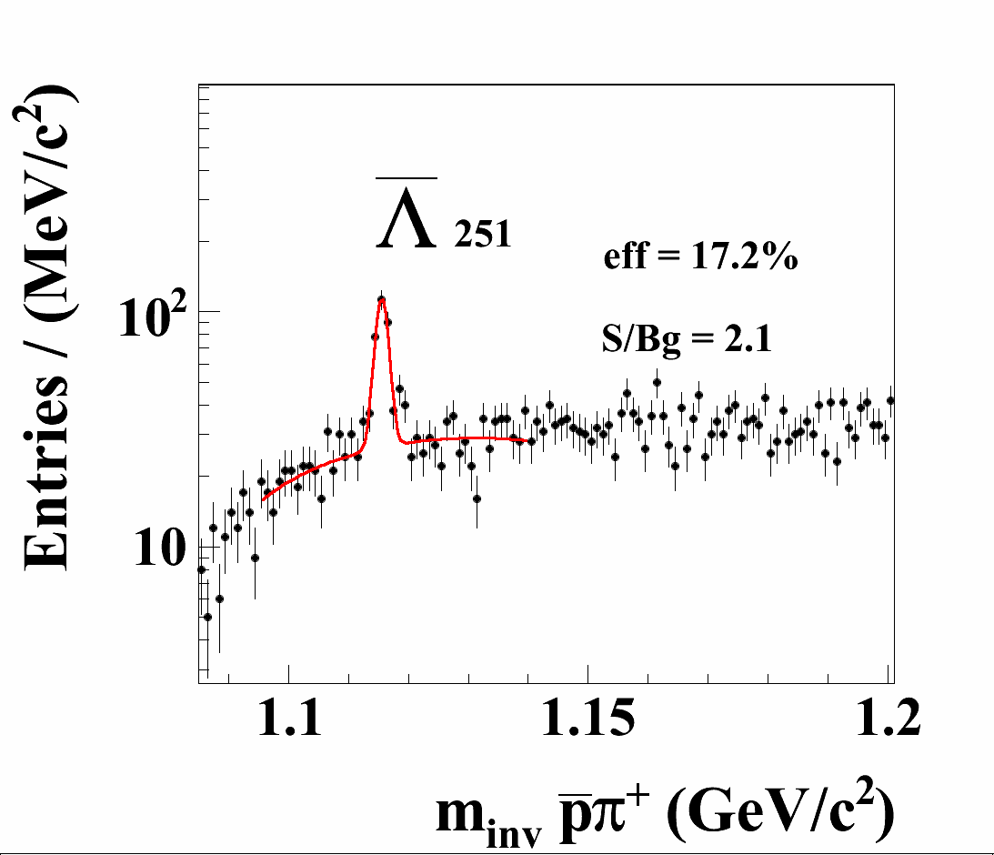
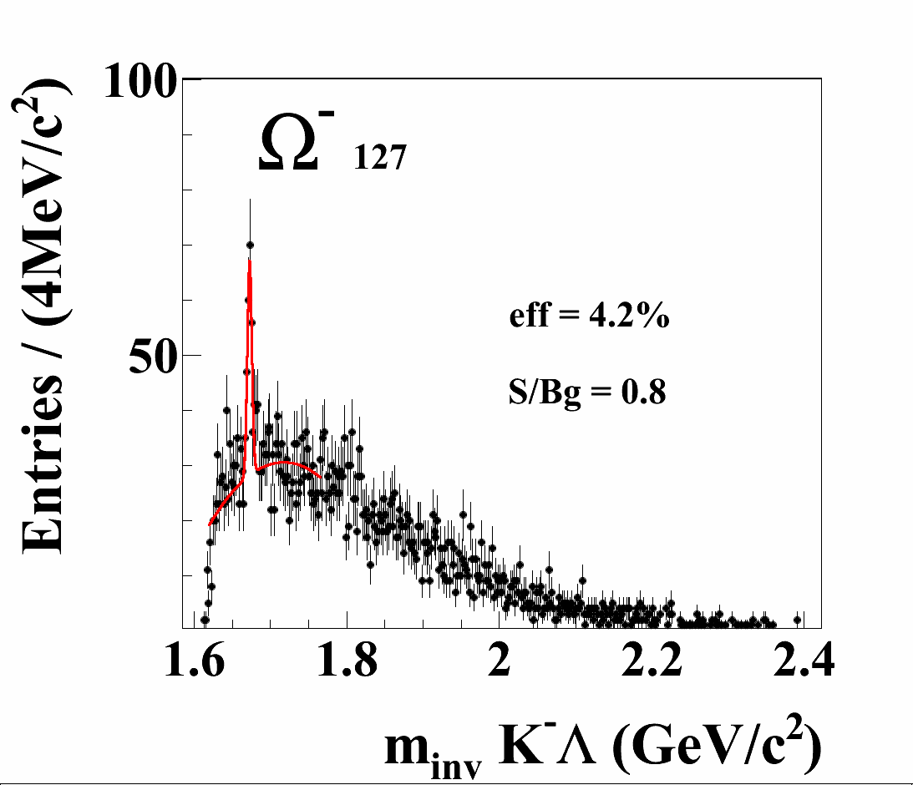
Hyperons in CBM at SIS100
Running scenario: Au+Au, C+C at 4, 6, 8, 10 A GeV
Example: Au+Au at 8 A GeV, 10⁶ central collisions
In addition:
K*,Λ*,Σ*,Ξ*,Ω*
Event rate:
100 kHz to 1 MHz

Slide 23
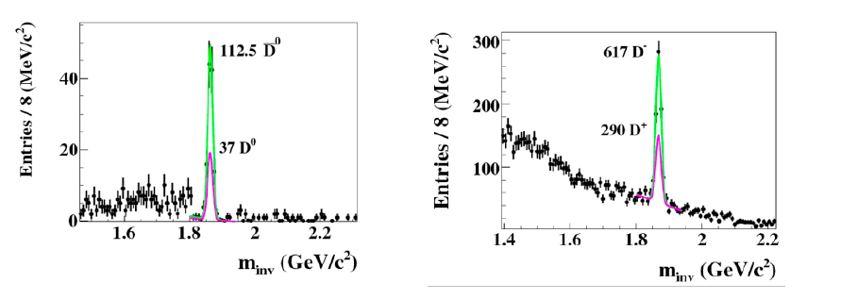
Open charm in CBM at SIS100
Charm production cross sections at threshold energies
Charm propagation in cold nuclear matter
30 GeV p + C
D⁰ →Kπππ
D± →Kππ

Slide 24
Experimental requirements
(Dileptons)
Ring
Imaging
Cherenkov
Time of Flight
Silicon
Tracking
System
Dipole
Magnet
Transition
Radiation
Detector
(4/12)
Micro
Vertex
Detector
DAQ/FLES HPC cluster
Projectile
Spectator
Detector
Muon
Detector

Slide 25
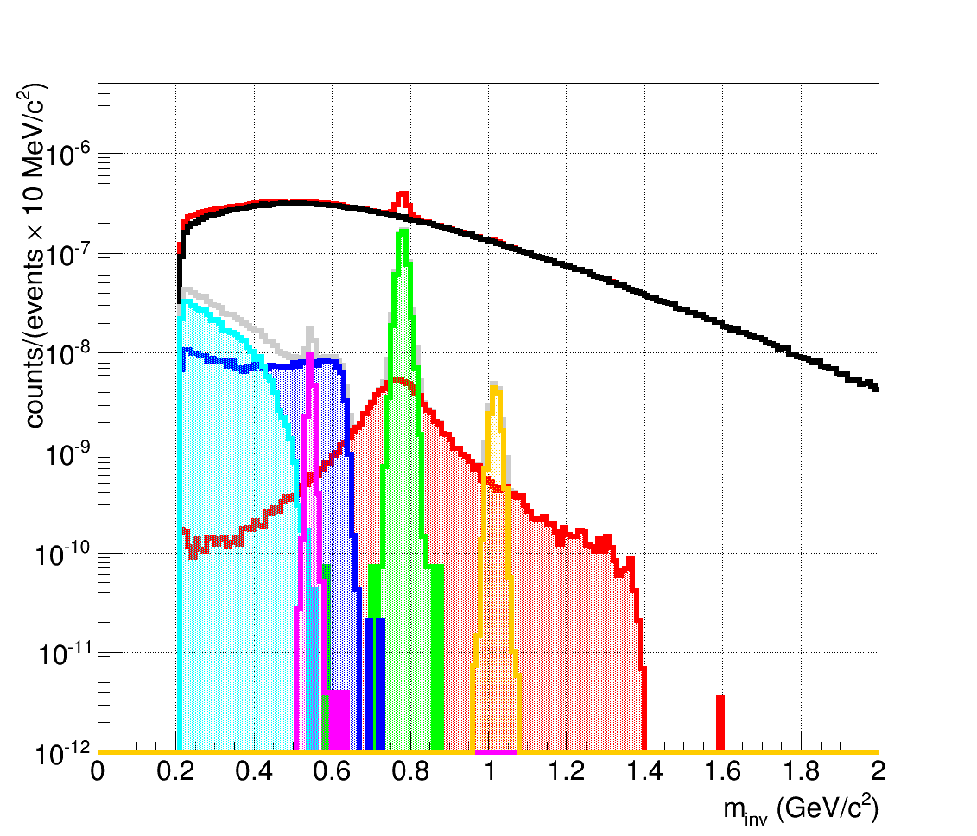
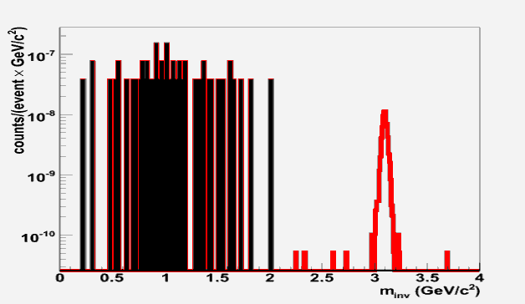

Leptons in CBM at SIS100
Simulation: Signal yields from HSD, Background from UrQMD
central Au+Au at 8 A GeV: 2×10⁶ ω in 2 weeks
30 GeV
p+Au
Electrons
Muons
(100k events)
J/ψ → µ⁺µ⁻
1000 J/ψ
in 10¹² events
(1 day)

Slide 26
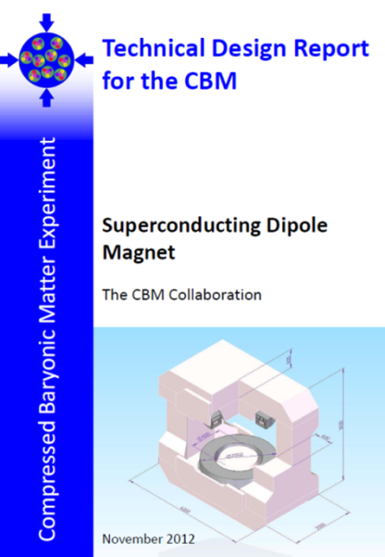
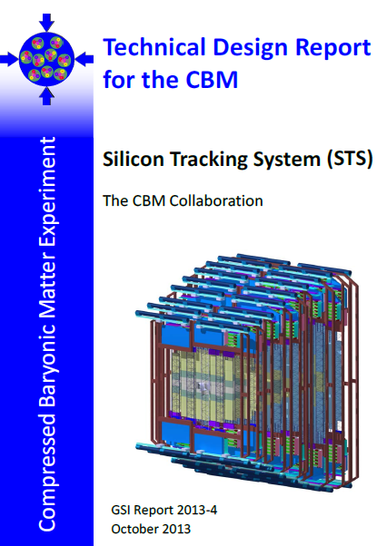
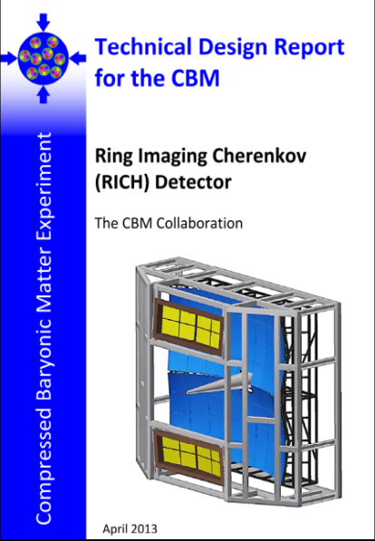
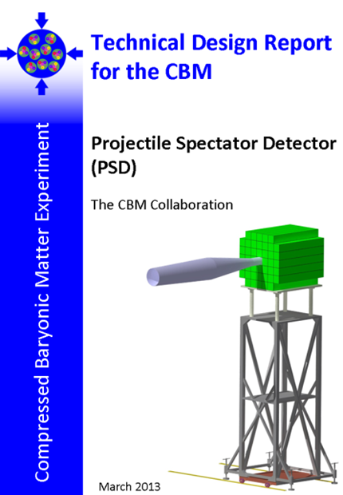
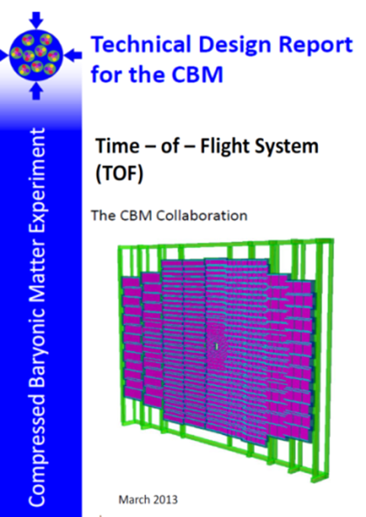
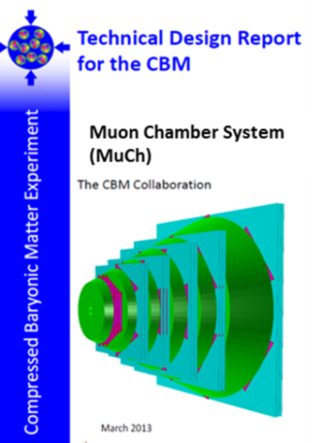
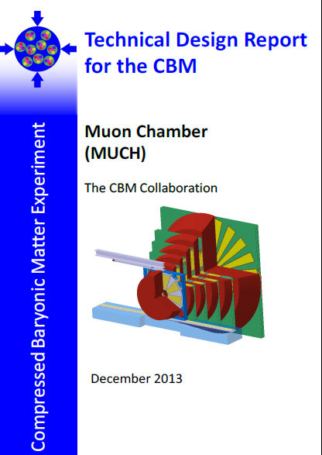
CBM Technical Design Reports
# | Project | TDR Status
1 | Magnet | approved
2 | STS | approved
3 | RICH | approved
4 | TOF | approved
5 | MuCh | approved
6 | HADES ECAL | approved
7 | PSD | approved
8 | MVD | submission 2016
9 | TRD | submission 2016
10 | ECAL | submission 2016
11 | DAQ/FLES | submission 2017

Slide 27
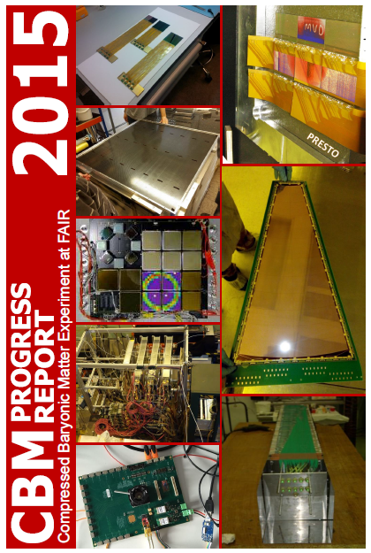
More on technical developments in:
CBM Progress Report 2015
CBM Collaboration
progress in the fields of
  detectors
  electronics
  DAQ
  computing
  simulations
http://www.fair-center.eu/en/for-users/experiments/cbm/documents.html

Slide 28
On-line event reconstruction
  There is no a-priori event definition possible:
    no simple trigger signatures: e.g. J/ψ → e⁺e⁻ and D,Ω → charged hadrons.
    extreme event rates set strong limits to trigger latency.
    therefore data from all detectors come asynchroneously.
    events may overlap in time.
The classical DAQ task of „event building“ is now rather a
„time-slice building“. Physical events are defined later in software.
    Data reduction is shifted entirely to software:
      Complex signatures involve secondary decay vertices; difficult to implement in hardware.
      maximum flexibility w.r.t. physics.
The system is limited only by the throughput capacity and by the
rejection power of the on-line computing farm.

Slide 29
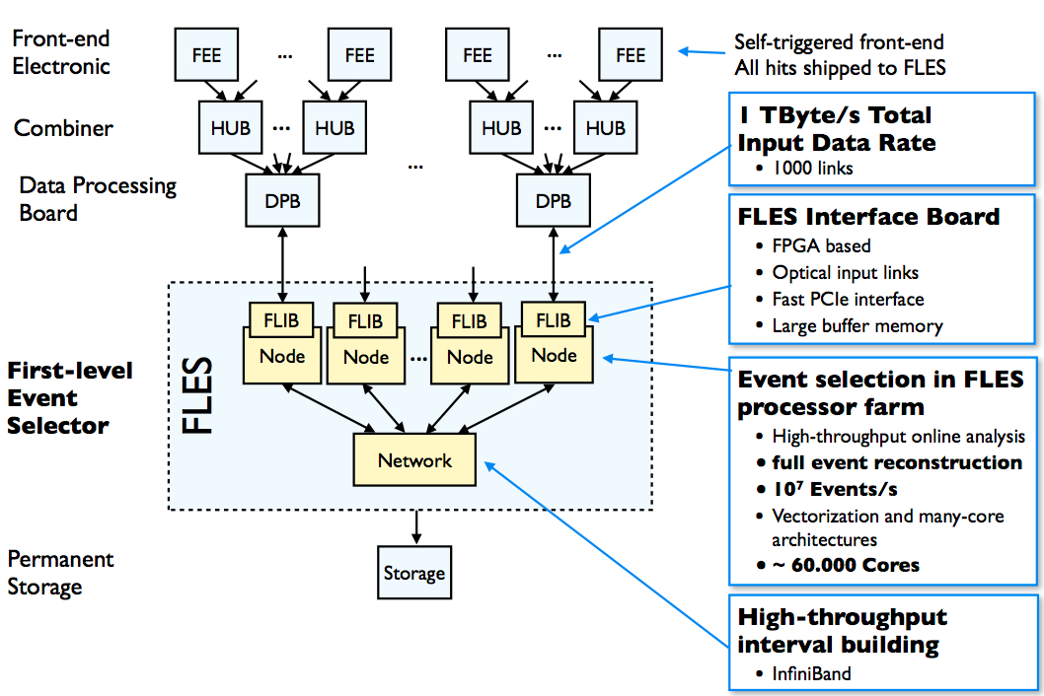
CBM online data flow
First-level Event Selector

Slide 30
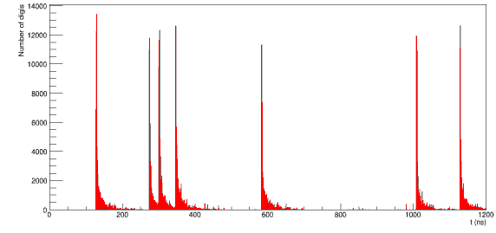
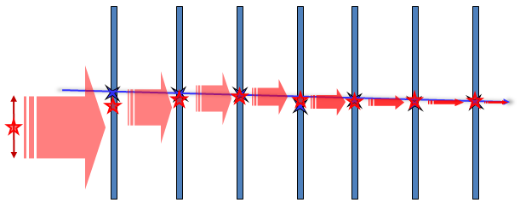
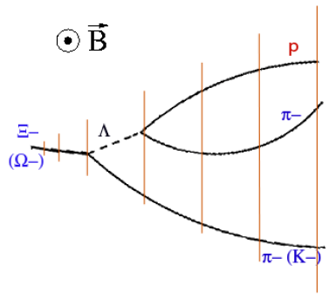
Steps of event reconstruction
hits
Time-slice sorting of detector hits:
First step in “pre-event” definition.
Track finding – Cellular Automaton:
Which hits in the detector layers belong to the same track?
    large combinatorial problem
    well to be parallelized
  applicable to many-core CPU/GPU systems
Track fitting – Kalman Filter:
Optimization of the track parameters.
  recursive least squares method, fast
Event determination
Which tracks belong to same interaction?
Particle finding:
Identify decay topologies and other signatures.
t
1
2
3
4

Slide 31
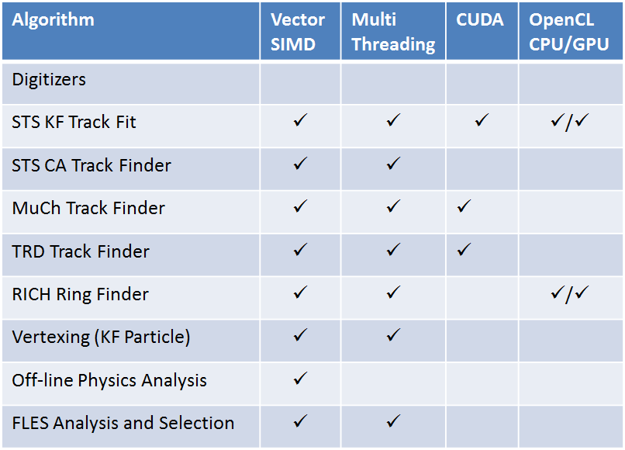
Parallelization of event reconstruction
On “event” level:
reconstruction with independent processes
Exploit many-core systems with multi-threading: 1 thread per logical core, 1000 events per core.
On “task” level:
digitizer, finder, fitter, analysis tasks: current readiness of parallelization
employing different computing techniques and architectures

Slide 32
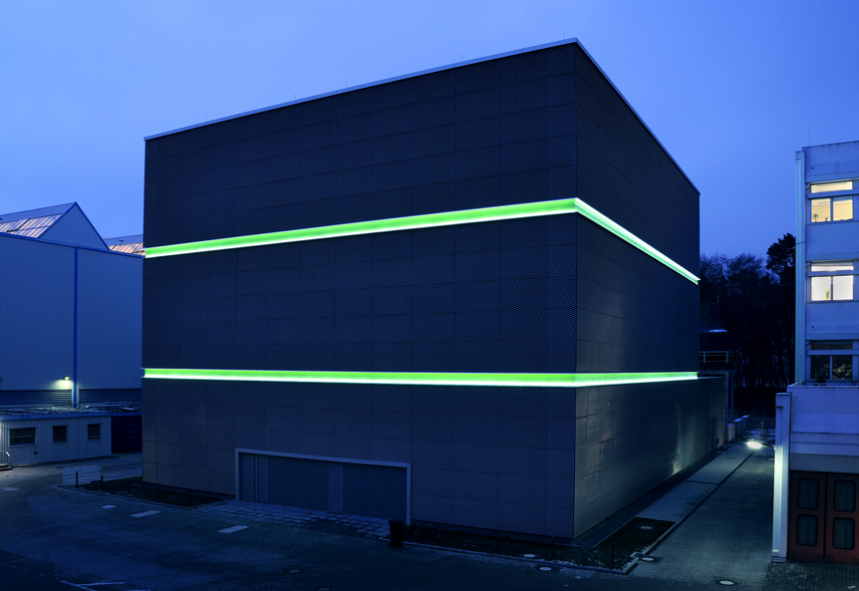
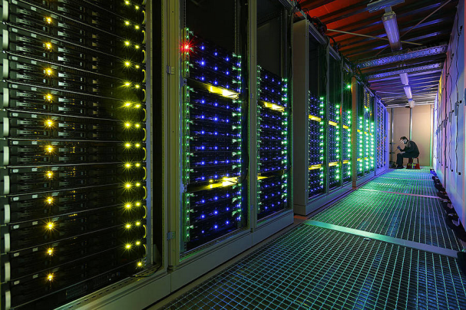
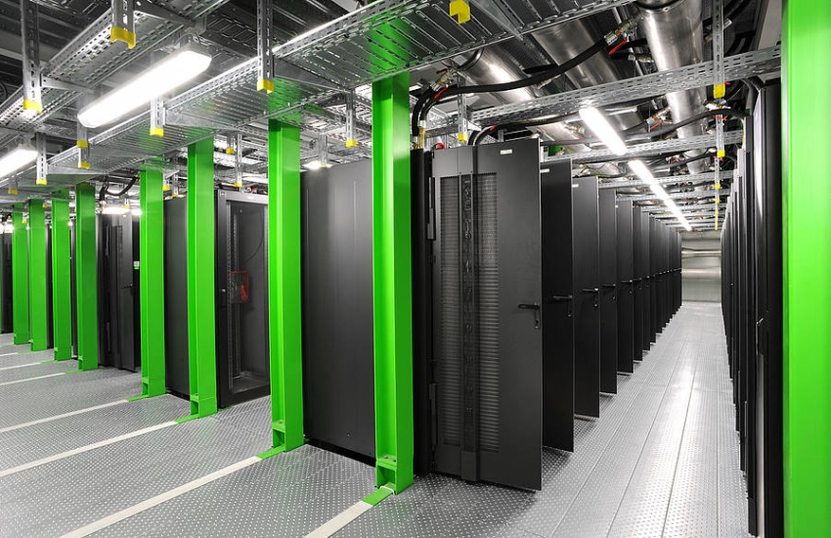
Green IT Cube, January 2016
new high-performance computing center at GSI
physics simulations, detector development for FAIR
Data processing and analysis from experiments in the
accelerator facilities of GSI, and FAIR
Space and cost effective
768 computer cabinets on six floors (1/3 now)
300,000 CPUs
12 MW cooling power
100 petabytes to store experiment data
data link from experiments: one terabyte/s

Slide 33
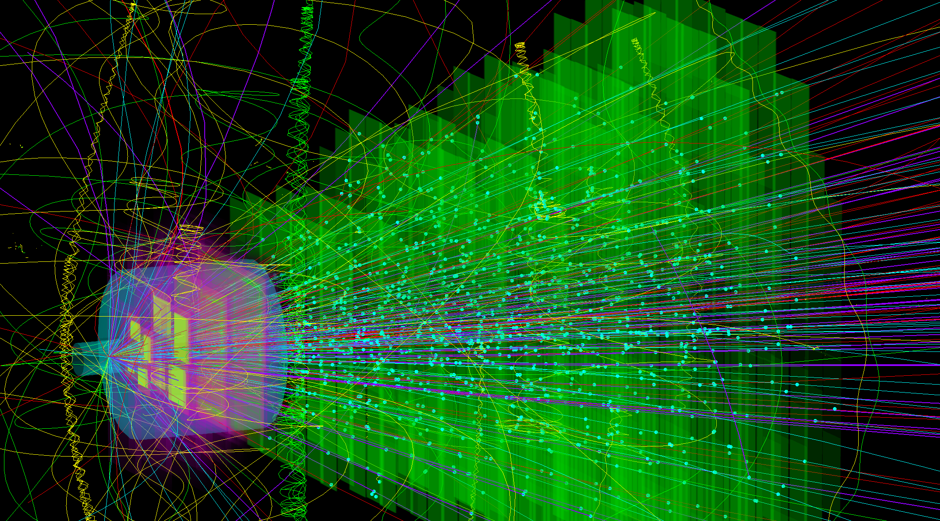
Tracking nuclear collisions
STS
Ni+Ni @ 15 AGeV
central collision
collision rates from 100 kHz to 10 MHz
1T magnetic dipole field
beam on target
MVD

Slide 34
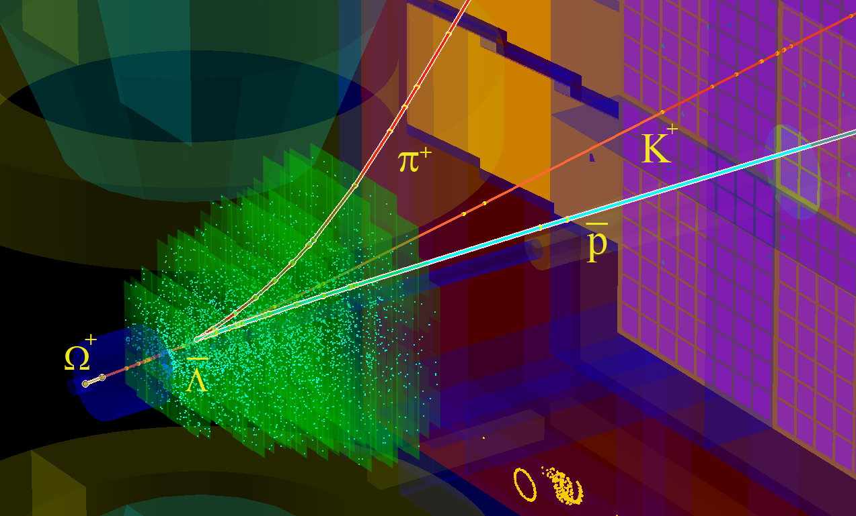
Search for physics signatures
Au+Au @ 10AGeV
165 π
170 p
26 K
15 Λ
20 K_{S}⁰
0.3 Ξ⁻

Slide 35
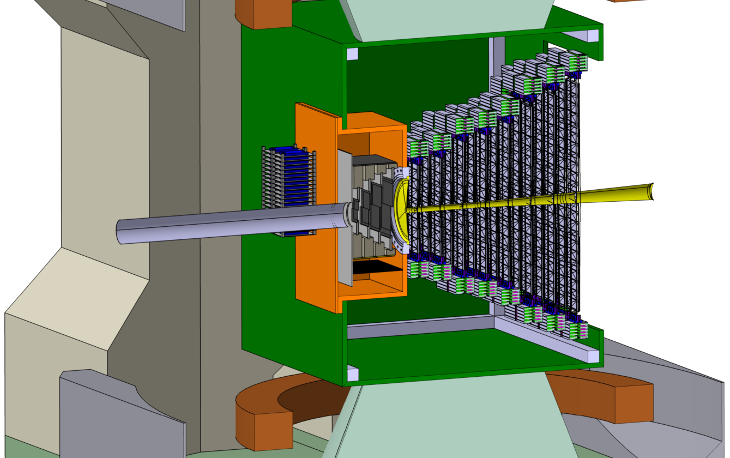

Silicon Tracking System
STS
beam
1 m
2.5°
25°
target
MVD

Slide 36




STS integration
896 modules:
4-5 modules
per ladder
front-end board: 8 self-triggering
r/o ASICs
8 stations, volume 2 m³, area 4 m²
896 detector modules
    1220 double-sided microstrip sensors
    ~ 1.8 million read-out channels
    ~ 16 000 r/o STS-XYTER ASICs
    ~ 58 000 ultra-thin r/o cables
106 detector ladders with 4-5 modules
power dissipation: 42 kW (CO₂ cooling)
ultra-thin r/o cables
sensor
material budget in physics aperture
[%X₀]
8 tracking stations
18 half- units
106 ladders

Slide 37



STS performance simulation
detailed, realistic detector model based on tested prototype components
CbmRoot simulation framework
using Cellular Automaton / Kalman Filter algorithms
track reconstruction efficiency
momentum resolution

Slide 38



Silicon microstrip sensors
sensor structure:
285/320 ± 15µm thick
n-type silicon
double-sided segmentation
1024 strips of 58 µm pitch
strip length 2/4/6/12 cm
angle front/back: 7.5 deg
read-out from top edge
rad. tol. up to 10¹⁴ n_{eq}/cm²
n-side
p-side
r/o direction
prototypes from CiS, Germany and Hamamatsu, Japan

Slide 39



Read-out electronics
purely data driven read-out
time-stamped data elements
Front-end Board
Read-Out Board
STS-XYTER ASIC
128 sensor channels
copper link
optical link
v1.0 produced
v2.0 in 9/2016
UMC 180 nm CMOS
Data Processing Board
time-slicing
channels | 128, polarity +/-
noise | < 1ke⁻ at 20-50pF load
ADC range | linear up to12 fC, 5 bit
clock | 250 MHz
power | < 10 mW/channel
timestamp | < 10 ns resolution
out interface | 5 × 500 Mbit/s LVDS
FLES farm
online event computing
time-stamped data
data combining
8 STS-XYTER chips
à 1/2/5 LVDS links out
under development
  GBTx chip-set (CERN):
  3 GBTx, 1 VTRx, 1 VTTx, 1 SCA
  42 E-links à 320 Mb/s
  3 GBT optical uplinks à 4.48 Gb/s
  under development /production

Slide 40




Module assembly
GSI-Detector Lab

Slide 41


System Integration

Slide 42
Current topics in STS development
signal-to-noise in module:
detailed understanding of sensor (degrading with irradiation), microcables, ASIC: capacitive + resistive load
read-out with final electronics/DAQ
system integration: powering, cooling, final dimensions of modules, ladders, support structures, board stack-up, routing integration of target-MVD-STS into dipole magnet
preparing for production readiness:
assembly centers, tasks, component yields,
quality assurance specifications and procedures, determination of timelines, contracts with industry (sensors)
...

Slide 43
CBM time line
TDRs: 2013 – 2017
production readiness of the sub-systems: 2016 – 2017 – 2018
construction: until 2020
ready for beam: 2021

Slide 44
Costs and funding – CBM Start version
70 % secured
Expressions of Interest:
applications in 2015 -2020

Slide 45


Facility for Antiproton & Ion Research
SIS18
SIS100/300
p-Linac
CBM
CBM: FAIR Day-1
experiment
CBM cave + building
FAIR phase 1
FAIR phase 2
100 m

Slide 46

Facility for Antiproton & Ion Research
FAIR Council, June 2016:
Decision to go ahead with the construction of FAIR.
Funding of the modularized start version is considered to be assured: Commitments of the shareholders to cover additional costs of 148 M€.
Building permits and all legal issues can be processed.
Aerial photo - April 2015

Slide 47
FAIR phase 0
CBM plans to operate prototype sub-systems already before the start of FAIR:
TOF: in STAR experiment at RHIC/BNL
RICH: in HADES experiment at SIS-18/GSI
STS: in BM@N experiment at Nuclotron/JINR
DAQ/FLES: in mCBM set-up at SIS-18
Aim: ‒ commissioning of detectors under real exp. conditions
‒ physics measurements
‒ training of the teams

Slide 48





STS in BM@N experiment at Nuclotron
Mutual interest by CBM groups from Germany and Russia to install, commission and use
4 CBM-like Silicon Tracking Stations in BM@N in 2018 – 2021
dipole magnet
STS
GEM
Au beams up to 4.5 GeV/u

Slide 49


The CBM Collaboration: 60 institutions, 530 members
Croatia:
Split Univ.
China:
CCNU Wuhan
Tsinghua Univ.
USTC Hefei
CTGU Yichang
Czech Republic:
CAS, Rez
Techn. Univ.Prague
France:
IPHC Strasbourg
Hungary:
KFKI Budapest
Budapest Univ.
Germany:
Darmstadt TU
FAIR
Frankfurt Univ. IKF
Frankfurt Univ. FIAS
Frankfurt Univ. ICS
GSI Darmstadt
Giessen Univ.
Heidelberg Univ. P.I.
Heidelberg Univ. ZITI
HZ Dresden-Rossendorf
KIT Karlsruhe
Münster Univ.
Tübingen Univ.
Wuppertal Univ.
ZIB Berlin
India:
Aligarh Muslim Univ.
Bose Inst. Kolkata
Panjab Univ.
Rajasthan Univ.
Univ. of Jammu
Univ. of Kashmir
Univ. of Calcutta
B.H. Univ. Varanasi
VECC Kolkata
IOP Bhubaneswar
IIT Kharagpur
IIT Indore
Gauhati Univ.
Korea:
Pusan Nat. Univ.
Romania:
NIPNE Bucharest
Univ. Bucharest
Poland:
AGH Krakow
Jag. Univ. Krakow
Silesia Univ. Katowice
Warsaw Univ.
Warsaw TU
Russia:
IHEP Protvino
INR Troitzk
ITEP Moscow
Kurchatov Inst., Moscow
LHEP, JINR Dubna
LIT, JINR Dubna
MEPHI Moscow
Obninsk Univ.
PNPI Gatchina
SINP MSU, Moscow
St. Petersburg P. Univ.
Ioffe Phys.-Tech. Inst. St. Pb.
Ukraine:
T. Shevchenko Univ. Kiev
Kiev Inst. Nucl. Research
27th CBM Collaboration meeting, GSI
11 -15 April 2016

Slide 50
Summary
CBM scientific program at SIS100:
Exploration of the QCD phase diagram in the region of neutron star core densities
→ large discovery potential.
First measurements with CBM:
High-precision multi-differential measurements of hadrons incl. multistrange hyperons, hypernuclei
and dileptons for different beam energies and collision systems → terra incognita.
Status of experiment preparation:
Prototype detector performances fulfill CBM requirements.
7 TDRs approved, 4 TDRs in preparation.
e.g. Silicon Tracking System:
Central detector of the experiment: charged-particle tracking, momentum measurement.
Development and construction in close cooperation of GSI and JINR. Electronics from Poland.
Using part of the STS detector for system tests at GSI and/or physics runs at external labs is under consideration: → BM@N, JINR (FAIR0 phase, 2018 – 2020)
Funding:
Substantial part of the CBM start version is financed (including Expressions of Interest).
CBM time line:
Resource loaded schedules for most of the detectors.
Aim: Detectors ready for beam end of 2020.

Slide 51
back-up slides

Slide 52















CBM Micro-Vertex Detector
Ultra-thin: CVD diamond, TPG
Sensors: CMOS MAPS
Radiation hard,
Thinned to 50 µm,
< 150 mW/cm²,
spatial resol. < 5 µm,
R/O several 10 µs/frame
Prototyping & test beam:
Customized FEE & DAQ:
TRB-based
MVD demonstrator
MVD prototype
PRESTO
RVC foam
Thermal Pyrolytic Graphite

Slide 53

Structure of STS-XYTER front-end
Two-stage trigger allows fast time stamp and low trigger level
V_{thF} < V_{ADCmin} → the time measurement is validated by the energy measurement – worst cases (noise) dropped

Slide 54

FEB Types @ 10 MHz, Au+Au, 10 AGeV
preliminary

Slide 55

CA Track Finder at High Track Multiplicity

Slide 56

4D Event Building at 10 MHz

