Slide 1
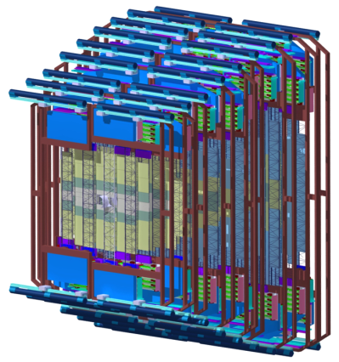
FAIR – CBM – STS
The Compressed Baryonic Matter Experiment at FAIR and its Silicon Tracking System
Johann M. Heuser,
GSI Helmholtz Center for Heavy Ion Research,
Darmstadt, Germany
Workshop on Detector Technologies for
High-Energy Physics
CiS Research Institute for Microsensor Systems,
Erfurt, Germany, 28+29 November 2016

Slide 2

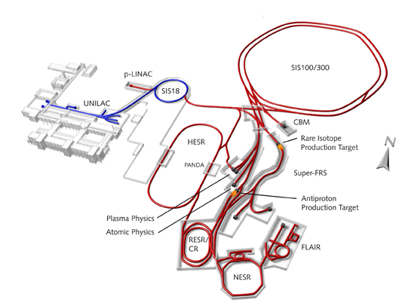

Facility for Anti-Proton and Ion Research
new international research laboratory to explore the nature and evolution of matter in the Universe
under construction in Darmstadt, Germany
Protons:
2 - 29/89 GeV
Ions:
2 – 14 GeV/u (SIS100)
10 – 45 GeV/u (SIS300)
√s_{NN}= 1.9 - 4.5 GeV
√s_{NN}= 4.2 - 9 GeV
Intensities:
10¹²/s @ Super-FRS,
10⁹/s @ CBM
Helmholtz Center for Heavy Ion Research

Slide 3
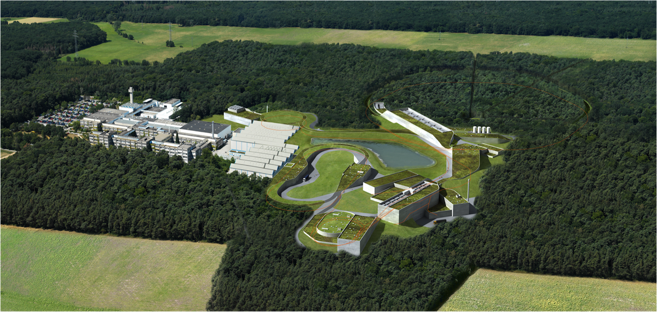










Facility for Anti-Proton and Ion Research
Finland
France
Germany
India
Poland
Romania
Russia
Slovenia
Sweden
UK

Slide 4
Facility for Anti-Proton and Ion Research
  CBM
  QCD phase diagram,
  High-density nuclear matter
  relativistic nuclear collisions
APPA
Materials Science & Radiation Biology
ions, antiprotons
PANDA
Hadron Physics
antiproton beams
NUSTAR
Nuclear Structure & Astrophysics radioactive ion beams
Finland
France
Germany
India
Poland
Romania
Russia
Slovenia
Sweden
UK

Slide 5
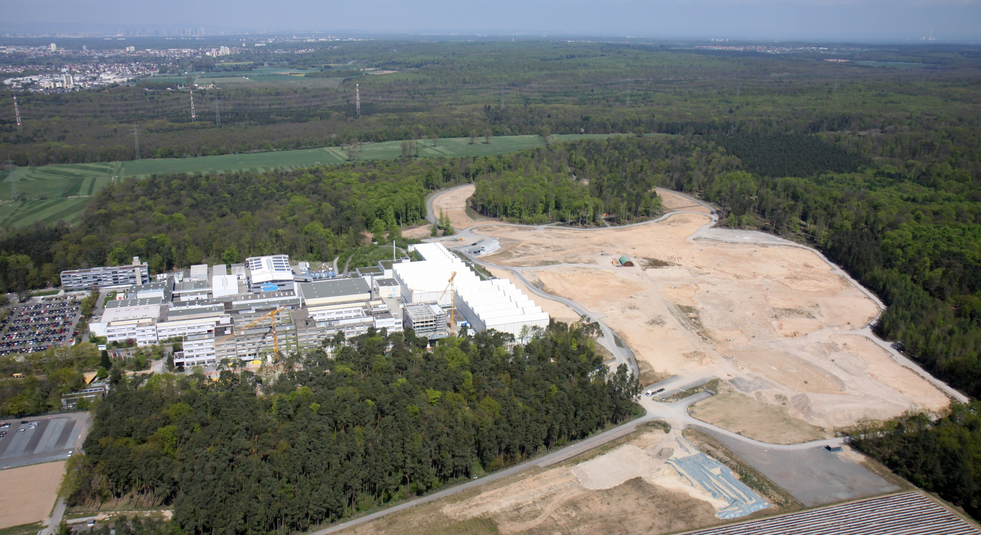
Facility for Anti-Proton and Ion Research

Slide 6
Facility for Anti-Proton and Ion Research
September 2016:
Formal approval by German Research Ministry to start civil construction of northern area; call for tender out: SIS100 tunnel plus connections.
Schedule for civil construction:
- concrete shell completed : 7/2020
- building ready for installation: 11/2021
- building ready for commissioning: 5/2022
Modularized Start Version
Experiments: FAIR phase 0 – before FAIR startup FAIR phase 1 – from 2023
FAIR phase 2 – by 2025, full operation
FAIR phase 3 – beyond MSV (SIS300, ...)

Slide 7
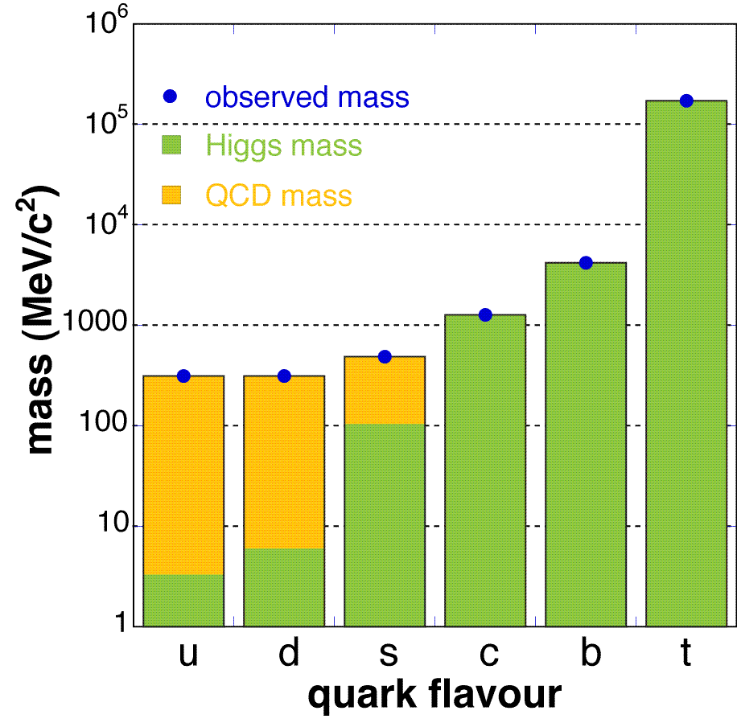
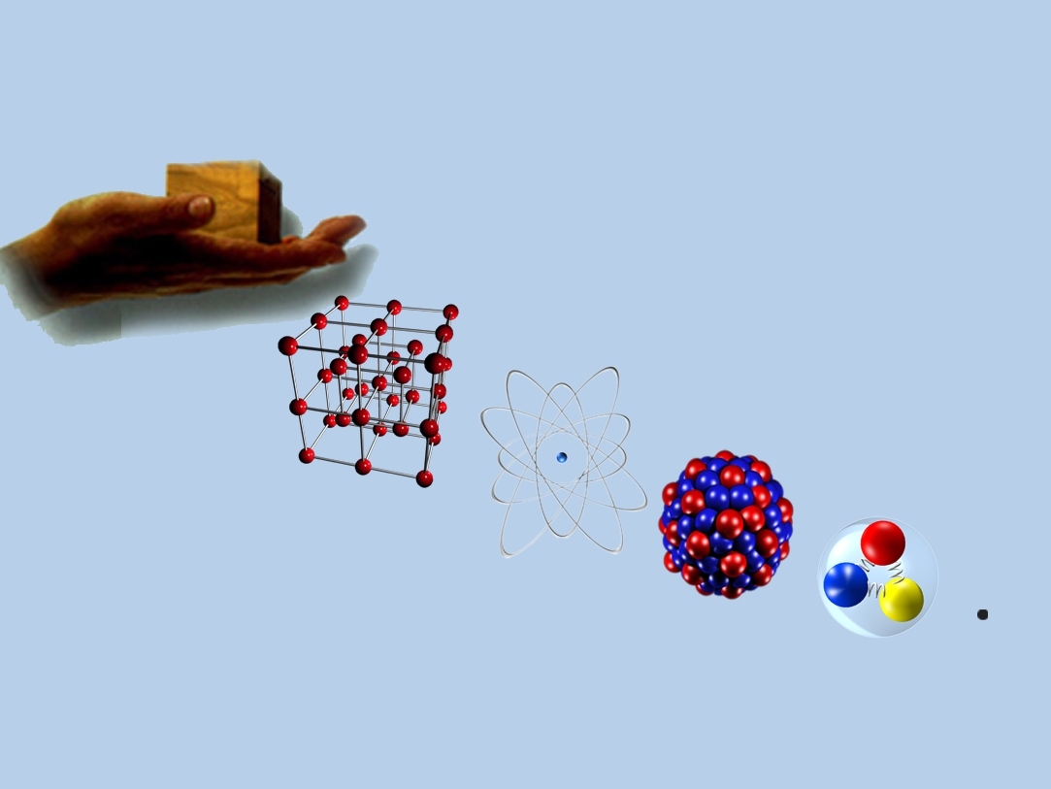
Compressed Baryonic Matter
Baryonic Matter
made from particles composed of
three quarks: proton (uud), neutron (udd)
Scientific questions
Why are there no free quarks?
Where does mass come from?
atom
(10⁻¹⁰ m)
electron
(10⁻¹⁴ m)
proton/neutron
(10^{–15} m)
quarks
(10⁻⁵ m)
atomic nucleus
(<10⁻¹⁸ m)
7

Slide 8
Compressed Baryonic Matter
Baryonic Matter
made from particles composed of
three quarks: proton (uud), neutron (udd)
Scientific questions
Why are there no free quarks?
Where does mass come from?
atom
(10⁻¹⁰ m)
electron
Approach
Break up matter, see it forming again, probe its properties during that process:
How does matter behave under
extreme conditions?
  temperatures as in “Big Bang”
  densities as in cores of neutron stars
Study systematically energetic collisions of nuclear matter (“heavy ions”)
(10⁻¹⁴ m)
proton/neutron
(10^{–15} m)
quarks
(10⁻⁵ m)
atomic nucleus
(<10⁻¹⁸ m)
8

Slide 9
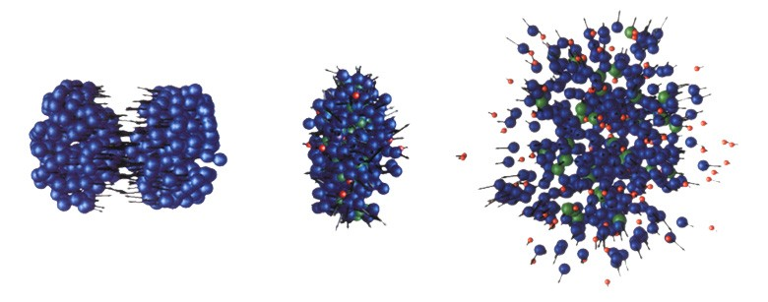
Relativistic heavy-ion collisions
Au
+
Au
high density phase
nucleons
resonances
mesons
transport models: ρ_{max} ≅ 12ρ₀
t
≈ 10⁻²² s (10 fm/c)
high density and high temperatures are reached on a very short time scale:
ρ = 3.4∙10¹⁶ g/cm³, T = 10¹² K
9

Slide 10
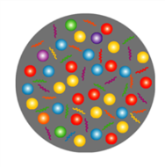
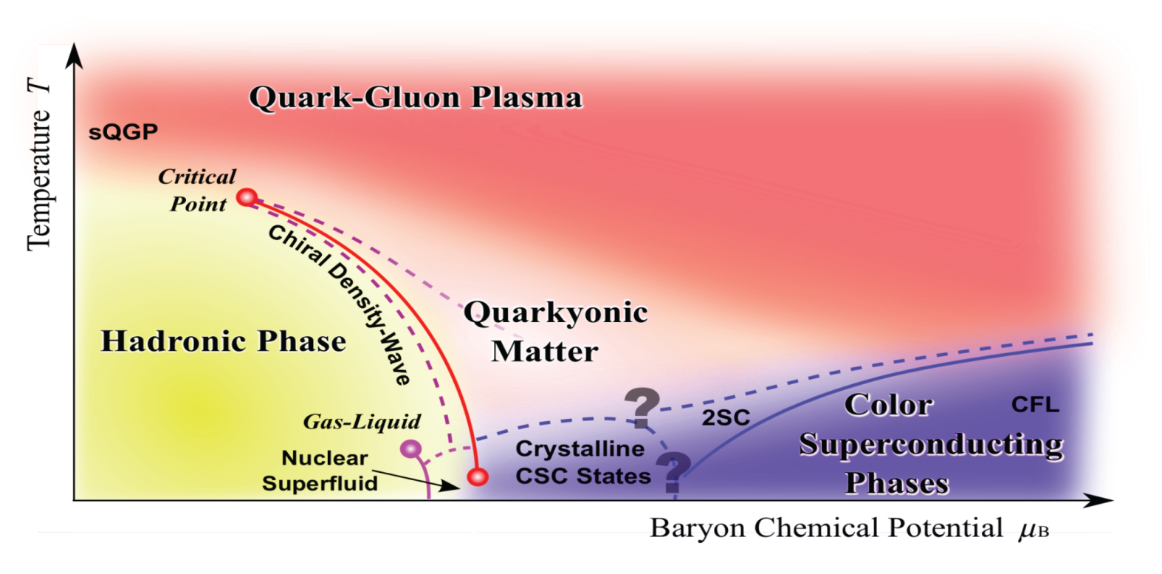
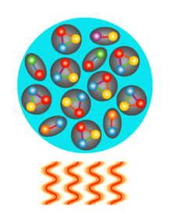
Exploring the QCD phase diagram
“density”
Courtesy of K. Fukushima & T. Hatsuda
At high collision energies (> 200 GeV/nucleon): very high temperature
N of baryons ≈ N of antibaryons → zero baryon density
Situation similar to early universe
L-QCD finds crossover transition between
hadronic matter and Quark-Gluon Plasma
Experiments: ALICE, ATLAS, CMS at LHC
STAR, PHENIX at RHIC
10

Slide 11
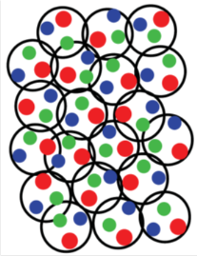
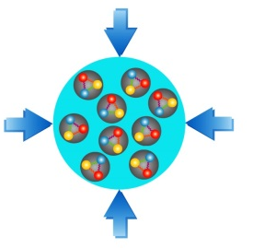
Exploring the QCD phase diagram
“density”
Courtesy of K. Fukushima & T. Hatsuda
At colllision energies 4 – 45 GeV/nucleon: highest baryon density
N of baryons >> N of antibaryons;
Densities like in neutron star cores
L-QCD not (yet) applicable
Models predict 1st order phase transition with mixed or exotic phases
Experiments: BES at RHIC, NA61 at CERN SPS,
CBM at FAIR, NICA at JINR
11

Slide 12
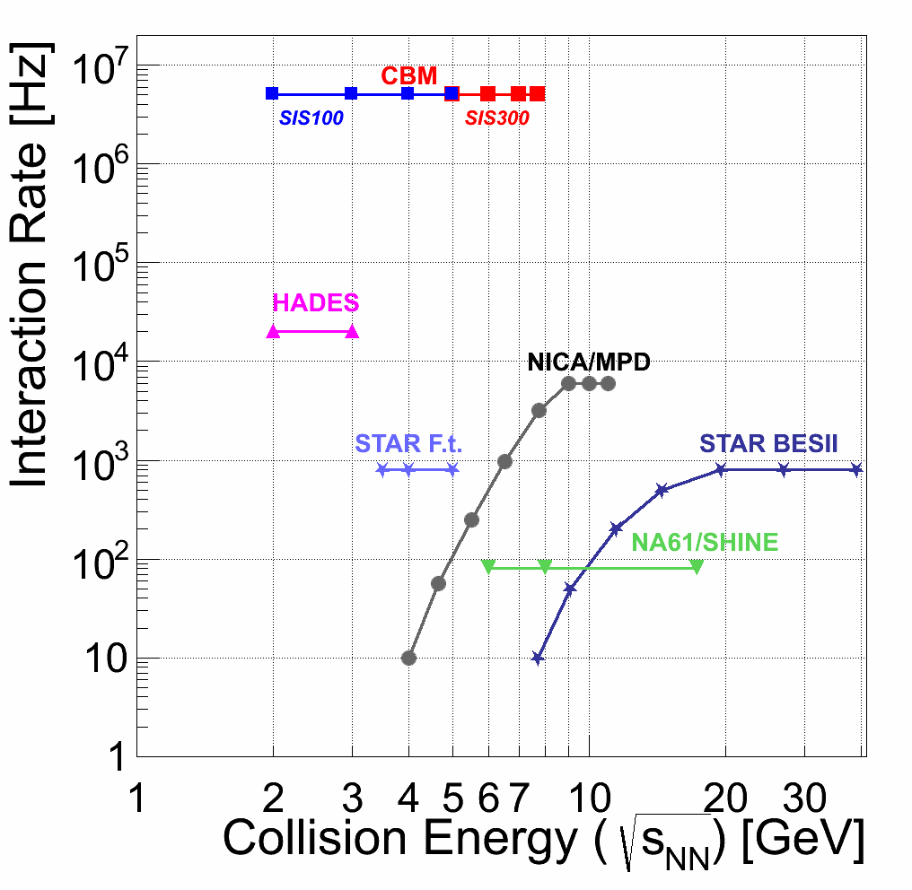
Experiments exploring dense QCD matter
high
net-baryon densities
12

Slide 13
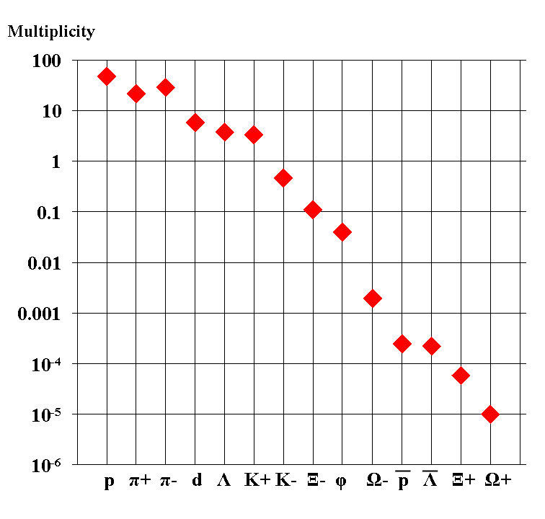
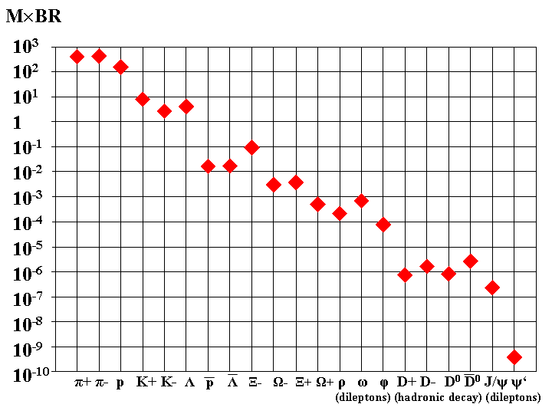
Particle yields in central Au+Au collisions
multiplicity × branching ratio
4 GeV/nucleon
multiplicity × branching ratio
25 GeV/nucleon
motivating CBM experimental requirements in precision and rates

Slide 14
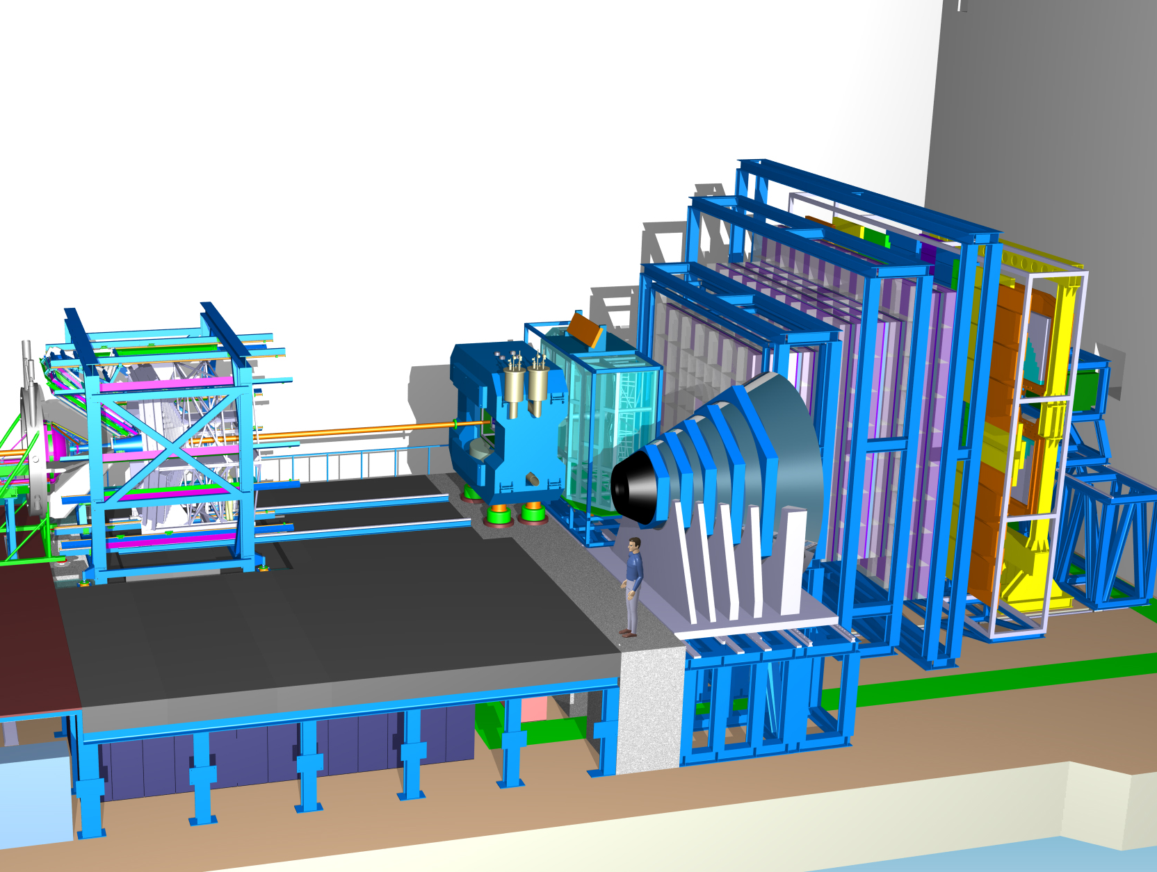
Compressed Baryonic Matter Experiment
Ring
Imaging
Cherenkov
Time of Flight
Silicon
Tracking
System
HADES
p+p, p+A
A+A (low mult.)
Dipole
Magnet
Transition
Radiation
Detector
Micro
Vertex
Detector
DAQ/FLES HPC cluster
Projectile
Spectator
Detector
Muon
Detector

Slide 15
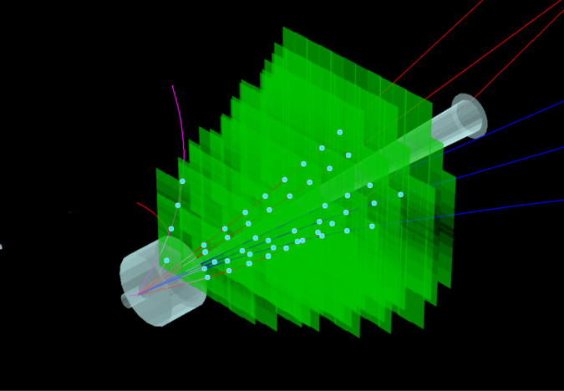
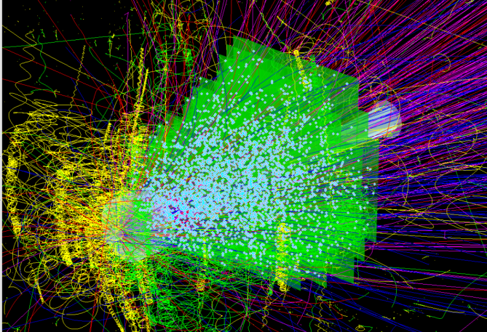
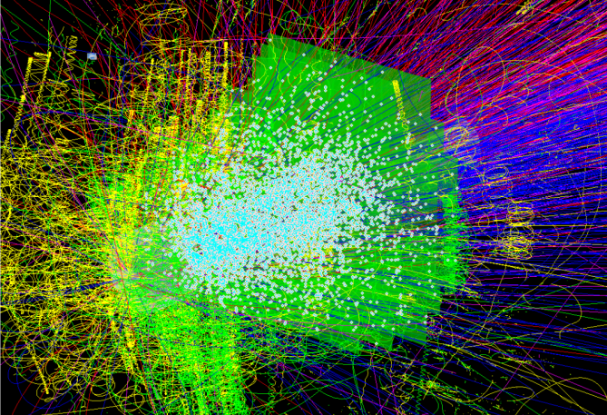
Silicon Tracking in CBM
track identification + momentum determination
    from few charged particles in p+A collisions at SIS100
    to hundreds of charged tracks in A+A collisions at SIS100 and SIS300
    collision rates: 10⁵ to 10⁷/s (A+A), up to 10⁹/s (p+A)
    no event pile-up, unambiguous time stamps
    momentum resolution of ~ 1.5 %
identification of decay topologies within STS aperture
UrQMD + GEANT + CbmRoot
p+C, 30 GeV
central Au+Au, 8 AGeV
central Au+Au, 25 AGeV
few charged particles
~350 charged particles
~700 charged particles

Slide 16
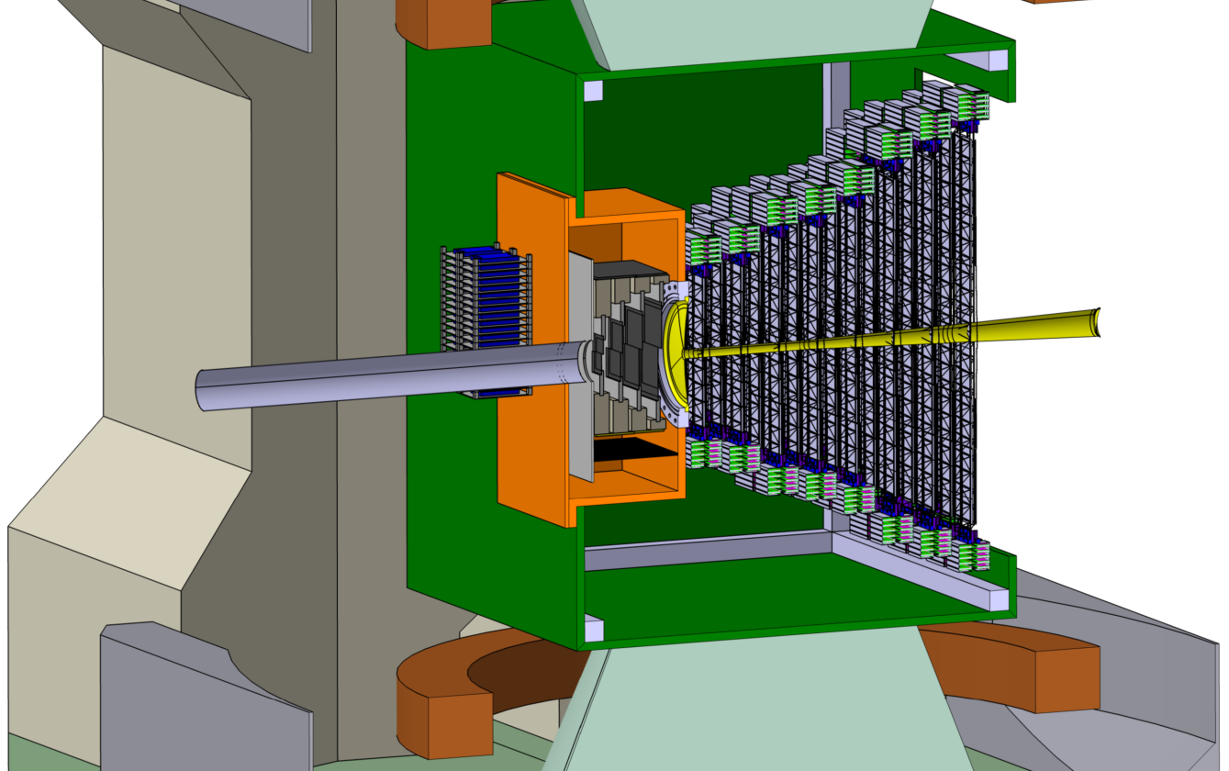
Silicon Tracking System
STS
beam
1 m
2.5°
25°
target

Slide 17
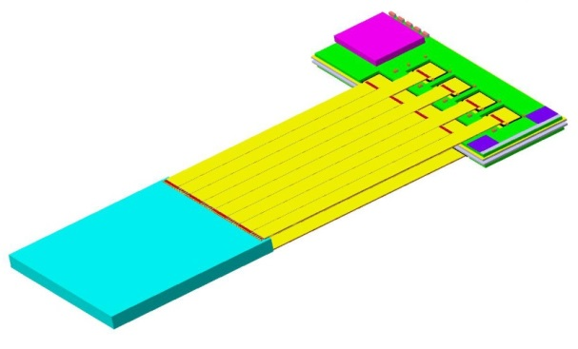
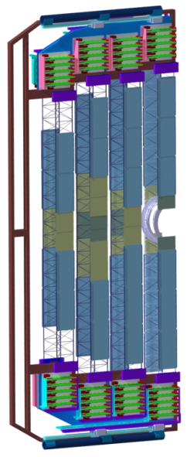

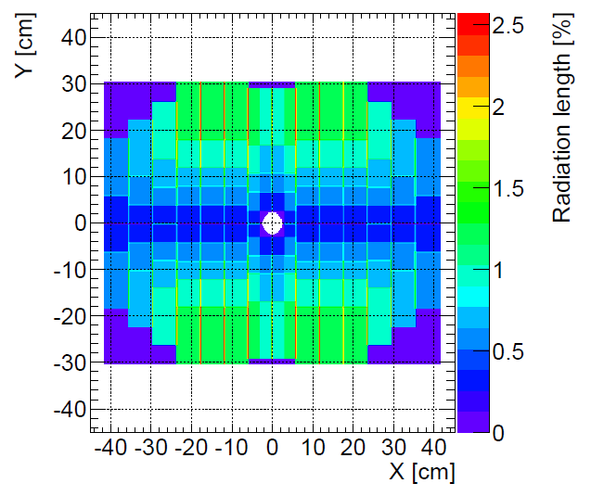
STS integration
896 modules:
4-5 modules
per ladder
front-end board: 8 self-triggering
r/o ASICs
8 stations, volume 2 m³, area 4 m²
896 detector modules
    1220 double-sided microstrip sensors
    ~ 1.8 million read-out channels
    ~ 16 000 r/o STS-XYTER ASICs
    ~ 58 000 ultra-thin r/o cables
106 detector ladders with 4-5 modules
power dissipation: 42 kW (CO₂ cooling)
ultra-thin r/o cables
sensor
C-frame
material budget in physics aperture
[%X₀]
8 tracking stations
18 half- units
106 ladders

Slide 18
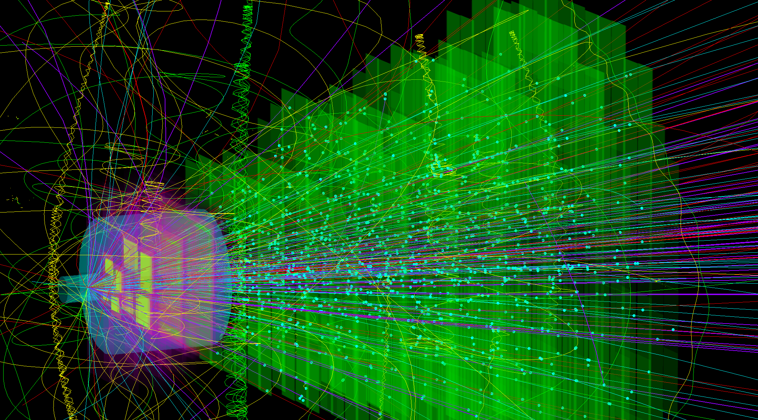
Ni+Ni @ 15 AGeV
central collision
collision rates from 100 kHz to 10 MHz
1T magnetic dipole field
beam on target
MVD
STS

Slide 19
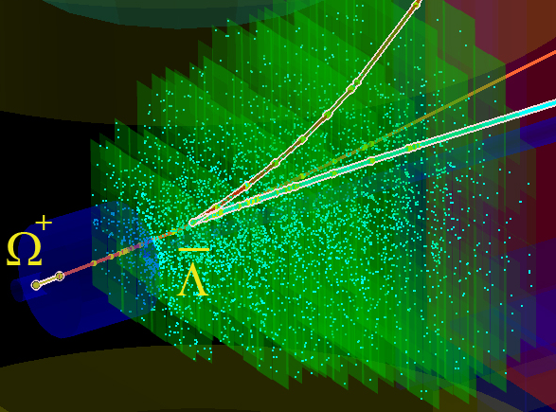
Ni+Ni @ 15 AGeV
central collision
collision rates from 100 kHz to 10 MHz
1T magnetic dipole field
π⁺
K⁺
p
beam on target
MVD
STS

Slide 20
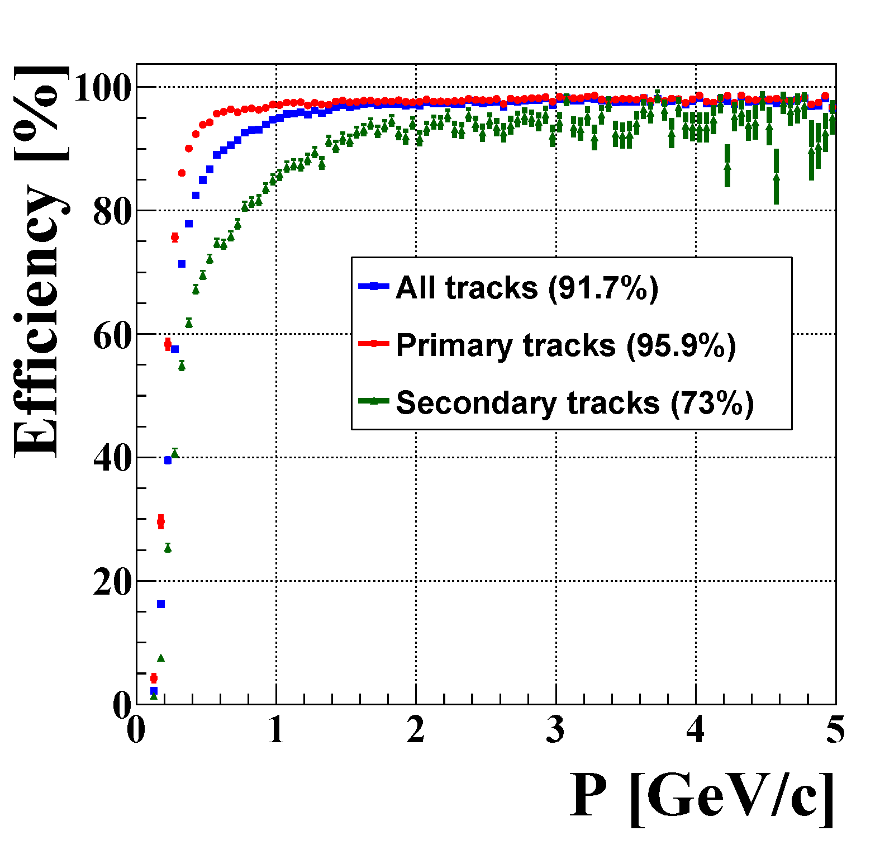
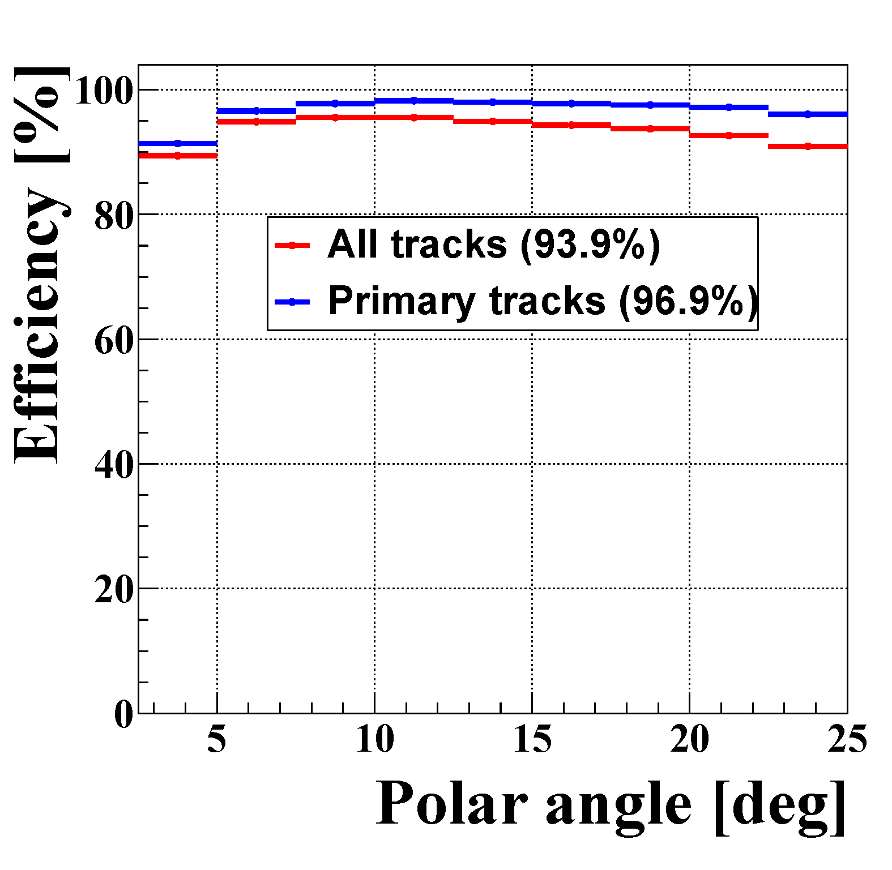
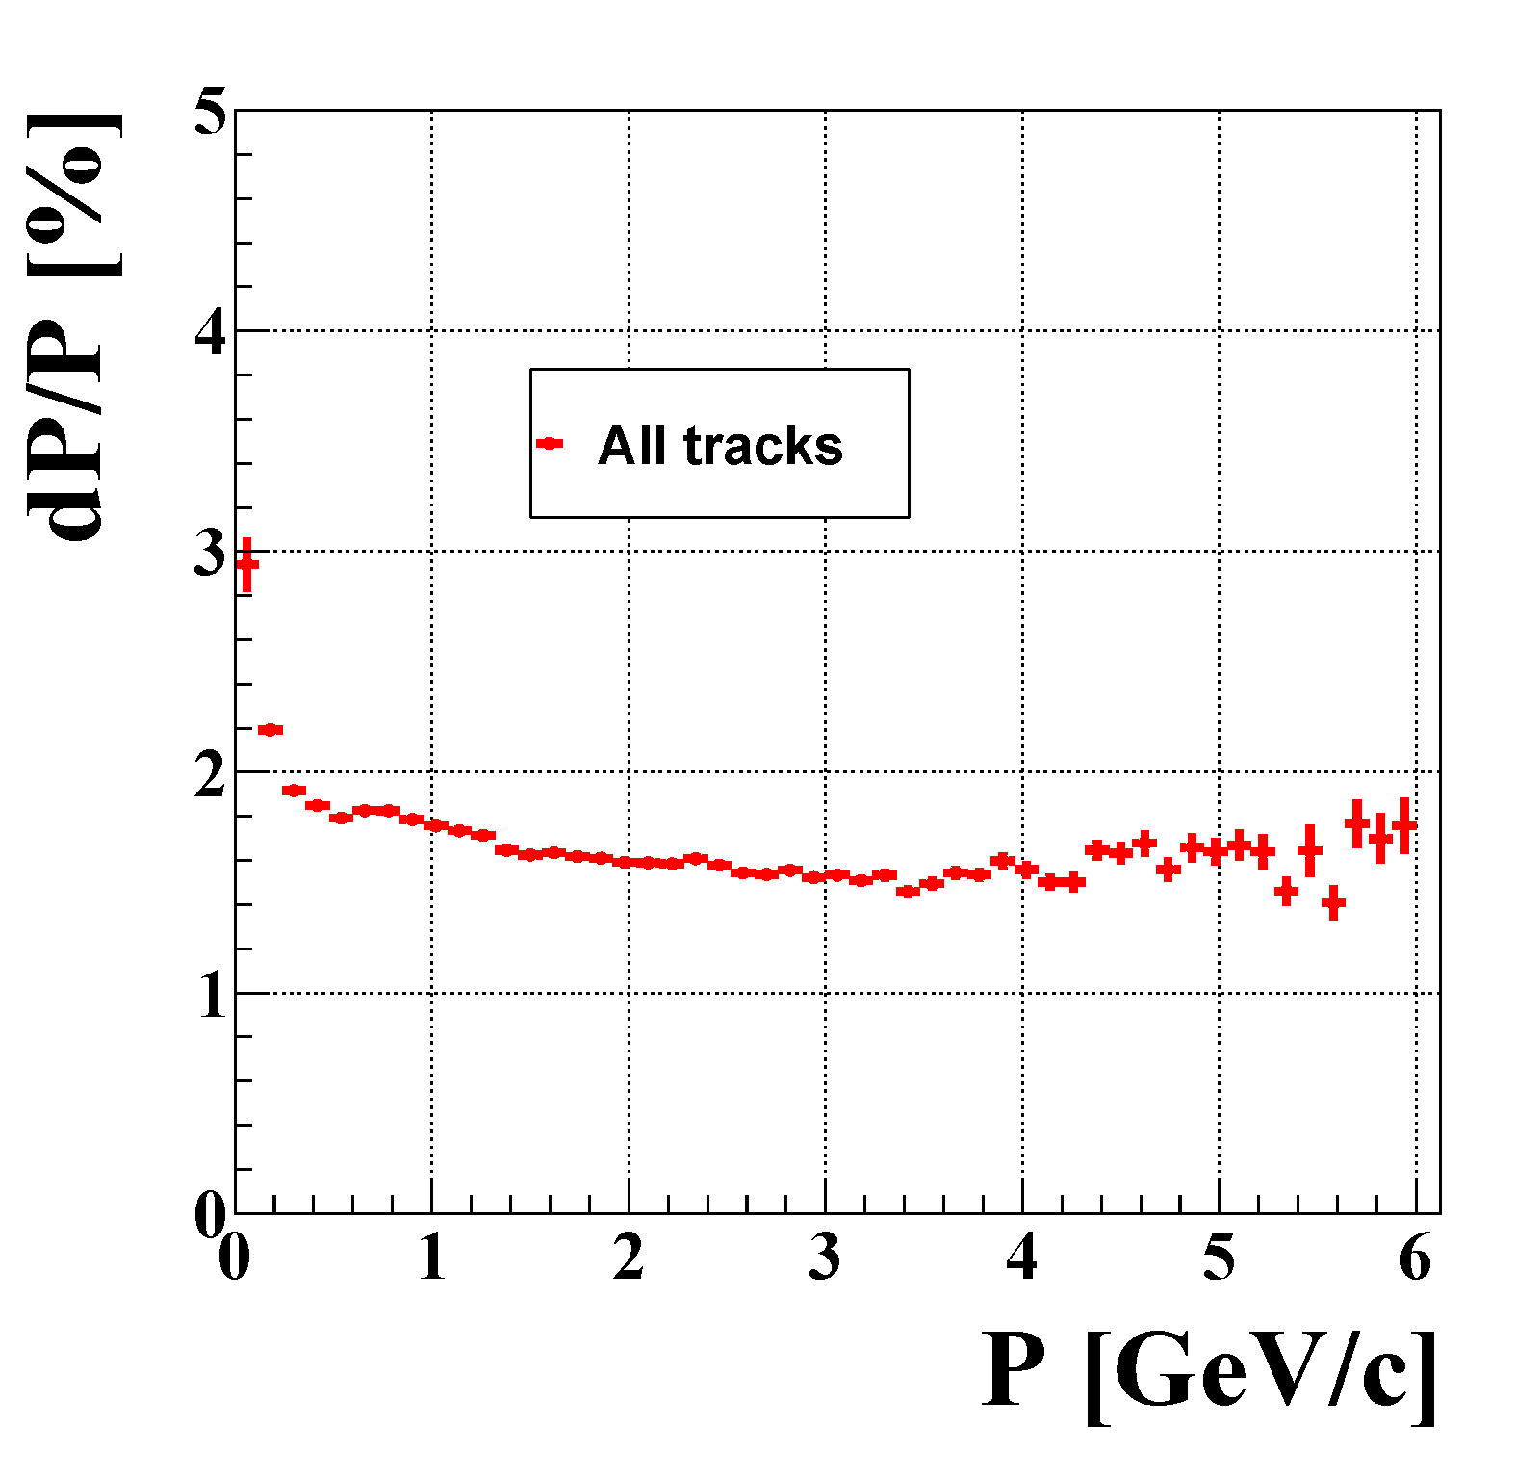
STS performance simulation
detailed, realistic detector model based on tested prototype components
CbmRoot simulation framework
using Cellular Automaton / Kalman Filter algorithms
track reconstruction efficiency
momentum resolution

Slide 21
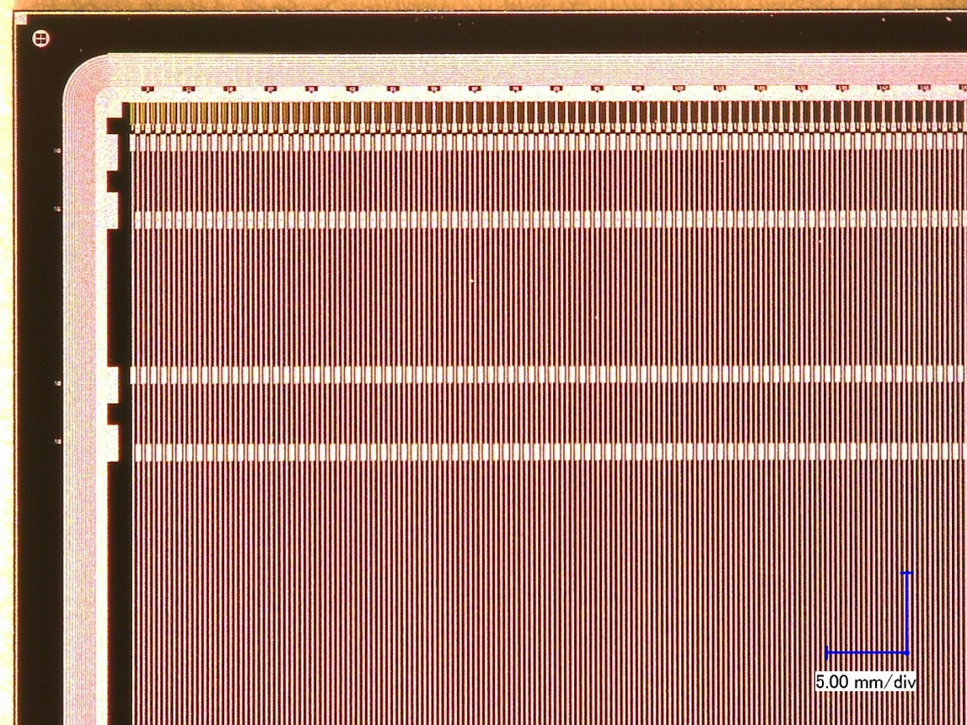
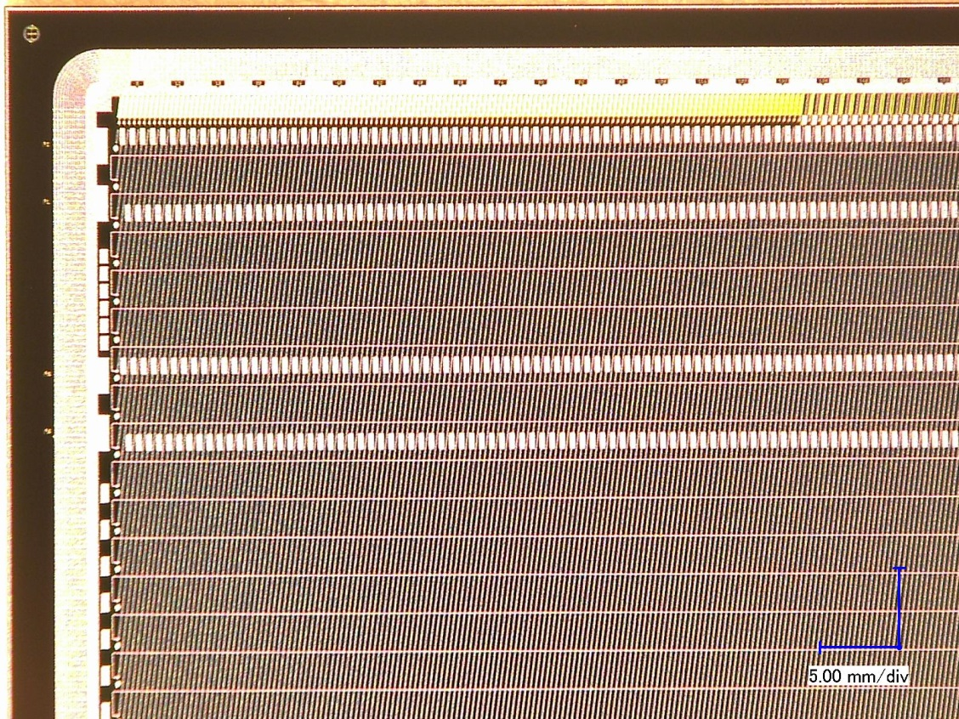

Silicon microstrip sensors
285/320 ± 15µm thick
n-type silicon
double-sided segmentation
1024 strips of 58 µm pitch
strip length 2/4/6/12 cm
angle front/back: 7.5/0 deg
n-side strip insulation:
modulated p-spray
read-out from top edge
double-metal routing on p-side
rad. tol. w.r.t. NIEL: max. 10¹⁴ n_{eq}/cm²
rad tol. w.r.t. TID: max. O(10) kGy
n-side
p-side
r/o electronics
0.5 mm/div

Slide 22
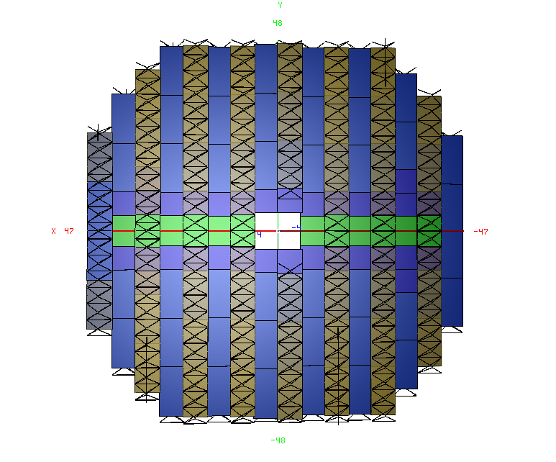
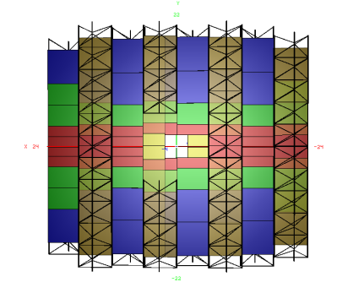
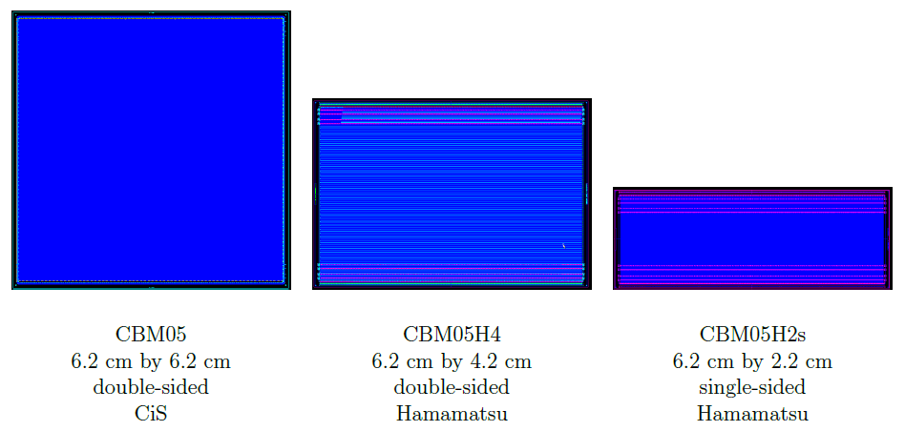
Microstrip sensor shapes
STS 8
900 modules altogether
STS 1
outer parts of large stations
geo v16a
standard sensors throughout the stations
strip length
fill gaps at beam hole
few sizes
6.2 cm × 2.2 cm
6.2 cm × 4.2 cm
6.2 cm × 6.2 cm
6.2 cm × 12.4 cm
20 x
60 x
260 x
252 x
324 x

Slide 23
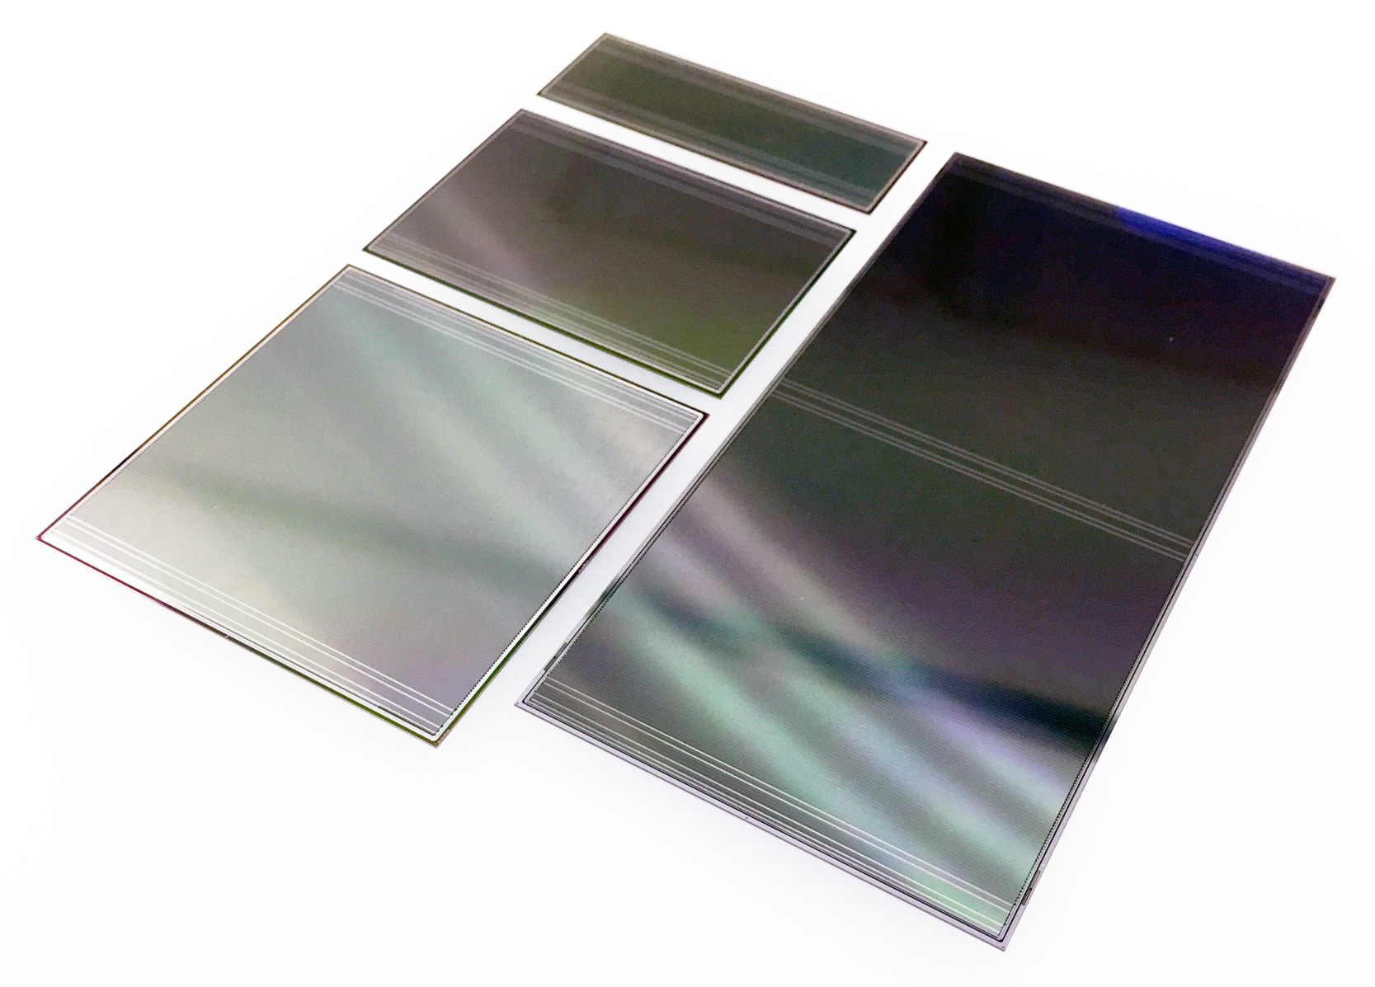
Prototype microstrip sensors
prototypes from CiS, Germany
and Hamamatsu, Japan

Slide 24
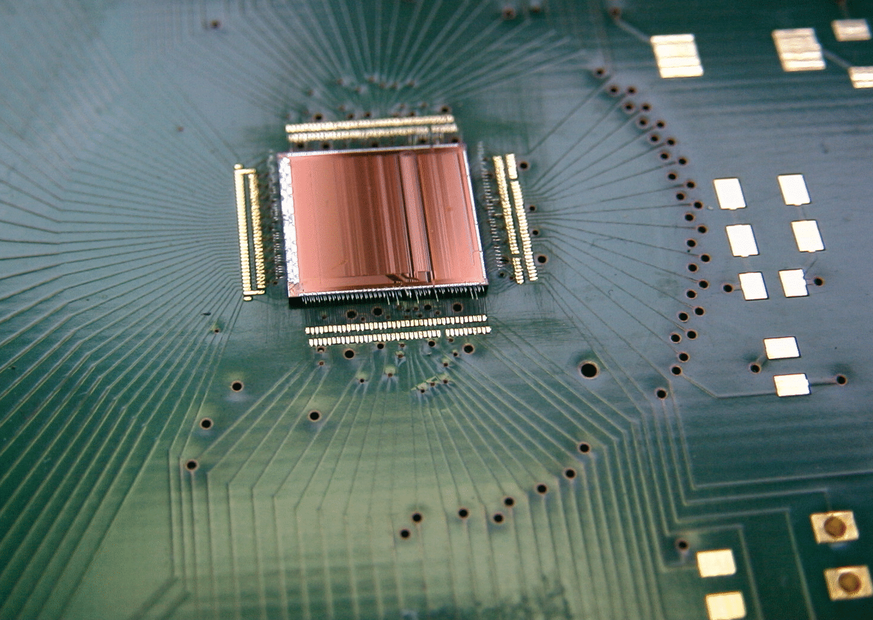
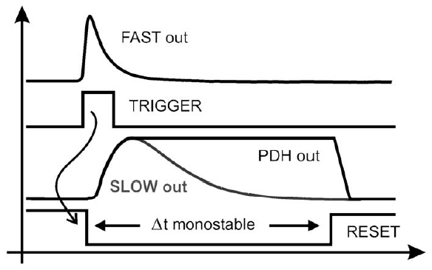
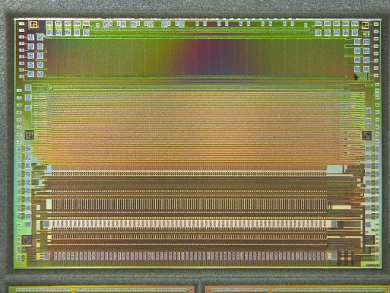
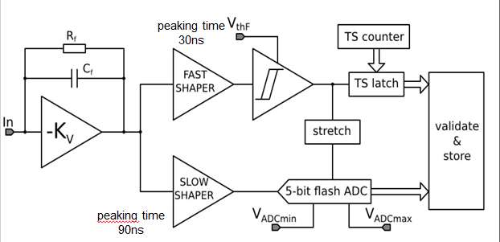

Front-end electronics
30 ns rise time
self-triggering:
channels deliver stream of ADC values above threshold + timestamp
128 channels
n-XYTER chip
- from a neutron imaging project
- used for current prototyping (v1, v2.0)
NIM A 568 (2006) 301–308
170 ns rise time
128 channels
30 ns
per channel:
two-stage internal trigger
adapted to high capacitive load
back-end GBT compatible
STS-XYTER chip
- dedicated development for STS, now v2.0
90 ns

Slide 25

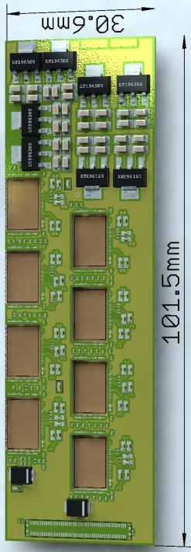
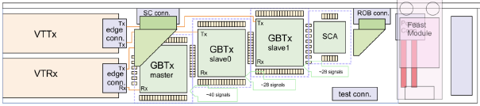
Read-out chain
STS-XYTER
ASIC
8 ×
Front-end Board
Read-Out Board
Power Boards
copper link
optical link
FLES farm
online event computing
Data Processing Board
time-slicing
sensor: 1024 channels
STS-XYTER ASIC | v1.0 (2013), v2.0 (2016)
CMOS process | UMC 180 nm
channels | 128, polarity +/-
noise | < 1ke⁻ at 20-50pF load
ADC range | linear up to12 fC, 5 bit
clock | 250 MHz
power | < 10 mW/channel
timestamp | < 10 ns resolution
out interface | 5 × 500 Mbit/s LVDS
data combining
STS-XYTER chips
à 1/2/5 LVDS links out
time-stamped data
under development
  GBTx chip-set (CERN):
  3 GBTx, 1 VTRx, 1 VTTx, 1 SCA
  42 E-links à 320 Mb/s
  3 GBT optical uplinks à 4.48 Gb/s
  under development /production

Slide 26
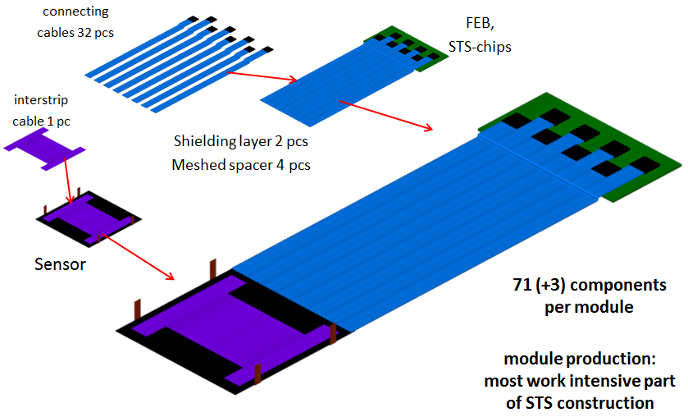
Module assembly
2 x 16 read-out cables
Integration of:
silicon sensors,
front-end electronics,
read-out cables
→ functional building block of the STS.
Front-end Board
1 inter-strip cable
2 shielding layers
4 spacer layers
more than 70 components/module
non-reworkable assembly
high-yield components essential
→ most work-intensive and critical
part of STS construction effort:
896 modules required
sensor
mounting legs

Slide 27
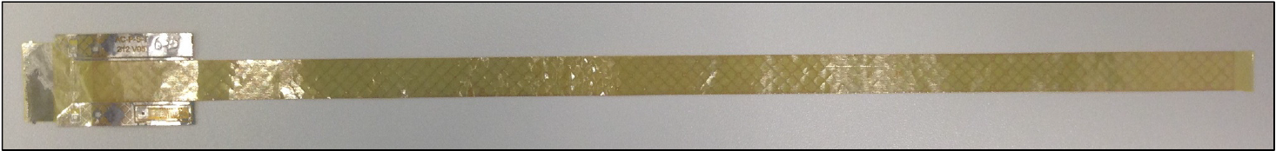
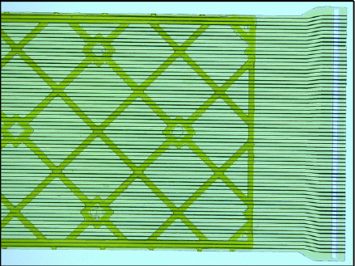
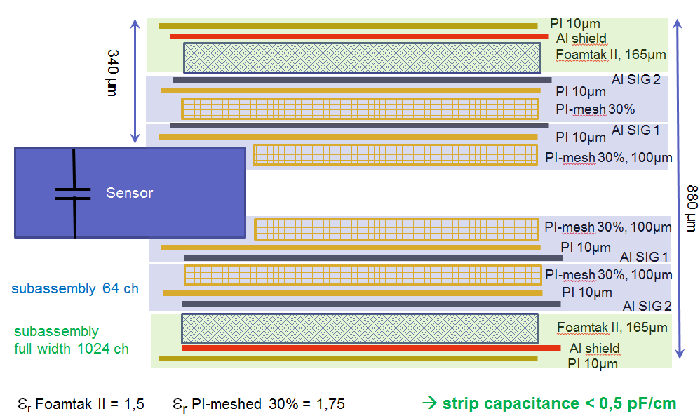
Read-out cables
Aluminum-Polyimide technology (LTU Ltd, Kharkov, Ukraine)
signal layer: 64 Al lines of 116 µm pitch, 14 µm thick, on 10 µm polyimide, lengths up to 55 cm

Slide 28
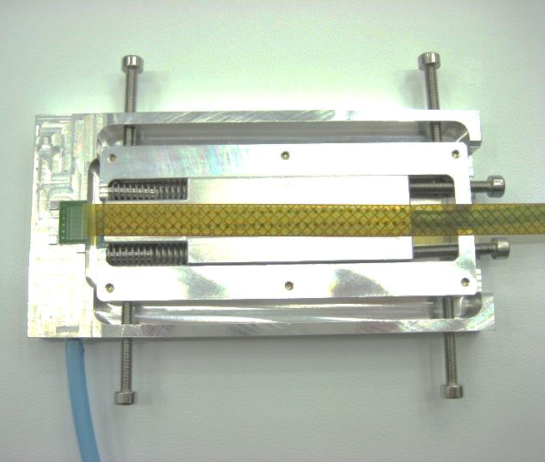
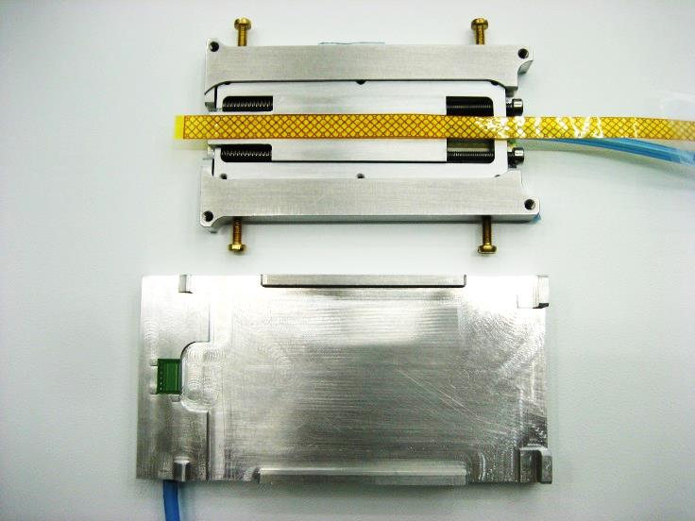
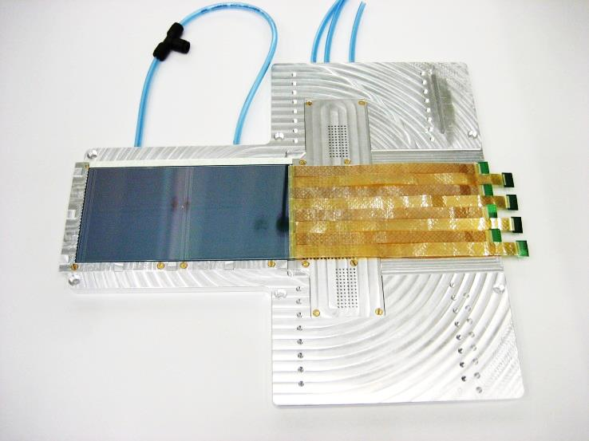
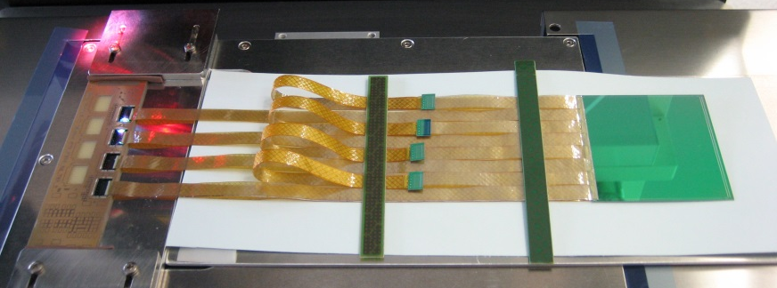
Module assembly
GSI-Detector Lab

Slide 29
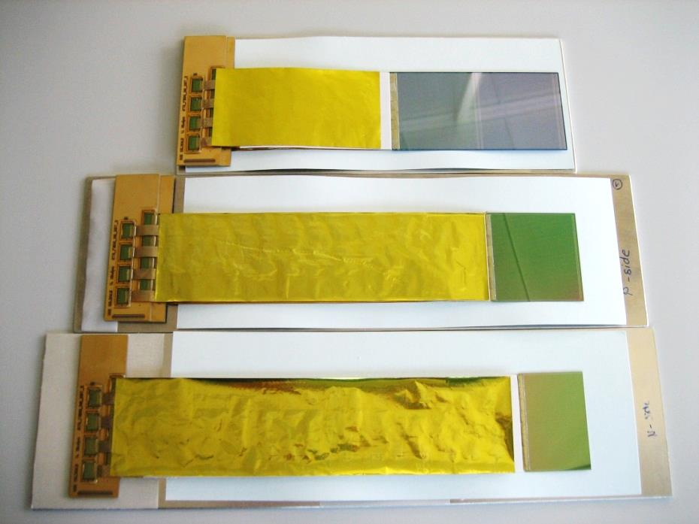
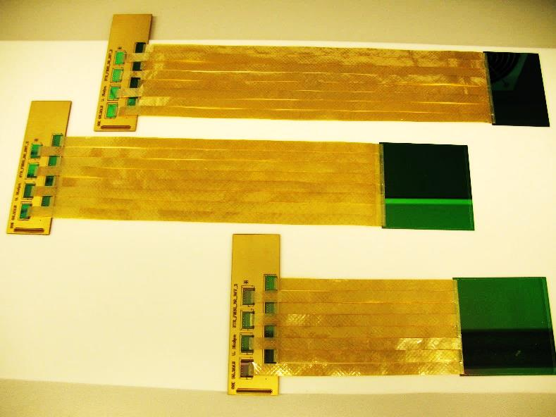
Module assembly
Assembly procedure established at both production centers:
GSI
JINR
dummy sensors, dummy FEBs

Slide 30



Ladder assembly
prototype carbon-fiber ladders , JINR team/CERN
ladder assembly tooling, under development at GSI
pre-series carbon-fiber ladders made in industry, GSI
mock-up ladder, JINR-LTU
30

Slide 31


System Integration
mechanical construction ladders, units, main-frame
component installation
cabling and powering
thermal insulation, cooling

Slide 32

CBM-STS Project Timeline
Technical Design Report approved in 2013
Production Readiness of components in 2017
→ here: silicon microstrip sensors
Production of components 2017 - 2020
STS system assembly in 2019 – 2020
STS commissioning in lab in 2021
Installation in CBM cave in 2022/2023
http://repository.gsi.de/record/54798

Slide 33
Core teams of the CBM-STS project
Germany
Darmstadt, Germany, GSI Helmholtz Center (GSI)
Karlsruhe, Germany, Karlsruhe Institute of Technology (KIT)
Tübingen, Germany, Eberhard Karls University (EKU)
Poland
Krakow, Poland, AGH University of Science and Technology (AGH)
Krakow, Poland, Jagiellonian University (JU)
Warsaw, Poland, Warsaw University of Technology (WUT)
Russia
Dubna, Russia, Joint Institute for Nuclear Research (JINR)
Ukraine
Kharkov, Ukraine, LED Technologies of Ukraine Ltd (LTU) ^{* Partner}
Kiev, Ukraine, Kiev Institute for Nuclear Research (KINR)

Slide 34

The CBM Collaboration: 60 institutions, 530 members
Croatia:
Split Univ.
China:
CCNU Wuhan
Tsinghua Univ.
USTC Hefei
CTGU Yichang
Czech Republic:
CAS, Rez
Techn. Univ.Prague
France:
IPHC Strasbourg
Hungary:
KFKI Budapest
Budapest Univ.
Germany:
Darmstadt TU
FAIR
Frankfurt Univ. IKF
Frankfurt Univ. FIAS
Frankfurt Univ. ICS
GSI Darmstadt
Giessen Univ.
Heidelberg Univ. P.I.
Heidelberg Univ. ZITI
HZ Dresden-Rossendorf
KIT Karlsruhe
Münster Univ.
Tübingen Univ.
Wuppertal Univ.
ZIB Berlin
India:
Aligarh Muslim Univ.
Bose Inst. Kolkata
Panjab Univ.
Rajasthan Univ.
Univ. of Jammu
Univ. of Kashmir
Univ. of Calcutta
B.H. Univ. Varanasi
VECC Kolkata
IOP Bhubaneswar
IIT Kharagpur
IIT Indore
Gauhati Univ.
Korea:
Pusan Nat. Univ.
Romania:
NIPNE Bucharest
Univ. Bucharest
Poland:
AGH Krakow
Jag. Univ. Krakow
Silesia Univ. Katowice
Warsaw Univ.
Warsaw TU
Russia:
IHEP Protvino
INR Troitzk
ITEP Moscow
Kurchatov Inst., Moscow
LHEP, JINR Dubna
LIT, JINR Dubna
MEPHI Moscow
Obninsk Univ.
PNPI Gatchina
SINP MSU, Moscow
St. Petersburg P. Univ.
Ioffe Phys.-Tech. Inst. St. Pb.
Ukraine:
T. Shevchenko Univ. Kiev
Kiev Inst. Nucl. Research
  http://www.fair-center.eu/for-users/
  experiments/cbm.html
  “Challenges in QCD matter physics –
  The scientific programme of the Compressed Baryonic Matter experiment at FAIR”
    arXiv:1607.01487 [nucl-ex]
    https://arxiv.org/abs/1607.01487
    v2, 24 November 2016

Slide 35
Backup slides

Slide 36
STS design constraints
Coverage:
  from center-of mass
  to close to beam rapitidies
  aperture 2.5° < Θ < 25°
Momentum resolution
  δp/p ≅ 1%
  field integral 1 Tm, 8 tracking stations
  25 µm single-hit spatial resolution
  material budget per station
  0.3 – max. ~1% X₀
  No event pile-up
  interaction rates 0.1 - 10 MHz
  self-triggering read-out
  timestamp resolution < 5 ns
  signal shaping time < 20 ns
Efficient hit & track reconstruction
  close to 100% hit efficiency
  > 95% track eff. for p > 1GeV/c
Minimum granularity
  at hit rates < 20 MHz/cm²:
  maximum strip length compatible with
  hit occupancy and S/N performance
  largest read-out pitch compatible with the required spatial resolution
Radiation hard sensors
  compatible with CBM physics program:
  1 × 10¹³ n_{eq}/cm² (SIS100)
  1 × 10¹⁴ n_{eq}/cm² (SIS300)
Integration, operation, maintenance
  compatible with the confined space
  in the dipole magnet
  efficient cooling for electronics
  cooling of sensors
  system design including target chamber, MVD, beam pipe
  extraction possible for maintenance
36

Slide 37






Module test stand
Functional test module,
128 channels front and back
to be set up with new acquisition chain
questions to be addressed:
  S/N as function of micro cable length
  ...
AFCK-DPB
4x FLIB
2x mFLES node

Slide 38
Contributions to STS construction
GSI, Darmstadt:
sensor procurement
read-out chain
LV and HV powering
detector controls
procurement of micro-cables
production of carbon-fiber ladder supports
assembly of 500 modules and 50 ladders for STS stations 5-8
mechanical integration
system assembly
JINR VB-LHEP, Dubna:
sensor procurement
assembly of 400 modules and 46 ladders for STS stations 1-4
AGH, Crakow :
production of
STS-XYTER ASICs
production of front-end electronics boards
JU, Crakow :
STS-XYTER ASIC QA
Tech. Univ. Warsaw:
ASIC data protocol
Univ. Tübingen:
sensor QA
module QA
cooling systems
all STS teams :
commissioning
KIT (GSI contract):
module assembly
38

Slide 39

CBM-STS assembly flow

Slide 40



Assembly center at GSI – QA site Tübingen
modules, ladders, system
sensor
QA
electrical
GSI Detector Laboratory
sensor
QA
optical
clean rooms, Solid State Section
realized in GSI + JINR cooperation with BMBF-JINR funding (2015)

Slide 41





Assembly site at KIT-Karlsruhe
Institute for Data Processing and Electronics
https://www.ipe.kit.edu/english/index.php
modules

Slide 42

Assembly site at JINR VB-LHEP
modules, ladders

Slide 43




Baryon densities in central Au+Au collisions
I.C. Arsene et al., Phys. Rev. C 75, 24902 (2007)
5 A GeV
10 A GeV
phase
coexistence
8 ρ₀
5 ρ₀

Slide 44

arXiv:1111.5475v2 [hep-ph] 13 Mar 2012

