Slide 1
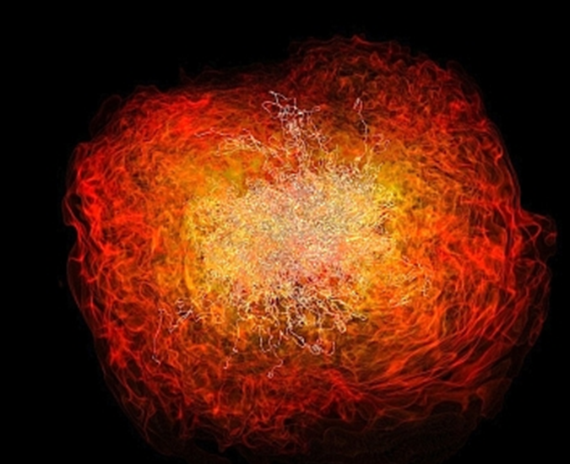
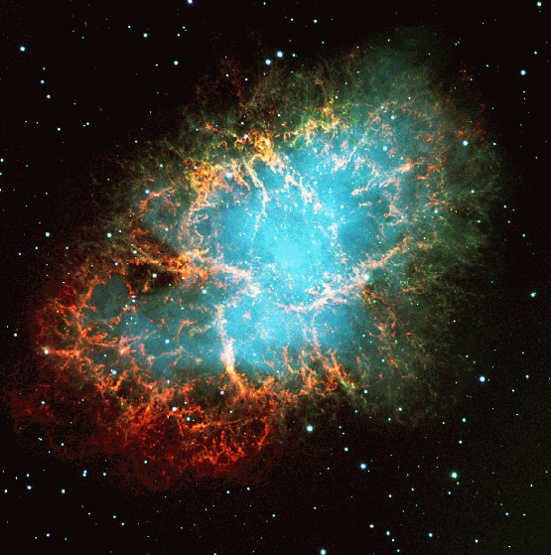
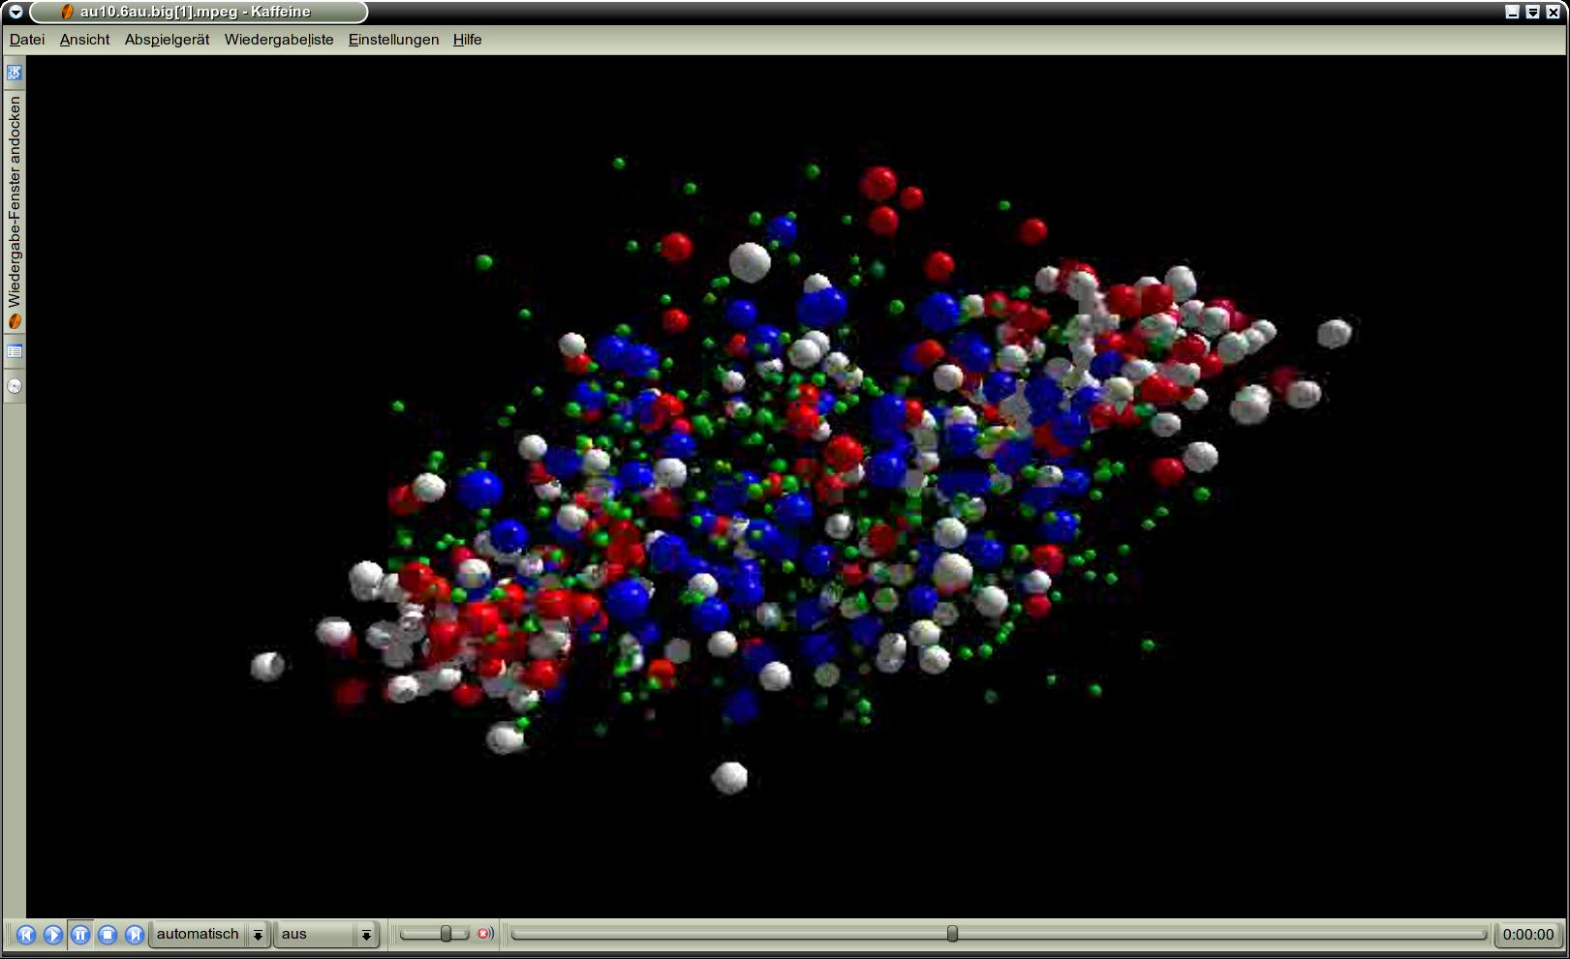
QCD matter physics at FAIR
Peter Senger GSI and Univ. Frankfurt
Outline:
➢ The Facility of Antiproton and Ion Research
➢ The CBM physics case: QCD matter at large µ_{B}
The Compressed Baryonic Matter experiment
CBM Phase 0
1
Quark Matter 2017, Chicago, 5-11 February 2017

Slide 2











Facility for Antiproton & Ion Research
SIS100/300
p-Linac
SIS18
Compressed Baryonic Matter
Primary Beams
10¹²/s; 1.5 GeV/u; ²³⁸U²⁸⁺
10¹⁰/s ²³⁸U⁹²⁺ up to 11 (35) GeV/u
3x10¹³/s 30 (90) GeV protons
Anti-Proton Physics
HESR
Super Fragment-Separator:
Nuclear Structure and Astrophysics
Secondary Beams
radioactive beams up to
1.5 - 2 GeV/u;
10¹¹ antiprotons 1.5 - 15 GeV/c
Technical Challenges
FAIR phase 1
FAIR phase 2
CR
rapid cycling superconducting magnets
dynamical vacuum
2
100 m

Slide 3
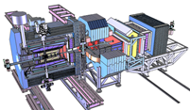
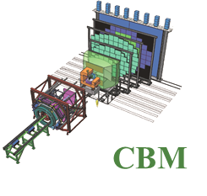
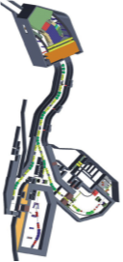
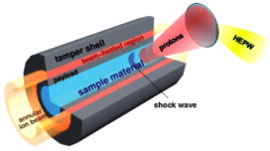
Facility for Antiproton & Ion Research
Experimental programs:
APPA: Atomic & Plasma Physics & Applications
➢ Highly charged atoms
➢ Plasma physics
➢ Radiobiology
➢ Material science
SIS18
SIS100/300
p-Linac
Compressed Baryonic Matter
HESR
CBM: Nucleus-nucleus collisions
➢ Nuclear matter at neutron
star core densities
➢ Phase transitions from
hadrons to quarks
Anti-Proton Physics
Super Fragment-Separator:
Nuclear Structure and Astrophysics
NUSTAR: Rare Isotope beams
➢ Nuclear structure far off stability
➢ Nucleosynthesis in stars and supernovae
CR
PANDA: Antiproton-proton collisions:
➢ Charmed hadrons (XYZ)
➢ Gluonic matter and hybrids
➢ Hadron structure
➢ Double Lambda hypernuclei
FAIR phase 1
FAIR phase 2
100 m
3

Slide 4
Status of FAIR
On Sept. 13, 2016 BMBF gave green light and 203 M€ to start civil construction.
1st call for tender Sept. 26, 2016: water management and excavation
2nd call for tender Nov. 22, 2016:
shell construction ‘north area’, includes SIS100 and CBM cave
Start of construction mid of 2017
Installation incl. commissioning of
the experiments is planned during 2021-2024
Full completion of FAIR by 2025
4

Slide 5
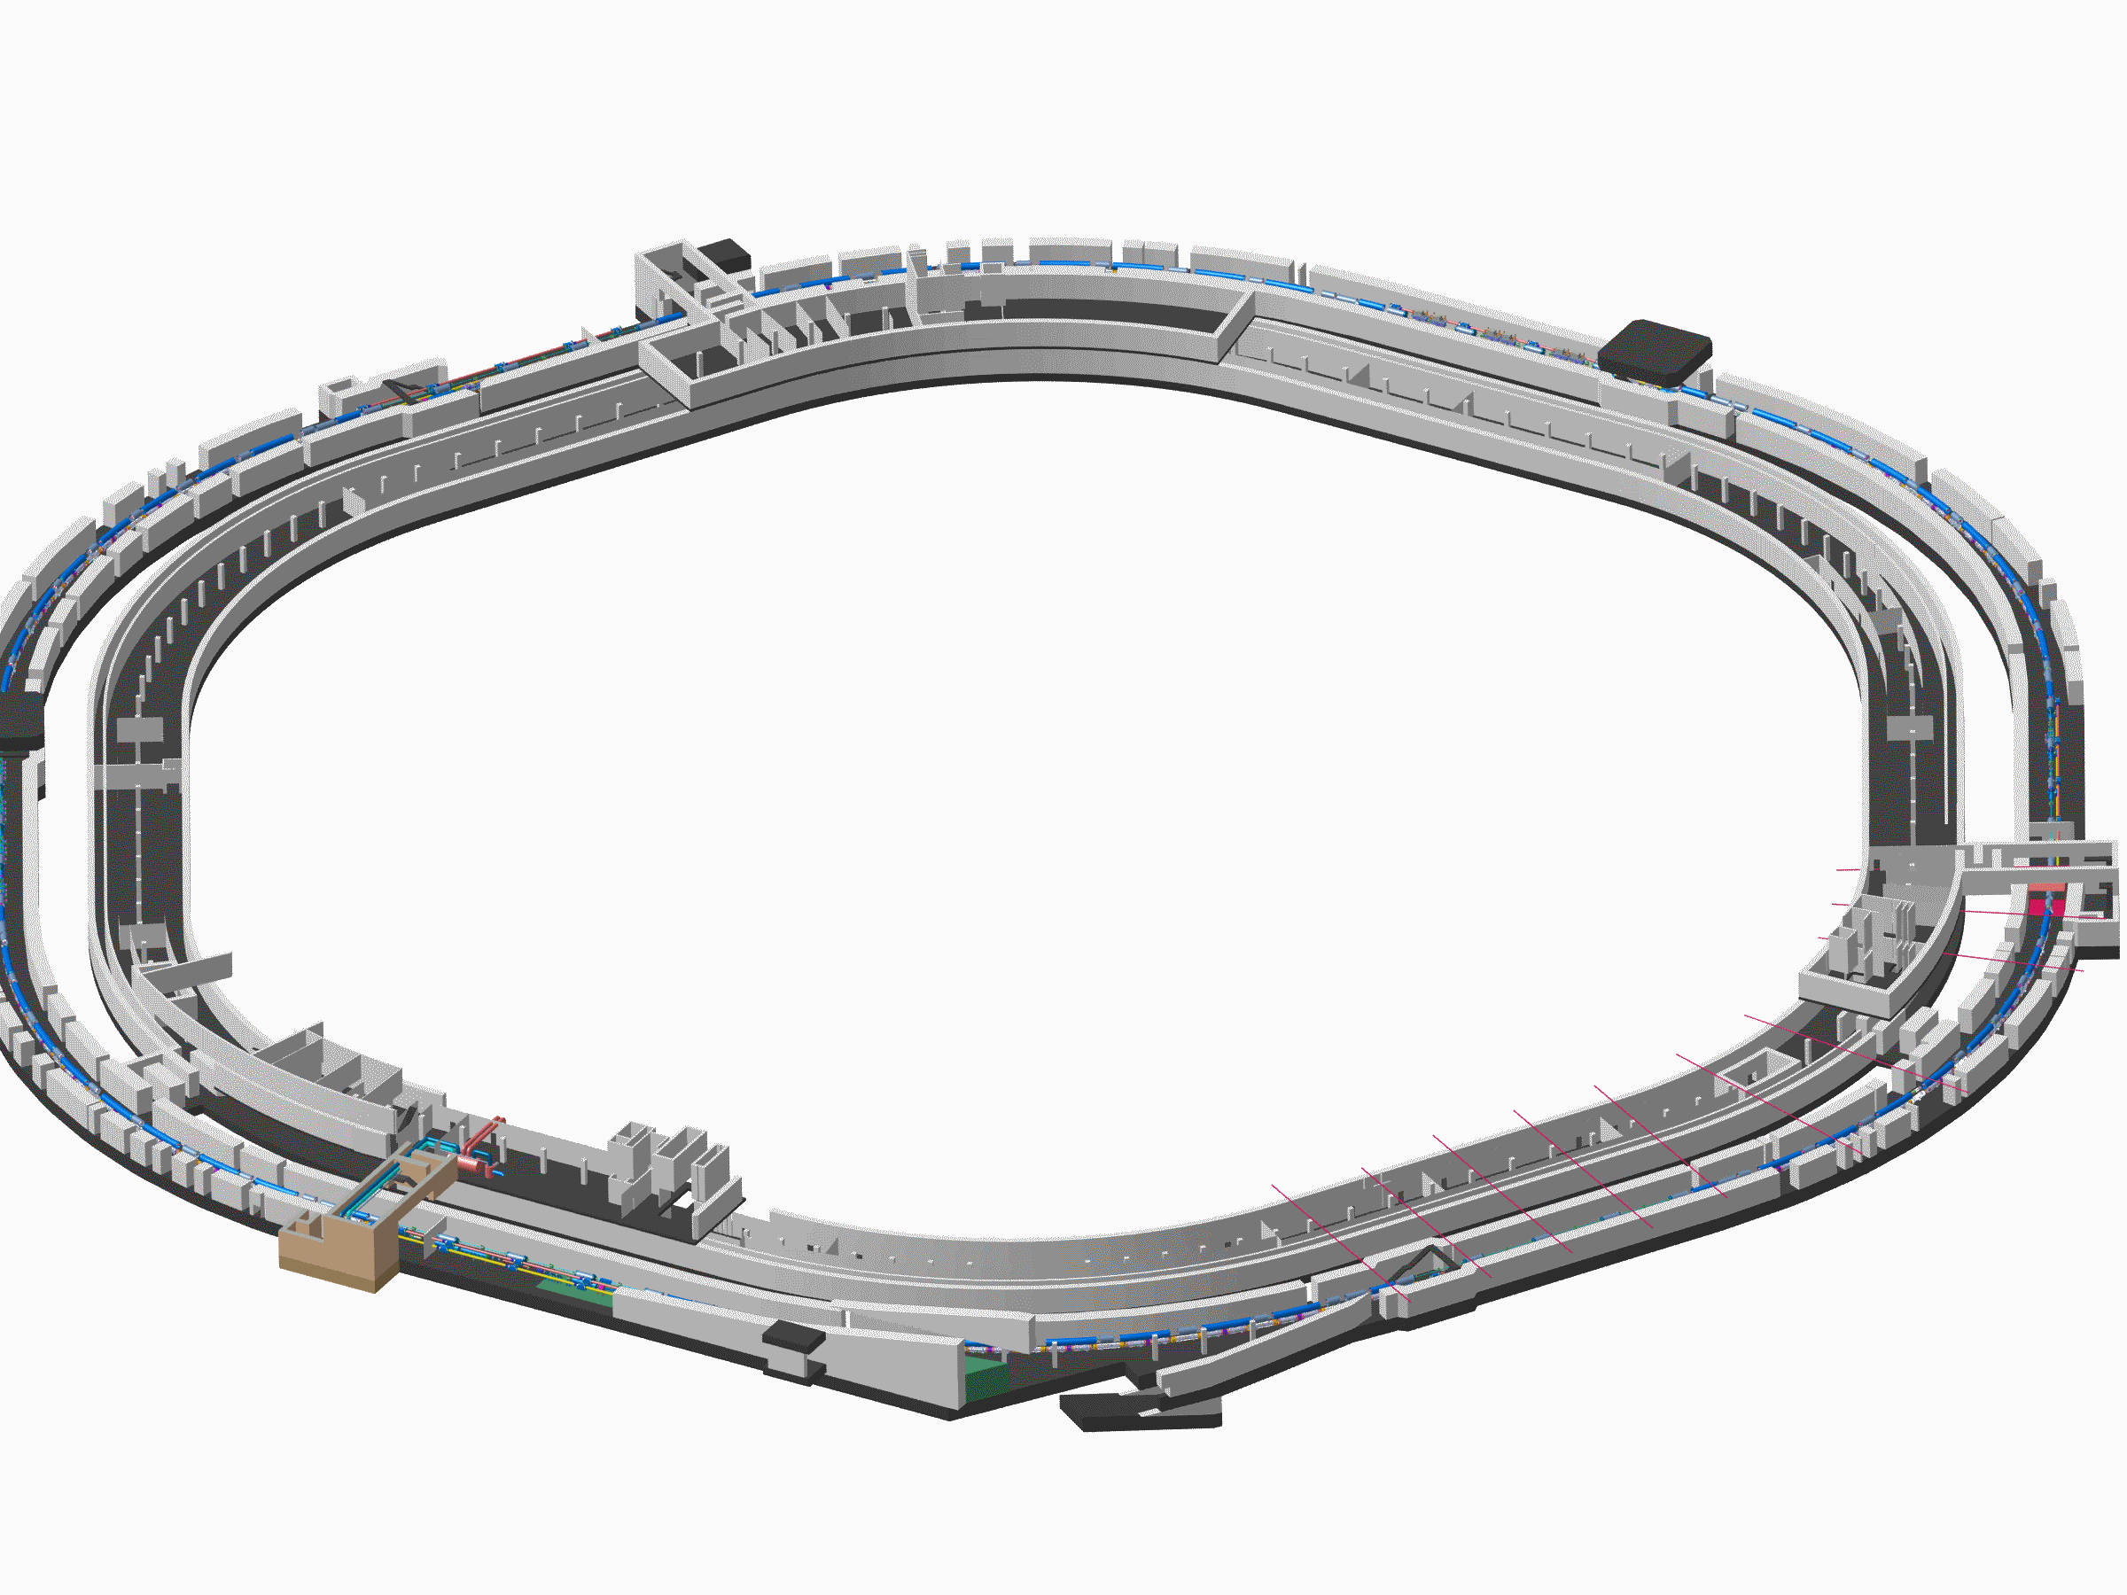
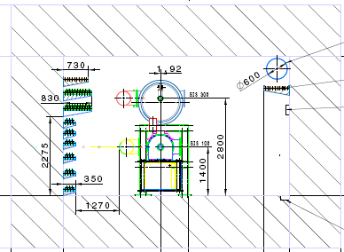
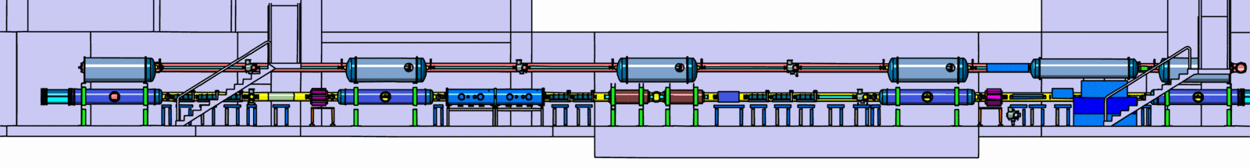
Tunnel for SIS100/300
5

Slide 6
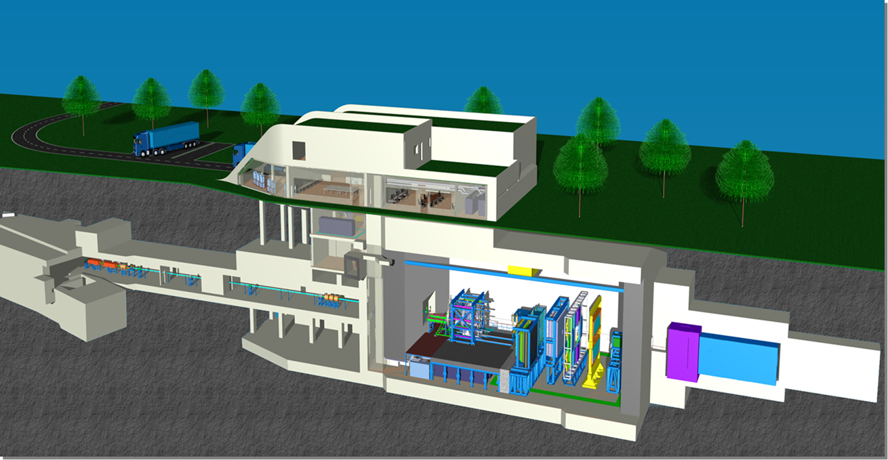
The Compressed Baryonic Matter (CBM)
experiment
6

Slide 7
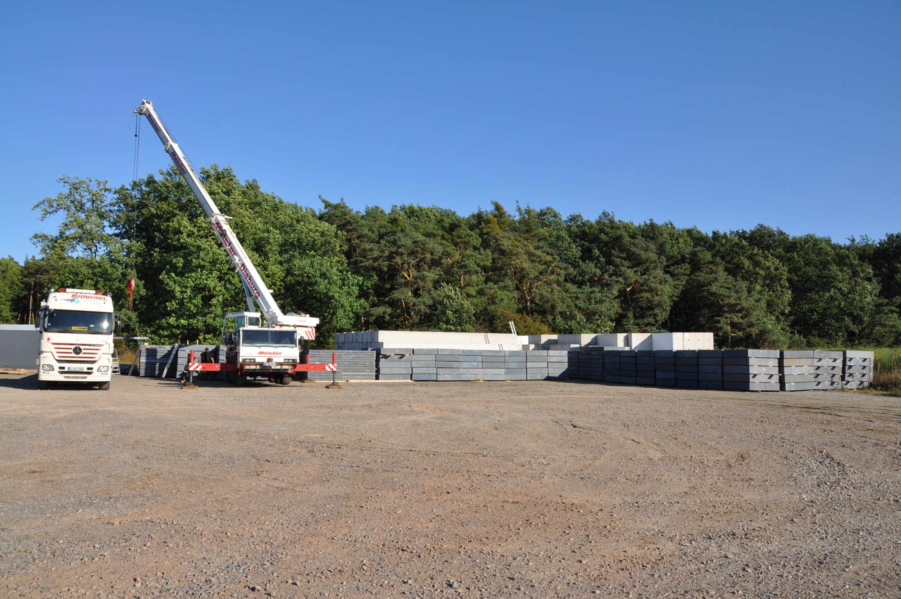
4000 tons of steel plates
transported from KIT to FAIR
for the CBM beam dump
7

Slide 8
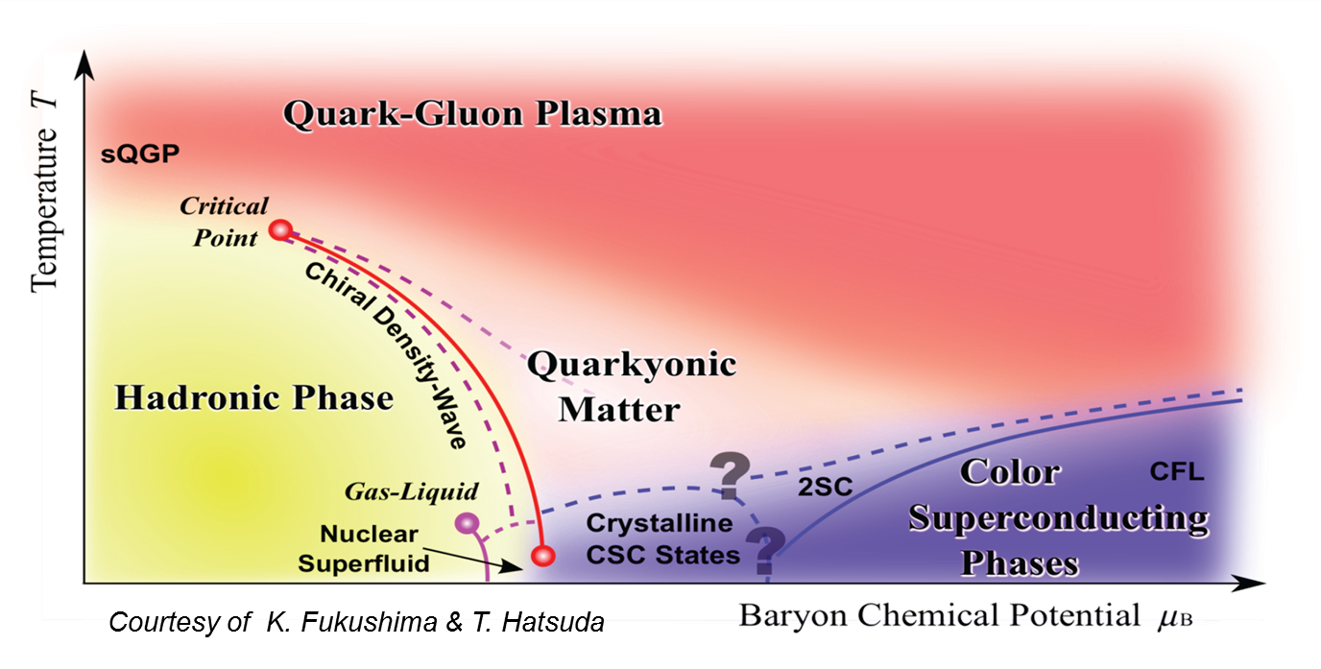
Exploring the QCD phase diagram
∼ 2 ρ₀
∼ 5 ρ₀
courtesy Toru Kojo (CCNU)

Slide 9


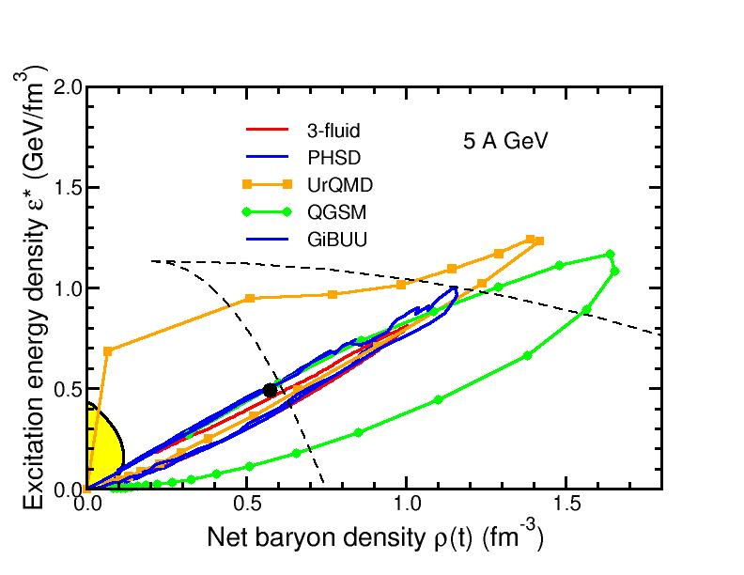
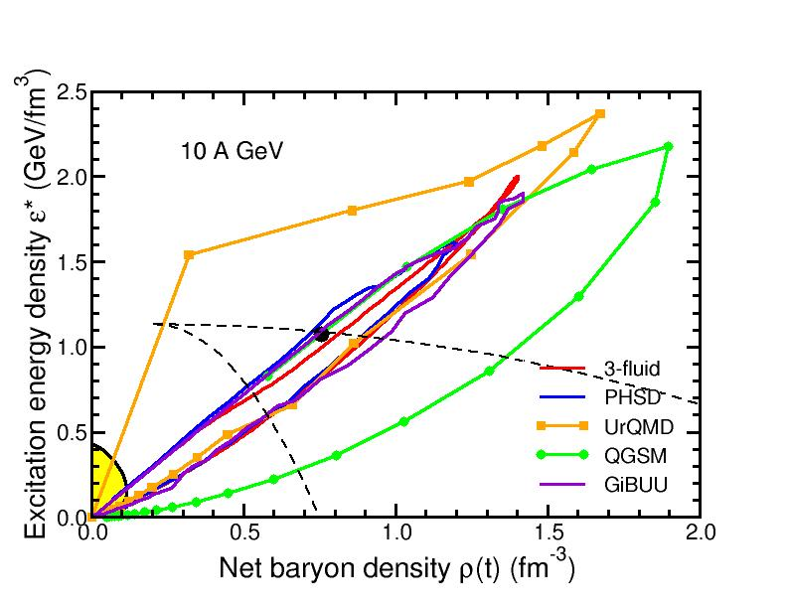
Baryon densities in central Au+Au collisions
I.C. Arsene et al., Phys. Rev. C 75, 24902 (2007)
5 A GeV
10 A GeV
8 ρ₀
5 ρ₀
phase
coexistence
phase
coexistence
9

Slide 10
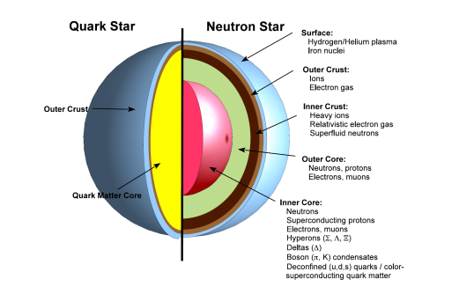
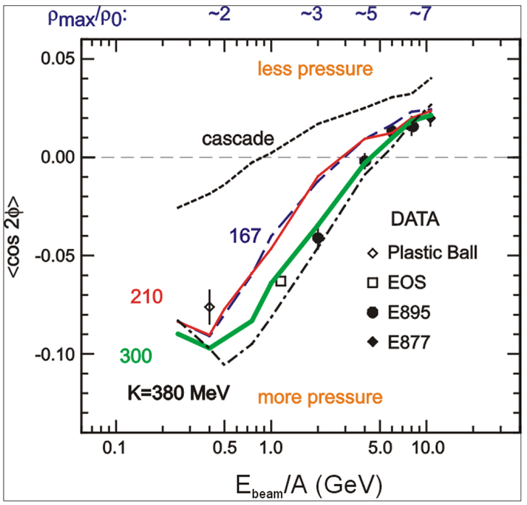
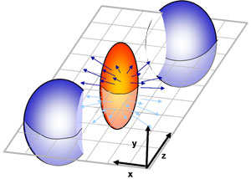
CBM physics case and observables
The QCD matter equation-of-state at neutron star core densities
➢ collective flow of identified particles (π,K,p,Λ,Ξ,Ω,...)
driven by the pressure gradient in the early fireball
AGS: proton flow in Au+Au collisions
Azimuthal angle distribution:
dN/dφ = C (1 + v₁ cos(φ) + v₂ cos(2φ) + ...)
P. Danielewicz, R. Lacey, W.G. Lynch, Science 298 (2002) 1592
10

Slide 11
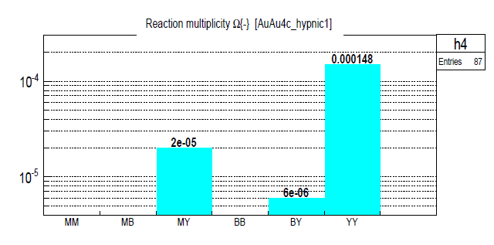
CBM physics case and observables
The QCD matter equation-of-state at neutron star core densities
➢ collective flow of identified particles (π,K,p,Λ,Ξ,Ω,...)
driven by the pressure gradient in the early fireball
➢ particle production at (sub)threshold energies via
multi-step processes (multi-strange hyperons, charm)
Direct multi-strange hyperon production:
pp → Ξ⁻ K⁺K⁺p (E_{thr} = 3.7 GeV)
pp → Ω⁻ K⁺K⁺K⁰p (E_{thr} = 7.0 GeV)
pp → Λ⁰Λ⁰ pp (E_{thr} = 7.1 GeV)
pp → Ξ⁺ Ξ⁻ pp (E_{thr} = 9.0 GeV)
pp → Ω⁺ Ω⁻ pp (E_{thr} = 12.7 GeV
Ω⁻ production in 4 A GeV Au+Au
Hyperon production via multiple collisions
pp → K⁺Λ⁰p, pp → K⁺K⁻pp,
pΛ⁰→ K⁺ Ξ⁻ p, πΛ⁰→ K⁺ Ξ⁻ π,
Λ⁰Λ⁰→ Ξ⁻ p, Λ⁰K⁻ → Ξ⁻ π⁰
3 . Λ⁰ Ξ⁻ → Ω⁻ n, Ξ⁻K⁻ → Ω⁻ π⁻
Antihyperons
1. Λ⁰ K⁺ → Ξ⁺π⁰ ,
2. Ξ⁺ K⁺ → Ω⁺ π⁺.
HYPQGSM calculations , K. Gudima et al.
11

Slide 12
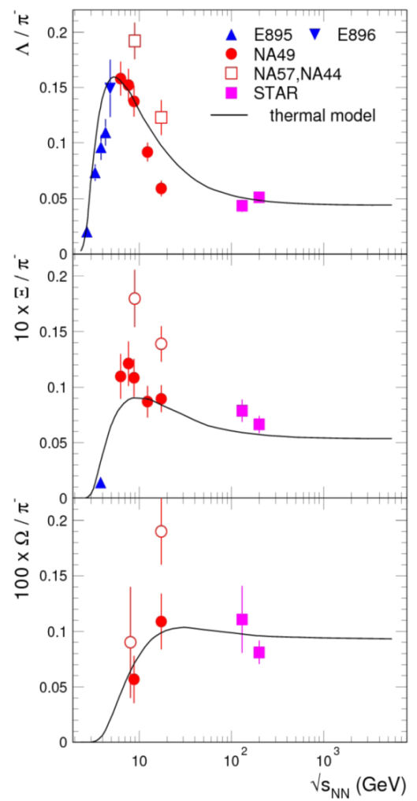
CBM physics case and observables
The QCD matter equation-of-state at neutron star core densities
➢ collective flow of identified particles (π,K,p,Λ,Ξ,Ω,...)
driven by the pressure gradient in the early fireball
➢ particle production at (sub)threshold energies via
multi-step processes (multi-strange hyperons, charm)
Direct multi-strange hyperon production:
pp → Ξ⁻ K⁺K⁺p (E_{thr} = 3.7 GeV)
pp → Ω⁻ K⁺K⁺K⁰p (E_{thr} = 7.0 GeV)
pp → Λ⁰Λ⁰ pp (E_{thr} = 7.1 GeV)
pp → Ξ⁺ Ξ⁻ pp (E_{thr} = 9.0 GeV)
pp → Ω⁺ Ω⁻ pp (E_{thr} = 12.7 GeV
Hyperon production via multiple collisions
pp → K⁺Λ⁰p, pp → K⁺K⁻pp,
pΛ⁰→ K⁺ Ξ⁻ p, πΛ⁰→ K⁺ Ξ⁻ π,
Λ⁰Λ⁰→ Ξ⁻ p, Λ⁰K⁻ → Ξ⁻ π⁰
3 . Λ⁰ Ξ⁻ → Ω⁻ n, Ξ⁻K⁻ → Ω⁻ π⁻
Antihyperons
1. Λ⁰ K⁺ → Ξ⁺π⁰ ,
2. Ξ⁺ K⁺ → Ω⁺ π⁺.
12

Slide 13
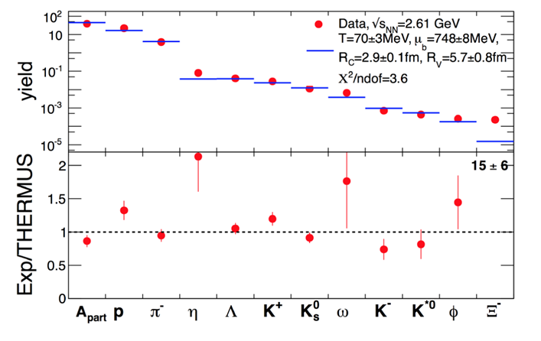
CBM physics case and observables
Phase transitions from partonic to hadronic matter
excitation function of strangeness: Ξ⁻(dss),Ξ⁺(dss),Ω⁻(sss),Ω⁺(sss)
→ chemical equilibration at the phase boundary
Particle yields and thermal model fits
A. Andronic et al., Jour. Phys. G38 (2011)
HADES: Ar + KCl 1.76 A GeV
G. Agakishiev et al., arXiv:1512.07070

Slide 14
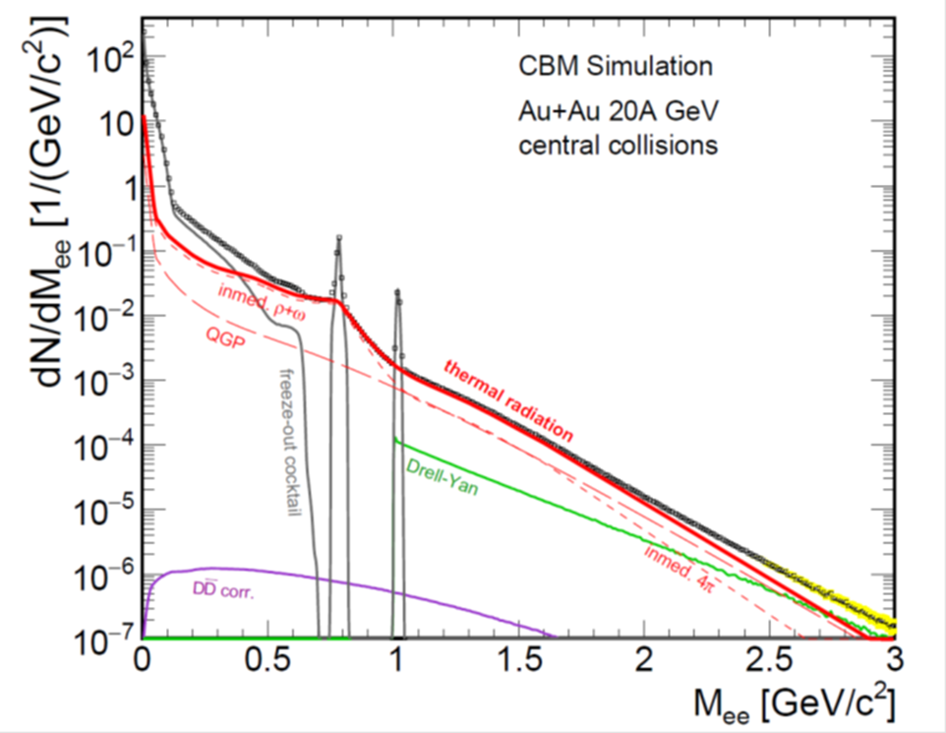
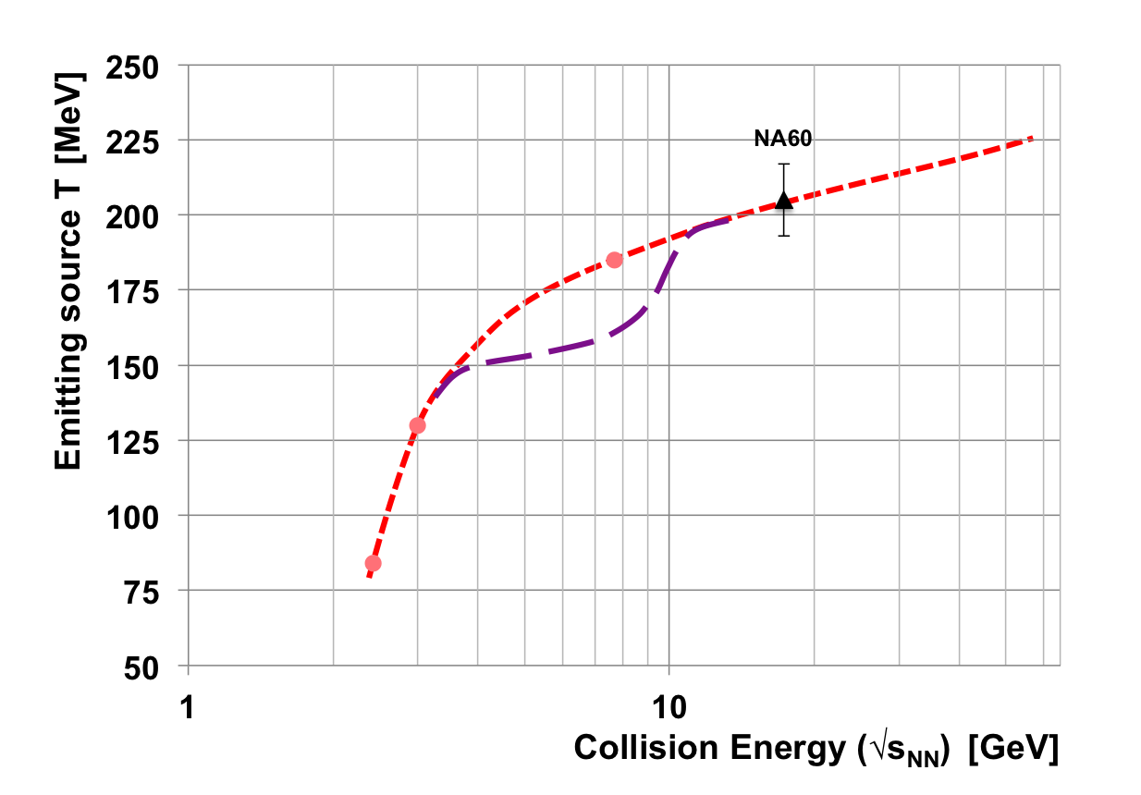
CBM physics case and observables
Phase transitions from partonic to hadronic matter
➢ excitation function of strangeness: Ξ⁻(dss),Ξ⁺(dss),Ω⁻(sss),Ω⁺(sss)
→ chemical equilibration at the phase boundary
Phase coexistence
excitation function (invariant mass) of lepton pairs:
thermal radiation from QGP, caloric curve
Invariant mass distribution of lepton pairs
Slope of dilepton invariant mass spectrum
1 GeV/c² < M_{inv} < 2.5 GeV/c²
The CBM Collaboration, arXiv:1607.01487

Slide 15
CBM physics case and observables
Phase transitions from partonic to hadronic matter
➢ excitation function of strangeness: Ξ⁻(dss),Ξ⁺(dss),Ω⁻(sss),Ω⁺(sss)
→ chemical equilibration at the phase boundary
Phase coexistence
excitation function (invariant mass) of lepton pairs:
thermal radiation from QGP, caloric curve
➢ anisotropic azimuthal angle distributions: “spinodal decomposition”
Spinodal decomposition of the mixed phase: net baryon number density fluctuations
C. Herold, M. Nahrgang, I. Mishustin, M.Bleicher
Nuclear Physics A 925 (2014) 14
Jan Steinheimer, Jorgen Randrup
Phys. Rev. C 87, 054903 (2013)
Eur. Phys. J. A (2016) 52: 239
15

Slide 16
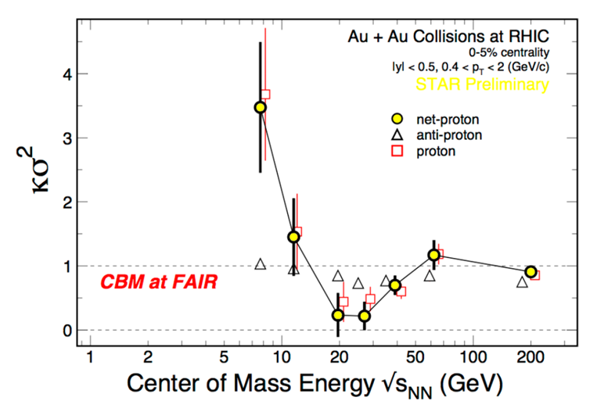
CBM physics case and observables
Phase transitions from partonic to hadronic matter
➢ excitation function of strangeness: Ξ⁻(dss),Ξ⁺(dss),Ω⁻(sss),Ω⁺(sss)
→ chemical equilibration at the phase boundary
Phase coexistence
excitation function (invariant mass) of lepton pairs:
thermal radiation from QGP, caloric curve
anisotropic azimuthal angle distributions: “spinodal decomposition”
Critical point
event-by-event fluctuations of conserved quantities (B,S,Q)
“critical opalescence”
4th moment of net-proton
multiplicity distribution:
critical fluctuations
STAR preliminary

Slide 17

CBM physics case and observables
Onset of chiral symmetry restoration at high ρ_{B}
➢ in-medium modifications of hadrons: ρ,ω,φ →e⁺e⁻(μ⁺μ⁻)
➢ dileptons at intermediate invariant masses: 4 π → ρ-a₁ chiral mixing
17

Slide 18

CBM physics case and observables
N-Λ, Λ-Λ interaction, strange matter?
➢ (double-) lambda hypernuclei
➢ meta-stable objects (e.g. strange dibaryons)
Double lambda hypernuclei production
in central Au+Au collisions at 10 A GeV:
 | Multiplicity | Yield in 1 week
⁵_{ΛΛ}H | 5 ⋅ 10⁻⁶ | 3000
⁶_{ΛΛ}He | 1 ⋅ 10⁻⁷ | 60
Assumption for yield calculation:
Reaction Rate 1 MHz
BR 10% (2 sequential weak decays)
Efficiency 1%
SIS100
A. Andronic et al., Phys. Lett. B697 (2011) 203
18

Slide 19
CBM physics case and observables
Charm production at threshold energies in cold and dense matter
➢ excitation function of charm production in p+A and A+A (J/ψ, D⁰, D±)
UrQMD calculation including subthreshold charm production via
N* → Λ_{c} + D and N* → N +J/ψ
19
J. Steinheimer, A. Botvina, M. Bleicher, Phys. Rev. C 95, 014911 (2017), arXiv:1605.03439v1

Slide 20
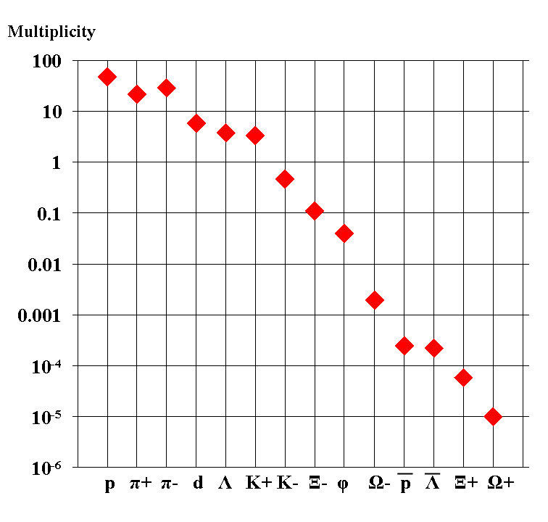
Experimental challenges
Particle yields in central Au+Au 4 A GeV
Statistical model, A. Andronic, priv. com.
AGS
extremely high
interaction rates
required !
e⁺e⁻
μ⁺μ⁻

Slide 21
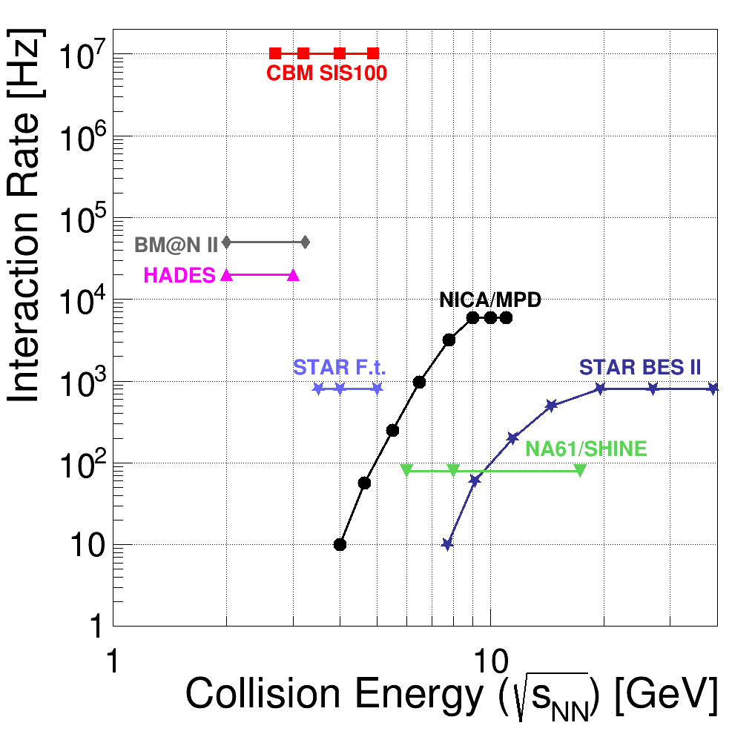
Experiments exploring dense QCD matter
high
net-baryon densities
The CBM Collaboration,
arXiv:1607.01487

Slide 22
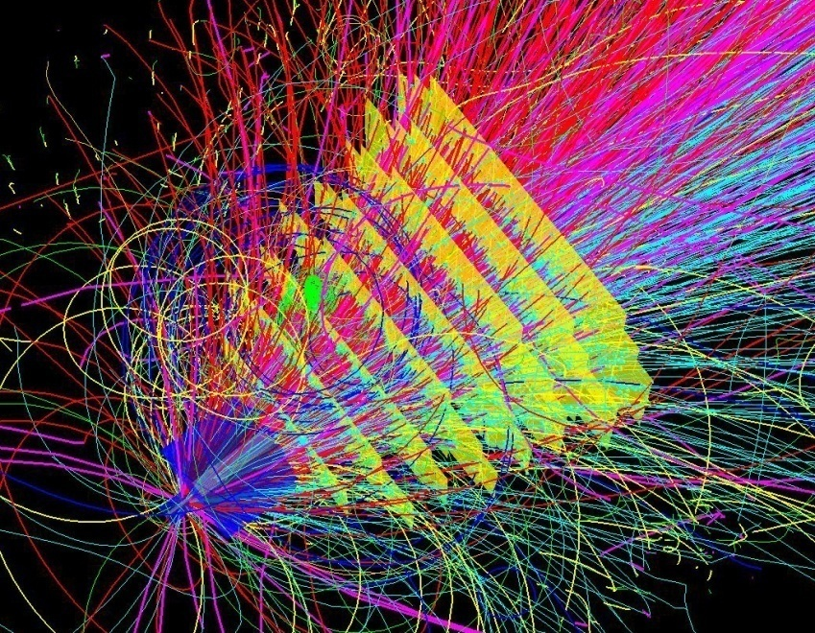
Experimental requirements
10⁵ - 10⁷ Au+Au reactions/sec
determination of displaced vertices (σ ≈ 50 μm)
identification of leptons and hadrons
fast and radiation hard detectors and FEE
free-streaming readout electronics
high speed data acquisition and high performance
computer farm for online event selection
4-D event reconstruction
22
Notes:
22
22
22

Slide 23
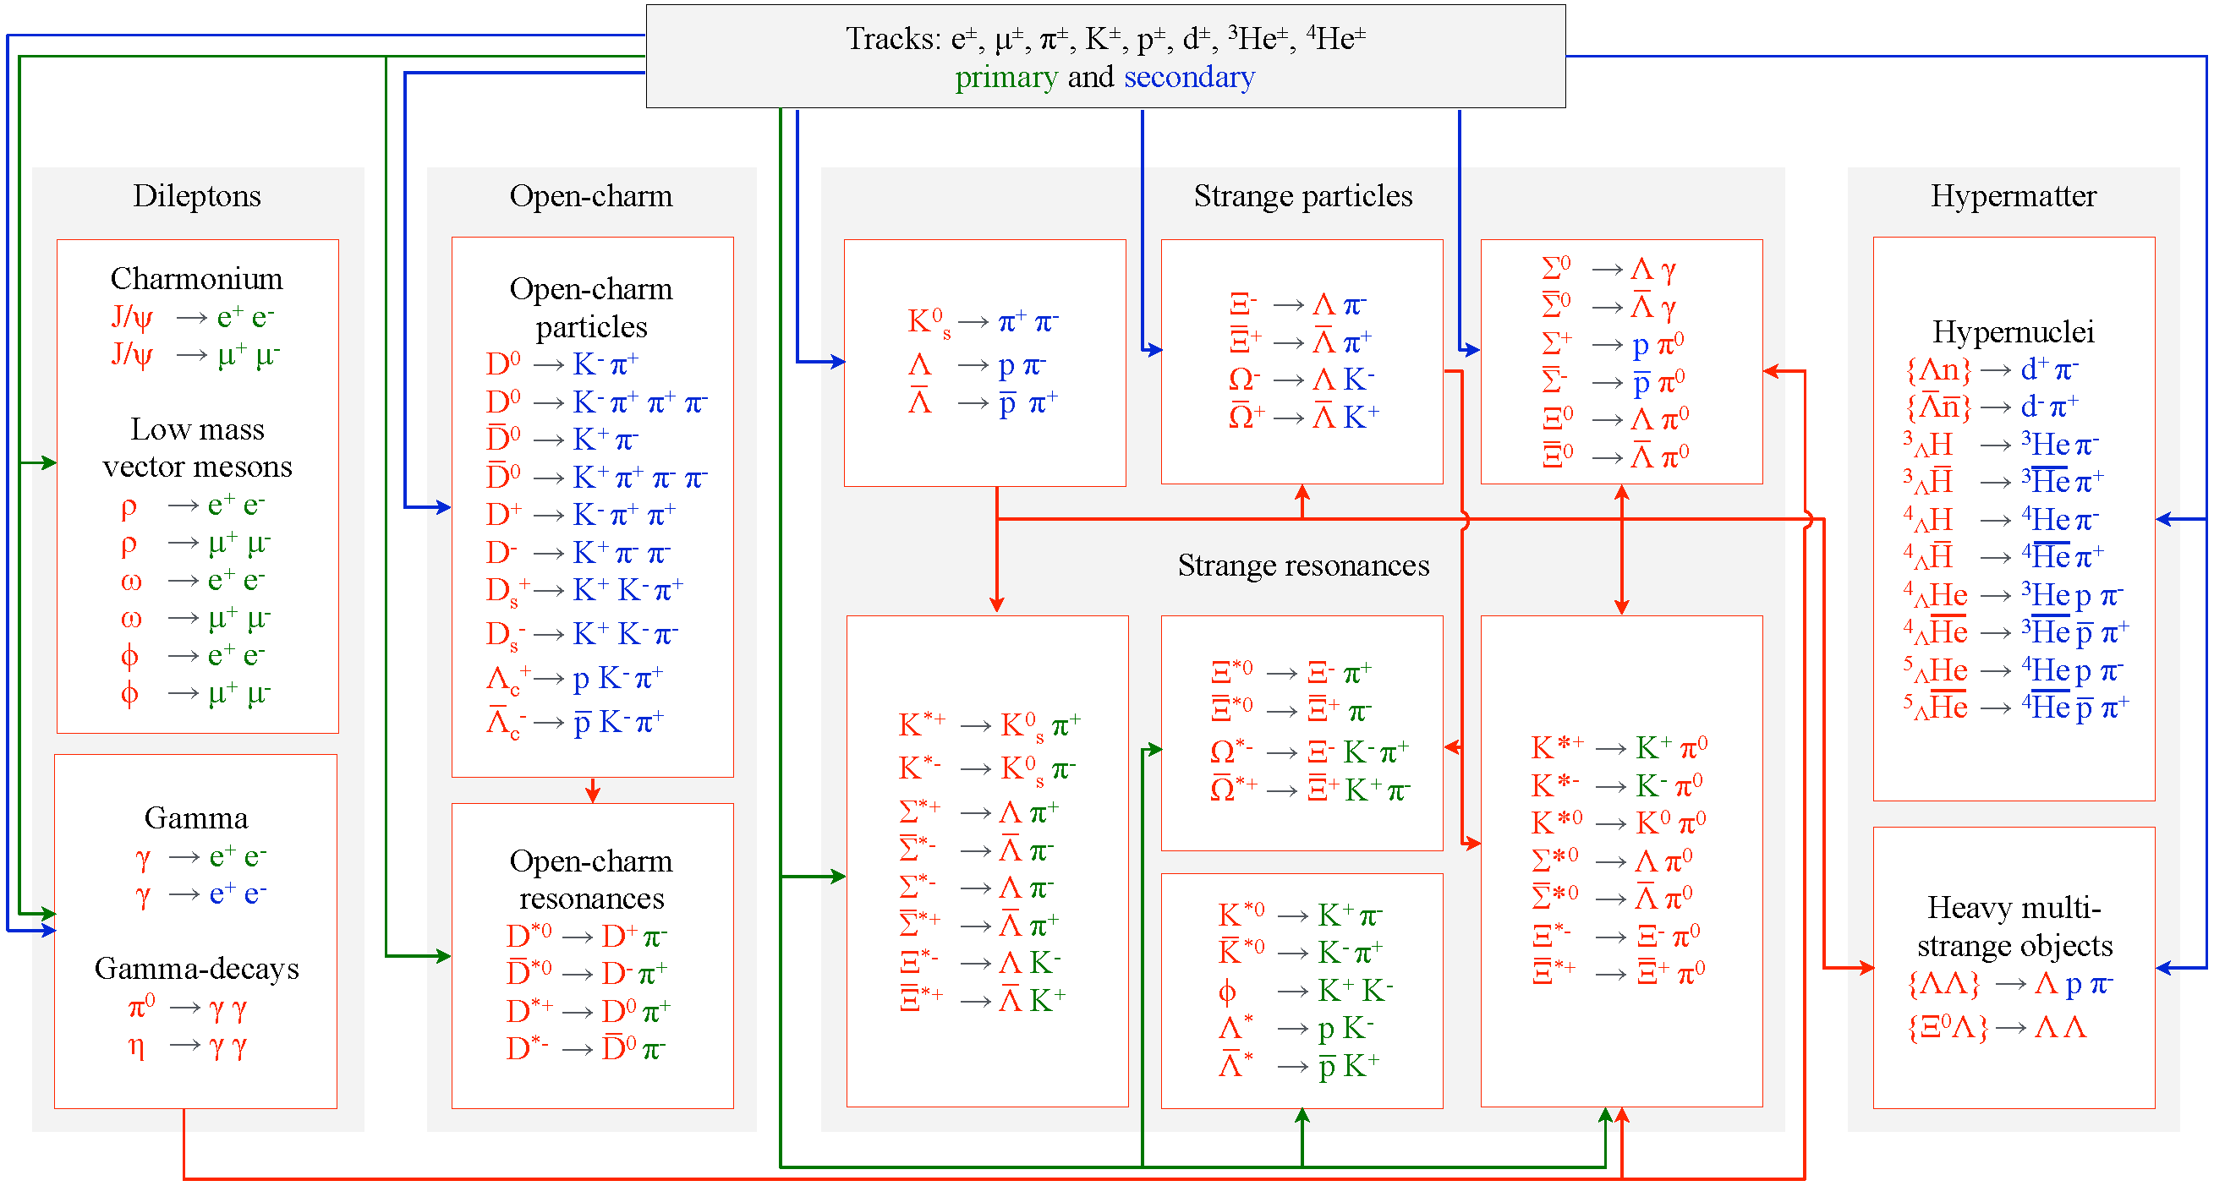
Online particle identification in CBM:
The KF Particle Finder
see poster by M. Zyzak

Slide 24
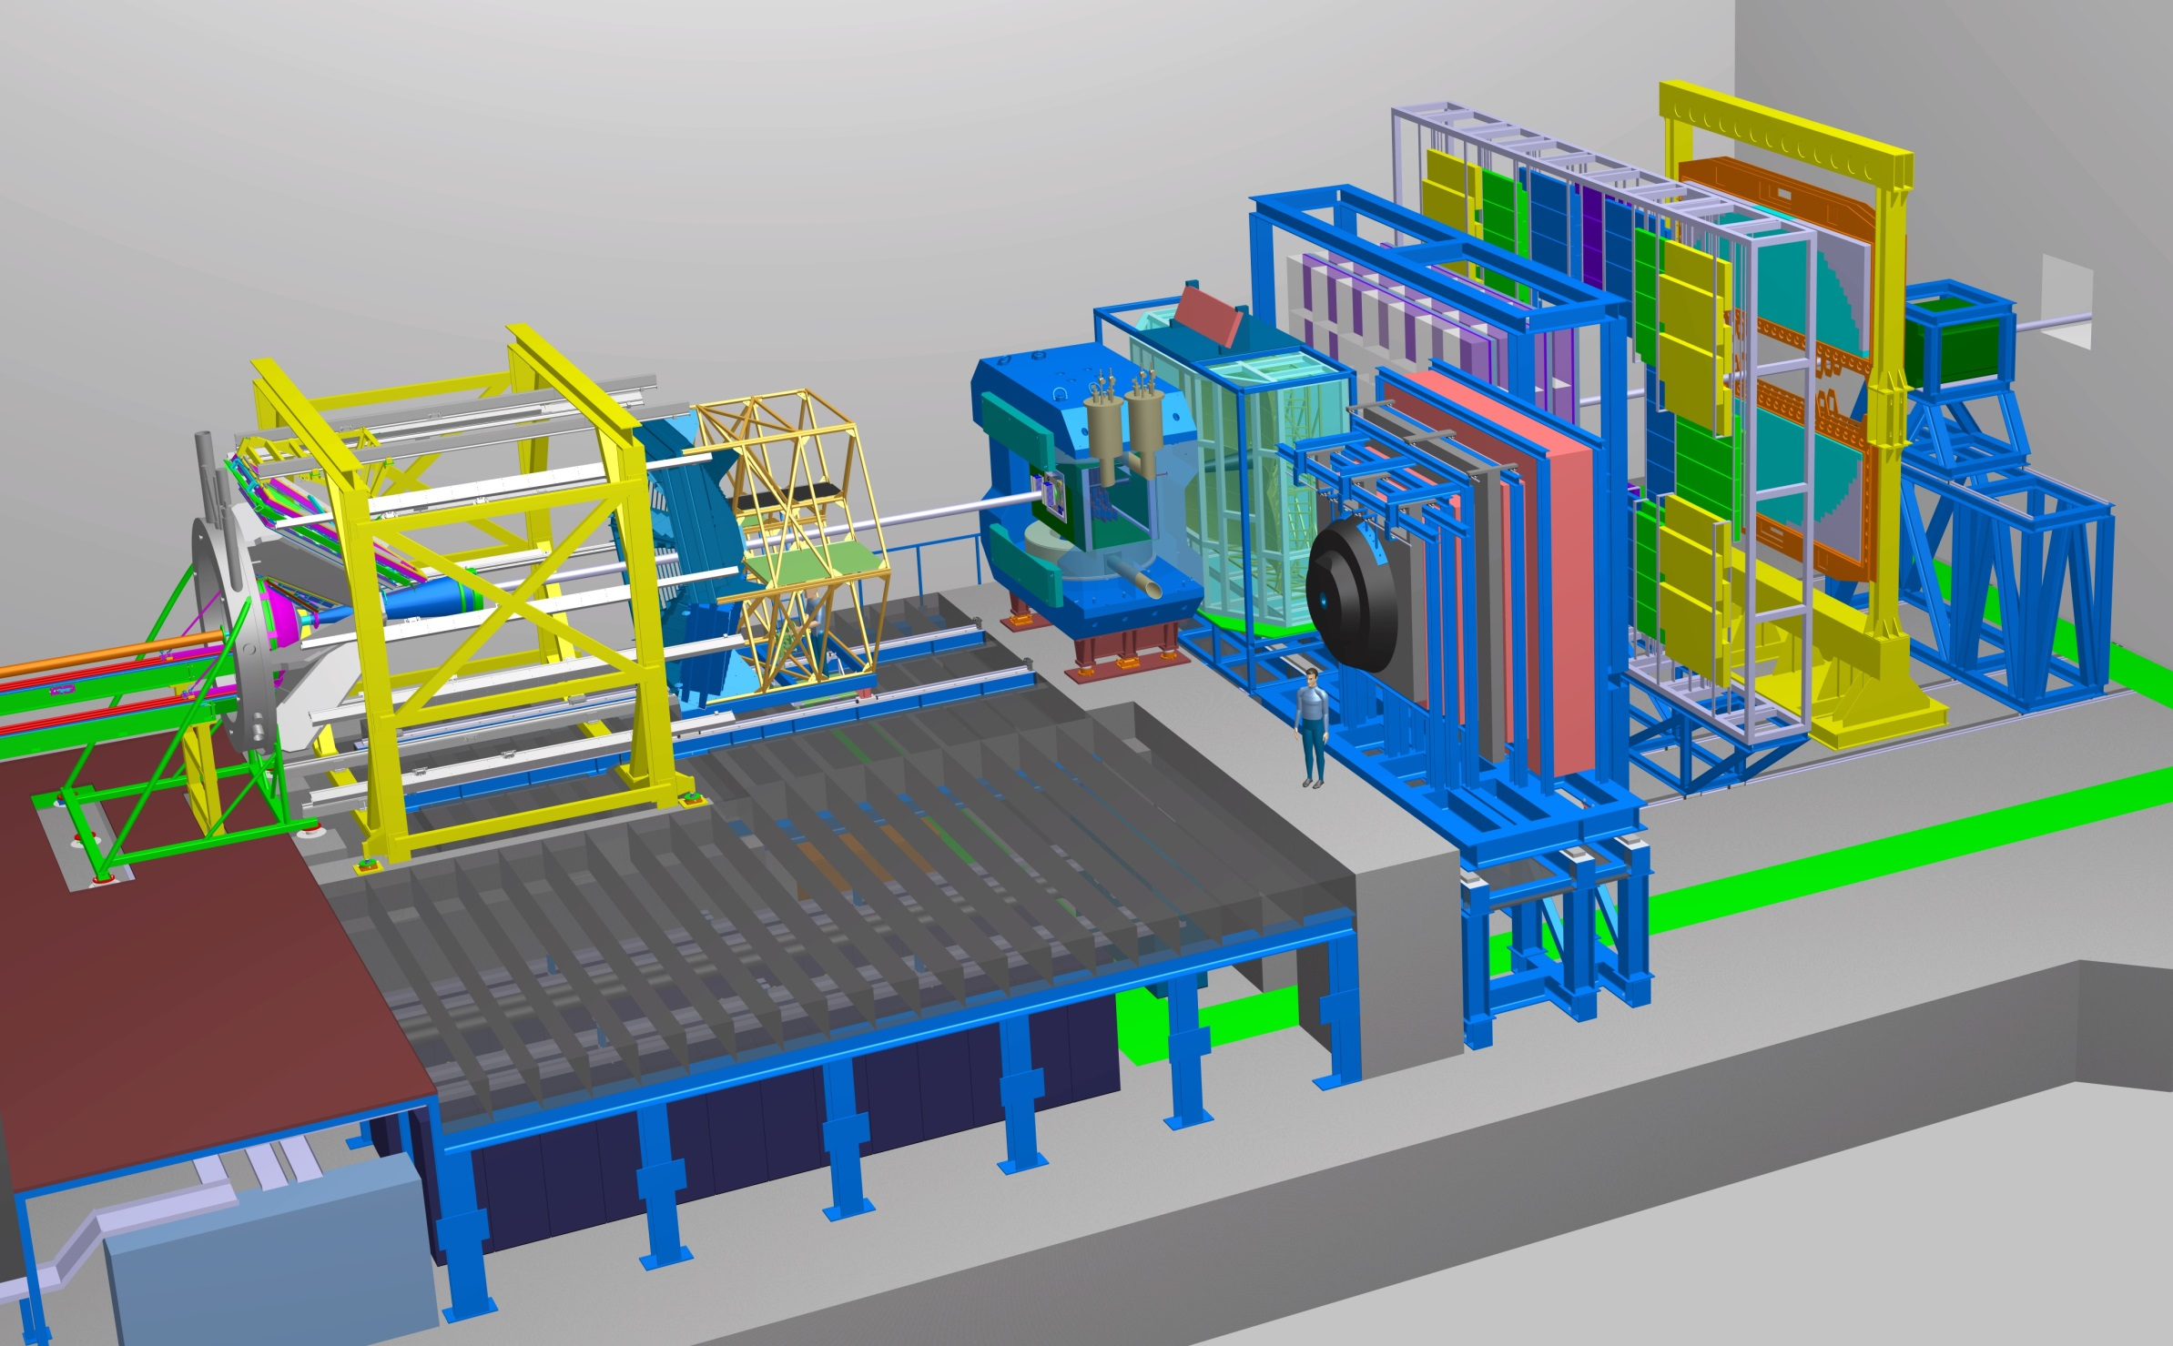
Experimental requirements
Transition
Radiation
Detector
Time of Flight
Detector
Ring
Imaging
Cherenkov
Dipol
Magnet
Silicon
Tracking
System
HADES
p+p, p+A
A+A (low mult.)
Micro
Vertex
Detector
Muon
Detector
Projectile
Spectator
Detector
DAQ/FLES HPC cluster
see posters on CBM detectors by I. Deppner, A. Dubey,
J. Heuser, T. Mahmoud,

Slide 25
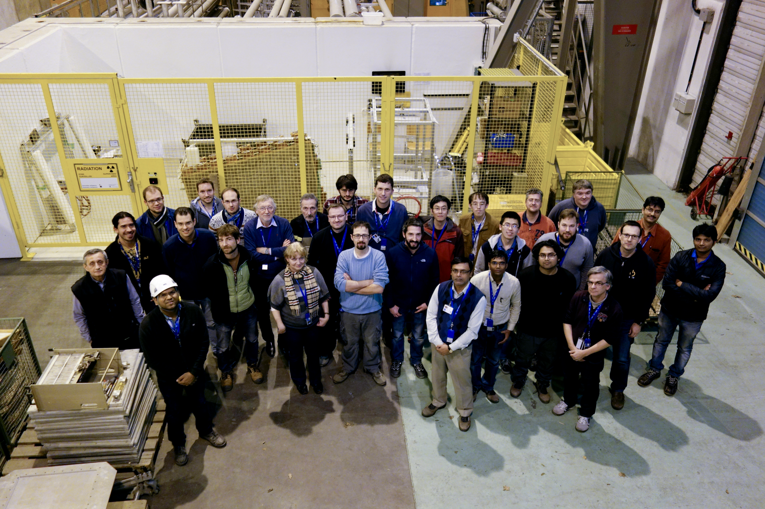
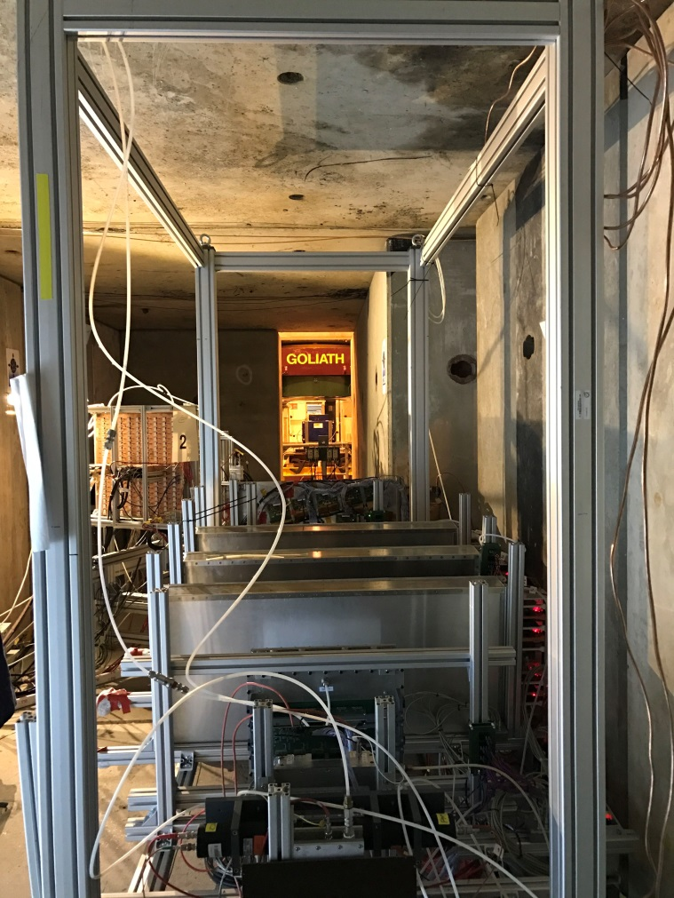
Test beam at CERN Nov. - Dec. 2016
Prototype TOF, GEM, TRD and diamond detectors with common free-streaming readout system and DAQ successfully tested.
Pb+Pb collisions with energies of 13, 30 and 160 A GeV.
Teams from China, Germany, India, Romania
25

Slide 26
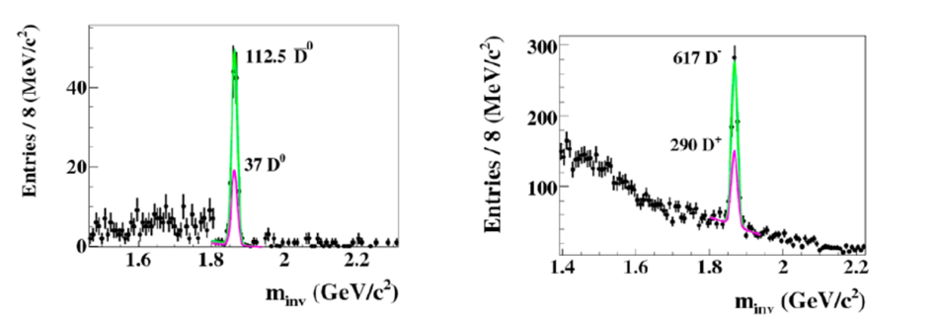
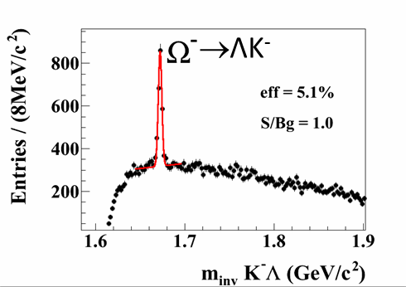
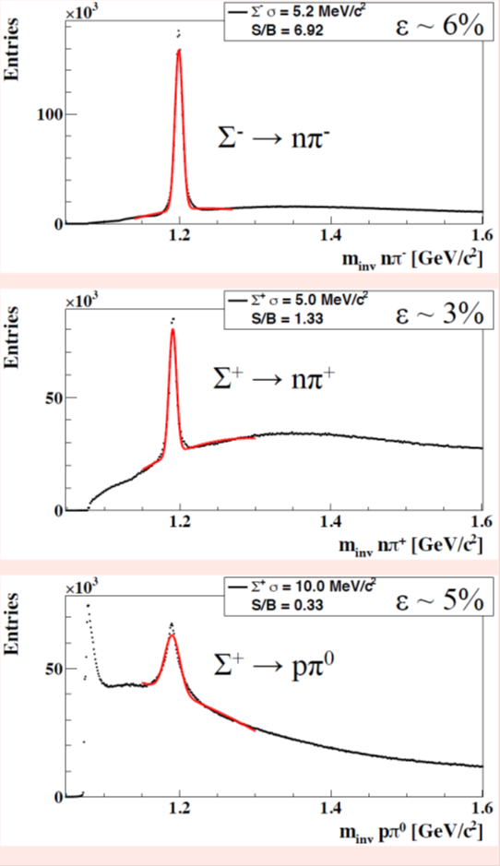
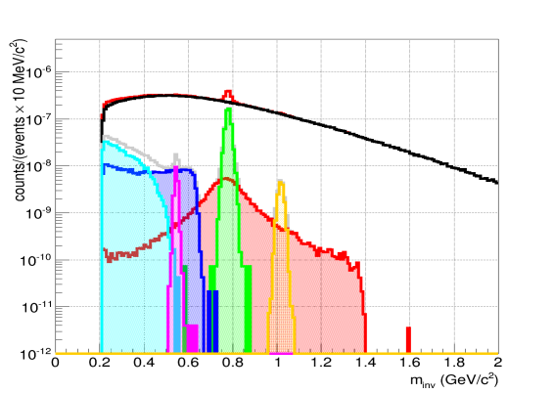
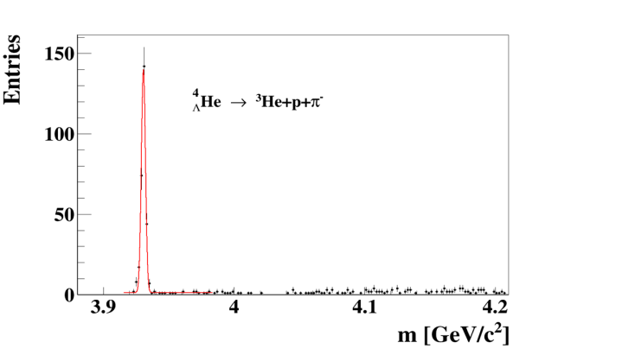
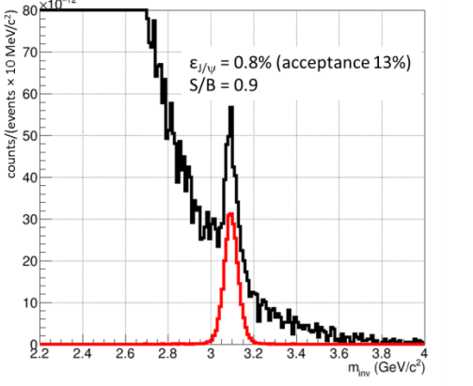
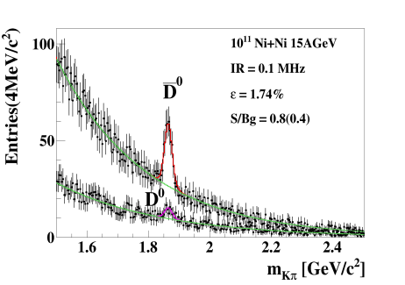

Simulations: central Au+Au collisions at 8A GeV and 10A GeV
Hyperons at 10 A GeV
Dileptons 8A GeV
D mesons 30 GeV p+Au
e⁺e⁻
µ⁺µ⁻
see posters by H.Cherif, I. Kisel, I. Vassiliev
η
ω
φ
ρ
Hypernuclei at 10 A GeV
D mesons Ni+Ni 15A GeV
Charmonium at 10 A GeV
26

Slide 27
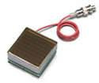
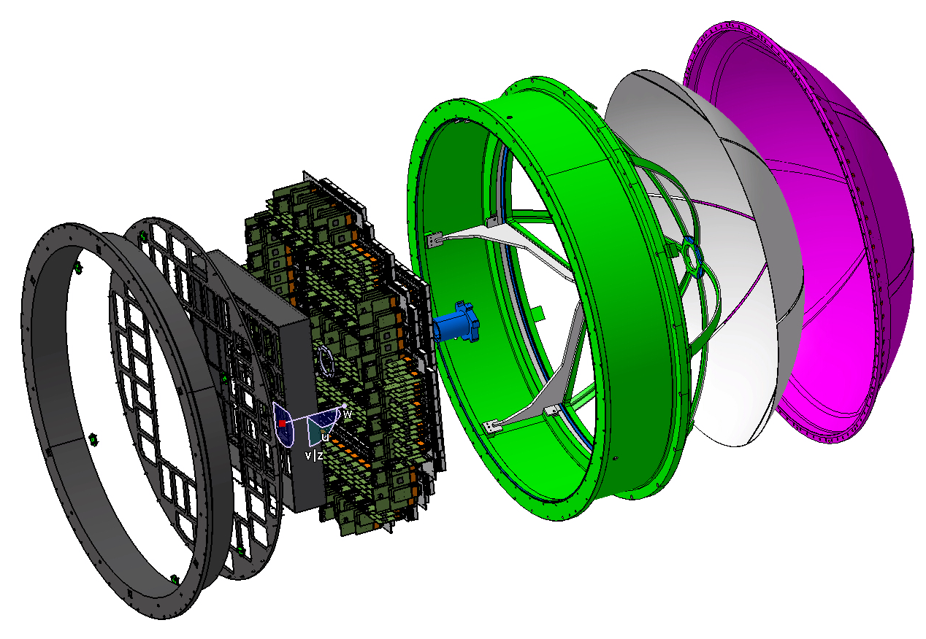
CBM Phase 0 experiments
1. Install, commission and use 430 out of 1100
CBM RICH multi-anode photo-
multipliers (MAPMT) in
HADES RICH photon detector
430 MAPMTs
Read
out
Supp. frames
Exist. RICH
27

Slide 28
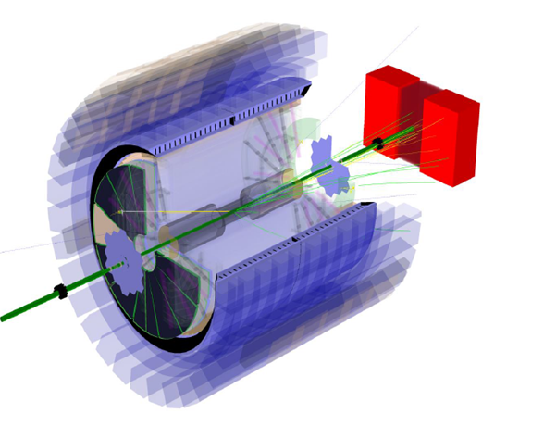
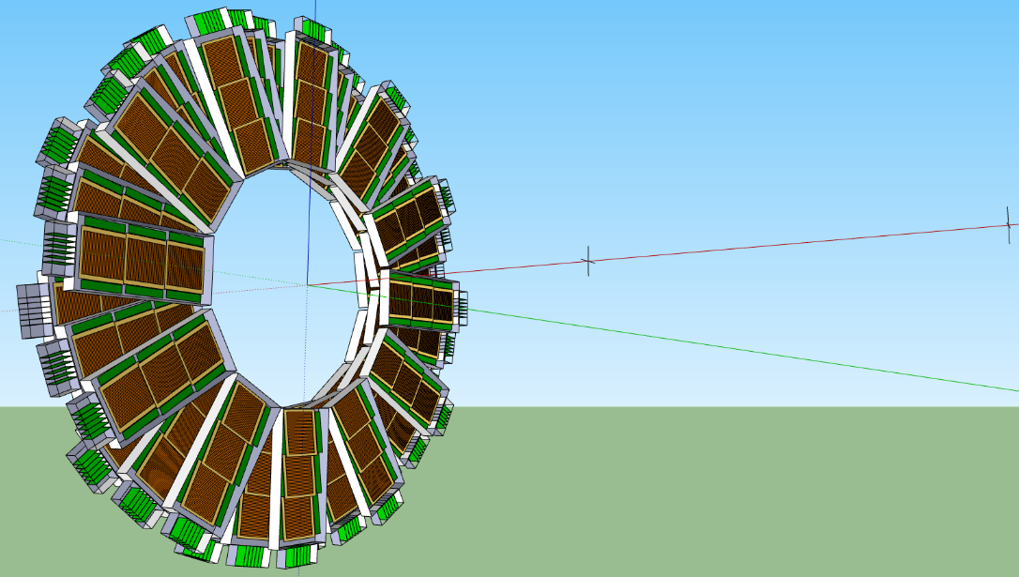
CBM Phase 0 experiments
1. Install, commission and use 430 out of 1100
CBM RICH multi-anode photo-
multipliers (MAPMT) in
HADES RICH photon detector
430 MAPMTs
Read
out
2. Install, commission and use
10% of the CBM TOF modules
including read-out chain
at STAR/RHIC (BES II 2019/2020)
Supp. frames
Exist. RICH
100 cm
collider vertex
(~250 cm)
fixed target pos.
(~500 cm)
CBM MRPC active area
28
CBM electronics

Slide 29
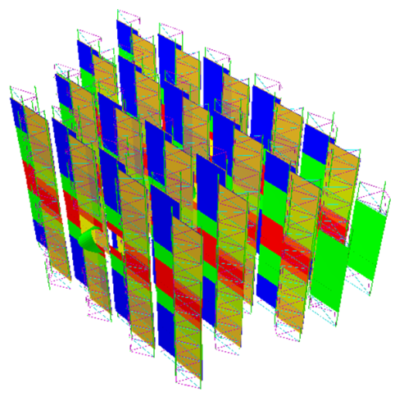
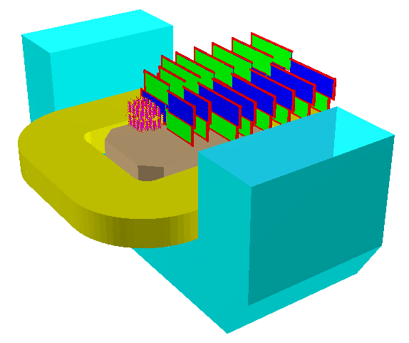
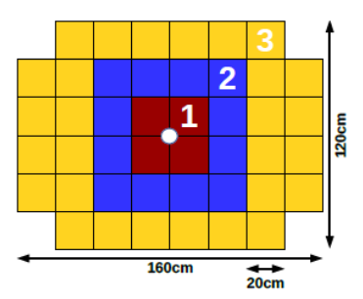
CBM Phase 0 experiments
3. Install, commission and use 4 Silicon tracking layers and the
Project Spectator Detector at the BM@N experiment at the
Nuclotron in JINR/Dubna (Au-beams up to 4.5 A GeV in 2018/19)

Slide 30
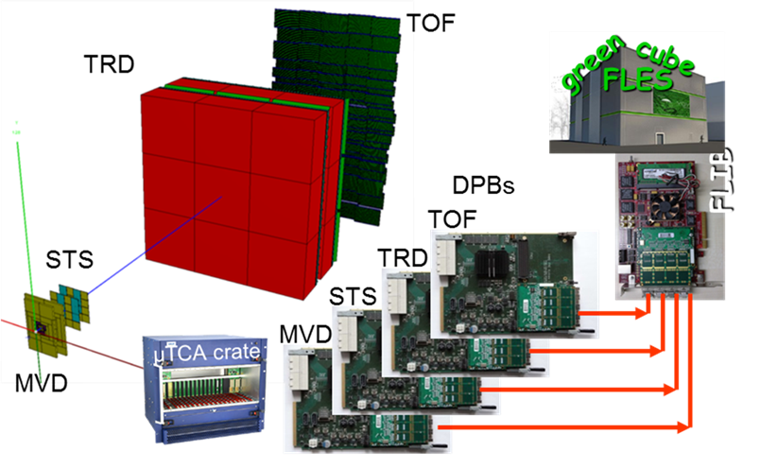
CBM Phase 0 experiments
3. Install, commission and use 4 Silicon tracking layers and the
Project Spectator Detector at the BM@N experiment at the
Nuclotron in JINR/Dubna (Au-beams up to 4.5 A GeV in 2018/19)
4. Build miniCBM at GSI/SIS18
for a full system test with
high-rate nucleus-nucleus
collisions from 2018 - 2021

Slide 31
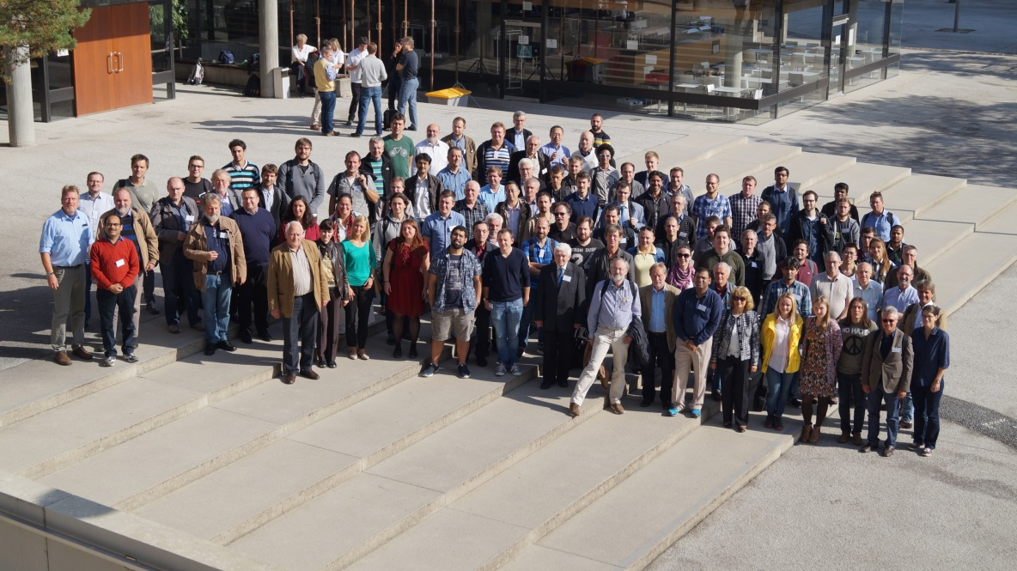
The CBM Collaboration: 55 institutions, 460 members
China:
CCNU Wuhan
Tsinghua Univ.
USTC Hefei
CTGU Yichang
Czech Republic:
CAS, Rez
Techn. Univ. Prague
France:
IPHC Strasbourg
Hungary:
KFKI Budapest
Eötvös Univ.
Germany:
Darmstadt TU
FAIR
Frankfurt Univ. IKF
Frankfurt Univ. FIAS Frankfurt Univ. ICS
GSI Darmstadt
Giessen Univ.
Heidelberg Univ. P.I.
Heidelberg Univ. ZITI
HZ Dresden-Rossendorf
KIT Karlsruhe
Münster Univ.
Tübingen Univ.
Wuppertal Univ.
ZIB Berlin
Russia:
IHEP Protvino
INR Troitzk
ITEP Moscow
Kurchatov Inst., Moscow
VBLHEP, JINR Dubna
LIT, JINR Dubna
MEPHI Moscow
PNPI Gatchina
SINP MSU, Moscow
Ukraine:
T. Shevchenko Univ. Kiev
Kiev Inst. Nucl. Research
India:
Aligarh Muslim Univ.
Bose Inst. Kolkata
Panjab Univ.
Rajasthan Univ.
Univ. of Jammu
Univ. of Kashmir
Univ. of Calcutta
B.H. Univ. Varanasi
VECC Kolkata
IOP Bhubaneswar
IIT Kharagpur
IIT Indore
Gauhati Univ.
Korea:
Pusan Nat. Univ.
Poland:
AGH Krakow
Jag. Univ. Krakow
Warsaw Univ.
Warsaw TU
Romania:
NIPNE Bucharest
Univ. Bucharest
28th CBM Collaboration meeting in Tübingen
26-30 September 2016
CBM Scientists
31

Slide 32
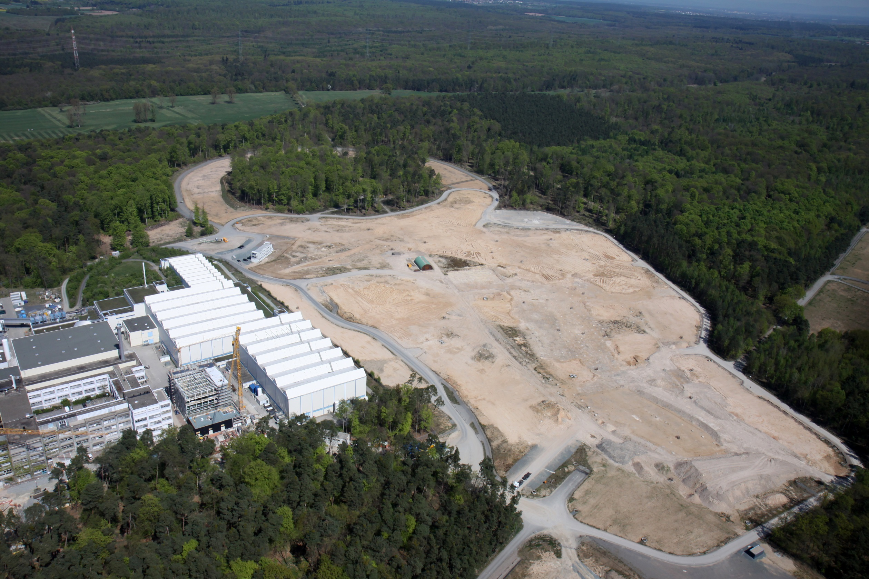
Summary
Status FAIR: Procurement of accelerator components ongoing. Civil construction starts mid 2017. FAIR Phase 1 full operational in 2025. Installation/commissioning of experiments planned during 2021-2024.
CBM scientific program at SIS100: Exploration of the QCD
phase diagram in the region of neutron star core densities
→ large discovery potential.
First measurements with CBM:
High-precision multi-differential measurements of hadrons incl.
multistrange hyperons, hypernuclei and dileptons for different
beam energies and collision systems → terra incognita.
Status of experiment preparation: Prototype detectors fulfill
CBM requirements. 7 out of 11 TDRs approved.
FAIR Phase 0:
HADES experiments with CBM RICH photon detector,
use CBM detectors at STAR/BNL and BM@N/JINR
32

Slide 34
Particle yields based on HSD calculations
10% most central Au+Au collisions at 6 and 10 A GeV
Particle (mass MeV/c²) | Multi- plicity 6 A GeV | Multi- plicity 10 A GeV | decay mode | BR | ε (%) | yield (s⁻¹) 6 A GeV | yield (s⁻¹) 10 A GeV | yield in 10 weeks 6 A GeV | yield in 10 weeks 10 A GeV | IR MHz
K⁺ (494) | 12.5 | 20 | - | - | 31 | 3.9·10⁵ | 6.2·10⁵ | 2.4·10¹² | 3.7·10¹² | 1
K⁻ (494) | 1.4 | 3 | - | - | 27 | 3.8·10⁴ | 8.1·10⁴ | 2.3·10¹¹ | 4.8·10¹¹ | 1
ρ (770) | 5 | 9 | L⁺L⁻ | 4.7·10⁻⁵ | 4.6 | 1.1 | 2.0 | 6.5·10⁶ | 1.2·10⁷ | 1
ω (782) | 3.3 | 6 | L⁺L⁻ | 7.1·10⁻⁵ | 5.2 | 1.2 | 2.2 | 7.4·10⁶ | 1.3·10⁷ | 1
φ (1020) | 0.07 | 0.12 | L⁺L⁻ | 3·10⁻⁴ | 6.0 | 1.3·10⁻¹ | 2.2·10⁻¹ | 7.6·10⁵ | 1.3·10⁶ | 1
Λ (1115) | 10.4 | 17.4 | pπ⁻ | 0.64 | 18 | 1.2·10⁵ | 2.0·10⁵ | 7.2·10¹¹ | 1.2·10¹² | 1
͞Λ (1115) | 4.6·10⁻⁴ | 0.034 | ͞pπ⁺ | 0.64 | 11 | 1.1 | 81.3 | 6.6·10⁶ | 2.2·10⁸ | 10
Ξ⁻ (1321) | 0.054 | 0.222 | Λπ⁻ | 1 | 6 | 3.2·10³ | 1.3·10⁴ | 1.9·10¹⁰ | 7.8·10¹⁰ | 10
Ξ⁺ (1321) | 3.0·10⁻⁵ | 5.4·10⁻⁴ | Λπ⁺ | 1 | 3.3 | 9.9·10⁻¹ | 17.8 | 5.9·10⁶ | 1.1·10⁸ | 10
Ω⁻ (1672) | 5.8·10⁻⁴ | 5.6·10⁻³ | ΛK⁻ | 0.68 | 5 | 17 | 164 | 1.0·10⁸ | 9.6·10⁸ | 10
Ω⁺ (1672) | - | 7·10⁻⁵ | ΛK⁺ | 0.68 | 3 | - | 0.86 | - | 5.2·10⁶ | 10
J/ψ (3097) | ⁻ | 1.74·10⁻⁷ | L⁺L⁻ | 0.06 | 5 | - | 5.2·10⁻⁴ | - | 3100 | 10
³ _{Λ}H (2993) | 4.2·10⁻² | 3.8·10⁻² | ³Heπ⁻ | 0.25 | 19.2 | 2·10³ | 1.8·10³ | 1.2·10¹⁰ | 1.1·10¹⁰ | 10
⁴_{Λ}He (3930) | 2.4·10⁻³ | 1.9·10⁻³ | ³Hepπ⁻ | 0.32 | 14.7 | 110 | 87 | 6.6·10⁸ | 5.2·10⁸ | 10
p + A collisions at 20 and 30 GeV
Particle (mass MeV/c²) | Multi- plicity 20 GeV | Multi- plicity 30 GeV | decay mode | BR | ε (%) | yield (s⁻¹) 20 GeV | yield (s⁻¹) 30 GeV | yield in 10 weeks 20 GeV | yield in 10 weeks 30 GeV | IR MHz
D± (1869) | 3.4·10⁻⁷ | 1.3·10⁻⁶ | K⁺π⁻π⁻ | 0.09 | 13 | 4.0·10⁻² | 1.5·10⁻¹ | 2.4·10⁵ | 9.2·10⁵ | 10
D⁰ (1865) | 5.1·10⁻⁷ | 2.0·10⁻⁶ | K⁺π⁻π⁻π⁺ | 0.08 | 2 | 8.2·10⁻³ | 3.2·10⁻² | 4.9·10⁴ | 1.9·10⁵ | 10
J/ψ (3097) | 7.5·10⁻⁸ | 2.9·10⁻⁶ | L⁺L⁻ | 0.06 | 5 | 2.3·10⁻³ | 8.7·10⁻² | 1.4·10⁴ | 5.2·10⁵ | 10

