Slide 1
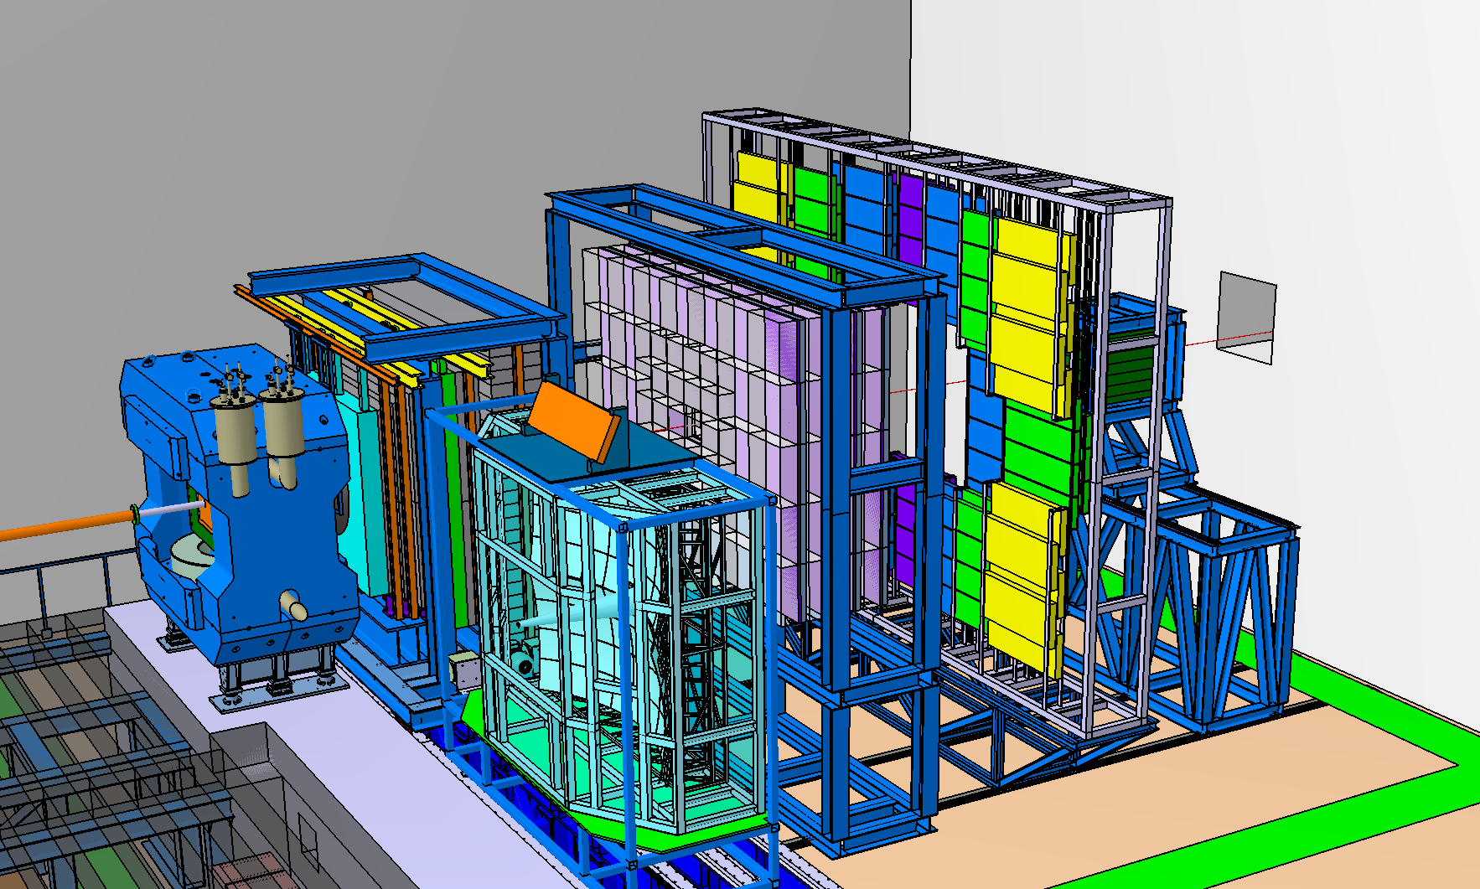
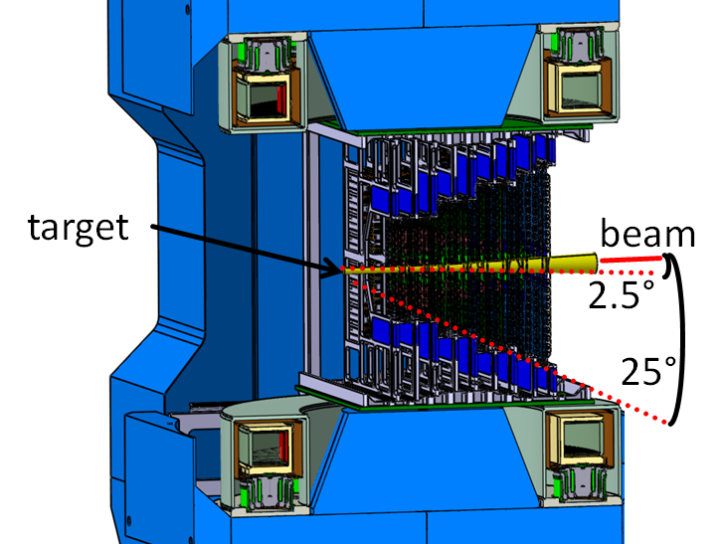
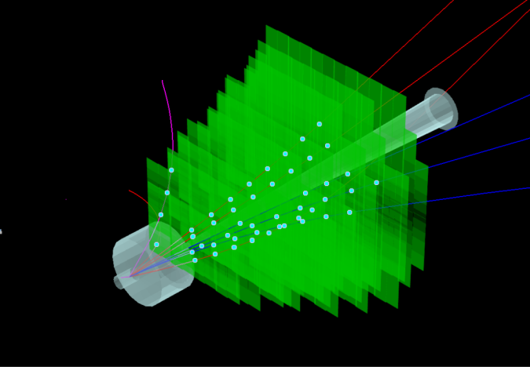
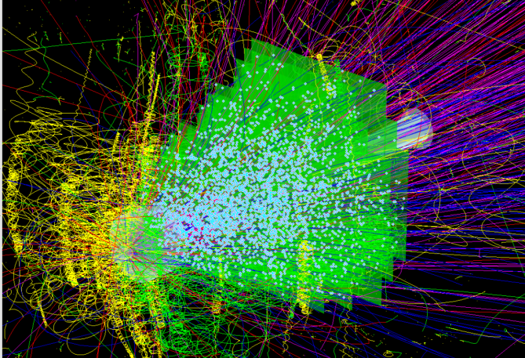
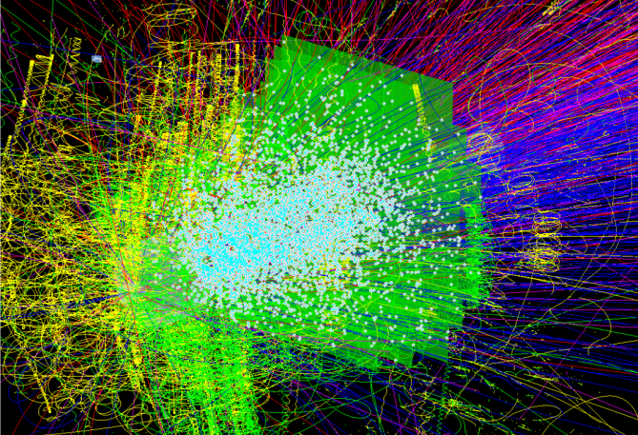
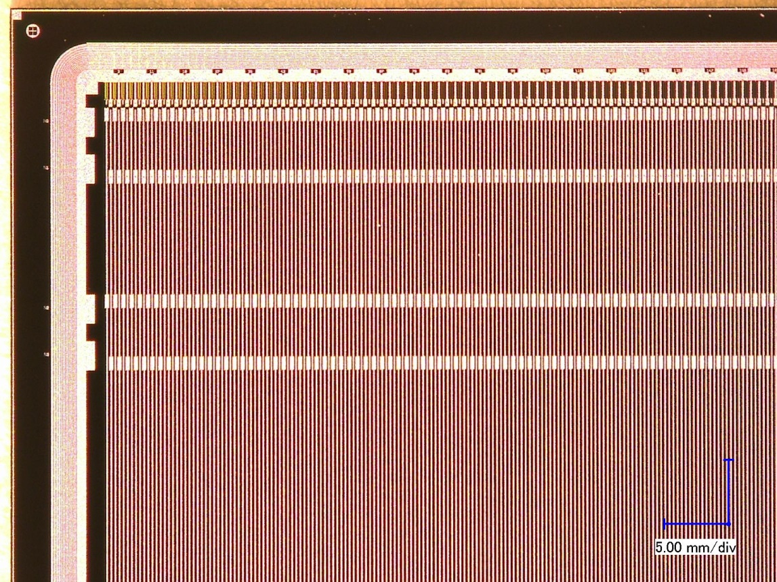
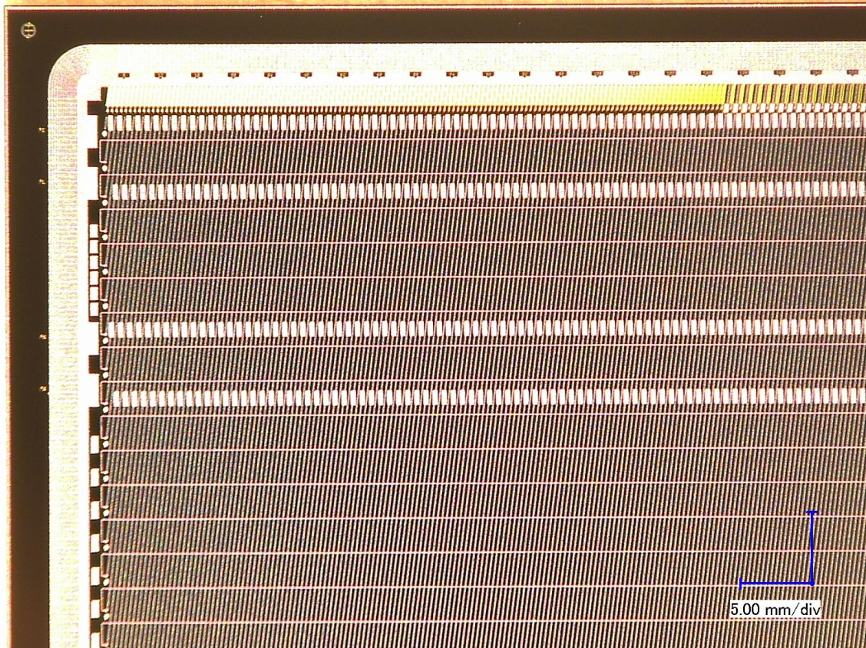
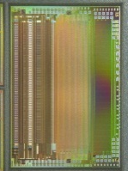
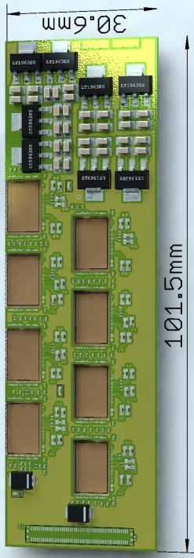
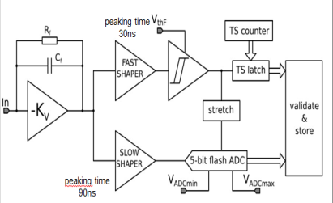
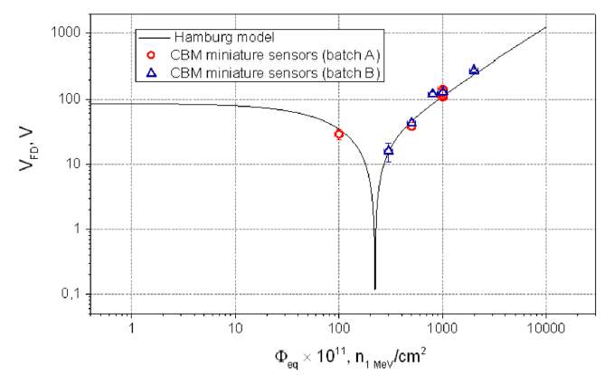
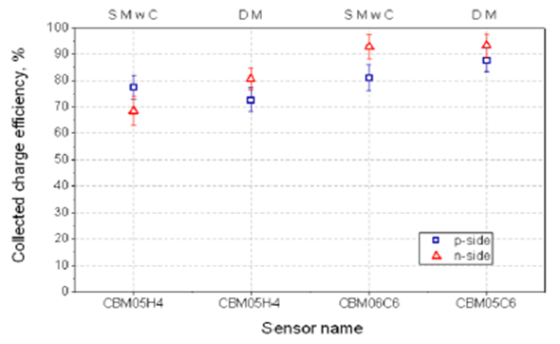
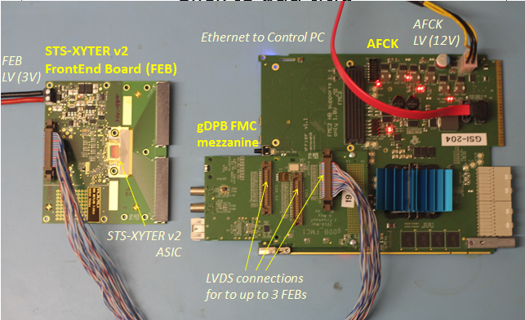
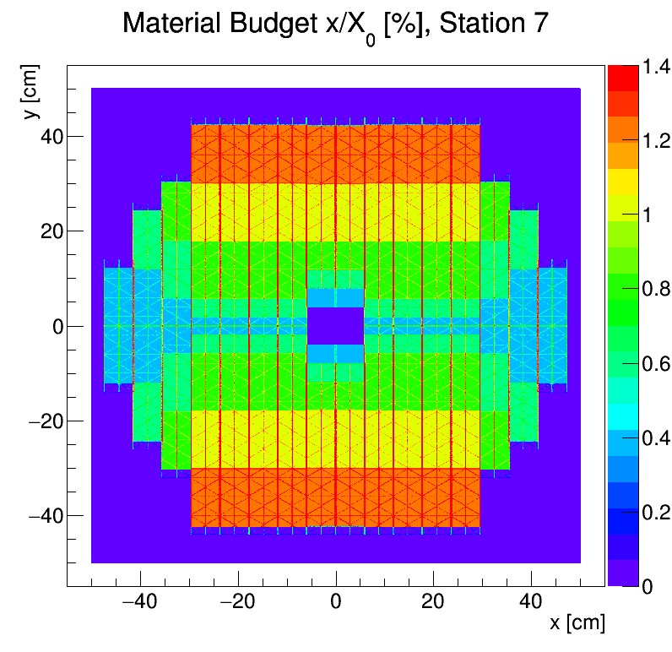
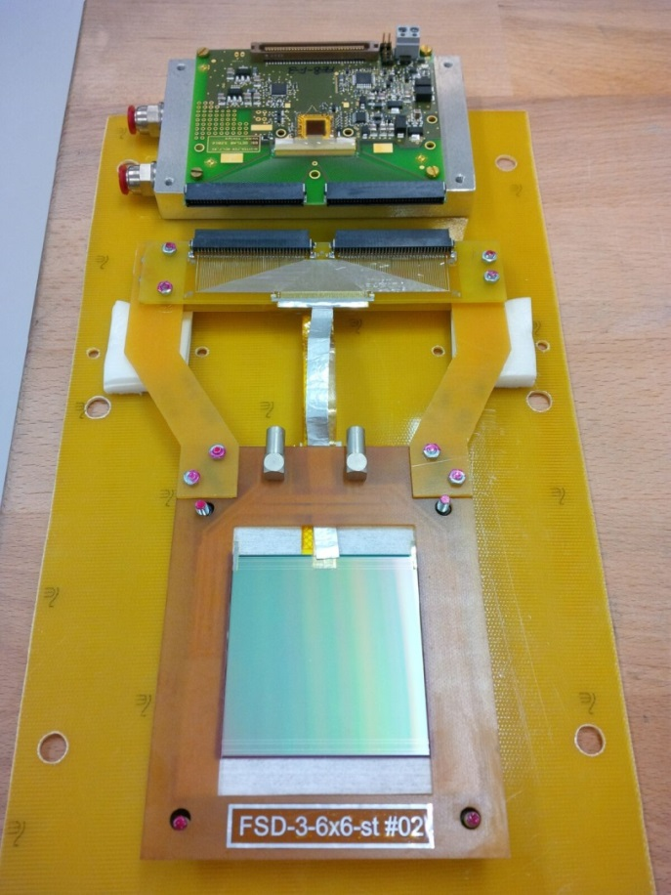
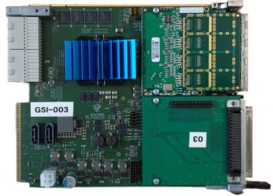
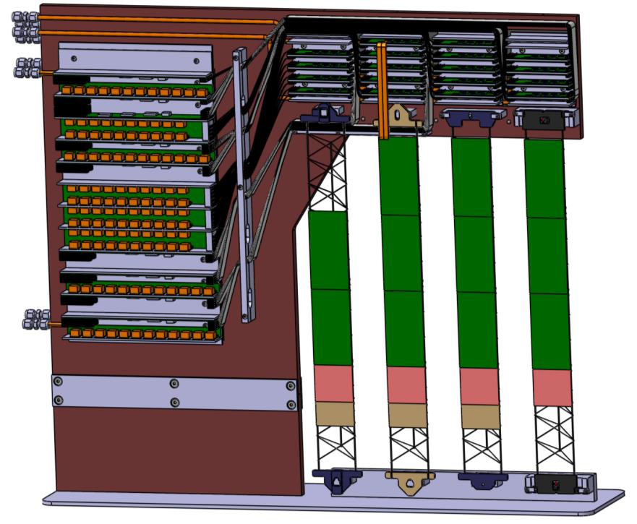
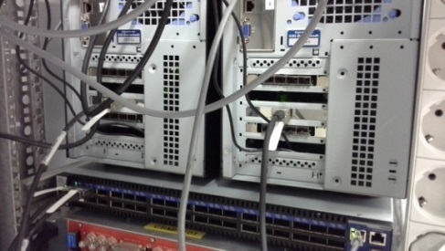
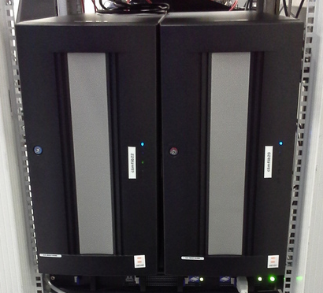
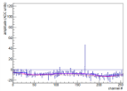
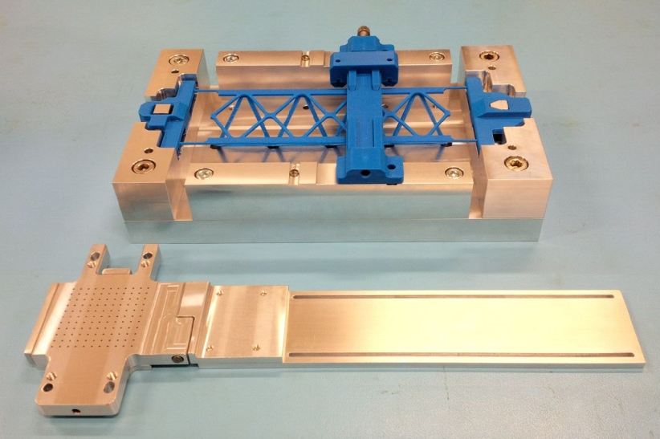
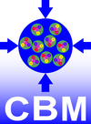
The Silicon Tracking System of the CBM experiment at FAIR Johann M. Heuser*, GSI Helmholtz Center for Heavy Ion Research, Darmstadt, Germany *J.Heuser@gsi.de, for the CBM Collaboration
The Compressed Baryonic Matter (CBM) experiment at FAIR
The Silicon Tracking System
Silicon
Tracking
System
Dipole
Magnet
Muon
Detector
Time of Flight Detector
pile-up free track point determination in high-rate collision environment: 10⁵ − 10⁷/s (A+A), up to 10⁹/s (p+A)
physics aperture : 2.5° ≤ Θ ≤ 25°, 0.3 m ≤ z ≤ 1.0 m
8 tracking stations
double-sided silicon microstrip sensors
hit spatial resolution ≈ 25 µm
self-triggering front-end electronics
time-stamp resolution ≈ 5 ns
material : ≈ 0.3 % – 1.2% X₀ per station
momentum resolution: Δp/p ≈ 1.8% (p > 1 GeV/c, 1 Tm field)
Micro
Vertex
Detector
Beam Dump
Transition
Radiation
Detector
Projectile
Spectator
Detector
Beam on Target
DAQ/FLES HPC cluster
Ring
Imaging
Cherenkov
Detector
longitudinal cut – Silicon Tracking System in Dipole Magnet
set-up in muon-hadron configuration at SIS100
Physics aim
Observables
Exploration of the QCD phase diagram at high net baryon densities and moderate temperatures
Starting with SIS100 projectile energies: 2÷11 GeV/nucleon / $\sqrt{sNN}$ = 2.7÷4.9 GeV, protons up to 29 GeV
Hadrons, electrons, muons, photons
Particle yields and multi-differential cross-sections
Rare diagnostic probes: strange mesons, light vector mesons (ρ, ω, φ), charm production
UrQMD + GEANT + CbmRoot
central Au+Au, 8 GeV/nucleon
central Au+Au, 25 GeV/nucleon
Recent paper: Challenges in QCD matter physics – The scientific programme of the CBM experiment at FAIR; arXiv:1607.01487v2 [nucl-ex] 24 Nov 2016
p+C, 29 GeV
few charged particles/collision
≈ 350 charged particles/collision
≈ 700 charged particles/collision
particle densities in STS up to ≈ 10/cm²
Silicon Microstrip Sensors
Read-out Electronics, Data Acquisition Chain
285/320 ± 15µm thick
n-type silicon
double-sided segmentation
1024 strips of 58 µm pitch
strip length 2/4/6/12 cm
angle front/back: 7.5°/0°
read-out from top edge
double-metal routing on p-side
radiation tolerance 10¹⁴ n_{eq}/cm², 1 Mrad
n-side
STS-XYTER ASIC 8 ×
Front-End Board
Read-Out Board
Power Boards
p-side
copper link
optical link
Data Processing Board
time-slicing
FLES online event computing center
microstrip sensor with 1024 channels
1:1
− 5:1
8:1
FLIB
r/o electronics
STS-XYTER ASIC | v2.0 (produced 2016) 2016 JINST 11 C02024
CMOS process | UMC 180 nm
channels | 128, polarity +/-
noise | < 1ke⁻ at 20-50 pF load
ADC range | linear up to12 fC, 5 bit
clock | 250 MHz
power | < 10 mW/channel
timestamp | ~5 ns resolution
out interface | 5 × 500 Mbit/s LVDS
data combining
off detector
self-triggering
STS-XYTER chips
à 1/2/5 LVDS E-links out
time-stamped data
GBTx chip-set (CERN):
3 GBTx, 1 VTRx, 1 VTTx, 1 SCA 42 E-links à 320 Mb/s
3 GBT optical uplinks à 4.48 Gb/s
prototype free-stream-ing DAQ system
0.5 mm/div
operated under beam test conditions
prototypes from CiS, Germany and Hamamatsu, Japan
under verification
under development
under development
System Integration
Current Development Activities
Concept:
front-end board
8 stations, volume 2 m³, area 4 m²
896 detector modules in various lengths
896 double-sided microstrip sensors
~ 1.8 million read-out channels
~ 16 000 r/o STS-XYTER ASICs
~ 16 000 ultra-thin r/o cables (5÷50 cm long)
106 detector ladders with 8-10 modules
power dissipation: ~40 kW (CO₂ cooling)
thermal enclosure: sensors at T = -5° C
Radiation hardness of sensors:
Front-end electronics:
896 modules
Φ = 2 × 10¹⁴ n_{eq} cm⁻² (2× end-of-life fluence) T= - 5° C
sensor
ultra-thin r/o cables
sensor type
neutron-irradiated sensors tested in the laboratory and with proton beam
C-frame
Module performance test stand:
test module, 128 channels on front and back sides
STS-XYTER v2 test set-up
Quarter-unit demonstrator:
read-out + power boards
AFCK-DPB
ladder mounting
mechanical stability
electronics cooling
cable routing
powering
connectivity
8 tracking stations
18 mechanical half-units
106 ladders
FLIB
FLES node
cooling plate
Module assembly:
Ladder assembly:
Project
Timeline:
Key Institutes:
2013 – Technical Design Report*
2017-2018 – Production Readiness (Sensors, Electronics, System Integration)
Detector construction until 2021
*GSI Report 2013-4 (Aug. 2013)
GSI-FAIR, Darmstadt, Germany; JINR, Dubna, Russia; Univ. Tübingen, Germany; KIT, Karlsruhe, Germany;
AGH, Cracow, Poland; JU, Cracow, Poland; WUT, Warsaw, Poland.
Assembly Centers: GSI-FAIR, JINR -VBLHEP
tab-bonding of Al-polyimide cables between ASICs and sensor
mounting of modules onto low-mass carbon-fiber supports
presented at
Quark Matter 2017, XXVI International Conference on Ultra-Relativistic Heavy-Ion Collisions, Chicago, IL, USA, 6-11 February 2017
supported by EU-Horizon2020 project CREMLIN

