Slide 1
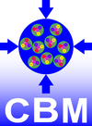
CBM detector and electronics tests at COSY in 2017 and Q1/2018
Johann M. Heuser
GSI Helmholtz Center for Heavy Ion Research GmbH, Darmstadt, Germany
for the CBM Collaboration
6th COSY Beamtime Advisory Committee Meeting, IKP FZ Jülich, 26 June 2017

Slide 2
Outline
Results from in-beam test, February 2017
Request for re-scheduled beamtime, May 2017
October 2017 (1 week)
Application for beamtime in Q1/2018:
Electronics tests: Feb. 2018 (1 week)
Detector tests: Feb./March 2018 (1 week)

Slide 3
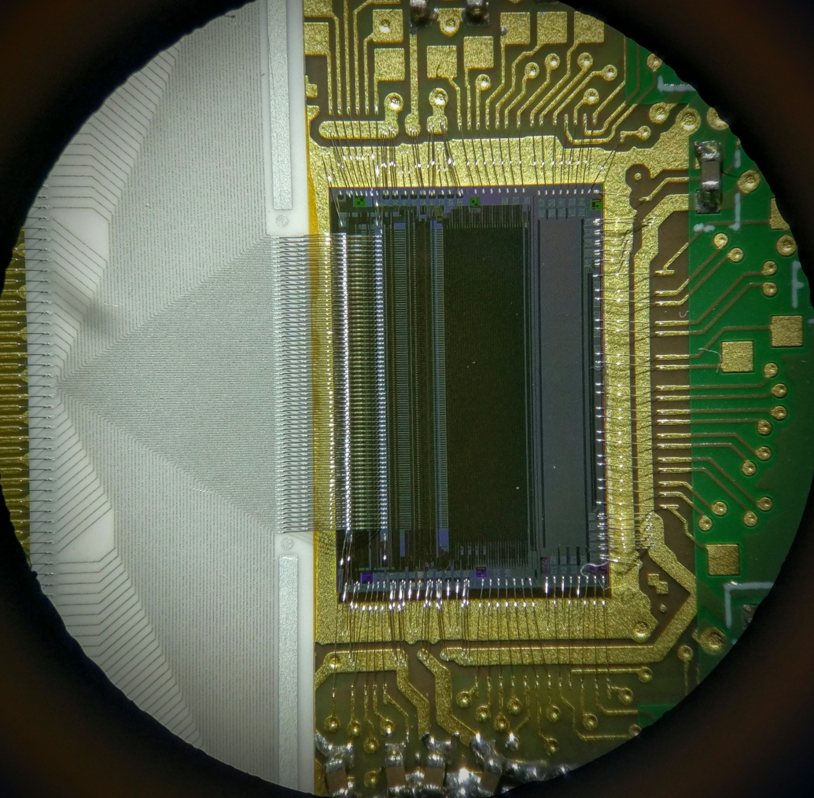
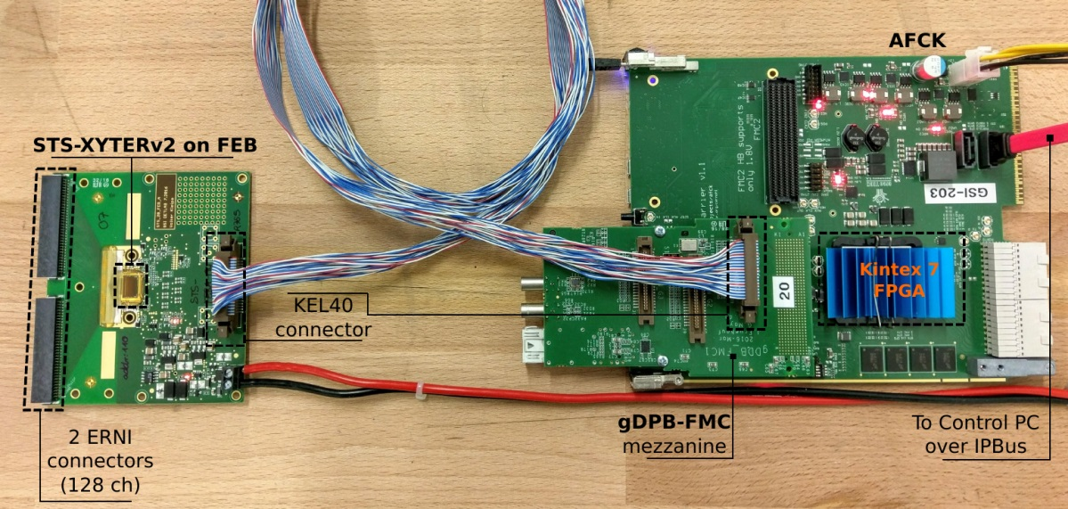
(1) Results from in-beam test, February 2017
STS-XYTERv2 ASIC – Test for single-event effects in JESSICA Cave

Slide 4
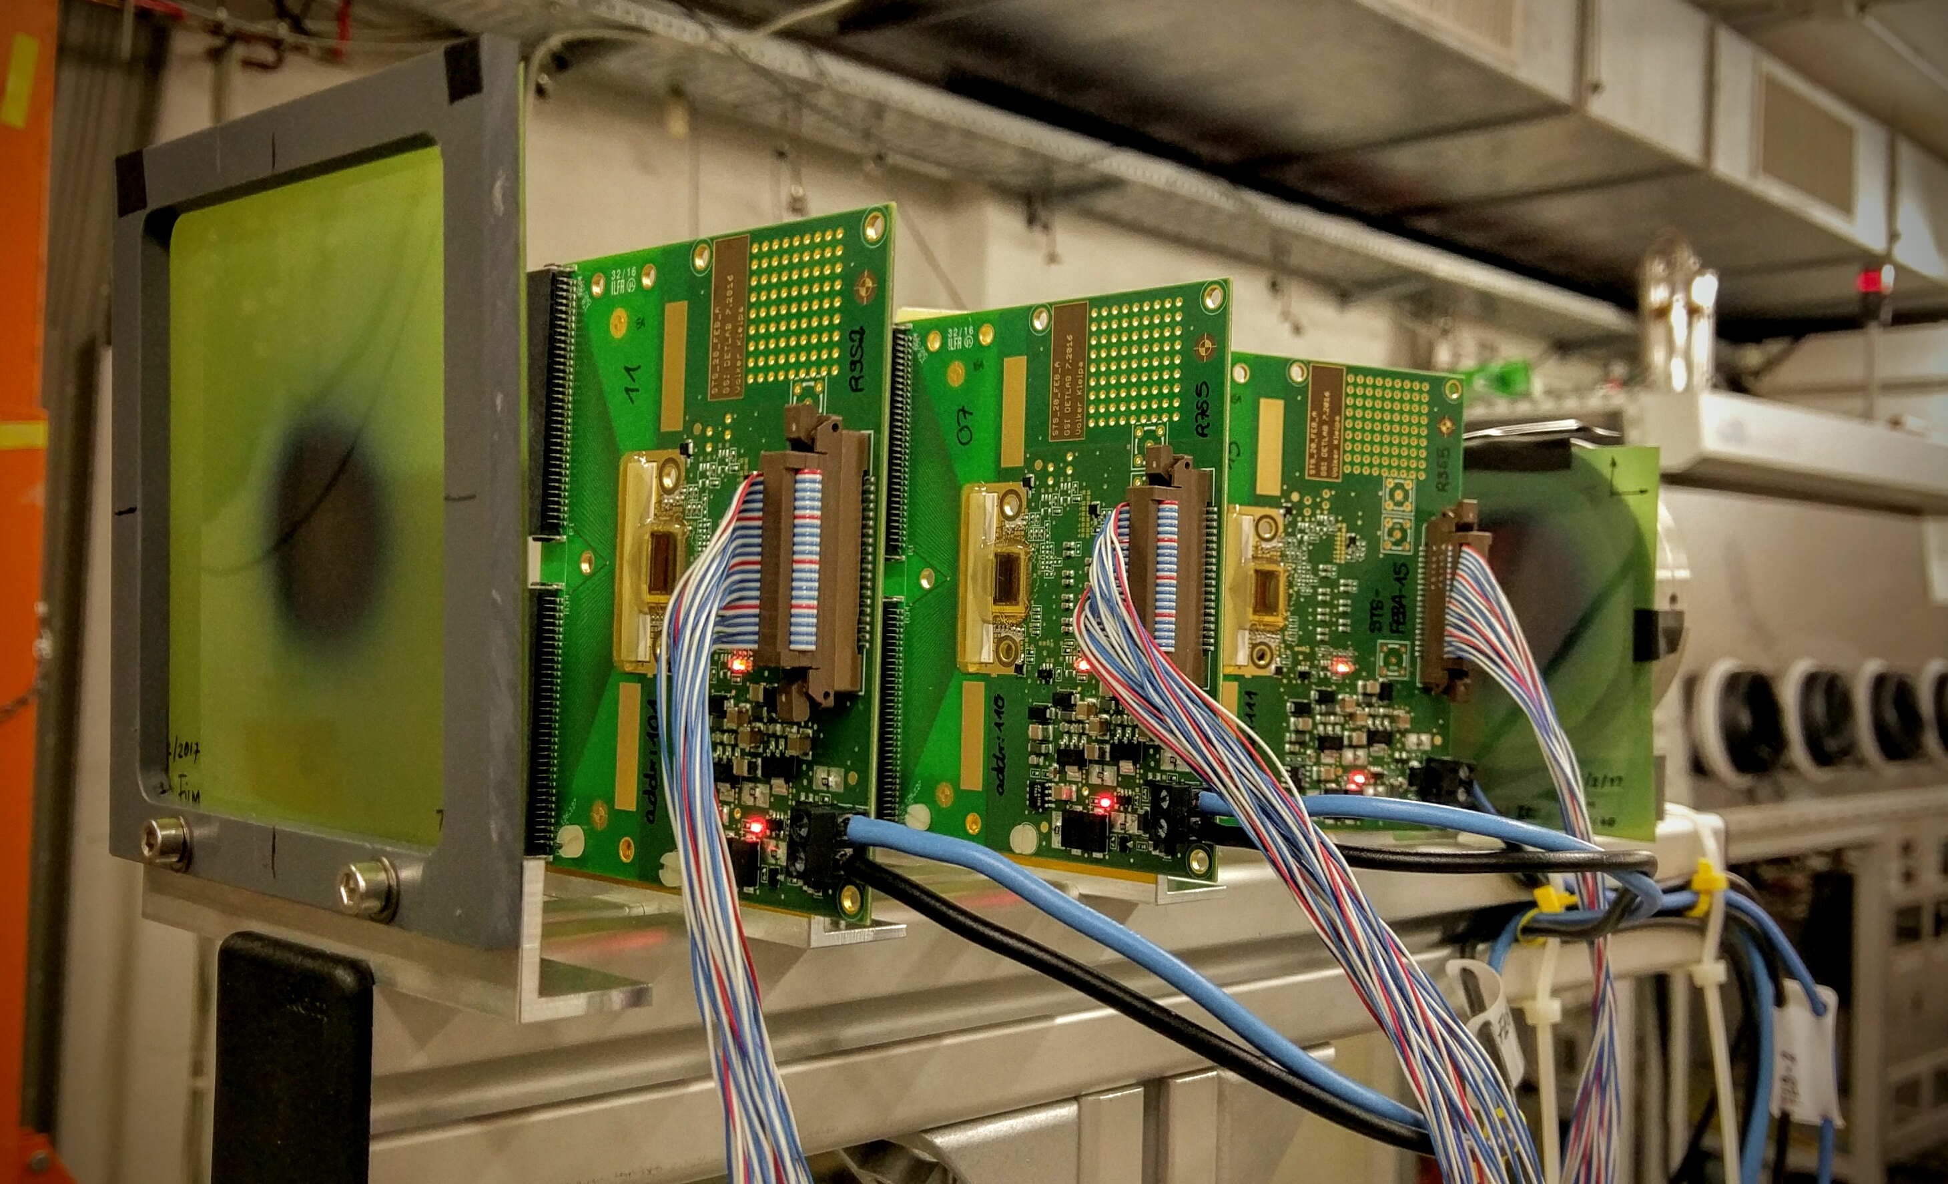
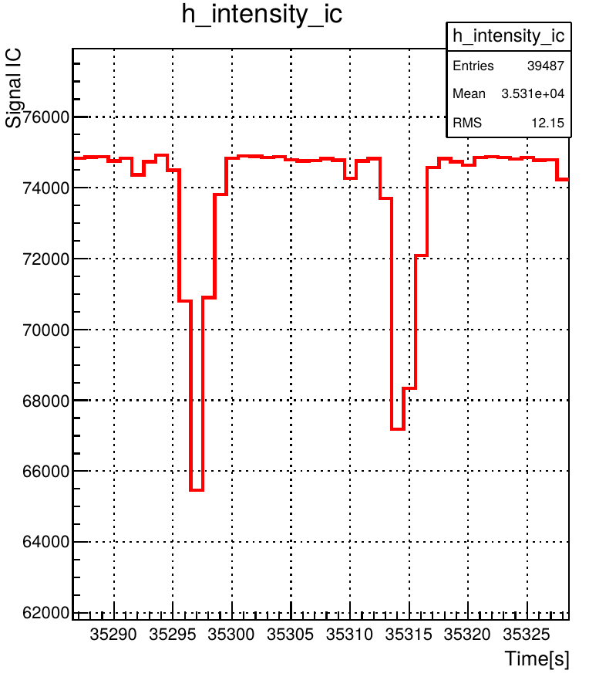
SEU Test Setup@COSY Feb.2017
Two different architectures:
→ DICE cells: 31744 bits (ADC trim DACs)
→ Flip-flops: 47616 bits (ADC disc counters)
→ 3 ASICs under test.
25º
Beam features:
→ 1.6 Gev/c momentum (Info from AT).
→ 18 s duty cycle.
→ 4 – 5 s spill length.
→ Average intensity per spill > 4 x 10⁹ p
→ Effective irradiation time: ~ 45 hours.
→ Integral intensity: ~ 3.7 x 10¹³ p.
Beam monitoring:
→ Ionization chamber (IC) for beam intensity.
→ Gafchromic films for beam position and beam profile.
~18 s cycle

Slide 5
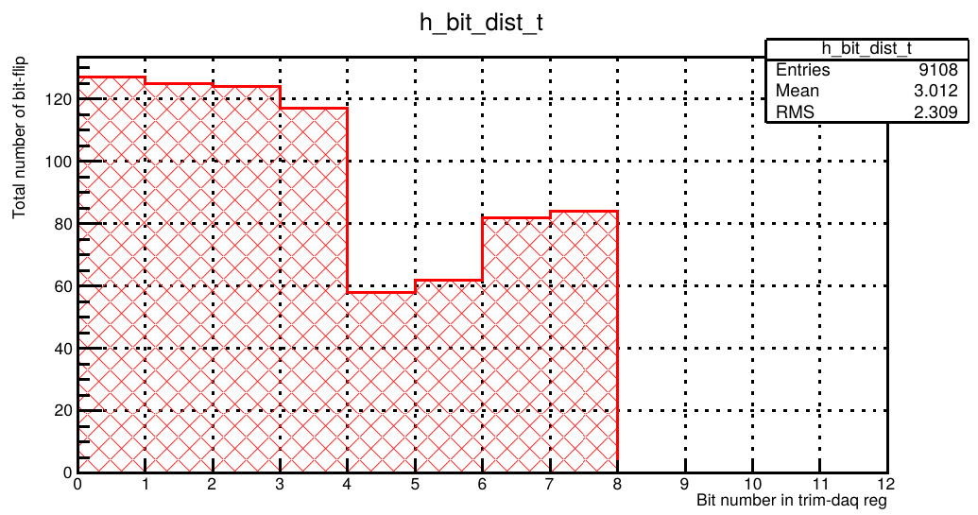
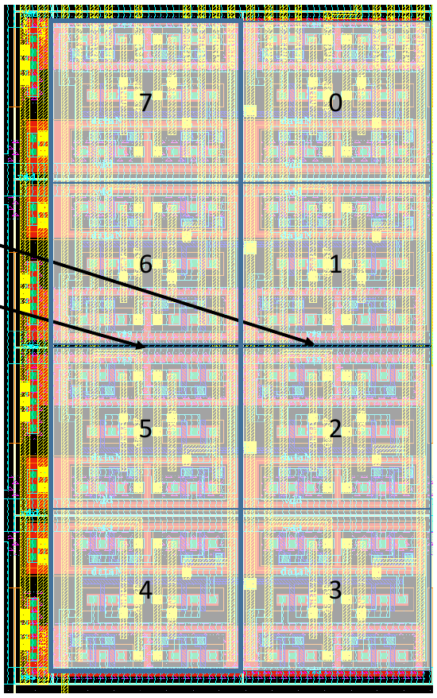
Results (I)
SEU in DICE cells (8 bits).
_____________TOTALS_____________
No. of bits SEU
Flip-Flops: 47616 75057
DICE cells: 31744 759
FF/DICE 1.5 66
Findings:
→ Improvement in the radiation hardness of the DICE cells architecture
relative to the STS-XYTERv1 as expected.
→ Hint for further enhancement (cells 4 to 7)

Slide 6
Results (II)
Two unexpected scenarios of malfunction observed during operation in test beam:
1) Potential latch-up in AFE (analog front end) control path
Symptoms
Errors in read-back from registers in the AFE: counters, configuration registers
correlated with higher supply current ( 0.6 A → 0.8 A )
startup procedure (sync, reset, configure) does not cure
power cycle recovers from condition
4 occurrences during normal operation
No effect seen in registers of digital backend
probably latch-up in row/column decoders of AFE registers
Possible means to fix: more contacts to bulk & wells - and add guard rings.
2) Randomly toggling bits in test counters
some counter bits do not retain stable values: some bits toggle randomly
Symptom: inconsistent or erroneous read-back
appeared at the same time in all 3 ASICs in beam during beam optimization at higher rates ( > 8 × 10⁹ p/spill)
Permanent effect
counters are not rad-hard → only used for monitoring in test phase, not critical
Problem does not affect configuration registers
Possible remedy: applying similar changes as applied to the DICE registers may also solve counter problems:
better T-well & n-well contacts by guard rings
further investigations planned in February 2018

Slide 7
(2) Request for re-scheduled beamtime 2017
In May 2017 we had the following tests scheduled (2 weeks):
Test of readout electronics for RICH-MAPMTs (DiRICH)
Diamond T0 tests with TRB3 read-out
Test of STS sensors (track reconstruction efficiency* → charge collection)
Test of new GEM detectors for MuCH*
Test of new DAQ chain* (n-XYTERv2 ASICs, front-end boards type F, AFCK read-out boards, prototype interface boards FLIB to FLES) * cancelled due to dying/noise problem in n-XYTER front-end boards
We would like to carry out part of the tests in October 2017:
DiRich read-out study
Diamond T0 test / HADES MDC
power regulators – TID effects
Configuration Scrubbing via GBT-SCA chain
1 week of beamtime,
2nd half of October (weeks 42+)** in JESSICA or BIG KARL cave
** due to CBM, HADES Collab. Meetings

Slide 8
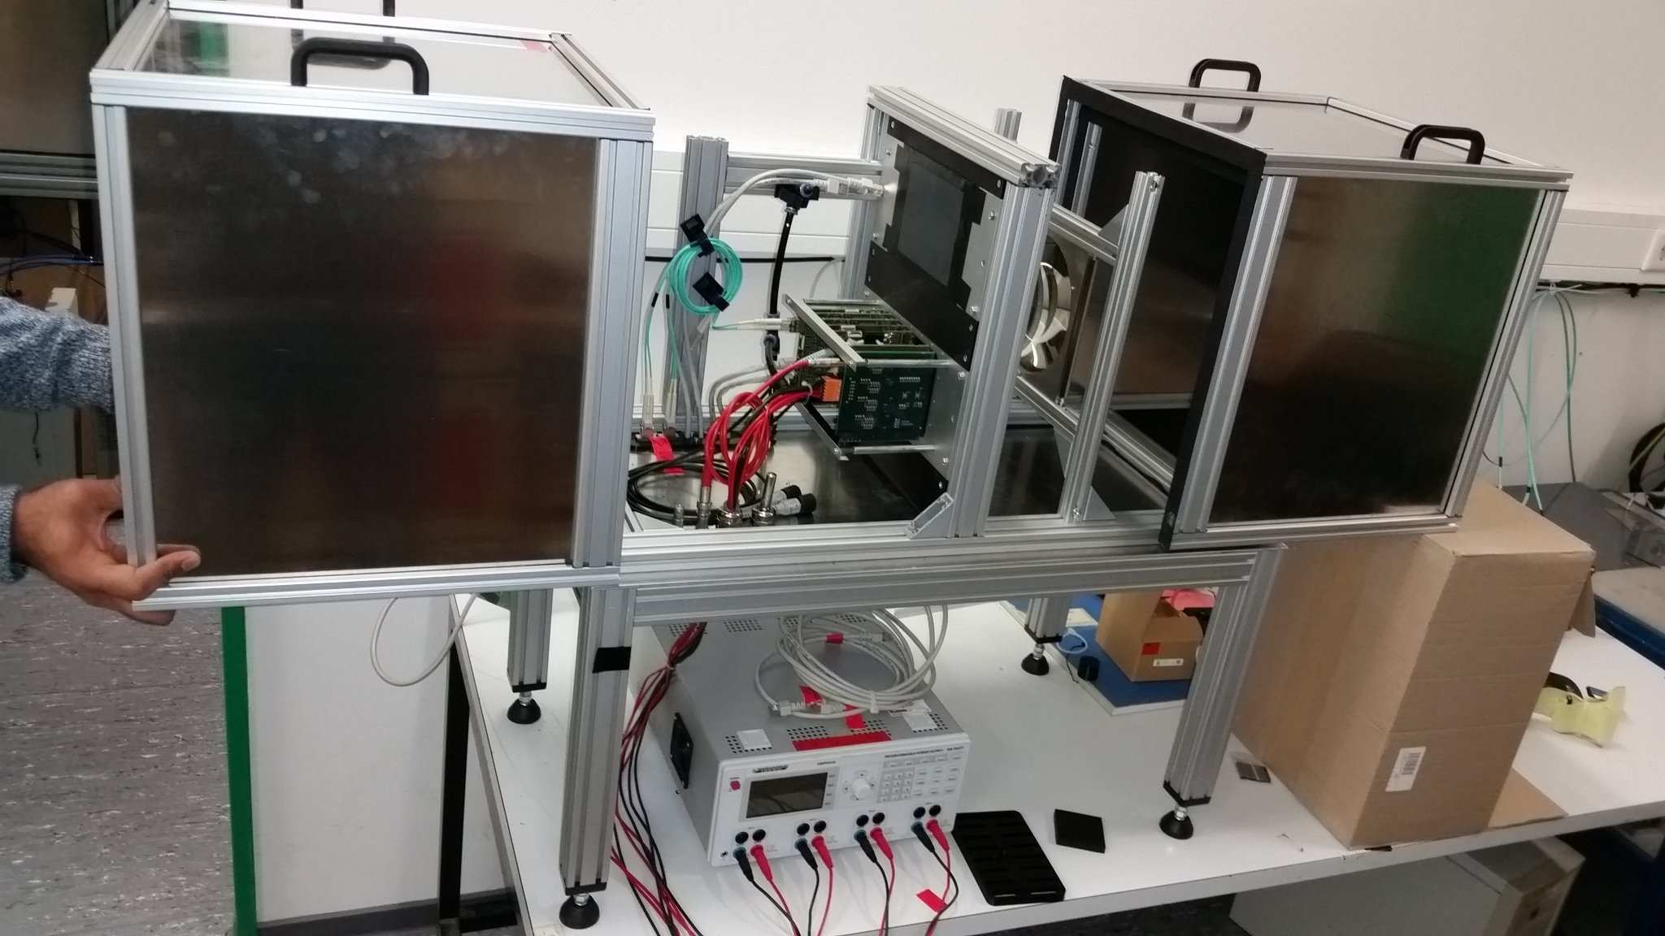
Test of readout electronics for RICH-MAPMTs
Goals for COSY test beam:
First full system test with complete front end electronics: 12 MAPMTs, 2 backplanes, 24 DiRICH, 2 DiRICH-Combiner
Check stability and functionality of new readout chain
Determine single photon detection efficiency with new DiRICH readout
Test readout chain under realistic high rate conditions
Test performance of new WLS coating
p
COSY Cherenkov prototype detector with lense radiator (right compartment), and 1 or 2 fully equipped readout modules (left compartment)
Status:
Second iteration of DiRICH front-end module
30x DiRICH2 produced, ready for testing (2 full backplanes, 12 MAPMTs)
COSY prototype testbox ready for beam:
- Solid glass lense Cherenkov radiator - with 2 modules: 12 MAPMTs, 24 DiRICH
Promising first tests at GSI with light pulser in preparation of COSY beamtime:
first DiRICH “ring” with light pulser + shadow mask at GSI

Slide 9
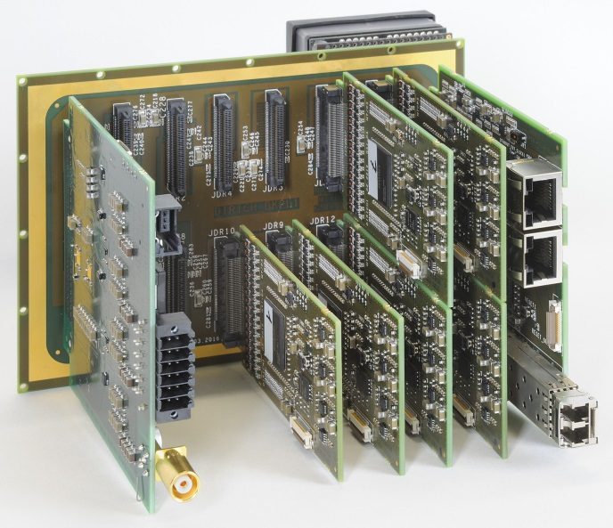
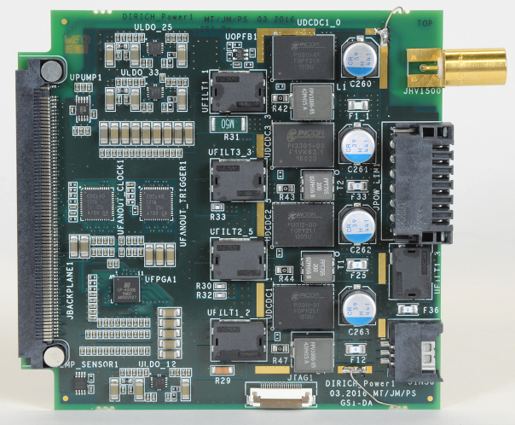
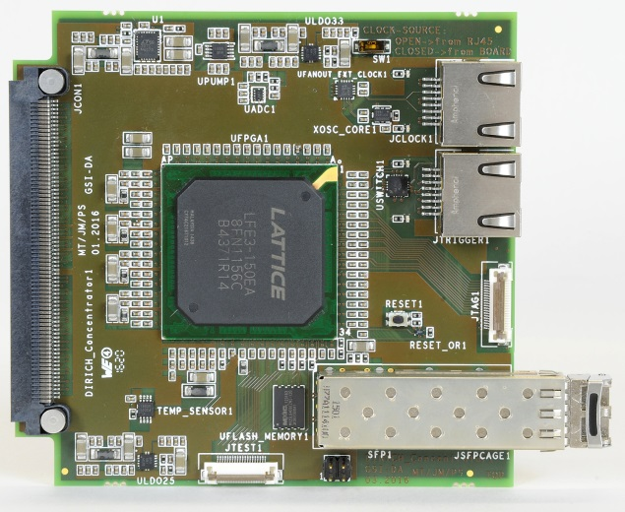
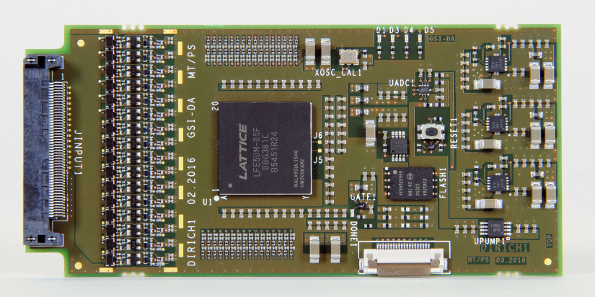
DiRICH read-out modules
DiRICH-Power module for LV and HV supply
full backplane for 6 MAPMTs, 12 DiRICH + Combiner + Power module
single DiRICH front-end module, 32 ch
DiRICH-Combiner module

Slide 10
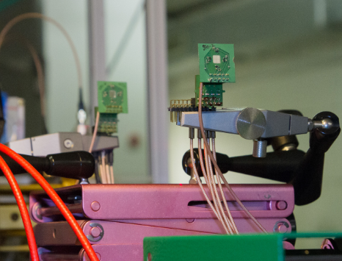
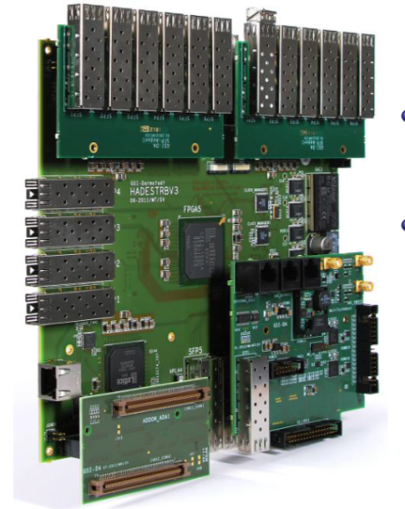
Diamond T0 tests with Scope/TRB3 read-out
TRB3 System:
FPGA-based high precision TDC measurement and DAQ in one
Leading edge precision: 8-12ps (RMS)
Very flexible trigger functionality (FPGA)
Hit rates < 50 MHz (burst)
Used in many FAIR Projects:
HADES (diamond/trigger/RICH/ECAL),
CBM RICH,
PANDA (Barrel-DIRC/Straw)
and also outside of FAIR: MUSE, A1, ...

Slide 11
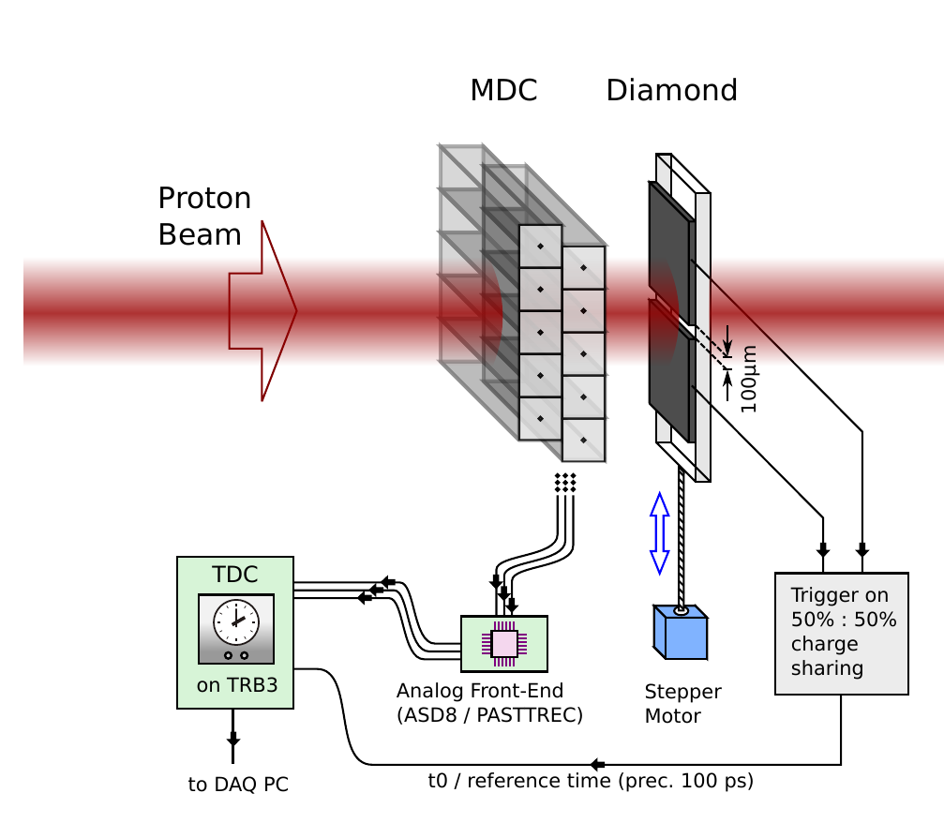
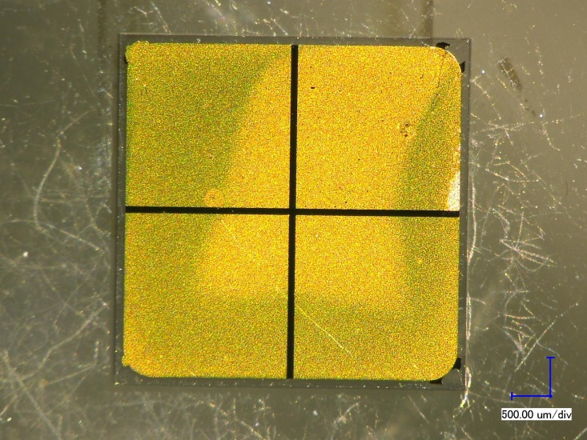
MDC & Diamond setup
Goals:
Study drift velocity map inside drift cell, gas mixture dependency
Compare precision of old & future HADES analog ASICs
Measure spatial resolution of full system: MDC + analog + digital electronics with standalone DAQ
Setup:
Mini Drift Chamber (MDC)
50x20 cm² active area
2 drift cell layers, each 40 cells (5x5 mm²)
reference / tracking by Diamond (scCVD) detector:
4 channels, 100µm gap
time precision < 100 ps
movable (µm step precision)
drift time map inside a single drift cell (measured by laser ionization @ HZDR)
Mini Drift Chamber (MDC)
scCVD

Slide 12
(3) Application for beamtime in Q1/2018
(a) One week of electronics tests in high-intensity proton beam (February 2018)
STS-XYTER v2 ASIC: near-final chip before its mass production;
carry out more detailed investigations of open questions:
verify single-event for register cells of different architectures
verify unexpected latch-up events observed previously
verify potentially dose-rate dependent failures at highest COSY intensities (> 7 × 10⁹ protons/spill of 5 seconds)
Test new custom-designed LDOs for effects of total ionizing dose and fast transients.
Test robustness of new Fault Tolerant Local Monitoring and Control (FTLMC) board against SEU radiation effects
Different FPGA electronics will be tested for single-event upsets and the effectiveness of data correction methods.

Slide 13
(3) Application for beamtime in Q1/2018
(b) One week of detector tests in mid-intensity, widened proton beam (February or early March 2018)
Test of prototype STS modules read out with the STS-XYTER v2 ASIC
The module will employ the final prototype sensors and microcables bonded to STS-XYTER v2 ASICs mounted on a technical prototype of the front-end electronics board.
Several modules shall be tested for their detection performance in a particle beam covering a good fraction of the silicon sensors. Beam widened to the pipe diameter in the Big Karl cave (about 6 cm diameter) is well suited to such test.
T0 Diamond detector test

Slide 14
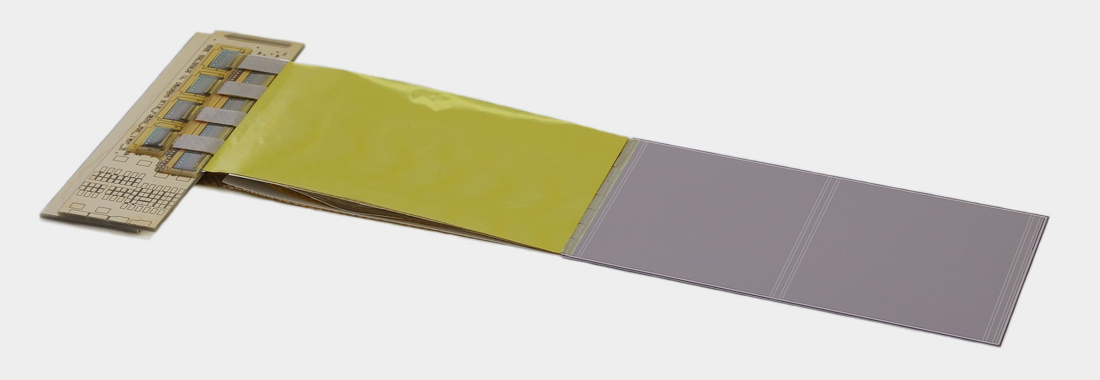
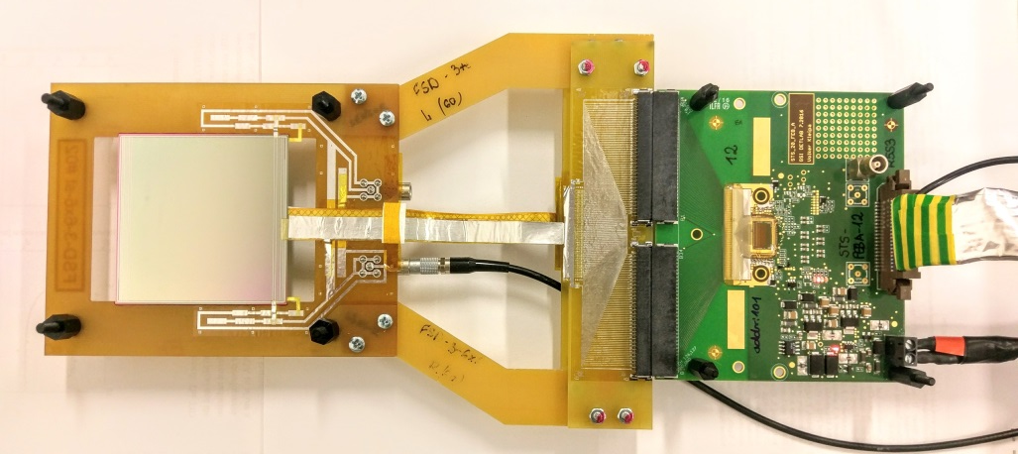
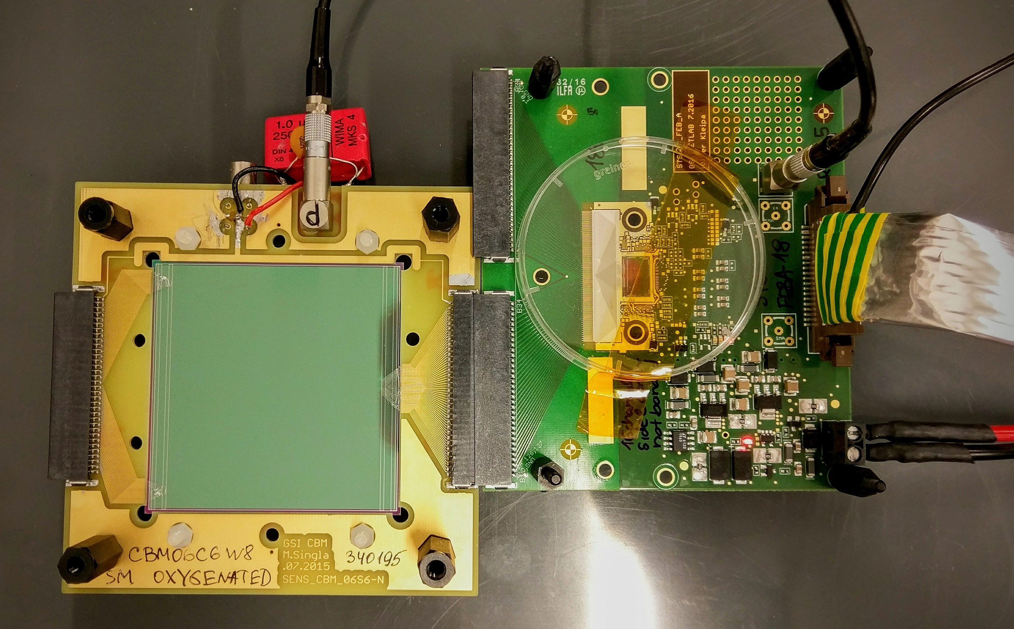
Prototype STS module read out with the STS-XYTER v2 ASIC
FEB-8 under development
dummy module from assembly trials
microcables
microstrip sensor
STS-XYTERv2 test board connected to a silicon microstrip sensor
prototype module with STS-XYTERv2 read-out under preparation

Slide 15
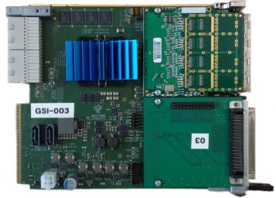
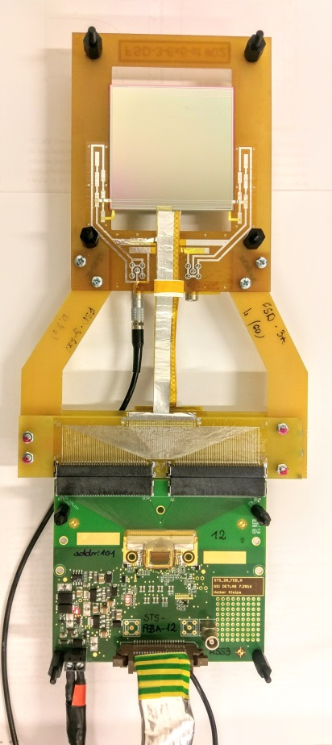
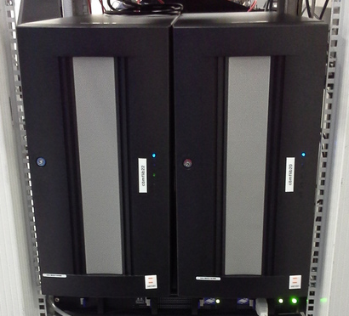
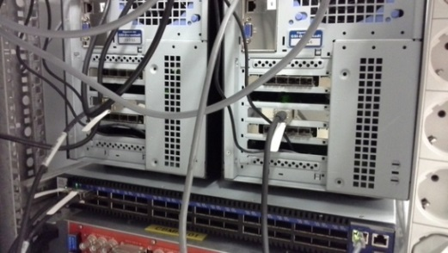
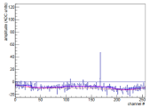
Prototype STS module read out with the STS-XYTER v2 ASIC
STS-XYTER FEB (r/o front + back ) 2x 128 chs
key issue to be addressed:
S/N as function of micro cable length
2 x 1 E-Link
IP bus
AFCK-DPB
FLIB
FLES node

Slide 16
CBM request October 2017 summarized
Total number of particles and type of beam (p,d,polarization) | Momentum range (MeV/c) | Intensity or internal reaction rate (particles per second)
 |  | minimum needed | maximum useful
p | p ~ 2700 p ~ 400 | ~ 10⁴ | up to 10⁶
Experimental area | Safety aspects (if any) | Earliest date of installation | Total beam time (No.of shifts)
JESSICA or Big Karl Cave | None | October 2017 Detector tests: DiRICH readout, T0 | 7 days around the clock (installation of equipment in advance of the beamtime week advantageous)

Slide 17
CBM application Q1/2018 summarized
Total number of particles and type of beam (p,d,polarization) | Momentum range (MeV/c) | Intensity or internal reaction rate (particles per second)
 |  | minimum needed | maximum useful
p | p ~ 2700 | ~ 10⁴ – 10⁶ (detector tests) | up to 10⁹ (electronics tests)
Experimental area | Safety aspects (if any) | Earliest date of installation | Total beam time (No.of shifts)
JESSICA or Big Karl Cave | None | February 2018 electronics tests: front-end ASIC STS-XYTERv2, power regulators,control boards, FPGA | 7 days around the clock (installation of equipment during the beamtime week is sufficient)
Experimental area | Safety aspects (if any) | Earliest date of installation | Total beam time (No.of shifts)
Big Karl Cave | None | February/early March 2018 detector tests: prototype STS module with STS-XYTERv2 read-out , T0 | 7 days around the clock (installation of equipment during the beamtime week is sufficient)

