Slide 1
CBM silicon tracker: status and potential items for collaboration
Silicon Tracking System – brief overview and status
Items for cooperation – already started, potentially new
Johann M. Heuser, GSI, CBM-STAR Joint Meeting, Wuhan, 23 September 2017

Slide 2
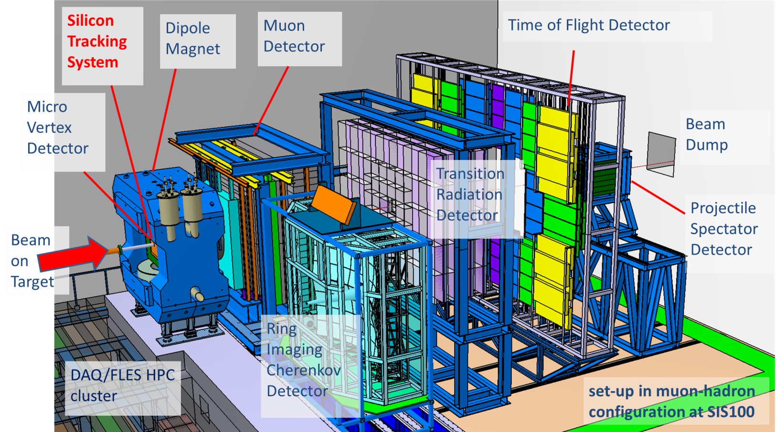
STS in CBM experiment

Slide 3
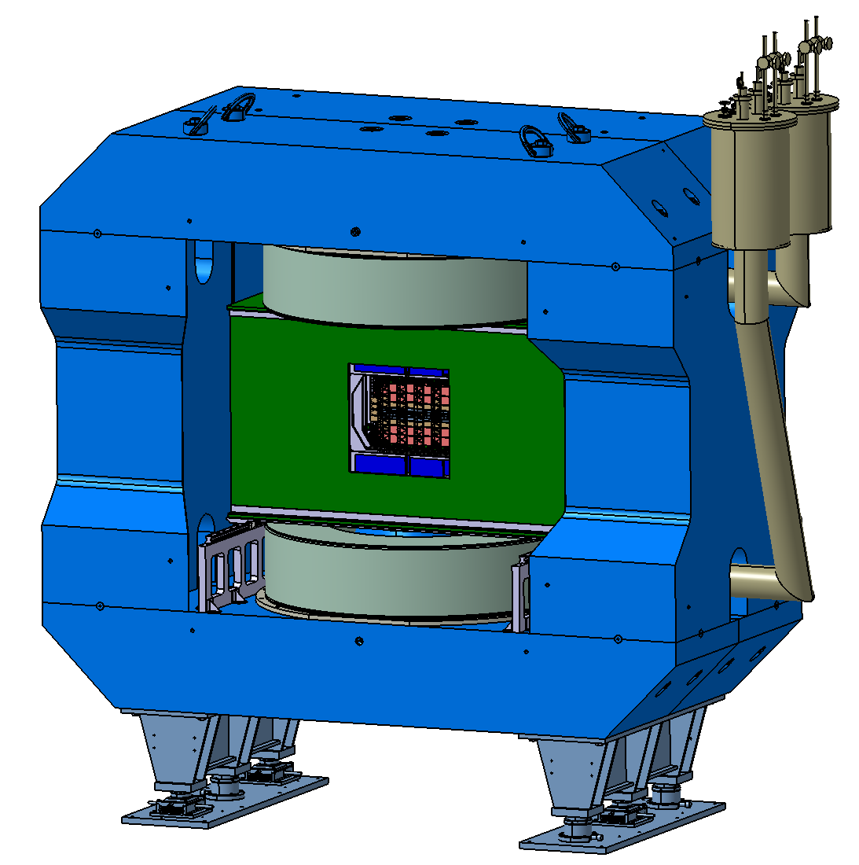
Silicon Tracking System

Slide 4
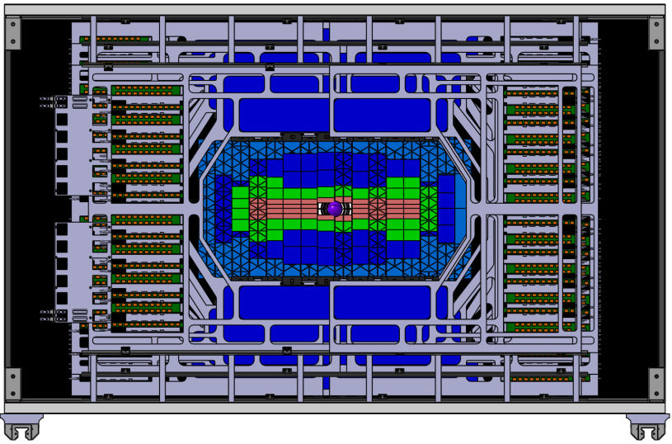
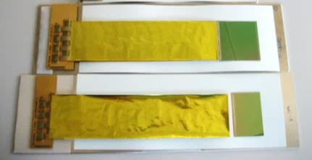
Silicon Tracking System
971
2300
1425
STS
beam axis
2.5°
FEE
25°
896 modules (1.8 M channels)
ROB POB
+ LV + HV supplies
+ cooling system
+ controls system
+ software
106 ladders
18 STS half- units

Slide 5
Status
[ source: detailed STS project plan ]
Towards Production Readiness:
Silicon Sensors:
readiness: 12/2017, tendering Early 2018
front-end electronics:
ASIC: prototype v2.0 under evaluation, readiness by Fall 2018
Front-end board: prototype: Fall 2017, ready for production: 7/2018
Read-out board: GBTx chip set ordered via CERN; ready 7/2018
Power boards: under development, FEAST dc-dc converter from CERN; ready 7/2017
modules:
prototypes for in-beam test: 12/2017; pre-production for mCBM: mid 2018
assembly procedure ready: 7/2018
ladders:
pre-production for mCBM: 5/2018 and 9/2018
system integration:
progressing towards units for mCBM: Mid 2018, for CBM: 10/2018
Core Readiness: 1/2019 Production: 2019 – 2022

Slide 6
Teams involved
Task | Team
Si microstrip sensors | GSI, Darmstadt, Germany EKU Tübingen, Germany JINR-VBLHEP, Dubna, Russia
Front-end ASIC and board | AGH, Cracow, Poland WUT, Warsaw, Poland GSI, Darmstadt, Germany JU, Cracow, Poland
Read-out and power boards | GSI, Darmstadt, Germany
Module assembly | GSI, Darmstadt, Germany JINR-VBLHEP, Dubna, Russia KIT, Karlsruhe, Germany
Ladder assembly | GSI, Darmstadt, Germany JINR-VBLHEP, Dubna, Russia
System Integration | GSI, Darmstadt, Germany
Cooling | EKU Tübingen, Germany
Assembly Centers: GSI-FAIR, JINR-VBLHEP

Slide 7
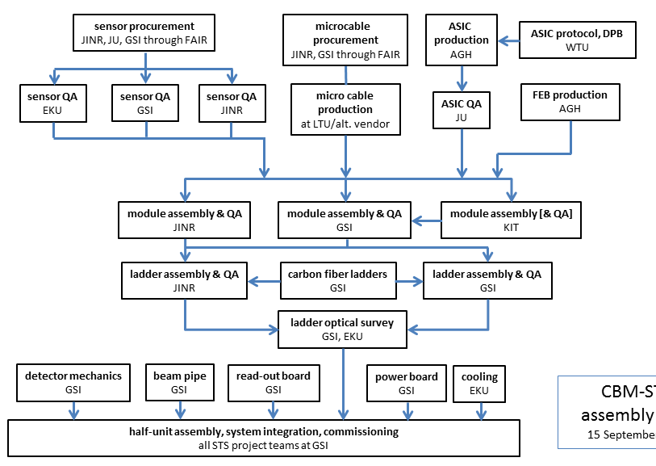
STS construction flow

Slide 8
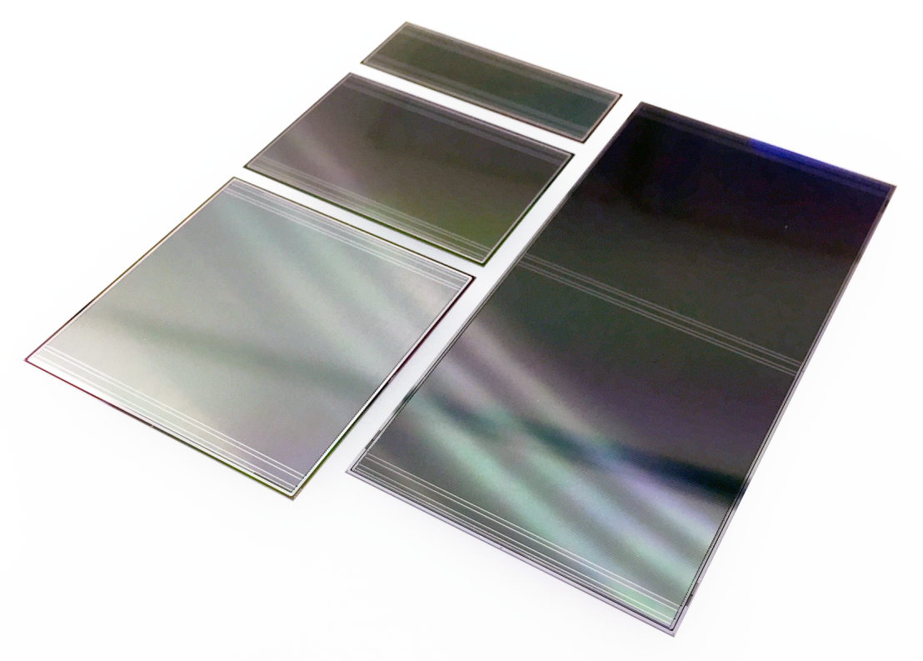
Silicon microstrip sensors
6.2 x 2.2 cm² 6.2 x 4.2 cm² 6.2 x 6.2 cm² 6.2 x 12.4 cm²
→ cooperation started:
sensor specimen + technical information sent to UIC (Zhenyu Ye) after 1st CBM-STAR meeting for independent evaluation
input welcome for Production Readiness in 2018

Slide 9
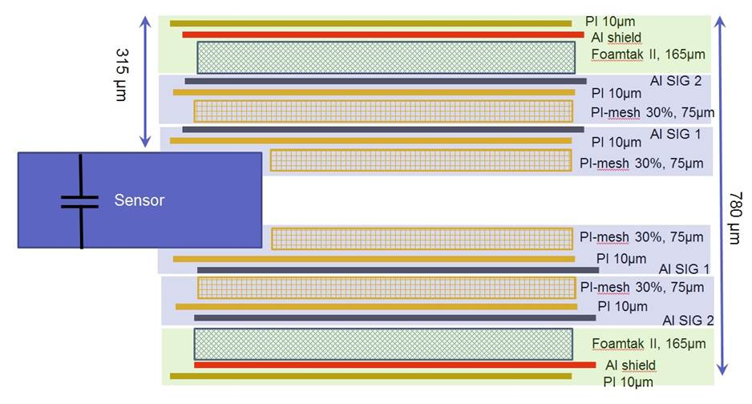
Micro cables/Module assembly
→ cooperation started:
technical information on micro cables sent to UIC (Zhenyu Ye) after 1st CBM-STAR meeting
Q: is there a US based vendor for this technology (Al or Cu based) ?
A: negative
UIC addressing to CERN TS-DEM

Slide 10
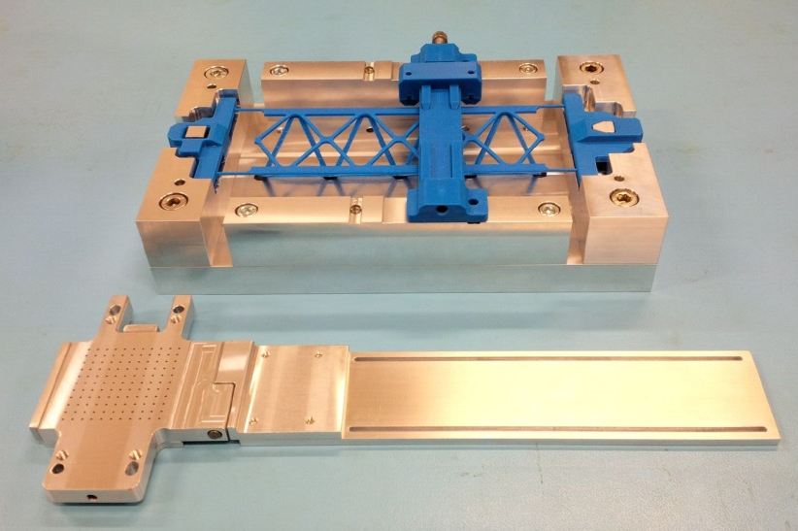
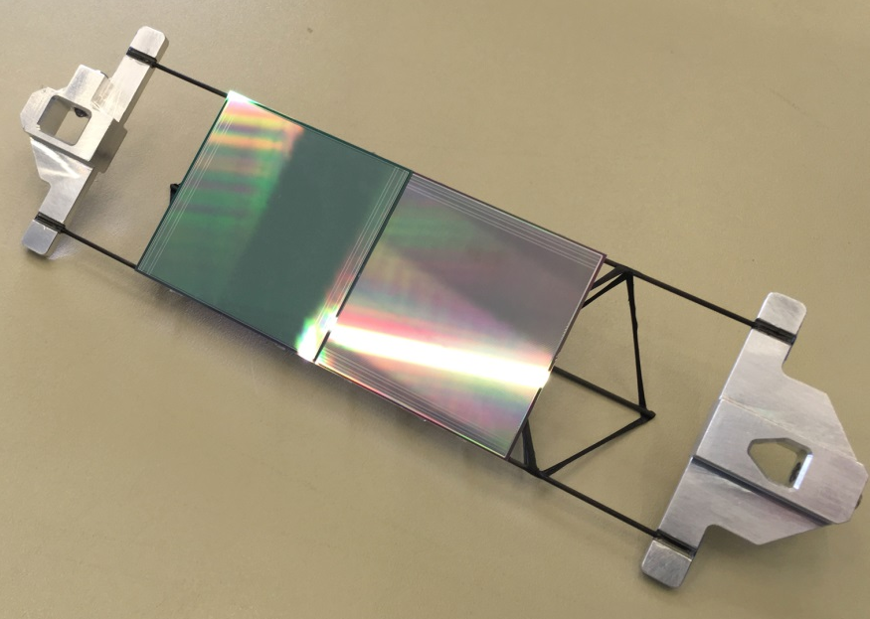
Ladder assembly

Slide 11
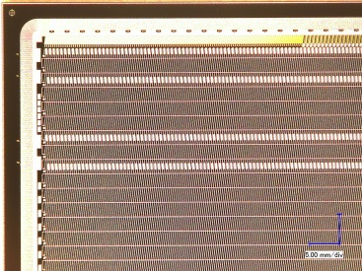
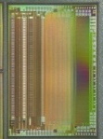
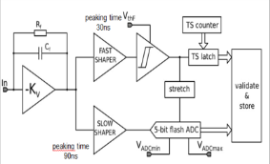
Read-out chain
STS-XYTER ASIC 8 ×
Front-end Board
Read-Out Board
Power Boards
copper link
optical link
Data Processing Board
time-slicing
FLES online event computing center
microstrip sensor with 1024 channels/side
data combining
STS-XYTER ASIC | v2.0 (produced 2016) 2016 JINST 11 C02024
CMOS process | UMC 180 nm
channels | 128, polarity +/-
noise | < 1ke⁻ at 20-50 pF load
ADC range | linear up to12 fC, 5 bit
clock | 250 MHz
power | < 10 mW/channel
timestamp | ~5 ns resolution
out interface | 5 × 500 Mbit/s LVDS
self-triggering
STS-XYTER chips
à 1/2/5 LVDS E-links out
time-stamped data
GBTx chip-set (CERN):
3 GBTx, 1 VTRx, 1 VTTx, 1 SCA 42 E-links à 320 Mb/s
3 GBT optical uplinks à 4.48 Gb/s
free-streaming DAQ system

Slide 12
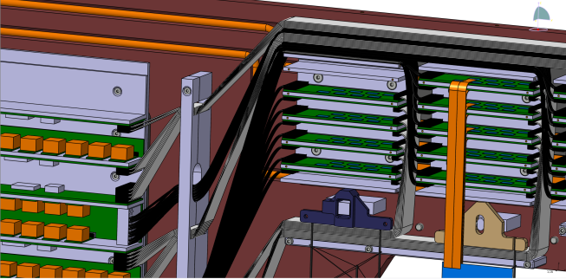
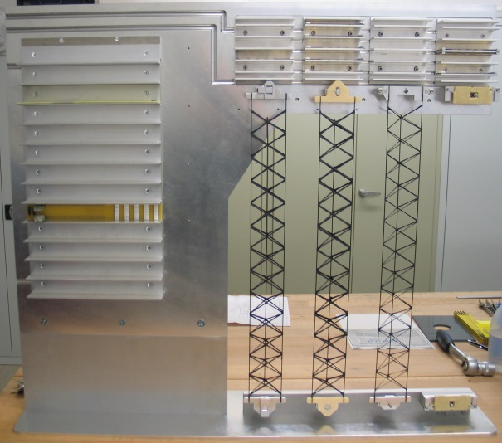
System Integration
Assembly of demonstrator ¼ Unit 07

Slide 13
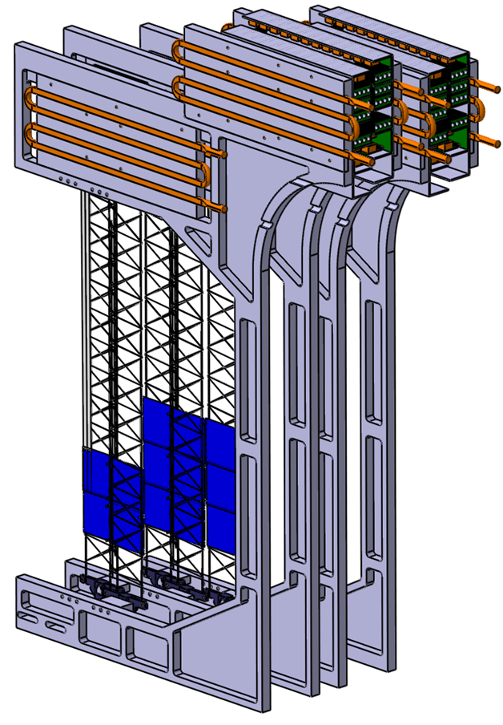
Test experiments
mSTS in mCBM
propsed: Fall 2018 – 2019, potentially until 2021
mSTS:
two tracking stations
aim: verify module/ladder/tracking performance
station 0: made from 2 ladders of 2 modules with sensor 6x6 cm²
station 1: made from 3 ladders of 3 modules with sensor 6x6 cm²

Slide 14
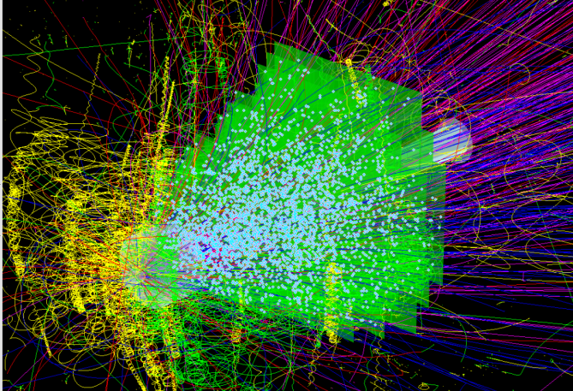
Detailed understanding of STS detector

Slide 15
Detailed understanding of STS detector
Validation of detector simulation against experimental data:
detailed coding of detector and physical processes/parameters (charge diffusion, cross talk, noise, attenuation, ...) available. But is it realistic, calibrated, validated?
alignment
fast 4d track reconstruction
Detector commissioning:
using prototype modules
mSTS/mCBM → STS/CBM
further grounds of
cooperation ?

Slide 16
Thank you

