Slide 1
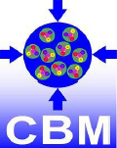


eTOF MRPC Production Status at Tsinghua University
Lyu Pengfei
Department of Engineering Physics,
Tsinghua University, Beijing, China
September 23rd, 2017
CBM-STAR Joint Meeting

Slide 2
Outline
Mass production status of MRPC3a
  Conceptional design of MRPC3a
  MRPC3a production procedure
  Quality assurance results
Preliminary test results
  HV test
  Cosmic test based on TRB system
Plan and time line
Summary

Slide 3
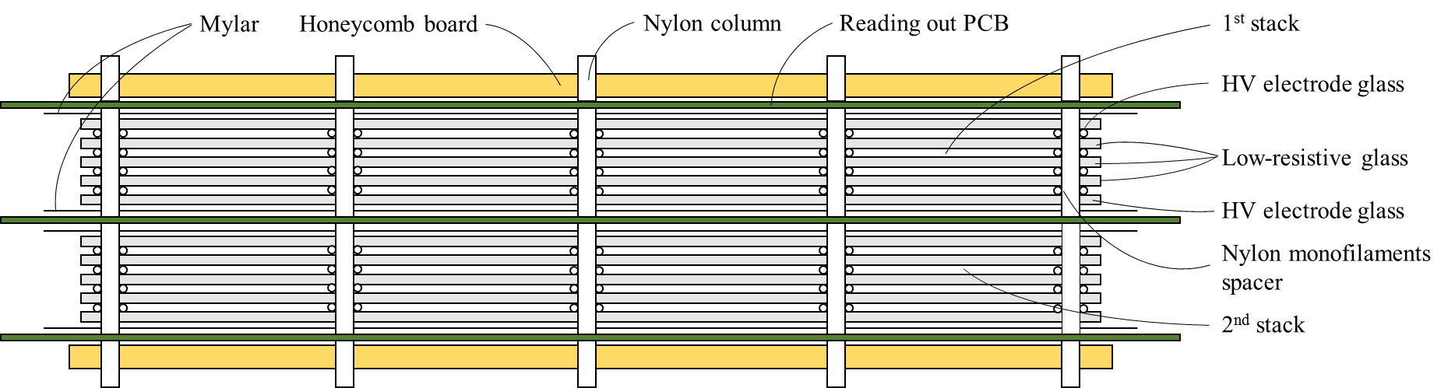
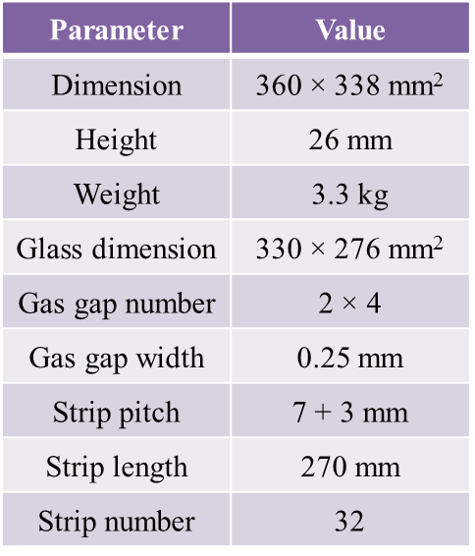
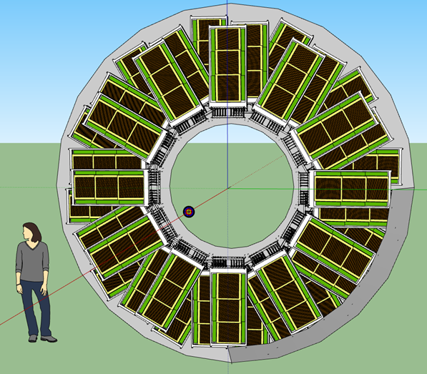
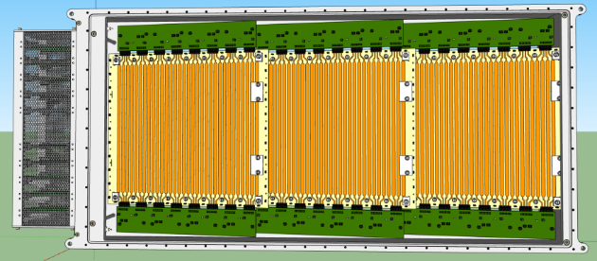
Conceptional Design of MRPC3a
The sectional sketch of the double-stack MRPC3a.
STAR eTOF
STAR module

Slide 4
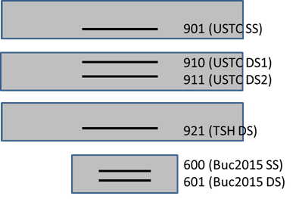
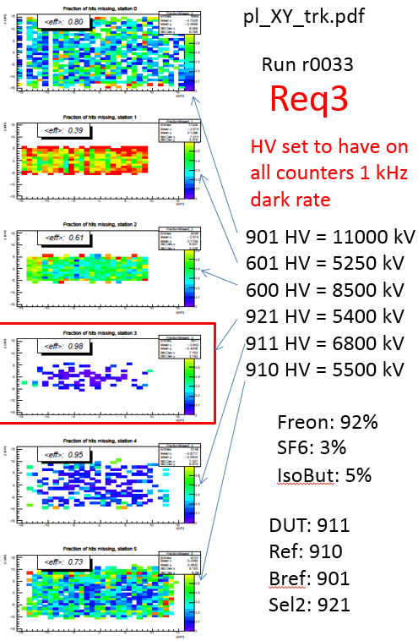
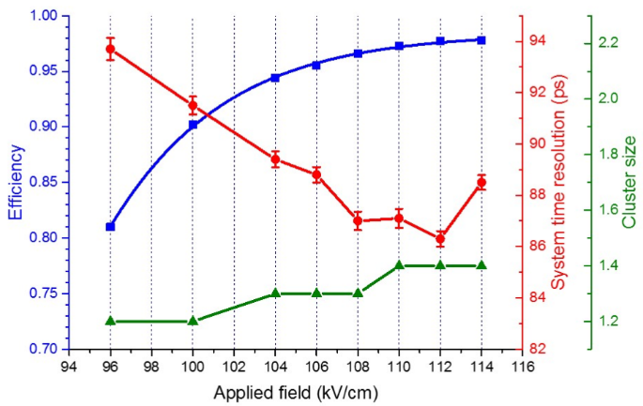
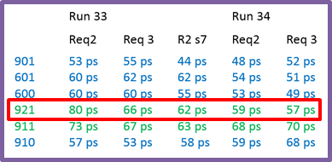
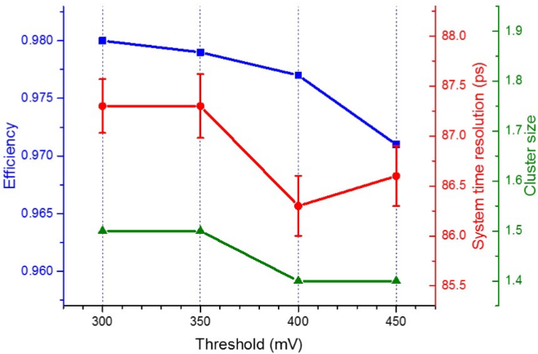
Conceptional Design of MRPC3a
MRPC3a prototype in SPS beamtest (Nov 2015).
MRPC3a prototype in Heidelberg cosmic test.
From Ingo’s talk on July 5th
30 GeV Pb beam on 1mm/2mm/3mm Pb.
Flux rate up to 10 Hz/cm².
Performance in HV and threshold scan:
Time resolution: ~ 60 ps
Efficiency: > 98%
Cluster size: ~ 1.5

Slide 5
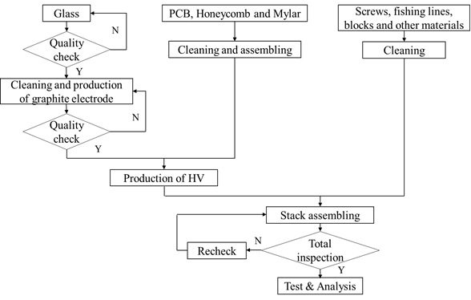
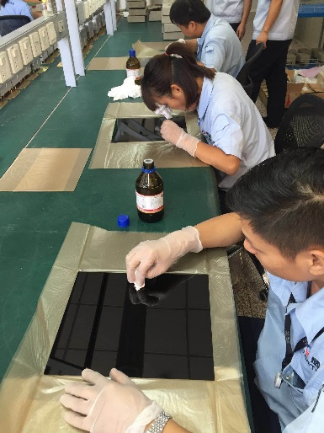
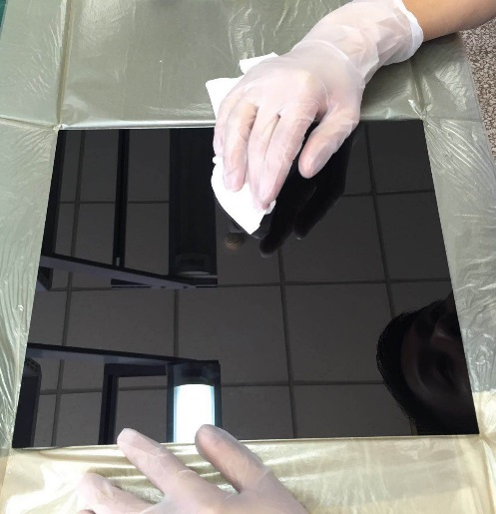
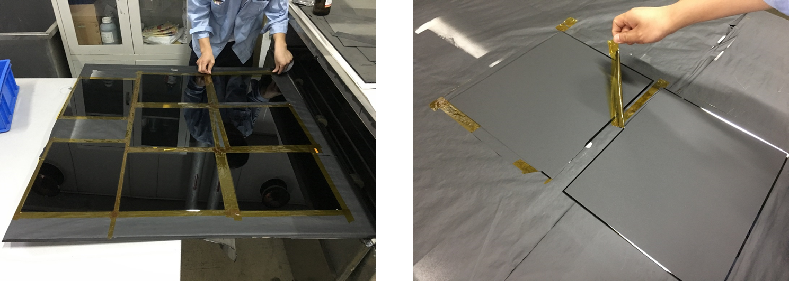
MRPC3a Production Procedure
Quality check of glass & electrode production.
Every piece of glass in each batch has been inspected.
Sprayed electrode. 3 mm space on edge is for getting rid of edge effect.
Electrode glass before spraying.

Slide 6
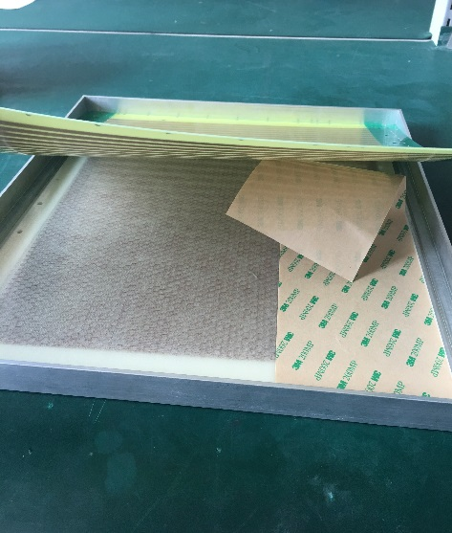
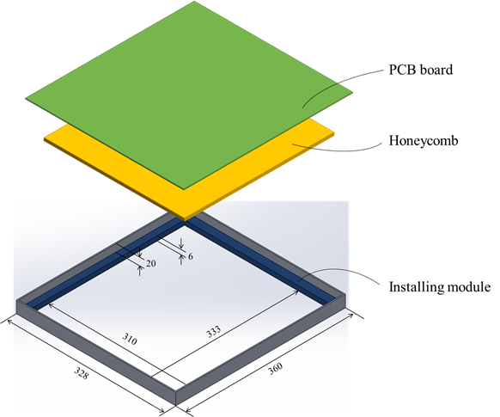
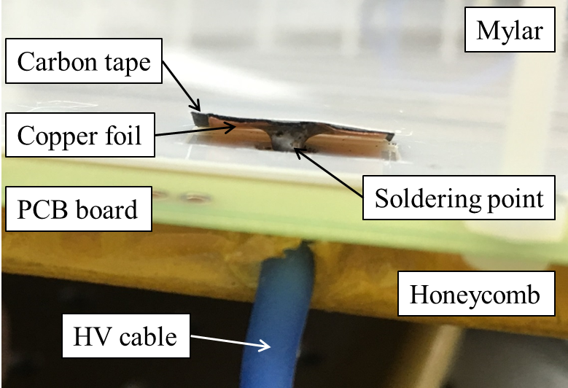
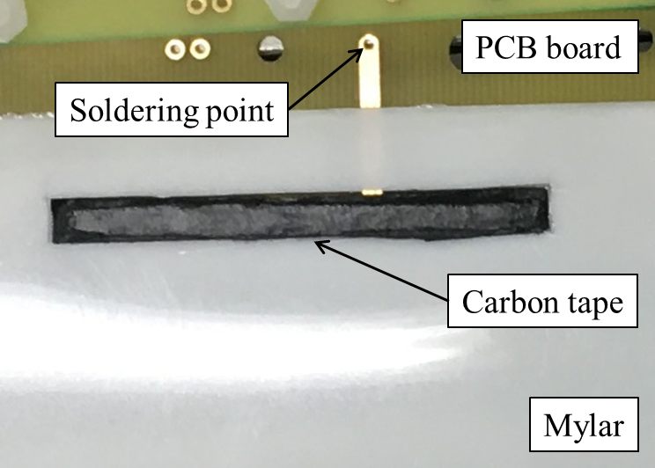
MRPC3a Production Procedure
Assembling PCB board & HV production.
An installing module can fix the PCB board and honeycomb together exactly.
HV connection to top & bottom board. This is to avoid discharge between HV & the nearest strip.
HV connection to middle board.

Slide 7
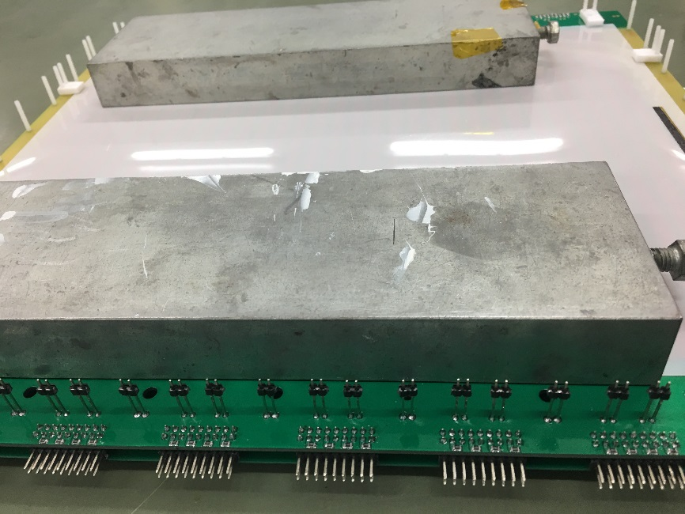
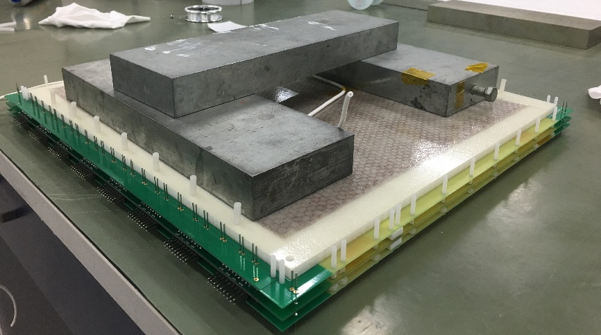
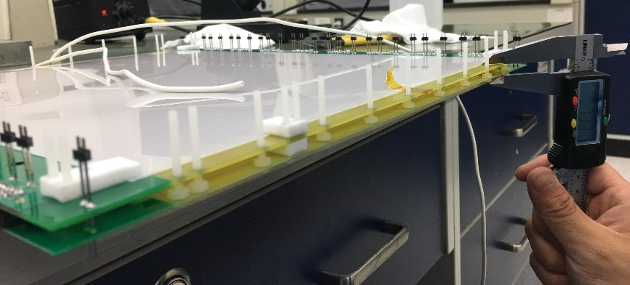
MRPC3a Production Procedure
Stack assembling procedure.
Iron bricks are applied to press the first stack, while the pins are soldered.
The same procedure is repeated when assembling the second stack.
Distance between the two PCBs is monitored during assembling.

Slide 8
Quality Assurance Results
Quality assurance of each type of materials and the assembling procedure is recorded.

Slide 9

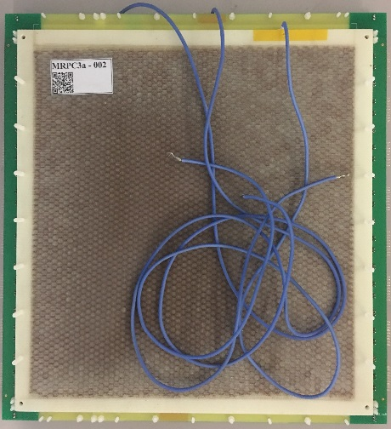
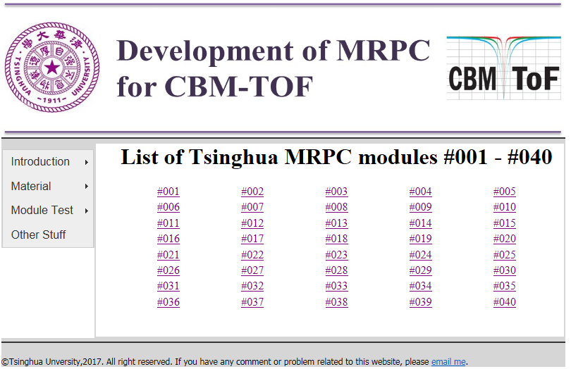
Quality Assurance Results
Quality assurance of each type of materials and the assembling procedure is recorded.
Detailed information can be found by scanning the QR code on it.
A website is developed to record all the QR information of each produced counter: http://hepd.ep.tsinghua.edu.cn/CBM_TOF/

Slide 10
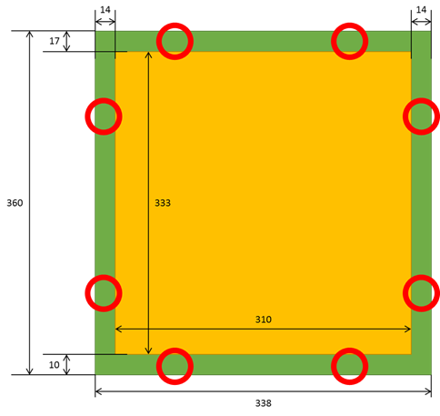
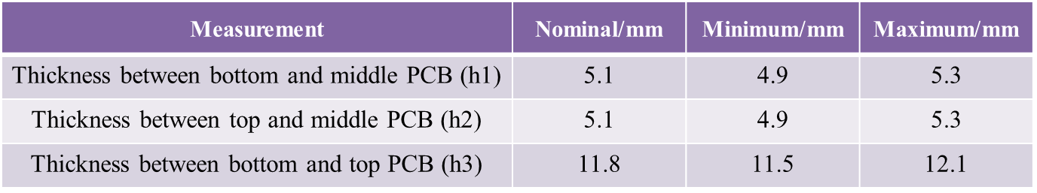
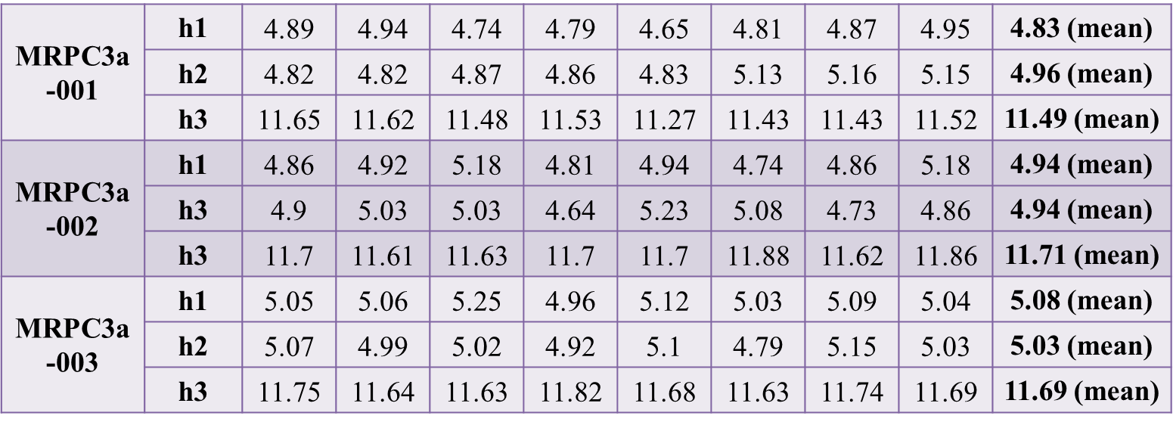
Quality Assurance Results
Thickness uniformity between each PCB has been measured at 8 points around the assemble counter.
The requirement is the thickness of two adjacent PCBs should be within ±0.2 mm of the nominal value.
The distance measured at the edge is not absolutely equal to the thickness in glass & gap region, but it could be a reference.

Slide 11
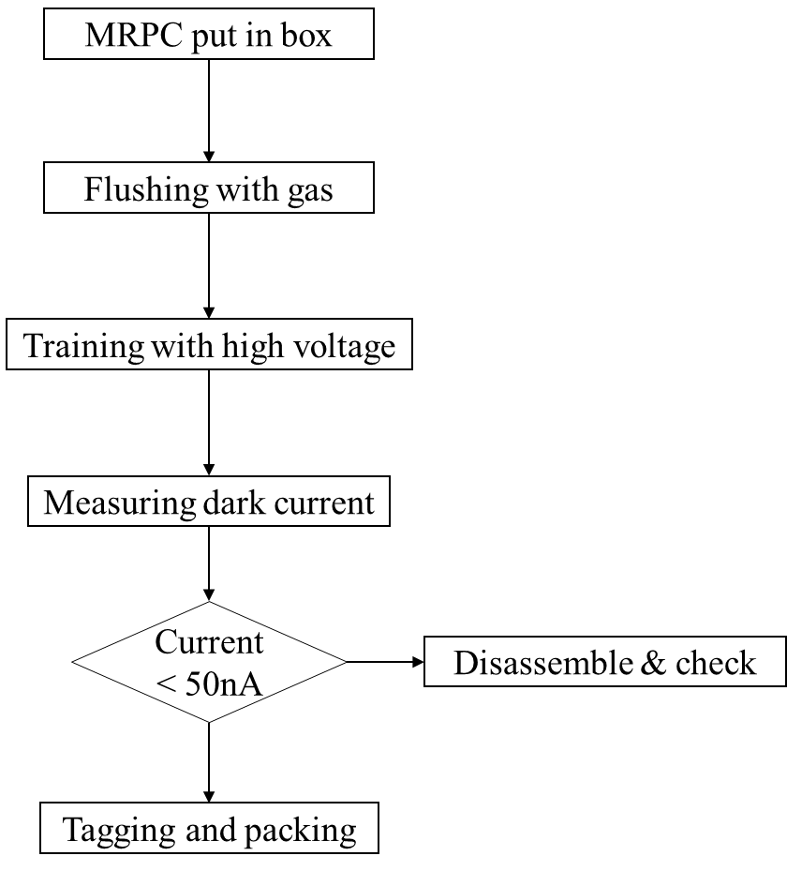
HV Test
All the MRPC3a counters should be tested with HV.
The working gas is 90% C₂H₂F₄, 5% i-C₄H₁₀ and 5% SF₆. The flushing time is 60 hours (determined by 3 times of the gas box volume 72 L and gas flow 3.6 L/h).
The counter should be trained 10 hours at the nominal voltage of 5500V.
Dark current read out from HV crate should be no more than 50 nA, otherwise, it will be disassembled to look for the reason.
The qualified counters are ready for cosmic test.

Slide 12
HV Test
After 10 hours’ HV training, the counter is set to 5600 V, and the PADI’s threshold 300 mV.
Dark current and noise rate monitored in 170 hours since the MRPCs are trained.
Dark current < 50 nA √
Noise rate around 1 Hz/cm²

Slide 13
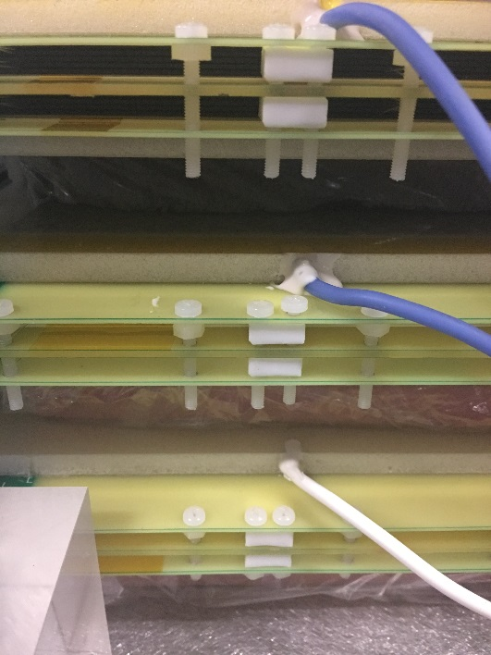
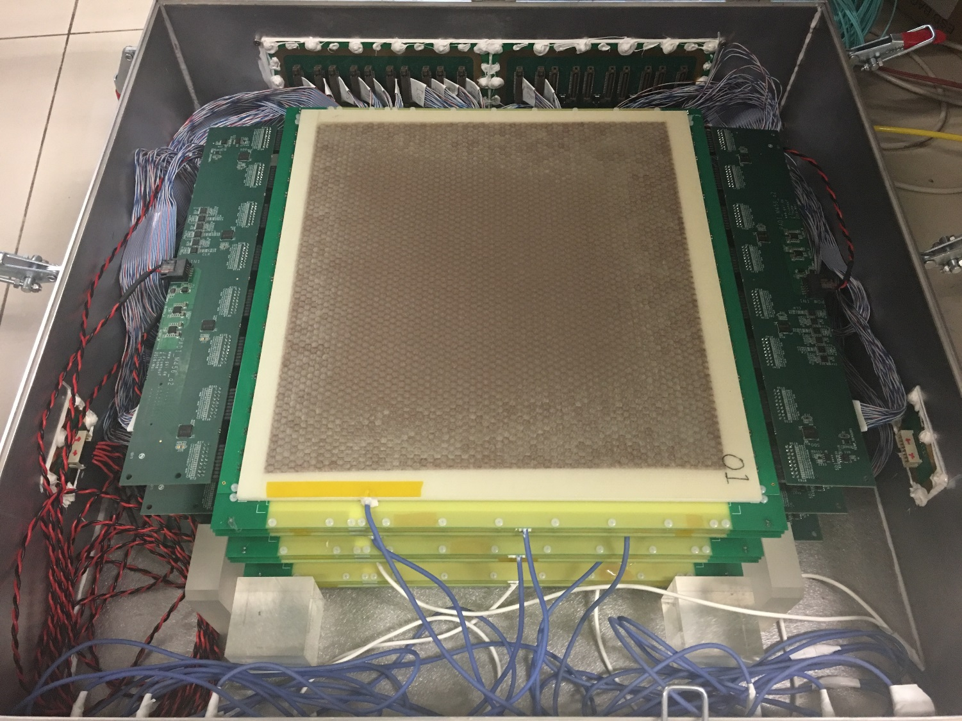
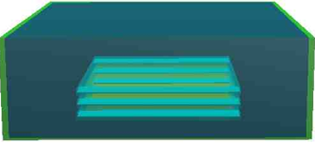
Cosmic Test Based on TRB System
MRPC setup in the gas box.
MRPC3a - 003
Interface board
PADI output
MRPC3a - 002
PADI 10
PADI power cable
MRPC3a - 000
Gas box
702
701
700
HV connector

Slide 14
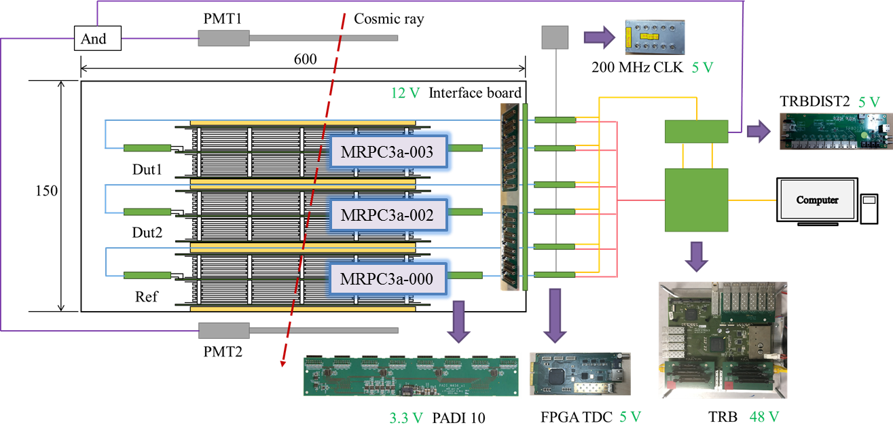
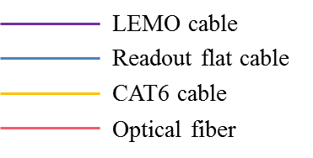
Cosmic Test Based on TRB System
TRB system setup.

Slide 15
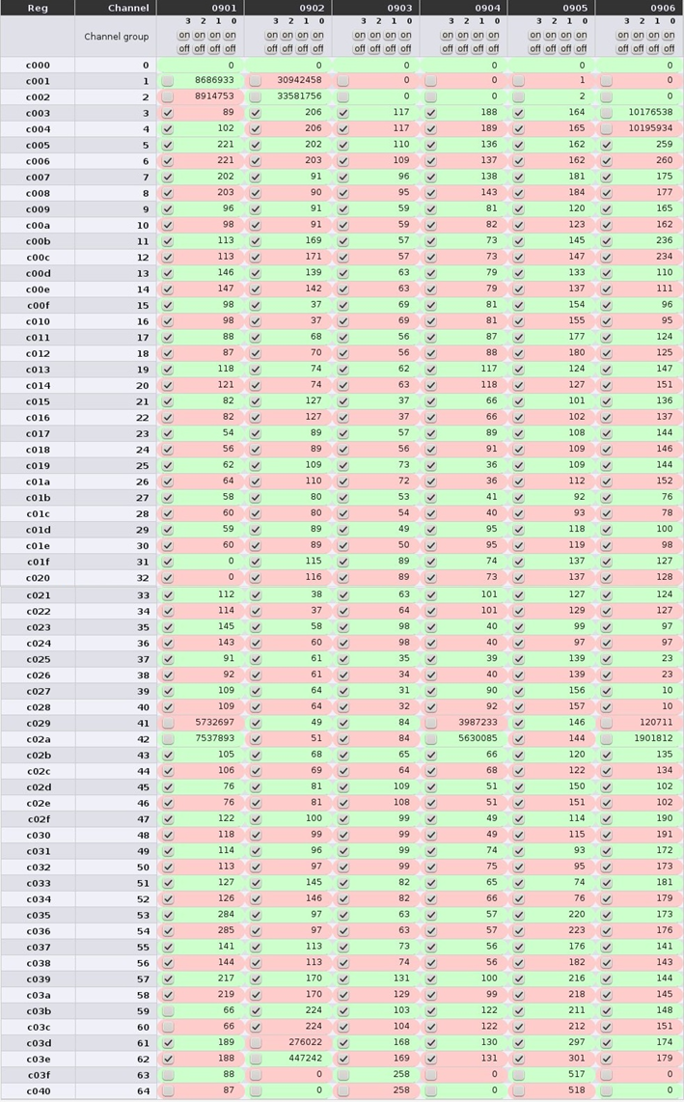
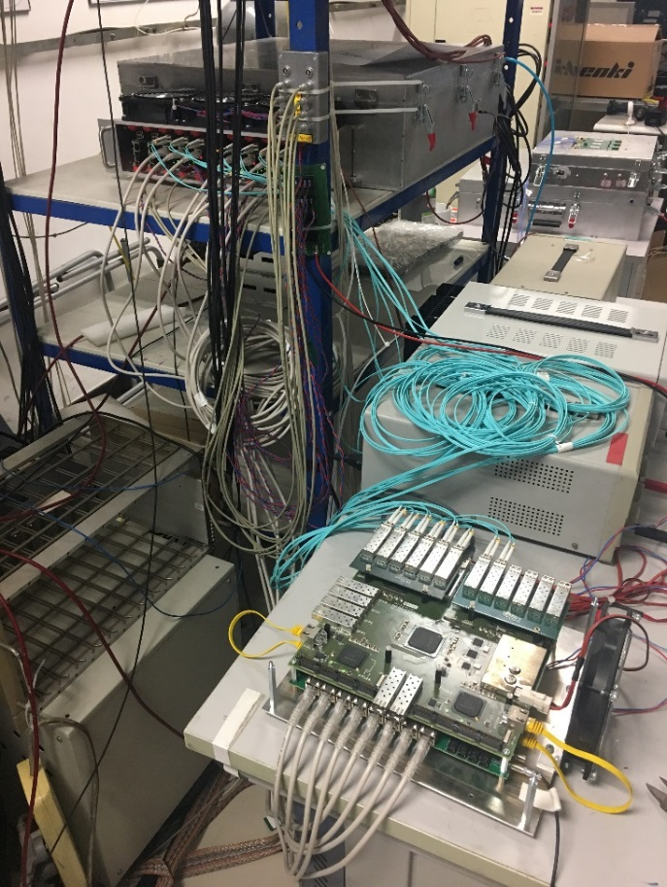
Cosmic Test Based on TRB System
Photo of the TRB system setup with MRPC3a test gas box.
Test gas box
FPGA TDCs
LV supply
TRB board
Noisy and dead zones are found at both ends and middle line of each TDC.

Slide 16
Cosmic Test: Calibration & Analysis
Run: 24Aug1829: Dut: 701; Ref: 702; Sel2/BRef: 700.
Calibration mode: 701702700.
HV: ±5600 V; Threshold: -300 mV; Gas: 90% Freon + 5% C₄H₁₀ + 5% SF₆
Analysis strategy:
create_calib.C (1000000,"CbmTofThu_24Aug1829")
Unpacking
apply_calib.C (1000000,"CbmTofThu_24Aug1829")
init_calib_digi.sh
Calibration
calib_runs_batch.sh 24Aug1829 701702700 700
iter_calib_digi.sh
gen_calib_digi.sh
Analysis
ana_sets_batch.sh 24Aug1829 701702700_700 0.5 701 702 700
iter_ana_hits.sh

Slide 17
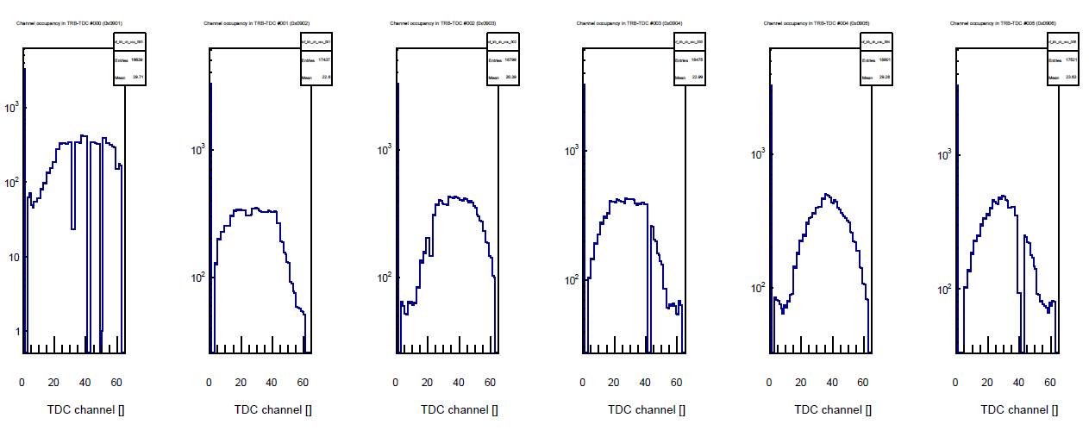
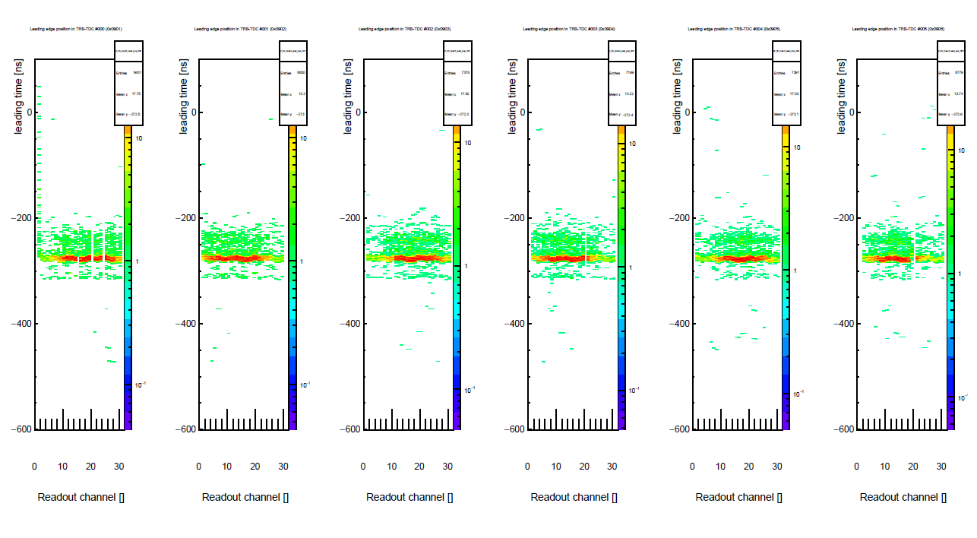
Cosmic Test: Calibration & Analysis
Unpacking:
TDC channel occupancy
MRPC3a - 000
MRPC3a - 002
MRPC3a - 003
TDC Leading edge time to trigger
MRPC3a - 000
MRPC3a - 002
MRPC3a - 003

Slide 18
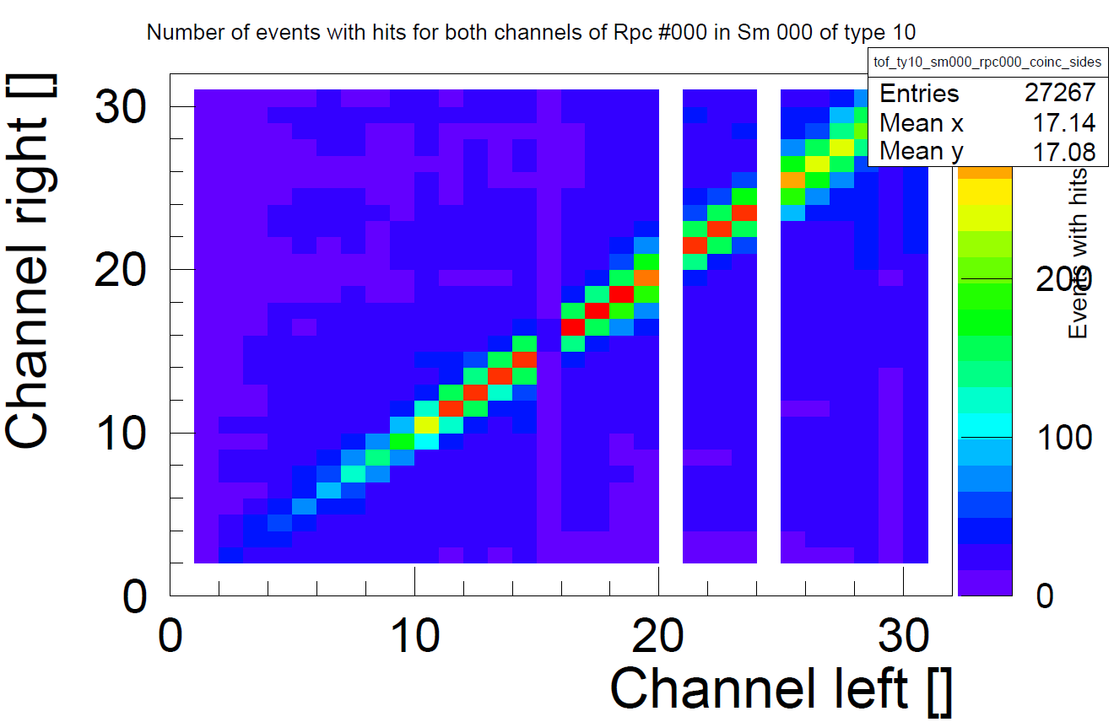
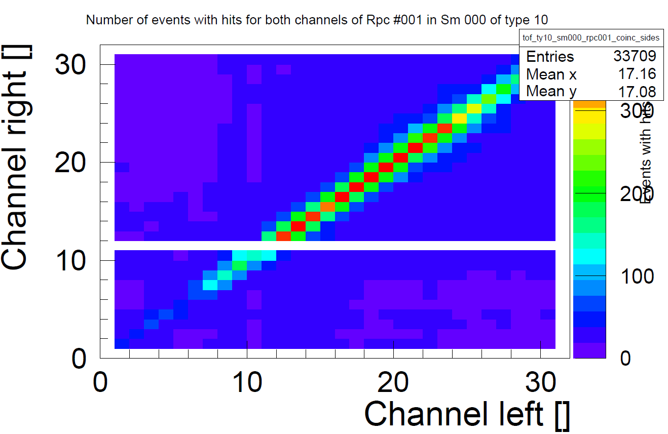
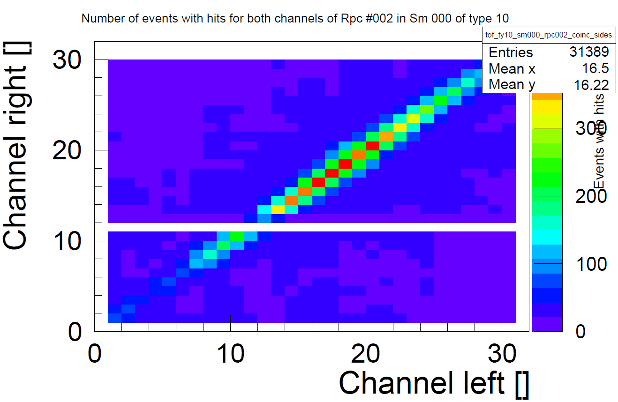
Cosmic Test: Calibration & Analysis
Unpacking:
MRPC3a - 000
MRPC3a - 002
Matching of left and right side of each MRPC. It can prove the mapping file we prepare is correct.
MRPC3a - 003

Slide 19
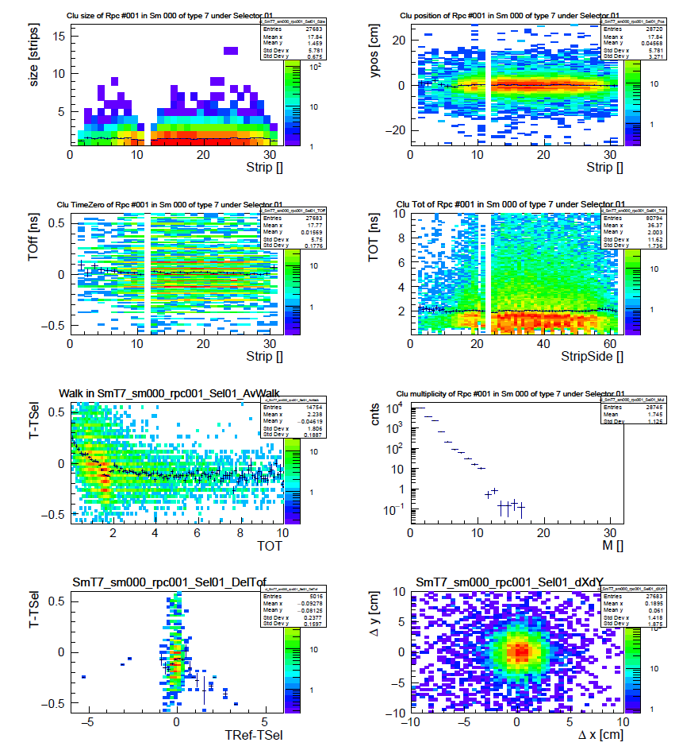
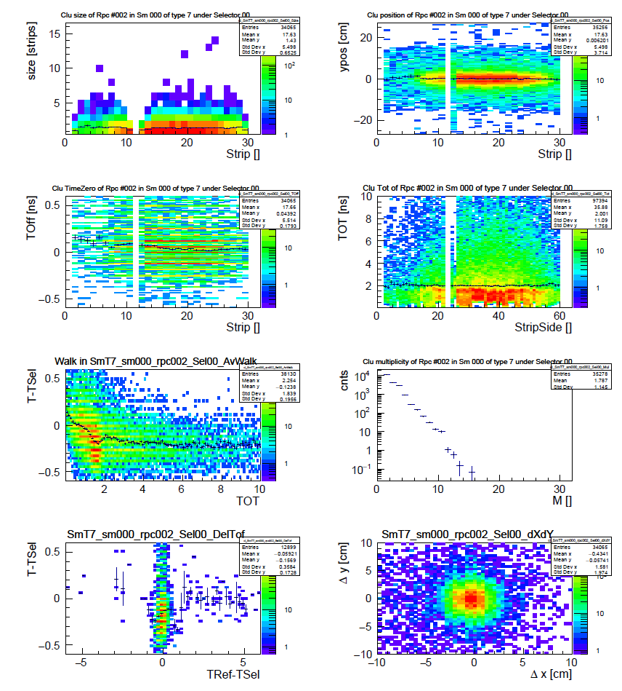
Cosmic Test: Calibration & Analysis
Calibration: Dut: 701; Ref: 702; Sel2/BRef: 700
pl_over_cluSel1_7_0_1
pl_over_cluSel0_7_0_2

Slide 20
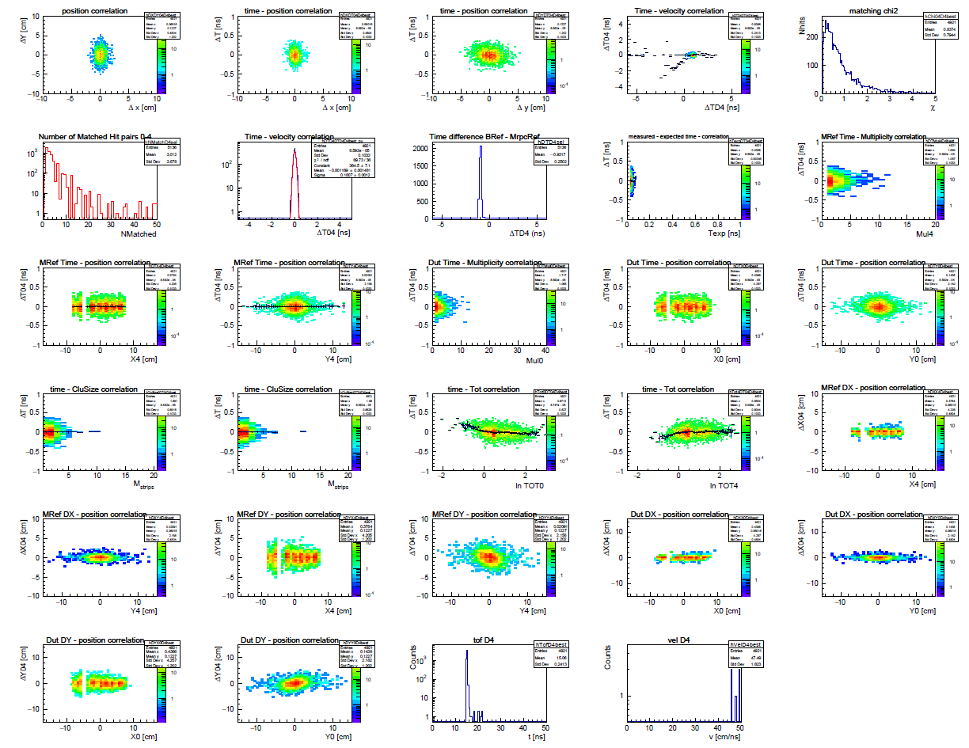
Cosmic Test: Calibration & Analysis
Analysis: Dut: 701; Ref: 702; Sel2/BRef: 700
pl_over_Mat04D4best
tofAnaTestbeam->SetDXWidth(1.2);
tofAnaTestbeam->SetDYWidth(2.0);
tofAnaTestbeam->SetDTWidth(0.15;
tofAnaTestbeam->SetPosY4Sel(1*dScalFac);
tofAnaTestbeam->SetDTDia(0.);
tofAnaTestbeam->SetCorMode(iGenCor);
tofAnaTestbeam->SetMul0Max(400);
tofAnaTestbeam->SetMul4Max(20);
tofAnaTestbeam->SetMulDMax(20);
tofAnaTestbeam->SetHitDistMin(10.);
tofAnaTestbeam->SetDTD4MAX(6.);
tofAnaTestbeam->SetPosYS2Sel(1*dScalFac);
tofAnaTestbeam->SetChS2Sel(0.);
tofAnaTestbeam->SetDChS2Sel(100.);
tofAnaTestbeam->SetChi2Lim(5.);
tofAnaTestbeam->SetChi2Lim2(2.);
tofAnaTestbeam->SetEnableMatchPosScaling(kFALSE);
tofAnaTestbeam->SetCh4Sel(15);
tofAnaTestbeam->SetDCh4Sel(15*dScalFac);

Slide 21
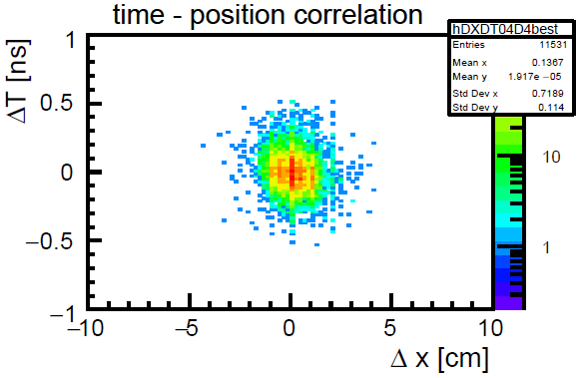
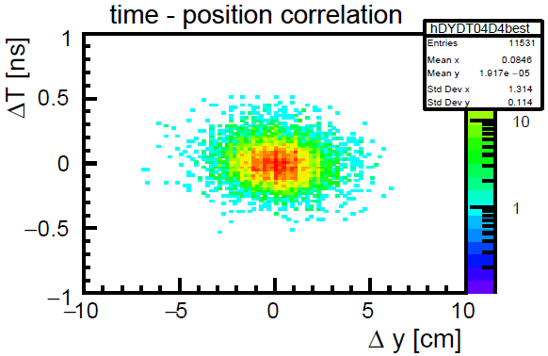
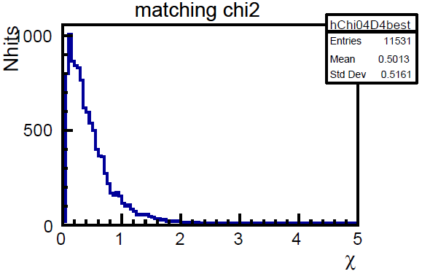
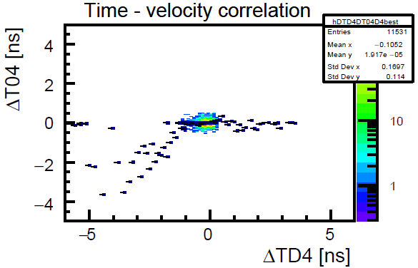
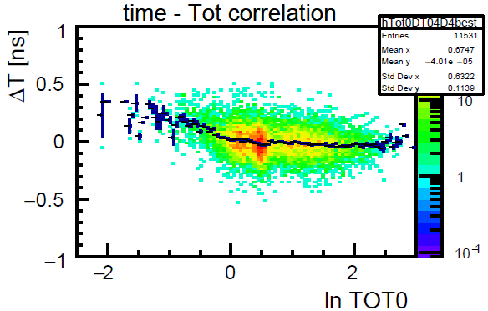
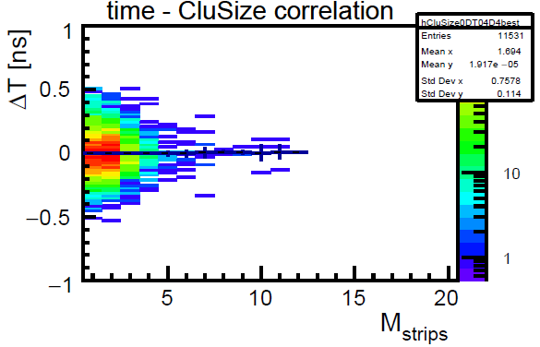
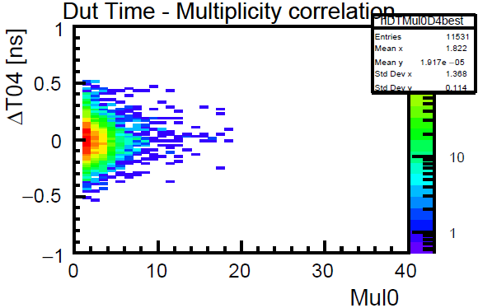
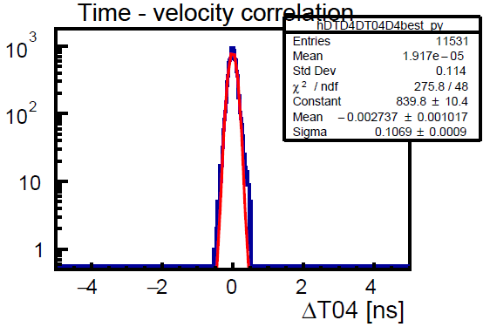
Cosmic Test: Calibration & Analysis
Analysis: Dut: 701; Ref: 702; Sel2/BRef: 700
pl_over_Mat04D4best
tofAnaTestbeam->SetDXWidth(1.2);
tofAnaTestbeam->SetDYWidth(2.0);
tofAnaTestbeam->SetDTWidth(0.15;
tofAnaTestbeam->SetPosY4Sel(1*dScalFac);
tofAnaTestbeam->SetDTDia(0.);
tofAnaTestbeam->SetCorMode(iGenCor);
tofAnaTestbeam->SetMul0Max(400);
tofAnaTestbeam->SetMul4Max(20);
tofAnaTestbeam->SetMulDMax(20);
tofAnaTestbeam->SetHitDistMin(10.);
tofAnaTestbeam->SetDTD4MAX(6.);
tofAnaTestbeam->SetPosYS2Sel(1*dScalFac);
tofAnaTestbeam->SetChS2Sel(0.);
tofAnaTestbeam->SetDChS2Sel(100.);
tofAnaTestbeam->SetChi2Lim(5.);
tofAnaTestbeam->SetChi2Lim2(2.);
tofAnaTestbeam->SetEnableMatchPosScaling(kFALSE);
tofAnaTestbeam->SetCh4Sel(15);
tofAnaTestbeam->SetDCh4Sel(15*dScalFac);
Efficiency: 96%
System time resolution: 100ps

Slide 22
Cosmic Test: Calibration & Analysis
The 3 MRPCs are supposed to have the same performance. However, their behaviors are not consistent under different calibration mode.
Dut | Ref | BRef/ Sel2 | Eff | Time Resolution/ps | Clustersize Dut | Clustersize Ref | Event number | Calibration mode
700 | 701 | 702 | 98.4% | 35.7 | 1.5 | 1.7 | 14414 | 700701702
700 | 702 | 701 | 97.6% | 35.5 | 1.6 | 1.7 | 15320 | 700702701
701 | 700 | 702 | 94.5% | 153.1 | 2.2 | 1.5 | 973 | 701700702
701 | 702 | 700 | 96.3% | 106.9 | 1.7 | 1.6 | 11976 | 701702700
702 | 700 | 701 | 84.0% | 153.8 | 2.0 | 1.6 | 1336 | 702700701
702 | 701 | 700 | 92.3% | 127.4 | 1.6 | 1.7 | 15078 | 702701700
When 700 is Dut, unreasonably good time resolution is got. When 700 is Ref, we lost most of the entries, and the performance deteriorates.

Slide 23



Cosmic Test: Calibration & Analysis
Tracking method is applied to find how most of the entries are lost in analysis class.
dis_hits.C(1,700701,1,"CbmTofThu_24Aug1829","700701702_702",702)
dis_hits.C(1,701700,1,"CbmTofThu_24Aug1829","701700702_702",702)

Slide 24



Cosmic Test: Non SF₆ Test
MRPC3a is required to work with non-SF₆ gas mixture at STAR.
From Ingo’s talk
In Heidelberg’s test, MRPC3a composed of low-resistive glass reaches 86% efficiency at 4800V without SF₆. Because of lower electric field, the time resolution worsens.

Slide 25
Cosmic Test: Non SF₆ Test
Similar non SF₆ test is repeated in Tsinghua.
Threshold: -300 mV; Gas: 95% Freon + 5% C₄H₁₀.
The dark current of 701 (MRPC3a - 002) always stays at +0.01 μA / -0.01 μA with HV increasing.
Noise rate of 701 (MRPC3a - 002)
The noise rate should be at same level to reach the same efficiency. So HV is increased to 5200 V to reach the nominal point.

Slide 26
Cosmic Test: Non SF₆ Test
Dut: 701; Ref: 702; Sel2/BRef: 700.
Calibration mode: 701702700.
The working point without SF₆ is 400V below that with SF₆, with an efficiency of 96%, system time resolution below 100 ps and 1.5 clustersize.

Slide 27


Plan and Time Line
Time line for the mass production of MRPC3a.
40 MRPC3a detectors will be shipped to Heidelberg in August 2017, by a conservative estimation according to the table of time line.
3 counters among the 6 are already packed and shipped to Heidelberg.

Slide 28
Summary
The mass production of MRPC3a counters has begun, and the first batch 6 counters are produced.
All these counters meet the quality assurance requirement.
Three counters (00, 02, 03) have been tested at nominal voltage with dark current around 10 nA and noise rate around 1 Hz/cm².
TRB system was established in Tsinghua lab. Data acquired from cosmic looks promising, but we are still debugging on the analysis.
MRPC3a counter is capable to keep the performance without SF₆.
All 40 MRPC3a counters are expected to be ready and shipped to Heidelberg by the end of December this year.

Slide 29
Thank You!
Lyu Pengfei
Department of Engineering Physics,
Tsinghua University, Beijing, China
September 23rd, 2017
CBM-STAR Day,
30th CBM Collaboration Meeting

Slide 30
Backup

Slide 31
Materials for one MRPC3a counter
Material | Length/mm | Width(Diameter)/mm | Thickness(Height)/mm | Quantity | Description
Low-resistive glass | 330 ± 0.2 | 276 ± 0.2 | 0.7 ± 0.02 | 10 | ~ 2×10¹⁰ Ωcm
HV graphite spray | 324 ± 0.5 | 270 ± 0.5 | 0.005 | 4 | < 10 MΩ/sq
Top PCB | 360 ± 0.2 | 338 ± 0.2 | 0.8 ± 0.05 | 1
Bottom PCB | 360 ± 0.2 | 338 ± 0.2 | 0.8 ± 0.05 | 1
Middle PCB | 360 ± 0.2 | 328 ± 0.2 | 1.6 ± 0.05 | 1
Protective resistor | / | / | / | 128 | 200 kΩ, 0603
Honeycomb | 333 ± 1 | 310 ± 1 | 6 ± 0.2 | 2
Block A | 23 ± 0.2 | 10 ± 0.2 | 4 ± 0.05 | 8 | PTFE
Block B | 14 ± 0.2 | 10 ± 0.2 | 4 ± 0.05 | 4 | PTFE
Mylar | 340 ± 0.2 | 286 ± 0.2 | 0.25 ± 0.02 | 8
HV cable | 1000 | 3 | / | 3
Fishing line | 26000 | 0.25 + 0.005 | / | /
M2.5 screw (nut) | 40 | 2.5 | / | 32 | Nylon
M4 screw (nut) | 40 | 4 | / | 16 | Nylon
2 × 9 connector | / | / | / | 16
Pin | 19 | 0.6 | / | 100
Carbon tape | 50 | 50 | 0.13 ± 0.02 | / | ~ 100 kΩ/sq
CAF4 for isolating, copper foil for HV making, absolute ethanol for cleaning are not included in this list.

Slide 32

Materials: PCB Board
Design of top/bottom PCB:
① 32 readout strips on a 10 mm pitch with 3 mm interval.
② Transmission feedthrough.
③ Installing holes for HV.
④ Mounting holes.
⑤ Installing holes for fishing line columns.
⑥ Installing holes for blocks.
⑦ Copper foil.
Design of middle PCB:
⑧ Signal transmission pins from bottom/top readout PCBs.
⑨ 200 kΩ protective resistors.
⑩ 2×9 connectors for signal output to PADI.
Design values of these PCBs:
Copper foil thickness: 0.035 mm.
Dielectric constant: 4.6.

Slide 33


Quality Assurance
Test module for glass inspection. Each batch of glass should be examined before they are applied into assembling of counters.

Slide 34



Test and Analysis: Cosmic-Ray Test
The performance requirement of the MRPC3a counter in cosmic-ray test.
Run 01Mar2217 SPS Feb 2015 (no diamond):
The time resolution in cosmic-ray can’t be as good as that in beamtest (velocity correction not sufficient).
Without any cuts: 103 ps
Only with walk correction: 121 ps

Slide 35


Cosmic Test: Calibration & Analysis
Comparison between calibration mode 700701702 and 701700702.
pl_over_cluSel1_7_0_0 700701702
pl_over_cluSel1_7_0_1 701700702

Slide 36


Cosmic Test: Calibration & Analysis
Comparison between calibration mode 700701702 and 701700702.
pl_over_Mat04D4best 700701702
pl_over_Mat04D4best 701700702
All the products have been uploaded to Kronos under path:
/lustre/nyx/cbm/users/plyu/CbmTofThu_24Aug1829

