Slide 1


Accelerator Development
FAIR p-Linac contributions in FP18/21
Working Group U. Ratzinger
IAP, Goethe-University Frankfurt
Maximilian Schütt – KfB Verbundworkshop, TEMF Darmstadt
08/31/2017

Slide 2
Modulated Ladder RFQ for FAIR p-Linac
630 mm bulk copper Laddder RFQ prototype successfully tested at GSI test bunker in FP12-15
Stable operation up to 500 kW
Kilpatrick value 3.1

Slide 3
Modulated Ladder RFQ
for FAIR p-Linac
3.4 m modulated Ladder RFQ design+manufacturing in FP15-18 including an improved beam dynamics
FAT in mid 2018
2018-19: final assembly: Vacuum supply+coupler, tuning, RF-measurements, conditioning and High Power tests at the GSI test bunker
Functional testing at high fields
2020-21: Proof of Principle: beam tests including LEBT, Emittance measurements
Tuner influence on Flatness & Beam Energy
DMU Model for prequalification
as of 07.06.2017

Slide 4
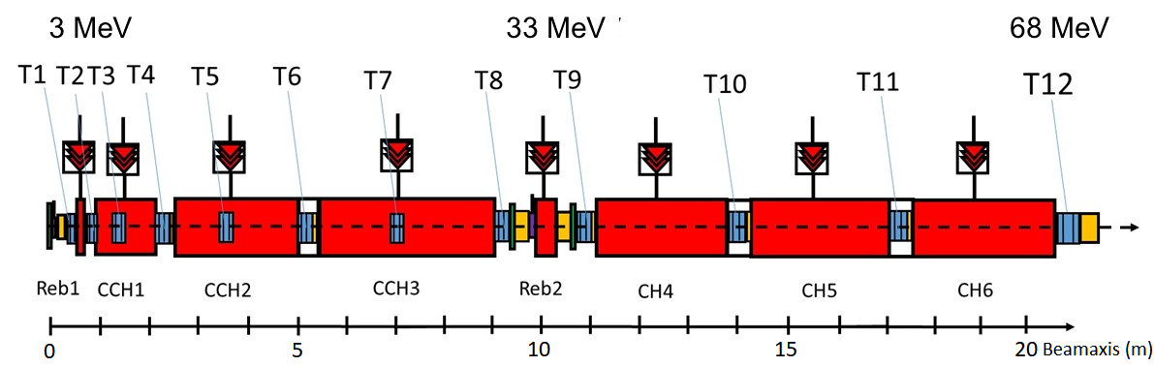
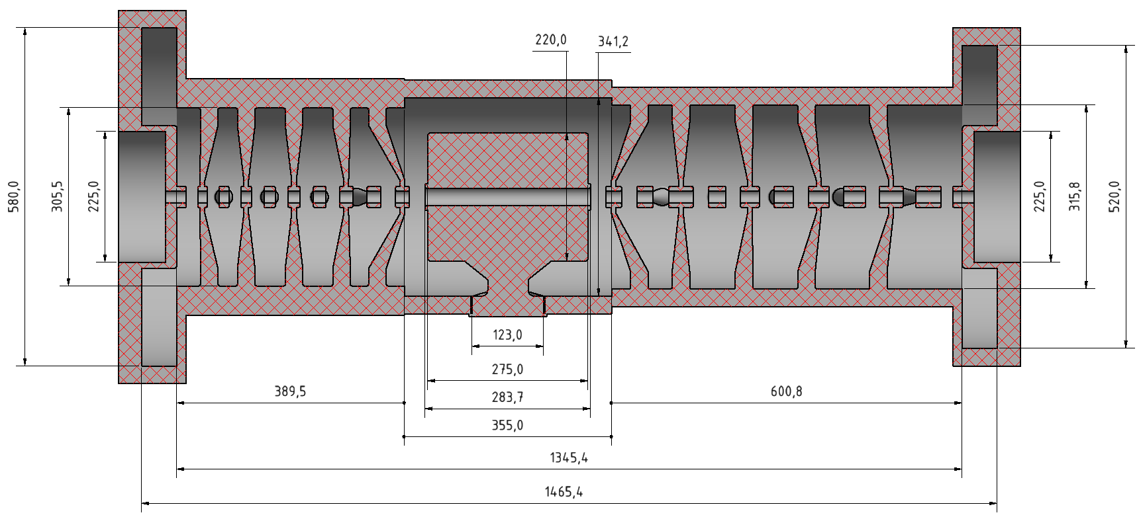

CH-DTL for FAIR p-Linac
$$3∙βλ$$
CCH1 for the FAIR p-Linac
1465
Courtesy of A. Almomani, M. Busch
1465 mm

Slide 5
CH-DTL for FAIR p-Linac
Cooperation with GSI in respect to:
Mechanical Detail Design
Audition of Manufacturing
Final Assembly
RF-measurements and optimization
Design and Adjustment of Plungers
Tuning of Voltage Distribution
including Simulations & Measurements
RF-conditioning
Contribute & Preparations for first beam tests and
beam diagnostics
Beam optimization for injection into SIS18
Collimator system and beam dynamics in collaboration with GSI
CCH1 for the FAIR p-Linac accelerating from 3 MeV to ~10 MeV at a length of 1.5 m.

Slide 6
Thank you!
AG Prof. Ulrich Ratzinger
Name | Position | Funktion
Klaus Volk | Wiss. Mitarbeiter | Strahlexperimente, Ionenquellen
Rudolf Tiede | Wiss. Mitarbeiter | Strahldyn.,Code-Entwicklung, Administration
Christopher Wagner | Wiss. Mitarbeiter | Controls, Elektronik
Ali Almomani | Postdoktorand | Strahldynamik, Resonatorauslegung
Hendrik Hähnel | Postdoktorand | Strahldynamik Unilac
Batu Klump | Postdoktorand | Strahlexperimente, Ionenquellen
Marc Syha | Doktorand | RFQ – Strahldynamik und Resonator
Max Schütt | Doktorand | Resonatordesign, Leiter - RFQ
Adem Ates | Doktorand | Strahldiagnose
Heiko Niebuhr | Doktorand | Strahltransport
Onur Payir | Master | Strahlseparation
Jan Kaiser | Master | Unilac - Hochenergieausbau
Qizheng Yan | Master | Strahlseparation
Christian Wirth | Bachelor | Strahldynamik, Code - Vergleiche
Leon Skorpil | Bachelor | Ionenquellenentwicklung

