Slide 1
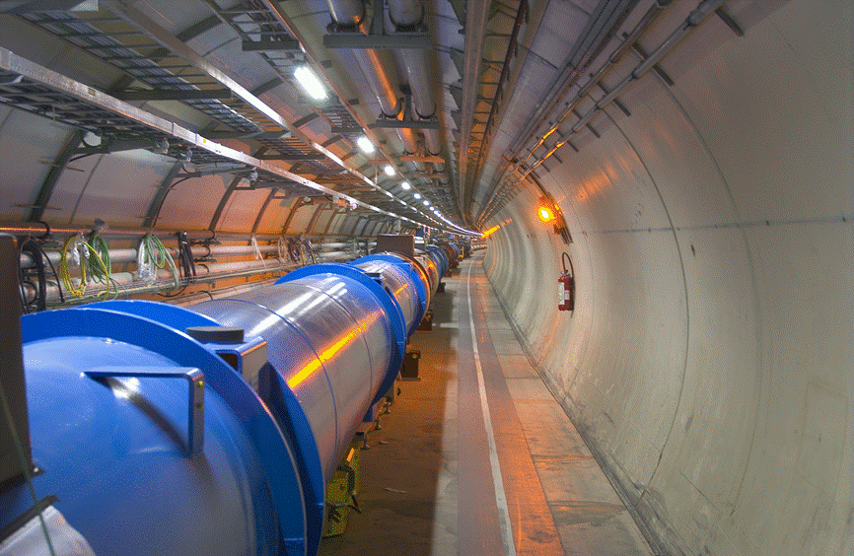
LHC Status and Energy prospects and HL-LHC Upgrade
O. Brüning
CERN, Geneva, Switzerland

Slide 2
LHC Performance up to RunII:
➔ Commissioning
➔ Exploring the limits
➔ L production
➔ Exploring the limits
➔ L production
➔ L production
On track for > 40fb⁻¹ in 2017

Slide 3
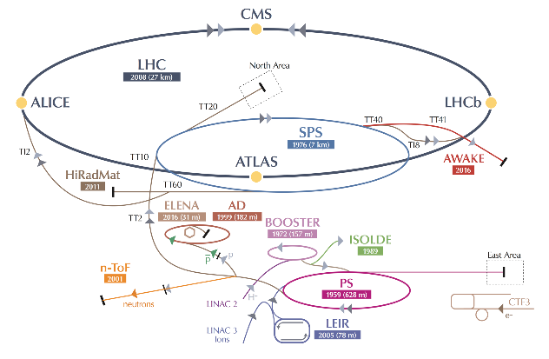
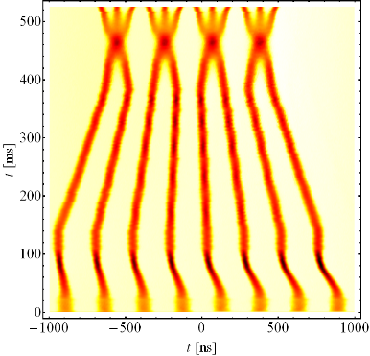
An extra boost from the injectors
A new production scheme – the “BCMS” - was put in place in the PS
RF cavities tuned at different frequencies play together to compress merge and split bunches
Beams ~30% brighter than standard scheme
The LHC performance fully relies on the performance of its injector complex
By itself one of the largest accelerator facility in the world with its own diverse and, for many aspects, unique physics program
E_{kin} = 2.5 GeV
➔ L > 1.75 10³⁴ cm⁻²s⁻¹

Slide 4
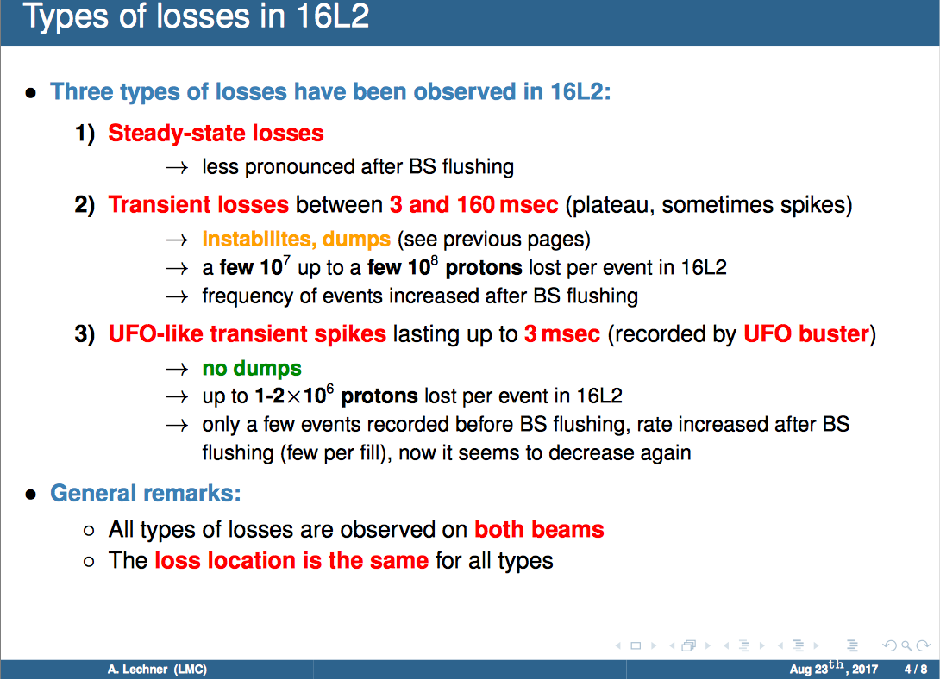

Slide 5
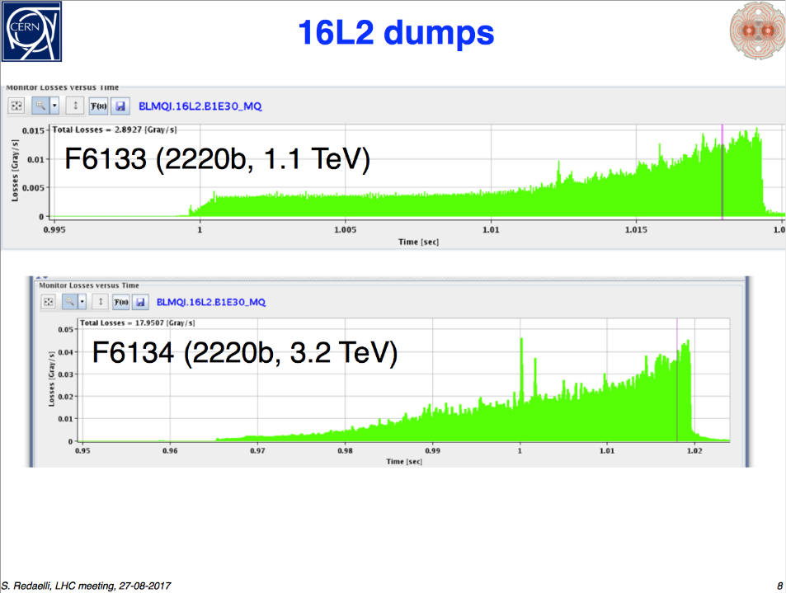
Nitrogen Leak in the LHC Beam Dump:
The losses in 16L2 and the related fast beam instability led to
frequent beam aborts after the BS flushing
Increased strain on the LHC beam dump
Bellows move by a couple of millimeters at each dump
Fatigue and leak in the vacuum container of the beam dump
Nitrogen leak
impact on machine performance
After Beam Screen flushing

Slide 6
LHC Full Energy Exploitation Study:
Organized in 3 Stages:
Operation at nominal energy of 7TeV (8.3T)
-powering tests in S34 and S45 before EYETS 16/17
➔ observation of multiple quenches at high fields
➔ observation of a second short to ground after quench
➔ Decision to consolidate the LHC diode boxes in LS2
and to plan for 7TeV operation only after LS2
Operation at ultimate beam energy of 7.56TeV (9T)
Ongoing and preparing for discussion at Chamonix 2018
➔ assuming all of Run3 stays at nominal and HL-LHC
commissioning will start at nominal ➔ not before Run4
3) Operation with beam energies beyond ‘ultimate’
➔ Operation @ nominal Beam Energy during LHC Run3

Slide 7
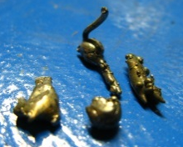
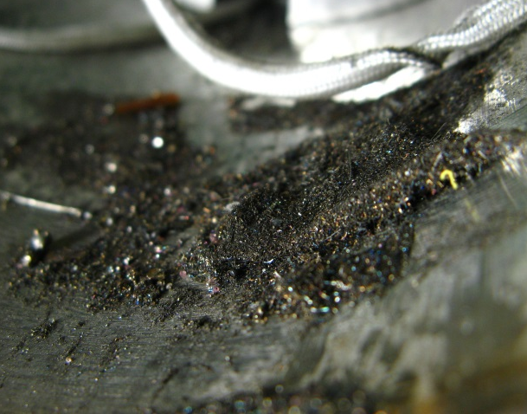
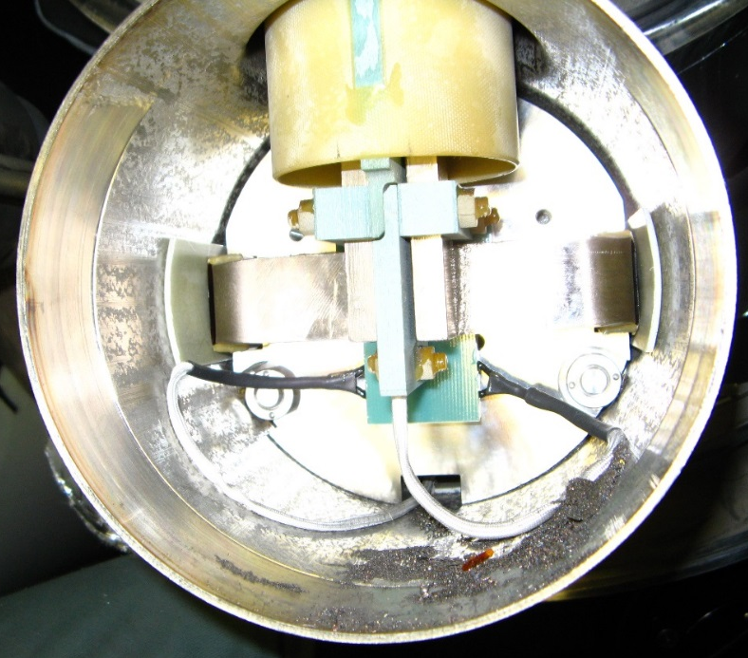
LHC Energy Exploitation Study: Phase1
Unforeseen Obstacles:
Short in the diode box following a training quench:
➔ released energy during quench at high
energy is capable of displacing debris that
has collected in the diode box
Second incident during training in ca. 252 quenches
(but also had 5-6 shorts before LS1)
Mateusz Bednarek
Earth Fault Burner:
Solution exists and could by now remove a short twice
But there is no guarantee that this method will always work!!!
Possibility of a double short on a given magnet!!!!
Risk Assessment:
Decision to cure this problem at the root cause!!!
➔ Systematic cleaning and insulation of the diode box!!!
Decision for Intervention during LS2 and
to stay at 6.5TeV for RunII!!!

Slide 8
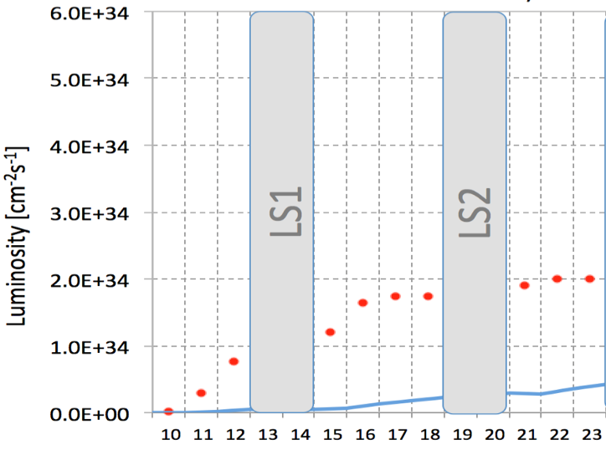


Performance Projections up to HL-LHC:
7 & 8 TeV in RunI
13 TeV after LS1
14 TeV after LS2
Run I
Run II
Run III
Splices fixed
➔
Energy
Injectors
upgrade
Diode Box
≈ 300 fb⁻¹
e-cloud UFOs!
≈ 150 fb⁻¹
x 2-3
Technical limits (in experiments, too) like :
x 3
LIU
Cryogenic limit &
Radiation Damage
of triplet magnets
6 + 23 fb⁻¹
0.75 10³⁴ cm⁻²s⁻¹
50 ns bunch
high pile up ∼40
> 1.5 10³⁴ cm⁻²s⁻¹
25 ns bunch
high pile up ∼40
1.5 -2.2 10³⁴ cm⁻²s⁻¹
25 ns bunch
very high pile up > 60

Slide 9
HL-LHC technical bottleneck:
Radiation damage to triplet magnets at 300 fb⁻¹
Cold bore insulation
≈ 35 MGy
Q2
27 MGy
MCBX3 20 MGy

Slide 10
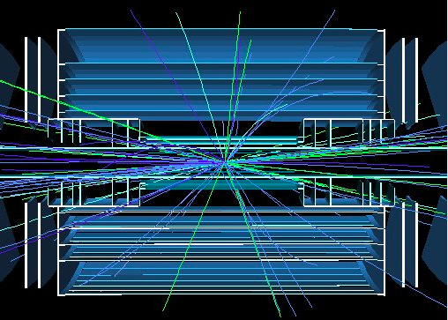
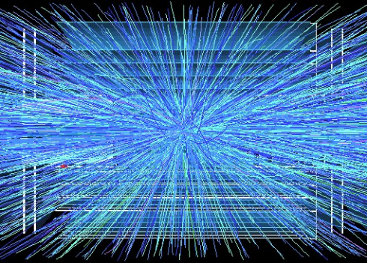
Goal of High Luminosity LHC (HL-LHC):
The main objective of HiLumi LHC Design Study is to determine a hardware configuration and a set of beam parameters that will allow the LHC to reach the
following targets:
Prepare machine for operation beyond 2025 and up to 2035
Devise beam parameters and operation scenarios for:
# enabling at total integrated luminosity of 3000 fb⁻¹
# implying an integrated luminosity of 250 fb⁻¹ per year,
# design oper. for μ ≤ 140 (➔ peak luminosity 5 10³⁴ cm⁻² s⁻¹)
        Operation with levelled luminosity!
10x the luminosity reach of first 10 years of LHC operation!!
HL-LHC TDR V0.1: https://edms.cern.ch/ui/file/1833445/1/HL-LHC_TDR_V.01.2017.08.04.h18.030.pdf
400
events
5 events

Slide 11
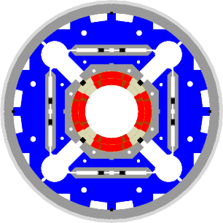
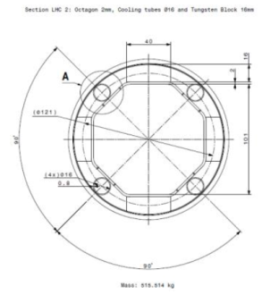
HL-LHC technical bottleneck:
Radiation damage to triplet magnets
Tungsten blocks
Need to replace existing triplet magnets with radiation hard system (shielding!) such that the new magnet coils receive a similar radiation dose @ 10 times higher integrated luminosity!!!!!
US-LARP MQXF magnet design
Based on Nb₃Sn
technology
Requires larger aperture!
New magnet technology
70mm at 210 T/m ➔150mm diameter 140 T/m
8T peak field at coils ➔ 12T field at coils (Nb₃Sn)!!!
Capillaries

Slide 12
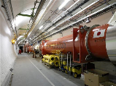




The critical zones around IP1 and IP5
ATLAS
CMS
3. For collimation we also need to change the DS in the continuous cryostat in IR7: 11T Nb₃Sn dipole
2. We also need to modify a large part of the matching section
e.g. Crab Cavities &
D1, D2
New triplet Nb₃Sn
required due to:
-Radiation damage
-Need for more aperture
Changing the triplet region is not enough for reaching the HL-LHC goal!
More than 1.2 km of LHC !!
Plus technical infrastructure
(e.g. Cryo and Powering)!!
and major Civil Engineering!!!

Slide 13
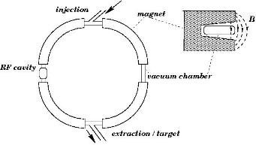
Future Accelerator Challenges: Energy
Circular Hadron Collider Challenges:
Superconducting magnet technology:
Homogeneous magnetic field:
ultra-relativistic ➔ maximize r & B
LHC: NbTi and R = 3.5km ➔ 8.5T peak field ➔ 7TeV
Nb₃Sn ➔ 16 T peak field
HTS ➔ 20T?
Perhaps up to 14TeV beam energy in LHC sized tunnel (27km)
Order of magnitude increase in beam energy:
➔ requires 20T magnets and 4 times larger tunnel!!!

Slide 14
LHC Energy Frontier:
Operation at ultimate beam energy: E = 7.56TeV [9T]
All LHC and HL-LHC magnet systems are designed for operation at ‘ultimate’ field of 9T MB equivalent:
➔ MB, MQ, PO, vacuum and cryogenics
➔ but this operation mode implies strong reduction
or removal of operation margins!
However, not all components are yet ready for operation at ‘ultimate beam energy’:
➔ Beam Dump and Collimation systems among others.
➔ This operation mode will require significant upgrades
➔ Study still ongoing and results expected for Cham ’18
Could perhaps be envisaged for second half of HL-LHC
exploitation, after LS4

Slide 15
LHC Energy Frontier:
Operation beyond ultimate beam energy: E > 7.56TeV
Proposal to replace 1/3 of all MB magnets with 11T Nb₃Sn magnets
➔ Major interventions [opening of all MB interconnects]
➔ Not clear other magnets can be scaled up in energy
e.g. insertion quadrupoles and triplet magnets
➔ Not clear other systems [e.g. beam dump system] can
be easily upgraded
Study ongoing and results expected for end 2018 / beginning 2019
Could perhaps be envisaged as a second LHC upgrade at the end of the HL-LHC exploitation period. But will require significant investment [time, resources and capital]!!!

Slide 16
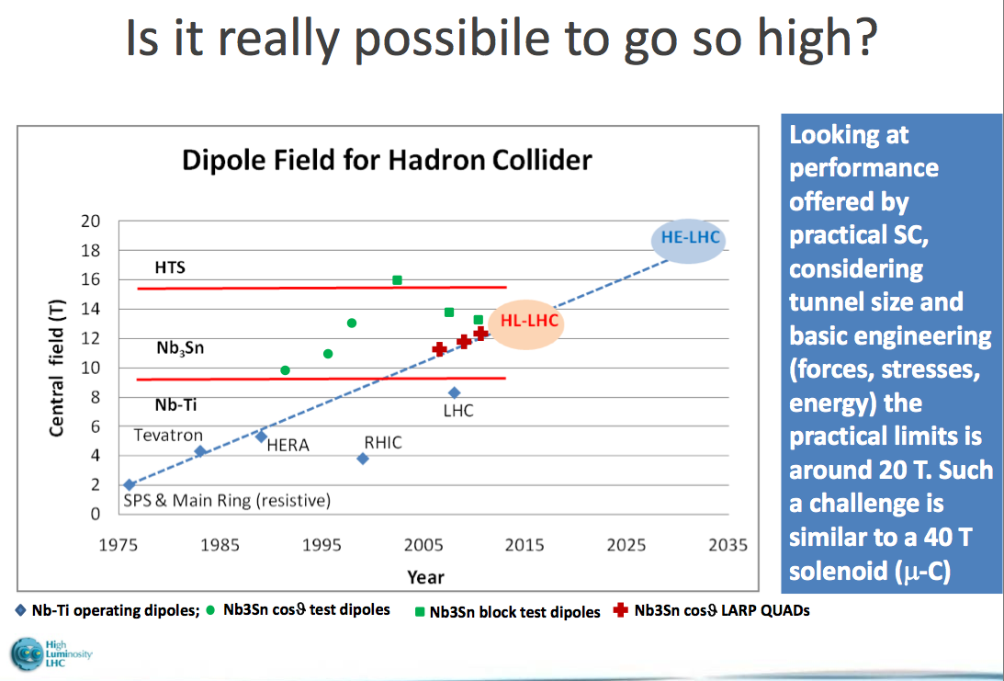
pp colliders – High Field SC Magnets
How High can we go? Livingston plot revisited:
Took about 15 years to push NbTi technology
Transition from NbTi to Nb₃Sn:
HL-LH lead the R&D for 11-12T magnets based on Nb₃Sn technology:
Started in earnest in 2004:
➔15-25 years R&D program
Limited to perhaps 16T!!!
Transition from NbTi to Nb₃Sn:
HL-LH lead the R&D for 11-15T magnets based on Nb₃Sn technology:
➔15-20 years R&D program
Transition to HTS:
Assume R&D period of similar size ➔ 2035?
HL-LHC
courtesy: L. Rossi (CERN) from 2011-2012

Slide 17
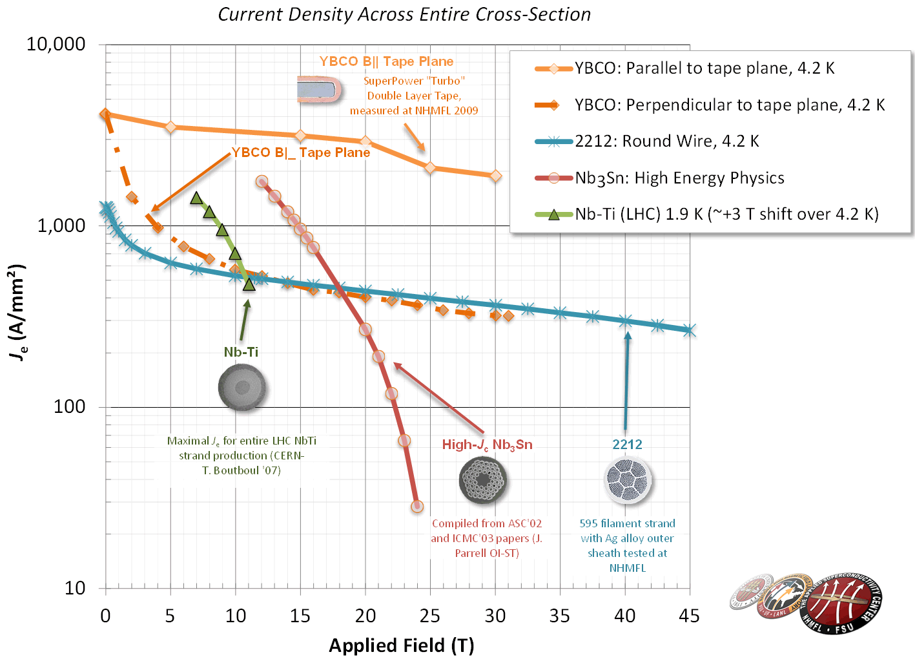
SC Magnet Technology
Nb₃Sn
  HL-LHC with 11-12T
  16 T for HEP
  Almost a commodity!
    15-20 t per year for MRI
    ITER needs 500 t
  ca x5 cost LHC Nb-Ti
HTS (needed → 20 T)
➔ on going R&D!
  Bi-2212: cost today 2-5x Nb₃Sn
  YBCO: cost today 10x Nb₃Sn
source: L. Rossi
from 2011 - 2012

Slide 18
pp colliders – High Field SC Magnets
When could HTS or high performance Nb₃Sn magnets become available?
Push Nb₃Sn and/or
Transition to HTS:
Assume R&D period of similar length as for NbTi and HL-LHC
➔ 15 to 25 years
➔ 2035?
Transition from NbTi to Nb₃Sn:
HL-LH lead the R&D for 11-15T magnets based on Nb₃Sn technology:
➔15-20 years R&D program
Transition to HTS:
Assume R&D period of similar size ➔ 2035?
HL-LHC
courtesy: L. Rossi (CERN) from 2011-2012

Slide 19
pp colliders: Future Project Options
HE-LHC: installation of new 16T magnets in LHC tunnel
➔ Requires Nb₃Sn magnet technology with 16T peak field:
  Magnet technology not yet at accelerator grade level
  Option for ‘post HL-LHC’ ➔ 2040ies
  Magnets will be more expensive than those of LHC
  Detailed study conducted under the FCC umbrella
  ➔ results expected by 2018
  Would imply ca. 5 years without HEP (LEP LHC took 10)!!
  Would bring ‘only’ a factor two in CM collision energy!
  Would be a technology demonstrator for FCC-hh
  New regime for proton beam dynamics! (SR and damping)
  (x 3-4?)

Slide 20
pp colliders: Future Project Options
FCC-hh: International Study under CERN coordination
➔ Requires magnet technology with > 16T peak field:
  CDR planned for 2018 in time for next European Strategy
  Based on 100km long tunnel in Geneva area (4 x LHC)
  ➔ almost 10 fold increase in CME wrt LHC
Main challenges will be:
-Magnet technology
-Cost (installation and operation)
-Power consumption
-Operational efficiency
SppC: Chinese Study
➔ Similar design as FCC-hh:
PCDR published in 2015
Based on 54km (PCDR) circumference & options for
78 and 100km considered in 2016

Slide 21
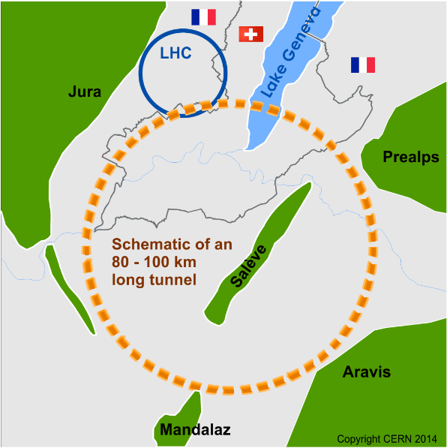
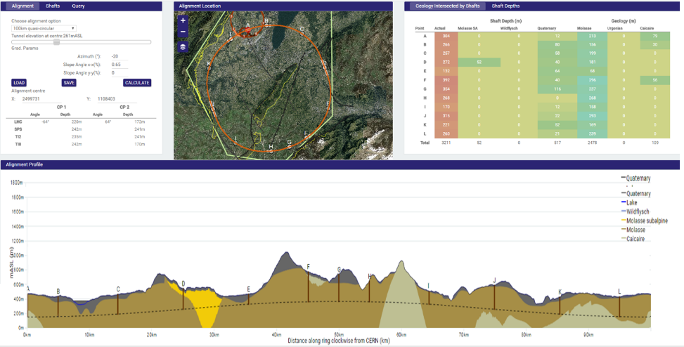
Future Circular Collider (FCC) study ; goals: CDR and cost review for the next European Strategy Update (2018)
International collaboration :
pp-collider (FCC-hh) → defining infrastructure requirements
including HE-LHC option: 16-20 T in LHC tunnel
e⁺e⁻ collider (FCC-ee) as potential intermediate step
p-e (FCC-he) option
100 km infrastructure in Geneva area
~16 T ⇒ 100 TeV in 100 km
~20 T ⇒ 100 TeV in 80 km
M. Benedikt

Slide 22
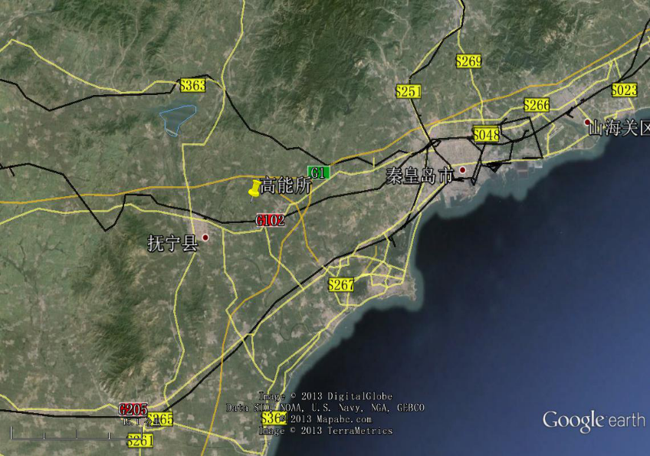
Chinese Circular Collider Study
Qinhuangdao (秦皇岛）
SppC (CepC)
50 km
easy access
300 km from Beijing
3 h by car
1 h by train
70 km
Yifang Wang

Slide 23
Lepton Collider Options
Qinhuangdao (秦皇岛）
easy access
300 km from Beijing
3 h by car
1 h by train

Slide 24
Linear Collider Technological Challenges
Linear Lepton Collider Challenges:
Superconducting RF:
1.3 GHz with high Q₀ & reasonable aperture
➔ efficient operation
Niob, 35MV/m @ 1.8K ➔ limited energy reach!
Normal conducting RF:
12 GHz ➔ high gradients (100MV/m) & novel power sources
➔ energy reach for given length
small apertures and low Q₀ ➔ efficiency and power consumption
Common goals and key aspects:
    Site size: between 30km and 50km
    Peak luminosity: > 10³⁴ cm⁻²s⁻¹
    Beam power (> 1MJ) ➔ machine protection
    Site power consumption: > 300MW ➔ 600MW
    Price: > 4 x LHC cost

Slide 25
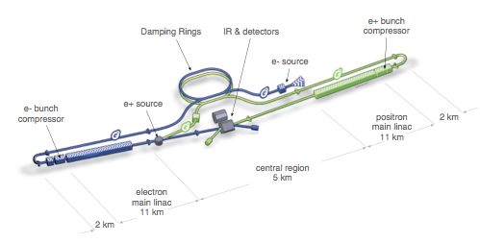

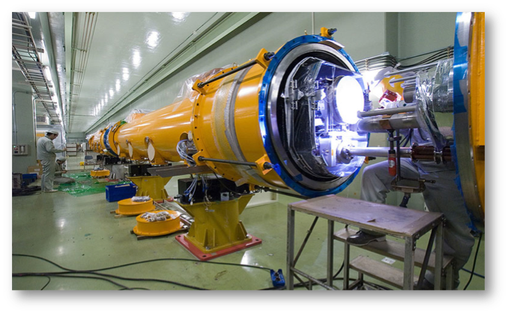

International Linear Collider
Steinar Stapnes; 2016
200-500 GeV cm (extendable to 1 TeV)
  L ~ 1.8×10³⁴ cm⁻²s⁻¹ (@ 500GeV)
  31km site length
  7.8 Billion ILCU + 23 Million p-hrs
>20 years R&D worldwide
  A truly global effort
  Over 2,000 man years
  >300 M$ globally
Cost driver: SRF technology
  17,000 1.3 GHz Nb cavities
  1,800 cryomodules
Mature SRF technology
Parameters | Value
C.M. Energy | 500 GeV
Peak luminosity | 1.8 x10³⁴ cm⁻²s⁻¹
Beam Rep. rate | 5 Hz
Pulse duration | 0.73 ms
Average current | 5.8 mA (in pulse)
E gradient in SCRF acc. cavity | 31.5 MV/m +/-20% Q₀ = 1E10
Stored beam energy | ca. 1 MJ
Site power consumption | 300MW
Technical validity / maturity and industrial scalability demonstrated with
European XFL at DESY!

Slide 26
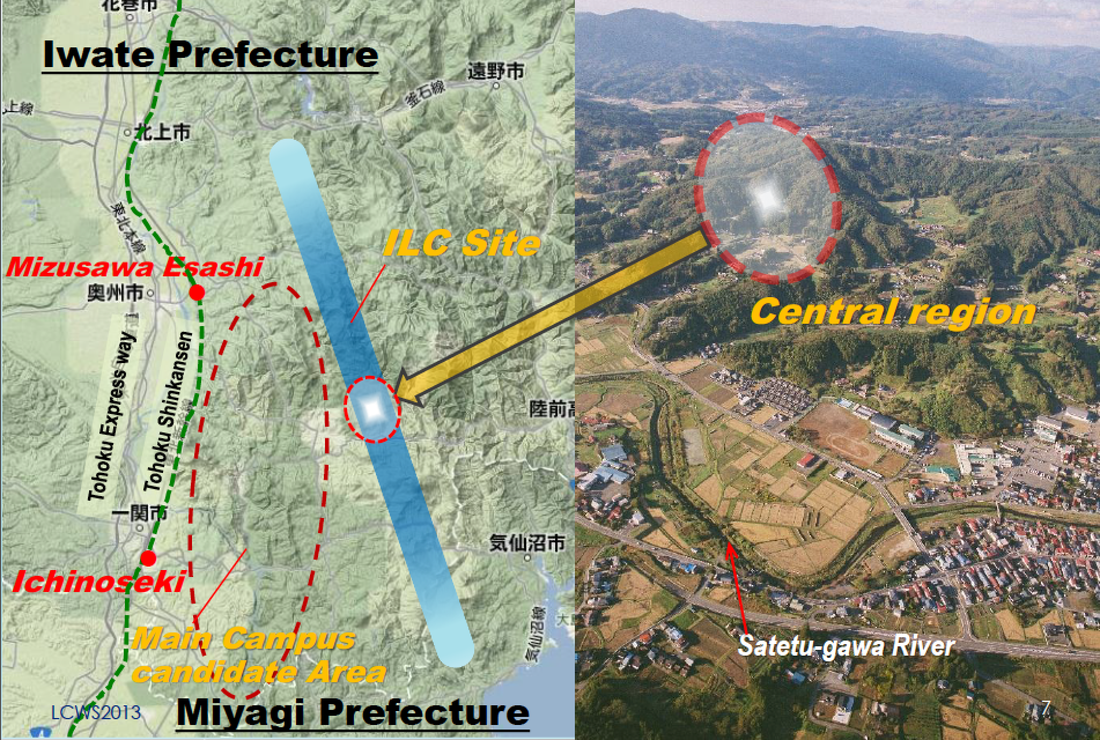
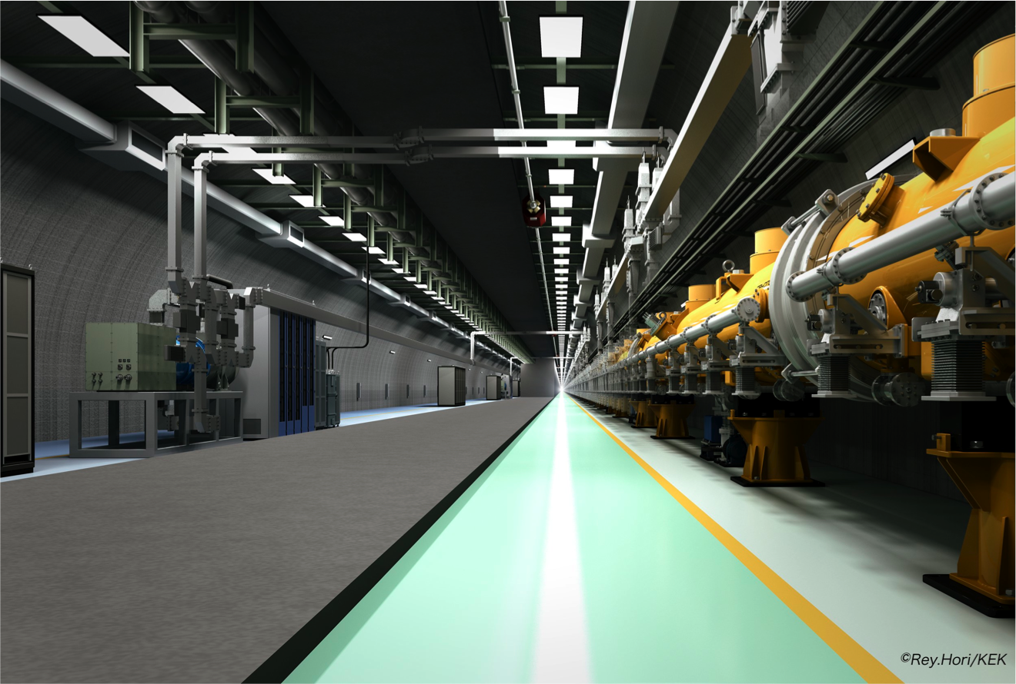
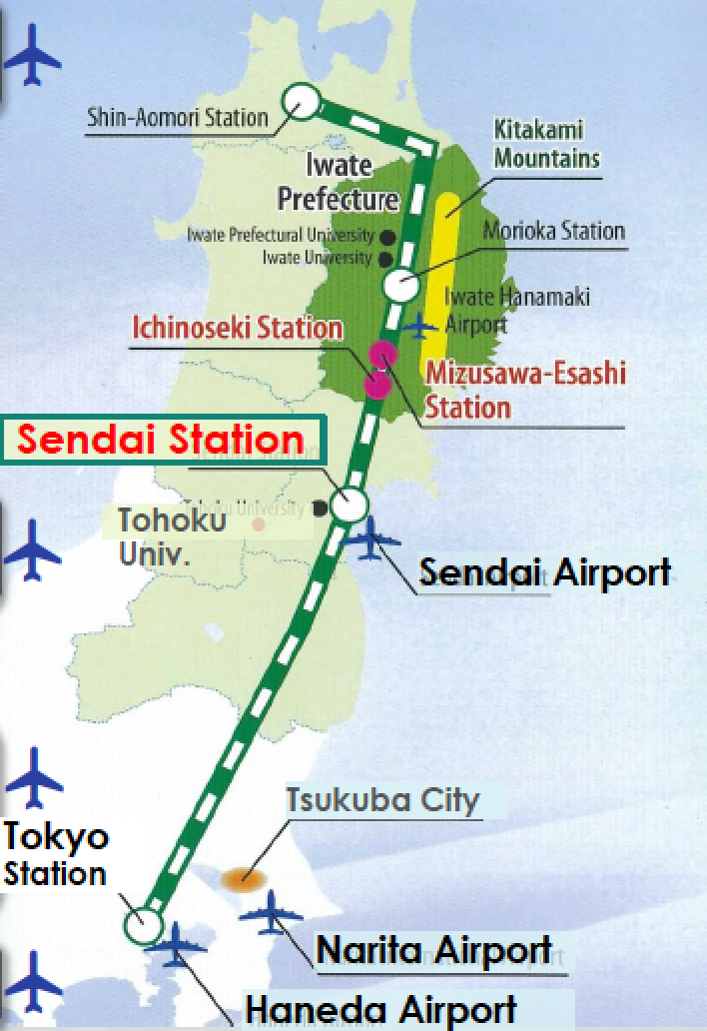
On-going evaluation in Japan concerning hosting the ILC
Steinar Stapnes; 2016
ILC Site slelection:

Slide 27
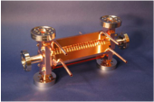
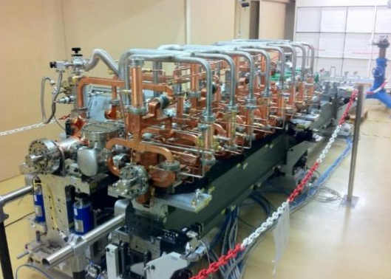
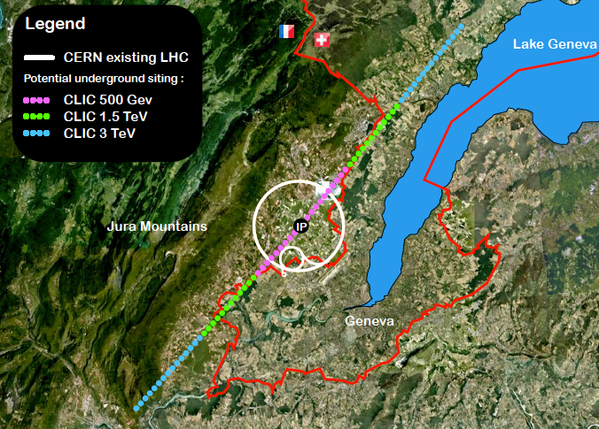
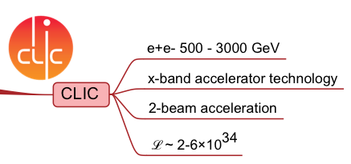
Compact LInear Collider (CLIC)
RF ~ 12 GHz
4.2-100A
G_{a} ~ 100 MV/m
3 TeV cm layout
LC represents a PARADIGM shift

Slide 28

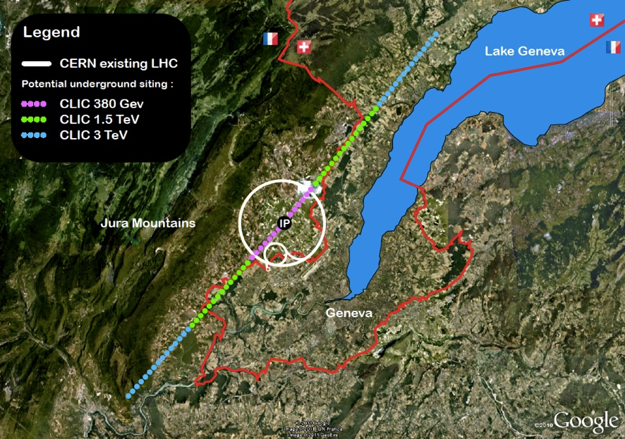



The CLIC electron-positron collider at CERN, layout with collision point in the Prevessin area
➔ Option for multi TeV e⁺/e⁻ collider
Steinar Stapnes; 2016ei
Accelerating Science and Innovation
Notes:
28

Slide 29
FCC-ee: Circular e⁺/e⁻ Option
Main Challenges
Synchrotron Radiation power loss!!
➔ need for large tunnel
➔ limit for maximum energy reach
Tunnel ➔ ‘synergy’ with FCC-hh
SC RF ➔ within reach with existing SCR technology (800mHz)
Short beam lifetime & top-up operation ➔ Super KEKB
➔ can you wait 10y for HE pp?
Main strong points
Impressive performance track record for circular colliders
Potential synergy (tunnel) with FCC-hh Collider project
Energy reach compatible with Higgs and top physics
Positron source requirements are much easier as compared to ILC

Slide 30


LHeC: Baseline Linac-Ring Option
Super Conducting Linac with Energy Recovery
& high current (> 20mA)
Two 1 km long SC
linacs in CW operation
(Q > 10¹⁰)
Q > 10¹⁰ requires
Cryogenic system
comparable to LHC!
10³⁴ cm⁻² s⁻¹ Luminosity reach | PROTONS | ELECTRONS
Beam Energy [GeV] | 7000 | 60
Luminosity [10³³cm⁻²s⁻¹] | 16 | 16
Normalized emittance γε_{x,y} [μm] | 2.5 | 20
Beta Funtion β∗_{x,y} [m] | 0.05 | 0.10
rms Beam size σ∗_{x,y} [μm] | 4 | 4
rms Beam divergence σ’∗_{x,y} [μrad] | 80 | 40
Beam Current [mA] | 1112 | 25
Bunch Spacing [ns] | 25 | 25
Bunch Population | 2.2*10¹¹ | 4*10⁹
Bunch charge [nC] | 35 | 0.64
Relatively large return arcs
ca. 9 km underground tunnel installation
total of 19 km bending arcs
same magnet design as for RR option: > 4500 magnets

Slide 31
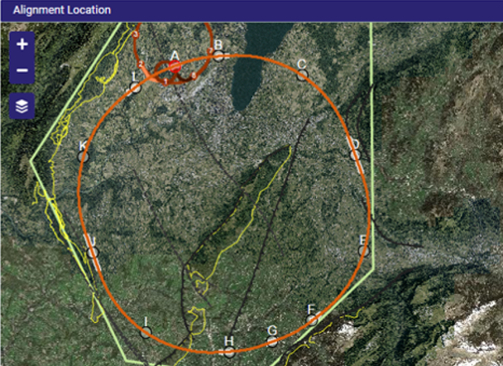
FCC-eh
Complementary to FCC study:
p-p collider “FCC-hh” √𝑠=100 TeV. (Nb₃Sn 16T magnets)
(80…100) km circumference tunnel infrastructure, e.g. in CERN area
The ERL could also be combined with the HL-LHC and HE-LHC
Complementary “FCC-hh”, HL-LHC and HE-LHC physics program

Slide 32
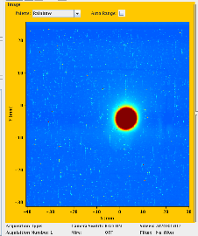
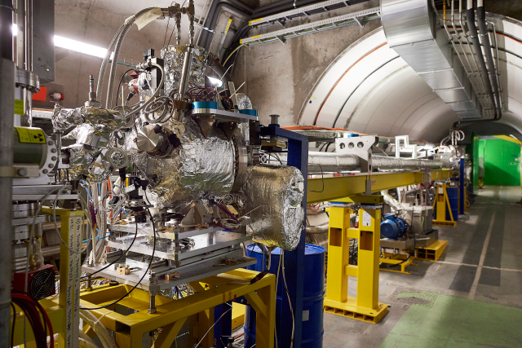
AWAKE
AWAKE: Advanced Proton Driven Plasma Wakefield Acceleration Experiment: Proof-of-Concept acceleration experiment to demonstrate a novel acceleration technique: Use SPS protons to generate powerful wakefields in a 10m plasma cell. Wakefields accelerate externally injected electron beam.
Aim at electron acceleration of several GeV/m
Experiments has started end 2016 → first observation of strong plasma wakes generated by proton beam
e⁻ spectrometer
Laser
RF gun
Plasma cell
e⁻
10m
p
Proton
beam
dump
SPS
protons
SMI
Acceleration
Proton
diagnostics
Laser
dump
AWAKE experiment and plasma cell looking upstream
First proton beam sent to AWAKE for proton beam line tests (16 June 2016)

Slide 33
Options for Collaborations
Hadron Collider:
Simulation tools in the context of Synchrotron Radiation and electron cloud
Beam stability simulations in the presence of e-cloud, rest-gas and beam-beam
Impedance models and calculation tools
Simulation of loss maps
High field magnet development (field quality and quench margins)
SRF controls and feedback (e.g. bunch length control)
Optics and lattice design
Impedance calculations and optimization

Slide 34
Options for Collaborations
Lepton Collider:
Circular: Optics and lattice design
Linear: performance optimization for different configurations
Plasma acceleration (AWAKE): simulation tools and diagnostics
e-p Collider:
Interaction region design and optics
ERL beam dynamics and beam stability: front-end simulations & HOM couplers
Test facilities: simulation tools for boot-strapping and commissioning
Virtual high beam power operation: failure modes and machine protection

Slide 35
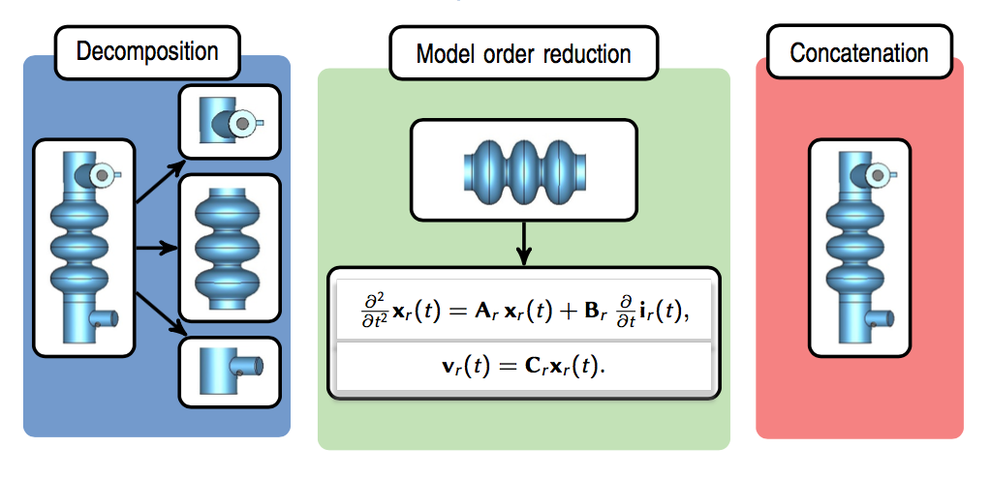
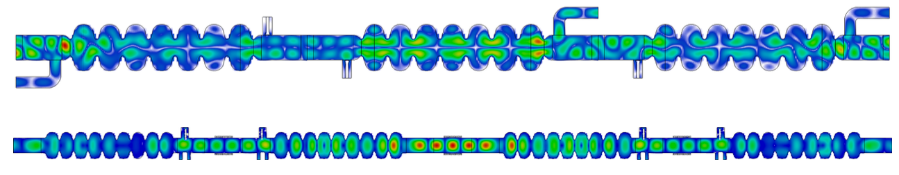
Possible Subjects for Collaborations: beam impedance
SSC workflow:
Impedance calculations:
accurate impedance models of cavity strings and of partial or full lattice periods needed.
HL-LHC/LIU: reduction of the HOM impedances the SPS travelling wave cavities, and of the overall impedances of full lattice periods.
University of Rostock has developed the State-Space Concatenation method (SSC) to simplify and to speed up such calculations.
Request to BEMB in preparation: Adaptation and application of SSC to calculate long coupled impedance structures of CERN machine (e.g. SPS half periods)
concatenation of multi-cell cavities:
see Johann Heller’s talk

Slide 36
Accelerator Beam Physics:
see Alexander Huschauer
Electron-cloud build-up and effects:
Extension of simulation tools (PyEcloud) to include 3D effects as in RF cavities
Interplay between ions and electron clouds and possible enhancement of the effects in the presence of anomalous gas sources (see recent experience with 16L2)
Optimization of algorithms to further profit of multi-core infrastructure and GPUs for:
  beam stability studies
  incoherent emittance growth & interplay with non-linearities with semi-frozen models
Optics and Single Particle Dynamics:
Extension of simulation tools (MAD-X) to include realistic field maps and fringe fields and more complex magnetic devices (wigglers, elements for electron lenses and coolers, etc.)
  Impedances and their effects:
  Characterization of the electromagnetic properties up to high frequencies of new materials and structures for accelerator components (coatings, surface geometries like LESS surfaces, etc.)
  multi-bunch macroparticle simulations of beams under the effect of impedances coupling several bunches
  Electron lenses as a possible tool for Landau damping
  Space Charge: Further development of the space charge implementation in MAD-X

Slide 38
LHC Upgrade Goals: Performance optimization
Luminosity recipe (round beams):
  1) maximize bunch intensities
  2) minimize the beam emittance
3) minimize beam size (constant beam power);
4) maximize number of bunches (beam power);
5) compensate for ‘F’;
6) Improve machine ‘Efficiency’
Injector complex
Upgrade LIU
  triplet aperture
    25ns
Crab Cavities
minimize number of unscheduled beam aborts

Slide 39
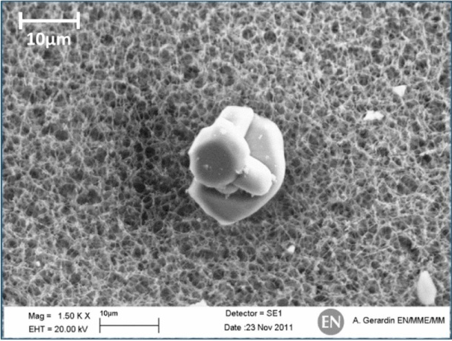
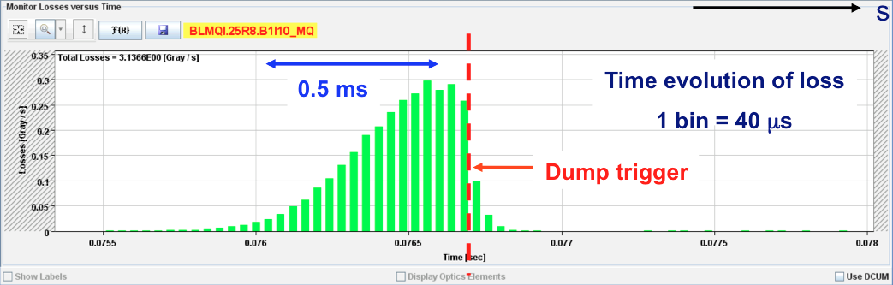
UFOs – Unidentified Falling Objects:
R~10 µm
Sudden local losses
Rise time of the order of 1 ms.
Potential explanation: dust particles
falling into beam creating scatter losses and
showers propagating downstream
Distributed around the ring – arcs, inner triplets, IRs
Even without quench, preventive dumps by QPS

Slide 40
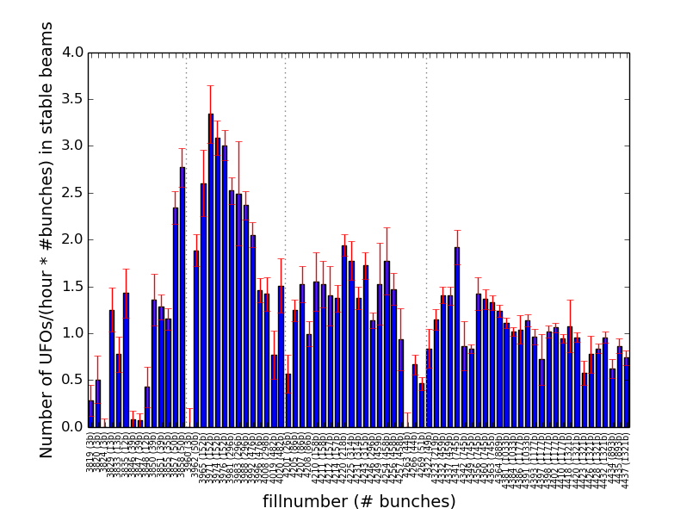
RunII Startup: UFO rates (September 2015)
There are many UFOs, a significant number > 1% of threshold
0.07% of all UFOs actually dump the beam
Signs of conditioning when normalizing rate by the total number of bunches
G. Papotti
25 ns

Slide 41
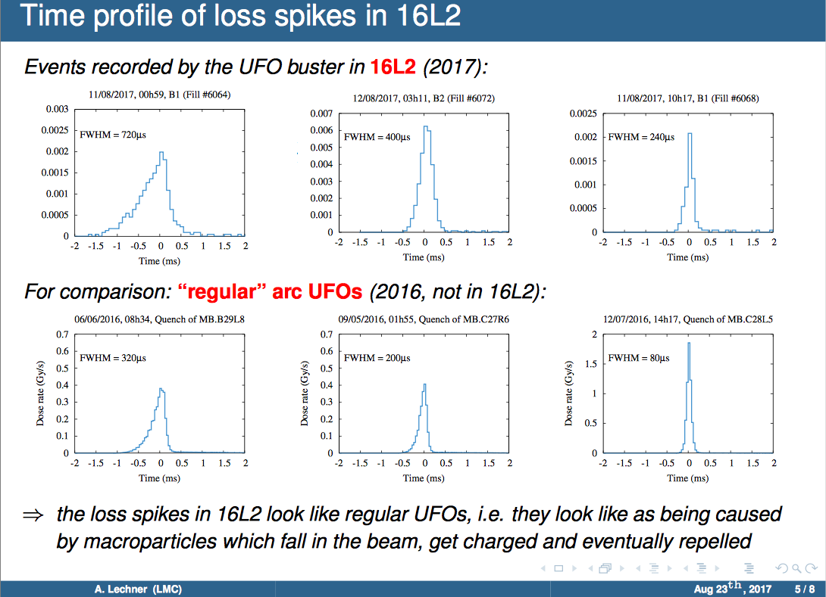

Slide 42
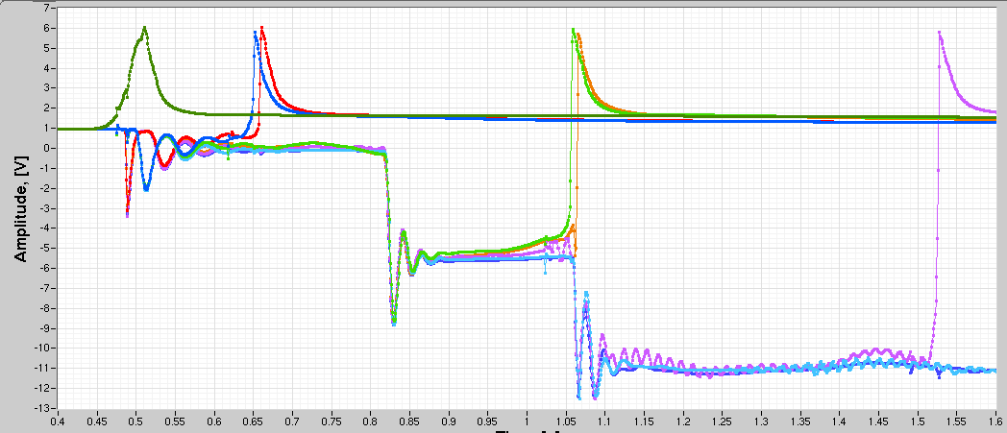
LHC Energy Exploitation Study: Phase1
Chamonix 2017
Sandrine Le Naour
Observations from the training campaign:
Multiple magnet quenches during a given training quench event:
➔ Multiple training quenches and / or EM coupling (timescale < 1s)
+ heat propagation at lower current ➔ multiple quenches!!
➔ Possible cascade effect for quenches at higher magnet current!!!
Example: I=11521 A with 6 quenches triggered by nQPS and iQPS
A16R4
C16R4
B16R4
B17R4
C17R4
A17R4
Time scale 0.5s

Slide 43
LHC Energy Exploitation Study: Phase1
All magnets re-tested in SM18 did not show intrinsic limitations to
reach ‘ultimate’ field (including 26MBs from tunnel)
Statistical analysis of all training quenches:
95% of all quenches are 1st quenches (magnets quench only once)
Most training quenches in 3000 series
No correlation in the training before and after thermal cycle!
  ➔Statistical process with Gaussian tails
Expectation for 7TeV:
33% of 2000 series
~140 quenches
90% of 3000 series
~370 quenches
ca. 500 to 600 quenches
to reach 7 TeV
ca. 2 quenches / day
Total of 1 month / sector
Chamonix 2017
Gerard Willering
Beam Energy for RunIII:
Probable to push beam energy towards 7 TeV after LS2 for RunIII
However, several equipment components might reach their
performance limits @ 7TeV
➔ needs validation during training campaign after LS2
Ezio Todesco

Slide 44
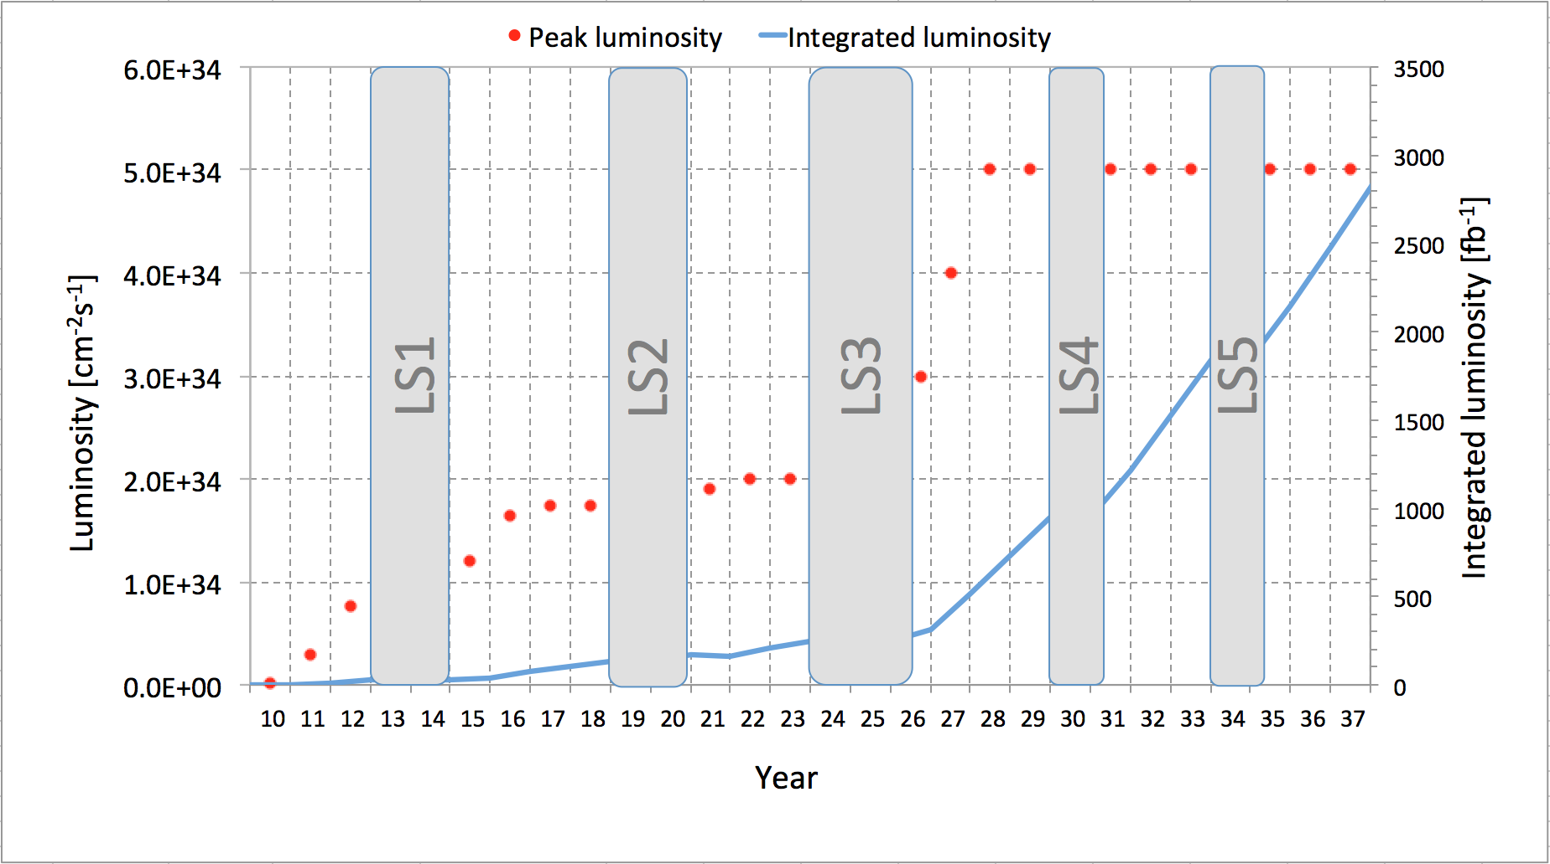
Performance Projections up to HL-LHC:
25 fb⁻¹
1000 fb⁻¹
3000 fb⁻¹
Run I
Run II
Run III
New
Low-β*
quads
Splices fixed
Injectors
upgrade
e-cloud UFOs!
Technical limits (in experiments, too) like :
Energy
6.5TeV
LIU
300 fb⁻¹
Intensity
Upgrade
0.75 10³⁴ cm⁻²s⁻¹
50 ns bunch
high pile up ∼40
1.5 10³⁴ cm⁻²s⁻¹
25 ns bunch
high pile up ∼40
1.5 -2.2 10³⁴ cm⁻²s⁻¹
25 ns bunch
very high pile up > 60
5 10³⁴ cm⁻²s⁻¹
levelled
25 ns bunch
very high pile up ∼140
Cryogenic limit, Radiation &
Damage of triplet magnets

