Slide 1










Status of the FAIR Project
Jürgen Henschel
FAIR Project Leader / Technical Director GSI & FAIR
Finland
France
Germany
India
Poland
Romania
Russia
Slovenia
Sweden
UK

Slide 2



FAIR Strategic objectives
FAIR phase 0
research
program
Construction
of FAIR
Upgrade
of existing
accelerators
Campus
development

Slide 3
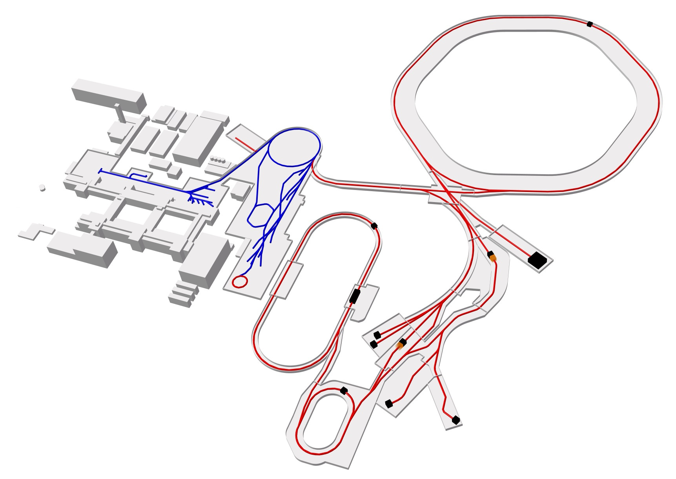
FAIR – The Facility
Ring
accelerator
Ring accelerator SIS100
Linear
accelerator
Production of new atomic nuclei
Antiproton
ring
Production of antiprotons
100 meters
Existing facility
Planned facility
Experiments
Collector
ring

Slide 4
FAIR Status
New Organization FAIR & GSI
Integrated resource loaded Project Master schedule
Project Management Process
Reorganization FAIR Site & Buildings
Reorganization of Planning / Tendering and Awarding for Civil Construction
Communication strategy
✓
✓
✓
✓
✓
✓

Slide 5
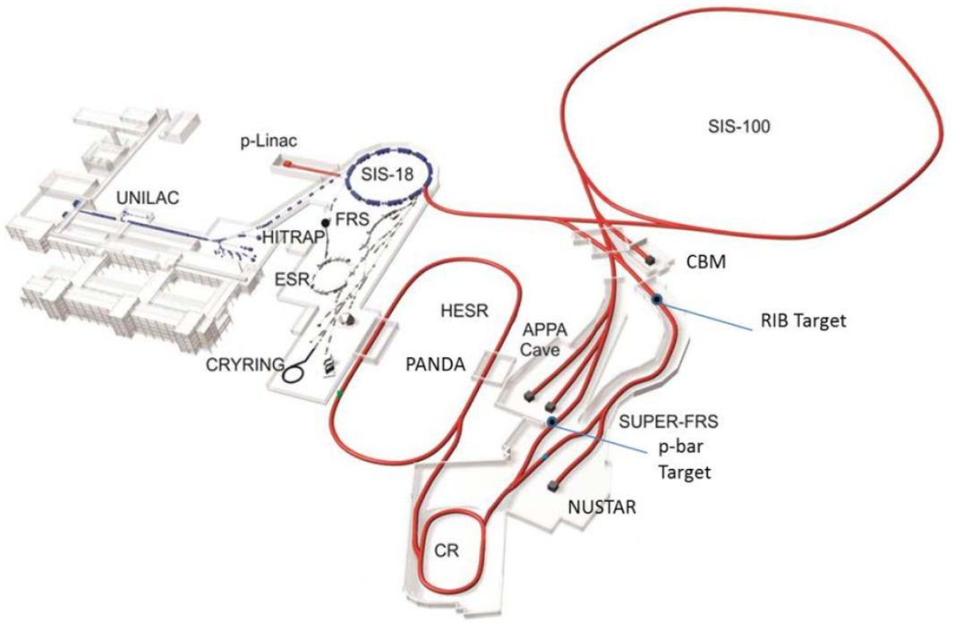
FAIR Status
Scope of the FAIR Project – The Modularized Start Version (MSV)
APPA
  SPARC: atomic physics in strong fields
  WDM+Hedgehob: dense plasma physics
  BIOMAT: biomedical and materials research
CBM
  HADES : hadrons in dense nuclear matter
  CBM: compressed baryonic matter
NUSTAR
  R3B: kinematically complete reaction studies
  with relativistic radioactive ion beams
  ILIMA: In ring lifetime and mass spectroscopy
  HISPEC/DESPEC: In beam and stopped beam
  spectroscopy of exotic nuclei
  MATS: Mass and lifetime spectroscopy in traps
  LASPEC: laser spectroscopy of exotic nuclei
  PANDA
  Hadron physics with antiprotons
5

Slide 6
FAIR Status
Planning scope is the MSV
The completion date is in 2025
Full integration in planning of Civil Construction, Machine & Experiments is achieved
A staged approach is realized (“Along the Beamline” / North & South) to speed up the start of experiments
Installation windows prior finalization of Civil construction are defined
Components (Machine & Experiments) for this installation identified & respective dates set
Continuous progress measurement is defined and established
Weekly, monthly and quarterly reviews are scheduled and performed
17th FAIR Council decisions as basis

Slide 7
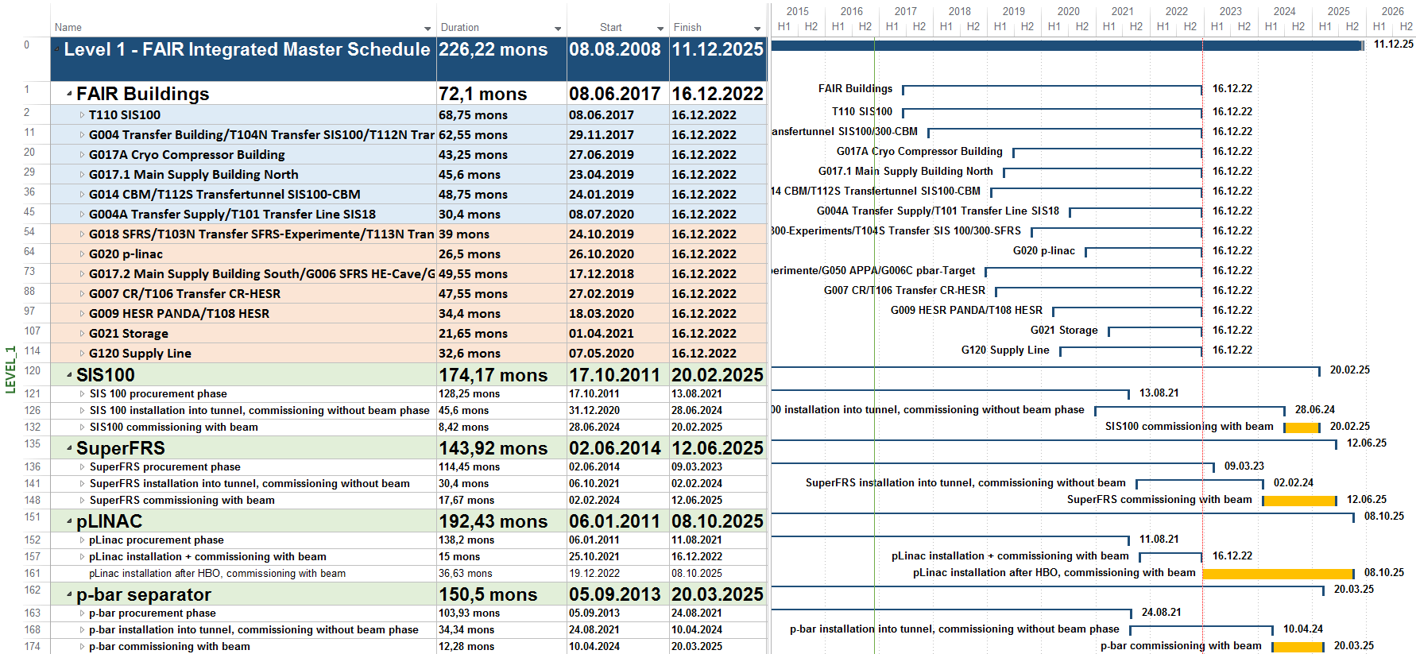
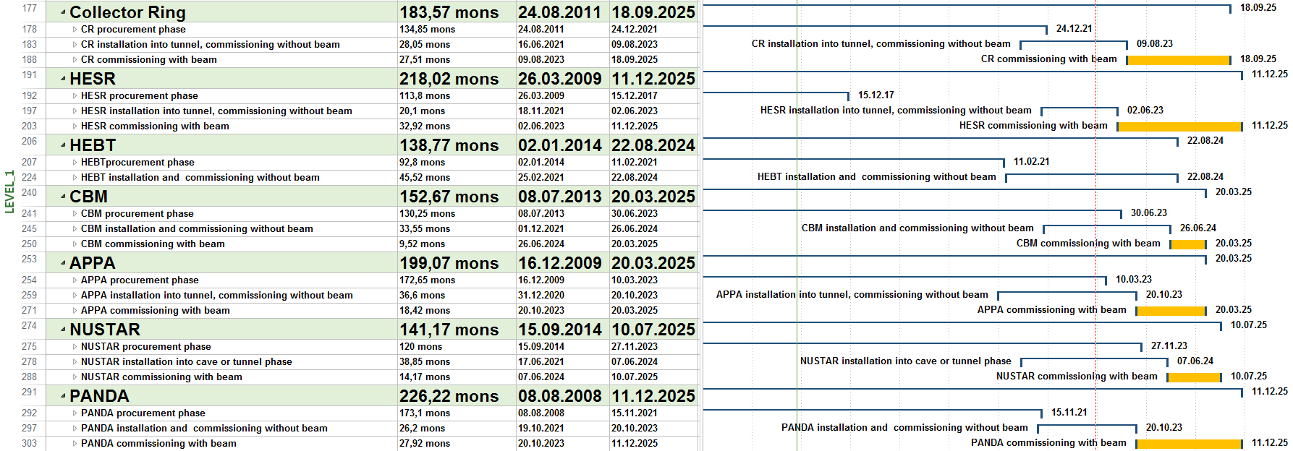
FAIR Project Master Schedule
Level 1 (Baseline overview) – Council – 7. December 2016

Slide 8
FAIR Project Progress - Accelerator

Slide 9
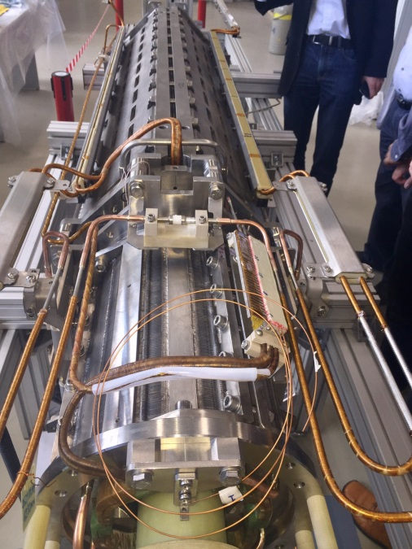
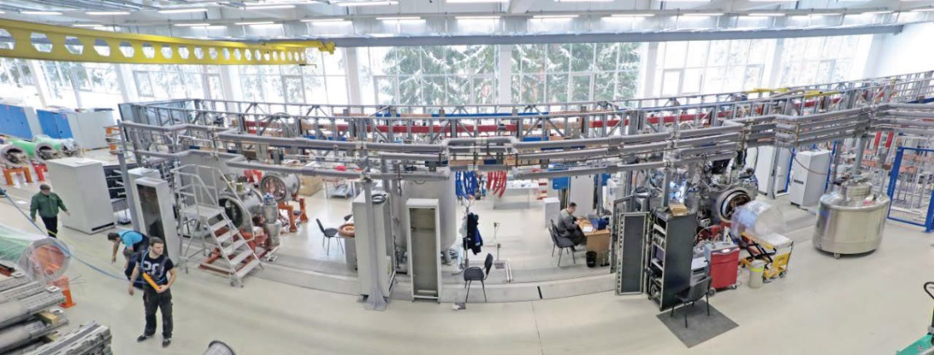
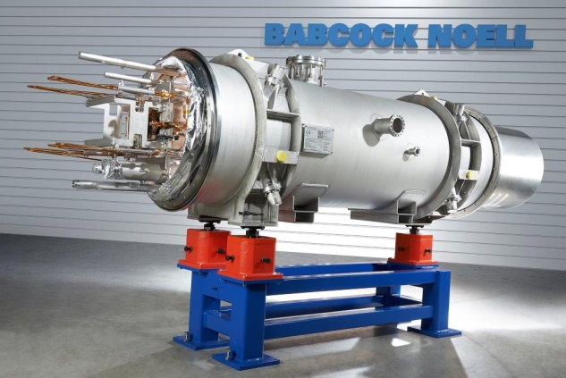
FAIR Project Progress - Accelerators
Highlights
SIS 100:
Dipoles serial production released (BNG)
First Of Series (FOS) Quadrupole units tests (Dubna)
FOS bunch compression cavity released (Aurion)
FOS acceleration cavity released (RI)
Injection systems tendered and awarded
New control system implementation on target schedule

Slide 10
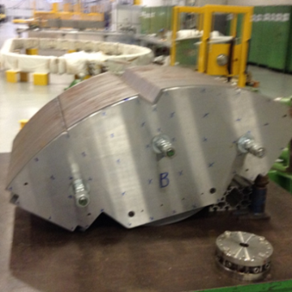
FAIR Project Progress - ACC
Highlights
Super FRS:
  Design of Pre series SC Multiplets completed PRR 2017
  SC Dipol tender finalized and published
  CERN Magnet testing facility in finalization
  FAT x-slit system successful
  Detectors (ToF, MUSIC) are in contract negotiations
  SC Vacuum chambers spec finalized
  CR for shielding flask
<70 ton
6950 mm

Slide 11
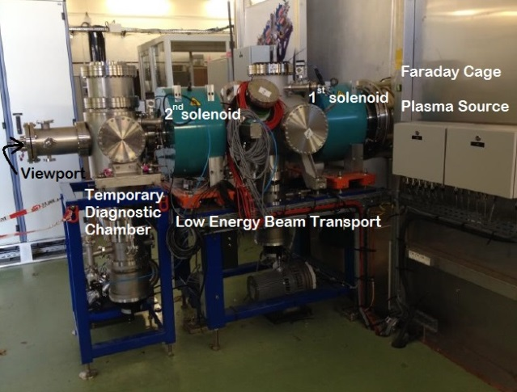
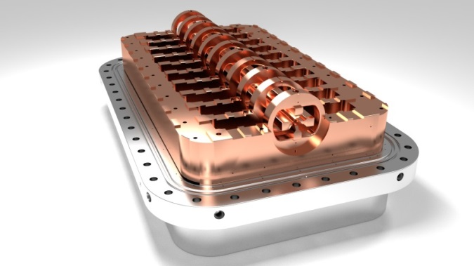
FAIR Project Progress - ACC
Highlights
p-Linac / Pbar Target:
Accelerate building successfully underway (-24 month)
GAF solution more cost effective than planned (~2 mio.€)
Proton source (CEA) in commissioning
Klystron FAT successful (CNRS)
RFQ (Ladder) design close to completion

Slide 12
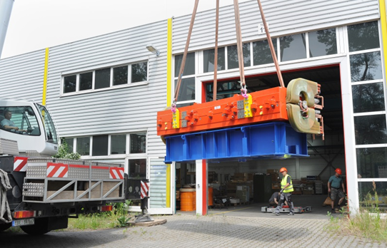
FAIR Project Progress - ACC
Highlights
CR:
CR TDR released
Component design ramp up
all needed contracts signed for now
HESR:
All Dipoles are produced and in delivery to storage area
QP & Sextupoles in production
RF equipment pending

Slide 13
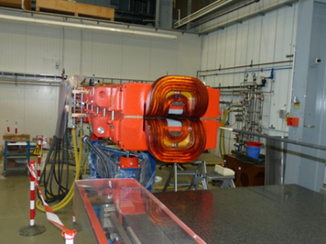
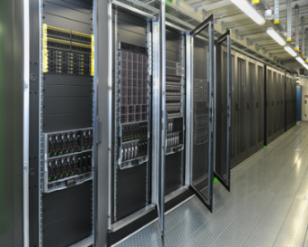
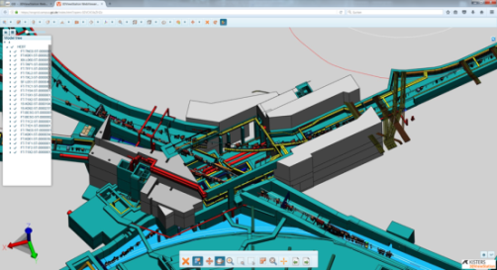
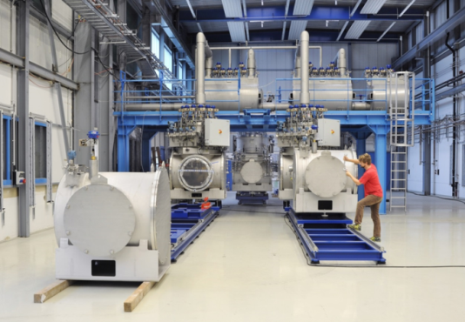
FAIR Project Progress - ACC
Highlights
Commons:
HEBT Dipoles (2) passed successfully SAT (Efremov)
Serial Production (52) released, FAT successfully passed
first 2 power converters (of 196) delivered (ECIL, India)
Cryo 2 tender in finalization (~ 30 mio.€)
STF ready for use
New control system in rollout

Slide 14
FAIR Project Progress – Civil Construction

Slide 15
FAIR Project Progress – Civil Construction

Slide 16
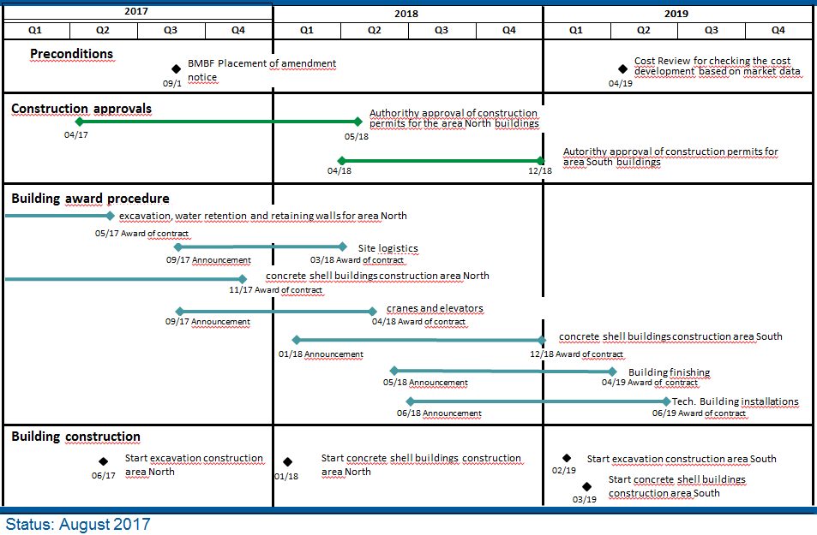
FAIR Project Progress – Civil Construction

Slide 17
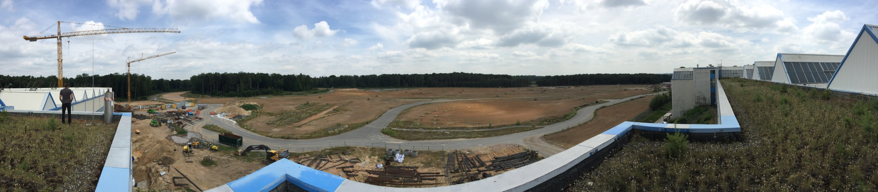
FAIR Project Progress – Civil Construction
Hier aktuelles Bild Bau
Notes:
17

Slide 18
FAIR Project Progress – next steps
Start civil works construction area North in summer 2017
Award of building shell construction area North in Q4 2017
Award of SFRS Dipoles
Tender of Cryo 2
Finalization of Experiment strategy for day 1

Slide 19
FAIR R&D needs
The construction of the FAIR facility and the procurement of the components is progressing well. Support from university groups will be especially needed for:
Developments towards highest beam intensities and brightness in the FAIR accelerators
Injectors: Transport of intense ion beams, brightness optimization, rf cavity developments and tests,….
Synchrotrons: Beam dynamics, vacuum, diagnostics, rf-control, ..
Storage rings: Internal targets, beam cooling, …..
Super-FRS: Beam optical model and optimizations, controls….
Components: SC magnet developments for fast ramping,….

Slide 20

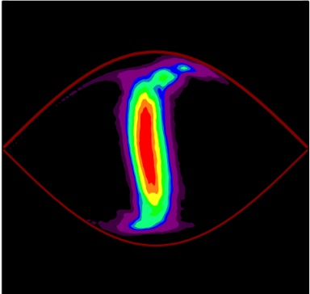
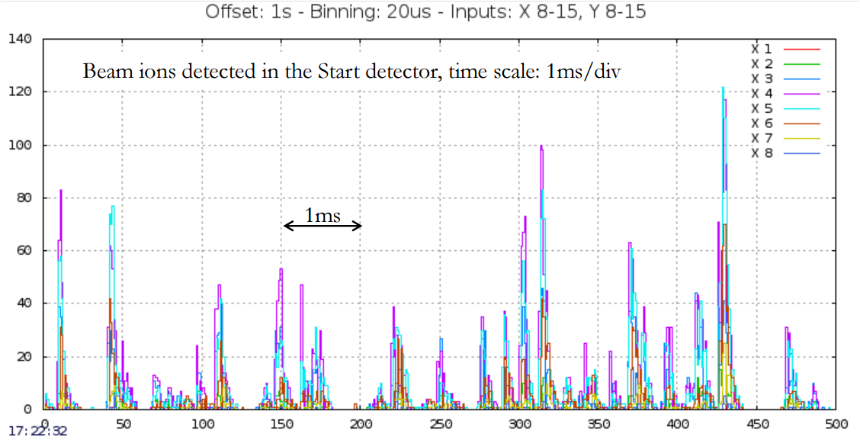
Accelerator Challenges of GSI/FAIR
An intensity frontier accelerator user facility for its four scientific pillars and beyond
Upgrade the heavy ion LINAC for high intensity operation
Beam intensity and brightness
reliability
Fast ramping super-
conducting synchrotron:
Fast ramping magnet
Low beam loss
XHV Vacuum
Machine protection
Operation reliability
Fast ramping injector:
Highest intensities for Protons- Uranium
SIS100
Proton LINAC
SIS18
rotated bunch
UNILAC
±25 ns
Challenging beam technique
Bunch compression or
Slow extraction with smooth spill structure
Novel beam technique for CRYring/ESR
Beam cooling
deceleration
HESR
Antiproton/heavy ion accelerator chain:
Efficient beam transportation/capture
High energy antiproton beam cooling
CR

Slide 21
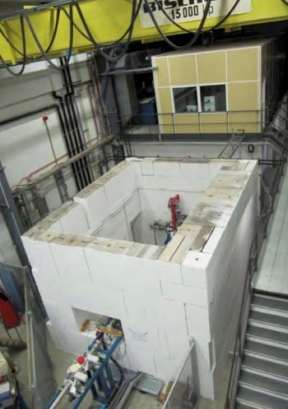
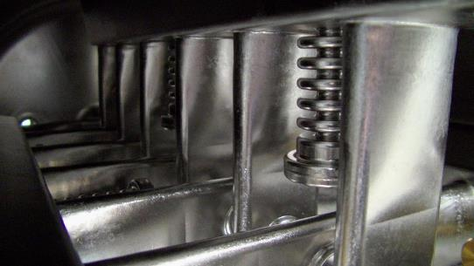
F&E Examples: Injektors
cw Linac demonstrator @ GSI
Compact superconducting RF Structures
for GSI (i.e. cw Linac)
Stripper:
Plasma Windows for high pressure applications
Plasmastripper
Gasstripper with Plasmawindow
Tests & CH Structures
Stripperfoils @ GSI

Slide 22
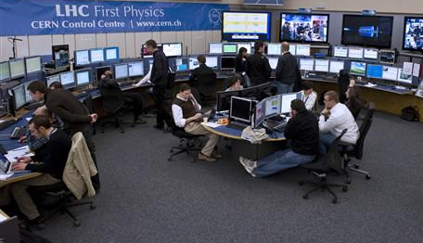
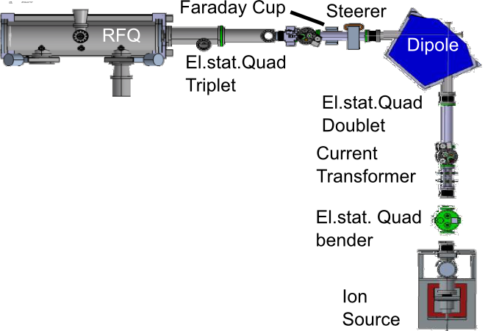
F&E Example:
Optimization („Autonomous Accelerator“)
Beispiel: CRYRING@GSI Injektor
CERN/LHC main control room
Development of evolutionary Algorithms and Methods for autonomous machine learning, with the aim
to optimize the Accelerator control through numerical Simulation and Models
faster and autonomous Adjustment of the System Beam / Accelerator
Failure & Machine protection at high Intensity beam modes
Real time feedback systems
The development of this systems just started. The colaboration with Universities will lead to improved results in quality and timing.
The results can be tested immediately on existing machines (i.e. Cryring @ FAIR)

Slide 23
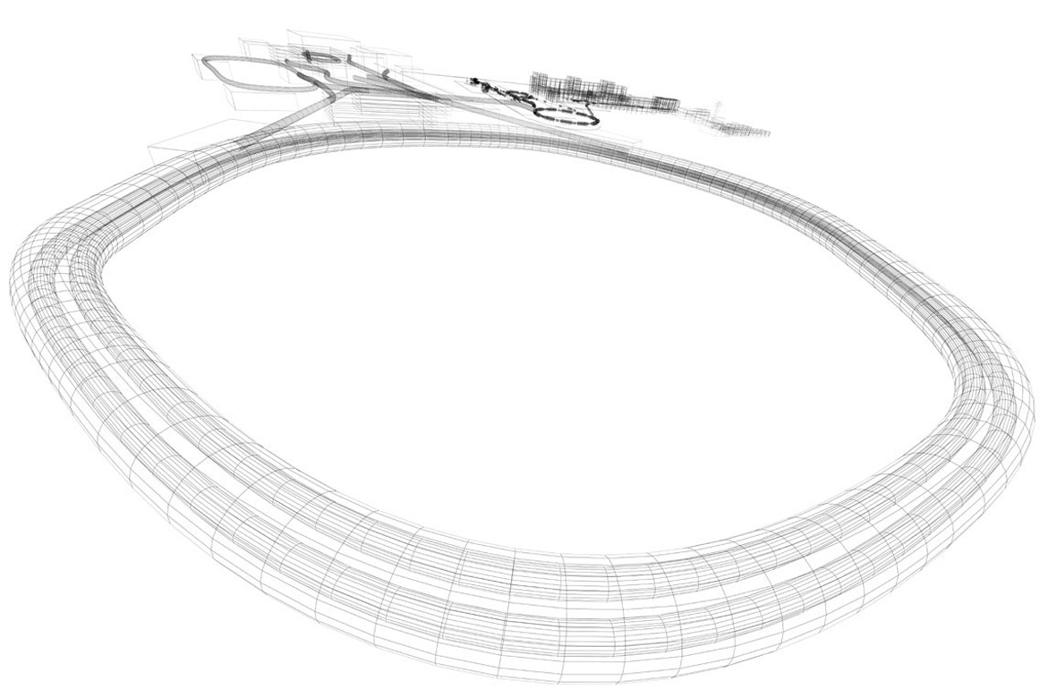
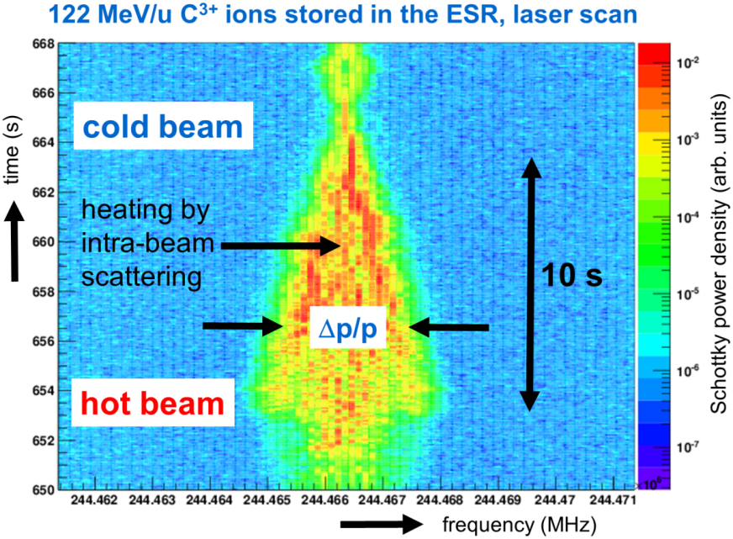
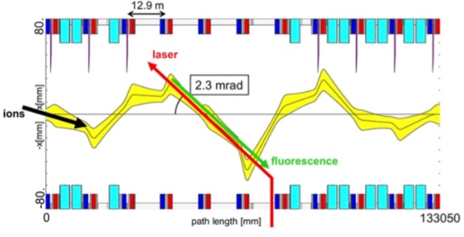
Heavy Ion Laser Cooling Pilot Facility
R&D Example: Laser cooling in SIS100
Laser-cooled relativistic
heavy ion beams
Z_{ion}= 10 – 60 (3 – 19 electrons)
g up to 13 (huge Doppler-shift)
Goal: Cooling of relativistiv heavy ion beams at final energy
Extraction of very cold and very short heavy ion bunches
Laser Cooling Facility included in SIS100 Tunnel Layout
only cooling method in SIS100
laser
beam
ion
beam
Components used for laser cooling experiments in ESR

Slide 24
R&D Example: Multi-purpose electron lenses
gun
HV
collector
Motivation
  Increased space charge limit
  (Landau) Damping of coherent transverse bunch oscillations
  …..
Pulsed electron lens
  Current modulation to match ion bunch current profile
Research topics
  Beam dynamics: Space charge dominated ion and electron beams in external fields
  Magnet design: Compact high quality magnets providing the longitudinal fields
electrons
ions
bunch structure
Electron Lens Parameters
Current | 10 A
Beam diameter | 50 mm
Energy | 30 keV
Axial magnetic field | 0.7 T
Modulation frequency | 2-5 MHz
Peak power | 250 kW
INJ
ACC
t
How an e-Lens might look: SIS18 electron cooler
gun
collector
interaction solenoid
toroid
toroid

Slide 25
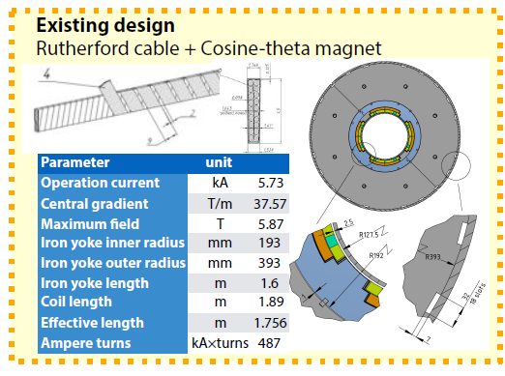
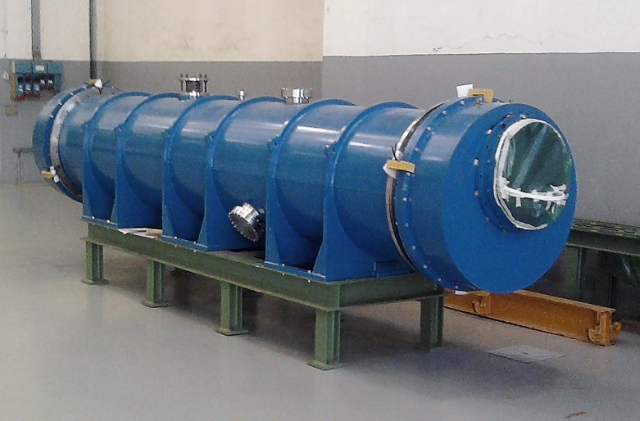
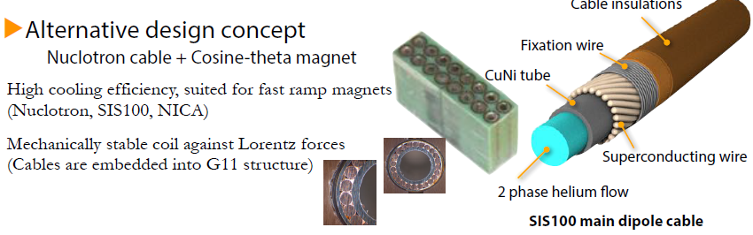
Advanced Superconducting Magnets
R&D Example: Fast Ramping Superconducting Magnets
Fast ramped superconducting magnets
Superconducting septa for beam extraction
Large aperture superconducting quadrupoles
Fastest ramped, full size s.c. cos(theta) dipole magnet world wide (SIS300 prototype)
Possible applications:
SISx00, CERN SPS2, FCC injector ring
Dr. Jürgen Henschel- KFB Workshop- 31.08.2017
25

Slide 26
FAIR R&D needs: Summary
The construction of the FAIR facility and the procurement of the components is progressing well. Support from university groups will be especially needed for:
Developments towards highest beam intensities and brightness in the FAIR accelerators
Injectors: Transport of intense ion beams, brightness optimization, rf cavity developments and tests,….
Synchrotrons: Beam dynamics, vacuum, diagnostics, rf-control, ..
Storage rings: Internal targets, beam cooling, …..
Super-FRS: Beam optical model and optimizations, controls ….
Components: SC magnet developments for fast ramping,….

