Slide 1
Computation of synchrotron radiation for FCC D. Bizzozero, E. Gjonaj, H. De Gersem. T. Weiland
SR in FCC-ee / FCC-hh
Magnetic bends in the IR of FCC
Effects on beam luminosity
Wall heating
High photon energy
Impact on detector operation
Present estimates
Semi-analytical for the radiated power
Optical ray approximation for SR-pattern in the bends
LHC IP5 geometry (Burkhard et al.)
Magnetic bend FCC-ee (Boscolo et al.)

Slide 2
Computation of synchrotron radiation for FCC D. Bizzozero, E. Gjonaj, H. De Gersem. T. Weiland
Numerical study SR wakefields
Direct solution of Maxwell’s equations using a high order DG-FEM method
Ultra-relativistic bunch approximation
Transformation of geometry in Frenet-Serret coordinates
Example of a bunch compressor
for DESY-XFEL

Slide 3
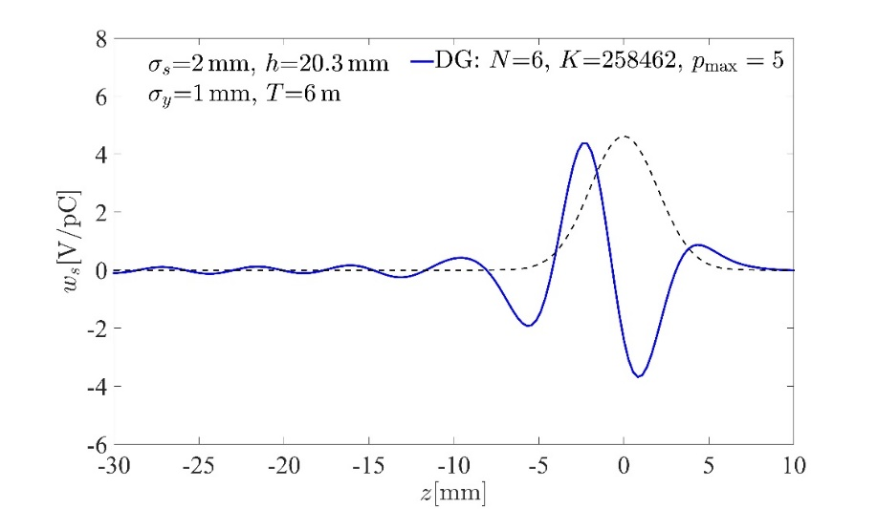
Computation of synchrotron radiation for FCC D. Bizzozero, E. Gjonaj, H. De Gersem. T. Weiland
Example calculation for a bunch compressor (DESY)
SR field map
Longitudinal SR wake field

