Slide 1
Wakefields of short bunches in lossy structures E. Gjonaj, H. De Gersem. T. Weiland
Wakefield coupling impedances
Microwave instabilities
Transverse mode coupling instabilities
Longitudinal multi-bunch instabilities
Beam induced heating
Relevance for CERN
SPS injection/extraction kickers
LHC-BGI, HF-fingers
Coated vacuum components for the CLIC DR
Resistive wall for FCC-ee, FCC-hh …
…
SPS injection kickers
RF-fingers
Notes:
BGI=Beam Gas Ionization monitors
SPS=The Super Proton Synchrotron
FCC=Future Circular Collider Study

Slide 2
Wakefields of short bunches in lossy structures E. Gjonaj, H. De Gersem. T. Weiland
Wakefield Simulations
3D-structures with complicated geometrical details
Impedance sheets: lossy / rough walls, coated surfaces
Dispersive and nonlinear (ferrite) materials
Open structures
Short bunches with very long wakefield transients
CST PS simulations may not be feasible or numerically expensive
MKI-kicker magnet

Slide 3
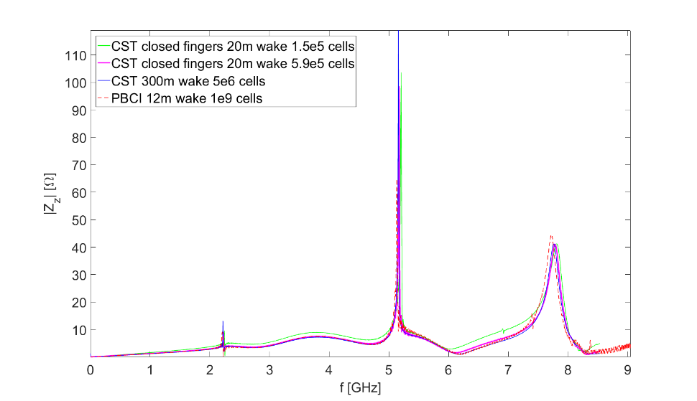
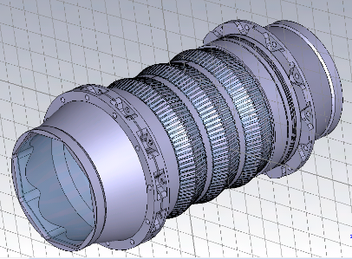
Wakefields of short bunches in lossy structures E. Gjonaj, H. De Gersem. T. Weiland
The moving window code PBCI
Dispersion-free method
Cluster parallelization
General surface/thin layer models:
MKI-kicker magnet
Notes:
CERN impedande group:
F. Caspers
E. Metral
G. Rumolo
B. Salvant
FCC-ee, Fcc-hh
F. Zimmermann
D. Schulte
Clic
G. Rumolo

