Slide 1
Plasma – Another Way for Heavy Ions Stripping
K.Cistakov, A. Fedjuschenko, G. Xu, Ph. Christ, F. Palmowski, C. Pokorny, L. Manganelli, Th. Ackermann, M. Iberler und J. Jacoby.
Notes:
Good Afternoon, My name is Konstantin Cistakov. I am part of the Plasma Physiscs Group at the Intititute for applied Sciences of The Goethe University. Our Group is currently working on…..

Slide 2
Types of Ion Stripper
Gas Stripper
Folien Stripper
Notes:
This types of Ion stripper are not tottaly optimal because…. For the case of gas stripper ….. And for the case of Folien? stripper

Slide 3
Plasma Stripper
Notes:
Plasma stripper comes as an optimal alternative as it has many advantages over the other types of Ion Stripper; For example….

Slide 4
Interaction of 1 MeV/u-energy beams of Au⁴⁺ with hydrogen gas and hydrogen plasmas of a 1 - 3 eV temperature 10¹⁷ cm⁻³ density* *According to V. Shevelko
Red Line - Ionisation
Black Line - Recombination
(v=1.3x10⁹ cm/s)
Notes:
Trotzdem=However
Sogar= even

Slide 5
Experimental Charge States Distribution Plasma vs. Cold Gas (Au²⁶⁺, 1MeV, n_{e} = 5x10¹⁵)

Slide 6
New Plasma Stripper
L_{coil}: 4.7 µH
Volume: about 12000 ml
Capacity: 80 µF
Current: up to 150 kA
Voltage: up to 35 kV
Magnetic Density: up to 3 T
Gas: H₂
Pressure: 20 Pa up to 160 Pa
Transfered Energy: about 50 kJ
Expected n_{e}: about 5x10¹⁷ cm⁻³
(Linear n_{e}: over 1x10¹⁹ cm⁻²)

Slide 7
Application for Beam Time End of 2018 – Beginning of 2019
Investigation of Charge State and Energy Loss of Heavy Ions After Interaction With Inductively Coupled Plasma
K. Cistakov, A. Fedjuschenko, G. Xu, Ph. Christ, Th. Ackermann, C. Pokorny, L. Manganelli, M. Iberler, and J. Jacoby
Plasma Physics Group, Institute of Applied Physics, Goethe University, 60438 Frankfurt am Main, Germany
R. Gavrilin, S. Savin and A. Golubev
Physics of high energy density in matter, ITEP, Russia
R. Cheng and Y. Zhao
Institute of Modern Physics, CAS, Lanzhou, China
S. Kumar, Y. Mathur and G. Rodrigues
Inter University Accelerator Centre, New Delhi, India
Olga Rosmej, Abel Blazevic and Karin Weyrich
GSI Helmholtzzentrum für Schwerionenforschung GmbH, D-64291 Darmstadt, Germany

Slide 8
Challenges & Outlook
Beam Time Measurement & Data Analyzing
Increasing of repetition rate
Improve form of a current pulse
Notes:
Vergiss nicht zu fragen wie heisst förder periode

Slide 9
Thank you for your attention!
New challenges require new approaches…

Slide 10
Motivation

Slide 11
Plasma Stripper
L_{coil}: 6 µH
Volume: 6000 ml
Capasity: 37.5 µF
Current: up to 33 kA
Voltage: up to 18 kV
Magnetic Density: up to 1 T
Gas: H₂
Pressure: 40 Pa up to 120 Pa
Transfered Energy: 5.8 kJ
Achieved Density: 3.2x10²² m⁻³
The longest observed nearly stable plasma persisted less than 30 µs. During this time the line density was measured to be decreasing slowly in the range of 4.5±1.5x10¹⁷ cm^{-2.}

Slide 12
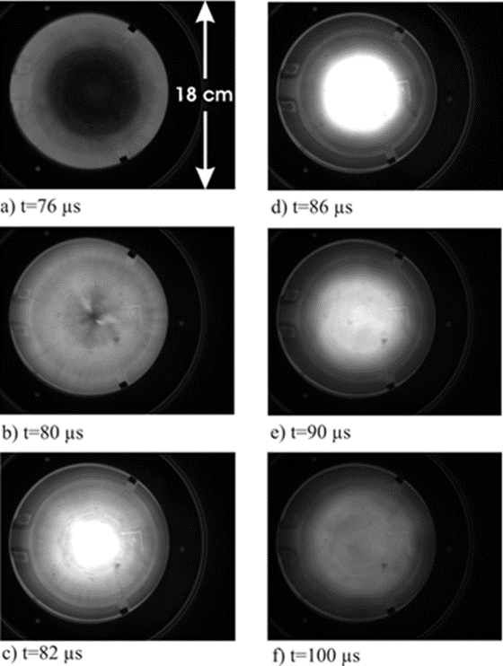

Slide 13
Charge states distribution of the gold beams after the plasma stripper
Projectile: 3.6MeV/u Au²⁶⁺
Plasma target: Hydrogen plasma ~10¹⁶ cm⁻³

Slide 14
Scenario of Heavy Ion Acceleration
production of ionized particles in the source: U4+ ions from MEVVA source
acceleration in first linac stage: high current injector to 1.4 MeV/u
charge stripping in gas stripper U28+ (intensity reduction)
further acceleration in linac to 11.4 MeV/u
charge stripping in carbon foil to U73+
synchrotron injection: with stripping -> high energy
without stripping -> high intensity
acceleration in SIS18 to variable energy maximum:
1 GeV/u for U73+
200 MeV/u for U28+
transfer to synchrotron SIS100 (w/o stripping to U92+)
acceleration in SIS100 to variable energy maximum:
11 GeV/u for U92+
2.7 GeV/u for U28+
production of rare isotopes with any energy in the range 0.5 to 2.7 GeV/u
separation and transfer of rare isotopes to storage ring (cooling at 0.74 GeV/u)

Slide 15
U⁴⁺ at 1.4 MeV/µ on H₂ target with 250 mbar pressure Gas-pressure dependence of charge-state fractions and mean charges of 1.4 MeV/u-uranium ions stripped in molecular hydrogen V.P. Shevelko, N. Winckler, I.Yu. Tolstikhina

Slide 16
Gas Stripper (H₂ Pulsed) STRIPPING OF HIGH INTENSITY HEAVY-ION BEAMS IN A PULSED GAS STRIPPER DEVICE AT 1.4 MeV/u P. Scharrer^{1,2,3}, W. Barth^{1,2}, M. Bevcic², Ch. E. Düllmann^{1,2,3}, L. Groening², K. P. Horn², E. Jäger², J. Khuyagbaatar^{1,2}, J. Krier², A. Yakushev²

Slide 17
Charge state distribution after stripping of uranium projectiles in a H₂ gas target and a N₂ gas target. W. Barth^{1,2}, A. Adonin¹, Ch. E. Düllmann^{1,2,3}, M. Heilmann¹, R. Hollinger¹, E. Jäger¹, O. Kester¹, J. Khuyagbaatar^{1,2}, J. Krier¹, E. Plechov¹, P. Scharrer^{1,2,3}, W. Vinzenz¹, H. Vormann¹, A. Yakushev^{1,2}, S. Yaramyshev¹ ¹ GSI Helmholtzzentrum für Schwerionenforschung, Darmstadt, Germany, ² Helmholtz Institut Mainz, Germany, ³ Johannes Gutenberg-Universität Mainz, Germany

Slide 18
Efficiency of Plasma Stripper vs. N2 Gas Stripper Au10+ at 1 MeV/µ (mean equilibrium charge)* *According to Thilo Ackermann and W. Shevelko

Slide 19
Theoretical prediction
Energy, [MeV/µ] | q_{eff}., Cold Gas | Plasma | Lenght (n_{e}=10¹⁸), [cm³]
1 | 13 | 49 | 23
3 | 37 | 64 | 80
10 | 75 | 86 | 220
Charge state after stripping*
Projectil:
Uranium with initial chare of <Q> = +4
Target:
Fully ionised Hydrogen
* according W. Shevelko

Slide 20
1st Generation of Plasma Stripper
L_{coil}: 6 µH
Volume: 4000 ml
Capasity: 34 µF and 50 µF
Current: up to 26 kA
Voltage: up to 9 kV
Magnetic Density: up to 500 mT
Gas: ArH₂ (2.8% H₂)
Pressure: 0.7 Pa up to 120 Pa
Transfered Energy: 1.6 kJ
Achieved Density: 8x10²² m⁻³

