Slide 1

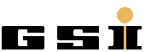
Risk Assessment for Barrel EMC
Performance Studies
EMC Session CM 17/2
June 8, 2017
K. Götzen
GSI Darmstadt

Slide 2
Risk Assessment for Barrel EMC
Risk assessment issue:
Impact of incomplete EMC Barrel to physics performance?
4 different ways of reduction (=leaving out crystals) studied
reduce from front (θ)
reduce from back (θ)
side
view
beam
beam
reduce asymmetric (φ)
reduce symmetric (φ)
front
view

Slide 3
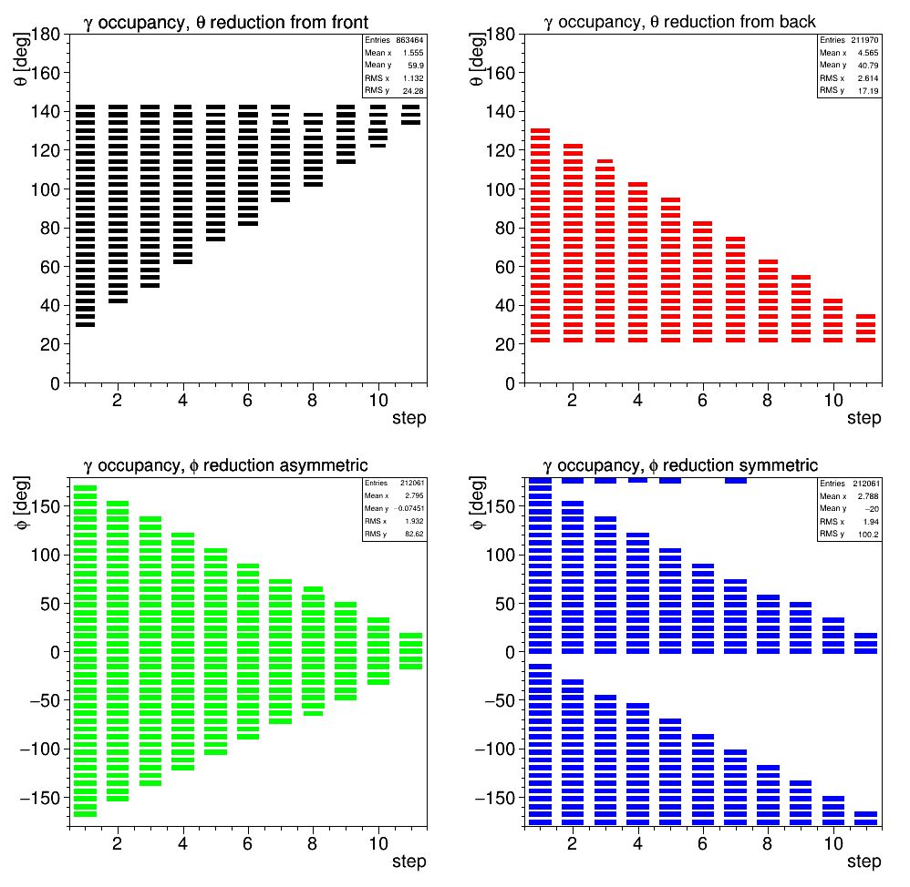
Angular Coverage

Slide 4
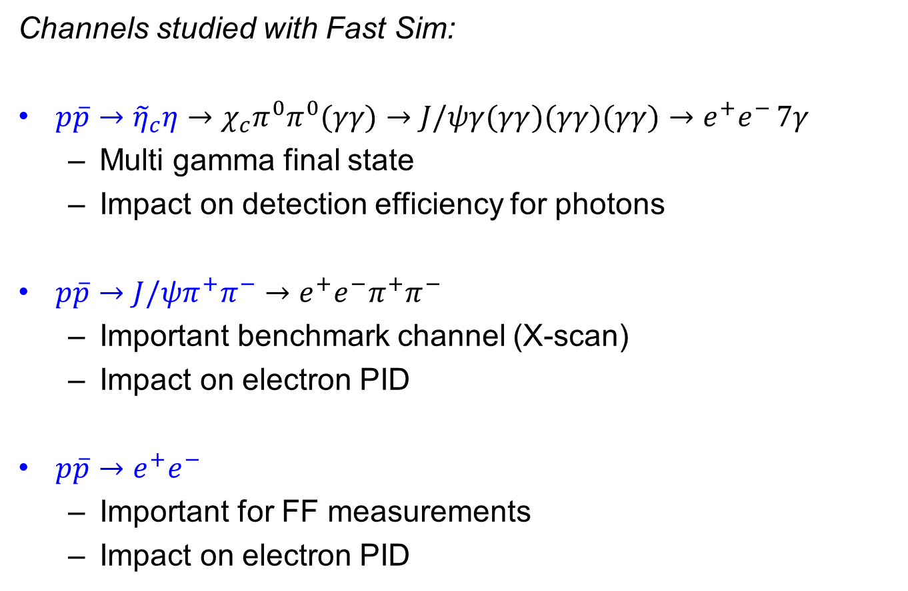
Physics Channels
Channels studied with Fast Sim:
${p\overline{p}→\tilde{η}}_{c}η→χ_{c}π^{0}π^{0}(γγ)→J/ψγ(γγ)(γγ)(γγ)→e^{+}e^{− }7γ$
  Multi gamma final state
  Impact on detection efficiency for photons
$p\overline{p}→J/ψπ^{+}π^{−}→e^{+}e^{−}π^{+}π^{−}$
  Important benchmark channel (X-scan)
  Impact on electron PID
$p\overline{p}→e^{+}e^{−}$
  Important for FF measurements
  Impact on electron PID

Slide 5
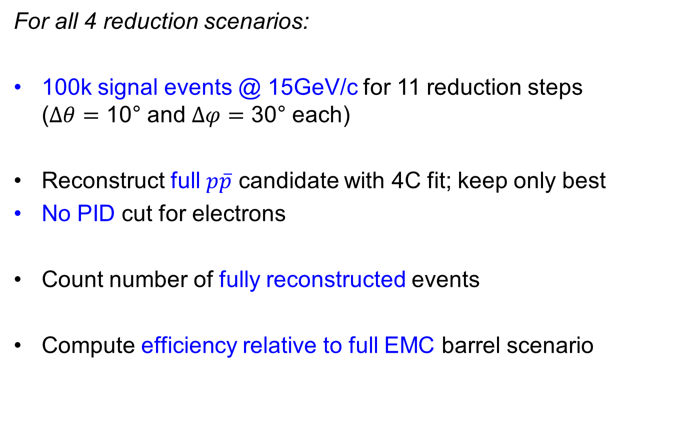
$${p\overline{p}→\tilde{η}}_{c}η$$
For all 4 reduction scenarios:
100k signal events @ 15GeV/c for 11 reduction steps
($Δθ=$ 10° and $Δφ=$ 30° each)
Reconstruct full $p\overline{p}$ candidate with 4C fit; keep only best
No PID cut for electrons
Count number of fully reconstructed events
Compute efficiency relative to full EMC barrel scenario

Slide 6
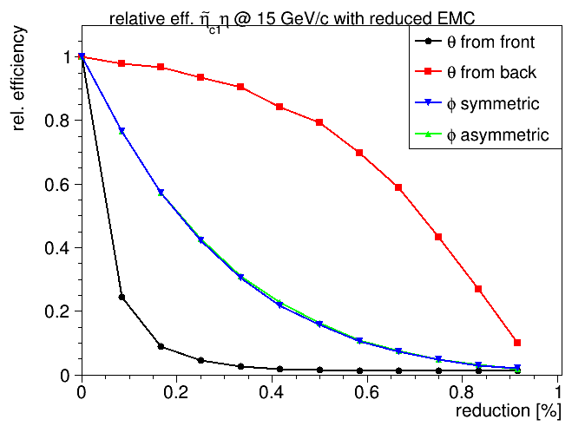

${p\overline{p}→\tilde{η}}_{c}η$ - Relative Efficiencies
Removing from back is best, from front worst case
No obvious difference between sym/asym removal in phi

Slide 7
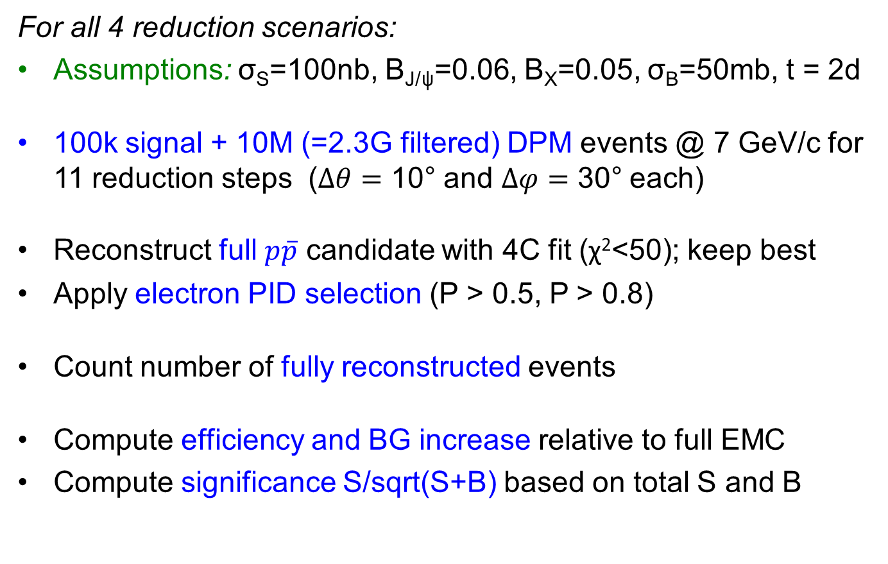
$$p\overline{p}→J/ψπ^{+}π^{−}$$
For all 4 reduction scenarios:
Assumptions: σ_{S}=100nb, B_{J/ψ}=0.06, B_{X}=0.05, σ_{B}=50mb, t = 2d
100k signal + 10M (=2.3G filtered) DPM events @ 7 GeV/c for 11 reduction steps ($Δθ=$ 10° and $Δφ=$ 30° each)
Reconstruct full $p\overline{p}$ candidate with 4C fit (χ²<50); keep best
Apply electron PID selection (P > 0.5, P > 0.8)
Count number of fully reconstructed events
Compute efficiency and BG increase relative to full EMC
Compute significance S/sqrt(S+B) based on total S and B

Slide 8
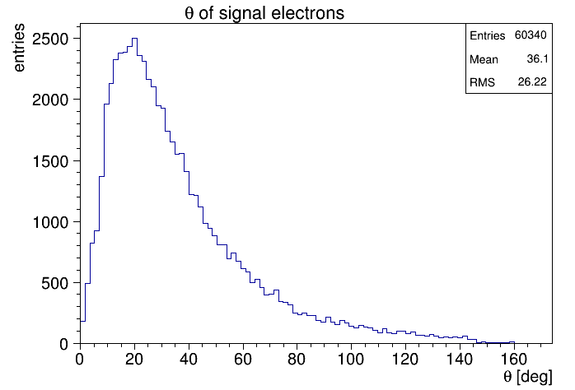
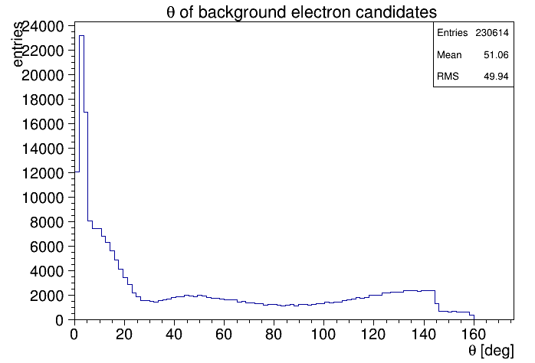
$$p\overline{p}→J/ψπ^{+}π^{−}$$
Theta distributions for signal and background

Slide 9
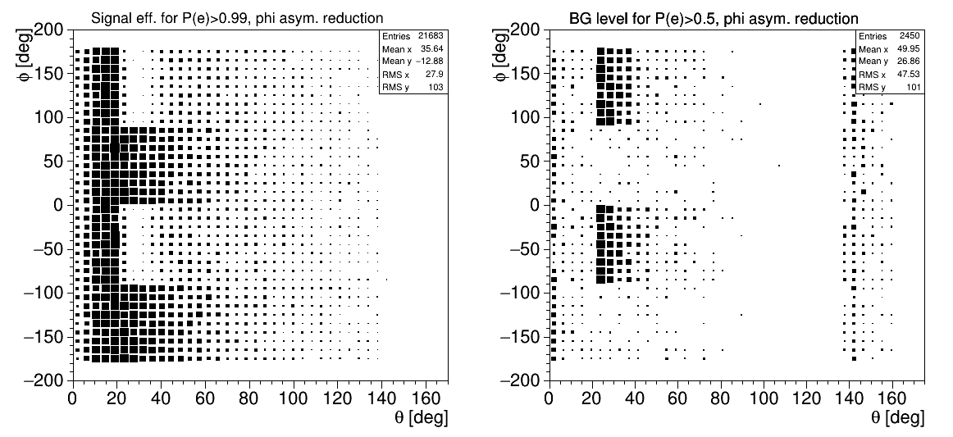

$p\overline{p}→J/ψπ^{+}π^{−}$ - Effect PID cut
Effect of PID cut on signal & background
Signal: P(e)>0.99
Background: P(e)>0.5
efficiency
loss
BG in-
crease

Slide 10
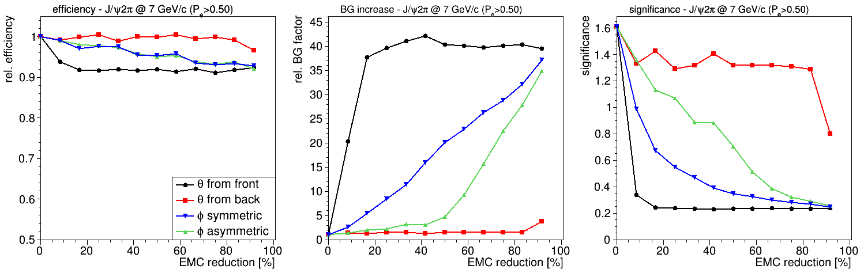

$p\overline{p}→J/ψπ^{+}π^{−}$- Eff, BG level
PID P_{e} > 0.5
  Signal efficiency doesn't drop strongly
  BG level θ red.: front worst, back quite robust
  BG level φ red.: asymmetric better than symmetric reduction

Slide 11
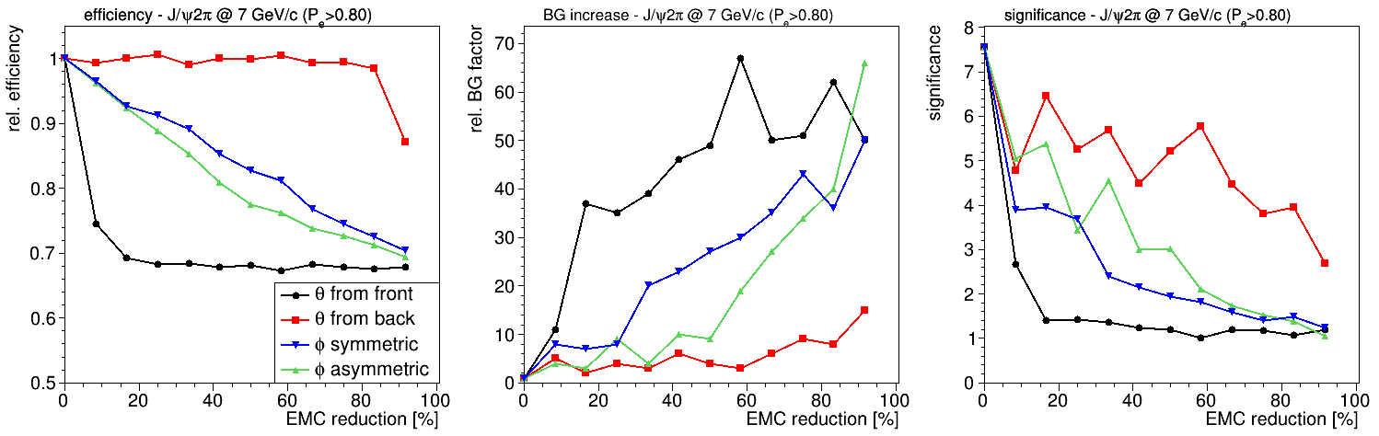
$p\overline{p}→J/ψπ^{+}π^{−}$- Eff, BG level
PID P_{e} > 0.8
  Stronger efficiency decrease due to PID cut down to relat. 70%
  BG level θ red.: front worst, back quite robust
  BG level φ red.: asymmetric better than symmetric reduction

Slide 12

$p\overline{p}→J/ψπ^{+}π^{−}$- Significance
Significance level almost constant for back reduction
Strong drop (factor 7!) for reduction from front
Better use asymmetric than symmetric reduction
P_{e} > 0.5
P_{e} > 0.8

Slide 13
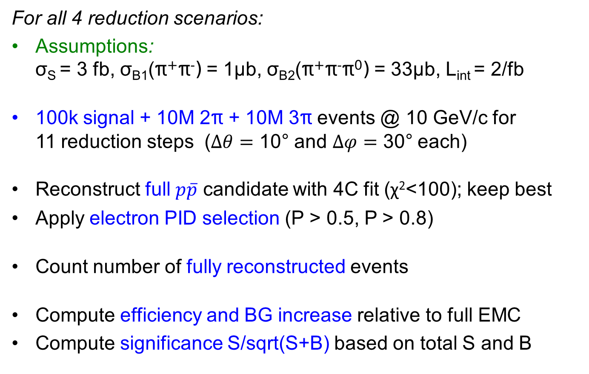
$$p\overline{p}→e^{+}e^{−}$$
For all 4 reduction scenarios:
Assumptions:
σ_{S} = 3 fb, σ_{B1}(π⁺π⁻) = 1μb, σ_{B2}(π⁺π⁻π⁰) = 33μb, L_{int} = 2/fb
100k signal + 10M 2π + 10M 3π events @ 10 GeV/c for
11 reduction steps ($Δθ=$ 10° and $Δφ=$ 30° each)
Reconstruct full $p\overline{p}$ candidate with 4C fit (χ²<100); keep best
Apply electron PID selection (P > 0.5, P > 0.8)
Count number of fully reconstructed events
Compute efficiency and BG increase relative to full EMC
Compute significance S/sqrt(S+B) based on total S and B

Slide 14
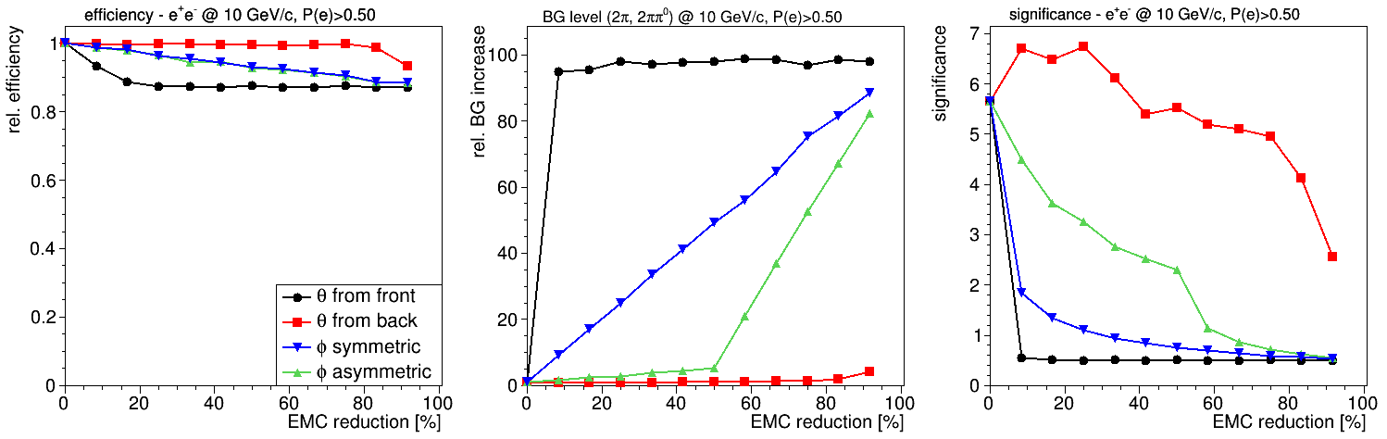


$p\overline{p}→e^{+}e^{−}$- Eff, BG level
PID P_{e} > 0.5
  Similar to $J/ψπ^{+}π^{−}$: Signal efficiency doesn't drop strongly
  BG level θ red.: front reduction worst, back red. quite robust
  BG level φ red.: asymmetric better than symmetric reduction

Slide 15
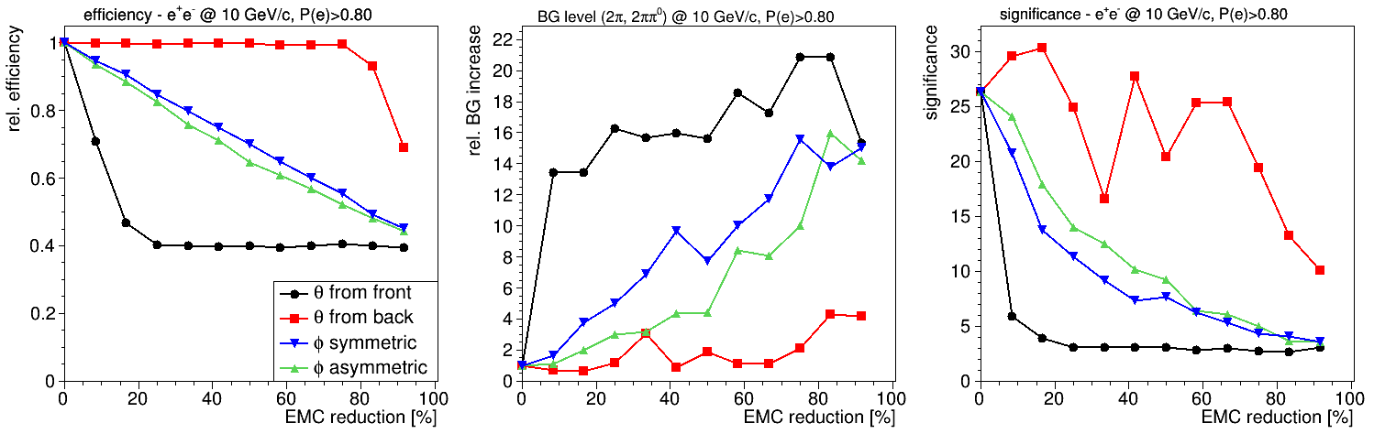
$p\overline{p}→e^{+}e^{−}$- Eff, BG level
PID P_{e} > 0.8
  Stronger efficiency decrease due to PID cut down to relat. 40%
  BG level θ red.: front worst, back quite robust
  BG level φ red.: asymmetric better than symmetric reduction

Slide 16

$p\overline{p}→e^{+}e^{−}$- Significance
Significance level almost constant for back reduction
Strong drop (factor 10) for reduction from front
Better use asymmetric than symmetric reduction
P_{e} > 0.5
P_{e} > 0.8

Slide 17
Summary & Conclusion
Simulated (FastSim) three physics channels to investigate performance with reduced Barrel EMC
4 different cases of reduction applied
Results:
  Best case: reduce from back side (at large θ) of EMC
  Inbetween: leave out EMC slices in φ, better asymmetric at one side than symmetric from both sides
  Worst case: reduce form front side (at low θ) from EMC

Slide 18
BACKUP

Slide 19
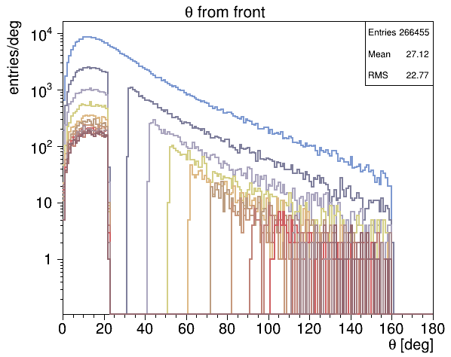
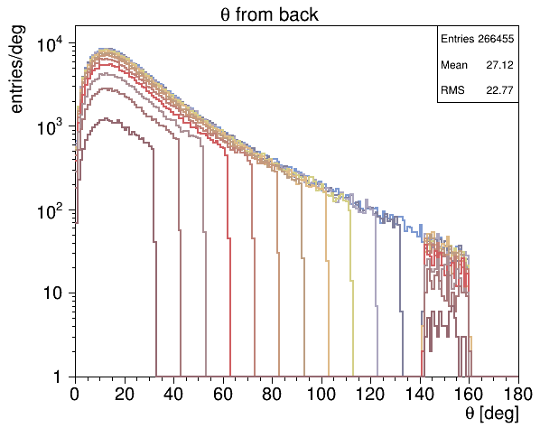
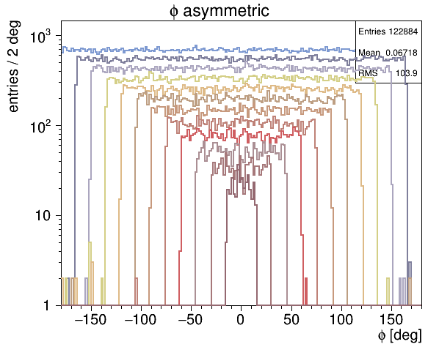
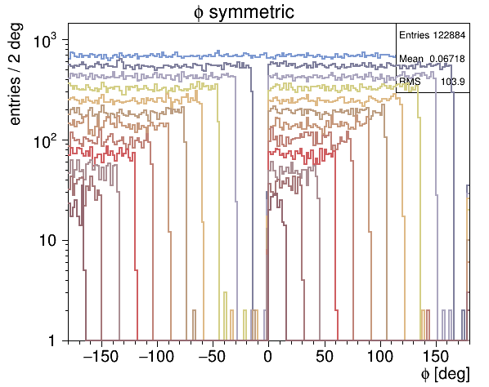

${p\overline{p}→\tilde{η}}_{c}η$ - Residual $γ$ from full reco cands
Photon distr. for all reduction scenarios from full reco cands
Colors represent different reduction steps
full
EMC

Slide 20
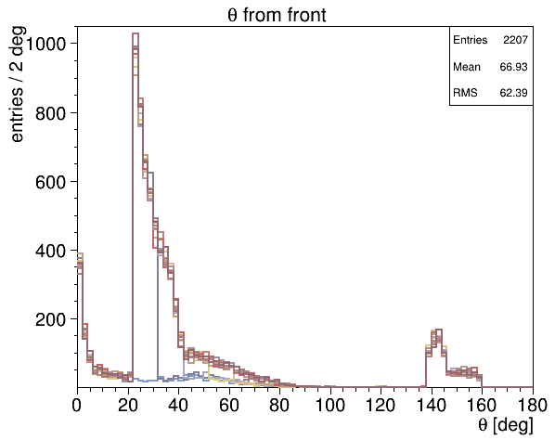
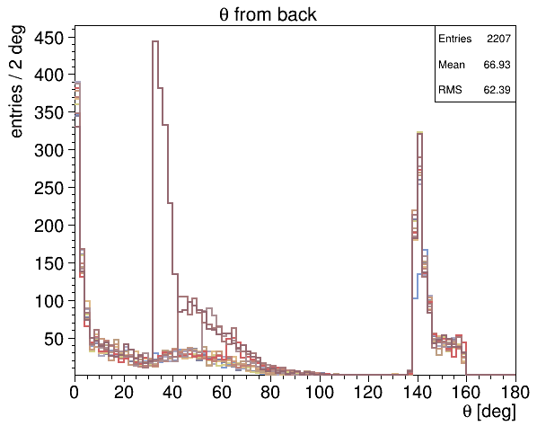
$$p\overline{p}→J/ψπ^{+}π^{−}$$
Background feedthrough in theta with PID P_{e}>0.5
for all 11 reduction steps
This flat one is from full EMC

