Slide 1
Hyperon Spectroscopy Status Report
Jun 8, 2017 | Albrecht Gillitzer, IKP Forschungszentrum Jülich
PANDA Collaboration Meeting 17/2, GSI Darmstadt, June 6-9, 2017

Slide 2
Items
Production of zero-width resonances in FTF & G4
Simulation & analysis of $\overline{p}p→Ξ^{−}{\overline{Ξ}}^{+}π^{0}$
‚Strange‘ decays / interactions seen in MC truth list

Slide 3
I: How to validate DPM & FTF simulation?
Macros in …/macro/qa/dpm4 ( and …/dpm3)
Found that macros are useless since they attempt to reconstruct J/ψ and ψ(2S)
Which are the appropriate criteria?
Idea: try to reconstruct composite particles
10⁵ DPM events;
MC Truth primary & secondary particles
Combination of two particles coming from same vertex

Slide 4
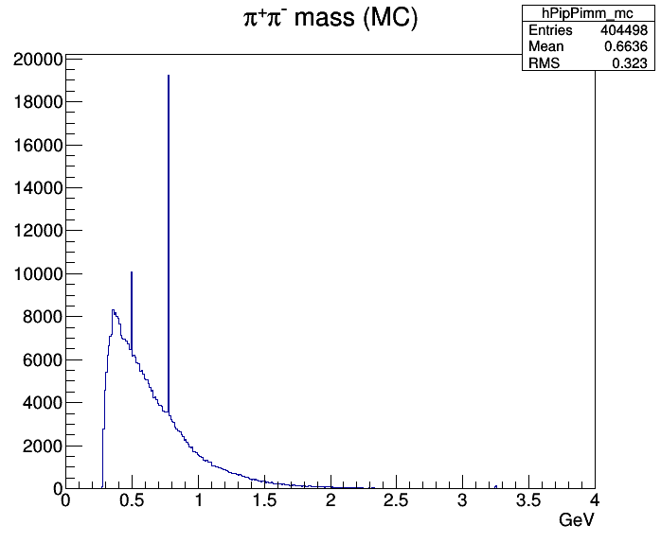
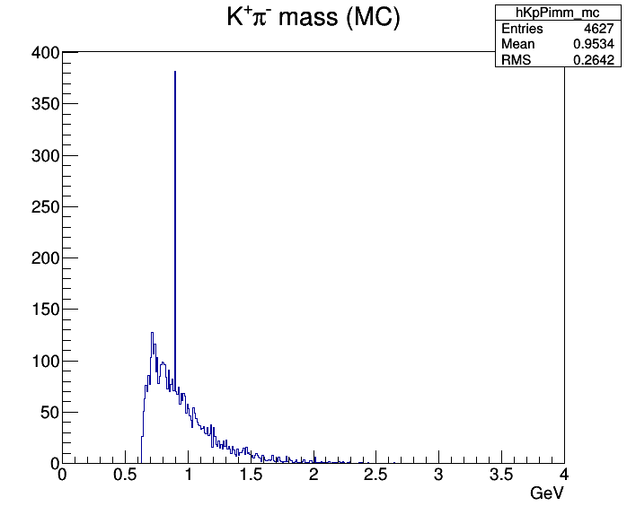
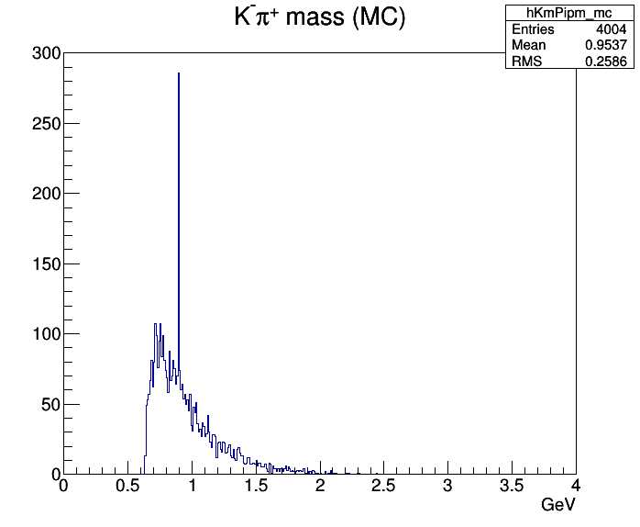
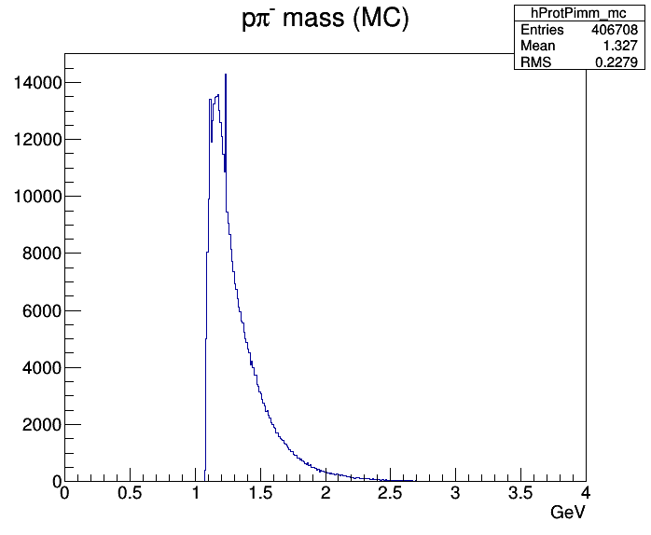
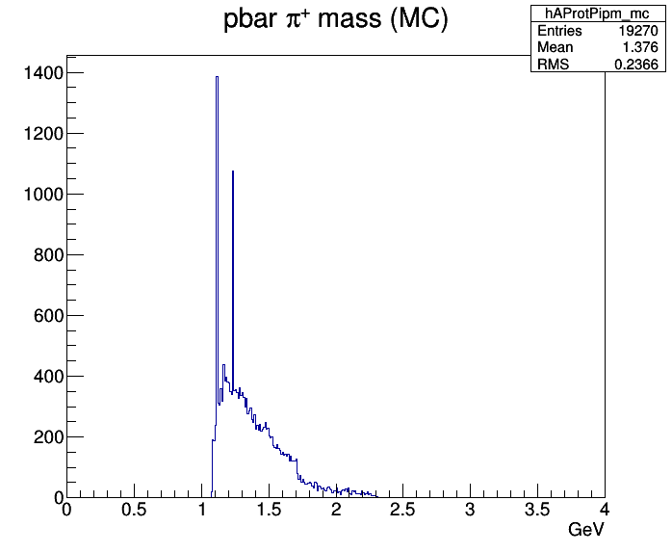
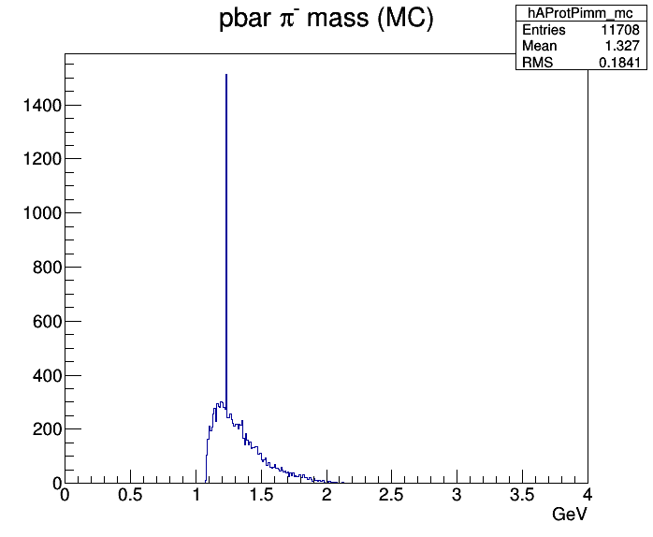
DPM 4.6 GeV/c $\overline{p}p$ prim. & sec. MC truth 2-body masses

Slide 5
Direct Test of DPM and FTF Generator Output
1.0 M events
4.6 GeV/c
Generator output
Result:
DPM does not produce these zero-width states
FTF produces the zero-width resonances

Slide 6
Final test with Box Generator Events
0.1 M events
4.6 GeV/c $\overline{p}$, then later also 15 GeV/c p
1 $\overline{p}$ per event → all particles except one are secondary
θ range: 5º – 45º
φ range: 0º – 360º
build 2-particle invariant mass spectra
condition: common start point

Slide 7
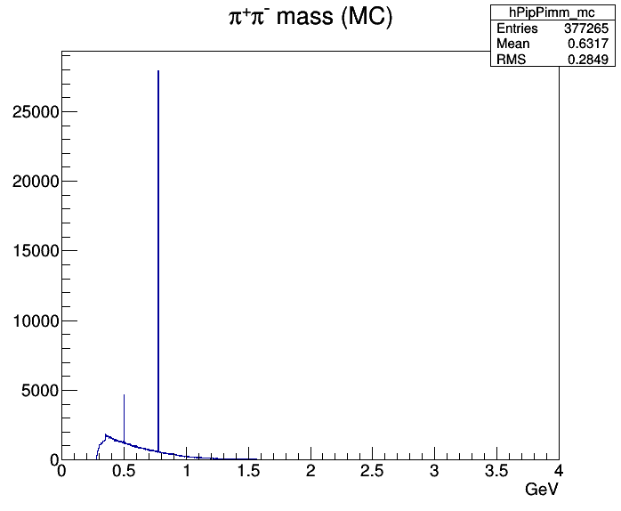
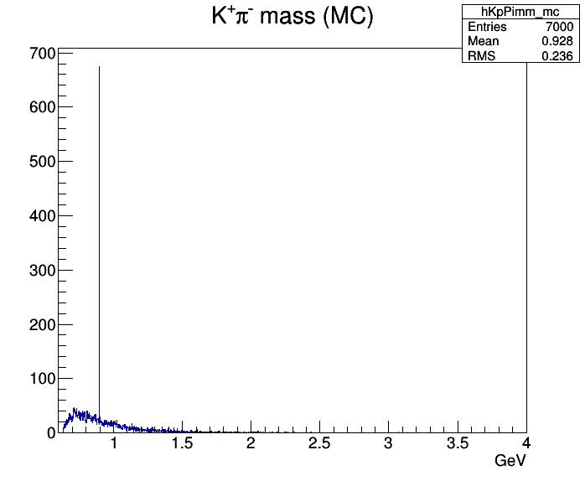
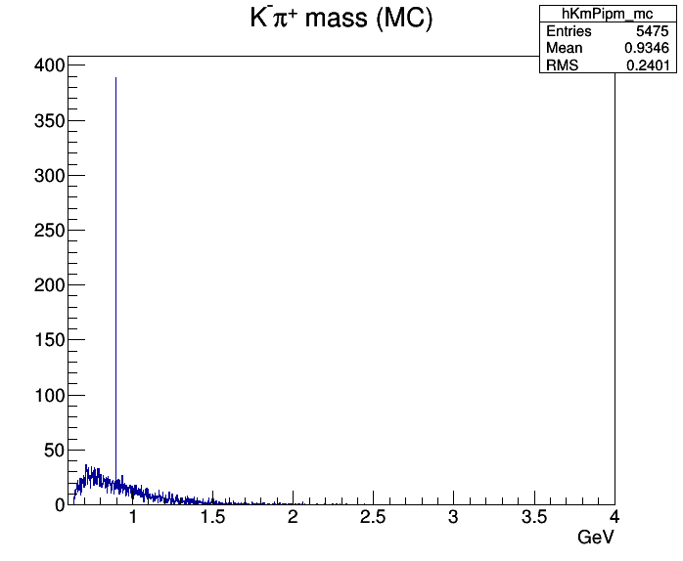
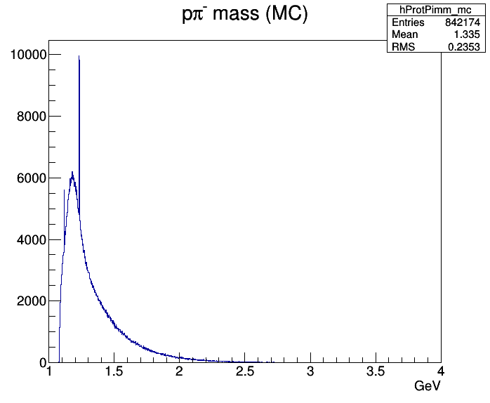
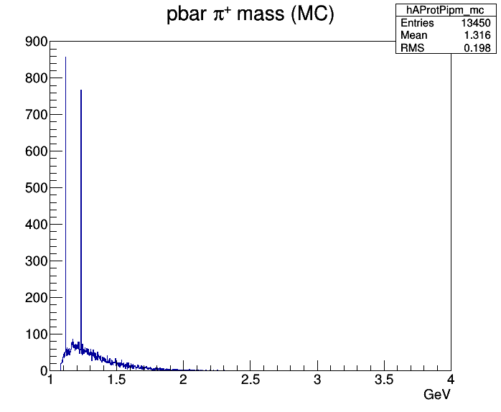
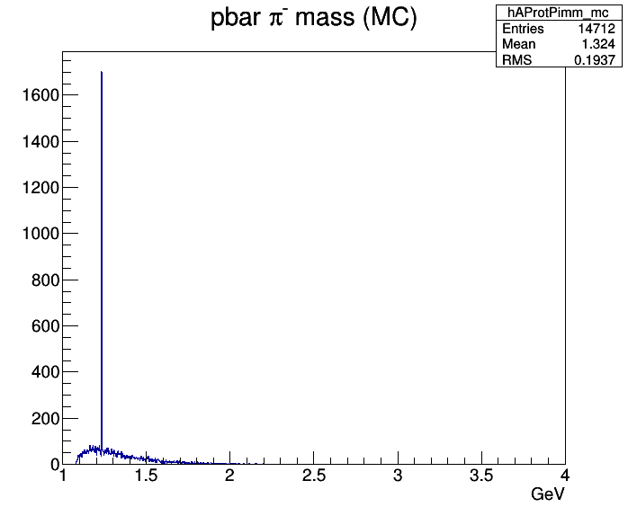
Box Gen 4.6 GeV/c $\overline{p}$ prim. & sec. MC truth 2-body masses

Slide 8
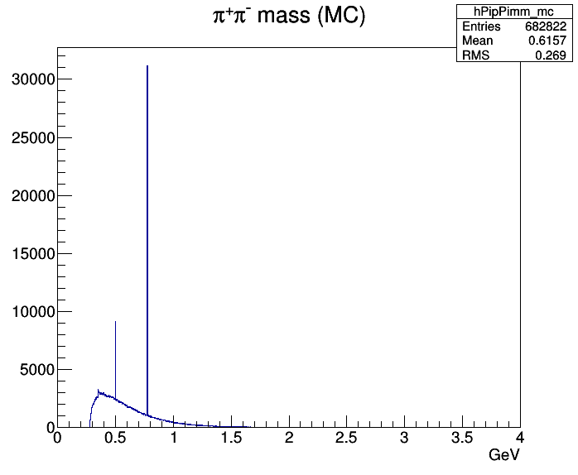
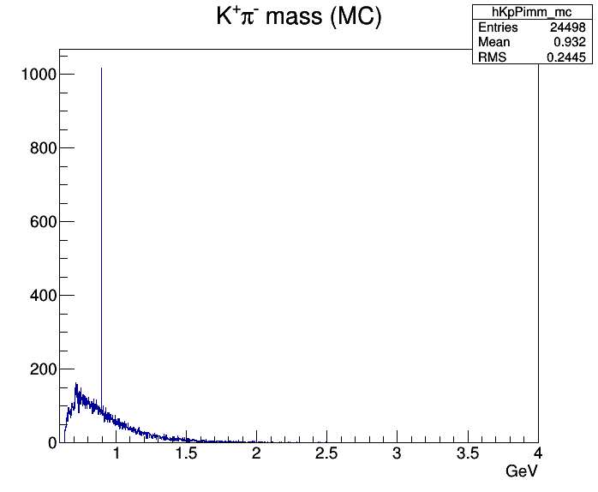
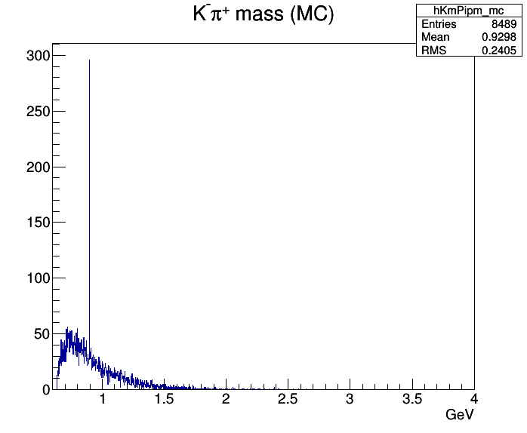
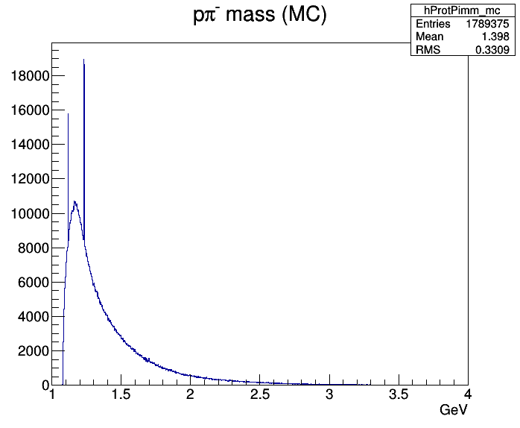
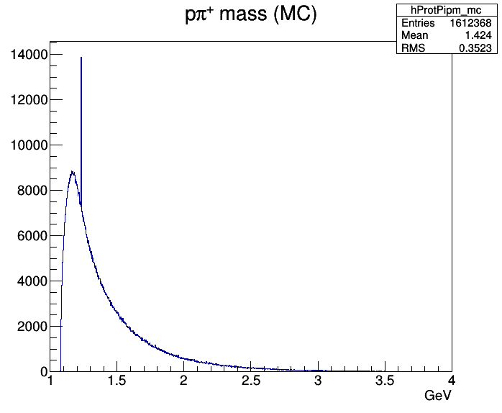
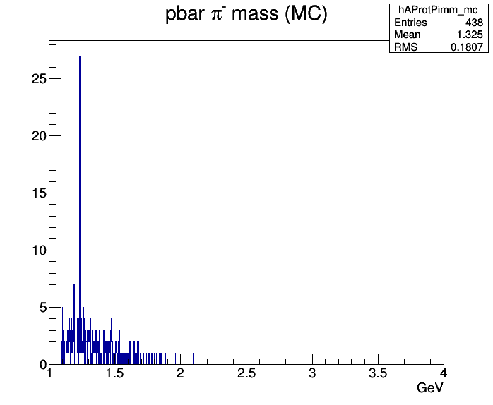
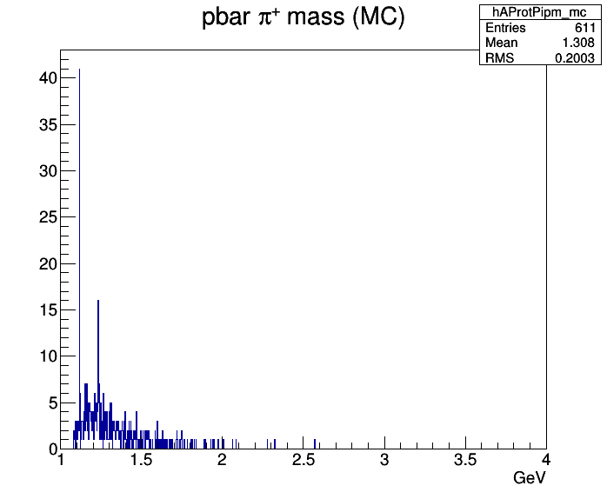
Box Gen 15 GeV/c $p$ prim. & sec. MC truth 2-body masses

Slide 9
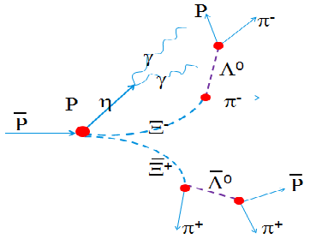
II: Simulation of $\overline{p}p→Ξ^{−}{\overline{Ξ}}^{+}π^{0}$
π⁰
4.6 GeV/c $\overline{p}p→Ξ^{−}{\overline{Ξ}}^{+}π^{0}$ (PHSP)
1∙10⁶ events simulated (trunk 29773)
${\overline{Ξ}}^{+},Ξ^{−}$ ‚stable‘ in EvtGen
$Λ→{pπ}^{−}$ & $\overline{Λ}→{\overline{p}π}^{+}$(~40%) analyzed
focus on reconstruction efficiency and momentum & position resolution
charged and composite particles: MC truth matched (correct PID, correct mother)
photons: include neutral candidates whose mother is a photon and whose grandmother is pbarpSystem

Slide 10
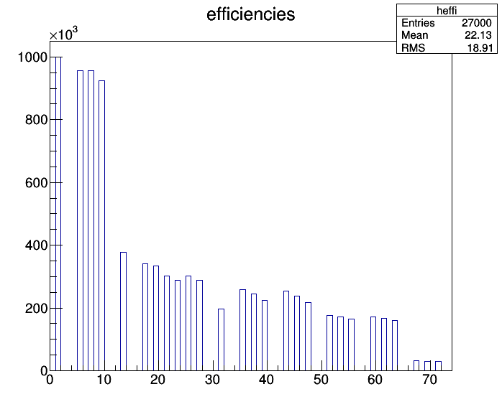
Event Statistics
#1: generated
#5: $Ξ,\overline{Ξ}$: 2 daughters
#7: $Ξ^{−}→Λπ^{−}$ & c.c.
#9: $Λ,\overline{Λ}$: 2 daughters
#13: $Λ→pπ^{−}$ & c.c.
#17: $p$
#19: $\overline{p}$
#21: $π_{1}^{+}$
#23: $π_{1}^{+}$
#25: $π_{1}^{+}$
#27: $π_{1}^{+}$
#31: $π^{0}$
#35: $Λ_{raw}$
#37: $Λ_{v.f.}$
#39: $Λ_{m.f.}$
#43: ${\overline{Λ}}_{raw}$
#45: ${\overline{Λ}}_{v.f.}$
#47: ${\overline{Λ}}_{m.f.}$
#51: $Λ_{raw}$
#53: $Λ_{v.f.}$
#55: $Λ_{m.f.}$
#59: ${\overline{Λ}}_{raw}$
#61: ${\overline{Λ}}_{v.f.}$
#63: ${\overline{Λ}}_{m.f.}$
#67: ${\overline{p}p}_{raw}$
#69: $\overline{p}p_{v.f.}$
#71: ${\overline{p}p}_{4C.f.}$

Slide 11
Reconstruction Efficiencies
reconstruction efficiencies in % :
note:
Ideal tracking, no condition on #hits yet
ideal PID
MC truth matching (correct mother)
KinVtxFitter → vertex, KinFitter → M, 4CFitter → initial p4
composite particles: losses due to mass & probability cut
$$p$$ | $$\overline{p}$$ | $$π^{−}$$ | $$π^{+}$$ | $$π^{0}$$ | $$Λ$$ | $$\overline{Λ}$$ | $$Ξ^{−}$$ | $${\overline{Ξ}}^{+}$$ | $$\overline{p}p$$
90.8 | 88.7 | 78.3 | 78.3 | 52.0 | 59.3 | 57.3 | 44.0 | 42.5 | 7.8

Slide 12
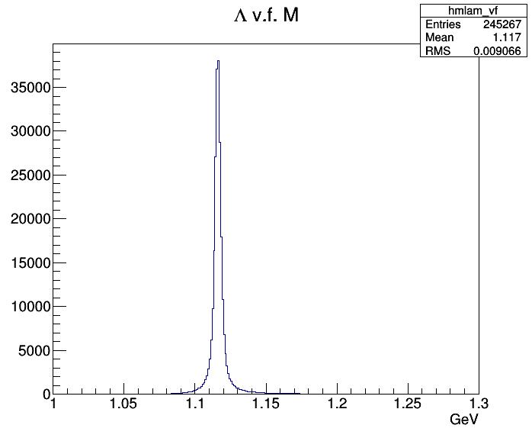
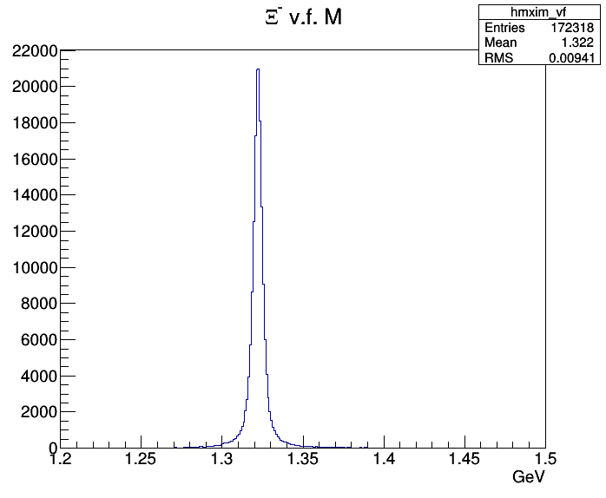
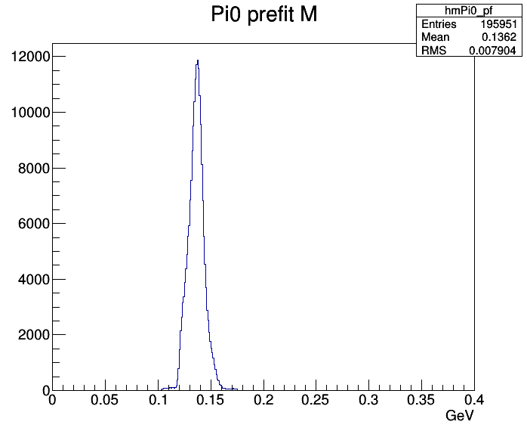
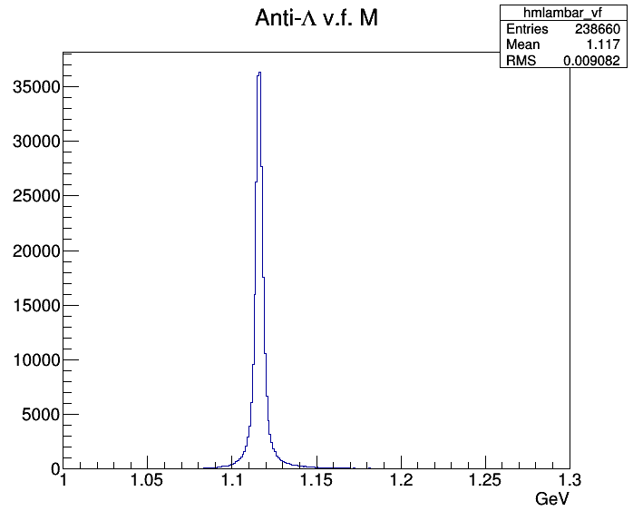
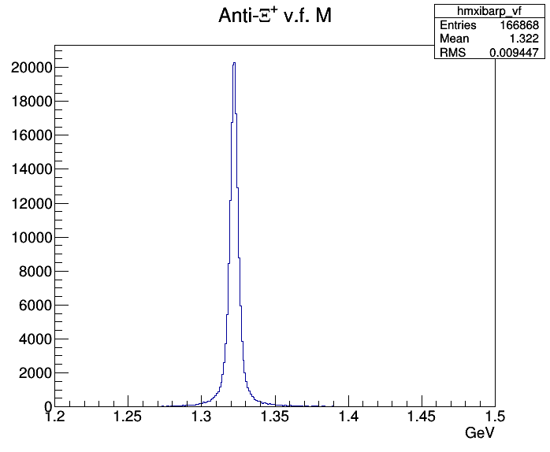
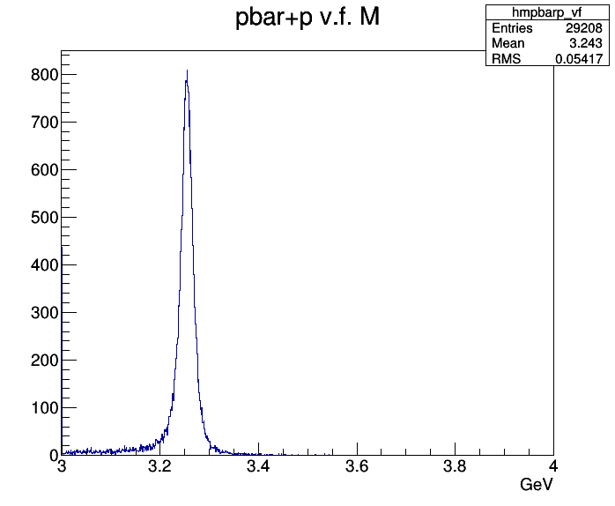

Slide 13
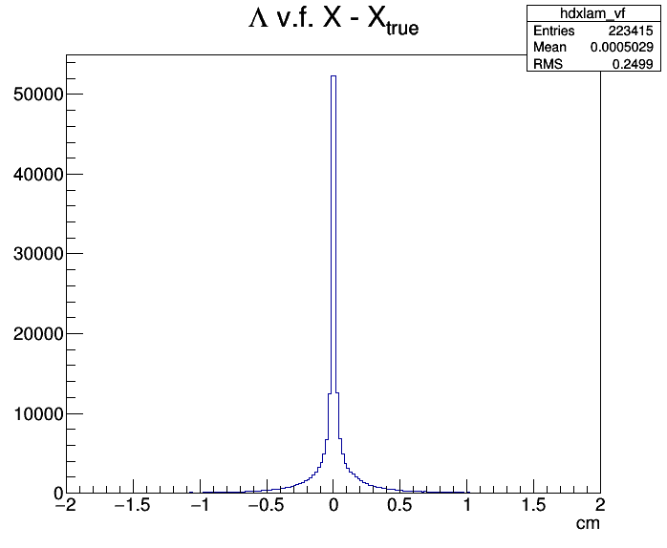
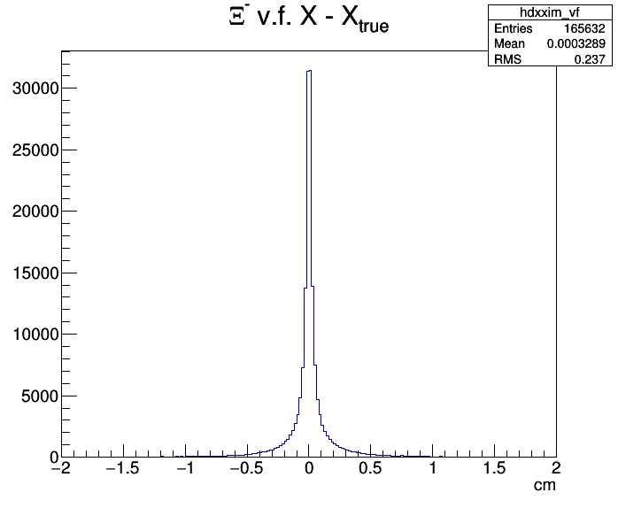
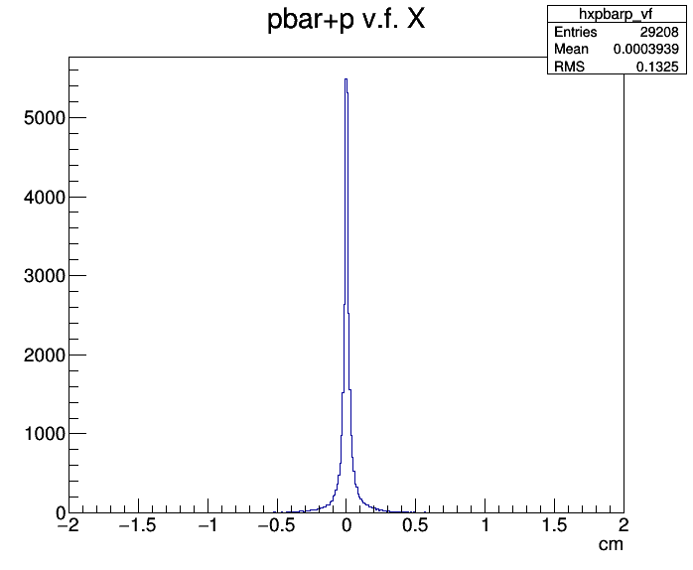
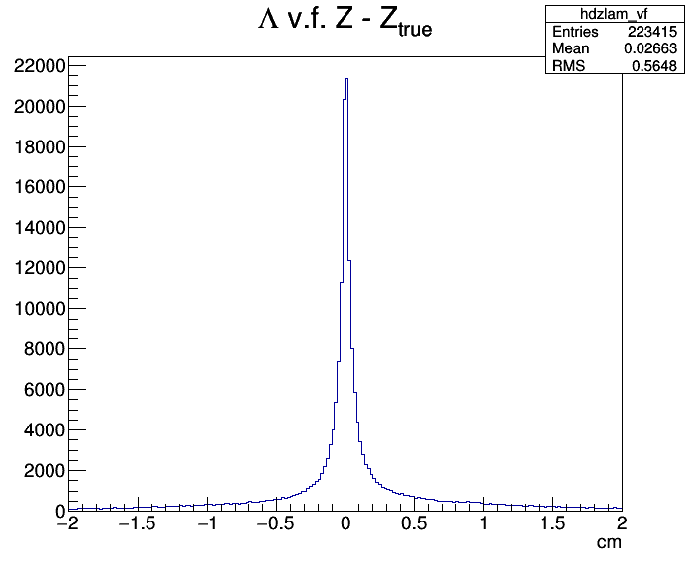
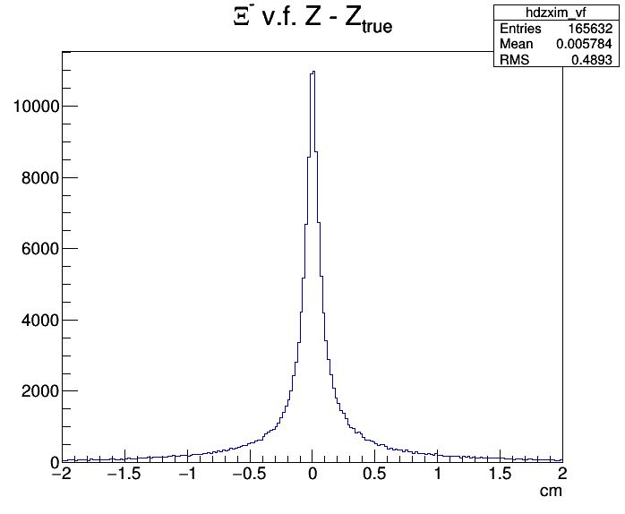
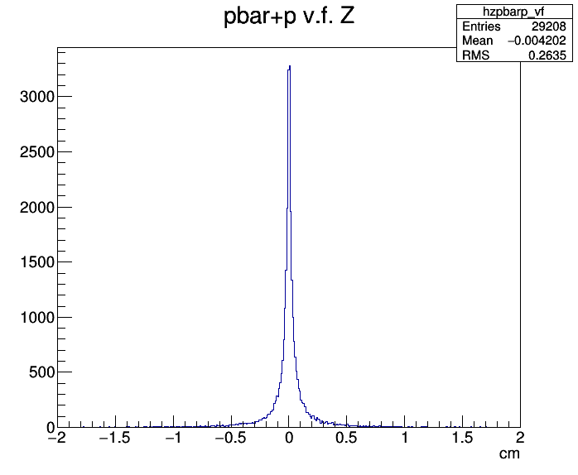

Slide 14
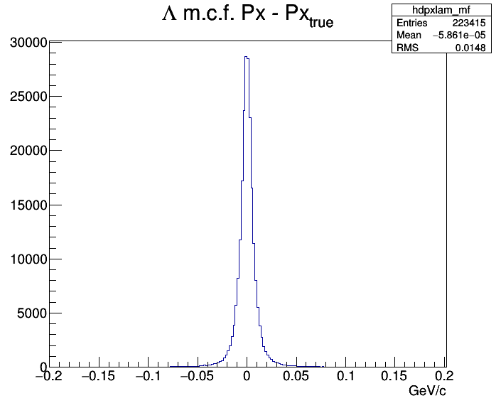
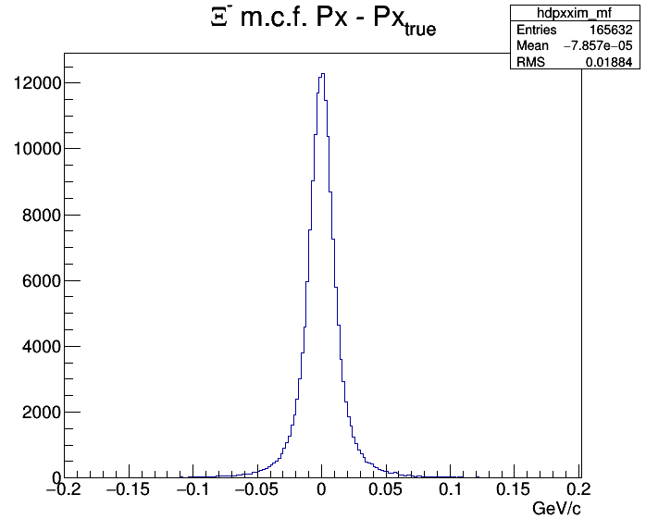
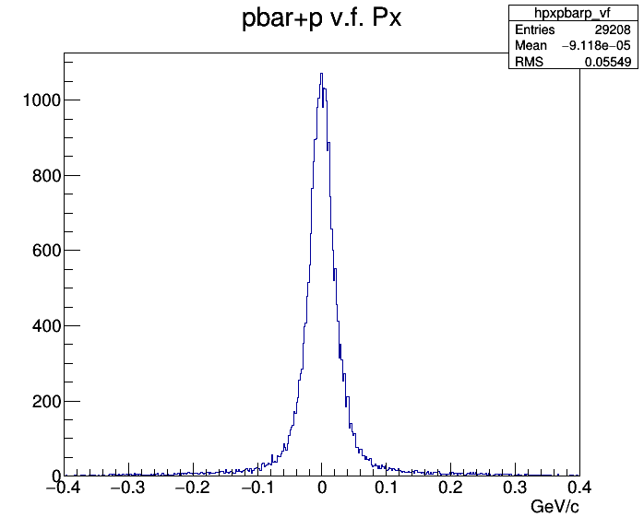
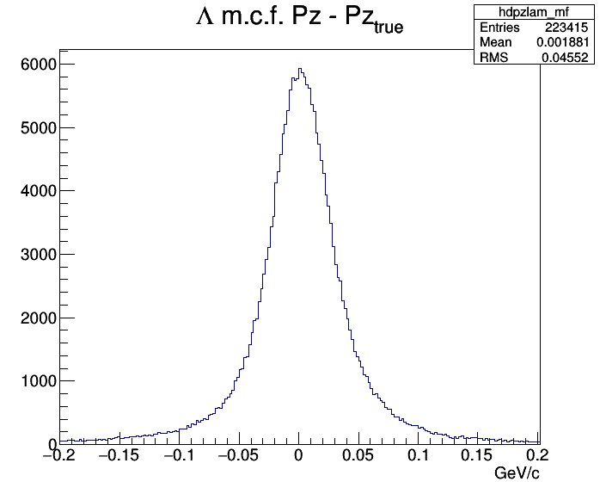
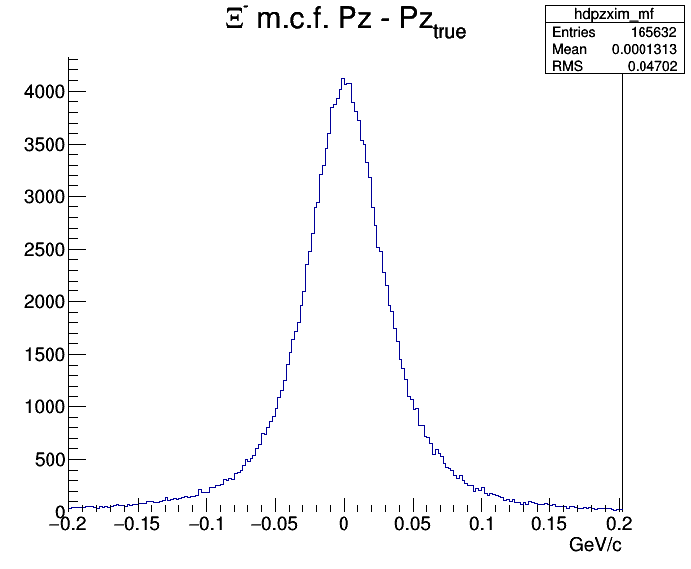
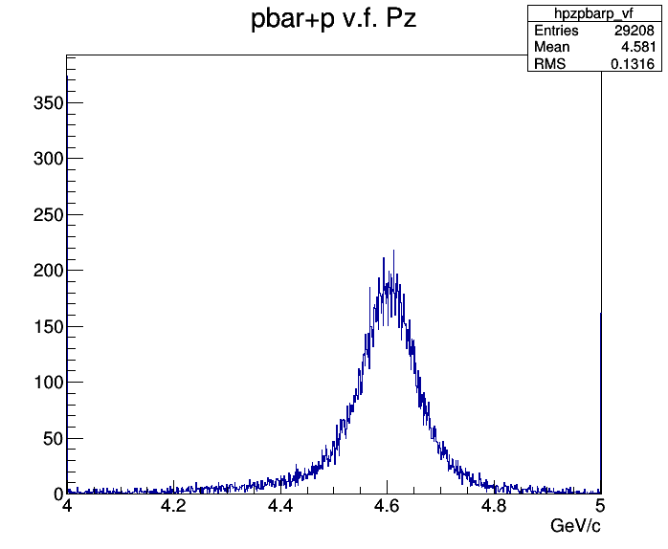

Slide 15
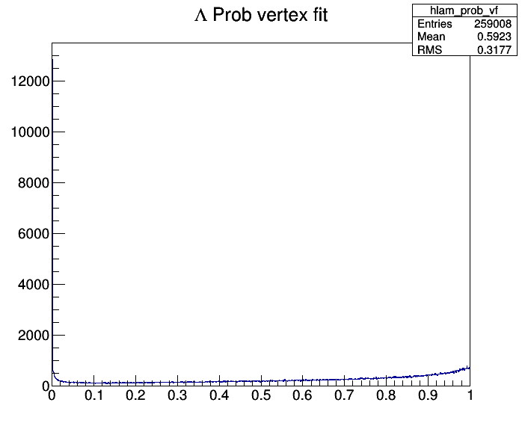
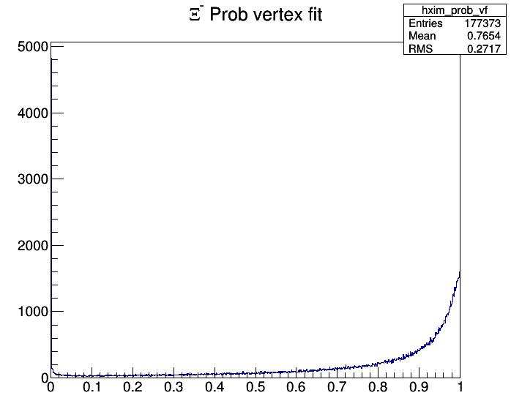
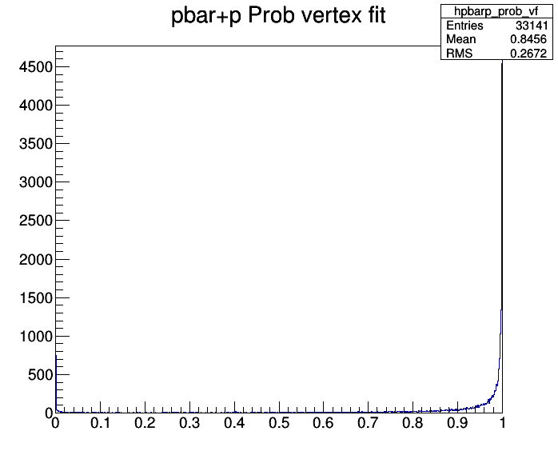
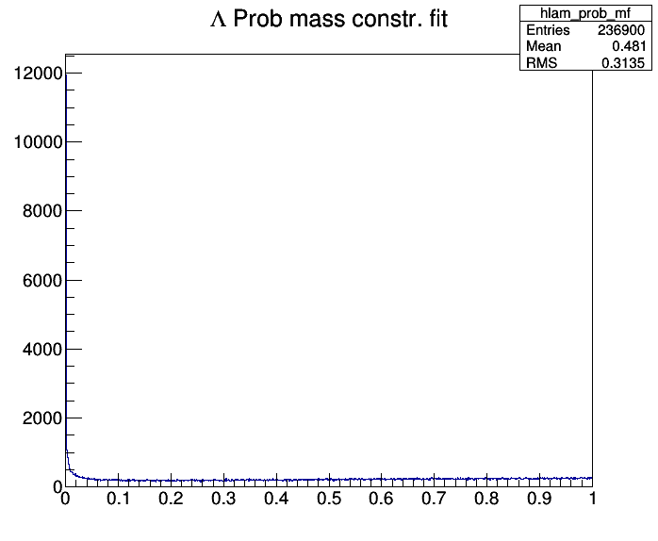
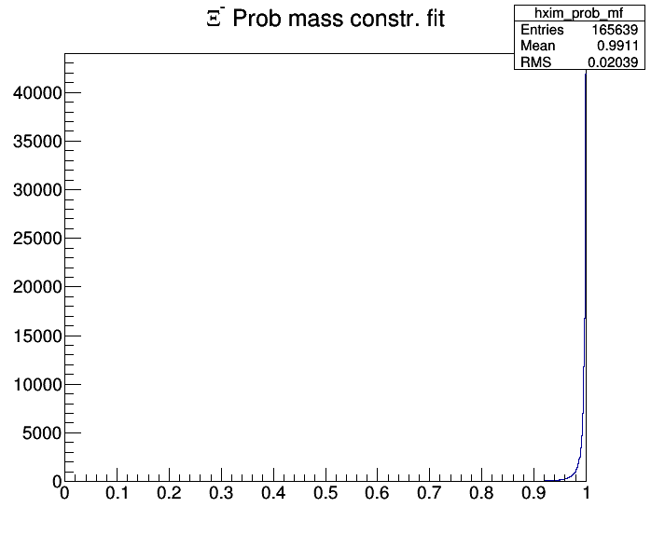
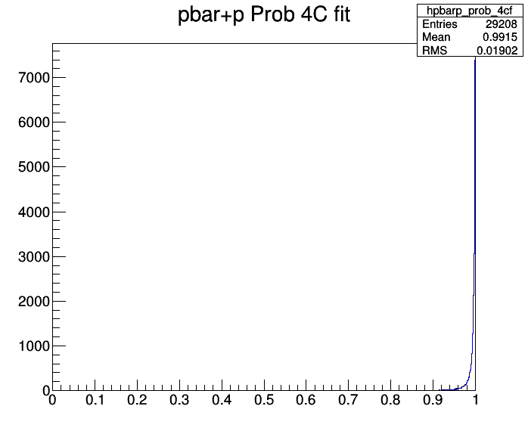

Slide 16
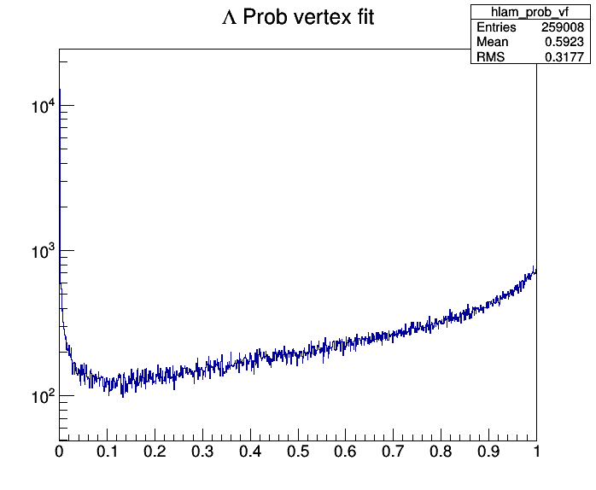
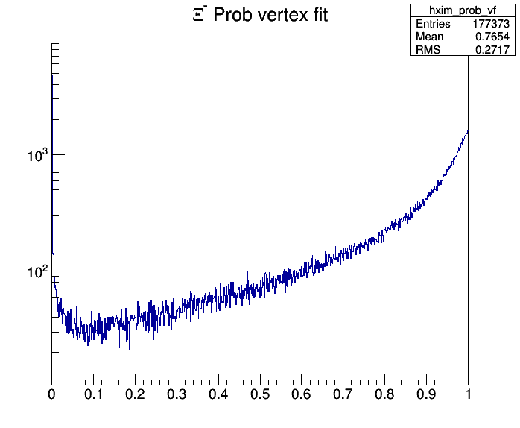
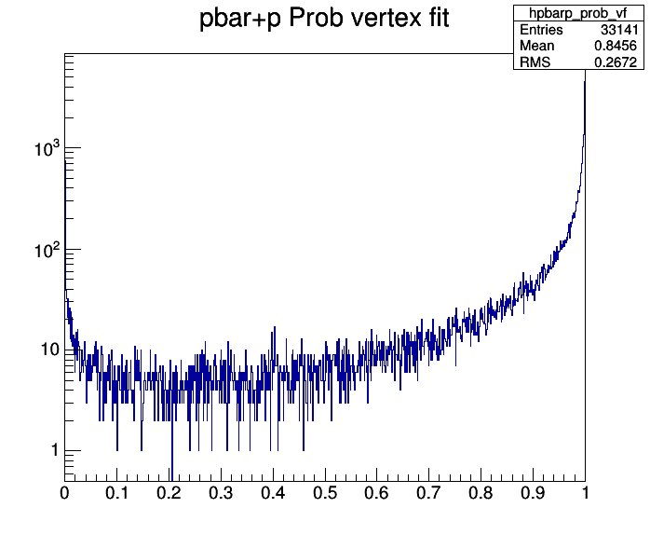
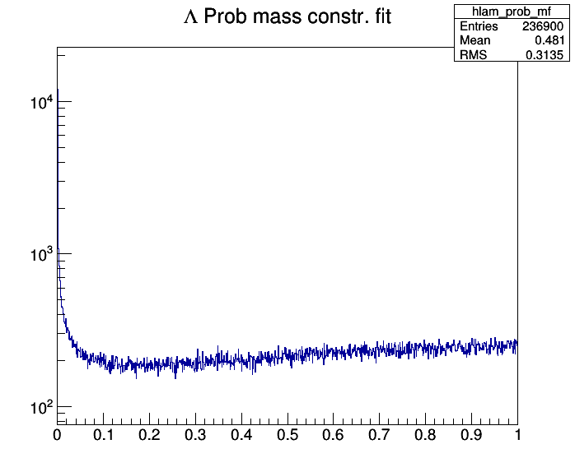
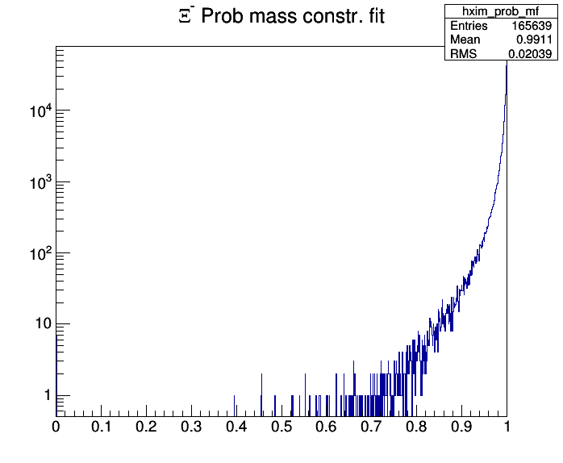

Slide 17
$Ξ^{−}{\overline{Ξ}}^{+}π^{0}$ Dalitz Plot
Here: still problem of entries at wrong masses after mass and 4C fits (meanwhile solved by Xinying)

Slide 18
III: ‚Strange‘ Decays / Interactions in MC Truth List
Recent improvement: option to select specific decay modes in Geant4 by using „UserDecayConfig“ file (Dominik Steinschaden)
Set $Λ→{pπ}^{−}$ & $\overline{Λ}→{\overline{p}π}^{+}$ decay modes to 100%
$Ξ^{−}→{Λπ}^{−}$ & ${\overline{Ξ}}^{+}→{\overline{Λ}π}^{+}$ is already ~100%
Expect ~100% $Λ→{pπ}^{−}$ & $\overline{Λ}→{\overline{p}π}^{+}$ final state
However: find only 92.4% in this final state
What happened to the missing events?

Slide 19
Checking the MC Truth List
Print all decays / interactions with deviations from selected pattern
# daughters, pid, $\vec{X}$, $\vec{p}$
Found deviations:
all particle species: $Ξ^{−},{\overline{Ξ}}^{+},Λ,\overline{Λ}$
Most cases not explainable by interaction with material
number of daughters differs from 2: e.g. 1, 3, … > 10
not all daughters have the same start vertex (???)
Problem either in G4 or in filling of MC list, but further study required

Slide 21
Event Scan: ‘Mysterious‘ Cases
${\overline{Ξ}}^{+}→e^{−}\overline{Λ}π^{+}$ (many)
electron added to the decay final state
different start vertex, always upstream of other particles
analogous for $Ξ^{−}, \overline{Λ}, Λ$
${\overline{Ξ}}^{+}→\overline{Λ}$ (many)
one single daughter, missing pion
analogous for $Ξ^{−}, \overline{Λ}, Λ$
$Λ→π^{−}γn$ (1); $Λ→3p 7n 2γ$ (1)
violate Q and S !
all daughters have same start vertex
All others are explainable as interaction with material

Slide 22
Summary
Zero-width resonances in G4 and FTF
Preliminary analysis of $\overline{p}p→Ξ^{−}{\overline{Ξ}}^{+}π^{0}$ at 4.6 GeV/c
Found cases in the MC particle list which are incompatible with ‚decays‘ or ‚interactions‘
Finding solutions is nicer than finding problems
but
Finding problems is still better than finding nothing !

