Slide 1
Central Tracker Support Frame MEC Session, CM June 2017 at GSI J. Lühning, GSI
Routing of cables & tubes from MVD & STT to upstream racks
“Shuttle” comprising MVD, STT, CSF, target cross
CT-shuttle without support for upstream components
CT-shuttle with easily removable support
Deflection of CT-shuttle with removable support
Splitting of D150 vacuum tube
Extension of CT-beams
Suspension of beam tube when BE-EMC is moving

Slide 2
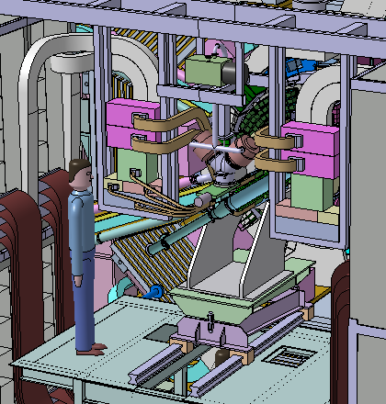
Routing of cables & tubes from MVD & STT to upstream racks
At the MEC Workshop in April, 2015, Dario Orecchini presented two options for routing STT cables & tubes to the racks on the aux-platform:
the loop (festoon) option, elegant and comfortable but requires a lot of space
the patch-panel option, cumbersome
Unfortunately we don’t have enough space for loop(s) so only patch panels seem feasible.
At the CM in December 2016, Artur Cebulla (FZ Jülich) presented a tentative routing.
A boundary condition: in z-direction, between any patch panel and the magnet doors, we have to provide at least 80 cm free space.
Patch panels might be hung to beams which rest on top of the upstream racks.

Slide 3
“Shuttle” consisting of MVD, STT, CSF*, target cross, cables * Central Tracker Support Frame
IP
z
As Tommaso Quagli pointed out at the CM in December 2016:
it is necessary to do an FEM analysis of the central tracker (STT+MVD) support.
 | Weight / [kg] | Centre-of-Gravity z(IP) / [cm]
STT, MVD, & CSF without cables | 150 ? | -24 ?
upstream vacuum tube with attached MVD supplies | 100 ? | -170 ?
STT cables & supplies | ? | ?

Slide 4
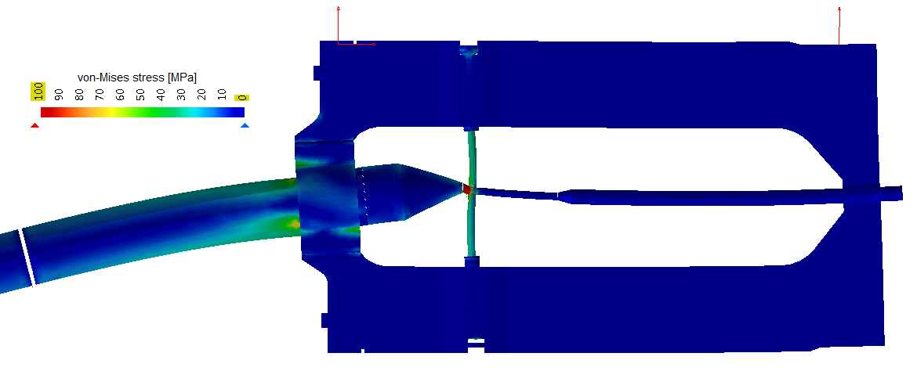
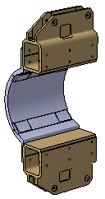
CT-shuttle without support for upstream components
IP
z
support shell(s) for D150 vacuum tube
without additional support for the upstream components the target cross would be overloaded.

Slide 5
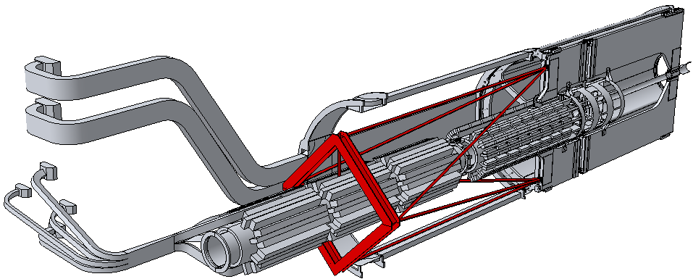
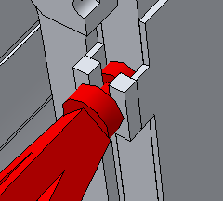
CT-shuttle with easily removable support
tension screw (M5 would be sufficient) holding less than 1000N
A relatively simple way to relieve the target cross: to install temporarily an aluminium support like the red one shown above.
weight of the support less than 10 kg
hangs in pick-ups at the CSF
placed only within the space reserved for the BE-EMC

Slide 6
Deflection of CT-shuttle with removable support
target cross relieved
Enlargement factor of the deflection shown above: 100
notable (intentional) deflection of the removable support
hardly any deflection of the vacuum components
no notable loads on the target cross anymore

Slide 7
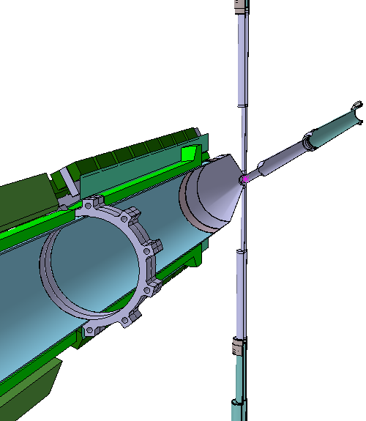
Splitting of D150 vacuum tube
Some time ago the beamline was split at z= -120 cm .
Certainly there was a reason.
Is there still?

Slide 8
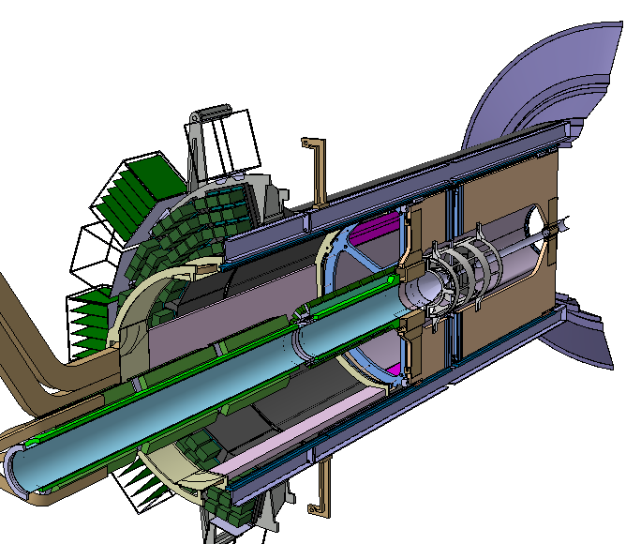
Extension of CT-beams
upstream end of CT-beams ?
CT-beam
CT-beam
How far upstream might the CT-beams end?
The barrel-DIRC doesn’t seem to be a limitation anymore.

Slide 9
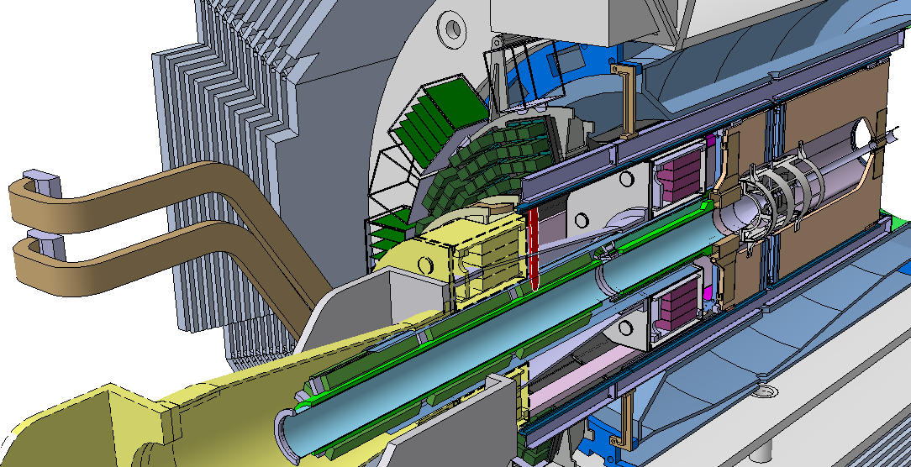
Suspension of beam tube when BE-EMC is moving
tension rod
Suspension with tension rod feasible? If at all, an aperture in the support cone of the BE-EMC would be necessary.

Slide 10
Thank you for your attention!

