Slide 1
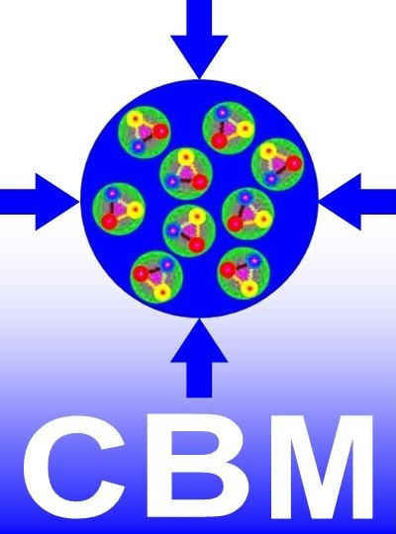
CBM ASIC-FEE
Development
PANDA Collaboration Meeting 17/1
GSI, Germany
June 6 – 9, 2017
Christian J. Schmidt,
GSI Darmstadt

Slide 2
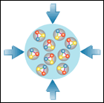
CBM-related Chip Developments and Options
PADI for Diamond
M. Ciobanu, ISS
CBM MuCH XYTER
E. Atkin et al, MEPhI
PADI for TOF
M. Ciobanu, ISS
Bucharest
CBM STS XYTER/MuCH-XYTER
AGH Krakow, R. Szczygiel et al
GET-4 TDC (TOF)
H. Flemming, H. Deppe, GSI
SPADIC for TRD
ZiTi Heidelberg, P. Fischer et al
Submission 1.1 bug fix version
done and under test
new: SPADIC 2.0 with e-link interface
CBM-GBTx
Chipset ordered from CERN
CBM-HUB (SIS 300)
DAQ, communications chip
U. Brüning et al, Ziti
T. Bhattacharyya et al, IIT
GBTx
FPGA emulation functional
Swagata Mandal, VECC
FASP for TRD
V.Catanescu, NIPNE
(optional front-end for the TRD)

Slide 3
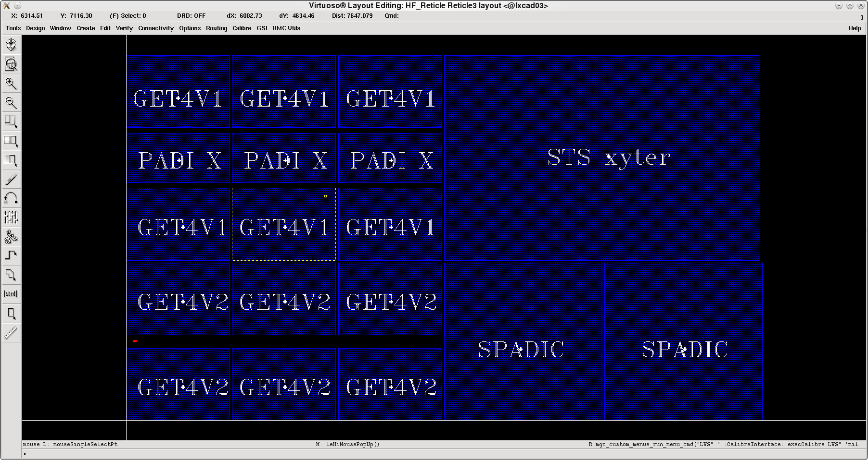
Long awaited STS-XYTER 2.0 Submission Mai 2016
...evolved to a grand CBM-Joined 6-Chip Submission
STS-XYTER 2.0 → yield 930 chips for STS-prototyping
TOF readout ASICs, Volume production for operation at STAR (20.000 ch)
  Get4 in two versions:
    Bug-fix version
    Version for robust operation at 40MHz
  PADI Timing-Pre-Amp for TOF
SPADIC V2 → TRD prototype run with CBM compatible e-link interface
  10 STS-XYTER dedicated wafers
    stealth diced (laser diced) at DISCO,
    Munich to get high chip body
    precision <10µm
    stealth dicing allows cutting as you wish
    → other chips survive as well
Reticle for production

Slide 4
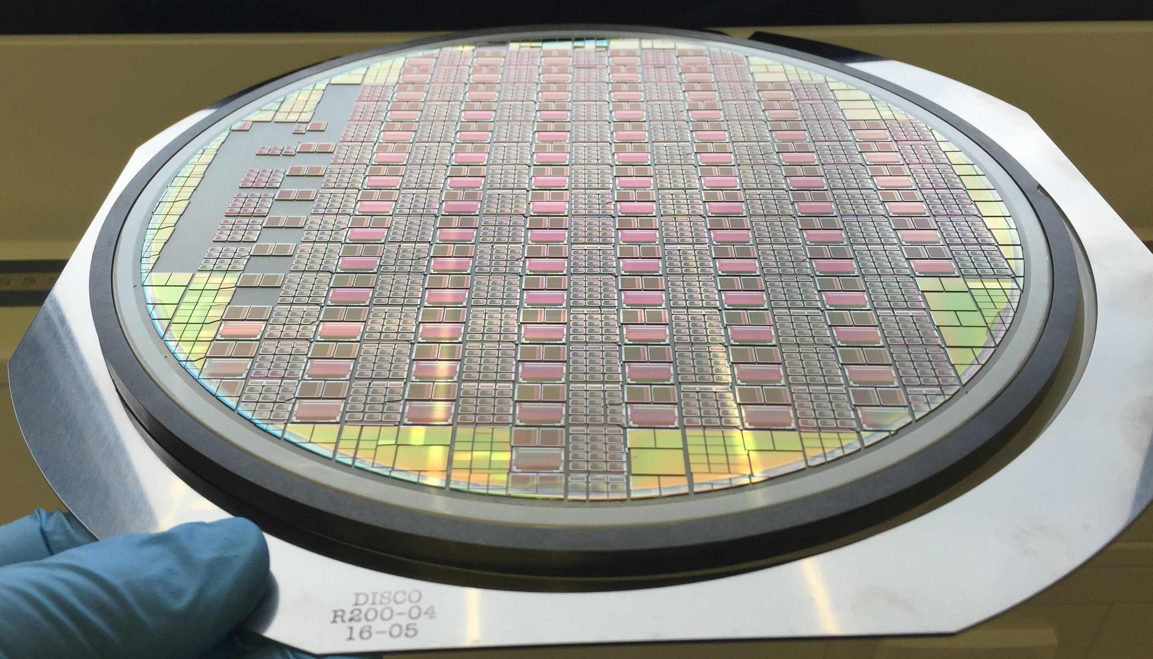
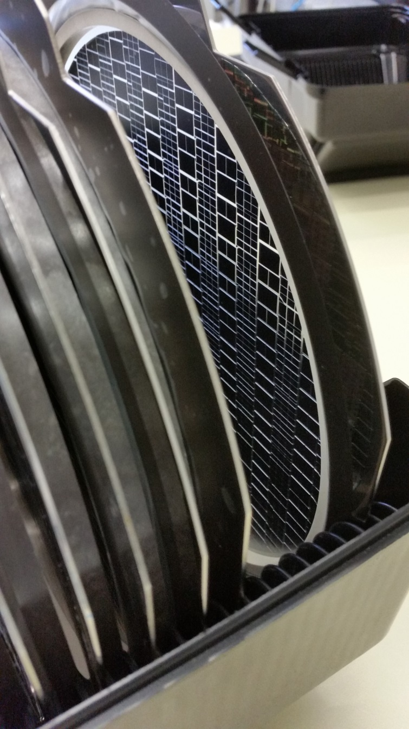
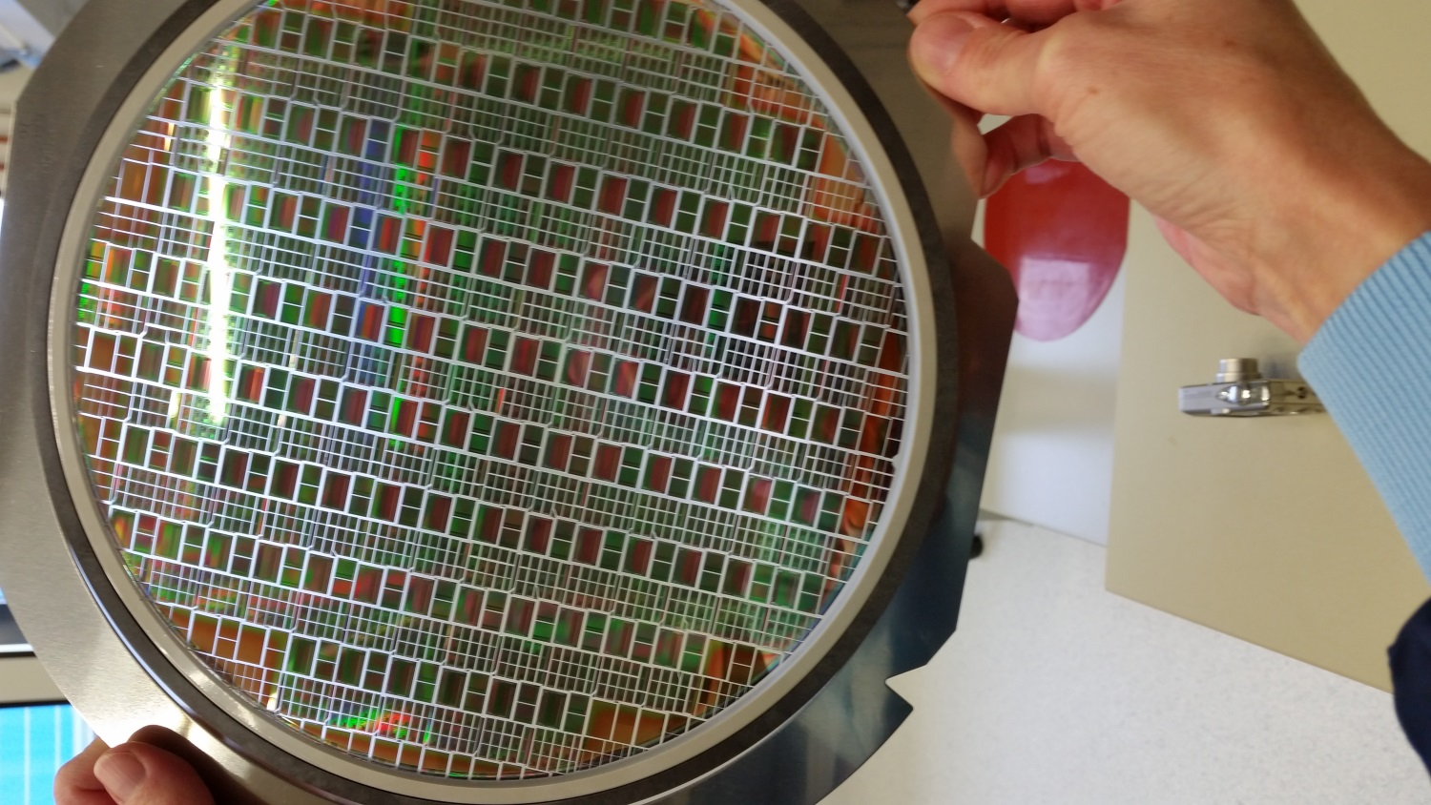
Unpacking was solemn like X-mas

Slide 5
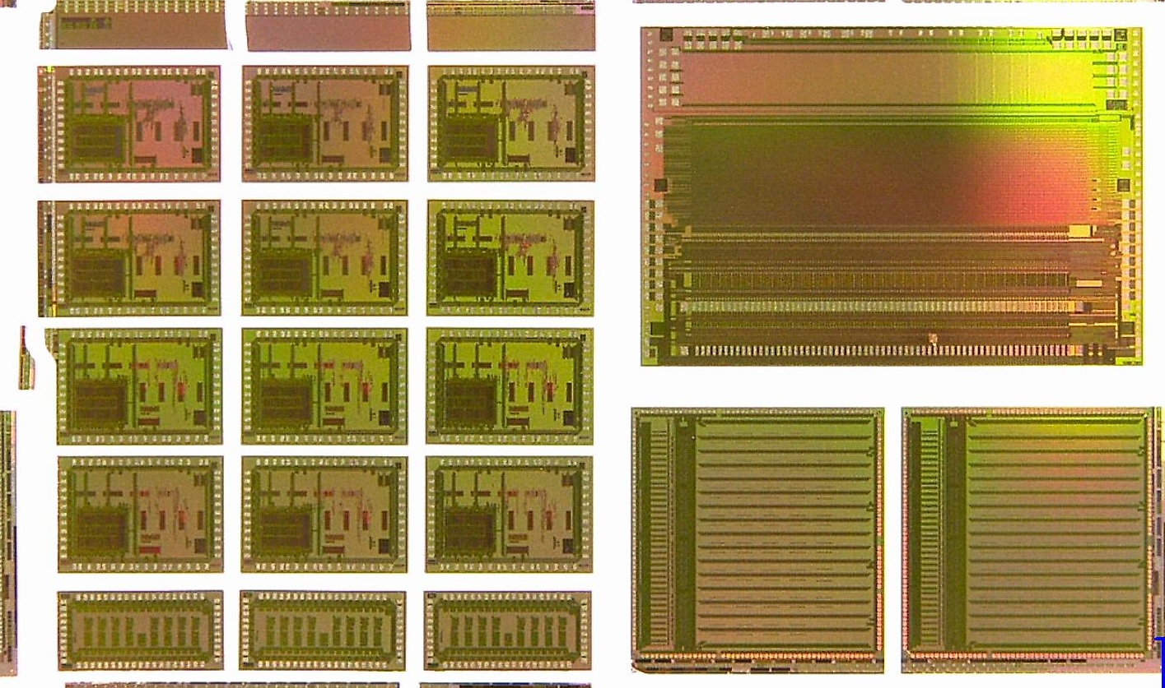
The CBM Reticle

Slide 6
STS-XYTER 2.0
128 ch front end solution for STS as well as MUCH at 250kHz per channel
Entirely data driven, self triggered
Designed so that noise specs will be met ( < 1000 ENC)
  for all envisioned sensor/cable combinations with up to 50cm cables and up to 12cm sensors
  at sensor end of life with 400nA leakage per channel
Full digital GBTx-E-link compatible interface/STS-protocol realized and verified
State-machines verified to operate out of arbitrary states
Radiation hardened design with extensive SEU protection
Complete focus on system capable design → much more than a prototype
  Complete controlled hierarchical reset scheme implemented

Slide 7
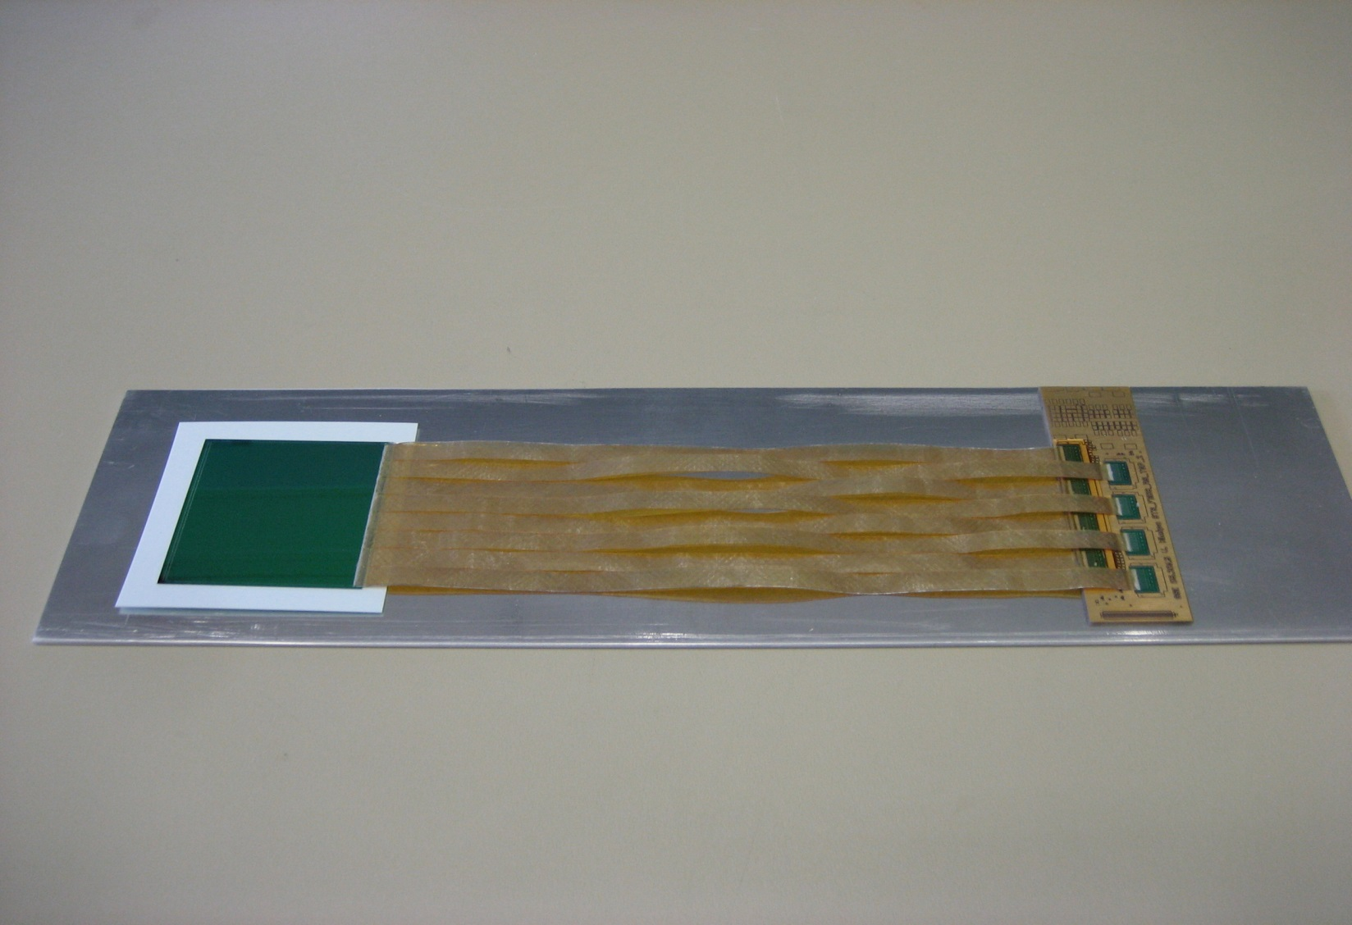
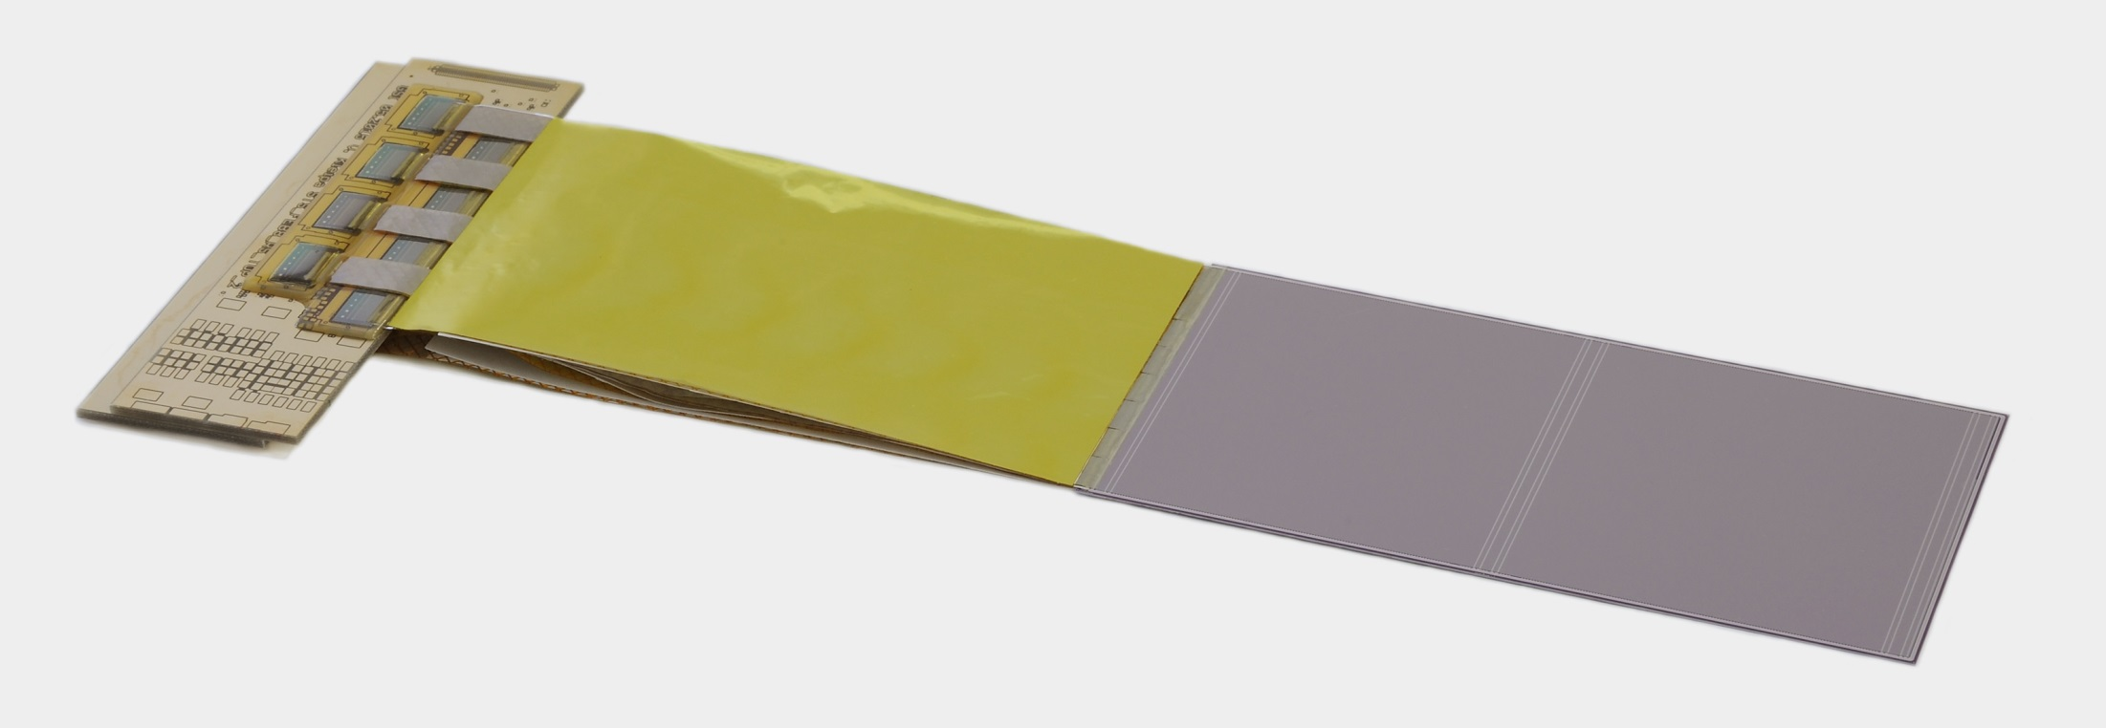
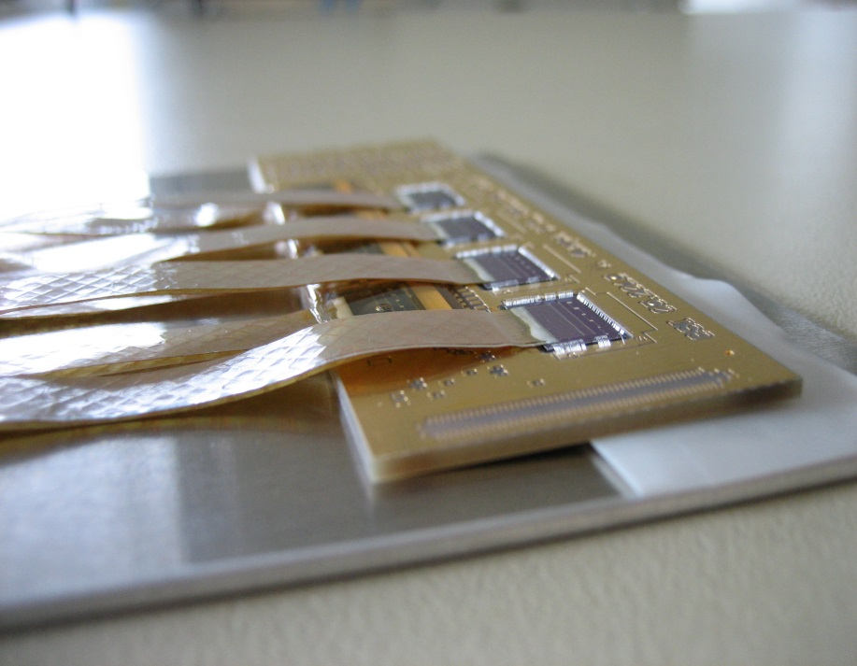
the Silicon-Sensor-Module
STS-module-components:
front-end-boards
signal transmission cable
double-sided silicon
microstrip sensor

Slide 8
STS-XYTER Silicon Strip Readout ASIC
STS-XYTER turns into MuCH-XYTER via a Gain Switch
Submission Review in Feb. 2015: Noise is an issue →
system issue, optimization with complete system perspective, extensive architectural studies
Submission Review in Oct. 2015 → full go for submission
STS-XYTER 2.0: adaptation to GBTx-eLink-readout, STS-r/o protocol
→ intensive collaboration AGH-WUT (W. Zabolotny (DPB)) on design and verification
  STS-XYTER defines critical path for STS!
  → This submission has all architectural elements included!
R. Szczygiel et al. AGH Krakow

Slide 9
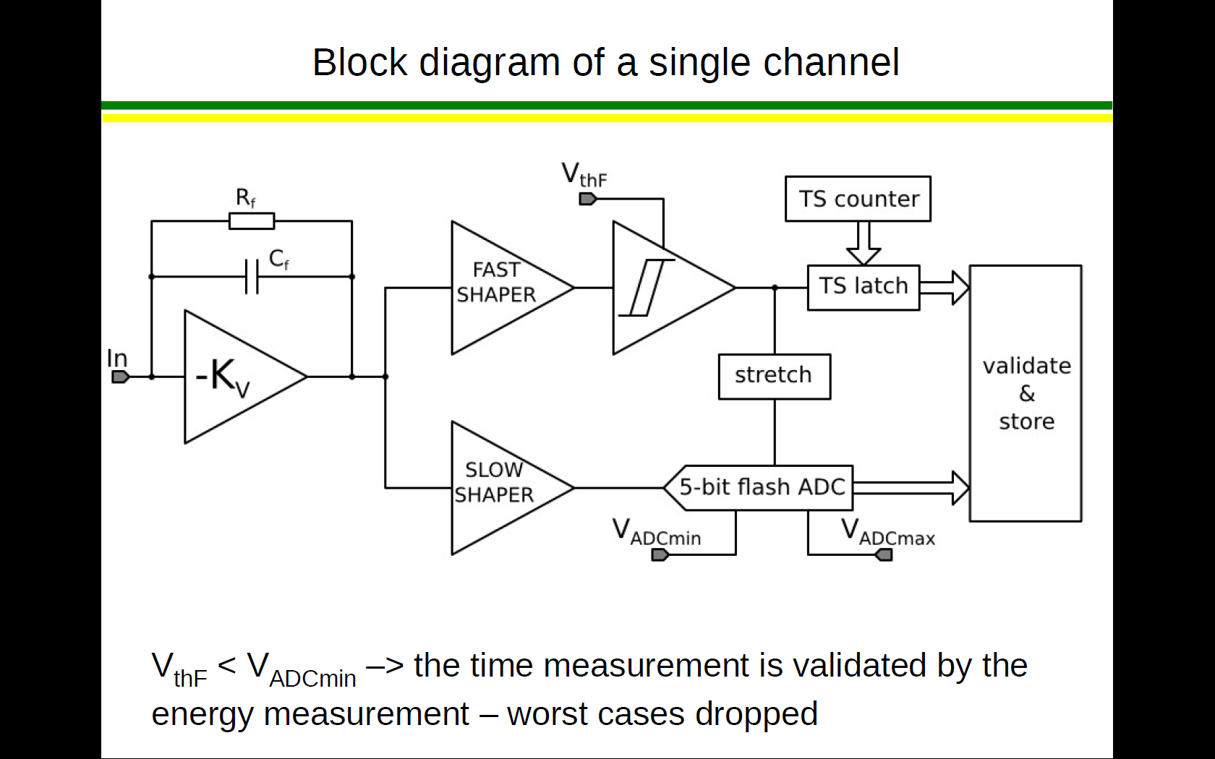
peaking time
30ns
peaking time
80ns
Two stage trigger allows fast time stamp and low trigger level

Slide 10
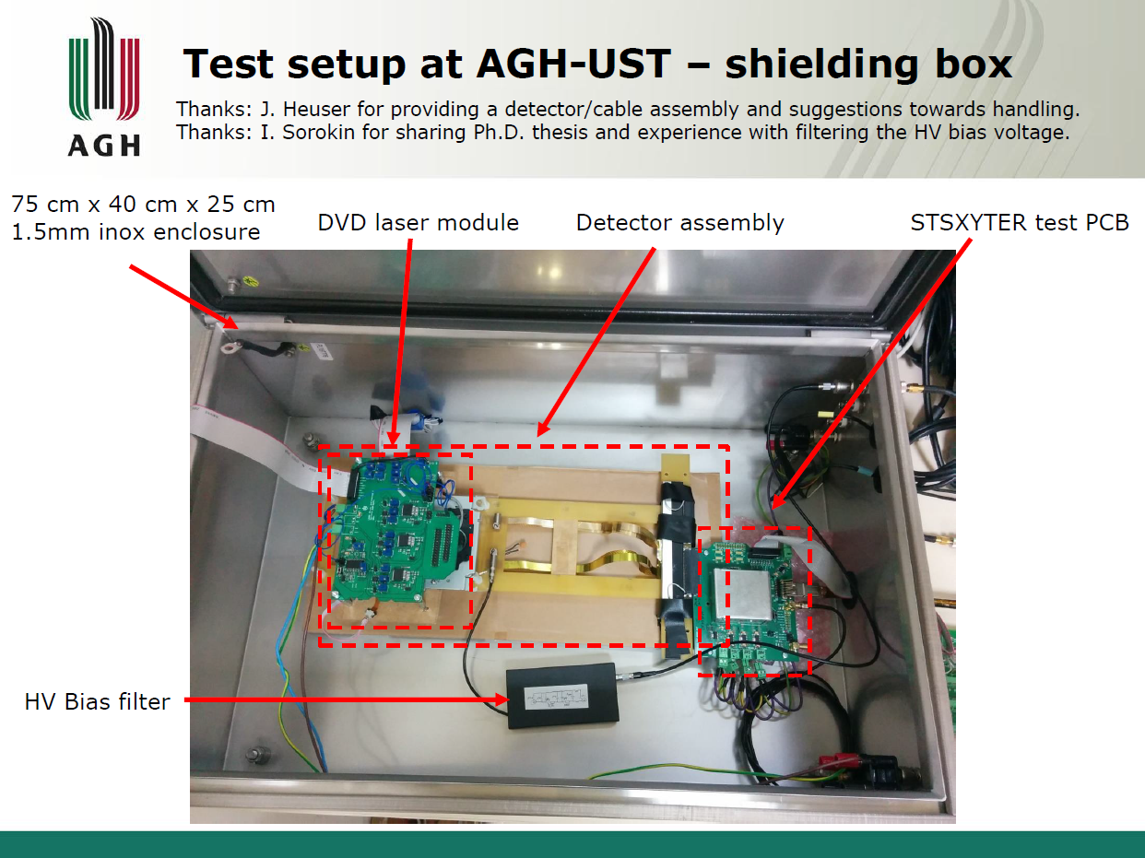
STS-XYTER v1.0: Thorough test in complete detector setup
noise measured in complete detector setup
2500 – 3000 ENC!
some power routing problems
fb resistor setting range to be adapted
Strategy on noise problem at that time: power, switchable bandwidth
Main goal: < 1000 ENC for all detector configurations

Slide 11
STS-XYTER Noise Consequences, Measures
Noise simulations indicate: It is not that simple!
→ engaged in extensive, full system simulations
re-evaluate n-mos rather than p-mos for ~30% higher g_{m}
evaluate front-end architecture for higher PSRR (additional circuitry to folded cascode)
evaluate higher power and larger input transistor
optimize cable design → reduction in capacitance
improve sensor strip resistivity
add LDO supply noise into considerations
....
this led to STS-XYTER 2.0 with GBTx-E-link interface

Slide 12
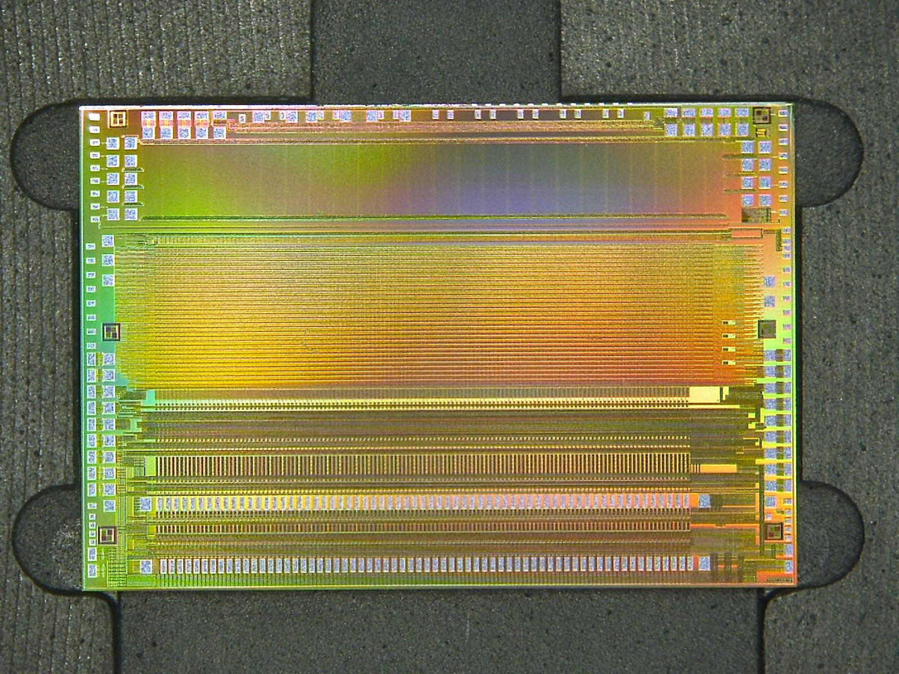

Slide 13
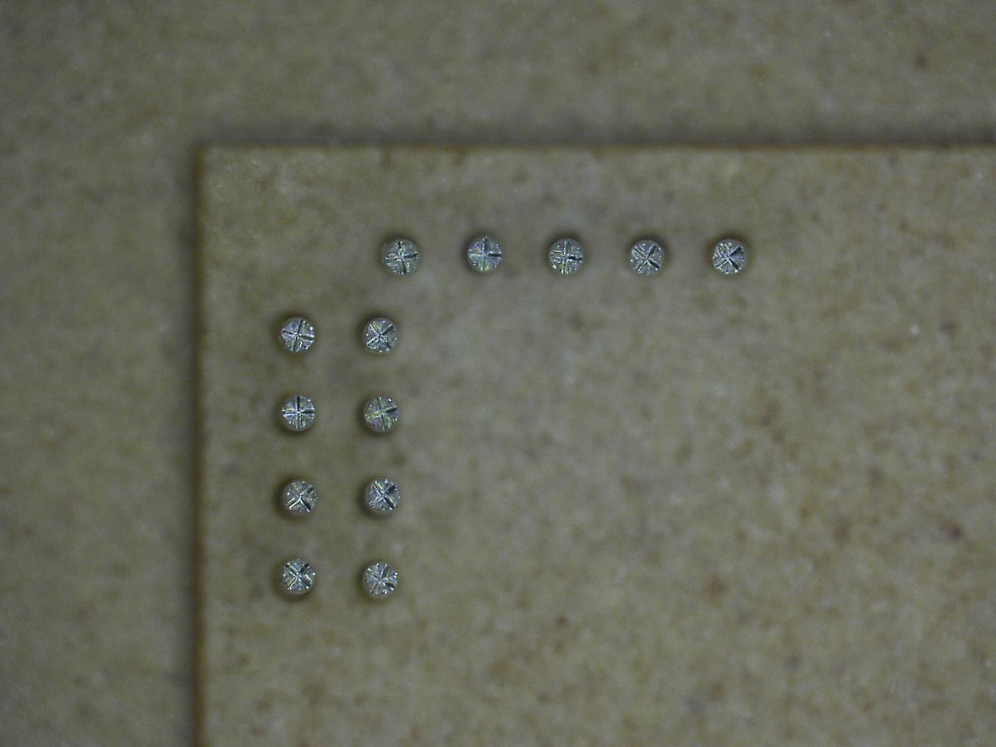
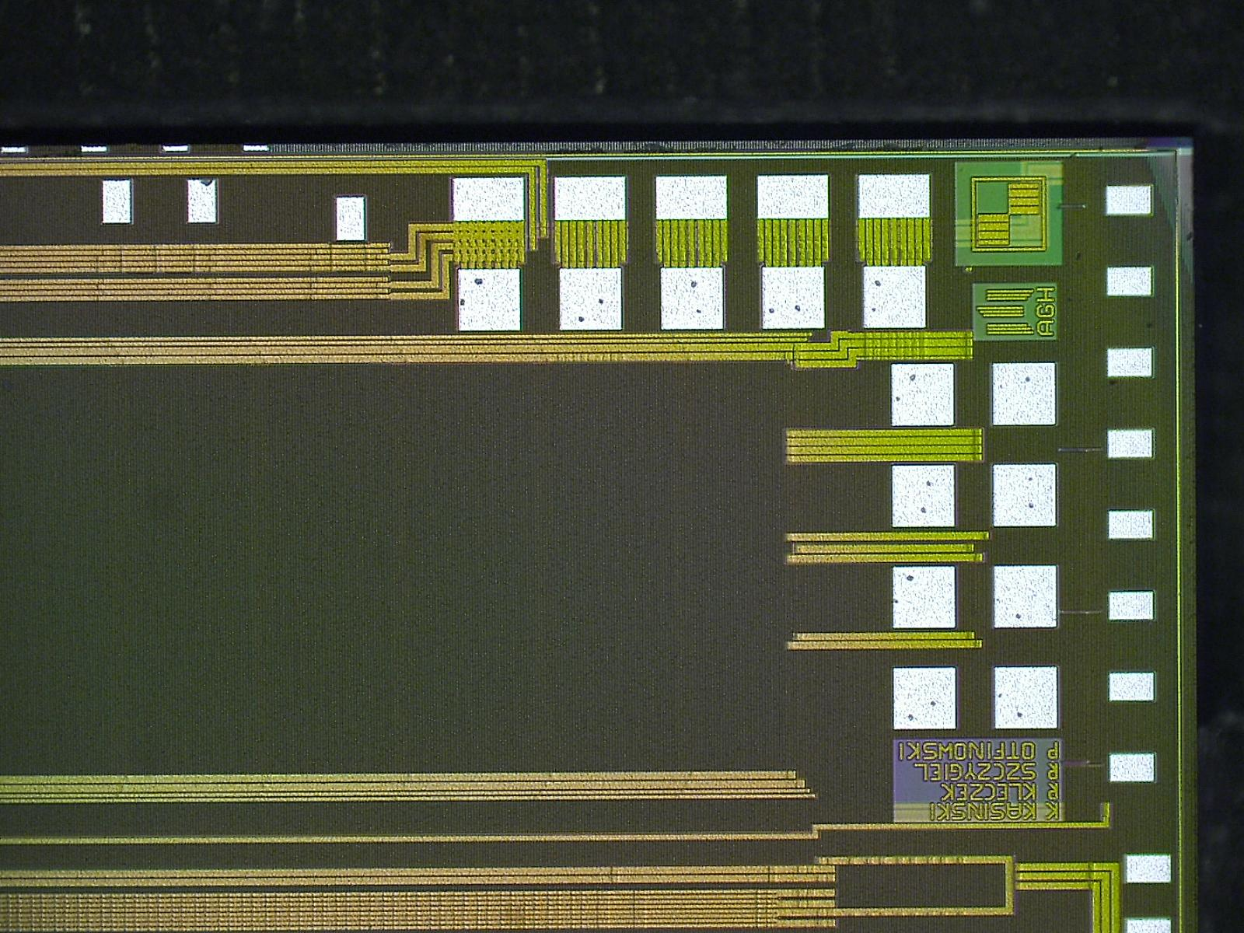
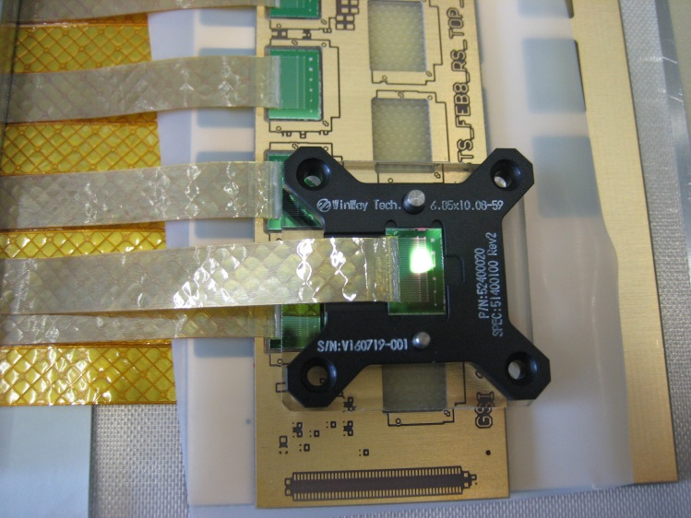
Dicing precision successful: 100µm Pogo-Pins match!

Slide 14
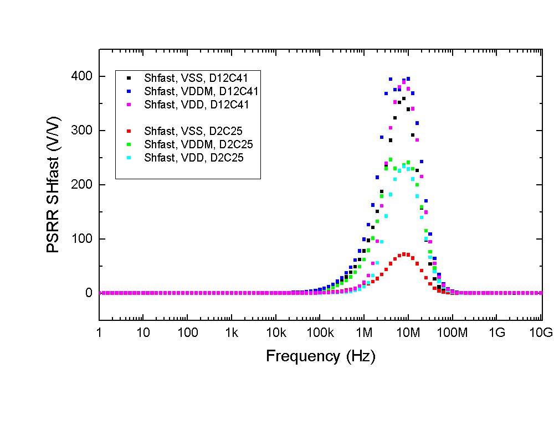
STS-XYTER 2.0 R. Szczygiel et al. AGH Krakow
STS-XYTER: high gain none-differential pre-amp → bad power supply rejection
Need to care for noise on power lines
Power efficiency essential in dense STS
→ Switch-mode supplies with linear point of load regulation
Transfer Function STS-XYTER

Slide 15
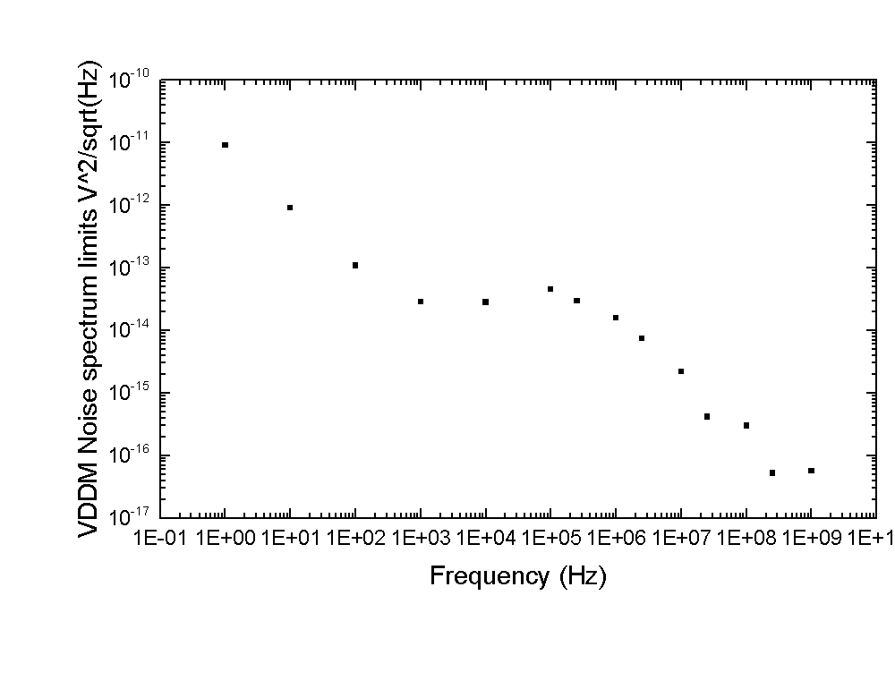
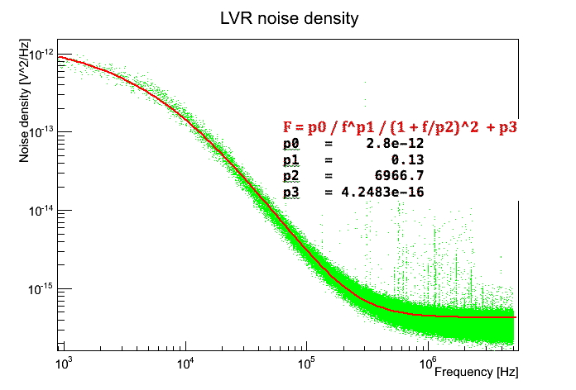
Derived Specifications for a Linear Power Regulator

Slide 16
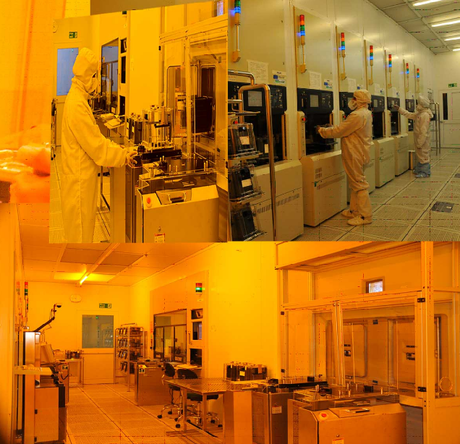
Indian Partner: Semi-Conductor Laboratory SCL Chandigarh
Semi-Conductor Laboratory (SCL)- Main Objective to aid, promote, guide and co-ordinate Research & Development in the field of semiconductor technology, Micro Electro Mechanical Systems and process technologies relating to semiconductor processing.
SCL developed 3μ, 2μ, 1.2μ and 0.8μ CMOS. Now SCL has a 0.18μ technologies as well specialized technologies such as CCD. SCL has over the years developed and supplied a number of key VLSIs, majority of which have been Application Specific Integrated Circuits (ASICs) for high reliability and industrial applications.

Slide 17
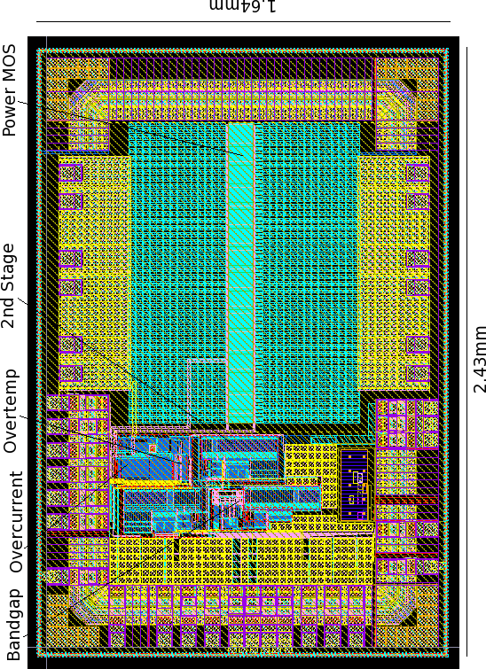

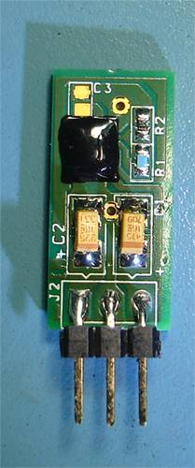
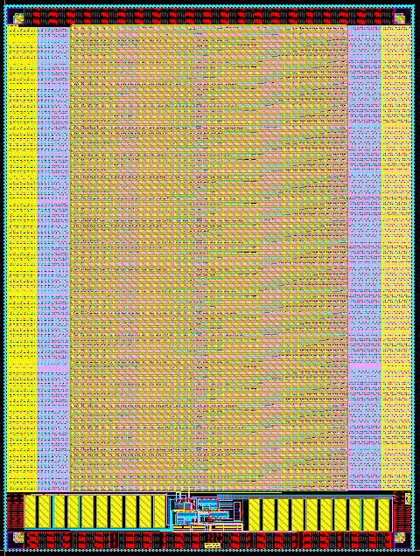
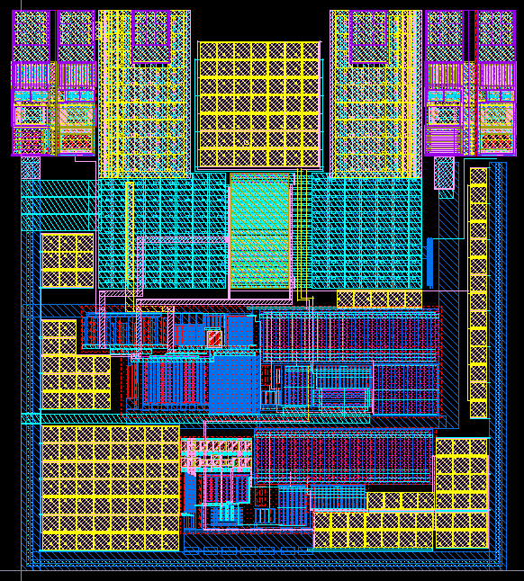
SCL-Standard Products: Power Management
Programmable LDO
COB
Miniaturization
POWER
MANEGEMENT
Fixed Output 1.8V
Full Load 150 mA
Drop-Out 400 mV @ full load
Input Voltage < 3.6V
Over Current Protection
Over Temperature Protection
with Hysteresis
LDO 1.8V, 12mA
Adjustable Output 1.8V onwards
Programmable Full Load 0.5A – 1.5A
Drop-Out 600 mV @ full-load
Input Voltage < 3.6V
Programmable Over Current Protection 1A – 3A
Over Temperature Protection
with Hysteresis
LDOs for Satellites!

Slide 18
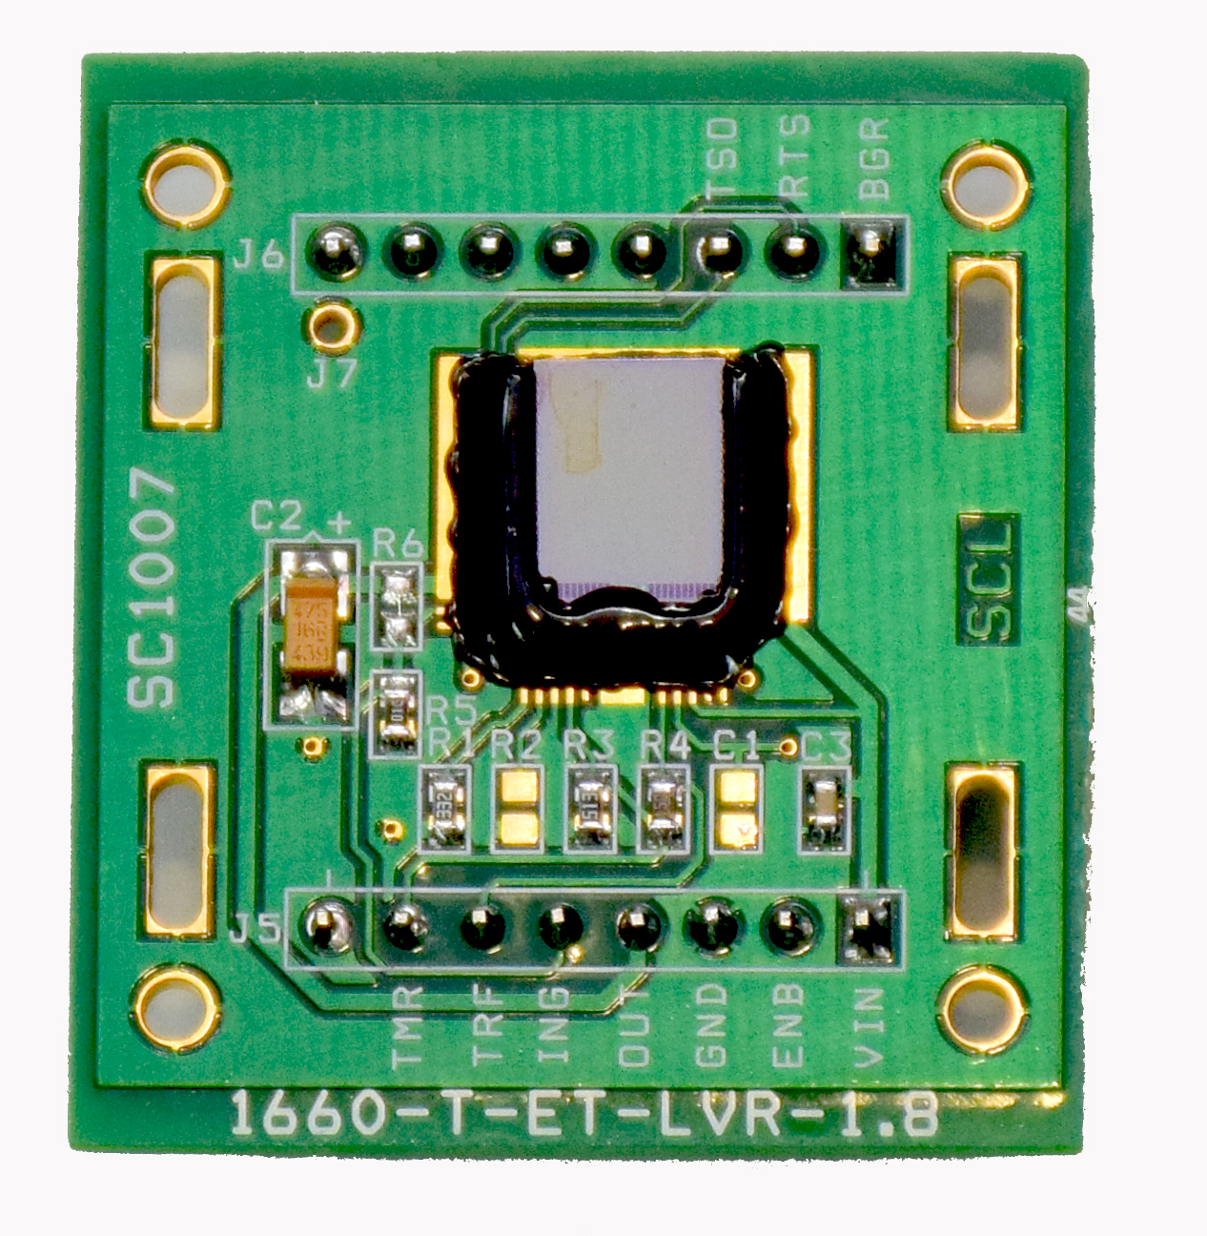
Electrical Results at SCL of Initial Prototypes of LDO
1.8 V / 1.6 A, similar results for 1.2 V / 1.6 A
Parameter | Test Conditions |  | SC1007 |  | Units
 |  |  | Min | Max
Nominal Voltage | Vin = 2.4V, R_{LOAD} = 0.125Ω (I_{LOAD}=1.6A) |  | 1.720 | 1.761 | V
 | Vin = 3.3V, R_{LOAD} = 0.125Ω (I_{LOAD}=1.6A) |  | 1.745 | 1.773
Initial Accuracy | R_{LOAD} = 0.125Ω (I_{LOAD}=1.6A) |  | -4.466 | -2.147 | %
Load Regulation | Vin = 2.4V, 0.125Ω≤ R_{LOAD} ≤ 11.25Ω (0.16A ≤ I_{LOAD} ≤ 1.6A) |  | 0.31 | 0.92 | %/A
Load Transient (±10mV Accuracy) | Load switched from <1.6A to 3A |  | 0.4 |  | ms
 | Other than above condition |  | 0.1 |  | ms
Temp Drift | Vin= 2.4, R_{LOAD} = 11.25Ω (I_{LOAD}=0.16A) Bgref |  | 17.25 |  | ppm/ºC
Line Regulation | 2.4V ≤ V_{IN} ≤ 3.6V, | R_{LOAD} = 11.25Ω (I_{LOAD}=0.16A) | 0.10 | 0.12 | %/V
 |  | R_{LOAD} = 2.25Ω (I_{LOAD}=0.8A) | 0.04 | 0.07
 |  | R_{LOAD} = 0.125Ω (I_{LOAD}=1.6A) | 0.03 | 0.05
Line Transient (±5mV Accuracy) | 2.4V ≤ V_{IN} ≤ 3.6V, No Load |  | 0.025 |  | ms
Power Supply Rejection | V_{IN} = 2.4 Vdc ± 500mV p-p Sine 10KHz to 100kHz at (I_{LOAD}=0.35A) Cin = 0.1uF, Cout = 4.7uF |  | 22.27 |  | dB
Dropout Voltage | R_{LOAD} = 11.25Ω (I_{LOAD}=0.16A) |  | 0.077 | 0.070 | V
 | R_{LOAD} = 0.125Ω (I_{LOAD}=1.6A) |  | 0.148 | 0.171
O/P Noise | 0.125Ω ≤ R_{LOAD} ≤ 11.25Ω (0.16A ≤ I_{LOAD} ≤ 1.6A) (100KHz to 100MHz) |  |  | 70 | µVrms
Short-Circuit Current (programmed) | Short (Programmed by 3.3Kohm resistance to GND) |  | 2.7 |  | A
Shutdown Temp. (programmed) | When R8 = 9.1kΩ, R7 = 14kΩ |  | 100 | 110 | ºC
Quiescent Current | R_{LOAD} = 11.25Ω (I_{LOAD}=0.16A) |  |  | 4.25 | mA
 | R_{LOAD} = 0.125Ω (I_{LOAD}=1.6A) |  |  | 4.82
All Specifications:
VIN =2.4-3.6V,
-55ºC ≤ T_{A} ≤ 125ºC,
CIN = 0.1uF,
COUT = 4.7µF,
unless otherwise specified.
Note:
All parameters are measured by using V_{NOM} at V_{IN} = 2.4V.
Short circuit current can go max up-to 3A and Thermal Shutdown (chip could bear) up to 160 ºC

Slide 19
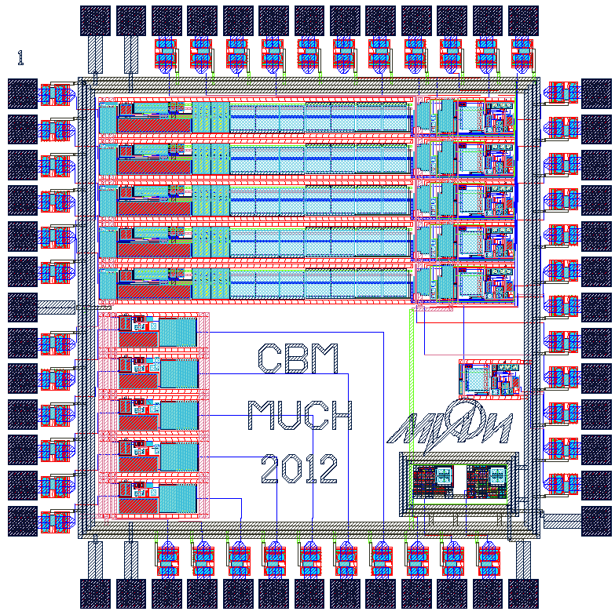
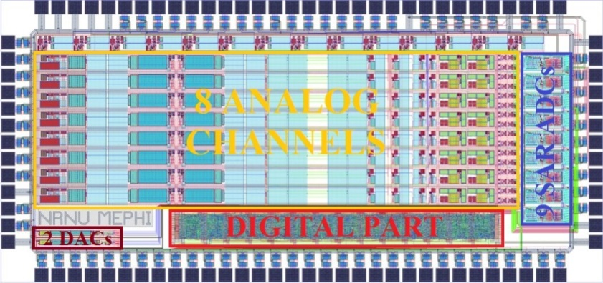
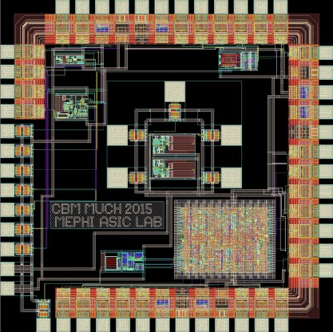
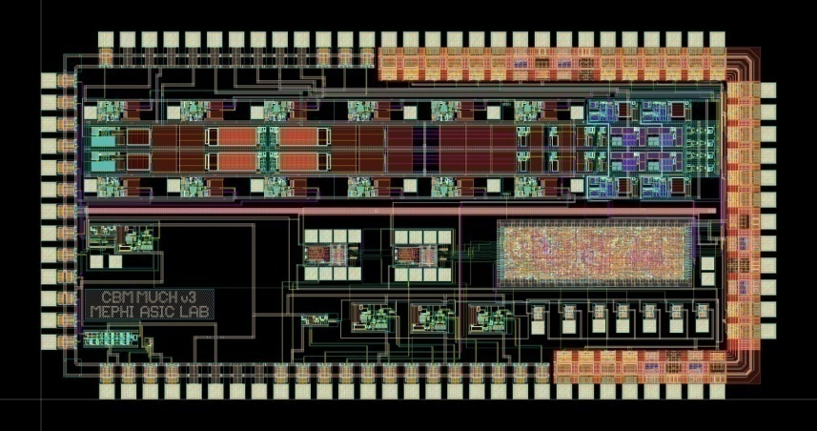


Alternative Chip design: 32-channel ASIC for MUCH from building blocks to a full size chip...
Evgeny Malankin and Pavel Ivanov, E. Atkin et. al.
4 prototype ASICs for GEM detectors have been developed:
10-channel
preamplifier
8-channel ASIC with discriminator, threshold DAC and ADC
ADC, SLVS
transceiver
Full-scale readout channel, digital control, timestamp, digital peak detector
CBM collaboration meeting, Tuebingen, Sept. 2016

Slide 20
Chip Features, submission planned Dec.
2 modes (high occupancy & optimized noise)
8 bit SAR-ADC (per channel)
Self-trigger
Timestamp
Digital Peak Detector (advanced noise immunity)
Data serializing and framing
320 MHz GBT-e-link compatible data transmission
CBM collaboration meeting, Tuebingen, Sept. 2016

Slide 21



Readout Chip for TRD
32 channels for each sign. polarity
Fully digitized signals → 32-ch oszilloscope
digital signal processing, very large data volume
Tim Armbruster, Michael Krieger, ZiTi, Uni Heidelberg

Slide 22
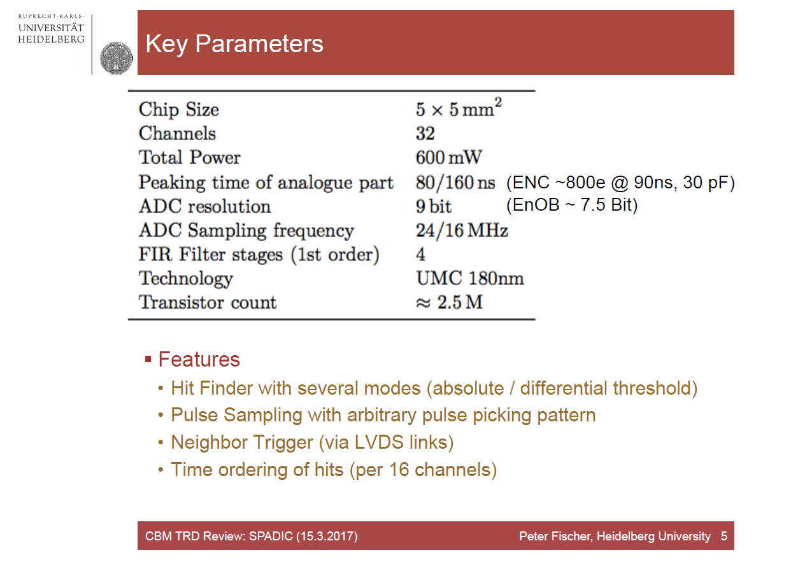

Slide 23
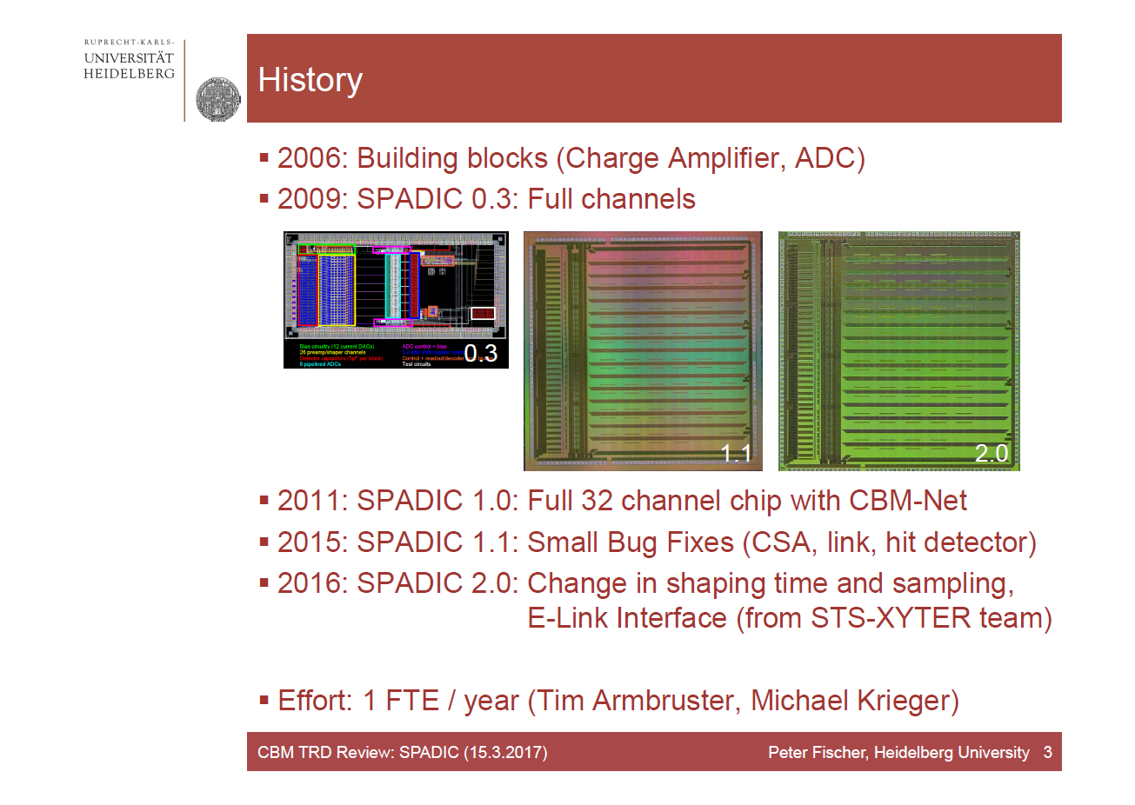

Slide 24
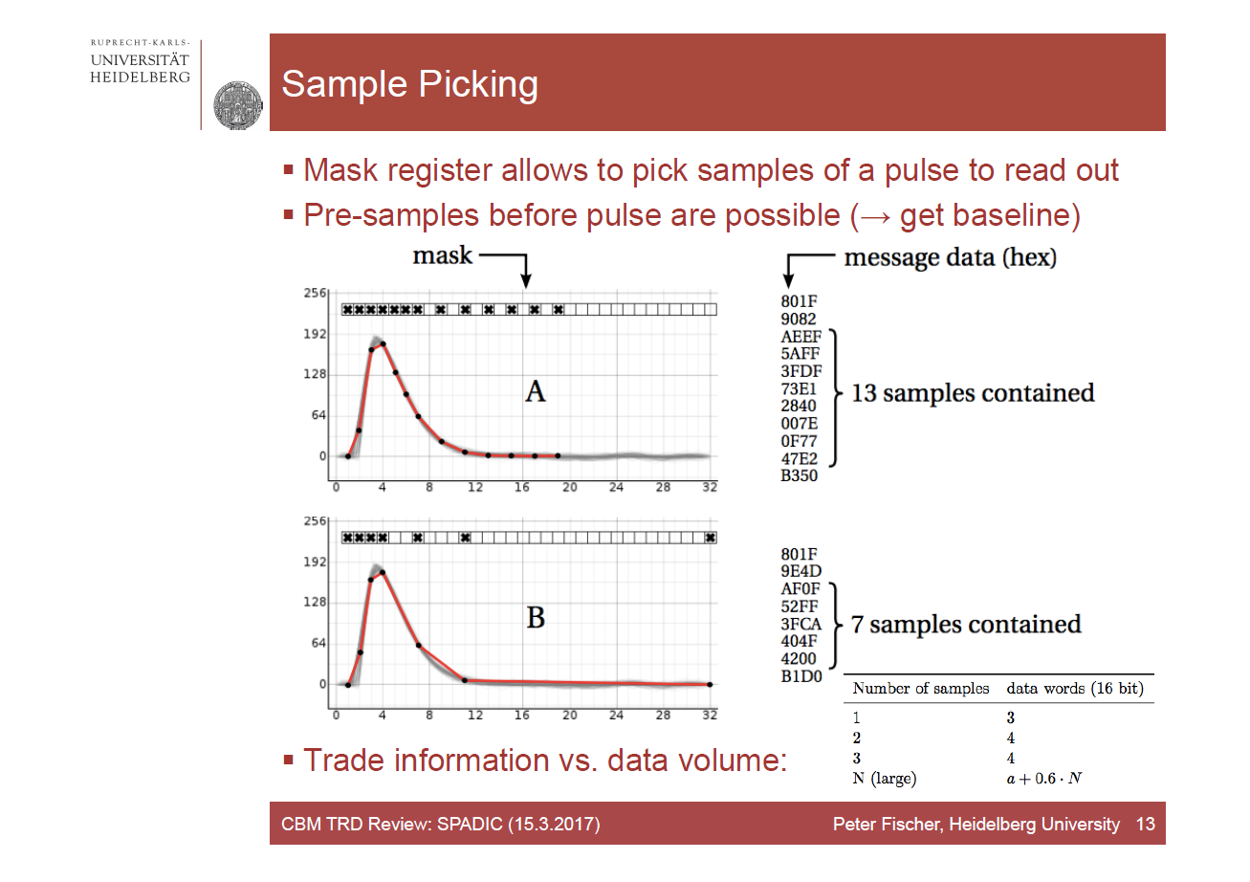
TRD-FEE Electronics, Plans
Spadic 1.0 will go through a bug fix submission until end of 2015
Redesign of Spadic 2.0 with GBTx interface to follow in 2016
will inherit GBTx interface of STS-XYTER (as much as possible)
FEE-Chips (FASP, Spadic) and System Performance being tested at CERN in Detector Prototype Beam Time

Slide 25
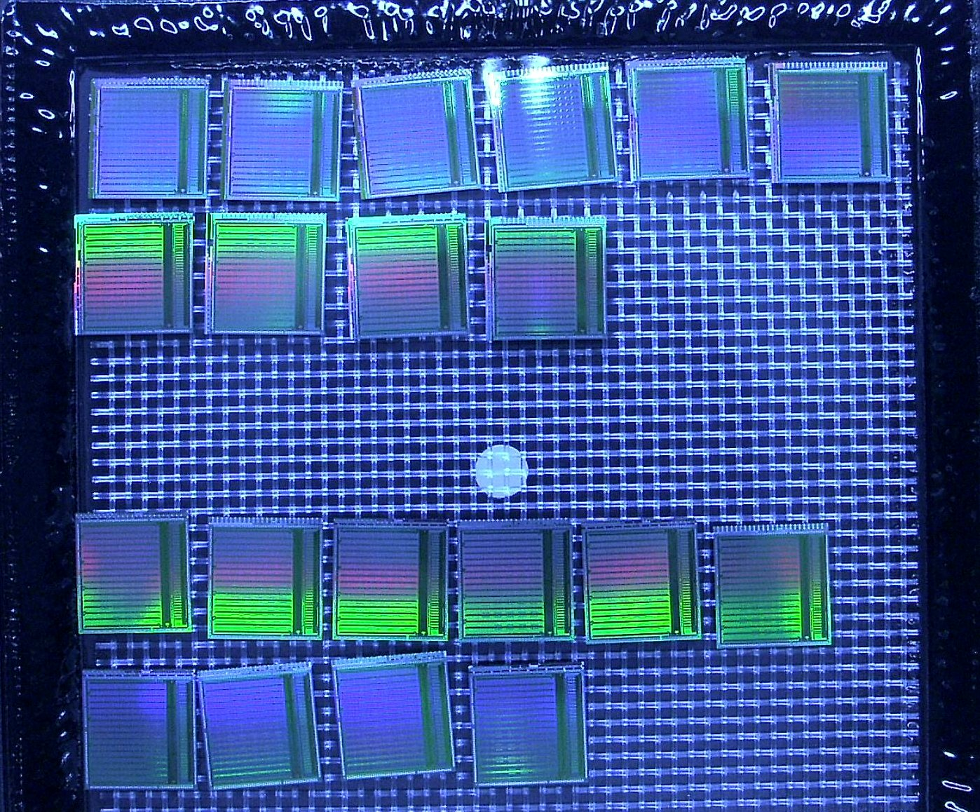
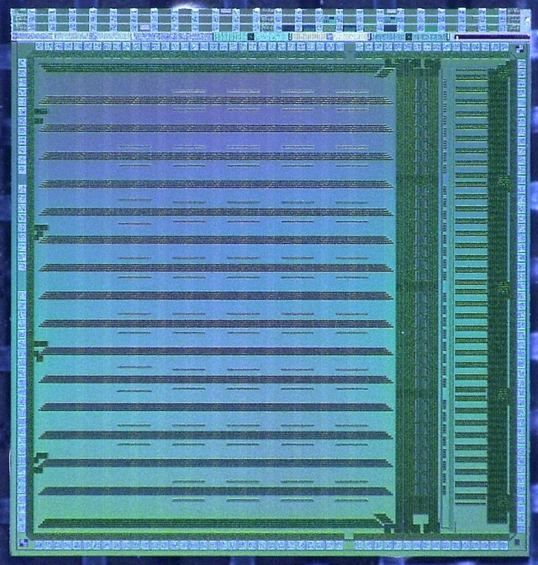
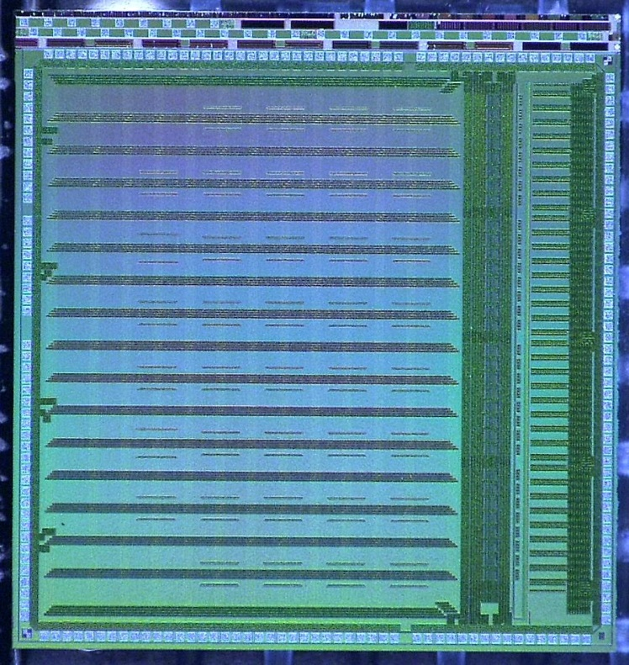
CBM TRD: Spadic 2.0 in both versions available
Two versions with aim to study: how to synthesize DDR multiplexers and serializers ...
by today, Michael Krieger managed to have the tools take the right choice...

Slide 26
Readout Chip for TRD: What’s new in SPADIC 2.0?
Replace CBMnet by (unnamed) interface to the DPB over E-Links (via GBTX) → second GBT-adapted CBM-Chip
GBTx clock frequencies: adapt ADC sampling rate from 25 to 16 MHz
Adjust the amplifier shaping time accordingly and to meet expectations on signals
Important: finish the design to catch the engineering run
Some simpler adjustments can be done already
  Increase the number of “pre-samples” (before the rising edge of a pulse)
Woytek Zabolotny´s (WUT) FPGA protocol test bench can be used for real tests
on STS-XYTER as well as Spadic

Slide 27
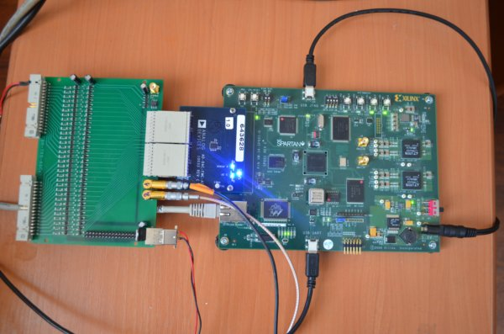
FASP: an alternative front-end for the TRD readout
TRD front-end with built-in peak detection and
fast baseline return
FASP 02: New submission planned:
Towards a 16 ch, purely analogue chip with
altered peaking time of 100ns, 200 fC dynamic range in AMS 0.35µ.
High precision analogue circuitry, built to precisely meet high-rates TRD necessities!
Design is not yet migrated to UMC 0.180 → exploitation of the CBM-XYTER backend toolbox not yet possible.
Could in principle be integrated into CBM back-end, providing sampling ADCs, data transfer and controls!
newly developed ADC-DAQ
interface
Vasile Catanescu, NIPNE, Bucharest

Slide 28
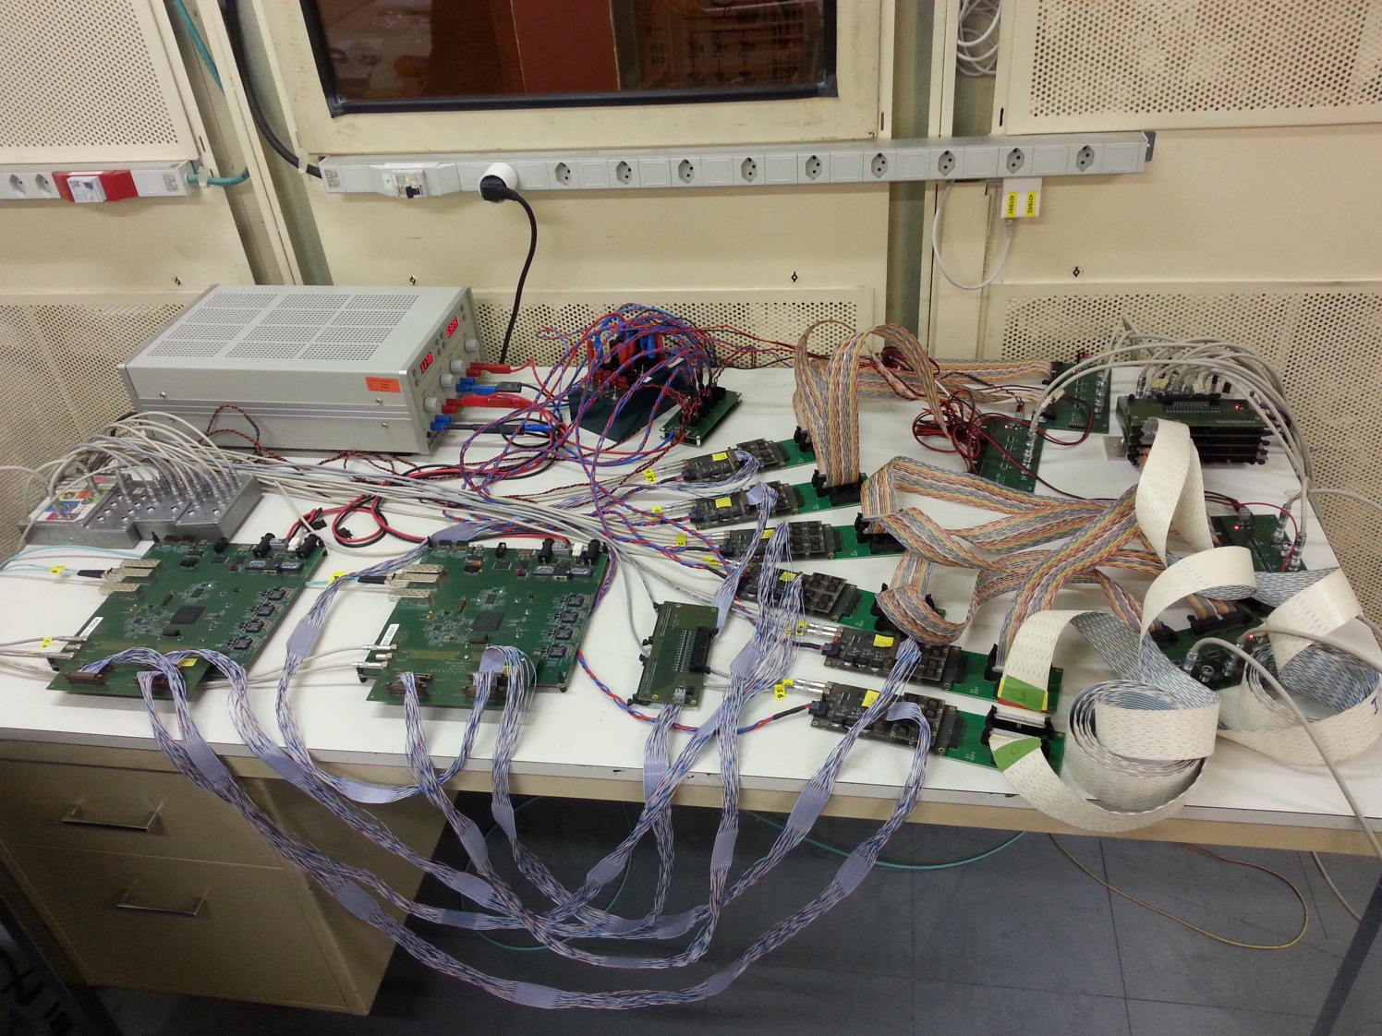
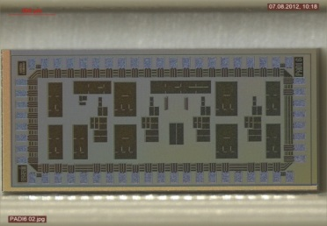
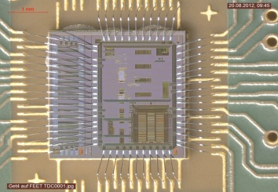
TOF Electronics, System Setup tested
Freerunning Setup @ CERN Feb. 2015
CERN Setup:
1x FLIB
2x SYSCORE 3
6x GET4 + PADI
= 192 Channel
Large 20.000 ch system being built for TOF application at STAR in 2018 (FAIR Phase 0)

Slide 29

PADI Preamplifier & Discriminator (PADI):FEE for CBM-TOF
Developer: Dr. Mircea Ciobanu (ISS / GSI)
Monte Carlo simulations allowed enormous improvements
  on offset dispersions ( better by factor of 4)
  bandwidth: pre-amp 390 MHz
  gain → PADI 6 and PADI 7
PADI-8 submitted in July 2013, an ever improved 8ch-version of PADI 7 for the CBM TOF-RPC-Wall
PADI-8D, a dedicated PADI for diamond
detector readout (omit 50 Ohm input
impedance, target p-detection in diamond,
1/3 noise)

Slide 30
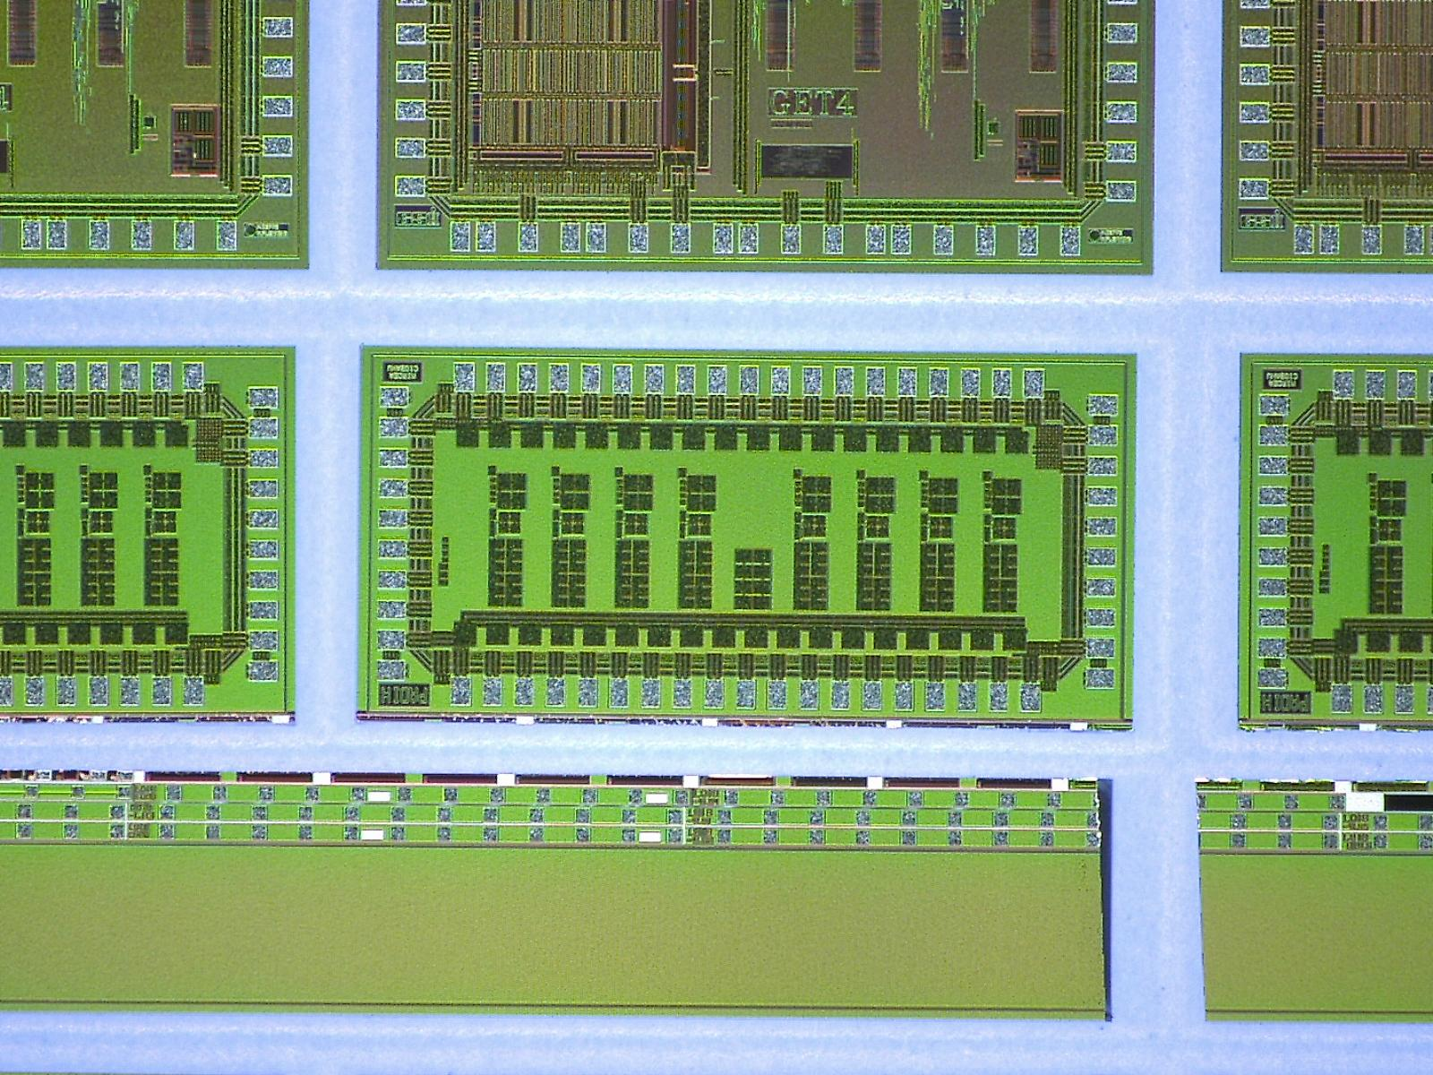
PADI, the one proven design, is available in large numbers now
Designer: Mircea Ciobanu

Slide 31
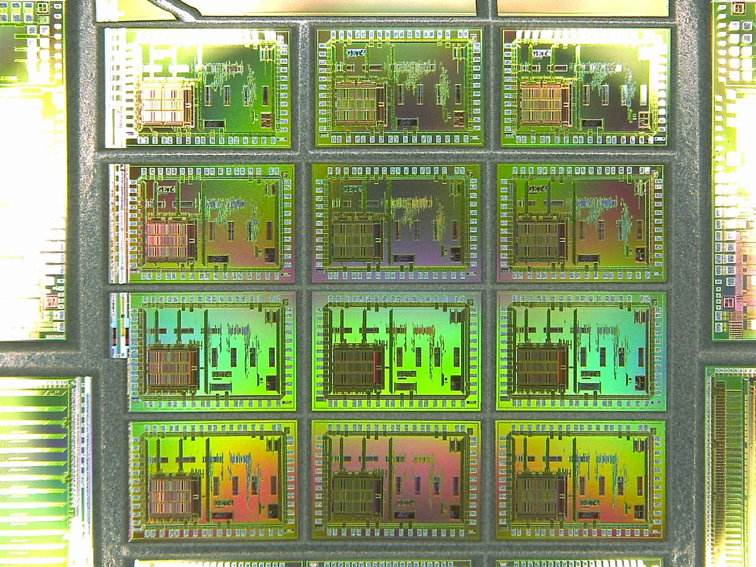
GET4

Slide 32
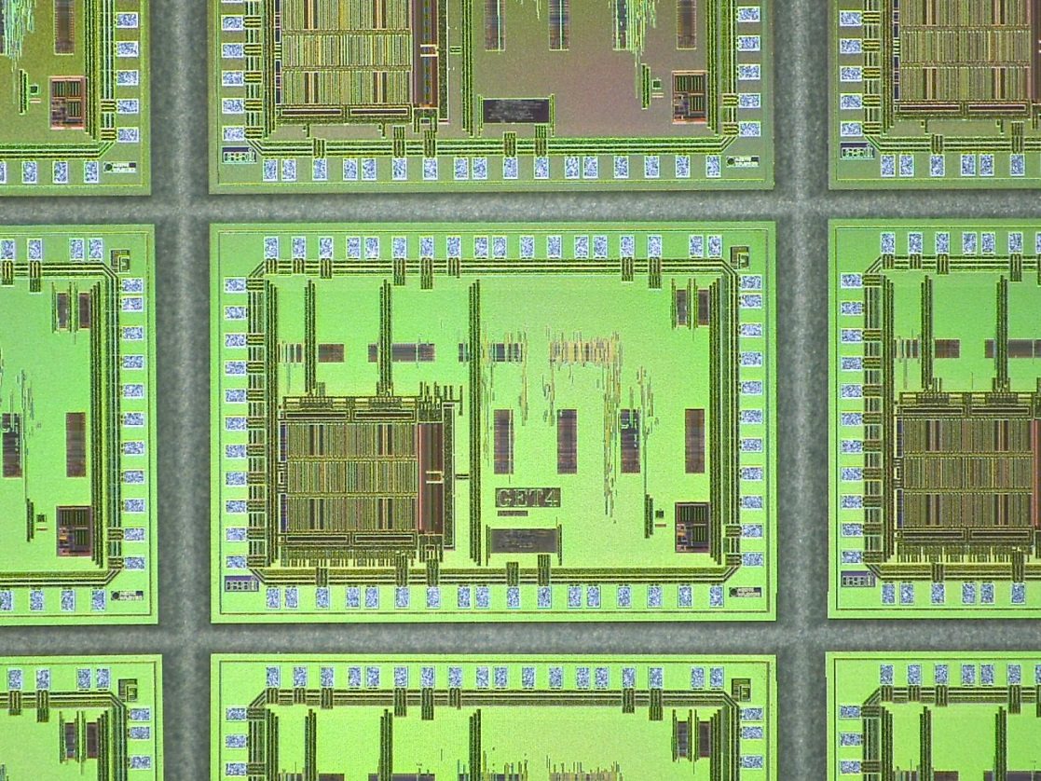
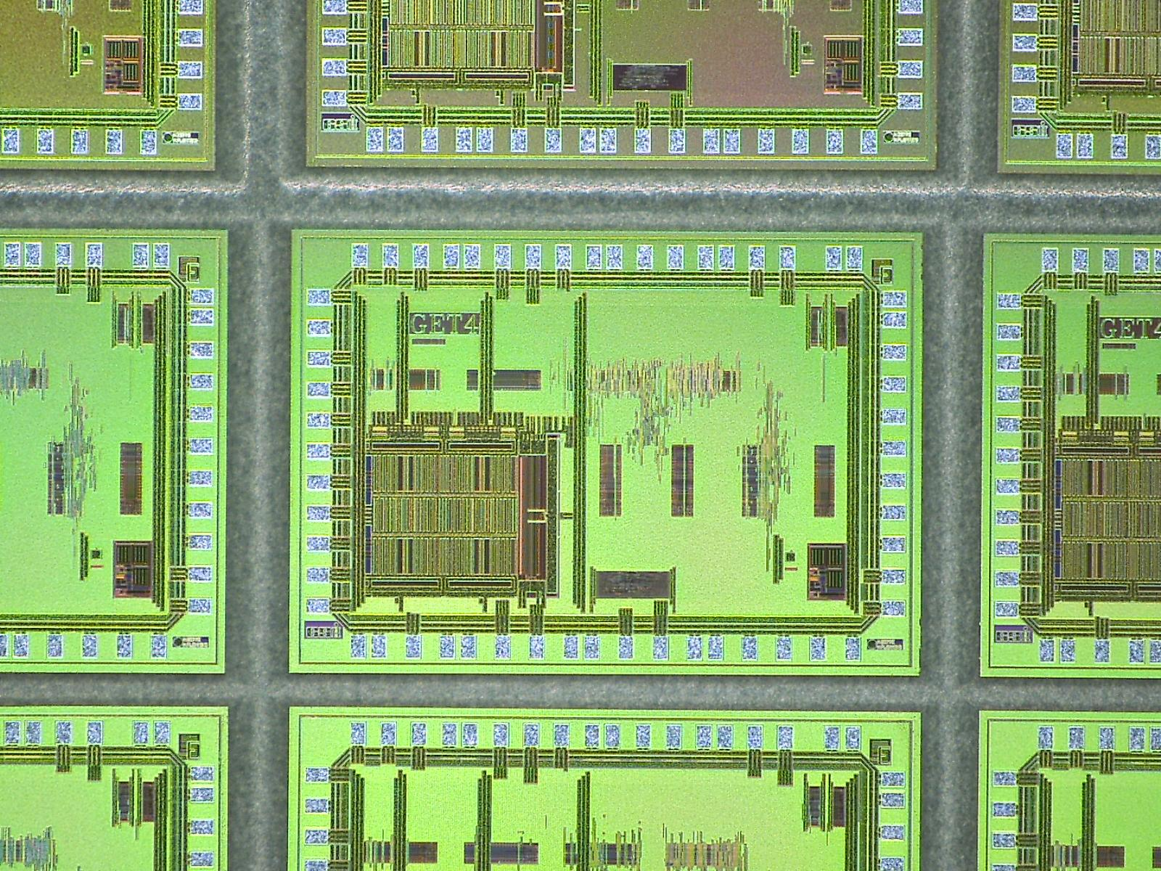
Get4: Multi Hit TDC (H. Flemming and H. Deppe)
Version A: Fixed known flaws in state machine that led to data loss...
Version B: Take measures to make design much less speed critical and robust.
Key suggestion by P. Fischer on design review: Shorten delayline to unconventional length: 113 rather than 128
Result possible through extra time given by STS-XYTER preparations and GSI restructuring paralysis....

Slide 33
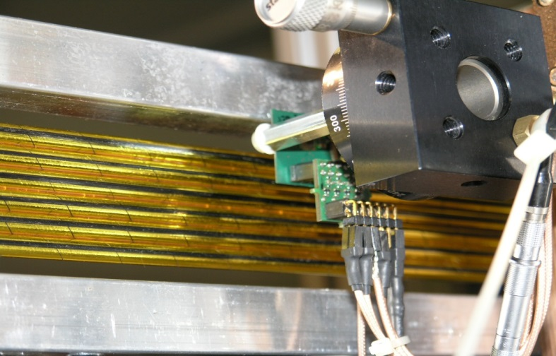
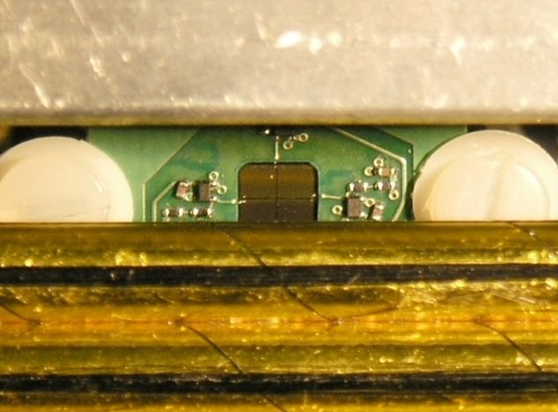
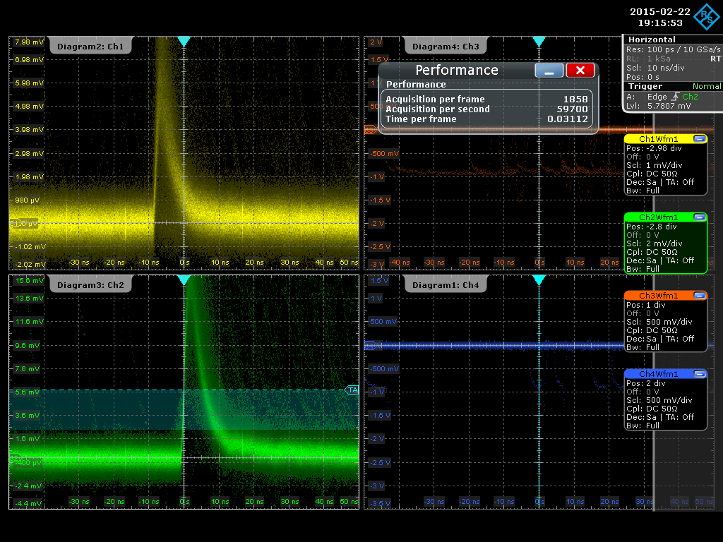
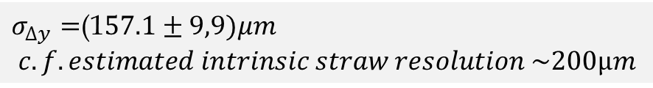
CBM-TOF Electronics for JINR Peshekonov MuCH Straws
Diamond to pinpoint p-track
Beamtime Tests at COSY
$σ_{∆y}=$(1$57.1±9,9)μm$
$$c.f. estimated intrinsic straw resolution \sim 200µm$$
MuCH Straws can rely upon TOF-Electronics
complete synergy, just need to buy more sets!
Great job Michael Träger, Jochen Frühauf and Jerzy Pietrasco!
Unfortunately V. Peshekonov ceased away and so straws are no more an option!
Notes:
Here you can see some pictures of the setup. The diamond tracker with its preamplifier, designed by W. König, was mounted on a movable stage for micrometer precise positioning. The out put of the PA was then directly fed into the oscilloscope.
The angular alignment between the straws and the diamond tracker can be seen in the lower left picture and the beam spot on the upper two straws in the lower right one.

Slide 34
