Slide 1
Part1
Gas gain measurement
M.Savrie
P.Gianotti
O.Levitskaya
A.Kashchuk
(mail address: anatoli.kachtchouk@cern.ch)

Slide 2
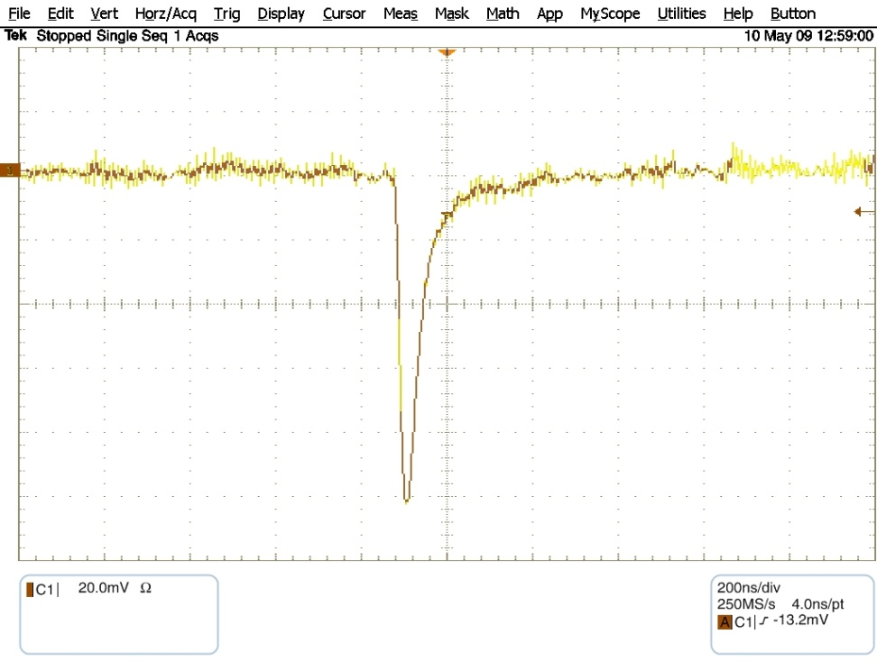
Amplifier
Response to delta pulse
Response to Fe-55 at HV=1700V
Peaking time 25ns
Very long
ion tail, ~300µs

Slide 3
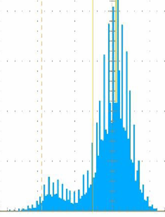
Fe-55
X-ray
Peak 5.9keV
Ar(90%)CO2(10%)
Overpressure 1000mb
HV=1700V
~150000 events
Energy resolution ~25% (FWHM)
(typical for gaseous detectors)
3keV
escape peak in Ar
Measured by scope
Tektronix TDS6124C
Thanks to R.Malaguti

Slide 4
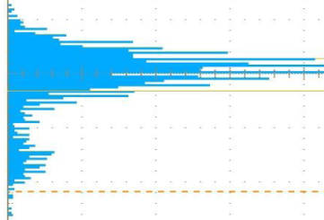
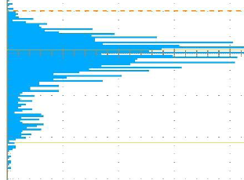
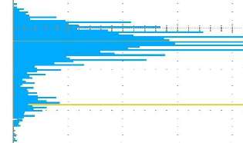
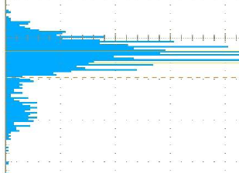
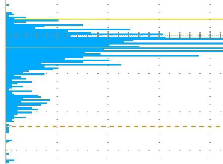
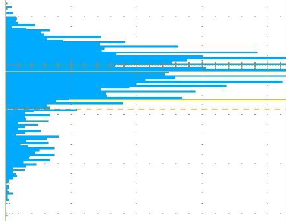
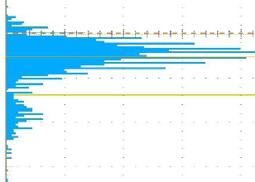
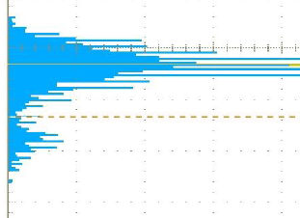
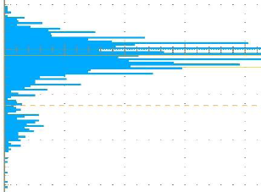
Fe-55
Typical spectra measured along straw

Slide 5
Gain uniformity along straw
Possible
anode wire eccentricity
increases gas gain

Slide 6
Gas gain: raw data
5.9keV peak position in mV
Calibration mV to fC

Slide 7
Gas gain at various points

Slide 8
Charge fraction depends on ion mobility
Gas mixture: Ar(90%)CO2(10%)
Straw tube: a=10µm (W-Re), b=5mm (Al)
Amplifier: Tpeak=25ns
Electron contribution in i(t) is neglected here

Slide 9
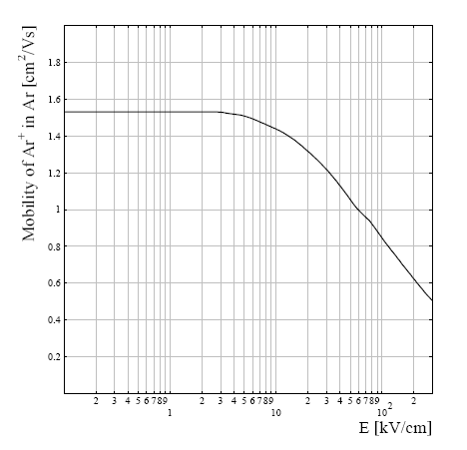
Charge fraction depends on ion mobility
(data for previous slide)
J.A.Hornbeck, Phys. Rev. 84 (1951), 615-620
r=a

Slide 10
Gas gain parameterization

Slide 11
Parameterization: criteria of goodness
In consistence to Diethorn’s parameters of LHCb muon MWPC for similar M at
http://lhcb-muon.web.cern.ch/lhcb-muon/siena06.pdf

Slide 12
Gas gain vs. over-pressure
Reduction of P by 100 mbar
well increases gas gain
Can be used for tuning M
Note:
In order to get high spatial resolution
the gas gain ~10⁵ is needed
(see NA62 results with CARIOCA)

Slide 13
NA62
Tracks taken for analysis
(auto-calibration)
Straws # 6 5 4 3 2 1
2
5
7
10
13
15
Layer 1
1
3
6
9
11
14
30
27
25
22
19
17
31
29
26
23
21
18
14
11
9
6
3
1
15
13
10
7
5
2
30
27
25
22
19
17
31
29
26
23
21
18
Layer 8
beam

Slide 14
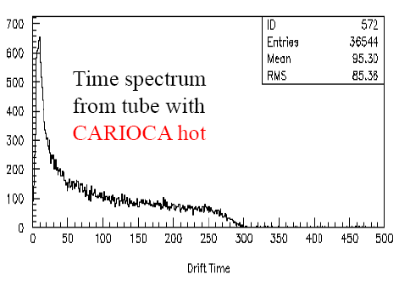
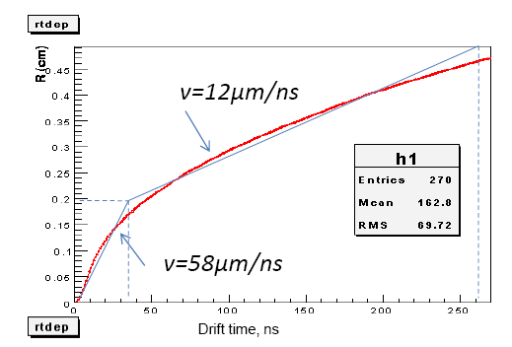
NA62
RT-dependence and electron velocity
Gas mixture – CO2+isoC4H10+CF4 (80:10:10)
σ_{x}=vσ_{t}

Slide 15
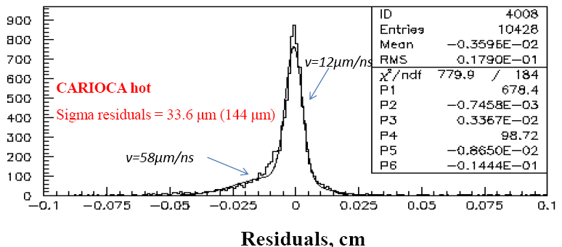
NA62
Two Gaussians due to two velocities
σ_{x}=vσ_{t}

Slide 16
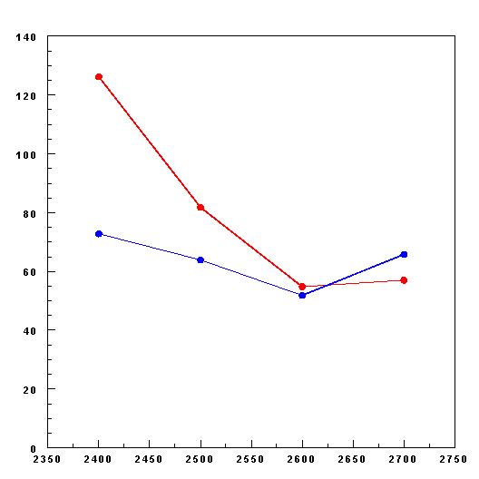
NA62
Spatial resolution vs. HV
Straw R=5 mm
CARIOCA
hot
Residual (µm)
open
60 µm
σ_{x}=vσ_{t}
HV (V)
M~2*10⁵

Slide 17
Spatial resolution vs. distance from wire
NA62
σ_{x}<100µm @ V~(15-30)µm/ns

Slide 18
ENC measurements Termination on near-end reduces noise

Slide 19
PANDA: minimal GG and HV for MIP
CARIOCA _ hot ENC~0.35fC with straw
Threshold 6ENC~2fC=12500e
Minimal gas gain M~54000 @ 3p.e.(1p.c.)
ln(M)=10.9
Minimal HV=1640V
ENC~0.35fC
y = 0,0107x - 6,7344
ENC~0.35fC

Slide 20
HV-plateau for X-ray and MIP
Gas mixture Ar(90%)CO2(10%): gas flux closed , when overpressure 1000mbar has been reached
Straw tube: a=10µm (W-Re), b=5mm (Al)
Amplifier (CARIOCA): Tpeak=10ns
400V (X-ray)
V min (MIP) @Th=2fC

Slide 21
HV-plateau for X-ray and MIP
400V (X-ray)
500V (MIP)
V min (MIP) @Th=2fC

Slide 22
Fe-55
Cross-talks
Part2
Top
straw
Bottom
Signal in one and only one straw –
very good method for cross-talk measurements
Cross-talk, if the signal in both straws

Slide 23
Fe-55
Ar(90%)CO2(10%)
from premixed bottle
at P=2000mbar
via very long plastic tubes
at gas flow rate 2 l/h
?
Top
Bottom
1500V
Preliminary
No explanation
why so long HV-plateau(!)
1400V
1% level
0.1%
Cosmic Ray
count level
800V
Signal within noise
region
Micro-discharges region

Slide 24
Fe-55
1% level
(w.r.t. 9kHz)
Electrical cross-talks
at HV=1700V (one straw at HV=0):
exponential vs. threshold
Preliminary
1% level
(w.r.t. 2kHz)
Th~2fC

Slide 25
Conclusion
Careful optimization of PANDA straw detectors is absolutely needed
with Garfield/Magboltz/Heed to know what has to be expected
Gas gain measured in Ferrara using Fe-55 X-ray and parameterized according to Diethorn’s model looks reasonable (more points will be done for publication)
It gives for MIP the minimal gas gain 54000 and HV_{min}=1640V at threshold 3p.e.(1p.c.) in Ar(90%)CO2(10%)
Results obtained in Frascati show cross-talks between 2 straws below 1%, but measurements are preliminary
In theses measurements the beginning of HV-plateau is obtained as in Ferrara at 1400V for Fe-55, but the plateau is extended up to 3100V while in Ferrara to only 1900V
No explanation of the reason: can be simply ascribed due to O2 and H2O contamination in the gas providing large loss of primary electrons by attachment
However, something interesting for extending HV-plateau can be found adding O2 (has to be better studied)
Gas gain stabilization by automatic HV tuning in order to keep M=const at possible T/P variations will be needed in case of short HV-plateau for MIP
in the real experiment

Slide 26
Notice
3% CO2 contamination and 97% Ar at P=3bar in MDT (Atlas, CERN)
Electron drift velocity reduced
Oxygen 3%-admixture in TRT at operational P~600mbar (Atlas, CERN)
Aging
?

Slide 27
END

