Slide 1
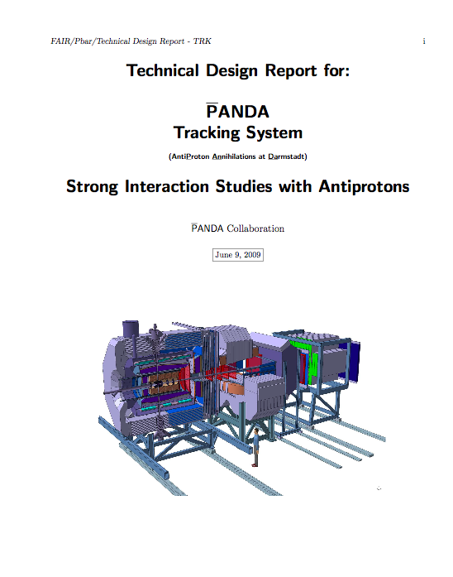
Status of the tracking TDR
Organization;
Repository status;
Work done;
Work to do.

Slide 2
Organization
The Tracking TDR is a multi-volume document describing the technical solutions chosen for:
Micro Vertex Detector;
Central Tracker;
Forward GEM Chambers
Forward Tracker.
The different volumes have different time scales.
For the Central Tracker two options are considered:
STRAW TUBE TRACKER
TIME PROJECTION CHAMBER

Slide 3
Organization
Regular meeting are organized to check the progresses and organize the work.
EVO meeting are taking place every three weeks normally on Thursday morning.
The Tracking WIKI page is the place to go to find information
http://panda-wiki.gsi.de/cgi-bin/view/Tracking

Slide 4
SVN Repository
Repository Access
A subversion repository " https://lxfocus14.pv.infn.it/svn/PndTrkTdr " has been created to host the files for the Tracking TDR.
The editing rules are similar to the ones for the TPR and the PB and all others PANDA official documents.
If you have not been contacted and want to be an author with svn access, please send an e-mail to Gianluigi Boca (Gianluigi.Boca@pv.infn.it).

Slide 5
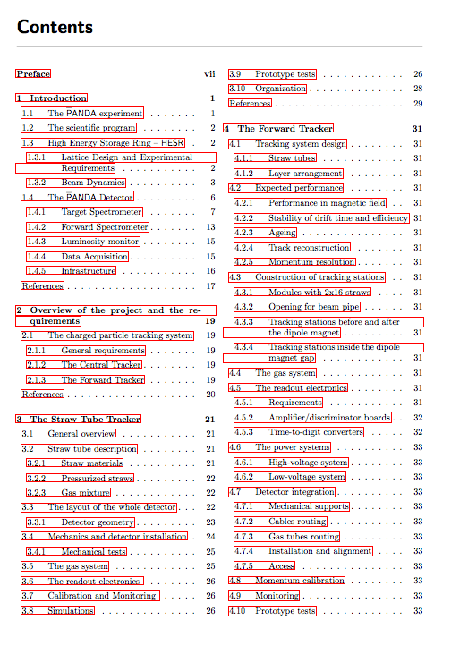
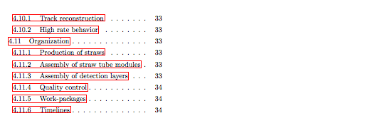
Table of contents
More details about the editors in charge of the single sections are available on the Tracking WIKI page.

Slide 6
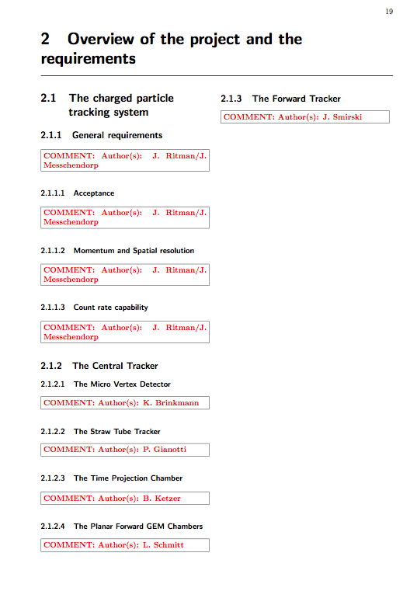
This is the most critical chapter of the whole document.
A complete software able to simulate the whole tracking system is necessary.

