Slide 1
MECHANICAL FRAME OF THE MVD
G. GIRAUDO
TORINO 16 June 2009

Slide 2
The MVD will be suspended in position to the Central Frame.
The two systems must be independent:
High Stiffness
Good Machining of the interfaces
Good Dimensional Control
Stress due to the assembly must be controlled:
Simulation (stochastic analysis)
….minimized….
G. GIRAUDO
TORINO 16 June 2009

Slide 3
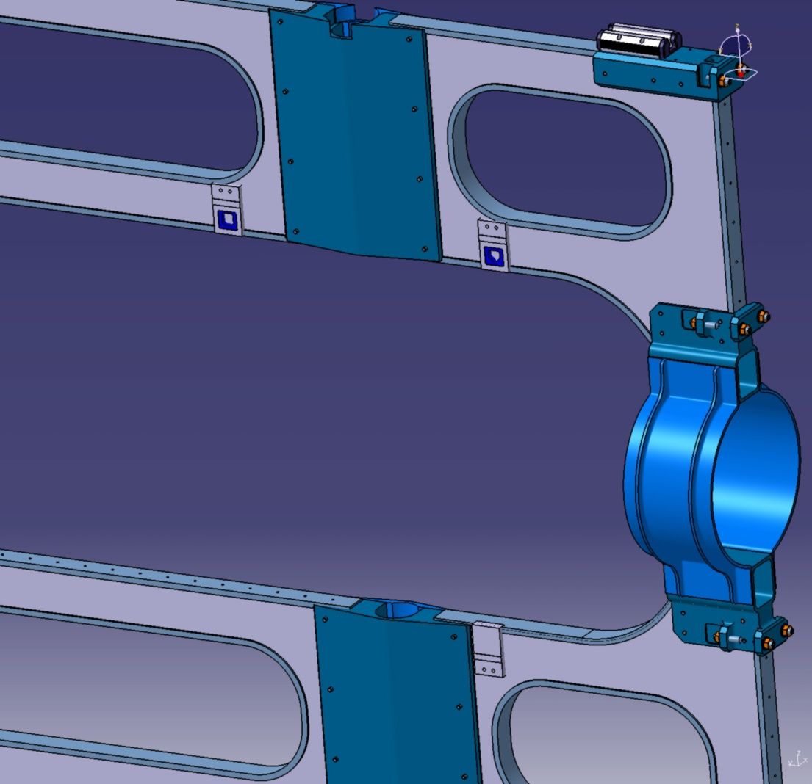
A PROPOSAL FOR MVD-CENTRAL FRAME COUPLING
Three bosses are embedded into the Central Frame.
Machining after assembly.
Two inserts are glued.
Survey of the inserts position and plane
geometry reached.
G. GIRAUDO
TORINO 16 June 2009

Slide 4
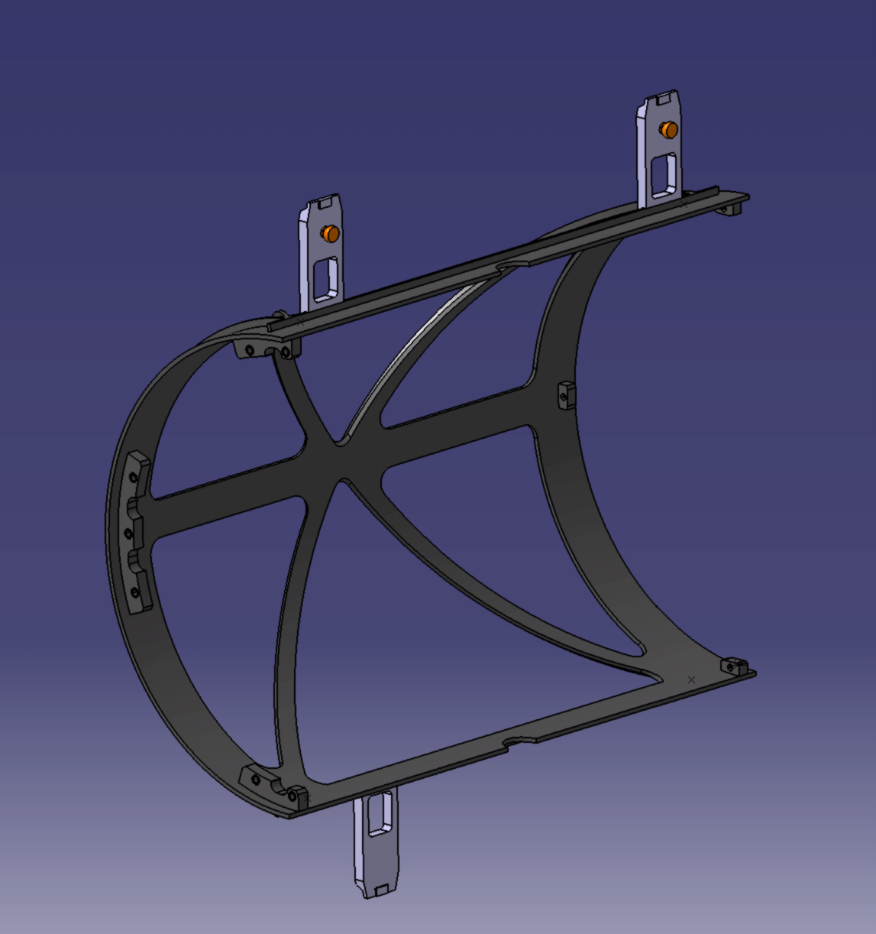
A PROPOSAL FOR MVD-CENTRAL FRAME COUPLING
Three reference arms
are assembled on the
external MVD frame.
Dedicated tools are needed.
Three small surfaces are
machined: definition of
a bearing plane.
Housings of the spheres are
machined.
Spheres fixed.
Final survey.
G. GIRAUDO
TORINO 16 June 2009

Slide 5
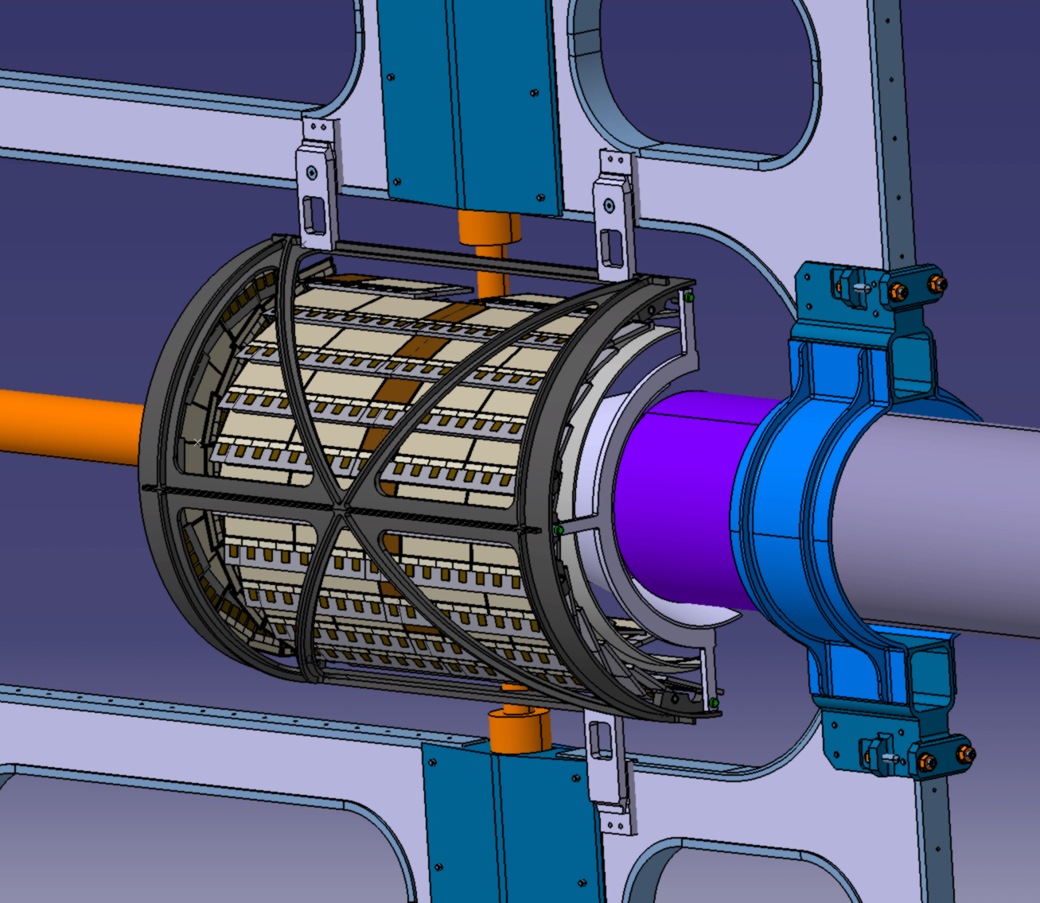
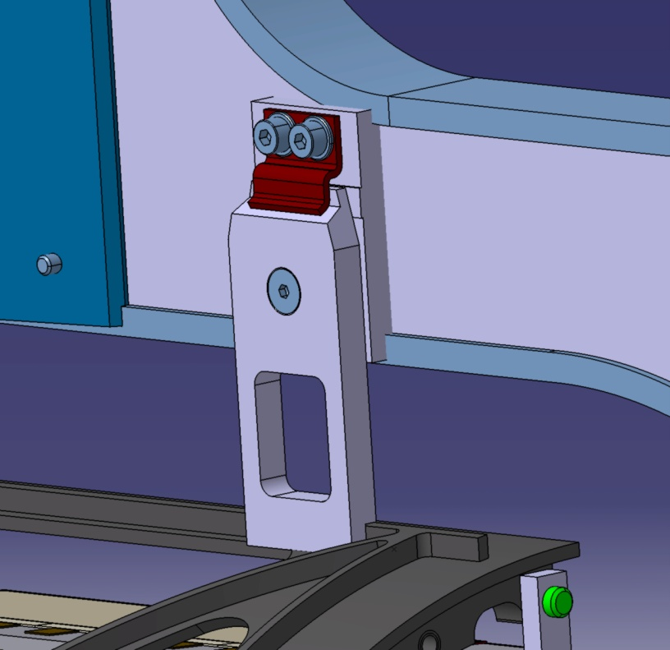
A PROPOSAL FOR MVD-CENTRAL FRAME COUPLING
Half MVD is suspended to
the Central Frame and fixed to
it with three springs.
G. GIRAUDO
TORINO 16 June 2009

Slide 6
NEXT …
Dimensional freezing
Material choice (FEM analysis)
Environmental Behaviour
Stiffness
Prototype (only geometry-stereo lithography)
Prototype for mechanical studies
G. GIRAUDO
TORINO 16 June 2009

